Slide 1
BLAST
Binocular Large Area Survey Telescope
Catching the low hanging fruits
Nordic-Baltic Astronomy Days – May 26, 2026
M. I. Andersen, DAWN/NBI
Johan Fynbo, DAWN/NBI & Kasper E. Heinz, DAWN/DTU-Space

Slide 2
BLAST core science case
Find all bright transient events in the sky:
  Most bright events go unnoticed today!
  These are the targets where most astrophysical information can be obtained..
  To understand rare events, continously monitoring the sky is essential!
  Definition of bright: Detailed spectra can be obtained with a medium sized telescope:
  - Sources brighter than ≈ magnitude 18 should be detected.
Need to monitor the full sky with high cadance.
  Not essential to go ultra-deep.
  High cadance more important than depth.

Slide 3
Variable phenomena
Supernovae:
Gamma-Ray Bursts, Shock-breakouts, rare types of SNe.
Transitting planets:
  Cold Jupiter’s
Solar system minor bodies:
  Small Earth impacting bodies.
Stars:
  Intrinsic variables, Eclipsing binaries, Flare stars, Novae, Microlensing.
AGN’s:
  Time variability
The unknown……………

Slide 4
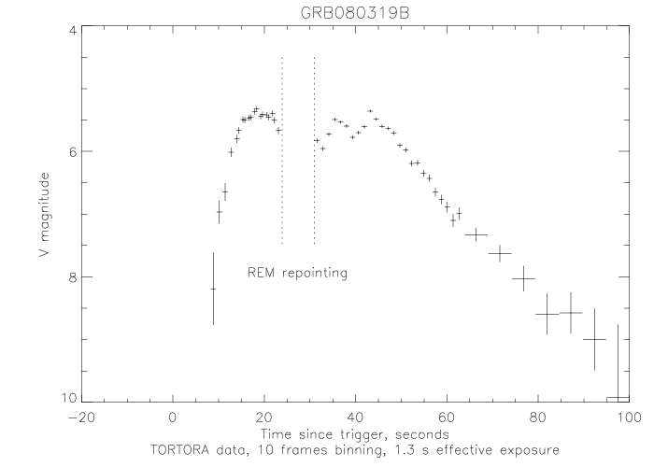
Gamma-ray Bursts can be bright!
GRB 080319 reached R = 5.6 (naked eye GRB).
Triggered by SWIFT (not the naked eye).
GRB optical counter parts brighter than V=16 could be observed from a site every 1-2 month.

Slide 5
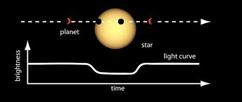
Transitting Exo-planets
Most transitting planets are found from space:
Kepler, TESS, Plato.
  High precision photometry.
  Shorter time coverage.
Duration of space missions typically ≲ a decade.
  No ‘Cold Jupiters’ are known from transits.
Jupiter seen in transit:
Depth of dip: 0.9 %
Duration of transit: 30 hours
Alignment probability: 0.1%

Slide 6
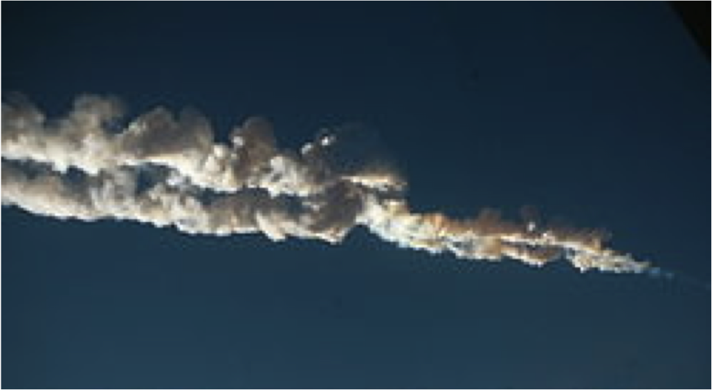
Things that fall from the sky…..
Chelyabinsk impact (Feb. 15, 2013) caused human injuries.
  Estimated to have been ≈ 18 m diameter.
  Could have been discovered days prior to impact.
  (if it had not approached Earth from the Sun side)
Small Earth impacting bodies, (≈ meter size) can be detected a few hours prior to impact.
  Fireballs can be predicted.
    Enhance public awareness.

Slide 7
Stellar time series photometry
Potential to have very long timeline semi-continous coverage.
  For brighter stars, detecting even low amplitude oscillations are possible.
  Unique sensus of super-flares in main sequence stars.
  Detection of micro-lensing by free floating planets.
  Any rare phenomena (like Boyajian’s star).
  …….
The list of themes is almost endless.

Slide 8
BLAST strategy
Ultra wide field cameras.
Super fast optics (low F-ratio) for high cadence sky limited exposures.
Minimize moving parts.
Large area detector.
Industrial scale ‘copy-and-paste’ systems.
One single mode of operation.

Slide 9
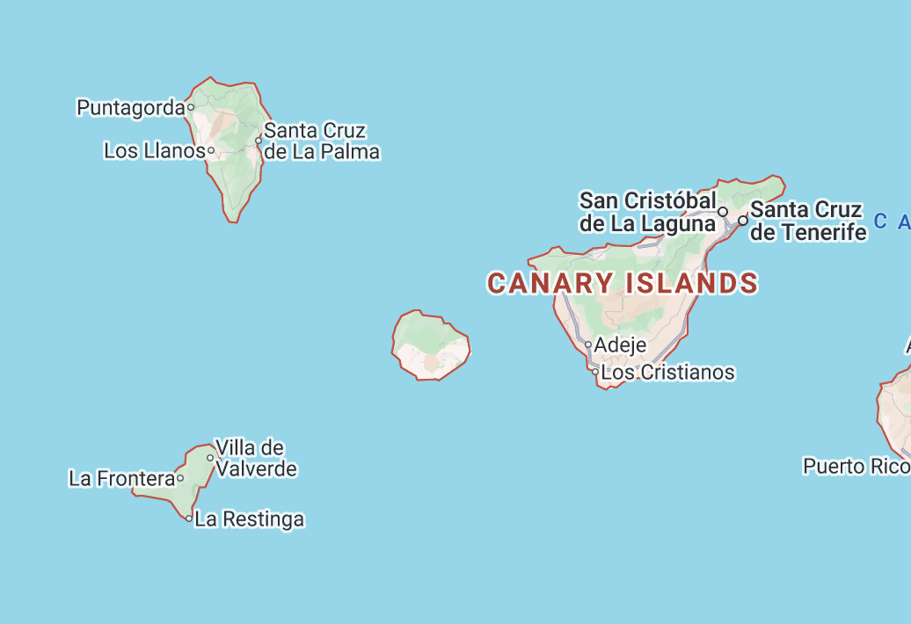
Operational strategy
La Palma
Short exposures, ≈ 10 sec.
  Track during exposure, rewind during readout.
    Pointing fixed relative to Earth, moving relative to sky.
      Stacking many exposures becomes more complicated.
      Light curve noise becomes uncorrelated.
Two cameras observe the same field.
  Subtract all known sources (GAIA catalog).
    Any new source must be present in both images.
    We can also detect transients with duration < 10 sec.
    The threshold for detection can be lowered to 4.25 sigma.
Operate pairs of cameras with ≈ 100 km separation.
  Any object within 2 Mkm will have a parallax of > 1 pixel.
Tenerife
100 km

Slide 10
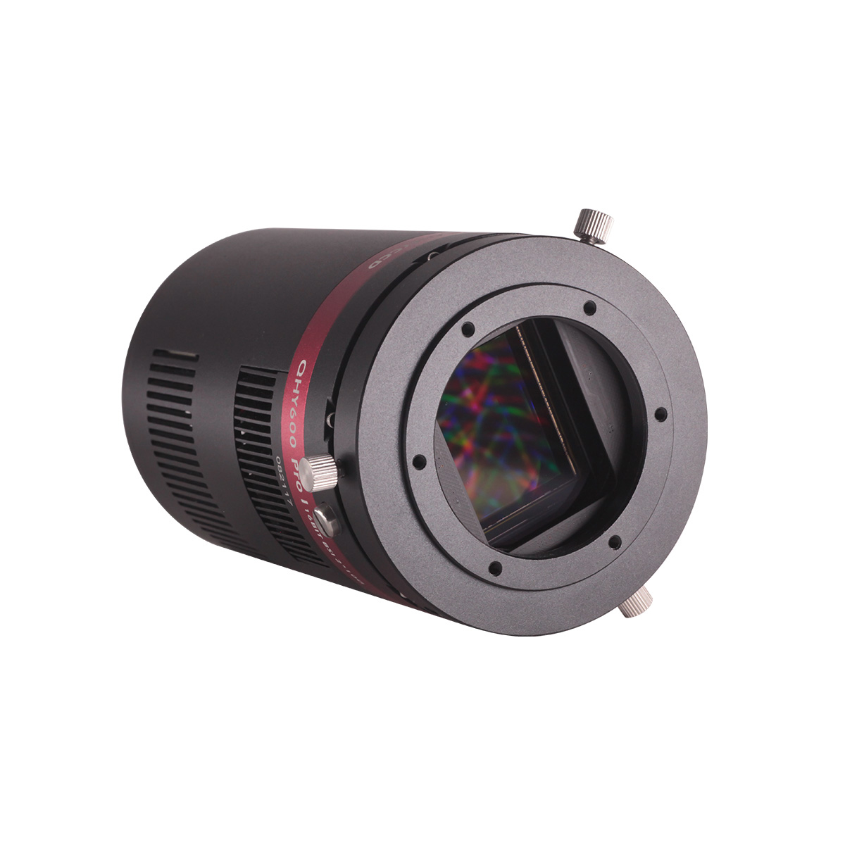
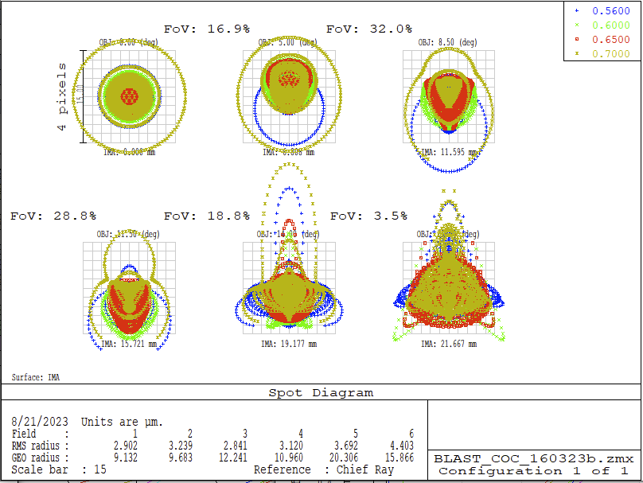
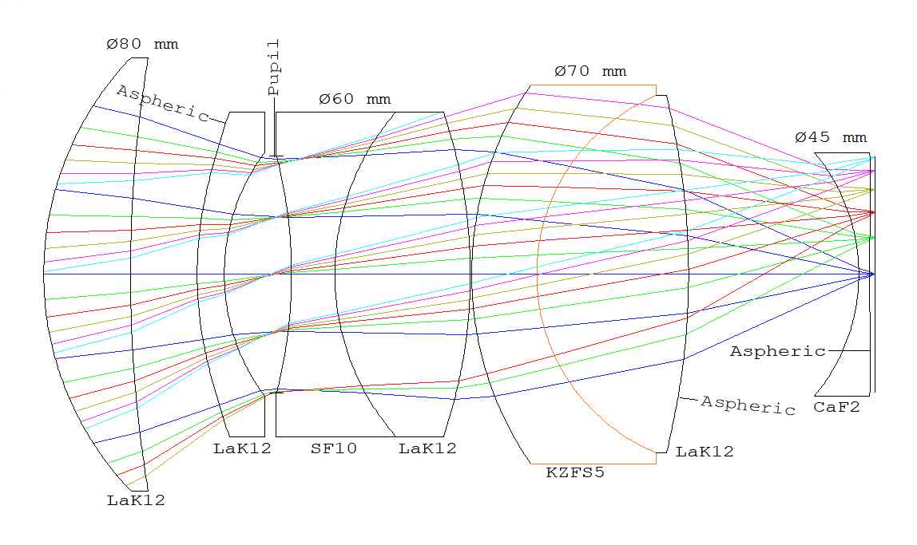
BLAST hardware in a nutshell
Spot diagram, RMS size ≈ 3 μm
QHY600 CMOS camera
F/1.25 lens, 62.4 mm aperture.
3.76 μm 61 Mpixel detector.
’Born’ with SDSS-r’ filter.
10”/pixel.
Field of View, 17.6º x 26.4º
1.1% of sky, 100 cameras cover all-sky.
Readout in 0.3 sec, 1.6 e- noise.
Point Spread Function ≈ 25” FWHM.
Optics layout w. 7 lenses

Slide 11
BLAST sensitivity
Two cameras:
  S/N=4.25 per single camera gives 6-sigma detection.
      This threshold will result in one false detection per 100 frames/cameras.
  Saturation limit is around r’ ≈ 10.
      Small sub-aperture double image allows unsaturated photometry to r’ ≈ 6.
# exposures | r’ | Photometric error, 1h stack
 | 10.00 | 0.0010
 | 12.00 | 0.0026
1 (10 sec) | 14.65 | 0.009
4 (40 sec) | 15.65 | 0.018
12 (2 min) | 16.05 | 0.03
60 (10 min) | 16.95 | 0.07
360 (1 h) | 17.95 | 0.17

Slide 12
Status:
Prototype funded through a Villum Experiment grant, 200 kEUR.
PI initially K. E. Heinz, now J. Fynbo.
Glass for up to 9 cameras has been ordered.
Negotiation on production of optics.
One detector system tested.
Definition of computers and pipeline pending.
Budget:
    Optics ≈ 10 kEUR/camera.
    Detector ≈ 10 kEUR/camera.
    Housing, computers etc. ≈ 10 kEUR/camera.

Slide 13
Collaboration ----
In context of the NOT
In context of the Nordic-Baltic community
In context of the amateur community
There will be enough data !!!!
There will be a need for branching pipelines.
There will be a need for other supporting observations.
  Managing software and data will be a huge challenge!!!
  Growing a coherent community around BLAST will be another challenge.
Outreach, Citizen Science and educational aspects should be in focus.

Slide 14
Summary and conclusion:
BLAST is designed to broadly serve time domain astronomy.
  Today it is realistic to cover the whole sky continously to relevant depth.
  A near continous coverage will require a multiple site setup:
    Any direction on the sky must be covered in binocular mode from at least two sites.
    This implies 400+ BLAST systems.
    Hardware costs alone of order 15 MEUR for a complete setup.
Our goal with the BLAST prototypes are to:
  Show that we can build the hardware.
  Demonstrate that we can detect transients and do time series photometry.

