Slide 1
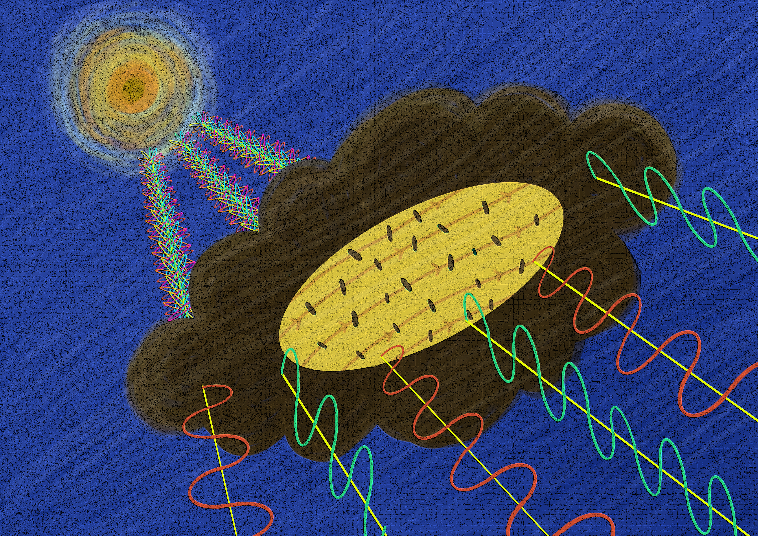

Enhancement of grain alignment near embedded protostars in the
DR21 Ridge
The Olympian Symposium 2026
Siddharth Kumar¹
Thushara G.S. Pillai², Georgia Panopoulou¹, Jens Kauffmann^{2,} L. N. Tram³
& SIMPLIFI team
¹Department of Space, Earth and Environment, Chalmers University of Technology, Gothenburg, Sweden
²Haystack Observatory, Massachusetts Institute of Technology, 99 Millstone Rd., Westford, MA 01886, USA
³ Leiden Observatory, Leiden University, PO Box 9513, 2300 RA Leiden, The Netherlands
Notes:
Good afternoon everyone. I am Siddharth Kumar , 3rd year PhD student working with Prof. Gina Panopoulou at Chalmers University of Technology. Today I will be presenting the work I did on enhancement of grain alignment near embedded protostards. First I would like to give some context and talk about why magnetic fields are important.

Slide 2
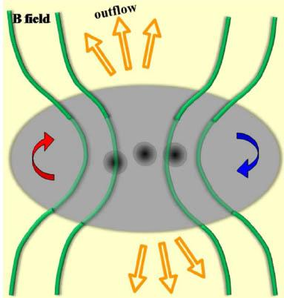
Why study Magnetic Fields?
Illustration of the magnetic field and motions in a massive star forming cluster.
Ordered Magnetic Fields in star-forming regions.
Either slow down by balancing gravitational collapse with magnetic pressure (Tomisaka 1988)
Or help by removal of angular momentum from protostellar cores via transport along magnetic field lines (Mouschovias & Paleologou 1979)
To characterize star formation dynamics we need to resolve magnetic field structure at the scales of star formation.
0.1 pc
Qiu et al. 2014
Notes:
On small scales
Observations from SOFIA and JCMT have shown ordered fields threading molecular clouds and dense cores affecting the dynamics of star formation.
Dynamically magnetic fields can either slow down starformation by balancing gravitational collapse with magnetic pressure
Or they can speed up the starformation by helping in remove angular momentum from protostellar cores via transport along magnetic field lines.
To fully characterize starformation dynamics, we need to resolve magnetic field structure at the scale of star formation.

Slide 3
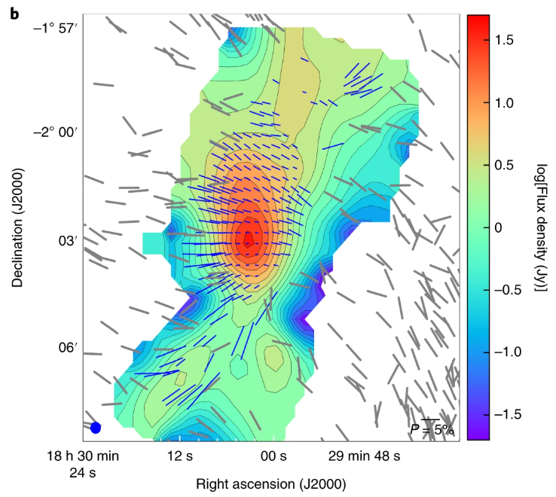
Open questions in the study of Magnetic Fields
Challenge
Polarization map of Serpen South
Need reliable polarization measurement at scale of star-forming region
As you move into denser regions the polarization signal decreases.
Can magnetic fields be reliably inferred from polarization in dense cores?
Pillai et. al. 2020
1 pc
Notes:
Again there are some challenges.
To study magnetic fields at scales of star formation we need reliable polarization measurements in dense cores.
But as you go deeper into the core the polarization signal decreases.
In the figure on the left, you have polarization map of serpens south with length of the polarization vectors proportional to the polarization degree.
As you can see in the outside you have higher polarization but as you go deeper into the core the polarization degree goes down
So, the question is can magnetic fields be inferred from polarization in dense cores?

Slide 4
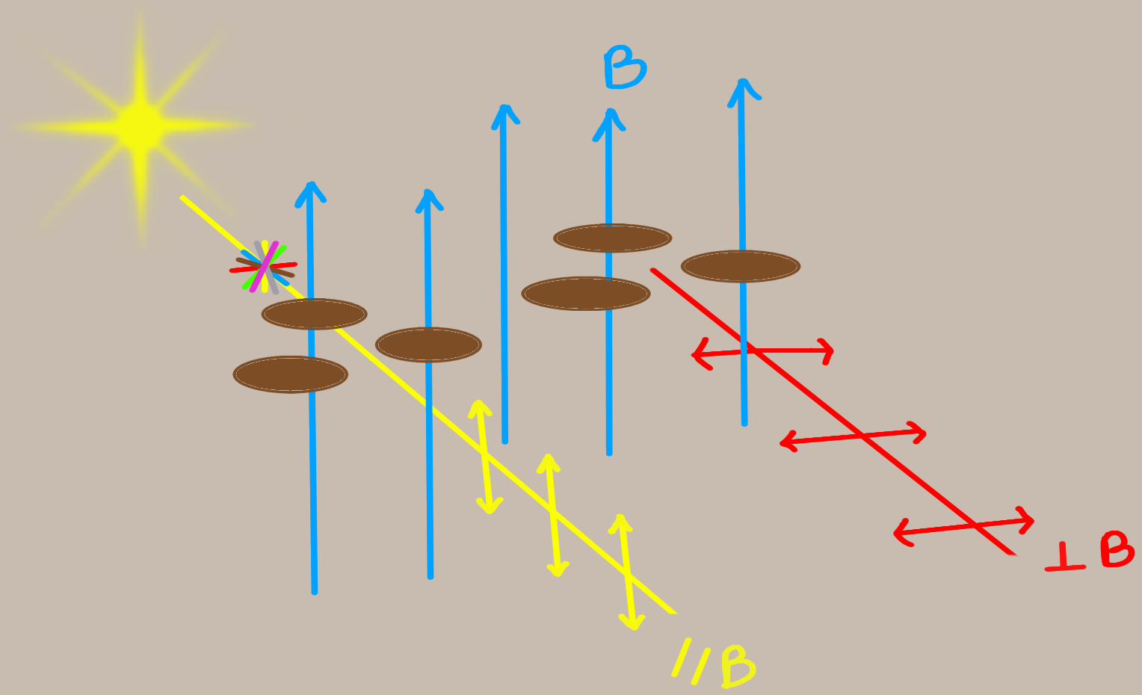
Inferring Magnetic Fields through Dust Polarization
In optical regime, polarization is parallel to the magnetic field on the plane of the sky.
In Far Infrared (FIR) regime, polarization is perpendicular to the magnetic field on the plane of the sky.
FIR
Optical
Notes:
Magnetic fields can also be inferred using dust polarization.
In optical regime the dust grains linearly polarize starlight which is generally unpolarized due to differential extinction giving polarization parallel to the magnetic field on the plane of the sky.
In FIR regime, the dust grains themselves emit polarized light, with the polarization perpendicular to the mangetic field on the plane of the sky.

Slide 5
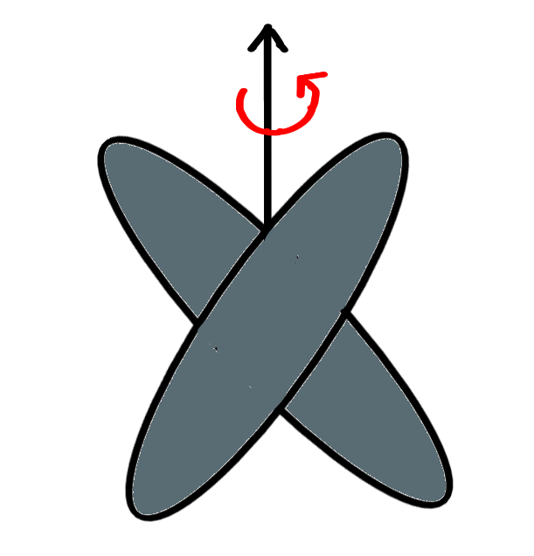
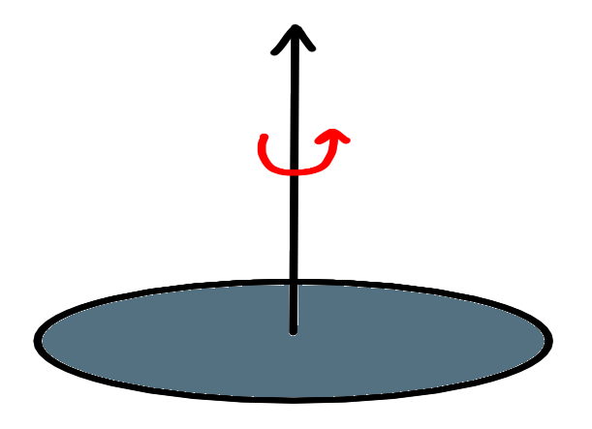
How are Dust Grains aligned?
Happens in two stages:
Stage 1: Internal alignment
Grain's axis of maximum inertia aligns with its angular momentum
Davis & Greenstein 1951, Barnett 1909; Purcell 1979)
Notes:
This alignment happens in two stages. Internal alignment, where the grain’s axis of maximum inertia align with its angular momentum and External alignment, where grain’s angular momentum aligns with a preferred axis in space. The leading theory for external alignment of the dust grains is Radiative Alignment Torque. RAT theory says that the grains are spun up by anisotropic radiation like a pinhweel being spun up by the wind and then they align with the magnetic fields through the process of fast larmour precessions.

Slide 6
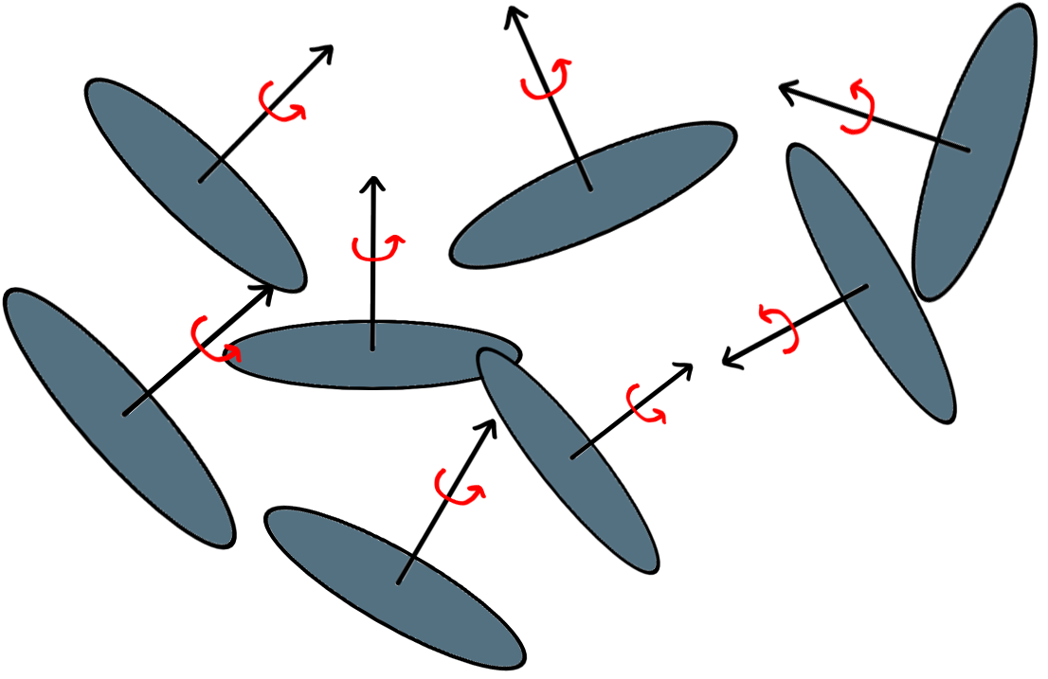
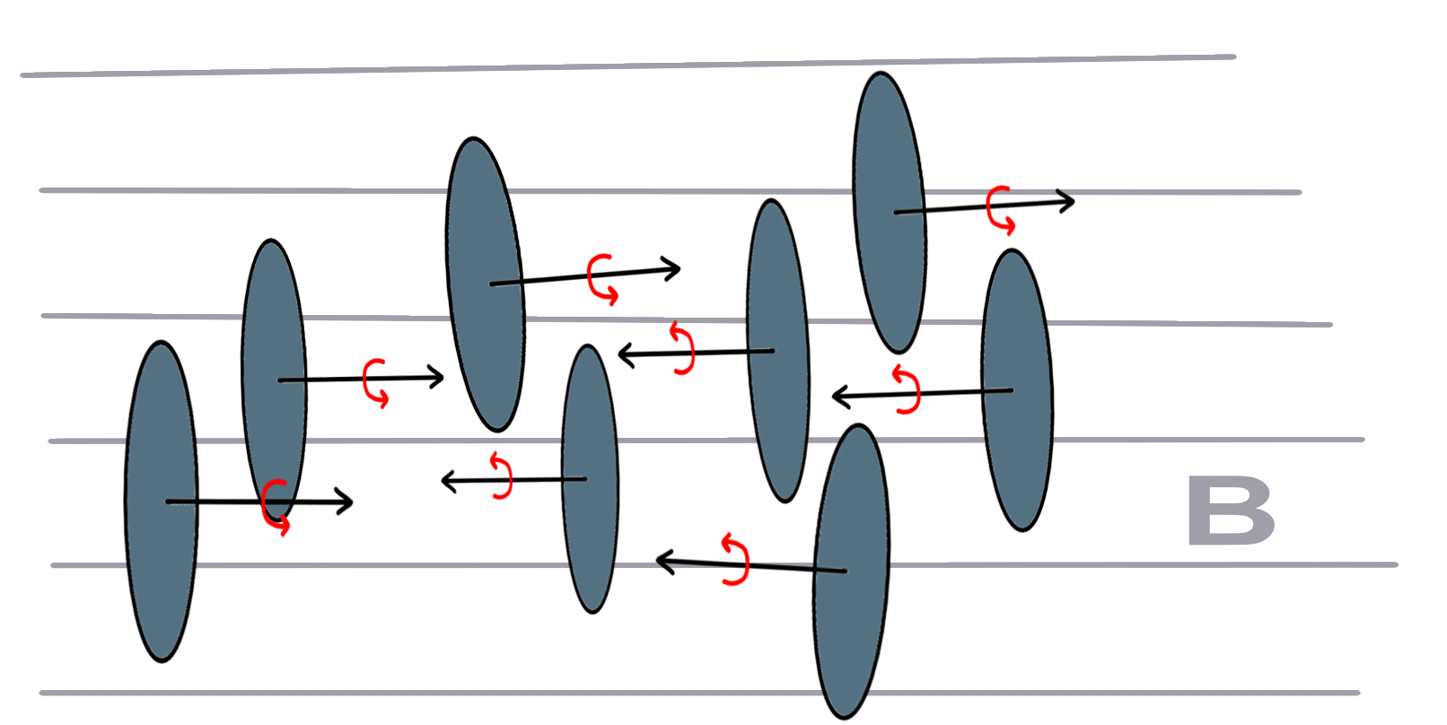
How are Dust Grains aligned?
Stage 2 External alignment
Grain's angular momentum aligns with a preferred axis in space.
Andersson et al. 2015, Lazarian & Hoang 2007b; Hoang et al. 2018)
For Dust Grains to be aligned with the magnetic field they need to be spinning
Notes:
This alignment happens in two stages. Internal alignment, where the grain’s axis of maximum inertia align with its angular momentum and External alignment, where grain’s angular momentum aligns with a preferred axis in space. The leading theory for external alignment of the dust grains is Radiative Alignment Torque. RAT theory says that the grains are spun up by anisotropic radiation like a pinhweel being spun up by the wind and then they align with the magnetic fields through the process of fast larmour precessions.

Slide 7
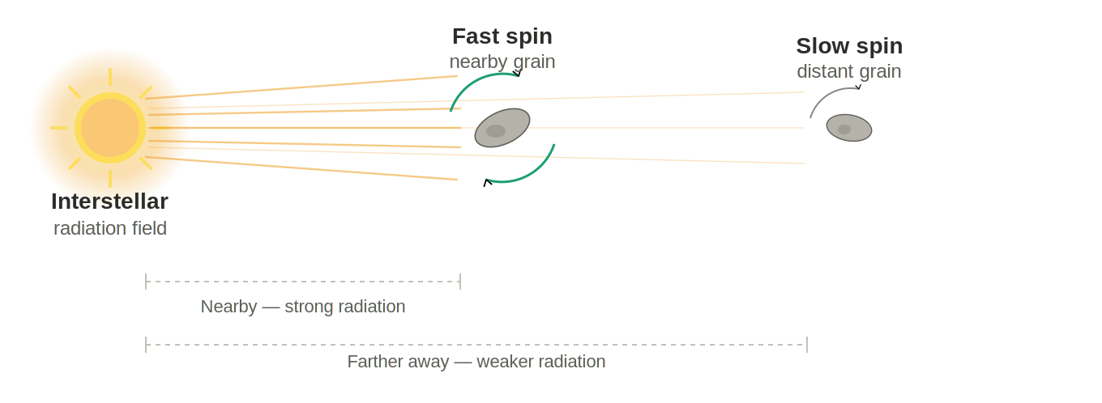
How are Dust Grains aligned?
Leading theory. Radiative Alignment Torque (RAT).
RAT theory says that the grains are spun up by anisotropic radiation like a pinwheel being blown on.
(Dolginov & Mitrofanov 1976; Draine & Weingartner 1996; Lazarian & Hoang 2007b; Hoang & Lazarian et al. 2007)
Image generated with Claude (Anthropic), 2026
Notes:
This alignment happens in two stages. Internal alignment, where the grain’s axis of maximum inertia align with its angular momentum and External alignment, where grain’s angular momentum aligns with a preferred axis in space. The leading theory for external alignment of the dust grains is Radiative Alignment Torque. RAT theory says that the grains are spun up by anisotropic radiation like a pinhweel being spun up by the wind and then they align with the magnetic fields through the process of fast larmour precessions.

Slide 8
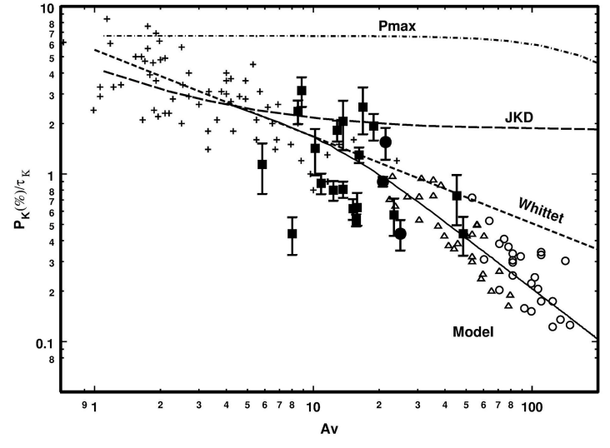
Grains not aligned at highest extinctions
Increasing density of dust
optical
Previous polarimetric
studies of pre-stellar have consistently observed a depolarizing trend with increasing column density referred to as the “polarization hole” effect (Alves et al. 2014).
optical
“Polarization efficiency”
More dust grains aligned
Sub-mm
Jones et al. (2015)
Notes:
Radiative Alignment Torque has been tested many times before. For example in the work of Jones et al 2015, where they looked at several prestellar cores in both optical and submm wavelengths. In the figure on the left from their work, they have plotted polarization efficiency on the y axis and extinction on the x axis.. In their work they saw a common decreasing trend of polarization efficiency vs extinctions in both optical and submm, with the slope even reaching 1 meaning no polarization. This follows directly from the prediction of RAT, higher extinction means low anisotropic radiation and low anisotropic radiation means lower polarization. Similar to the work here, previous studies of pre-stellar cores have also consistently observed decreasing polarization with increasing extinction. This effect is commanly referred to as the polarization hole.

Slide 9
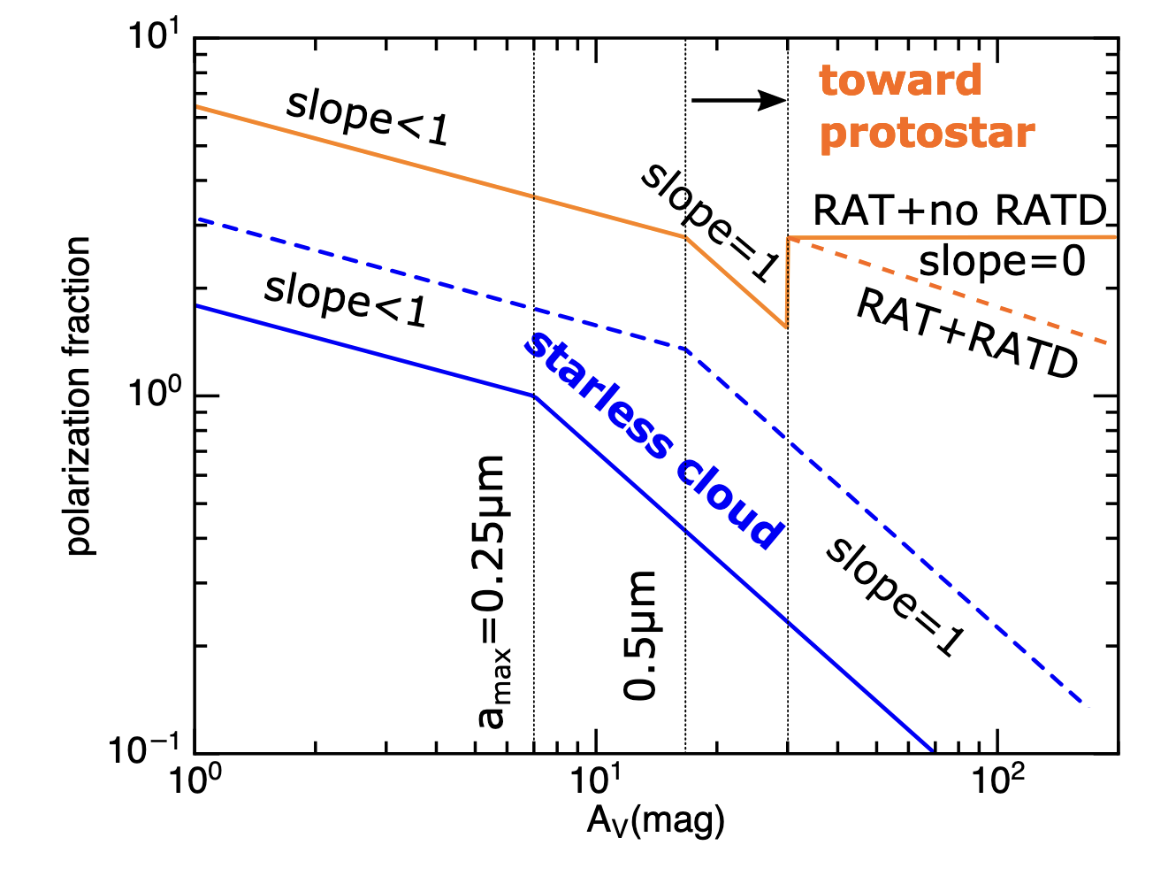
Alignment towards protostars?
Increasing density of dust
Based on RAT if we look at proto-stellar cores then the polarization efficiency should increase due to increasing radiation flux from embedded cores.
More dust grains aligned
Hoang et. al. 2021
Notes:
But what if there was a source of radiation in the core? What happens if there is a protostar embedded in the dense core. This question was investigated thoroughly in Hoang et al 2021. They annalytically studied grain alignment in the context of RAT. In the figure on the right taken from their work, in the case of pre-stellar core they see depolarization at high extinction, just like the observations. But in the case of embedded protostar,
they predict that one should see an increase in polarization efficiency even at high extinctions due to the radiation from the embedded protostar. And this prediction is what we wanted to test in our study. So let’s test this prediction!

Slide 10
Alignment towards protostars?
Polarization map of Serpen South
Based on RAT if we look at proto-stellar cores then the polarization efficiency should increase due to increasing radiation flux from embedded cores.
Pillai et. al. 2020
Notes:
But what if there was a source of radiation in the core? What happens if there is a protostar embedded in the dense core. This question was investigated thoroughly in Hoang et al 2021. They annalytically studied grain alignment in the context of RAT. In the figure on the right taken from their work, in the case of pre-stellar core they see depolarization at high extinction, just like the observations. But in the case of embedded protostar,
they predict that one should see an increase in polarization efficiency even at high extinctions due to the radiation from the embedded protostar. And this prediction is what we wanted to test in our study. So let’s test this prediction!

Slide 11
Alignment towards protostars?
Polarization map of Serpen South
Based on RAT if we look at proto-stellar cores then the polarization efficiency should increase due to increasing radiation flux from embedded cores.
Let’s test the prediction!
Pillai et. al. 2020
Notes:
But what if there was a source of radiation in the core? What happens if there is a protostar embedded in the dense core. This question was investigated thoroughly in Hoang et al 2021. They annalytically studied grain alignment in the context of RAT. In the figure on the right taken from their work, in the case of pre-stellar core they see depolarization at high extinction, just like the observations. But in the case of embedded protostar,
they predict that one should see an increase in polarization efficiency even at high extinctions due to the radiation from the embedded protostar. And this prediction is what we wanted to test in our study. So let’s test this prediction!

Slide 12
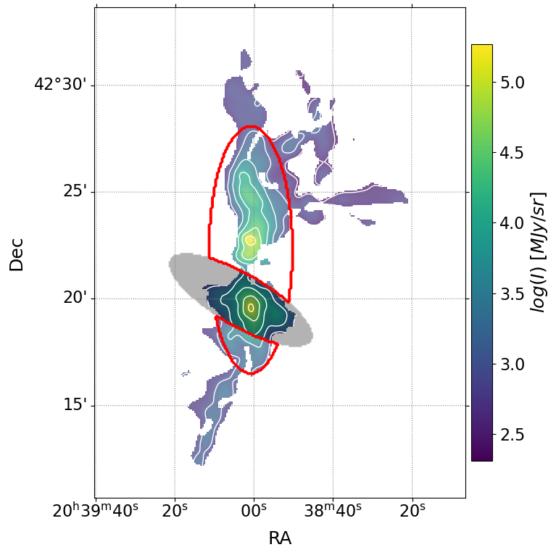
Our tesing grounds: DR21
Stokes I
DR21, the densest, most massive cloud structure in Cygnus X.
Among many protostars, has two massive protostars DR21(M) and DR21(OH).
We mask out the outflow (region in shadow)
Focus on the ridge (red contour)
SOFIA/HAWC+ at 214 µm at 20.3’’
Part of SIMPLIFI
PI: Thushara G.S. Pillai
ridge
DR21(OH)
outflow
DR21(M)
Kumar et. al. 2026 (subm.)
Notes:
For our work, we have chosen DR21 part of the massive star-forming region Cygnus X with the stokes I map shown on the right.
It is located 1.5kpc away and has two massive protostars DR21 and DR21(OH) as shown here.
For our study, we mask out the outflow shown as the shadow region. The masking was done as the outflow is too energetic and doesn’t represent the general properties of the star forming region.
In the scope of this presentation, I will be focusing on the region inside the red contour called the DR21 ridge.
The observation was done using SOFIA/HAWC+ instrument at 214micron wavelength and 20.3’’ angular resolution.

Slide 13
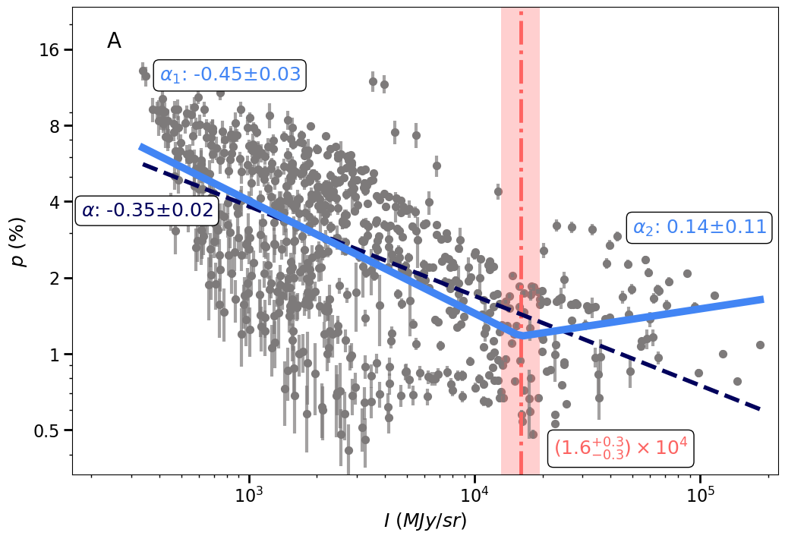
Polarization trend flattens out at high intensities
Increasing density of dust grains
or
Deeper into the star-forming region
More dust grains aligned
Kumar et. al. 2026 (subm.)
Notes:
The first trend that we checked was how polarization varies with intensity.
In the graph plotted above on the y axis you have polarization fraction in percentage, which you can think of like how much dust is aligned.
On the x axis you have Intensity, where increasing intensity means going deeper into the star-forming region.
From the graph what you see is that as the intensity increases that is as the we go deeper into the region, the polarization goes down, which is what you would expect from the theory.
However, at the breakpoint here shown in red, you see that the trend changes and the slope becomes more or less flat.

Slide 14
Polarization trend flattens out at high intensities
Increasing density of dust grains
or
Deeper into the star-forming region
Reasons for decrease in polarization?
Increasing turbulence in magnetic fields
Loss of grain alignment efficiency
More dust grains aligned
Kumar et. al. 2026 (subm.)
Notes:
To understand the behaviour of this trend, we looked to two major reasons for depolarization in dense cores,
which are increasing turbulence in magnetic fields
and loss of grain alignment efficiency.

Slide 15
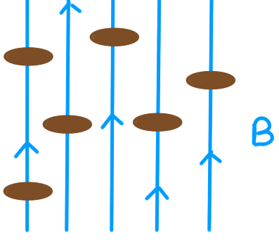
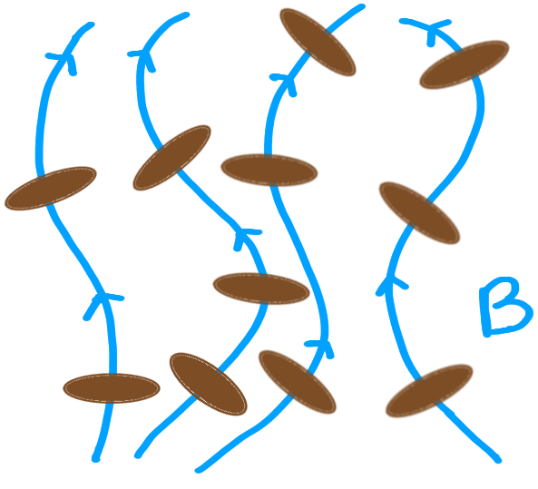
Turbulent magnetic fields decrease polarization
Ordered Magnetic Field
Turbulent Magnetic Field
Turbulent magnetic fields randomizes the plane of polarization
Decreases the net polarization observed along the line of sight.
Notes:
Before I show you the behaviour of turbulence. Let me give more contenxt on how turbulence affects polarization.
On the left I am showing an example of ordered magnetic field lines and the right is an example of turbulent magnetic fields.
As the magnetic fields become more turbulent the polarization that you get from the dust grains becomes more randomized, decreasing the effective polarization fraction along the line of sight.
Now the question is how do we quantify this turbulence in magnetic fields.

Slide 16
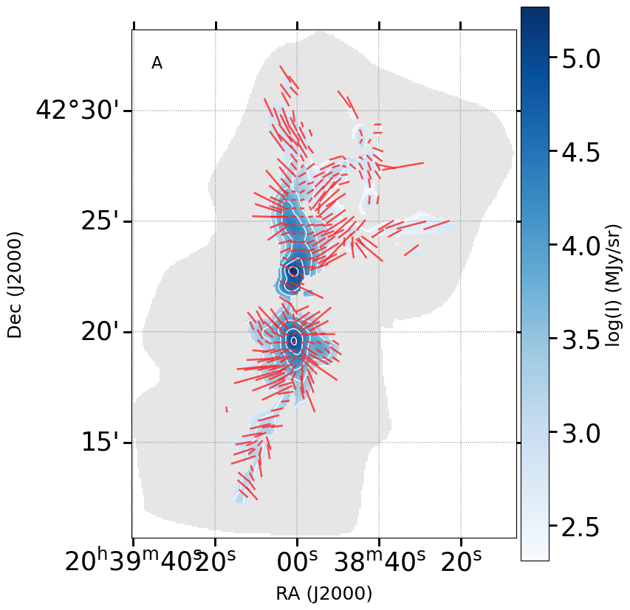
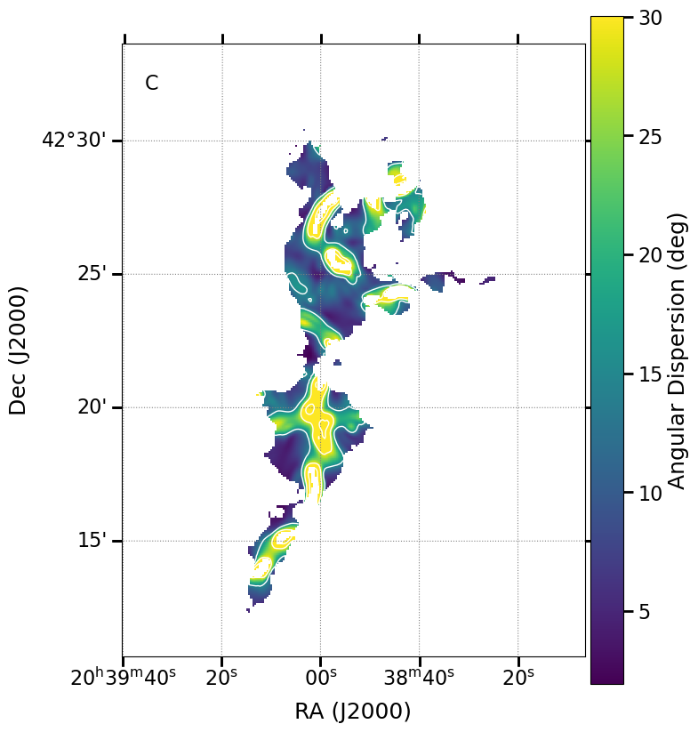
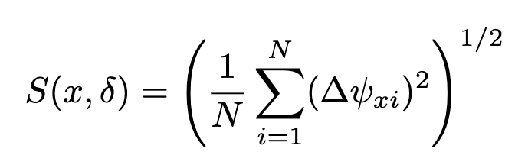
Angular dispersion can be used to quantify turbulence
Polarization Map
Angular Dispersion Map
Angular dispersion
Measures change in polarization angles
Notes:
One way to quantify turbulence is by using polarization angles and calculating something called Angular dispesion.
In the most basic terms it is a measure of how the polarization angles change.
On the left you have polarizaiton angle map plotted on Stokes I with polarization vectors shown in red
and on the right is the calculated angular disperison map. If you look at these plots side-by-side what you would notice is that regions where you see changes in polarization angles are the regions corresponding to high angular dispersion.

Slide 17
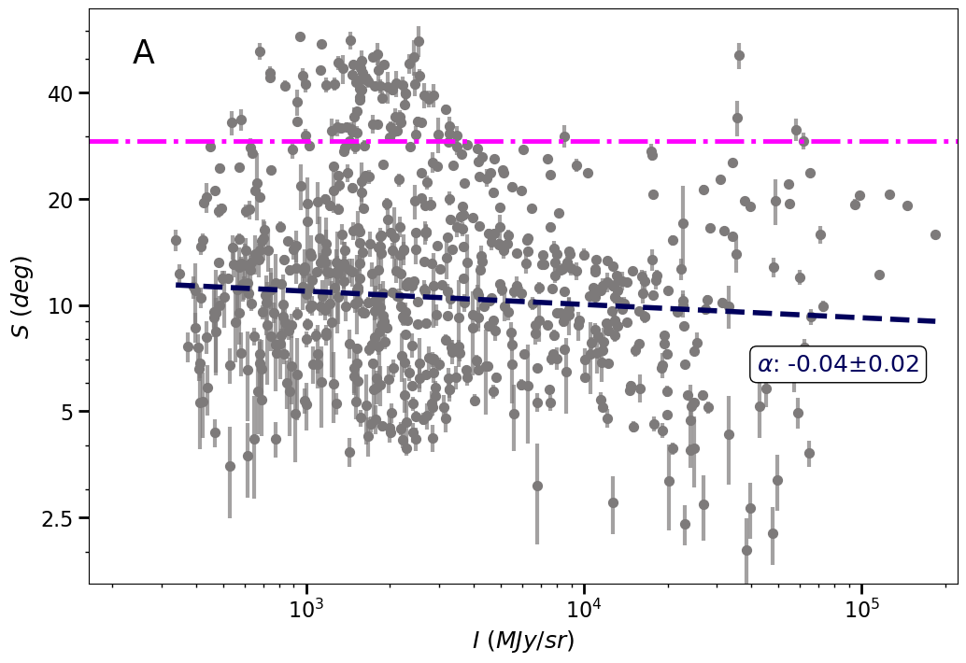
Turbulence is not a major contributor to depolarization
Increasing density of dust grains
or
Deeper into the star-forming region
We see no significant correlation between Angular dispersion and Intensity.
Increasing Turbulence
Turbulence not a significant contributor to depolarization
Kumar et. al. 2026 (subm.)
Notes:
Now that we understand turbulence better, we can finally study its behaviour.
On the graph here, I have plotted angular dispersion on the y axis and intensity on the x axis. Doing this analysis what we learned was that the turbulence more or less remains constant as we go deaper into the region.
As we saw no significant correlation between angular dispersion and intensity, we believe that turbulence is not a significant contributor to depolarization.

Slide 18
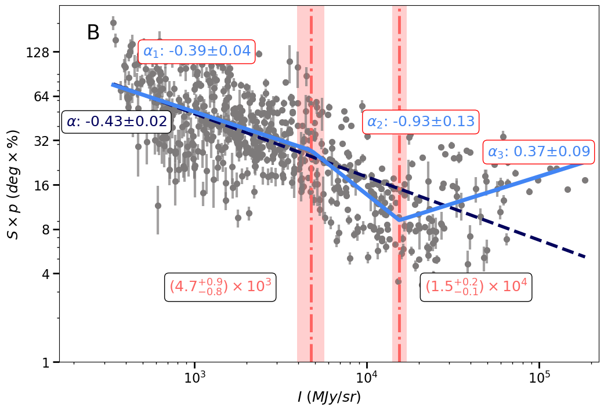
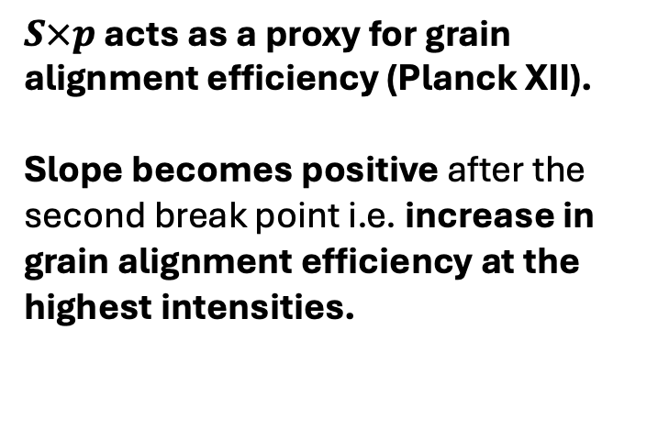
Increase in grain alignment efficiency at the highest intensities
Increasing density of dust grains
or
Deeper into the star-forming region
$S×p$ acts as a proxy for grain alignment efficiency (Planck XII).
Slope becomes positive after the second break point i.e. increase in grain alignment efficiency at the highest intensities.
Increasing grain alignment efficiency
This suggests a re-activation of grain alignment in the densest region
Kumar et. al. 2026 (subm.)
Notes:
Now coming to the second contributing factor for depolarization, loss of grain alignment efficiency.
one can use angular dispersion times p as a proxy for grain alignment efficiency.
In the figure on the left, you can see Sxp on the y axis and intensity on the x axis.
Again starting at the lowest intensity and going higher, we see the expected decreasing trend and at the first break point in the power law, the slope becomes even more steeper.
But after the second break point, the slope changes sign and the graph shows an increasing grain alingment efficiecny at highest intensities.
This suggests that there must be an internal source of radiation, to help align the dust grains.
We theorized that thesee enhanced polarization efficiency must be from reactivation of RAT from embedded protostars in the region.

Slide 19
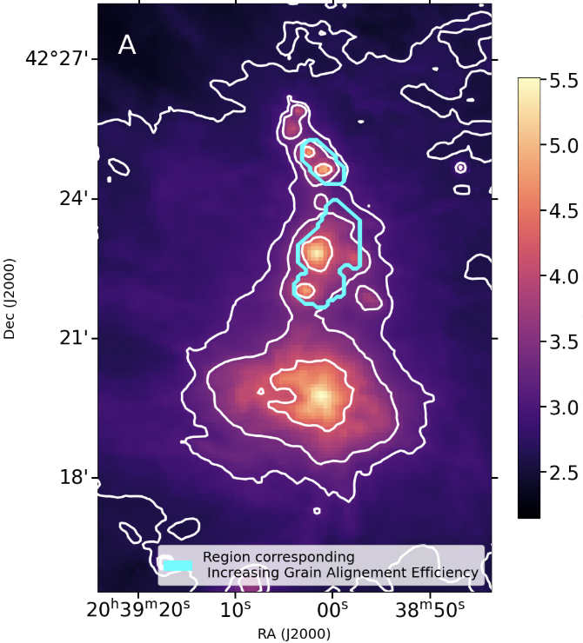
Re-activation of grain alignment happens near protostars
70µm emission traces the warm dust around proto-stellar cores.
Data points for increasing grain alignment efficiency coincide with the highest 70 µm intensities.
For more extensive analysis including analytical modelling check out Kumar et. al. 2026 (subm.)
Kumar et. al. 2026 (subm.)
Notes:
To test this theory, we used 70µm emmission.
70µm traces warm dust around the protostellar cores.
In the figure on the left I have plotted a 70µm emision map of DR21 with the region showing the increase in grain alignment efficiency marked by the blue contour.
From the plot we see that the data points corresponding to the increase in grain alignment efficiency are spatially correlated to the high 70 micron emission. With this I can safely say that we are observing re-activation of RAT towards protostellar cores and I finish my presentation thank you.

Slide 20
Summary and conclusions
We tested the predictions of RAT theory in DR21 using 214µm dust polarization study
Observed a flattening of the polarization fraction–intensity slope at the highest intensities.
To explain this flattening, we examined turbulence and grain alignment efficiency as functions of intensity.
Found no significant correlation between angle dispersion (a proxy for turbulence) and intensity.
Detected an increase in grain alignment efficiency at the highest intensities.
Found that the regions showing enhanced alignment efficiency are spatially correlated with high 70 µm suggesting re-activation of RAT from embedded protostars.

Slide 21
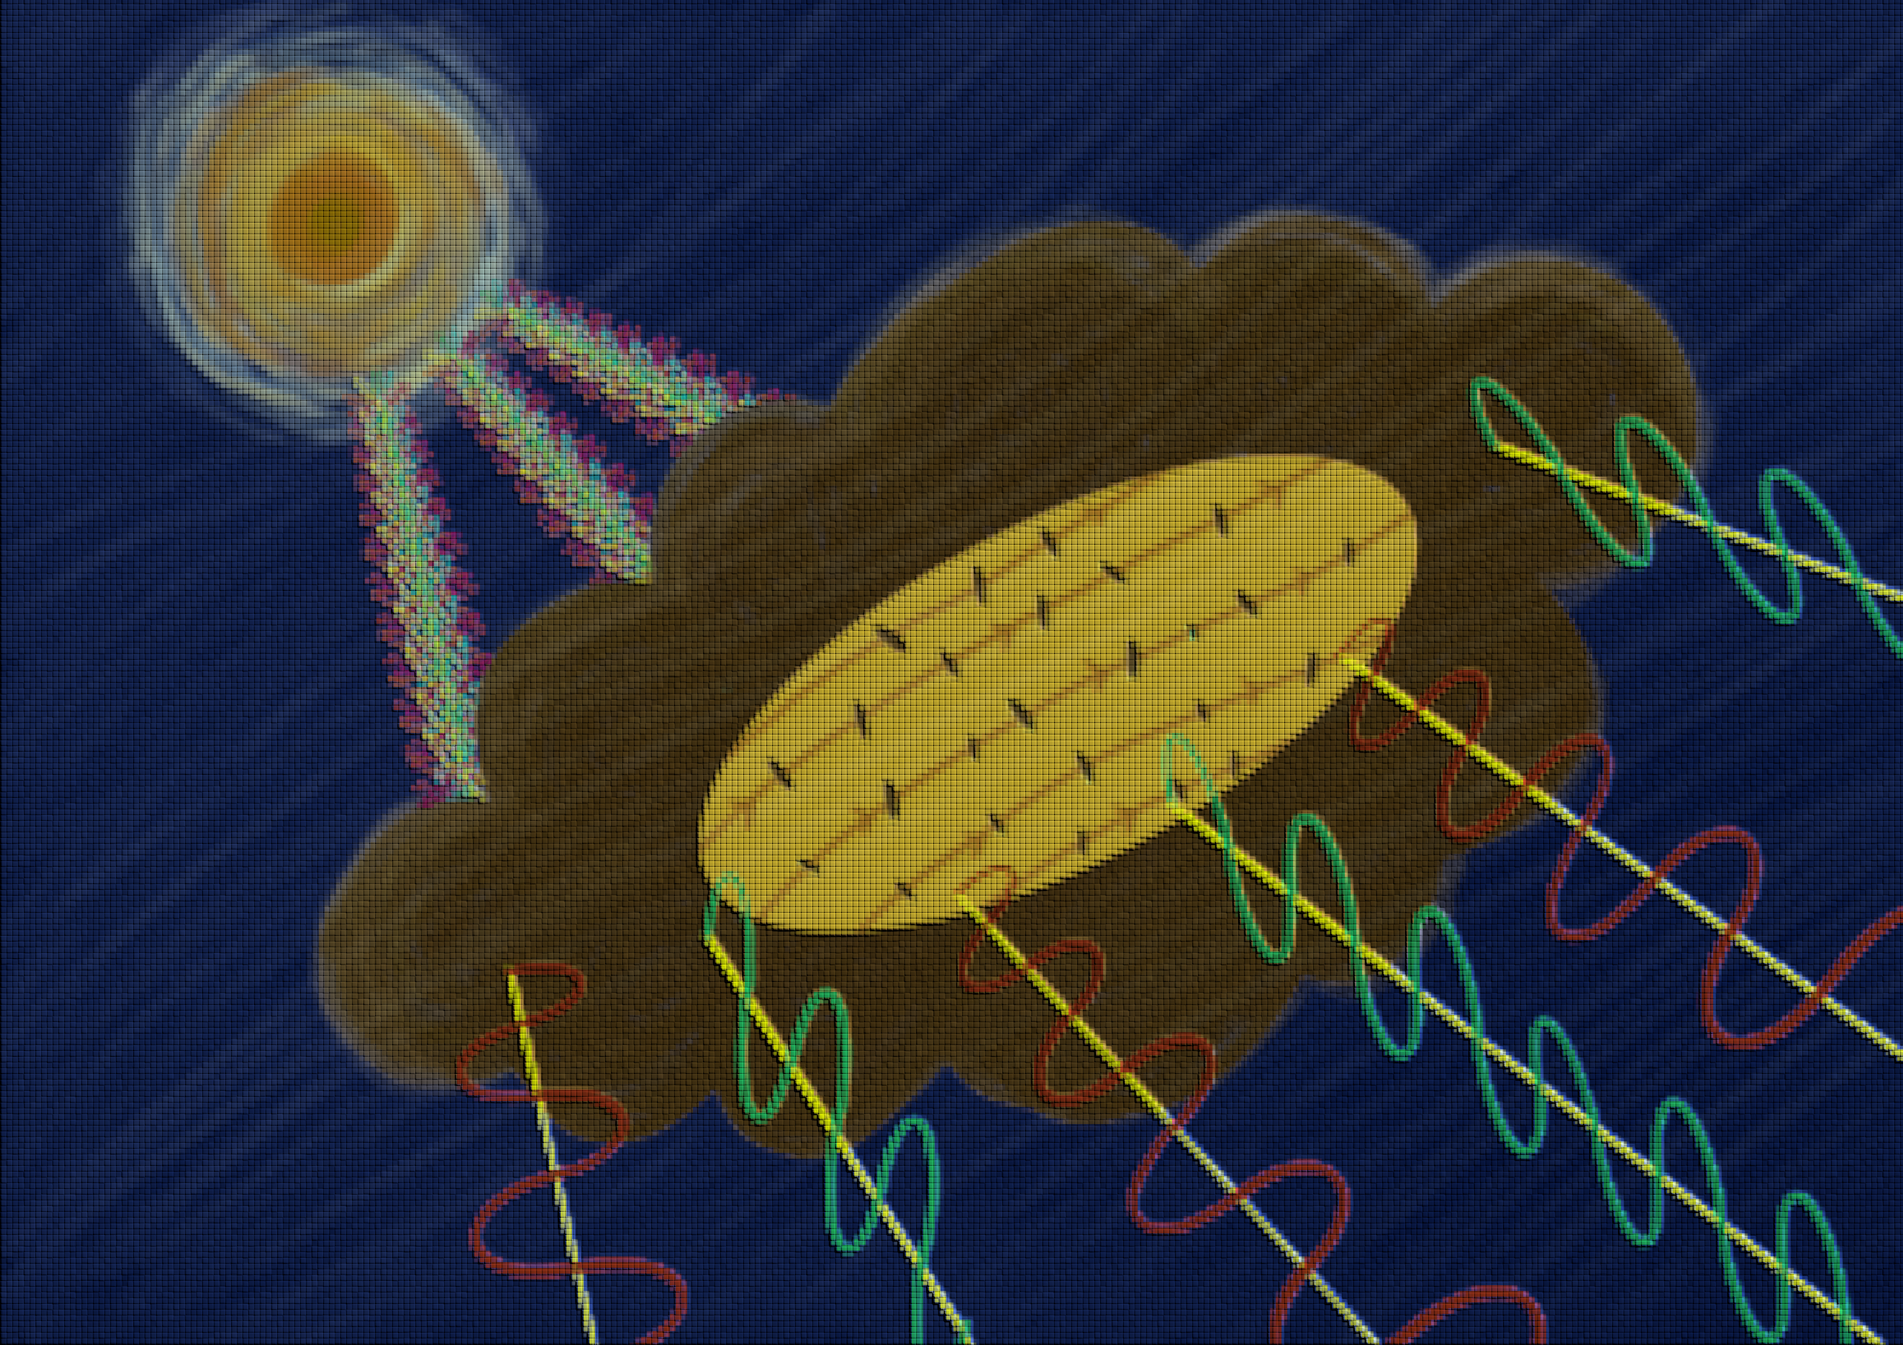
Extra Slides

Slide 22
How are Dust Grains aligned?
Happens in two stages:
Stage 1 Internal alignment : Grain's axis of maximum inertia aligns with its angular momentum
Stage 2 External alignment : Grain's angular momentum aligns with a preferred axis in space.
Internal Alignment
Leading theory: External alignment likely through Radiative Alignment Torque (RAT).
RAT theory says that the grains are spun up by anisotropic radiation like a pinwheel being blown on.
The spinning grains align their angular momentum with magnetic fields.
External Alignment
Notes:
This alignment happens in two stages. Internal alignment, where the grain’s axis of maximum inertia align with its angular momentum and External alignment, where grain’s angular momentum aligns with a preferred axis in space. The leading theory for external alignment of the dust grains is Radiative Alignment Torque. RAT theory says that the grains are spun up by anisotropic radiation like a pinhweel being spun up by the wind and then they align with the magnetic fields through the process of fast larmour precessions.

Slide 23
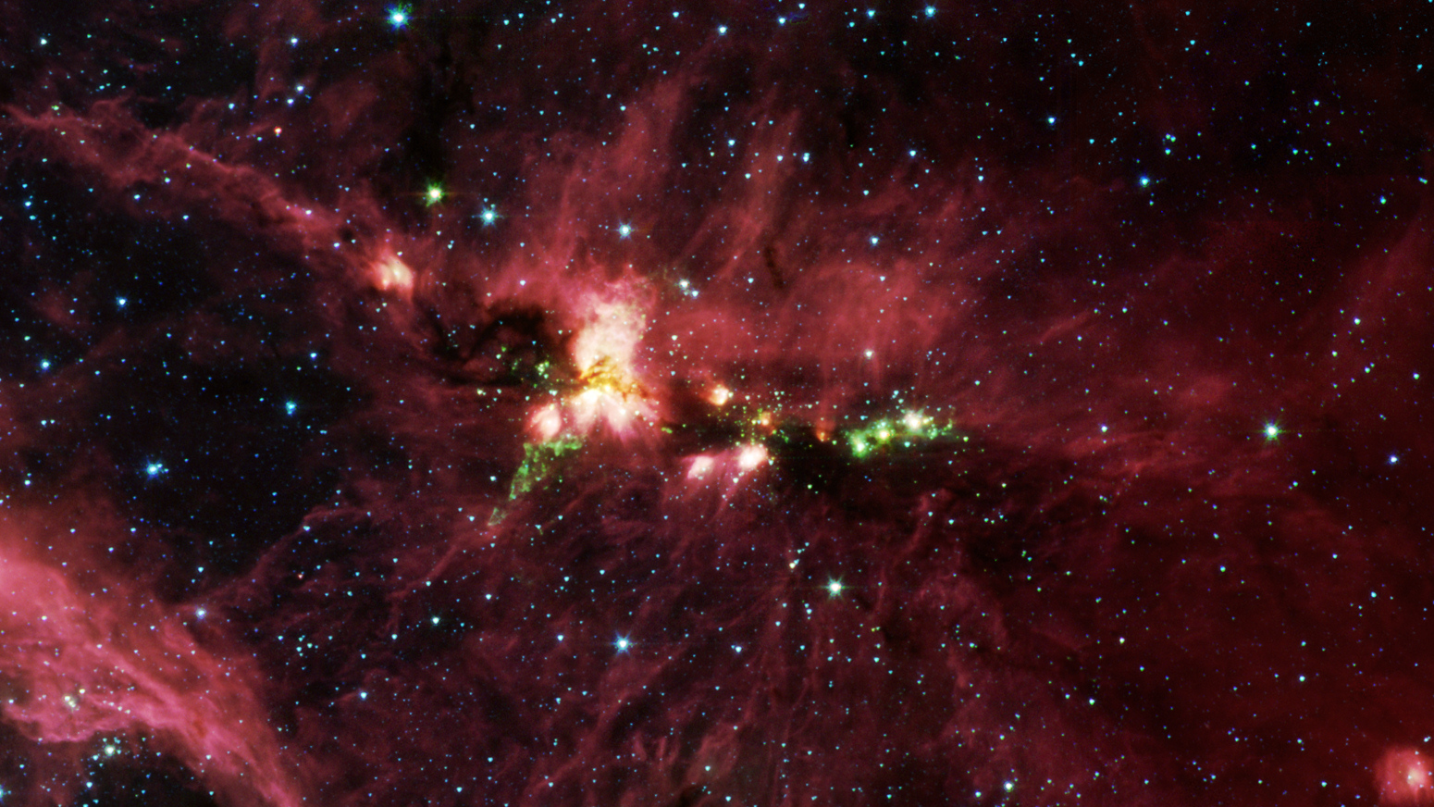
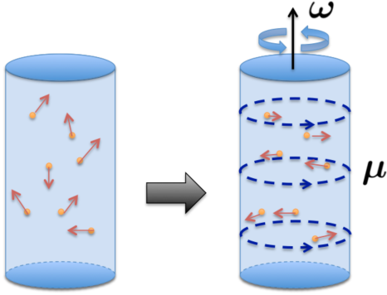
Grain alignment
Happens in two stages:
Stage 1 internal alignment : Grain's axis of maximum inertia aligns with its angular momentum
Leading theory: Internal alignment likely through Barnett relaxation effect.
Barnet effect is the the magnetization of an uncharged body when spun on its axis.
Rotating grains obtain a magnetic moment.
Relaxation occurs due to dissipation of grain rotational energy into heat.
This dissipation in turn happens because of magnetization within a paramagnetic grain rotating around a non-principal axis.
K. Fukushima et. al. 2018
Notes:
Now the question comes why does dust carry information about the magnetic fields. To understand that we need to start with understanding grain alignment. So dust in the ISM goes through two stages of alignment. First is the internal alignement where a dust’s axis of maximum inertia aligns with the angular momentum. The leading theory is the through Barnett relaxation effect, where rotating grains obtain a magnetic moment and the relaxation comes from dissipation of grain rotational energy into heat due to rotating magnetization within a paramagnetic grain rotating around a non-principal axis.

Slide 24
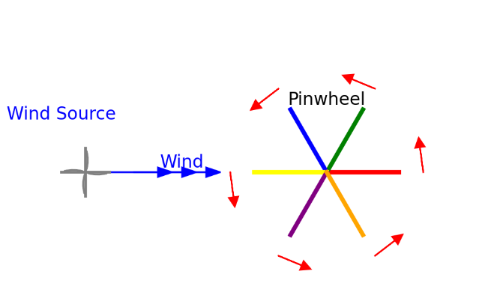
Grain alignment
Stage 2 external alignment : Grain's angular momentum aligns with a preferred axis in space.
Leading theory: External alignment likely through Radiative Alignment Torque (RAT).
RAT theory says that the grains are spun up by anisotropic radiation like a pinwheel being blown on.
The spinning paramagnetic dust grains which have an internal magnetization interacts with the magnetic fields.
Fast Larmor precession establishes the magnetic field as a preferred axis of the external alignment.
Notes:
Stage 2 is external alignment where grain’s angular momentum aligns with a preferred axis in space in our case with the magnetic fields the leading theory is the radiative alignment theory where anisotropic radiation causes the grains to spin and the fast Larmor precession establishes the magnetic field as a preferred axis of the external alignment.

Slide 25
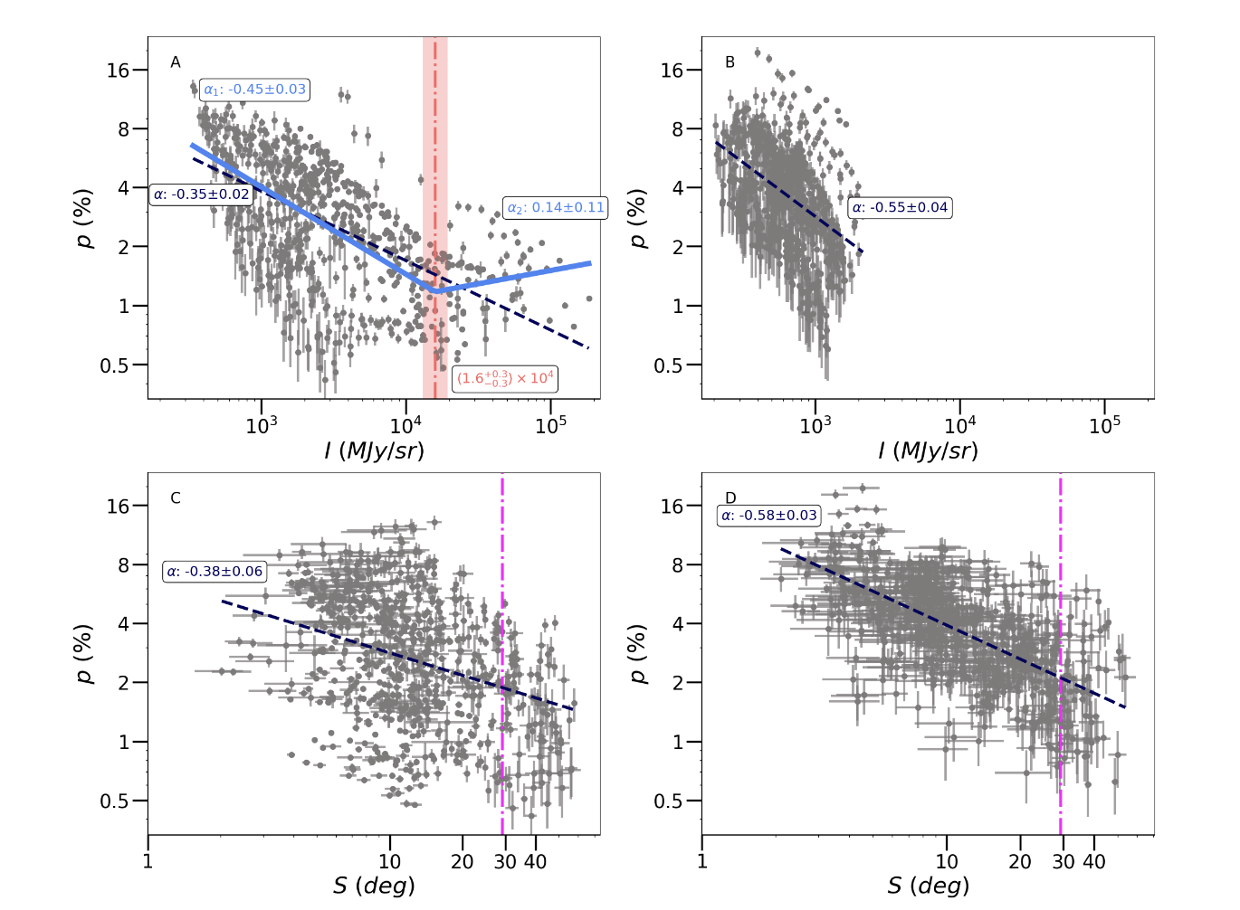

Slide 26
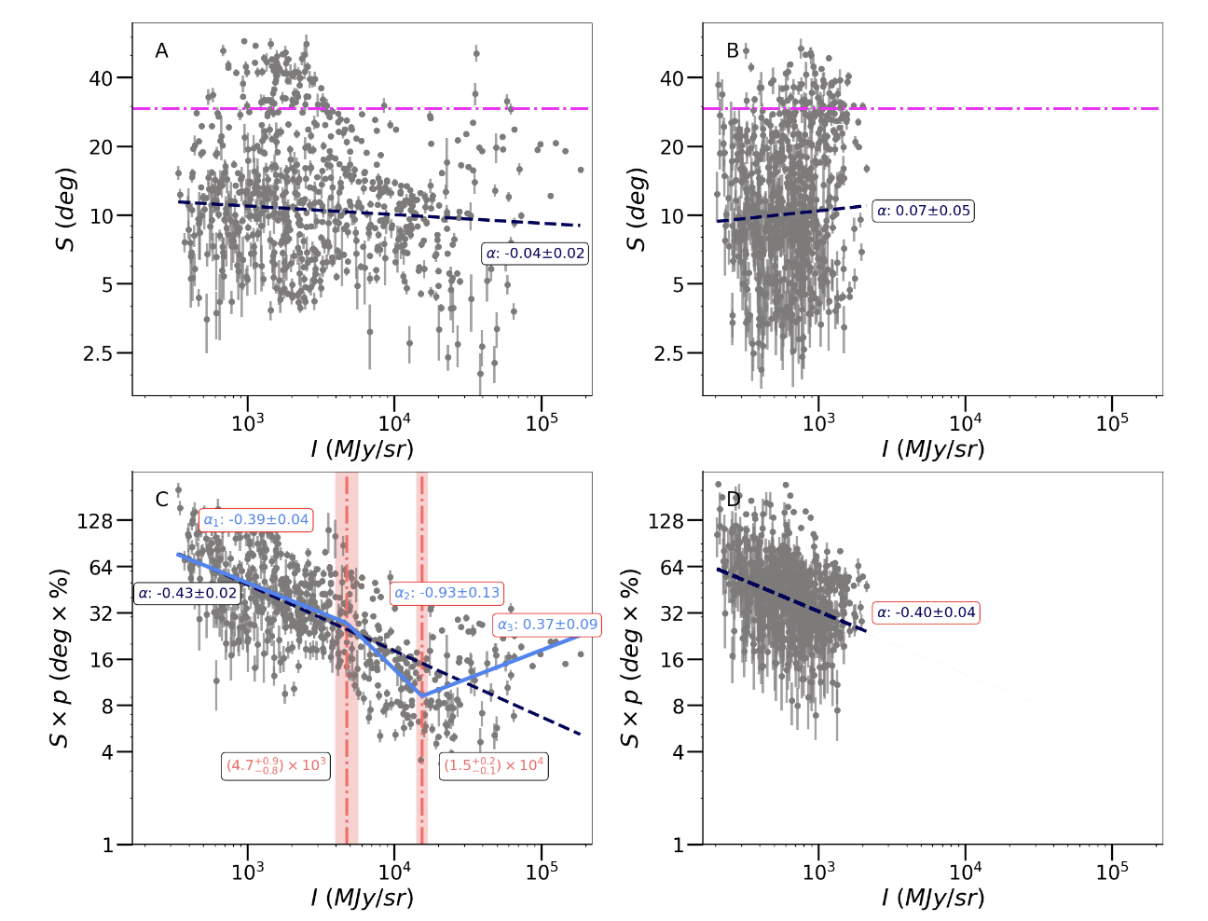

Slide 27
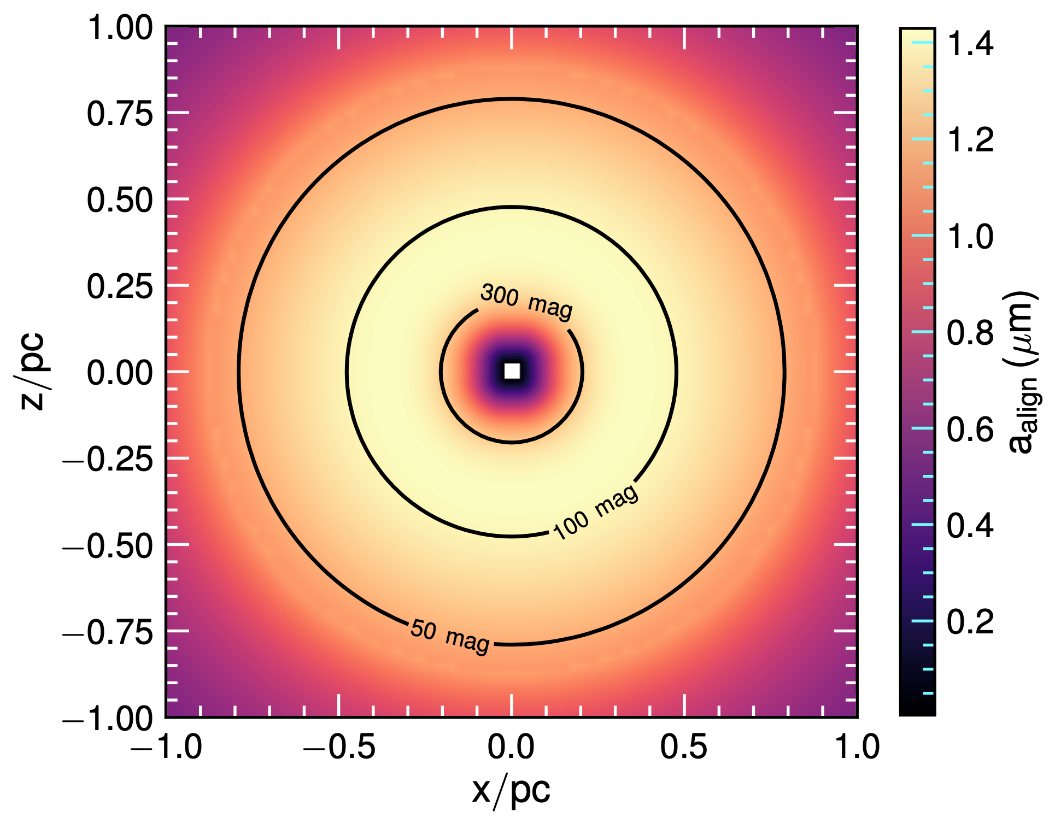
Radiative modelling

Slide 28
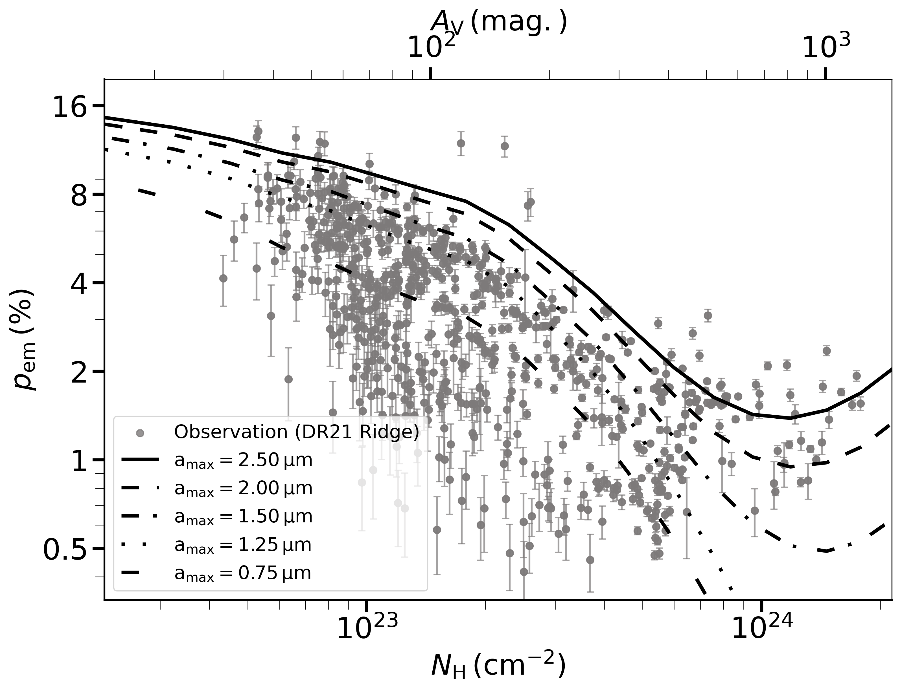
Predictions from modelling matches observations
Performed an simple analytical modelling of a spherical proto-stellar envelope with a central luminous source.
Central luminosity of the protostar being L⋆ = 1 x 10⁵ L⊙
The alignment was quantified using the spatial distribution of the minimum alignment size of dust grains, a_{align} and maximum grain size for alignment a_{max}.
For amax ≥ 1.50 μm the model predicts a flattening and subsequently a gradual increase in polarization fraction at the highest column densities.
When the modeling was repeated for an embedded protostar with lower luminosity (L⋆ = 10⁴ L⊙) no turn-up was observed.
Kumar et. al. 2026 (subm.)
Notes:
To test this theory, we used 70µm emmission. 70µm traces warm dust around the protostellar cores. In figure a) plotting grain alingment efficiency vs intensity, I have highlighted the data points corresponding to the turnover in grain alignment efficiency, In figure b) I have plotted an histogram distribution of 70µm intensity of the region, here you can see that the highlighted data points correspond to the highest 70µm emission, and again on figure c) where I have plotted a 70µm emision map of DR21 overplotted with MIR cores from Kryukova 2012, We see that the highlighted data points corresponding to the increase in grain alignment efficiency and highest 70µm emission are spatially correlated to the MIR cores present in the ridge. With this I can safely say that we are observing re-activation of RAT towards protostellar cores and I finish my presentation thank you.

Slide 29
