Slide 1

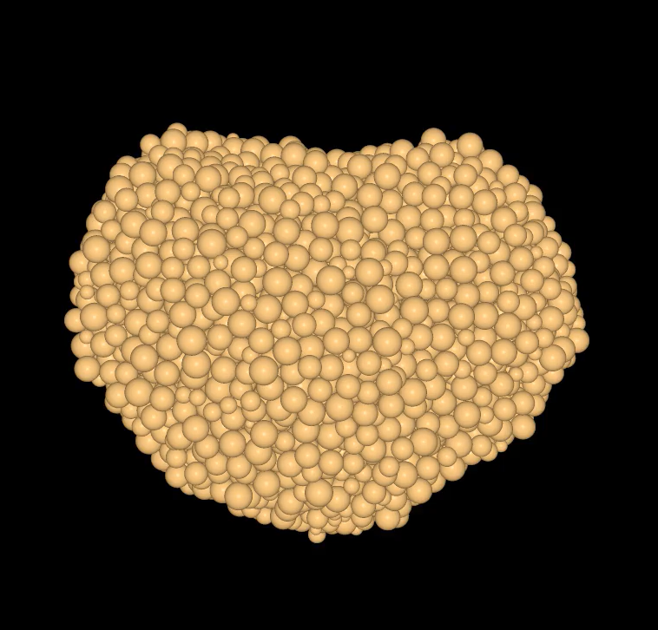


Predictions for the Apophis 2029 Earth Close Approach from DEM Simulations
Joseph V. DeMartini
(joseph.demartini@helsinki.fi)
Adriana Daca
Derek C. Richardson
Naomi Murdoch

Slide 2
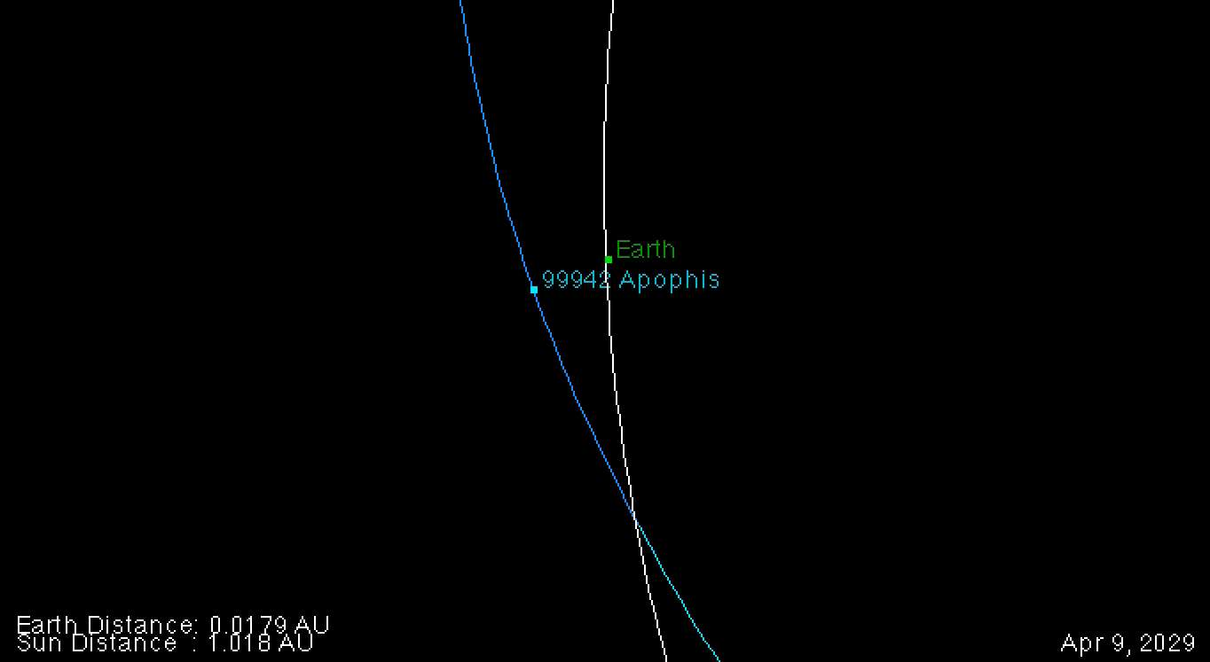

The Apophis Close Encounter
Friday the 13th, April 2029
Apophis will MISS the Earth
Physical Characterstics:
  D ~ 350 m
  $\overline{P}$ ~ 30.56 h (tumbling)
  Sq-type
Confirmed Missions:
  RAMSES (ESA)
  OSIRIS-APEX (NASA)
Credit: NASA, JPL

Slide 3
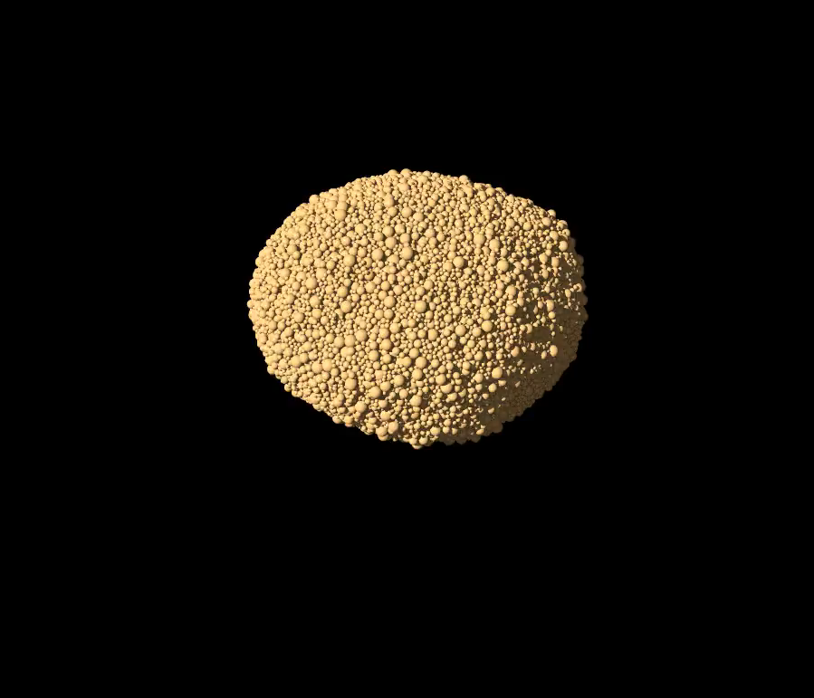
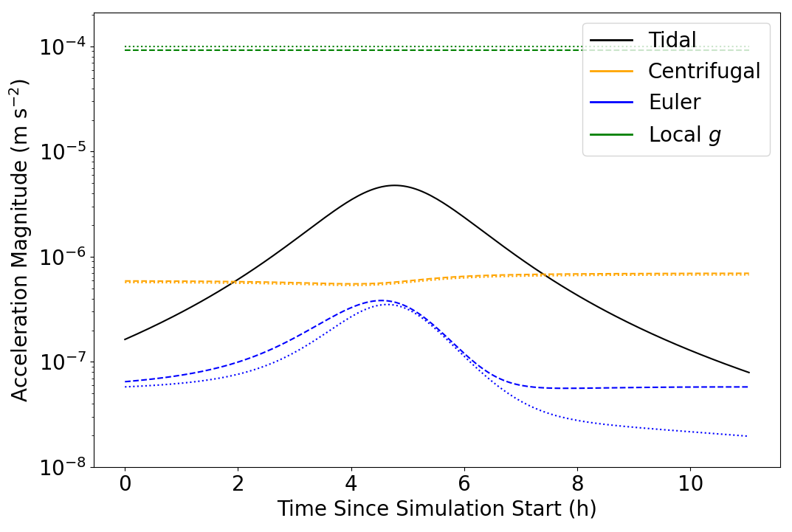
Apophis Close Encounter – Physical Details
A violent rotational change
Agrusa et. al, 2024
DeMartini et al., 2025
Changing rotational state

Slide 4
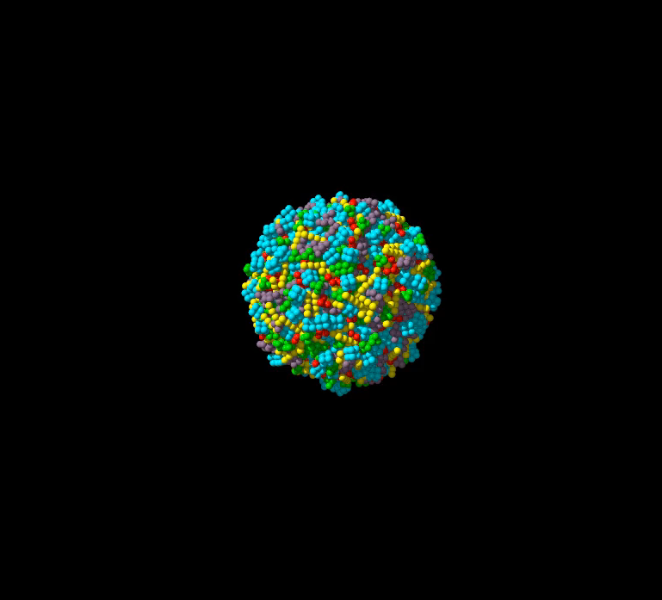
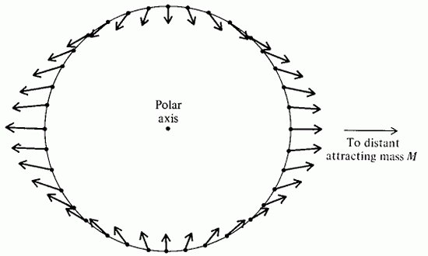
Apophis Close Encounter – Physical Details
A violent tidal deformation
Marohnic et. al, 2026
Changing shape (deformation)

Slide 5
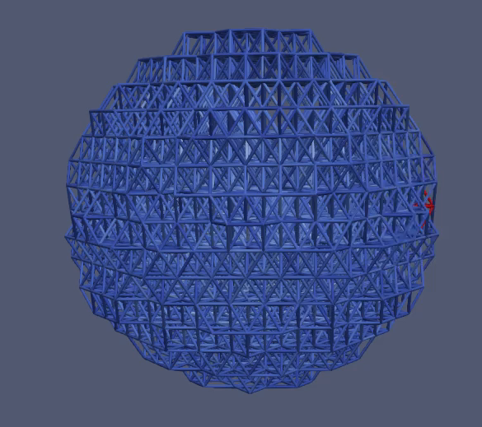
Apophis Close Encounter – Physical Details
A violent seismic event
(DeMartini unpublished work)
DeMartini et al., 2025
Seismic events

Slide 6
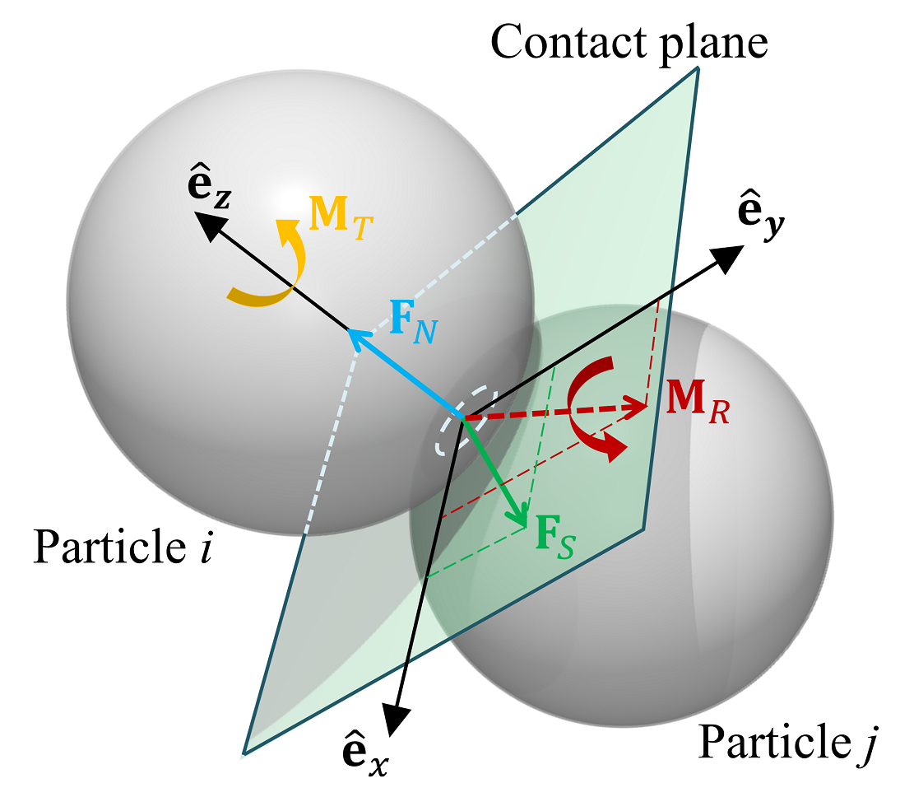
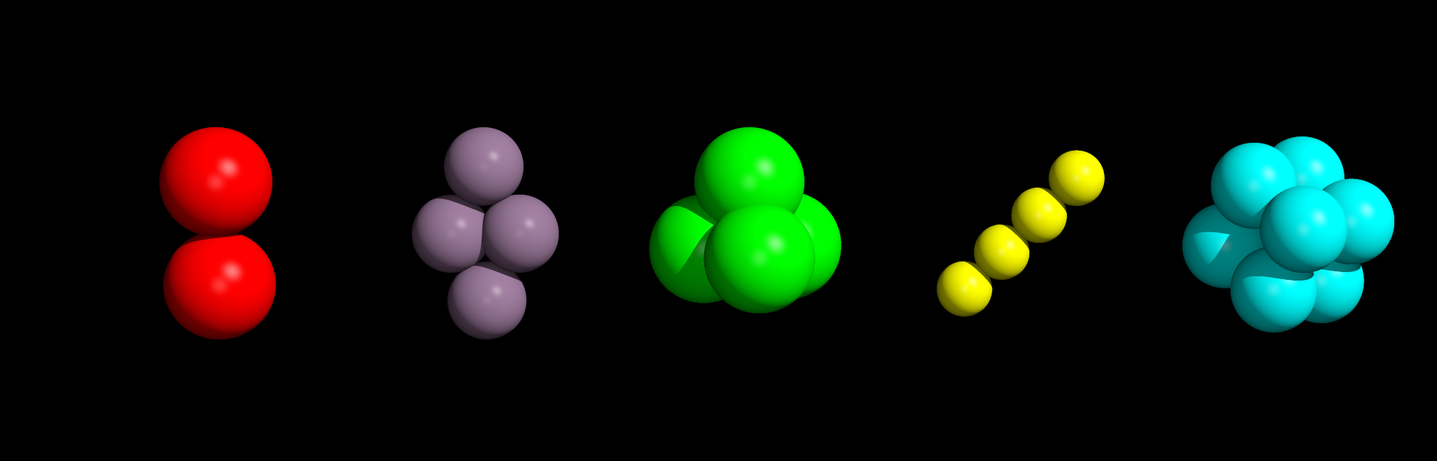
Numerical Approach - pkdgrav
Zhang et al. 2017
Parallel, N-body Gravity tree code
  Calculate mutual gravity between spherical particles
Soft-Sphere Discrete Element Method
  Calculates interparticle contact forces
  Restoring (Hooke’s Law) spring force
    Spring constant ~ Material stiffness (Young’s Modulus)
  Energy damping + rolling, twisting, sliding friction
  Irregular shapes (“aggs”) w/ bonded-spheres
Marohnic et al., 2023
Notes:
Small timesteps necessary to see full spring oscillation
parallelization bc we’re just computing forces constantly (not tracking collision events like HSDEM)
1 Mpa = fairly large kn for pkdgrav (similar to that measured for 67P/CG)

Slide 7
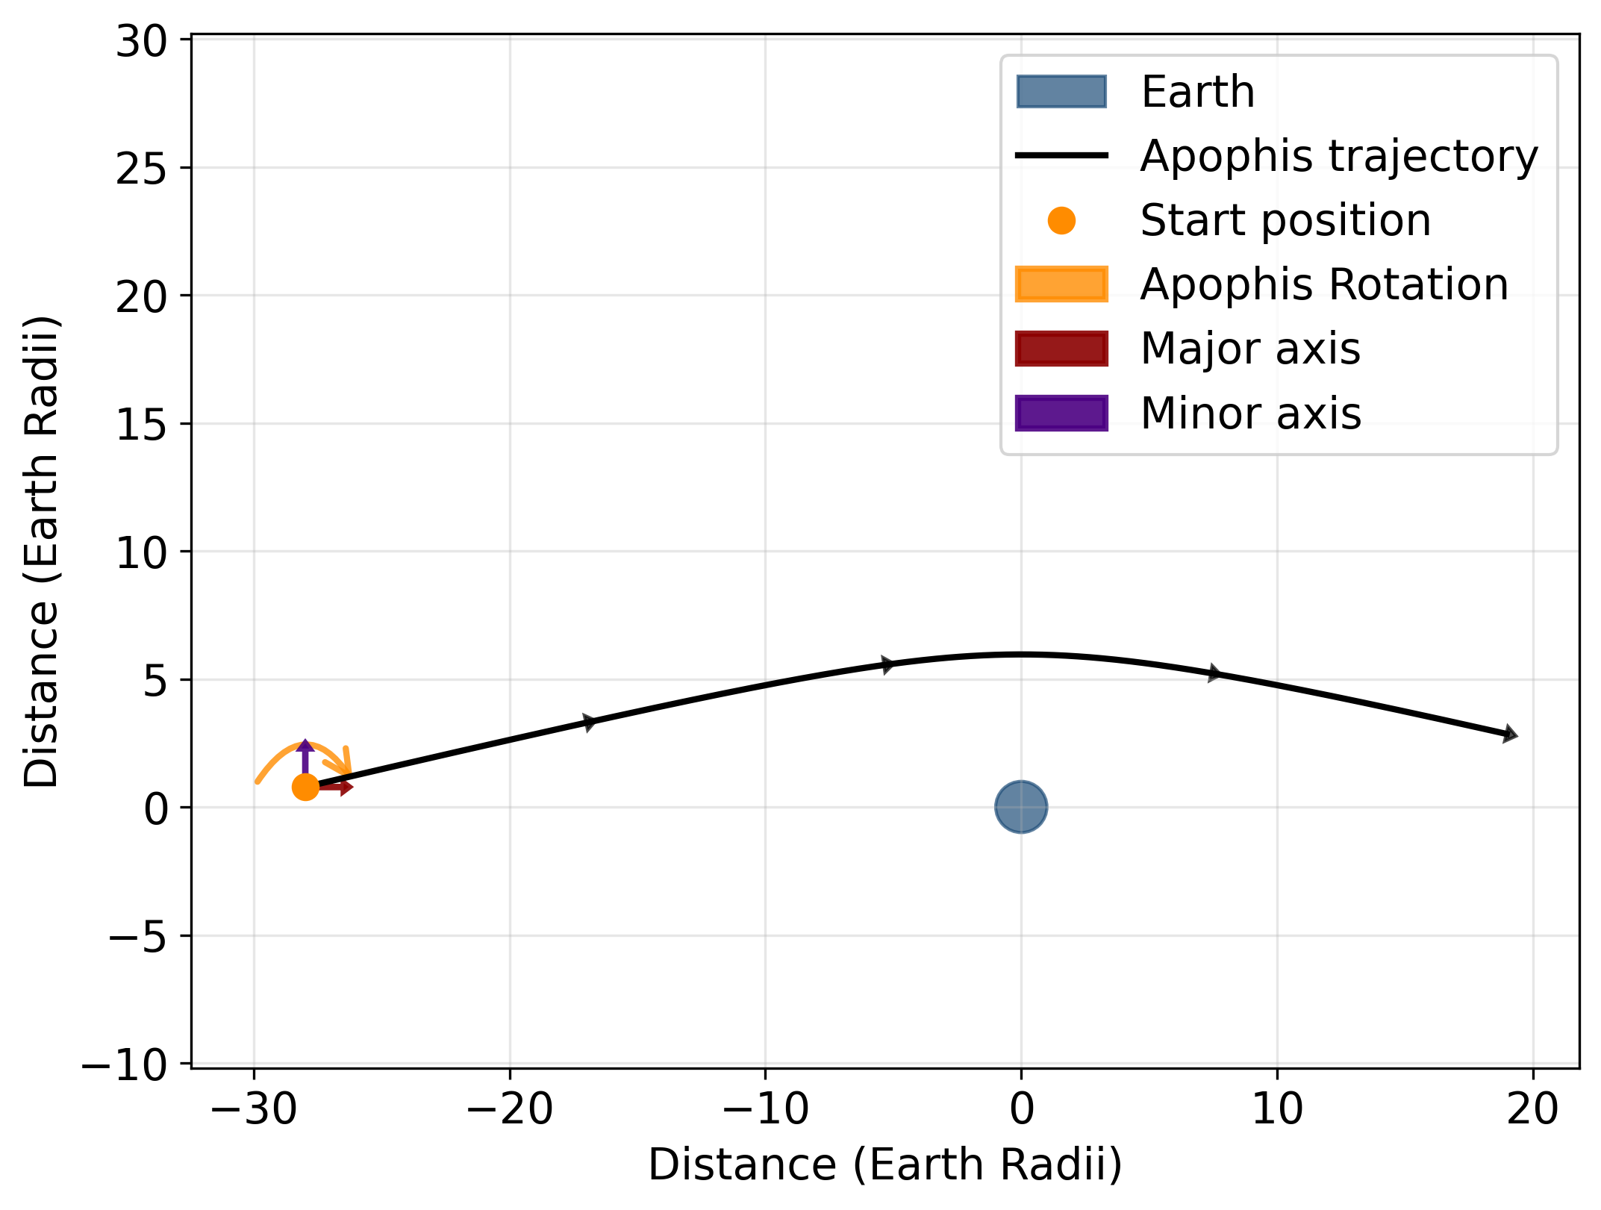
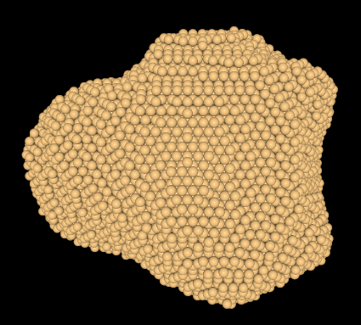
Apophis Close Encounter – Simulation Setup
DeMartini et al., 2019
DeMartini et al., 2025

Slide 8
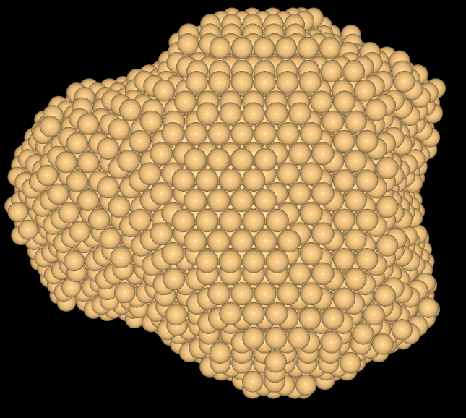
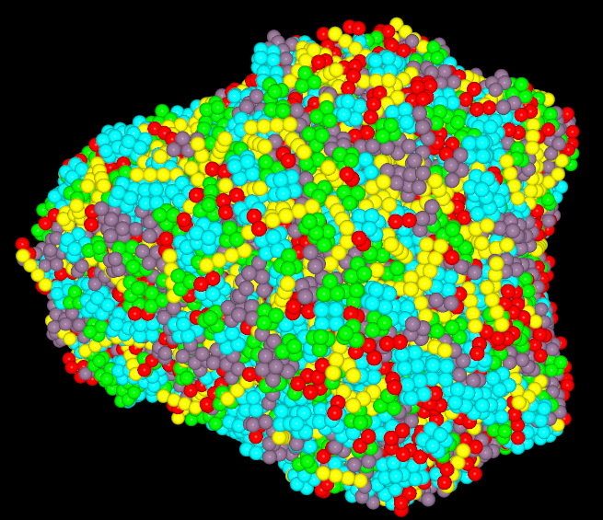
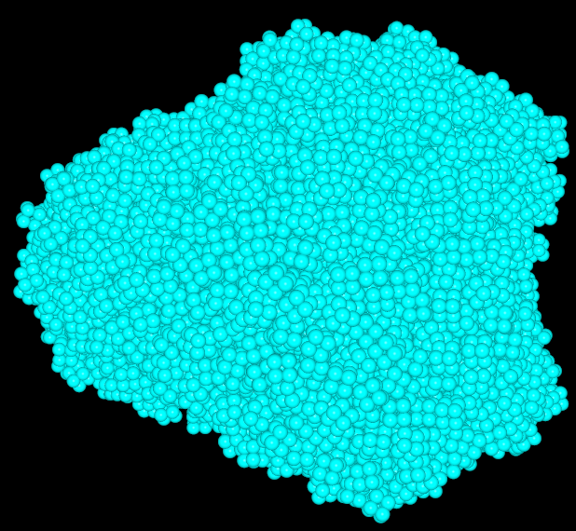
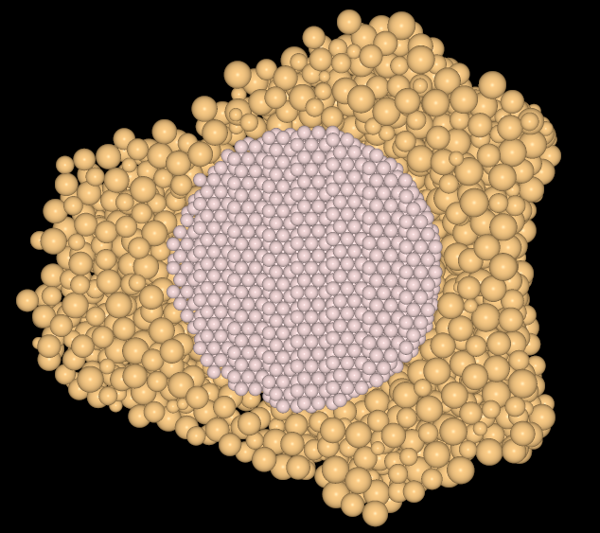


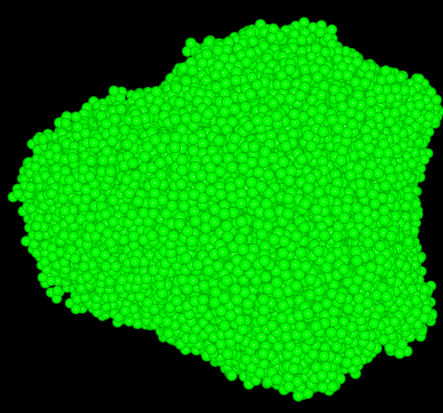
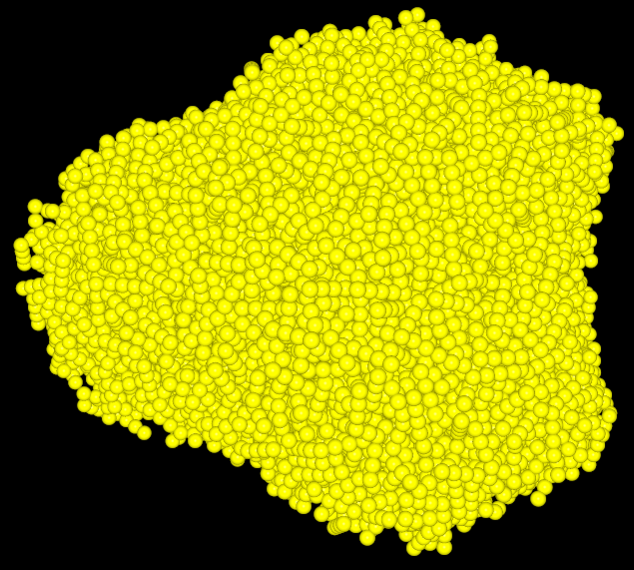
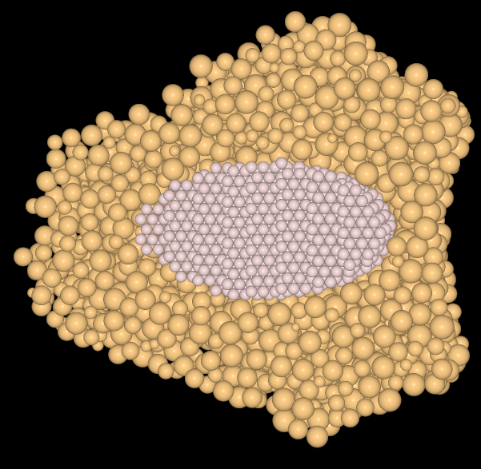


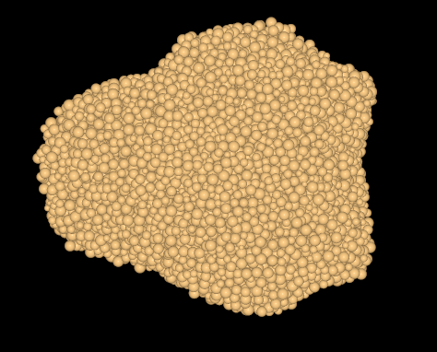
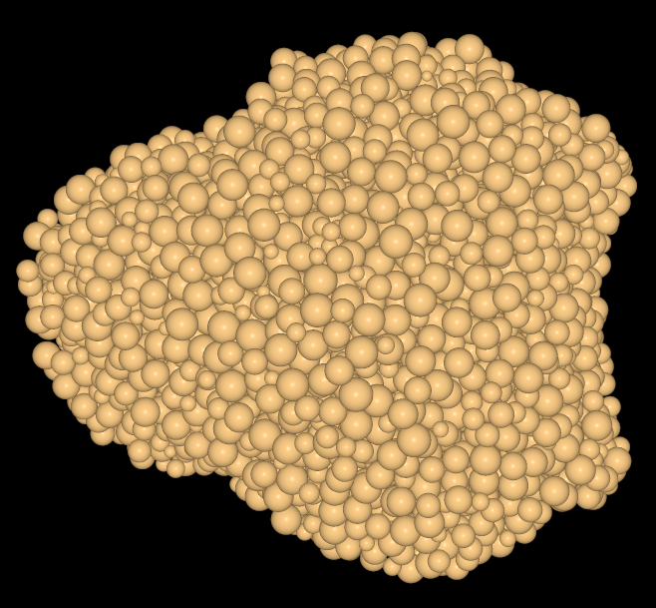
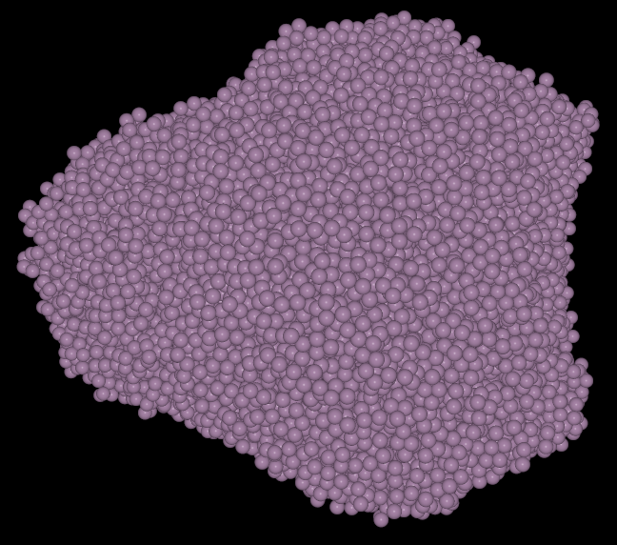
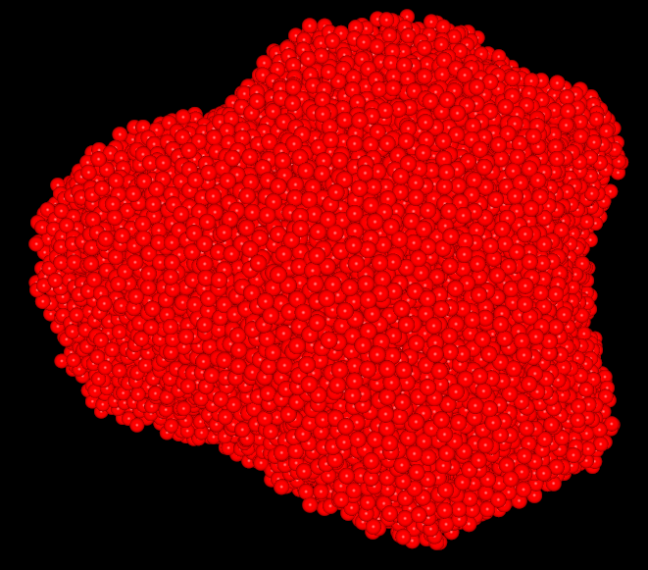
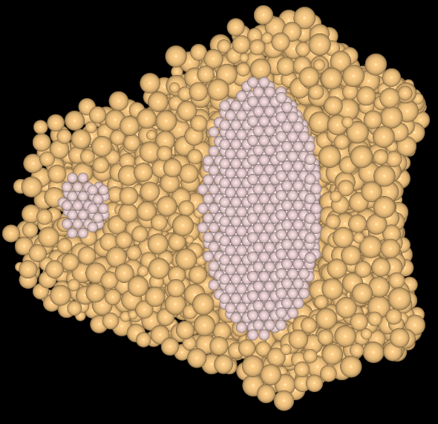

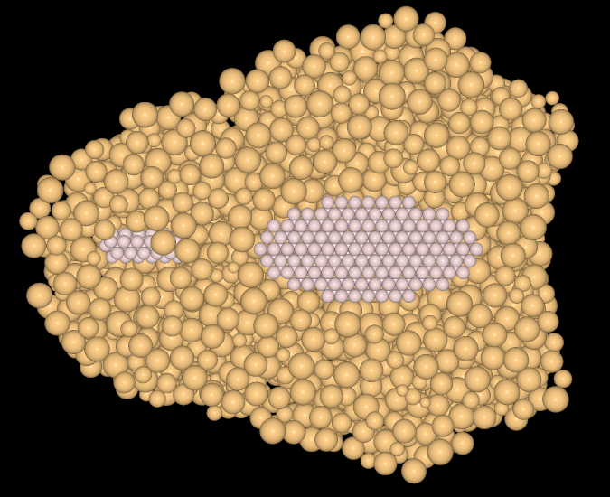
Apophis Close Encounter – Simulation Setup
HCP
HCP
MAP
“UAP”
DeMartini et al., 2019
High-resolution
RPP
RPP
Irregular Shapes (“Aggs”)
Rigid Cores
DeMartini et al., 2025
DeMartini et al., 2025
DeMartini et al., 2025

Slide 9
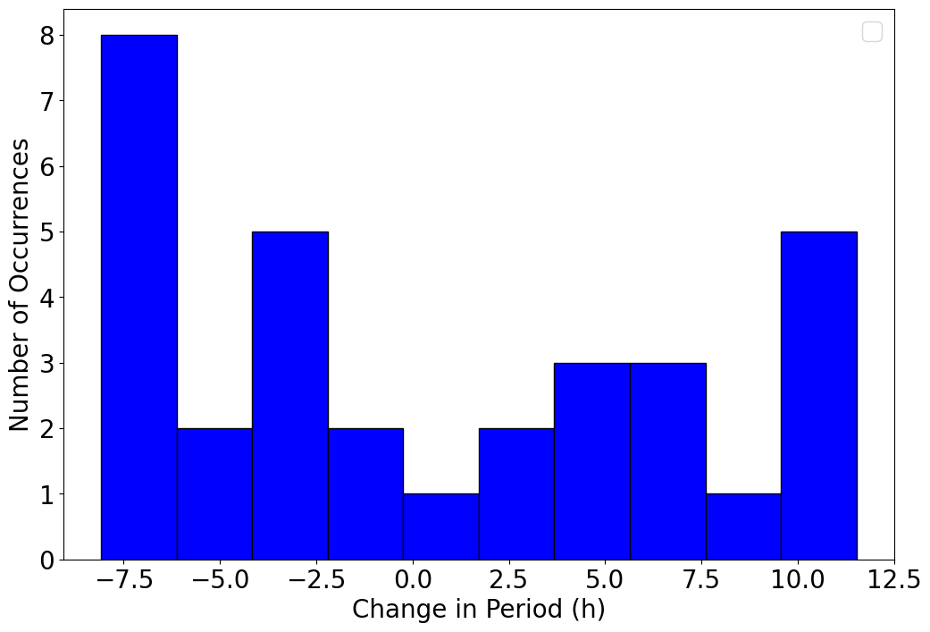
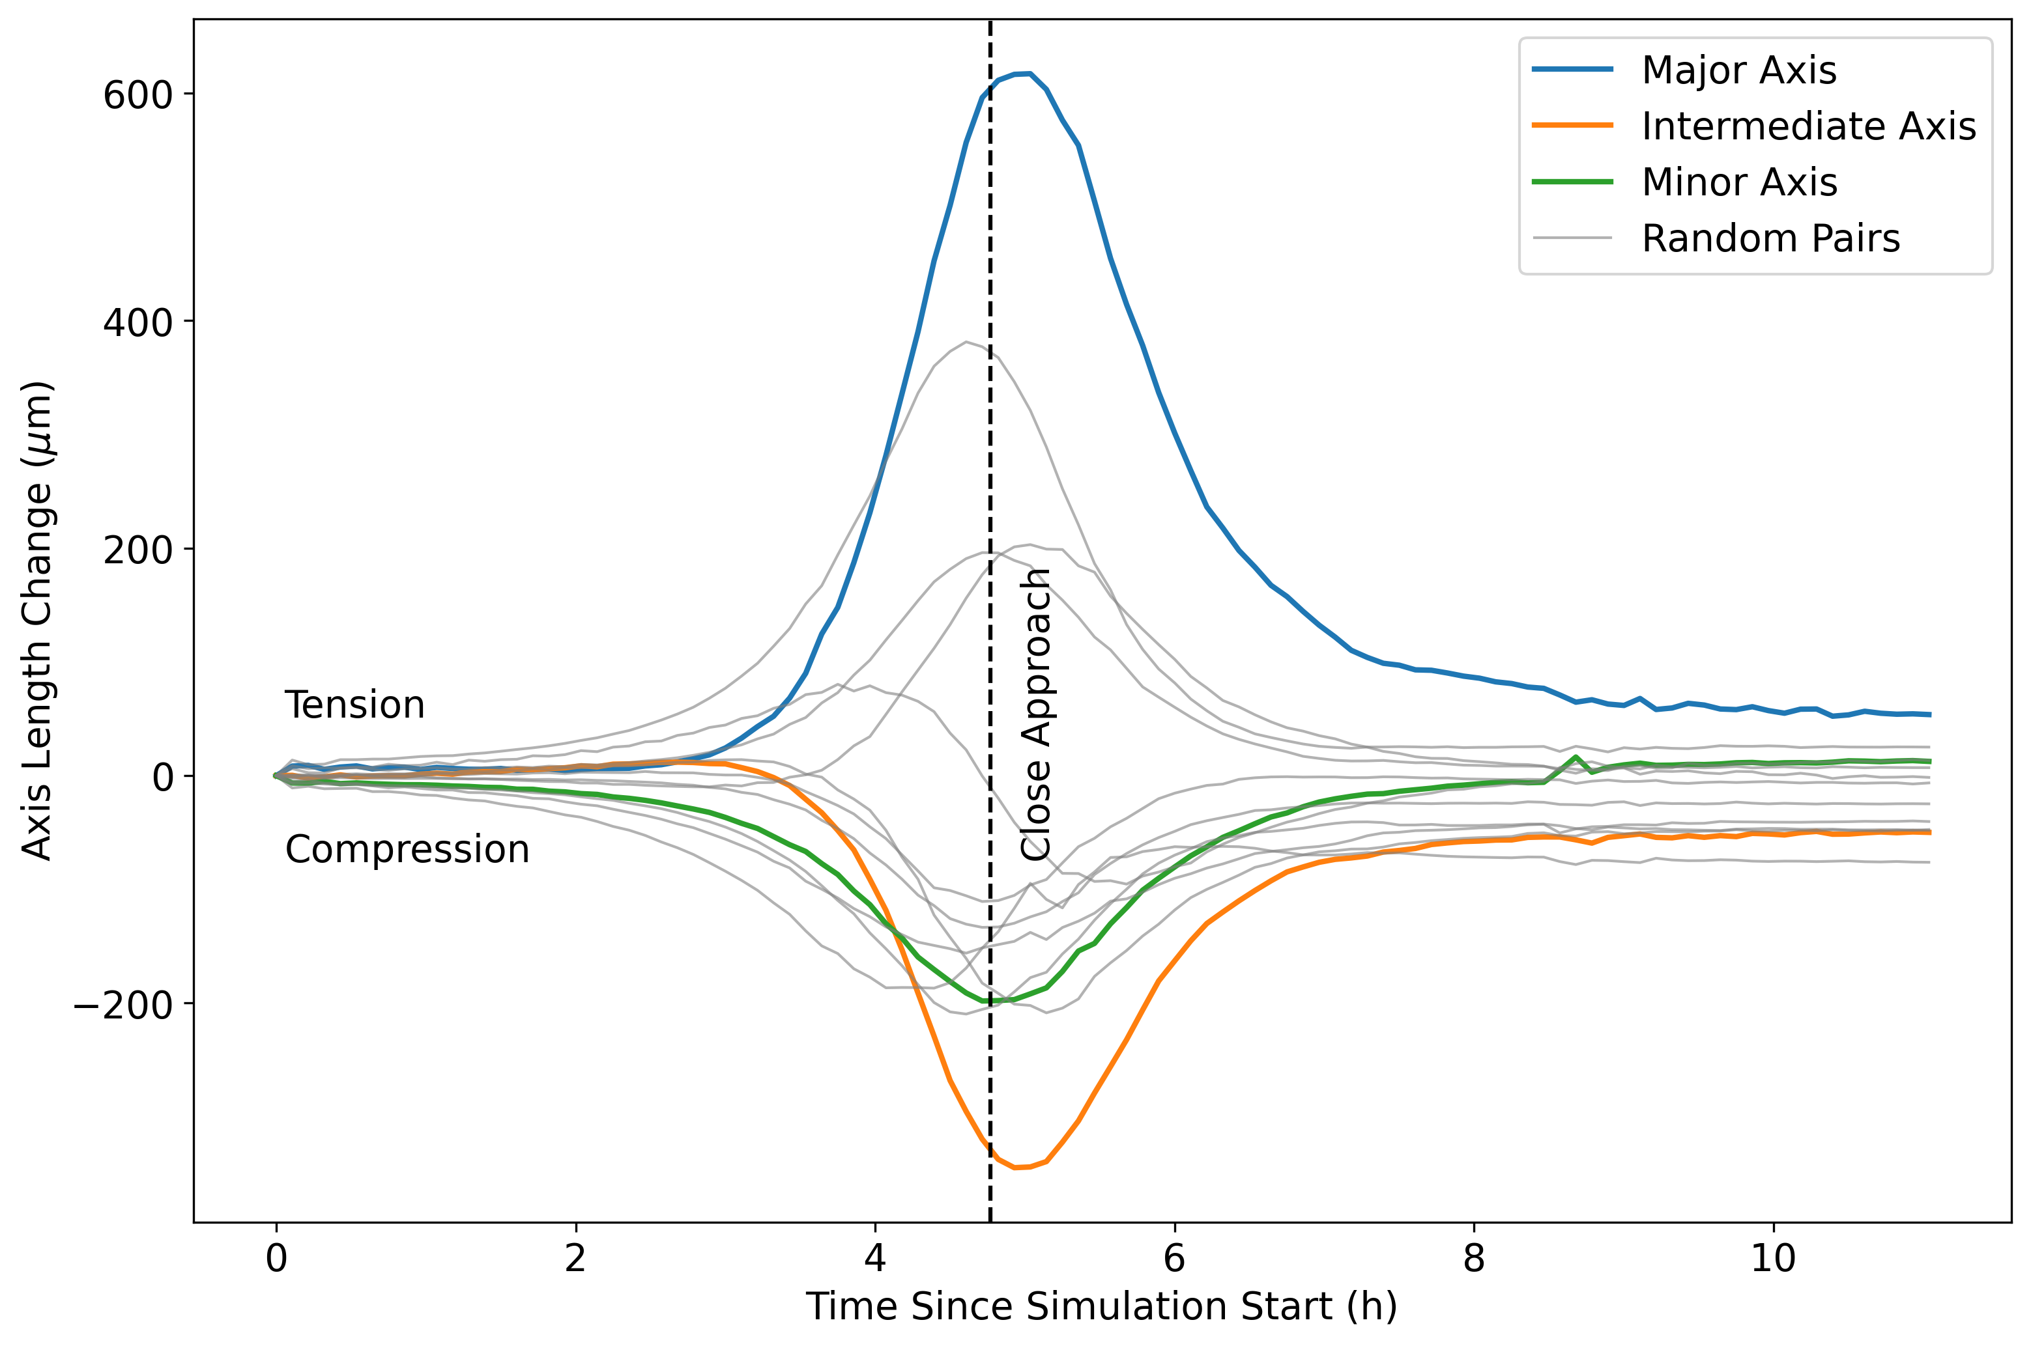
Apophis Close Encounter – Spin Change & Deformation
DeMartini et al., 2025
RPP
Apophis’ rotation rate is likely to change,
but depends on encounter orientation
Apophis will only deform slightly,
and the deformation will likely not be measurable

Slide 10
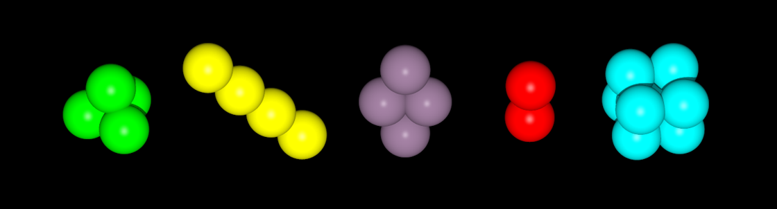
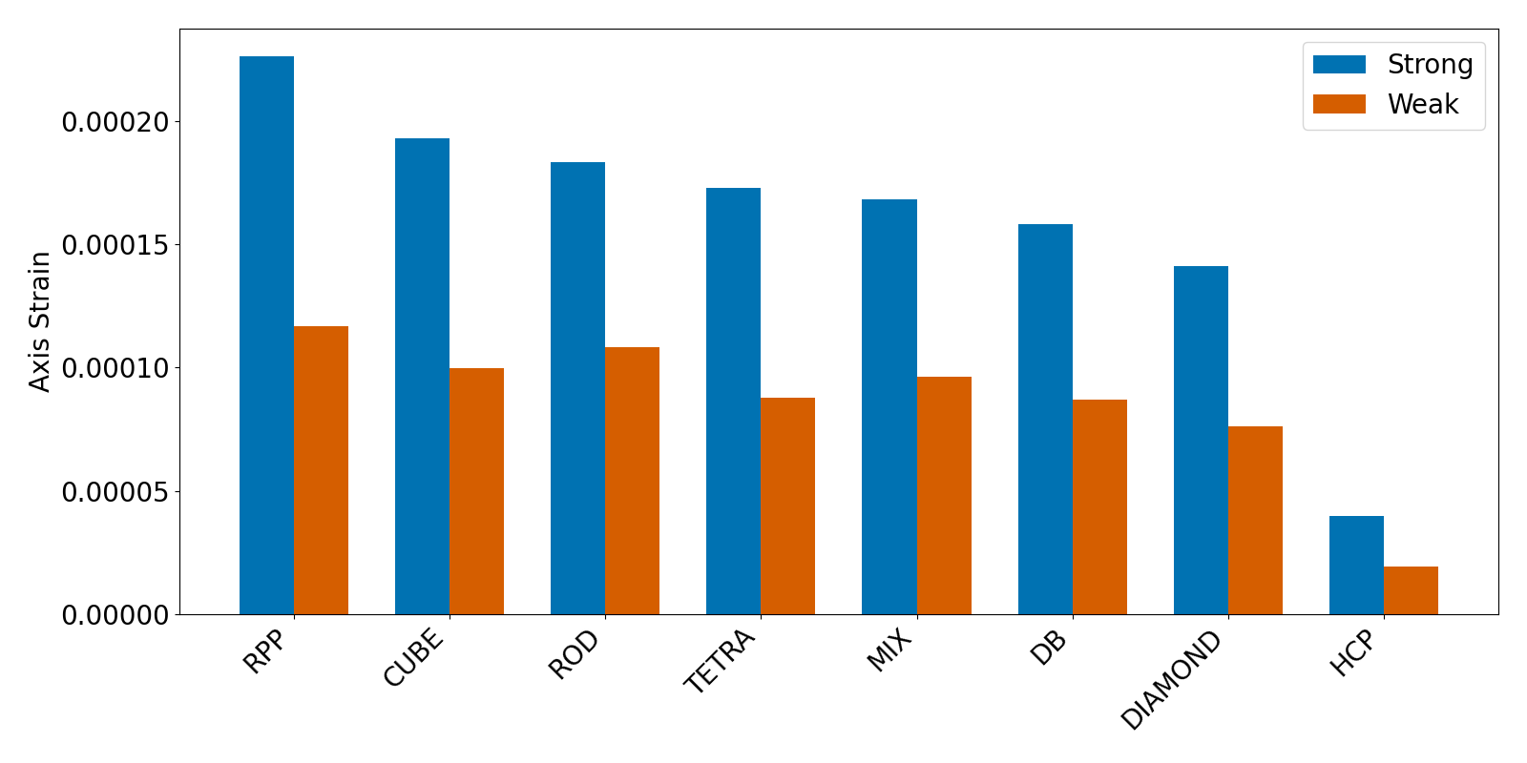
Apophis Close Encounter – Deformation
DeMartini et al., 2025

Slide 11

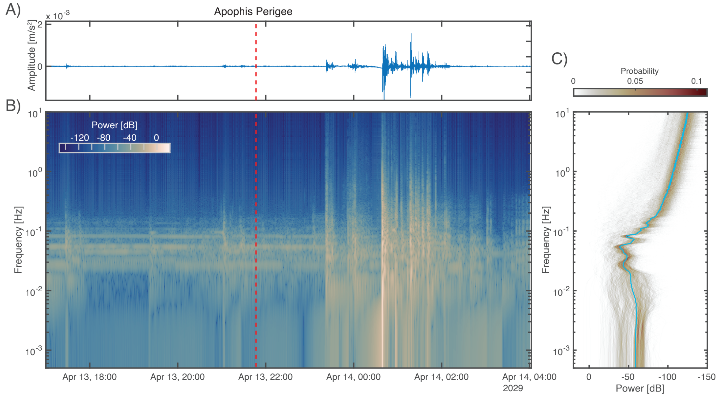
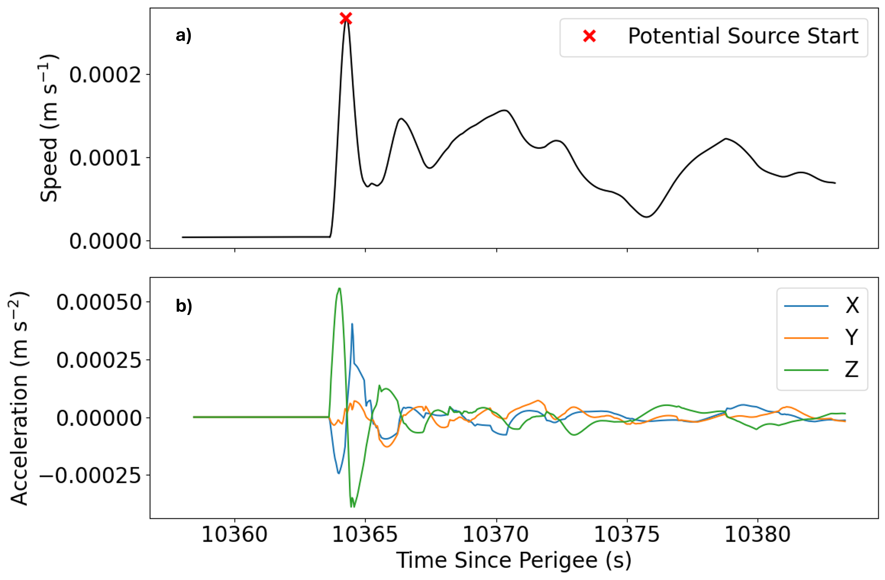
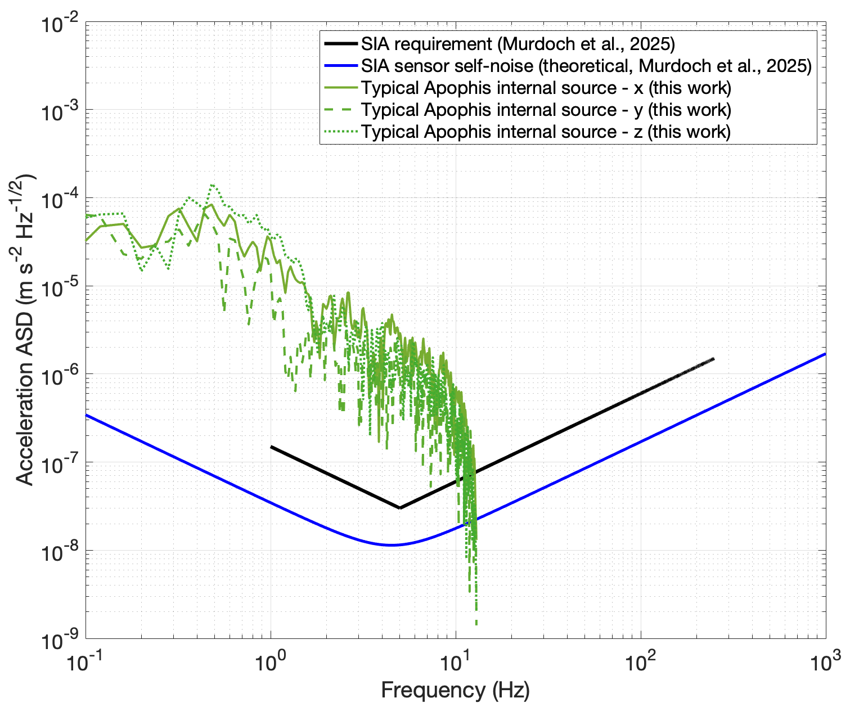
Apophis Encounter – Seismicity
RPP
DeMartini et al., 2025

Slide 12
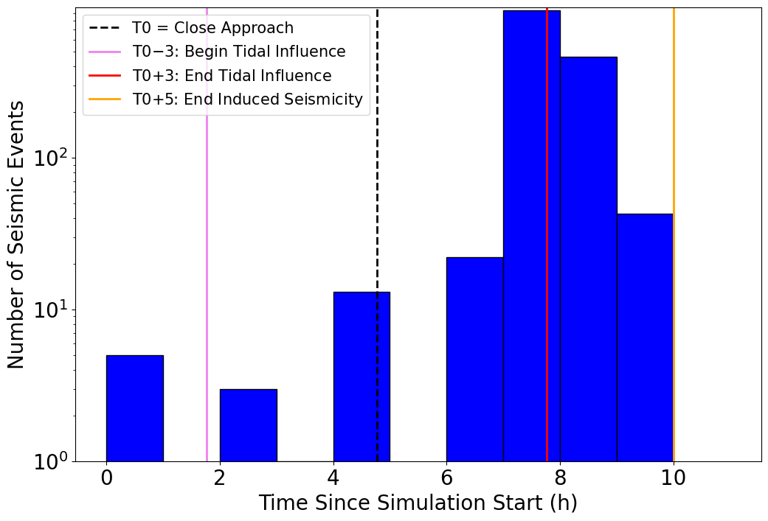
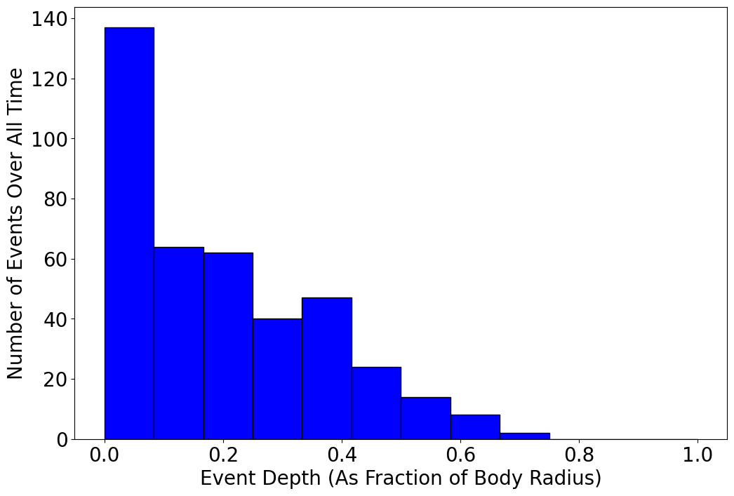
Apophis Close Encounter – Seismicity
RPP
DeMartini et al., 2025
Most seismic events will be shallow and
occur after the tides have weakened
but should be measurable by in-situ instruments!

Slide 13
Conclusions
Irregular shapes increase both shear strength and porosity
Apophis will likely experience a change to its rotation state
A rubble pile Apophis will experience small, elastic tidal deformation
A rubble pile Apophis is likely to experience long- and short-period seismic events
  Short-period: after perigee and at shallow depths
Contact
Joe DeMartini (he/him/his)
Postdoc, University of Helsinki
joseph.demartini@helsinki.fi

Slide 14
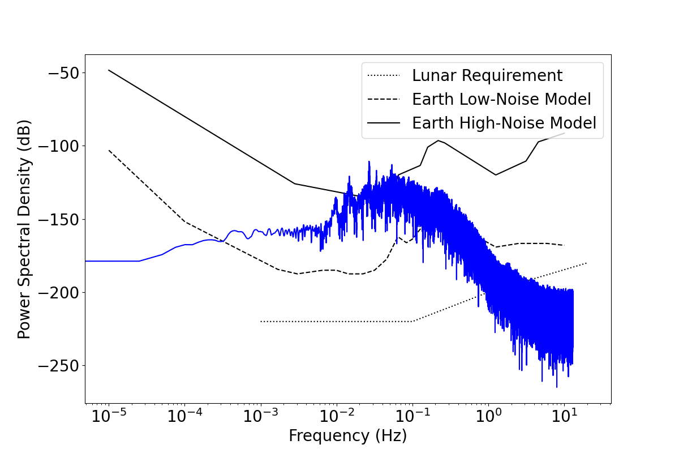
Backups

Slide 15
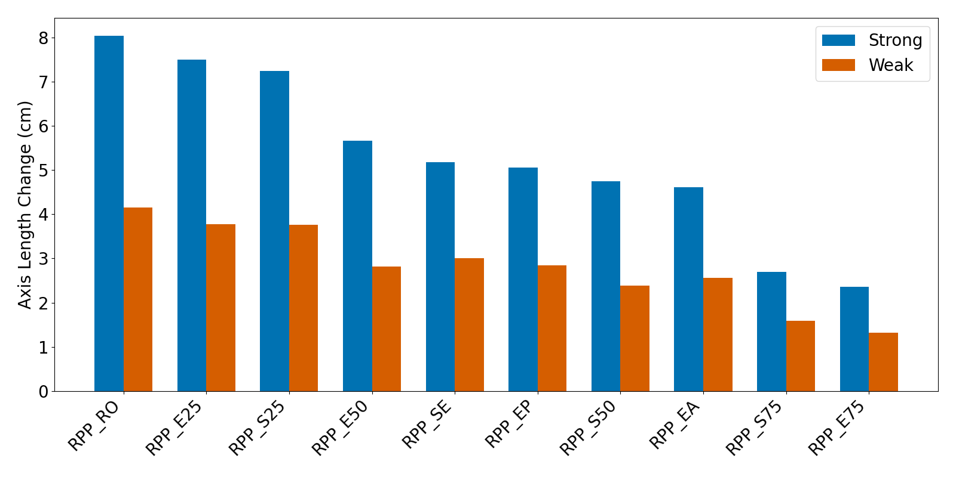
Backups

