Slide 1
Compositional Properties of near-Earth binary asteroid (163693) Atira from Nordic Observatories
Eric MacLennan
Department of Physics, University of Helsinki, Finland
Grigori Fedorets, Zuri Gray, Teemu Willamo, Tuomas Salo, Anne K. Virkki, Mikael Granvik, Karri Muinonen

Slide 2
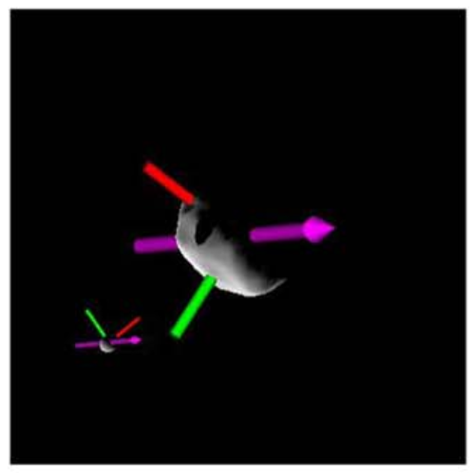
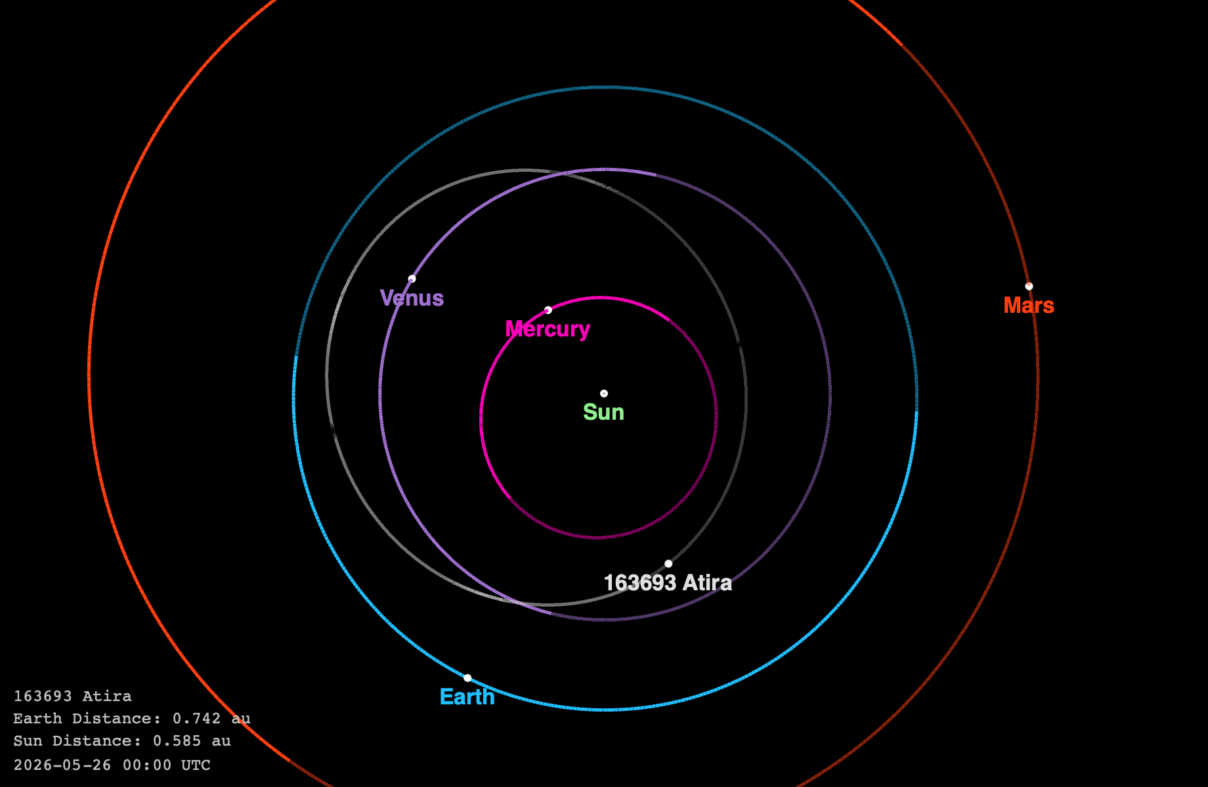
(163693) Atira
binary asteroid that was detected from radar observations
  detailed shape model (top right)
  primary is ~5 km, secondary is ~1 km
orbit is located completely interior to Earth’s
  very difficult to observe from most locations
additional lightcurves are useful for modeling the shape and orbit of the components
the taxonomic class and composition are unknown
Deleon+ 2024

Slide 3
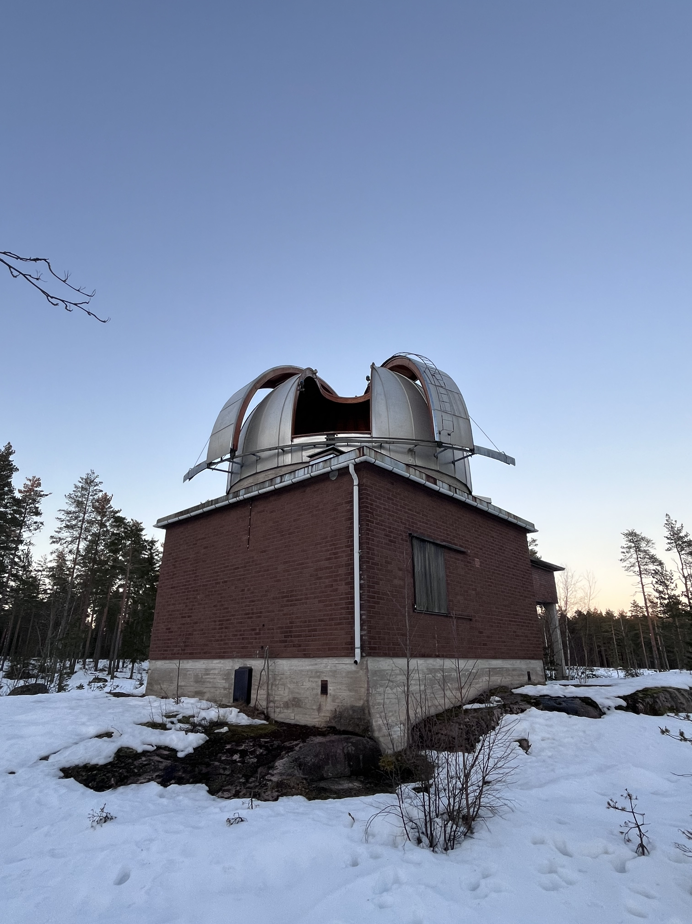
Observation Summary
March 5 – 6, 2024:
  lightcurve photometry @ Metsähovi Observatory
  spectroscopy & polarimetry @ NOT
Dec 2025 – Apr 2026:
  NOT polarimetry (4 more dates)
  NOT spectroscopy (2 more dates)
  TTT color lightcurves (several dates)
Deleon+ 2024

Slide 4
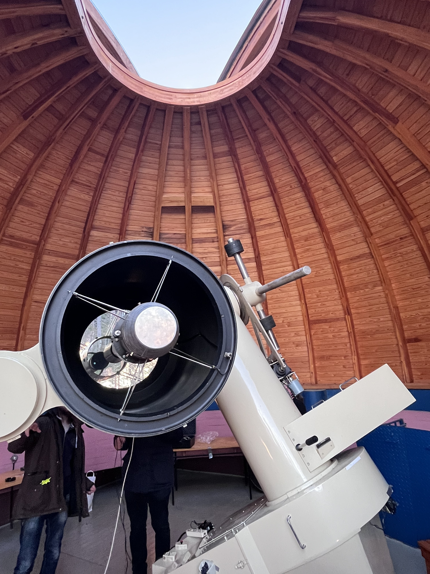
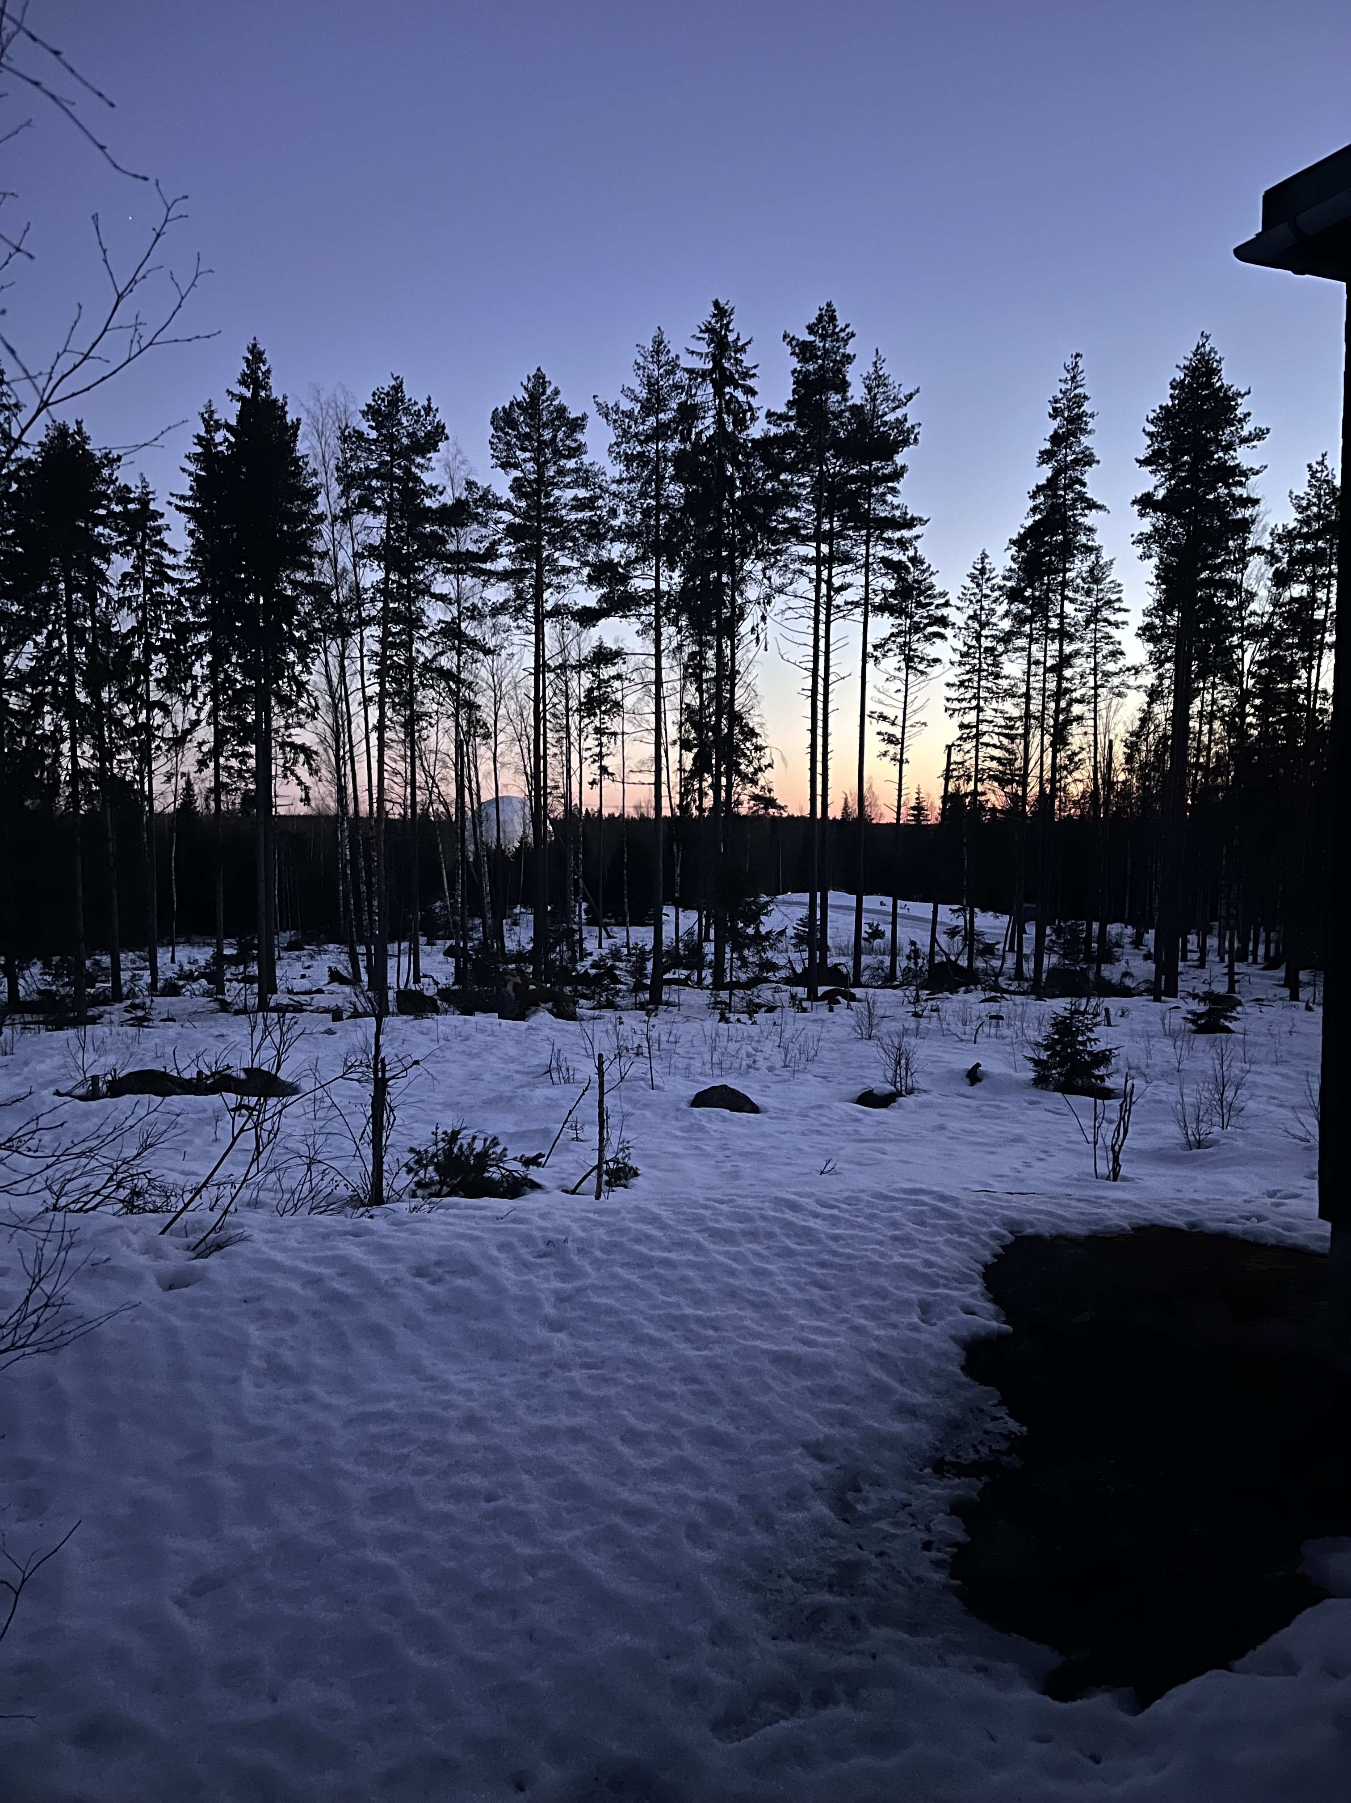
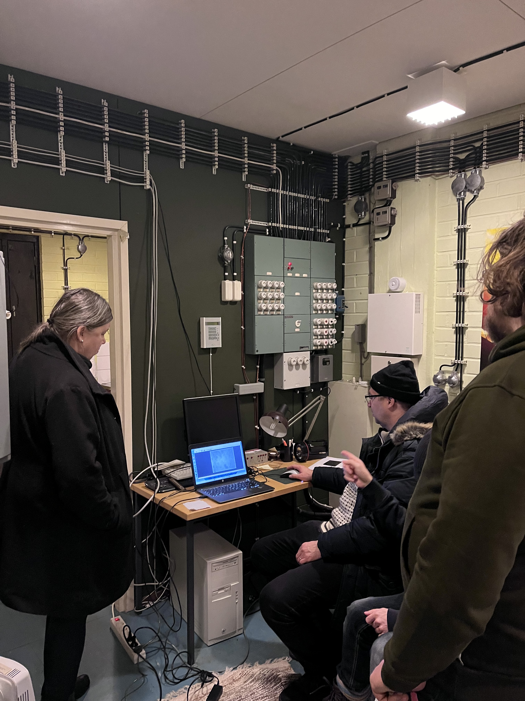
Metsähovi: March 5-6, 2024

Slide 5
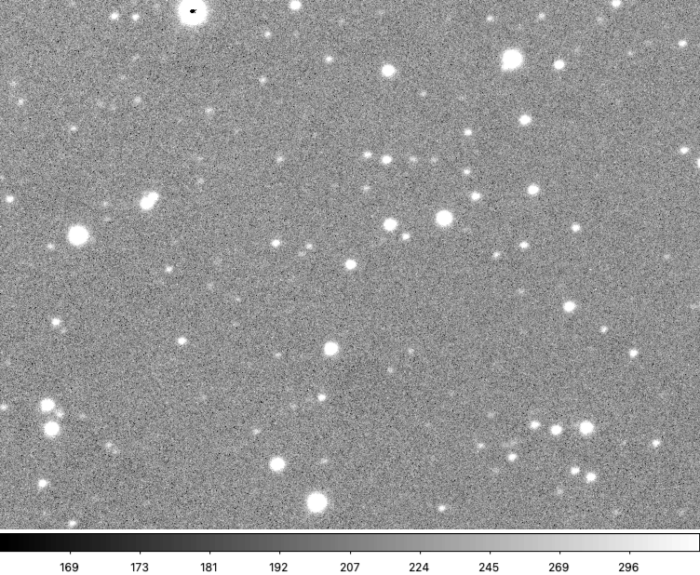
Metsähovi: March 5-6, 2024

Slide 6
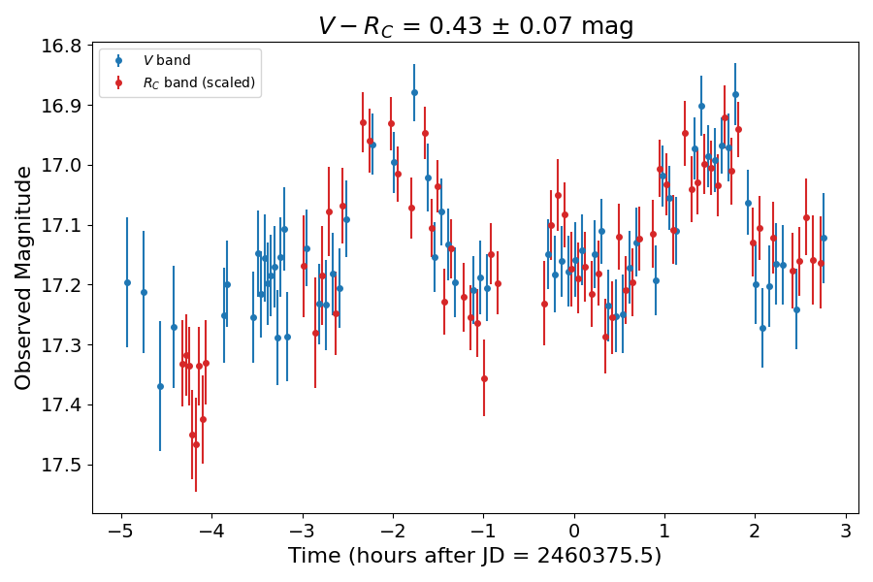
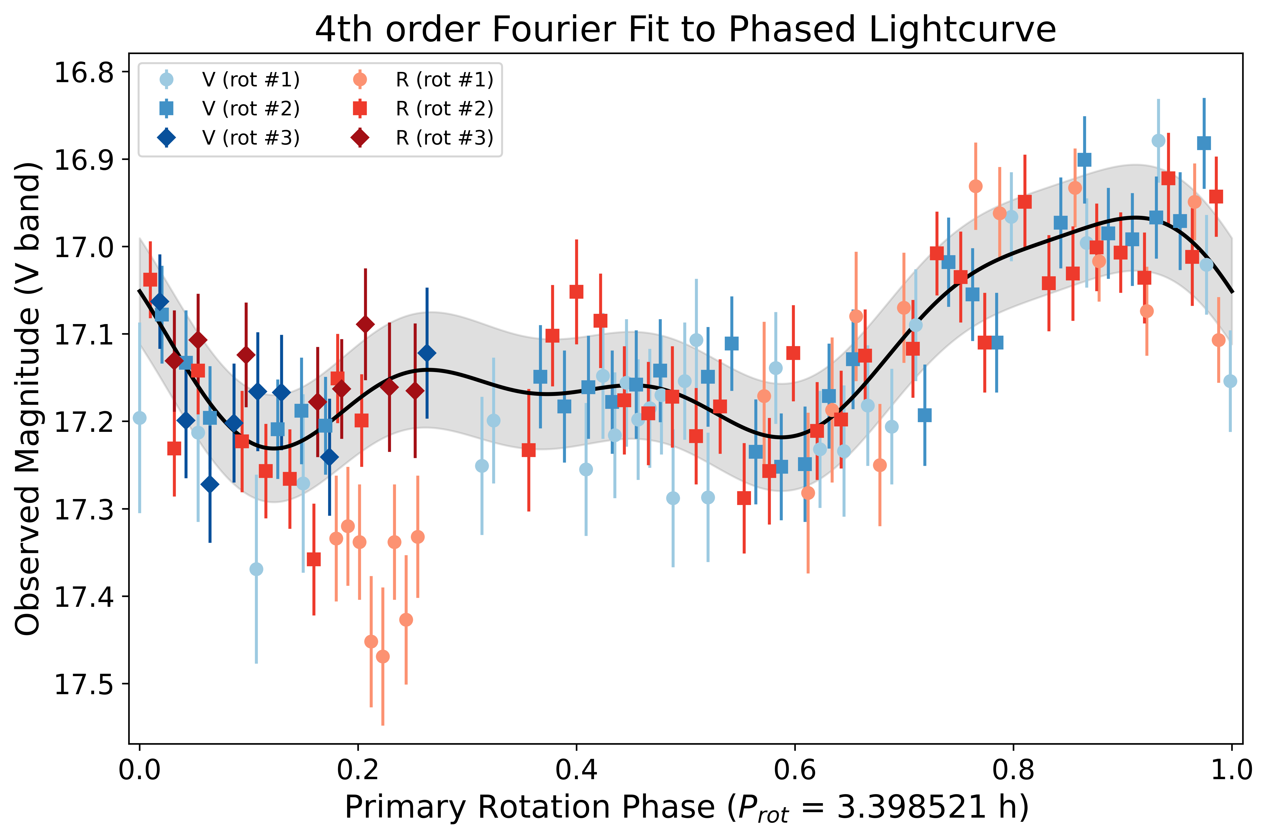
Metsähovi: March 5-6, 2024

Slide 7
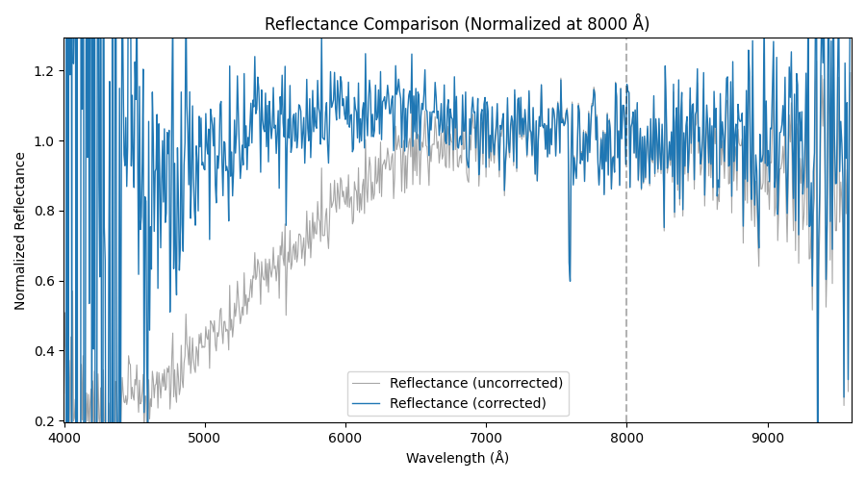
NOT: Spectrum
spectroscopic slit was ​mis-aligned from the parallactic angle
flux is lost at the bluer wavelengths of the spectrum
a dispersion model was used to recover the lost flux

Slide 8
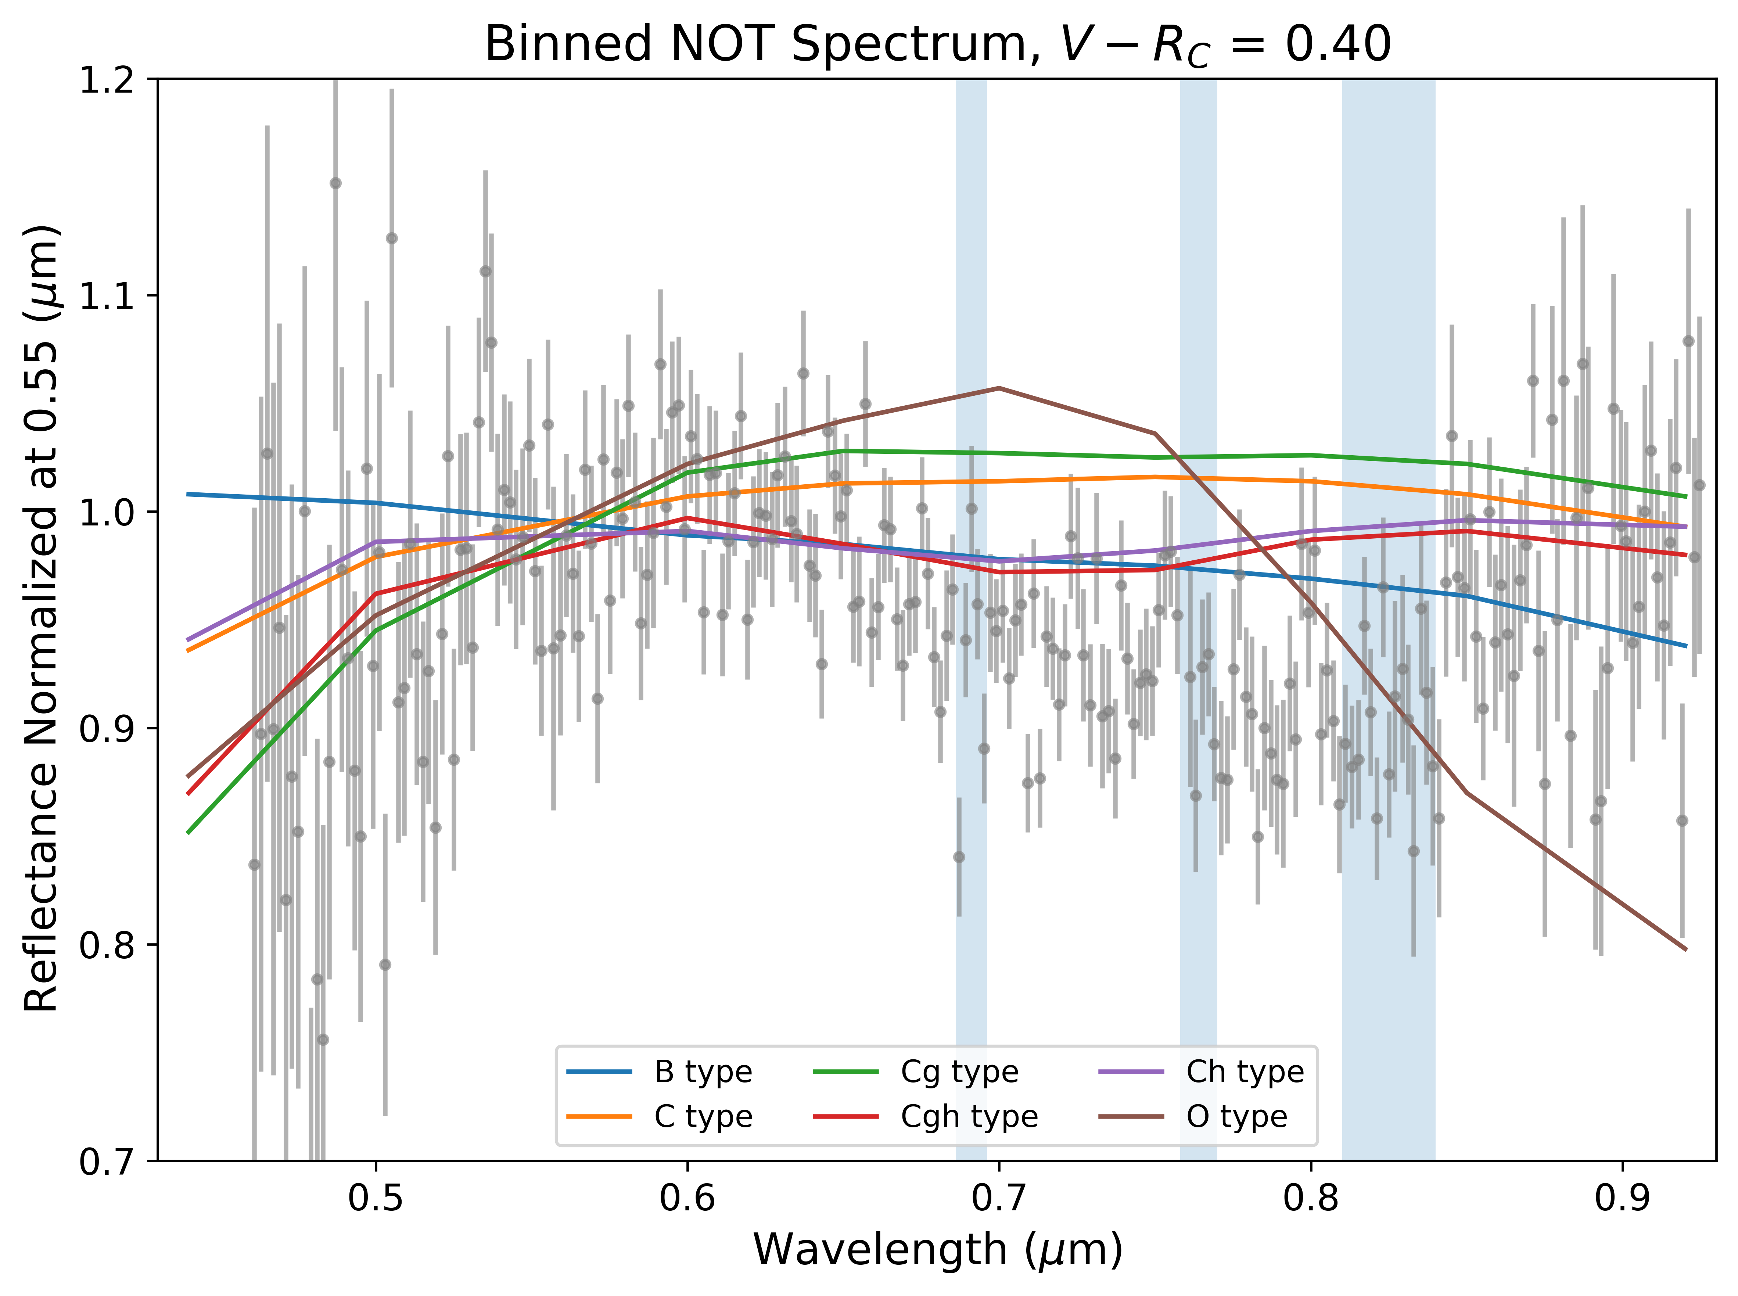
Spectral Classification
reflectance spectrum is most similar to Cgh type (SMASS)
absorption feature indicates hydrated phyllosilicates

Slide 9
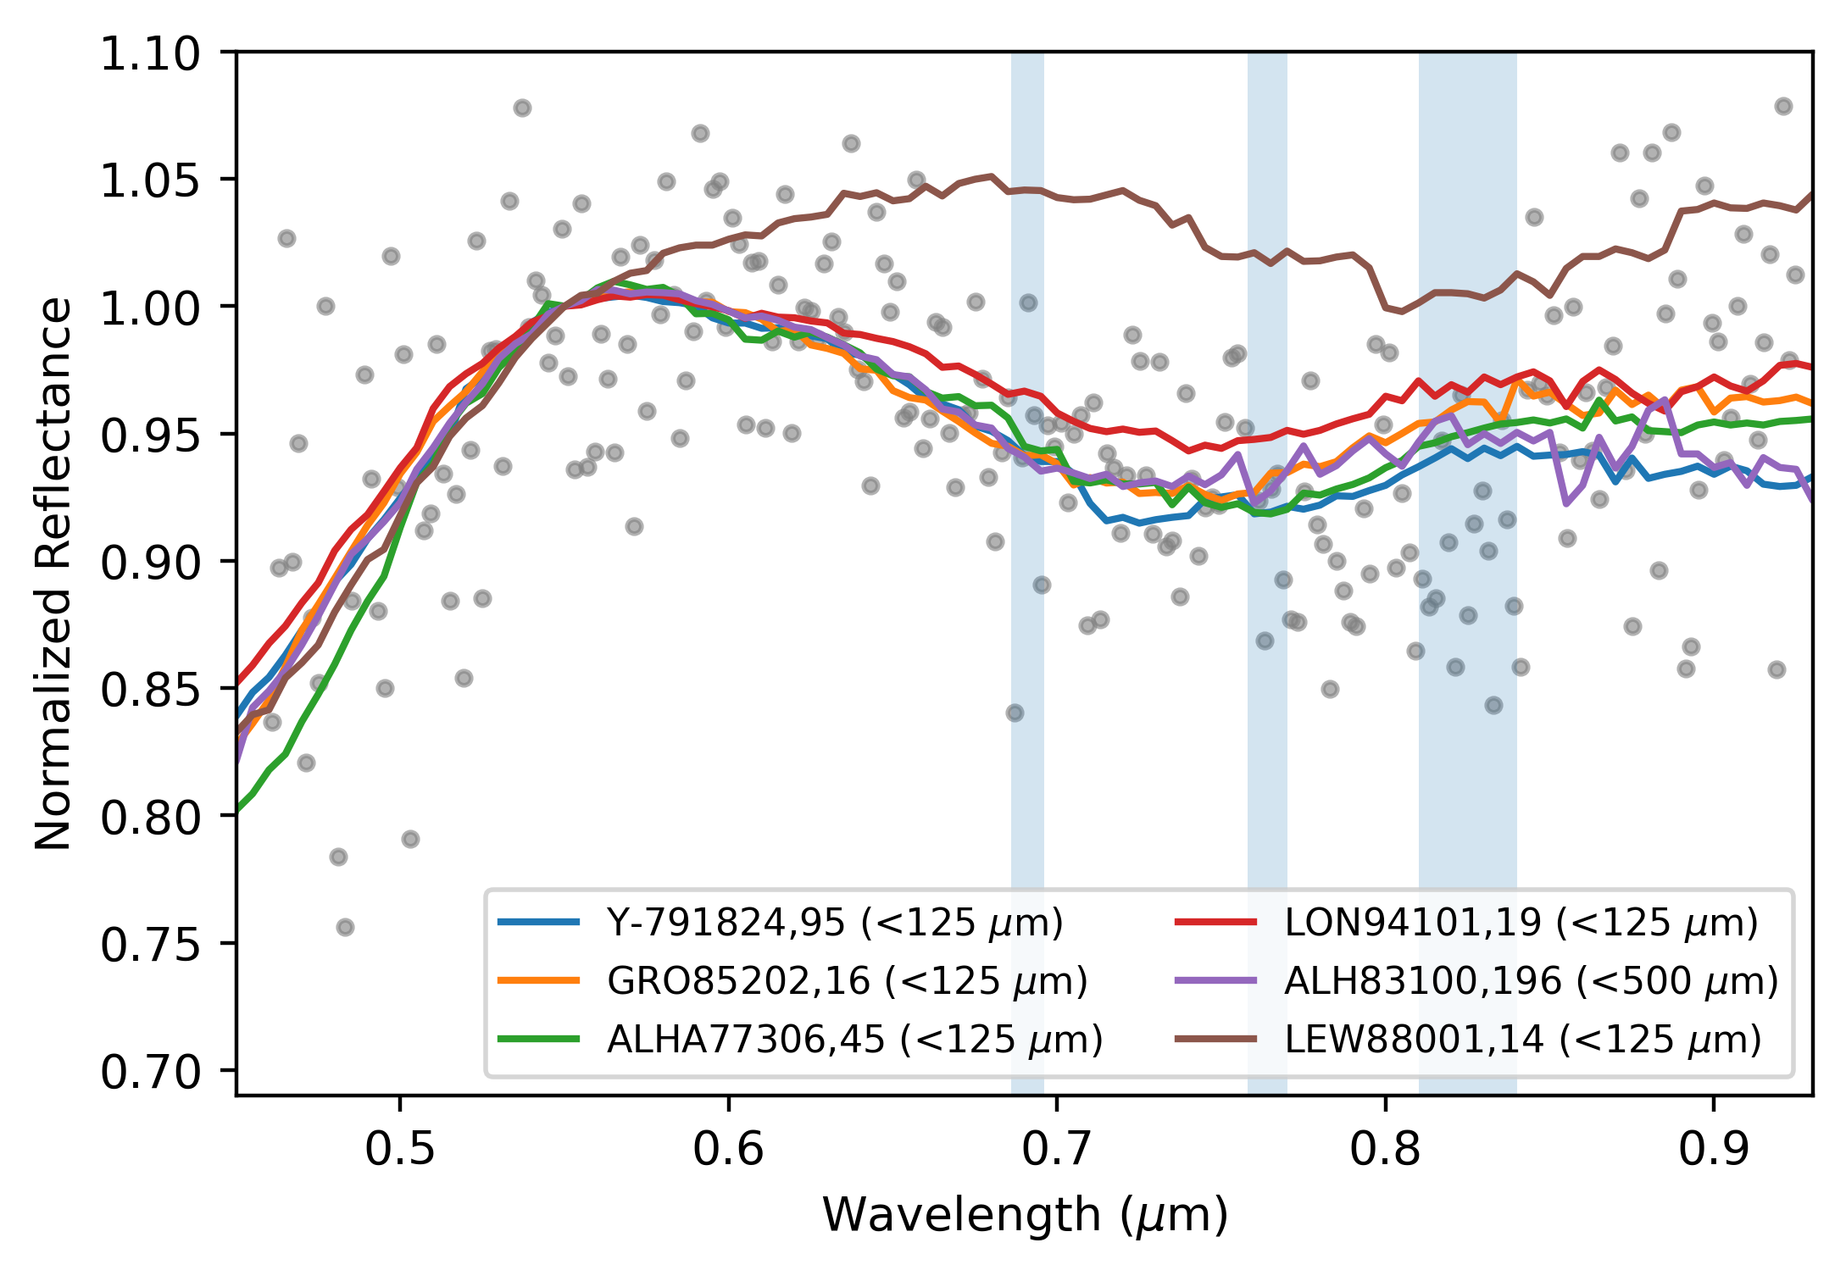
Meteorite Comparison
near-perfect match to CM carbonaceous chondrites
Strong feature relative to other Ch/Cgh asteroids
  7% absorption depth
  others have 2-3%

Slide 10
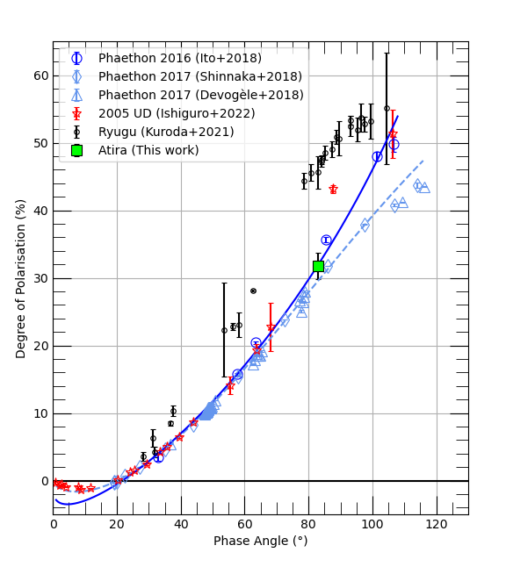
NOT: Polarimetry
high degree of polarization suggests a low albedo (< 10%)
Ryugu: Cb-type
Phaethon: B-type
2005 UD: C-type

Slide 11
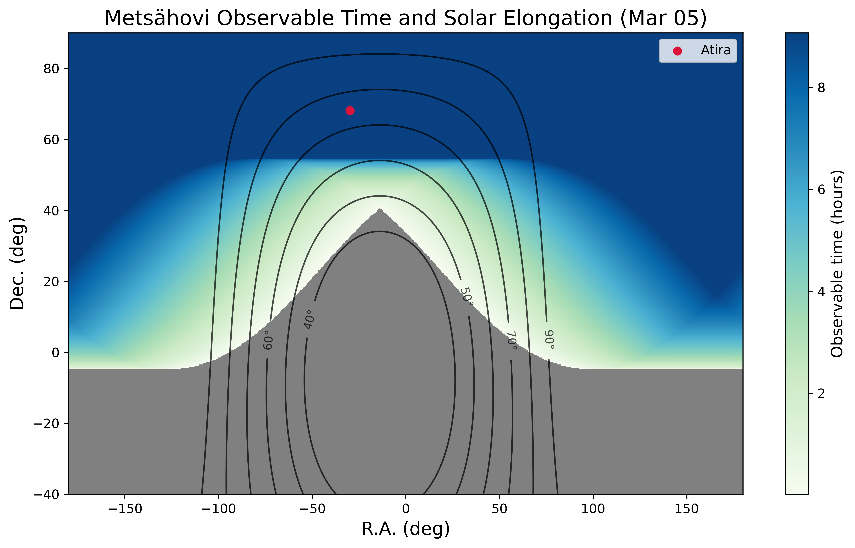
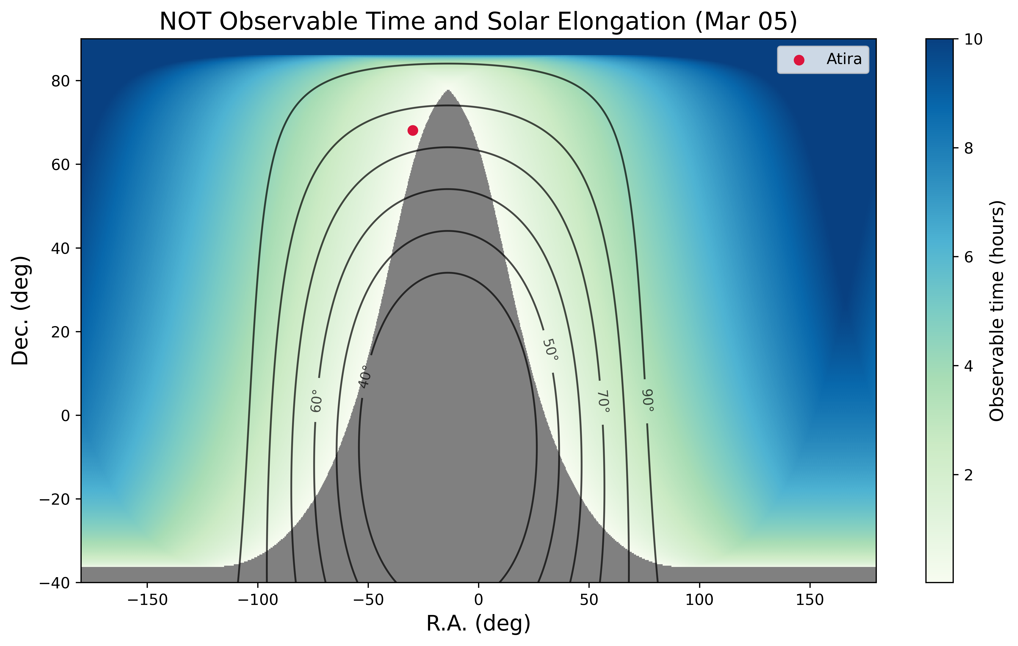
Observing Inner-Earth Objects

Slide 12
2025 – 2026 Campaign
Gather more lightcurves to refine the radar shape/spin model, including the size and orbit of the secondary
  Two-meter Twin Telescope, Tenerife
Obtain higher-quality spectra to confirm spectral classification
  January follow-up showed C/Cg-type classification (no absorption)
  April 01 spectra showed both Cg-type and Cgh-type behavior over ~20min
More polarimetry to characterize the phase-polarization behavior
  Difficult to consistently fit a phase-polarization curve to 5 total points

Slide 13
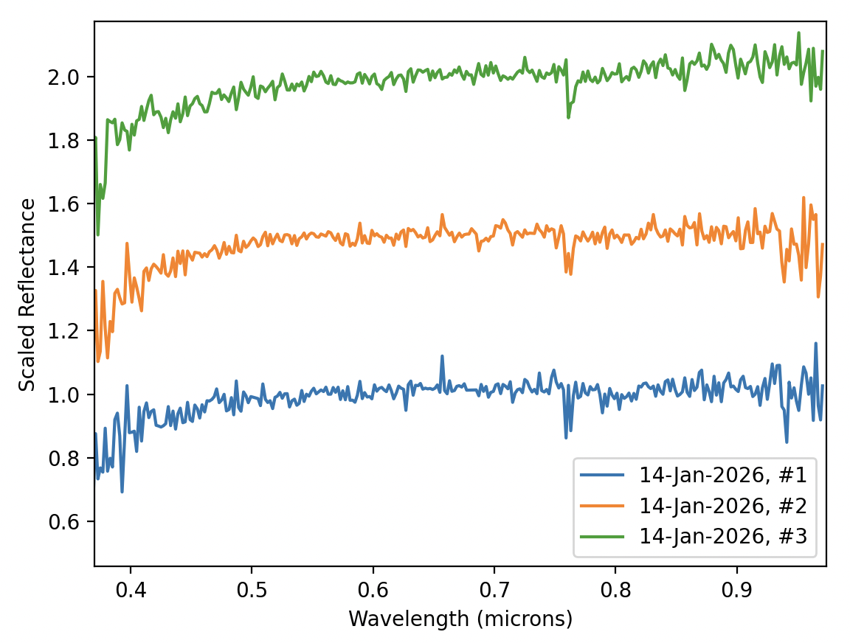
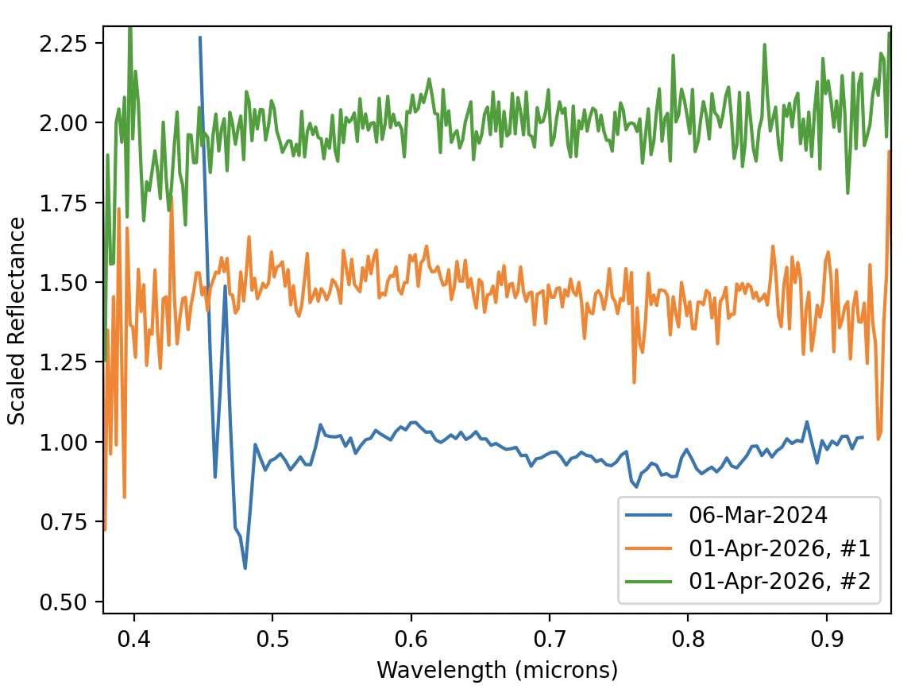
2025 – 2026 Campaign: Spectra
near-equatorial viewing aspect
high latitutde viewing aspect

Slide 14
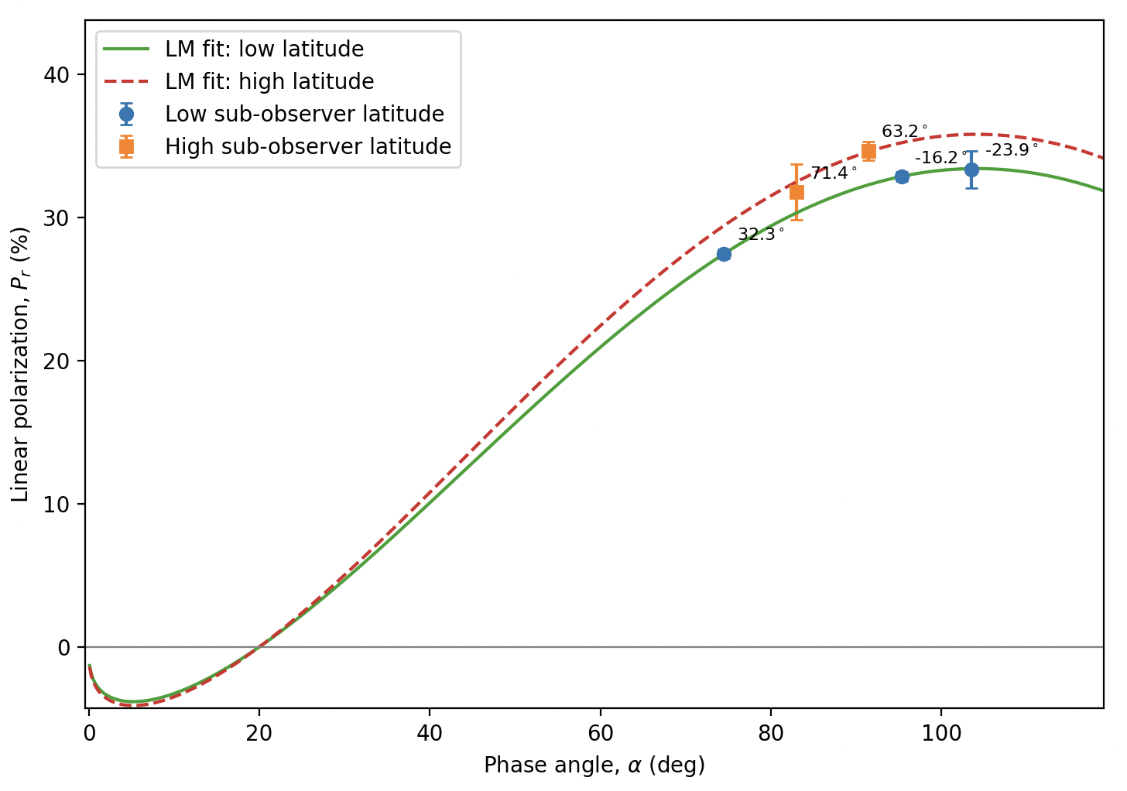
2025 – 2026 Campaign: Polarimetry

Slide 15
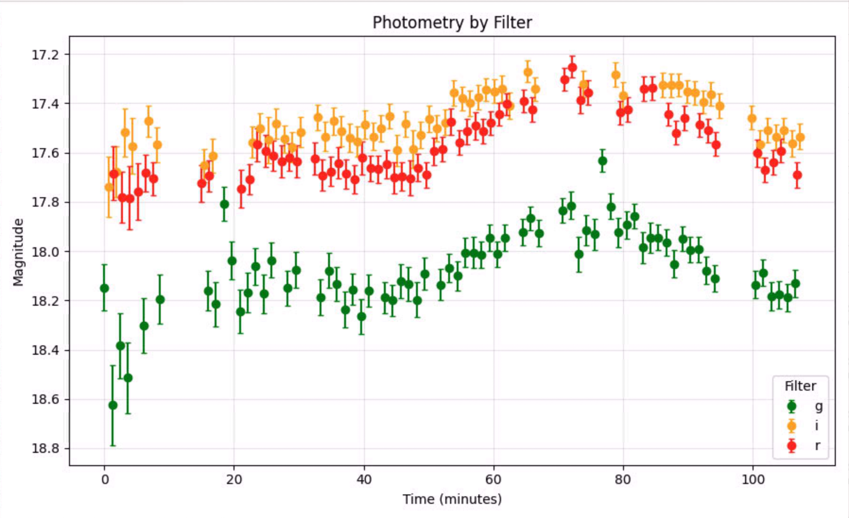
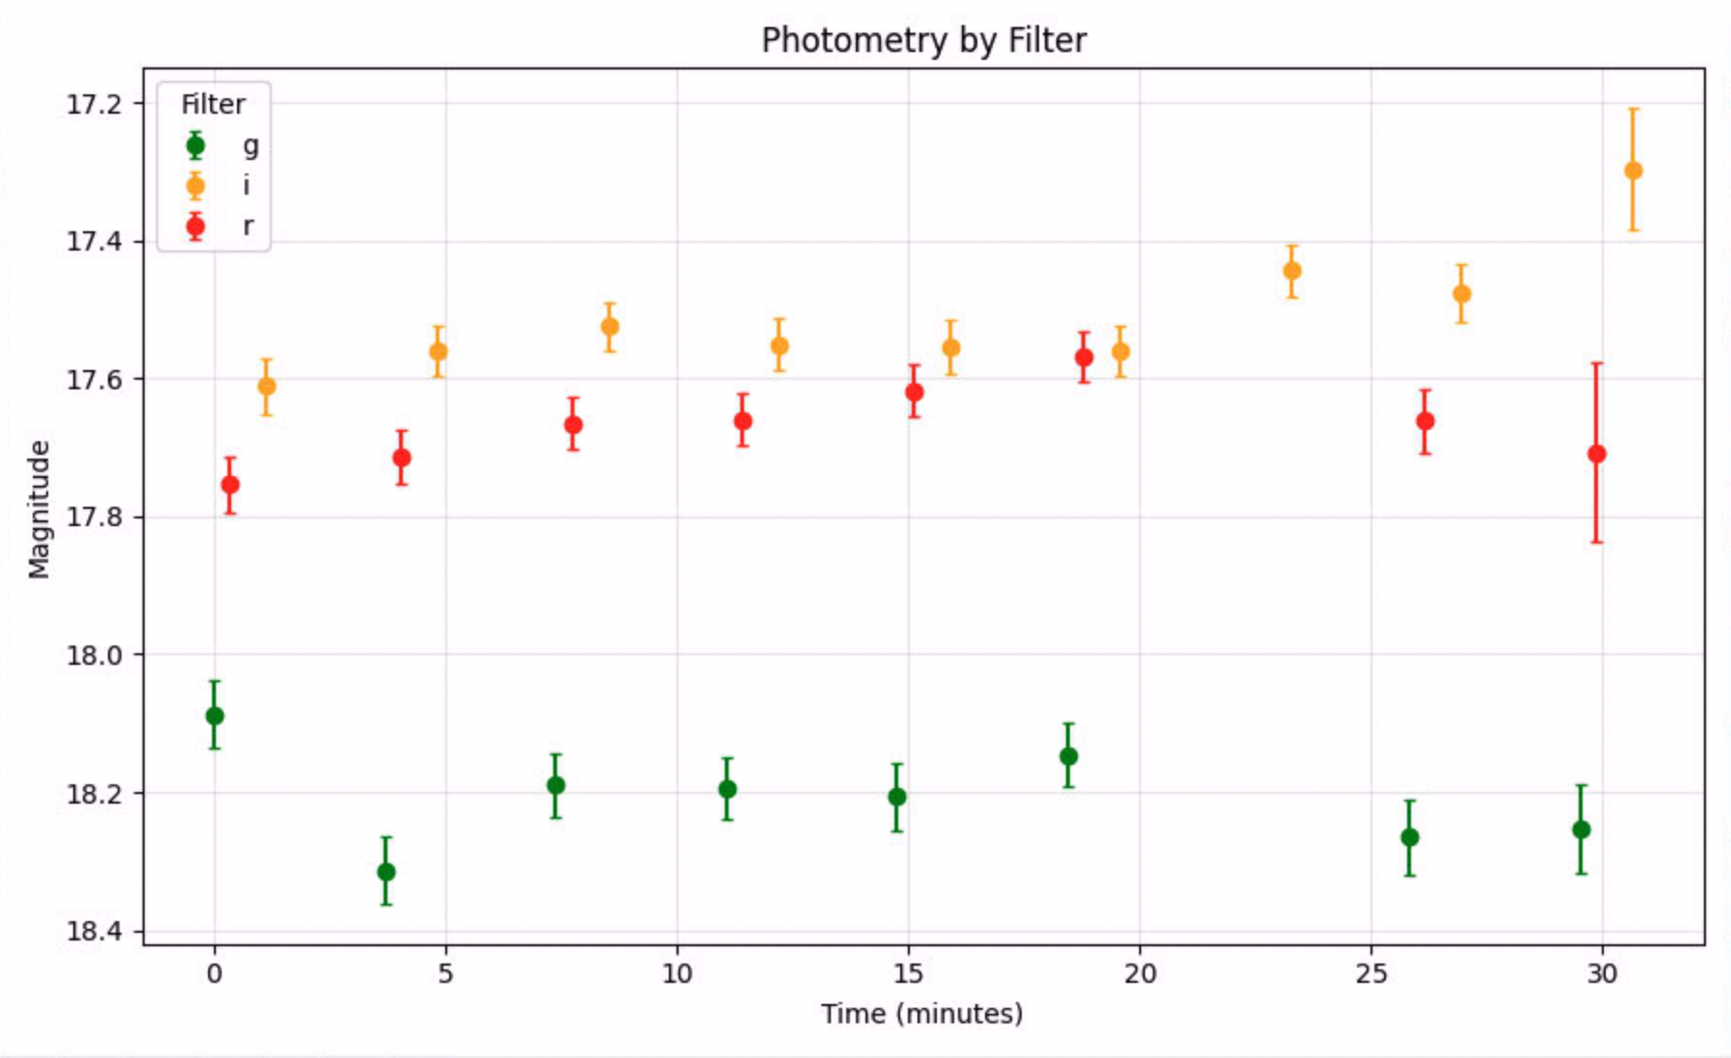
2025 – 2026 Campaign: Lightcurves

Slide 16
Follow-up: Modeling Heterogeneity
Use the radar-based shape model to correlate rotational phase with changes in spectra and colors
Consider heterogeneity on the primary
Possibility of distinguishing secondary surface properties?

