Slide 1
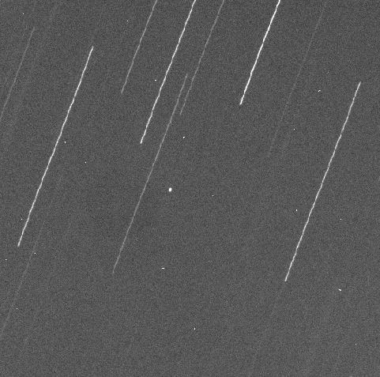
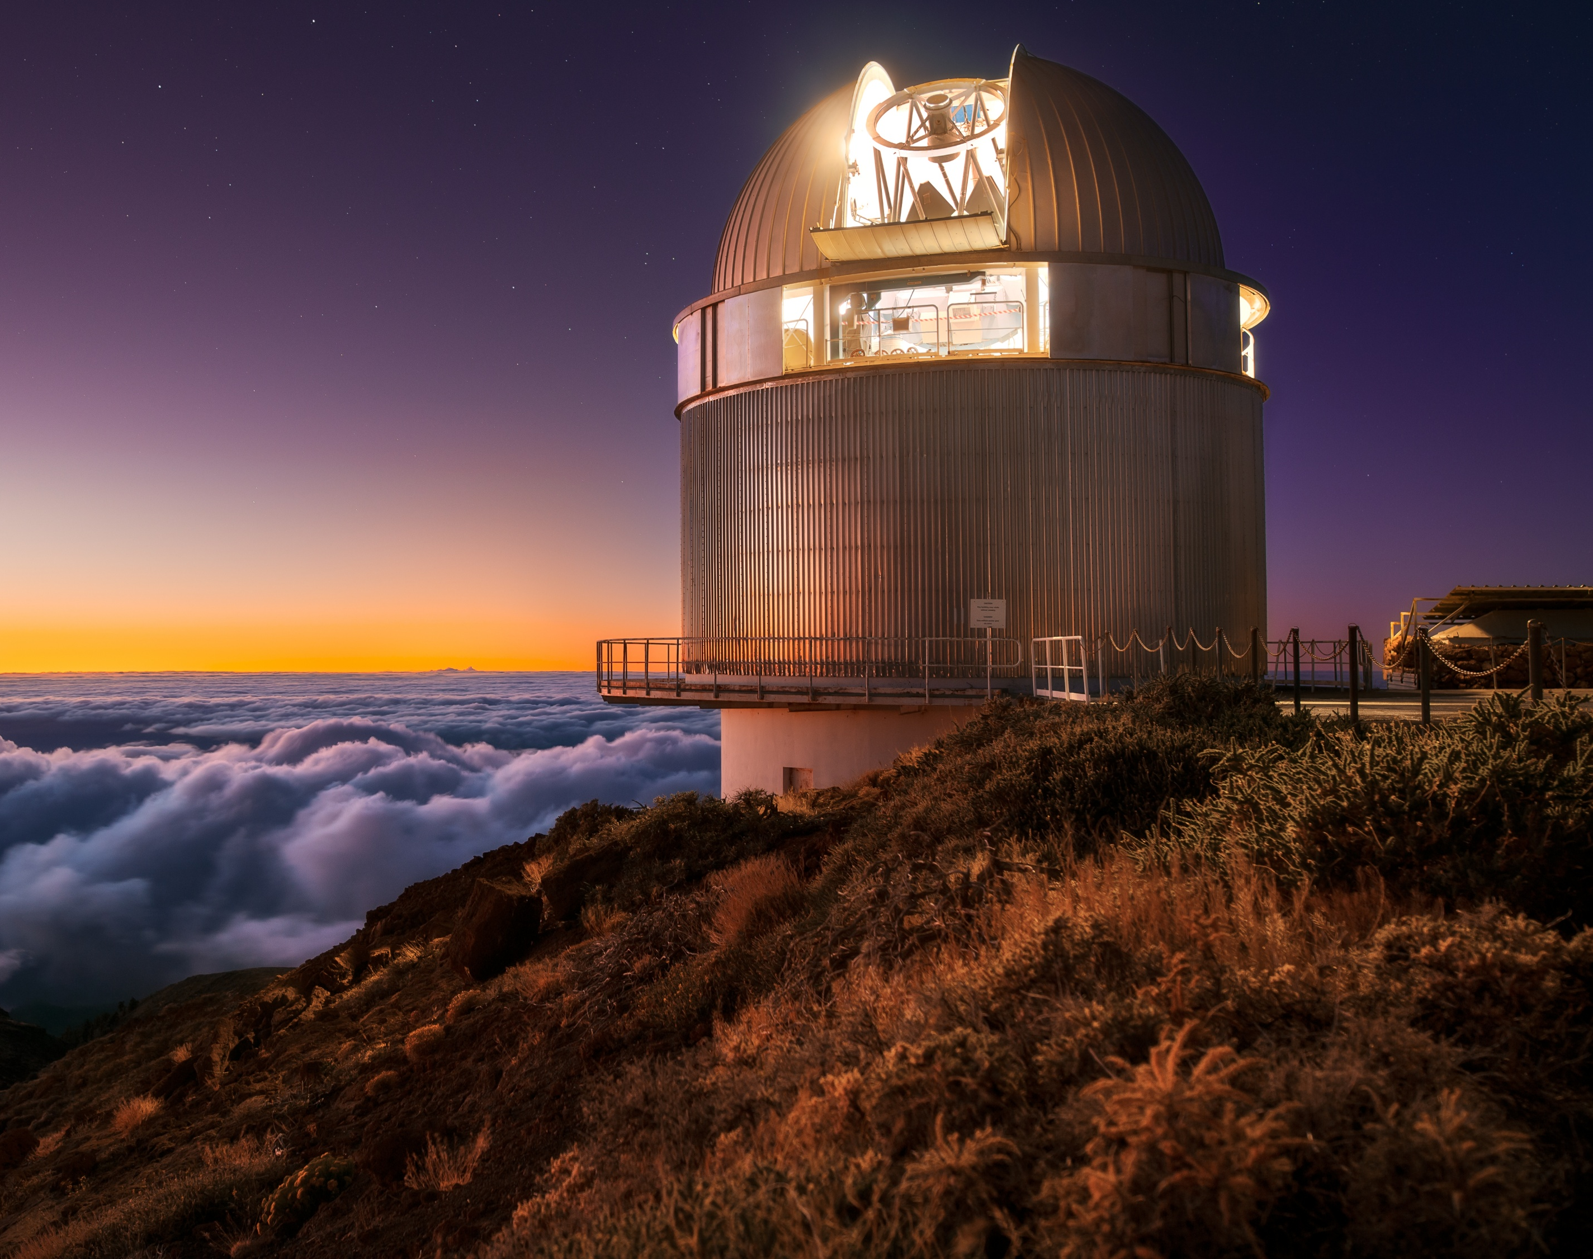


Observing the building blocks of the Solar System with the Nordic Optical Telescope
Grigori Fedorets^{1,2}, Amanda Djupvik³,
Otto Solin¹ & Mikael Granvik^{2,4}
¹Finnish Centre for Astronomy with ESO, University of Turku, Finland
²Department of Physics, University of Helsinki, Finland
³Nordic Optical Telescope, La Palma, Spain
⁴Asteroid Engineering Laboratory, Luleå University of Technology, Kiruna, Sweden

Slide 2
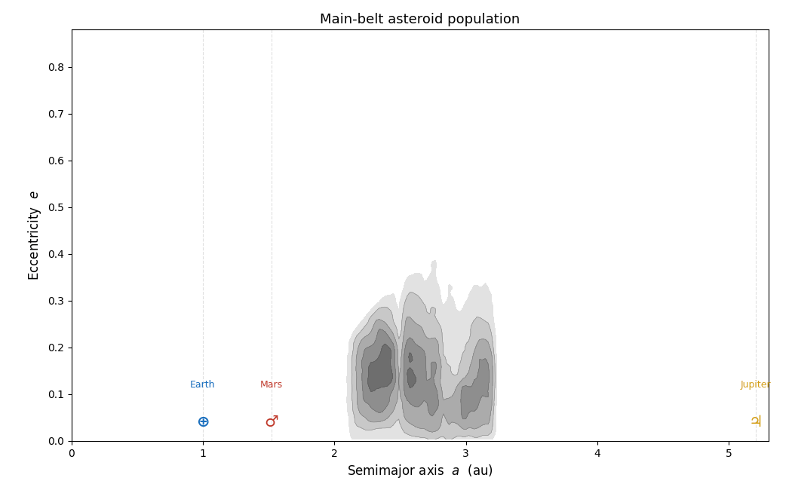

Slide 3
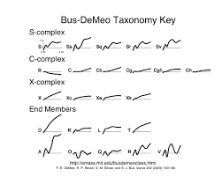
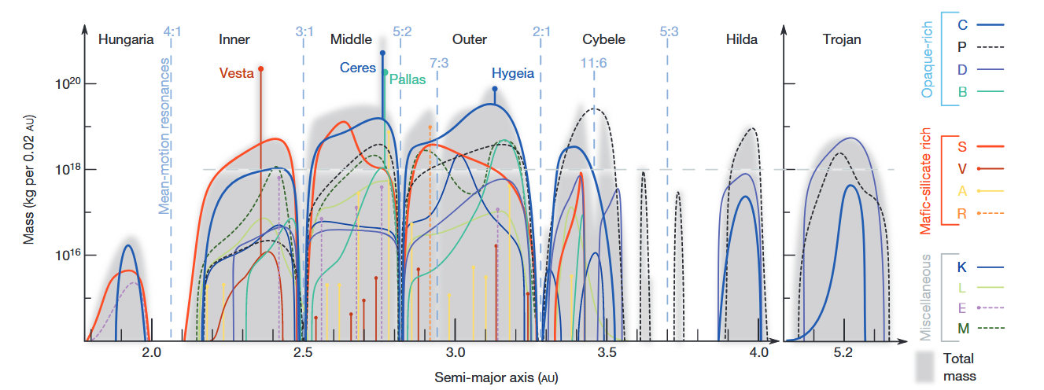
Asteroids are different and are spread unevenly
DeMeo & Carry (2014)

Slide 4
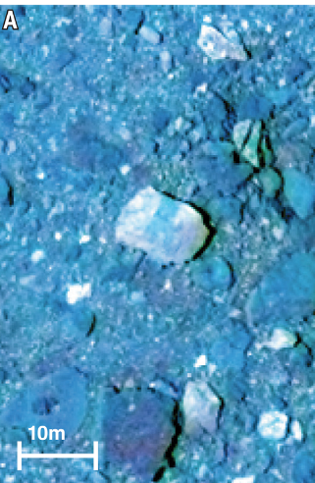
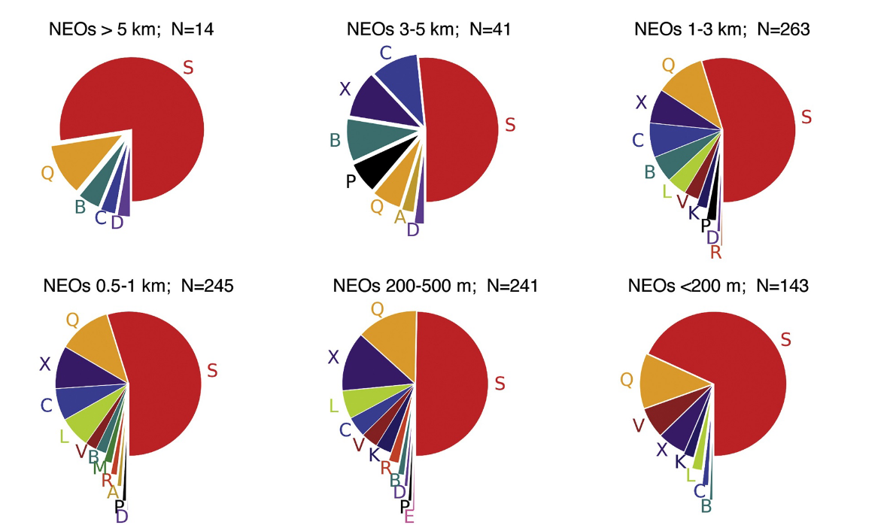
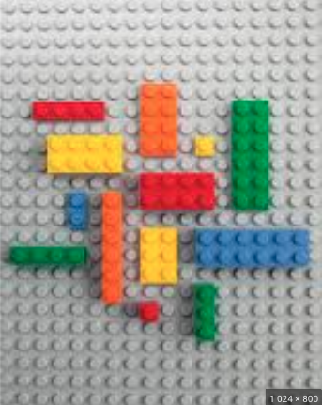
Small asteroids: population-level studies
Binzel et al. (2019)
DellaGiustina et al. (2020)

Slide 5
Scientific questions
Main: what is the composition of very small
near-Earth asteroids?
Why is this interesting?
The missing mantle problem
  Testing the ”battered to bits” hypothesis
  Are there more A- and V-types amongst the small asteroids because they are easier to break?
Can the population of small asteroids be traced to individual events?
  Brož et al. (2024) and Marssett et al. (2024) hypothesise that the majority of very small asteroids originate from three young families
  In this case, should be dominated by S-class objects.

Slide 6
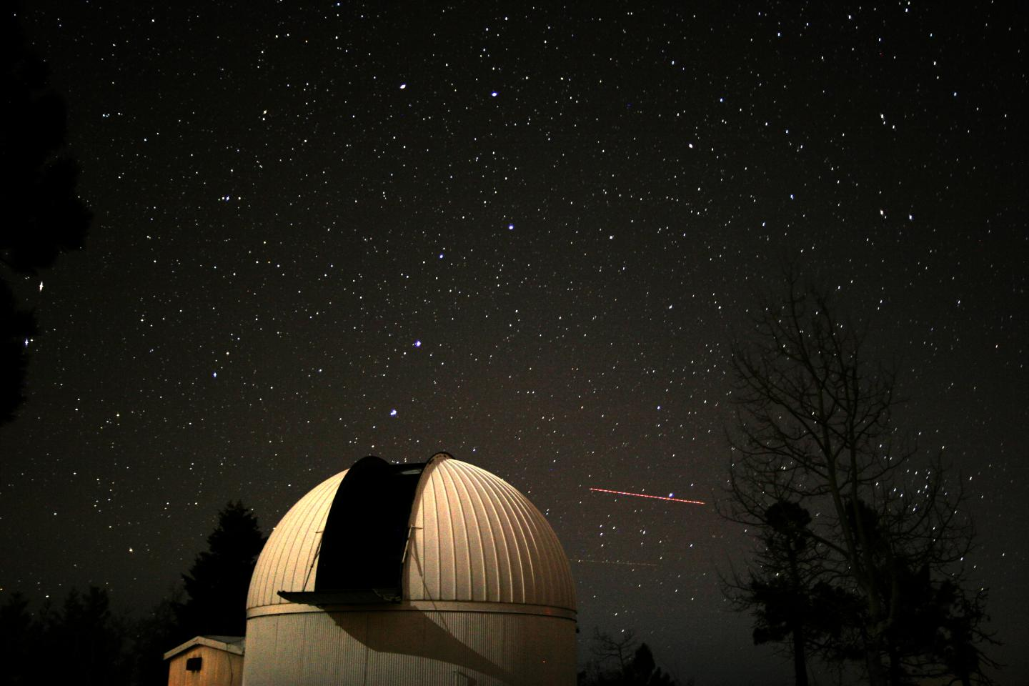

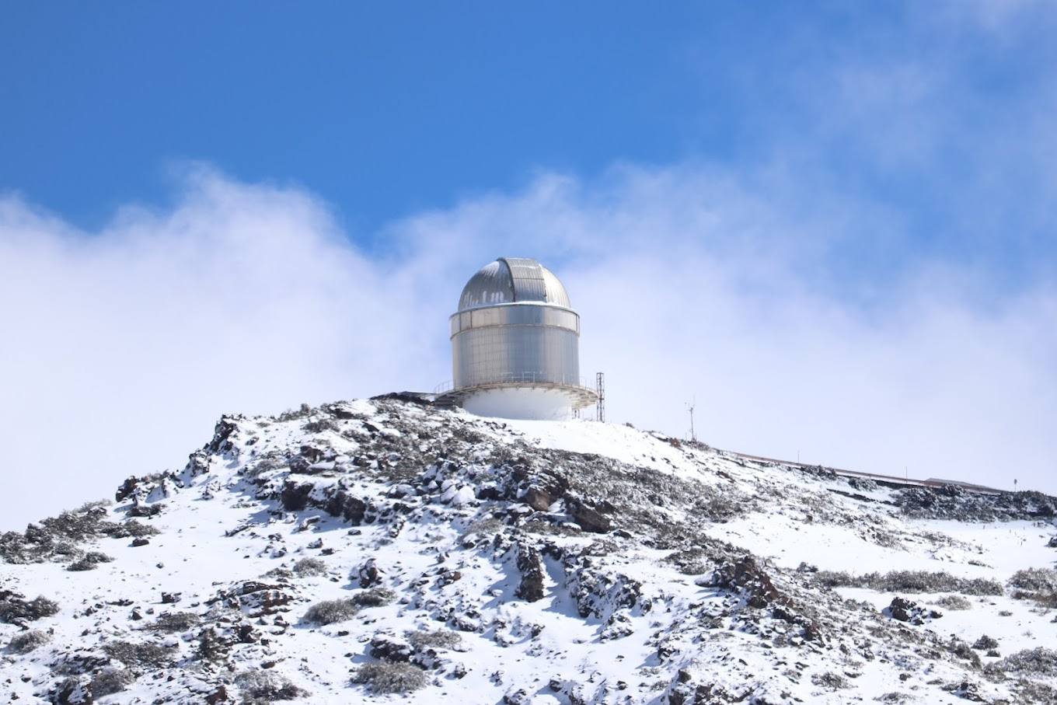




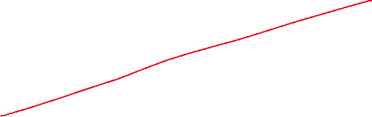
Observation workflow
NEORANGER
(Solin & Granvik, 2018)
… and upcoming LSST!
?

Slide 7
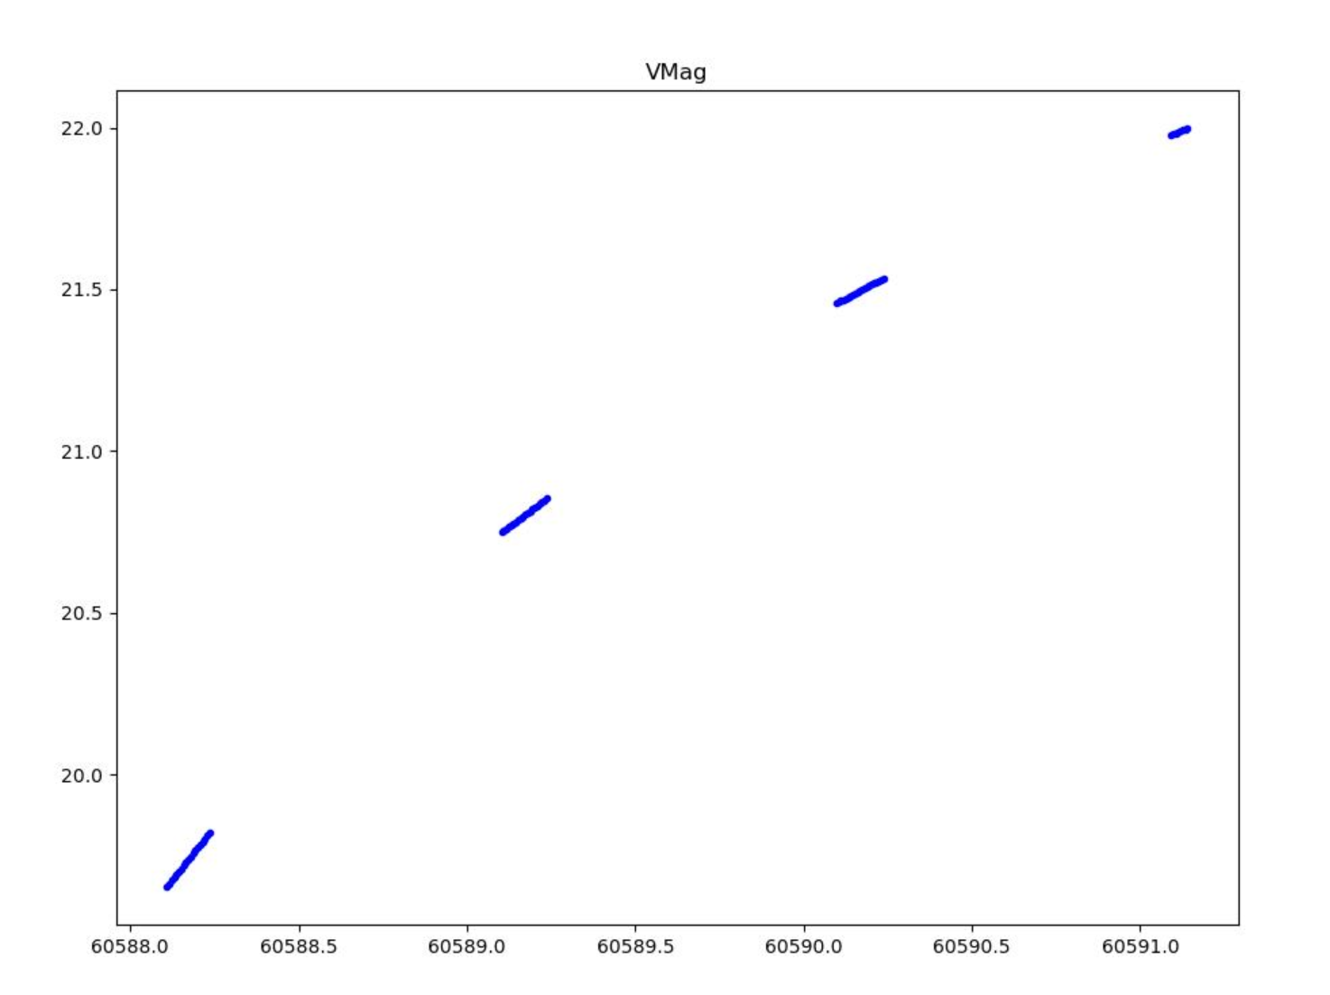
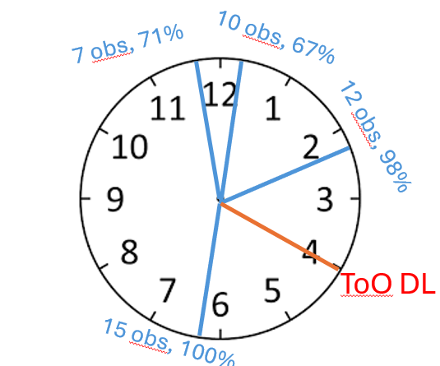
NEORANGER
Solin & Granvik (2018)
Constantly monitoring the Minor Planet Center for new data
Sends candidates based on requested Keplerian elements and size estimate
Updates estimates when new data arrives

Slide 8
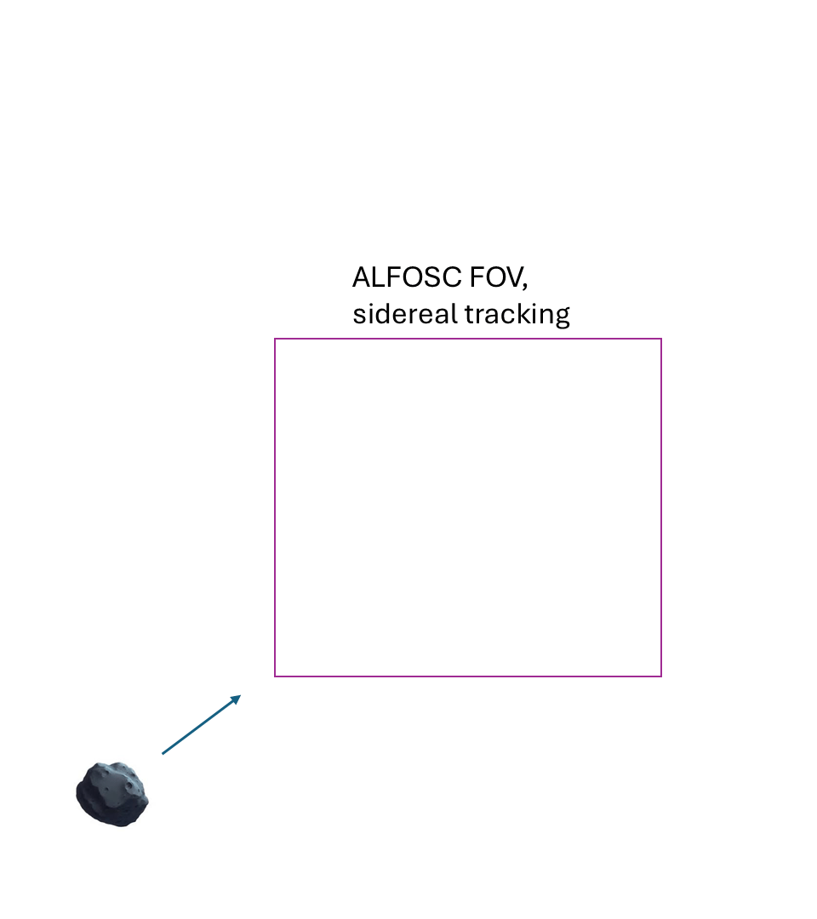
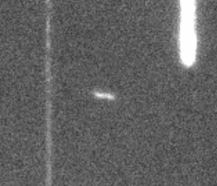
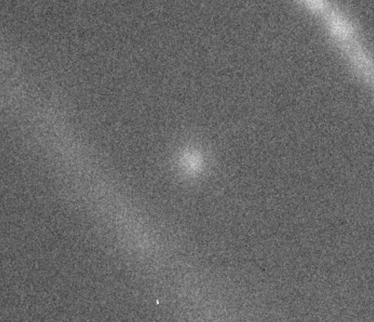
Observing very fast objects: hitandrun

Slide 9
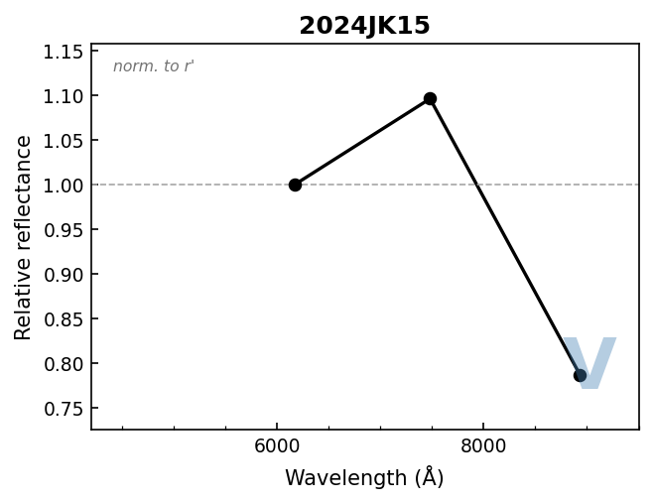
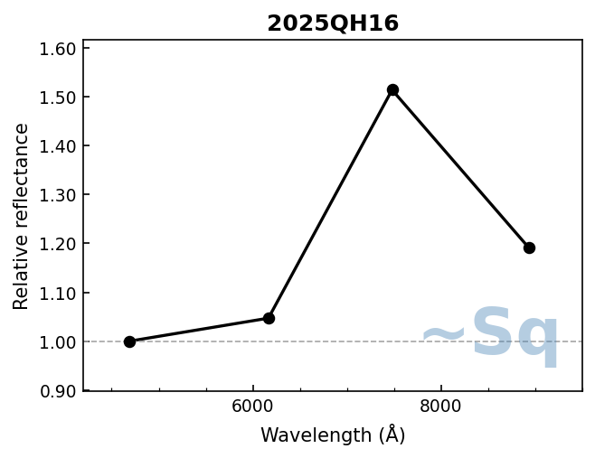
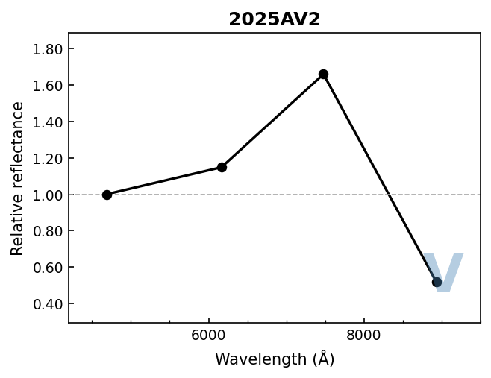
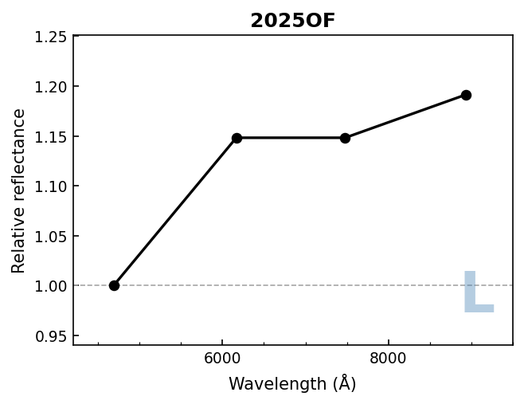
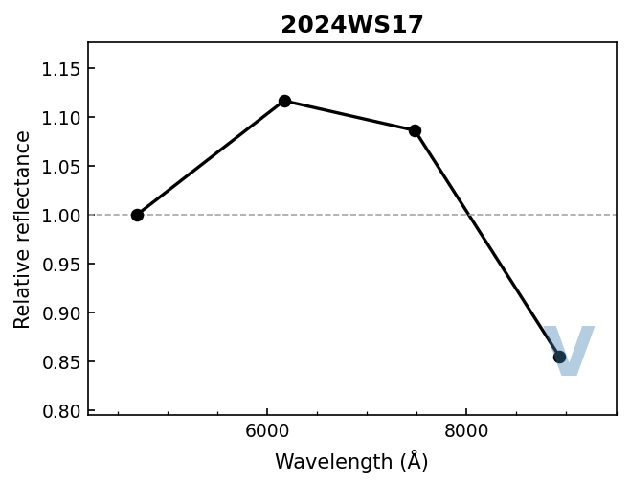
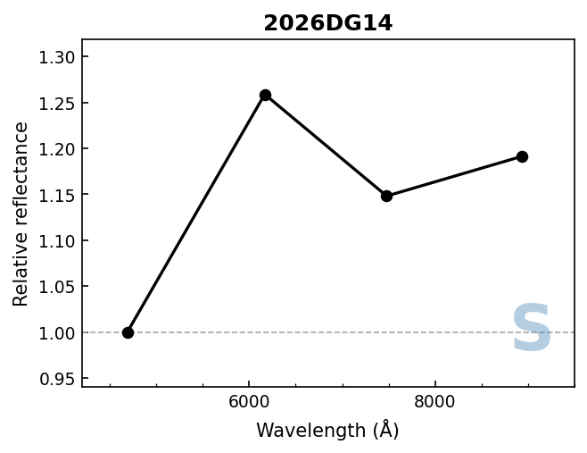
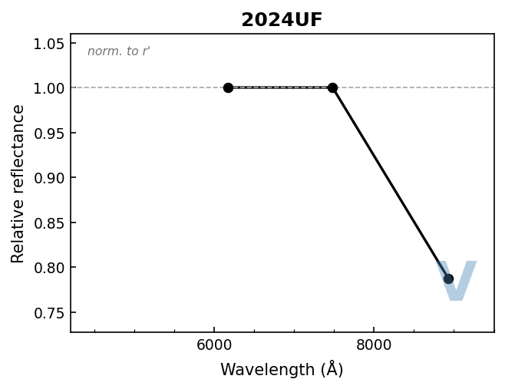
Results I

Slide 10
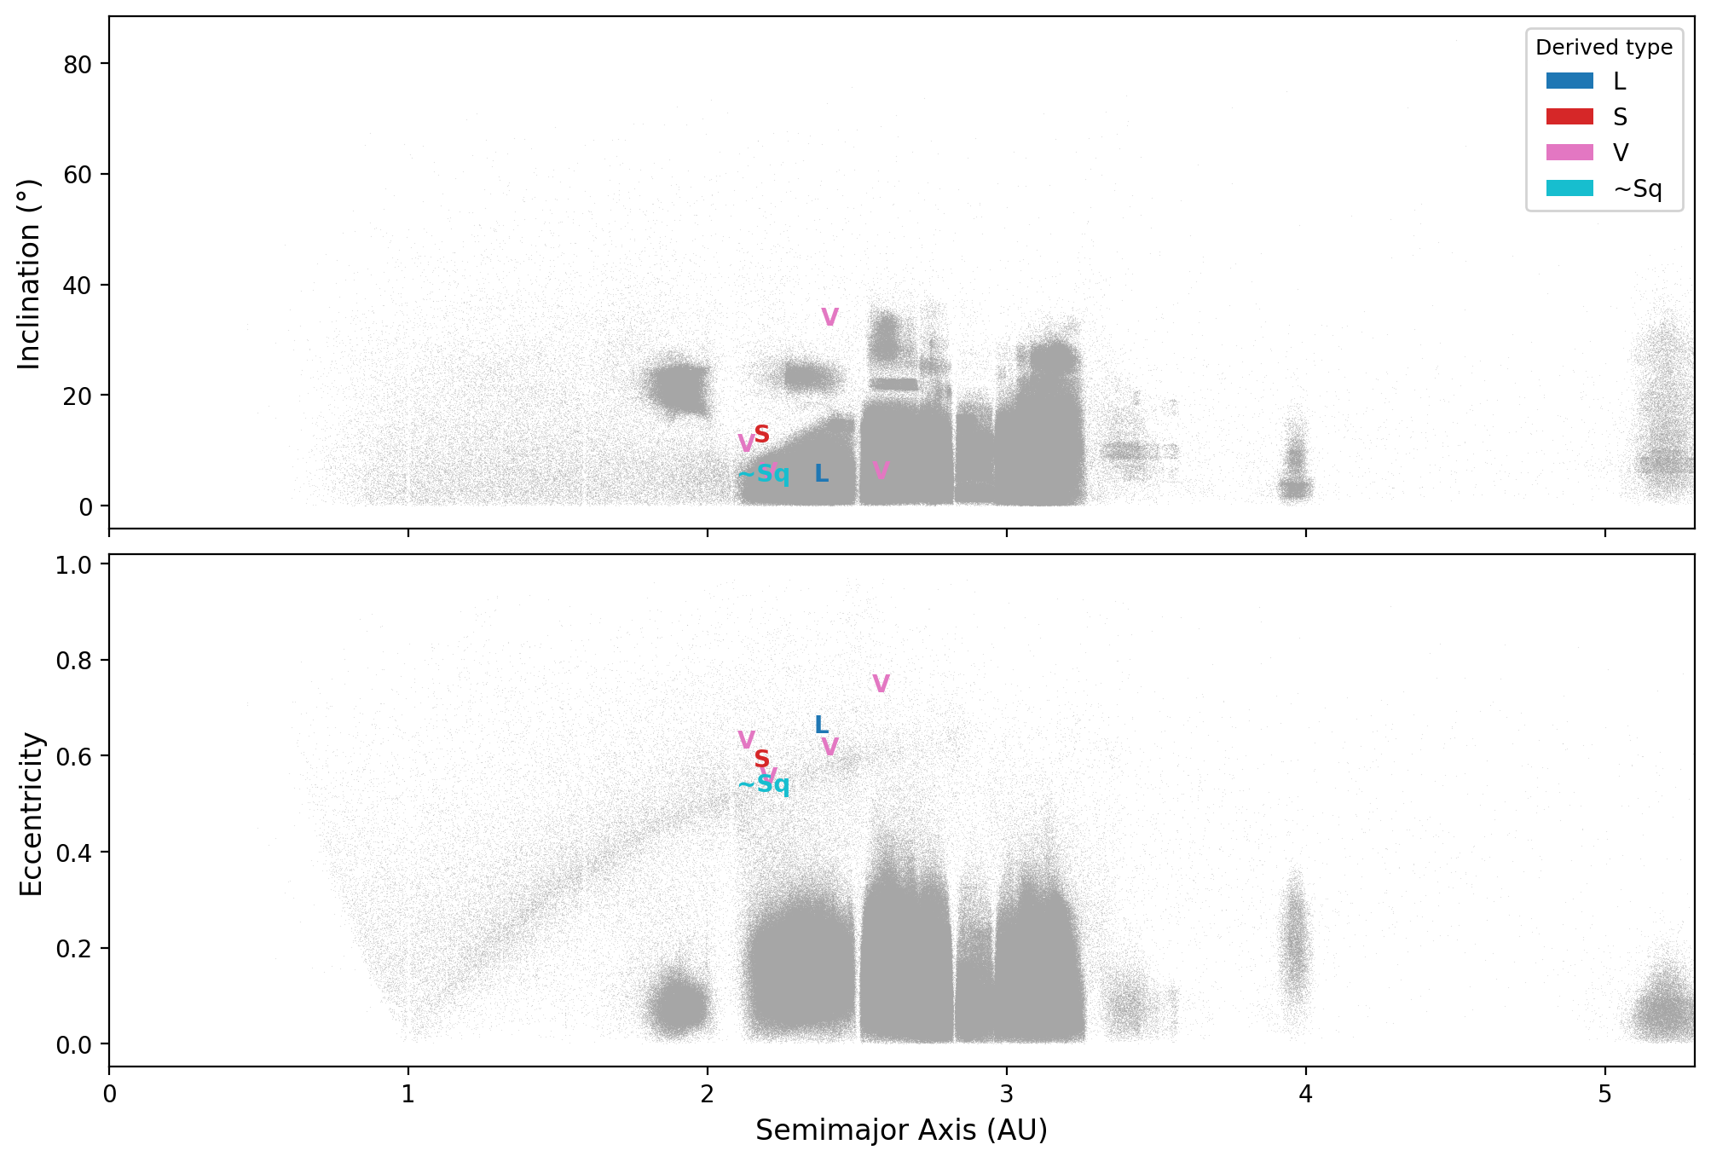
Results II

Slide 11
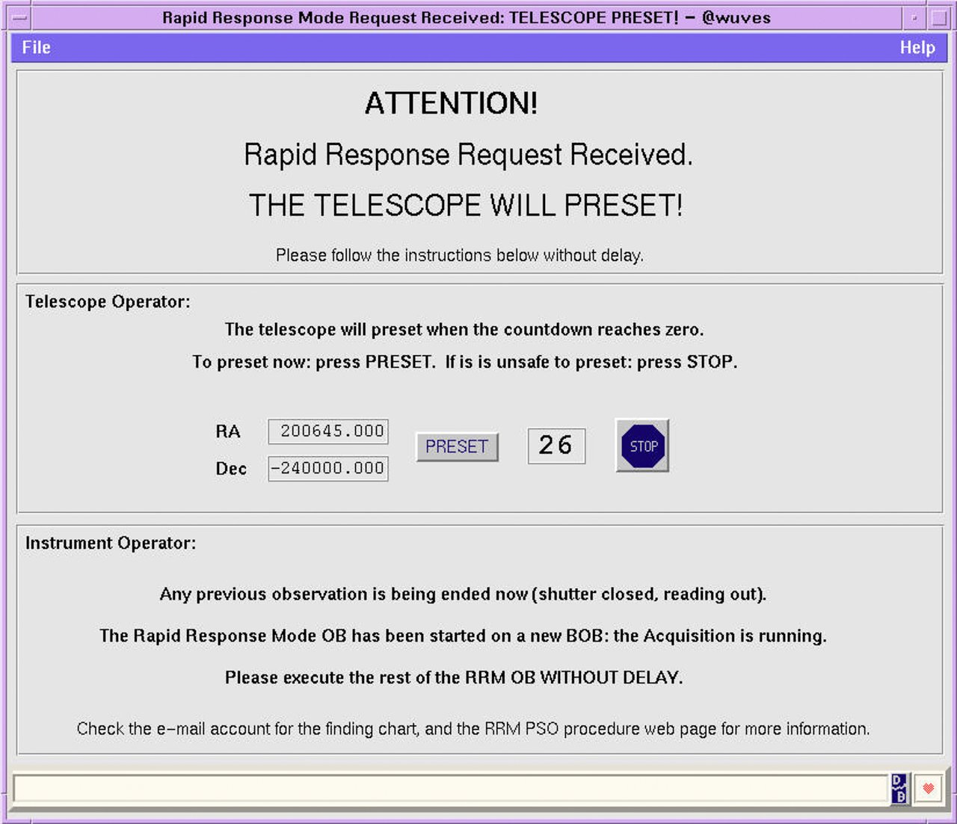
Future work
Expanding the programme to SOXS@NTT for 21st magnitude targets
Maybe also OPTICON for bad weather mitigation?
Imminent impactors: RRM mode for moving objects
Asteph to the NOT OB system: observations can be made by anyone

Slide 12
Summary
Very preliminary results indicate that there might be more V-types among very small asteroids.
  not yet a statistically significant sample
Recent developments and NOT operating mode permit performing observations of very close approaching, fast and unconfirmed asteroids.
A big thank you to all present and past NOT staff and students for actually carrying out these observations!

