Slide 1
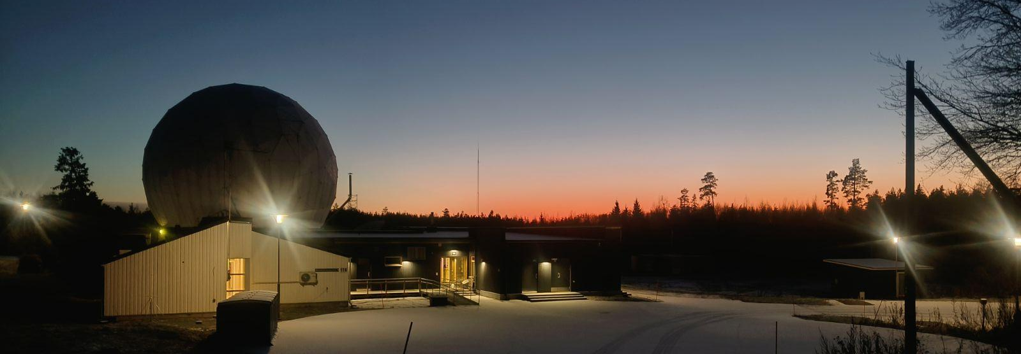


Metsähovi Radio Telescope New Digital Backend for triple-band receiver
Bela Dixit^{1,2}, Kaj Wiik^{1,2,3} , Talvikki Hovatta^{1,2,4} , Tuomas Savolainen^{1,2}
¹Metsähovi Radio Observatory, Aalto University ,²Department of Electronics and Nanoengineering, Aalto University , ³Department of Physics and Astronomy, University of Turku, ⁴Finnish Centre for Astronomy with ESO, University of Turku

Slide 2
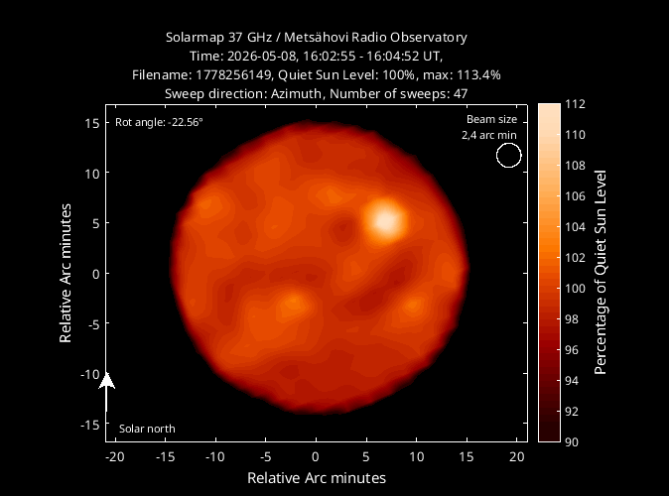
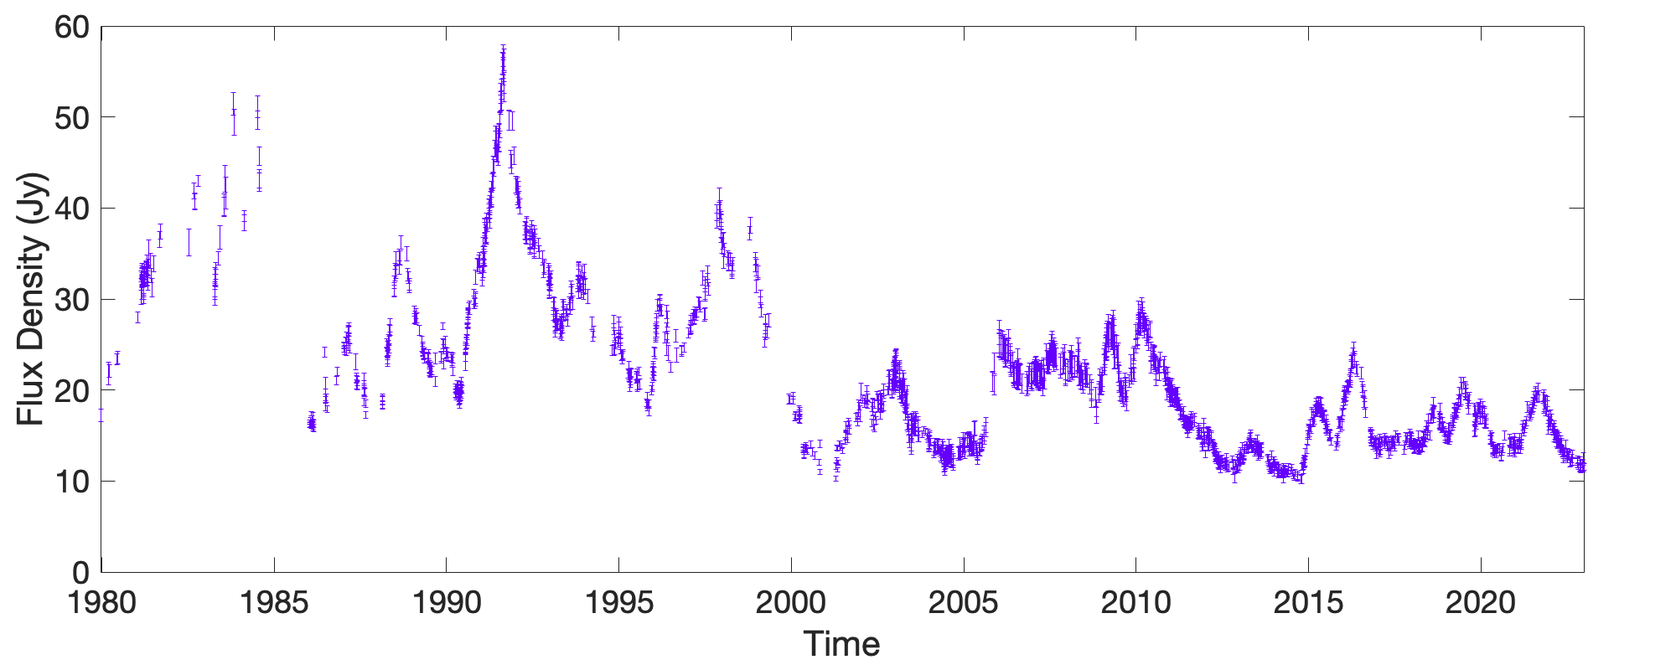
Aalto University Metsähovi Radio Observatory: Context
14m parabolic dish antenna, Cassegrain focus
Located in Kirkkonummi, Finland
50 years of radio astronomy operations
Single-dish monitoring and part of VLBI network
Key role:
Long-term AGN monitoring
Solar observations
Reference:https://www.metsahovi.fi/opendata/
AGN (3C273) Plot Courtesy: Sofia Kankkunen

Slide 3
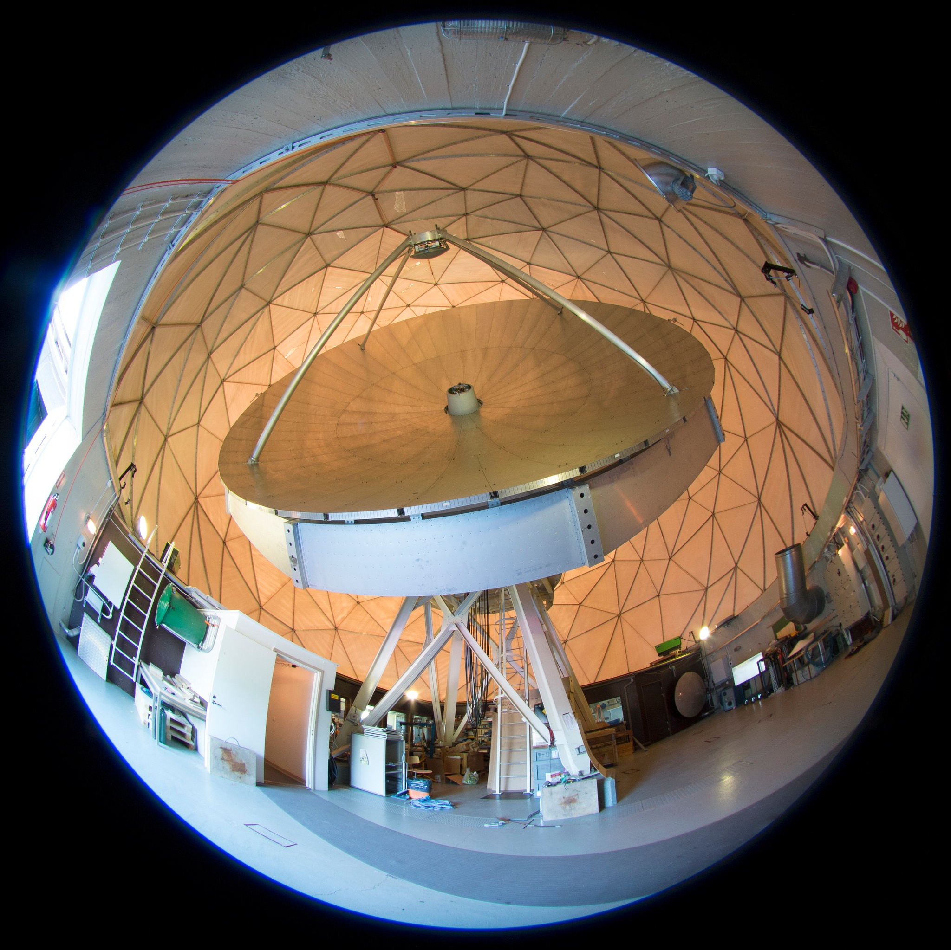
Existing Receivers and Limitations
Single-dish receivers
  Operational band : 22GHz and 37GHz
  Bandwidth : 1GHz
  Receiver temperature : 270K and 280K(operate at ambient temperature)
VLBI receivers
  operational band : 22 GHz, 43 GHz and 86 GHz
  Bandwidth: 500 MHz
  Receiver temperature: 60K,100K and 120K
Limited polarization and sensitivity
Image Courtesy:Merja Tornikoski
Reference: https://www.aalto.fi/en/services/metsahovis-main-receiverss

Slide 4
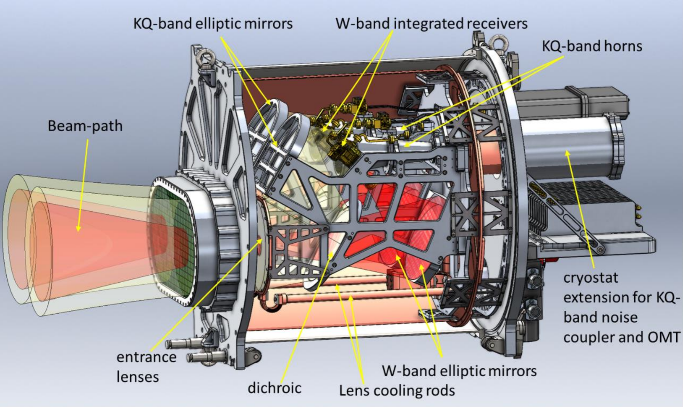
Receiver Upgrade in Progress
New triple-band receiver (3BandRx) from MPIfR
Simultaneous operation:
  K (18–26 GHz)
  Q (34–50 GHz)
  W1 (80–96 GHz)
  W2 (100–116 GHz)
Cryogenic cooling
Full polarization capability
Single-dish and VLBI operations possible with the same receiver
Triple-band Receiver (3BandRx)
Image Courtesy:Max Planck Institute for Radio Astronomy - Electronics Division

Slide 5
Triple-band receiver:Sensitivity in single-dish mode
Lower
=
Better
280
Trec=30-50K (cryogenic cooling)compare to 270-280K current receiver (operate at ambient temperature).
At 37 GHz Tsky ~50K then Tsys(Tsky+Trec) will drop down from 330K to 90K or factor of 3.5x
Wider bandwidth, increased from 1 GHz to 8 GHz, providing an additional ~2.8× gain
Overall sensitivity improvement in nominal weather conditions: ~10x
37 GHz cont.
22 GHz cont.
240
200
160
Noise temperature [K]
120
86 GHz VLBI
43 GHz VLBI
80
22 GHz VLBI
IRAM 30m
New receiver,
W-band
40
Effelsberg 100m Q-band
ALMA B3
New receiver,
KQ-band
ALMA B1
ALMA B2
Parkes 64m K-band
0
Nobeyama 45m eQ-band
0
20
40
60
80
100
120
Frequency [GHz]
Plot Courtesy :Joni Tammi
Reference: https://www.mpifr-bonn.mpg.de/technology/electronics/projects/vlbi3band?c=8966833

Slide 6
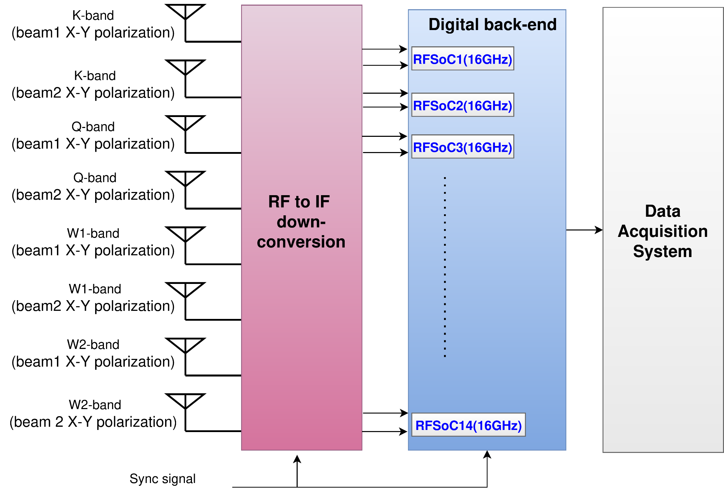
Bandwidth Expansion and System Scale
Signal flow block diagram
Bandwidth per band:
  K: 8 GHz
  Q, W1, W2: 16 GHz each
Two polarizations, two beams
Total processed bandwidth: 224 GHz
Requires a completely new digital backend

Slide 7
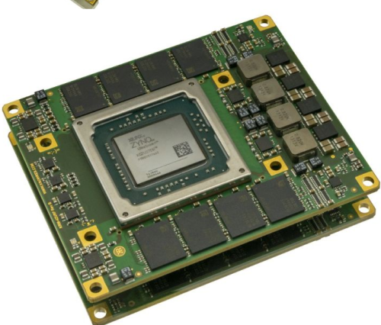
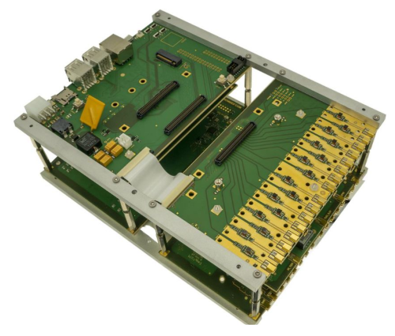
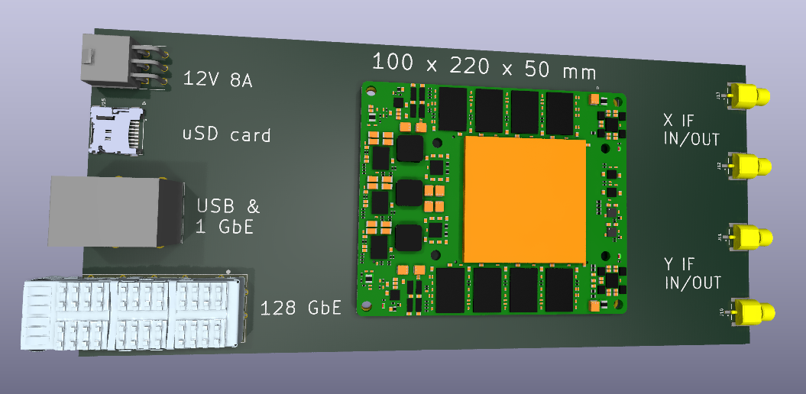
Digital Backend Requirements
Simultaneous multi-band processing
Real-time full-Stokes polarimetry
Compact hardware suitable for Cassegrain platform
Support for external clocking and synchronization
Chose a modular RFSoC design to allow a custom carrier board with integrated RF and digital I/O
Selected the Knowledge Resources RFSoC module to support this design
KR RFSoC
custom carrier board
Reference: https://www.knowres.com/wp-content/uploads/2020/03/KRM-4ZU2XDR_FLYER.pdf

Slide 8
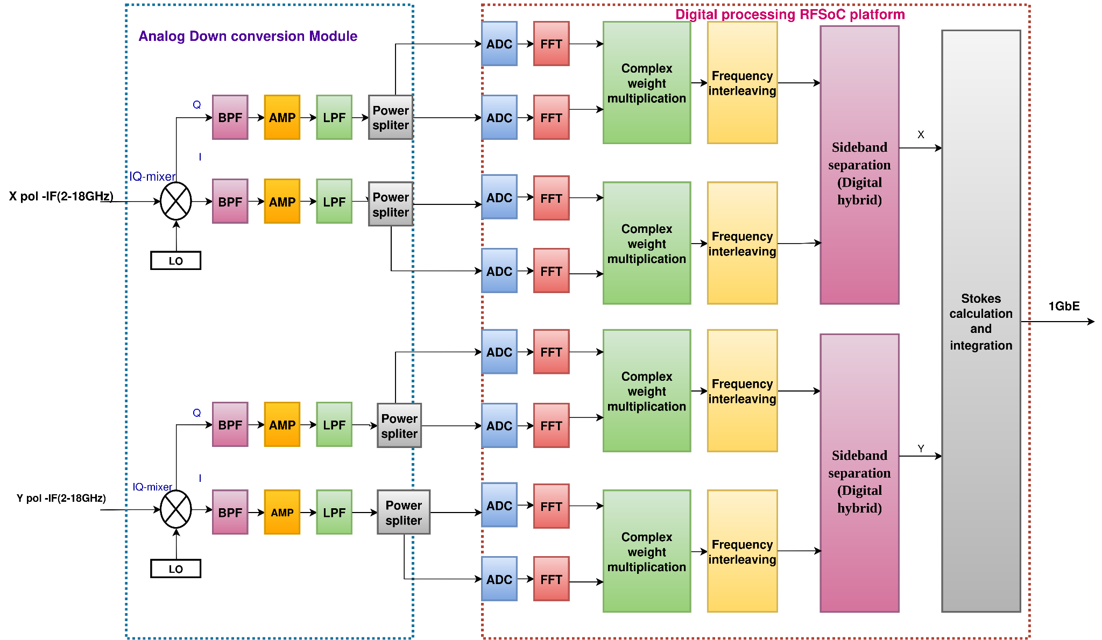
RFSoC-Based Digital Backend
2x8 GHz full stokes polarimeter design block diagram
Integrated high-speed Analog-to-Digital Converter (ADCs) for direct IF digitization
Field-Programmable Gate Array (FPGA) fabric for real-time signal processing
Embedded ARM processors for control and data handling
Scalable design up to 224 GHz total bandwidth

Slide 9
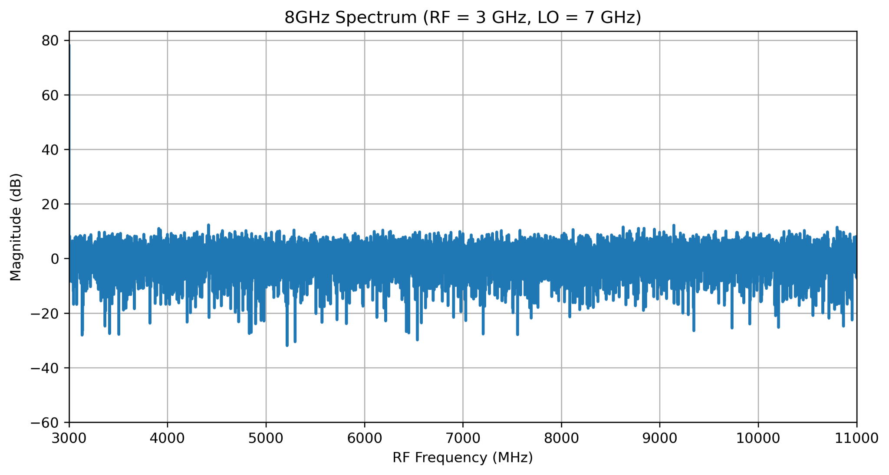
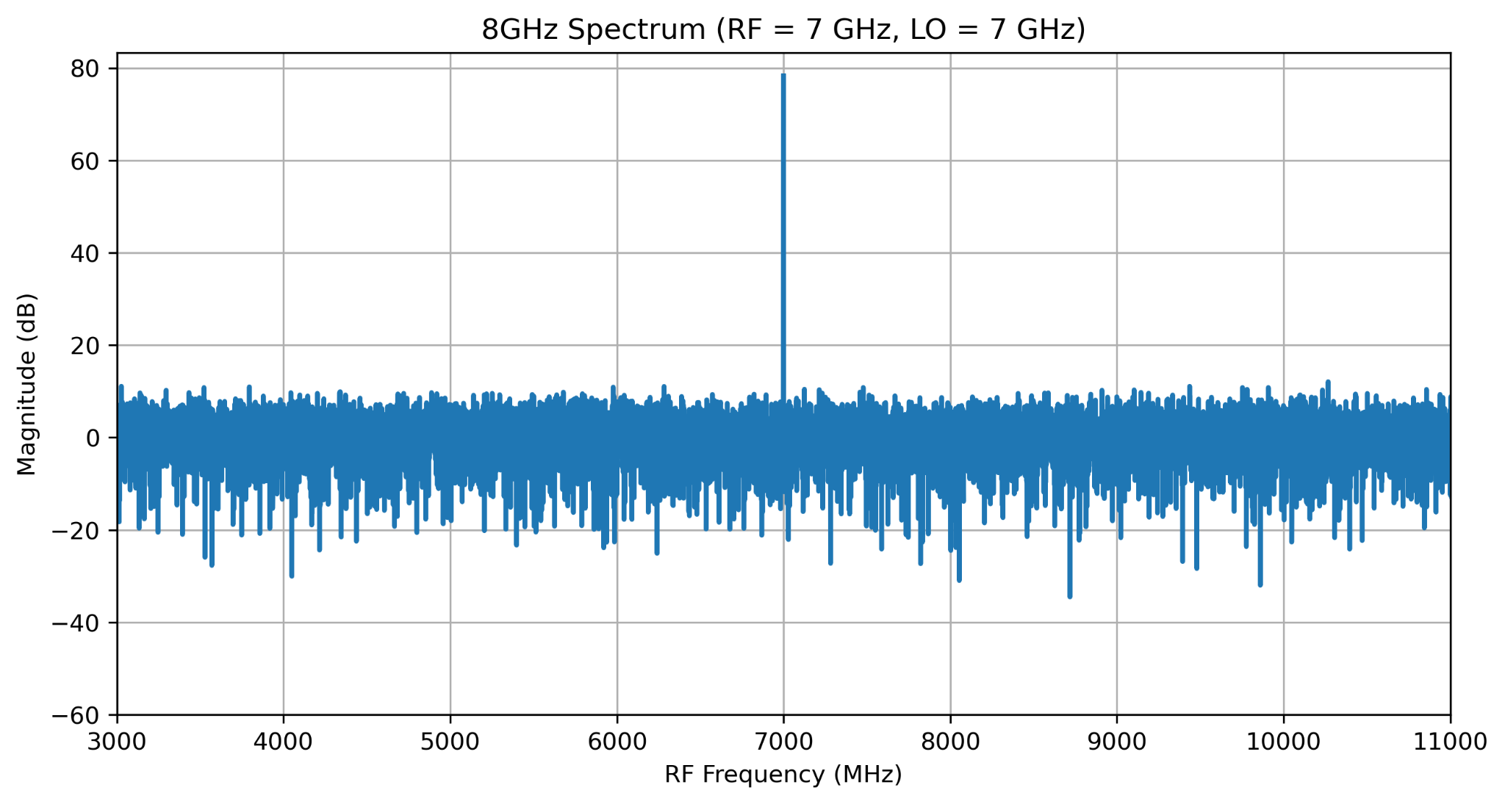
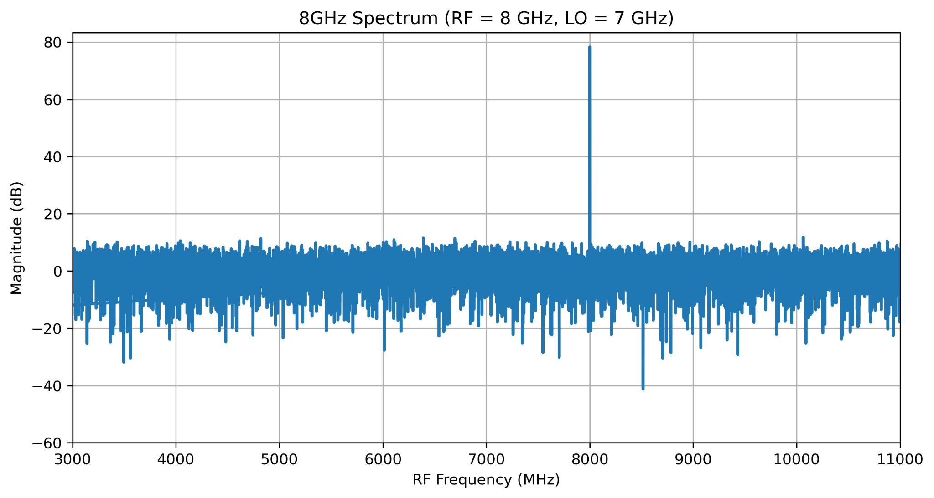
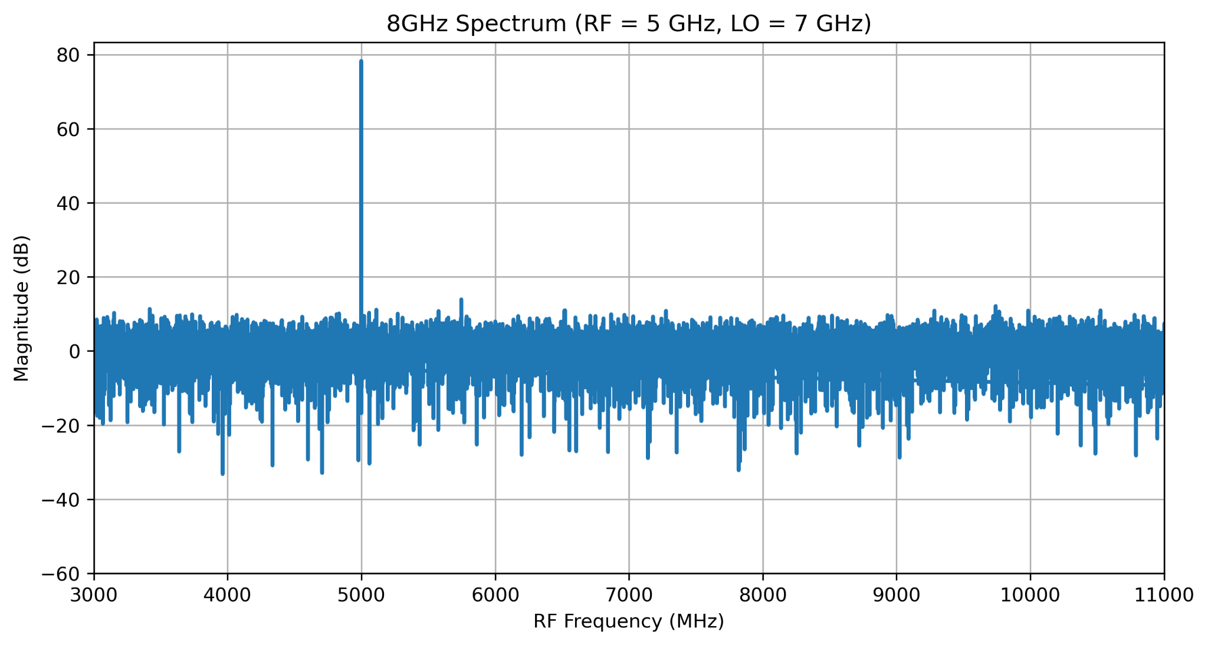
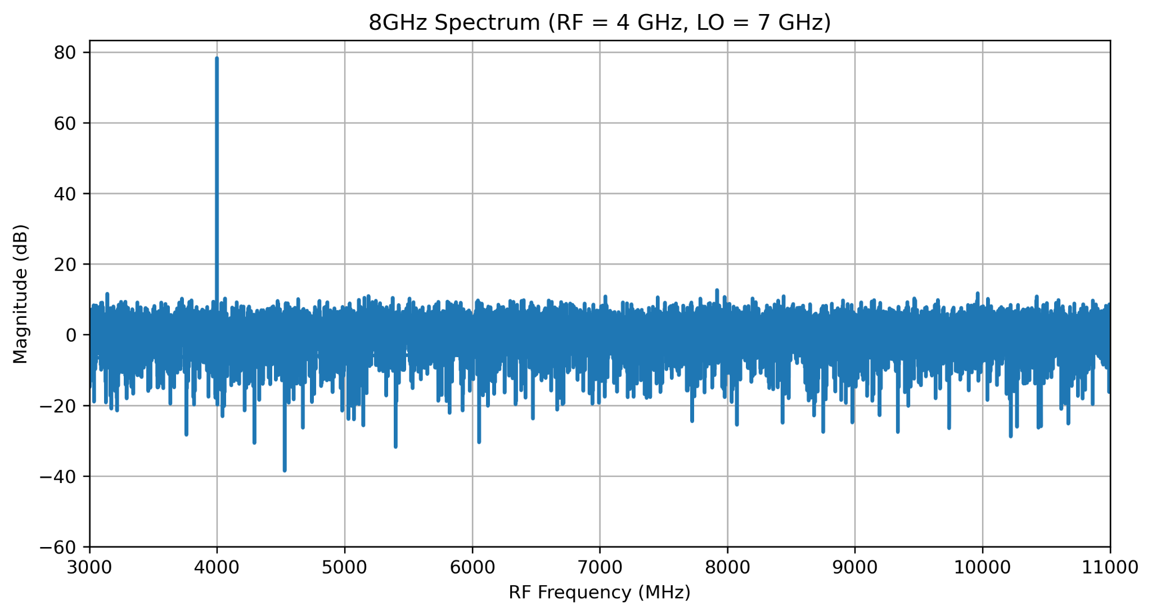
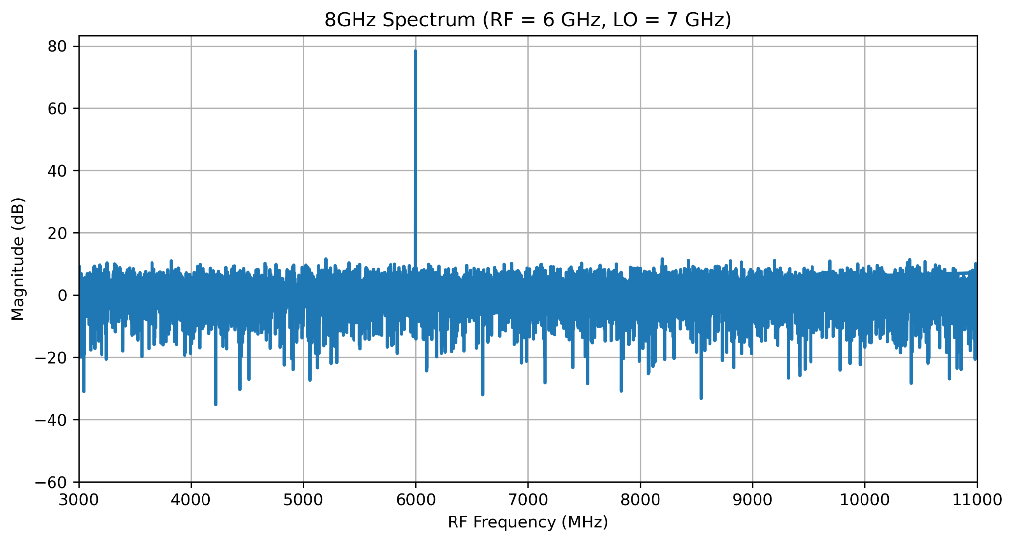
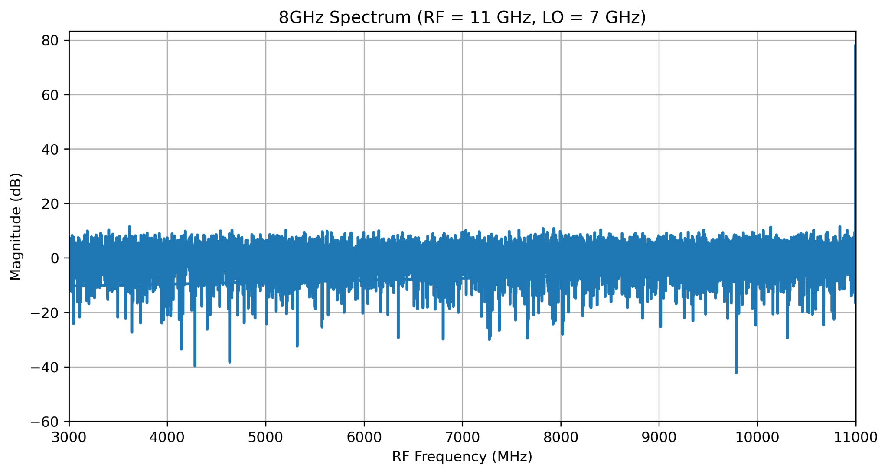
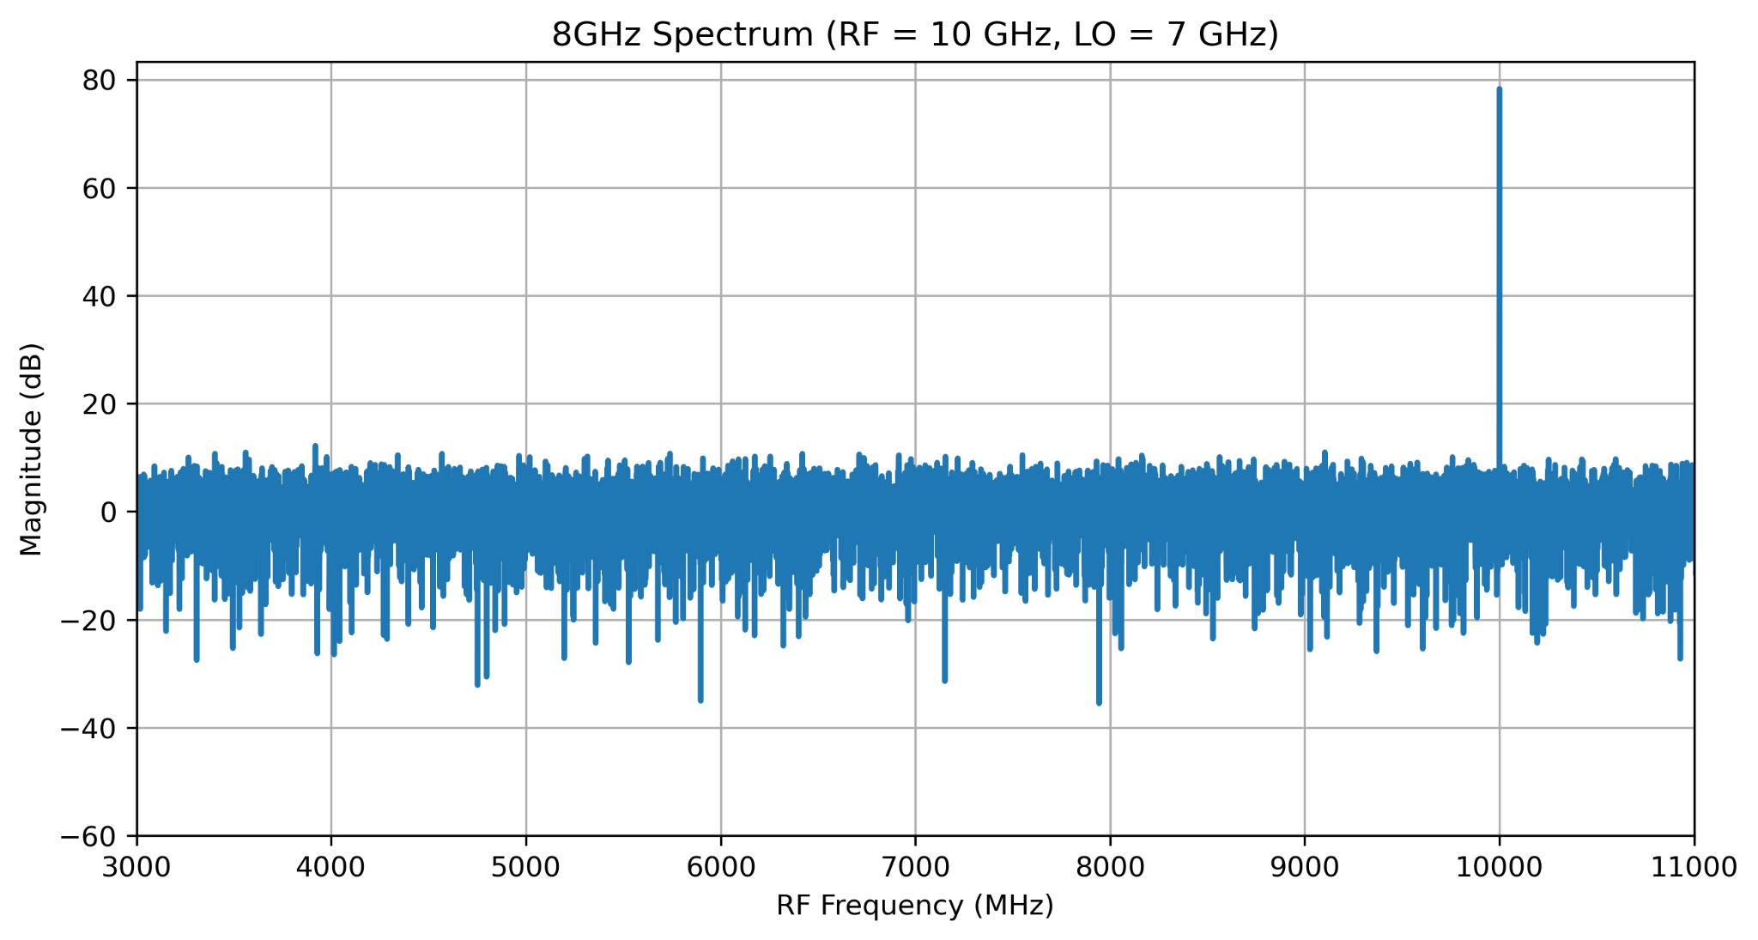
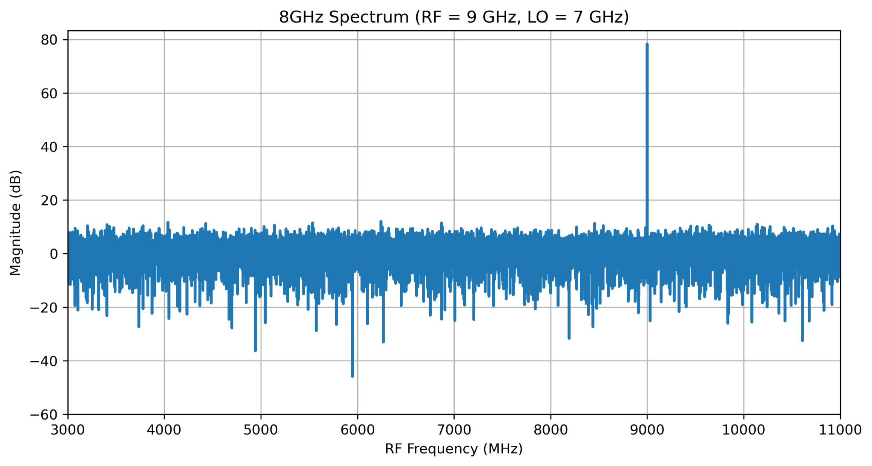
Wideband Processing Using Interleaved ADCs and sideband separation
8 GHz bandwidth achieved using 4 GSps ADCs
Interleaved ADC (IADC) and sideband separation techniques enables wideband spectrometry and polarimetry
Firmware for development: CASPER tool flow
Key challenges due to ADC mismatches:
  Amplitude offsets
  Phase offsets
8 GHz Spectrometer: Simulation Results Considering and Correcting ADC Mismatches

Slide 10
Summary and Outlook
New triple-band receiver demands a novel backend
RFSoC-based system enables real-time, wideband polarimetry
Prototype validated simulation and hardware
Next steps:
  ADC calibration with new carrier board
  Full polarimeter implementation
  Integration with 3BandRx and commissioning (expected by end of 2026)

Slide 11

Acknowledgement
Aalto University Metsähovi Radio Observatory (MRO)
Finnish Centre for Astronomy with ESO-University of Turku
European Research Council (ERC)
Collaboration for Astronomy Signal Processing and Electronics Research(CASPER)
Max Planck Institute for Radio Astronomy - Electronics Division
Receiver Funded by ELEC and by donations from the Weisell foundation, Magnus Ehrnrooth foundation and over 80 private donors
Advanced Micro Devices(AMD)
Knowledge Resources GmbH

Slide 12
Kiitos!

Slide 13
Backup Slides

Slide 14
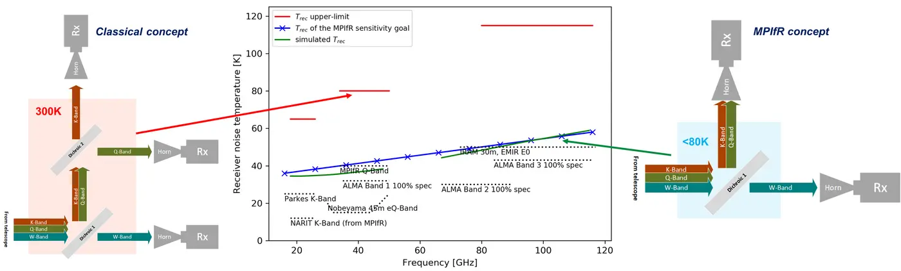
Triple-band receiver
Image Courtesy:Max Planck Institute for Radio Astronomy - Electronics Division

Slide 15
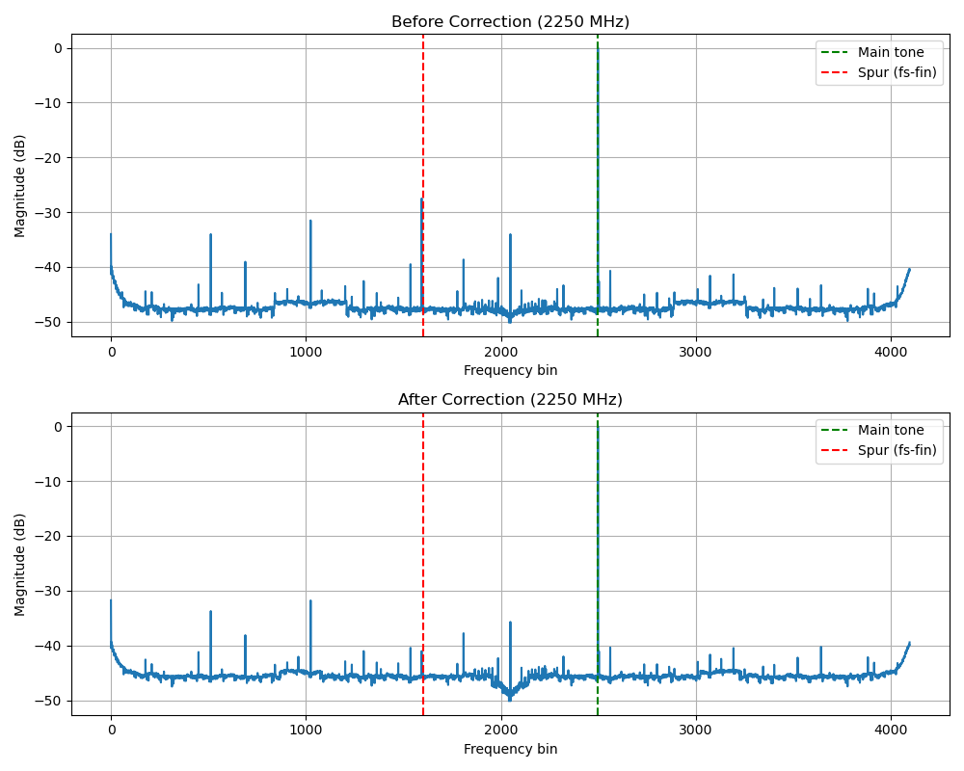
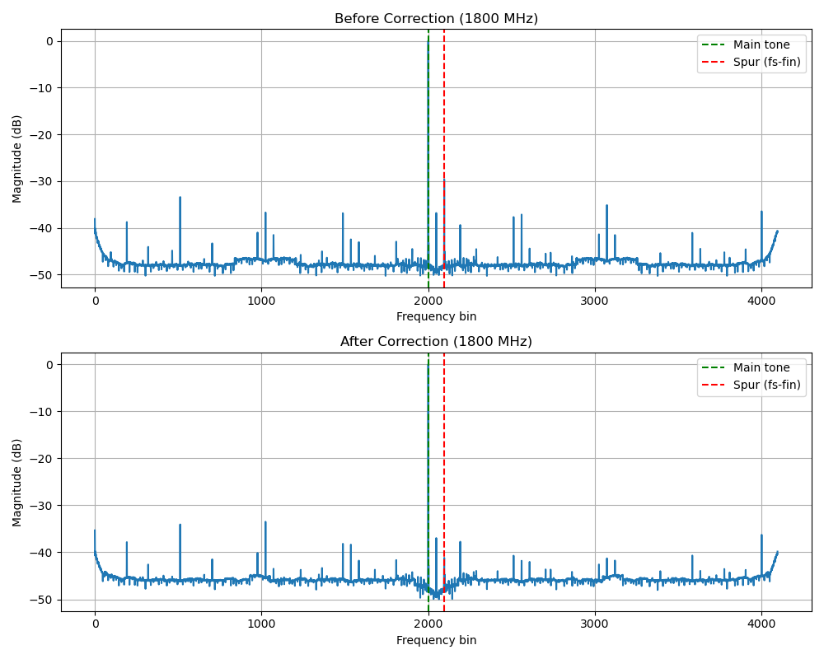
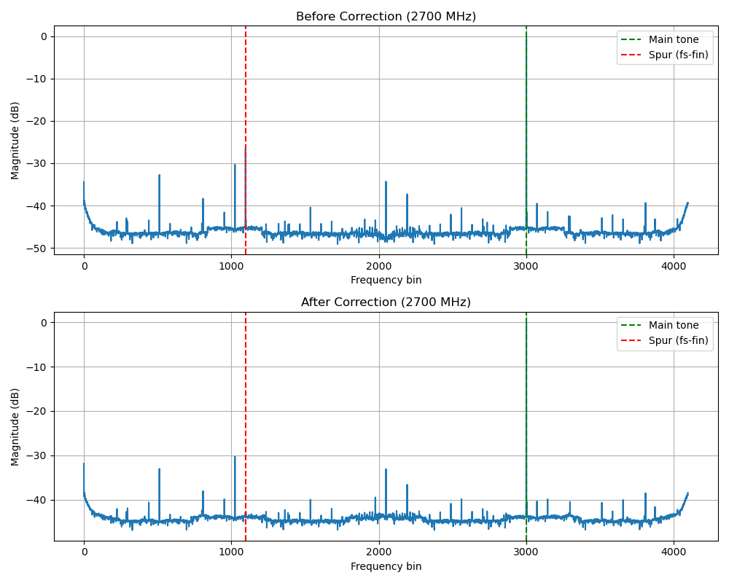
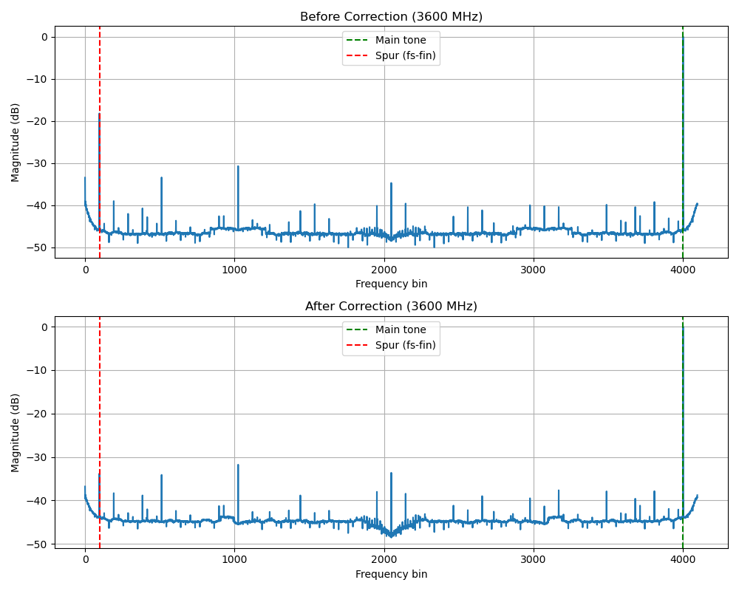
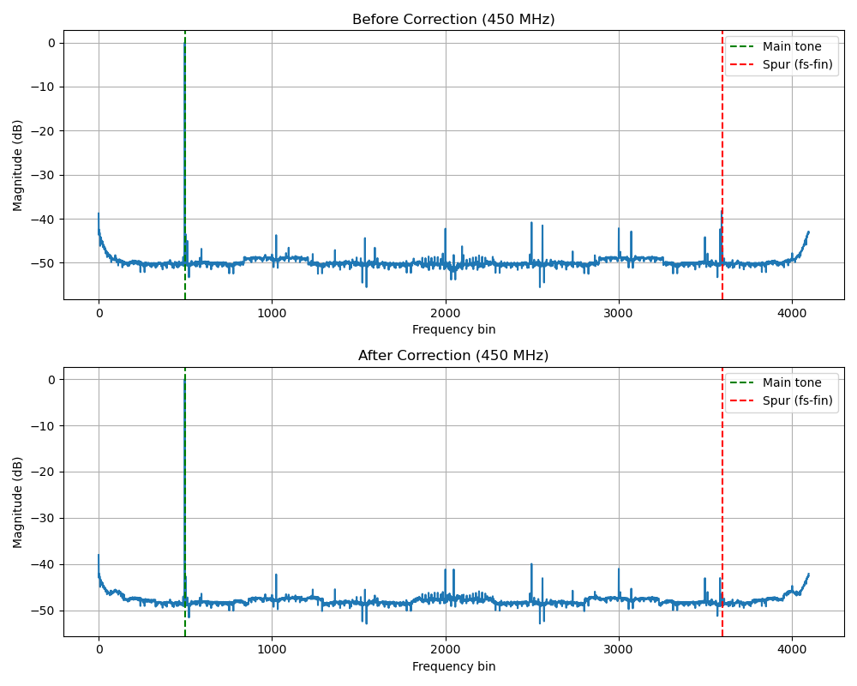
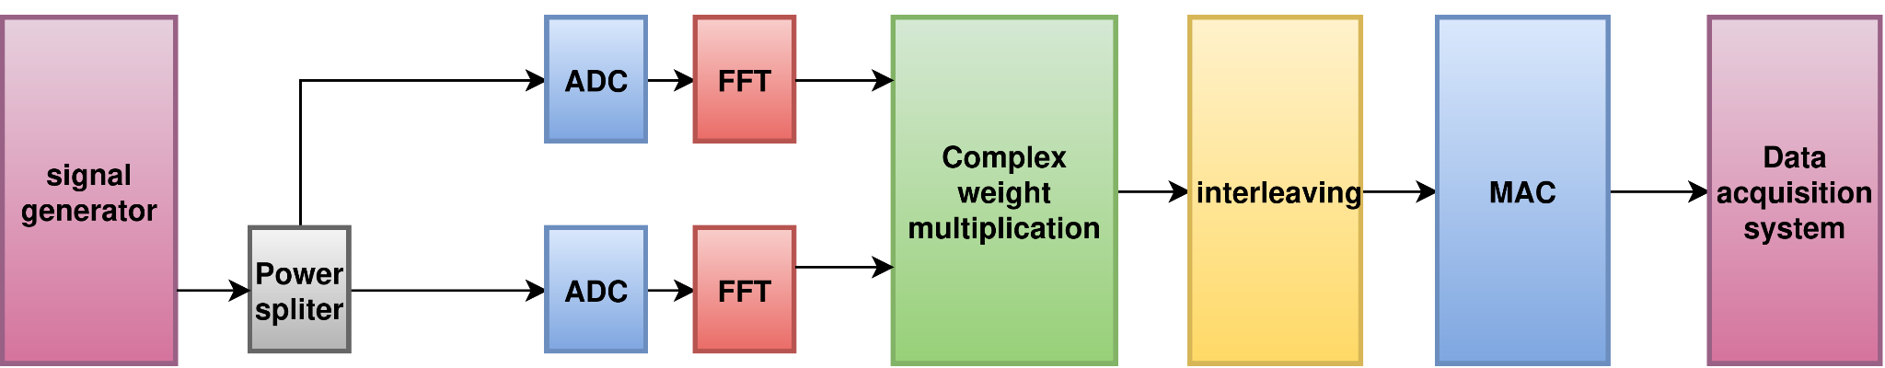
Hardware Implementation of two input IADC on RFSoC Boards(4GHz spectrometer)

Slide 16
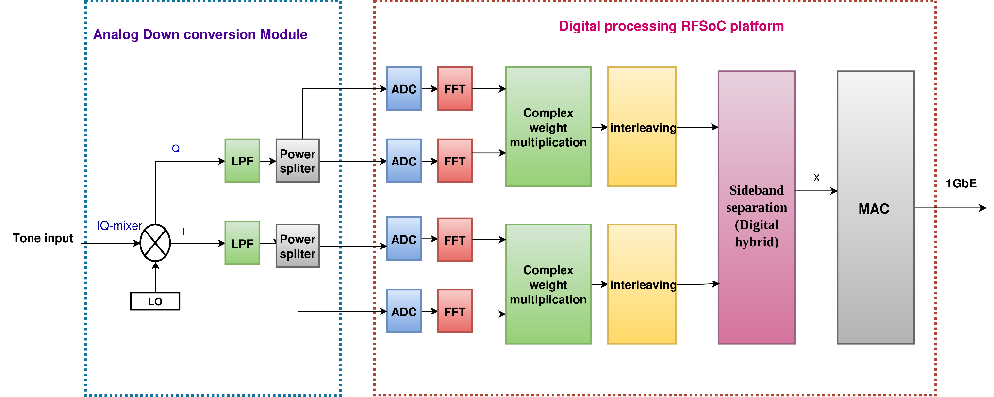
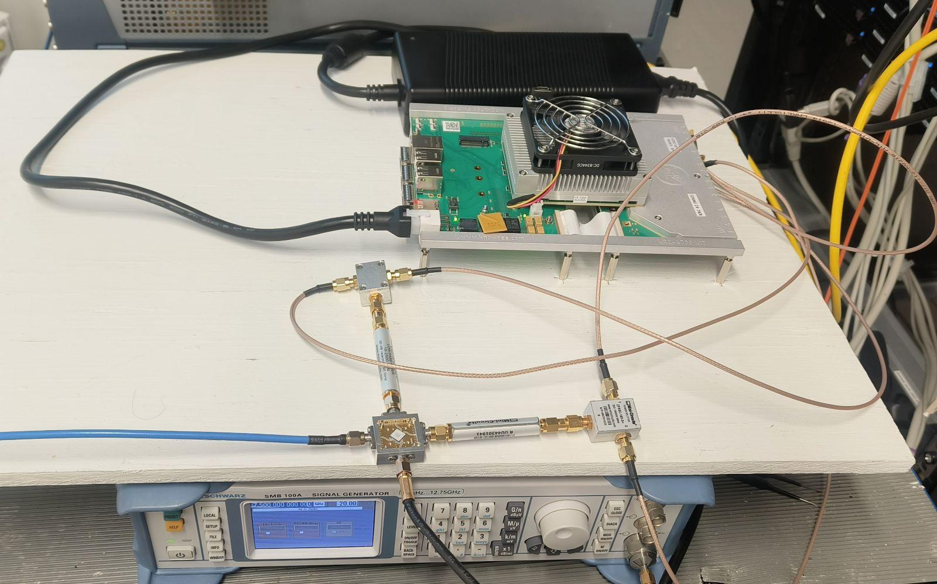
Hardware Implementation of Interleaved ADCs and sideband separation together
(8 GHz spectropolarimeter ) :In progress
RFSoC
Power splitter
LPF
IQ-mixer

