Slide 1
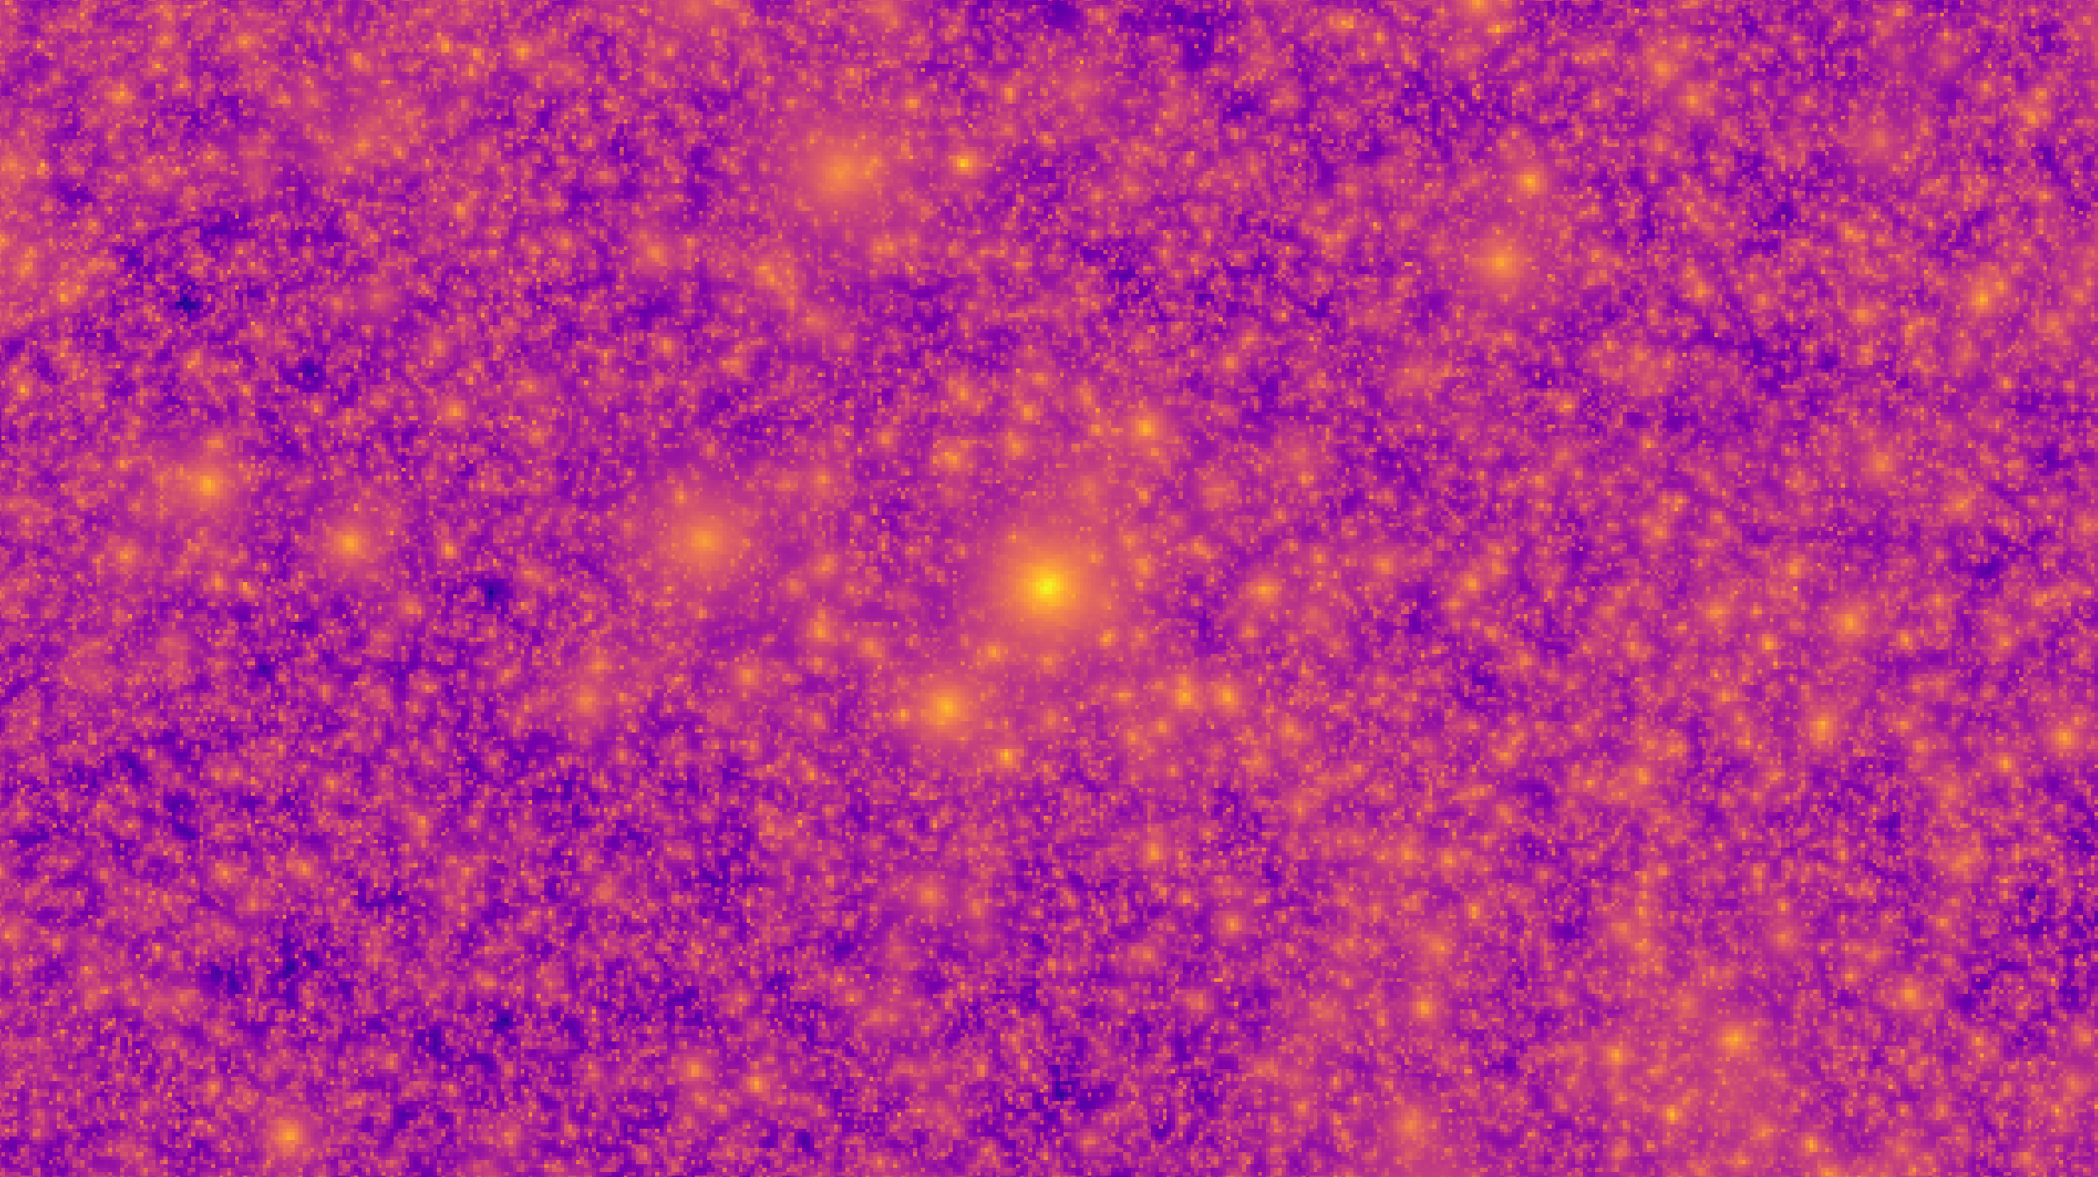



Modelling the thermal and kinetic Sunyaev–Zel'dovich effects in HalfDome simulations
Kristers Nagainis, Adrian Bayer, Jia Liu, Liender Thiele, Bernard Foing, Henk Hoekstra, Koen Kuijken
ERAF doctoral grant Nr. 1.1.1.8/1/24/I/003

Slide 2
Content
Sunyaev-Zel’dovich effects
HalfDome simulation implementation
Simulation based inference
Fast radio bursts
Conclusions

Slide 3
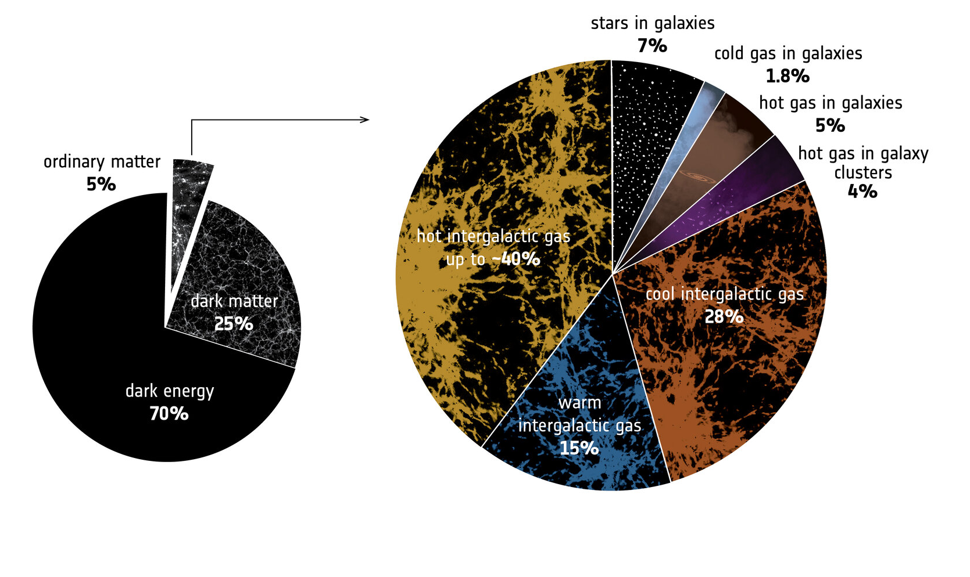
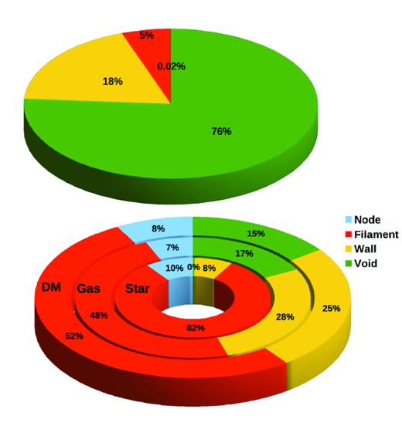
Hot Universe
Most baryonic matter in gaseous state
Only a fraction lies in clusters
Gas profiles inform about feedback processes (mainly AGN)
Credit: ESA
Ganeshaiah Veena+ 2019

Slide 4
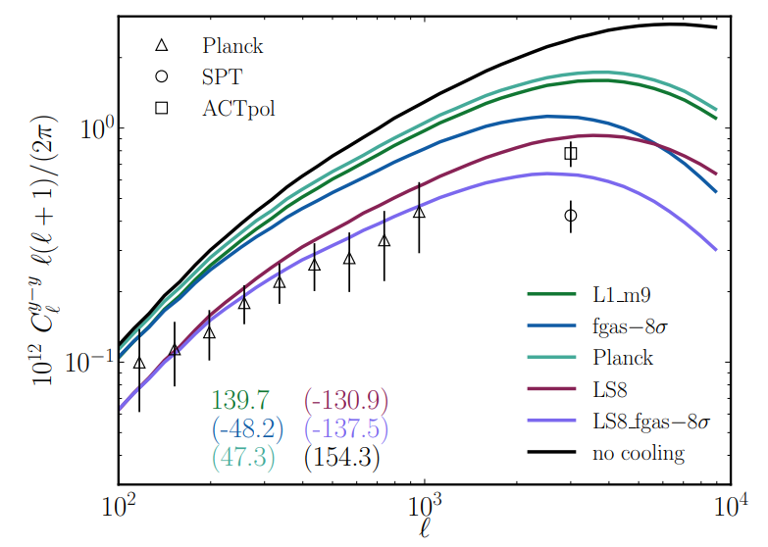
Hot Universe
Most baryonic matter in gaseous state
Only a fraction lies in clusters
Gas profiles inform about feedback processes (mainly AGN)
Indication that AGN feedback is stronger than previously thought
What can we learn from DM simulations?
Ian McCarthy+2025

Slide 5
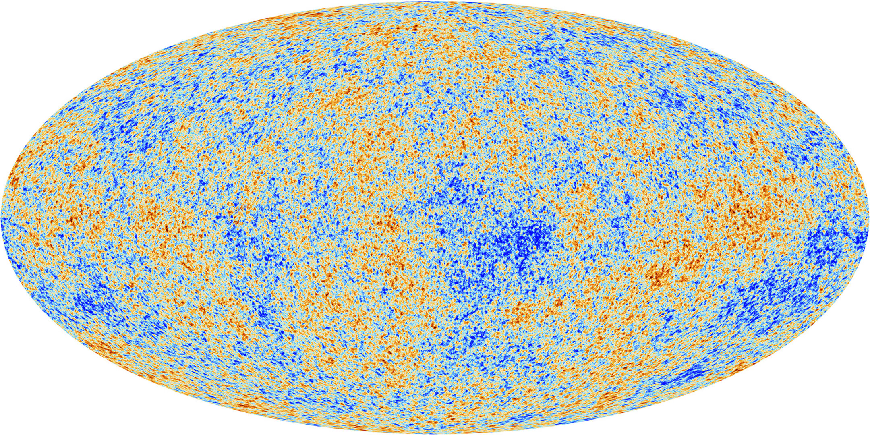
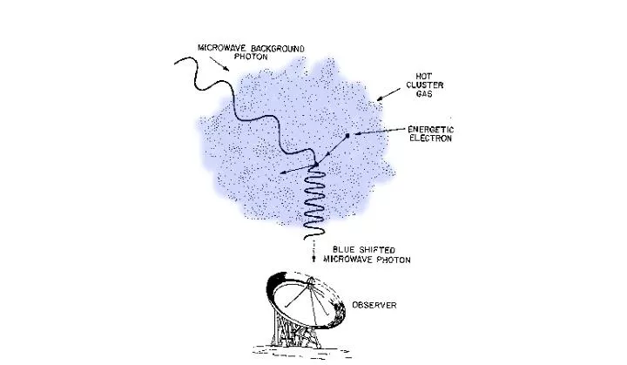
Sunyaev-Zel’dovich (SZ) effect
Describes secondary anisotropies of cosmic microwave background (CMB)
Induced by high energy free electrons in clusters and medium
Spectral distortions from inverse Compton effect

Slide 6
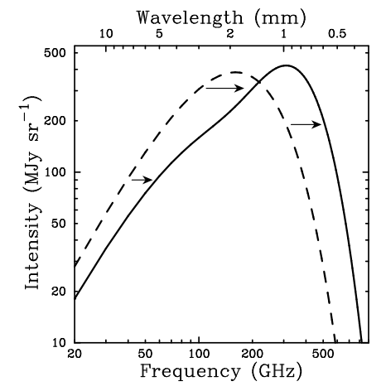
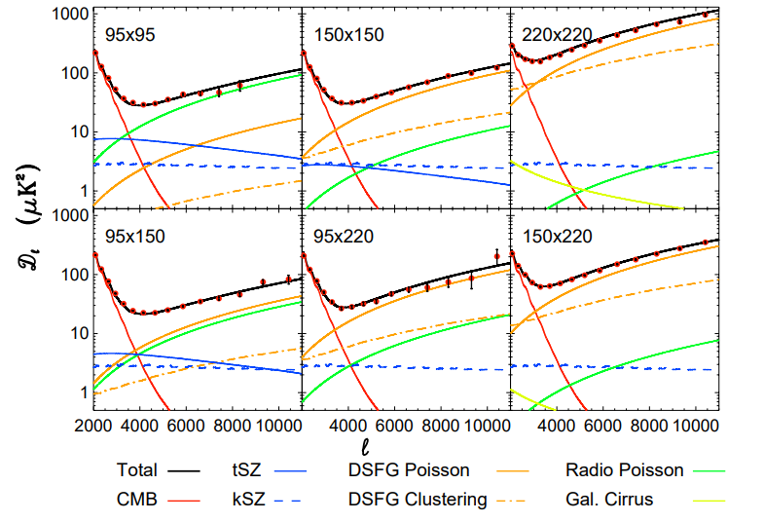
Thermal and kinetic Sunyaev-Zel’dovich (tSZ/kSZ)
Caused by hot thermal distribution of electrons
Thermal: depends on electron pressure
Kinetic: electron density and velocity
Contaminated by cosmic infrared background (CIB), primary CMB, point sources
Simulations needed to analyze systematic effects and dependencies
John Carlstorm+2002
C.L.Reichard+2025

Slide 7
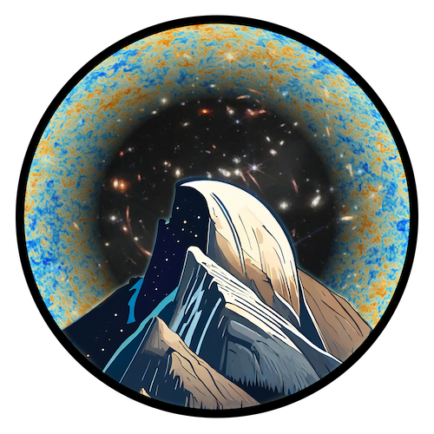
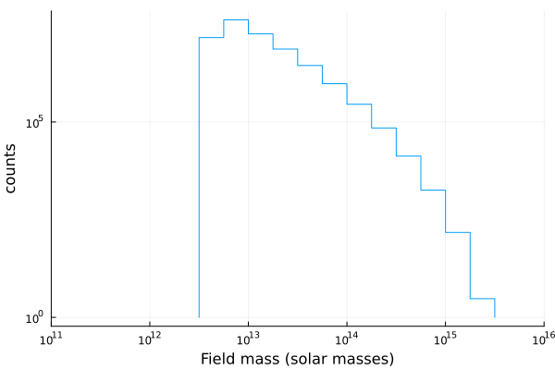
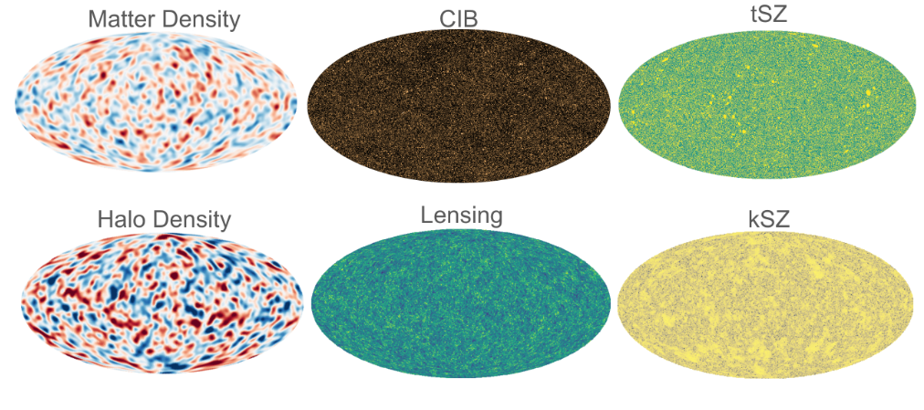
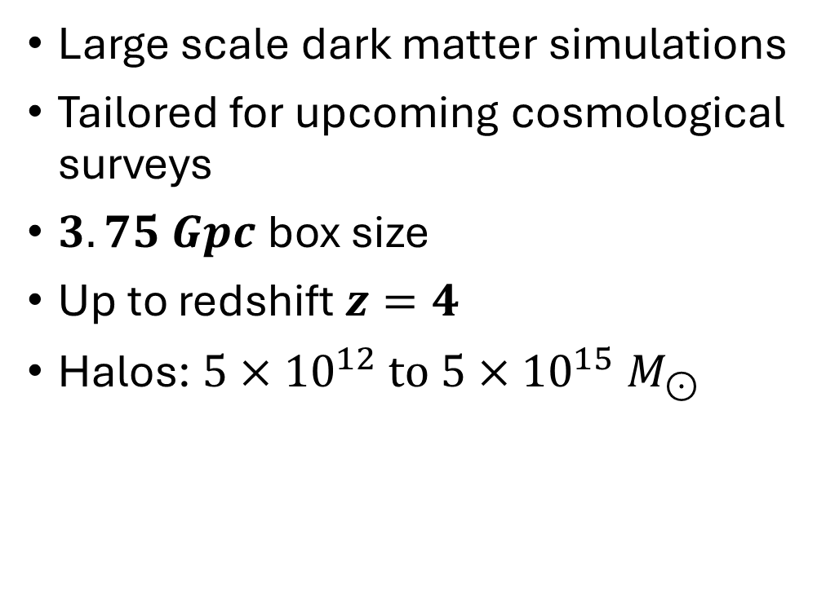
HalfDome simulations
Large scale dark matter simulations
Tailored for upcoming cosmological surveys
$3.75 Gpc$box size
Up to redshift $z=4$
Halos: $5×{10}^{12} to 5×{10}^{15} M_{⊙}$

Slide 8
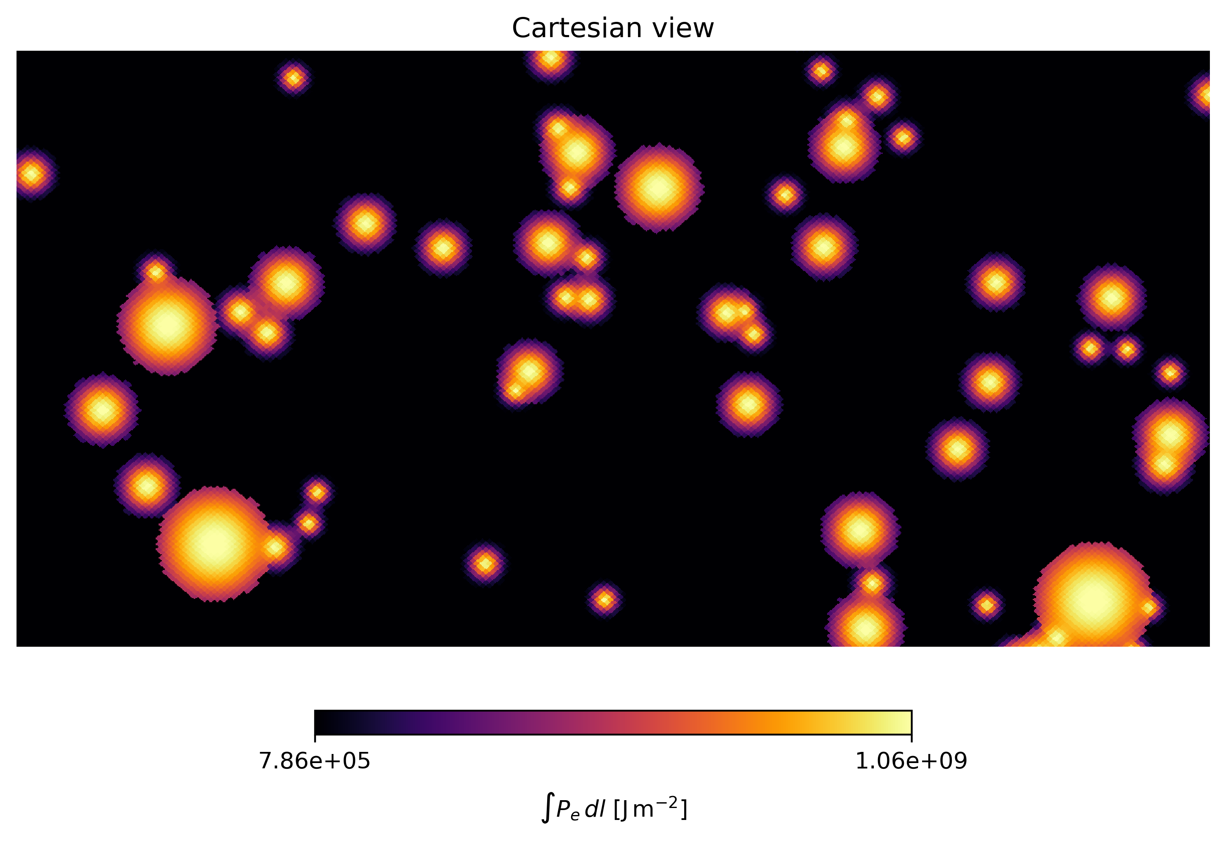
Baryon pasting
Creating observarbles from dark matter simulations
Adding gas profiles on top of halos or particles
Battaglia model used: gNFW profiles with mass and redshift dependence
Calibrated from hydro simulations

Slide 9
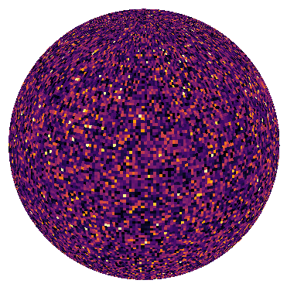
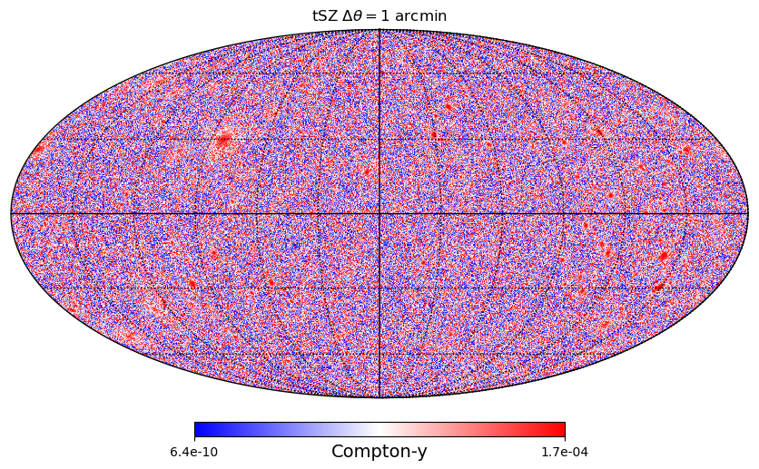
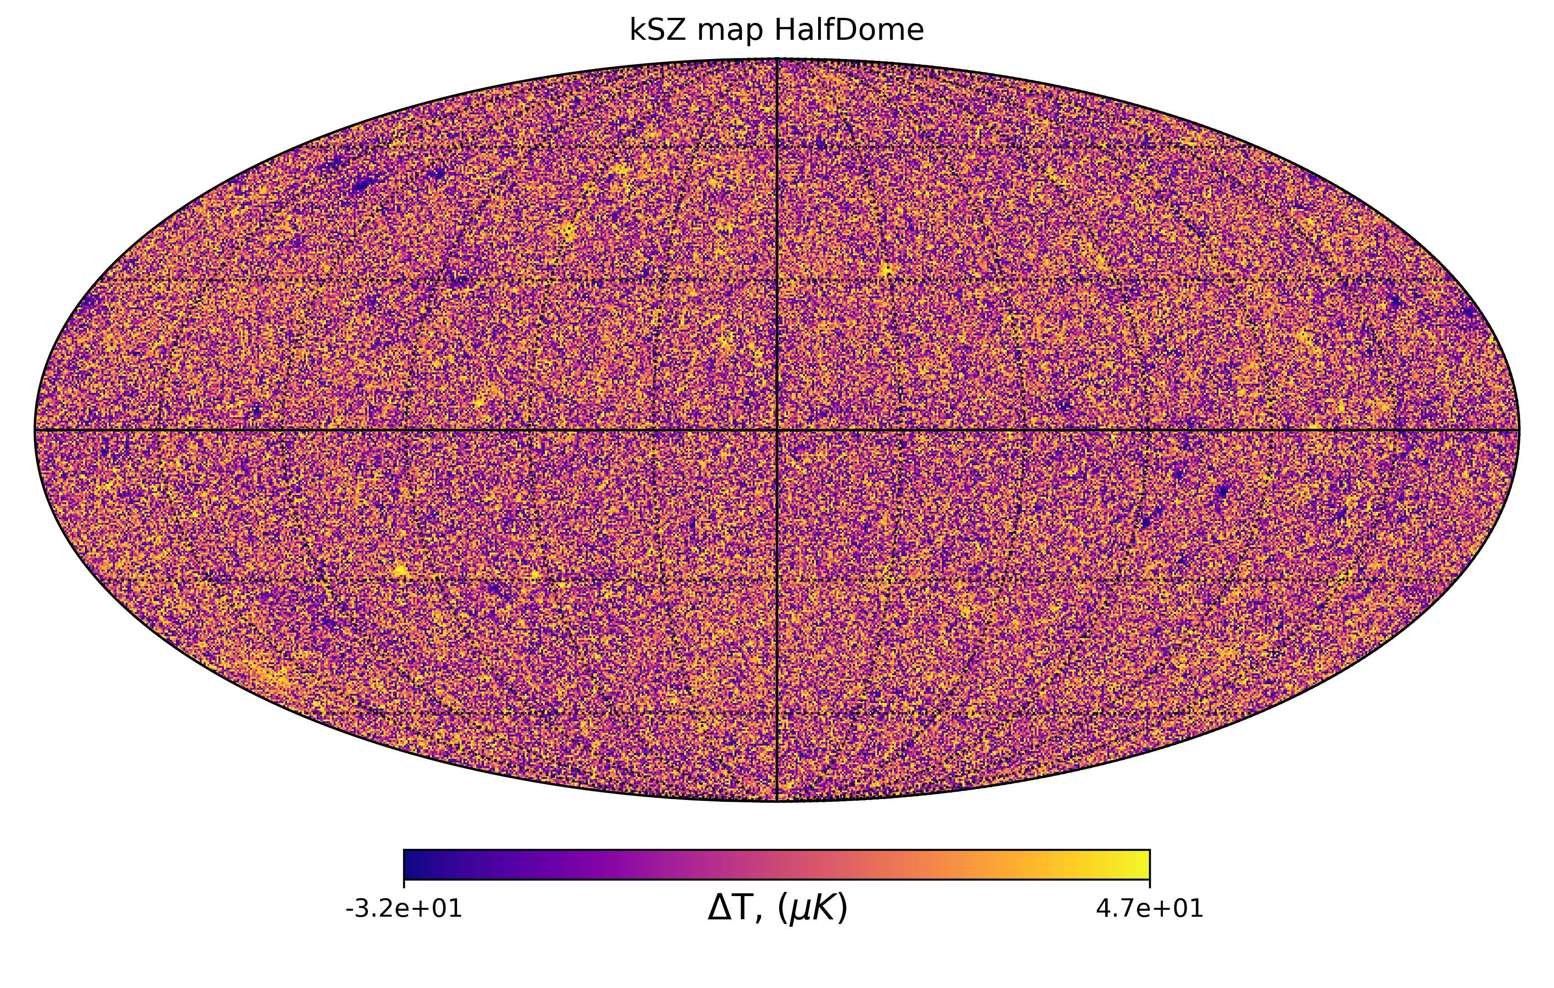
tSZ and kSZ maps
Full-sky maps of both tSZ and kSZ effects
Only halo component
Can be used to cross-correlated with other metrics

Slide 10
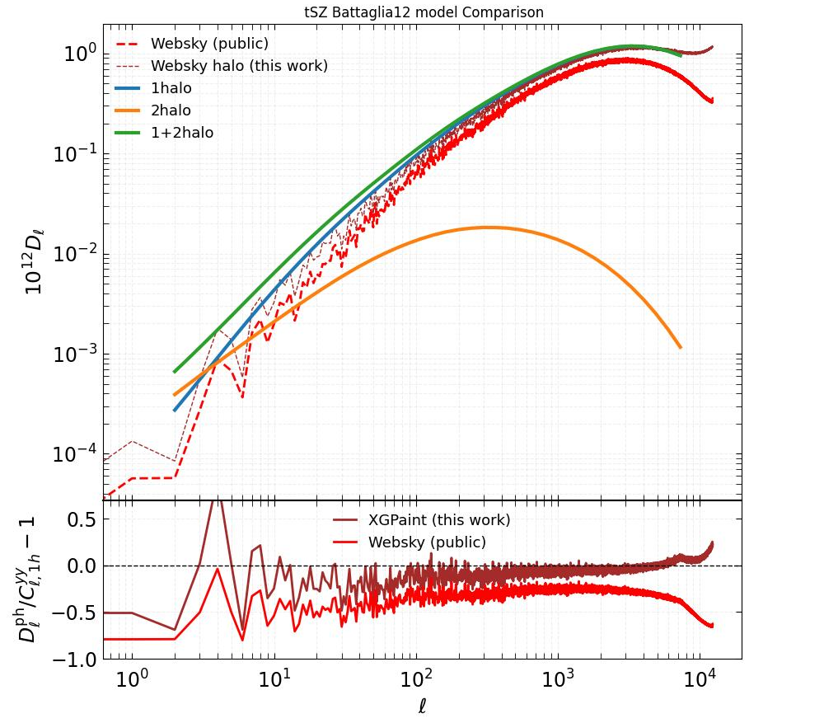
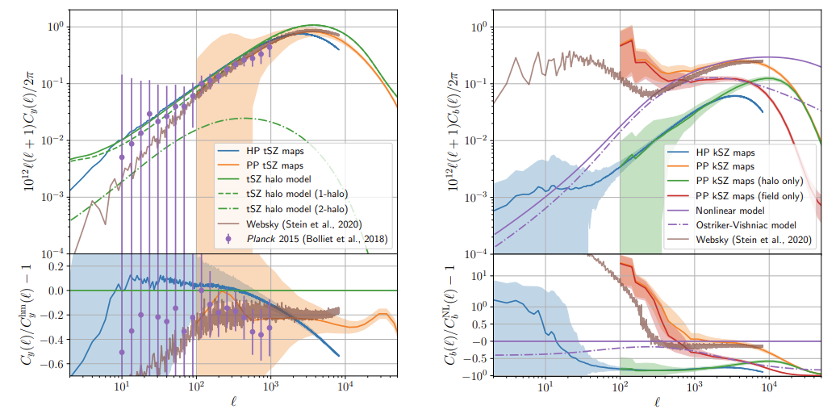
tSZ and kSZ maps
Tested with other simulations (e.g., Websky) and models
Good agreement also with other baryon pasting models (e.g., Osato model)
Matches observations from Planck
(George Stein+2020)
(Ken Osato+2022)

Slide 11
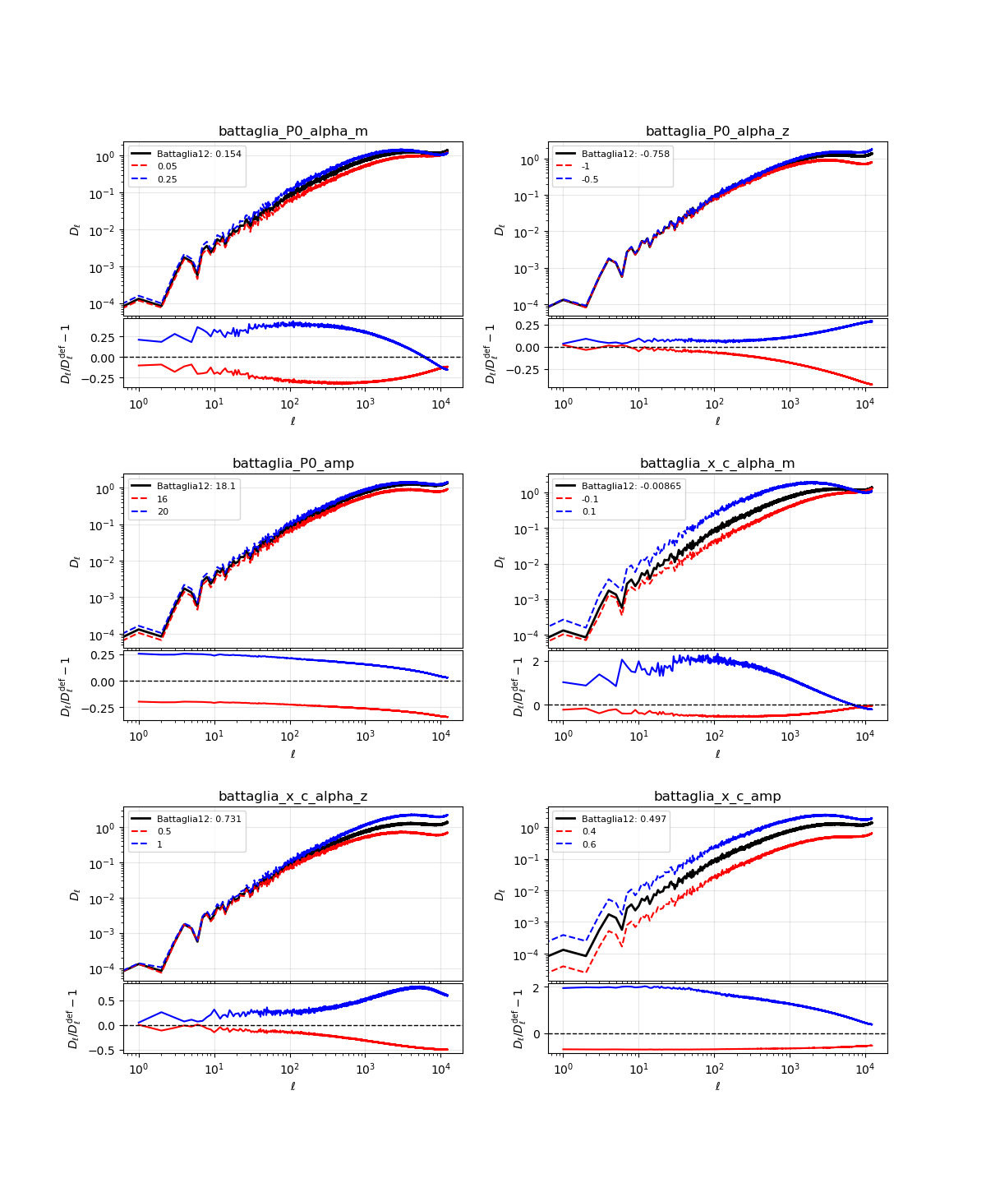
Battaglia parameter variation
Battaglia model ^{(Nicholas Battaglia+2012)} is outdated, but many still use it
Gas profiles affect the correlation profiles
9 free parameters
(Almost) all have different affect on the profile

Slide 12
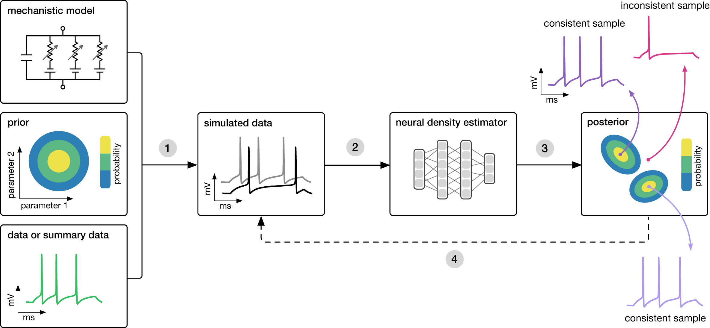
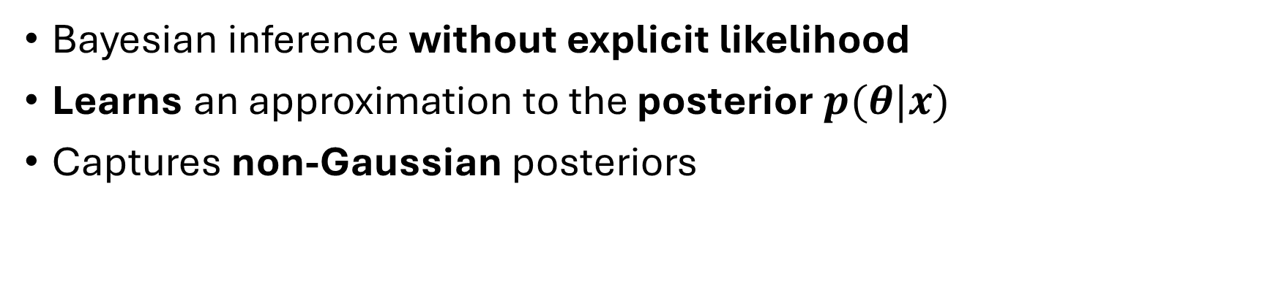
Simulation based inference (SBI)
Bayesian inference without explicit likelihood
Learns an approximation to the posterior $p(θ|x)$
Captures non-Gaussian posteriors

Slide 13
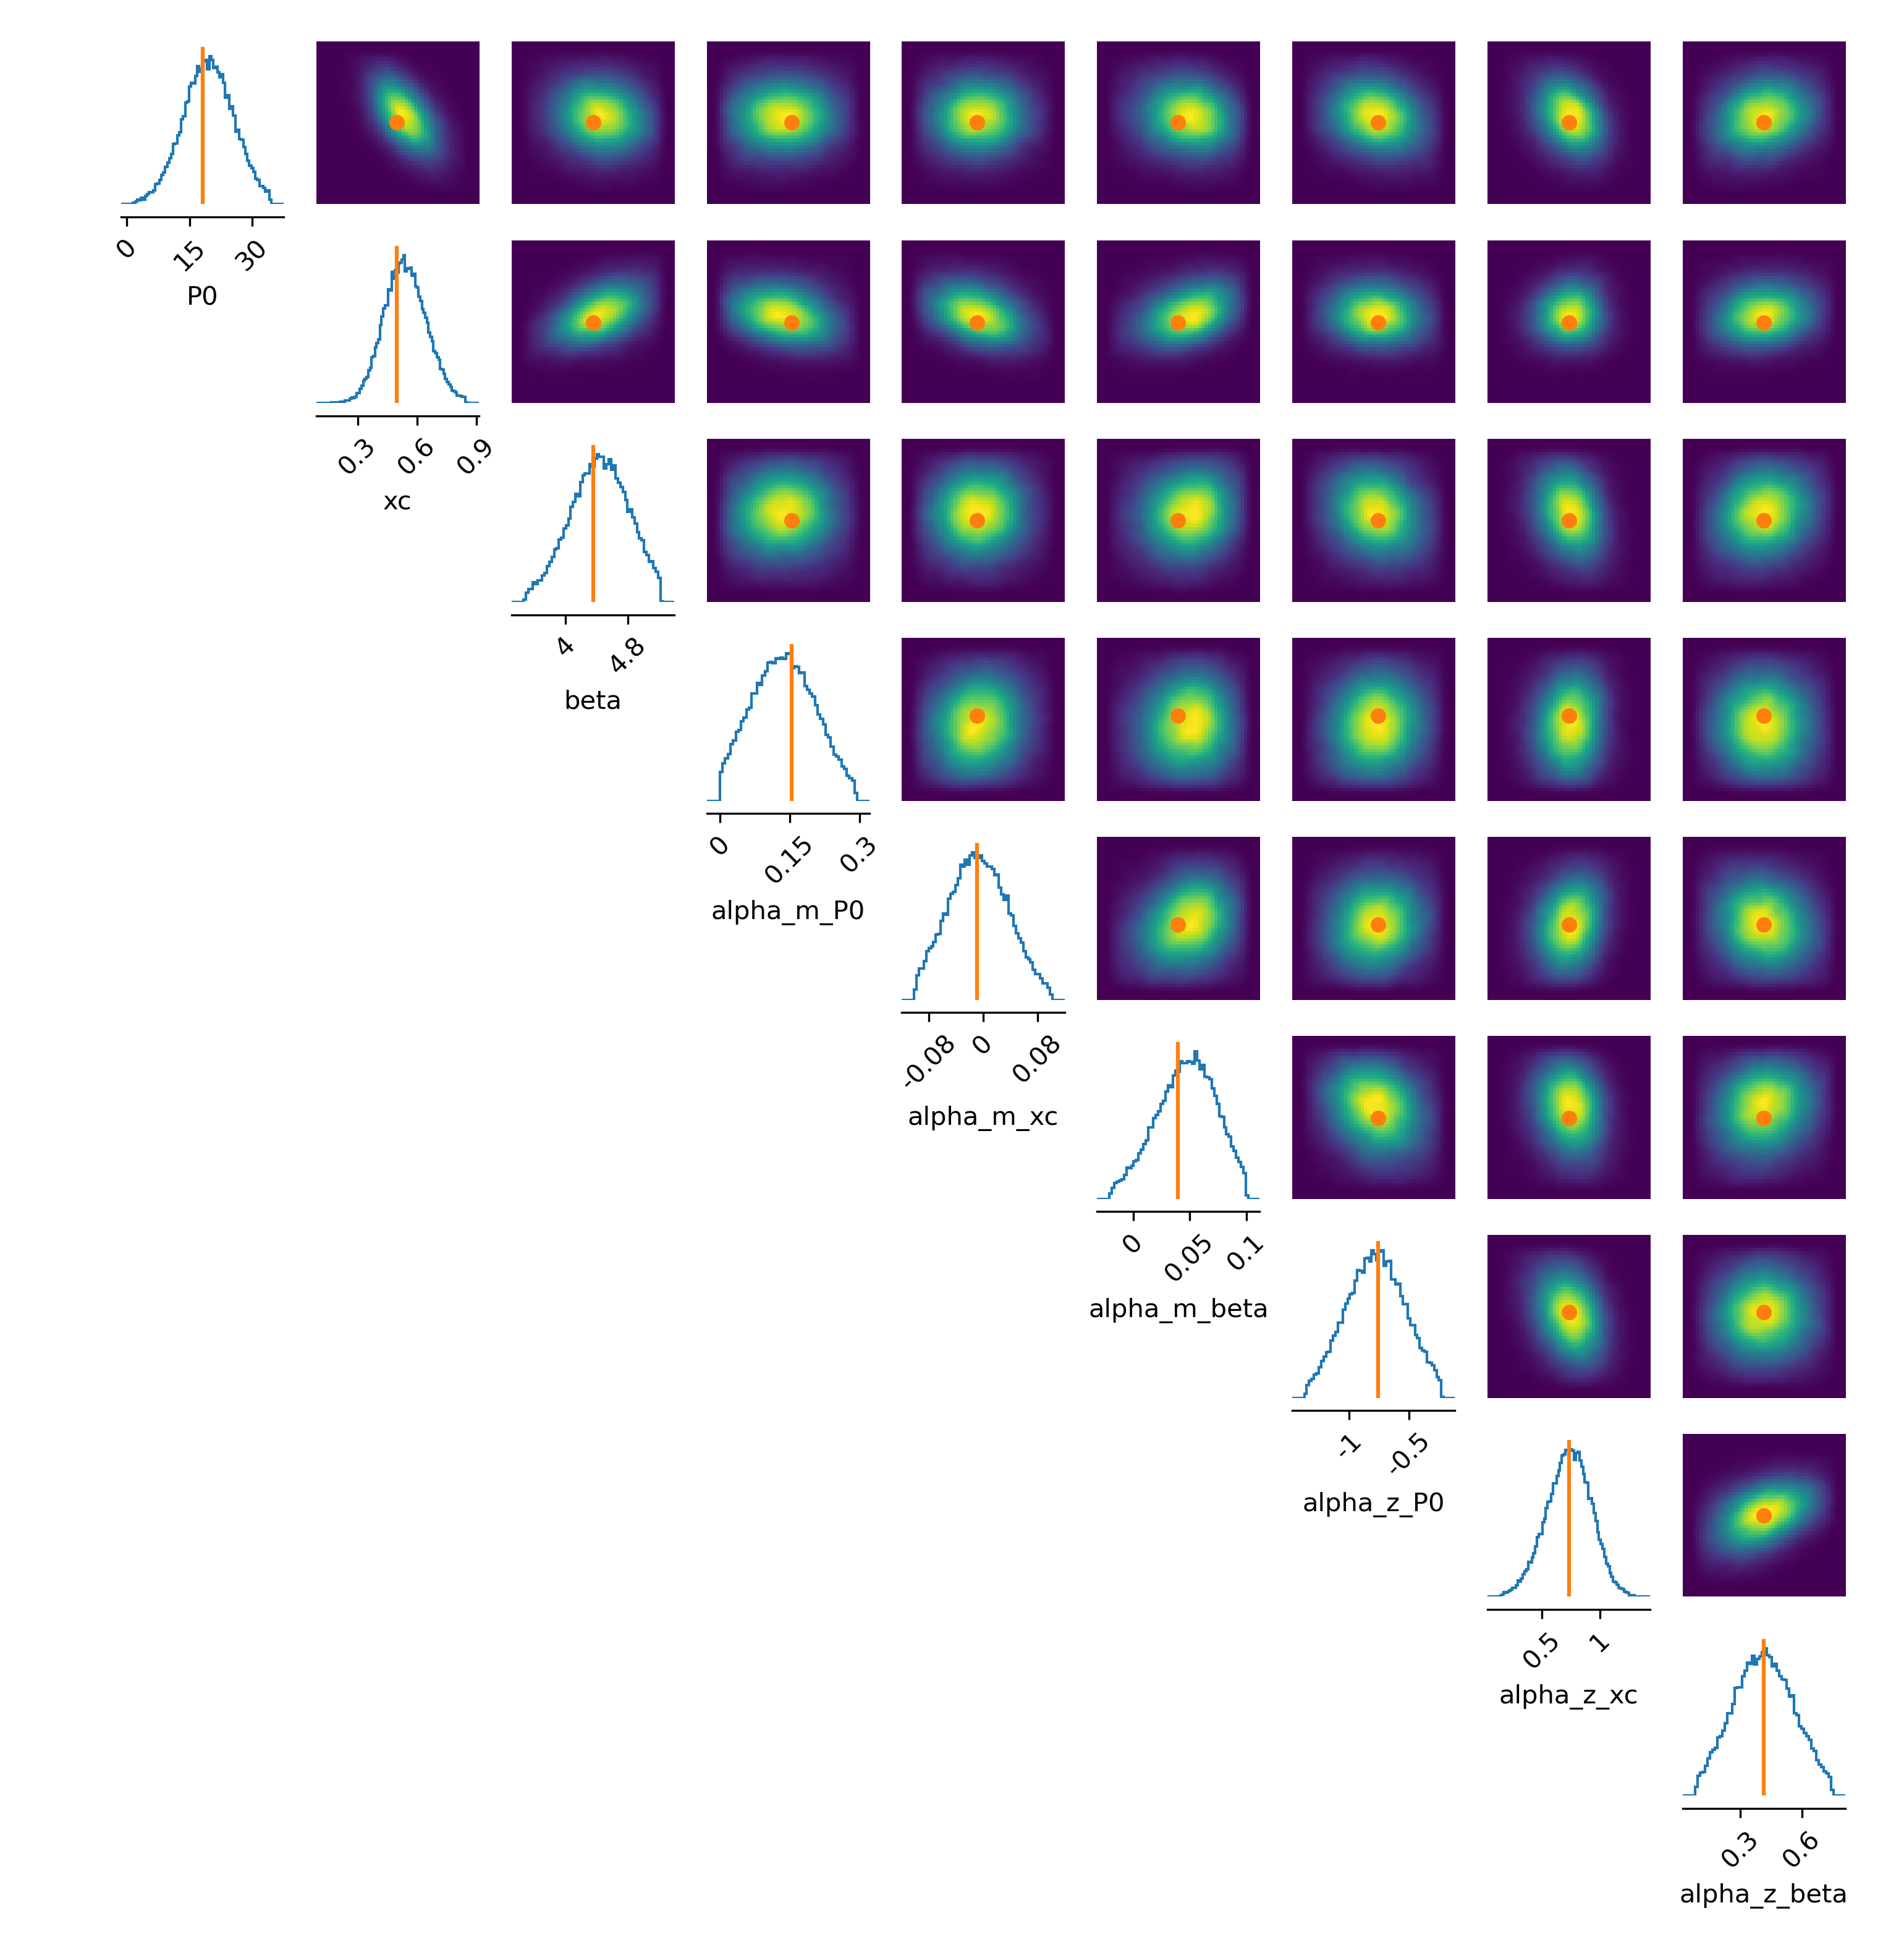
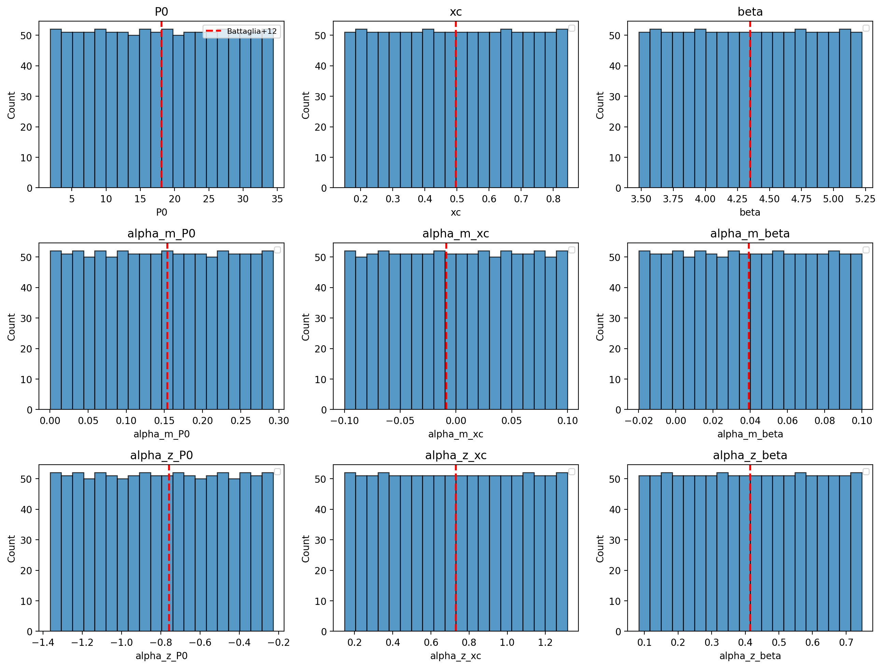
Simulation based inference (SBI)
Prior based on Battaglia and latest simulation analysis (FLAMINGO, CAMELS)
Inference for noisy synthetic data vector
All parameters constrained
No strong degeneracies
Amplitude
Mass dependence
Redshift dependence

Slide 14
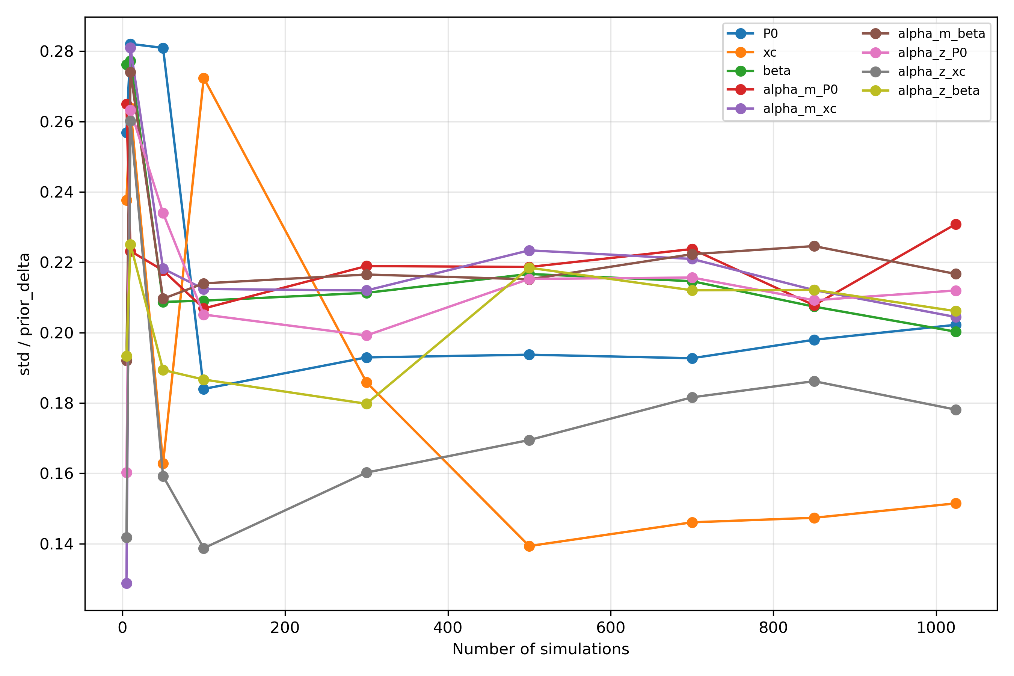
Simulation based inference (SBI)
Prior based on Battaglia and latest simulation analysis (FLAMINGO, CAMELS)
Inference for noisy synthetic data vector
All parameters constrained
No strong degeneracies
Most converges, but more simulations needed

Slide 15
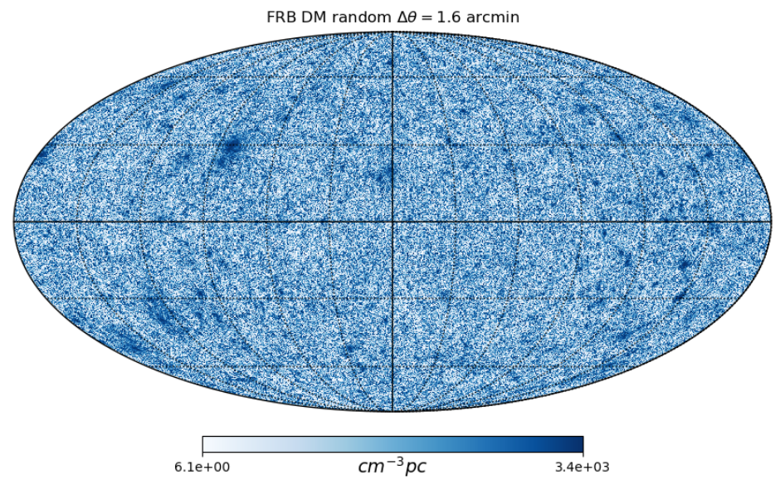
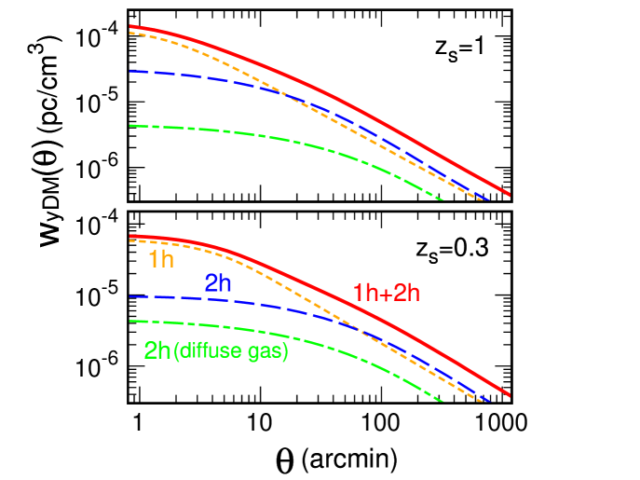
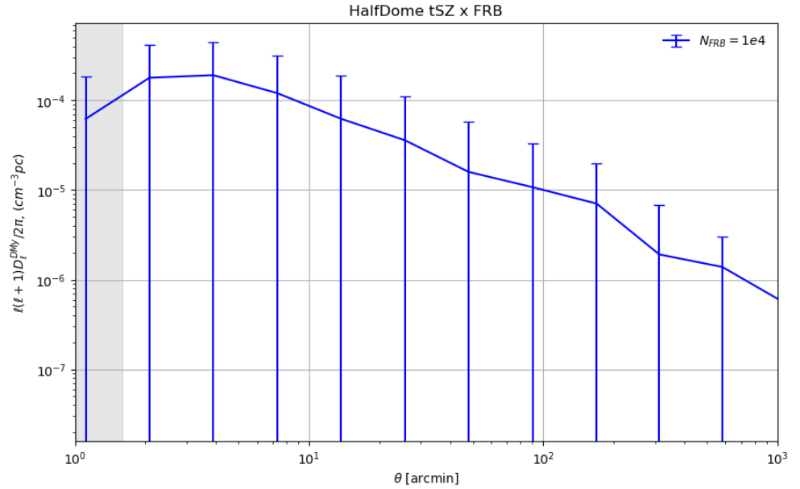
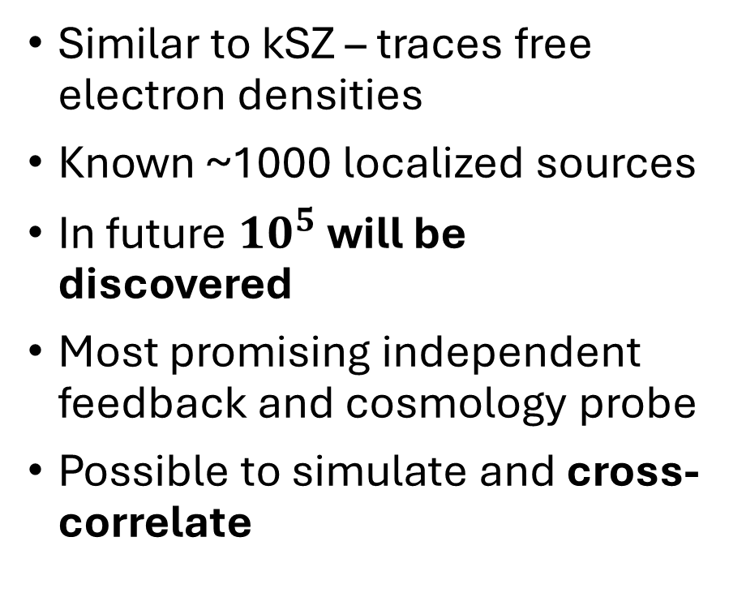
Fast radio burst (FRB) dispersion measures (DM)
Similar to kSZ – traces free electron densities
Known ~1000 localized sources
In future ${10}^{5}$ will be discovered
Most promising independent feedback and cosmology probe
Possible to simulate and cross-correlate
Takahashi et al. 2025

Slide 16
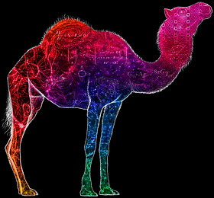
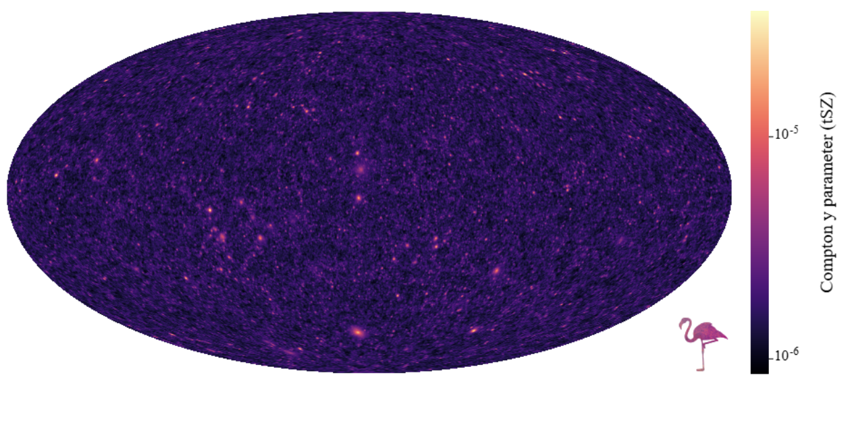
Next steps
SBI with hydrodynamic simulations and ACT/SPT data
Exploring cross-correlation with FRBs and different sources
Different baryon pasting models (e.g., CAMELS emulator)

Slide 17
Conclusions
Baryon pasting: effective way to generate many simulations for different observables
Thermal and kinetic SZ: can constrain the gas distribution within halos and baryonic feedback
Simulation based inference: useful tool to overcome the issue of likelihood intractability
Cross-correlations break parameter degeneracies and improve constraints

