Slide 1


Determining
Cosmic Enviroments from
Galaxy Properties
Zoe Rhiannon Jones
Tues 26th May, 2026
Nordic-Baltic Astronomy Days in Turku, Finland

Slide 2
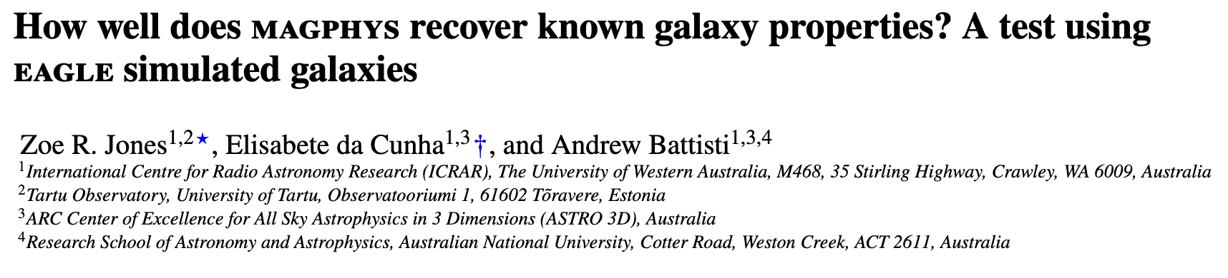
Testing SED Models
Investigating whether the MAGPHYS SED model can recover accurate physical parameters from simulated galaxies
arXiv:2603.22945

Slide 3
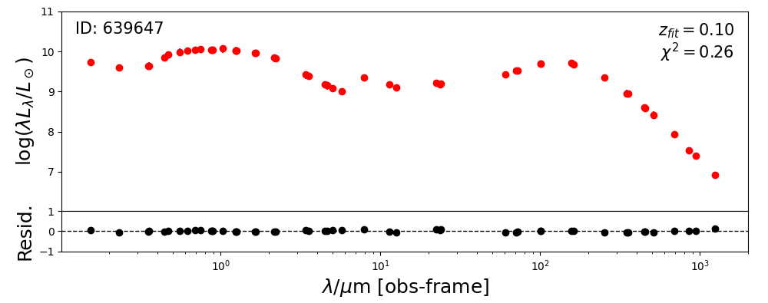
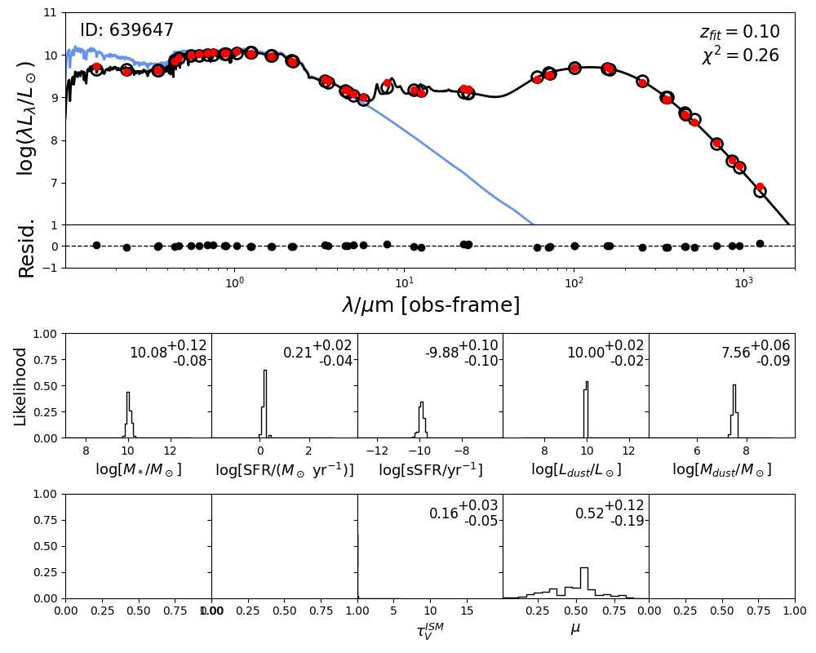
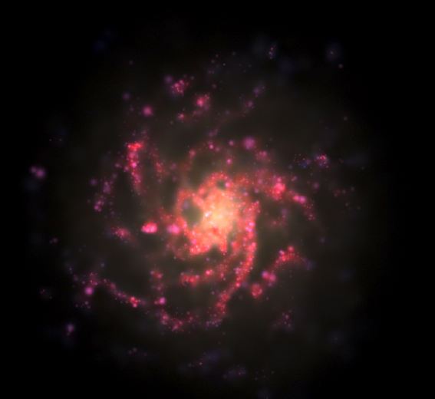
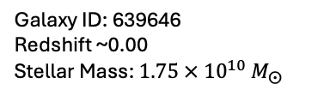
Testing SED Models
True Parameters
(EAGLE)
Simulated SEDs
(SKIRT)
Alpine et al. (2016)
Camps et al. (2018)
MAGPHYS
Compare
da Cunha et al. (2008)
Recovered Parameters
Camps et al. (2016)
Galaxy ID: 639646
Redshift ~0.00
Stellar Mass: $1.75 × {10}^{10} M_{⨀}$

Slide 4

Weighted Galaxy Matching
Studying the relationship between galaxy properties and their environments
*Artist interpretation of me meeting with my supervisors

Slide 5
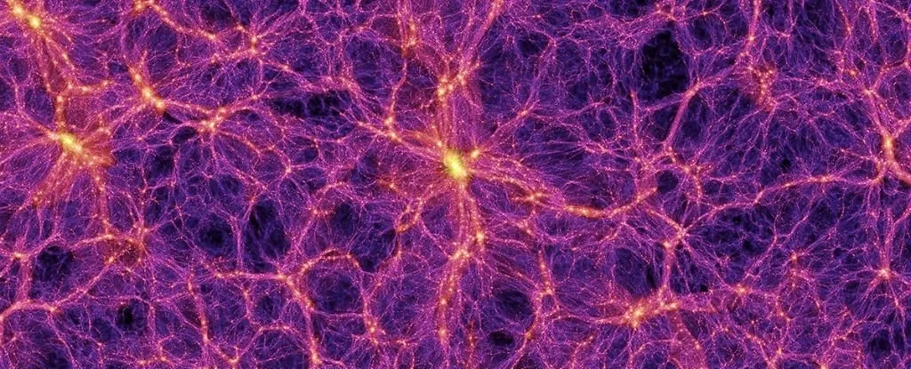
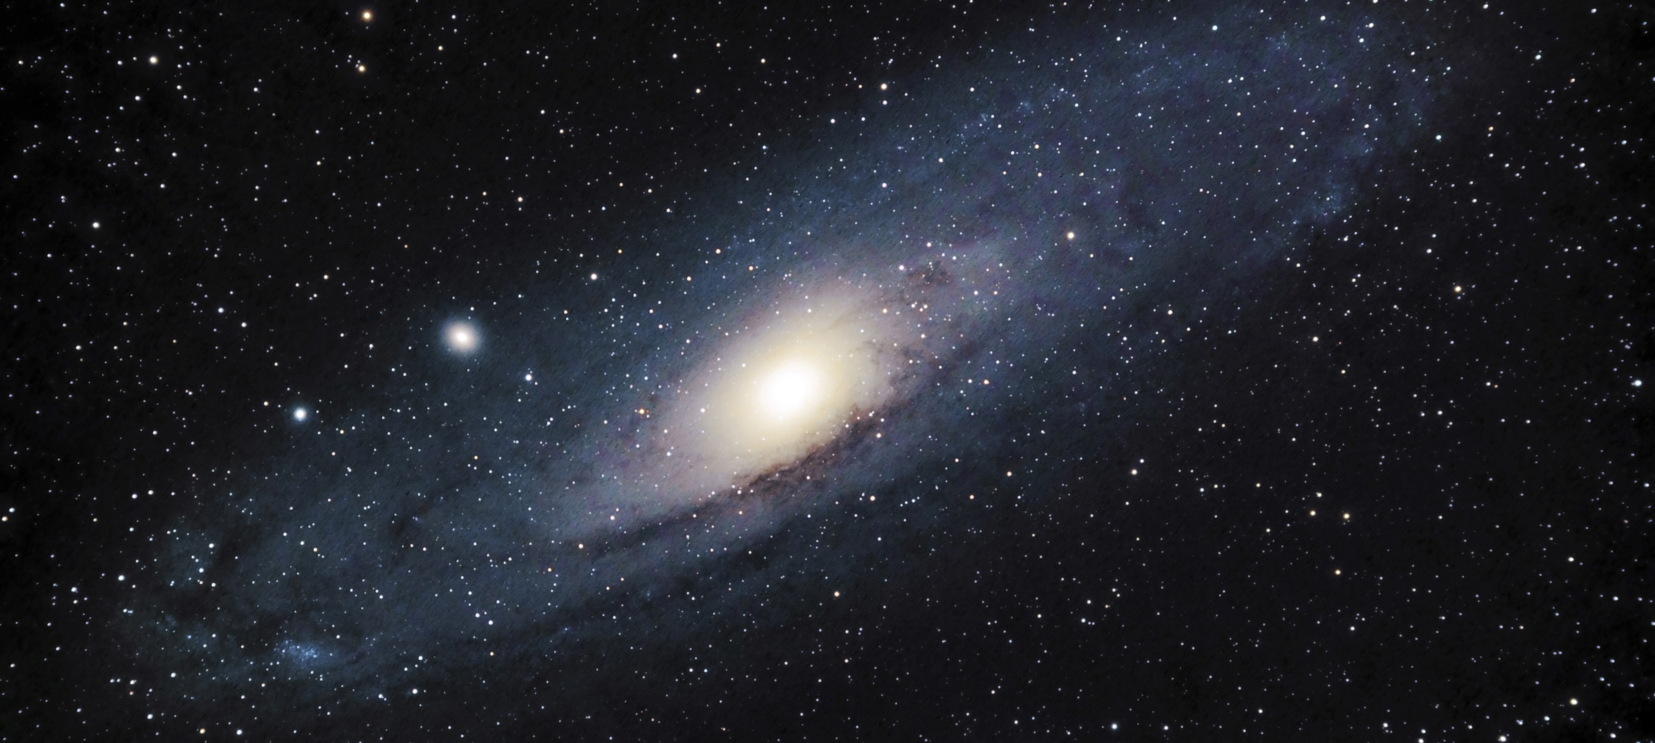
Galaxy Environments

Slide 6
Galaxy Environments

Slide 7
Project Overview
Aim: To create a tool to find the similarity between galaxies based on their SEDs
Data: Testing on GAMA data with the goal of using it on 4MOST data
Goal: Will then be able to take one mystery galaxy and learn which part of the comsic web holds the most similar galaxies, and therefore which part of the cosmic web is it most likely to inhabit

Slide 8
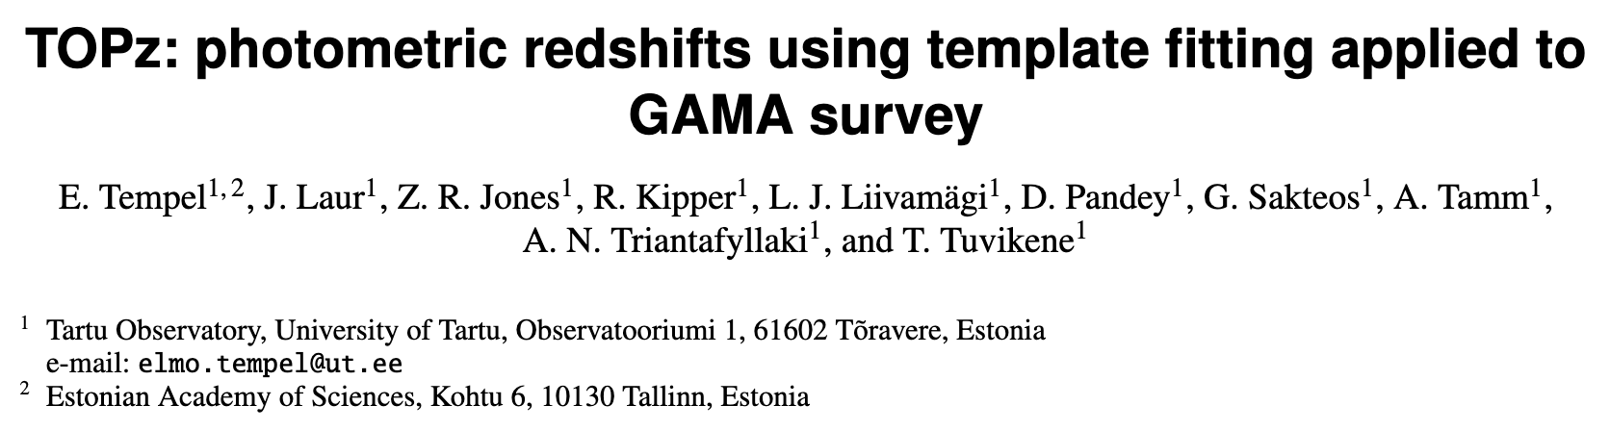
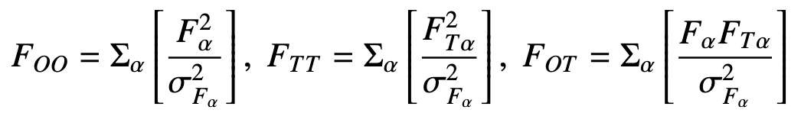
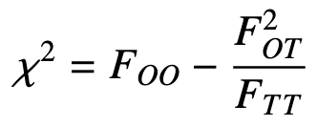
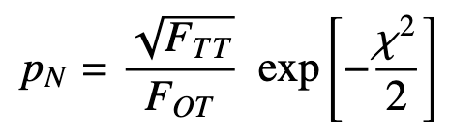
Method
“Template” galaxies
arXiv:2503.24039
 | ID1 | ID2 | ID3 | ID4 | ID5 | ID6 | IDN
ID1
ID2 | ??? | ??? | ??? | ??? | ??? | ??? | ???
ID3
“Observed” galaxy

Slide 9

Method
“Template” galaxies
arXiv:2503.24039
 | ID1 | ID2 | ID3 | ID4 | ID5 | ID6 | IDN
ID1 | - | P1 | P2 | P3 | P4 | P5 | PN
ID2 | P1 | - | P2 | P3 | P4 | P5 | PN
ID3 | P1 | P2 | - | P3 | P4 | P5 | PN
“Observed” galaxy

Slide 10
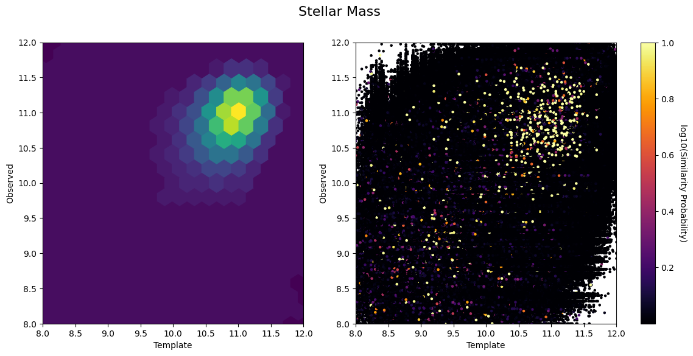
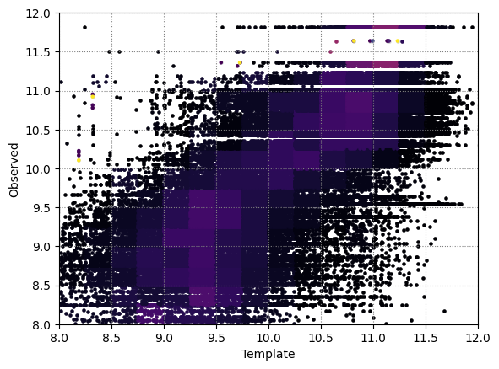
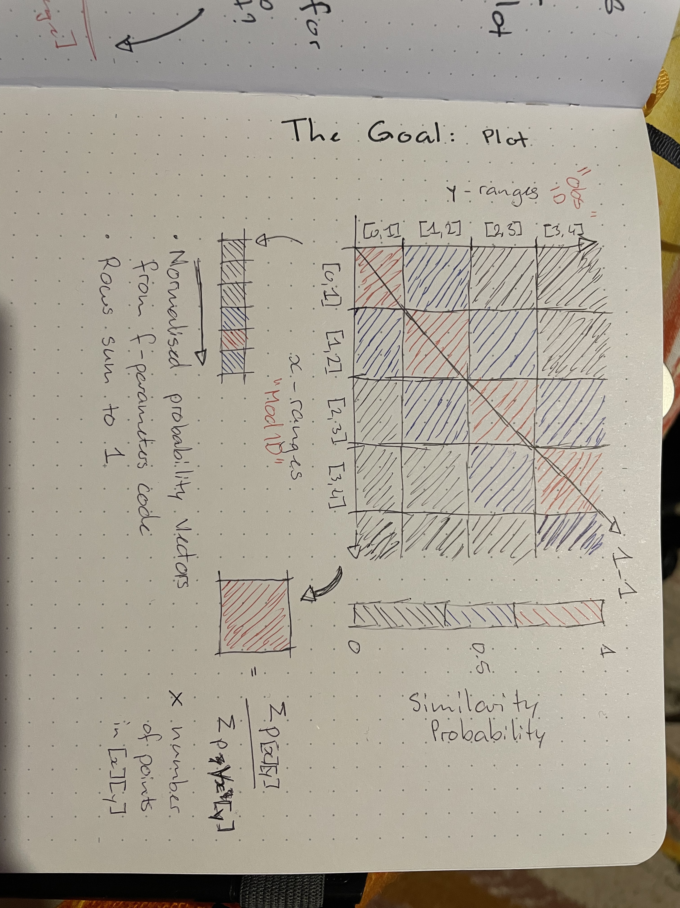
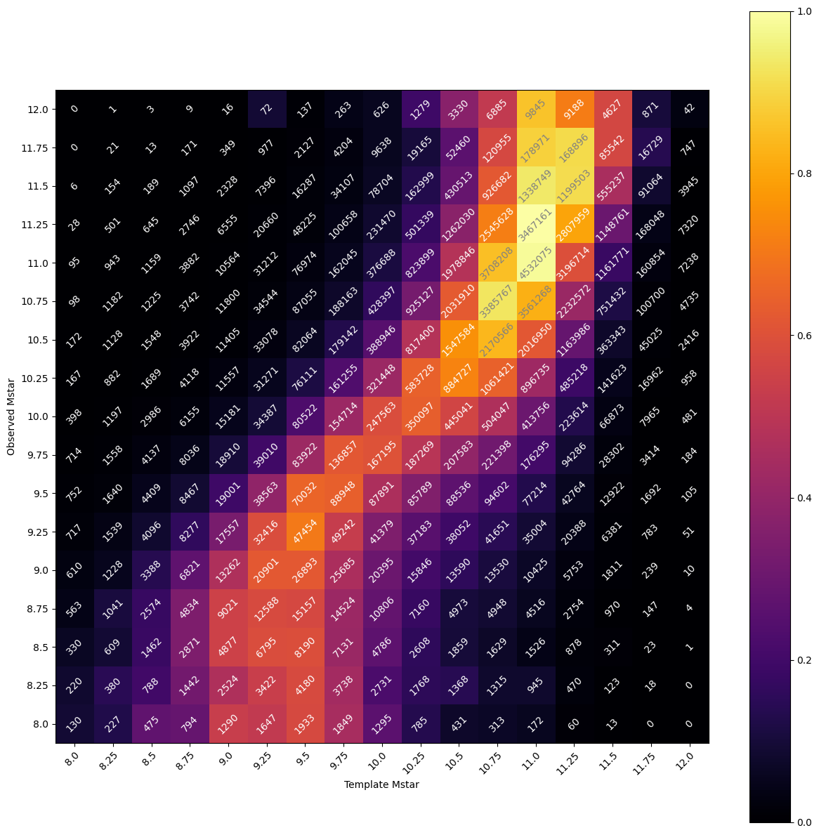
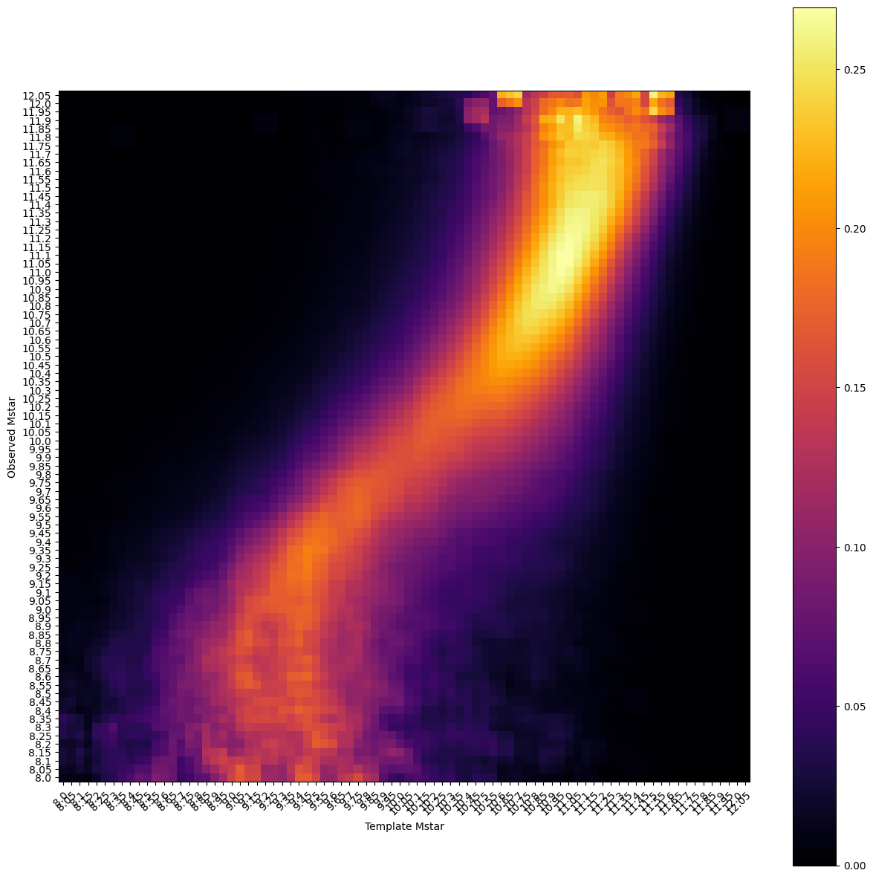
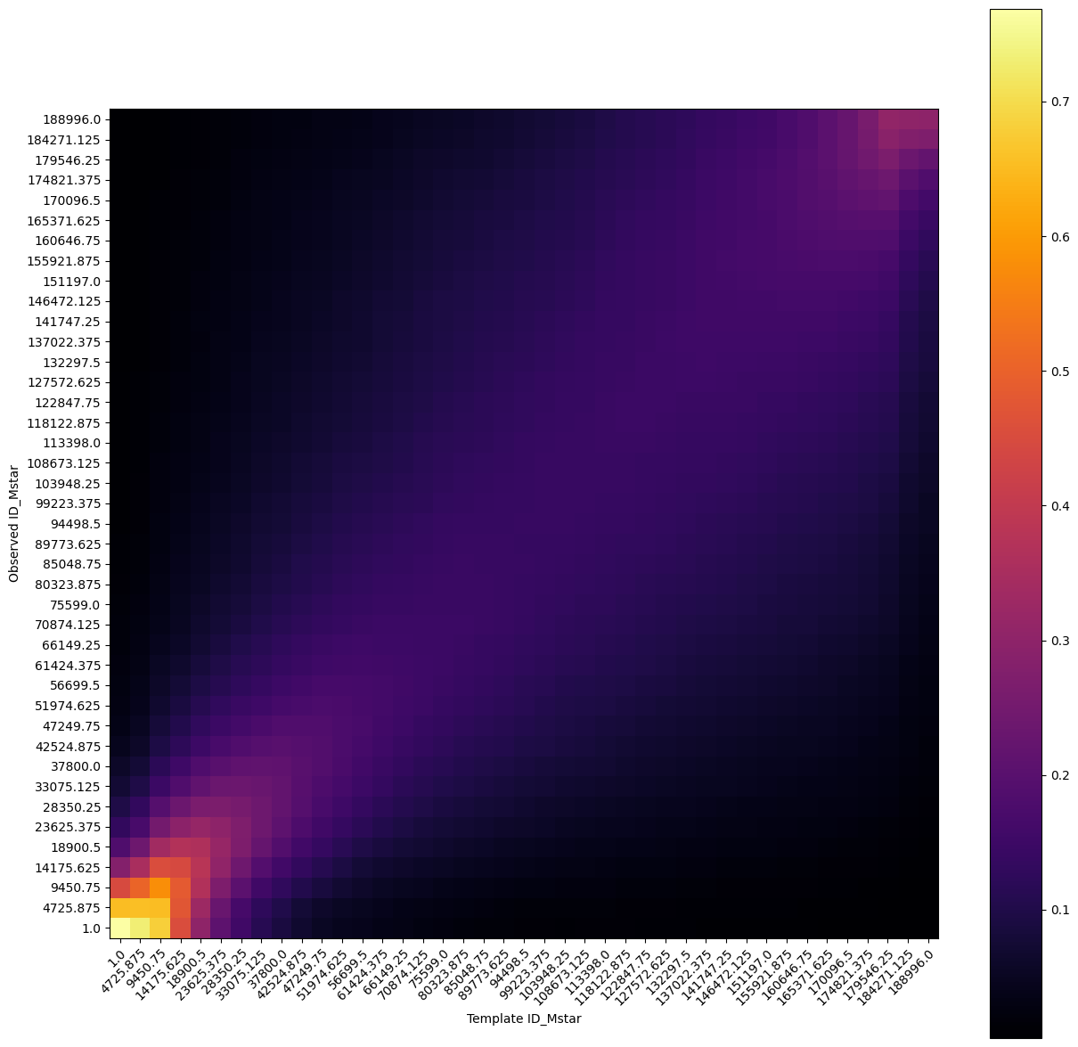
A series of increasingly maddening preliminary
Results

Slide 11
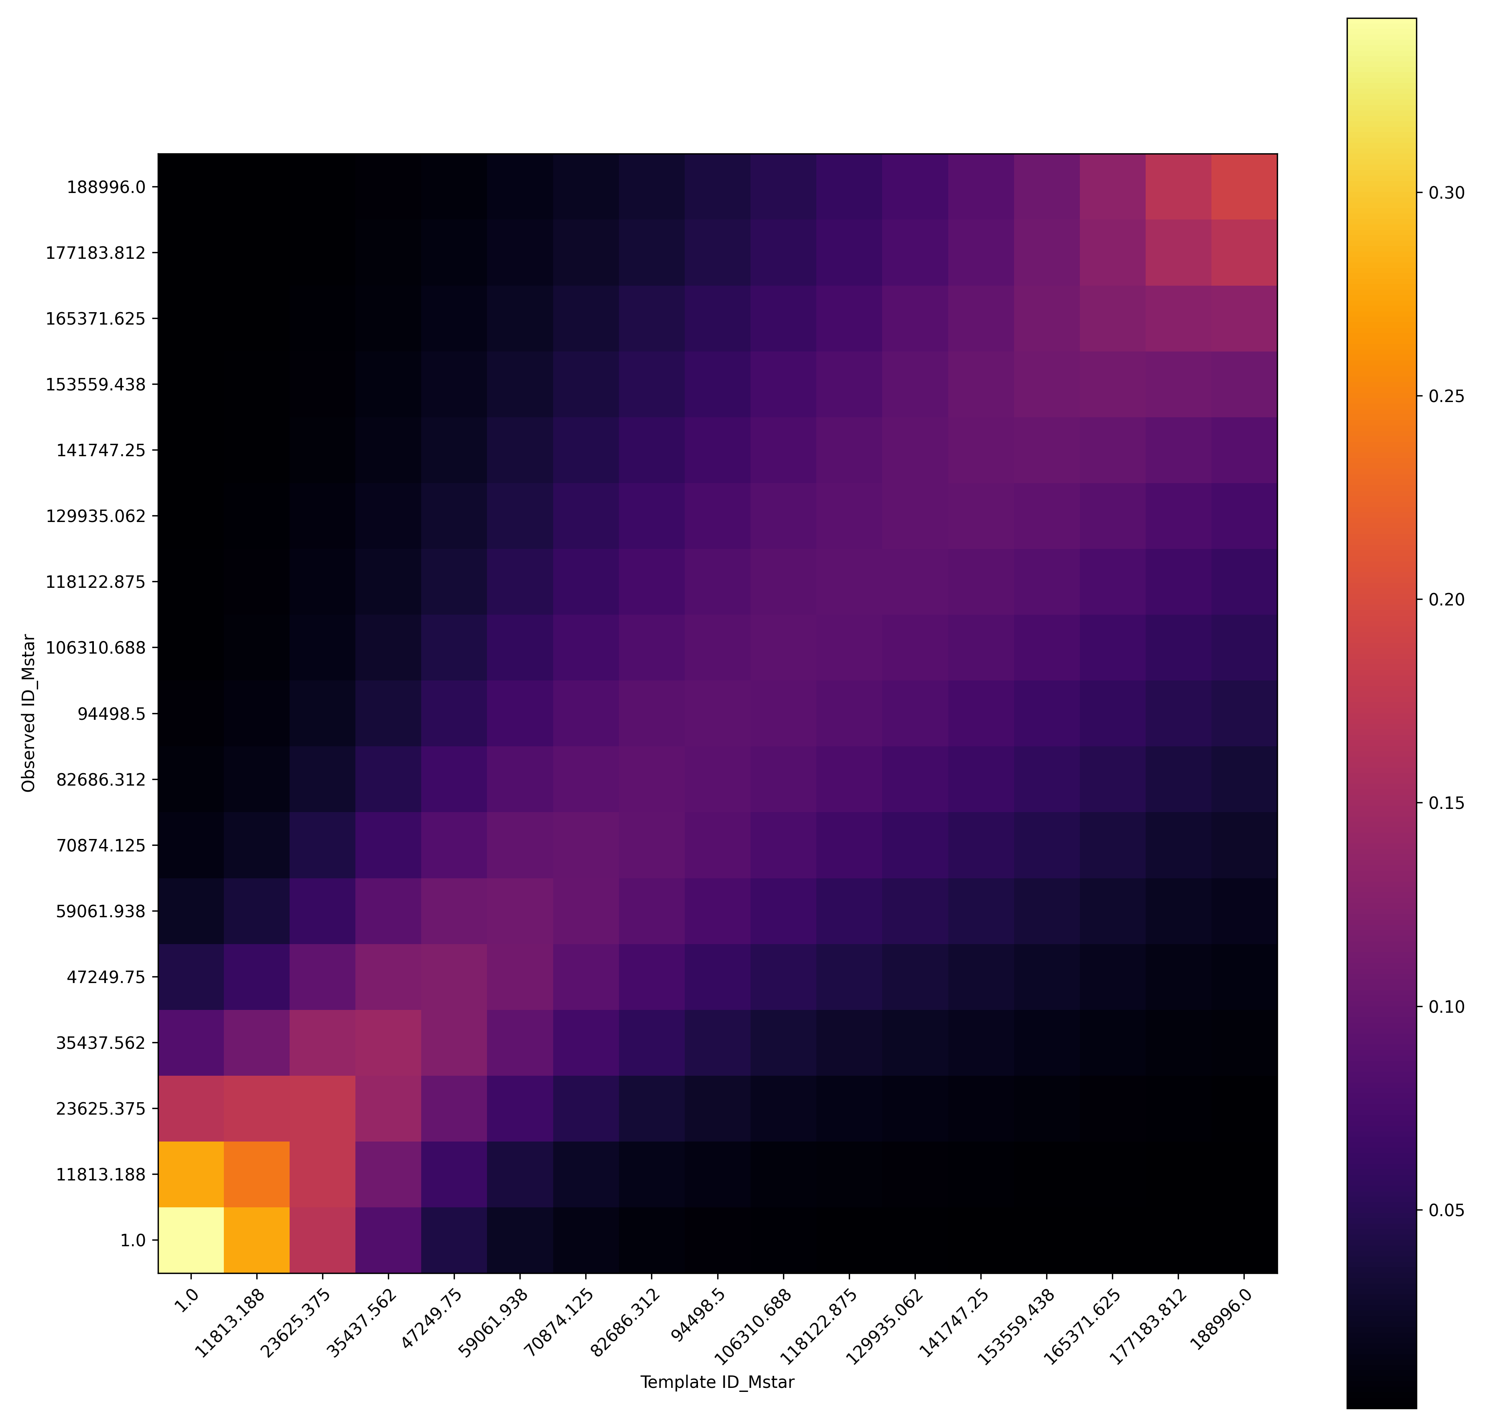
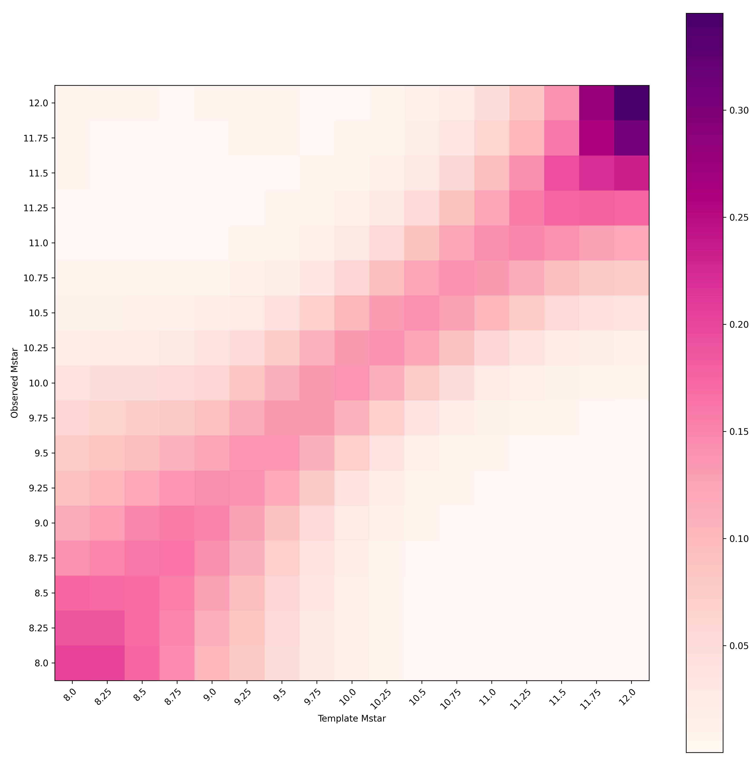
Results

Slide 12
Future Potential for this Project
Can start changing galaxy parameters -> changes SEDs -> changes the similarity with different parts of the cosmic web
  Will show which parameters are most sensitive to environment
Investigate how the web environment affects galaxy evolution
  Take subsamples of galaxies from different environments to find their average SEDs
Apply our tool to 4MOST WAVES and 4HS data in future

Slide 13
Questions?

