Slide 1

Cosmological N-body simulations in trivial and non-trivial topological manifolds with StePS
Nordic-Baltic Astronomy Days
26 May 2026, Turku
Gábor Rácz
University of Helsinki

Slide 2
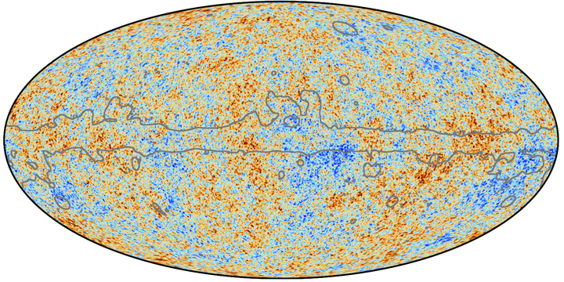
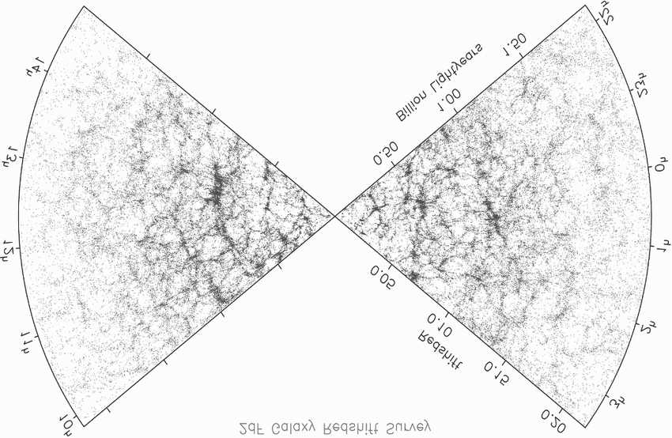
Introduction: Large-scale structure formation
Gábor Rácz
Formation of cosmic structures:
Small density fluctuations at early times (𝛅~10⁻⁵ at the time of the CMB)
These fluctuations grow over time due to self-gravity.
Late time observations: cosmic web: Galaxies, Clusters, Filaments, Walls, and Voids.
The Cosmic Microwave Background (CMB)
The distribution of local galaxies
13.7Gy evolution
Can we follow this evolution in theory?
Can we use these observations to test our models?
ESA/Planck Collaboration (July 2018)
Colless M.M. et al. (June 2003)

Slide 3
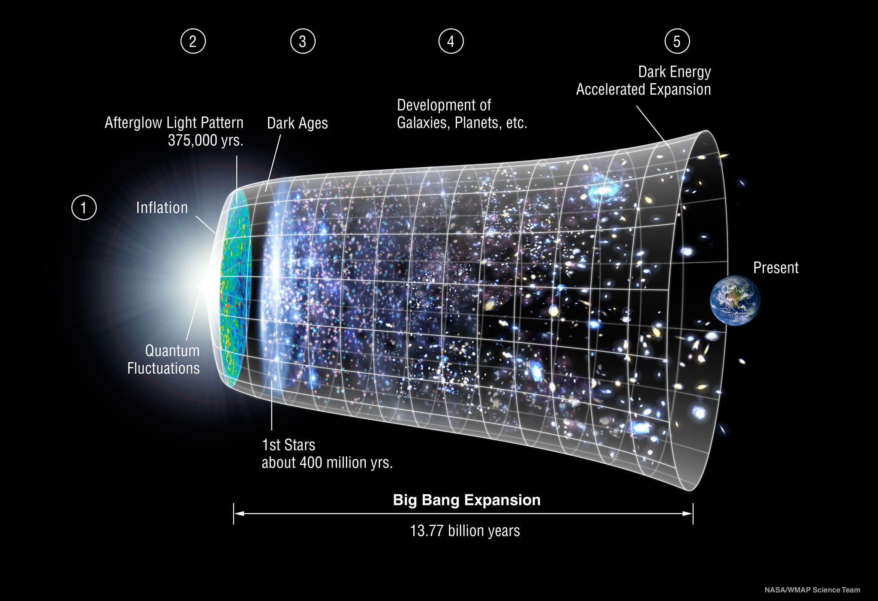
Introduction: Large-scale structure formation
Gábor Rácz
The ΛCDM model
Main assumptions:
Gravity can be described by GR
Energy density at present time is dominated by dark energy and dark matter:
  Cosmological constant (Λ)
  Cold (collisioness) Dark Matter (CDM)
  (+few % baryion)
Gaussian Initial Conditions (ICs)
Isotropy and homogeneity (on large scales)
No global curvature (Ω_{k} = 0)
Trivial Eucledian ℝ³ topological manifold
NASA/ LAMBDA Archive / WMAP Science Team

Slide 4
Topological manifolds
A topological manifold is a topological space that locally resembles real n-dimensional Euclidean space.
The topological manifold determines the global symmetries of the space.
Question: What topological manifold describes our Universe?
Name | Definition | Cartesian coordinates | Continuous Symmetries | Bounary Conditions
Real coordinate space | ℝ³ = ℝ × ℝ × ℝ | -∞ < x < ∞ -∞ < y < ∞ -∞ < z < ∞ | Translation (any direction) Rotation (any axis) | Vacuum
3-dimensional torus | T³ = S¹ × S¹ × S¹ | 0 < x < L_{x} 0 < y < L_{y} 0 < z < L_{z} | Translation (any direction) | Periodic box
“Cylindrical” space | S¹ × ℝ² | -∞ < x < ∞ -∞ < y < ∞ 0 < z < L_{z} | Translation Rotation (around the z axis) | Periodic cylinder

Slide 5
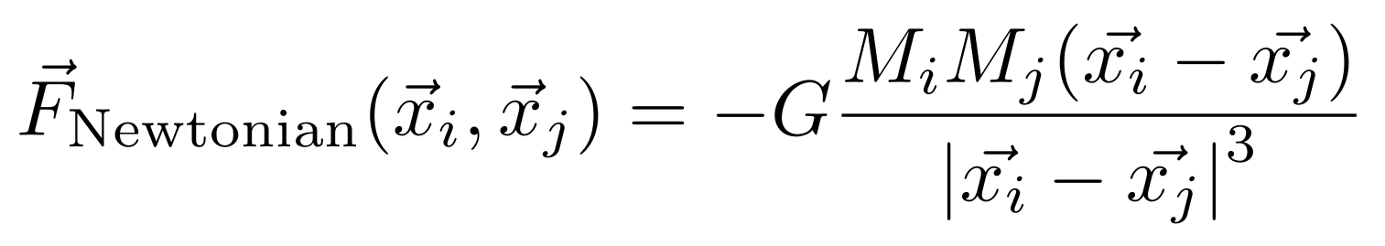
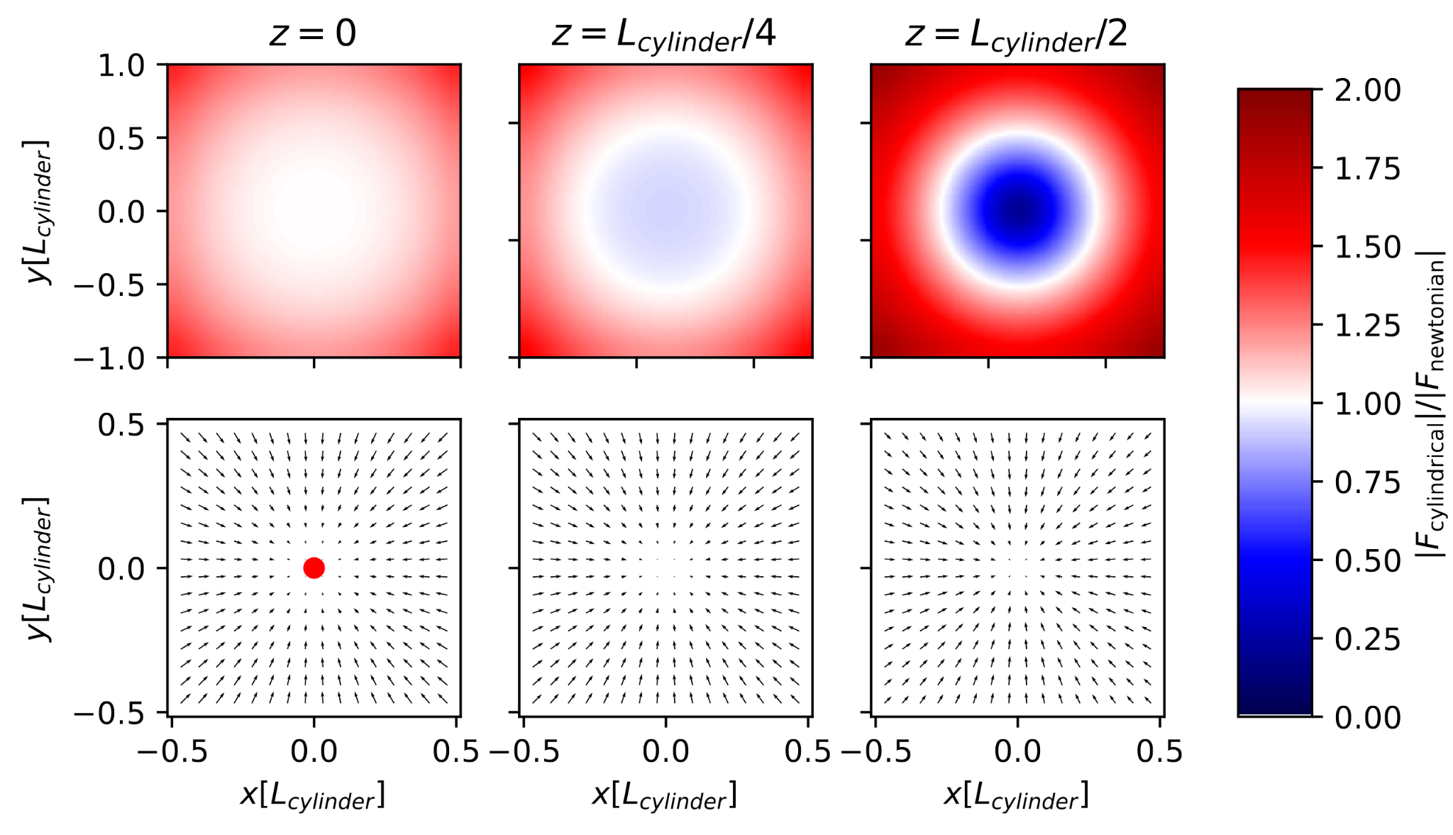
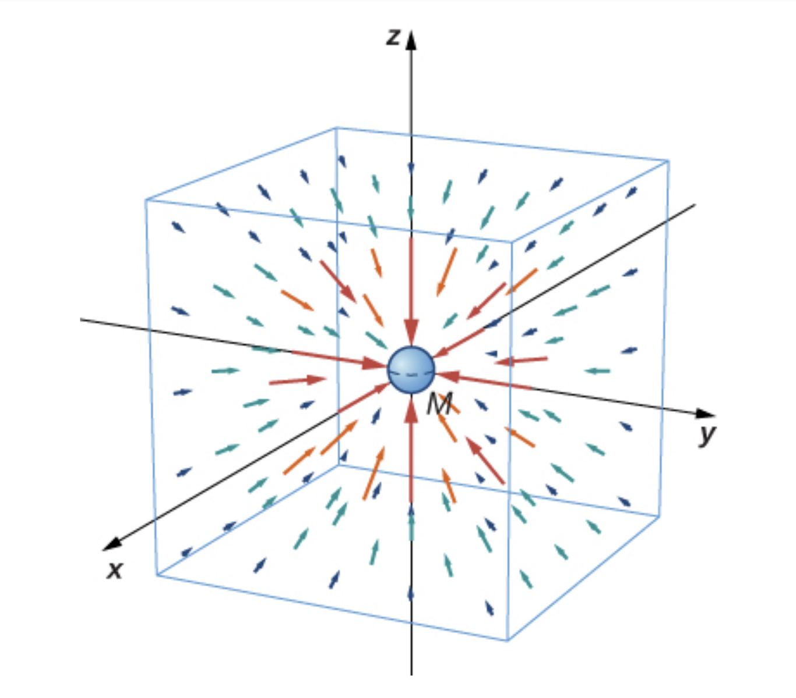
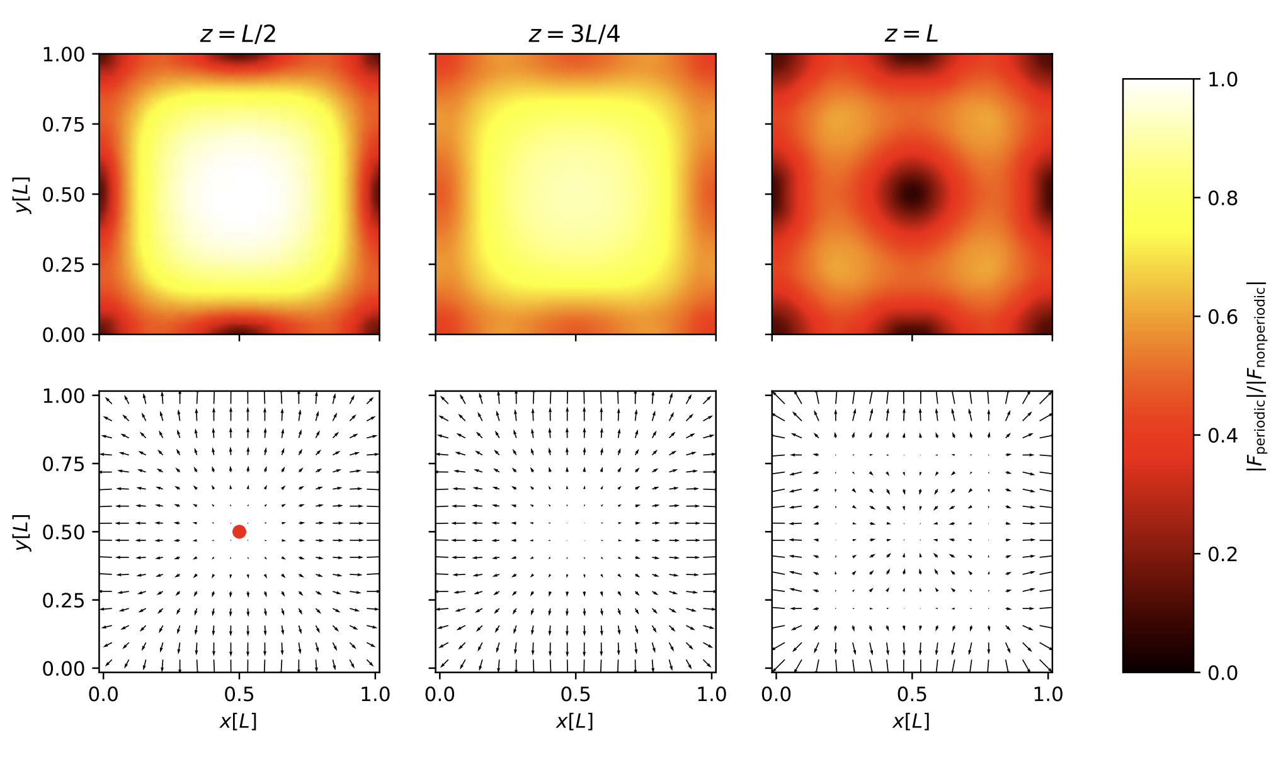
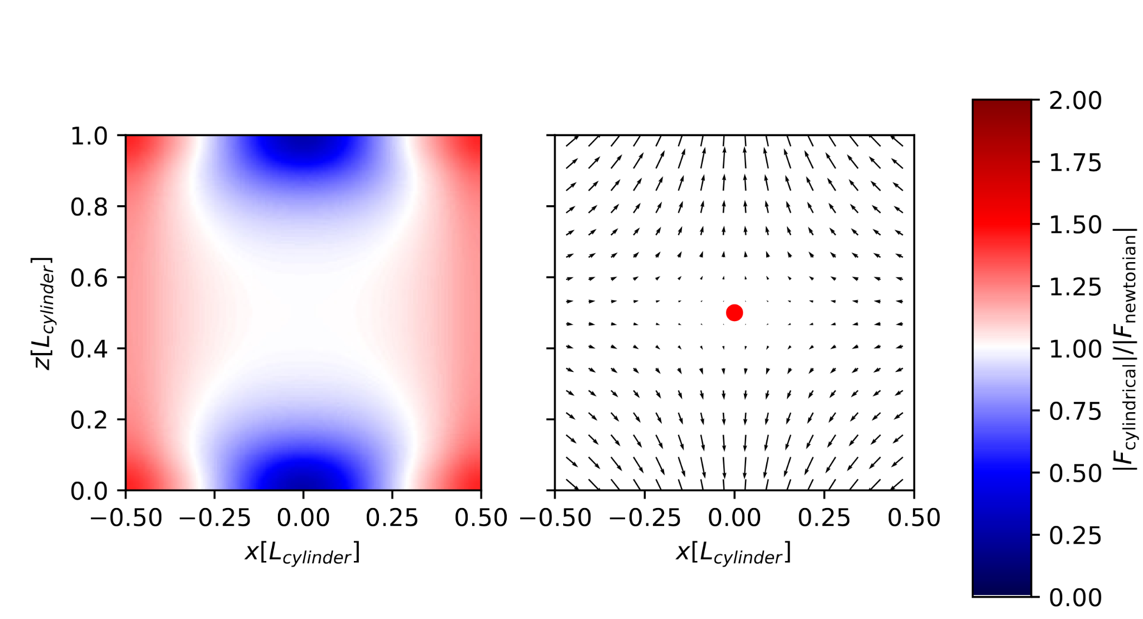
Gravity in different manifolds
Trivial ℝ³ space
Newton’s law of universal gravitation
This force law is isotropic and has an infinite range
Non-trivial T³ space
All periodic images have to be used in the force calculation
This force law is anisotropic
Forces are always weaker in a periodic box, compared to the ℝ³ case.
Non-trivial S¹ × ℝ² space
All periodic images in the “z” direction have to be used in the force calculation
This force law is anisotropic
Image source: https://commons.wikimedia.org/wiki/File:Gravitational_field.png

Slide 6
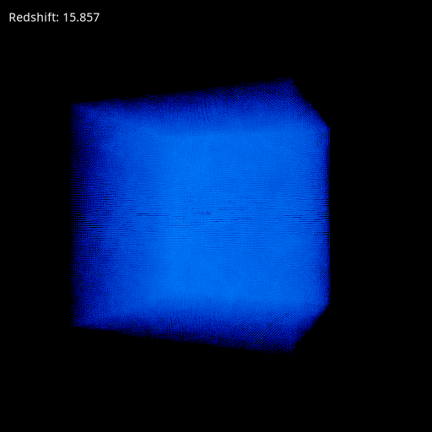
Simulating non-linear structure formation - T³
Gábor Rácz
Cosmological N-body simulations:
Cosmic density field is sampled by discrete particles
The gravitational N-body problem is solved between these particles in comoving coordinates, which factor out the expansion of the Universe.
Main problem: finite computational resources.
The ℝ³ space is infinite
For constant resolution, we would need infinite number of particles.
Standard solution:
Using T³ instead of running the simulation in ℝ³
Hoping this will not affect our results.
Standard choice in almost all simulation software (GADGET, AREPO, SWIFT, PKDGRAV, etc.)

Slide 7
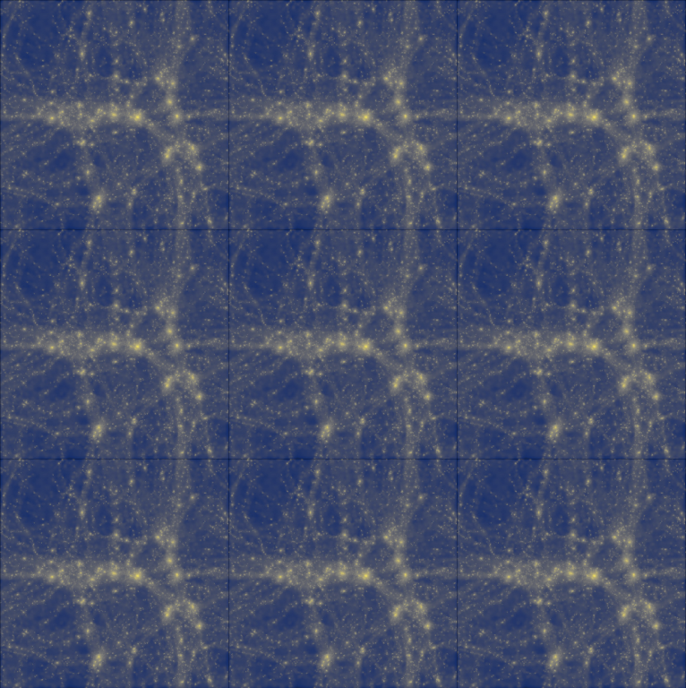
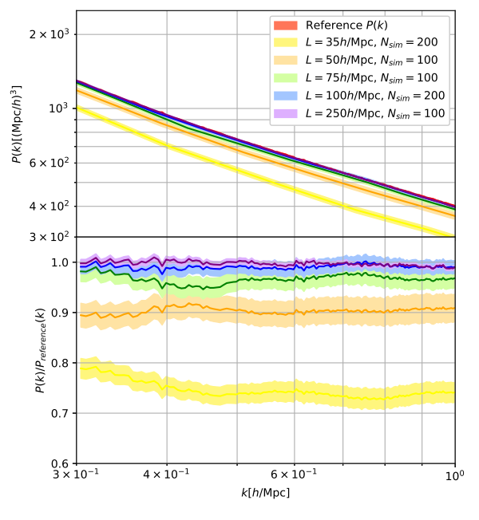
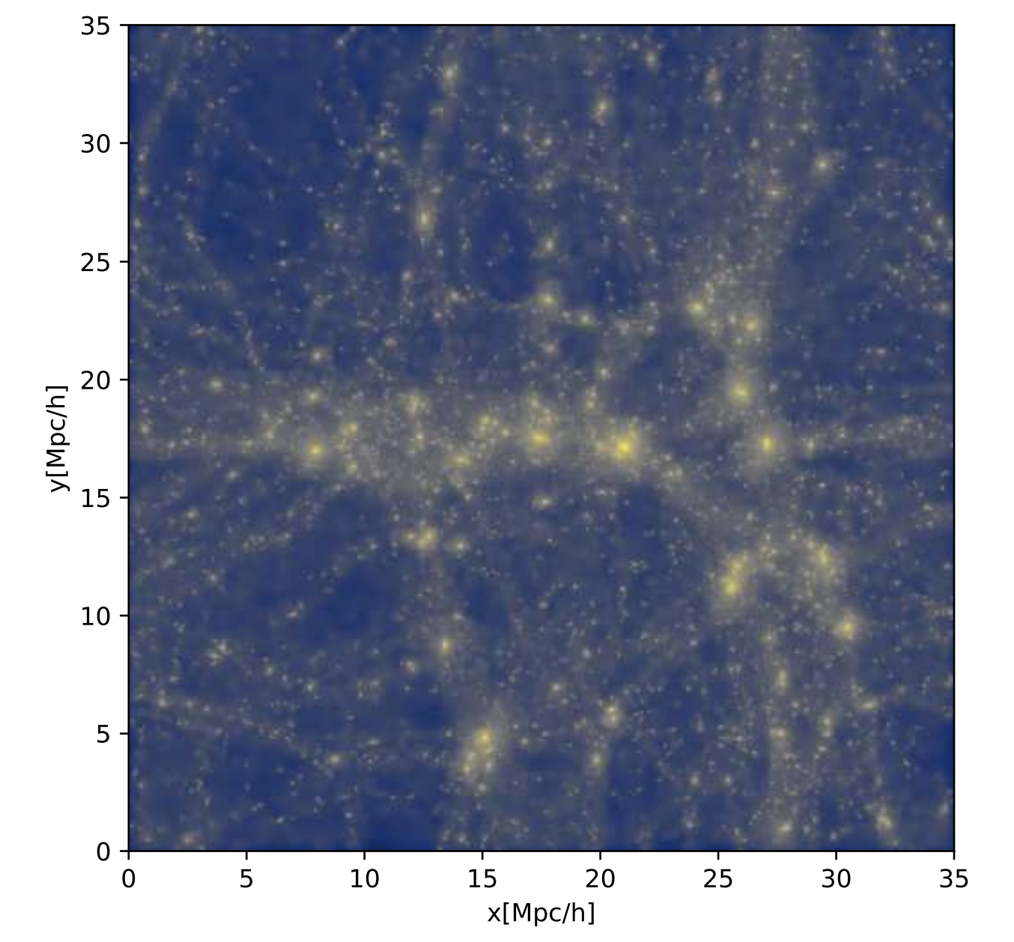
Simulating non-linear structure formation - T³
Advantages of fully-periodic boundary conditions:
Possible to use constant spatial resolution
FFT can be used to solve the Poisson equation (PM)
Simple data processing (FFT can be used)
Consequences of non-trivial T³ topology:
Since the Green function is anisotropic: anisotropic structure formation can happen (significant if L<100Mpc [at redshift 0])
No continuous rotation invariance (only discrete O_{h} invariance): The angular momentum is not conserved.
Gravity is always weaker in a periodic box: suppressed structure formaion (significant if L<200Mpc [z=0])
Missing modes: suppressed structure formaion (significant if L<200Mpc [z=0])
Small T³ boxes are not representative, and they can break the cosmological principle. (But they are still used in galaxy-formation simulations)

Slide 8
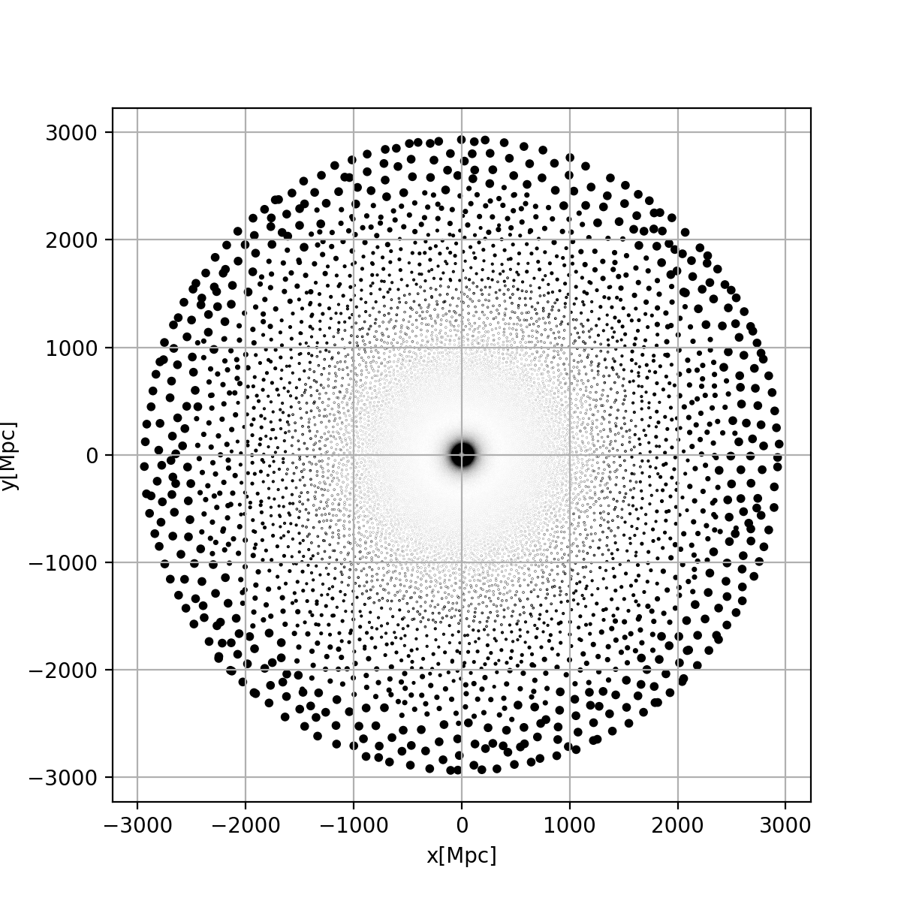
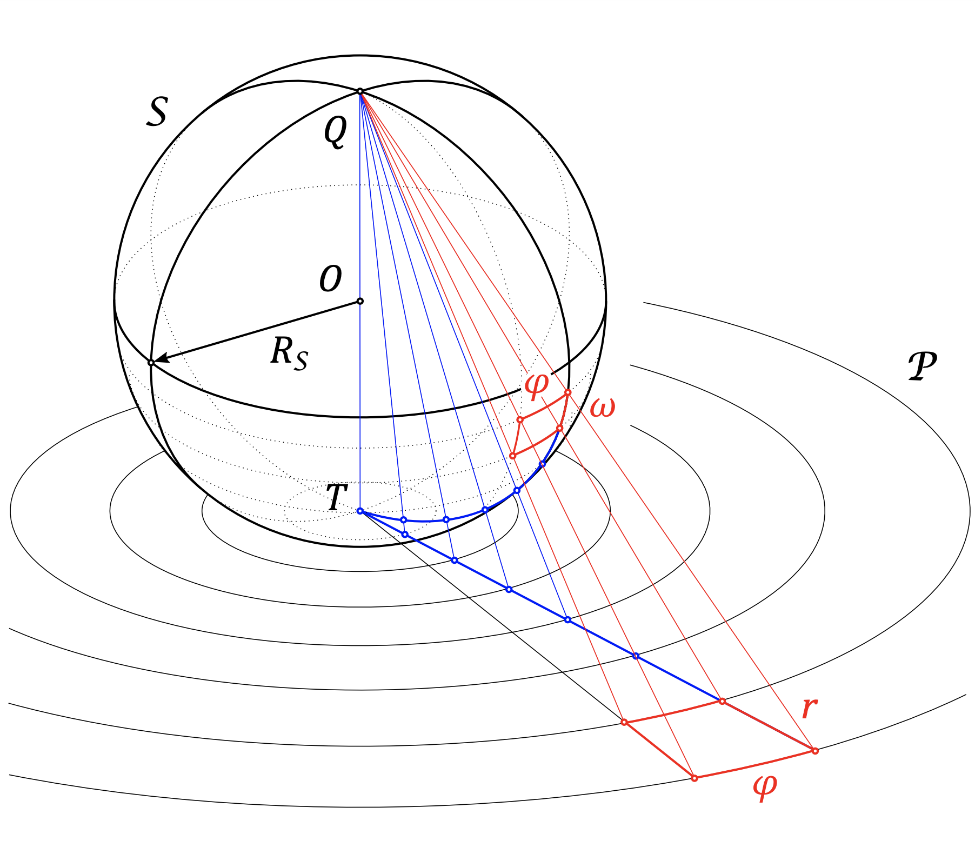
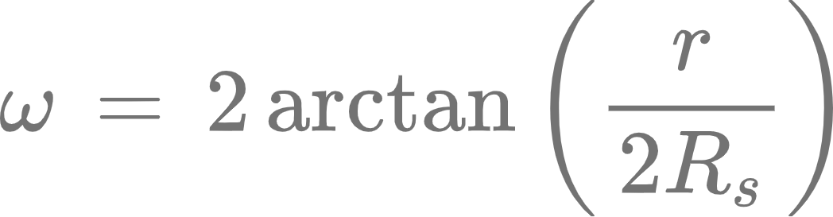
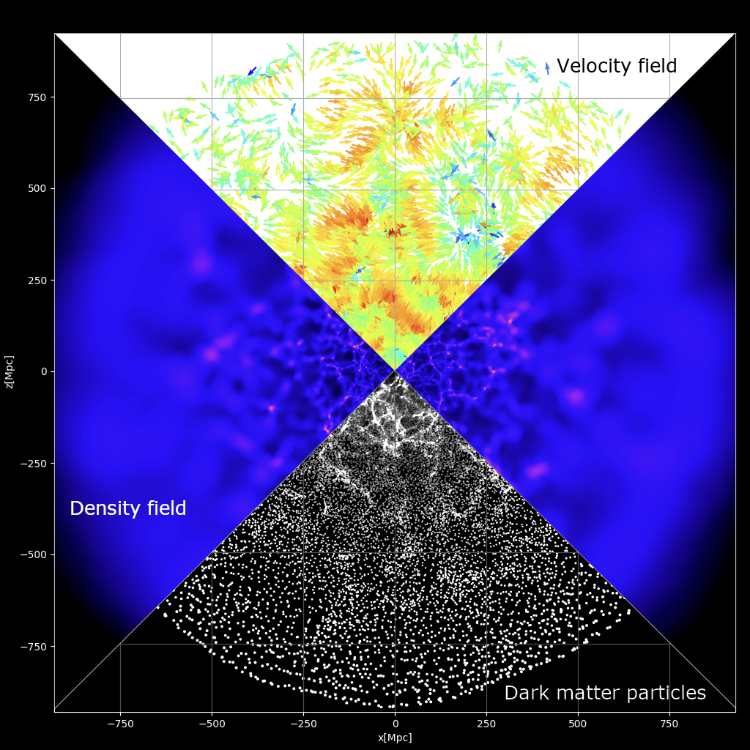
StePS (STEreographically Projected cosmological Simulations)
2D stereographic projection
Initial particle load in non-compact space
It is possible to map the infinite spatial extent of the ℝ³ into a finite volume by using inverse stereographic projection:
We are running cosmological simulations with finite resources in ℝ³ by using constant resolution in this compact space.
StePS: A novel code for running simulations in different topologies:
C/C++ code specifically designed for compactified ℝ³ and S¹ × ℝ² simulations
T³ periodic simulations also implemented
Direct [~𝒪(N²)] and Octree [~𝒪(NlogN)] force calculation
MPI-OMP-CUDA parallelization
Scale-independent DE models (ΛCDM, wCDM, CPL, etc.)
Custom tabulated expansion history
Publicly available (https://github.com/eltevo/StePS)

Slide 9
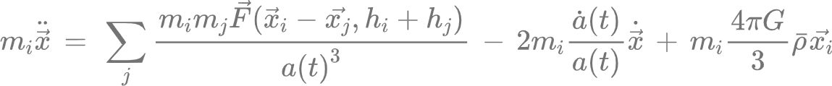
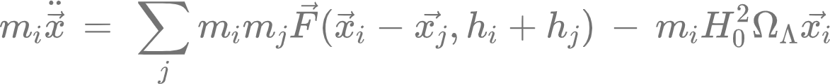
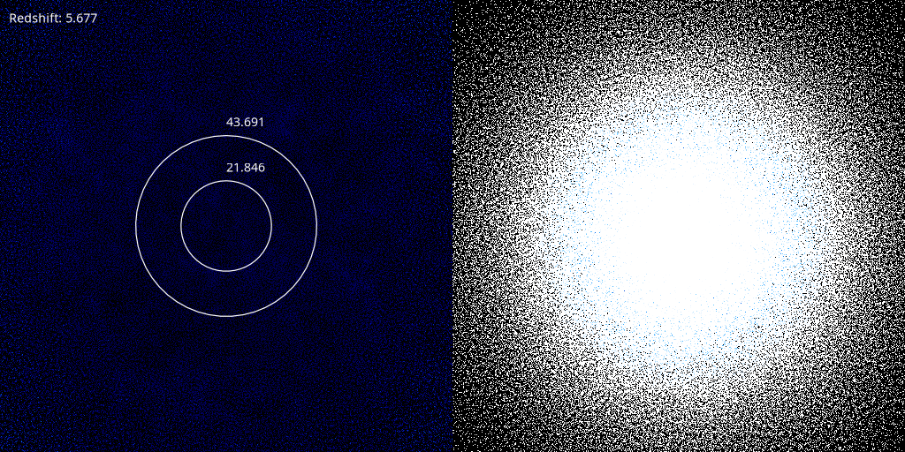
Simulating structure formation in ℝ³ with StePS
Gábor Rácz
Equations of motion in ℝ³:
(comoving) (non-comoving)
In comoving coordinates:
In non-comoving coordinates:
Running ℝ³ StePS simulations in comoving and static coordinates are giving the same results.
Comoving simulations: The simulated volume expands with the Universe
Non-comoving case: We do not have to solve the Friedmann equations, since the expansion dynamics are governed by the self-gravity of the system

Slide 10
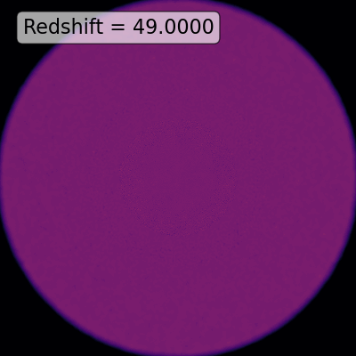
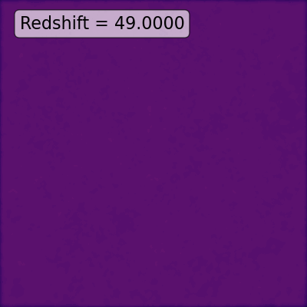
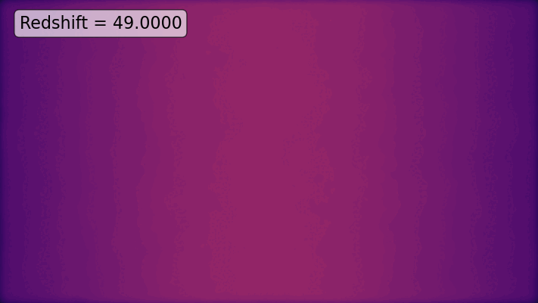
Simulating structure formation in S¹ × ℝ² with StePS
Gábor Rácz
It is possible to run comoving simulations with StePS in S¹ × ℝ² by compactifying the ℝ² part this space.
This topology is ideal for studying systems with cylindrical symmetries like filaments and their environments. (The ‘z’ component of the total angular momentum is conserved)
The first simulation in S¹ × ℝ² space: L_{z}=1Gpc; D_{sim}=1Gpc; Npart=2.4×10⁷; min(M_{part})=10¹¹M☉
Thin slice in the x-y plane
Thin slice in the x-y plane (zoom)
Evolution in the central region

Slide 11
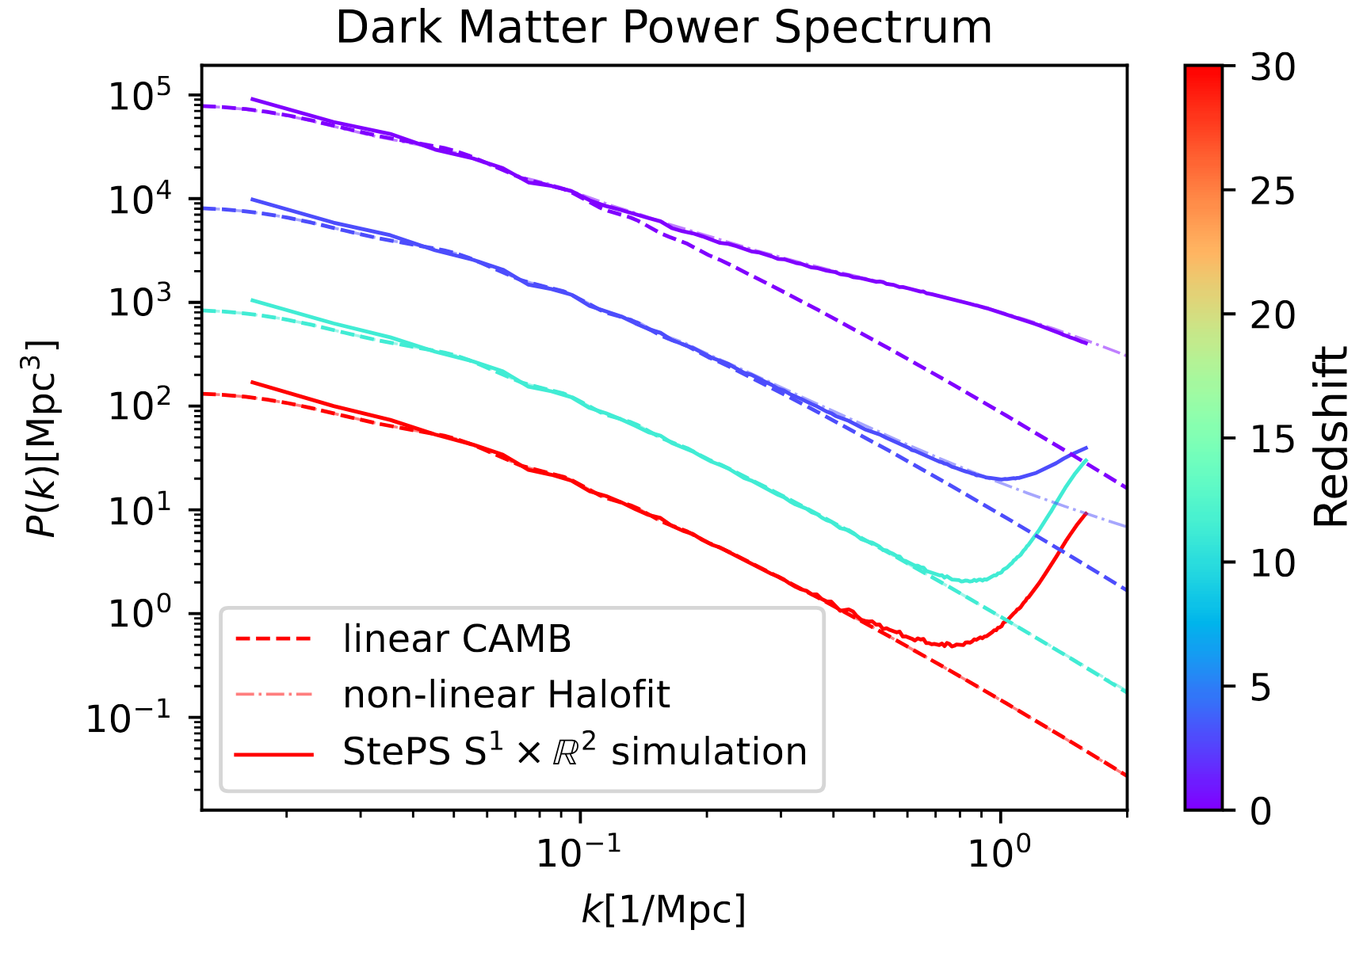
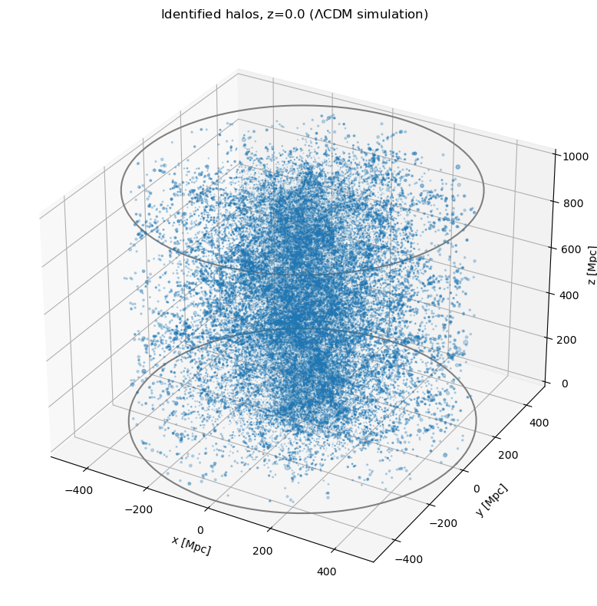
Simulating structure formation in S¹ × ℝ² with StePS
Gábor Rácz
Analysing compactified ℝ³ and S¹ × ℝ² simulations
DM power spectrum estimation:
The usual FFT-based method cannot be used, since the simulation topology is not a 3-torus
Zoom-in simulation: the small-scale modes only resolved in the central region
Problem with shotnoise: since the simulation is zoom-in, the shotnoise does not follow the usual ~1/n_{DM} law.
StePS_Pk.py: a new P(k) estimator based on the FKP (Feldman, Kaiser, Peacock) algorithm
DM halo finder:
The available halo finders are not designed for the cylindrical topology
Zoom-in simulation: the smallest halos are only resolved in the central region, while the largest halos are in a much bigger volume
StePS_HF.py: a new spherical overdensity halo finder designed for StePS (spherical & cylindrical) simulations

Slide 12
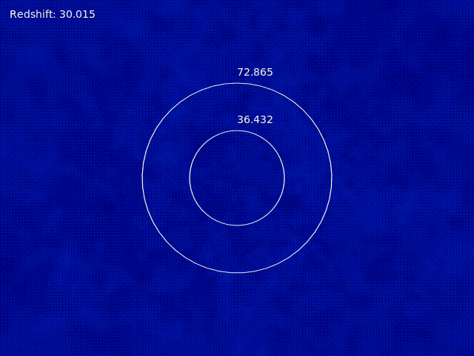
Simulating structure formation in S¹ × ℝ² with StePS
Since S¹ × ℝ² space is ansotropic, we expect to see similar artifacts as in T³.
If L_{z} ≲ 200Mpc (z=0):
Suppressed structure formation due to the missing modes in the ‘z’ direction
Filaments are more likely to form parallel with the ‘z’ symmetry axis
Walls are usually perpendicular to the ℝ² (‘x-y’) plane
L_{z} = 50Mpc; D_{sim} = 1500Mpc StePS simulation

Slide 13
Overview
Publications:
Compactified ℝ³ simulations: G. Rácz, I. Szapudi, I. Csabai, and L. Dobos, MNRAS, 477, 1949–1957 (2018)
GPU implementation: G. Rácz, I. Szapudi, L. Dobos, I. Csabai, and A. S. Szalay, Astron. Comput. 28, 100303 (2019)
T³ artifacts: G. Rácz , I. Szapudi , I. Csabai , and L. Dobos, MNRAS, 503, 5638–5645 (2021)
S¹ × ℝ² simulations: G. Rácz, V. H. Varga, B. Pál, I. Szapudi, I. Csabai, and T. Sawala, A&A [accepted] (2026)
S¹ × ℝ² initial conditions: B. Pál, G. Rácz, I. Csabai, and I. Szapudi, A&A [submitted] (2026)
Links:
StePS simulation code: https://github.com/eltevo/StePS/
stepsic initial condition generator code: https://github.com/eltevo/stepsic
Example S¹ × ℝ² simulation data: https://eltevo.github.io/projects/cylindrical-simulations/
The topological manifold:
Determines the conserved quantities (Noether’s theorem)
Affects the structure formation
T³ and S¹ × ℝ² are not supported by the observaions (Linear size comparable or larger than the particle horizon is still possible)
How to avoid these effects:
Keep the fundamental modes linear (L,L_{z} > 200Mpc if z=0)
If high resolution needed, use zoom-in techniques instead of small boxes
ℝ³ simulations are free from all topological imprints, and the total angular momentum is conserved.
Thank you for your attention!

