Slide 1
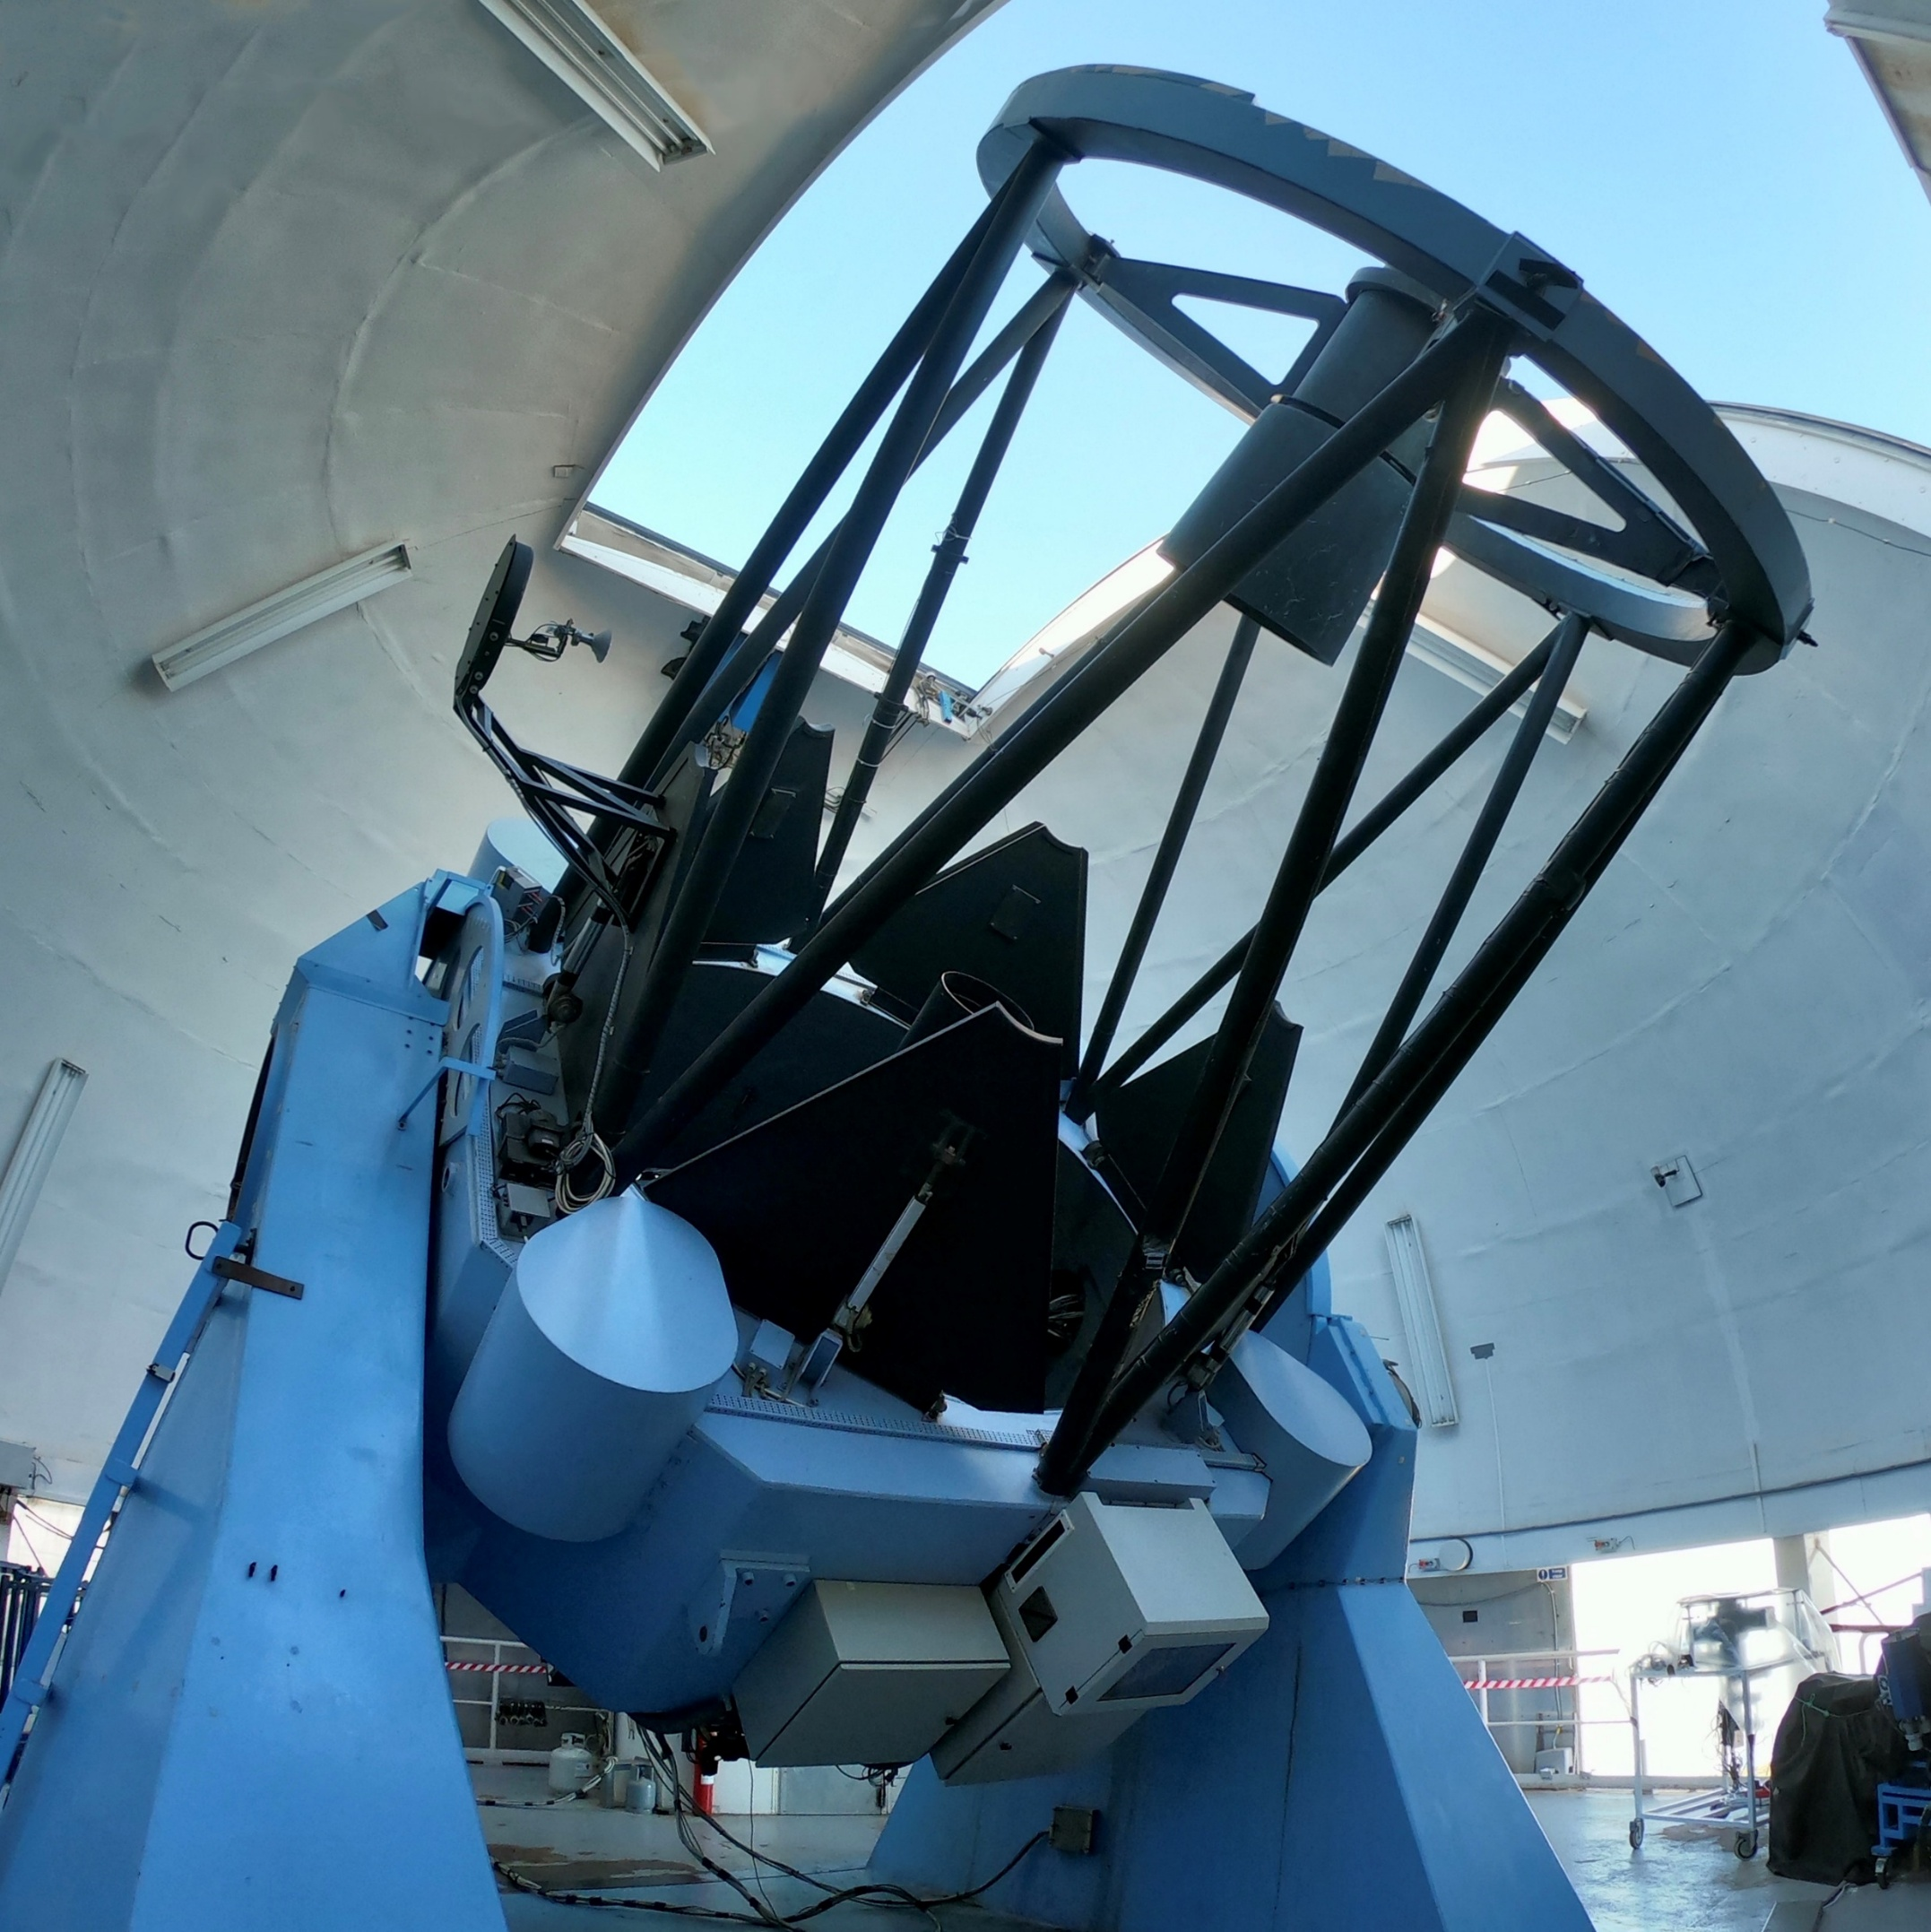

NTE

Slide 2
NTE Team
Niels Bohr Institute
Michael I. Andersen – Systems engineer
Lise Christensen – Pipeline responsible
(Niels Michaelsen – Mechanics)
Tom Reynolds – Pipeline development
Anton N. Sørensen – Calibration and AIT
Joonas K. M. Viuho – Motors and control, detectors, simulated data, and more
Kostas Valeckas – Pipeline development
Dennis Wistisen – Mechanics
Many students – simulated data, ETC, testing, RRM, etc.
Nordic Optical Telescope
Sergio Armas – Software systems
Jacob W. Clasen – Project Manager
Anlaug Djupvik – Astronomer, IR applications
Carlos Perez – Mechanics
Tapio Pursimo – Astronomer, imaging
John Telting – Astronomer, spectroscopy
Partner institutes
John E. V. Andersen – VIS Imager mechanics
University of Aarhus, Denmark
Stefano Covino – Head of science team
INAF Brera, Italy
Anders S. Damgaard - VIS Imager mechanics
University of Aarhus, Denmark
Vitaly Neustreov – Imaging pipeline
FINCA/University of Oulu, Finland
Marco Riva – Spectrograph camera optics
INAF Brera, Italy

Slide 3
Outline
I will not explain why we are so delayed, but if you want to know more ask or come and talk to me. The essence is: we are too few and lack funding.
Ask what NTE can do for you
and what you can do for the NTE
Thanks to all those who have helped so far!
What NTE is
Status of project

Slide 4
Science cases for the NTE
Transient phenomena
  GRBs, kilonovae, GWs
  supernovae Ia,
  core-collapse supernovae,
  new transients: FRB , Changing look AGN, TDE, ...
Other programs where the time domain is important
  reverberation mapping
  exoplanet atmospheres
Non-transient programs
  AGN hosts
  spectroscopic follow-up of sources from wide-field surveys
  QSOs from Gaia
  Solar System objects
Important drivers:
wide wavelength coverage
Resolution
simultaneous optical and near-IR imaging
rapid follow-up
Innovation
Teaching
versatility

Slide 5
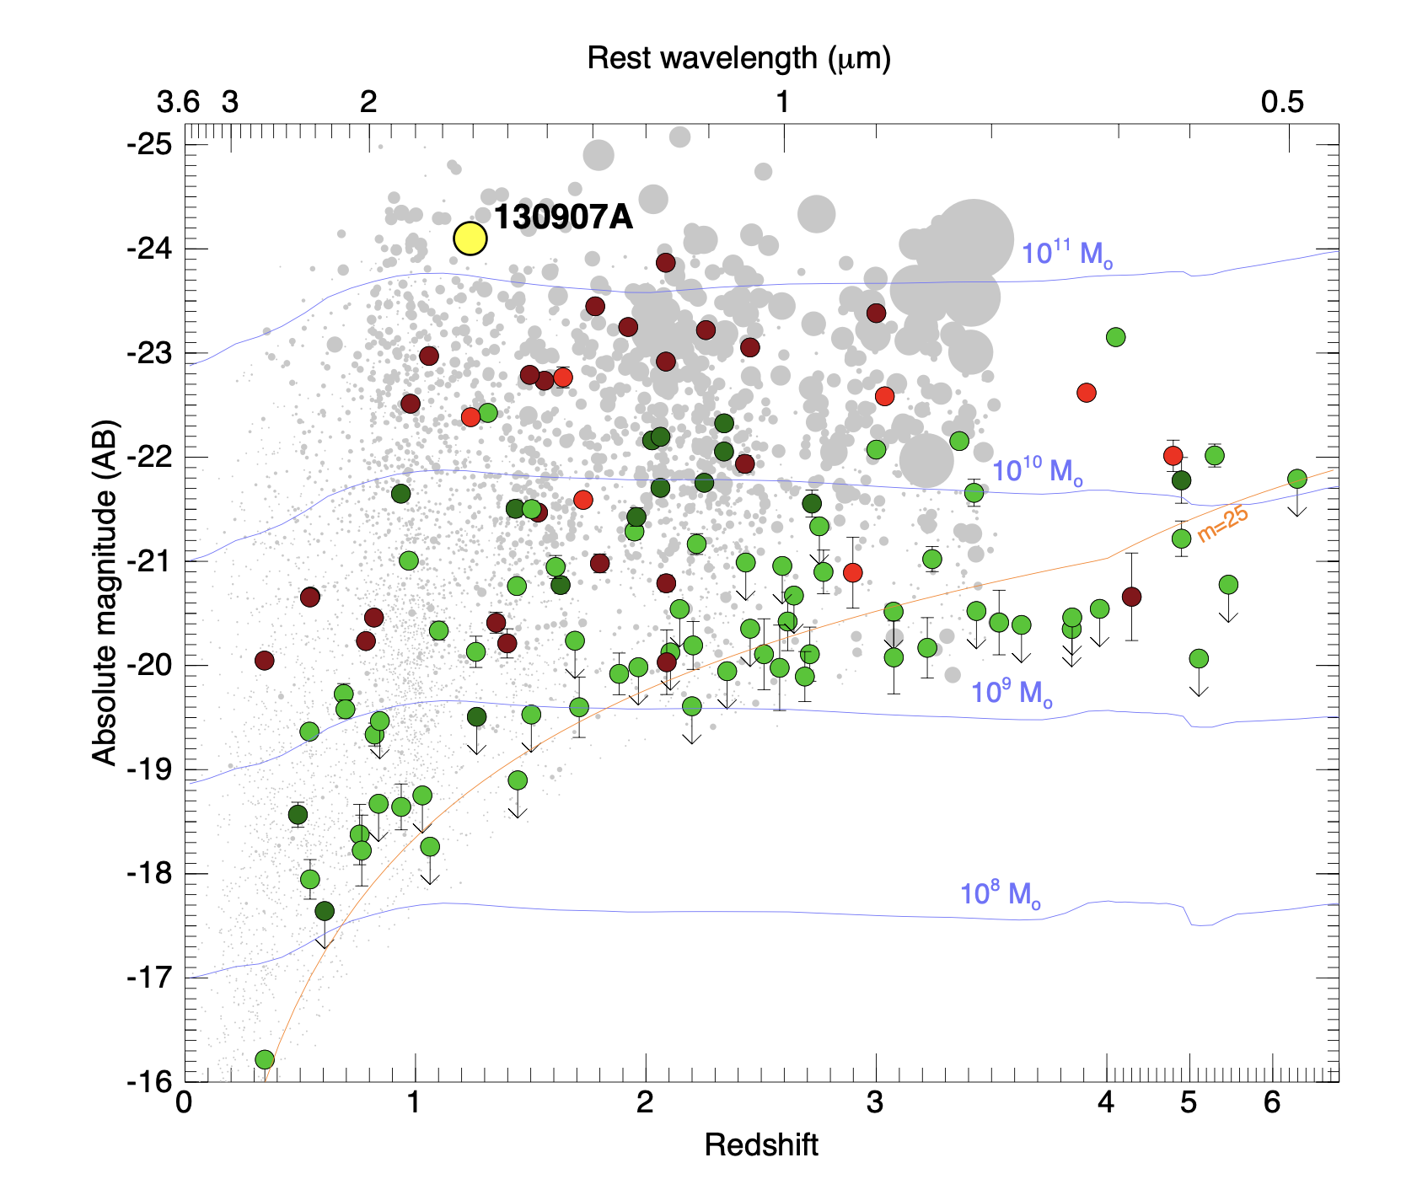
Dusty sightlines
GRB130907A, z=1.24
DePasquale et al. in prep

Slide 6
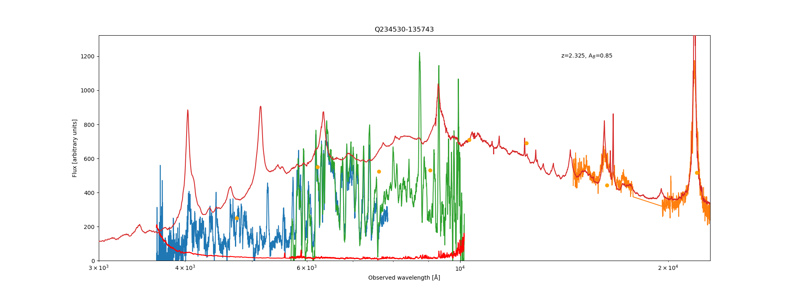

Slide 7
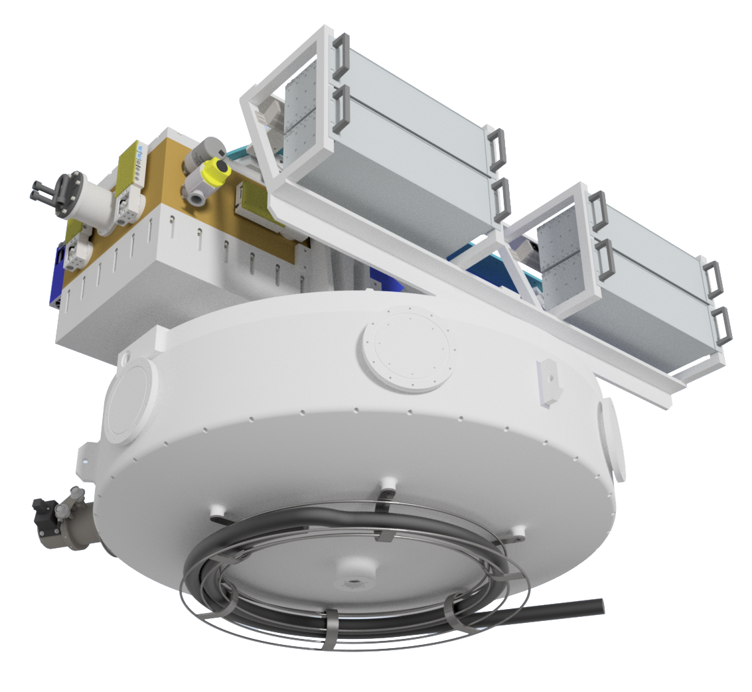
The NTE concept
Dual imager
Single slit spectrograph
Imagers and spectrograph covering from U to K band
Short re-configuration time
Independent operation of VIS and NIR arms in both imaging and spectroscopy
Almost permanently mounted

Slide 8
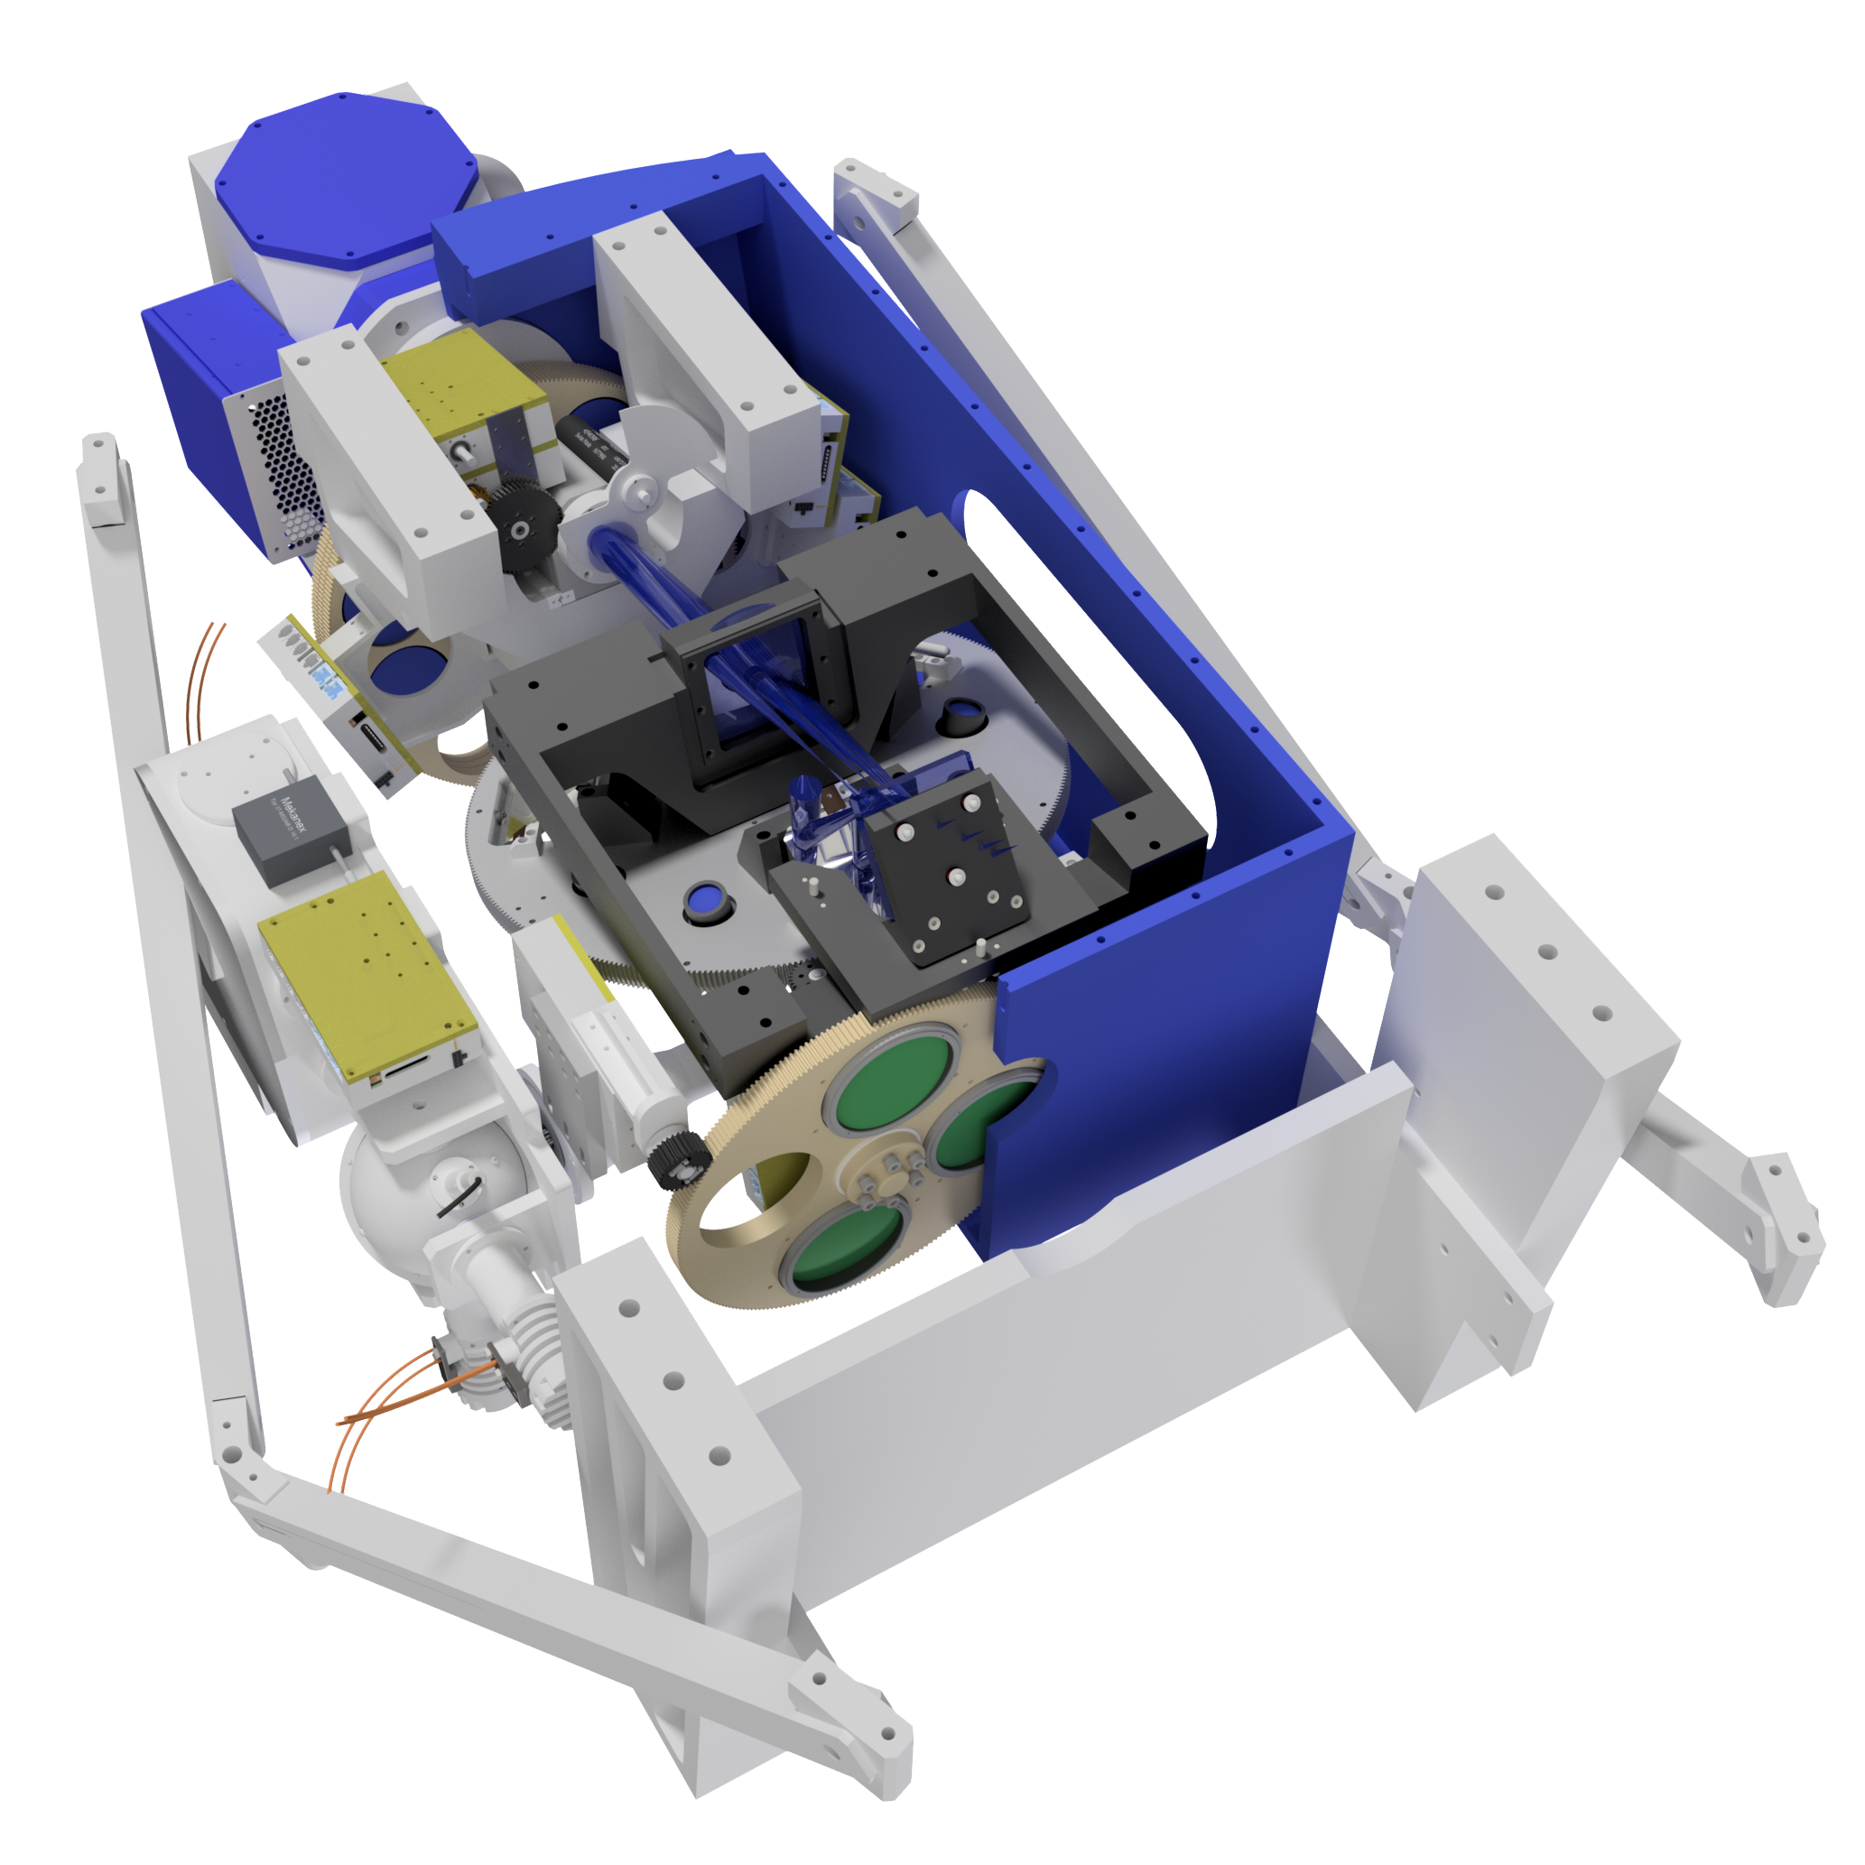
VIS Imager
ANDOR COSMOS sCMOS Camera
Shutter
Field lens
Beam selector wheel
Filter wheels
Folding mirror
Dichroic sending light to VIS Imager
Calibration unit
VIS Imager box and struts support the spectrograph cryostat
Warm IR filter wheel

Slide 9
Project status: VIS imager
Design is complete.
Optics delivered.
VIS Imager is at NBI, waiting termination of camera flange and minor mechanical parts associated with optic mounting.
Optics integration is pending NBI workshop.
COSMOS sCMOS available. Funding secured. Final quote has been requested.
Transport/lab rig produced in Turku and now safely in Copenhagen.

Slide 10
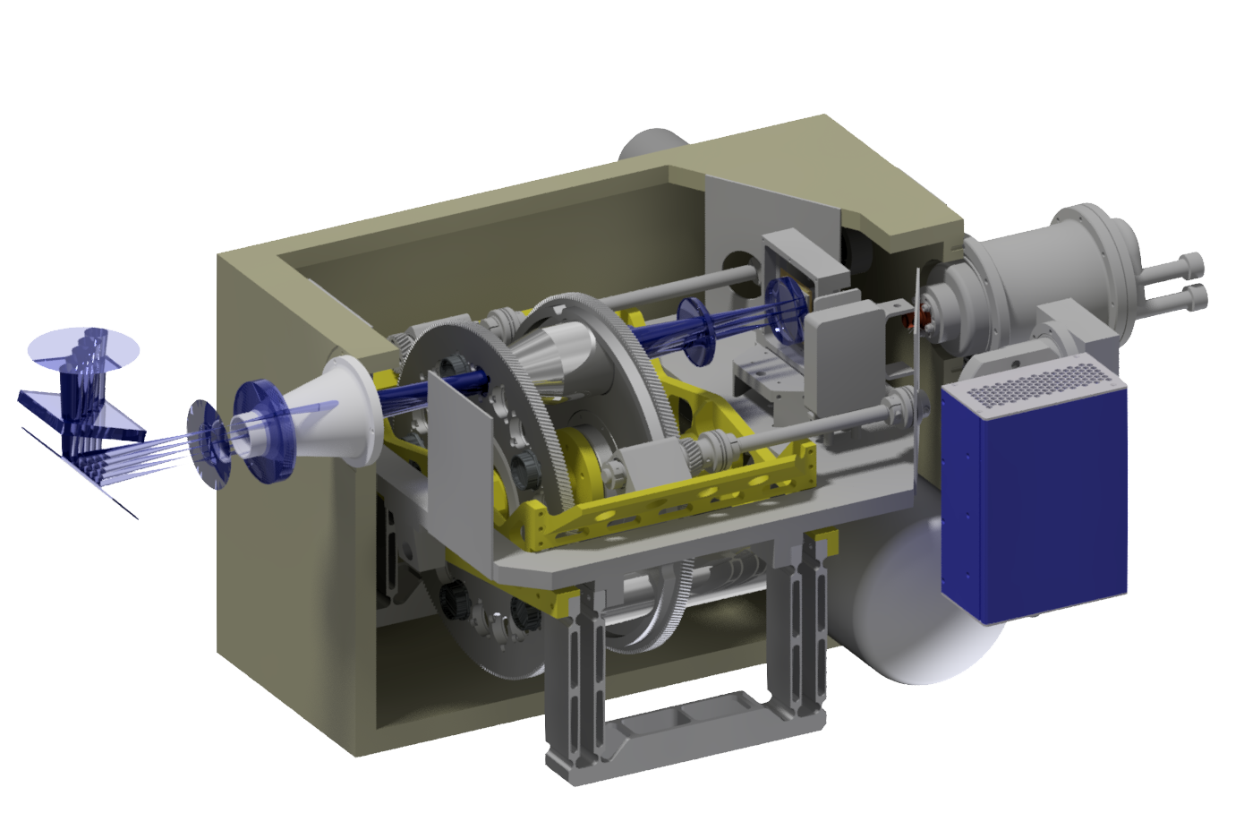
IR Imager
Camera wheel
Cold filter wheel
Hawaii 2RG
Dichroic mirror sending light to IR Imager
LN2 spare tank
Flexure hinge for focusing

Slide 11
Project status: IR imager
Mechanical design complete.
Design report is being updated and FDR planned for 15-18 June.
Resources for manufacturing available. Detailed planning pending FDR.
Detector system ready, engineering grade detector available.
Ordering dichroics and folding mirrors is pending funding.
CryoTiger cooling machine available.

Slide 12
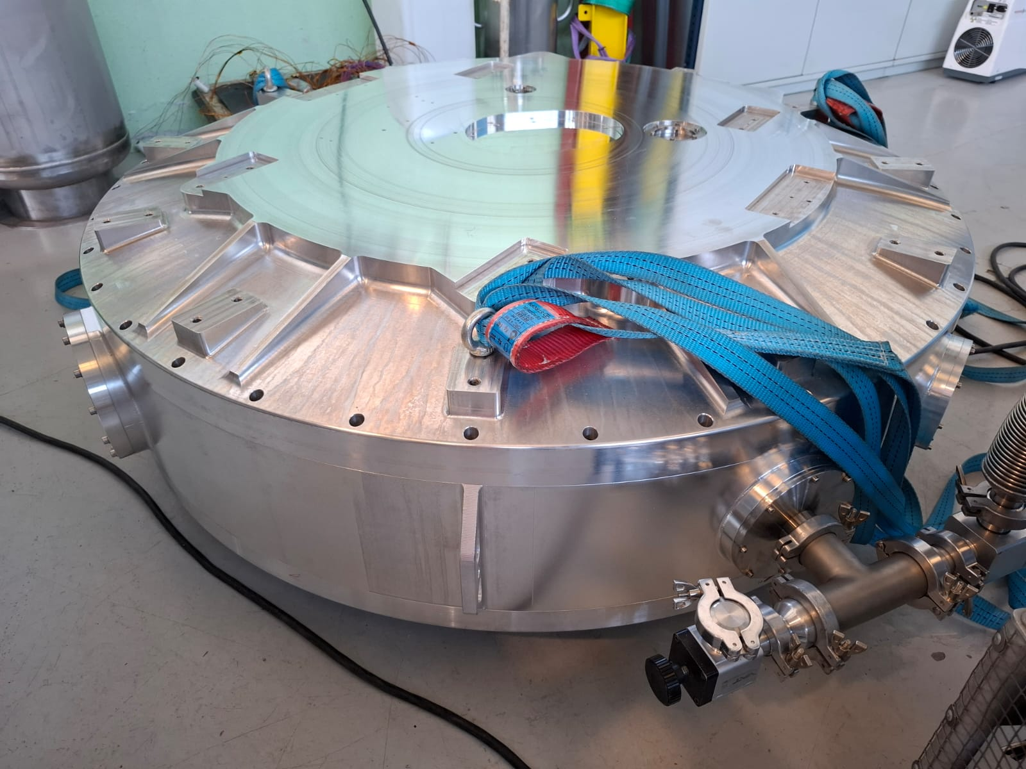
Project status: NTE SPEC
Detailled design and manu. is pending on the following sub-systems:
  Corrector lens mount.
  Fixed Grating mount.
  Prism mount.
  Field slicing mirror mounts.
  Detector mounts, UV and VIS.
Cryogenic tubing, radiation shields, MLI.
Spectrograph vacuum vessel has been remade. Expected delivery to NBI is around end of May.

Slide 13
Project status: Overall
We are trying to keep the ball rolling where we can.
The two imagers are on a good track towards compleation.
For the spectrograph we need more funding. Our pan is to have the spectrograph ready to take a spectrum in the visible in 2.5 yr. This requires about 300-400k€.
Overall we need about 1M€ to complete the full instrument.
Contributions both in terms of funding and workshop FTEs very welcome!

Slide 14
Thank you.

