Slide 1


Supermassive black hole dynamics in massive early-type galaxies
Alex Rawlings
29 May 2026 — Nordic Baltic Astronomers’ Days

Slide 2
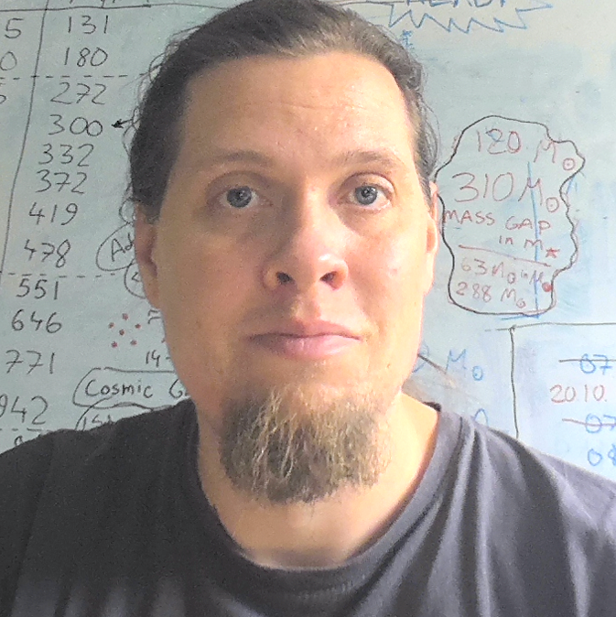
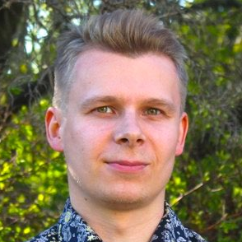


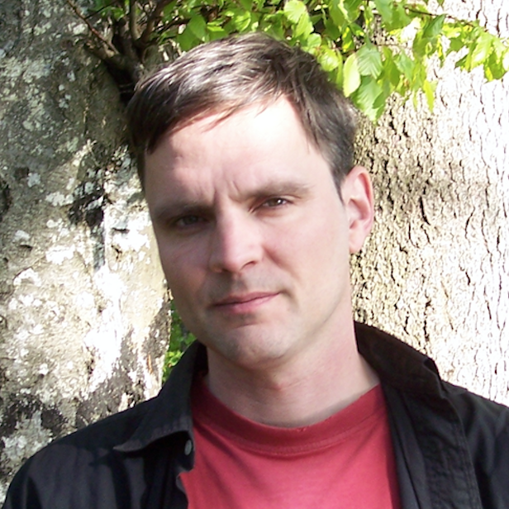
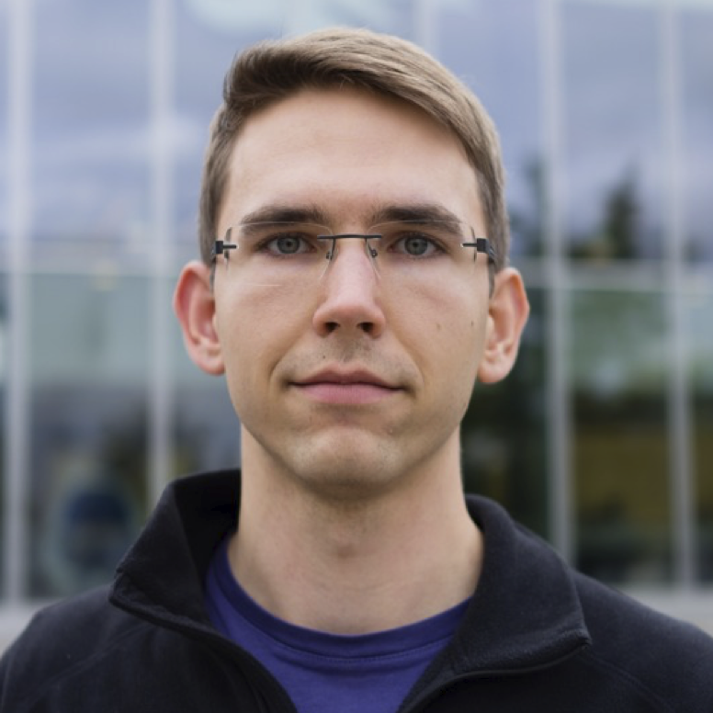
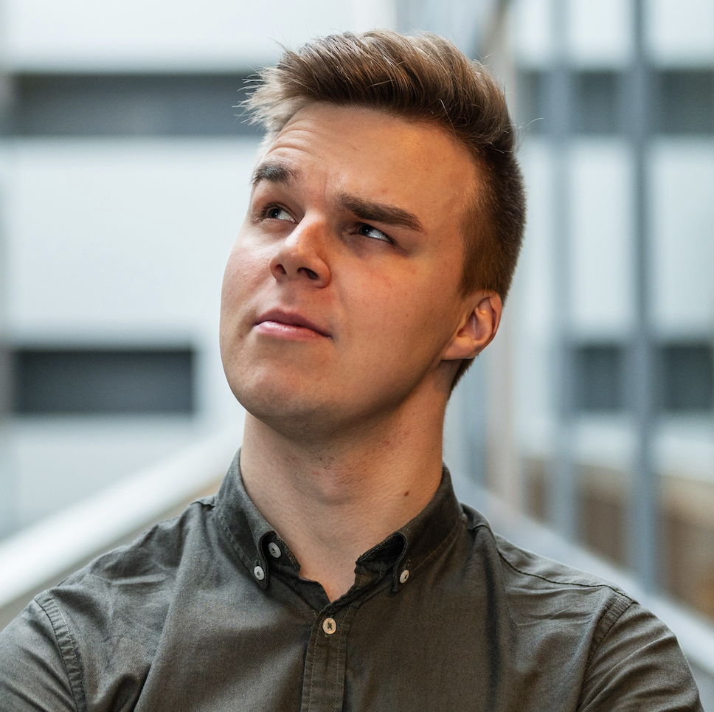

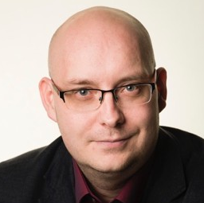

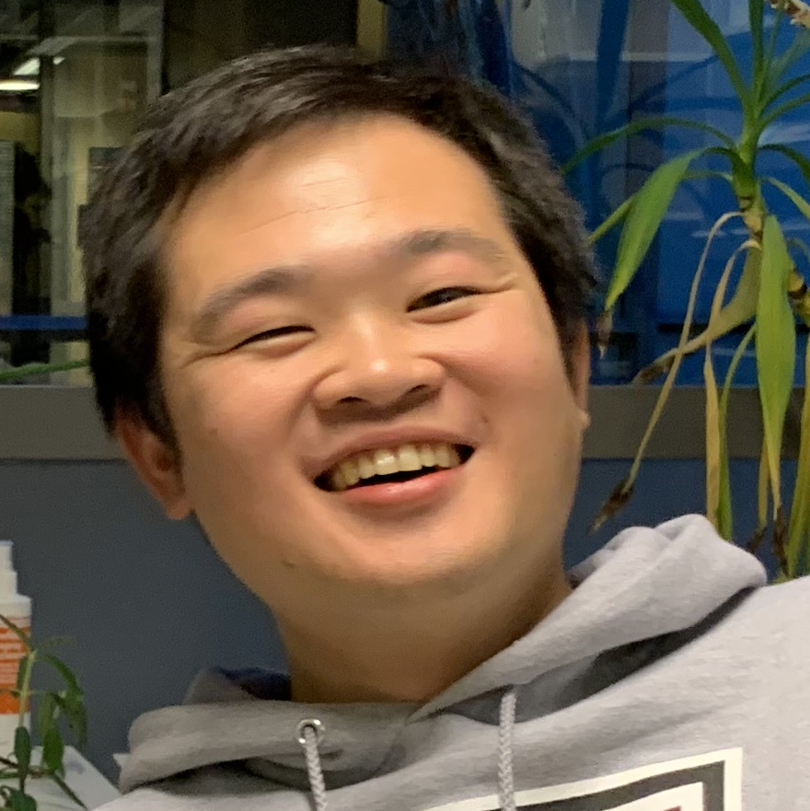


Coauthors of my PhD projects
Antti
Atte
Bianca
Dimitrios
Jens
Matias
Max
Noa
Peter
Ruby
Shihong
Sonja
Thorsten

Slide 3
Coauthors of my PhD projects
Antti
Atte
Dimitrios
Jens
Matias
Max
Noa
Peter
Shihong
Thorsten
?
Bianca
Ruby
Sonja

Slide 4
Frequentist thinking:
“given my model, what is the chance of observing this data?”
Bayesian thinking:
“given my observations, what can I say about my model?”
3 of 13 of coauthors are women, what can I say about the total proportion of scientists in Finland that are women?
50% of people are not men, what are the chances of having 3 of 13 coauthors as women?

Slide 5
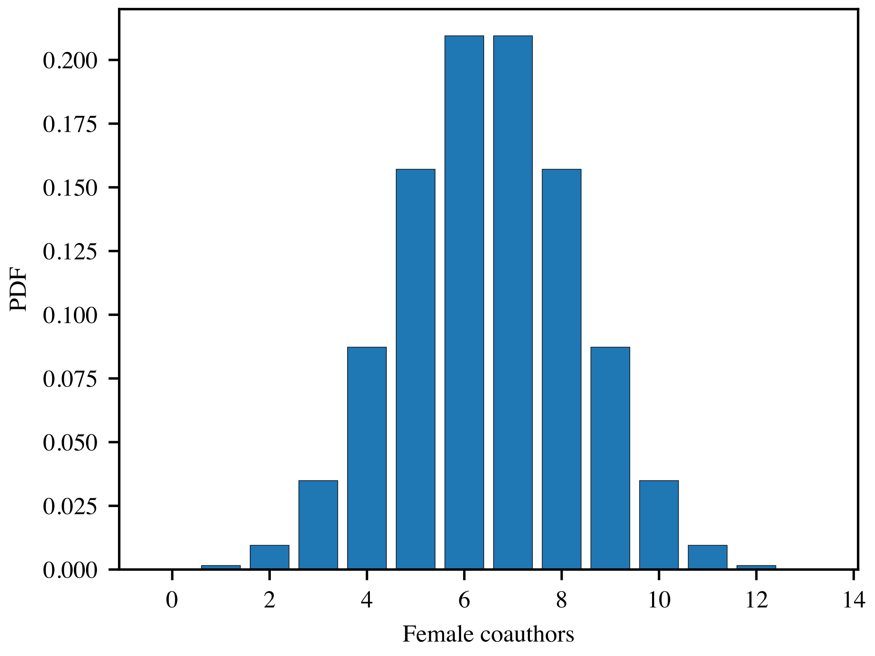
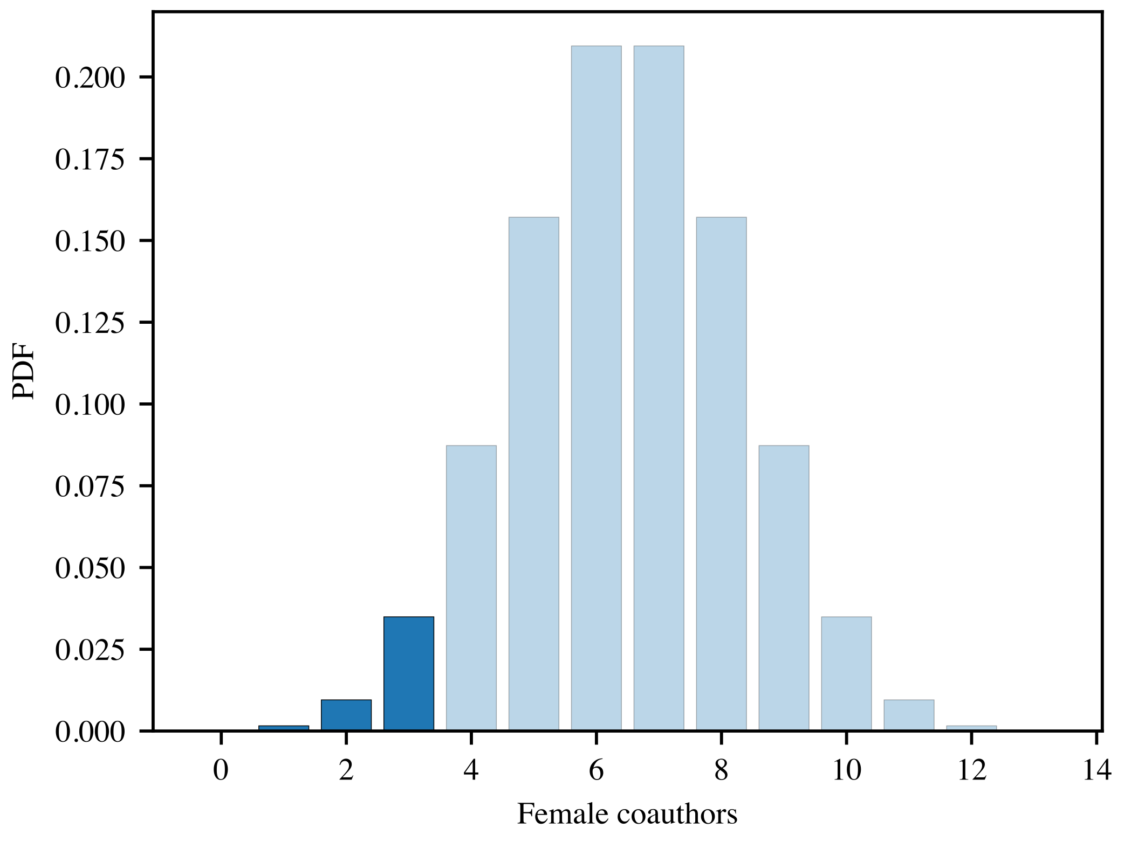
Frequentist
50% population born women
50% of scientists women
50% population born women
% of scientists women?
BARRIER

Slide 6

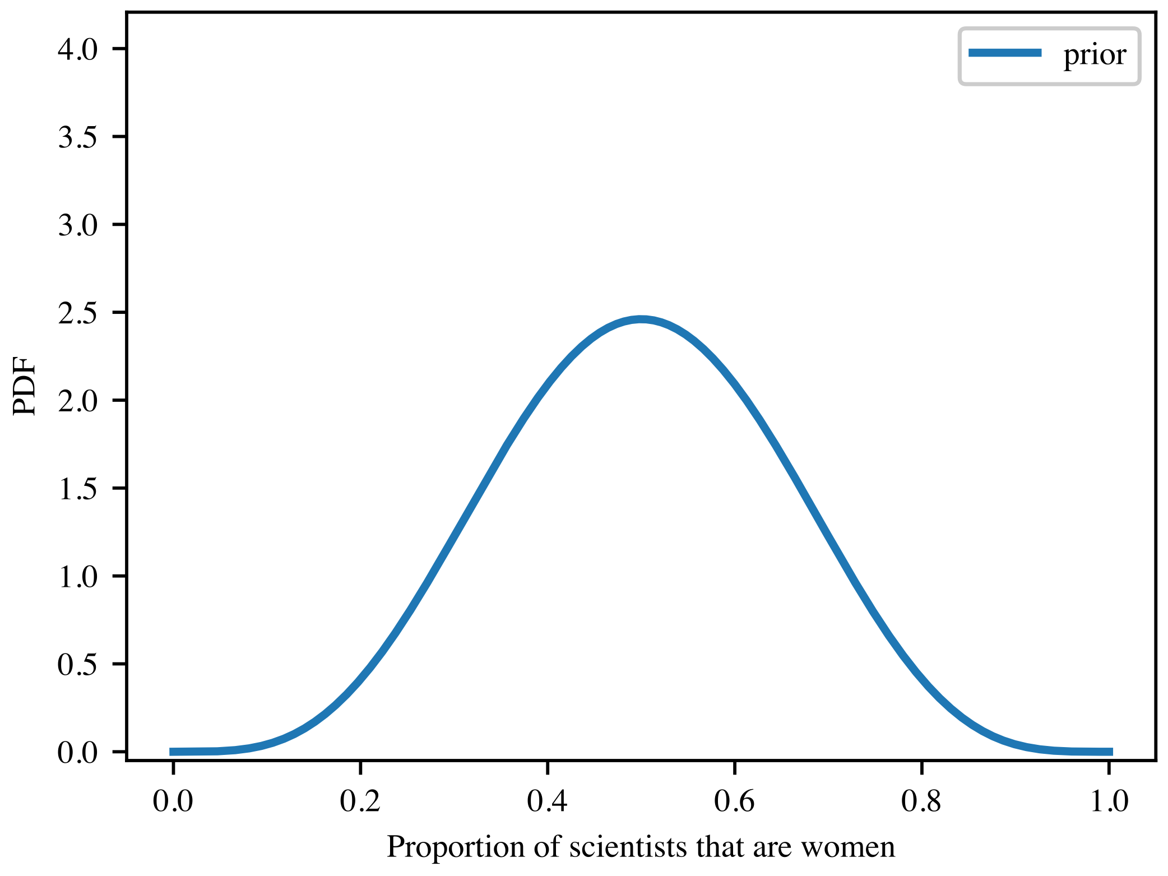
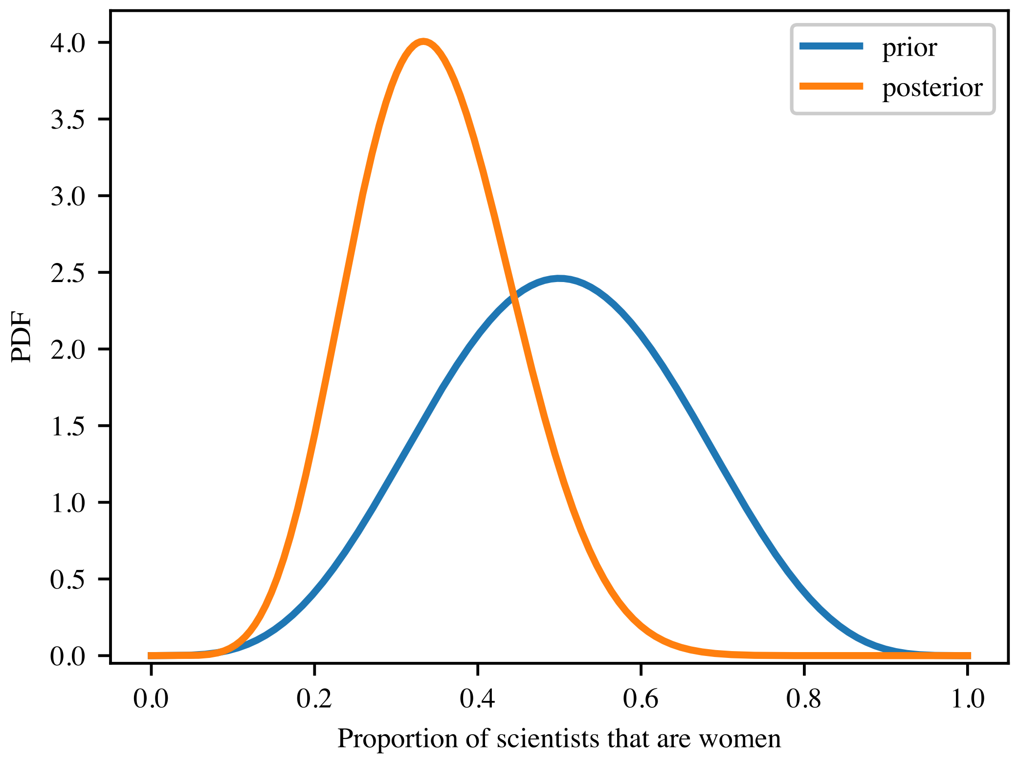
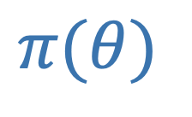
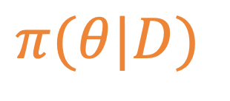

Bayesian
maximum a posteriori: 33%
$$π(θ|D)$$
$∝$ $⋅L(D|θ)$
$$π(θ)$$

Slide 7
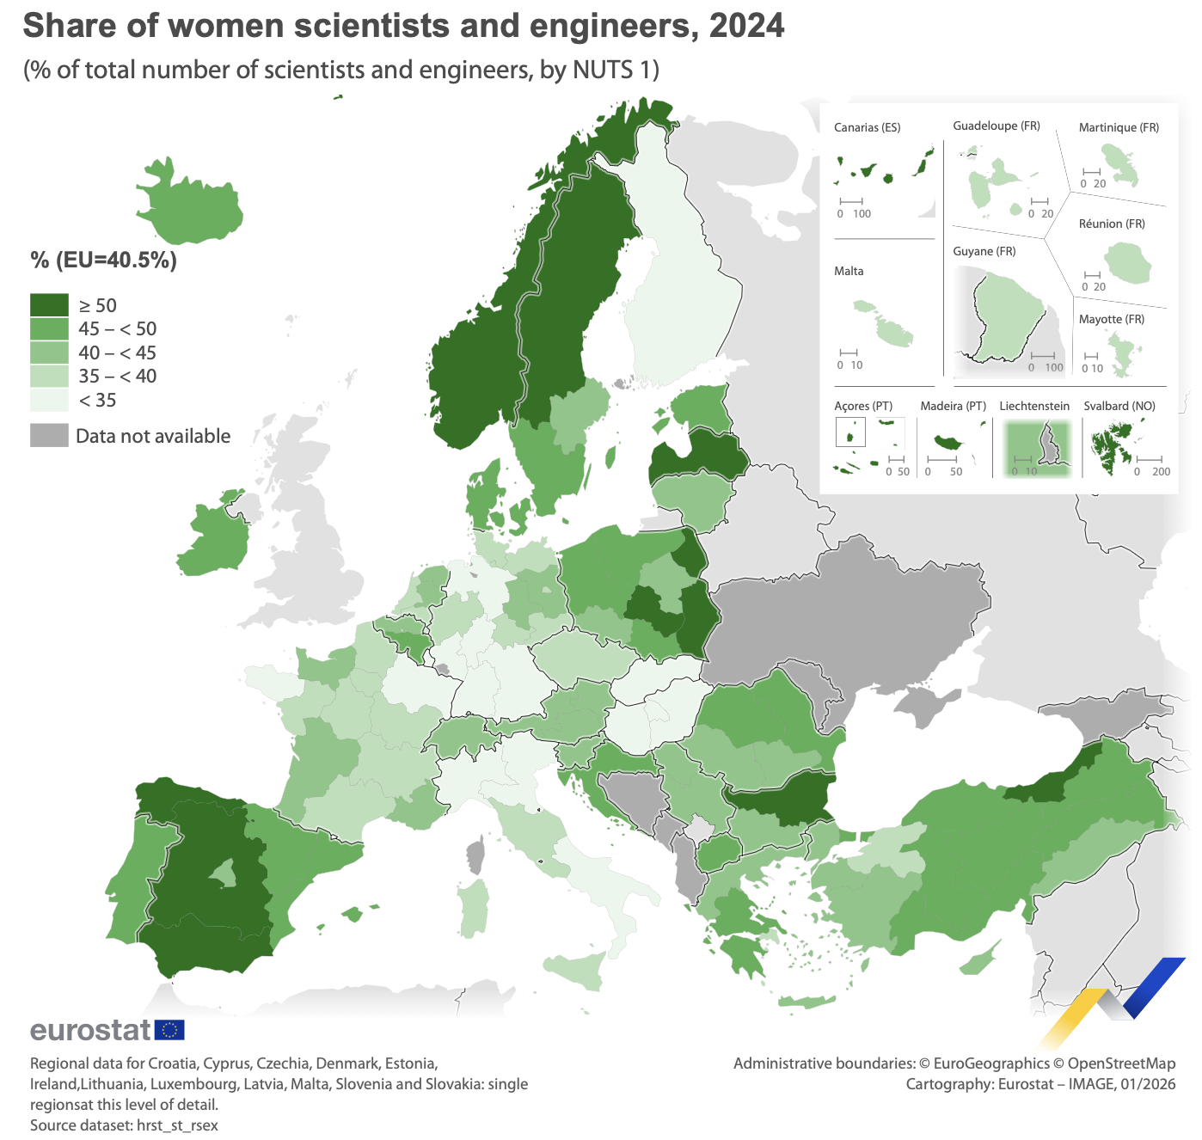

Czechia | 38.6%
Denmark | 48.8%
Estonia | 47.9%
France | 38.2%
Germany | 34.0%
Italy | 35.2%
Latvia | 50.1%
Lithuania | 43.8%
Netherlands | 38.9%
Norway | 53.5%
Poland | 47.0%
Spain | 47.6%
Sweden | 46.0%
30.7% in Finland
lowest in EU
https://ec.europa.eu/eurostat/web/products-eurostat-news/w/edn-20260211-1

Slide 8

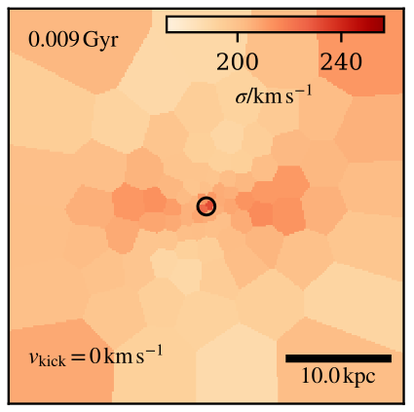
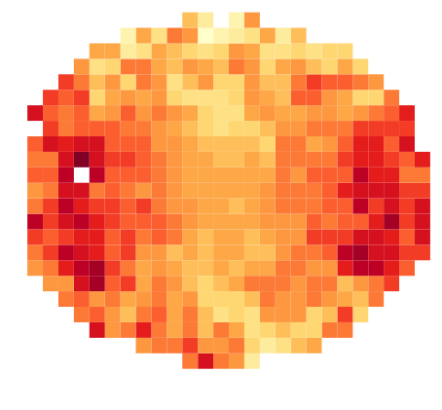

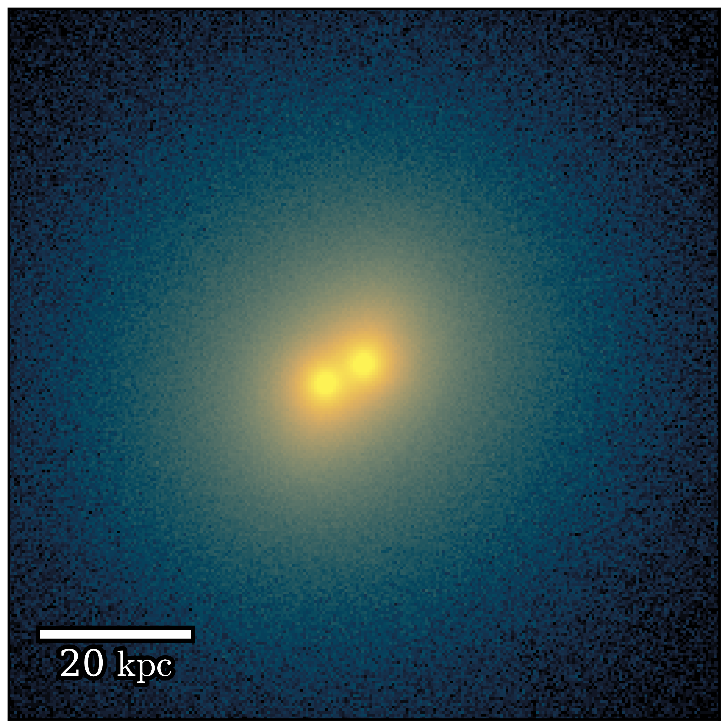




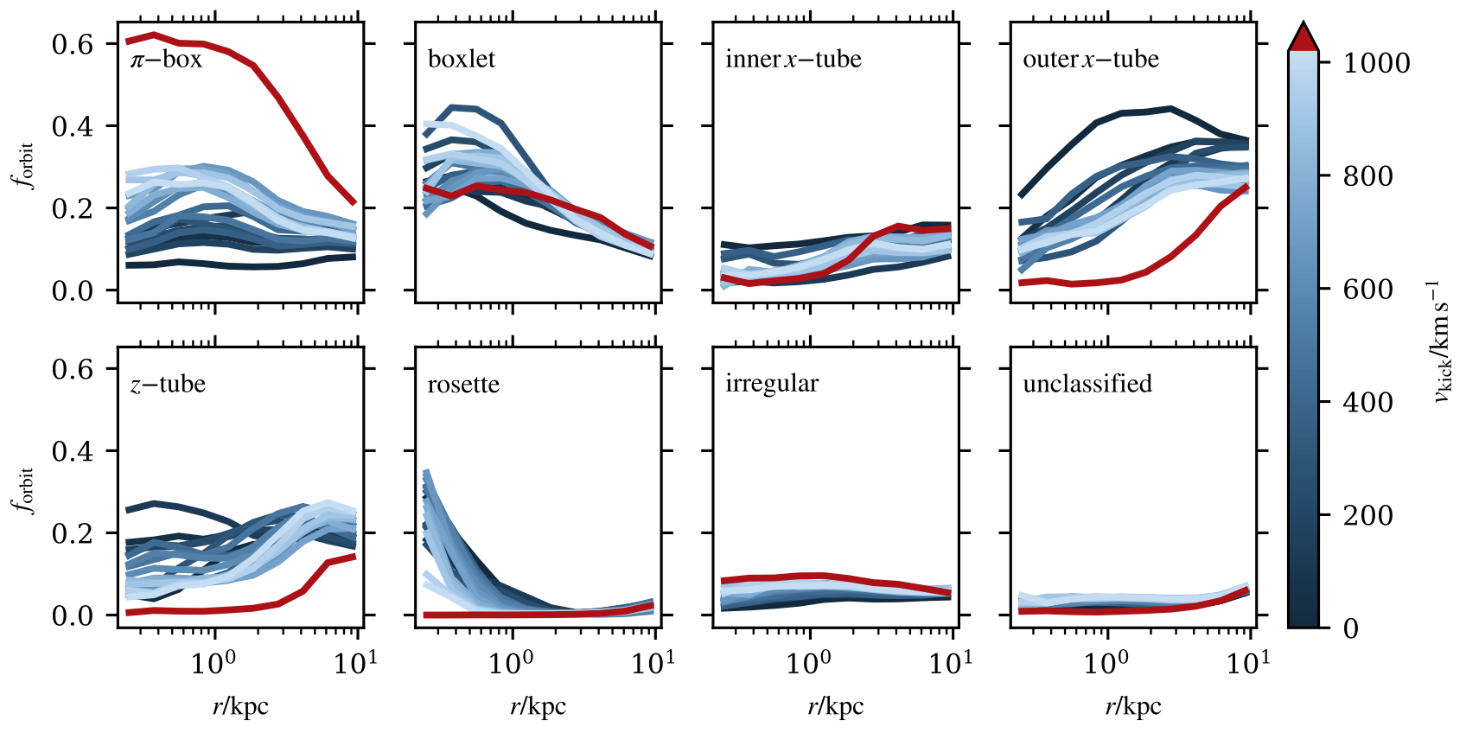
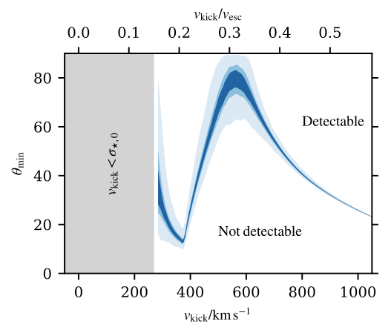


Our job as simulators
iterate
create model with desired physics and assumptions
observable quantities
real data
compare
explain
simulate
intrinsic quantities
predictions

Slide 9
Observations
Inferences
Theory
Questions
Galaxies interact
SMBHs dynamically interact
SMBHs present in galaxies
SMBH-galaxy co-evolution ongoing

Slide 10



Theory
recoil kick
dynamical friction (~kpc)
separation from centre
3-body scattering (~pc)
GW emission (~mpc)
time

Slide 11
Observations
Inferences
Theory
Questions
Galaxies interact
SMBHs dynamically interact
3-stage merger process
SMBHs present in galaxies
SMBH-galaxy co-evolution ongoing
GW-driven recoil

Slide 12
How well can we constrain SMBH binary orbits?
What is the effect of post-merger recoil?
Questions
What diversity to expect in predicted SMBH merger rates?
How detectable is ongoing SMBH recoil?

Slide 13
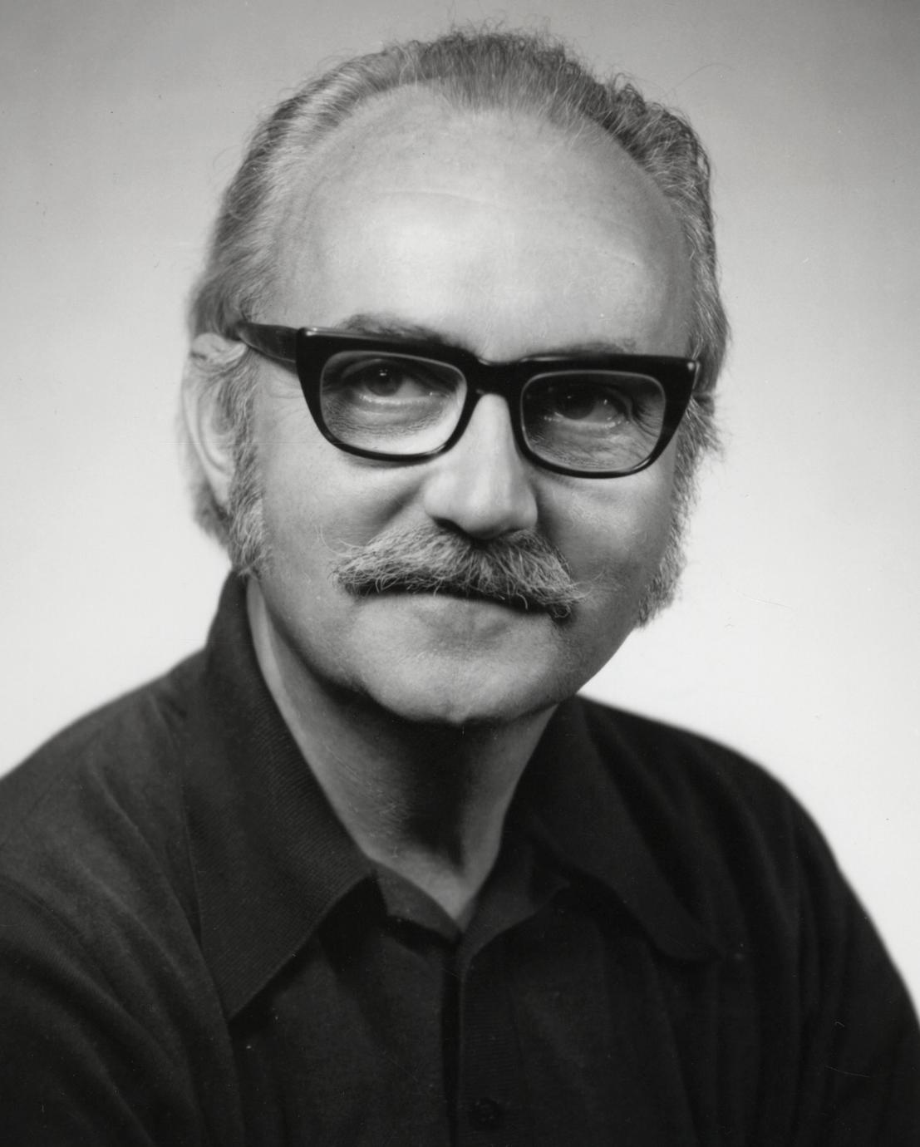
“All models are wrong,
but some are useful”.
— George Box FRS, statistician

Slide 14
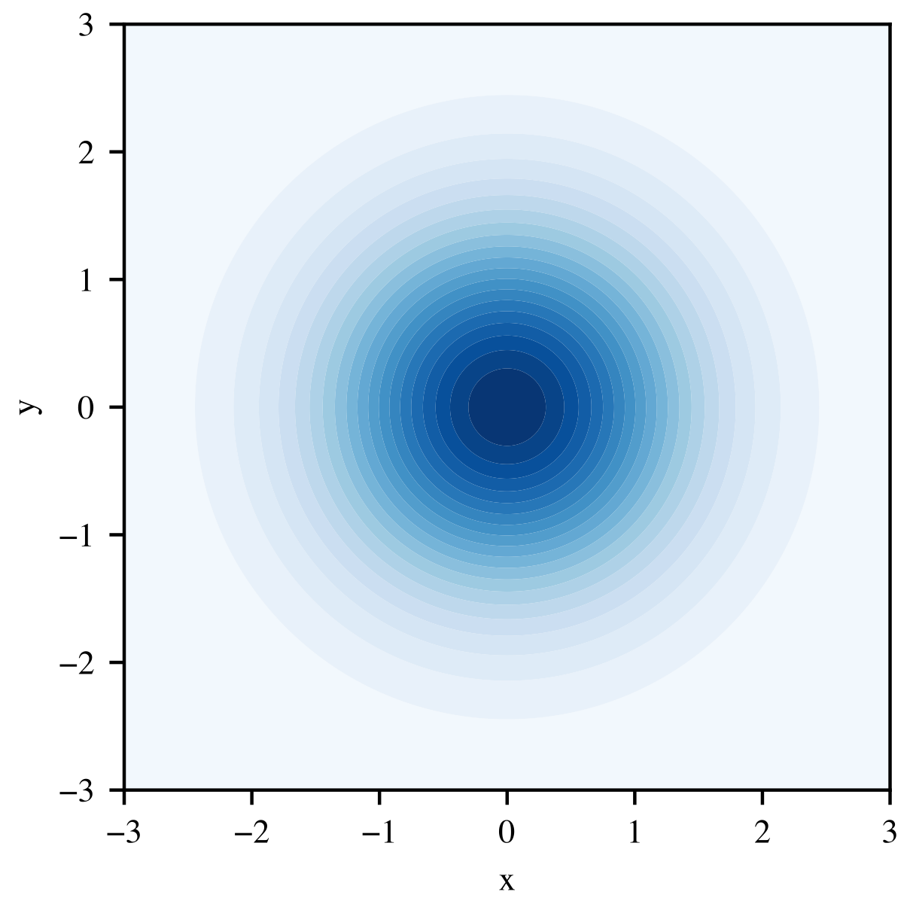
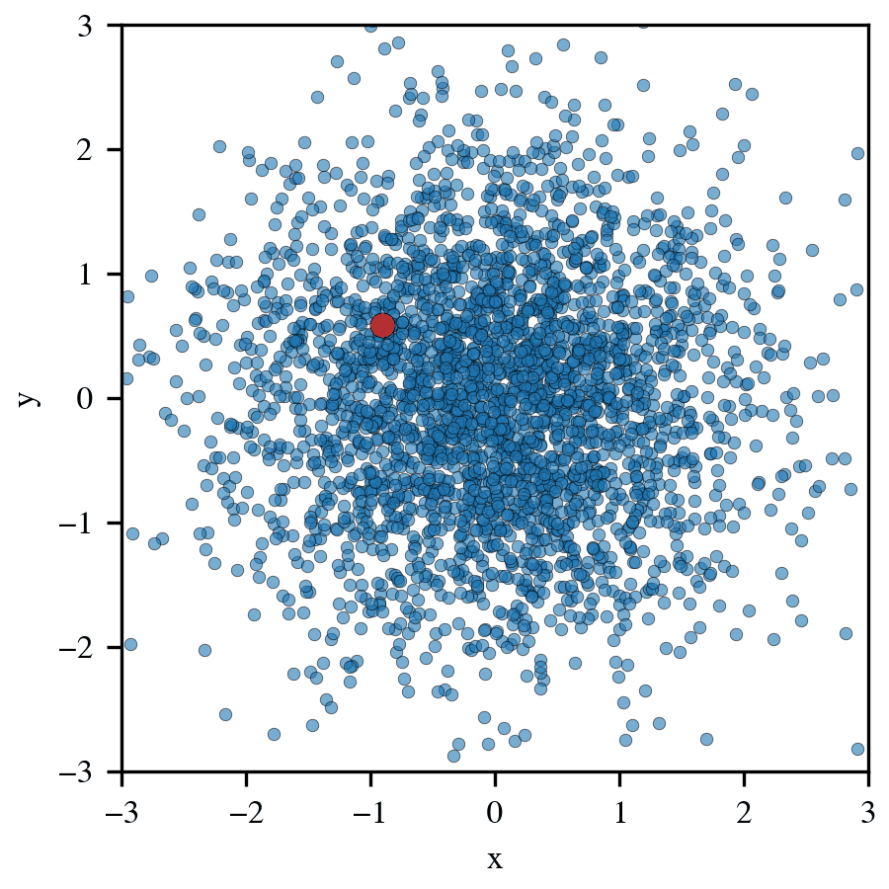
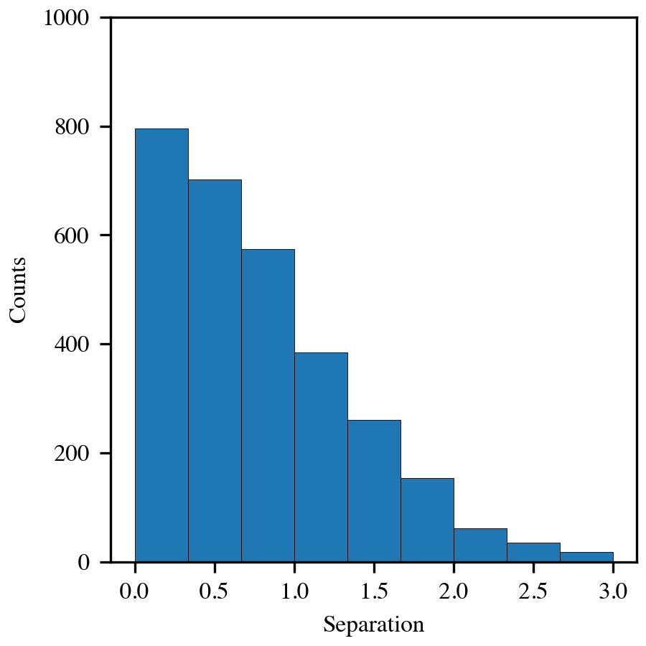
Particles sampled from distribution function
Absolute locations of particles is meaningless
Relative locations of particles holds meaning

Slide 15
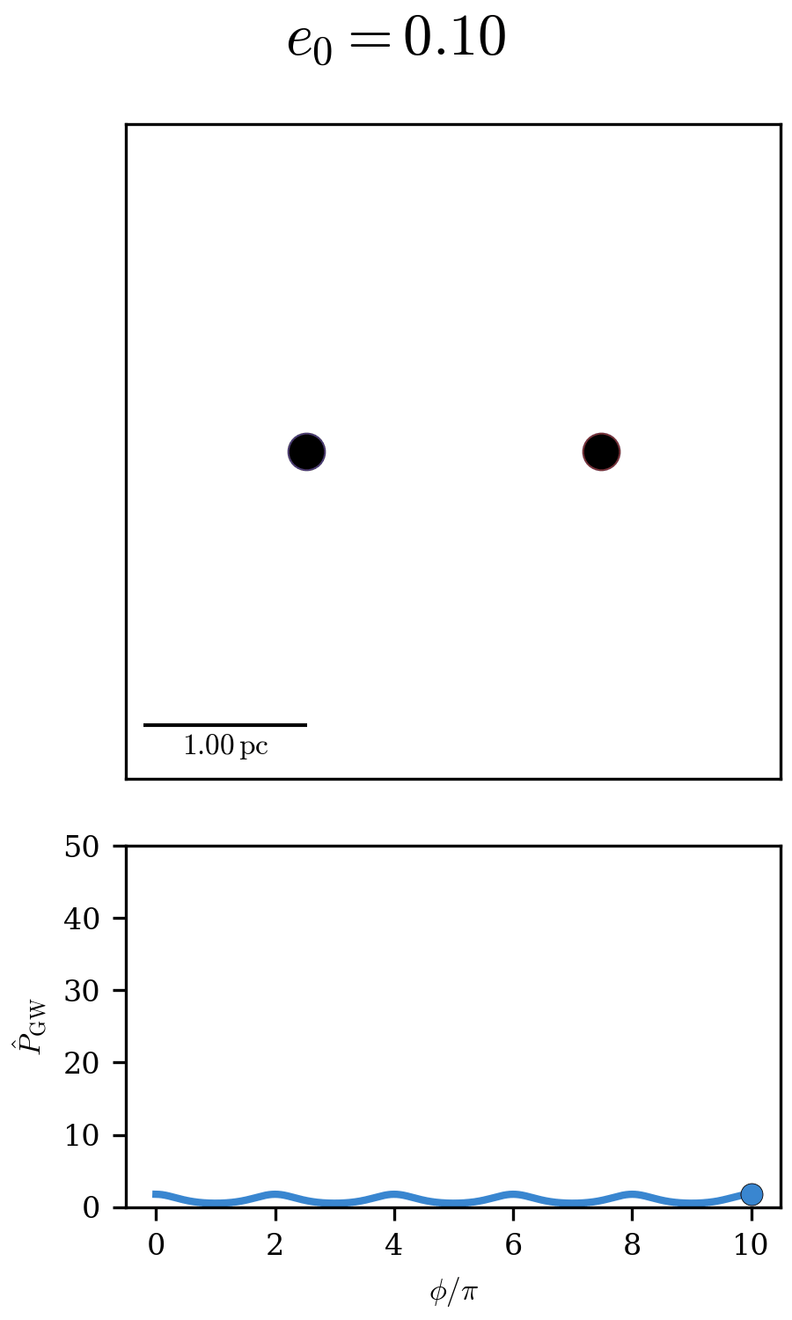
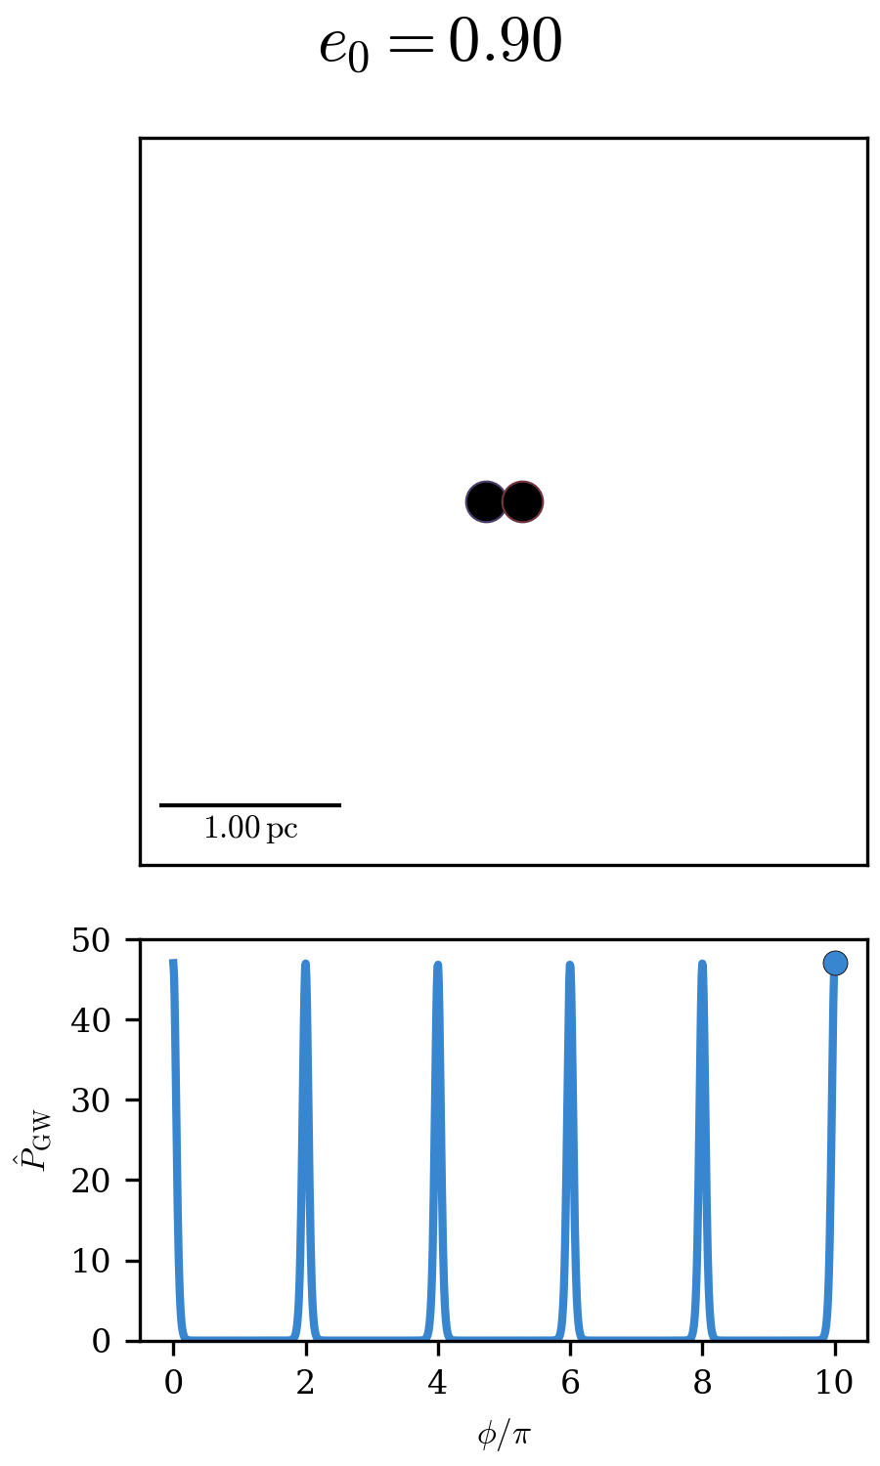
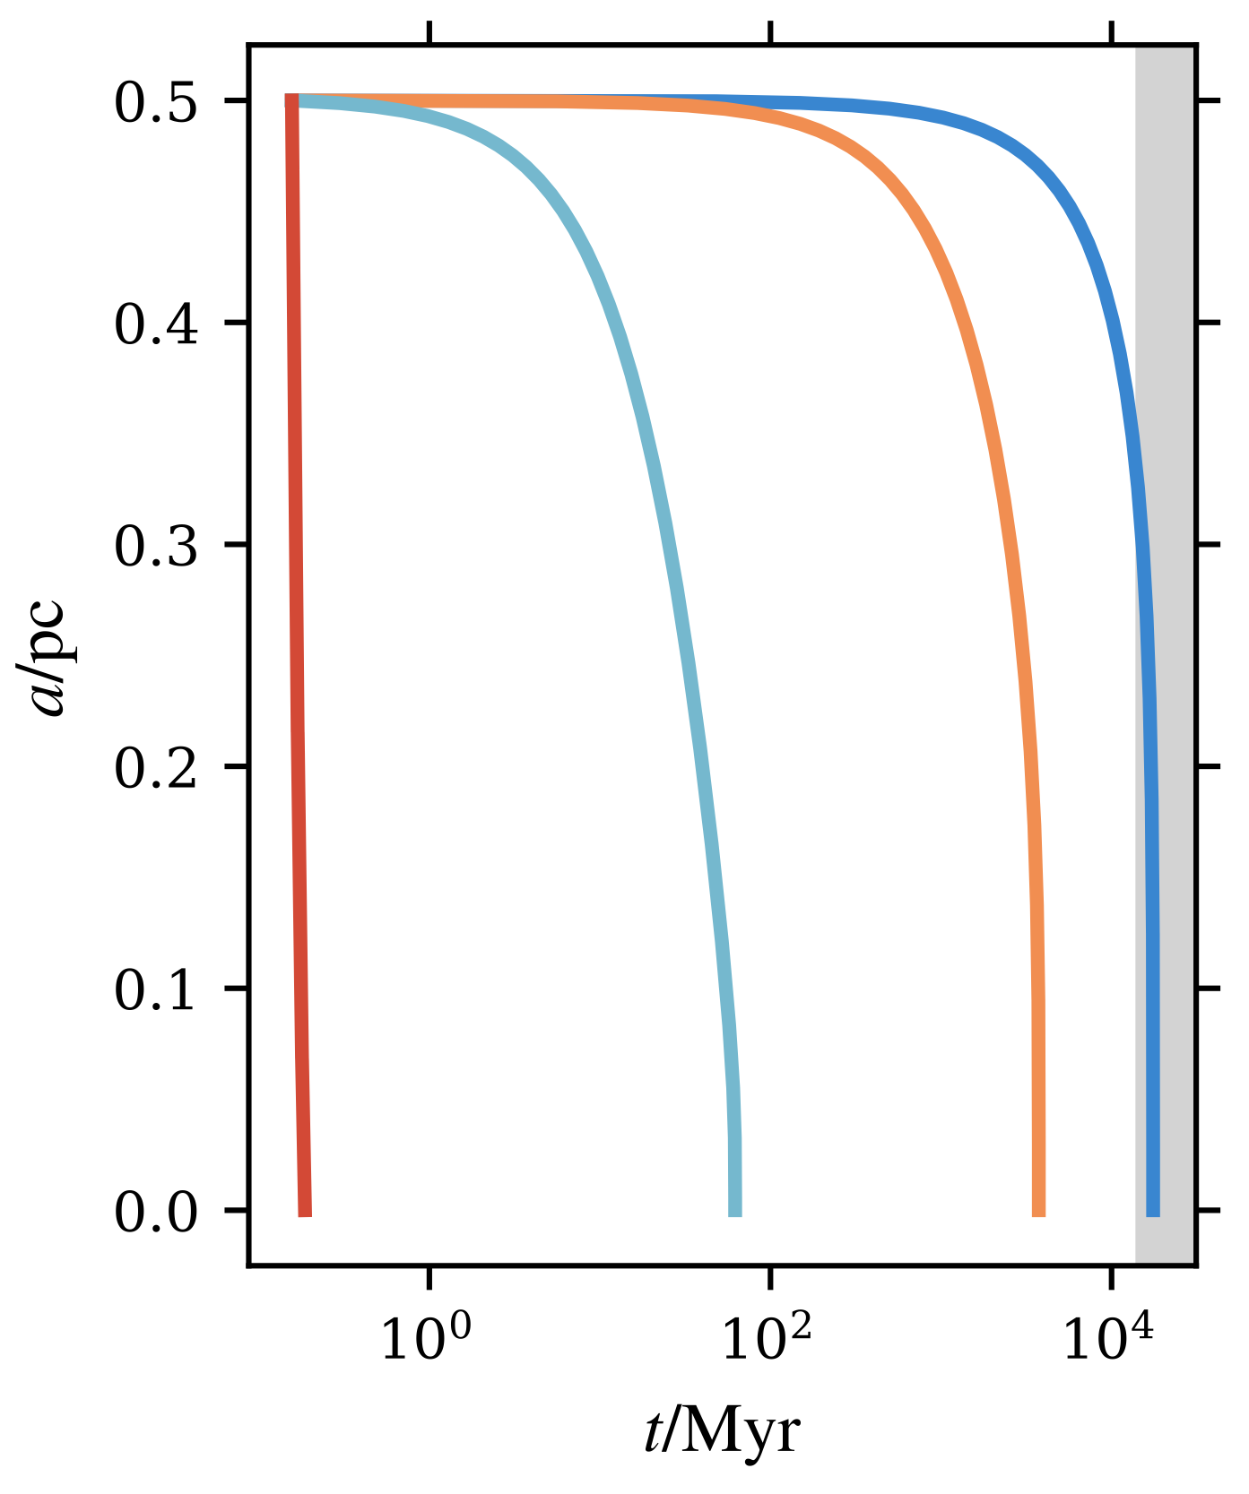




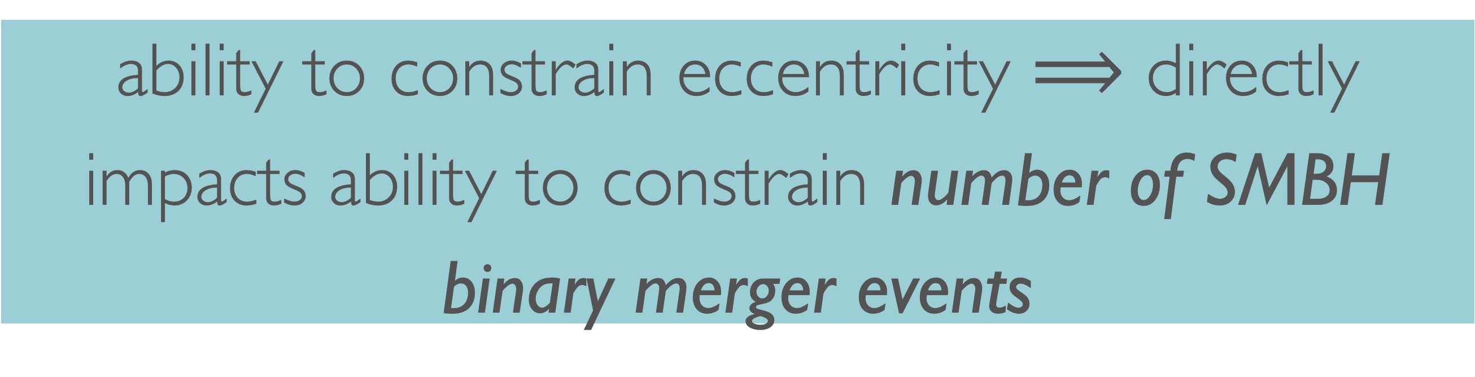
The importance of SMBH binary eccentricity
age of Universe
ability to constrain eccentricity $⟹$ directly impacts ability to constrain number of SMBH binary merger events
$$e_{0}=0.99$$
$$e_{0}=0.90$$
$$e_{0}=0.60$$
$$e_{0}=0.10$$

Slide 16
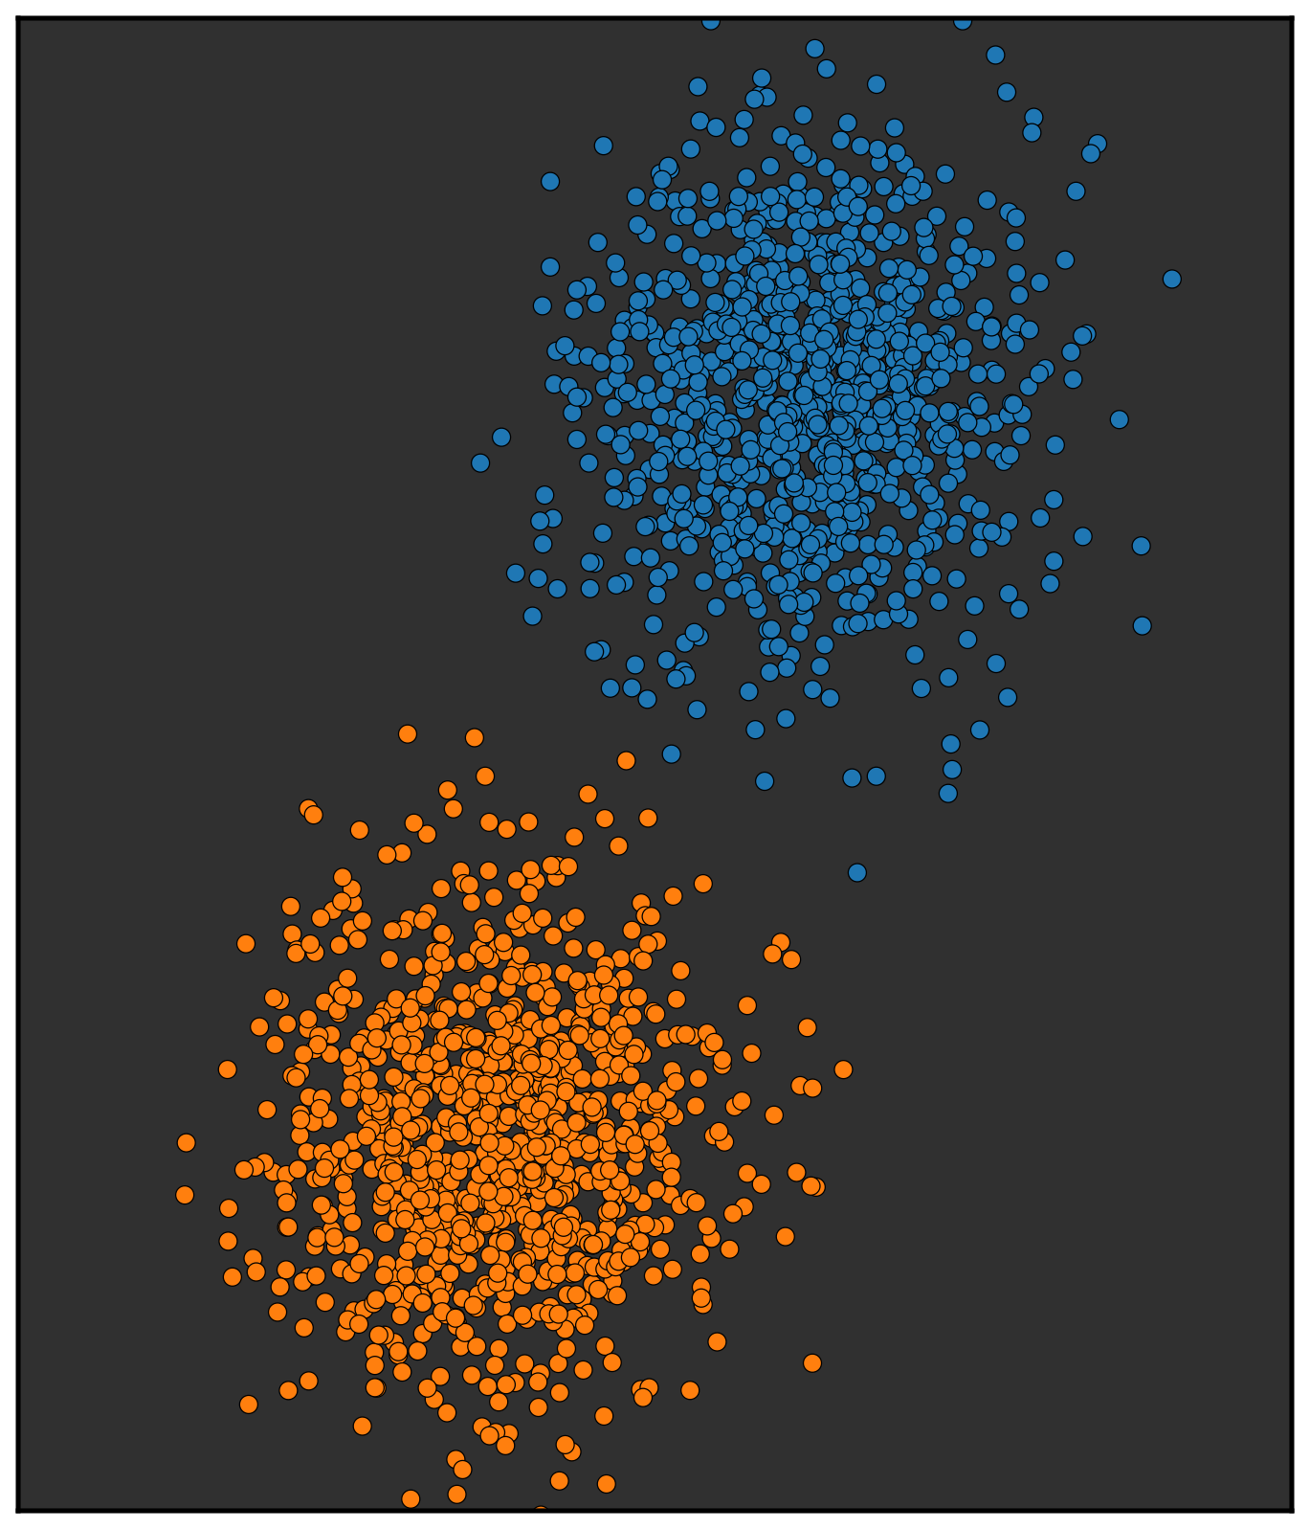
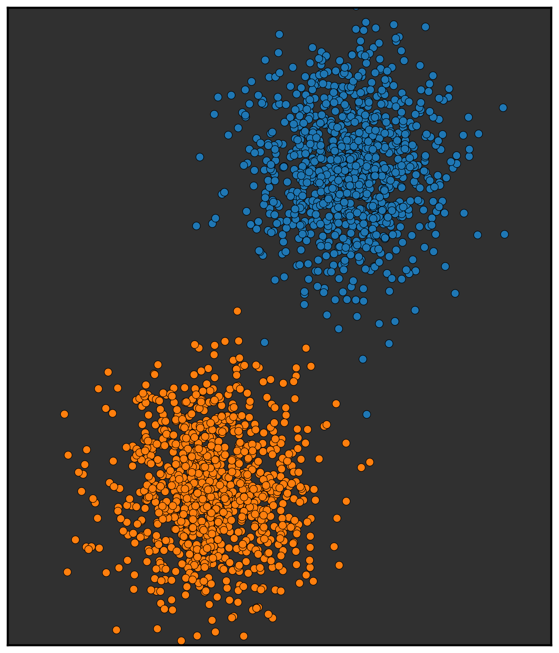
downsampled
downsampled

Slide 17
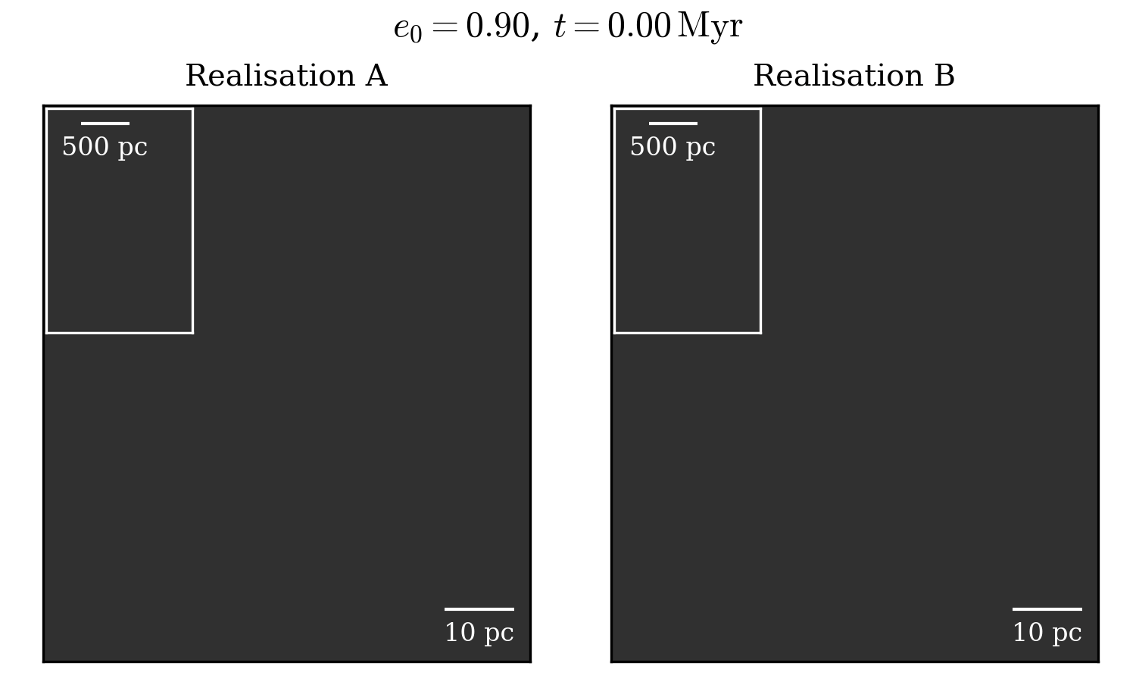

Slide 18
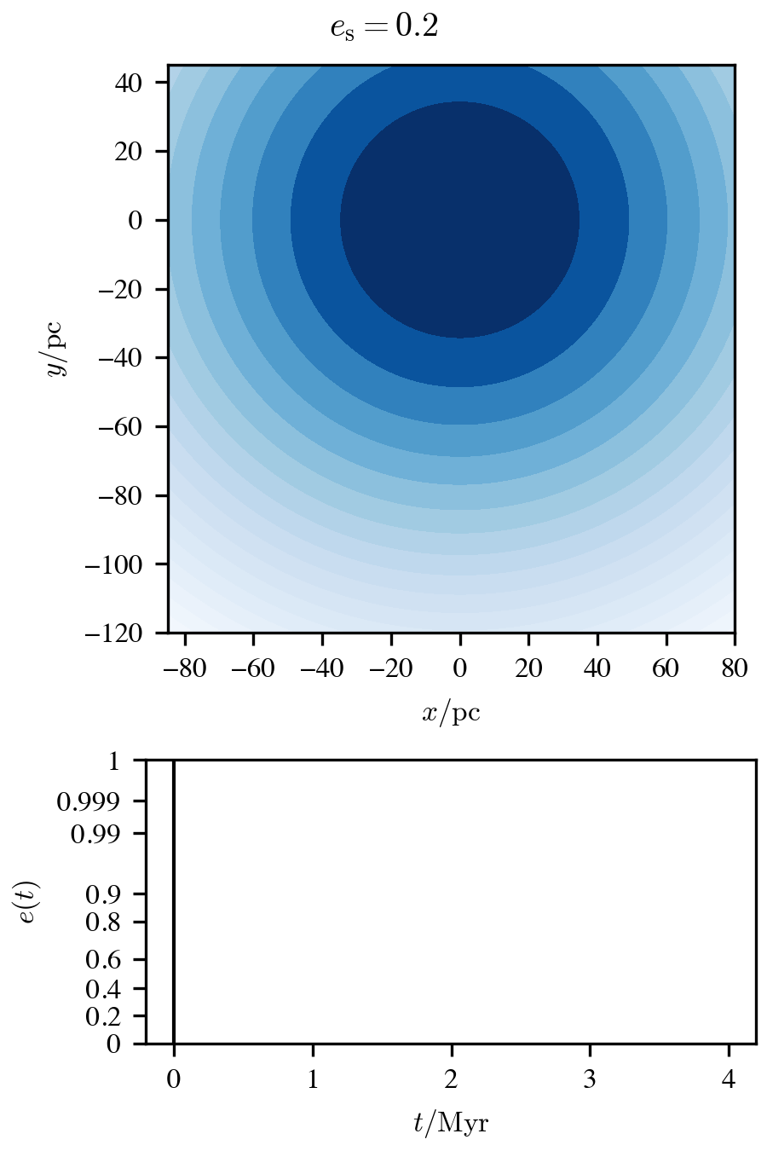
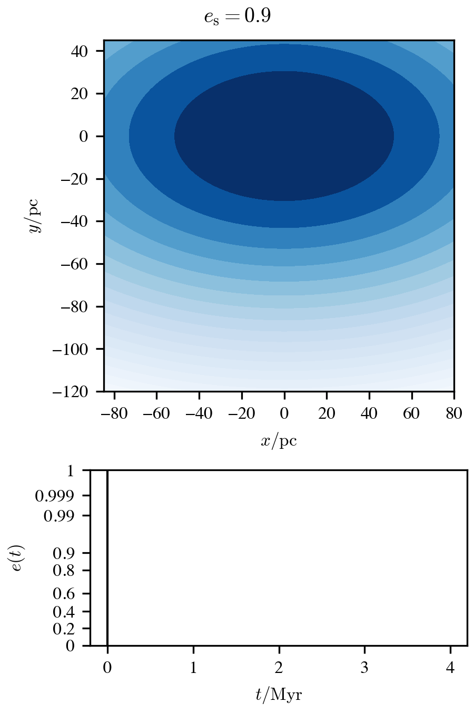
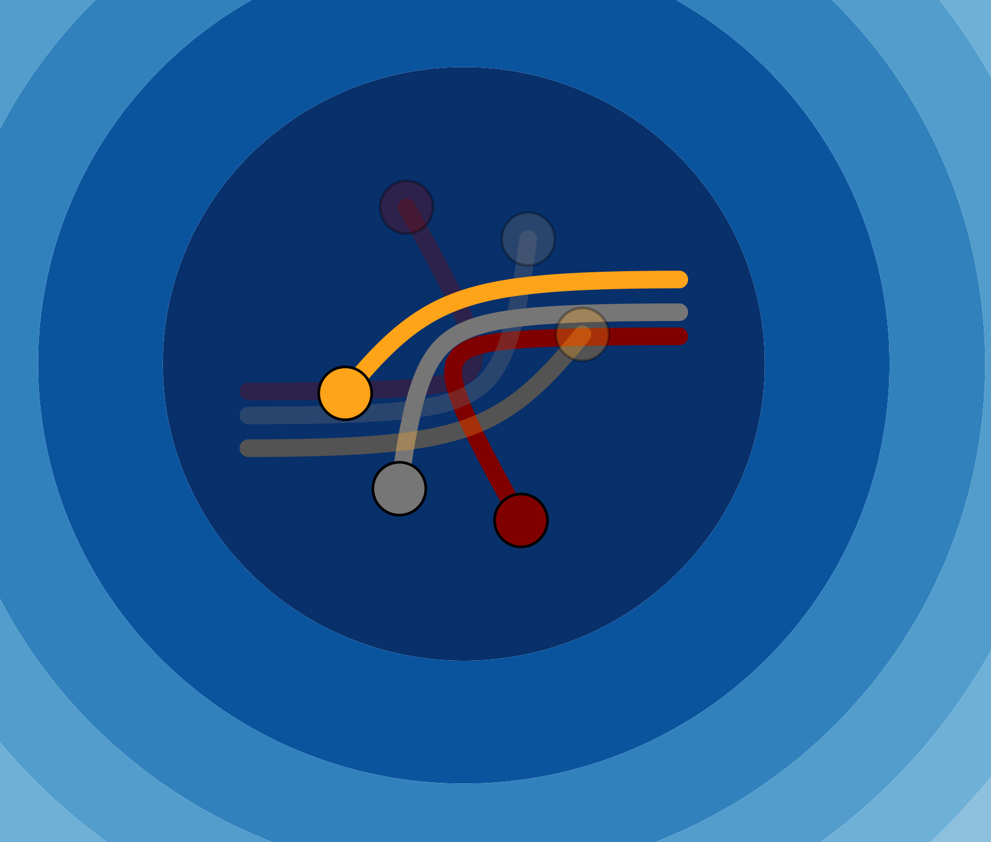

$$b$$

Slide 19

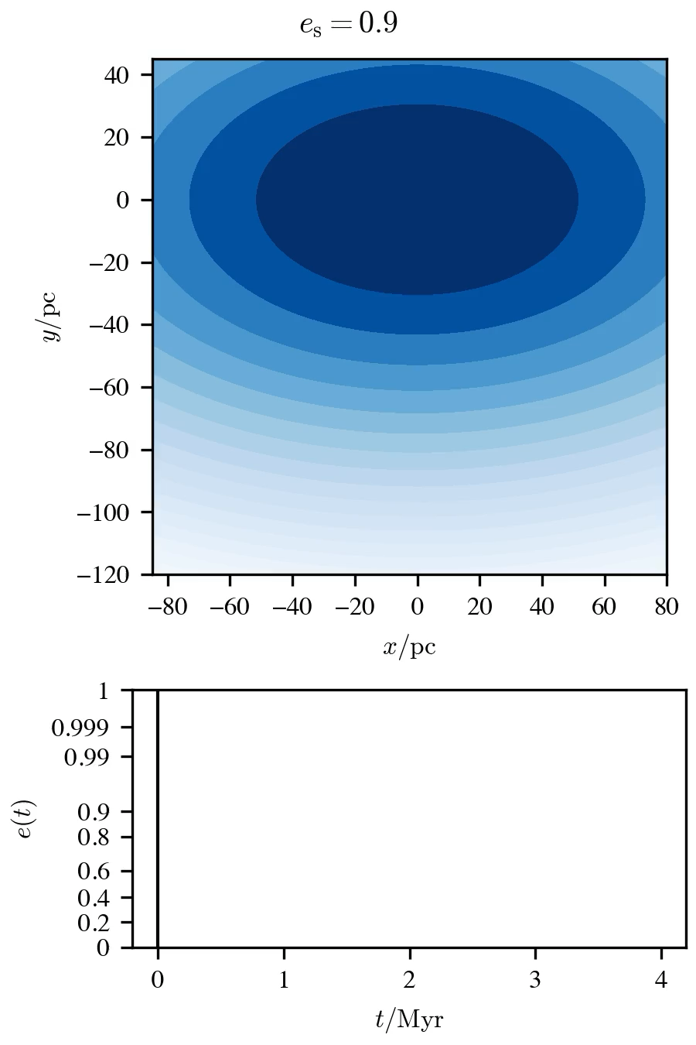
$$b$$

Slide 20

Difficult, depends on the orbit and potential
How well can we constrain SMBH binary orbits?
Sensitive to Brownian motion of SMBHs

Slide 21
How well can we constrain SMBH binary orbits?
What is the effect of post-merger recoil?
Questions
What diversity to expect in predicted SMBH merger rates?
How detectable is ongoing SMBH recoil?

Slide 22
What is the effect of post-merger recoil?
How detectable is ongoing SMBH recoil?

Slide 23







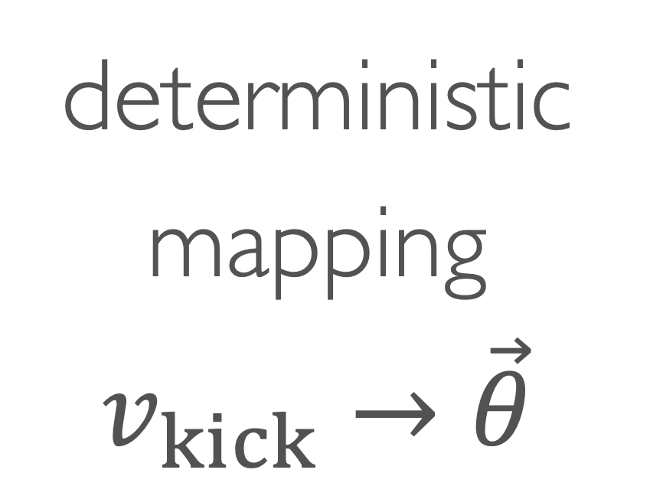
Recoil Simulations
evolve until SMBH settles
deterministic mapping$v_{kick}→\vec{θ}$
clone

Slide 24
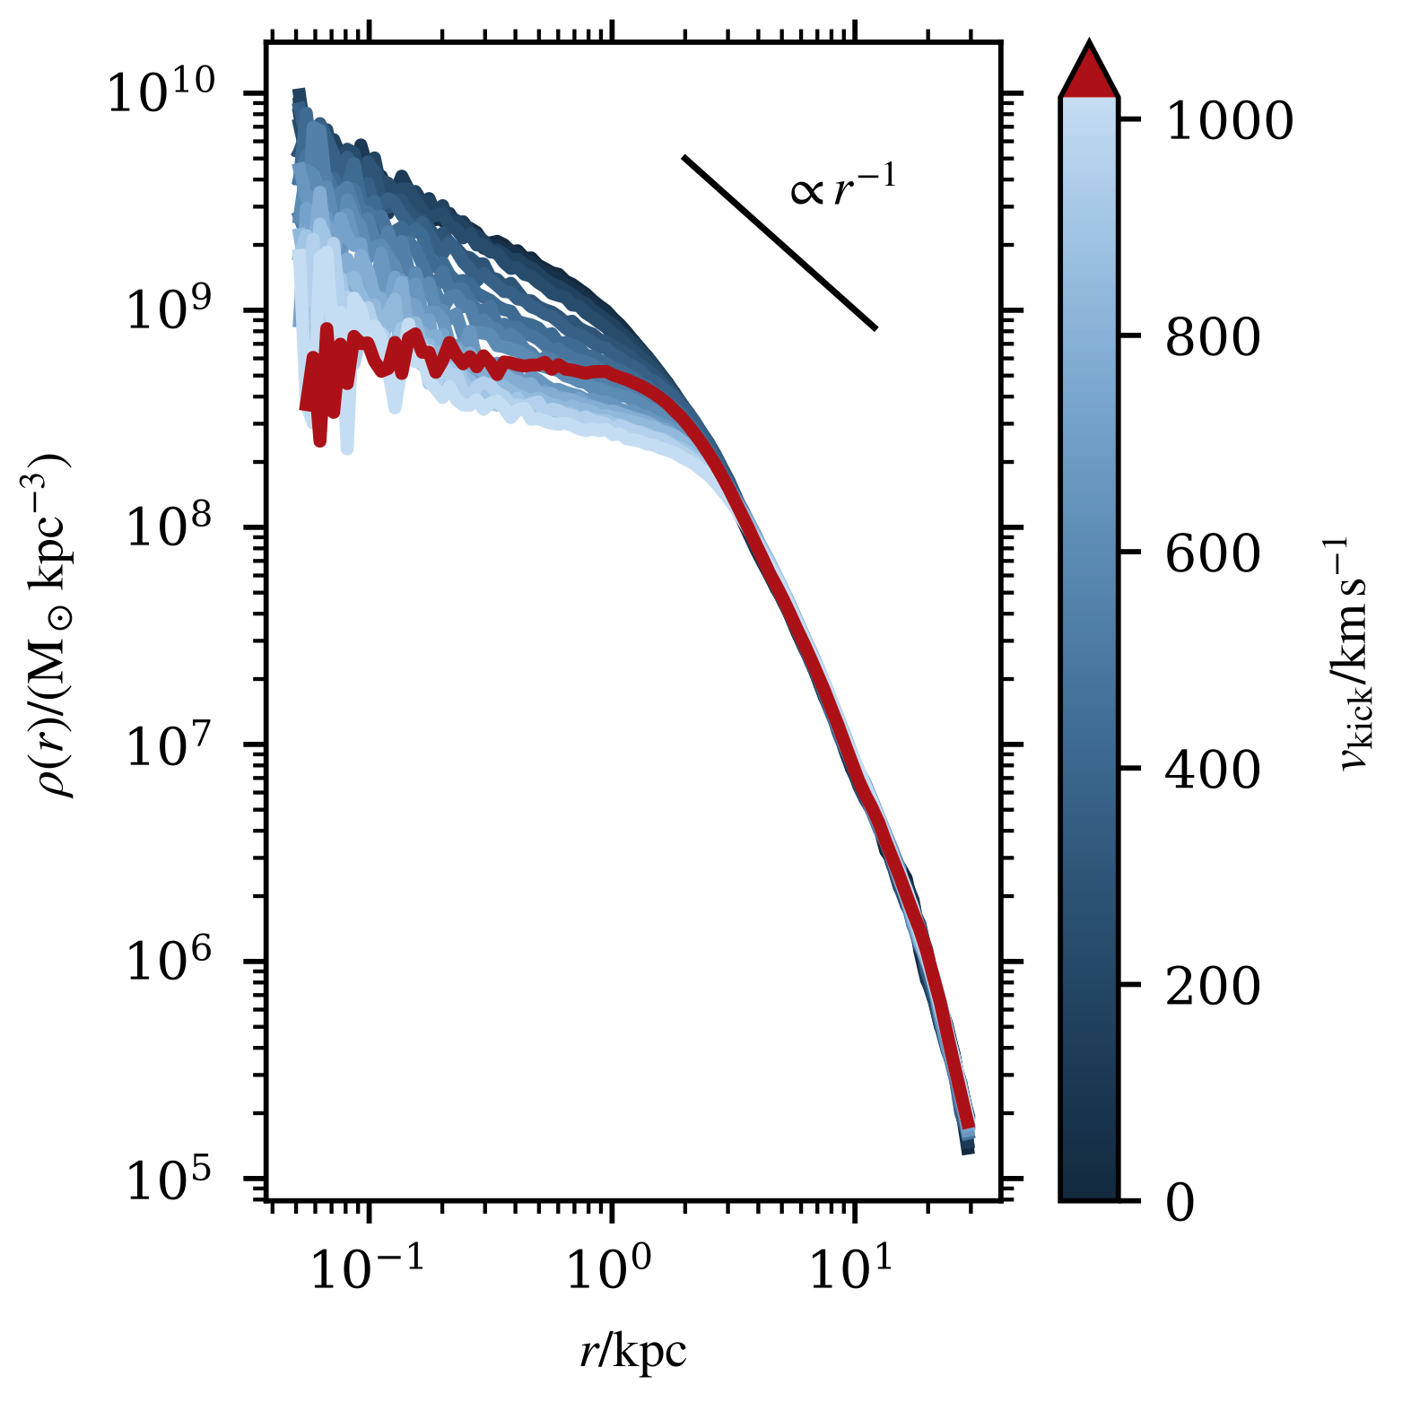
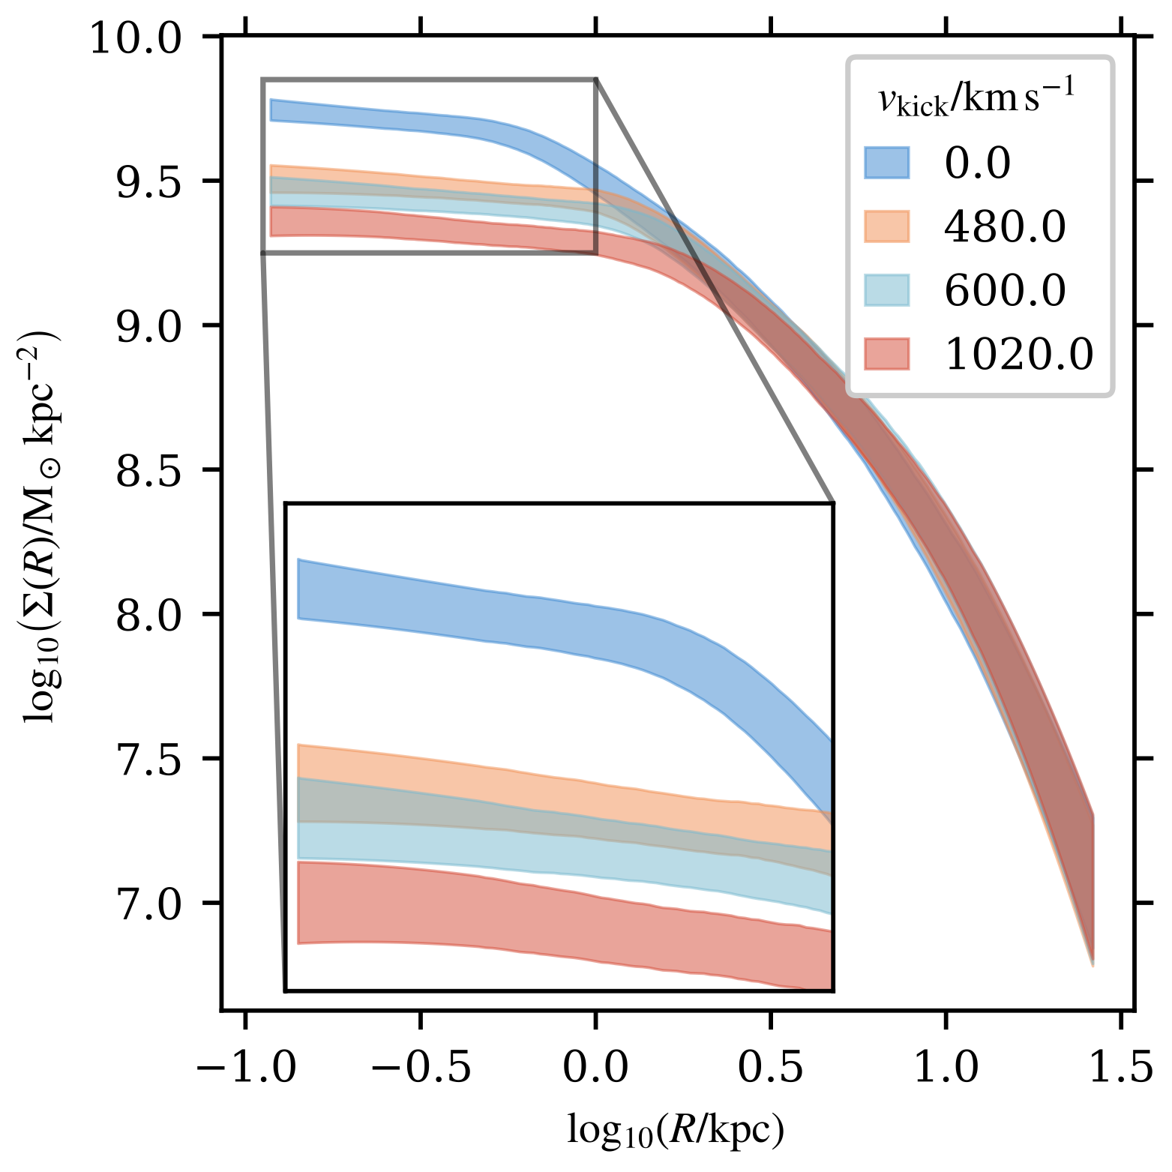
Density profiles
3D
2D

Slide 25
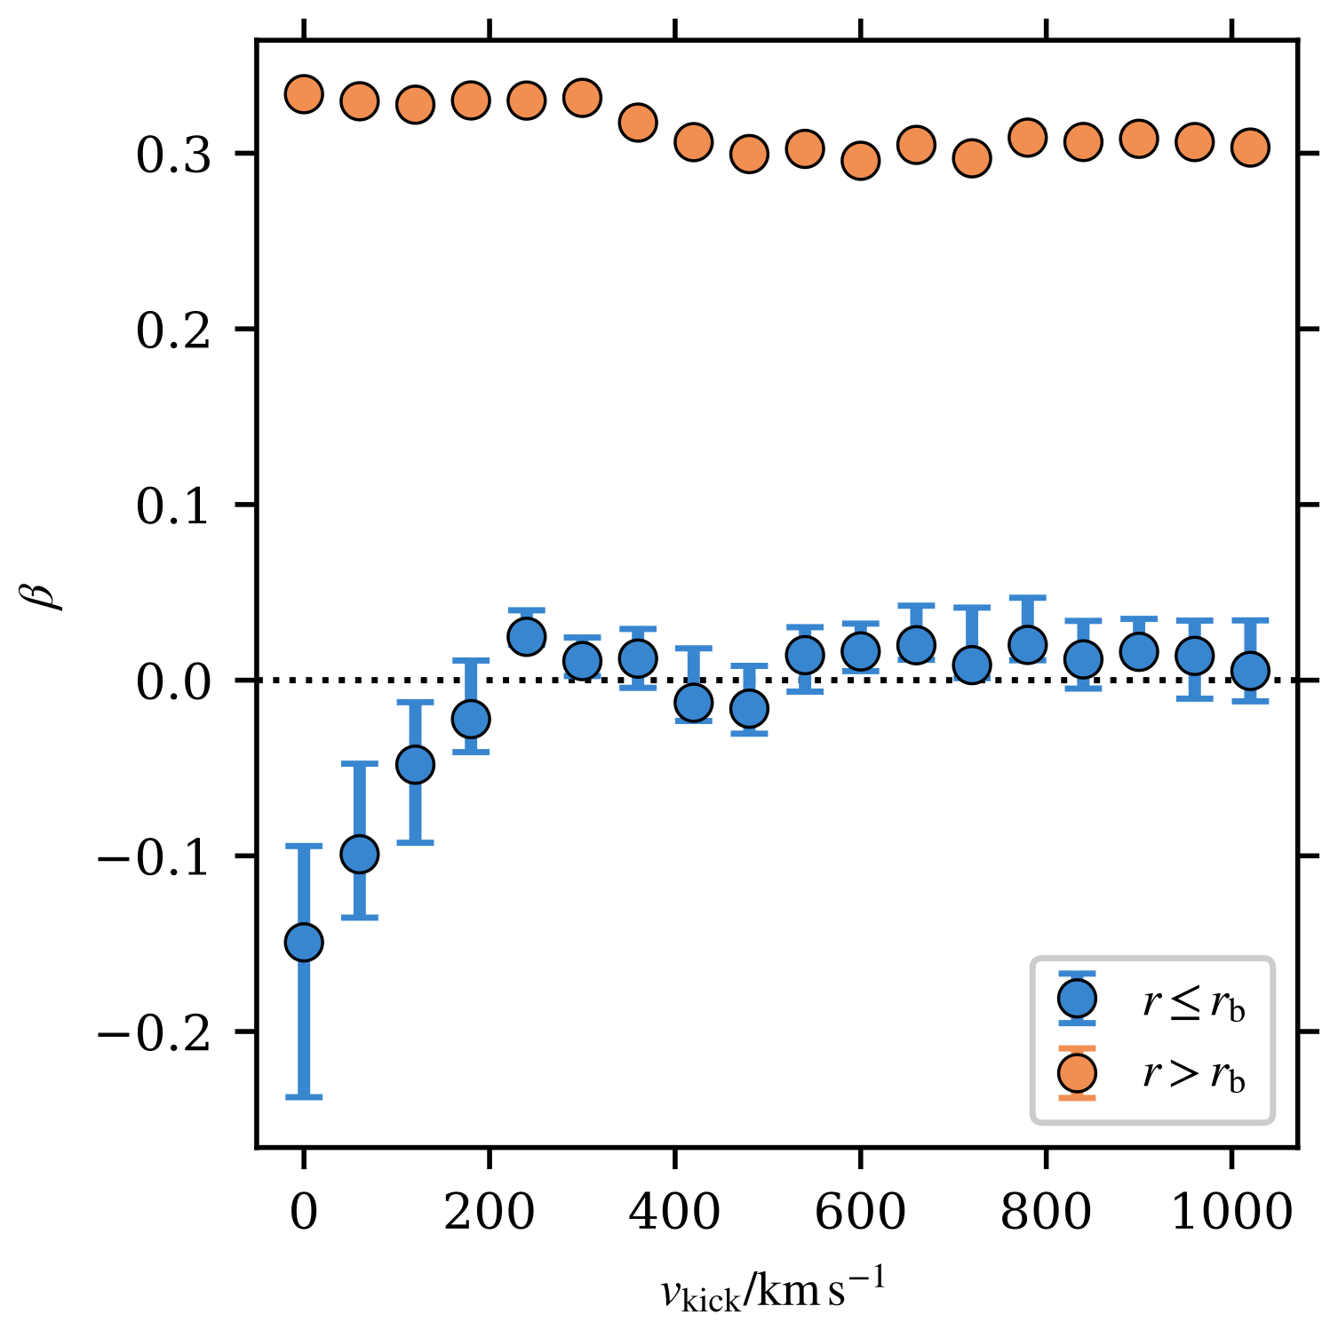


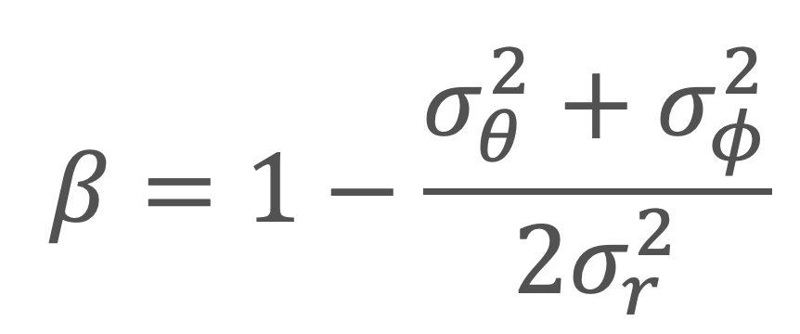
Tangentially-biased $β$ only when $v_{kick}≲σ_{⋆,0}$
$$β=1−\frac{σ_{θ}^{2}+σ_{φ}^{2}}{2σ_{r}^{2}}$$
central stars
radial bias
no bias (ergodic)
consistent with observations
tangential bias

Slide 26

Larger kicks lower central stellar density
What is the effect of post-merger recoil?
Larger kicks induce more radial orbits in centre
SMBHs typically experience mild recoil

Slide 27
What is the effect of post-merger recoil?
How detectable is ongoing SMBH recoil?

Slide 28
Identifying black hole recoil cluster (BRC)
BRC contains stars strongly bound to SMBH
BRC stars move with SMBH as it recoils

Slide 29
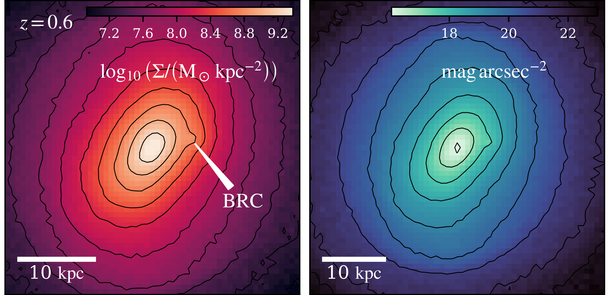



BRC visible in photometry
mock observation
simulation
Euclid VIS-like spatial resolution at $z=0.6$

Slide 30
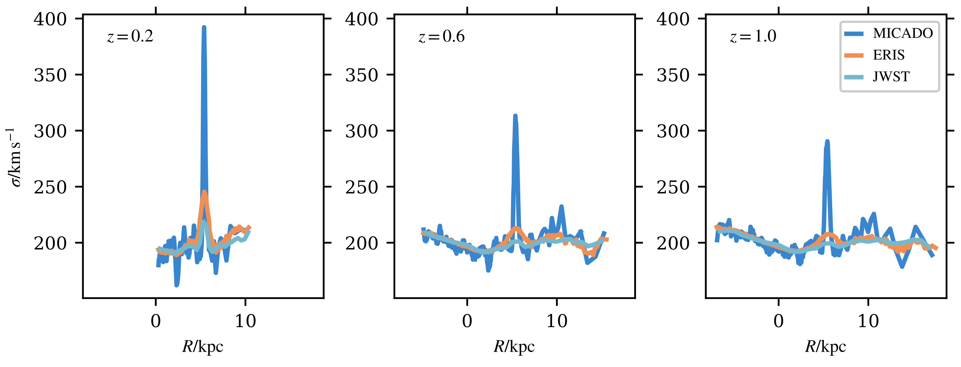
BRC with slit spectroscopy
ELT instruments will be crucial for detecting BRCs

Slide 31
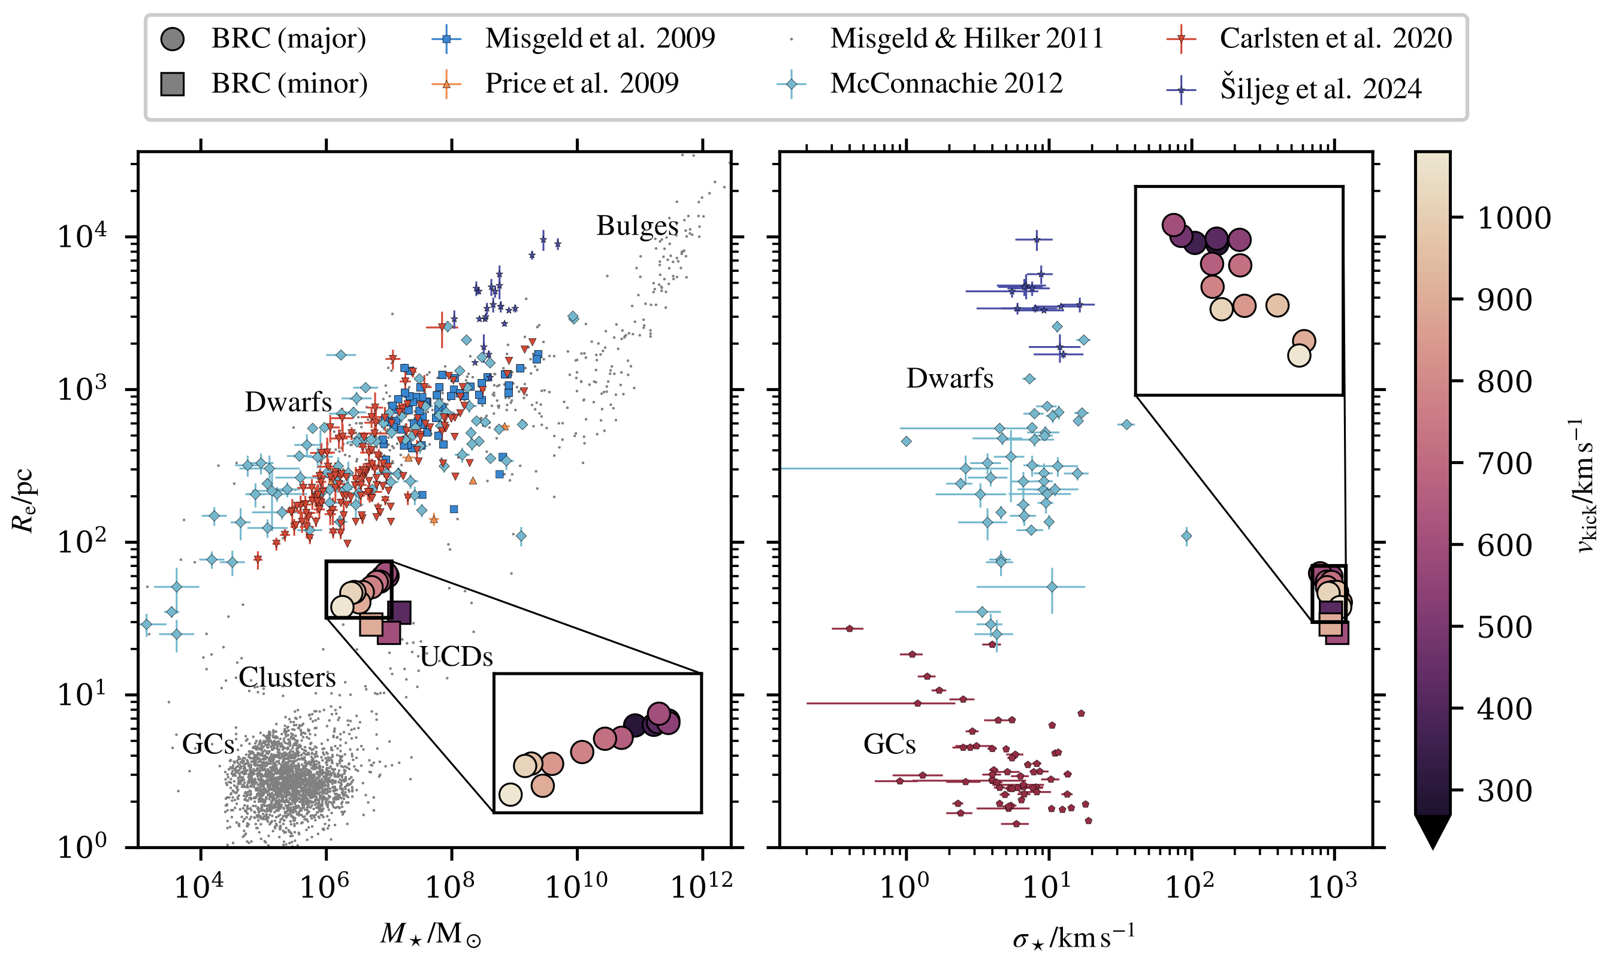
BRC comparison to local faint objects
BRCs from major and minor mergers inhabit similar parameter space

Slide 32

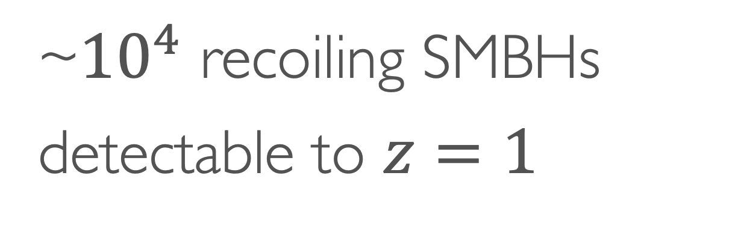
Detections with Euclid possible out to z~1.0
How detectable is ongoing SMBH recoil?
Kinematic follow up critical for confirmation
~${10}^{4}$ recoiling SMBHs detectable to $z=1$

Slide 33
How well can we constrain SMBH binary orbits?
What is the effect of post-merger recoil?
Questions
What diversity to expect in predicted SMBH merger rates?
How detectable is ongoing SMBH recoil?

Slide 34



SMBH binary orbits
Galaxy merger redshift
SMBH recoil lowering stellar density
Host galaxy masses
What diversity to expect in predicted SMBH merger rates?
Baryonic physics
Number of previous SMBH mergers
Unknown factors
Prevalence of complex multi-galaxy mergers

Slide 35


3 main messages
much to understand for SMBH dynamics
requires proper statistics (Bayesian!!)
let’s make the community inviting to everyone

Slide 36
some questions just need a picture

Slide 37
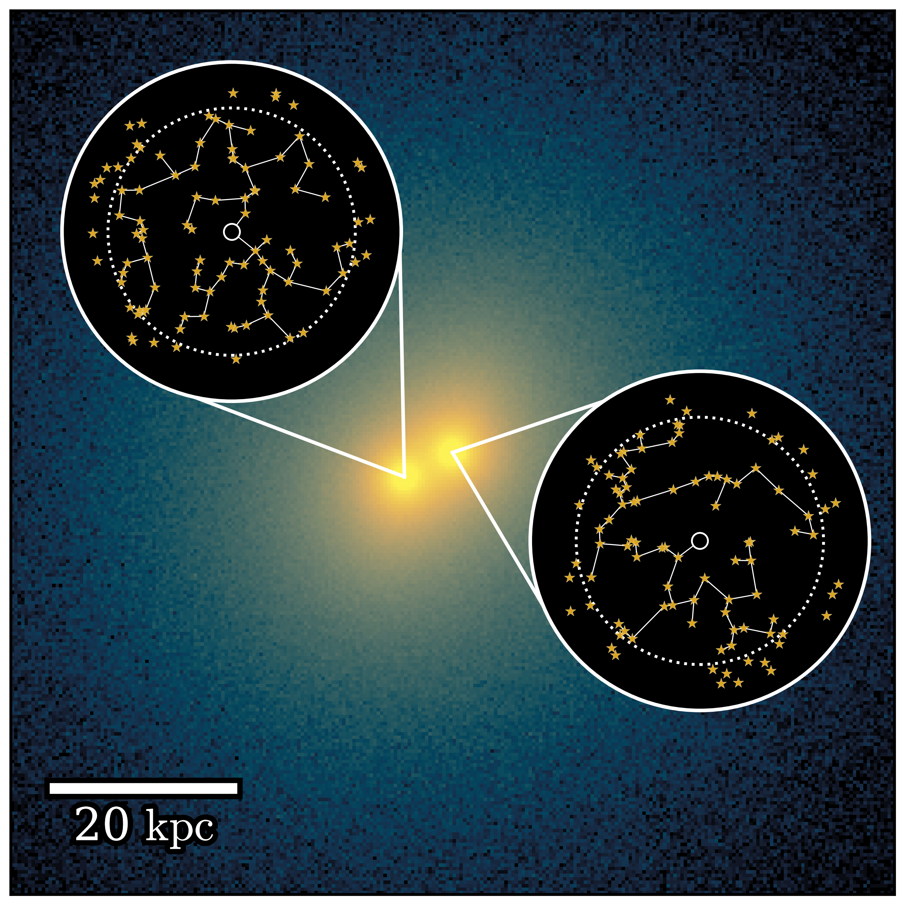
Simulation code: Ketju
particles outside Ketju region still see BH as non-softened
large-scale evolution with Gadget4 (softened)
particles inside Ketju region also see BH as non-softened

Slide 38
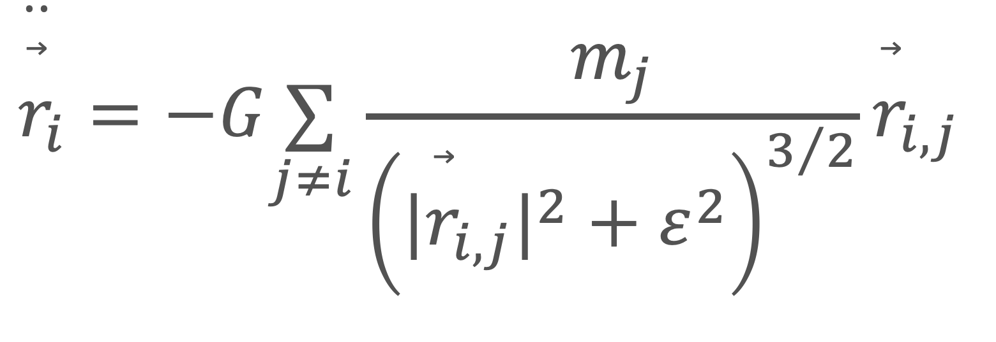
Simulation particles
$${\overset{··}{\overset{⃗}{r}}}_{i}=−G\underset{j≠i}{∑}\frac{m_{j}}{{\left(|{\overset{⃗}{r}}_{i,j}|^{2}+ε^{2}\right)}^{3/2}}{\overset{⃗}{r}}_{i,j}$$
a single simulation particle…
represents many real stars

Slide 39
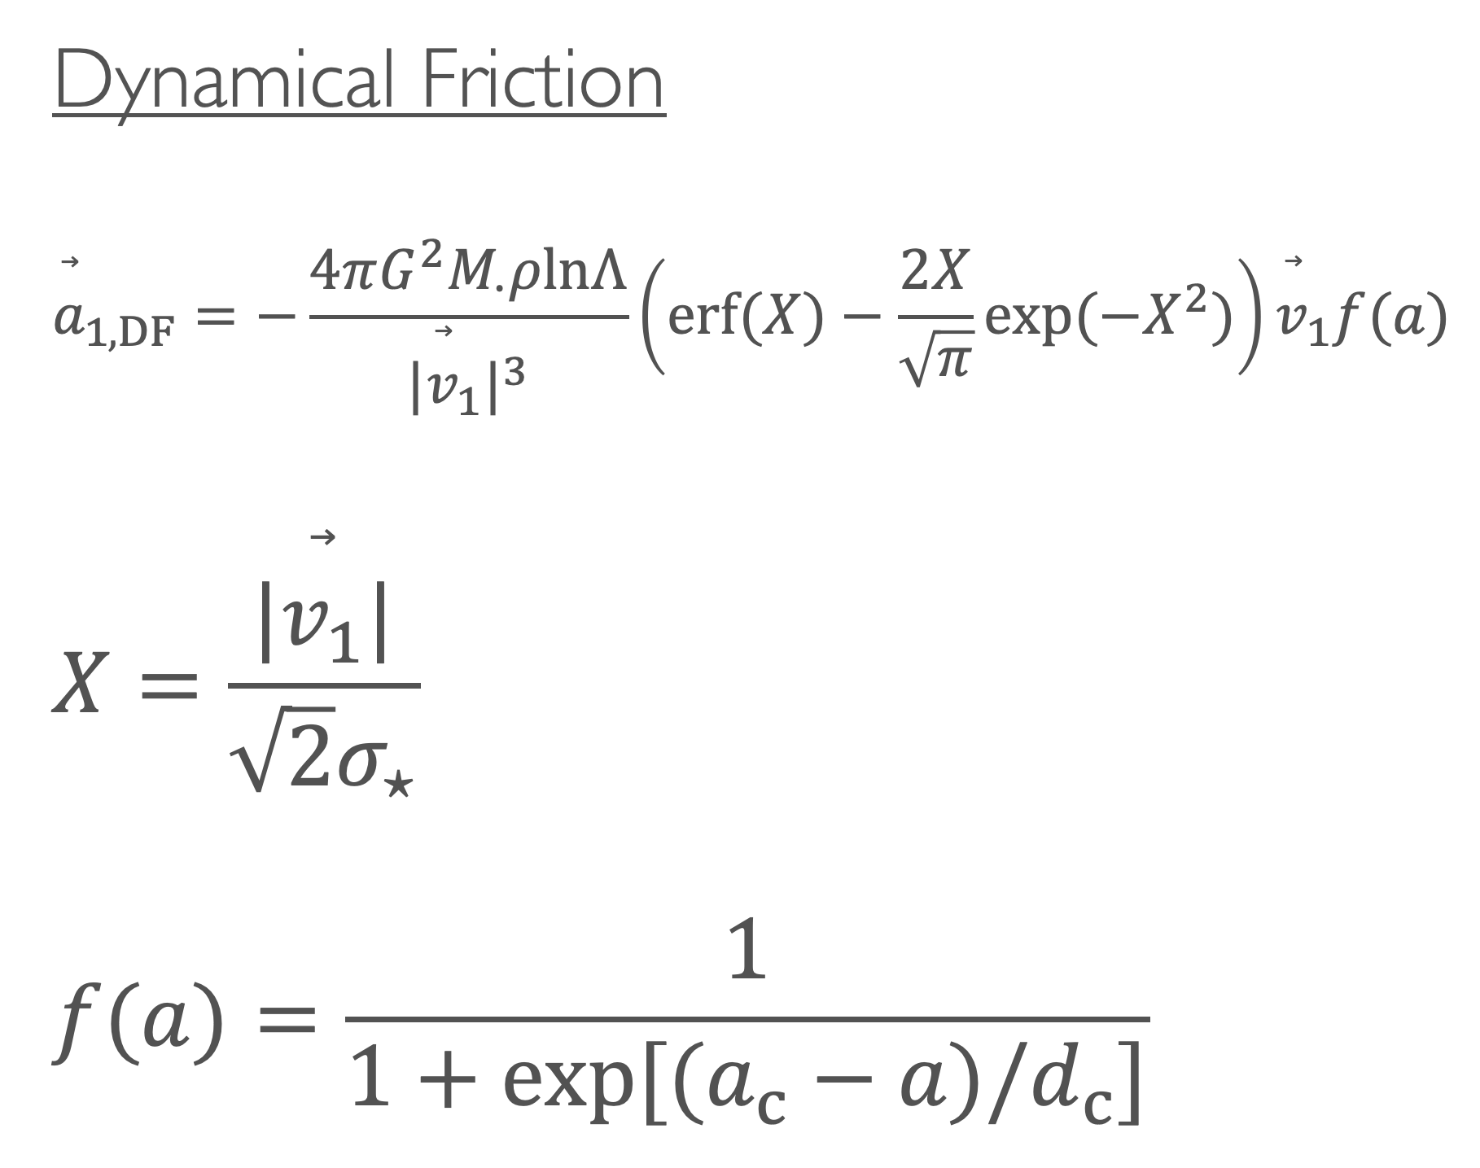
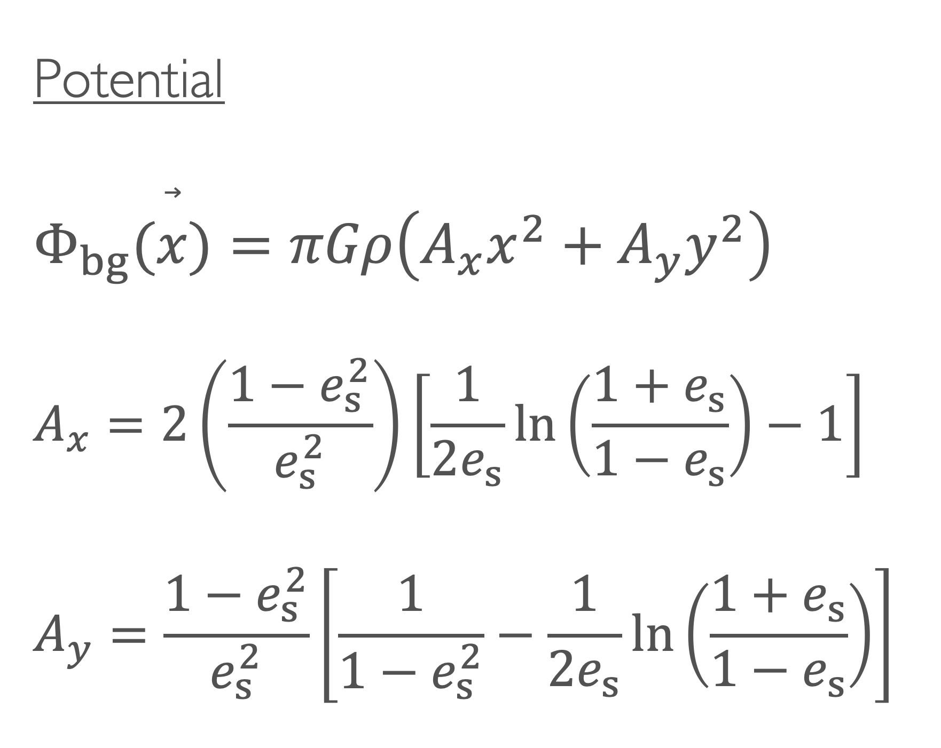
Model details
Potential
$$Φ_{bg}(\overset{⃗}{x})=πGρ\left(A_{x}x^{2}+A_{y}y^{2}\right)$$
$$A_{x}=2\left(\frac{1−e_{s}^{2}}{e_{s}^{2}}\right)\left[\frac{1}{2e_{s}}ln\left(\frac{1+e_{s}}{1−e_{s}}\right)−1\right]$$
$$A_{y}=\frac{1−e_{s}^{2}}{e_{s}^{2}}\left[\frac{1}{1−e_{s}^{2}}−\frac{1}{2e_{s}}ln\left(\frac{1+e_{s}}{1−e_{s}}\right)\right]$$
Dynamical Friction
$${\overset{⃗}{a}}_{1,DF}=−\frac{4πG^{2}M_{∙}ρlnΛ}{|{\overset{⃗}{v}}_{1}|^{3}}\left(erf(X)−\frac{2X}{\sqrt{π}}exp(−X^{2})\right){\overset{⃗}{v}}_{1}f(a)$$
$$X=\frac{|\overset{⃗}{v_{1}}|}{\sqrt{2}σ_{⋆}}$$
$$f(a)=\frac{1}{1+exp[(a_{c}−a)/d_{c}]}$$

Slide 40



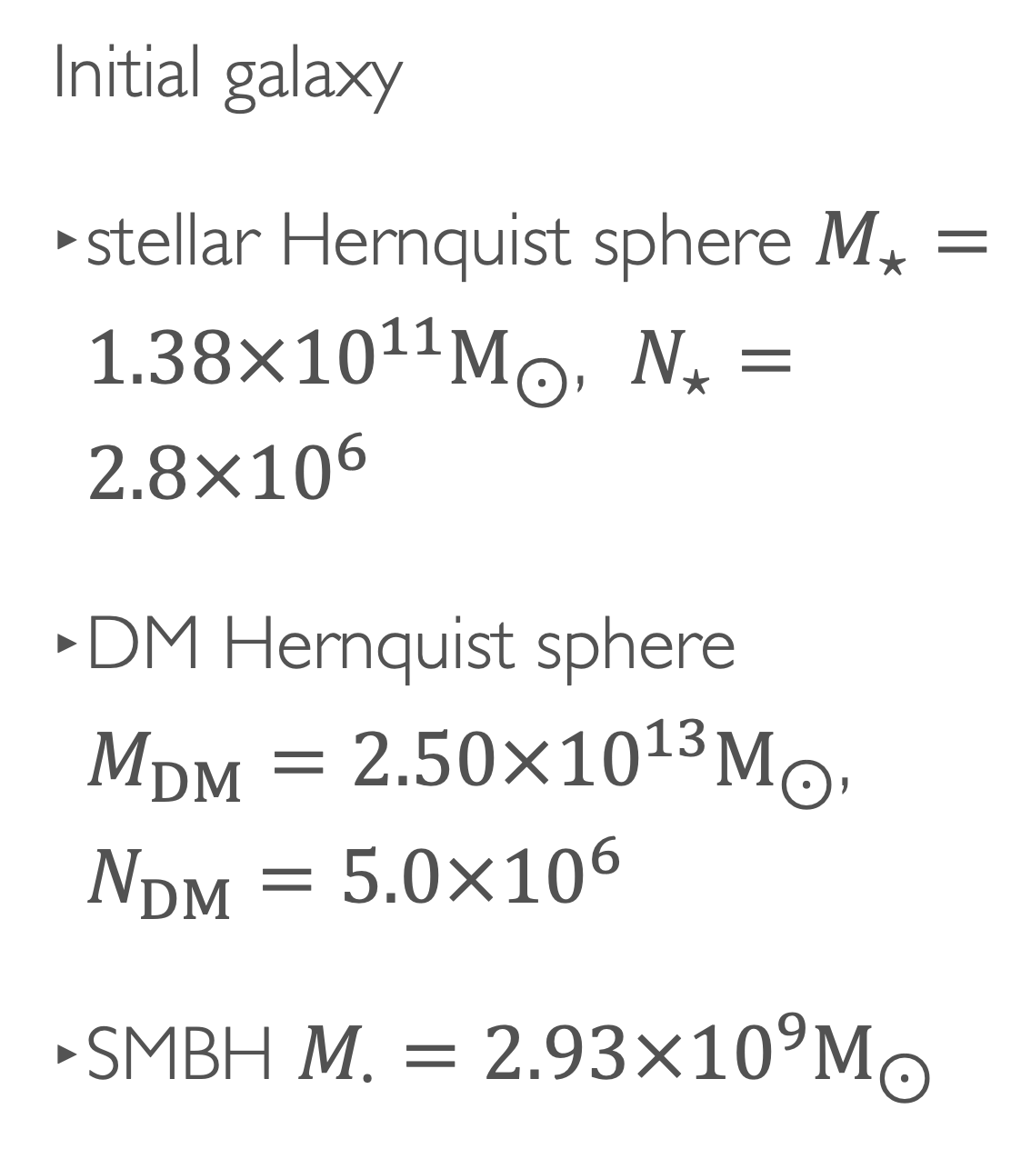
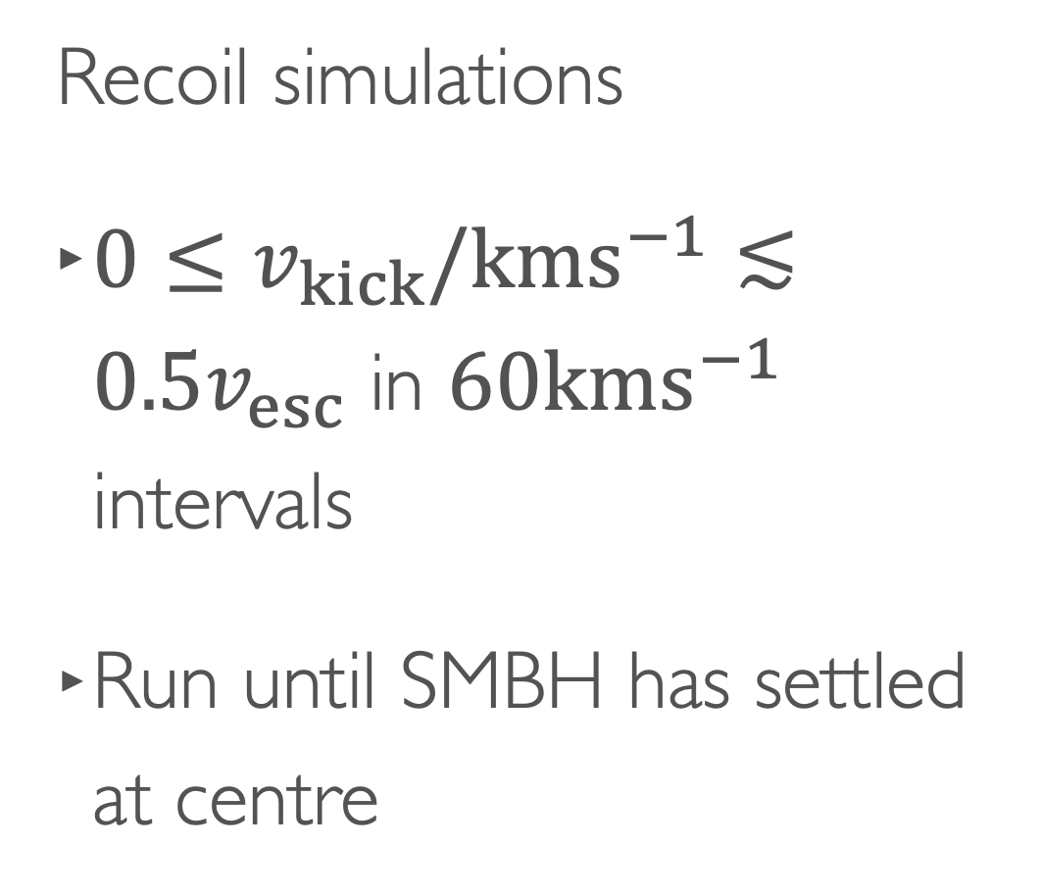
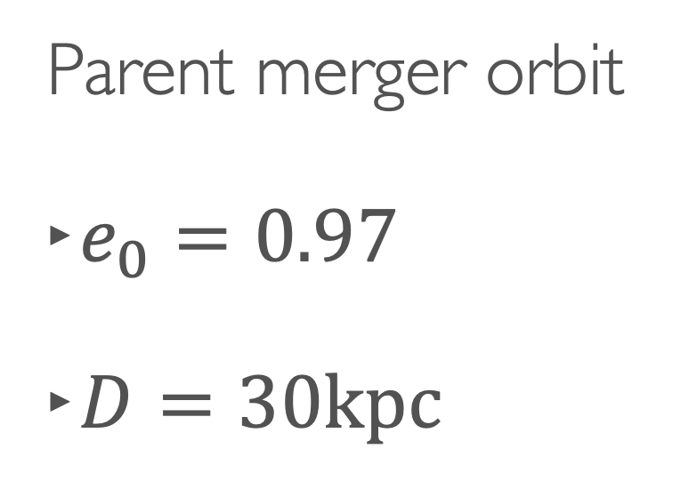
Recoil Simulations
Initial galaxy
stellar Hernquist sphere $M_{⋆}=1.38×{10}^{11}M_{⊙}$, $N_{⋆}=2.8×{10}^{6}$
DM Hernquist sphere $M_{DM}=2.50×{10}^{13}M_{⊙}$, $N_{DM}=5.0×{10}^{6}$
SMBH $M_{∙}=2.93×{10}^{9}M_{⊙}$
Recoil simulations
$0≤v_{kick}/kms^{−1}≲0.5v_{esc}$ in $60kms^{−1}$ intervals
Run until SMBH has settled at centre
Parent merger orbit
$e_{0}=0.97$
$D=30kpc$

Slide 41

SMBH binaries scour a core in stellar light

Slide 42

Orbits: an overview
no net angular momentum
net angular momentum

Slide 43








Integral field units (IFUs) & fitting LOSVD profile
$$ℒ=\frac{1}{\sqrt{2π}σ}e^{−w^{2}/2}\left\{1+\overset{n}{\underset{j=3}{∑}}h_{j}H_{j}(w)\right\}$$
$$w≡\frac{v_{LOS}−V}{σ}$$
$$y$$
Hermite polynomials
$$v_{LOS}$$
$$λ$$
$$x$$

Slide 44

Meaning of different LOSVD moments

Slide 45








Estimates for SMBH binary-scoured radius
all $→$
box $→$
$$v_{kick}=0kms^{−1}$$
tube $→$
$$r_{b,0}$$
$$v_{kick}=600kms^{−1}$$

Slide 46





How many BRCs do we expect?
major mergers
$$N_{m}(ξ_{0},M_{0},z_{0},z)=∫_{z_{0}}^{z}dz^{′}∫_{ξ_{0}}^{1}dξ^{′}\frac{dN_{m}}{dξ^{′}dz^{′}}\left(M(z^{′}),ξ^{′},z^{′}\right)$$
1galaxy = 1 SMBH
redshift
20% BRCs detectable
$$N≈N_{m}(z)f_{obs}\frac{t_{apo}}{t_{lookback}(z)}$$
median time to apocentre
~8000 BRCs out to z=0.6

Slide 47
BRC detection workflow
not BRC candidate
no
photometric data
cored density profile?
yes

Slide 48
BRC detection workflow
not BRC candidate
no
off-centre intensity peak?
yes
compare to other faint objects

Slide 49
BRC detection workflow
not BRC candidate
no
do IFU mapping
asymmetric velocity dispersion?
yes

Slide 50
BRC detection workflow
not BRC candidate
no
deep kinematic observation
high velocity dispersion?
yes

Slide 51
BRC detection workflow
BRC candidate

Slide 52
Coauthors of my PhD projects
Antti
Atte
Dimitrios
Jens
Matias
Max
Noa
Peter
Shihong
Thorsten
those who are in Finland…
…and in science
Bianca
Ruby
Sonja

