Slide 1
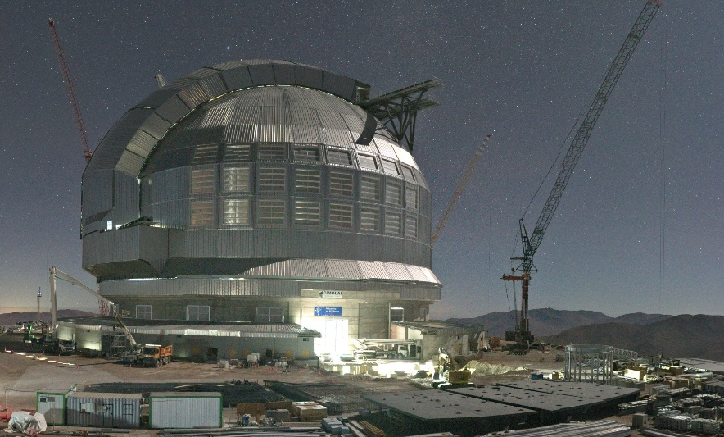
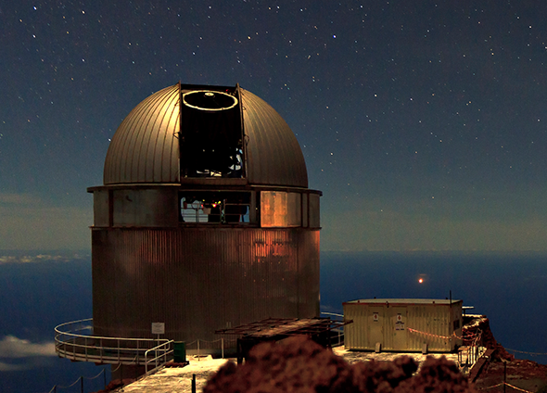
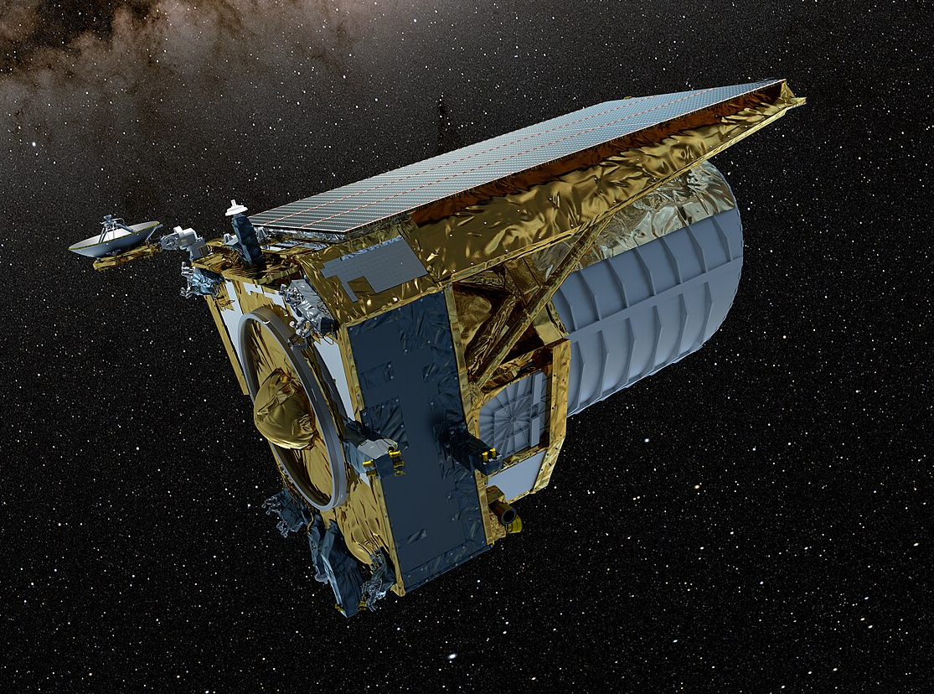
Instrument Centre for Danish Astrophysics
Hans Kjeldsen and Mai Korsbæk
Aarhus University, Denmark

Slide 2
Instrument Centre for Danish Astrophysics

Slide 3
IDA Ecosystem

Slide 4
IDA Organisational structure

Slide 5
IDA Working Groups

Slide 6
Mission & Vision

Slide 7
Denmark’s membership of International Research Infrastructure

Slide 8
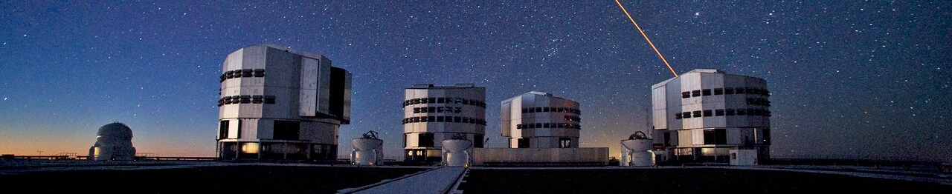
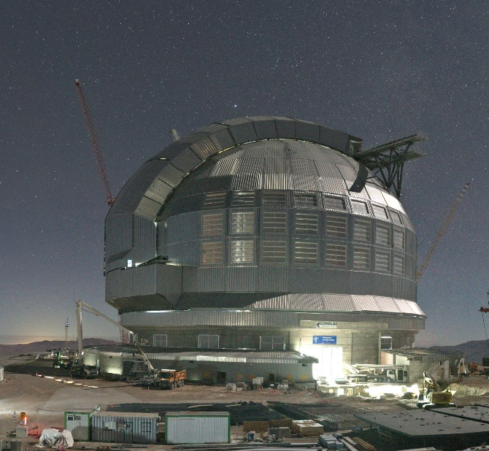
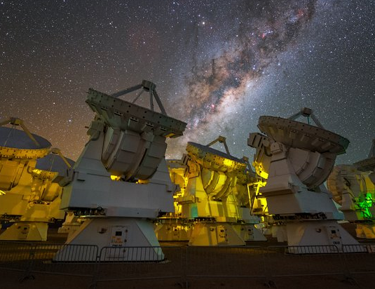
Scientific Use

Slide 9
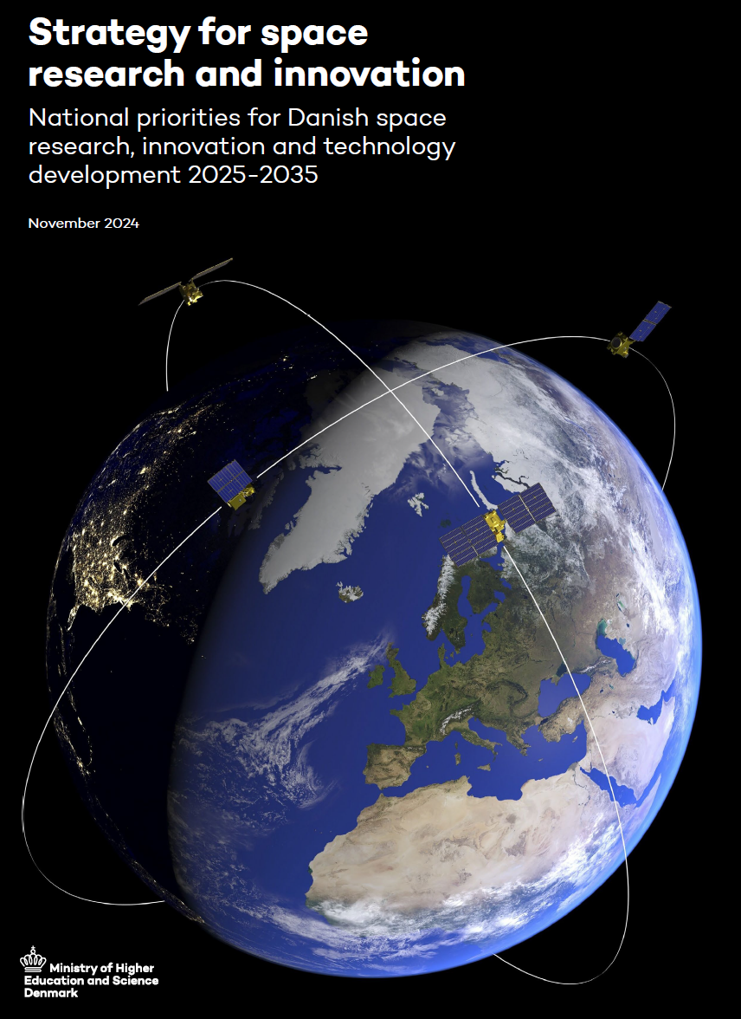
Strategic Infrastructure

Slide 10
Education & Innovation

Slide 11
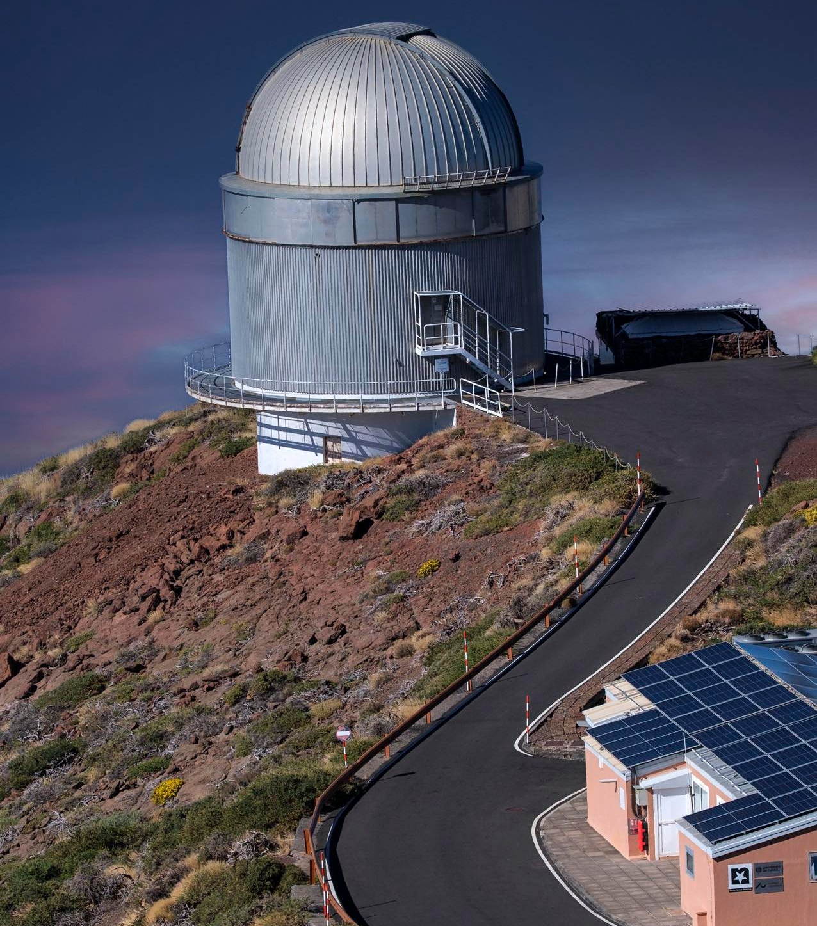
Research Policy & Society

Slide 12
