Slide 1


Arnolds Ūbelis
NSP FOTONIKA-LV – center of excellence
in photonics sciences and space research

Slide 2
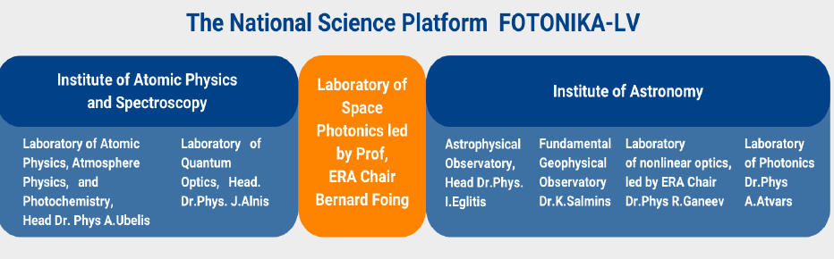

Slide 3
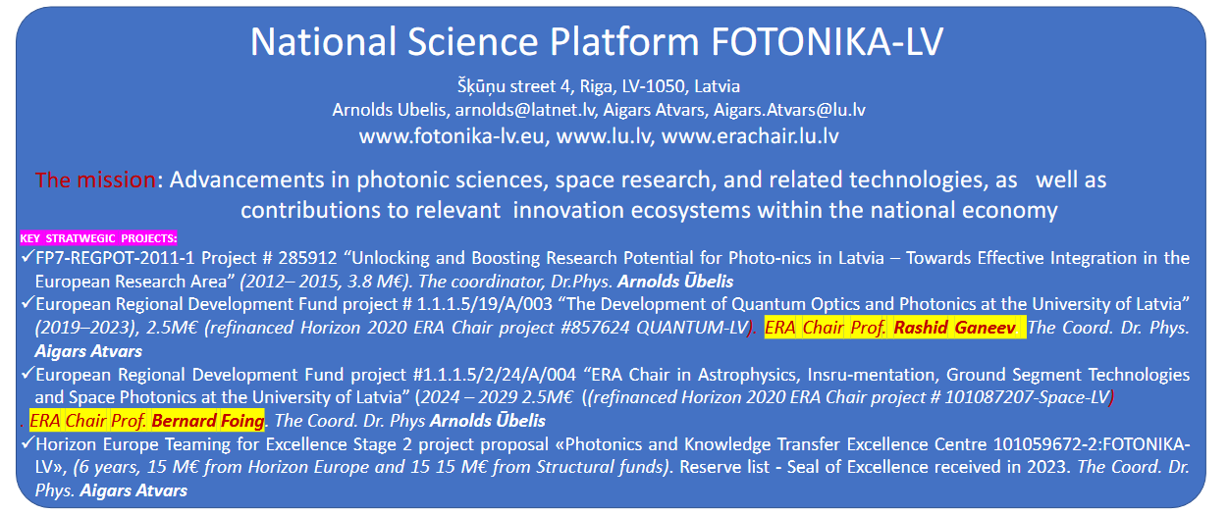

Slide 4
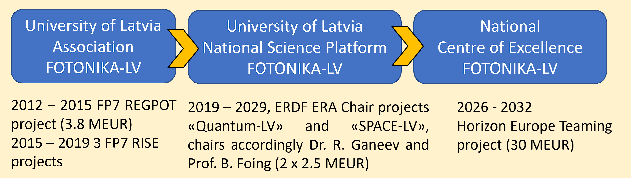

Slide 5

Horizon Europe Teaming for Excellence Stage 2 project proposal «Photonics and Knowledge Transfer Excellence Centre 101059672-2:FOTONIKA-LV», (6 years, 15 M€ from Horizon Europe and 15 15 M€ from Structural funds). Reserve list - Seal of Excellence received in 2023. The Coord. Dr. Phys. Aigars Atvars

Slide 6
Highlights of research laboratories and observatories
of NSP FOTONIKA-LV
at the University of Latvia

Slide 7
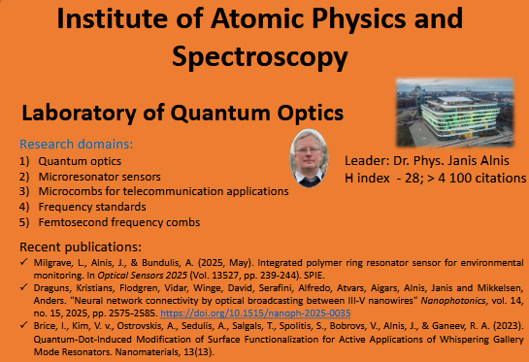

Slide 8
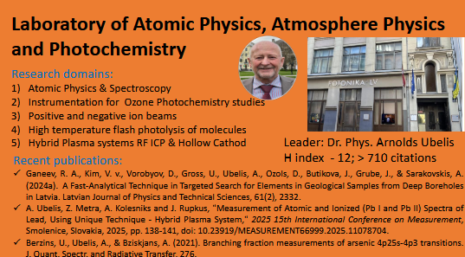

Slide 9
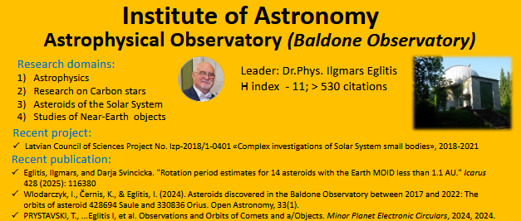

Slide 10
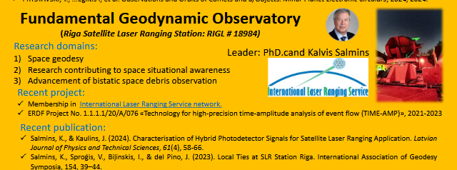

Slide 11
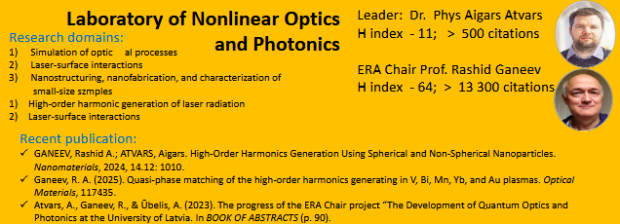

Slide 12
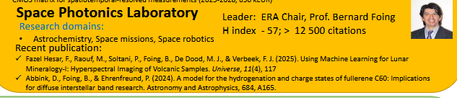

Slide 13
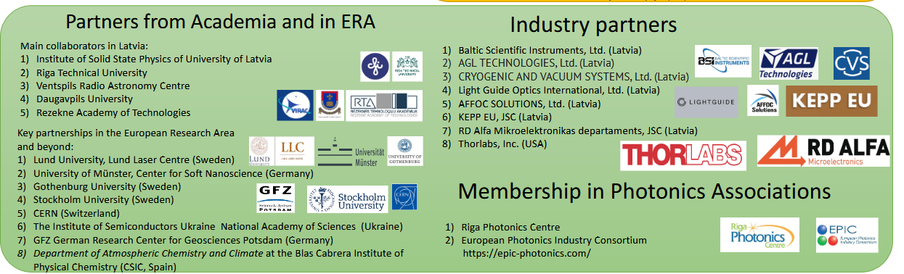

Slide 14
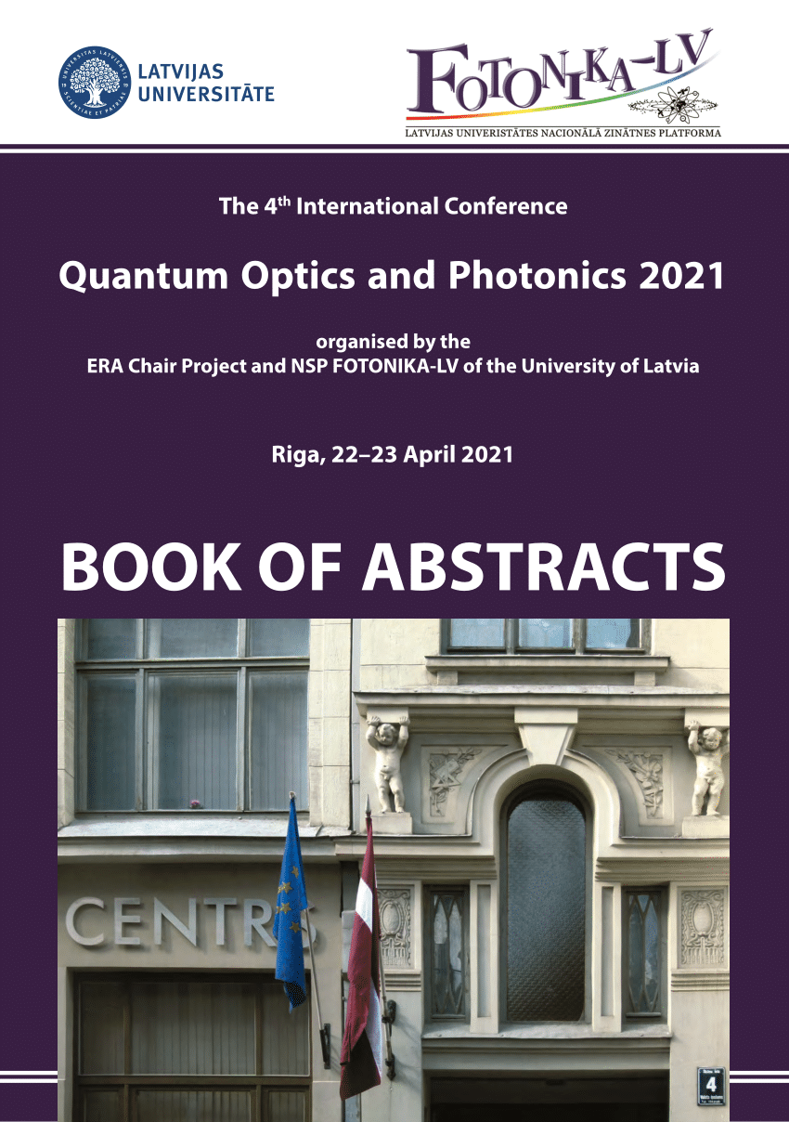
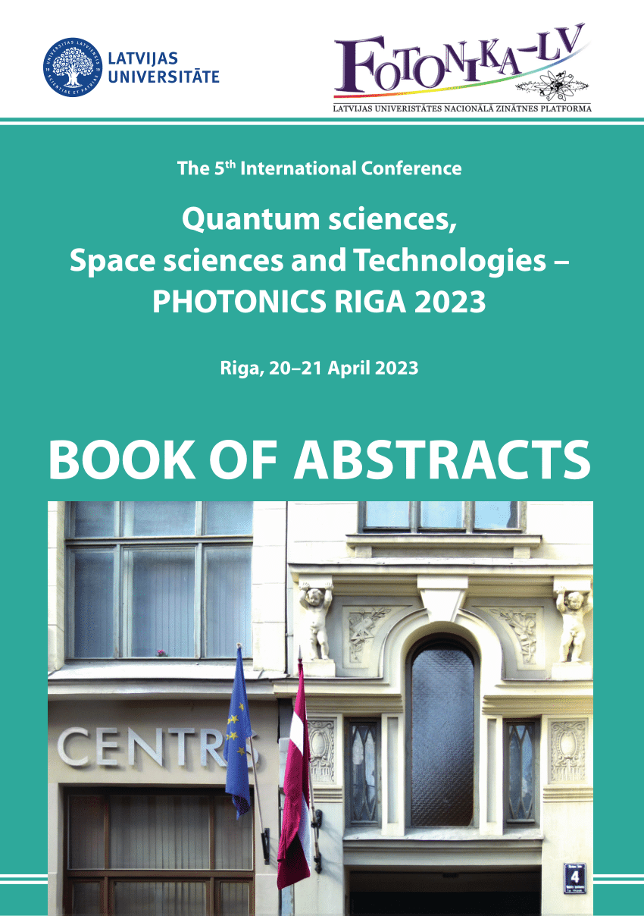
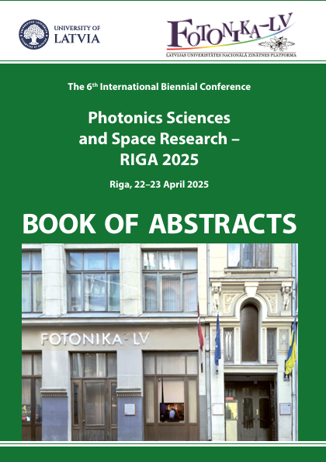
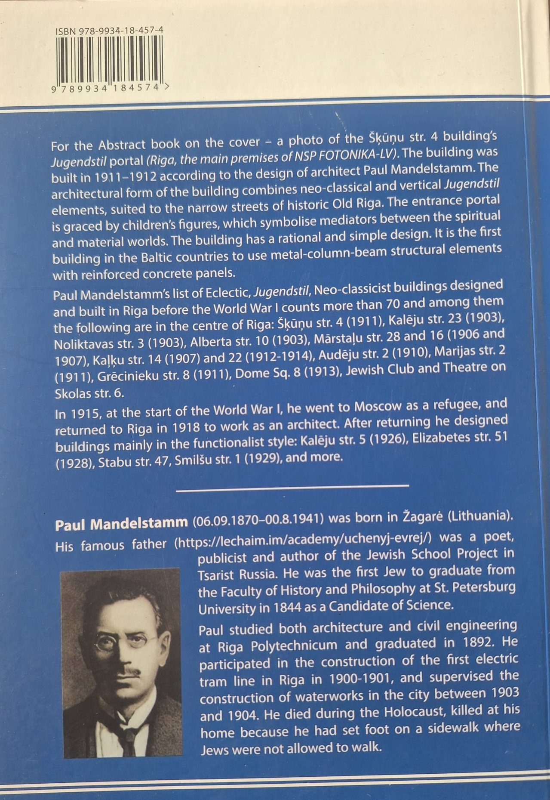

Slide 15
It is crucial for NSP FOTONIKA-LV:
to be successful with financed projects
via intensive project life
Currently, national institutional funding in Latvia
Covers only 10-15 % of the needs of
Universities Research units

Slide 16
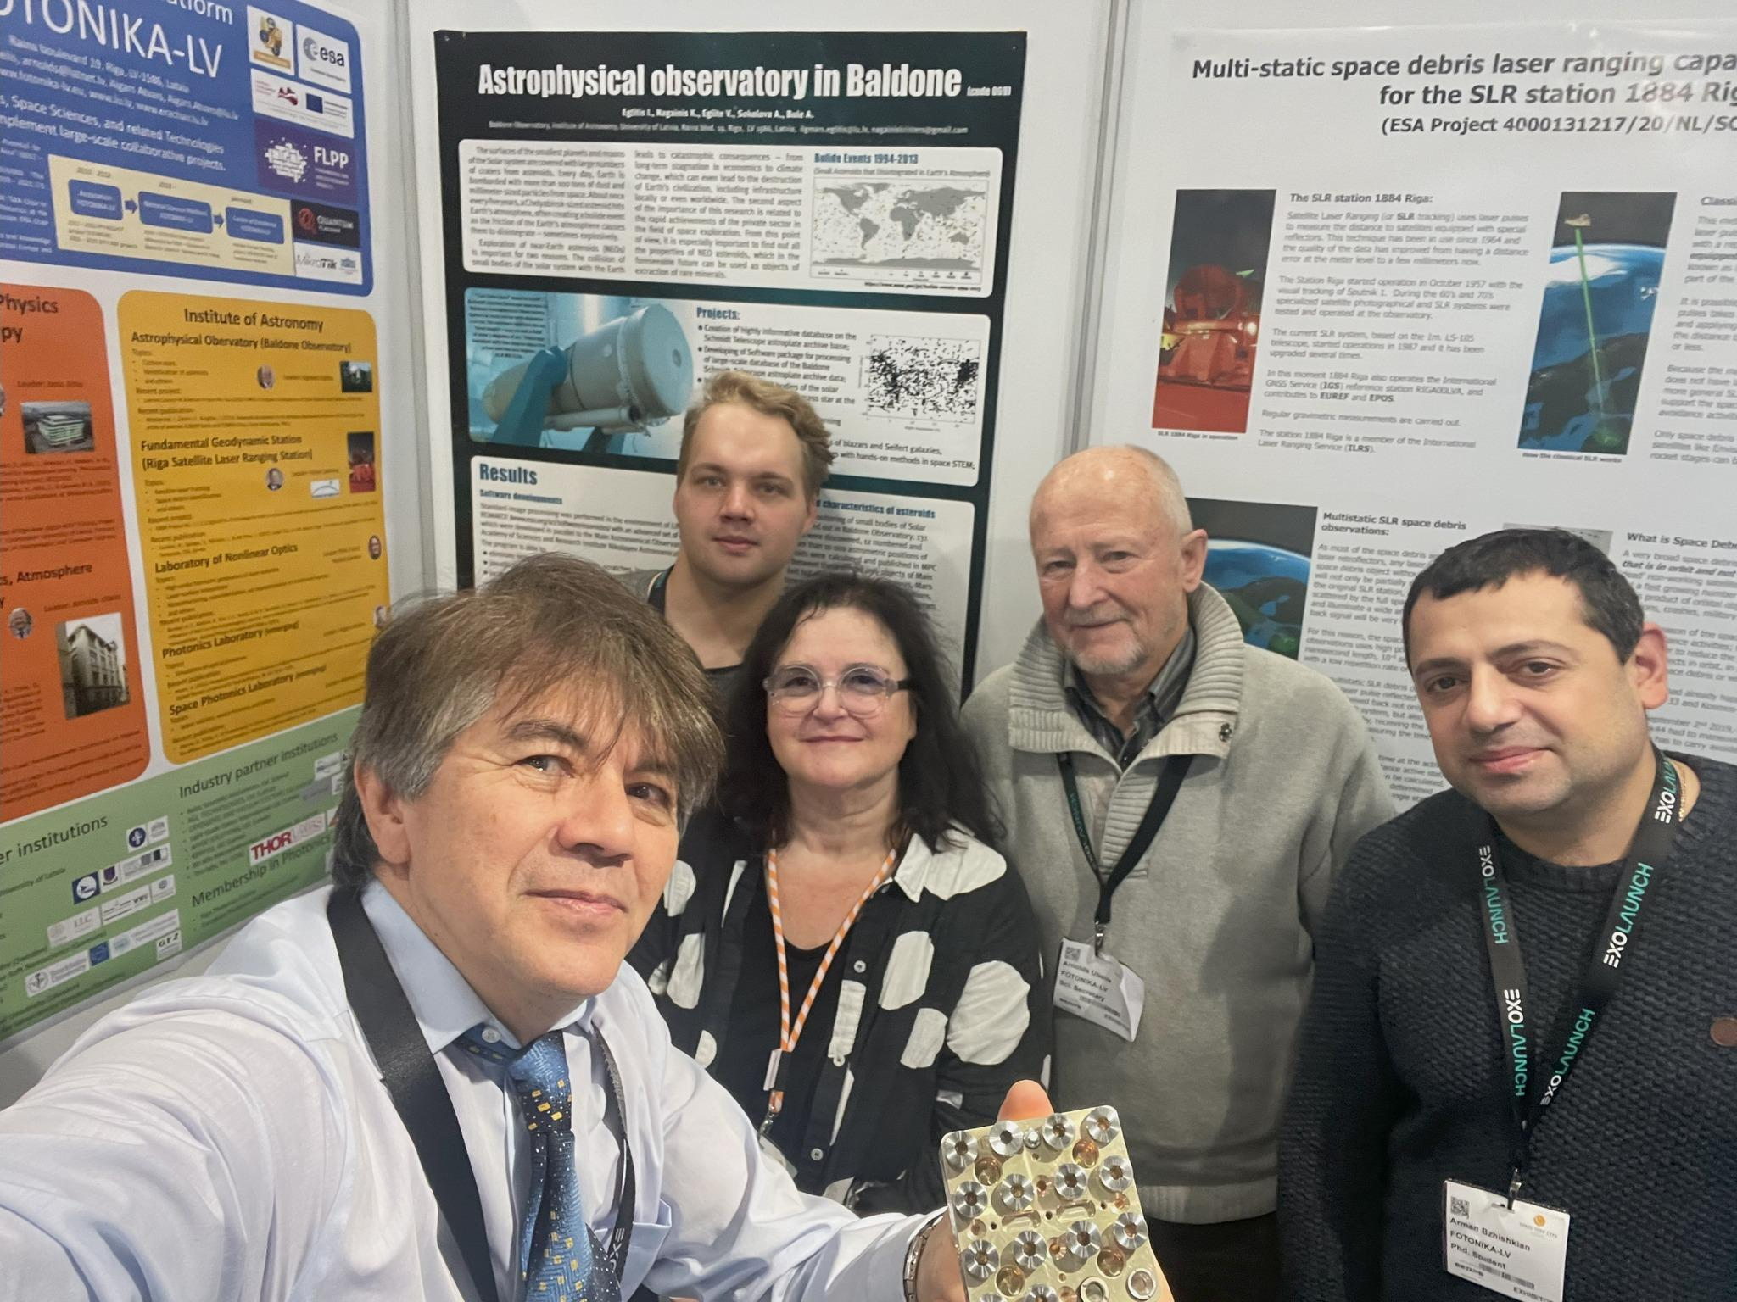

Slide 17
Thank you !

