Slide 1



Welcome to Turku!
Scan for Indico program

Slide 2
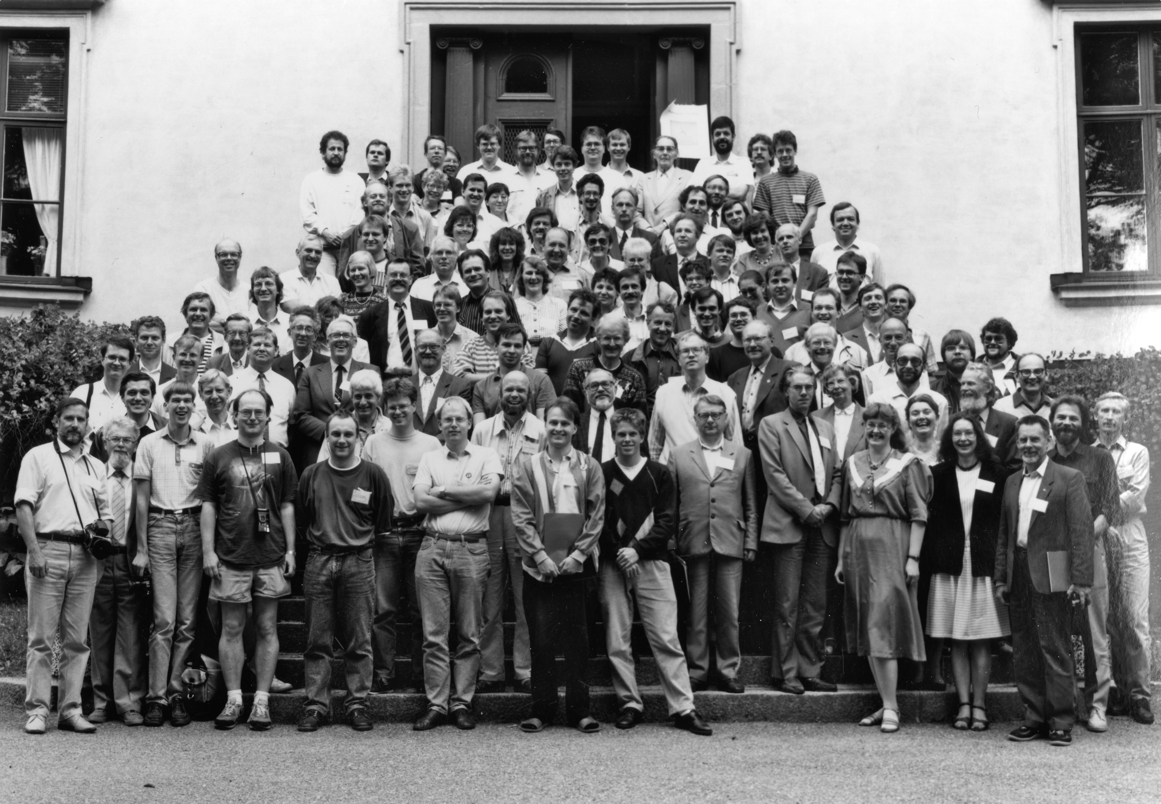
Motivation
The last Nordic-Baltic meeting was 36 years ago...
To boost collab. between Nordic-Baltic astrophysicists
To allow the younger generation to present their research and network
To strengthen the Nordic-Baltic connection to major astronomical organizations
Abbasi et al. (2023)
Nordic-Baltic astronomy conference (Uppsala, 1990)
Click here to see the photo
2
Notes:
1: there are more than 200 of you are here
2: there are 135 contributed talks and 30 posters, most by the younger generation
3: there several prominent speakers from major astronomical organizations

Slide 3

Nametags
Yellow background = LOC
Junior researcher
Early-career researcher
Senior researcher
QR code to Indico page
Abbasi et al. (2023)
Free bus (Föli) ticket
3

Slide 4
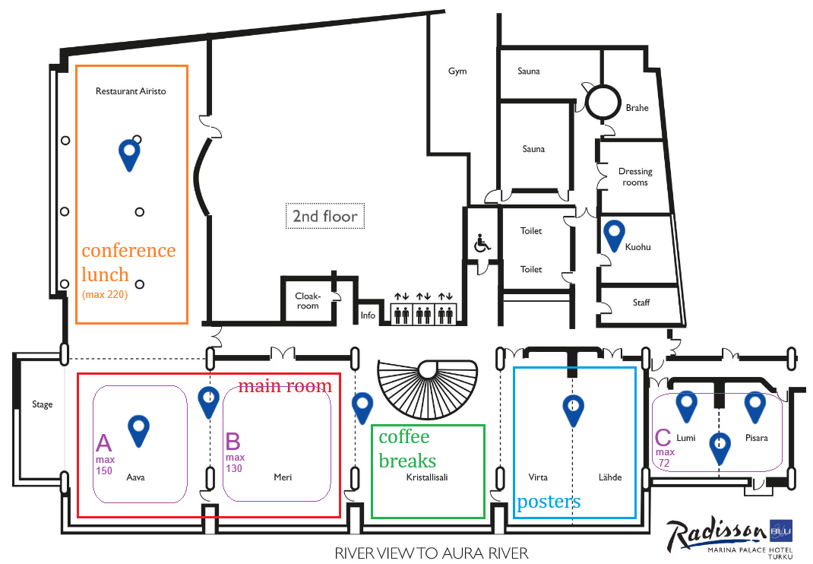
Overview
Toilets
Mornings = Plenary sessions in A+B
Afternoons = Parallel sessions in A | B | C
Lunch is included (served at Airisto)
Coffee break and poster areas are combined
Abbasi et al. (2023)
Coffee is always served here
Note: Room B should be fully unobstructed!
4

Slide 5

Detailed timetable found below...
Scan for Indico program
Plenary topics covered by 17 highlight speakers:
Scan for overview program
Nordic / Baltic research
SKAO
ESA
ESO + CTAO
IceCube
KM3NeT
Abbasi et al. (2023)
or
or
click here
click here
5

Slide 6
Instructions for contributed speakers
Speaker instructions are found here
Format: 10 min talk + 5 min questions
We must have your slides 1 day before your talk
EITHER upload to Indico directly OR upload to GDrive / Seafile
  File name must be “YourFirstname_YourLastname_Talk”
  File format must be PDF or PPTX
By default, all slides and posters will be made public
If you do not want your slides to be public, let me know at:
pouya.kouch@utu.fi
Abbasi et al. (2023)
6

Slide 7
Instructions for poster presenters
Poster instructions are found here
Find an empty poster slot and attach your poster
Take your poster down before 13:00 on Friday
100-sec rapid talk for posters (unless you’re a highlight speaker)
  Highlight speakers should promote their poster in their highlight talk
We must have your slide 1 day before your rapid talk
  The slide must be 1 page only (16:9 aspect ratio) in PDF format
  File name must be “YourFirstname_YourLastname_Rapid.pdf”
If you want your poster to be public, send it to us (see instructions)
By default, all rapid slides will be public (let me know if you don’t want that)
Abbasi et al. (2023)
7

Slide 8
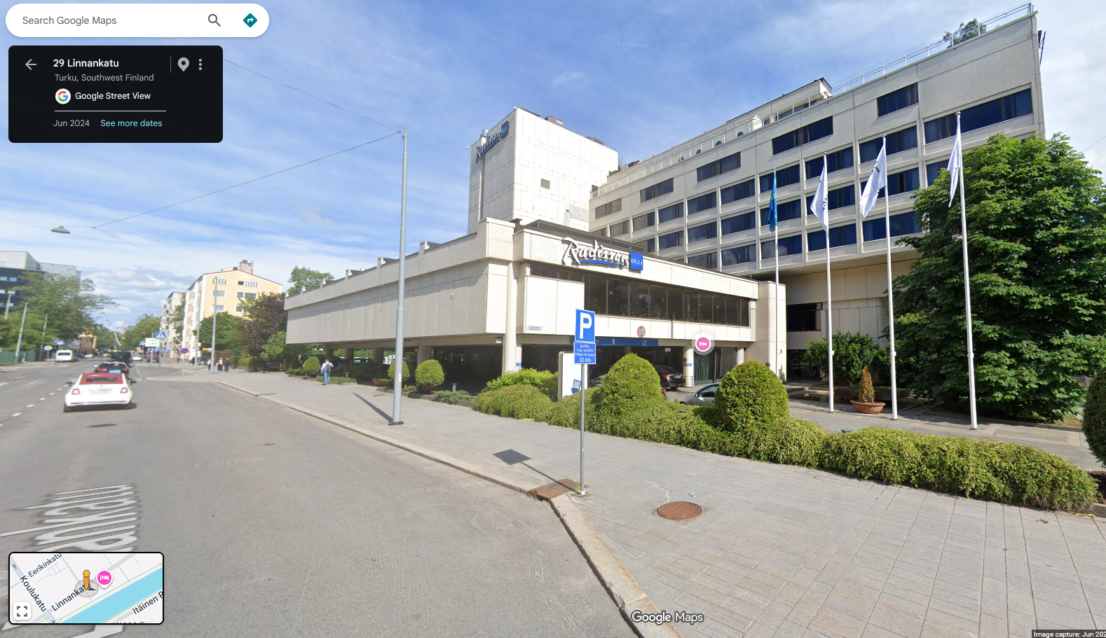

Excursion (today!)
Tuorla Observatory (Väisälä Space Park)
Väisäläntie 20, 21500 Piikkiö
You may drive there
Those taking the bus, we meet in front of the hotel (road-side) at 18:15
Tours start in Tuorla at $\sim$19:00
Back in Turku at $\sim$21:15
Abbasi et al. (2023)
Note: No restaurants or stores at Tuorla !
Please grab something to eat between 17:30 – 18:15
8

Slide 9
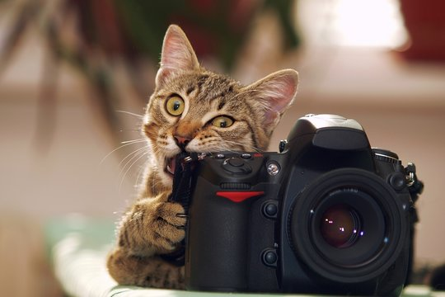
Conference photo
Wed at 12:15 (after rapid talks)
Location: in/around the venue (TBD)
We will take photos for posterity and promotional purposes
Some may be shared publicly
If you do not want to appear in public photos, let me know at:
pouya.kouch@utu.fi
Abbasi et al. (2023)
9

Slide 10
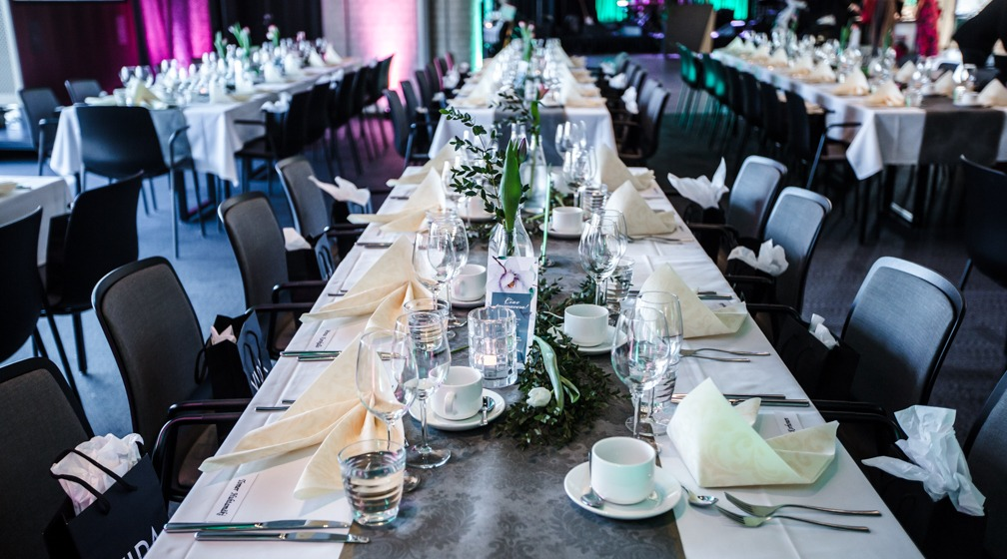
Social dinner
Thu at 19:00
At the conference venue, in
the same restaurant as the conference lunch (Airisto)
There will be a pre-defined seating order
Abbasi et al. (2023)
10

Slide 11

Finland-specific session
Fri at 11:00 (open to all participants)
  Announcement of the Väisälä Prize winner for the best Finnish astronomy PhD between 2024−2025
  Science talk by the winner
Fri at 11:45 (open to FAS members only!)
  Annual meeting of the Finnish Astronomical Society
Abbasi et al. (2023)
11

Slide 12
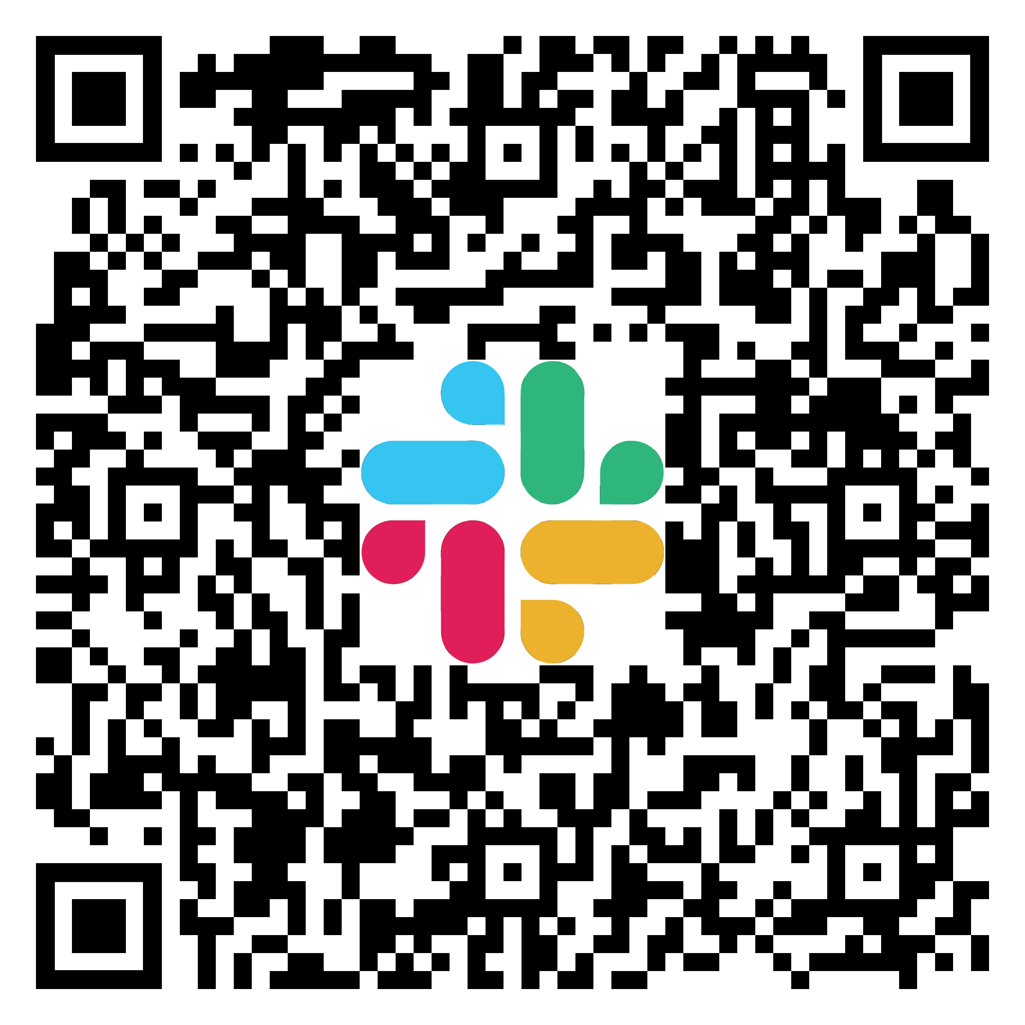
Slack
Quick announcements
Sharing conference photos
Reaching the LOC and other participants easily
or click here
12

Slide 13





Many thanks to our sponsors
or click here
Wifi: Marina Palace VIP
Pw: trueblu1
13

