Slide 1

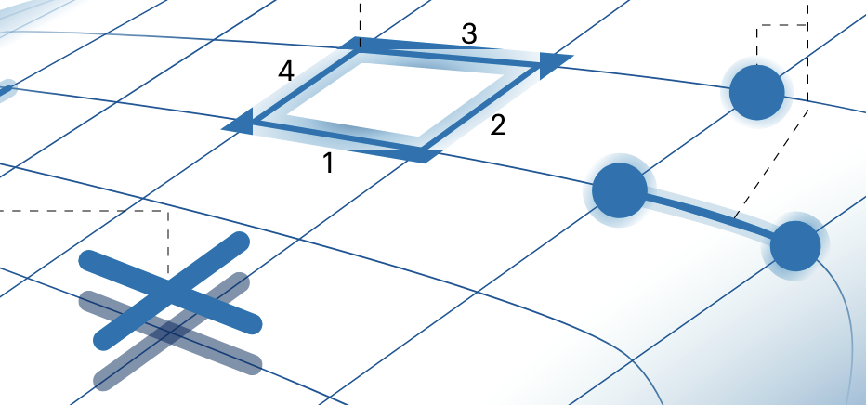
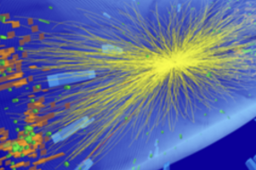
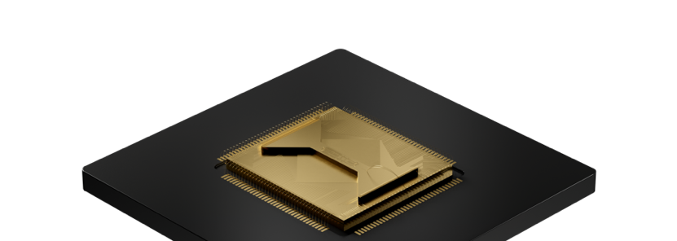
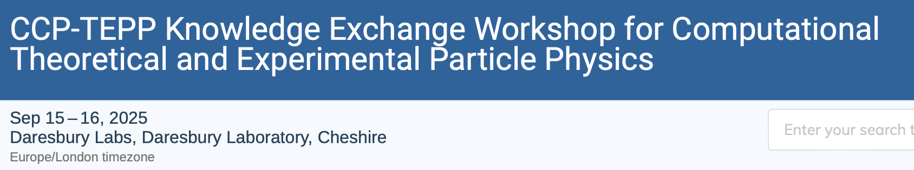

circuit
Quantinuum Systems and
their benefits for Lattice Gauge Theories
Enrico Rinaldi
Lead R&D Scientist
© 2024 Quantinuum. All Rights Reserved.
Notes:
Today I am here to talk about hardware.
In particular the quantum hardware we are developing and perfecting at Quantinuum and how it is already beneficial to study phenomena in lattice gauge theories.
As Christian, I could not start my talk without the image of a high energy physics collision. Perhaps it would be more appropriate to actually use an image of the basic ingredients of a lattice gauge theory, lifted from the awesome review of Christian Zohren Natalie and Martin.
I think this image really captures the spirit of my talk: a QCCD trapped ion chip used to study lattice gauge theories.

Slide 2



Supporting the quantum ecosystem at every level
Cybersecurity
Quantum Chemistry
Quantum AI
Ecosystem Platforms
Quantum Origin: Enterprise-grade quantum computing-enable cryptographic solutions
InQuanto: transforming the discovery of new materials and novel processes
Aiming to solve commercial and specific problems that cannot be solved using today’s classical computers
Enables other partners to leverage the power of quantum via open-source access
High-performance quantum software development kit
Multi-platform | Open-source
Full Stack SaaS Platform | Cloud Native
Complete software platform that allows developers to build and deploy algorithms with minimum effort and maximum flexibility
The world’s highest-performing quantum hardware
Ecosystem Quantum Processors
Public
Notes:
We shape up the quantum ecosystem by supporting it at all levels of the quantum stack, from the metal layer to the application layer.
On the application layer we have our internal efforts and products, and we enable other partners to leverage the power of the stack via open-source access. Applications rely on TKET, our open-source compiler, and now also on Quantinuum NEXUS, a cloud native SaaS platform for algorithmic development on quantum computer platforms.
Users of NEXUS can directly access our Quantinuum Systems which I will describe today, as well as Quantum processors from other providers by bringing in their own API credentials.

Slide 3
Quantinuum Hardware – Highest Fidelity, Most Capability
QCCD architecture on a commercial device – a scalable path to fault tolerance
SYSTEM MODEL
H1
SYSTEM MODEL
H2
QUANTINUUM HELIOS
Unparalleled quality
Proven to scale
Solving complex problems
Public
Notes:
In the last part of my talk I will also introduce you to our our next generation system, Helios, and explain how it continues our legacy of systems that are built with high fidelity qubits, to scale to useful, complex problems.

Slide 4


Atomic ions are ideal quantum ‘bits’
Quantum information is stored in electronic state
Each atom is identical, each qubit is identical
Strong interaction via positive charge and valence electron resonance
Errors are fundamentally understood
We precisely capture, control, and manipulate ions for quantum operations
Orbitals
P
S
¹⁷¹Yb⁺
Hyperfine levels
  initialize into well-defined & determinate state
  maintain coherence
  provide sets of universal quantum gates
  devise non-destructive qubit state readout
$$|1⟩$$
F=1
²S_{1/2}
F=0
$$|0⟩$$
Public
Notes:
In our actual implementation, we store the qubit in the hyperfine sublevels of the electronic ground state of an ion, Ytterbium 171.
This state has excellent coherence properties and it is a perfect candidate for atomic clocks
Then by using the electronics orbitals as our ‘handles’ we can use pulses of resonant light to do LOCALIZED state preparation, implement quantum logic gates, or do state readout..

Slide 5
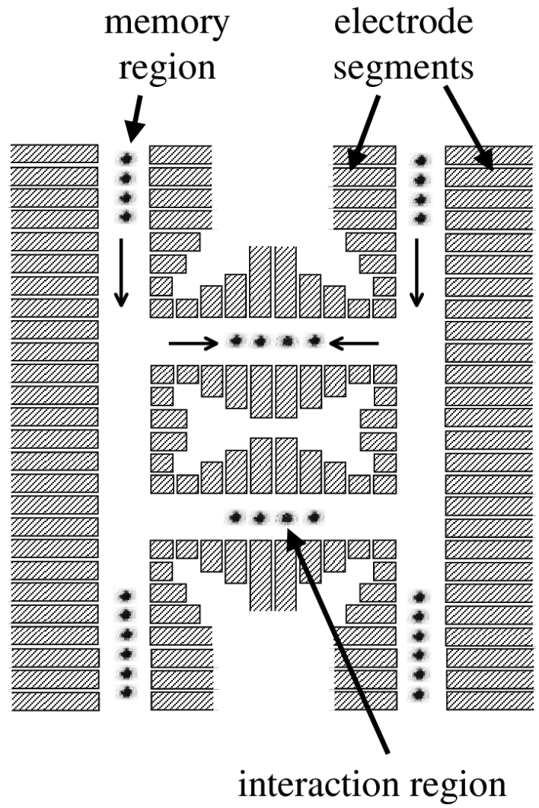
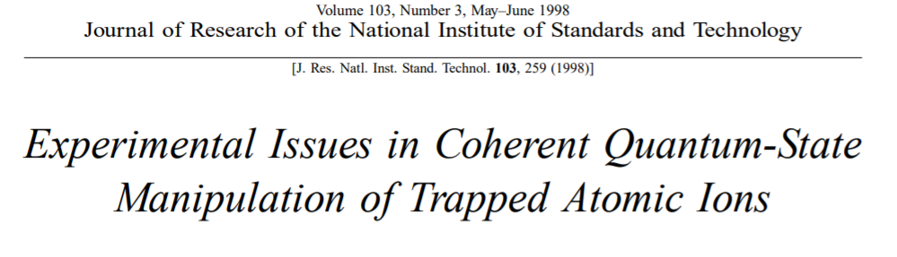
Architecture for a Large-Scale Quantum Computer
Known as QCCD - Quantum Charge-Coupled Device
Key Concepts
Qubits through ions
Connectivity by physical transport
Dedicated zones for logic/initialization/measure
High-fidelity gates via laser gates on short ion chains
Scalability enabled by micro-fabricated traps
Additional references:
D.J.Wineland, C. Monroe, et. al., Entangled states of atomic ions. for quantum metrology and computation, Atomic Physics 15, pp. 1-474 (1997)
Kielpinski, D., Monroe, C. & Wineland, D. Architecture for a large-scale ion-trap quantum computer. Nature 417, 709–711 (2002).
Public
Notes:
The architecture we use is known the Quantum Charge Coupled Device.
First proposed of in the 1990s, it envisioned an extended device where trapped ions could be moved between different zones for different kind of operations.
Crucially it enabled scaling to large scale devices by linking small ion traps with transport using microfabricated trap structures.

Slide 6
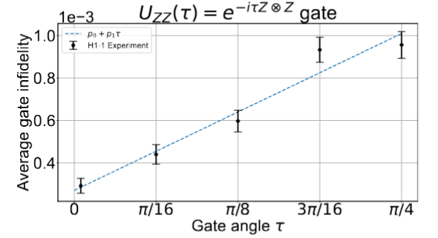
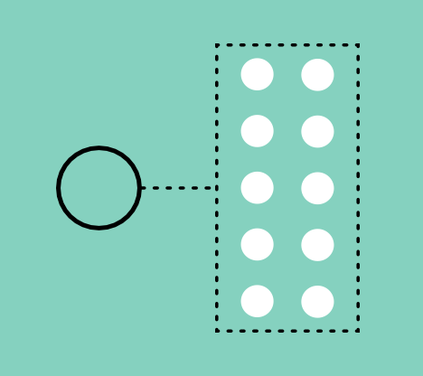
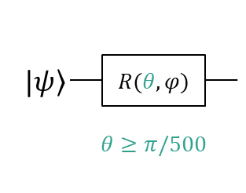
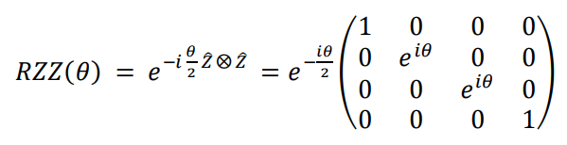


QCCD architecture
differentiating features
Robust Coherence
All-to-All Connectivity
High-Fidelity Ops
$$\left|1\right\rangle$$
Nearest Neighbor
All-to-All
Isolated Ops Zones
$$\left|0\right\rangle$$
+
+
+
Sympathetic Cooling
+
+
Flexible and reconfigurable
MCMR and conditional logic
Parameterized Angle
SQ and TQ gates
Public
Notes:
Make huge difference in computational outcomes.
All-to-all: eliminate swap gates and associated errors.
Most important feature: high fidelity operations – large circuits.
Arbitrary angle gates – reduce number of 2Q gates, and lower total error
Conditional logic – measurement feed forward (will hear later in webinar), QEC

Slide 7





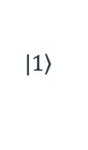
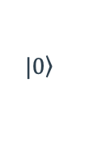
QCCD Trapped-Ion Architecture
Quantum Charge Coupled Device (QCCD) Architecture
Dedicated
storage zone
5 Dedicated
gate zones
Dedicated
storage zone
Ion
loading zone
Gating lasers
H1 Generation Ion Trap Architecture
Quantum bits (qubits) are stored in the electronic states of IDENTICAL Yb⁺ ions
QCCD architecture enables using gate zones
Minimal and frequent calibrations
All-to-all connectivity
High fidelity operations
Cooling ions provide mid-circuit cooling, maintaining circuit fidelity throughout circuit
$$|\left.1\right\rangle$$
Hyperfine qubit
¹³⁸Ba⁺
Cooling ion
¹⁷¹Yb⁺
$$|\left.0\right\rangle$$

Slide 8













Physical Implementation
$$t=0$$
$$t=1$$
1-qubit gate
$t=$ 0 1 2 3 4
Move, Join
$$|0⟩$$
H
$$t=2$$
2-qubit gate
$$|0⟩$$
H
$$|0⟩$$
$$|0⟩$$
Swap, Split
Move, Join
$$c_{1}$$
$$t=3$$
2-qubit gate
$$t=4$$
Measure

Slide 9


Transport Primitives
150μm
Split and Combine
Ion is transported into the same zone
Ions are combined into a single potential well and then re-separated
Swap
Ions are carefully manipulated to reorder positions
Notes:
All of the apparatus described allows us to be able to control atoms very precisely and repeatably
Here is a real-world view of an ion being transported into the same zone as another ion, combined into a single well, and separated back apart. We can do these operations millions of times without fail and always know exactly where each ion is.
At the bottom, you can see a physical swap operation where two atoms delicately move around each other. This is different than a logical swap where quantum information is transferred. In the physical swap, no quantum information is exchanged or affected.

Slide 10
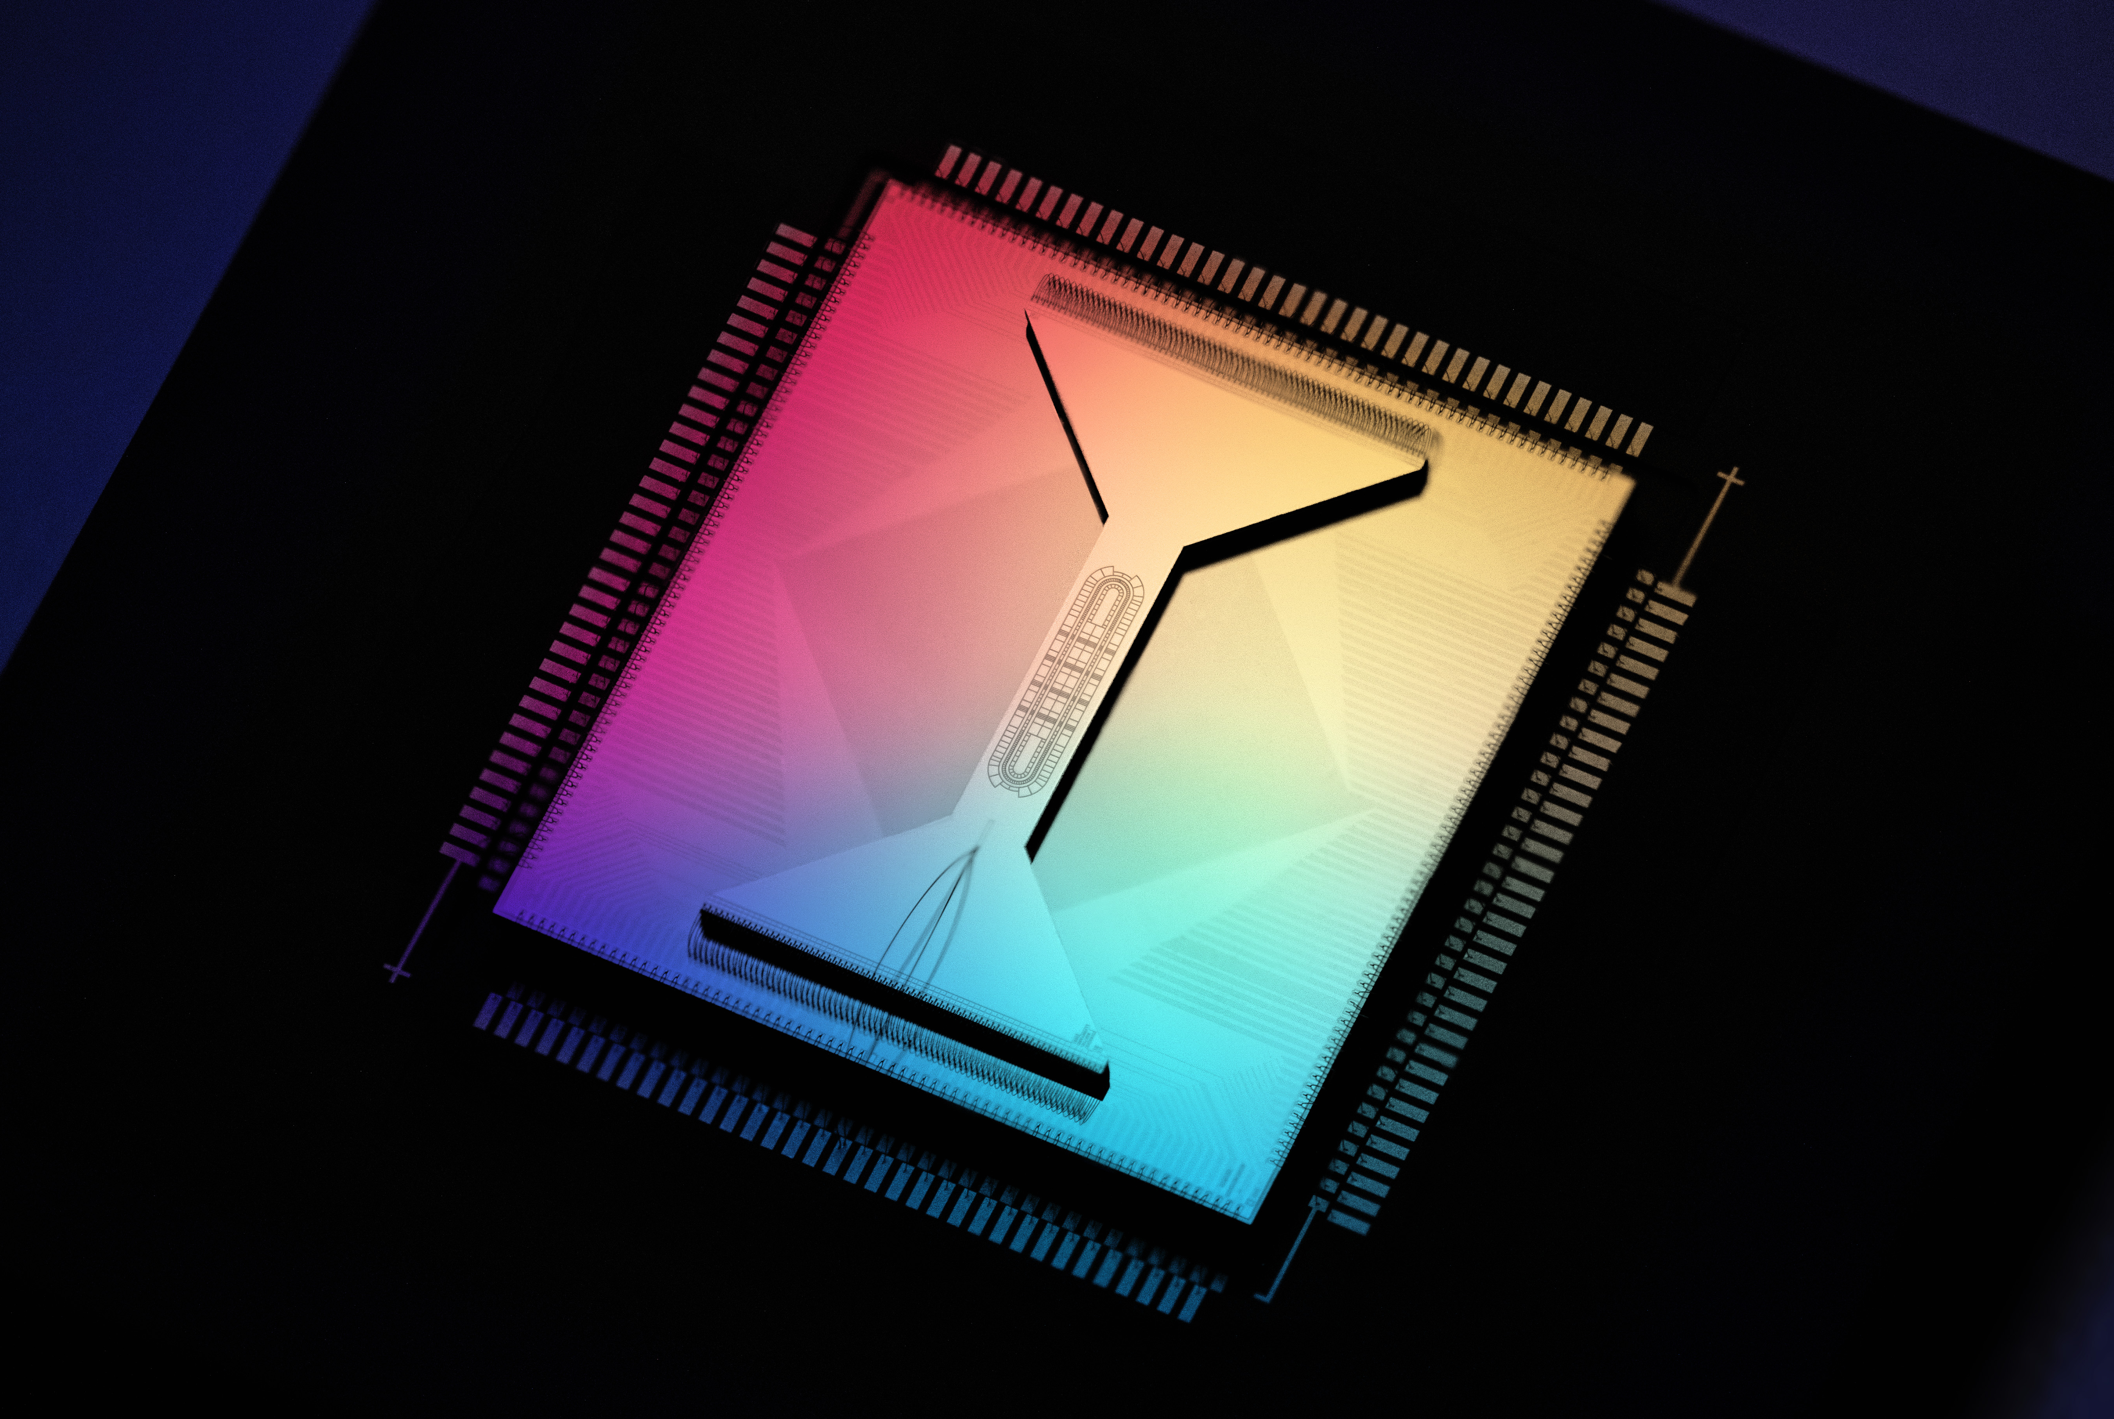

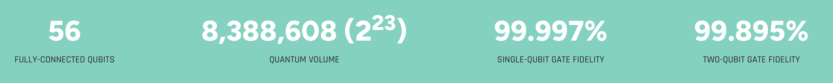
H2
© 2025 Quantinuum. All rights reserved.

Slide 11
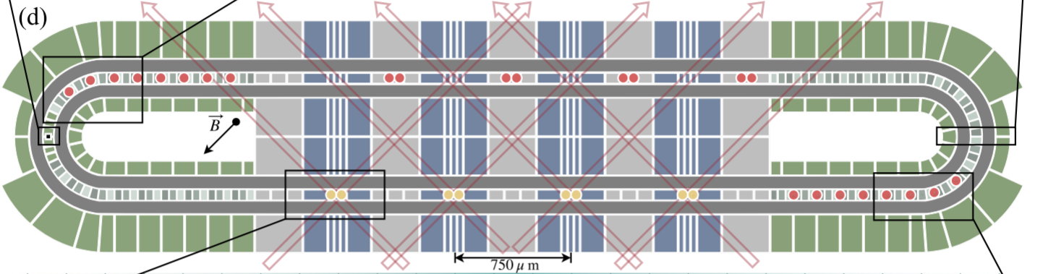
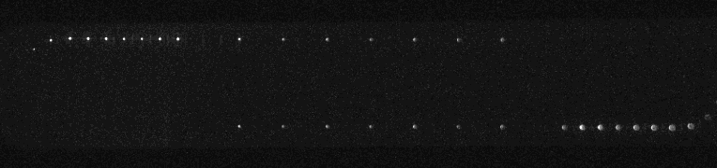
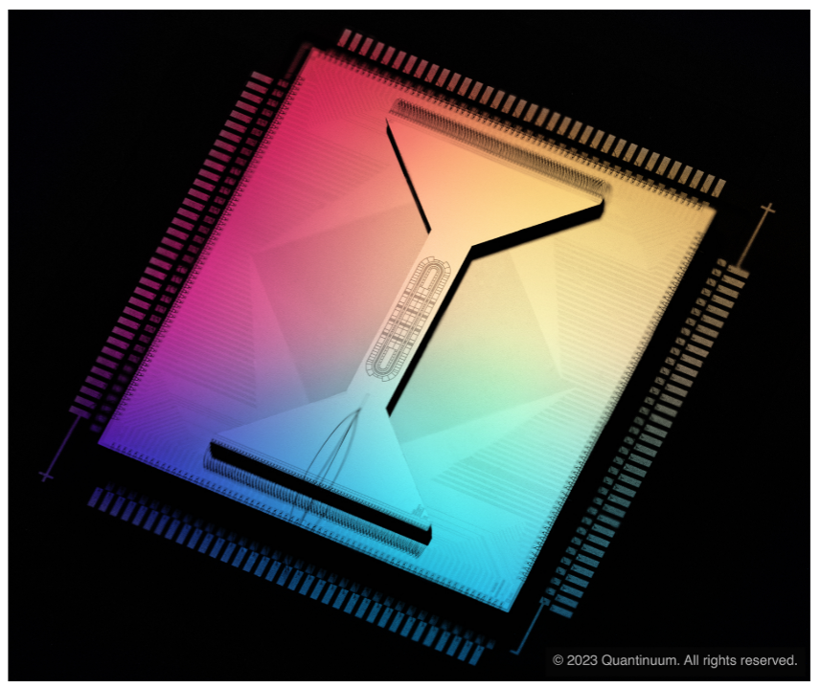
A Race Track Trapped-Ion Quantum Processor
System Model H2 with N=56 qubits
Moses, S. A., et. al., A Race Track Trapped-Ion Quantum Processor, Phys. Rev. X 13, 041052 (2023).
video: 32 qubits in the trap
11
Notes:
Last month we launched H2 – race track, 32 qubits. Movie. More qubits, same high fidelity.
4 gate zones on each side, only operating on one side right now.
Scalable features: electrode reuse, RF tunnels, fast 2D MOT loading.
Extensive benchmarking in paper.

Slide 12
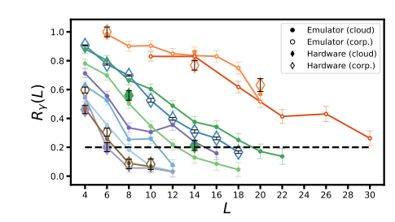
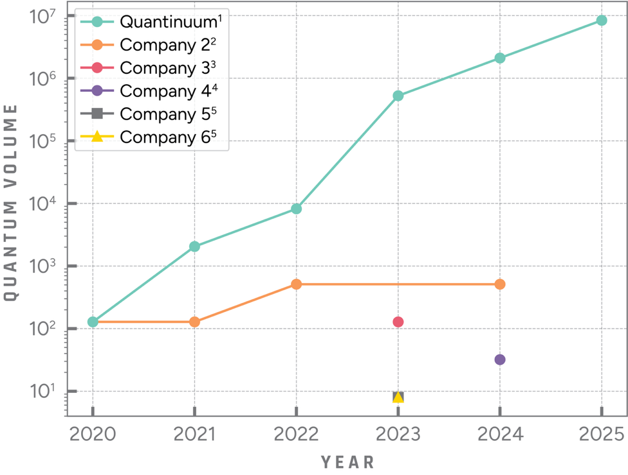
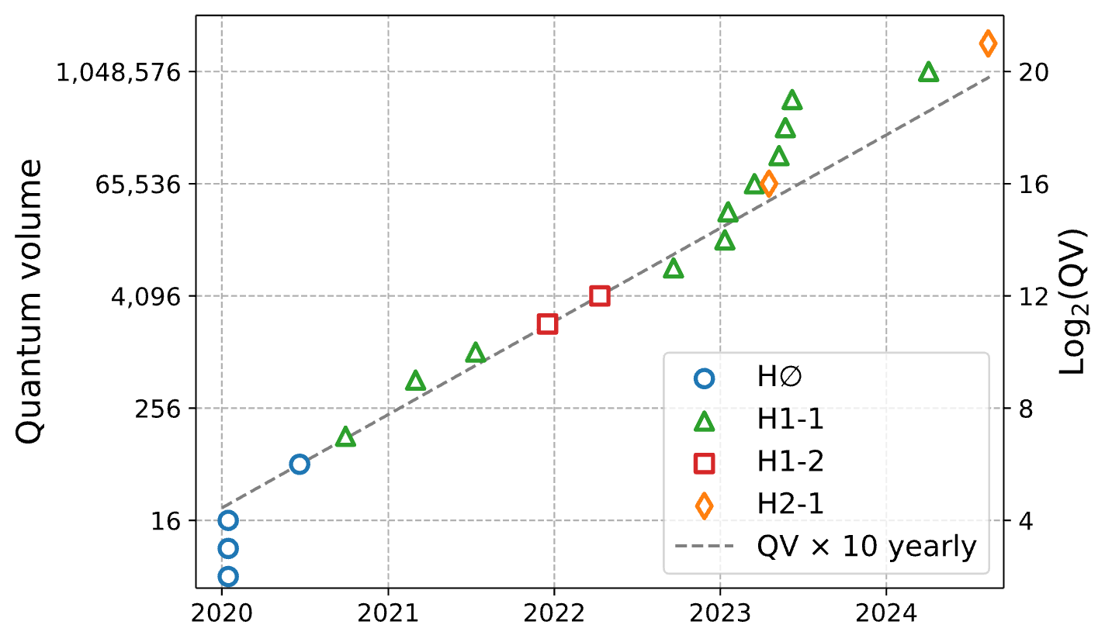
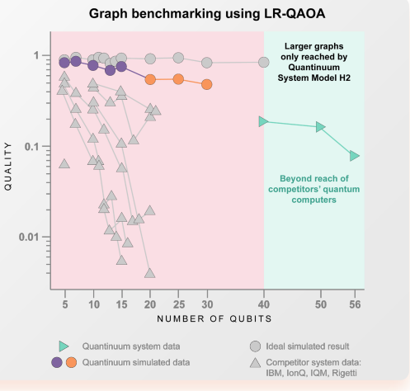
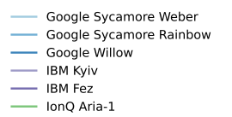
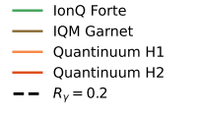
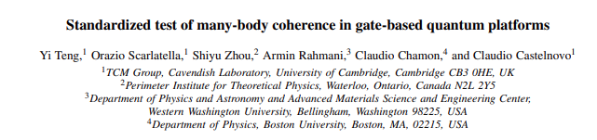

Performance - Consistently demonstrating differentiation
Consistently demonstrating separation from other systems
2020 – 2025: 13 records in setting new quantum volume high water marks, 16000x better than next best
Feb 2025 – Julich Supercomputing center benchmarking results on IBM, IQM, Rigetti, IonQ, QNTM
“The performance of Quantinuum… is superior to that of the other QPUs”
April 2025 - Researchers in Cambridge benchmarking results Google, IBM, IonQ, IQM and Quantinuum
Coherence Measure (Q-Grade)
All others
https://www.quantinuum.com/blog/quantum-volume-milestone
Public
Notes:
Quantinuum systems have demonstrated rather distinctive performance from all other for years now – both my metrics like quantum volume, which we use to track our own progress, but also by independent researchers and experts.

Slide 13
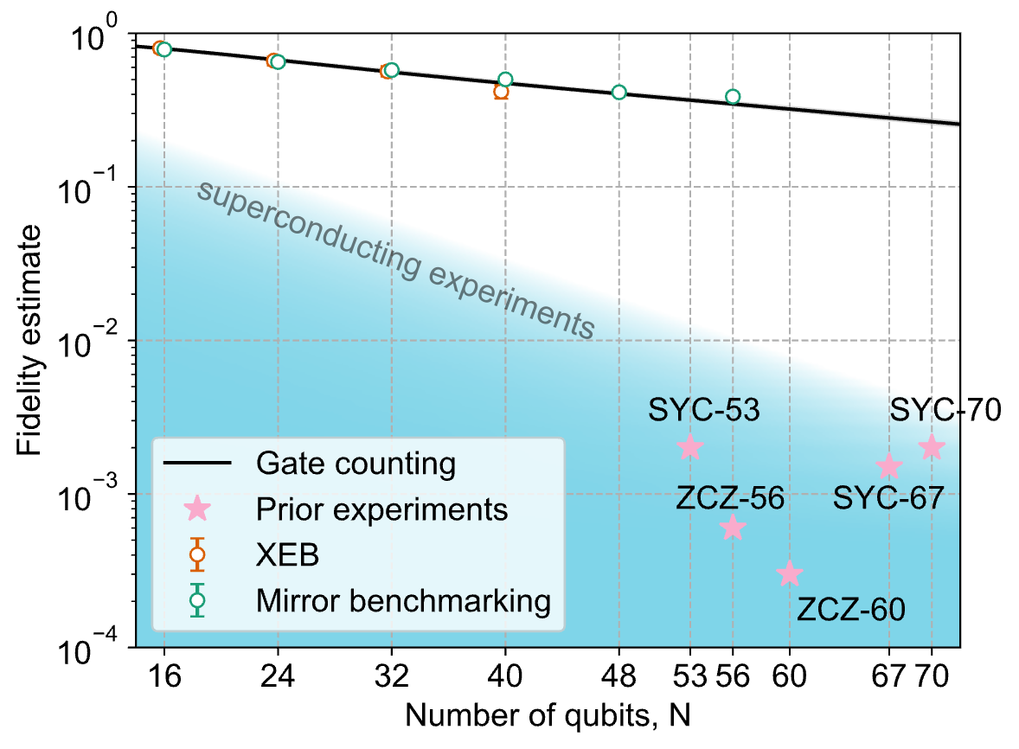
RCS fidelities compared to competitors
H2 @ N=56
100x
F. Arute, et al., Nature 574, 505 (2019).
Q. Zhu, et al., Science Bulletin 67, 240 (2022).
A. Morvan, et al., arXiv 2304.11119 (2023).
M. DeCross et al., arXiv 2406.02501
Public

Slide 14
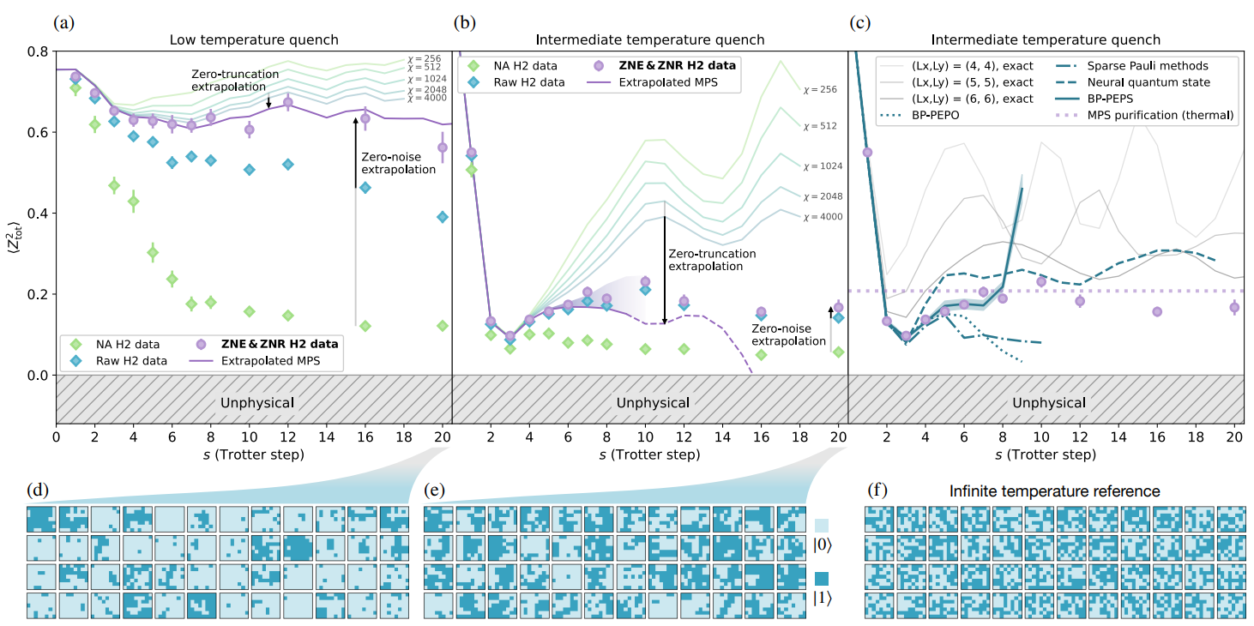
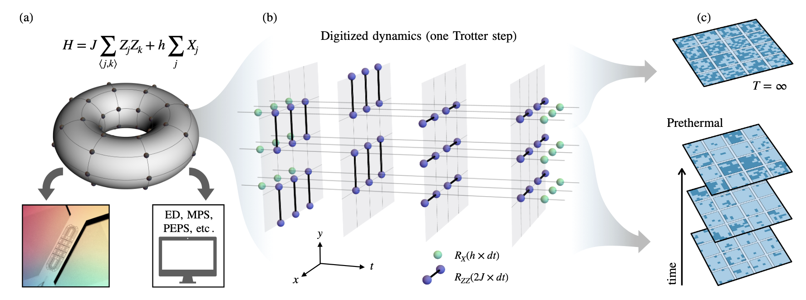
Studying quantum matter with H2-1 Quantum Ising model
“Digital quantum magnetism at the frontier of classical simulations” arXiv:2503.20870
Simulate 2D Ising model on 7 x 8 rectangular lattice using H2
Partial entangler fidelities of 99.94(1)% enable circuits with > 2,000 two-qubit gates
Public

Slide 15
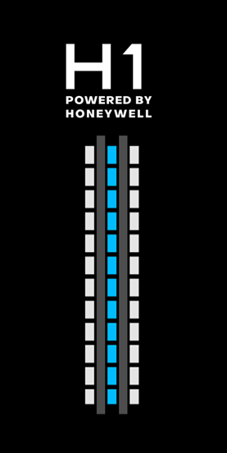
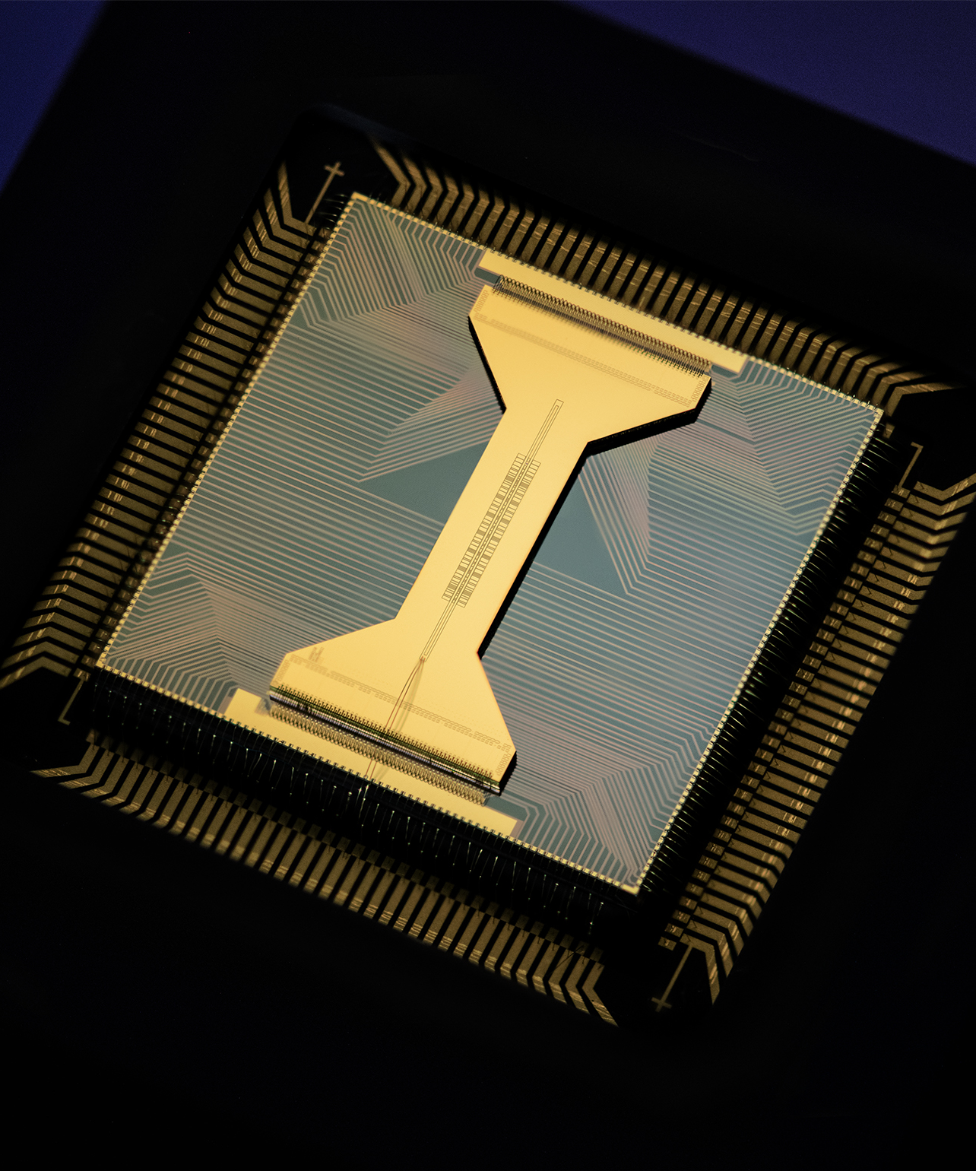
Some HEP works on Quantinuum System H1
Neutrino oscillations:
  https://arxiv.org/abs/2210.08656
  http://arxiv.org/abs/2407.13914
Nuclear beta decay:
  https://arxiv.org/abs/2209.10781
Quantum gravity in the lab:
  https://arxiv.org/abs/2205.14081
Scattering wave packets of hadrons:
  https://arxiv.org/abs/2402.00840
Shear viscosity of SU(2) LGT:
  https://arxiv.org/abs/2402.04221
(2+1)D QED ground state:
  http://arxiv.org/abs/2411.05628
SYK model simulations
  http://arxiv.org/abs/2507.07530
20 fully-connected qubits
5 parallel gating zones
TQ gate fidelity 99.91%
SQ gate fidelity > 99.998%
SPAM fidelity > 99.7%
Measurement cross talk error < 0.01%

Slide 16

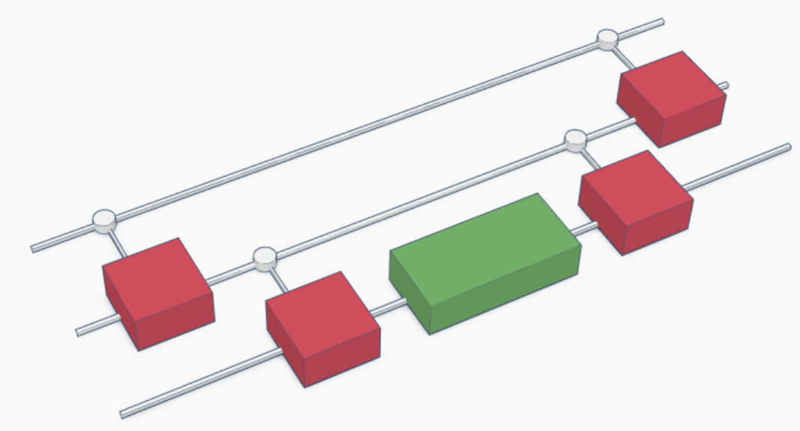

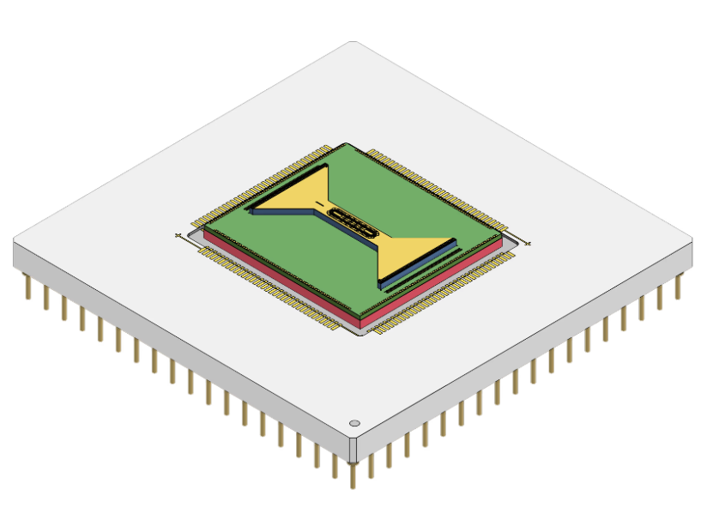
Example of workflow used for (2+1)D QED calculation
  http://arxiv.org/abs/2411.05628
Quantinuum Nexus orchestration platform:
Manage circuits
Submit jobs to multiple backends
Share results within organizations
Quantinuum TKET toolkit:
Design circuits in a compositional way
Optimize and reduce gate count
Compile to any gate set and architecture
Quantinuum Systems:
Emulators with realistic noise models
Support Mid-Circuit-Measurments-and-Reset and qubit reuse
Arbitrary angle ZZ and SU(4) gates
Quantinuum quantum chemistry library:
Define arbitrary Hamiltonians (bosons and fermions)
Define circuit ansatze
Efficient re-usable protocols for quantum observables

Slide 17
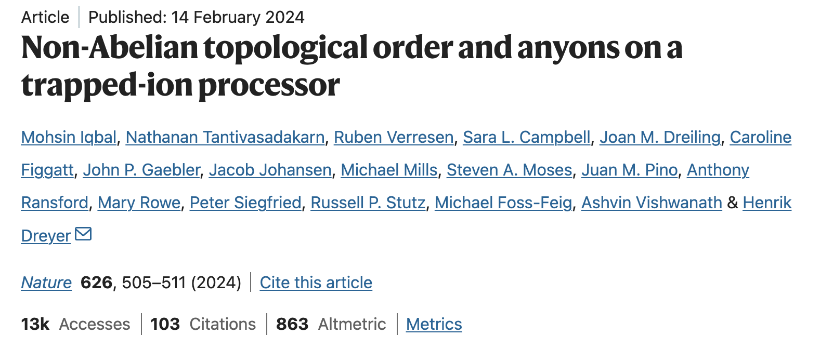
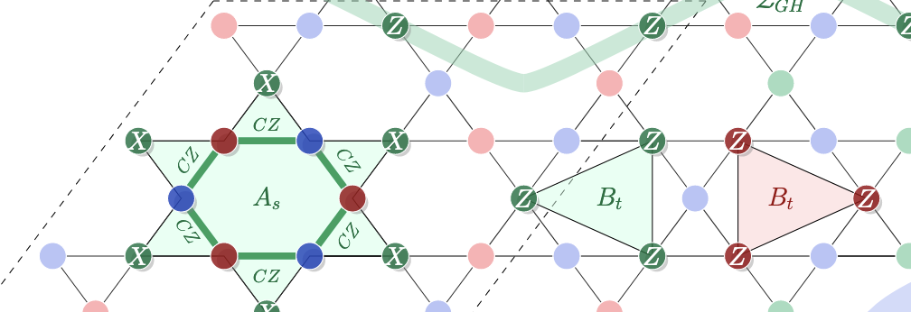
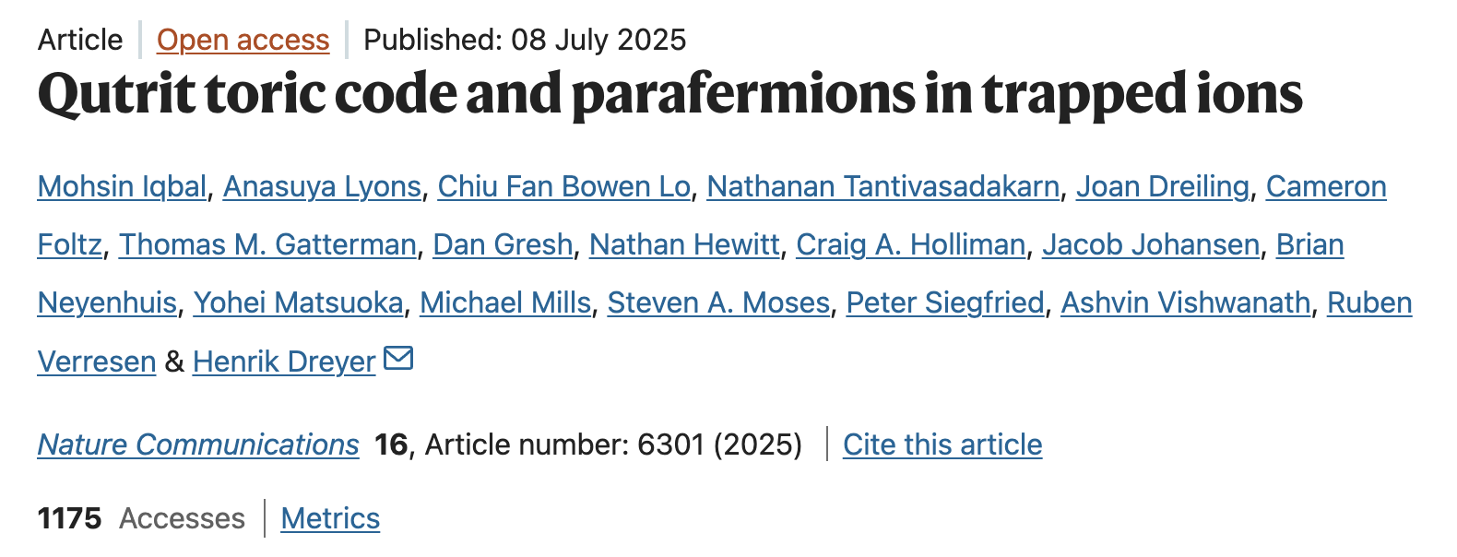
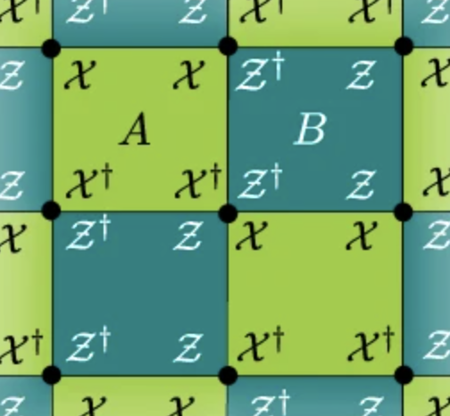
Some LGT works on Quantinuum System H2
D4 LGT
Z3 LGT

Slide 18
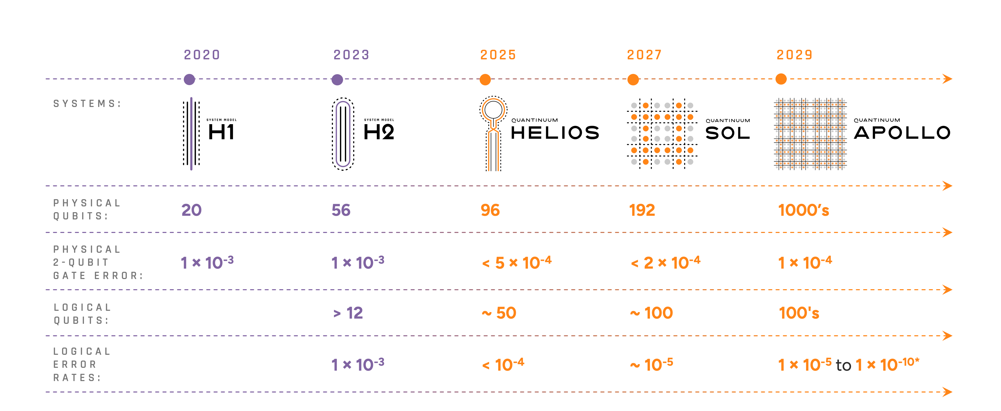
Quantinuum Hardware Roadmap
Today
Tomorrow
Public
Notes:
Add the division of NISQ to fault tolerant and how Helios has to be an inflection point.

Slide 19
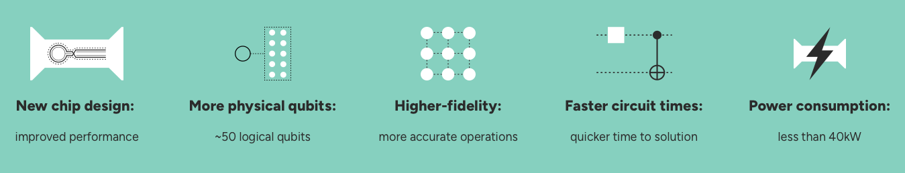
Provides all Quantinuum Systems features, including:
All-to-all connectivity
Parameterized 2-qubit operations
Mid-circuit measurement & reset
Conditional Operations
QEC decoder toolkit
Application-level leakage detection
Qubit Reuse Compiler
Emulation and debugging (Selene)
Real-time Random Number Generator
Public

Slide 20


Helios – Our Next Gen System
¹³⁷Ba⁺
¹³⁷Ba⁺ qubit
Helios Processor Architecture
Quantum Programming Stack
Public
Notes:
Qubits for scaling, processor for scaling, software for scaling.
Double the depth – new qubit unlocks lower gate error, for 2x deeper circuits with high fidelity results
Double the qubits – dense memory architecture
Quadruple the speed – parallel operations enable > 4x more gates per second
‘dynamic transport’ – not sure what this means, need to think about if I even talk about it?
Previous QTM QPUs used processor to sort, so qubit routing didn’t gain much outside of a static routine
Previous QTM QPUs utilized pre-planned, static routing, and made gates conditional. Helios uses a new software stack and the flexibility of the qubit access to dynamically plan both gates and transport in response to mid-circuit measurements.
Random access memory in Helios architecture provides huge gains in routing time to plan dynamically in response to mid-circuit measurements

Slide 21

Helios QPU – QCCD junctions changes topology
First commercial QCCD junction
Public
Notes:
Quantinuum Helios Processor: junction adds a new dimension to the QCCD architecture
Junction is much more efficient than ‘swap’ for qubit routing
Junction for speed Junction enables all-to-all connectivity with N operations compared to N^2 for swaps
Junction built to scale – we solved the wiring problem and shown how we can sort with a single signal per junction, not possible in swaps
Separating the qubit routing fully from the processor – need to save this message for the launch
The first commercial QCCD processor with junction architecture

Slide 22


What is a QCCD junction?
First commercial QCCD junction
Linear ion trap geometry
Swap sorting time grows out of control
Junctions merge short linear traps
Swap sorting replaced by junction sorting
Public
Notes:
Quantinuum Helios Processor: junction adds a new dimension to the QCCD architecture
Junction is much more efficient than ‘swap’ for qubit routing
Junction for speed Junction enables all-to-all connectivity with N operations compared to N^2 for swaps
Junction built to scale – we solved the wiring problem and shown how we can sort with a single signal per junction, not possible in swaps
Separating the qubit routing fully from the processor – need to save this message for the launch
The first commercial QCCD processor with junction architecture

Slide 23
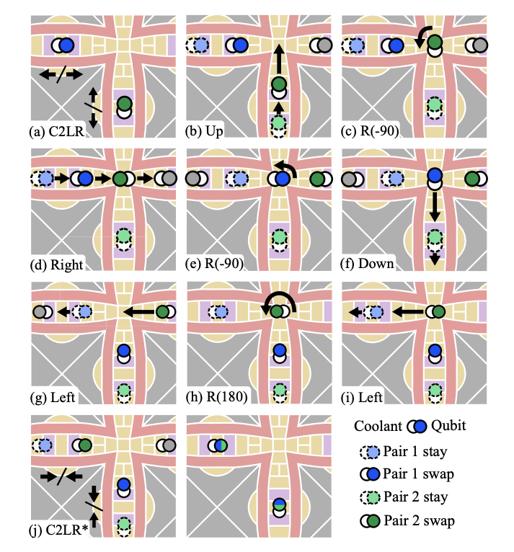
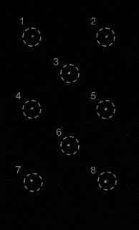
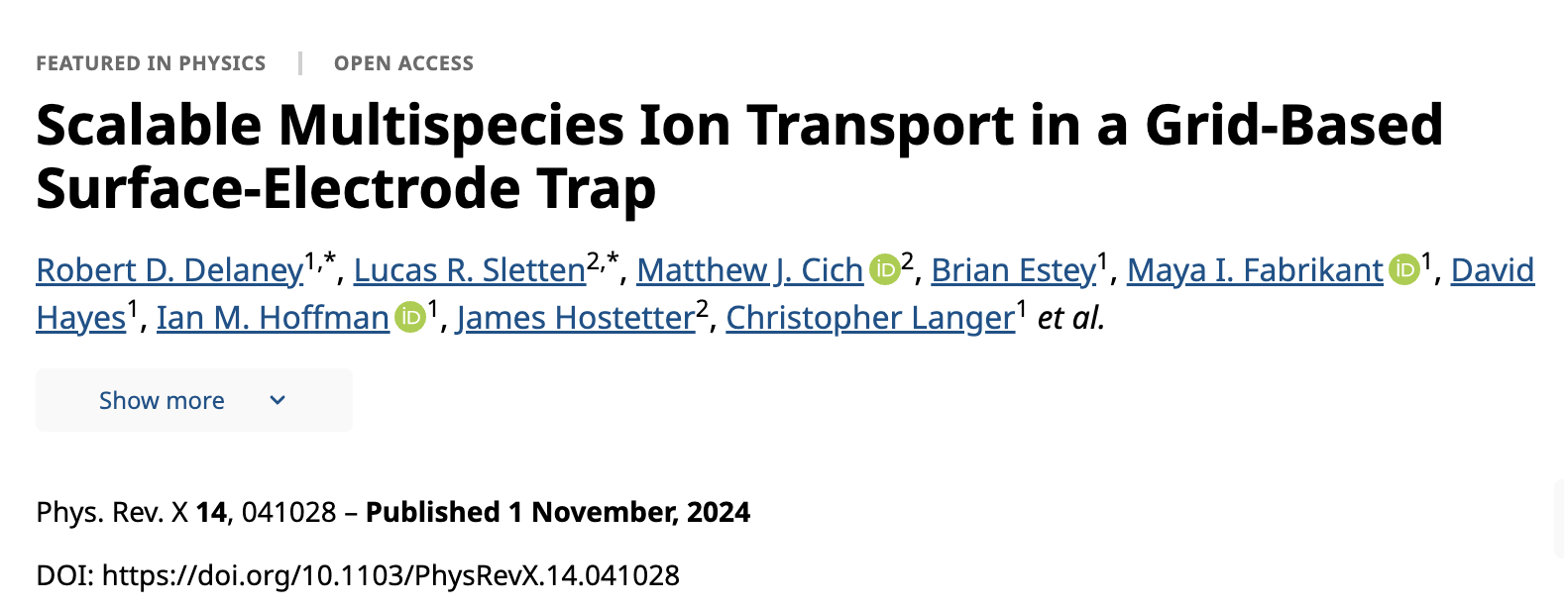
Junctions scale to future systems
First commercial QCCD junction
Quantinuum leading in ion trap junction design
Public
Notes:
Demonstrated high speed, low loss, low motion exication

Slide 24


A “2x" system
Helios will offer roughly 2x more qubits with 2x lower two-qubit gate errors, while operating more than 2x faster than System Model H2.
Transport-enabled quantum computer
Classical Control Unit
Classical Memory (instructions)
Input
Output
96 high fidelity Ba⁺ qubits
Junction speeds up on-the-fly qubit routing
Scales to future fault-tolerant systems
Quantum Processing Unit
Q Logic
Q Memory
Public
Notes:
Don’t put it on the slide but say in words – processor time dominated by the sorting operations! And swaps scale poorly as N^2. H2 already at the limit.
The original H-series roadmap was from the beginning focused on how to get to a 2D grid architecture, while being able to offer early QCCD hardware before junctions had been fully developed. Also made pure ‘R&D’ traps to get the technology ready. Even so, face with the gap to the first jump to the grid. Had to be a LARGE jump to make a compelling product, couldn’t just be ~ 24 qubits after the success of H1 at 20 qubits. We new it would take significant development on H3 (more on that later). Is there a way to use a small number of junctions in the short term, deliver a meaning jump in performance as a commercial product creating the space to build up to the H3 true 2D grid architecture? Step 1 – how do we scale up to higher ion number?? Step 2 – how do we not ruin our timing budget when doing that?
The early vision of the 2D grid architecture is raw scaling – once you work out the unit cell, you can repeat ad nauseum and achieve the ‘sea-of-qubits’ architecture with maximal parallelism with computation happening anywhere in the processor. This assumes that you have access to all the processor functions in nearly every location through the device. This is the only path for devices like superconducting or silicon chips. But the ability to move the qubits through the device opens up the option to consider other architectures with specialized regions, and changes the calculus on how to most efficiently use different kinds of resources. The simplest to consider is the separation of processor from memory, connected by a routing structure, elements of a classical von Neumann architecture

Slide 25


Quantinuum Next-Generation Software
Guppy
Application programming
HUGR
Intermediate representation
Includes TKET2 compilation
SELENE
Cloud instance
SELENE-SIM
Local instance
Public

Slide 26

from guppylang.decorator import guppy
from guppylang.std.quantum import qubit, cx, h
@guppy
def bell() -> tuple[qubit, qubit]:​
q0, q1 = qubit(), qubit()​
h(q0)​
cx(q0, q1)​
return q0, q1
pip install guppylang
from guppylang.std.quantum import measure
from guppylang.std.builtins import result
@guppy
def main() -> None:
q0, q1 = bell()
v0 = measure(q0)
v1 = measure(q1)
result("q0", v0)
result("q1", v1)
Arbitrary control flow
Arbitrary classical compute
Quantinuum native operations
Automated system qubit resource management
Static compiling and safety
hugr = guppy.compile_module()
from selene_sim.build import build
from selene_sim import Stim
from hugr.qsystem.result import QsysResult
runner = build(hugr)
shots = QsysResult(runner.run_shots(Stim(), n_qubits=2, n_shots=10))
Public

Slide 27
Guppy Control Features
from guppylang import guppy
from guppylang.std.quantum import qubit, toffoli, s, measure
from guppylang.std.quantum.functional import h
@guppy
def repeat_until_success(q: qubit, attempts: int) -> bool:
"""
Repeat-until-success circuit for Rz(acos(3/5))
from Nielsen and Chuang, Fig. 4.17.
"""
for i in range(attempts):
a, b = h(qubit()), h(qubit())
toffoli(a, b, q)
s(q)
toffoli(a, b, q)
if not (measure(h(a)) | measure(h(b))):
result("rus_attempts", i)
return True
return False
repeat_until_success.check() # type check
For/While loops
Arrays
Lists
Structures
Generics
Higher-order functions
Public
Notes:
Source: planqc-guppy (Mark Koch) (left side)
Source: Ross Duncan 2024-10-17 Osaka talk (right side), modified

Slide 28
Our next generation quantum ecosystem
Built for applications in the post-NISQ era
Cybersecurity
Quantum Chemistry
Quantum AI
Ecosystem Platforms
Quantum Origin: Enterprise-grade quantum computing-enable cryptographic solutions
InQuanto: transforming the discovery of new materials and novel processes
Aiming to solve commercial and specific problems that cannot be solved using today’s classical computers
Enables other partners to leverage the power of quantum via open-source access
Guppy
Pythonic Domain-Specific programming embedded within Python | Open-source
Nexus – Quantum Operating System
TKET2
Complete software platform that allows developers to build and deploy algorithms with minimum effort and maximum flexibility
Retargetable Guppy program optimization whilst matching baseline TKET1 performance
Quantinuum Systems
Quantum Computers
Selene
Ecosystem Quantum Processors
A digital twin for Helios and beyond, supporting emulation, debugging and metrics estimation.
QNTM Current-gen
Third-party
QNTM Next-gen
Public
© 2025 Quantinuum. All Rights Reserved.
Notes:
Helios, a new QCCD ion trap machine with enhanced real time capabilities.
Guppy, a python-like quantum-classical programming language to compose programs for machines like Helios.
Selene, a digital twin for Helios
Availability of cloud-hosted Selene instances
Matrix Product States simulation to access
Nexus support for Guppy

Slide 29
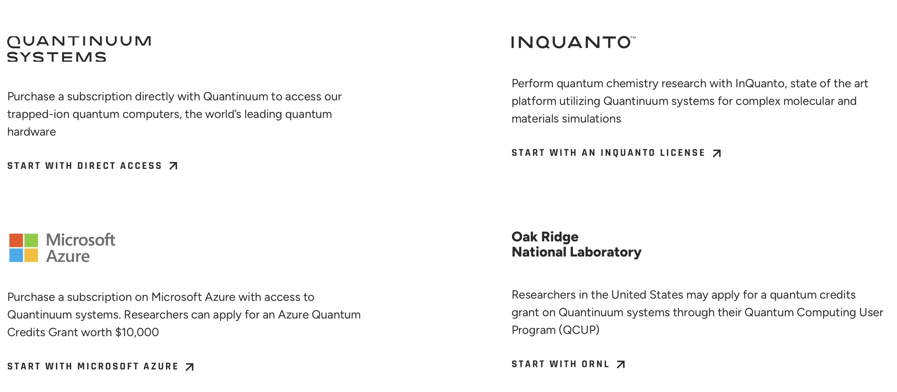
Access to Quantinuum Systems
https://www.quantinuum.com/

Slide 30

docs.quantinuum.com

Slide 31
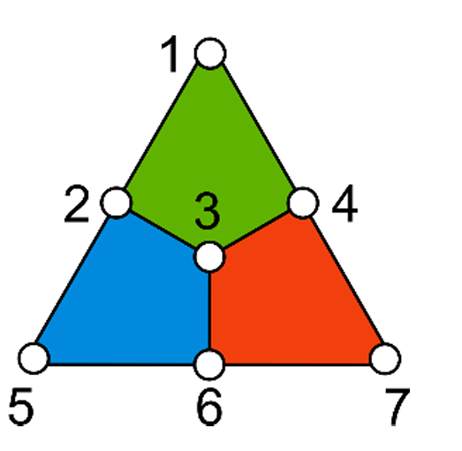
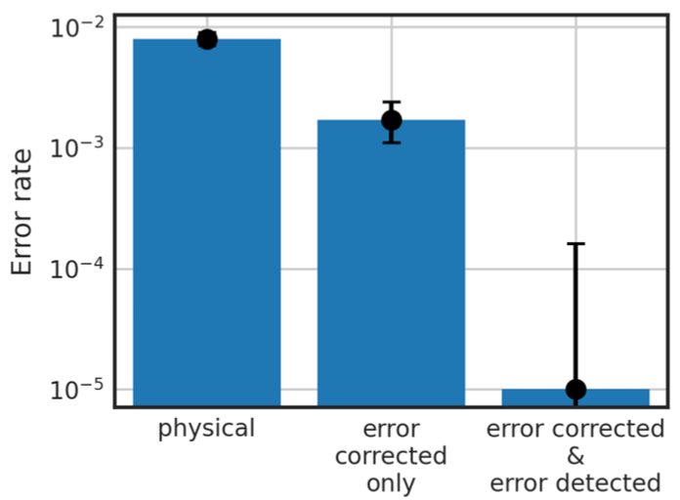
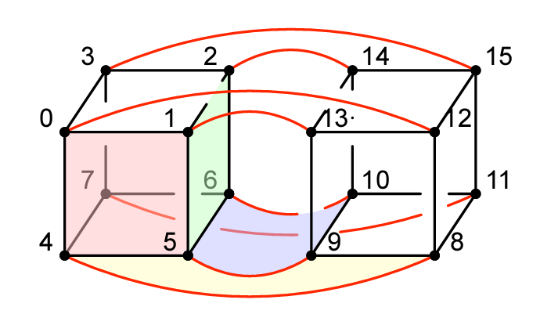
Some QEC research milestones at Quantinuum
First to demonstrate real-time error correction (July 2021, demonstrated on H1-1 (10 qubits at the time, now 20), https://arxiv.org/abs/2107.07505)
First to demonstrate break-even logical error rates (August 2022, demonstrated on H1-1, https://arxiv.org/abs/2208.01863)
First to demonstrate teleportation of a logical qubit (April 2024, demonstrated on H2-1, https://arxiv.org/abs/2404.16728)
Beyond Break Even (April 2024, demonstrated on H2-1, collaboration with Microsoft, https://arxiv.org/abs/2404.02280)
Leading in Demonstrations of high-dimensional QEC codes (Aug-Sept 2024, demonstrated on H2-1, https://arxiv.org/abs/2408.08865, https://arxiv.org/abs/2409.04628)
Public

