Slide 1


Analysis Facilities and SWIFT-HEP
Sam Eriksen
15th September 2025

Slide 2
Analysis Facilities

Slide 3


Analysis Facilities
What does an analysis facility mean?
Infrastructure and services that provide integrated data, software and computation resources to execute one or more elements of an analysis workflow
These resources are shared among members …
arvix:2404.02100
Why develop analysis facilities? A well designed AF service can:
Lower the insight for an analysis
Provide easily-scalable computation environment
Provide user-friendly environment
Accelerate the delivery of physics results

Slide 4
Analysis Anatomy
data
New idea/extension of existing work
One cycle as short as a day or as long as a month
Task
Task
Task
create/modify code
data
New ideas for improvement,
mistakes identified, or updates
Run analysis on laptop/cluster/grid
Task
Task
Understand results
data
Publication
Task
data

Slide 5
Analysis Anatomy
data
Task
Task
Task
Analysis step
output
data
caching
GPU
capable
Task
Task
portability
data
CPU-only
Task
data

Slide 6
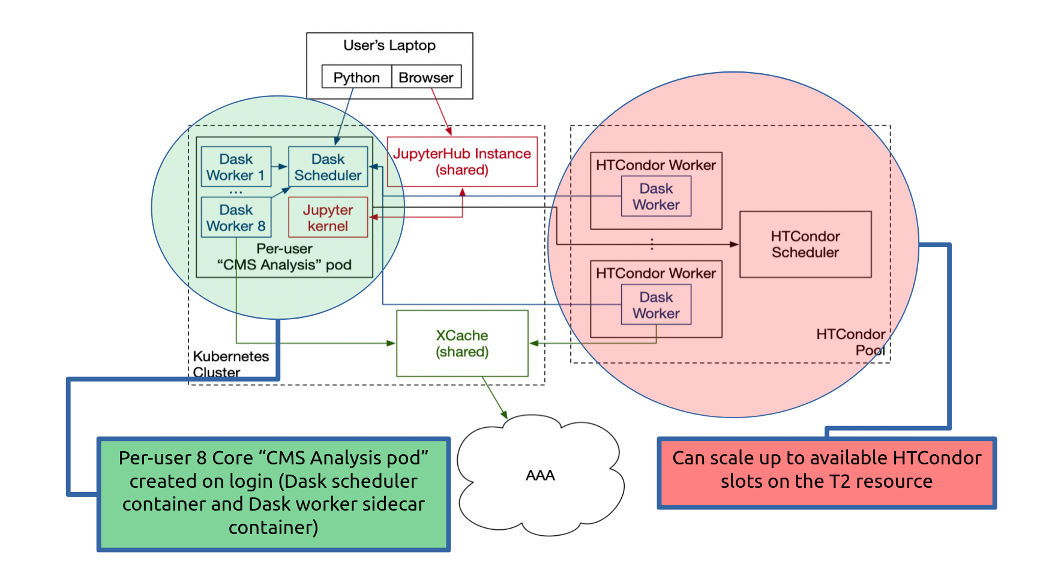
Analysis Facilities
An example is coffea-casa
Provides services for low latency columnar analysis enabling rapid processing of data in a column-wise fashion
Based on dask and Jupyter Notebooks

Slide 7
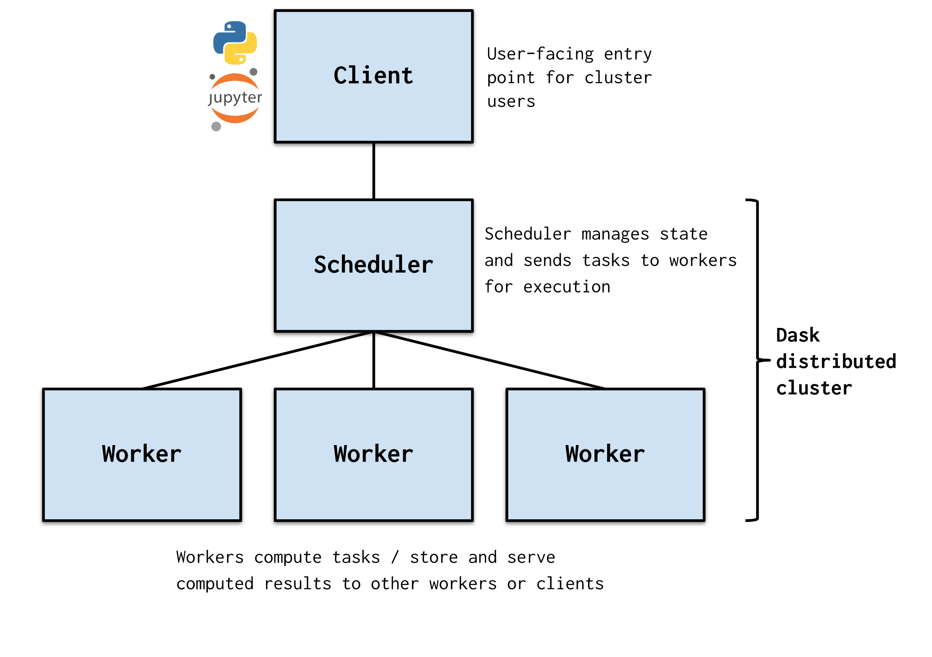
Dask
What is dask
A python library for parallel and distribution computing
from dask.distributed import LocalCluster, Client
cluster = LocalCluster()
cluster.scale(n_jobs=1) # runs dask worker
client = Client(cluster)
def square(x):
return x**2
future = client.submit(square, 10)
result = future.result()

Slide 8
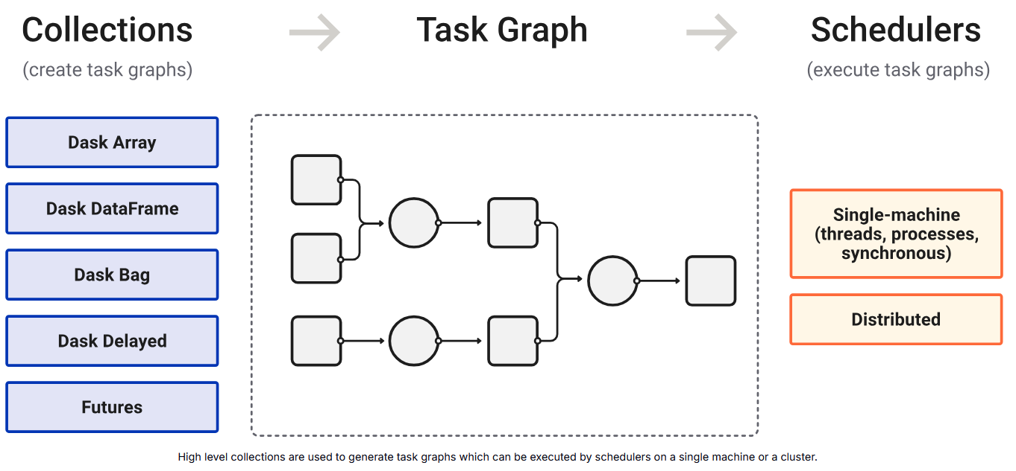
Dask
What is dask
A python library for parallel and distribution computing

Slide 9
SWIFT-HEP

Slide 10
What is/was SWIFT-HEP doing with analysis facilities
SoftWare and InFrastructure Technology for High Energy Physics
SWIFT-HEP + GridPP == experiment agnostic AF spanning across GridPP sites == Virtual Analysis Facility
Virtual analysis facility
Shared jupyter-hub
Data lake
Can run on DiRAC

Slide 11
Analysis Anatomy
data
2 work packages were focused on AF
WP1: Intelligent data and workflow management
WP5: Analysis Systems
Task
Task
Task
WP1
Analysis step
output
data
caching
DIRAC
GPU
capable
Data lake
Task
Task
portability
Heterogeneous hardware
data
Specialised hardware (GPUs, etc…)
CPU-only
Task
WP5 in a nutshell:
Run analysis workloads optimally** on distributed (GridPP) resources
** balanced between user-experience and computing efficiency
data

Slide 12
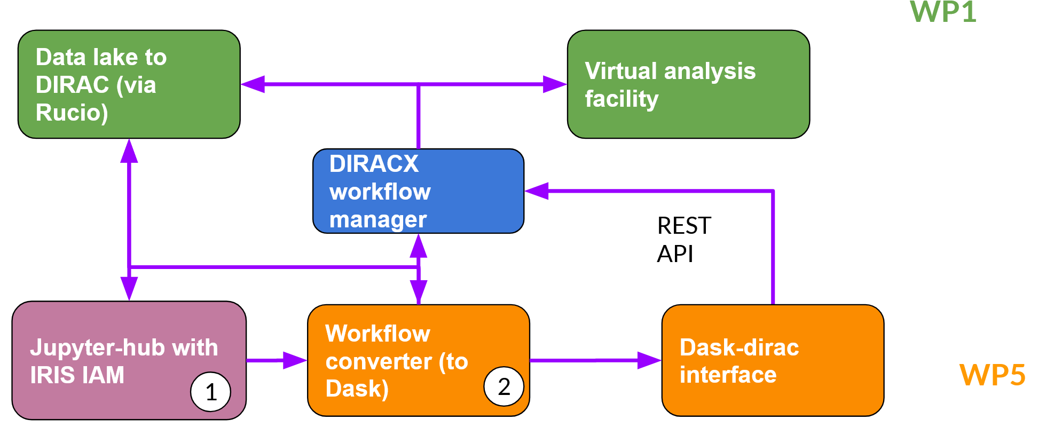
Long Term: Roadmap
More detailed slides

Slide 13
Short Term: Roadmap
WP1
WP1
Data lake to DIRAC (via Rucio)
Data lake to DIRAC (via Rucio)
Virtual analysis facility
Virtual analysis facility
Via tags (slide 26)
DIRAC workflow manager
Via tags (slide 26)
DIRAC workflow manager
Specify resource requirements per analysis component (portability)
Specify resource requirements per analysis component (portability)
REST API
REST API
4
FileCatalog?
4
FileCatalog?
Dask to DIRAC interface
(dask-dirac)
Dask to DIRAC interface
(dask-dirac)
Connect to data lake (caching)
Connect to data lake (caching)
Caching at analysis step level
Caching at analysis step level
WP5
WP5
2
1
2
1
3
3
More detailed slides

Slide 14
What have we actually implimented

Slide 15
A new cluster: DiracCluster
from dask.distributed import LocalCluster, Client
cluster = LocalCluster()
cluster.scale(n_jobs=5) # runs dask worker
client = Client(cluster)
LocalCluster
Scheduler is local
Workers are local
from dask.distributed import SlurmCluster, Client
cluster = SlurmCluster()
cluster.scale(n_jobs=5) # runs srun
client = Client(cluster)
SlurmCluster
Scheduler is local
Workers are slurm jobs
from dask.distributed import PBCluster, Client
cluster = PBCluster()
cluster.scale(n_jobs=5)
client = Client(cluster)
PBCluster
Scheduler is local
Workers run slurm jobs
from dask_dirac import DiracCluster
from dask.distributed import Client
cluster = DiracCluster()
cluster.scale(n_jobs=5) # runs dask-dirac submit
client = Client(cluster)
DiracCluster
Scheduler is local
Workers are DIRAC
Requirement;
- that DIRAC site has an open port
- local has port open (configurable)

Slide 16
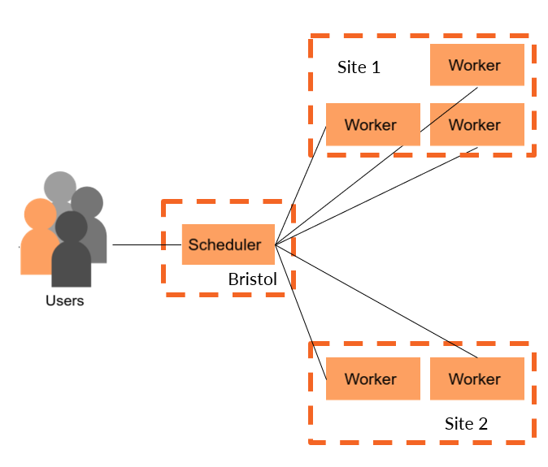
DiracCluster
from dask_dirac import DiracCluster
from dask.distributed import Client
cluster = DiracCluster(sites=[site_list],
gpus=<bool>, nthreads=<int>)
cluster.scale(n_jobs=5)
client = Client(cluster)
Can split across multiple sites
- Requires open port for worker
Able to require GPU for job
- More on this later
Able to select the number of threads (default is all)

Slide 17
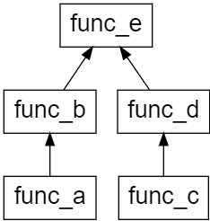
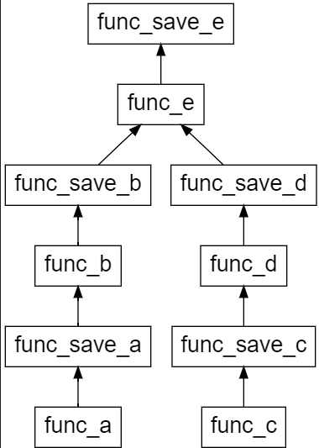
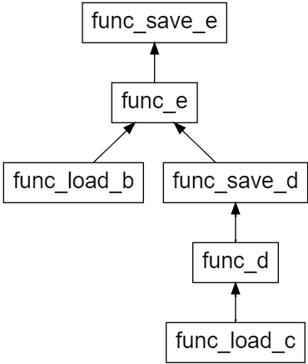
A new client: DiracClient
from dask.distributed import Client
client = Client(cluster)
Client
Job (task graph) split and passed to scheduler
from dask_dirac import DiracClient
client = DiracClient(cluster)
DiracClient
Intercepts task graph allowing for caching checks

Slide 18
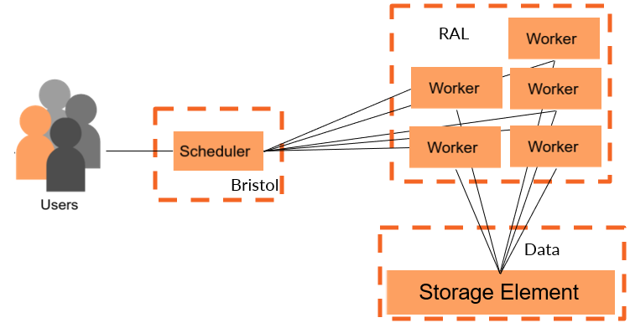
DiracClient
from dask_dirac import DiracClient
client = DiracClient(cluster,
cache_location=<path>)
Cache supported:
local
Dirac storage element
Working towards:
RUCIO

Slide 19
Practical Examples

Slide 20
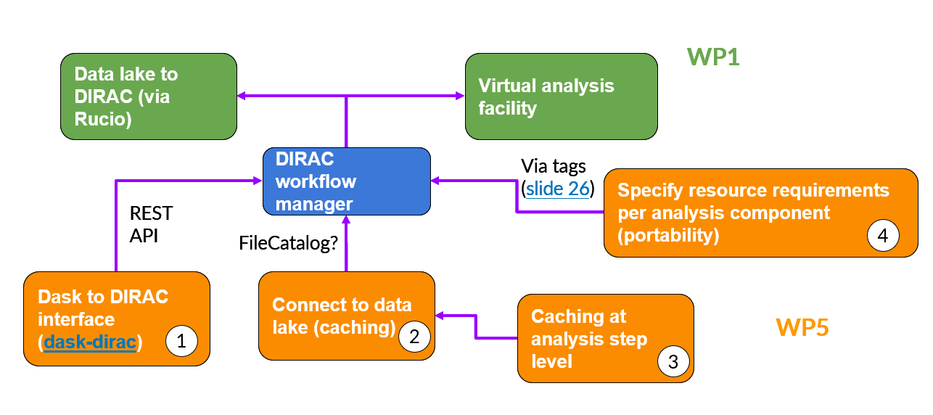
Practical Example 1 CMS AGC
Demonstration of using dask-dirac

Slide 21
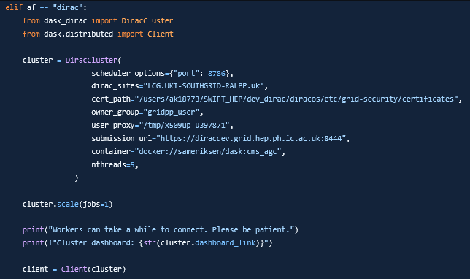
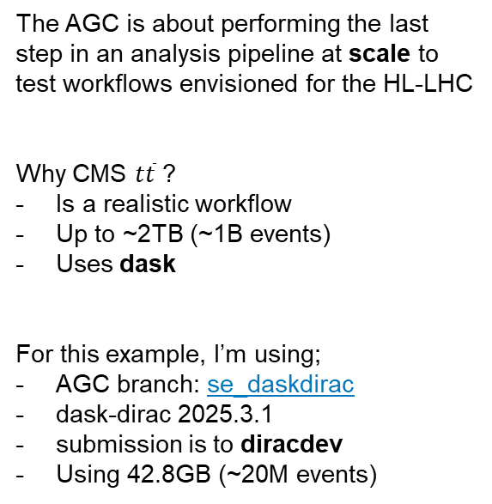

Practical Example 1: CMS AGC
IRIS-HEP Analysis Grand Challenge
CMS $t\overline{t}$ using 2015 Open Data
doi: 10.22323/1.414.0235
In order to use dask-dirac, what edits were made?
Added the DiracCluster as an option
Set af = dirac when running
The AGC is about performing the last step in an analysis pipeline at scale to test workflows envisioned for the HL-LHC
Why CMS $t\overline{t}$ ?
Is a realistic workflow
Up to ~2TB (~1B events)
Uses dask
For this example, I’m using;
AGC branch: se_daskdirac
dask-dirac 2025.3.1
submission is to diracdev
Using 42.8GB (~20M events)

Slide 22
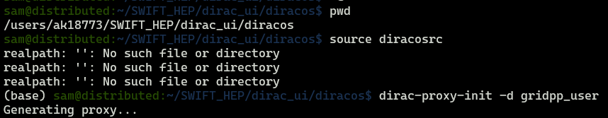
Practical Example 1: Step 1
Get a grid proxy
Exactly the same of any other grid job
Follows instructions from dirac docs with one difference
We configure for the development server
dirac-configure -F -S GridPP -C dips://diracdev.grid.hep.ph.ic.ac.uk:9135/Configuration/Server -I

Slide 23
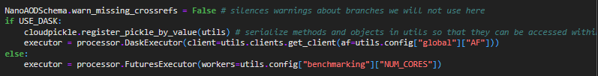
Practical Example 1: Step 2
Run the analysis notebook as normal
Analysis is a jupyter notebook
Set: af = dirac
Set: number of files
When we get to defining the executor, this is where dask-dirac is used
In this example, 1 job submitted (see slide 15); visible on https://diracdev.grid.hep.ph.ic.ac.uk:8443/DIRAC

Slide 24
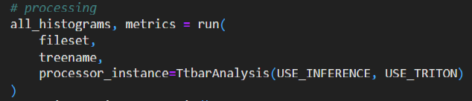

Practical Example 1: Step 2
Run the analysis notebook as normal
And once the job starts, workers connect and the analysis begins

Slide 25
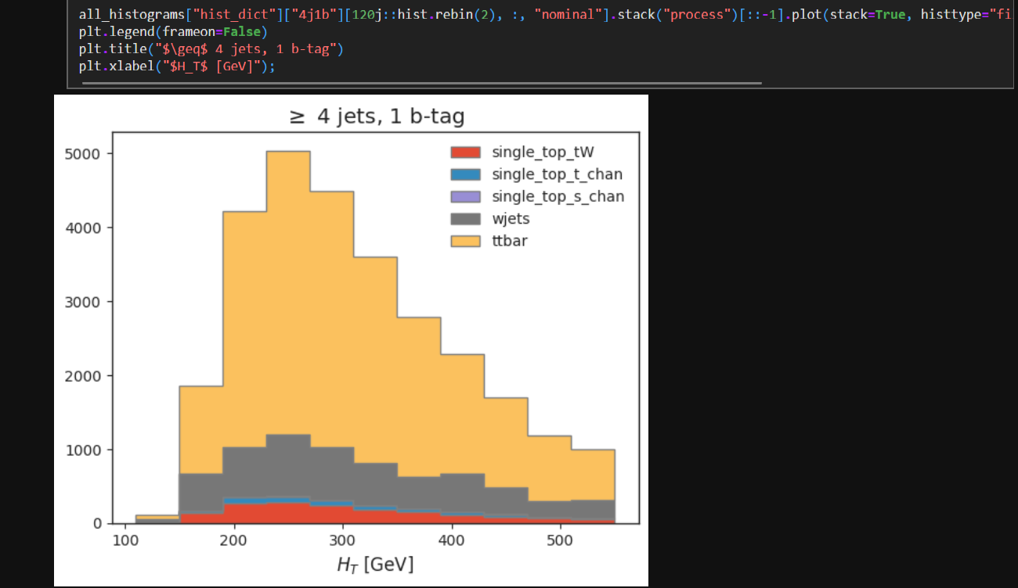
Practical Example 1: Step 2
Run the analysis notebook as normal
Once processing if finished, the results are retried from the workers and we can plot the result

Slide 26
Practical Example 2 DiracClient
Demonstration of using caching

Slide 27
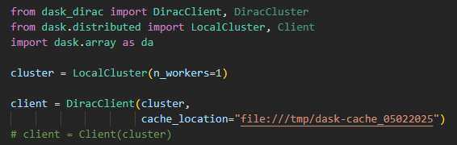
Practical Example 2: DiracClient
dask-dirac
April2025_workshop.ipynb
In order to use the DiracClient, what edits were made?
Just from dask.distributed.Client to dask_dirac.DiracClient
Set a cache_location (dirac://, file://, rucio://, etc…)
This example is to show caching in action on a simple example.
What is the example?
LocalCuster (workers are local)
DiracClient
Local caching
Where is this example?
April2025_workshop.ipynb
dask-dirac 2025.3.1

Slide 28
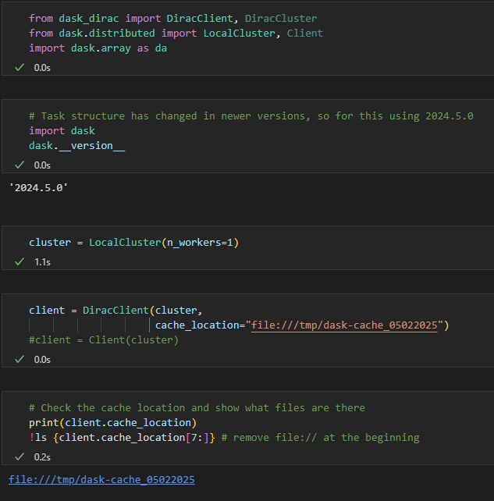
Practical Example 2: DiracClient
Local Cluster; workers are on same machine
Only change from conventional approach
Using DiracClient rather than Client
Nothing in the cache location

Slide 29
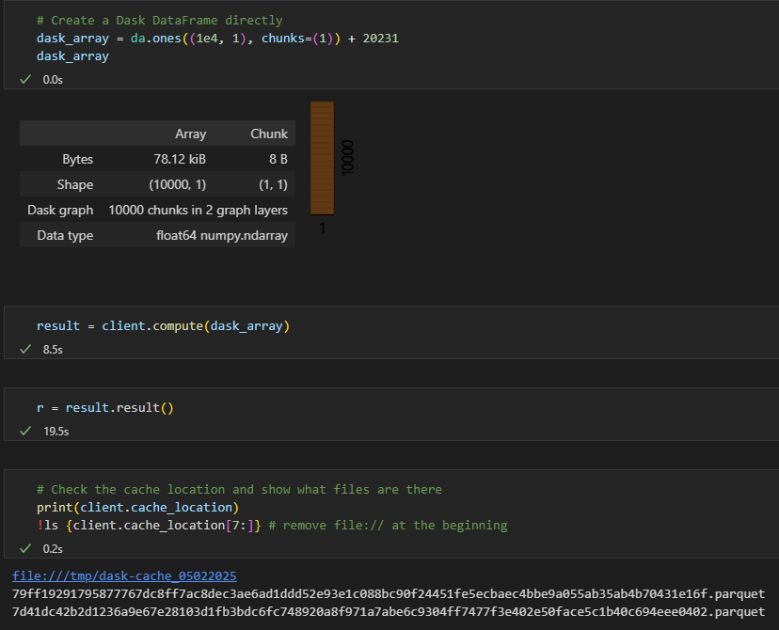
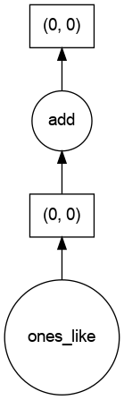
Practical Example 2: DiracClient
Processing is adding a number to an array.
Behind the scenes, task graph has been altered so the two stages are cached

Slide 30
Summary
dask-dirac
Effectively splits up work across these sites
We can use request and use GPUs
Lowers barrier to DIRAC!
low-level cache
Between processing steps and persistent
Some really complex graphs may not work
What more are we planning?
Will integrate RUCIO when it’s ready
Write up this work + improve documentation -> invite others to use
This is still a prototype -> need to get production ready

Slide 31
Questions?

Slide 32
Overview
WP5 (Analysis Systems)
overview + roadmap
Current progress in WP5
Future for WP5
Previous updates
November 2024
March 2024
November 2023
September 2023
May 2023
March 2023
February 2023

Slide 33
BACKUP

Slide 34
Practical Example 3 LZ Analysis
Demonstration of interchangeability of CPU and GPU in analysis

Slide 35
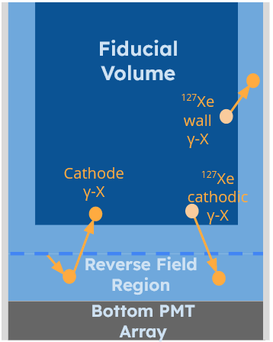
Practical Example 3: LZ AGC with GPUs
dask-dirac
April2025_workshop.ipynb
Context: One background in LZ are γ-X events, these can look like dark matter, and originate where not all charge is collected.
This analysis looks at simulations and determines what rate of these we should expect.
What is the example?
LZ analysis on simulated data
Local Cluster
6-files, ~1-5 GB each
~4 mil events
In production, it’s closer to ~100 TB
Where is this example?
April2025_workshop.ipynb
dask-dirac 2025.3.1
What is this example about?
Now we can access grid-GPUs, can we easily integrate into workflows?
Offering an LZ analysis

Slide 36
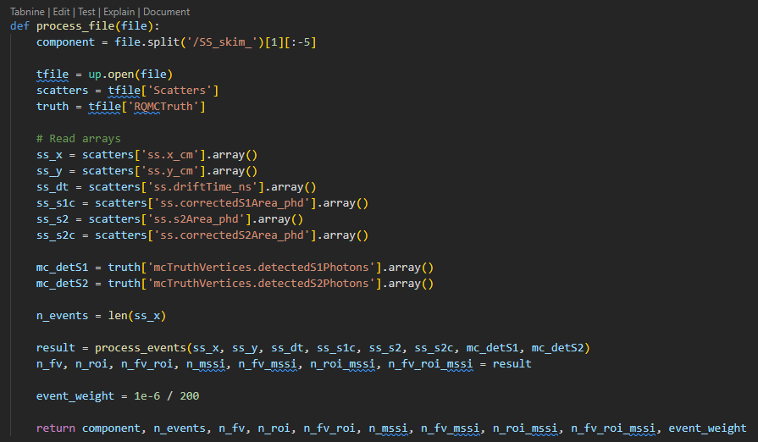
Practical Example 3: LZ AGC with GPUs
In the core of the analysis; CPU version
Open a file
Make some arrays
Some processing of arrays

Slide 37
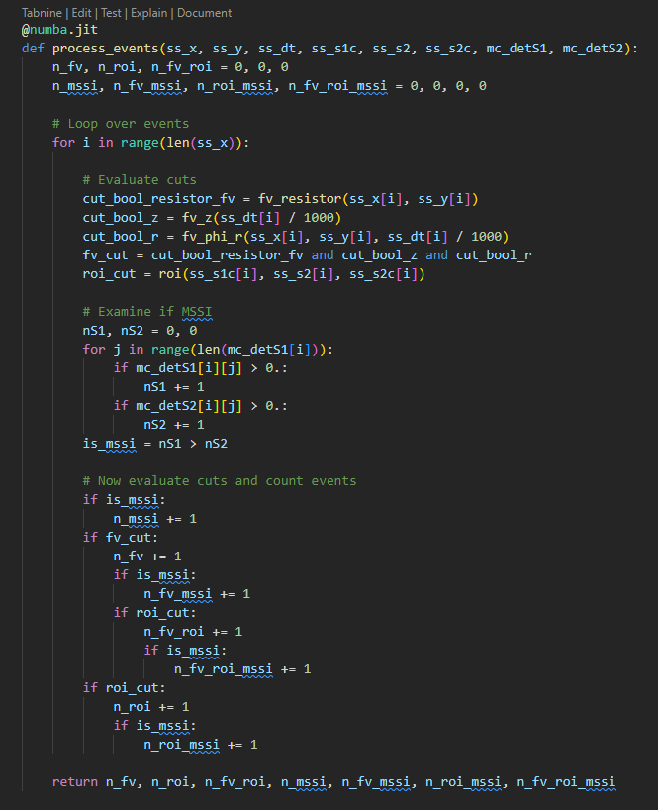
Practical Example 3: LZ AGC with GPUs
Loop over entries in array
Evaluate a bunch of cuts
Count events which pass cuts

Slide 38
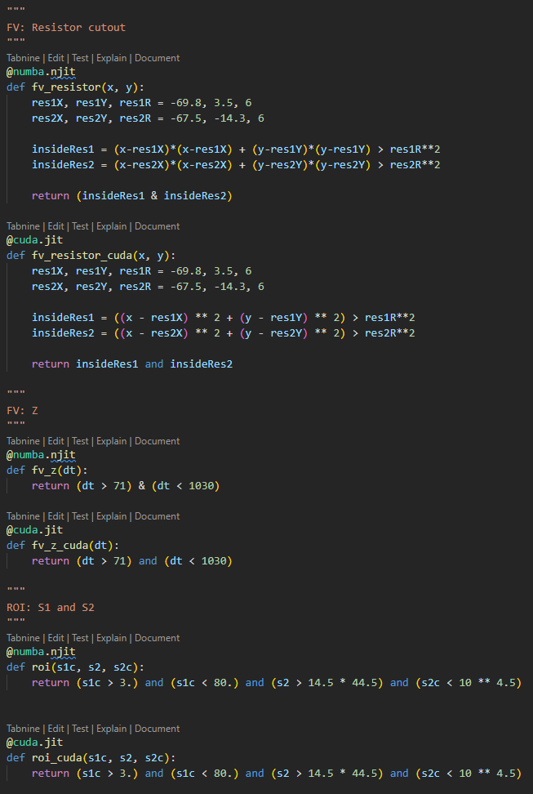
Practical Example 3: LZ AGC with GPUs
How does CPU and GPU approaches differ?
For most of the cuts, no change is needed

Slide 39
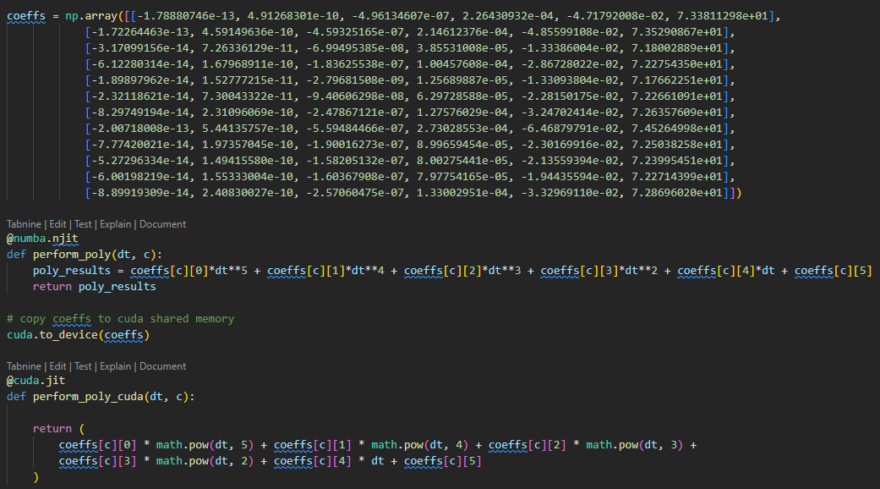
Practical Example 3: LZ AGC with GPUs
How does CPU and GPU approaches differ?
copy to GPU

Slide 40
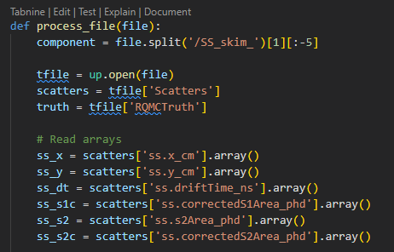
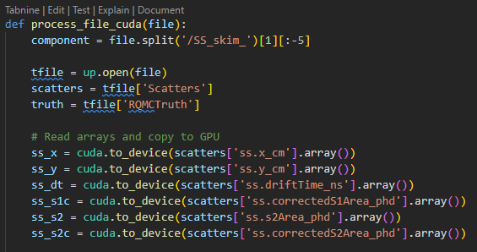
Practical Example 3: LZ AGC with GPUs
How does CPU and GPU approaches differ?
Arrays have to be copied to GPU

Slide 41
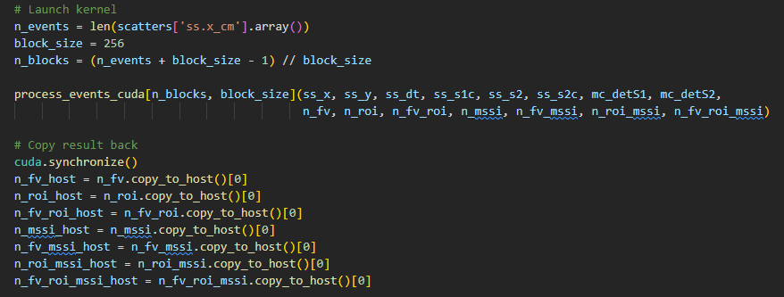
Practical Example 3: LZ AGC with GPUs
How does CPU and GPU approaches differ?
Result has to be copied back

Slide 42
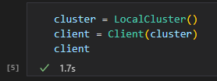
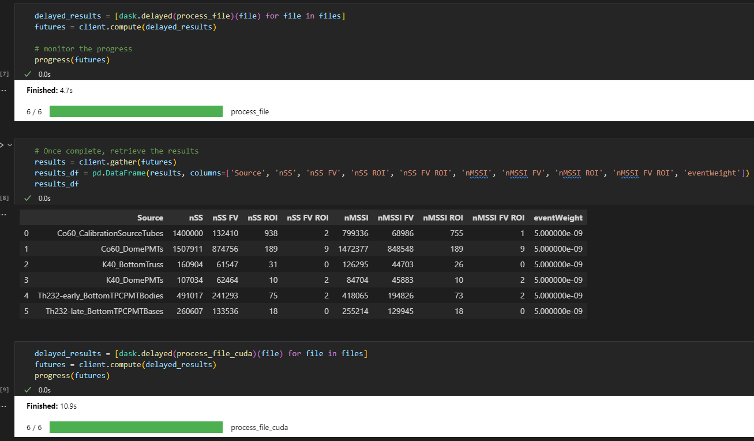
Practical Example 3: LZ AGC with GPUs
Dask
This can still easily be parallelised with dask

Slide 43
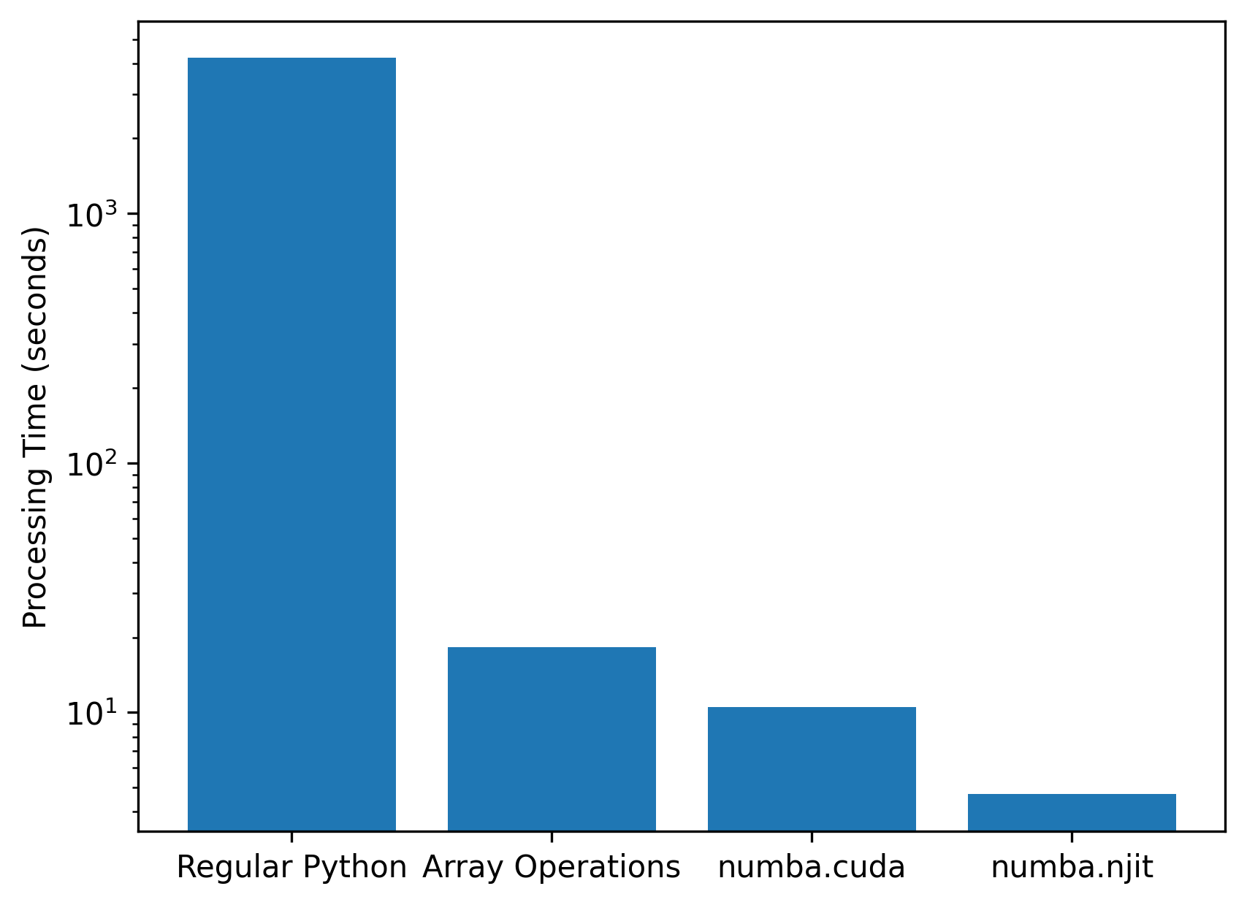
Practical Example 3: Time Improvement
Summary
We think in ‘regular python’ and ‘array operations’
Minor modifications are required for GPU use
In this example, GPU overhead is greater than operation speed improvement
Can this be improved further?
The point of this example is to make grid GPUs more accessible
For GPU there are replacements: CuPy for numpy and cuDF for pandas

Slide 44
WP5: Roadmap
Dask to DIRAC interface
(dask-dirac)
Add extension to dask
Dask is able to parallelize any python code
1
1
Connect to data lake (caching)
Add the ability to save output after dask instance has closed
2
Caching at analysis step level
3
Avoid having to re-run analysis steps
Persistent caching
Specify resource requirements per analysis component (portability)
4
E.g. Let some stages run on GPUs
See talk by Luke Kreczko for some future planning

Slide 45


Intermission: Dask
Dask can submit to most batch systems all the same - fantastic from users’ perspective
Can we use Dask in HEP?
Coffea (Analysis Grand Challenges)
RDataframe
Awkward-array (native support)
FAST-HEP (custom graphs)
Scale any Python code
Parallelize any Python code with Dask Futures, letting you scale any function and for loop, and giving you control and power in any situation.
From https://www.dask.org/
If infrastructure can be used via Dask → wide use is possible

Slide 46
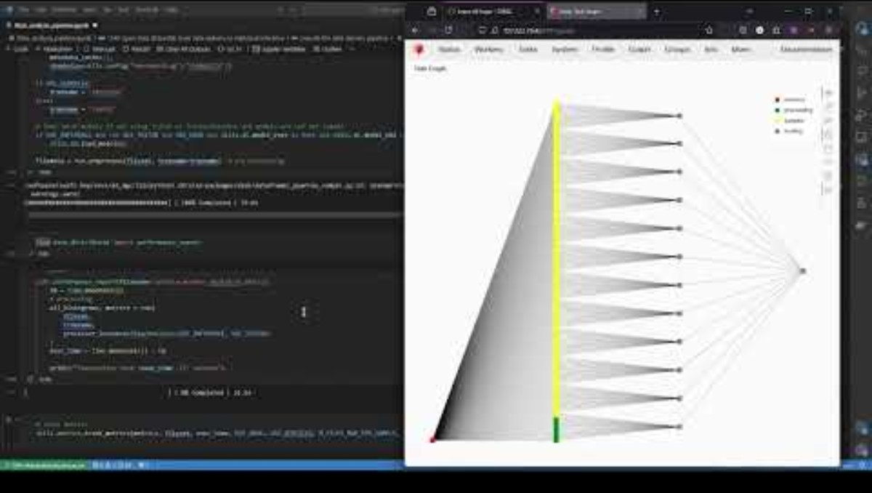
Practical Example 1: CMS AGC Running example

Slide 47
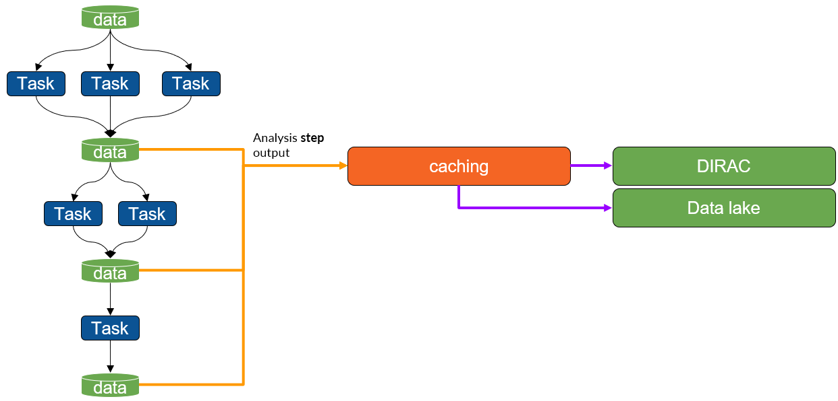
What have we been focusing on
Caching at analysis step level
What do we want to demonstrate
Imagine a complex task that you want to run.
If you know you are going to have to run this multiple times, but are only modifying one of the functions, you can think of a few ways to reduce the reprocessing;
Most obvious would be to break up the graph and submit each task separately and save the outputs, and if you are rerunning, load the bits you haven’t changed.
We want that to automatically happen when you submit something.

Slide 48
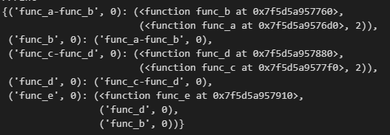
Modifying a task graph: Practical example
Caching at analysis step level
This is what we have to play with;
Task is;
Calculate hash
Check if hash exists somewhere
If exists; replace with load
If doesn’t; add save
hash(‘func_b’, hash(‘func_a’, 2))
Same as above
hash(‘func_d’, hash(‘func_c’, 2))
Same as above
hash(‘func_e’, hash(‘func_d’, hash(‘hash_c’, 2)), hash(‘func_b’, hash(‘func_a’, 2)))

Slide 49
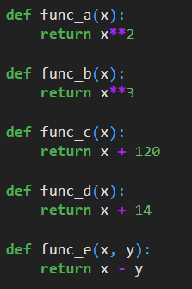
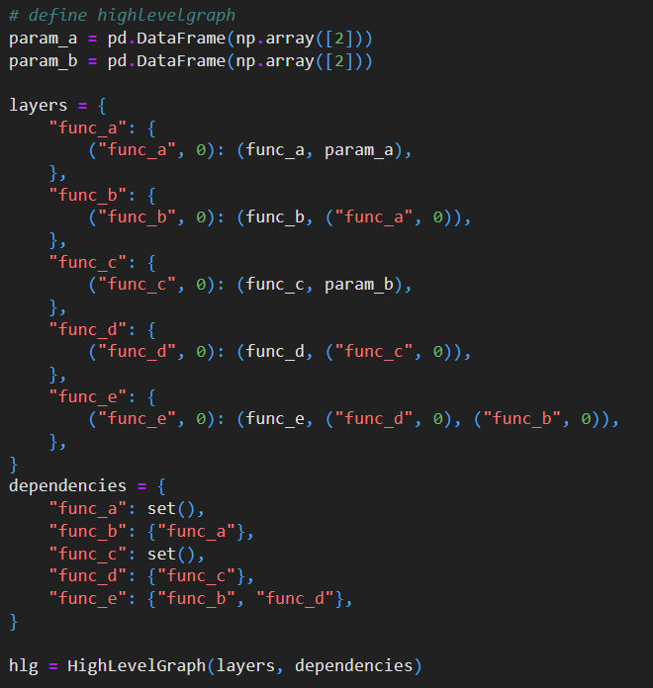
Modifying a task graph: Practical Example
Caching at analysis step level

Slide 50
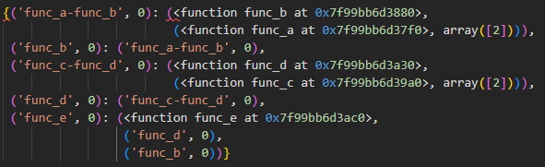
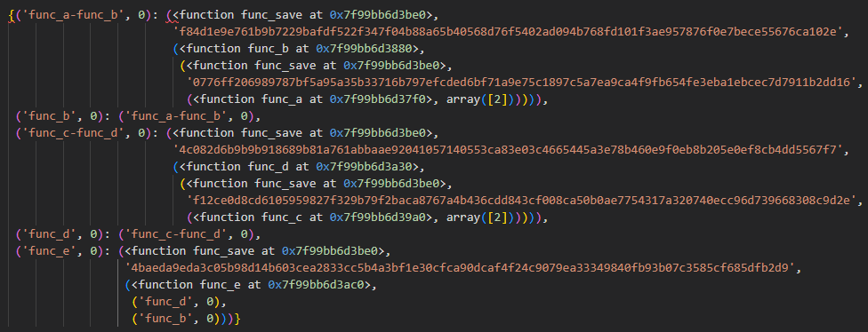
Practical Example
Caching at analysis step level

Slide 51

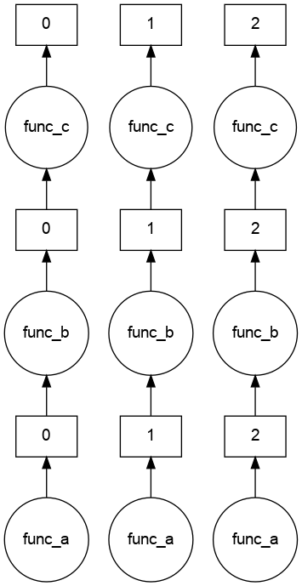
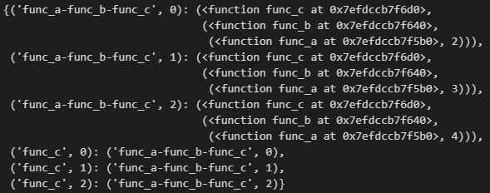
Practical Example
Caching at analysis step level

Slide 52
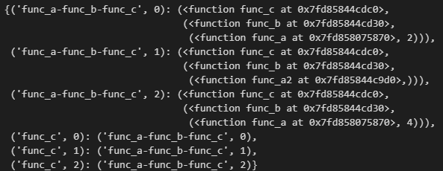
Practical Example
Caching at analysis step level

Slide 53
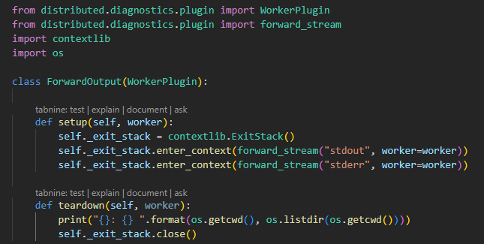
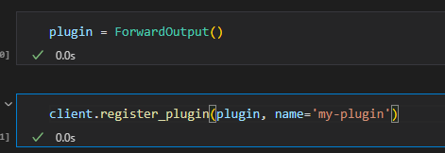

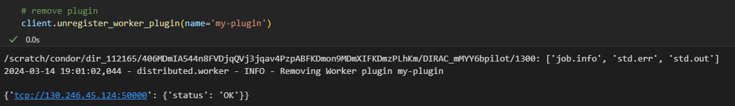
Worker Plugin example
Caching at analysis step level
Description
When worker is shutdown/killed or the plugin is disconnected, the directory path and contents are displayed

Slide 54
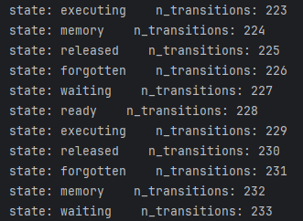
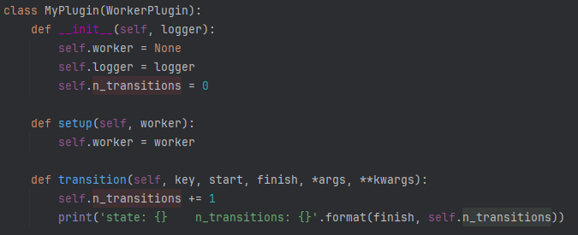
Worker Plugin example
Caching at analysis step level
Description
When worker is transitioning between states, the state is printed and the number of transitions are counted

Slide 55
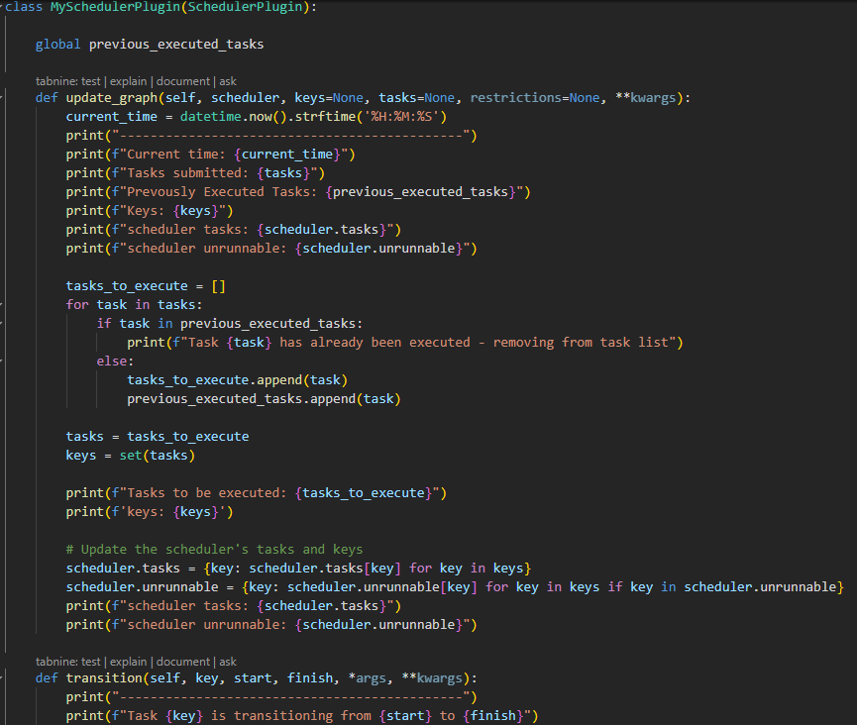
Scheduler Plugin example
Caching at analysis step level
Description
Remove a task from the graph if it has already been executed

Slide 56
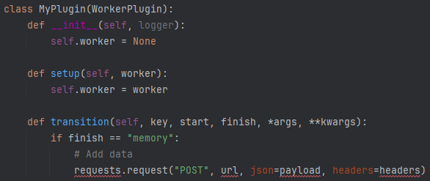


Where we left things last time
Caching at analysis step level
Began looking at intermediate result caching using scheduler plugins
Allows for tasks to be run when a worker connects/disconnects or transitions (e.g. from running to memory) a job
Idea: perform check (ideally via RUCIO) if result exists before a task starts

Slide 57
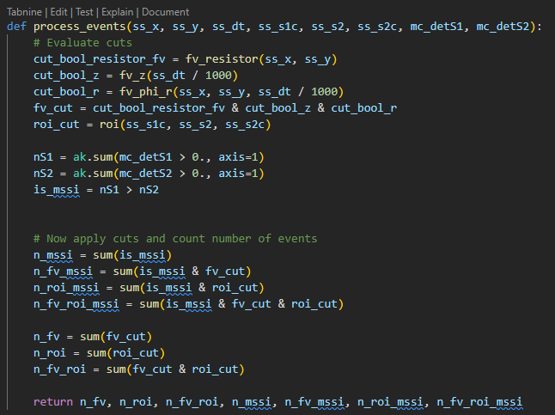
Practical Example 3: LZ AGC with GPUs

