Slide 1



GridPP Infrastructure and Future Analysis Facilities
Alastair Dewhurst
Notes:
The abstract pattern can be removed or repositioned if required. Be careful to ‘Send to Back’ so that it does not obscure any important information.

Slide 2
Introduction
About me:
PhD on ATLAS
ATLAS Computing Contact at Tier-1
Tier-1 Manager
Head of Platforms and Services in SCD
Platforms and Services provides cutting-edge scientific computing platforms to enable world leading research.
Theme is split into groups that focus on the community they support.
Alastair Dewhurst
JASMIN
DAaaS
Tier-1
Computing Platforms
Federating Services
Head of Service Management

Slide 3
Infrastructure
GridPP (Tier-1)
Analysis Facility
HPC
(DiRAC)
University Cluster
Scale
Laptop

Slide 4
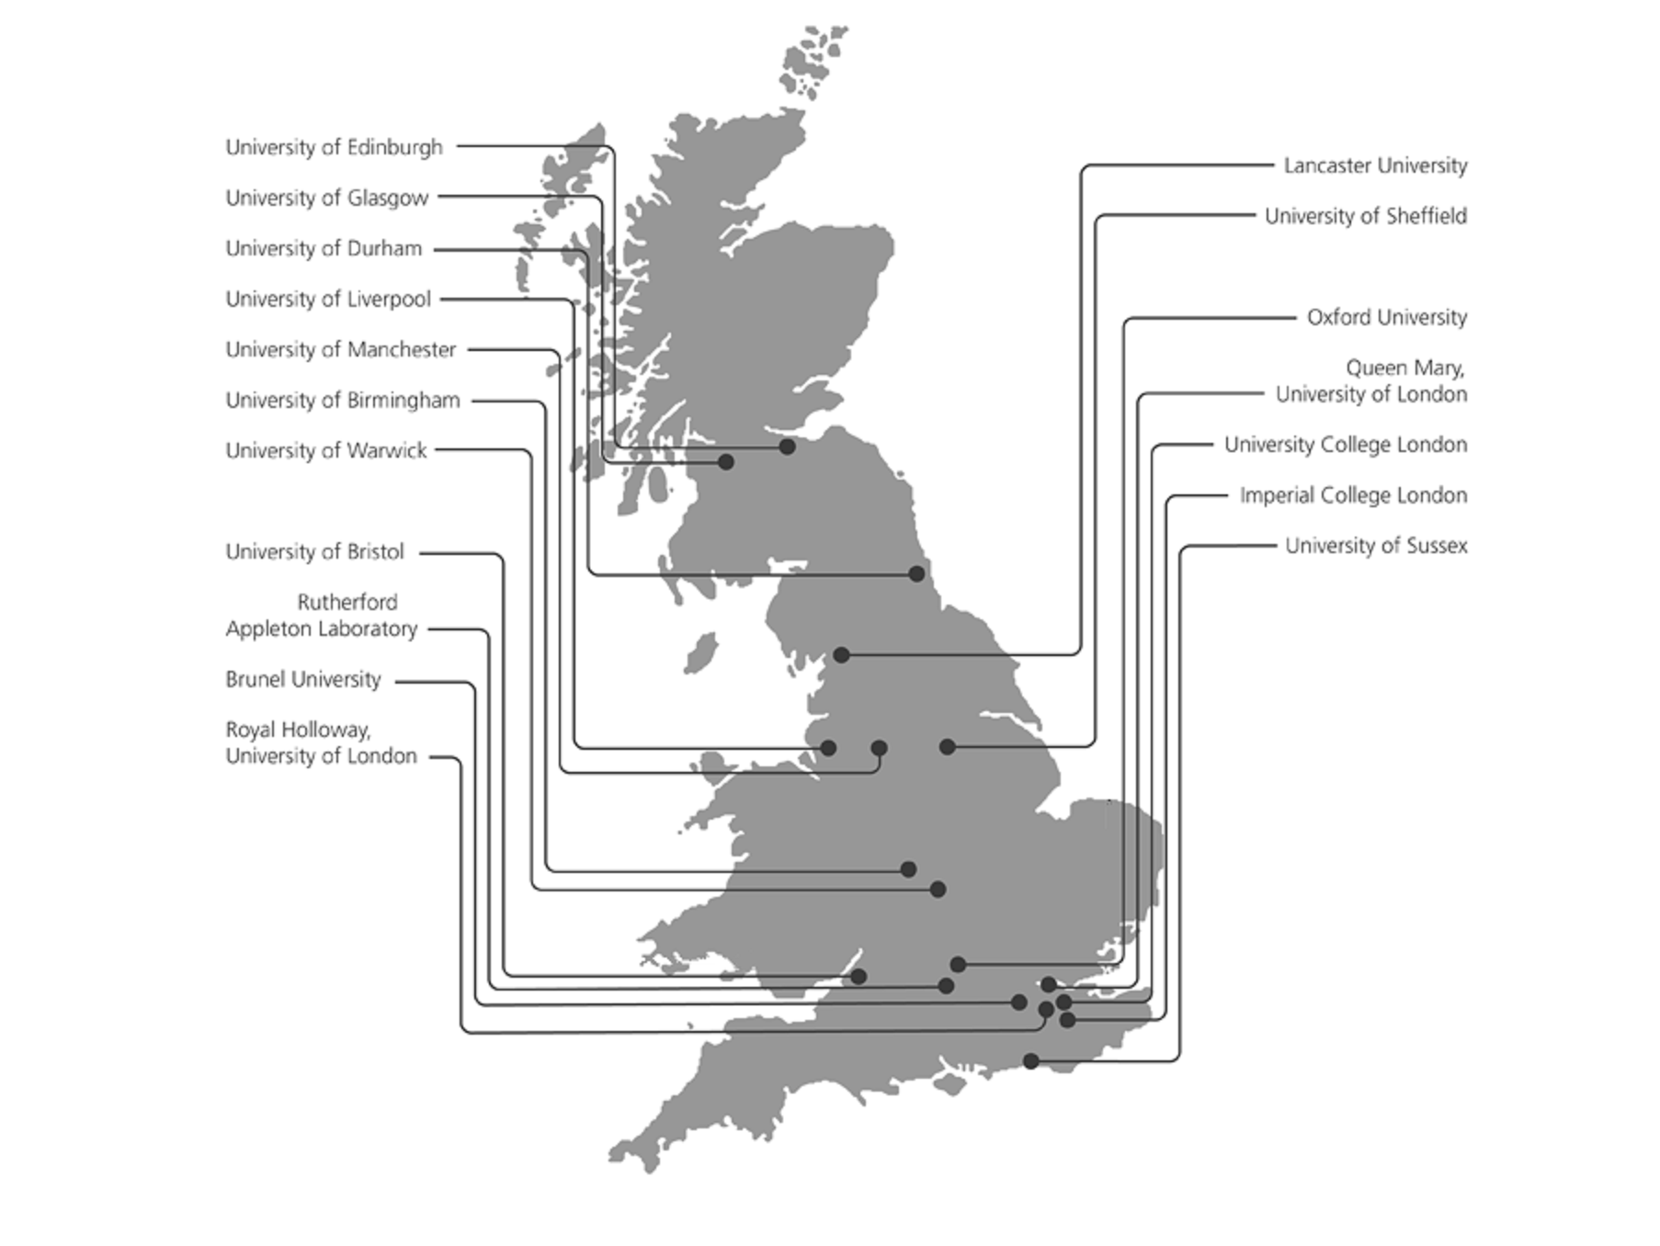
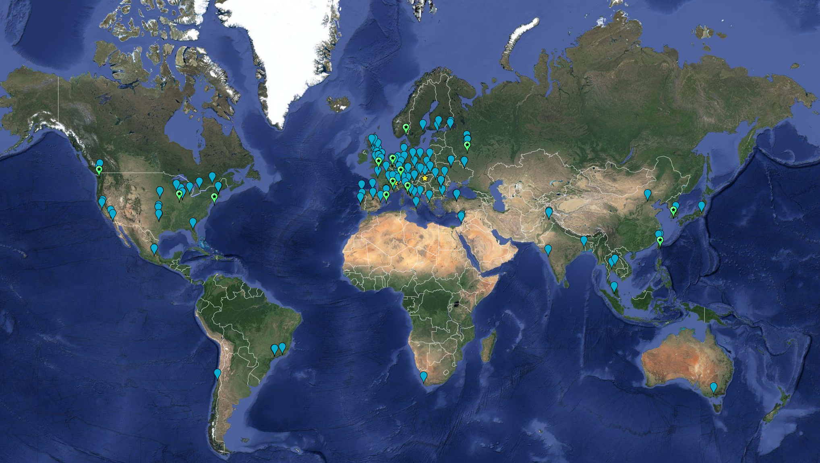
GridPP in the WLCG
FY25/26 Requirements | RAL | GridPP Tier-2s | WLCG Total
CPU (Cores) | 46,000 | 42,600 | 335,000
Disk (PB) | 66 | 39 | 497
Tape (PB) | 212 |  | 1620
Map showing WLCG Sites
Tier-2 leverage local resources to provide significantly more resources than officially requested.

Slide 5
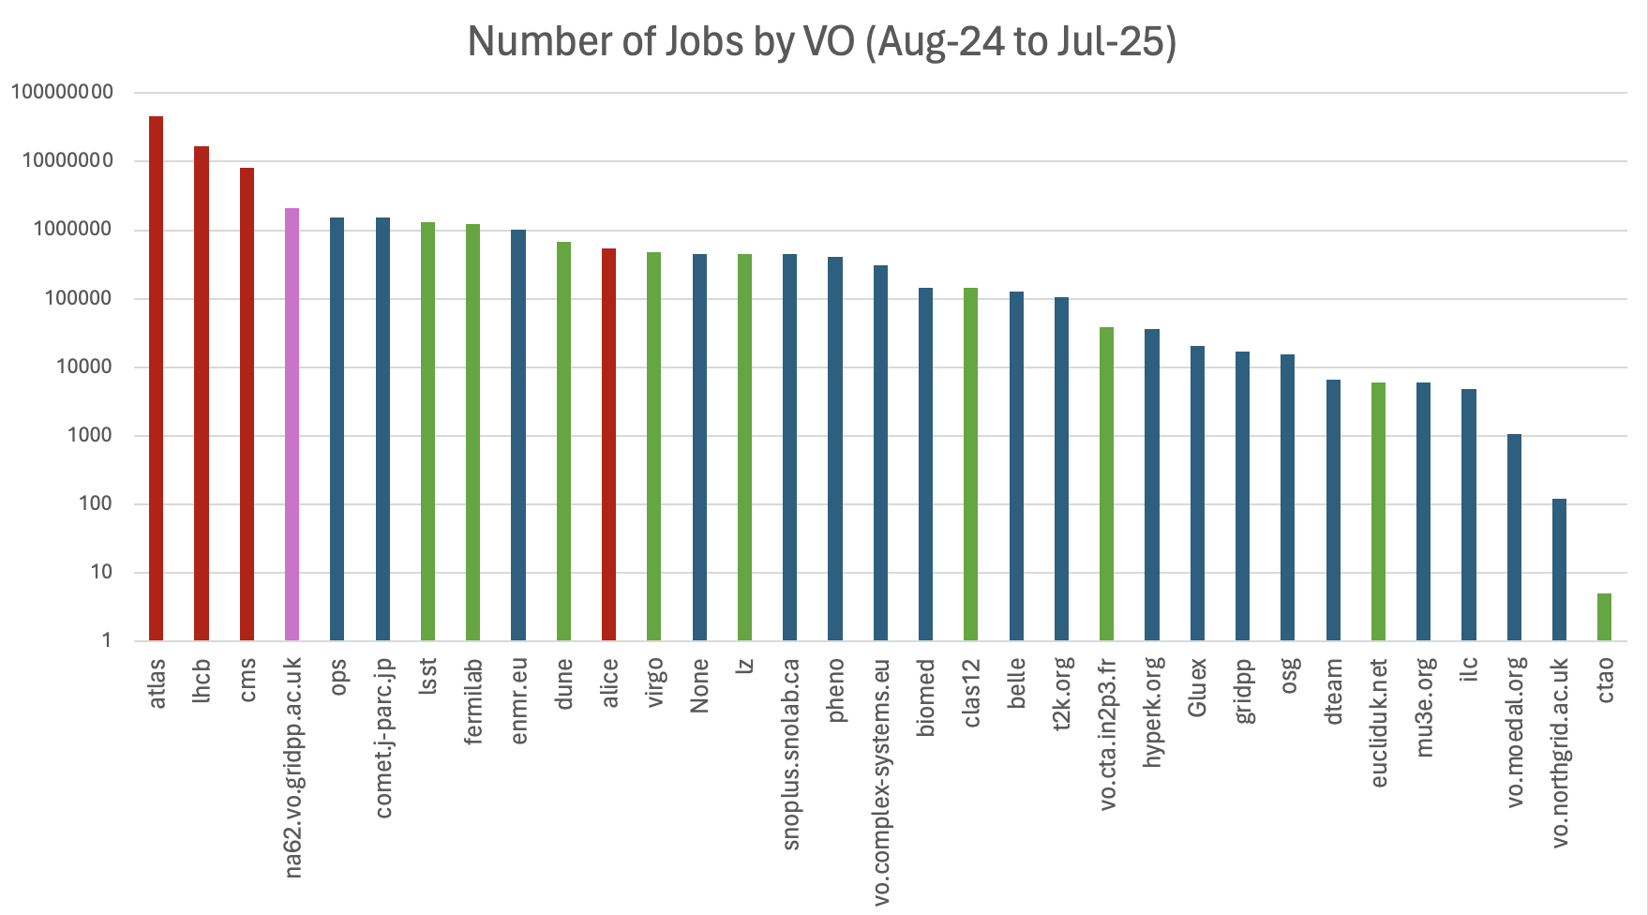
GridPP for non-LHC experiments
Continue to support over 30 VOs:
LHC; IRIS; and Others, including NA62
21 VOs submitted more than 100k jobs (one every 5min!) and 9 VOs more than a million (one every 30s!), in the last year.

Slide 6
What does RAL Tier-1 do?
I see the Tier-1s as the final step in the LHC data taking process.
Not as time critical as the trigger(!) but data taking will be affected if data archival is blocked for several days.
During data taking ~10% of the raw data produced at CERN is sent to RAL to be archived on our tape service.
RAL has a dedicated 200Gb/s link to CERN.
The Disk and CPU contribute to a global pool of resources used for a range of task.
RAL take a leading roles in the more data intensive activities.
RAL is crucial for distribution data to the UK universities working on the LHC.

Slide 7
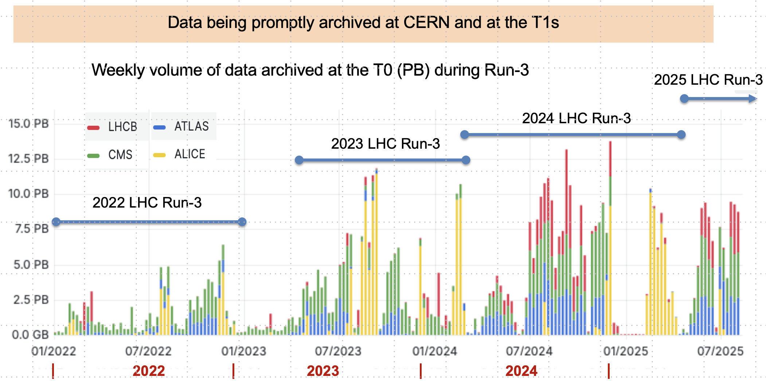
Data Archival

Slide 8
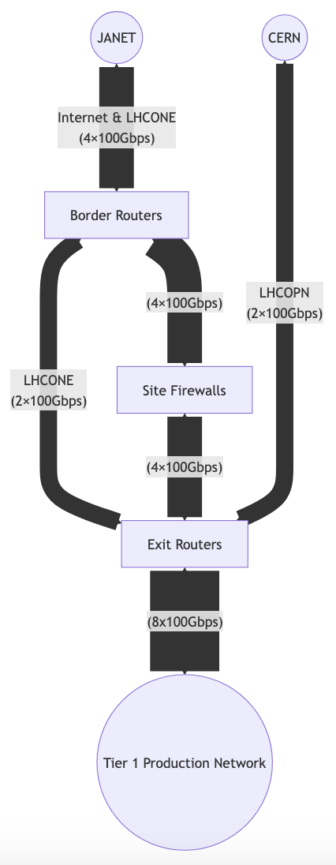
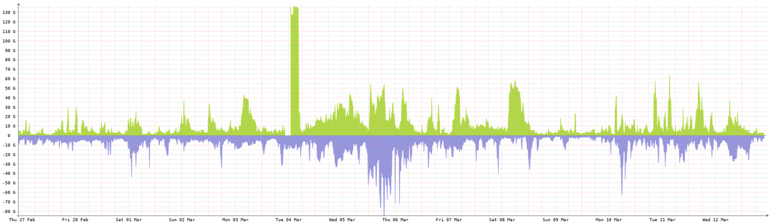
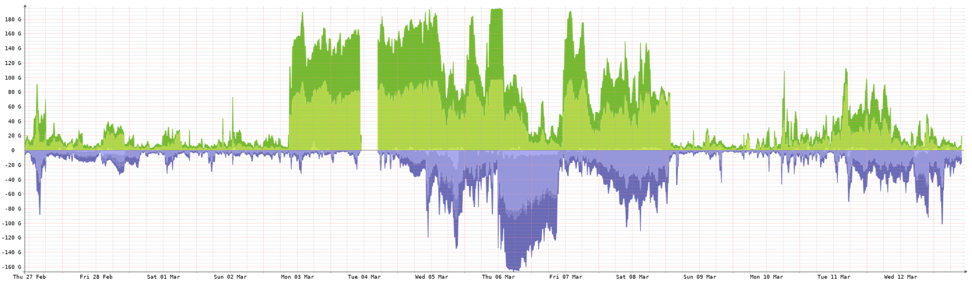
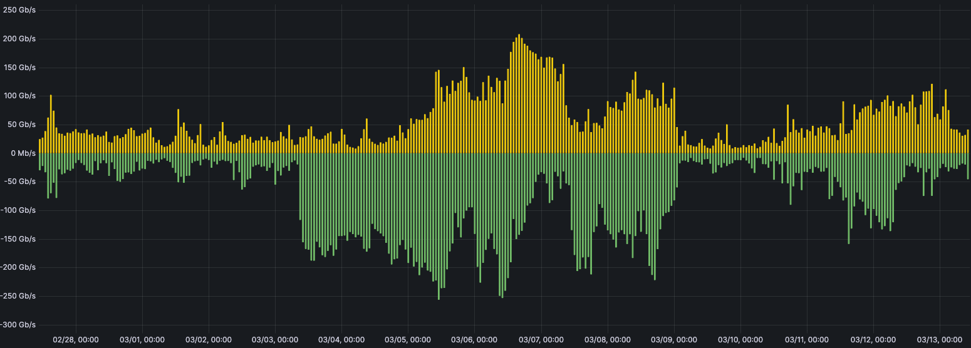
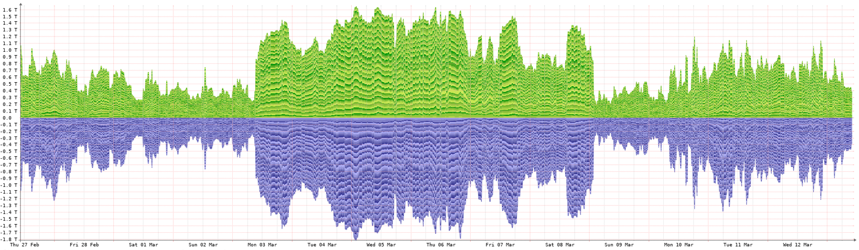
Tier-1 Data Challenge 2025
The Tier-1 provides computing resources for the LHC experiments. From the 3rd to 7th March we ran a data challenge (in addition to production work) to test our external network links and disk storage (Echo).
Successful failover test
The LHCONE is a VPN which allows us to bypass the site firewall when transferring data to other sites also on the LHCONE.
The LHCOPN is a dedicated 2 x 100Gb/s link to CERN. We were able to saturate this link!
< Data Challenge >
The internal Tier-1 network sustained over 1.5Tb/s during the challenge.
The total peak throughput from external sources was 256Gb/s ingress and 208Gb/s egress.

Slide 9
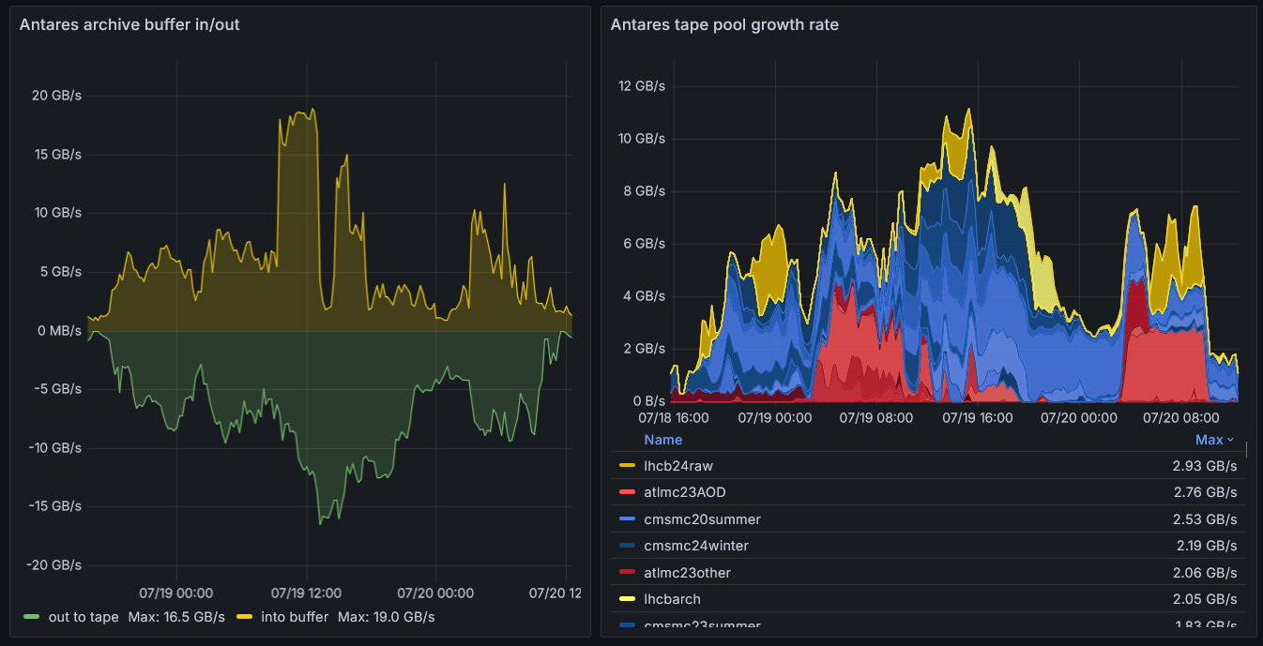
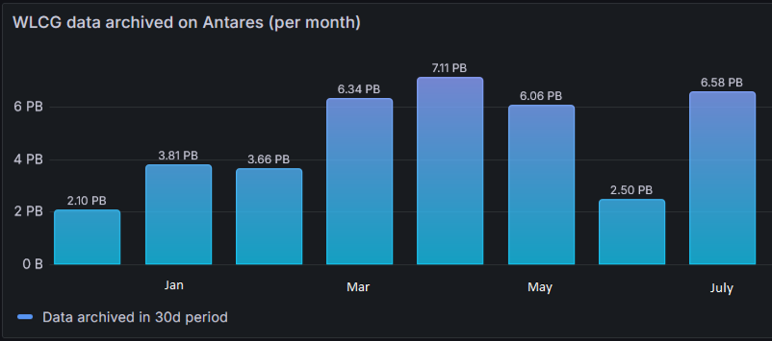
Tape
GridPP has funded a single Tape Library with a capacity of ~15,000 tapes.
LTO-9 = 3980 x 18TB tapes
TS1160 = 5085 x 20TB tapes
TS1170 = 1665 x 50TB tapes
We are reaching the throughput limit of our tape drives.

Slide 10
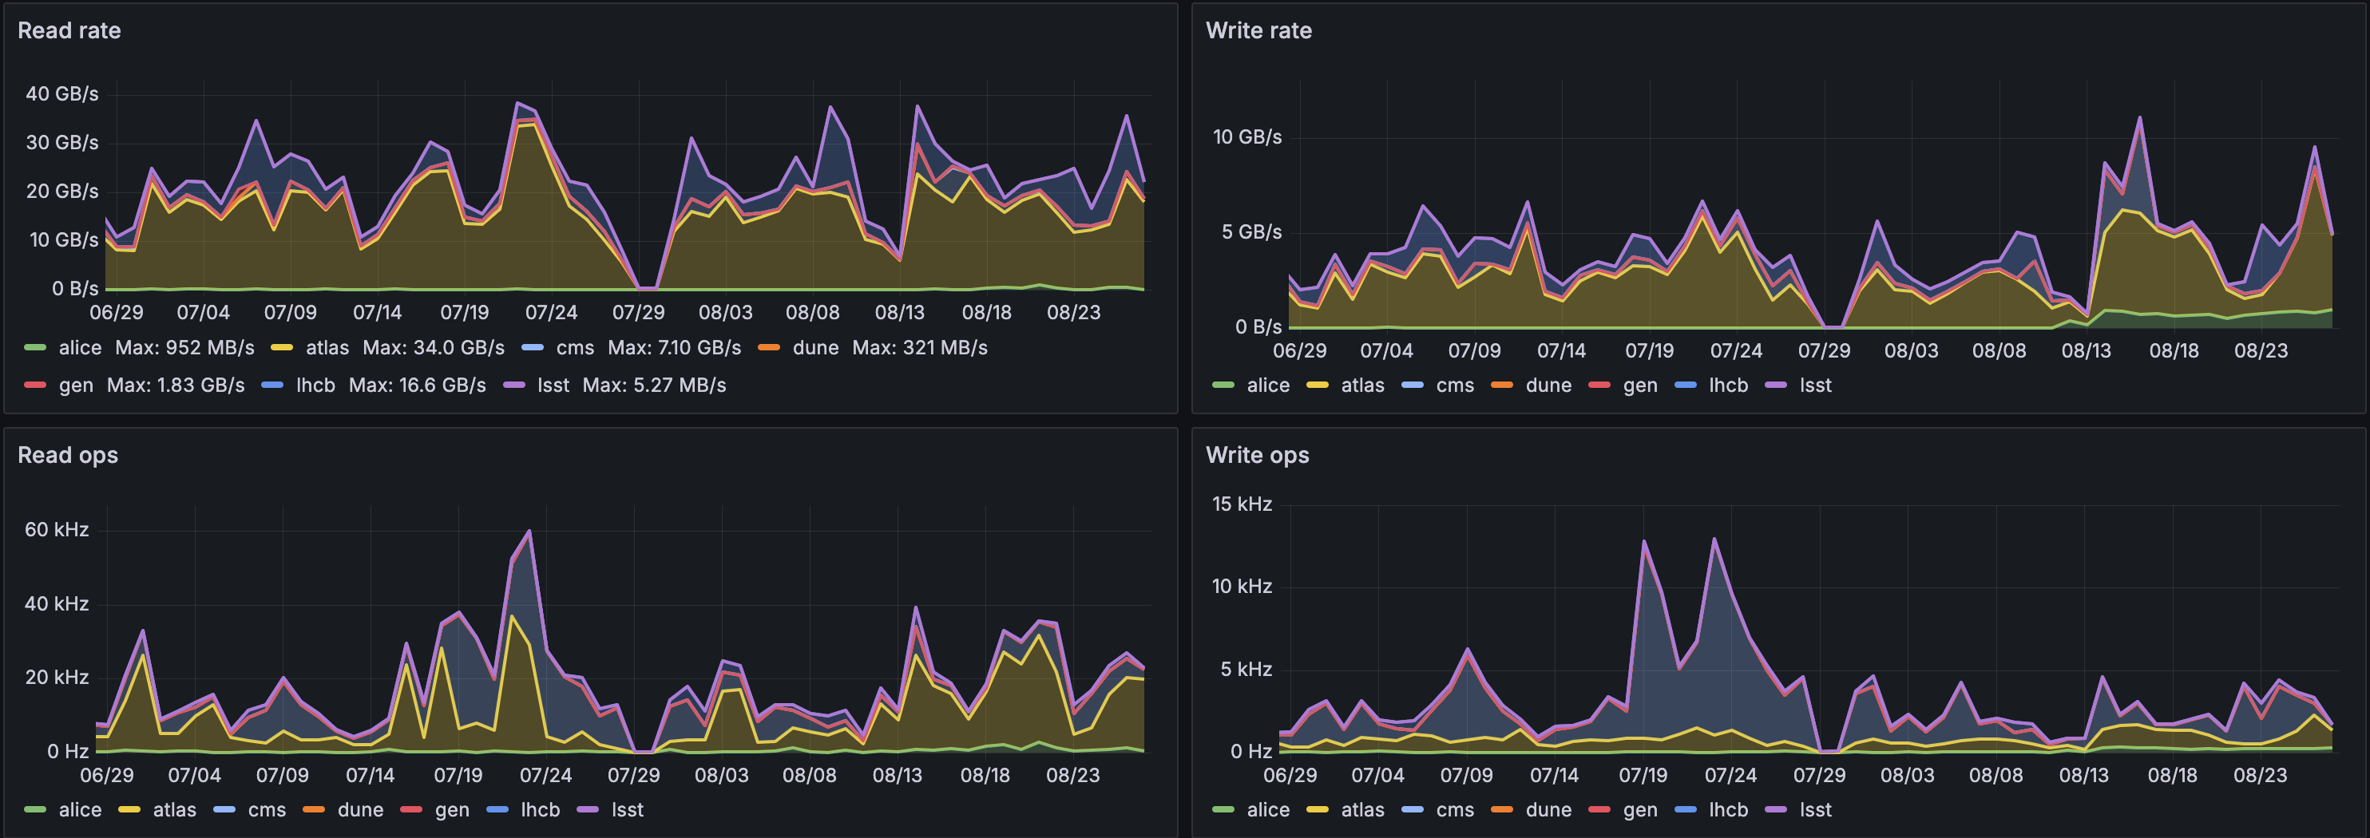
Tier-1 Disk (Echo)
Tier-1 relies on a Ceph based object store with XRootD plugin to provide storage.
Highly optimized setup
332 storage nodes providing 98PB of allocatable capacity.
April 2025

Slide 11
Echo Architecture
Other sites
Worker Node
Job container
Job container
User job
User job
XRootD client
External GW
XRootD client
GridFTP server
External GW
Job container
XRootD server
rados plugin
GridFTP server
User job
rados plugin
libradosstriper
rados plugin
libradosstriper
libradosstriper
XRootD client
GW container
WN
WN
Ceph Cluster
Job
Job
Job
Job
Job
Job
VO data pool
Job
Job
GW
Job
Job
GW
WN
WN
Job
Job
Job
Job
Job
Job
Job
Job
GW
Job
Job
GW

Slide 12
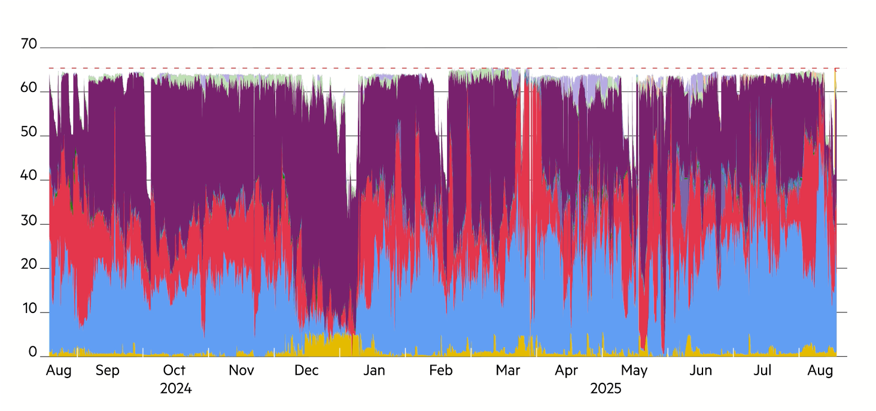
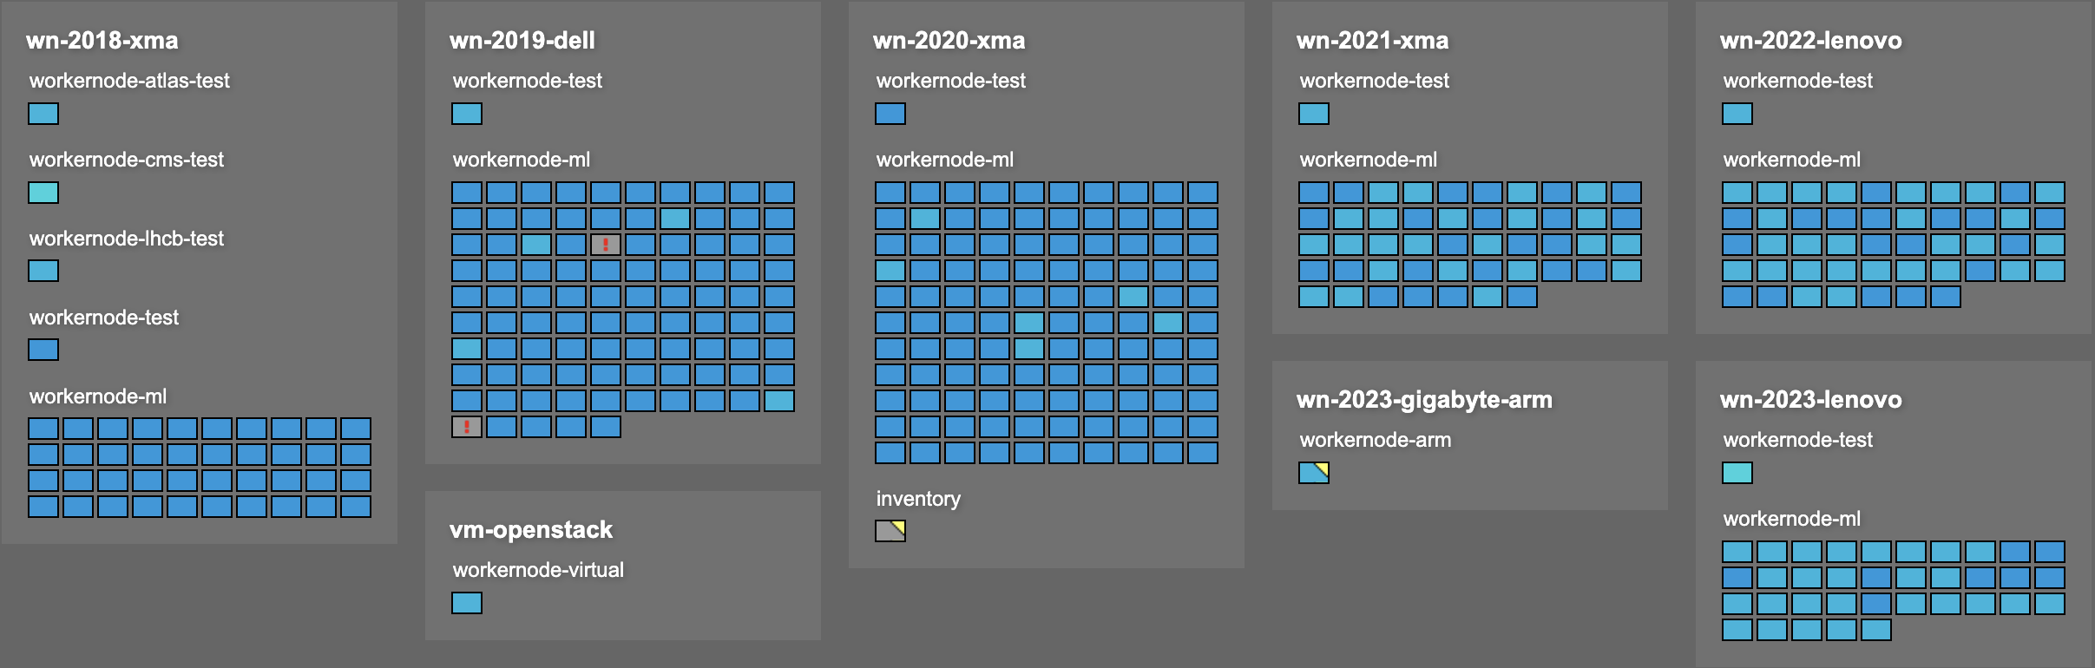
Tier-1 Batch Farm
Batch farm uses HTCondor + ARC CE since well before 2018.
384 Worker Nodes providing 67,840 slots.
Hardware is evolving rapidly
We have purchased AMD since 2019 and core counts have gone from 64 - 384
2018 – HDD, 2019 – SSD, 2021 – Separate OS SSD, 2022 – NVMe(s)

Slide 13
Analysis Facilities
The Tier-1 is a highly specialized facility to process, archive and move large amounts of LHC data.
The Tier-2s provide a huge amount of more general resources which can be support production and analysis work.
Why do we need analysis Facilities?
Users are requiring more heterogenous resources (e.g. GPUs!).
The amount of data required to be analyzed keeps increasing.
Not every university/institute has amazing local resources.
At RAL, we provide Analysis Facilities for other communities, I want to collaborate and expand their usage!

Slide 14
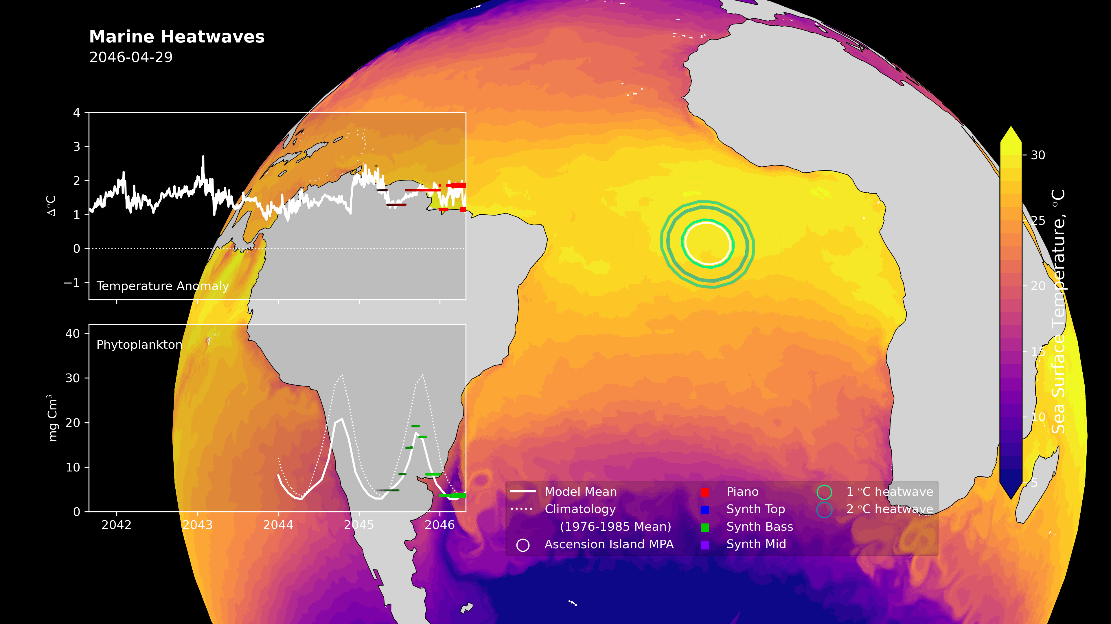

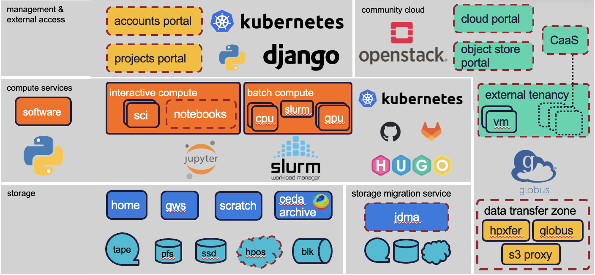
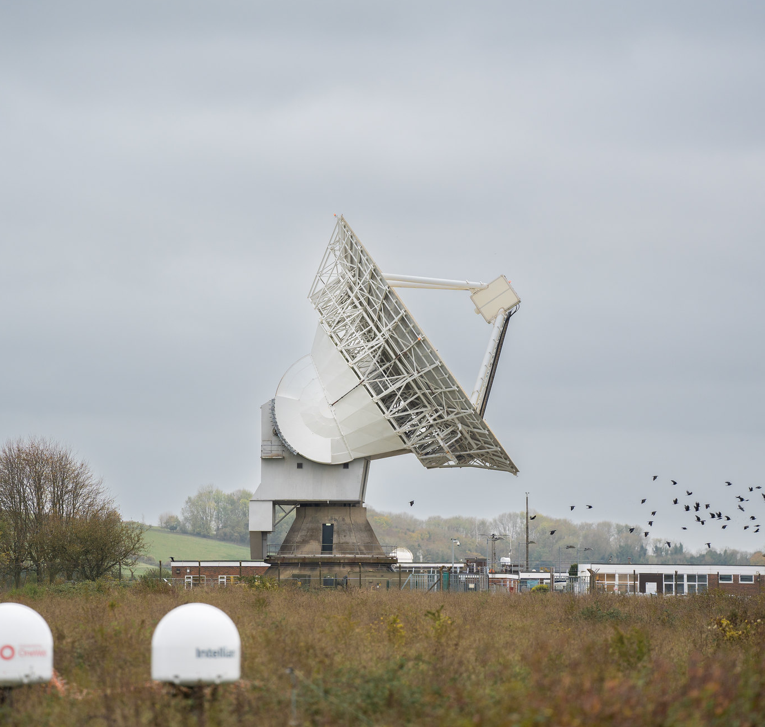
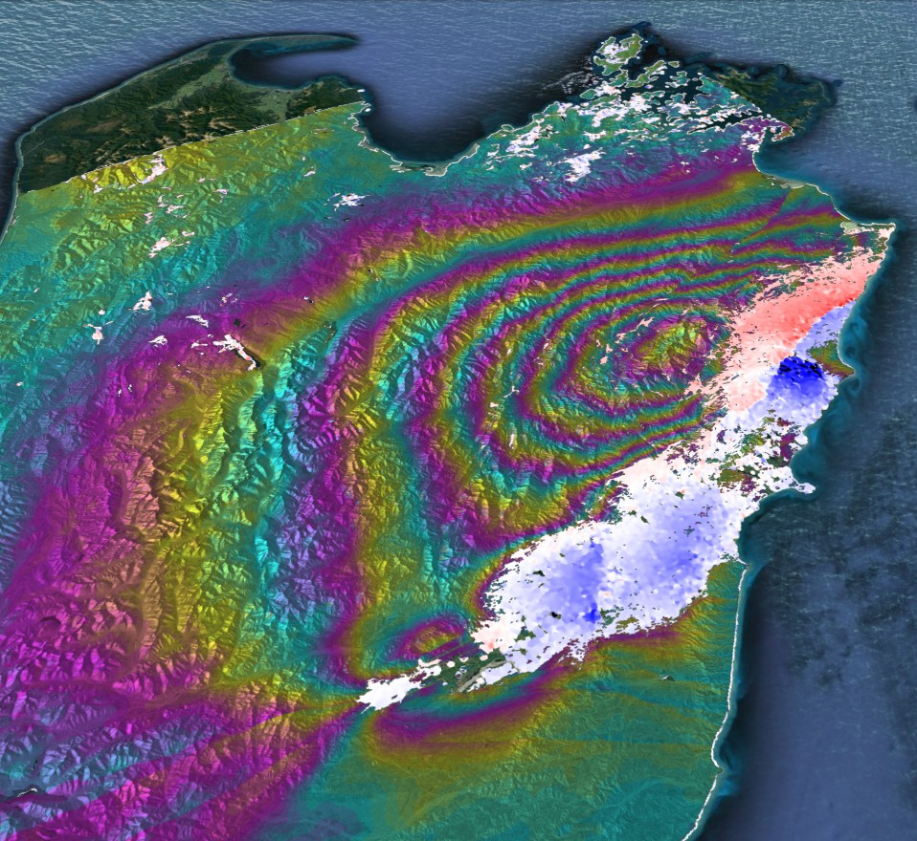

JASMIN
Provide large-scale data analysis facilities to support data-intensive environmental science.
A bespoke high-throughput computing (HTC) environmental science facility, fulfilling requirements for high-performance data analysis in the environmental science community
Over 2000 users conducting collaborative research on climate change, oceanography, air pollution, earthquake deformation…
Access to curated archives of Centre for Environmental Data Analysis (CEDA), a key part of NERC’s environmental data service
https://jasmin.ac.uk

Slide 15
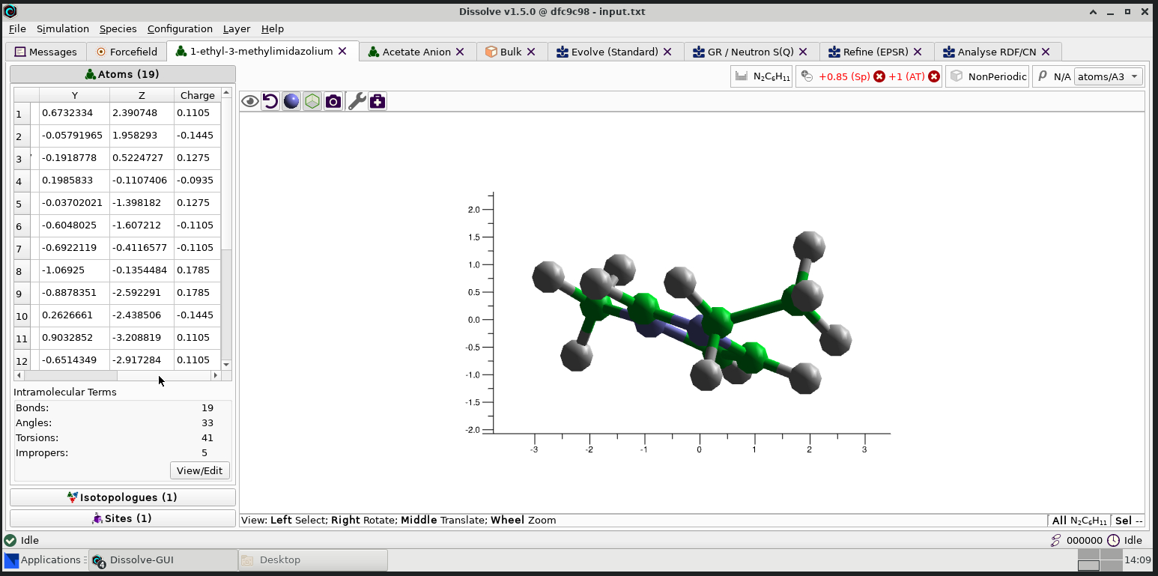
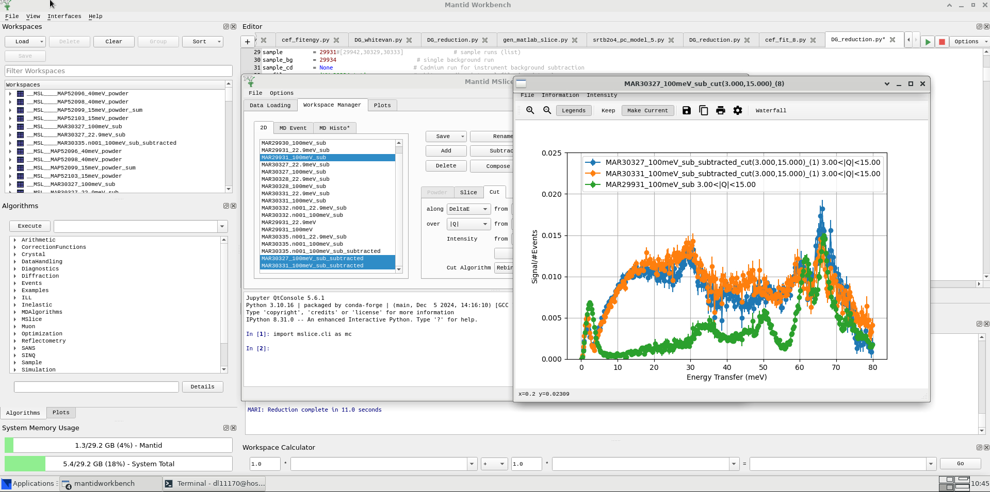
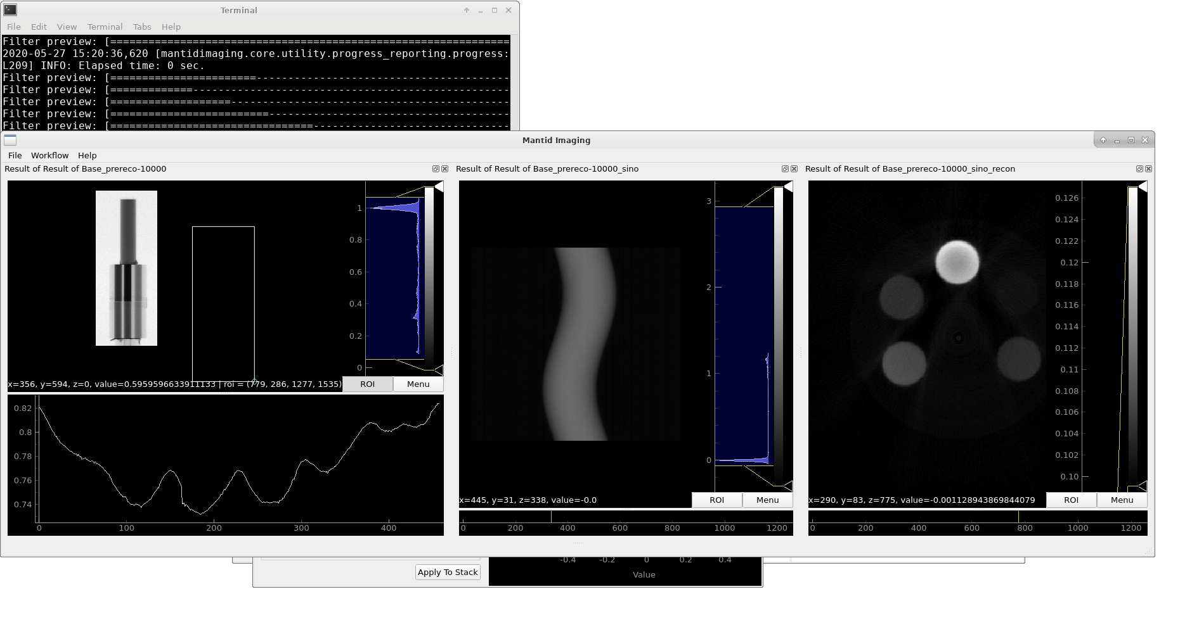
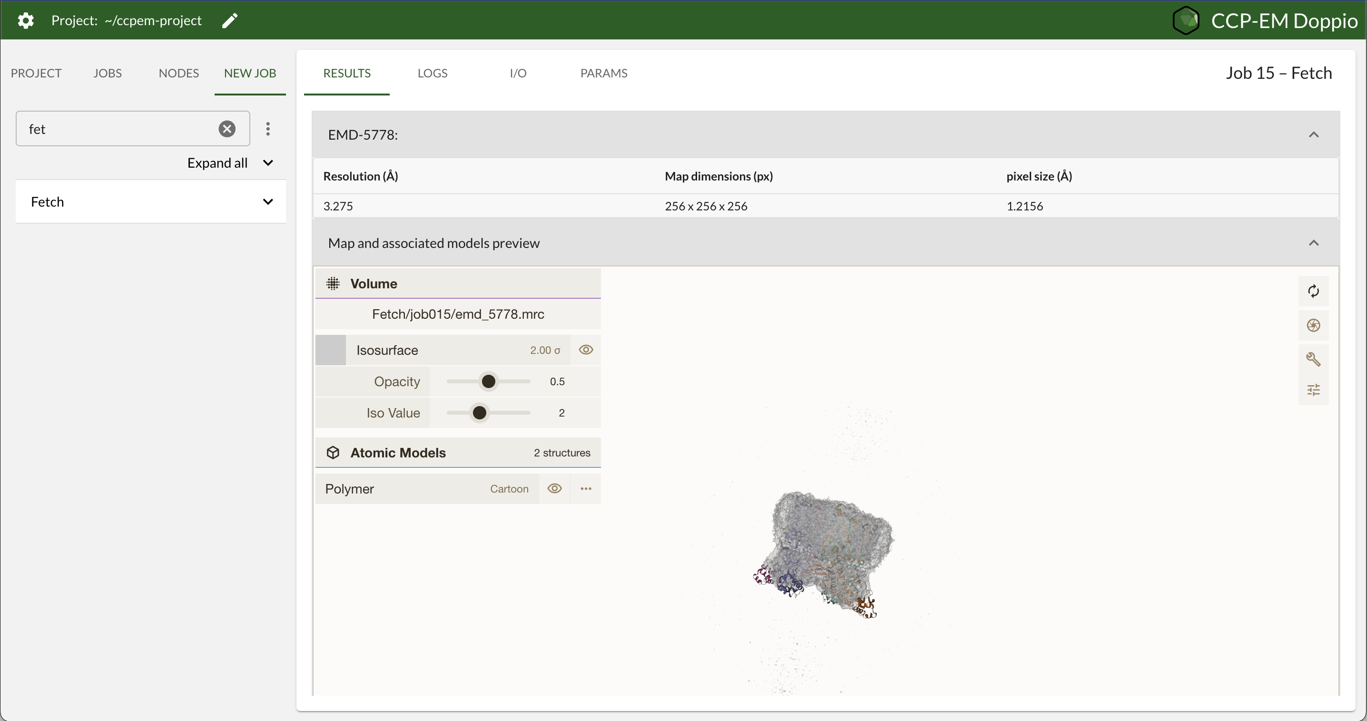
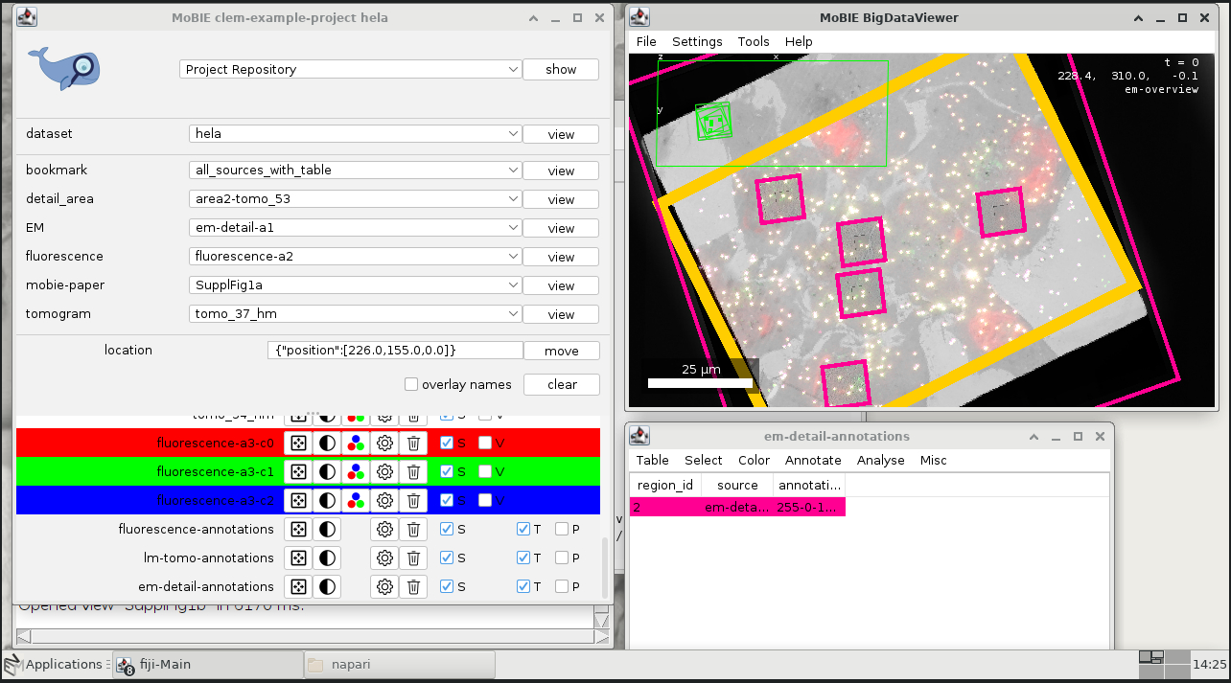
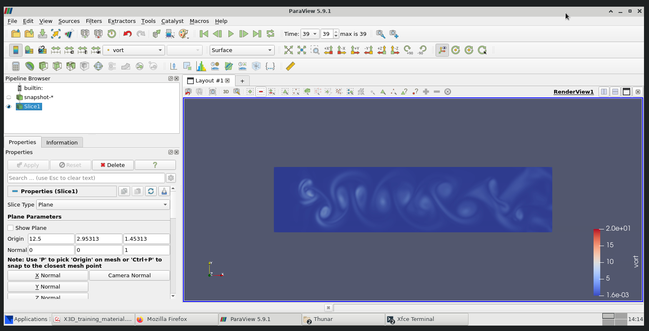
DAaaS
Empowers scientists through scalable computing resources, pre-installed scientific software, and centralised data storage for efficient, collaborative research across disciplines.
ISIS
826 users working on 6811 Workspaces to analyse experiment data
CLF
138 users working on 847 Workspaces to analyse experiment data
Training
413 users working on 914 Workspaces on 19 training courses
AI for Science Theme
Supporting colleagues in this theme running their workflows on STFC Cloud hardware
Diamond
Working with the ePSIC group to support 3 of their experiments since September 2024
Notes:
To replace photo with one of your own. 1) Send the geometric shape overlay to the back – Right-Click > Send to Back > Send to Back. 2) Replace image – use the guides provided to correctly position it. 3) Send your image to the back so that the geometric overlay re-appears over the image. Please remove or amend the image credit if you are using a different image to the one provided.

Slide 16
IaaS
Infrastructure as a Service (e.g. OpenStack) is something we can provide at RAL.
While it is ideal for some specialized use cases I don’t believe it is the best way forward in general.
People who advocate for it often:
Treat a PhD student as slave to keep the service running.
Don’t follow proper cyber-security processes / other legal requirements.
Make unrealistic assumptions about the underlying infrastructure.
Once you reach a scale where your service needs dedicated sysadmin to run it, you may as well work with us!

Slide 17
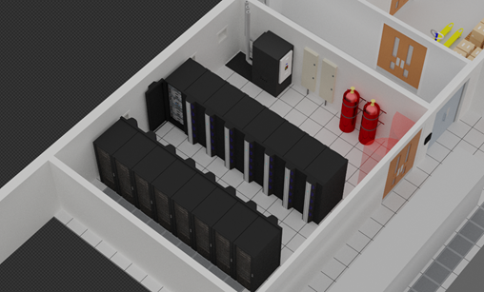
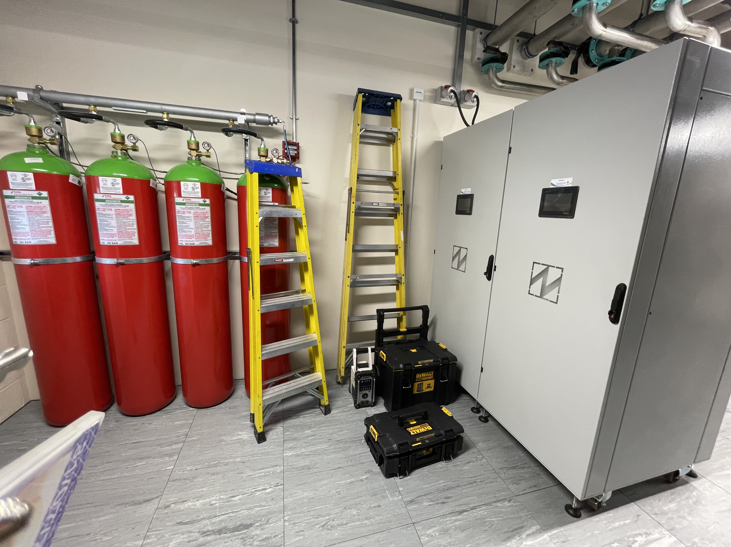
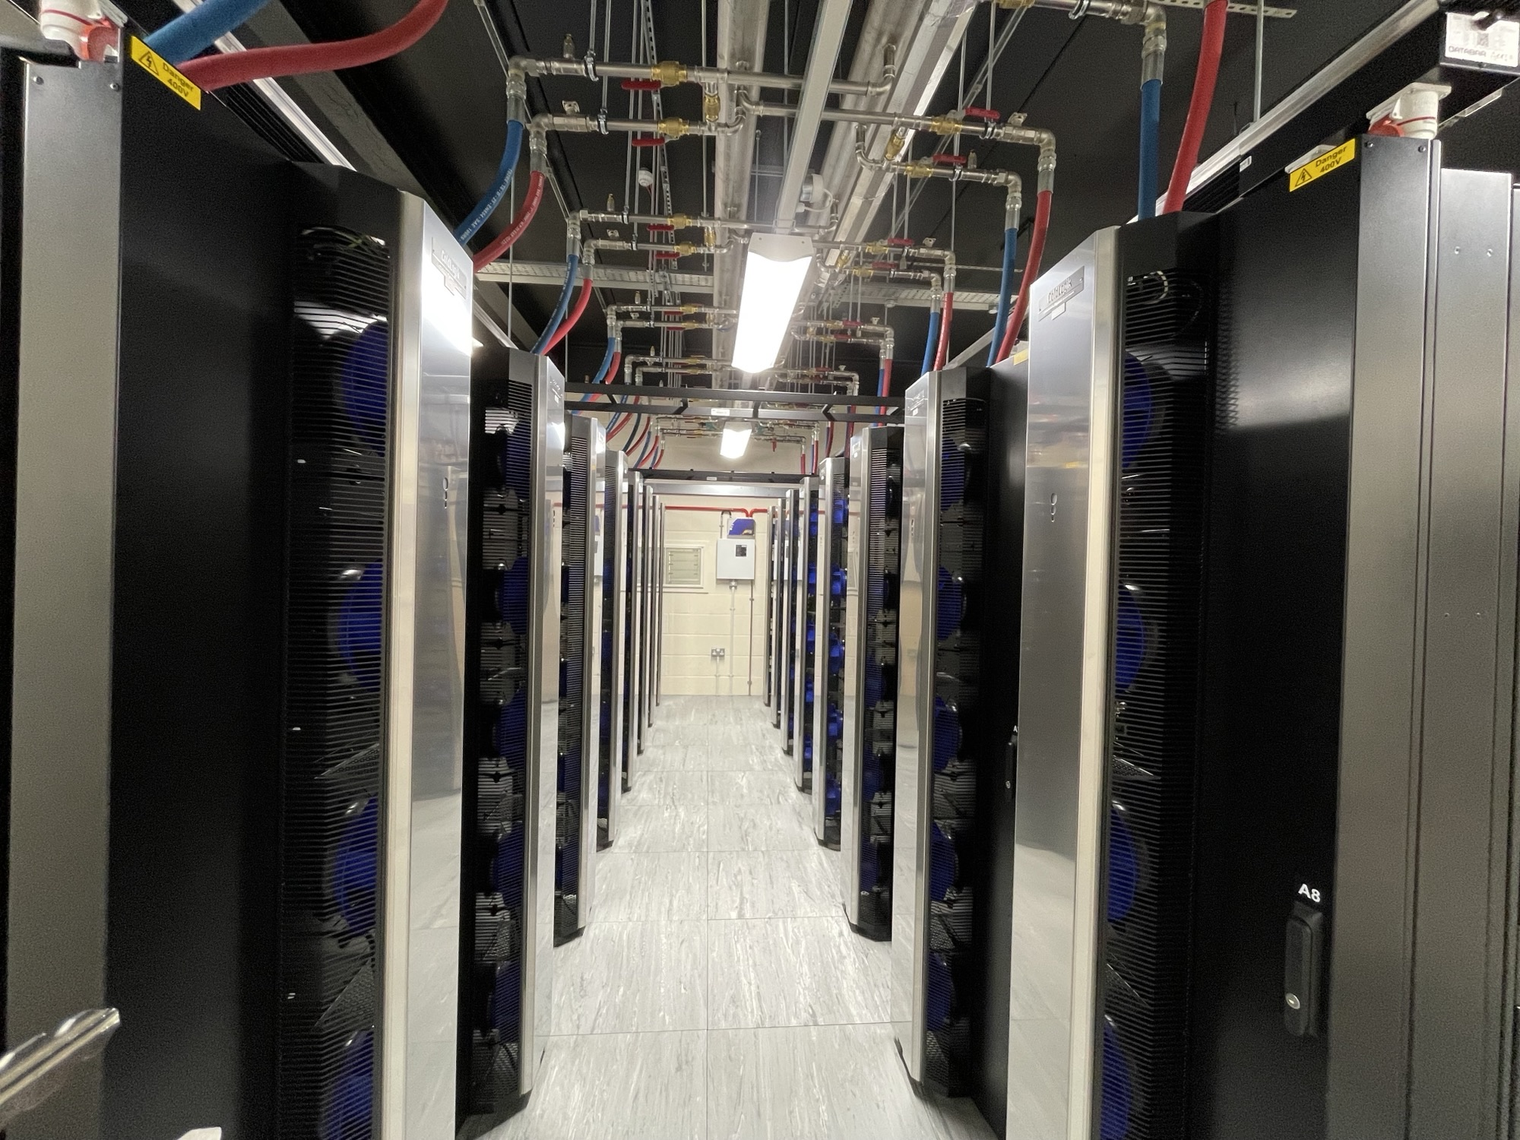
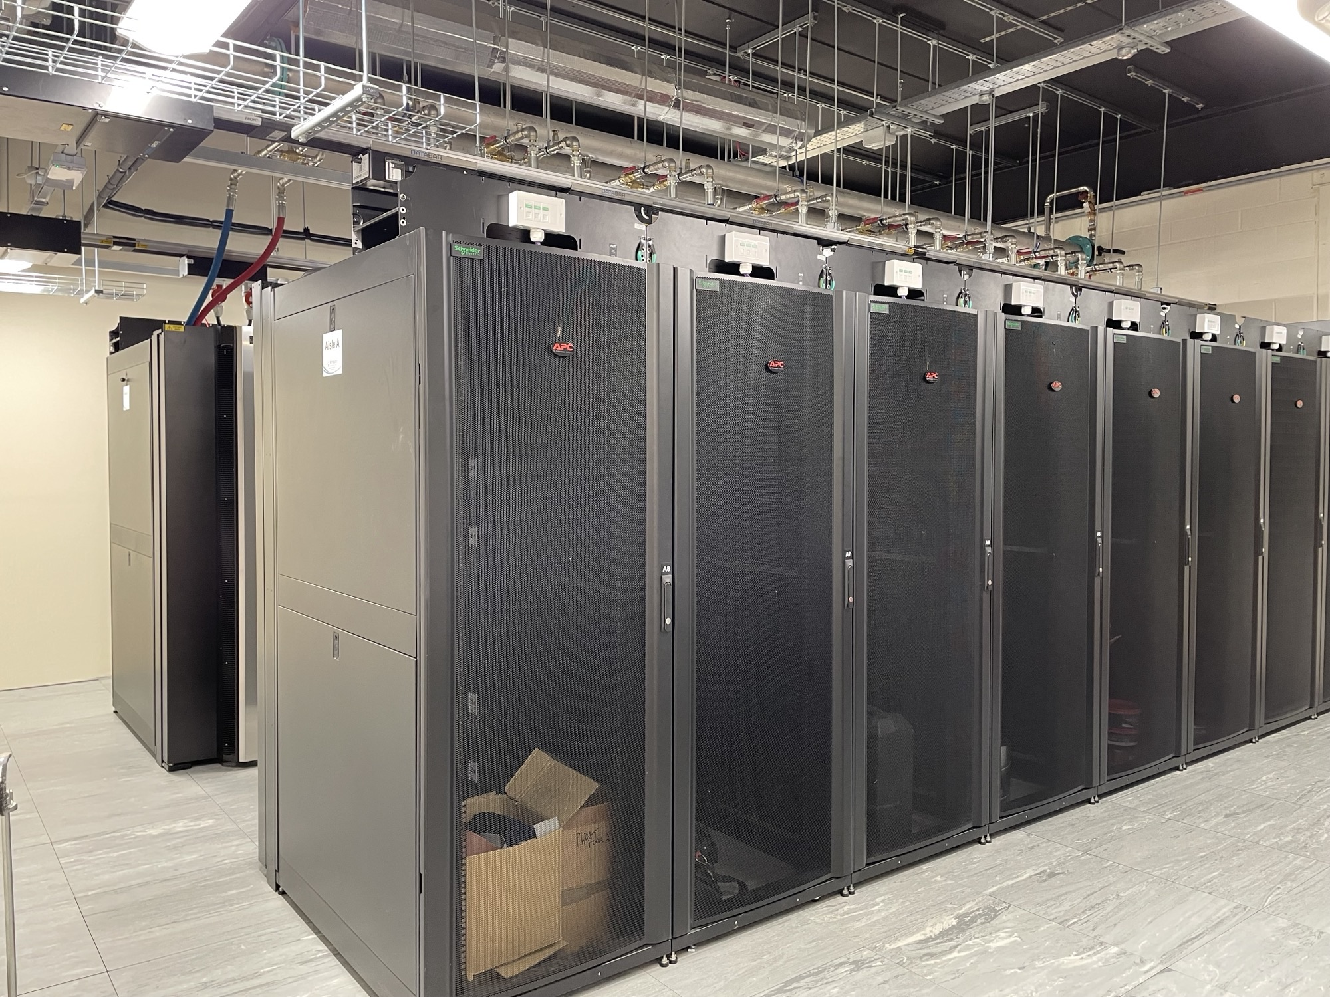
Net Zero & Sustainability
New “Ultra High Power” Data Centre Room has been built at RAL.
600kW capacity.
PUE of 1.2 expected.
Proposal: Move existing Tier-1 batch hardware to this room.
ΔPUE = 0.1
£ / kWh = 23p
gCO₂ / kWh = 143
Batch Farm ~200kW
Potential saving:
£40k / year
25,000 kgCO₂ / year

Slide 18
Vision and future plans
GridPP has been optimized over 10+ years of data taking to really efficiently process data.
The Tier-1 is a highly specialized facility that is extremely cost effective but not suitable for all use cases.
Tier-2s provide excellent local analysis facilities but the can’t scale indefinitely.
HPC will definitely been needed for certain use cases.
Other communities make use of Analysis Facilities and provide a range of resources.
I would like to expand what we currently have at RAL to the particle physics community.

Slide 19



Notes:
The abstract pattern can be removed or repositioned if required. Be careful to ‘Send to Back’ so that it does not obscure any important information.

