Slide 1
Uranium-based Battery Technology to Create New value for Society
Kazuki Ouchi
Assistant Principal Researcher,
Special Team for Battery Energy Storage, NXR Development Center,
Nuclear Science Research Institute, Japan Atomic Energy Agency
Notes:
Thank you for your kind introduction.
I am honored to have the opportunity to make this presentation here.

Slide 2

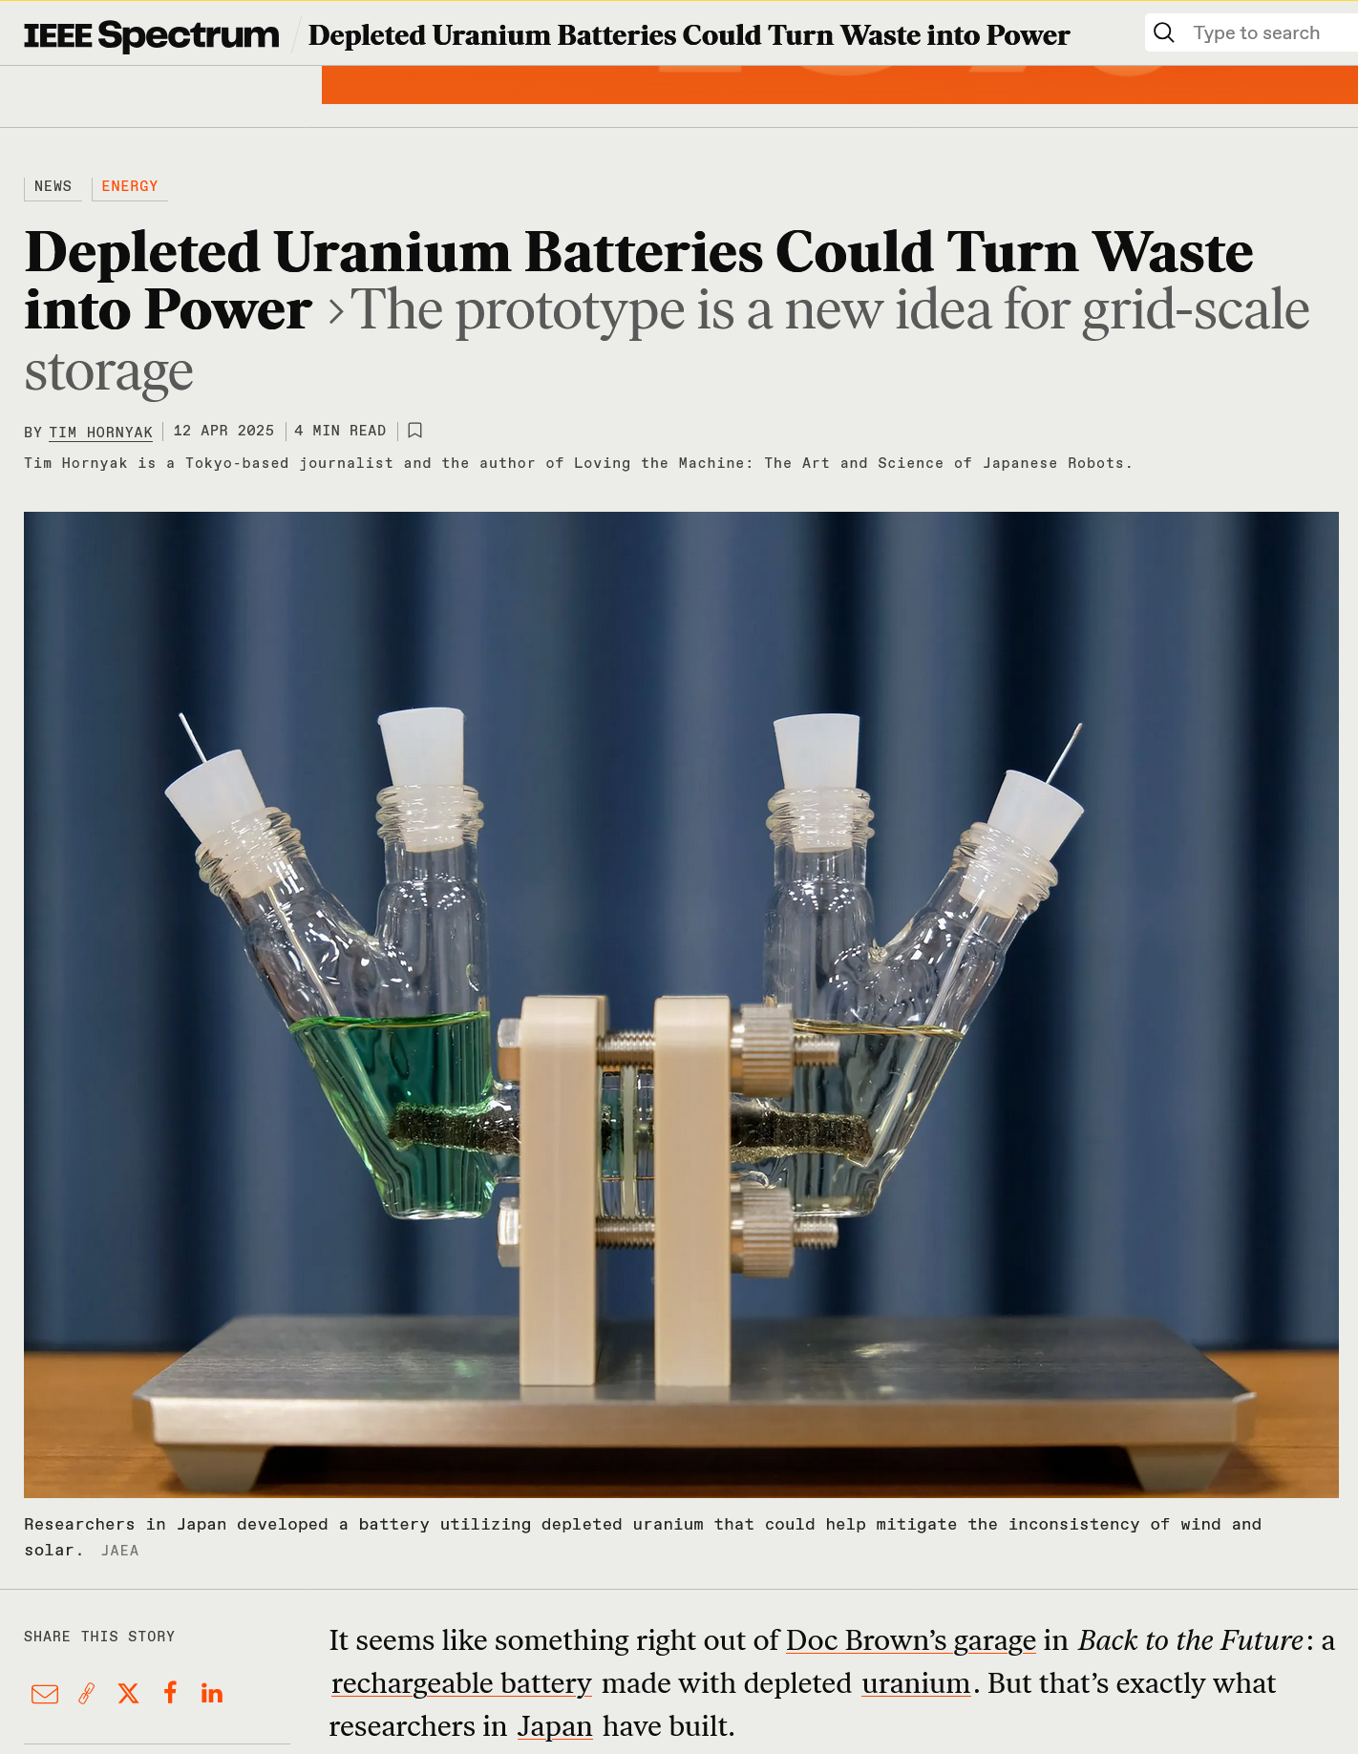
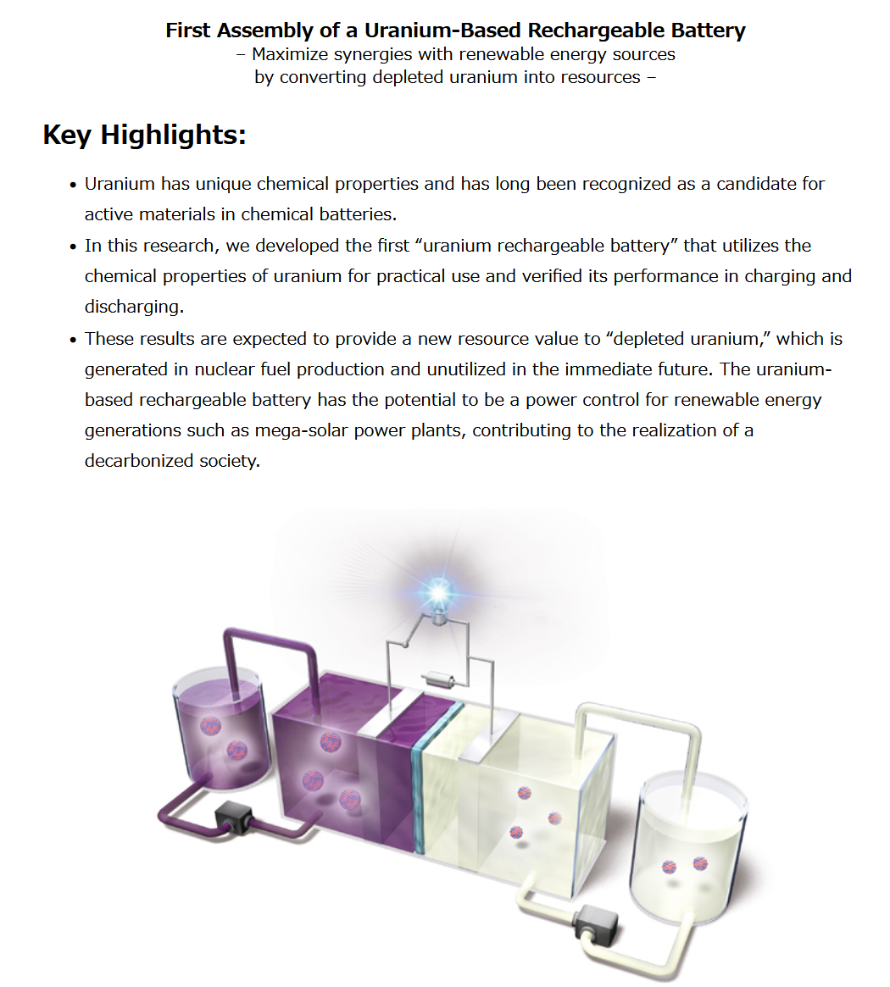

Press Release
IEEE Spectrum
First Assembly of a Uranium-Based Rechargeable Battery Mar. 13, 2025
Press Release Link
https://spectrum.ieee.org/depleted-uranium-battery
Notes:
We have successfully assembled a uranium battery for the first time and conducted charge and discharge tests. These were issued a press release last March.
Also, this battery was featured in IEEE Spectrum last April.
Today, I would like to introduce the uranium-based battery technology.

Slide 3
Outline
1. The Japan Atomic Energy Agency (JAEA)
2. Applications to create value of depleted uranium
3. The research and development of uranium-based
battery
3-1 Approaches by other research groups
3-2 Our approach
Notes:
This is the outline in this presentation.
First, I will introduce the Japan Atomic Energy Agency (JAEA), I am affiliated with.
Next, I will talk about Applications to create value of depleted uranium.
Finally, I will explain the research and development of uranium-based battery.

Slide 4
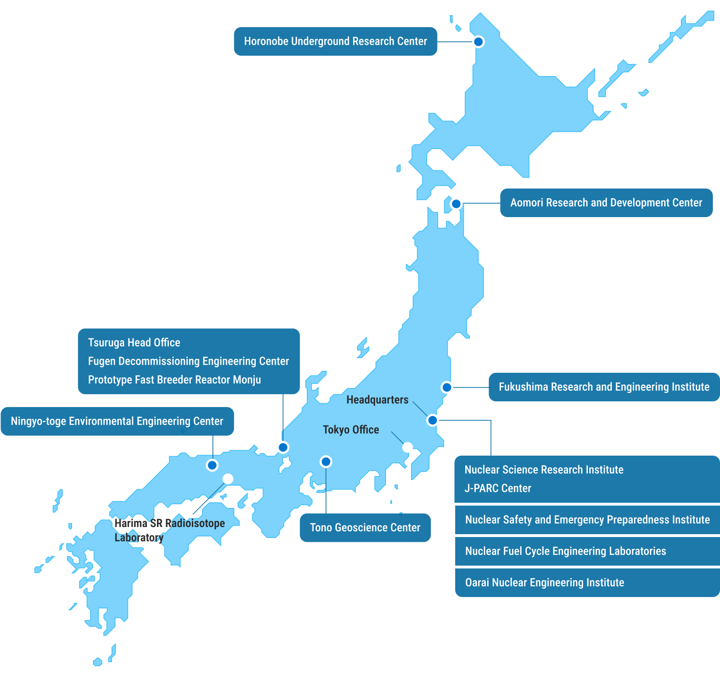
What is JAEA ?
The Japan Atomic Energy Agency (JAEA) is a comprehensive nuclear research and development organization in Japan.
Hokkaido
Nuclear Science Research Institute (Tokai, Ibaraki)
Aomori
Tokyo
Fukui
175 km
(About 2 hours by train)
Fukushima
Yokohama
Okayama
Ibaraki
Gifu
Notes:
Japan Atomic Energy Agency, JAEA is a comprehensive nuclear research and development organization in Japan.
JAEA's research institutes are located throughout Japan, from Hokkaido in the north to Okayama in the west.
I work at the Nuclear Science Research Institute in Tokai Village, Ibaraki Prefecture.
Tokai Village is located 175 km northwest of Yokohama, taking about two hours by train.

Slide 5
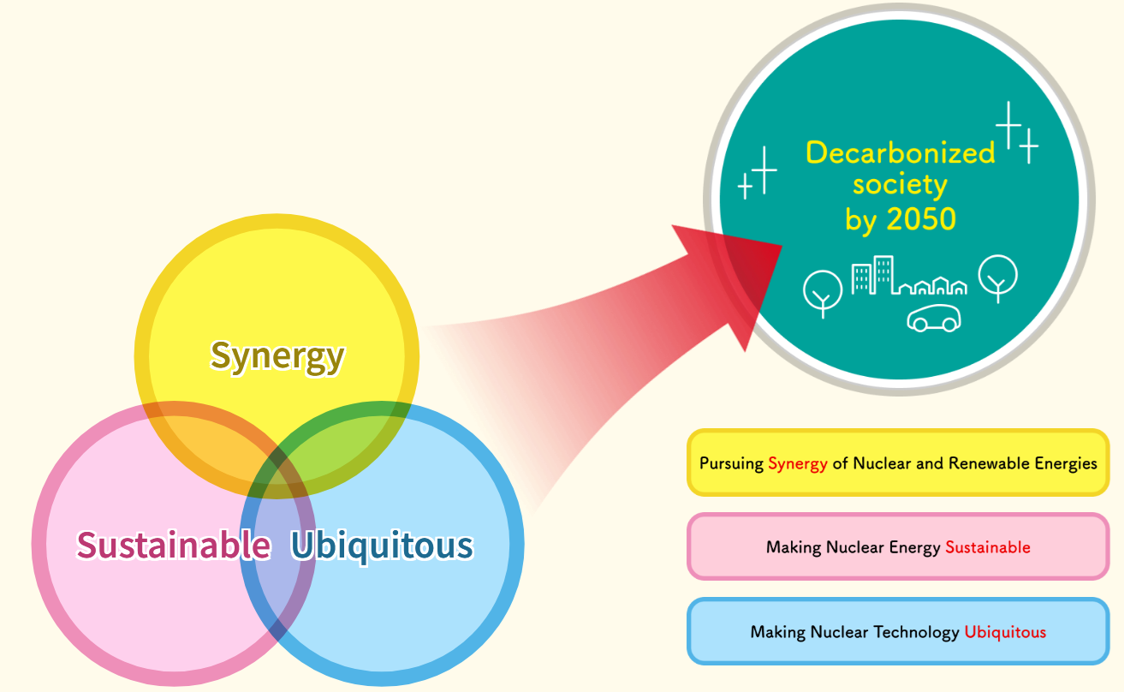
Our Vision and Three Core Pillars for R&D
Synergy and Ubiquitous R&D at Nuclear Science Research Institute
Exploring the Future though the Synergy of Nuclear and Renewable Energies
Uranium flow battery
Separation Technique of Useful Elements
Thermoelectric Power Generation
Uranium Recovery from Seawater
Notes:
JAEA has recently adopted the vision of “Exploring the Future though the Synergy of Nuclear and Renewable Energies.”
Under this vision, JAEA aims to realize a decarbonized society.
To achieve decarbonized society, JAEA advances research and development based on three core pillars: “Synergy,” “Sustainable,” and “Ubiquitous.”
“Synergy” involves R&D for synergy effects between nuclear and renewable energies.
“Sustainable” focuses on R&D to make nuclear energy itself sustainable.
‘Ubiquitous’ targets R&D for diversifying nuclear energy applications.
Based these pillars, JAEA aims to realize “decarbonized society” and “low-resource, high-efficiency society,” and contribute to human society.
(Animation) The Nuclear Science Research Institute focuses on (Animation) uranium redox flow battery in “Synergy”, and (Animation) separation technique of useful elements, thermoelectric power generation, and seawater uranium recovery technology in “Ubiquitous” .

Slide 6
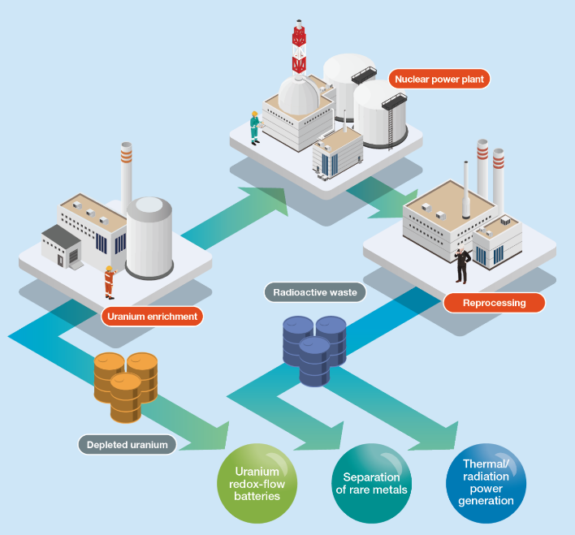
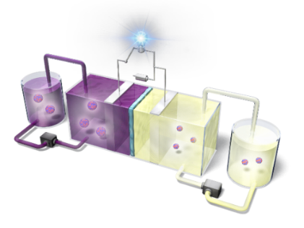
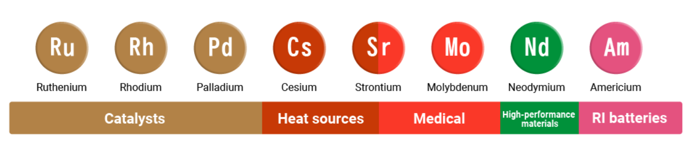
Creating New Values
Creating new resource value for elements that have been overlooked in nuclear engineering, and exploring the nuclear frontier
Uranium Redox Flow (URF) Battery
From uranium storage to energy storage
Separation of useful elements
Thermoelectric power generation using Am
JAEA launched NXR Development Center in April 2024.
Waste to Resources
Notes:
JAEA is focusing on creating new value for elements that have been overlooked in nuclear engineering, and exploring the nuclear frontier.
In April 2024, JAEA established the NXR Development Center to strengthen this initiative.
The NXR Development Center comprises three projects:
Uranium redox flow battery project is shifting uranium storage to energy storage by using depleted uranium generated in the uranium enrichment process.
The project of separation of useful elements is developing methods to recover resources from radioactive waste generated in the reprocessing process.
Thermoelectric power generation project is developing technology to use recovered resource such as americium.
Today, I will focus on uranium redox flow battery.

Slide 7
Outline
1. The Japan Atomic Energy Agency (JAEA)
2. Applications to create value of depleted uranium
3. The research and development of uranium-based
battery
3-1 Approaches by other research groups
3-2 Our approach
Notes:
This is the outline in this presentation.
First, I will introduce the Japan Atomic Energy Agency (JAEA), I am affiliated with.
Next, I will talk about Applications to create value of depleted uranium.
Finally, I will explain the research and development of uranium-based battery.

Slide 8


What is Uranium?
Uranium (U)
is the heaviest naturally occurring element.
Two main types in nature:
U-238: Majority (99.3%) U-235: Usable for nuclear power but very scarce (0.7%)
For nuclear power generation:
Enrichment
Nuclear fuel
increases isotopic concentration of U-235
Natural uranium
U-235：3~5%
Current nuclear reactors
Byproduct
“Depleted uranium (DU)” contains a lower isotopic concentration of U-235
Notes:
First, I would like to explain what uranium is.
Uranium is the heaviest naturally occurring element.
, and mainly used in nuclear power generation.
Uranium exists main two types: uranium-235 and uranium-238, differing in mass.
Uranium-235 can be used for nuclear power generation, but it is very scarce.
Therefore, to use natural uranium for nuclear power generation, enrichment process is required.
This process increases the concentration of uranium-235.
This enrichment also produces depleted uranium as a byproduct, which contains a lower concentration of uranium-235.
Depleted uranium also cannot be used in current nuclear power reactors.

Slide 9
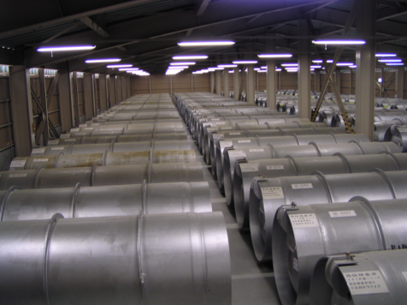
Depleted uranium (DU)
16,183 t (2023) in Japan
1.6 million t of DU are stored worldwide¹
The stocks are held as UF₆.
https://www.jaea.go.jp/04/zningyo/profile1020.html
Stored in cylinders as UF₆ gas
Not appropriate for Long term storage
Although DU has been proposed as a fuel for fast-breeder reactors (FBRs), the commercially viability of FBR technology remains a distant prospect.
1) https://world-nuclear.org/information-library/nuclear-fuel-cycle/uranium-resources/uranium-and-depleted-uranium
Notes:
Therefore, there are approximately 16,000 tons of depleted uranium in Japan and 1.6 million tons worldwide.
Depleted uranium is stored in the chemical form of uranium hexafluoride.
Because Uranium hexafluoride is stored in cylinders as a gas, it is not appropriate for long-term storage.
Depleted uranium has been proposed as a fuel for fast reactors, which are next-generation reactors, but the commercially viability of fast reactors remains a distant prospect.

Slide 10
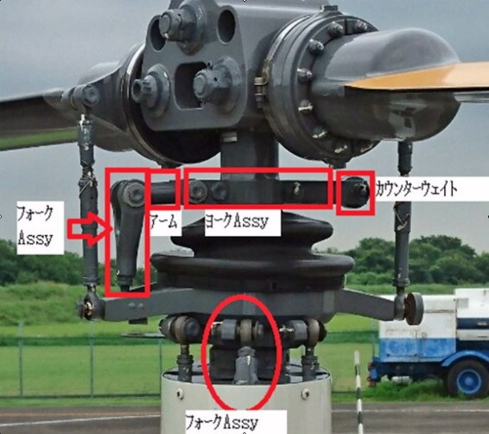
The utilization of promising depleted uranium
Physical property of uranium
Density: approximately 18.9-19.8 g/cm³
About 2.5 times heavier than iron (specific gravity 7.9) and about 1.7 times heavier than lead (specific gravity 11.34)
Example:
Previously used as counterweights for turbine blades
Safety concerns regarding the dispersion of radioactive material (depleted uranium) in the accident
Currently replaced by non-radioactive alternatives
https://alphaaviation.aero/ja/kiji/gakko-kiji/68855
A new approach to the utilization of depleted uranium is desired.
Notes:
Depleted uranium was utilized as application methods based on physical property of its high density.
It was previously used as a counterweight for the turbine blades of rockets and aircrafts.
Due to safety concerns regarding the dispersion of radioactive material in the accident, it has currently been replaced by non-radioactive materials.
Therefore, a new approach to the utilization depleted uranium is desired.

Slide 11
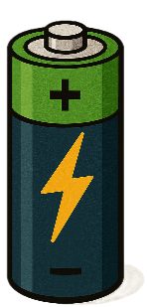
Oxidation states of uranium
Chemical property of uranium
0
+3
+4
+5
+6
Oxidation
Oxidation
Oxidation
Oxidation
U
U³⁺
U⁴⁺
UO₂⁺
UO₂²⁺
Reduction
Reduction
Reduction
Reduction
Oxidation number of uranium: 0, +3, +4, +5, +6
→Suitable as active materials of rechargeable batteries
A promising application of depleted uranium
Notes:
Uranium has a chemical property exhibiting various oxidation states.
Its oxidation number are 0, 3, 4, 5 and 6.
This property makes it suitable as active materials of rechargeable batteries.
Depleted uranium also has this property, making uranium battery a promising application.

Slide 12
To assemble uranium battery
Possible redox couples
1. Aqueous System²⁾
i) U(III)/U(IV) | U(V)/U(VI)
U(III) and U(V) cannot be stabilized.
2. Molten Salt System²⁾
ii) U(III)/U(IV) | U(V)/U(VI)
iii) U(0)/U(III) | Redox couple of other than uranium
3. Organic Solvent System
iv) U(III)/U(IV) | U(V)/U(VI) or redox couple of other than uranium
Required conditions for assembling a battery
・Redox reaction should be reversible.
・Reaction of active materials should be significantly fast.
・Reduced or oxidized active materials should be relatively stable.
2) Shiokawa, Y.; Yamamura, T.; Watanabe, N.; Umekita S. Utilization of actinide as cell active materials, JAERI-tech/2002-017, 2002.
Notes:
Several redox reaction candidates exist for a uranium battery.
In aqueous system, combination of trivalent/tetravalent and pentavalent/hexavalent uranium pair.
In molten salt system, combination of trivalent/tetravalent and pentavalent/hexavalent uranium, or combination of zero/trivalent uranium and Redox couple of other than Uranium.
In these systems, trivalent and pentavalent uranium cannot be stabilized.
Therefore, many previous researches have been studied in organic solvent system.
In this system, combinations of trivalent/tetravalent and pentavalent/hexavalent uranium, or reactions involving uranium with other elements, have been investigated.
Required conditions for assembling a battery are as follows.
First, the redox reaction should be reversible.
Second, the reaction of the active material should be significantly fast.
Third, the reduced or oxidized active material should be relatively stable.

Slide 13
Outline
1. The Japan Atomic Energy Agency (JAEA)
2. Applications to create value of depleted uranium
3. The research and development of uranium-based
battery
3-1 Approaches by other research groups
3-2 Our approach
Notes:
This is the outline in this presentation.
First, I will introduce the Japan Atomic Energy Agency (JAEA), I am affiliated with.
Next, I will talk about Applications to create value of depleted uranium.
Finally, I will explain the research and development of uranium-based battery.

Slide 14
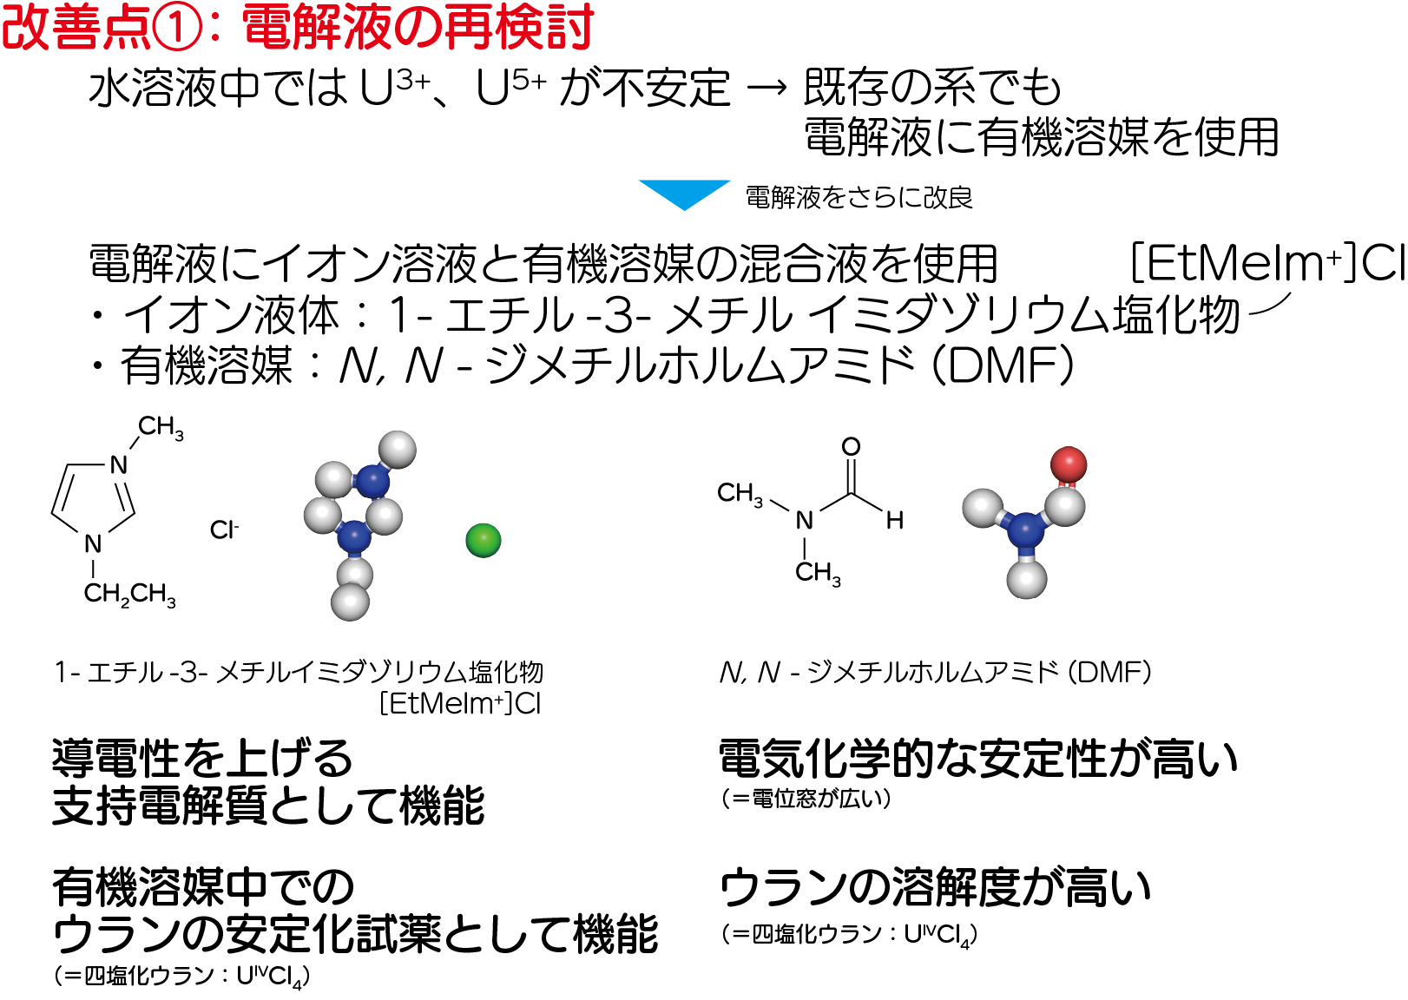
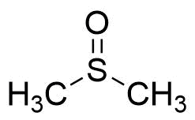
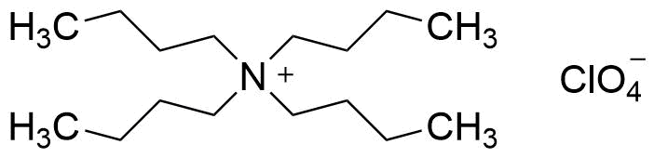
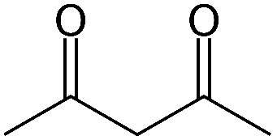
The design by other research groups
Application of depleted uranium
In the 2000s decade, Shiokawa et al. proposed the concept of a redox flow battery using uranium.
Design of the electrolytic solution
Organic solvent
Supporting electrolyte
N,N-dimethylformamide (DMF)
Dimethyl sulfoxide (DMSO)
Tetrabutylammonium perchlorate (TBAP)
Stabilizing of U(III) and U(V)
Improved conductivity
Ligand
Stabilizing reagent for uranium redox reaction
Acetylacetone
(acac)
2) Shiokawa, Y.; Yamamura, T.; Watanabe, N.; Umekita S. Utilization of actinide as cell active materials, JAERI-tech/2002-017, 2002.
Notes:
In the 2000s decade, Shiokawa et al. proposed the concept of a redox flow battery using uranium.
They used a mixture of organic solvent, supporting electrolyte and ligand as an electrolytic solution.
The organic solvents were used dimethylformamide (DMF) and Dimethyl sulfoxide (DMSO) to stabilize U(III) and U(V).
Supporting electrolyte was used to improve conductivity of the solution.
Ligand was used Acetylacetone(acac) as a stabilizing reagent for uranium redox reaction.

Slide 15
The reaction of uranium in organic solvents
U(III)/U(IV)
U(V)/U(VI)
1 mmol/L U(acac)₄⁴⁾
1 mmol/L UO₂(acac)₂⁴⁾
＊
pa
＊
pa
＊
＊
＊
E = -1.44 V
pc
E = -2.46 V
pc
Solvent: DMF; Supporting electrolyte: TBAP (0.1M);
Scan speed: 0.05, 0.1, 0.2, 0.5, 1.0, 2.0 V s⁻¹
Solvent: DMSO; Supporting electrolyte: TBAP (0.1M);
Scan speed: 0.05, 0.1, 0.2, 0.5, 1.0, 2.0 V s⁻¹
pc
pc
U(acac)₄ + e⁻
U(acac)₄⁻
UO₂(acac)₂⁻ + e⁻
UO₂(acac)₂
pa
pa
Nearly reversible (k_{s} = 1.4×10⁻² cm/s)
Nearly reversible (k_{s} = 7.7×10⁻³ cm/s)
＊: There are several unassigned peaks.
The investigation was insufficient.
Solvent conditions are different.
4) Yamamura et al., J. Phys. Chem. C, 111, 18812 (2007).
Notes:
They investigated the reaction behaviors of uranium acetyl acetone, acac complexes in organic solvents.
These figures show the cyclic voltammograms of a tetravalent uranium acac complex and the hexavalent uranium acac complex.
The vertical axis represents current density, and the horizontal axis represents potential.
Pc is potential of reduction peak and pa is potential of oxidation peak.
The redox potential, E is the midpoint between pc and pa.
The redox potential of tri and tetra uranium was -2.46 V.
The redox potential of tri and tetra uranium was -1.44 V.
Both reactions were fast, and nearly reversible.
Therefore, these reactions may be applicable to batteries.
However, the investigation was insufficient such as several unassigned peaks indicated by asterisks and different solvent conditions.

Slide 16
Energy efficiency calculation of uranium battery
Calculation
The energy efficiency was evaluated using the redox potentials and standard rate constants of redox reaction for uranium complexes in organic solvents.
Estimated cell voltage: 1.04 V
Energy efficiency obtained by the calculation⁵⁾
Negative electrode
Positive electrode
High energy efficiency even at high-current density
charge
discharge
Issues
U(acac)₄ + e⁻ U(acac)₄⁻
UO₂(acac)₂⁻ + e⁻ UO₂(acac)⁺
discharge
charge
The reactions have not been examined in detail.
Previous studies have been limited to basic research, and the U battery has not actually been constructed.
5) Shiokawa et al., J. Phys. Soc. Jpn., 75, 137 (2006).
Notes:
They also evaluated the energy efficiency using the redox potentials and reaction rate constants shown in the previous slide.
This battery was designed with the reaction of tri and tetravalent uranium complexes in the negative electrolyte and the reaction of penta and hexavalent complexes in the positive electrolyte.
The results are shown in the figure. The vertical axis represents energy efficiency, and the horizontal axis represents current density.
Uranium batteries are indicated by this symbol.
High energy efficiency even at high-current density
However, The reactions have not been examined in detail.
As a result, previous studies have been limited to basic research, and the U battery has not actually been constructed.

Slide 17
Outline
1. The Japan Atomic Energy Agency (JAEA)
2. Applications to create value of depleted uranium
3. The research and development of uranium-based
battery
3-1 Approaches by other research groups
3-2 Our approach
Notes:
This is the outline in this presentation.
First, I will introduce the Japan Atomic Energy Agency (JAEA), I am affiliated with.
Next, I will talk about Applications to create value of depleted uranium.
Finally, I will explain the research and development of uranium-based battery.

Slide 18

Concept of Uranium Redox Flow Battery
Uranium Redox Flow (URF) Battery
Flow negative and positive active materials from external tanks to the cells
→ Increasing the capacity to 10 MW class, while that of the lithium ion battery is around 1 MW
Negative electrolyte tank
(U⁴⁺/U³⁺)
Positive electrolyte tank
(Fe³⁺/Fe²⁺)
[1] Shiokawa et al., J. Phys. Soc. Jpn., 75, 137 (2006).
charge
discharge
U⁴⁺ + e⁻ U³⁺
Pump
Cell
Fe³⁺ + e⁻ Fe²⁺
discharge
charge
Pump
Advantages of using uranium: compared to vanadium, which is used in practical RF battery
100% domestically produced: Battery material that does not require dependence on import compared to vanadium which is entirely dependent on import
Effective use of depleted Uranium
Notes:
We focused on uranium redox flow battery as a battery technology utilizing depleted uranium.
I would like to explain the technology of redox flow battery.
The feature of this battery is that cells for charging and discharging and tanks for storing the electrolyte are separate.
It charges and discharges by pumping electrolyte containing dissolved active materials from external tanks to the cells.
Redox flow battery can increase the capacity to 10 MW class, while that of the lithium ion battery is around 1 MW.
A practical Redox flow battery is used vanadium as an active material.
Vanadium is entirely dependent on import.
The advantage is that using depleted uranium enables the provision of domestically produced battery.

Slide 19



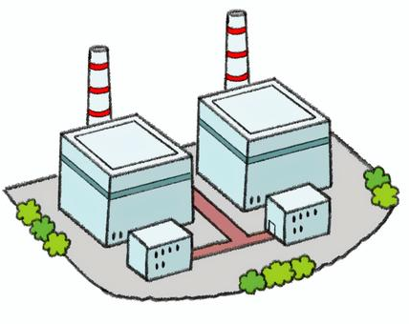
“URF Battery” : New technology for effective utilization of depleted uranium
Providing large-capacity batteries by utilizing approximately 16,000 tons of depleted uranium stored in Japan
Nuclear
×
Renewable
Resource utilization
URF batteries
Uranium fabrication
Depleted uranium
Surplus power
Solar and wind power generation
Source: iStock.com/imacoconut
Emergency power supply
Issues:
System adjustment for stable supply
The instability of fluctuating power generation affected by weather conditions and time of day
Nuclear power plant
Power consuming area
Synergy
Optimizing the balance between supply and demand by storing & supplying surplus electricity
Can use as emergency power supply
Battery technologies utilizing depleted uranium will maximize the synergy effect of nuclear and renewable energy.
Notes:
Renewable energy sources like solar and wind power are unstable to fluctuate by weather and time of day.
Providing large-capacity URF batteries would enable optimizing the balance between supply and demand by storing & supplying surplus electricity.
Also, URF batteries can use as an emergency power suppiy for nuclear power plants.
Battery technologies utilizing depleted uranium will be maximize the synergy effect of nuclear and renewable energy.

Slide 20
To assemble new uranium battery
Key point 1: Redesign of the electrolytic solution
A mixture of ionic liquid and organic solvent was selected.
Ionic liquid
Organic solvent
1-ethyl-3-methylimidazolium chloride
N,N-dimethylformamide (DMF)
Advantages: Possesses two functions
1) Supporting electrolyte
2) Stabilizing reagent for uranium redox
Advantages:
1) Wide electrochemical window
2) High solubility of U^{IV}Cl₄
Key point 2: Adoption of the Fe²⁺/Fe³⁺ redox couple
The Fe²⁺/Fe³⁺ redox couple was selected as the positive electrolytic solution instead of UO₂⁺/UO₂²⁺.
→Higher cell voltage can be expected.
K. Ouchi et al., Sci. Rep., (2025) 15:18515.
Notes:
This time, our goal was to actually assemble a battery.
There are two key points in assembling the uranium battery.
The first is that we redesign the electrolytic solution composition.
We used a mixture of organic solvent and ionic liquid as the electrolytic solution.
The ionic liquid was selected one with two functions of supporting electrolyte and stabilizing for uranium redox reaction.
Our system does not require the addition of another ligand.
The organic solvent was selected dimethylformamide (DMF) with wide electrochemical window and high solubility for the uranium starting material.
The second point is the adoption of the iron reaction as the positive electrolytic solution.
This is expected to improve cell voltage.

Slide 21
Redox reactions of U and Fe
U and Fe pair provides feasible redox reactions as active materials for battery.
1.4 V
+0.43 V
-1.02 V
We found that it is nearly reversibe for U³⁺/U⁴⁺ and Fe²⁺/Fe³⁺ redox reactions in the ionic liquid and organic solvent mixture.
K. Ouchi et al., Sci. Rep., (2025) 15:18515.
Notes:
We investigated whether the U-Fe pair provides feasible redox reactions as active materials for batteries.
These figure shows the cyclic voltammograms of uranium and iron.
As a result, we found that it is nearly reversibe for U3+/U4+ and Fe2+/Fe3+ redox reactions in the ionic liquid and organic solvent mixture.
The cell voltage of battery is estimated by the potential deference of uranium and iron redox potentials.
The cell voltage is approximately 1.4 V.
This value is higher than the estimated cell voltage of shiokawa’s uranium battery.

Slide 22
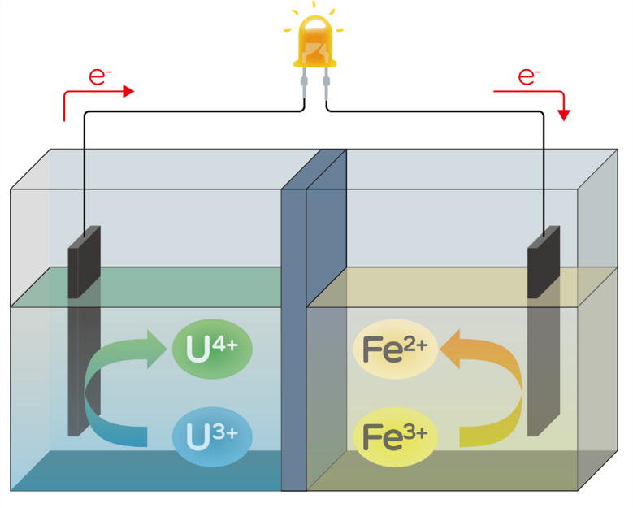
Assembly of a U-based battery
H-type cell with a simple structure was used as the suitable prototype configuration for the evaluation of the rechargeable battery.
charge
discharge
U⁴⁺ + e⁻ U³⁺
Fe³⁺ + e⁻ Fe²⁺
discharge
charge
K. Ouchi et al., Sci. Rep., (2025) 15:18515.
Notes:
We attempted experimental demonstration of the uranium-based battery.
This time, H-type cell with a simple structure was chosen as the suitable prototype configuration for the evaluation of the rechargeable battery.
Carbon felt was used for both electrodes.
It was combined a tetravalent uranium solution as the negative electrolytic solution and a divalent iron solution as the positive electrolytic solution.
During charging, iron ions in the positive electrolytic solution change their oxidation state from divalent to trivalent, releasing electrons.
These electrons flow through the circuit to the negative electrode, changing the oxidation state of uranium ions from tetravalent to trivalent.
During discharge, uranium ions change from trivalent to tetravalent and iron ions change from trivalent to divalent, generating current in the circuit.

Slide 23
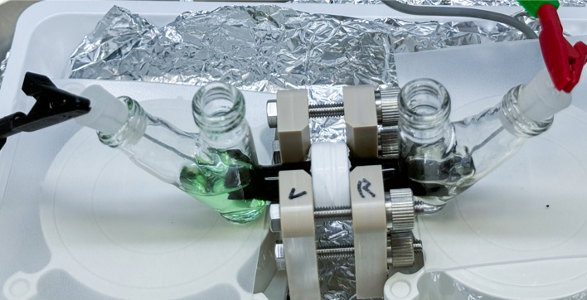
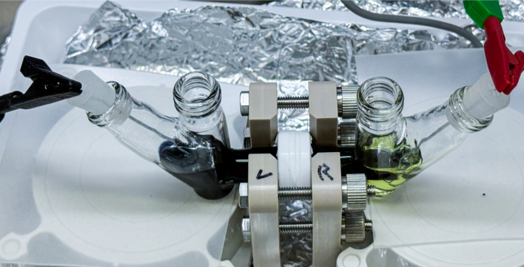
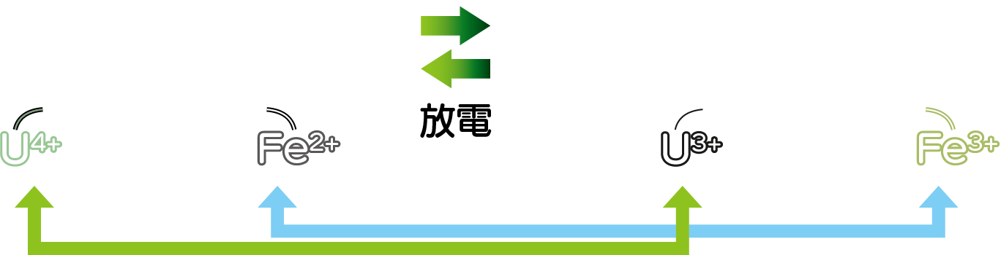
Color change of the electrolytic solution
Negative electrode
Positive electrode
Charge
Negative electrode
Positive electrode
Discharge
Negative electrolytic solution
Positive electrolytic solution
Charge: green → dark purple
Charge: light yellow → deep yellow
U⁴⁺
U³⁺
Fe²⁺
Fe³⁺
Discharge: dark purple → green
Discharge: deep yellow → light yellow
U³⁺
U⁴⁺
Fe³⁺
Fe²⁺
The color change in the electrolytic solution is caused by the change in the oxidation state of ions at both electrodes during the charging and discharging of the U-based battery.
K. Ouchi et al., Sci. Rep., (2025) 15:18515.
Notes:
Change of oxidation state during charging and discharging can be visually confirmed.
This photo shows an assembled U battery.
Before charging, the uranium solution is green.
As charging progressed, the solution gradually changed to a dark purple, finally appearing black as shown in the photo.
This change corresponds to the reduction of uranium ions from the tetra to trivalent state.
The iron solution changed to deep yellow by the oxidation during charging.

Slide 24
Charge/discharge of U-based battery
Open-circuit voltage (OCV)
= Cell voltage 1.3 V
Voltage drop: > 300 mV
(discharge at 2 mA)
The relatively stable OCV demonstrates the battery’s ability to store electricity.
The cell voltage decreased as the discharge current increased, primarily due to the relatively high internal resistance of the battery originated from the H-type cell configuration.
K. Ouchi et al., Sci. Rep., (2025) 15:18515.
Notes:
This figure shows the charge/discharge curves of the prototype U-based battery.
After charging, the open-circuit voltage, OCV of the uranium-based battery was measured.
The voltage was observed approximately 1.3 V.
This value was close to the potential deference of uranium and iron redox reaction.
This open-circuit voltage remained stable for 30 minutes.
This result indicates the battery's ability to store electricity.
Also, Voltage drops was observed in discharging at 2 mA .
This is due to the internal resistance of the battery originated from the H-type cell configuration.
We are currently optimizing cell conditions to reduce internal resistance.

Slide 25
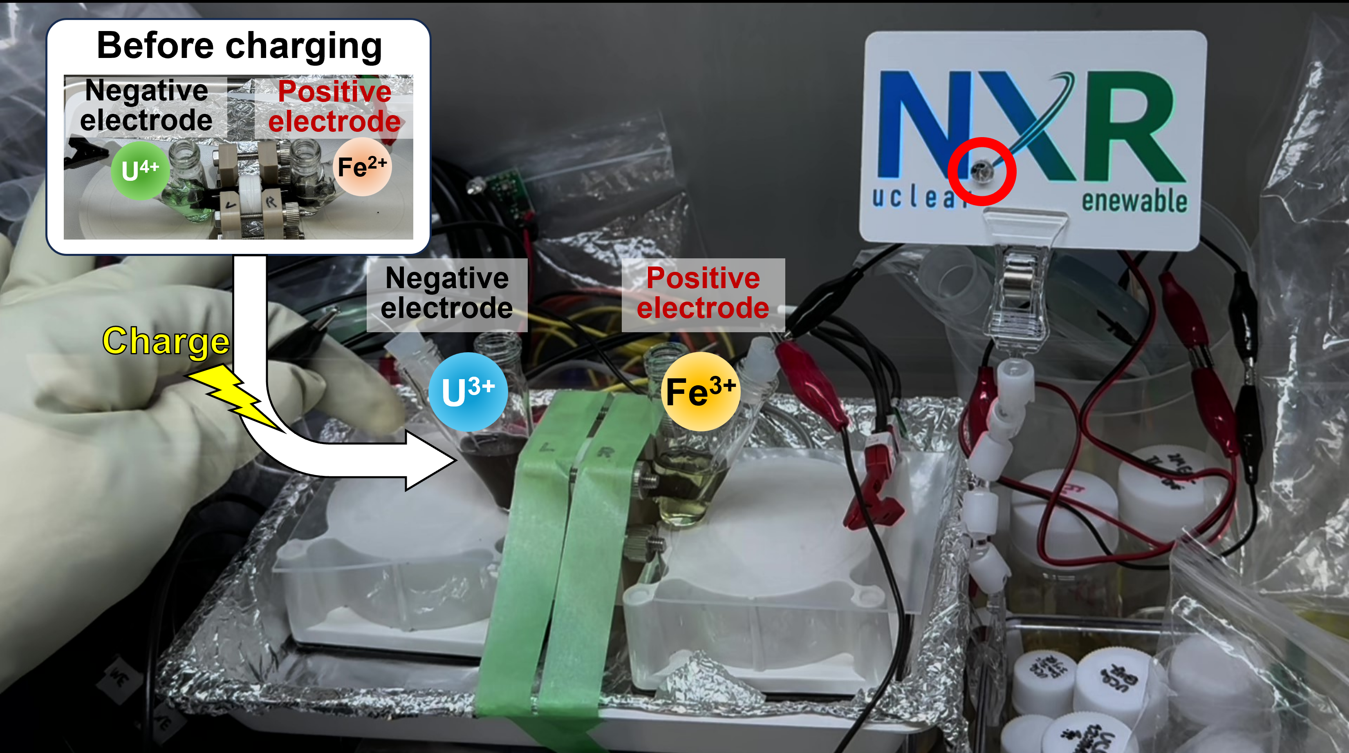
LED light emission test with U-based battery
Discharge
The first-ever experimental demonstration of a U-based battery
Kazuki Ouchi, Katsuhiro Ueno, Masayuki Watanabe, “The rechargeable battery using uranium as an active material”, Scientific Reports, 2025, 15:18515.
Notes:
We conducted a LED Light emission test as a demonstration of U battery.
We will show you a video of the test.
When the charged battery was connected to the LED, it was confirmed the LED's light emission.
Play again.
This success is the first experimental demonstration of uranium battery.
the achievement was published in Scientific Reports, and we are applying for a patent in Japan, and .

Slide 26


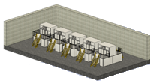

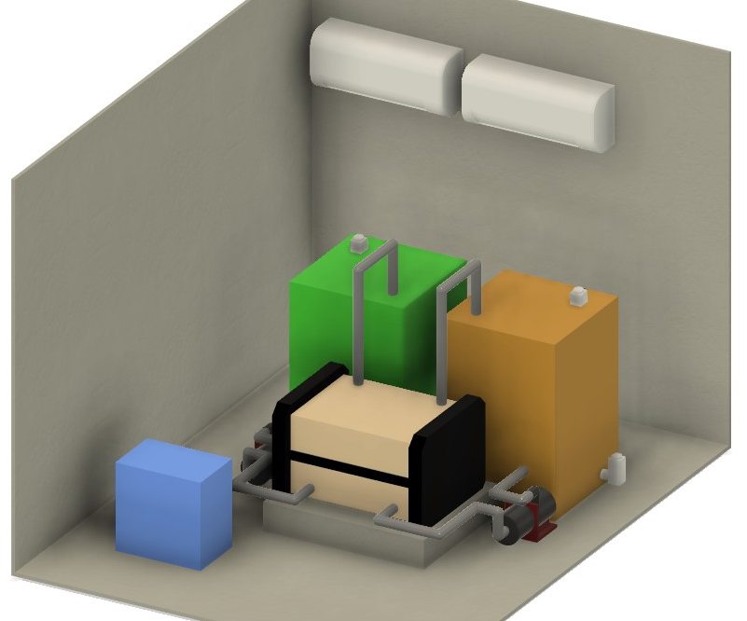
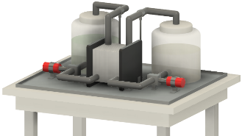
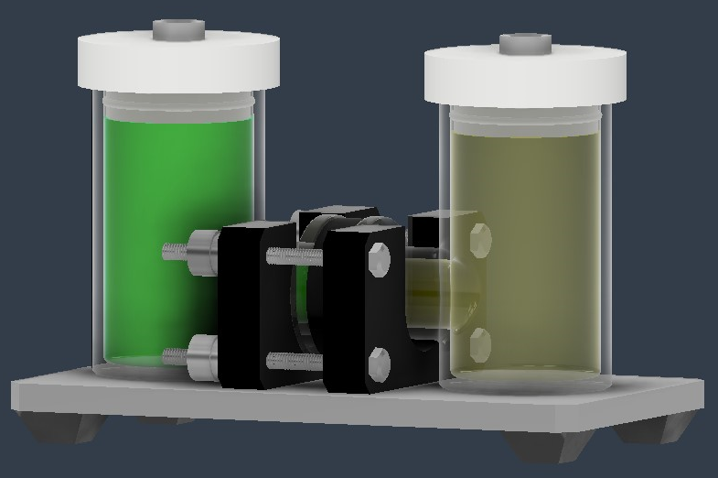
Strategic plan
Scale
Amount of power generation (amount of U)
Actual scale
30,000kW scale (U 700ton)
Depleted uranium 16,000 ton = 1,000,000kWh = 540,000 households/day
Engineering scale
5kW scale (U 100kg)
* Supplying night time power consumption (20:00-06:00), excluding nuclear energy power generation（Basic Energy Plan of the government of Japan sets a target of 20 %)
5W scale (U 100g)
U ~5 g scale
Lab
scale
at Nuclear Science Research Institute
at nuclear facilities in Japan
2024
2026
2028
2030
2032
↑ NXR Development Center was established.
A promising method for utilizing depleted uranium in innovative applications
Notes:
This figure shows the strategic plan for developing uranium redox flow batteries.
The horizontal axis represents years, and the vertical axis indicates battery scale.
We plan to scale up to lab, engineer, and demonstration scale in the future.
Batteries utilizing 16,000 tons of depleted uranium are equivalent to 1,000,000 kWh.
This is estimated to cover the nighttime power consumption of 540,000 households per day.
As described above, uranium battery technology is a promising method for utilizing depleted uranium in innovative applications.

Slide 27
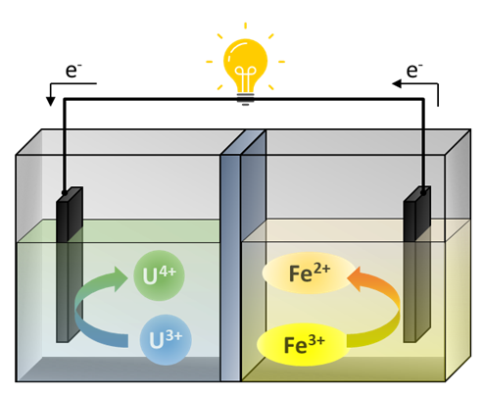
Summary
Previous study: there were no studies of actually assembling rechargeable batteries and reporting their performance
・Organic solvent
・Stabilizing reagent for uranium
・Supporting electrolyte
・Negative electrode: U³⁺/U⁴⁺， Positive electrode：U(V)O₂⁺/U(VI)O₂²⁺
・Estimated cell voltage: ~1.04 V ^{[2]}
Negative electrode
Positive electrode
This study: we developed the first “uranium-based battery”
・Organic solvent
・Ionic liquid that functions as supporting electrolyte and stabilizing reagent for uranium
・Negative electrode： U³⁺/U⁴⁺， Positive electrode：Fe²⁺/Fe³⁺
・Measured cell voltage: 1.3 V
Simplified electrolyte composition
Improved battery performance
Negative electrode
Positive electrode
[2] Yamamura et al., J. Phys. Chem. C, 111, 18812 (2007).
Notes:
This is a summary of this study.
We developed the first “uranium-based battery”
Furthermore, we succeeded in simplifying the electrolyte composition and improving battery performance.

Slide 28
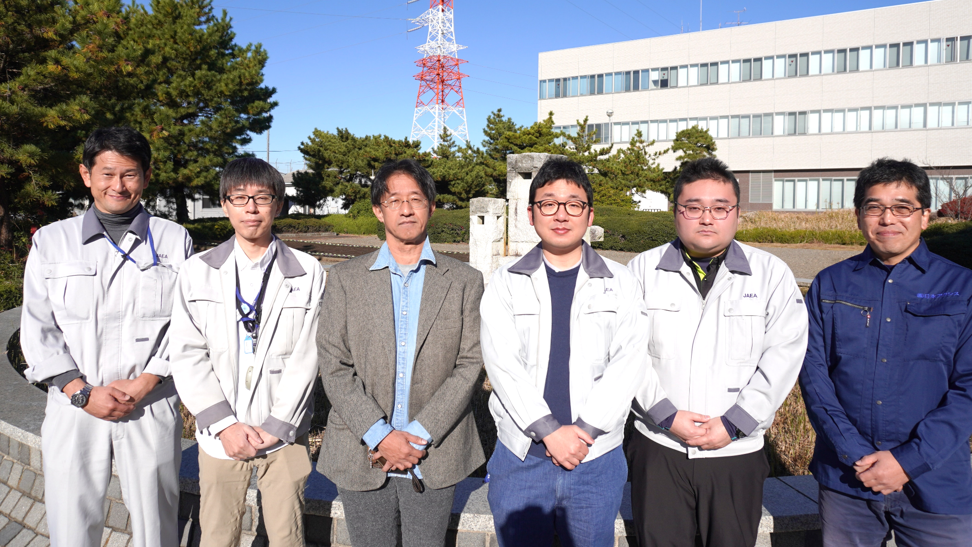
Acknowledgment
Special Team for Battery Energy Storage, NXR Development Center
Team leader: Masayuki Watanabe
Team member: Katsuhiro Ueno, Ryo Hamano
Development assistant: Noriaki Chiba, Keiichi Sasaki, Kazuma Ohta, Noriko Iizuka
Notes:
Finally, I would like to thank everyone on the team who worked on this research.
Thank you for your kind attention.

