Slide 1
Plasmas for Sustainability
John P. Verboncoeur
Michigan State University
†Email: johnv@msu.edu
IEEE NPSS Climate Change Workshop
Yokohama, Japan
07-Nov 2025

Slide 2
Outline
Motivation
Plasma Fundamentals
Electrification/Decarbonization of Materials Manufacturing
Disrupting Haber-Bosch
A Plasma-Driven Hydrogen Ecosystem

Slide 3
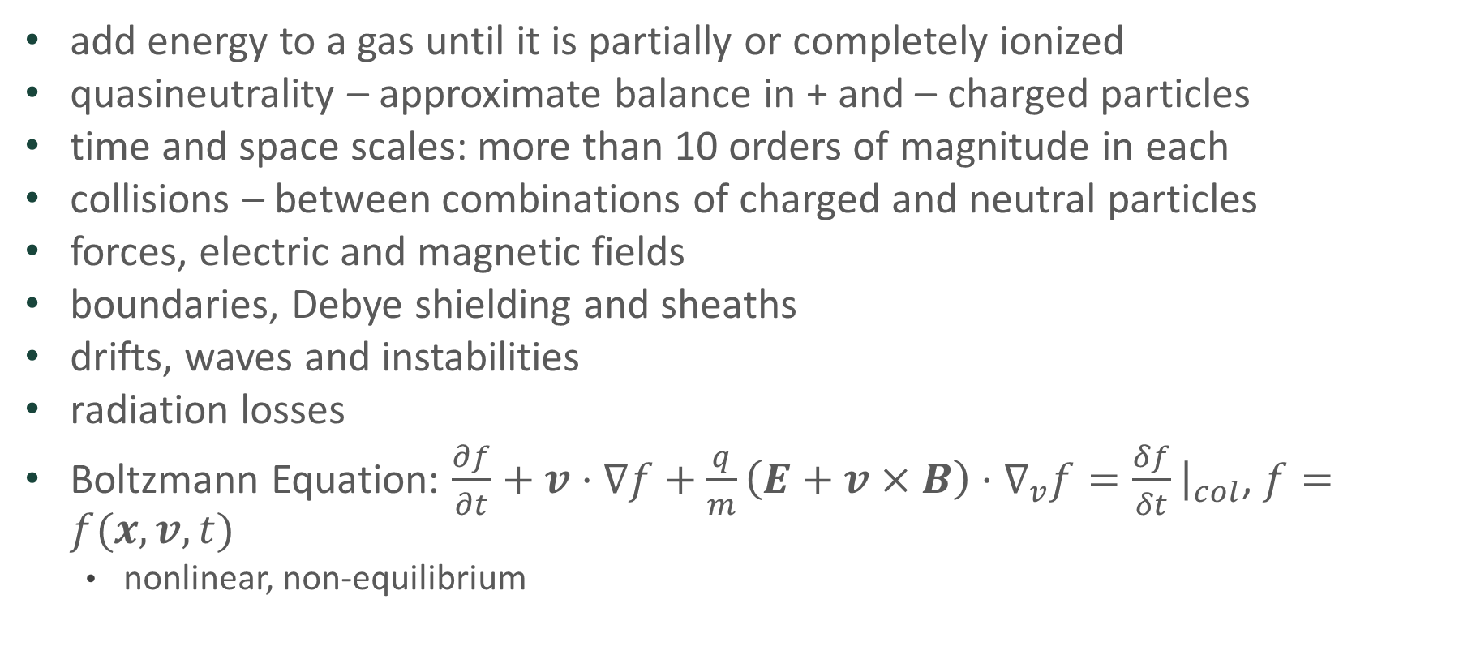
Plasma: Fourth State of Matter
add energy to a gas until it is partially or completely ionized
quasineutrality – approximate balance in + and – charged particles
time and space scales: more than 10 orders of magnitude in each
collisions – between combinations of charged and neutral particles
forces, electric and magnetic fields
boundaries, Debye shielding and sheaths
drifts, waves and instabilities
radiation losses
Boltzmann Equation: $\frac{∂f}{∂t}+v⋅∇f+\frac{q}{m}\left(E+v×B\right)⋅∇_{v}f=\frac{δf}{δt}{\left.​\right|}_{col}$, $f=f(x,v,t)$
nonlinear, non-equilibrium

Slide 4
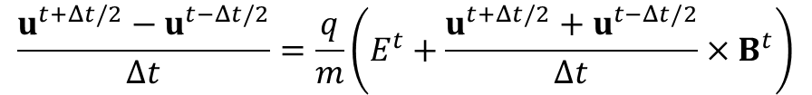

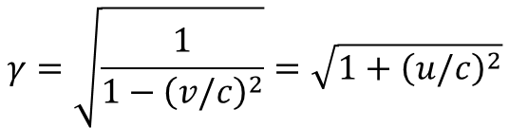


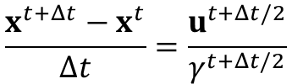
Newton-Lorentz Equations of Motion
$$\frac{d}{dt}γmv=F=q\left(E+v×B\right)$$
$$\frac{d}{dt}x=v$$
$$γ=\sqrt{\frac{1}{1−{\left(v/c\right)}^{2}}}=\sqrt{1+{\left(u/c\right)}^{2}}$$
$$u−γv$$
Discretized using Leapfrog integrator:
$$\frac{u^{t+Δt/2}−u^{t−Δt/2}}{Δt}=\frac{q}{m}\left(E^{t}+\frac{u^{t+Δt/2}+u^{t−Δt/2}}{Δt}×B^{t}\right)$$
Second order accurate
Requires few operations
Requires minimal storage
Stable for ω_{p}Δt<2 (cold)
$$\frac{x^{t+Δt}−x^{t}}{Δt}=\frac{u^{t+Δt/2}}{γ^{t+Δt/2}}$$

Slide 5



Electromagnetic Field Equations
remains satisfied from t=0
center difference on orthogonal mesh:
Yee mesh

Slide 6
Electrification/Decarbonization of Materials Manufacturing
Motivation
Fundamentals
Reaction Chain Analysis
Conclusion & outlook

Slide 7
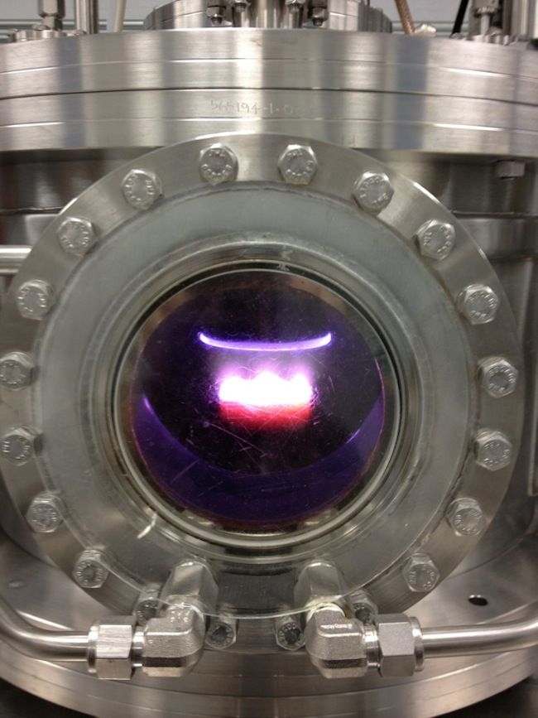
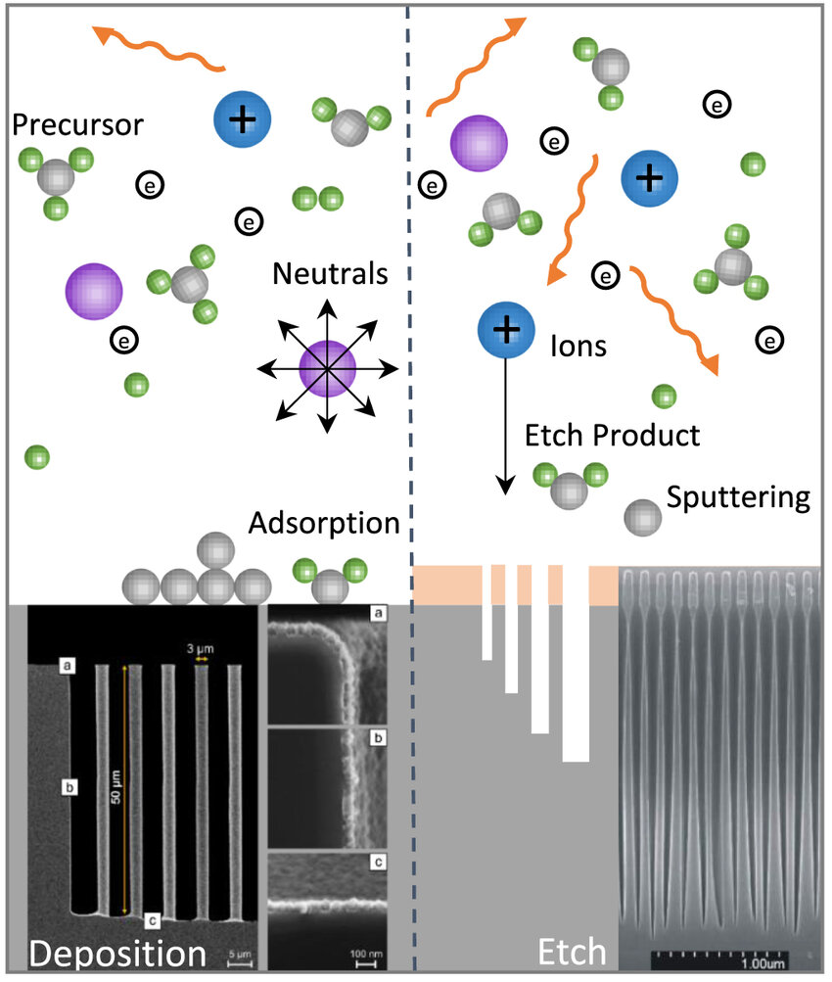
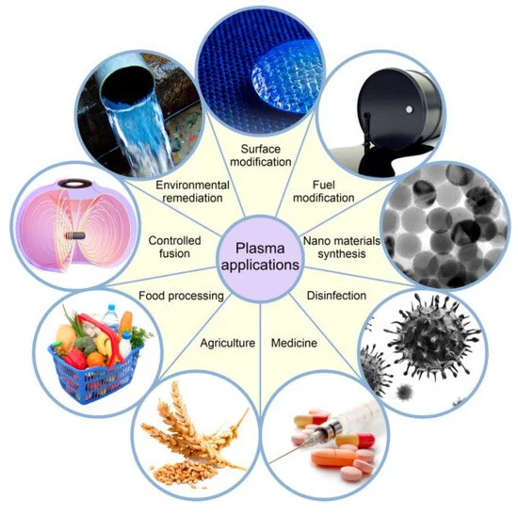
1. Motivation
E.M. Konchenko et al., Int. J. Mol. Sci. 2023, 24(20), 15093
Chemistry reaction-dominant gas discharges: many systems and applications
Control of energy flow in reaction chains:
optimize valorizable products
minimize waste products
Rapid (<ms) startup – can use inexpensive variable green energy
Amenable to distributed production – site with distributed power production
Meet future regulations for decarbonization, and benefit from incentives to electrify

Slide 8
Motivation - 2
Industrial Chemical Processes (ICP) account for about 7.5% of the total US green house gas (GHG) emissions, and 25% of US GDP
75% of ICP GHG emissions is from on-site combustion of fossil fuels for process heat
Important chemicals include petrochemicals, ammonia (including fertilizer), hydrogen (steel), aluminum
Methane for process heat, including heating catalyst
Thermal inertia of catalyst means it can take several hours to reach operating temperature – cannot use variable power sources like solar and wind directly

Slide 9
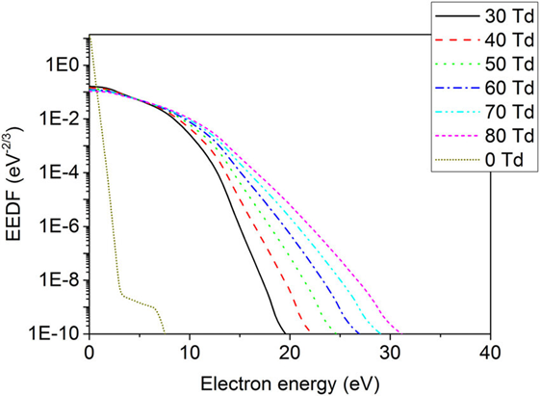
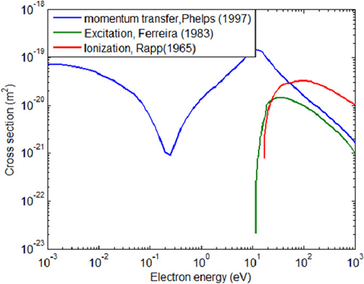

2. Fundamentals: EEDFs and Chemistry
Collision rate in fluids is so high they are always in equilibrium (Boltzmann distribution).
Conventional chemical processes use Boltzmann distribution - slope is determined by temperature $T$
Reaction rate is increased with temperature (Arrhenius equation $rate=A\exp{(−E_{a}/RT)}$, with $A$ and $E_{a}$ reaction constants and R the universal gas constant
catalysts can also significantly increase rates – also requires heat – usually methane
Main work is done at energy peaks of important cross sections – the rest is waste heat
Collision rate in fluids is so high they are always near equilibrium *
What if we could put more energy where it works for us and reduce waste heat?

Slide 10

2. Fundamentals - Nonequilibrium
Plasma is the fourth state of matter, a collection of ionized gases and radicals comprising over 99% of visible matter
Can be non-equilibrium when driven by strong electric fields, beams, photons
More energy where it does work on cross sections – acts like a catalyst
Conventional catalysts can provide additional enhancement
Goal is to inject more energy into preferred reactions, less in adverse reactions

Slide 11
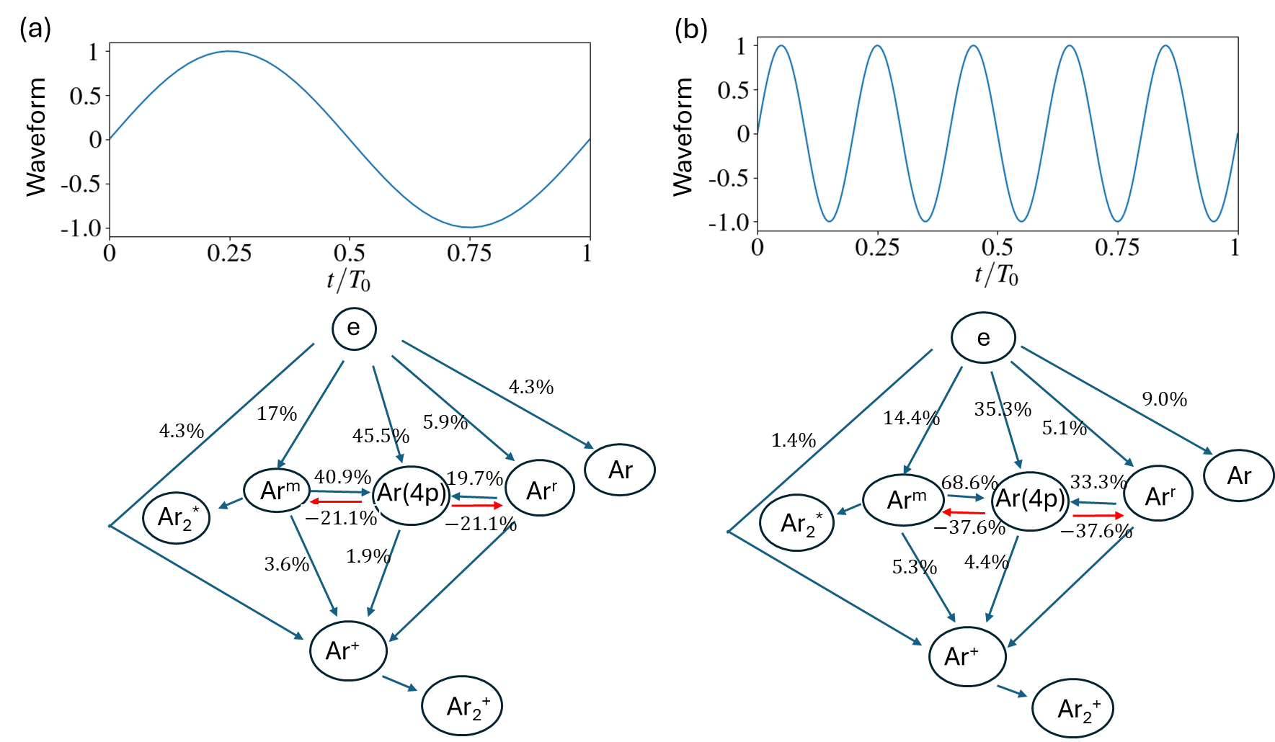
Driving Field Control of Energy Flow in Reaction Chains
Driving frequency 0.1GHz
Driving frequency 0.5GHz
Discharge conditions: driving current amplitude J=5x10⁵A/m² gap 1mm, 1 atm
Using ML to optimize driving signal across large parameter space

Slide 12
Use Case: Hydrogen Ecosystem
Distributed production of ammonia using green energy and plasmas
Plasma can handle variable power, unlike thermal catalysts
Can replace CO₂ intensive Haber-Bosch process (9% of GHG load) for ammonia for fertilizers used in 50% of global crop production
Can provide ammonia for materials manufacturing industry
Can provide transport medium for hydrogen – we know how to transport ammonia economically in pipelines and by truck
Can provide hydrogen for hydrogenation to upgrade bio-fuel energy density – net zero carbon jet fuel!
Requires ammonia cracking at use point for H fuel cells or H combustion
Or ammonia burning fuel cells, producing N₂ and H₂O
Large trucks can crack in situ, resulting in low H inventory for safety

Slide 13
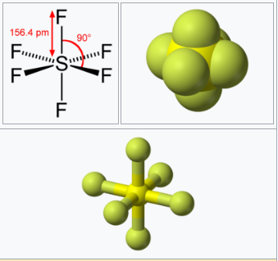
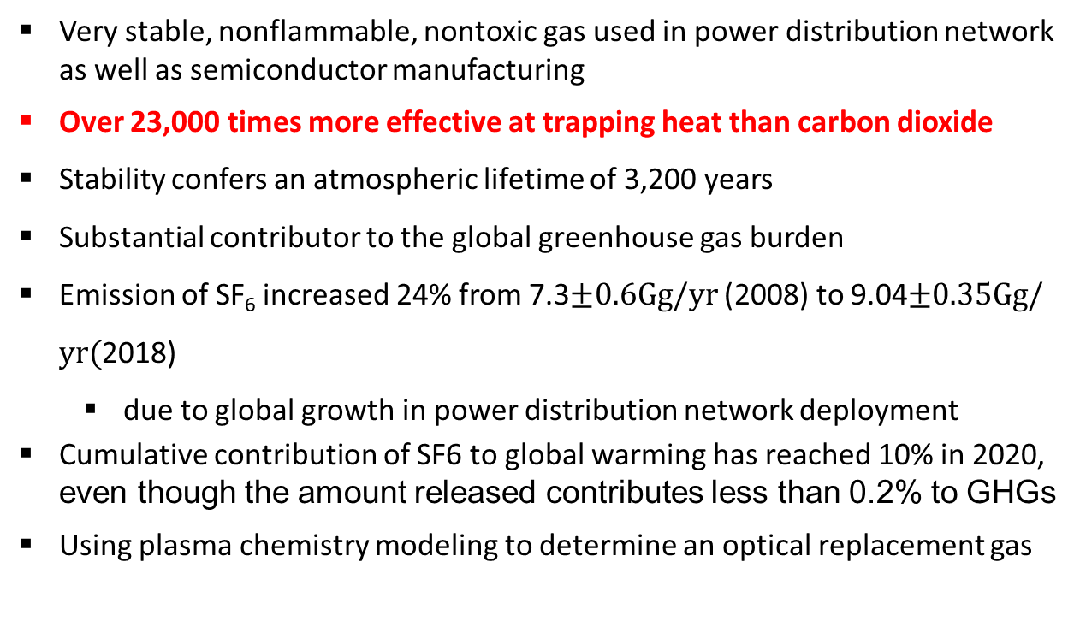
Use Case: SF6
Sulfur hexafluoride (SF₆) as an example:
Very stable, nonflammable, nontoxic gas used in power distribution network as well as semiconductor manufacturing
Over 23,000 times more effective at trapping heat than carbon dioxide
Stability confers an atmospheric lifetime of 3,200 years
Substantial contributor to the global greenhouse gas burden
Emission of SF₆ increased 24% from 7.3$±0.6Gg/yr$ (2008) to 9.04$±0.35Gg/yr($2018)
due to global growth in power distribution network deployment
Cumulative contribution of SF6 to global warming has reached 10% in 2020, even though the amount released contributes less than 0.2% to GHGs
Using plasma chemistry modeling to determine an optical replacement gas
SF6 [1]
Illustration from wikipedia
Importance: analyzing reaction chains and mechanism of suppressing breakdown
in SF₆ driven by high voltage from DC to microwave frequencies

Slide 14
Other Plasma Applications
Plasma remediation of chemical waste (e.g. PFAS, Nox, H₂S)
Reducing environmental hazards in semiconductor manufacturing
Alternate gases and processes
Agri-food Systems
Haber-Bosch (fertilizer)
Food sterilization (cold plasmas, gammas)
Plastics remediation
Surface bonding to replace environmentally damaging adhesives
Many more!

Slide 15
Conclusions and outlook
Industrial Chemical Processes (ICP) provide a major opportunity for decarbonization
Methane process heat source not easily replaced by green electric source due to thermal inertia
Plasma processes can be pulsed, and turn on and off in a microsecond – amenable to green energy
Placing distributed ICP where excess green energy is generated can valorize land use, provide an additional incentive to generate green energy
Modulate electric field waveform shape or beams to influence distribution function, selecting desirable reaction chains and reducing undesirable ones
Enhance products you can sell
Minimize products you pay to haul away
ARPA-E, DOE, NSF have interest in sponsoring – building a national network
Seeking for industry and government partners to develop this technology to achieve:
Decarbonization and energy efficiency via underutilized green energy
Distributed production to valorize underutilized land beyond green energy production alone
Net economic benefit

Slide 16
Thank you!

