Slide 1

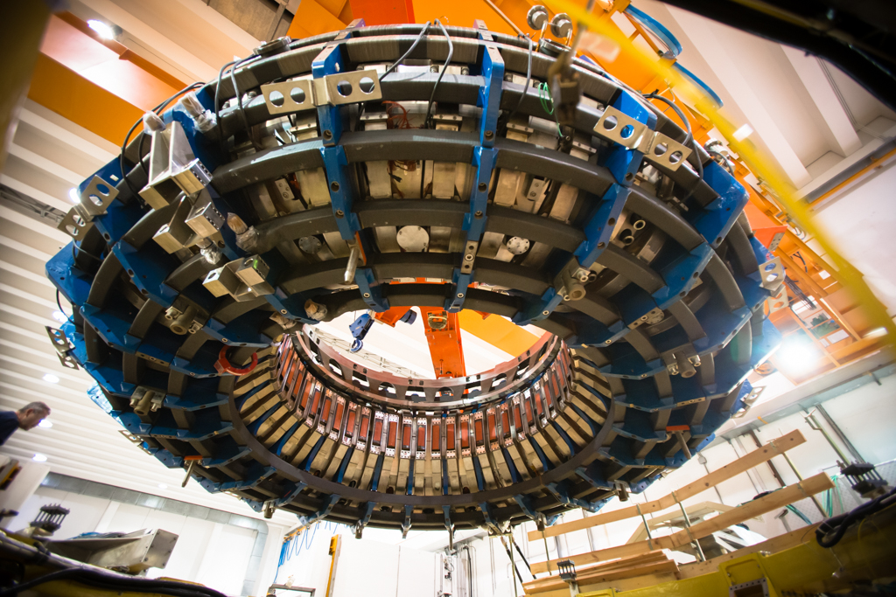
The PNRR-IR NEFERTARI project:
a network of Research Infrastructures for Magnetic Confinement Fusion Research
Challenges and strengths from managerial perspective
Simone Peruzzo
Research Infrastructure Manager
CNR-ISTP
On behalf of NEFERTARI project Team
PNRR-IR NEFERTARI project Final Workshop
Padova 25-27/03/2026

Slide 2



Distribution of experimental facilities enhanced or newly realized with NEFERTARI
RFX-mod2
Toroidal machine for RFP & TOKAMAK confinement study
HVPTF
High Voltage Padova Test Facility – vacuum and gas insulation study
EMCL
Electro-Magnetic Compatibility Laboratory
NeutronXLab
Development of neutronic and SXR diagnostics
BiGym
Linear Plasma Machine – plasma wall interaction
FARHA-ONE
FAcility for Remote HAndling
Hardware in the loop simulation Lab
LaserDiLab
Development of optical diagnostics

Slide 3
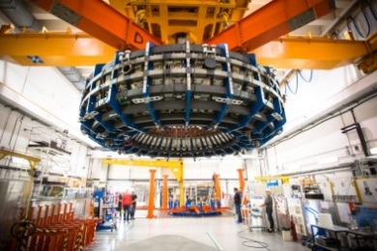
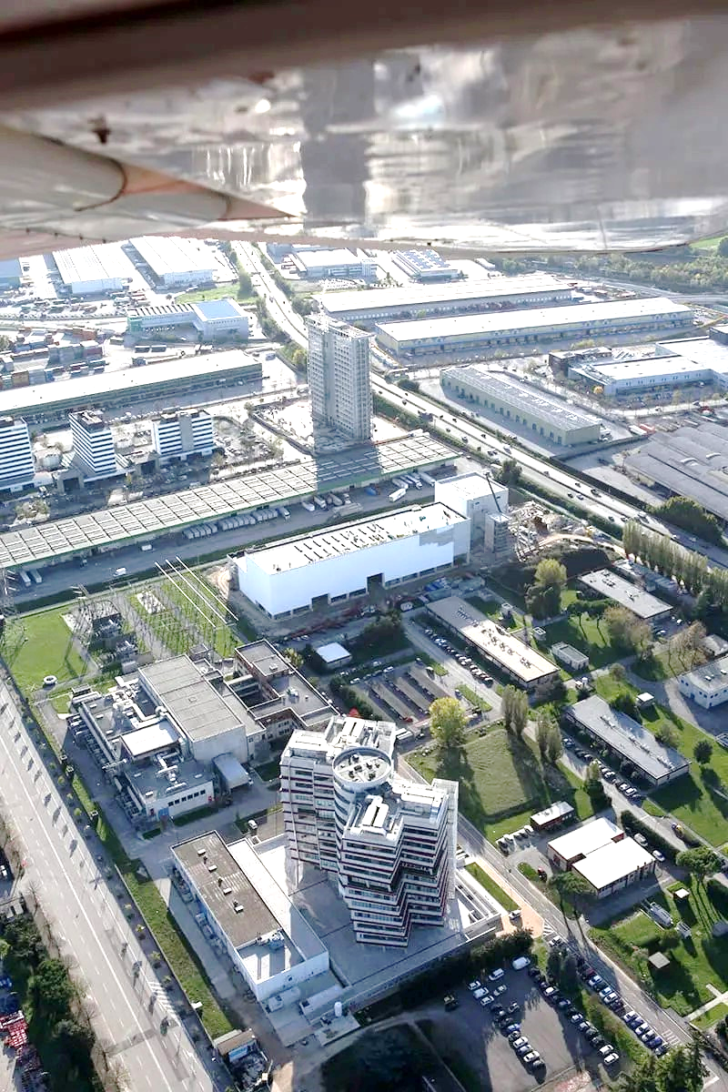
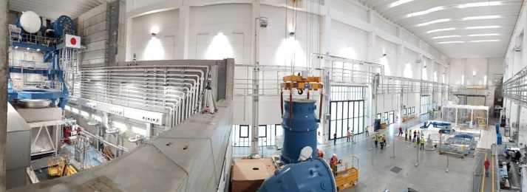
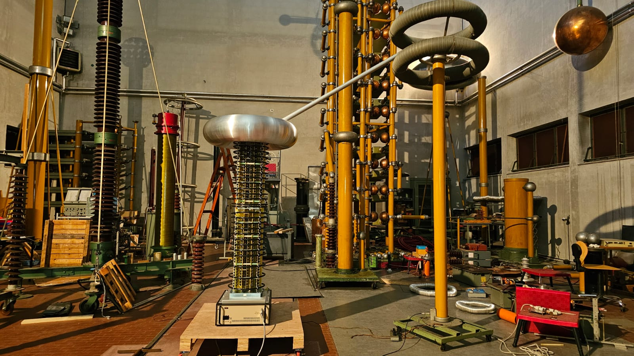


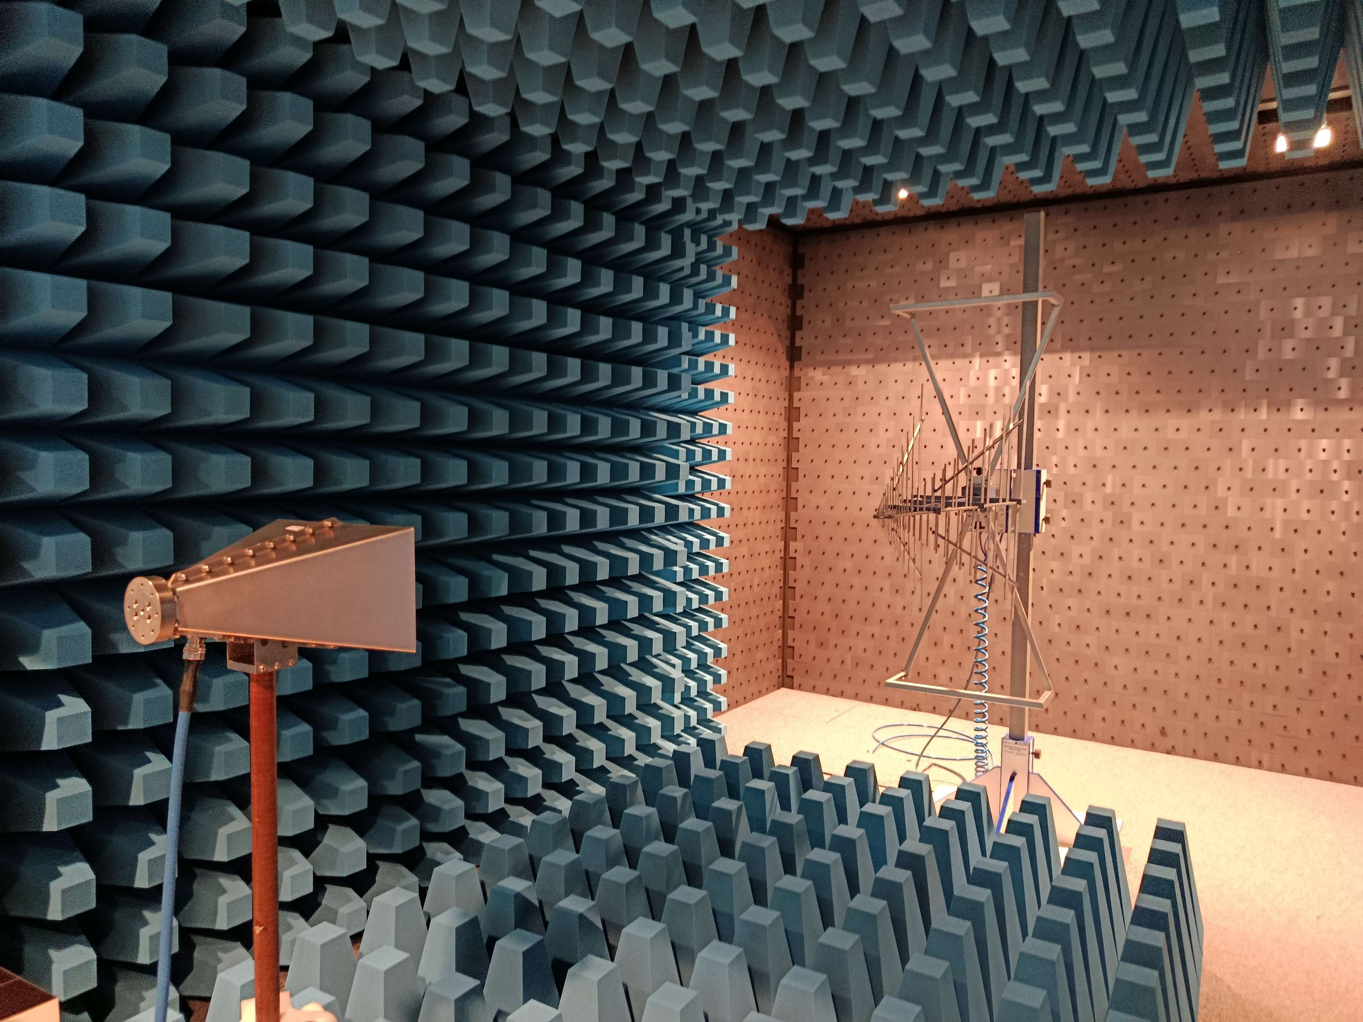





CNR Research Area
of Padova
Neutral Beam Test Facility
Funded in the framework of international agreements ITER – F4E – MUR up to 2030 (in prospect up to 2040)
RFX-mod2 experiment at a glance:
1992 - 99: RFX
2004 - 16: RFX-mod
• 2018 - 23: modification of the vessel complex
• 2023 - 26: new experimental plants & diagnostics
2027 - … : RFX-mod2
High Priority Research Infrastructure included in the Italian «Research Infrastructure National Plan 2021-27» - ENERGY sector (ESFRI)
experimental phases
Labs @UniPD-DII
experimental phase
HVPTF
PNRR-NEFERTARI investment @PD: 10 M€
pre-existing investment: 110 M€
EMCLab

Slide 4
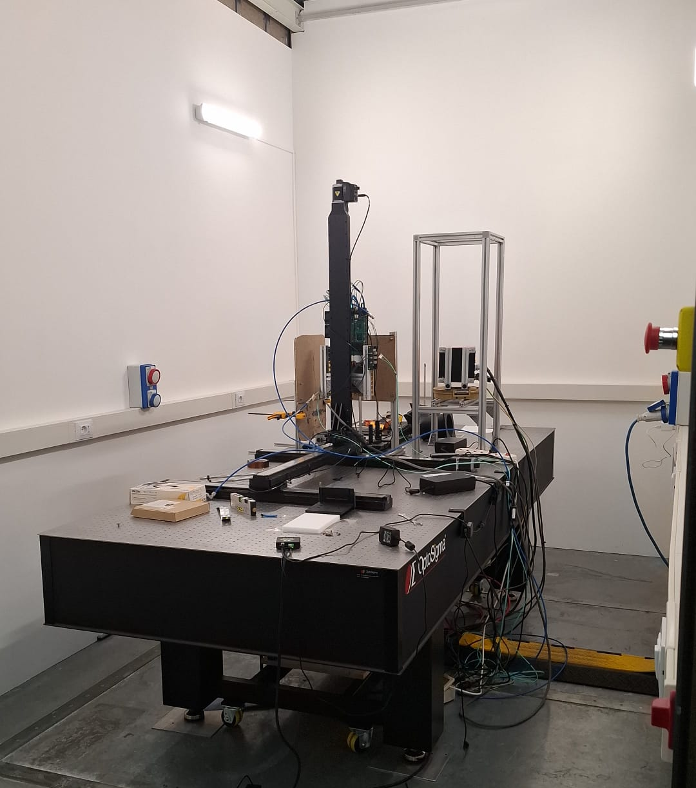
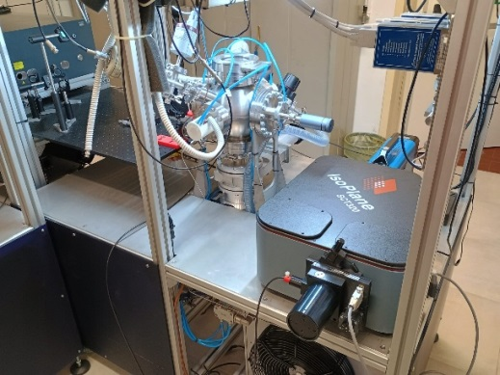
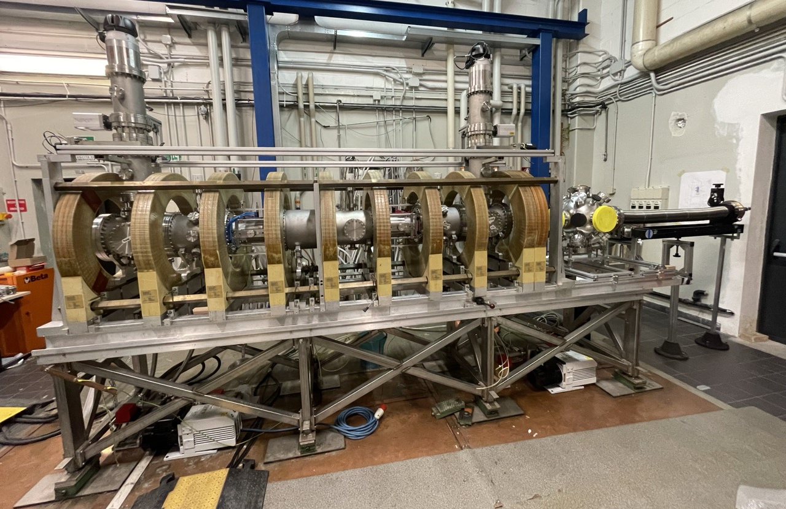
experimental facilities @ CNR-ISTP BA & MI
BiGym
Linear Plasma Machine for plasma wall interaction
(@ISTP-Mi )
NeutronXLab
Development of neutronic and SXR diagnostics
(@ISTP-Mi)
LaserDiLab
Development of optical diagnostics
(@ISTP-Ba)
PNRR-NEFERTARI investment @BA & Mi: 4 M€
pre-existing investment: 1 M€

Slide 5


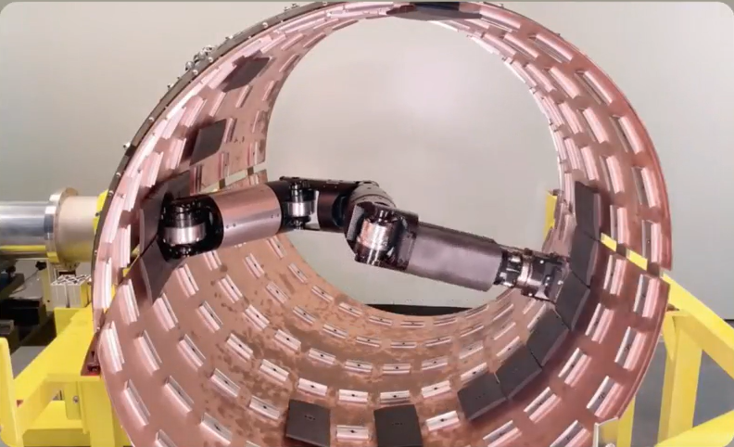
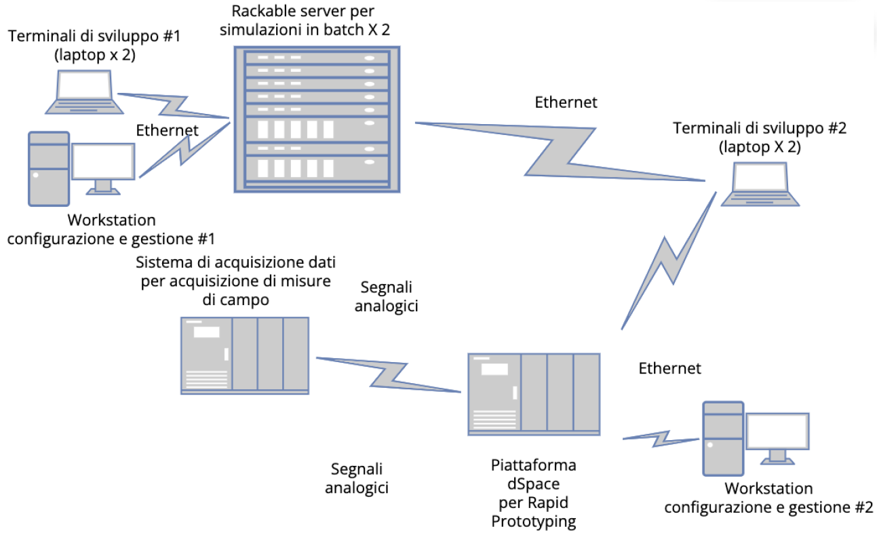
experimental facilities @ UniNA
FARHA-ONE
FAcility for Remote HAndling
(@UniNA-DII )
Hardware in the loop simulation Lab
(@UniNa-DIETI)
PNRR-NEFERTARI investment @NA: 1 M€
pre-existing investment: - - -

Slide 6
Project Closure SWOT Analysis
Strengths
All technical objectives achieved
Budget fully spent as planned (thanks to project extension)
Remarkably skilled and resilient project team
Highly collaborative team with a deep commitment to the shared goals
Weaknesses
Lack of common practices among partners for quality management (poor implementation of the PMP)
Insufficient team-building initiatives
Human resource recruitment below the forecasted level
Shortage of administrative staff at the lead beneficiary (CNR), compensated for by research personnel
Opportunities
Enhanced facilities for in-house research and for supporting external projects (DTT, ITER, DEMO)
Increased relationships with Suppliers (for potential Public-Private Partnerships)
Prospects for further funding (Mission Innovation, PRN by MASE)
Maintaining and sharing complementary expertise among diverse labs
Threats (past)
Changing regulations for public procurement (d.lgs. 36/2023)
Implementation of electronic public procurement platforms (since Jan 2024)
War Russia – Ukraine (EU sanctions against Russia)
Threats (future)
Absence of a governance framework for the integrated management of the enhanced infrastructures
Lack of tangible prospects for maintaining the staff recruited under the project

