Slide 1
Laser ablation models and experimental activities in support of a LIBS diagnostics for the BiGyM linear plasma device for fusion-relevant applications S. Cipelli^{1,2}
Final workshop of the NEFERTARI project (New Equipment for Fusion Experimental Research & Technological Advancements with Rfx Infrastructure)
Padova
March 24 – 27, 2026
¹Istituto per la Scienza e Tecnologia dei Plasmi, CNR, 20125 Milano, Italy ²Centro Ricerche Fusione (CRF) – Università degli Studi di Padova, 35122 Padova, Italy

Slide 2
Outline
LIBS: Laser Induced Breakdown Spectroscopy
Design of an in-situ LIBS on the BiGyM linear plasma device
Laser ablation modeling
Nanosecond laser ablation
Picosecond laser ablation
Experimental in-situ LIBS retention measurements on the PSI-2 linear device
Conclusions and future developments
Collaboration with WP9 CNR-ISTP Bari
1

Slide 3
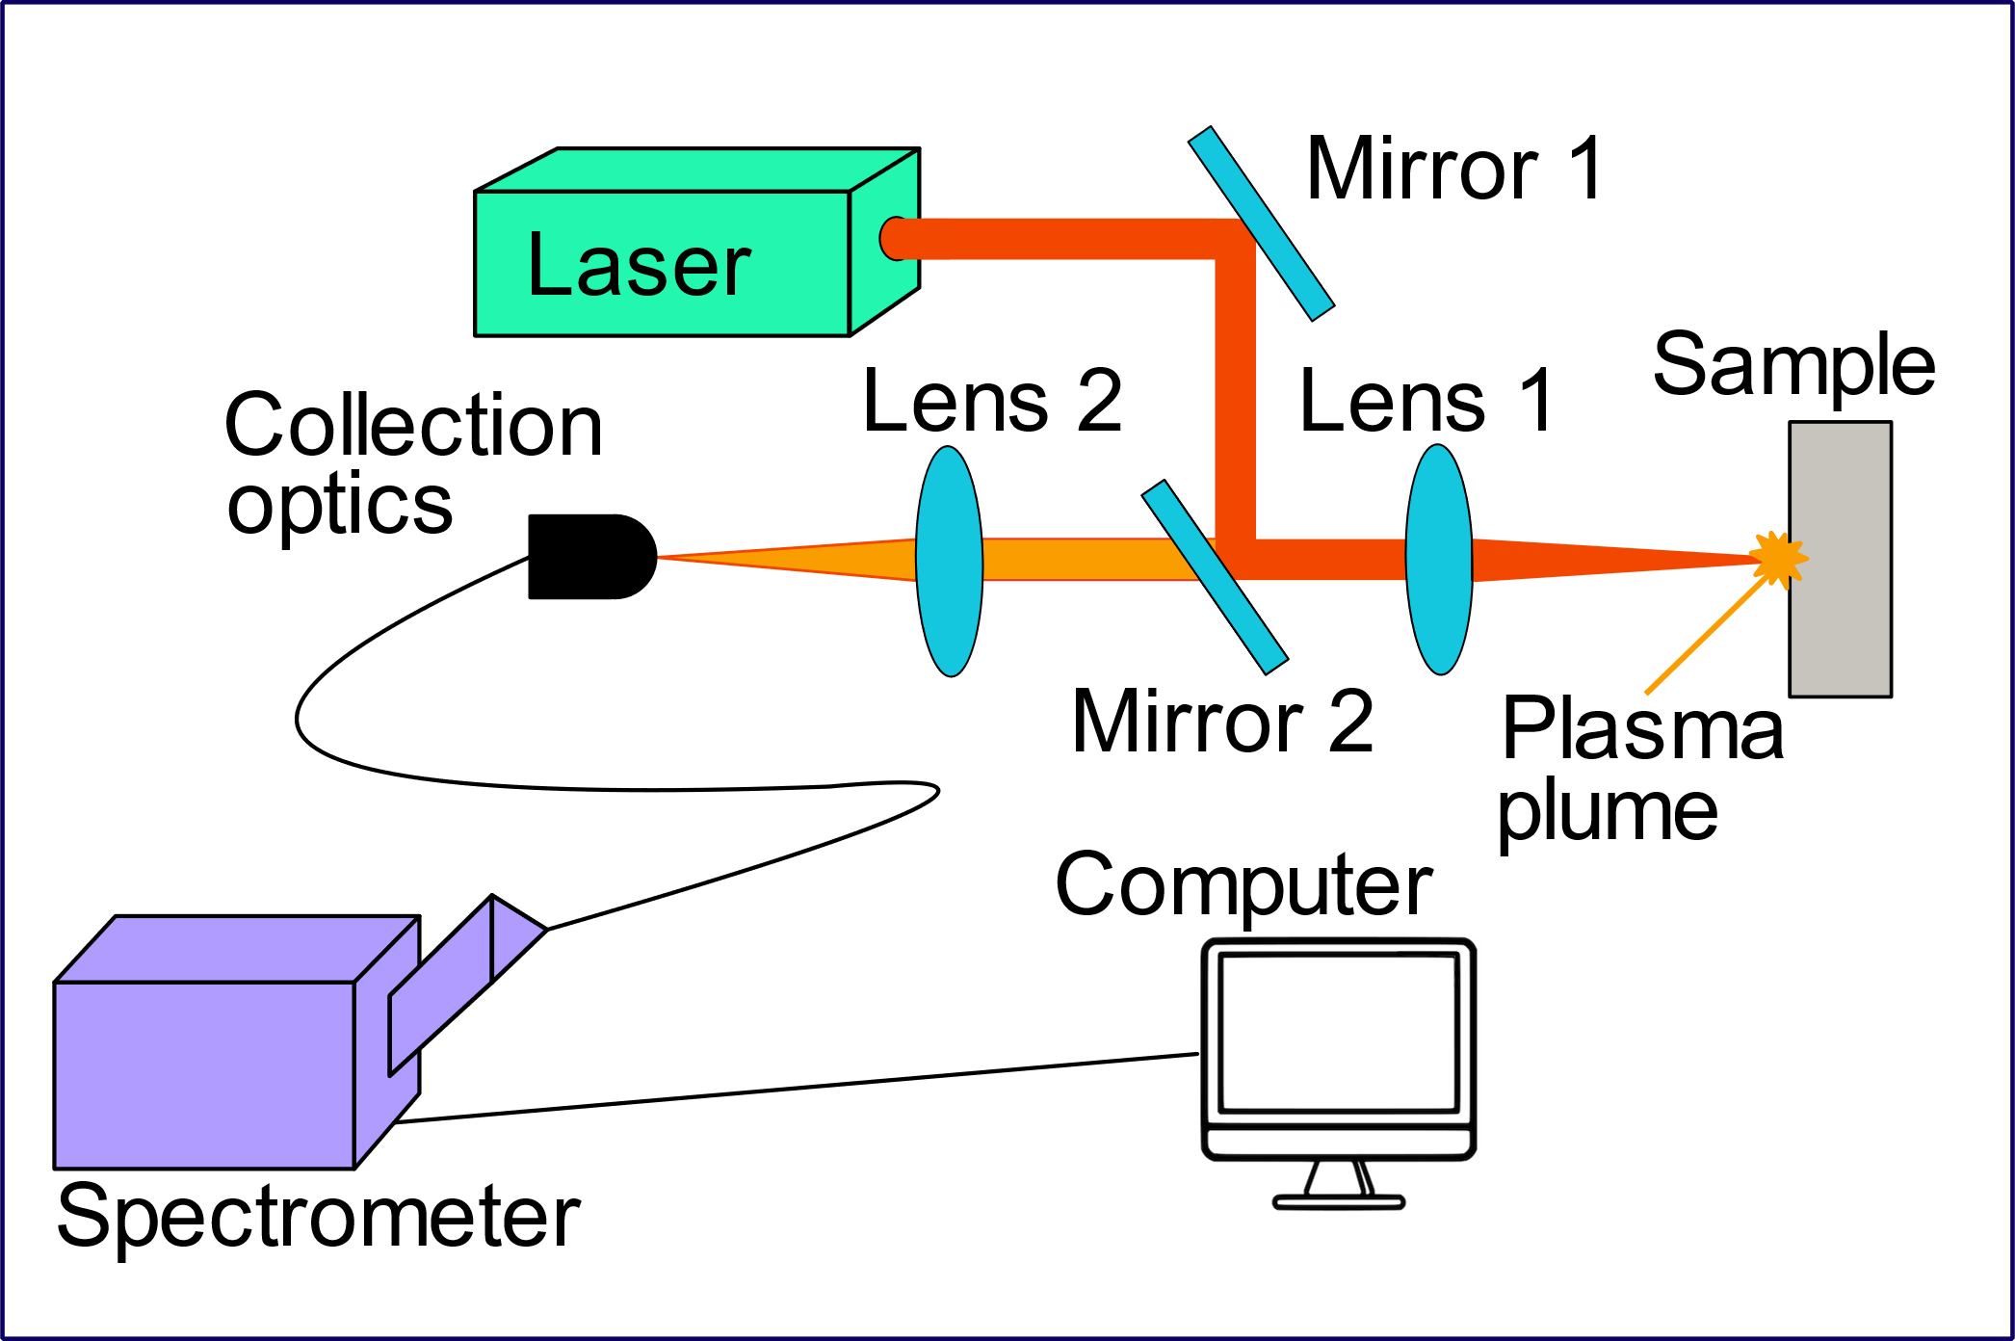
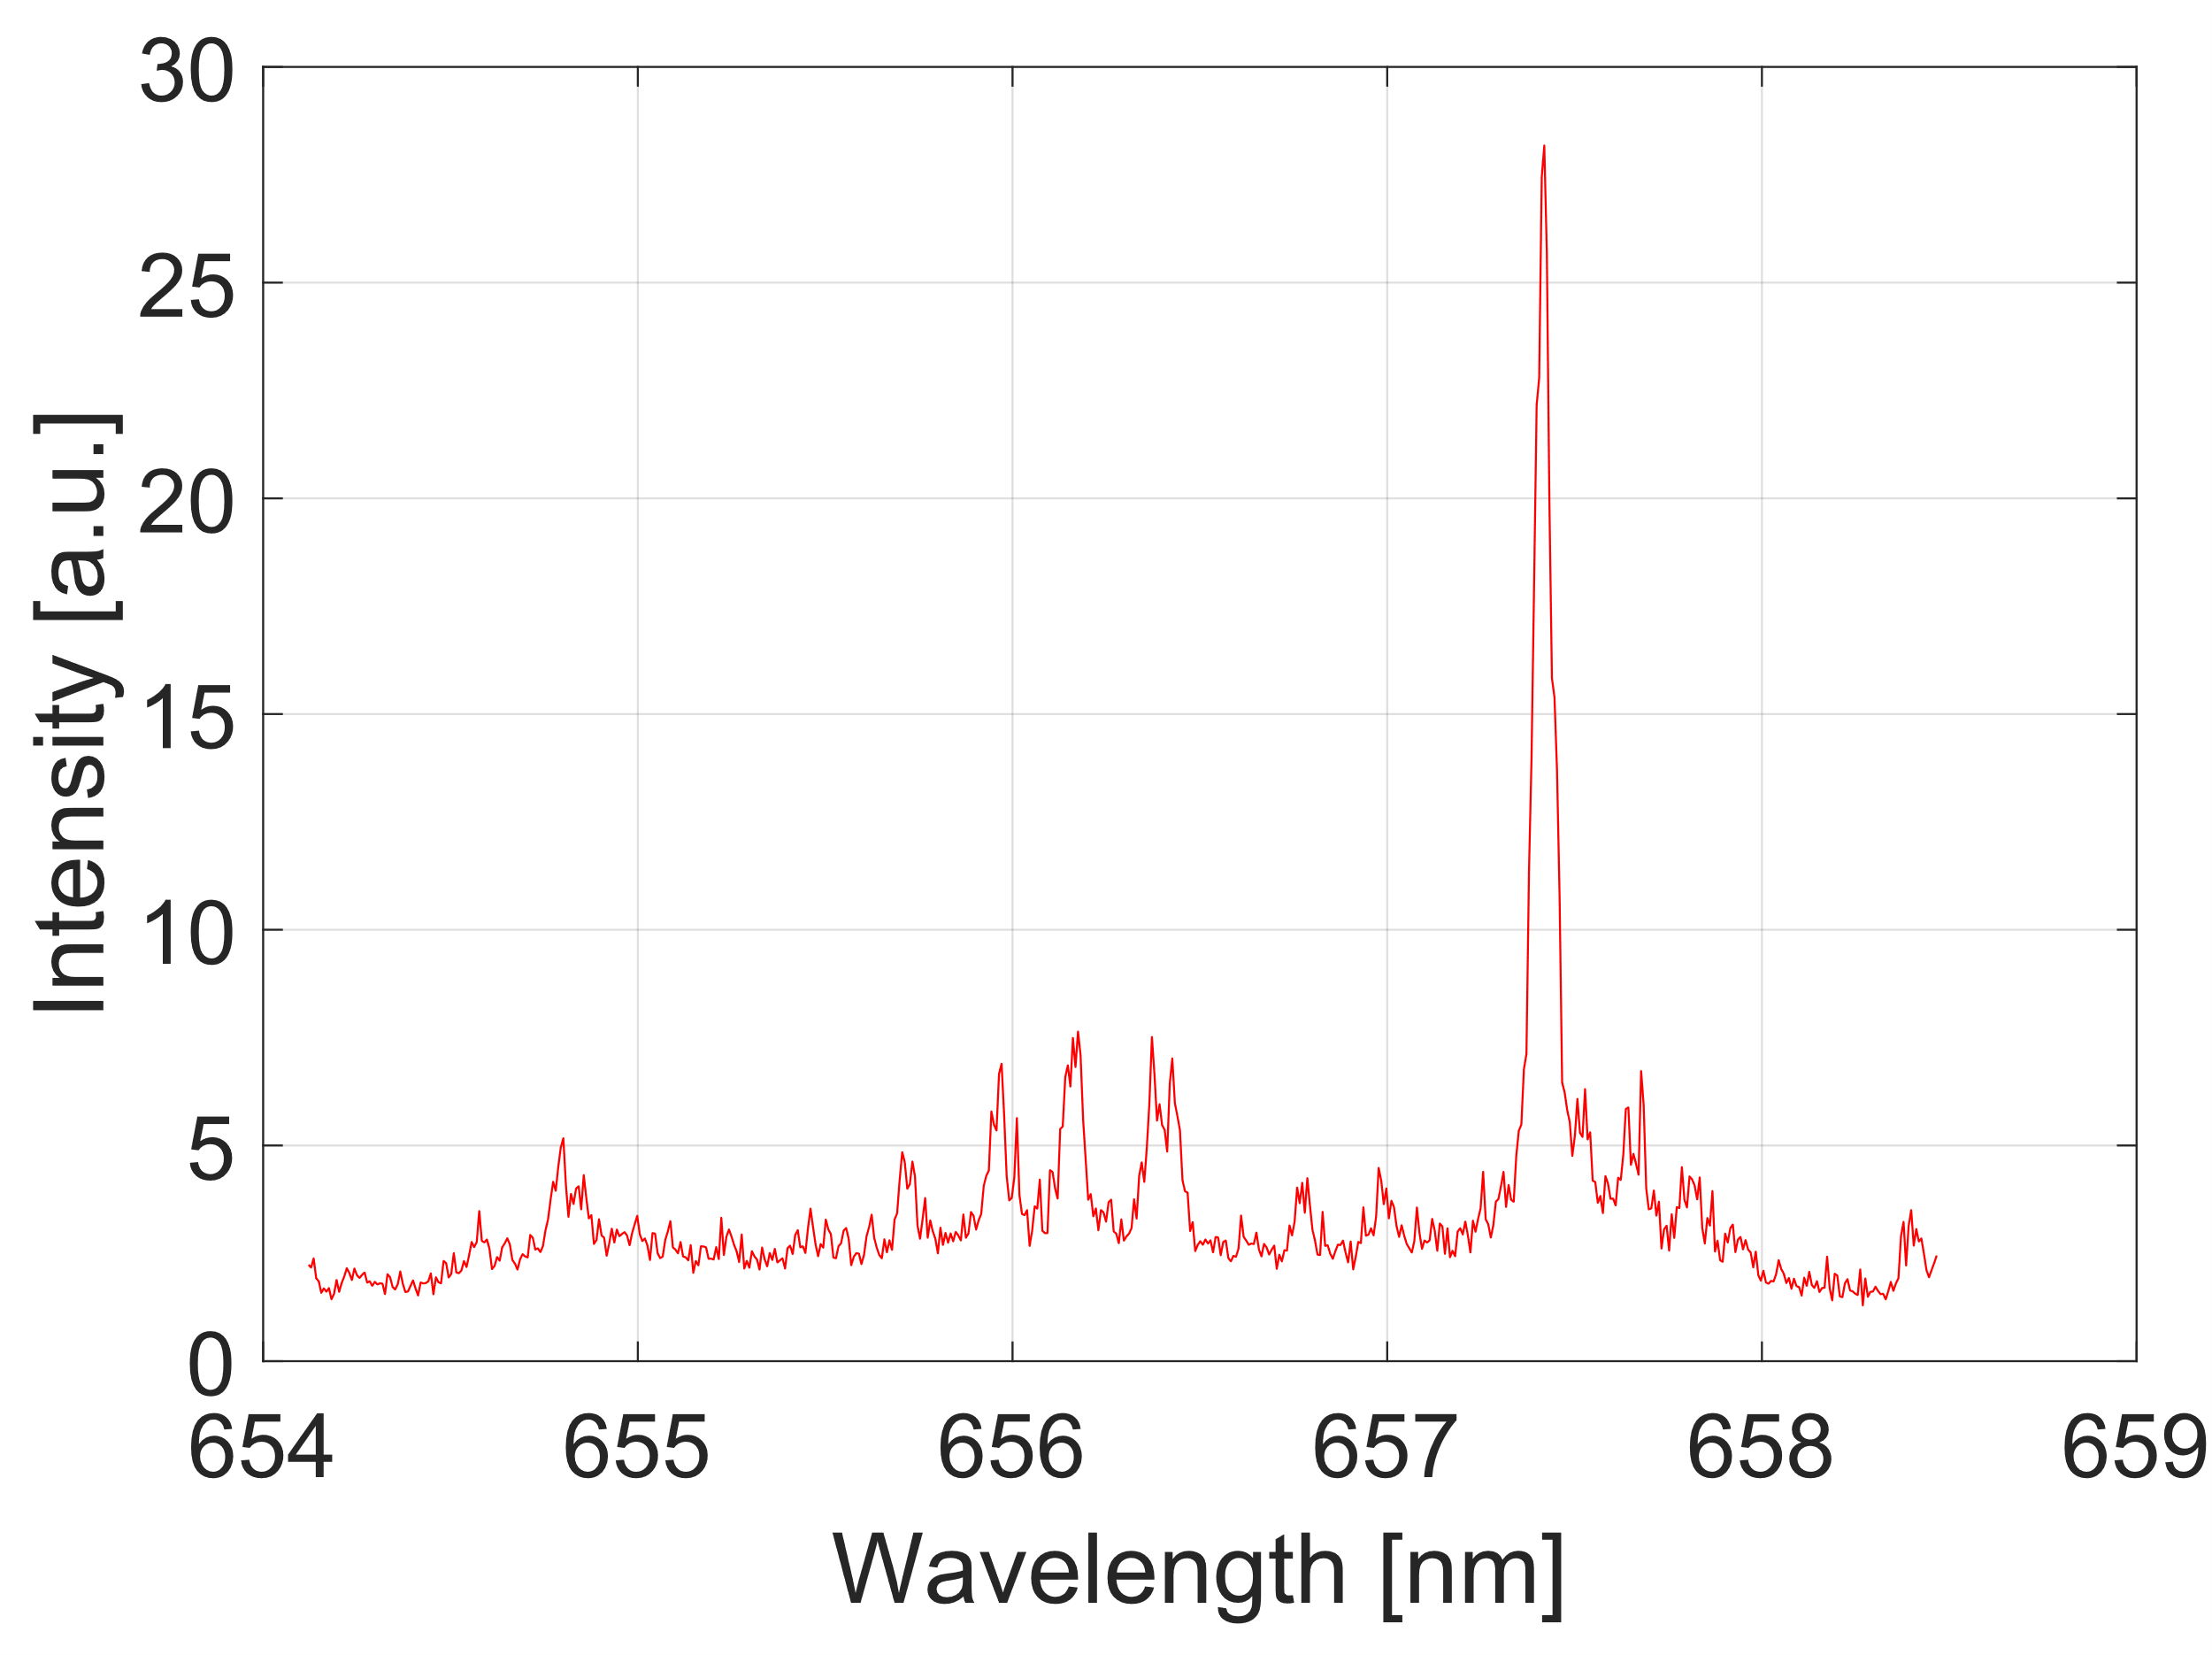
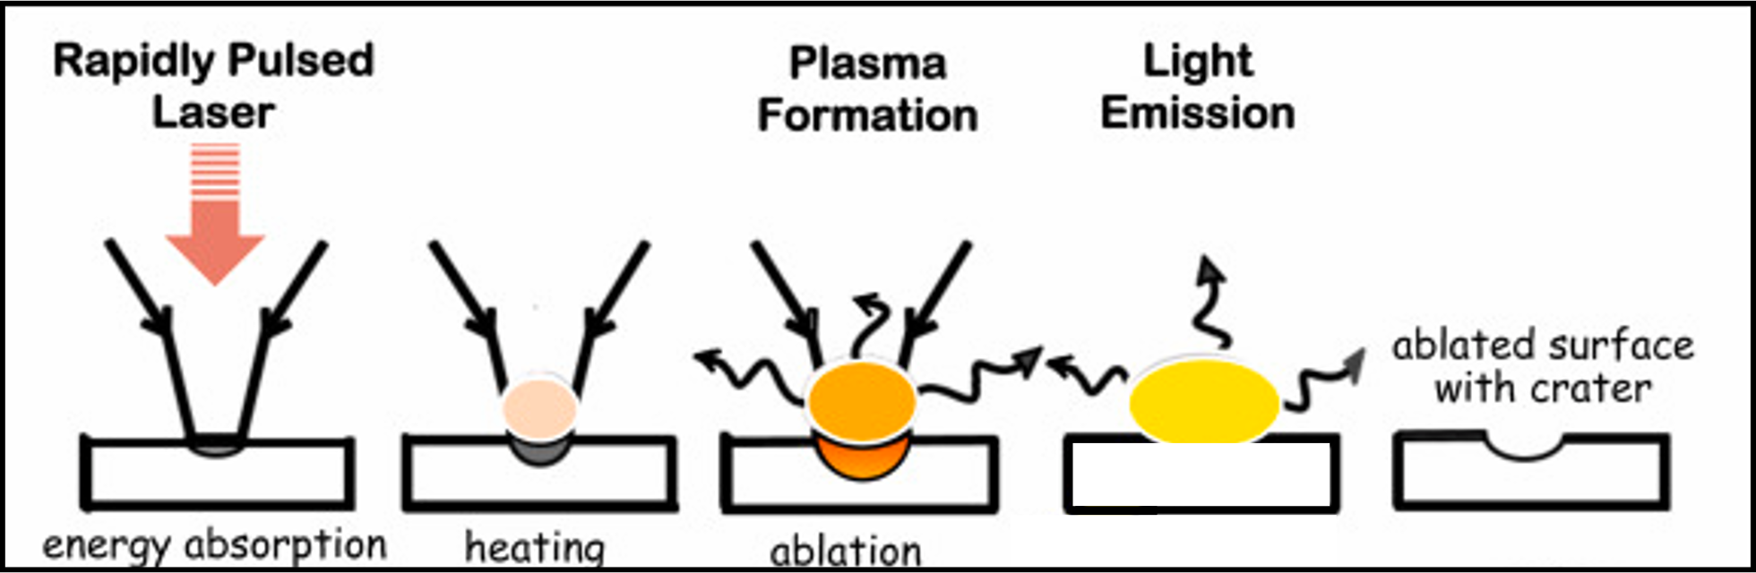
LIBS: Laser Induced Breakdown Spectroscopy
Main advantages:
Possibility of in-situ measurements
Remote detection
No sample preparation
Minimal damages to the target
Possible combination with laser-based cleaning techniques
Can operate in harsh environments (vacuum, presence of magnetic field and background plasma)
Information about chemical and isotopic composition
Promising diagnostics for PFCs monitoring in tokamaks and LPDs
2

Slide 4


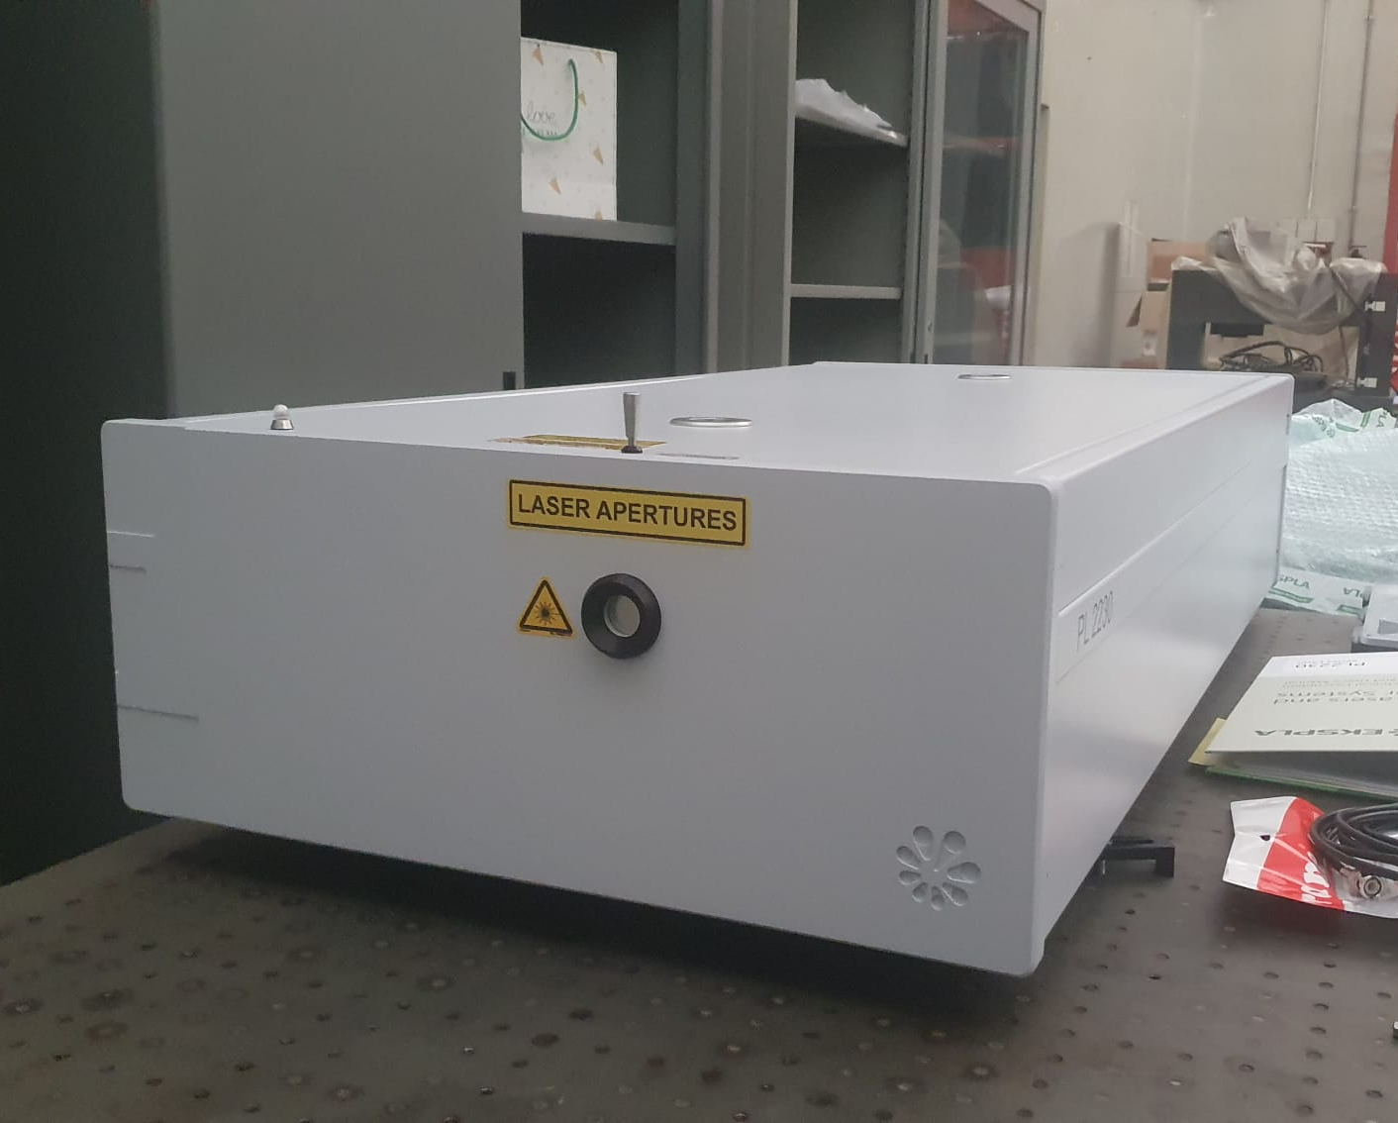
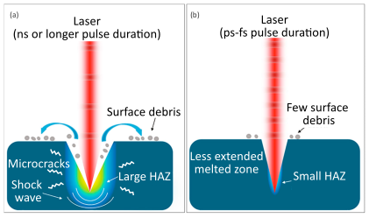
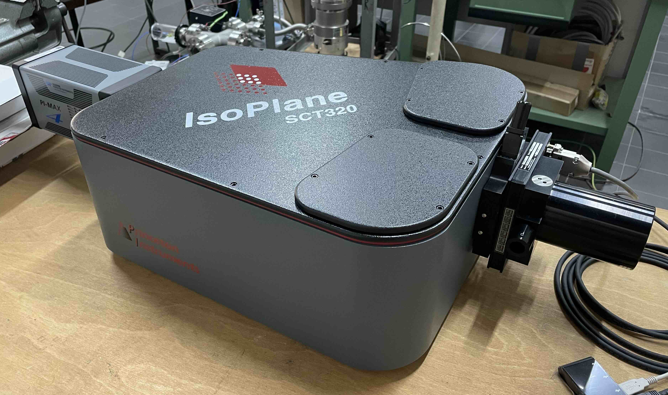
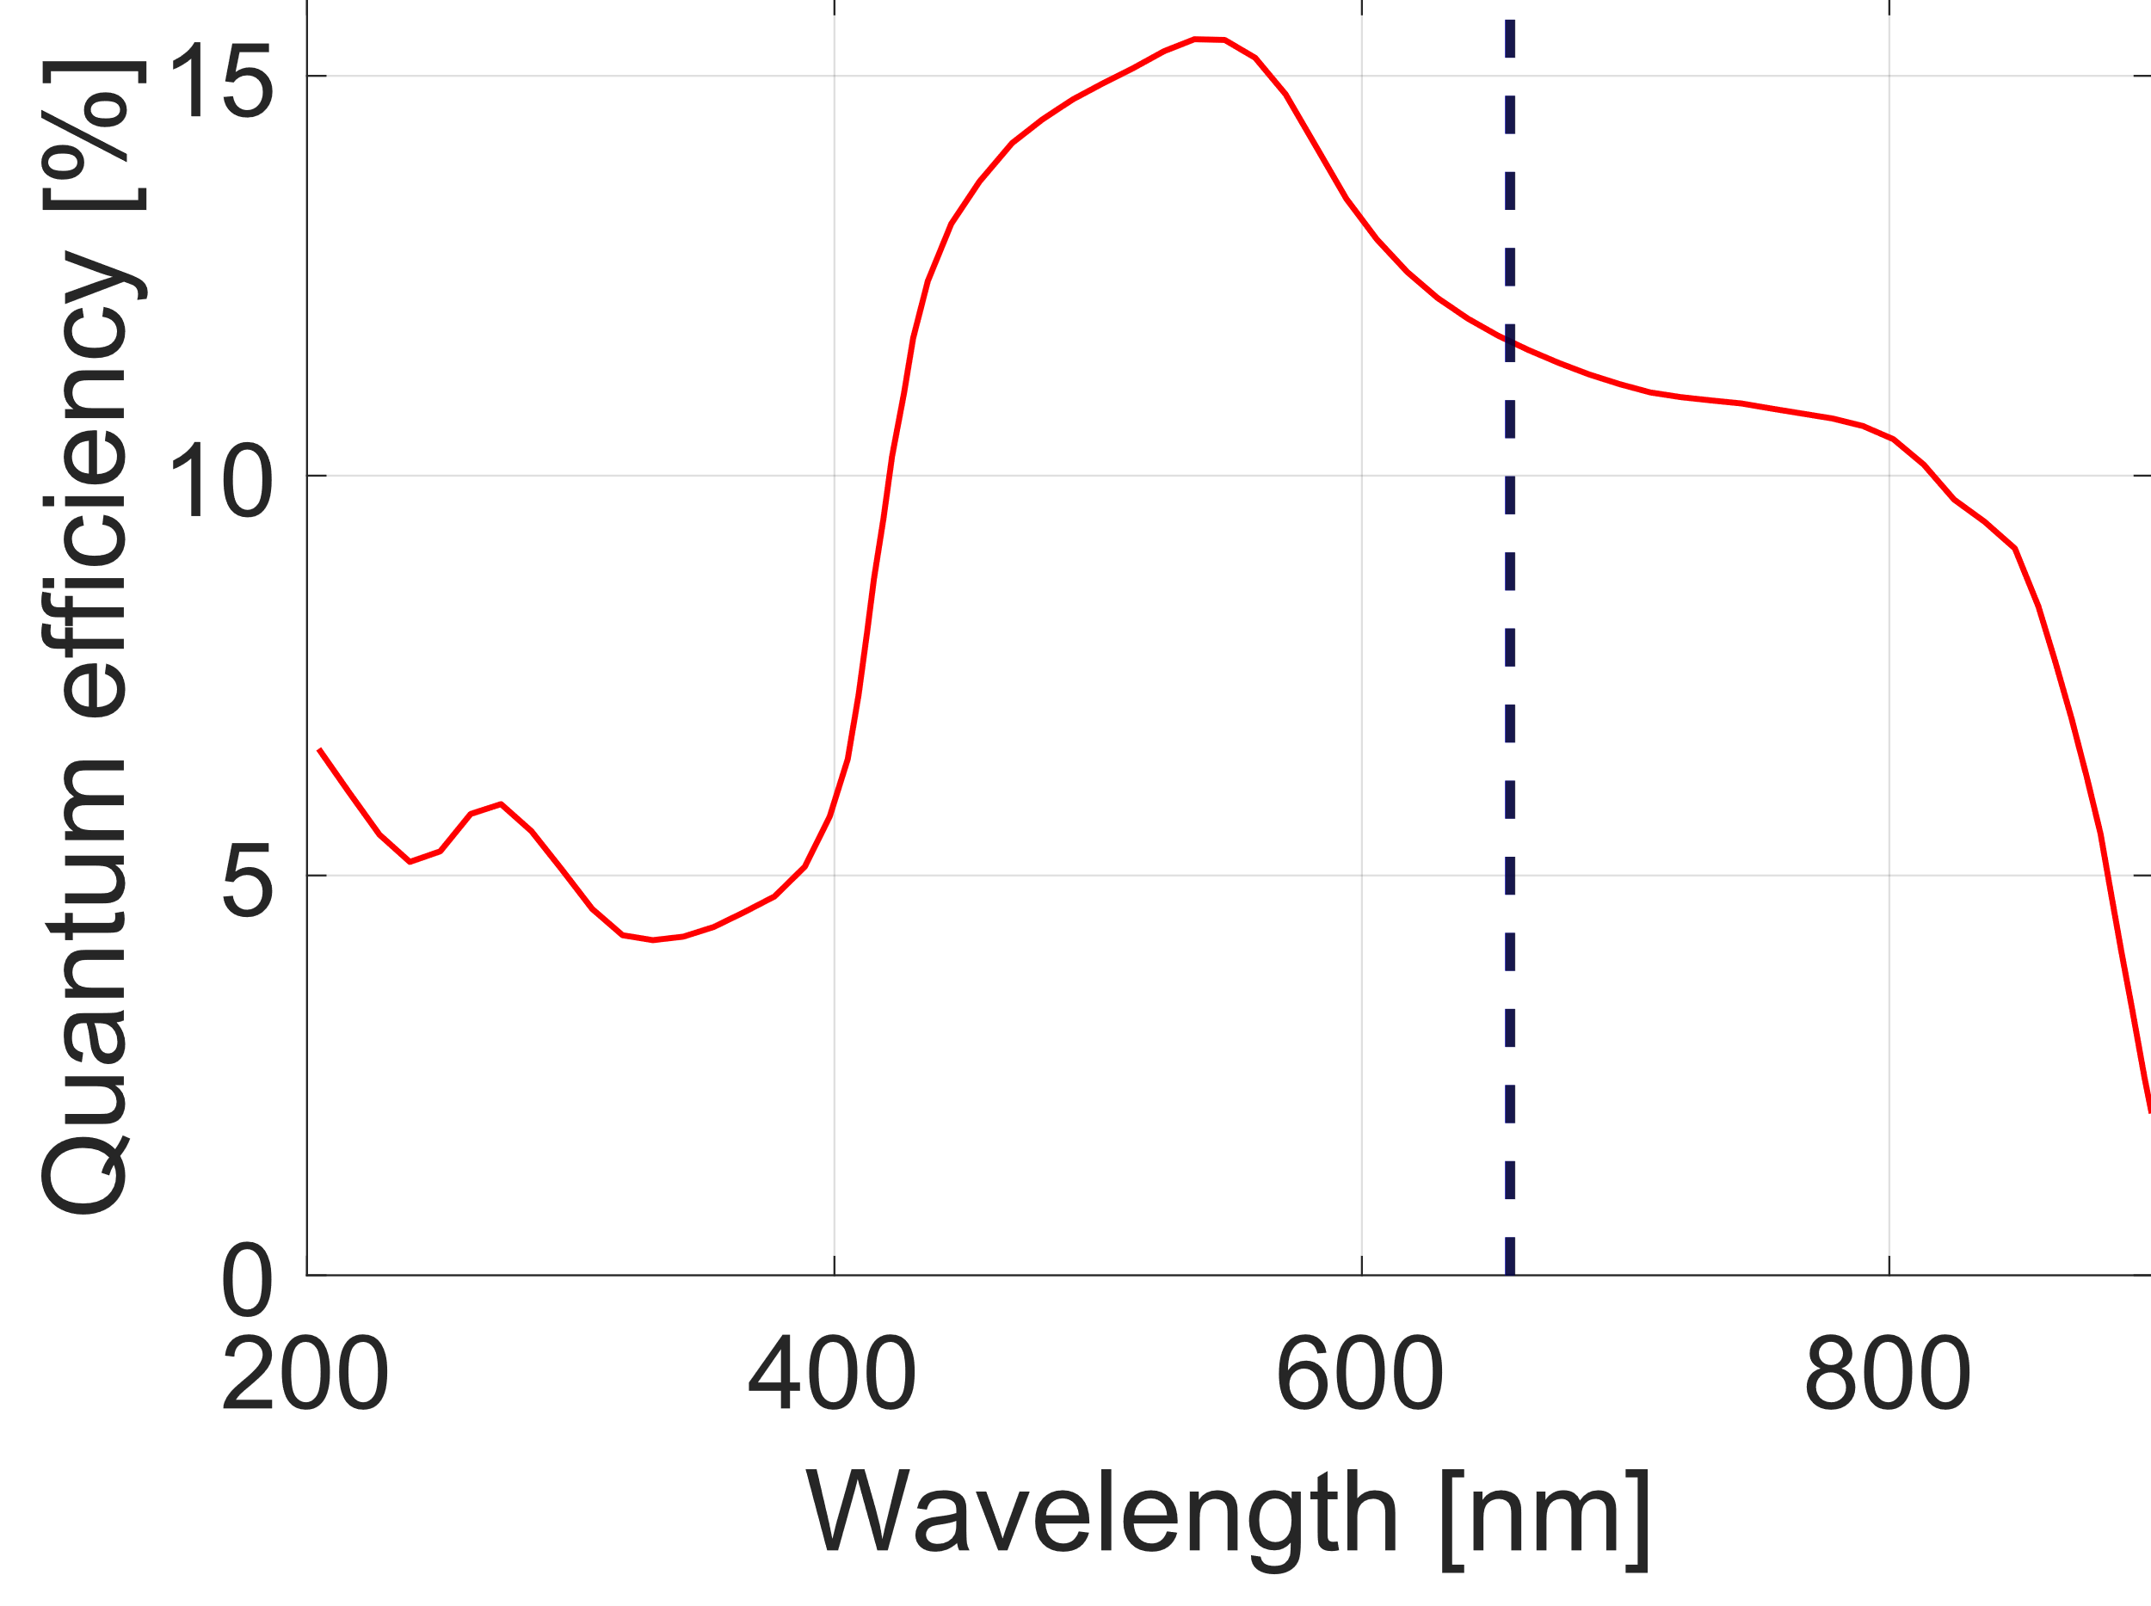
Design of an in-situ LIBS on the BiGyM linear plasma device
Compact design
Correction of optical aberrations
Set of 3 interchangeable gratings
PMAX Intensified CCD camera (Gen II SR intensifier)
Picosecond laser pulse
→ reduced Heat-Affected Zone (HAZ), improved depth resolution
High max pulse energy
→ high SNR, broad fluence range available
Nominal λ [nm] | 1064
Pulse duration [ps] | 29 ± 5
Max pulse energy [mJ] | 70
Repetition rate [Hz] | 10
Focal lenght [mm] | 320
Min slit width [μm] | 10
3

Slide 5
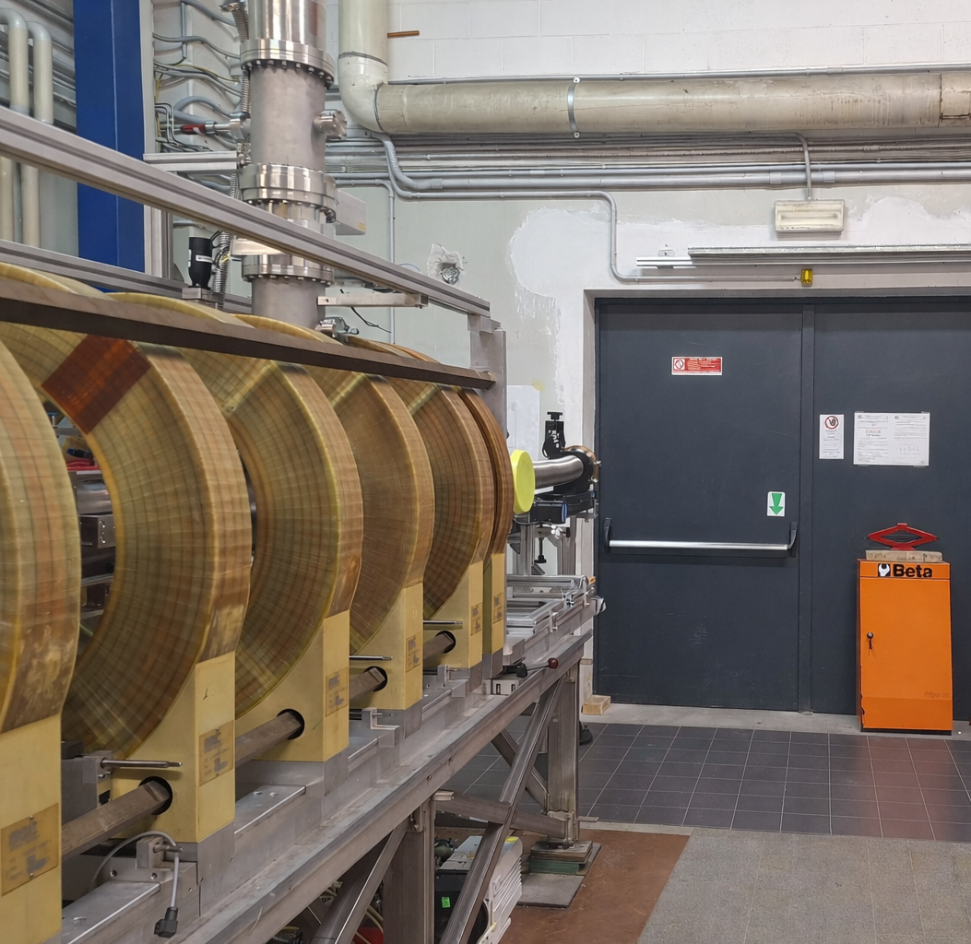
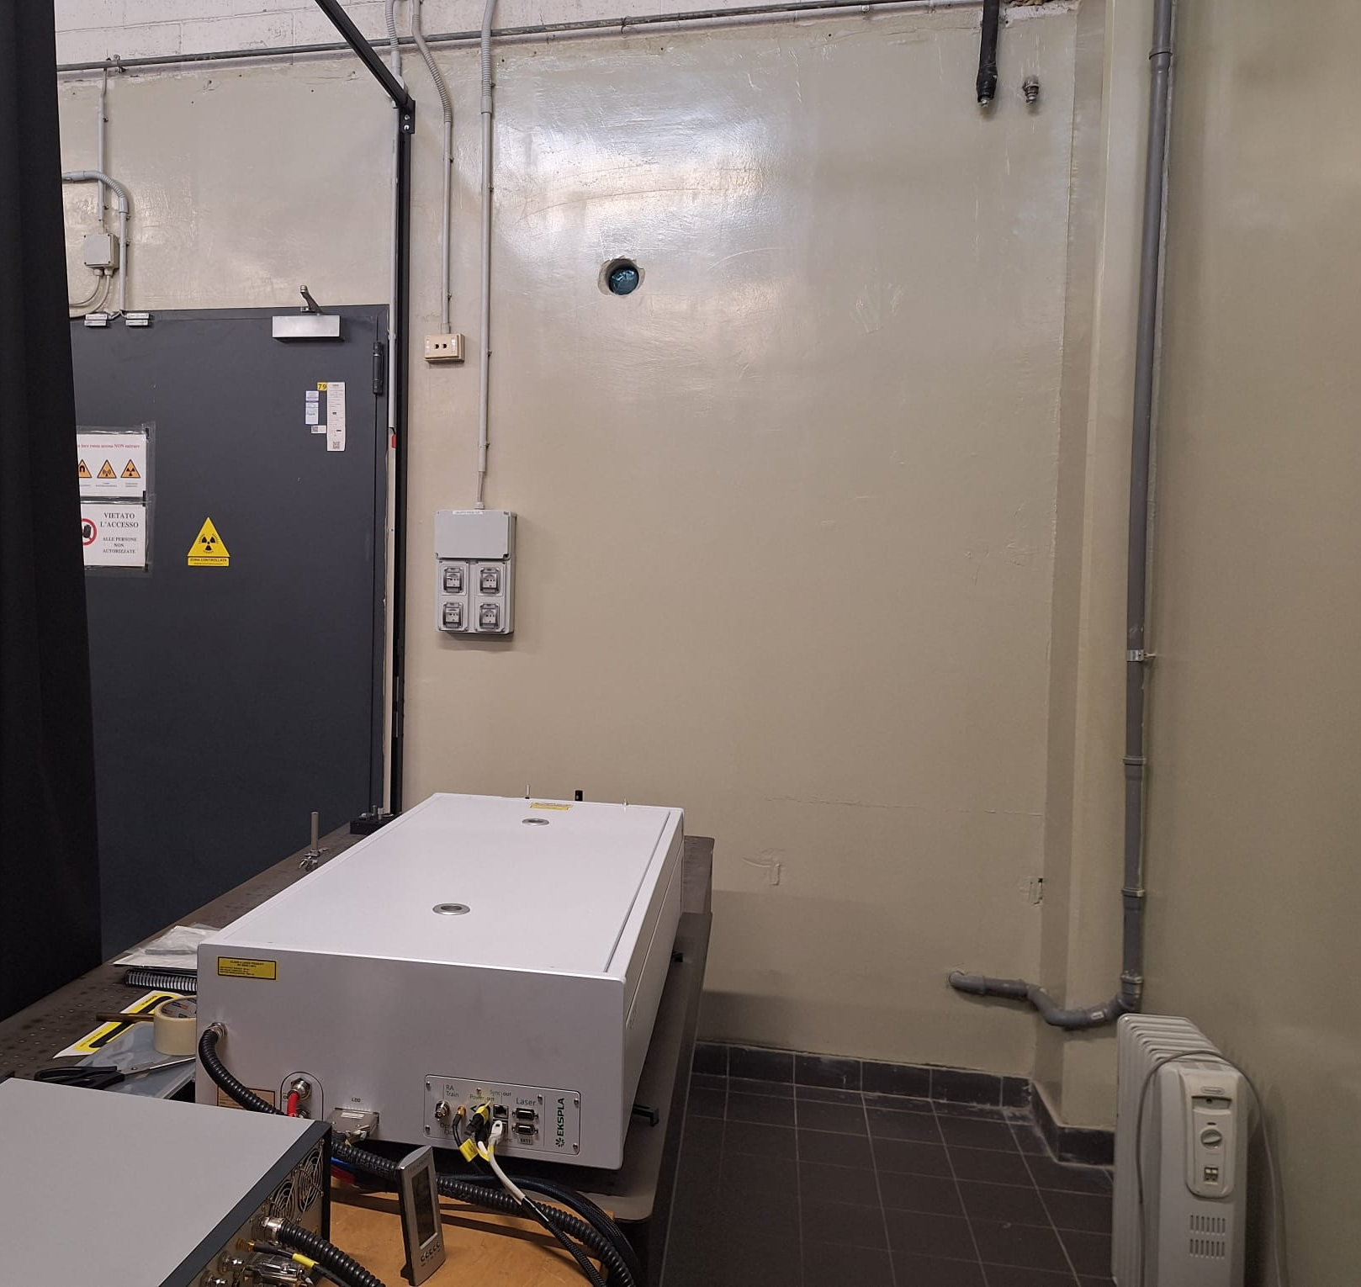
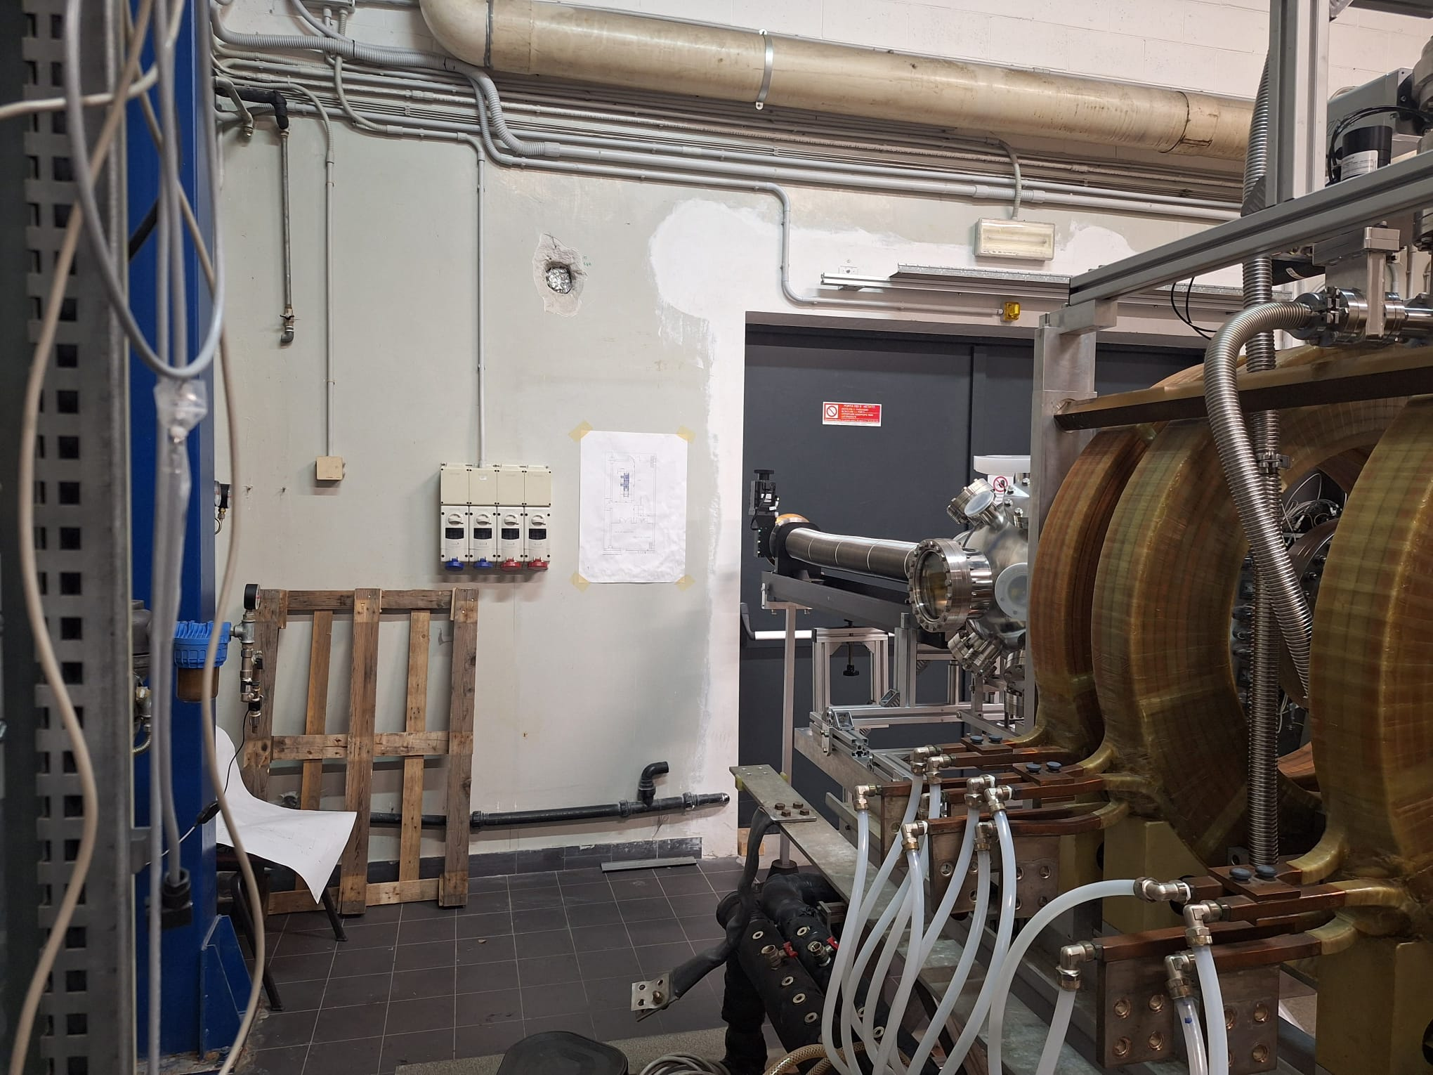
Design of an in-situ LIBS on the BiGyM linear plasma device
BiGyM linear device laboratory
Diagnostics laboratory
BiGyM pre-chamber
Hole for the optical path
Hole for the optical path
EKSPLA laser
4

Slide 6
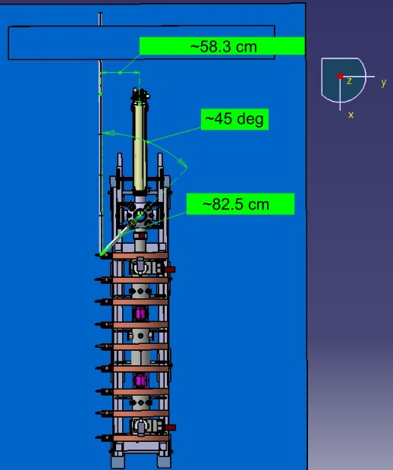
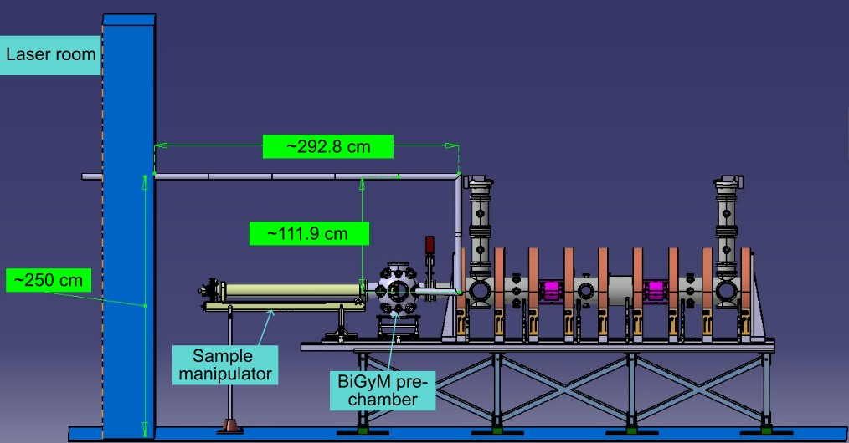
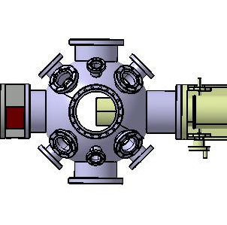
Design of an in-situ LIBS on the BiGyM linear plasma device
Technical drawing of an optical path connecting the laser system to the BiGyM pre-chamber
~8 m optical path length
Beam enclosed by safety tubes
Use of 3 fixed mirrors + 1 motorized steering mirror (for control of focusing position)
Focusing lens
Lens + optical fiber for collection of plasma light
Top view
Side view
Laser beam guide
Optical fiber
5

Slide 7
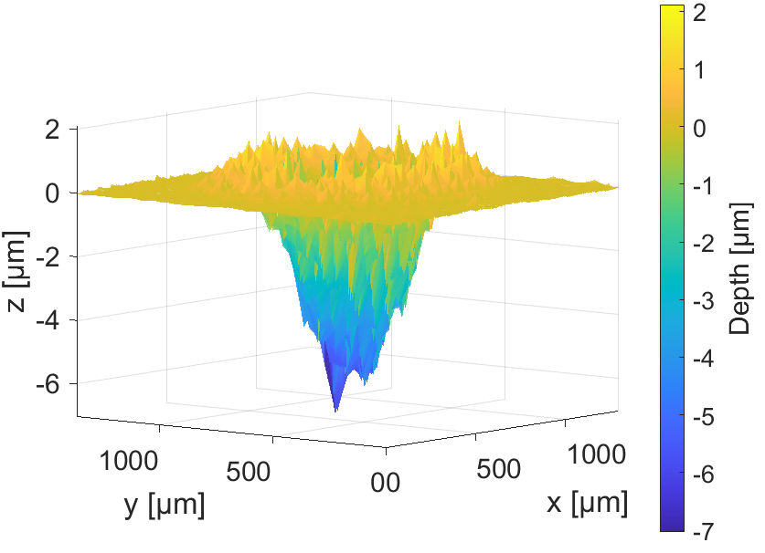
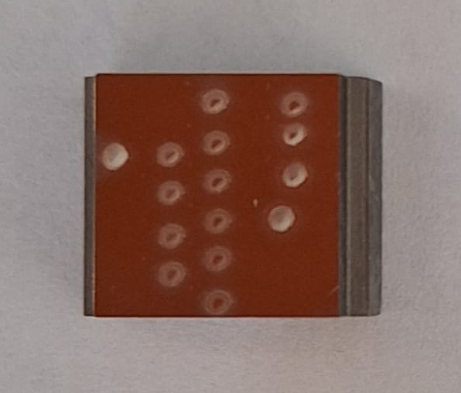
Laser ablation modeling
Example of LIBS ablation craters on tungsten
3D reconstruction of ablation crater
A schematic view of the LIBS process
LASER ABLATION MODELING
As a support tool for the LIBS measurements interpretation
Important for nuclear fusion applications (retention)
Spatial information on retained H isotopes
Supports correct interpretation of LIBS signal (thermal-induced effects on particles)
Single pulse signal is influenced by:
Ablation crater dimensions (spatial resolution)
Thermal penetration depth (thermal-induced phenomena)
Prediction ablation crater characteristics
Simulation of the temporal evolution of temperature field
6

Slide 8
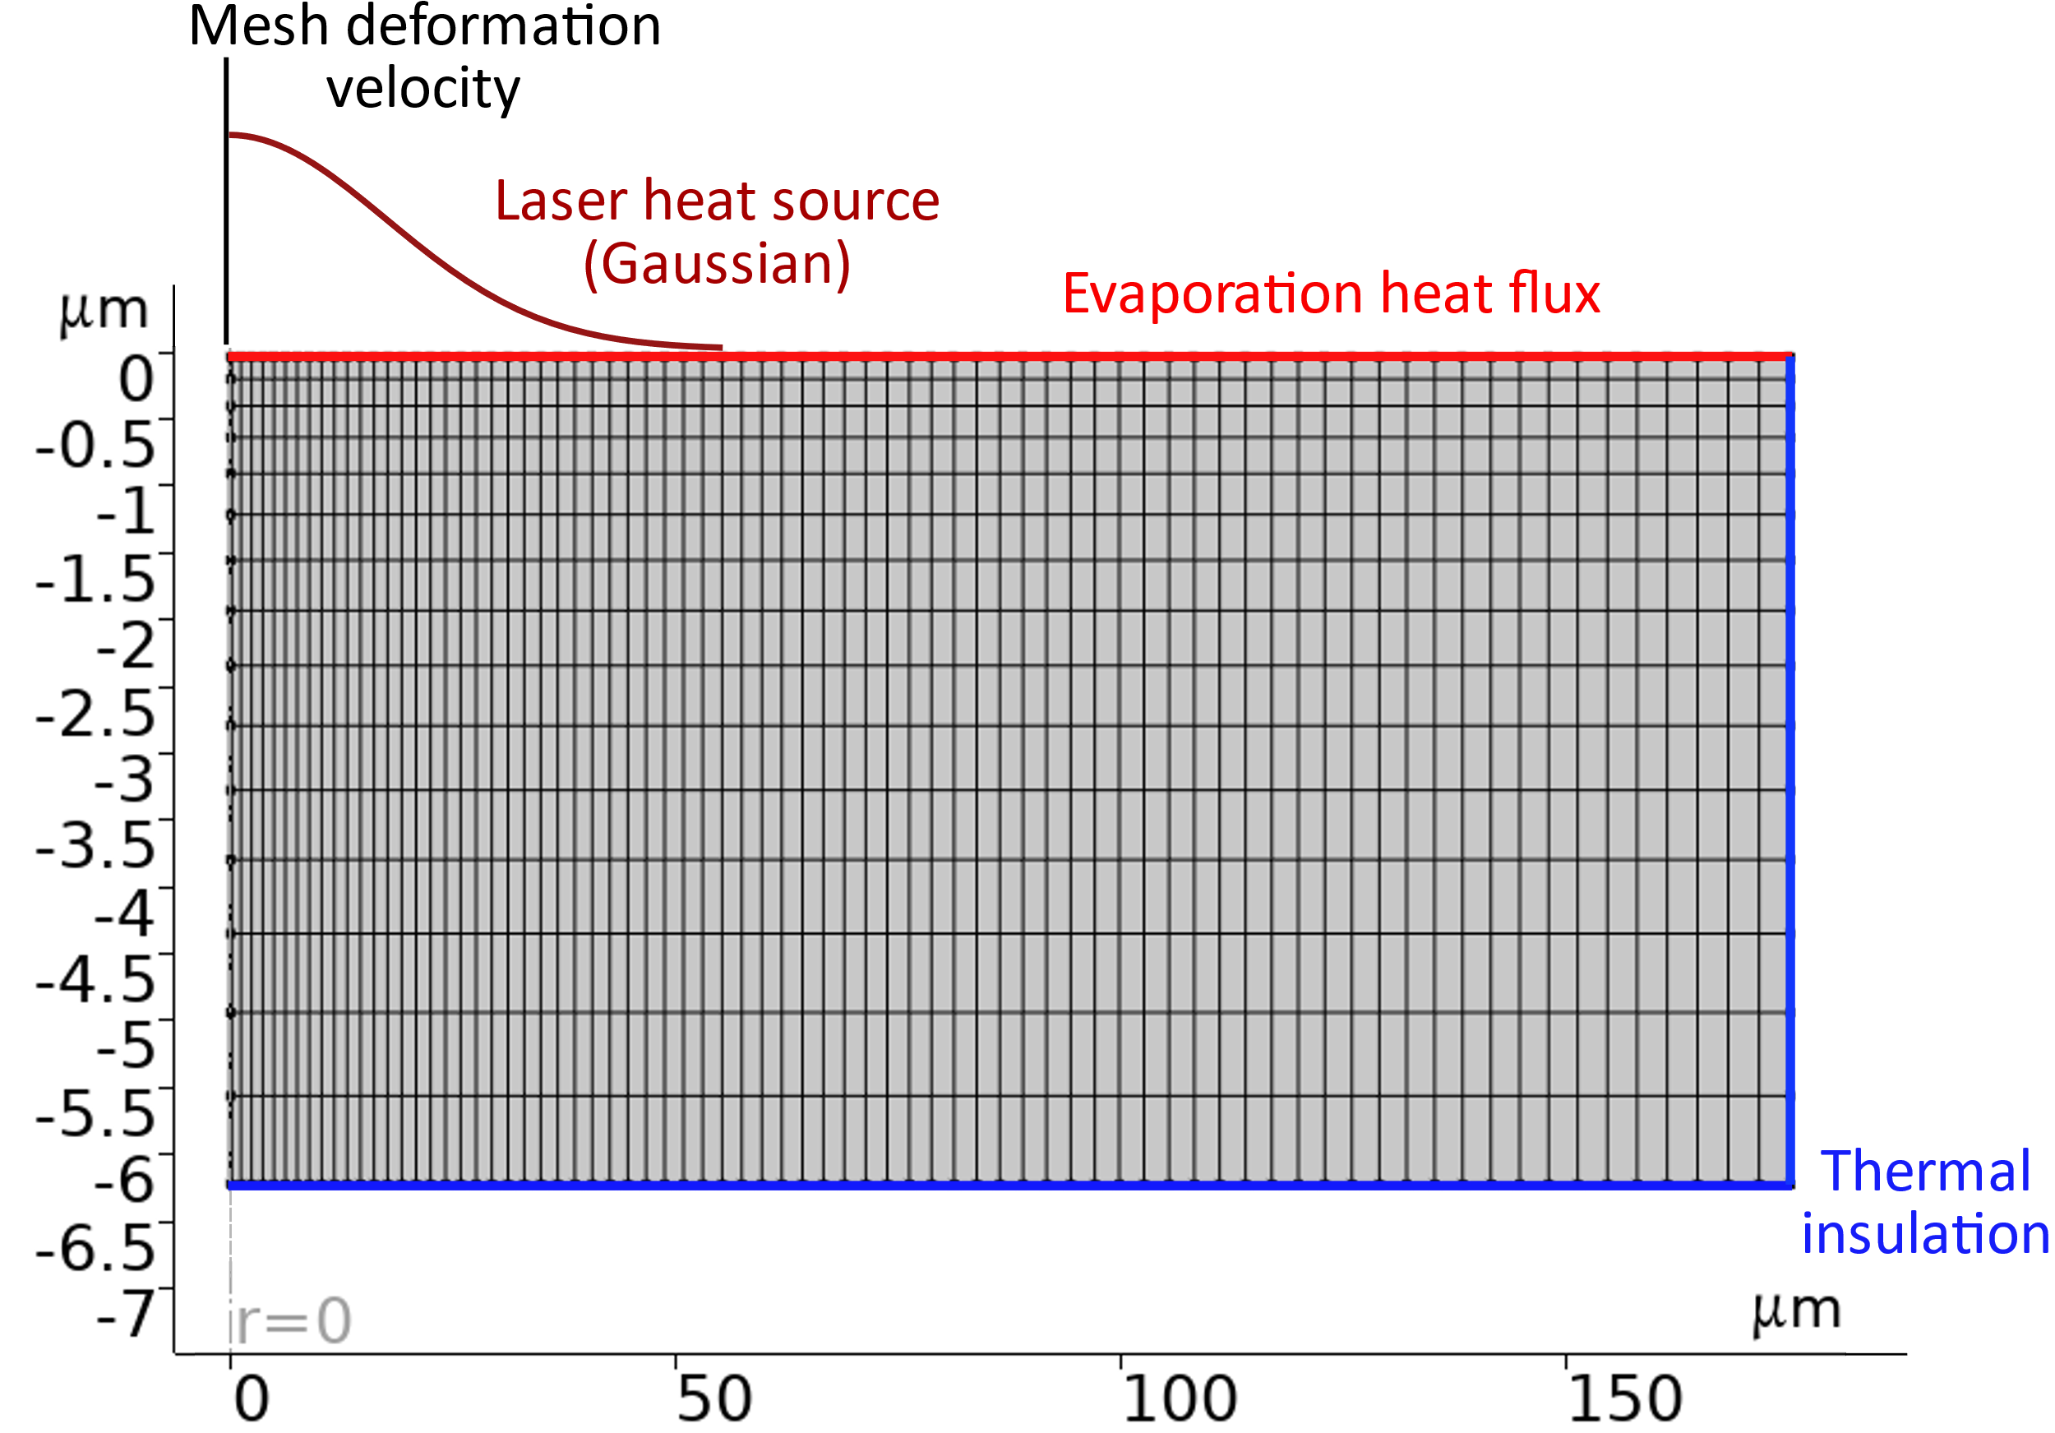
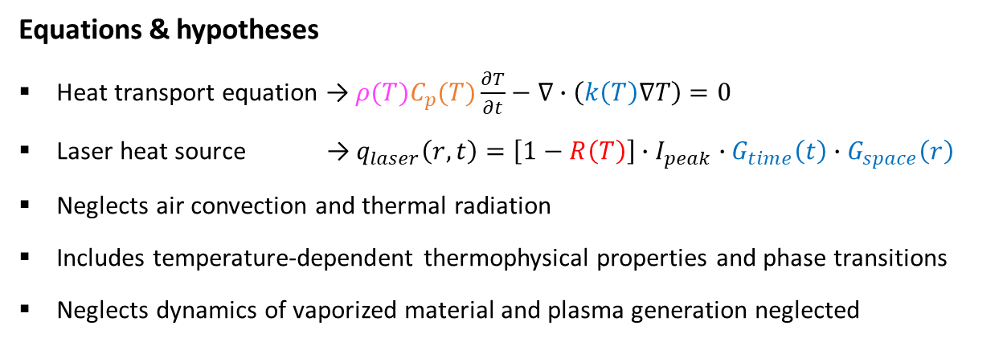
Nanosecond laser ablation modeling
Simulation of laser-target interaction
Vacuum conditions
ns pulse duration
Single pulse incidence
Finite Element (FE) model developed using COMSOL Multiphysics®
Starting point: ns laser ablation (reference choice for most of the existing setups)
Depends on the observed ablation regime
Normal evaporation
Phase explosion
Isobaric heat capacity
Equations & hypotheses
Heat transport equation → $ρ(T)C_{p}(T)\frac{∂T}{∂t}−∇∙\left(k\left(T\right)∇T\right)=0$
Laser heat source → $q_{laser}\left(r,t\right)=\left[1−R\left(T\right)\right]∙I_{peak}∙G_{time}\left(t\right)∙G_{space}\left(r\right)$
Neglects air convection and thermal radiation
Includes temperature-dependent thermophysical properties and phase transitions
Neglects dynamics of vaporized material and plasma generation neglected
Mass density
Thermal conductivity
Material reflectivity
Gaussian temporal profile and spatial distribution
2D axisymmetric
Plasma shielding introduced with a semi-empirical approach
7

Slide 9
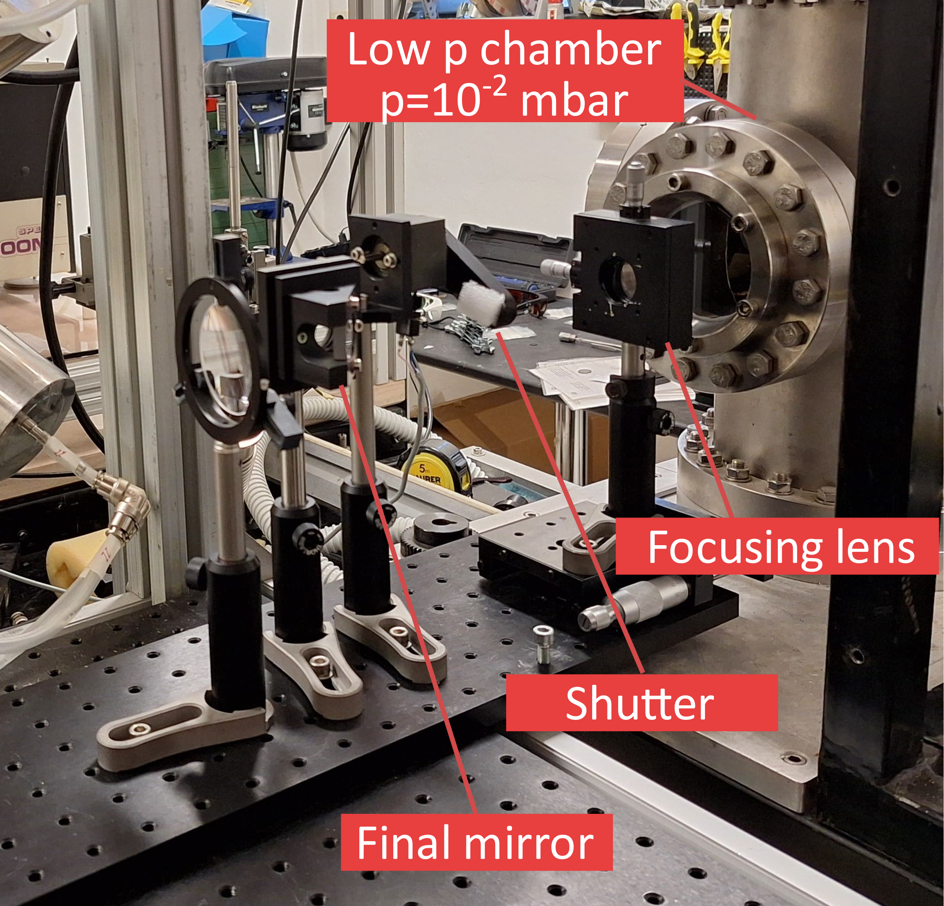
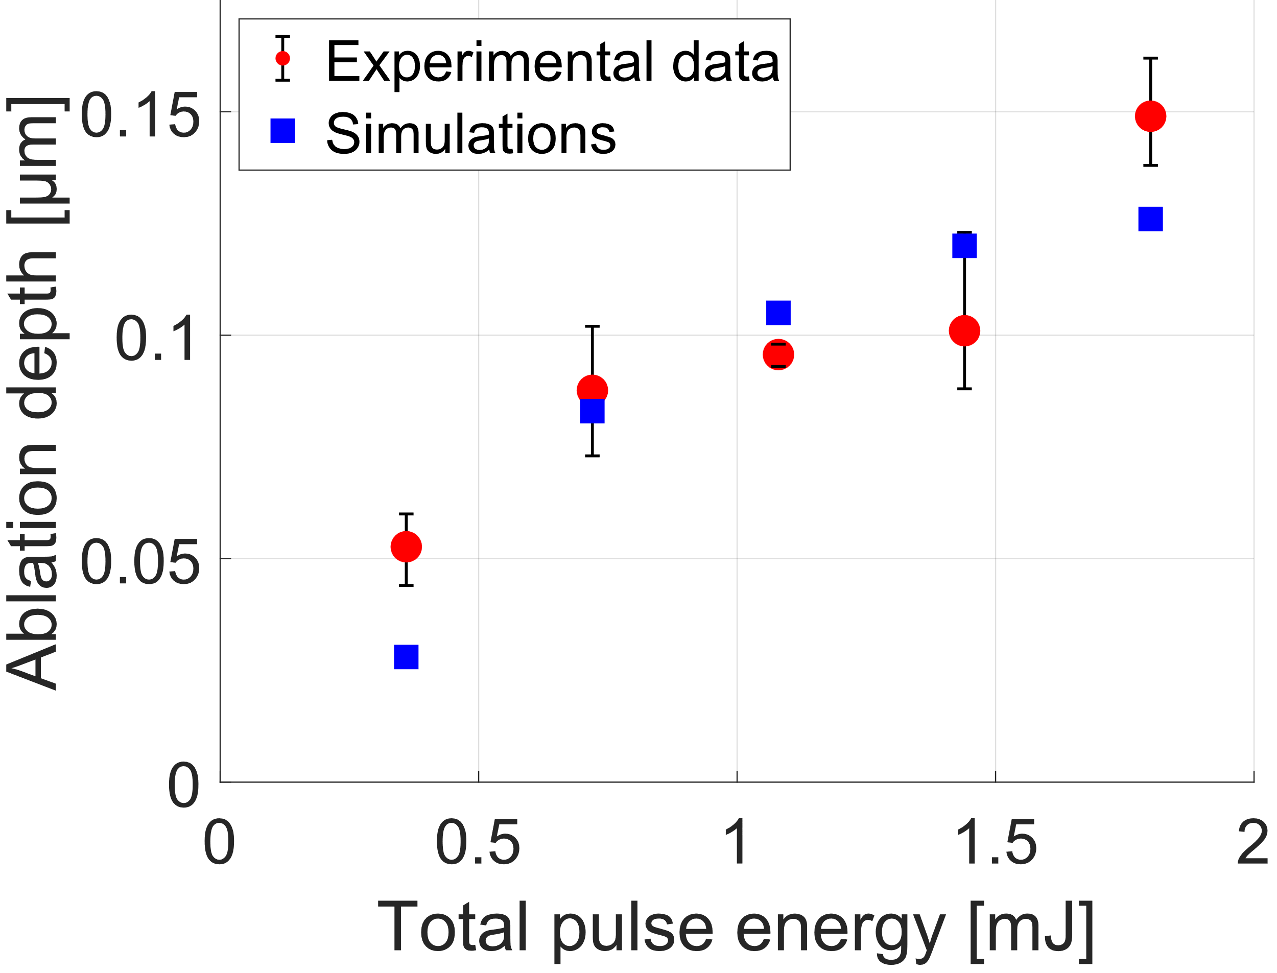
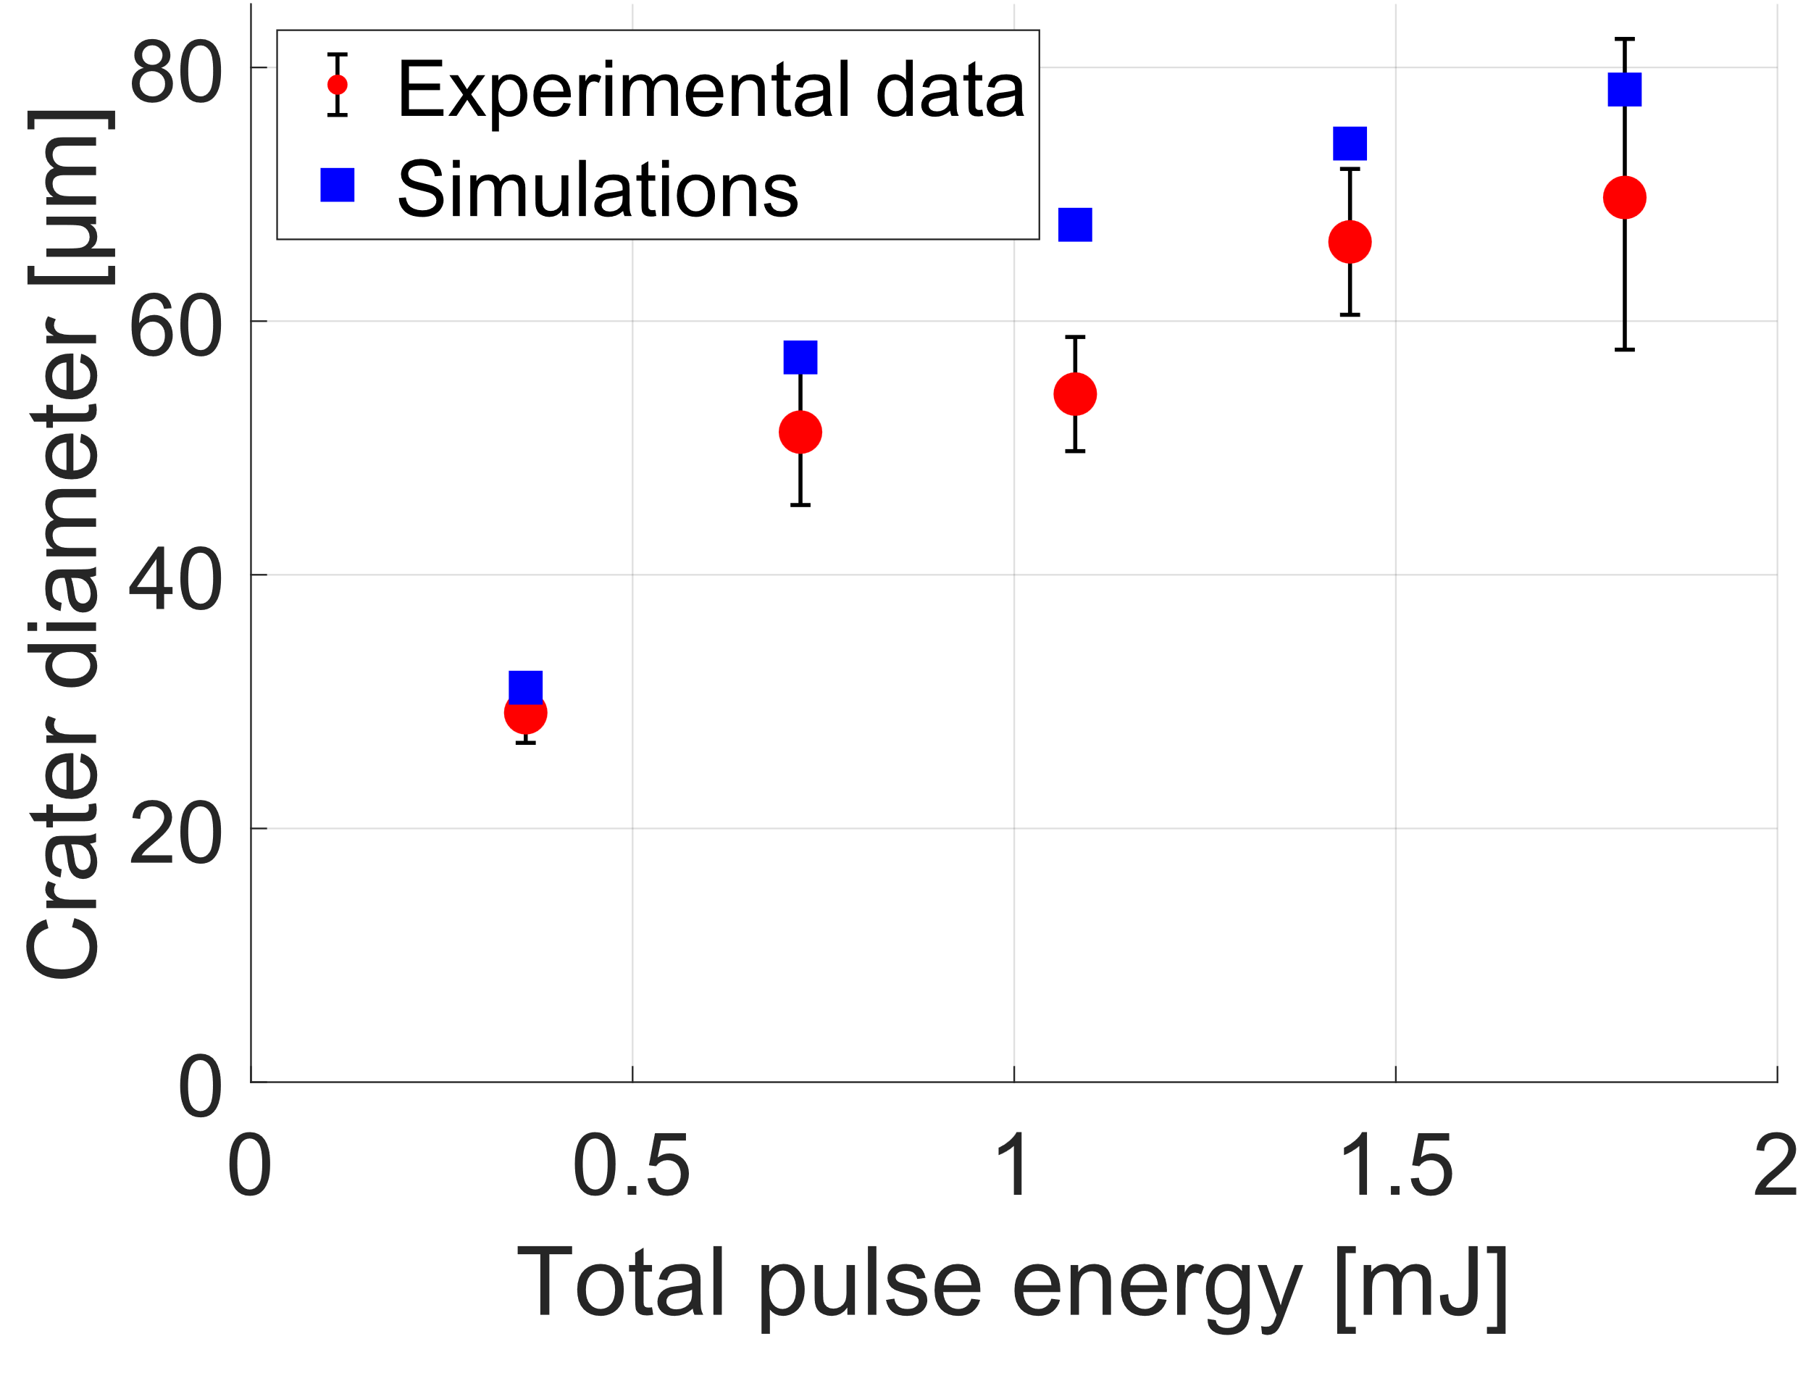
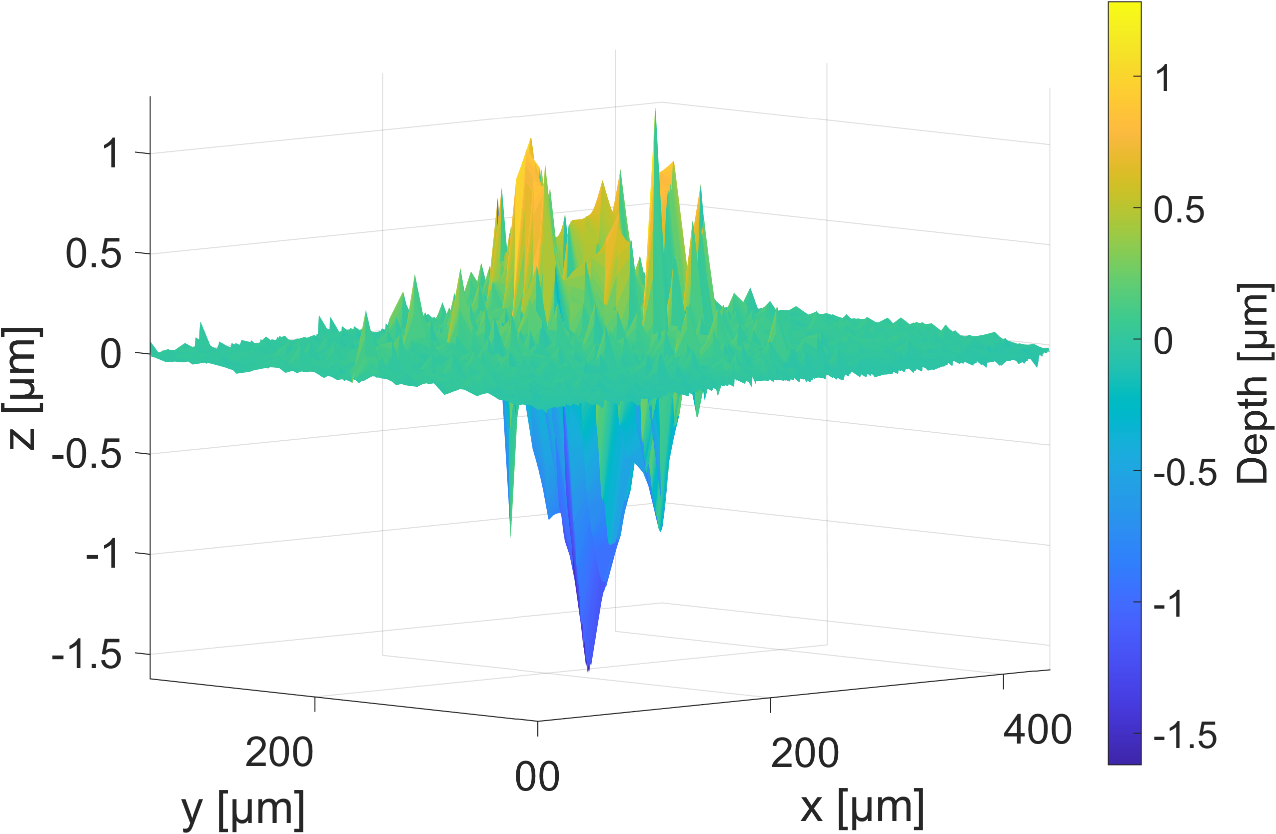
Nanosecond laser ablation modeling
Results for tungsten
Experimental validation: laser irradiation of samples at CNR-ISTP Bari
No signs of violently expelled material (gentle ablation, normal evaporation)
Modeling hypothesis: consider only the central axisymmetric part of the pulse
Crater surface analysis - W
SEM
E = 1.8 mJ 10 pulses
CNR-ICMATE
50 μm
Mechanical profilometer
Nd:YAG laser
τ_{L} = 10 ns
λ = 1064 nm
RR = 10 Hz
2 materials
Tungsten
Silicon
8

Slide 10
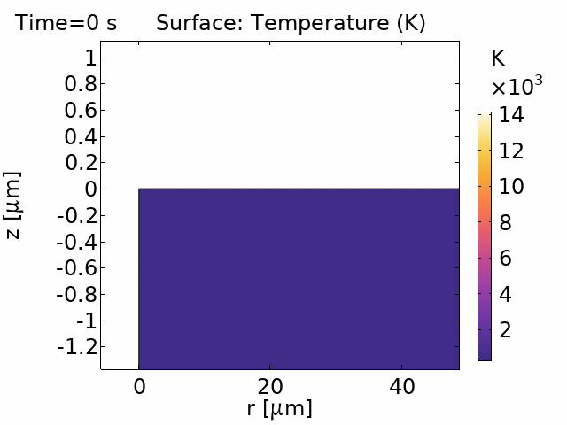
Nanosecond laser ablation modeling
Results for tungsten
Experimental validation: laser irradiation of samples at CNR-ISTP Bari
Crater surface analysis - W
COMSOL® T field
E = 1.8 mJ
SEM
E = 1.8 mJ 10 pulses
CNR-ICMATE
50 μm
Mechanical profilometer
Nd:YAG laser
τ_{L} = 10 ns
λ = 1064 nm
RR = 10 Hz
2 materials
Tungsten
Silicon
Molten region extending 700 nm below crater bottom
9

Slide 11
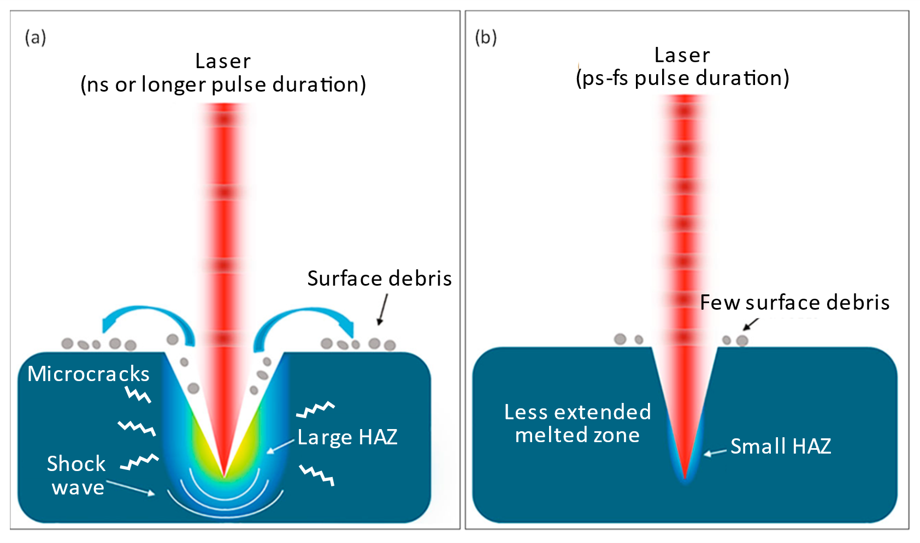
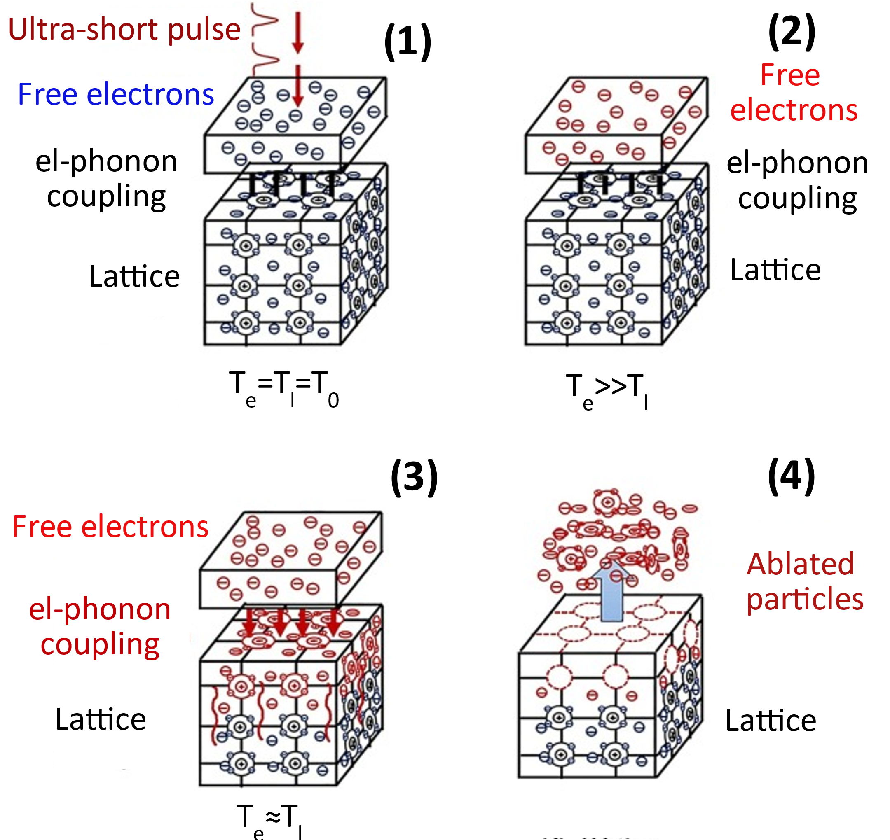
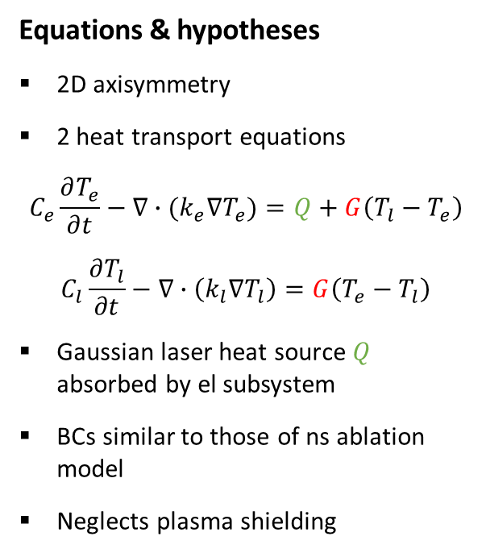
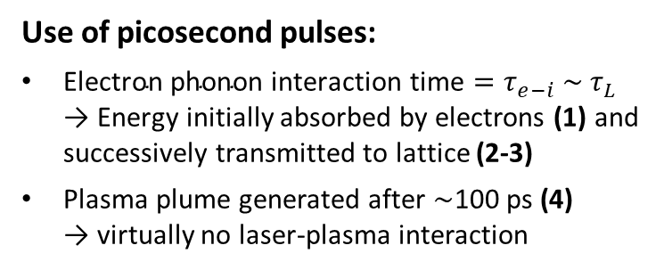
Picosecond laser ablation modeling
Two Temperature model (TTM)
Equations & hypotheses
2D axisymmetry
2 heat transport equations
$$C_{e}\frac{∂T_{e}}{∂t}−∇∙(k_{e}∇T_{e})=Q+G\left(T_{l}−T_{e}\right)$$
$$C_{l}\frac{∂T_{l}}{∂t}−∇∙\left(k_{l}∇T_{l}\right)=G\left(T_{e}−T_{l}\right)$$
Gaussian laser heat source $Q$ absorbed by el subsystem
BCs similar to those of ns ablation model
Neglects plasma shielding
electrons-phonons coupling constant
Use of picosecond pulses:
$\text{Electron} \text{phonon} \text{interaction} \text{time}=τ_{e−i} \sim τ_{L}$ → Energy initially absorbed by electrons (1) and successively transmitted to lattice (2-3)
Plasma plume generated after ~100 ps (4) → virtually no laser-plasma interaction
10

Slide 12
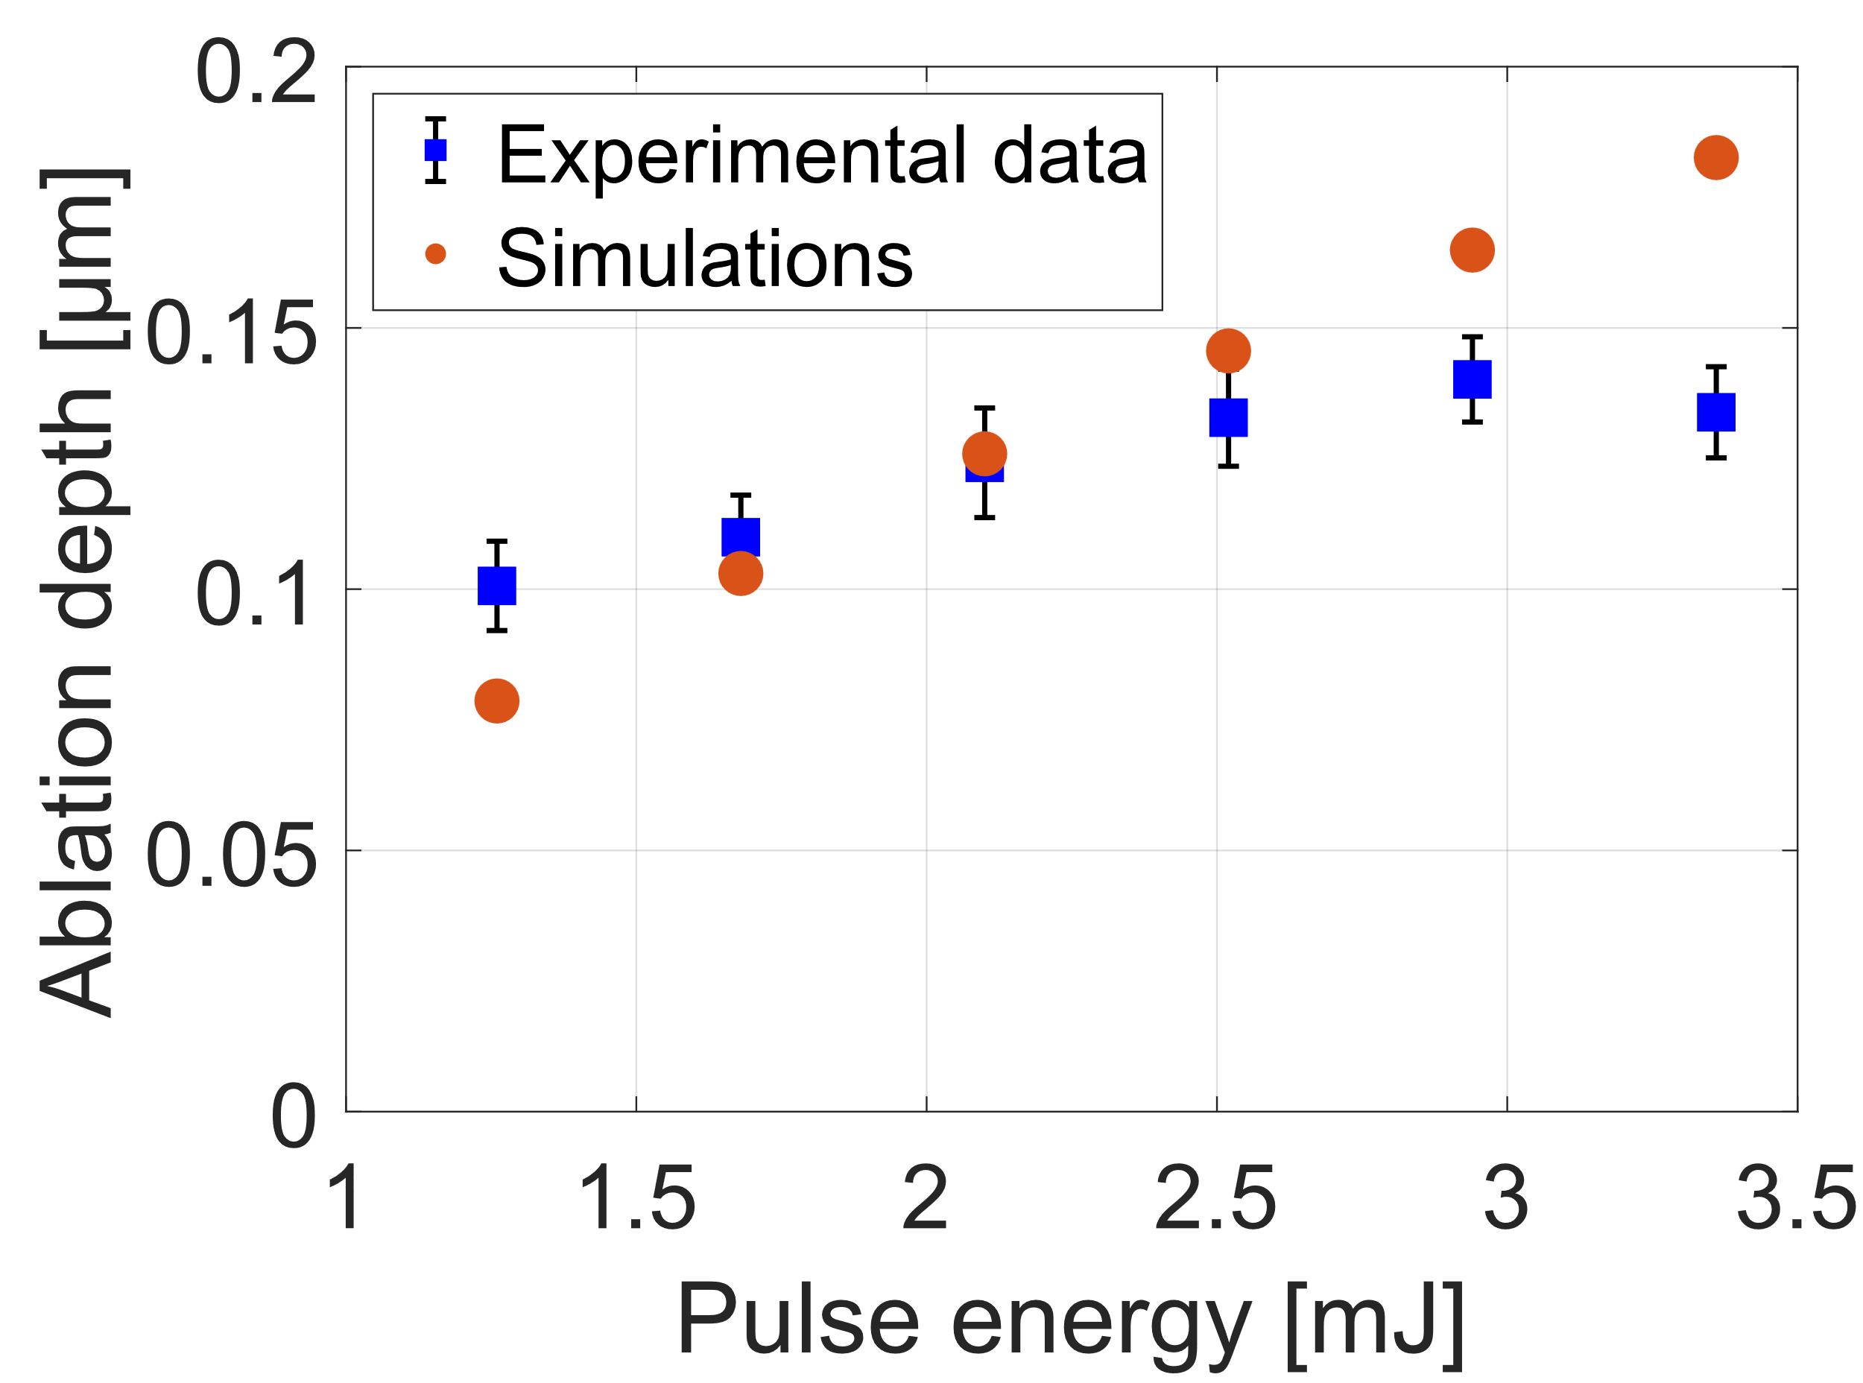
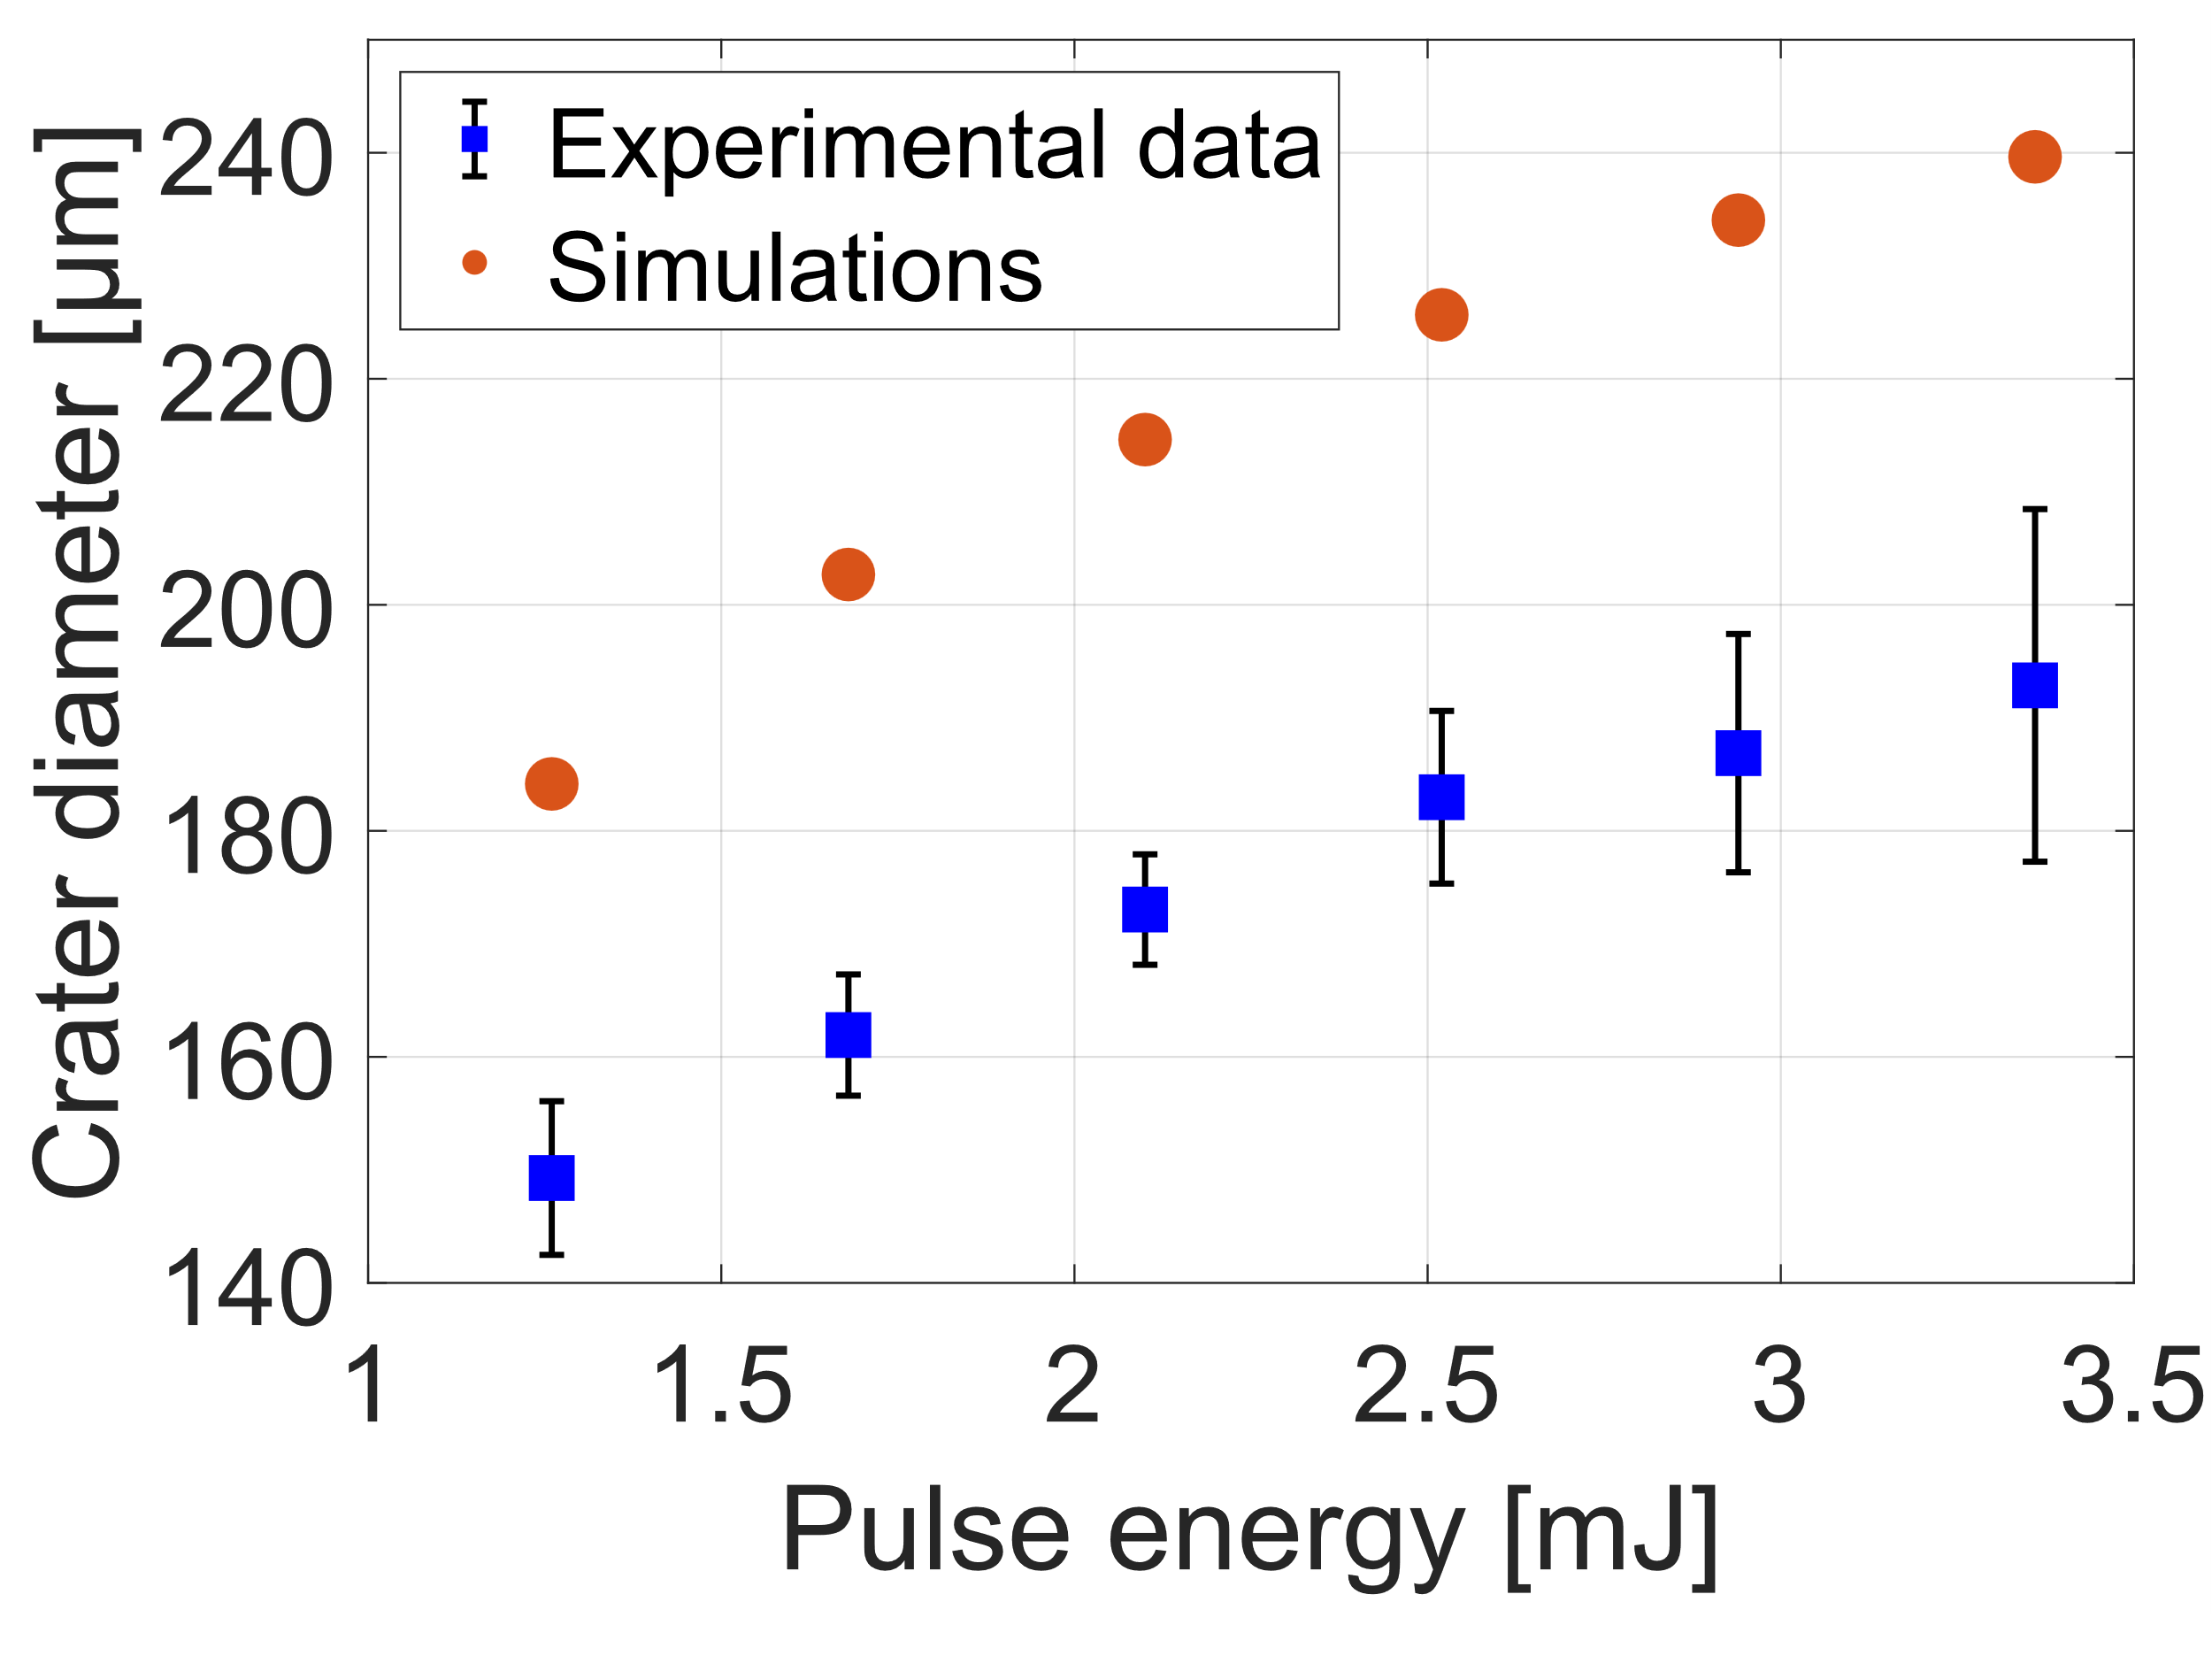
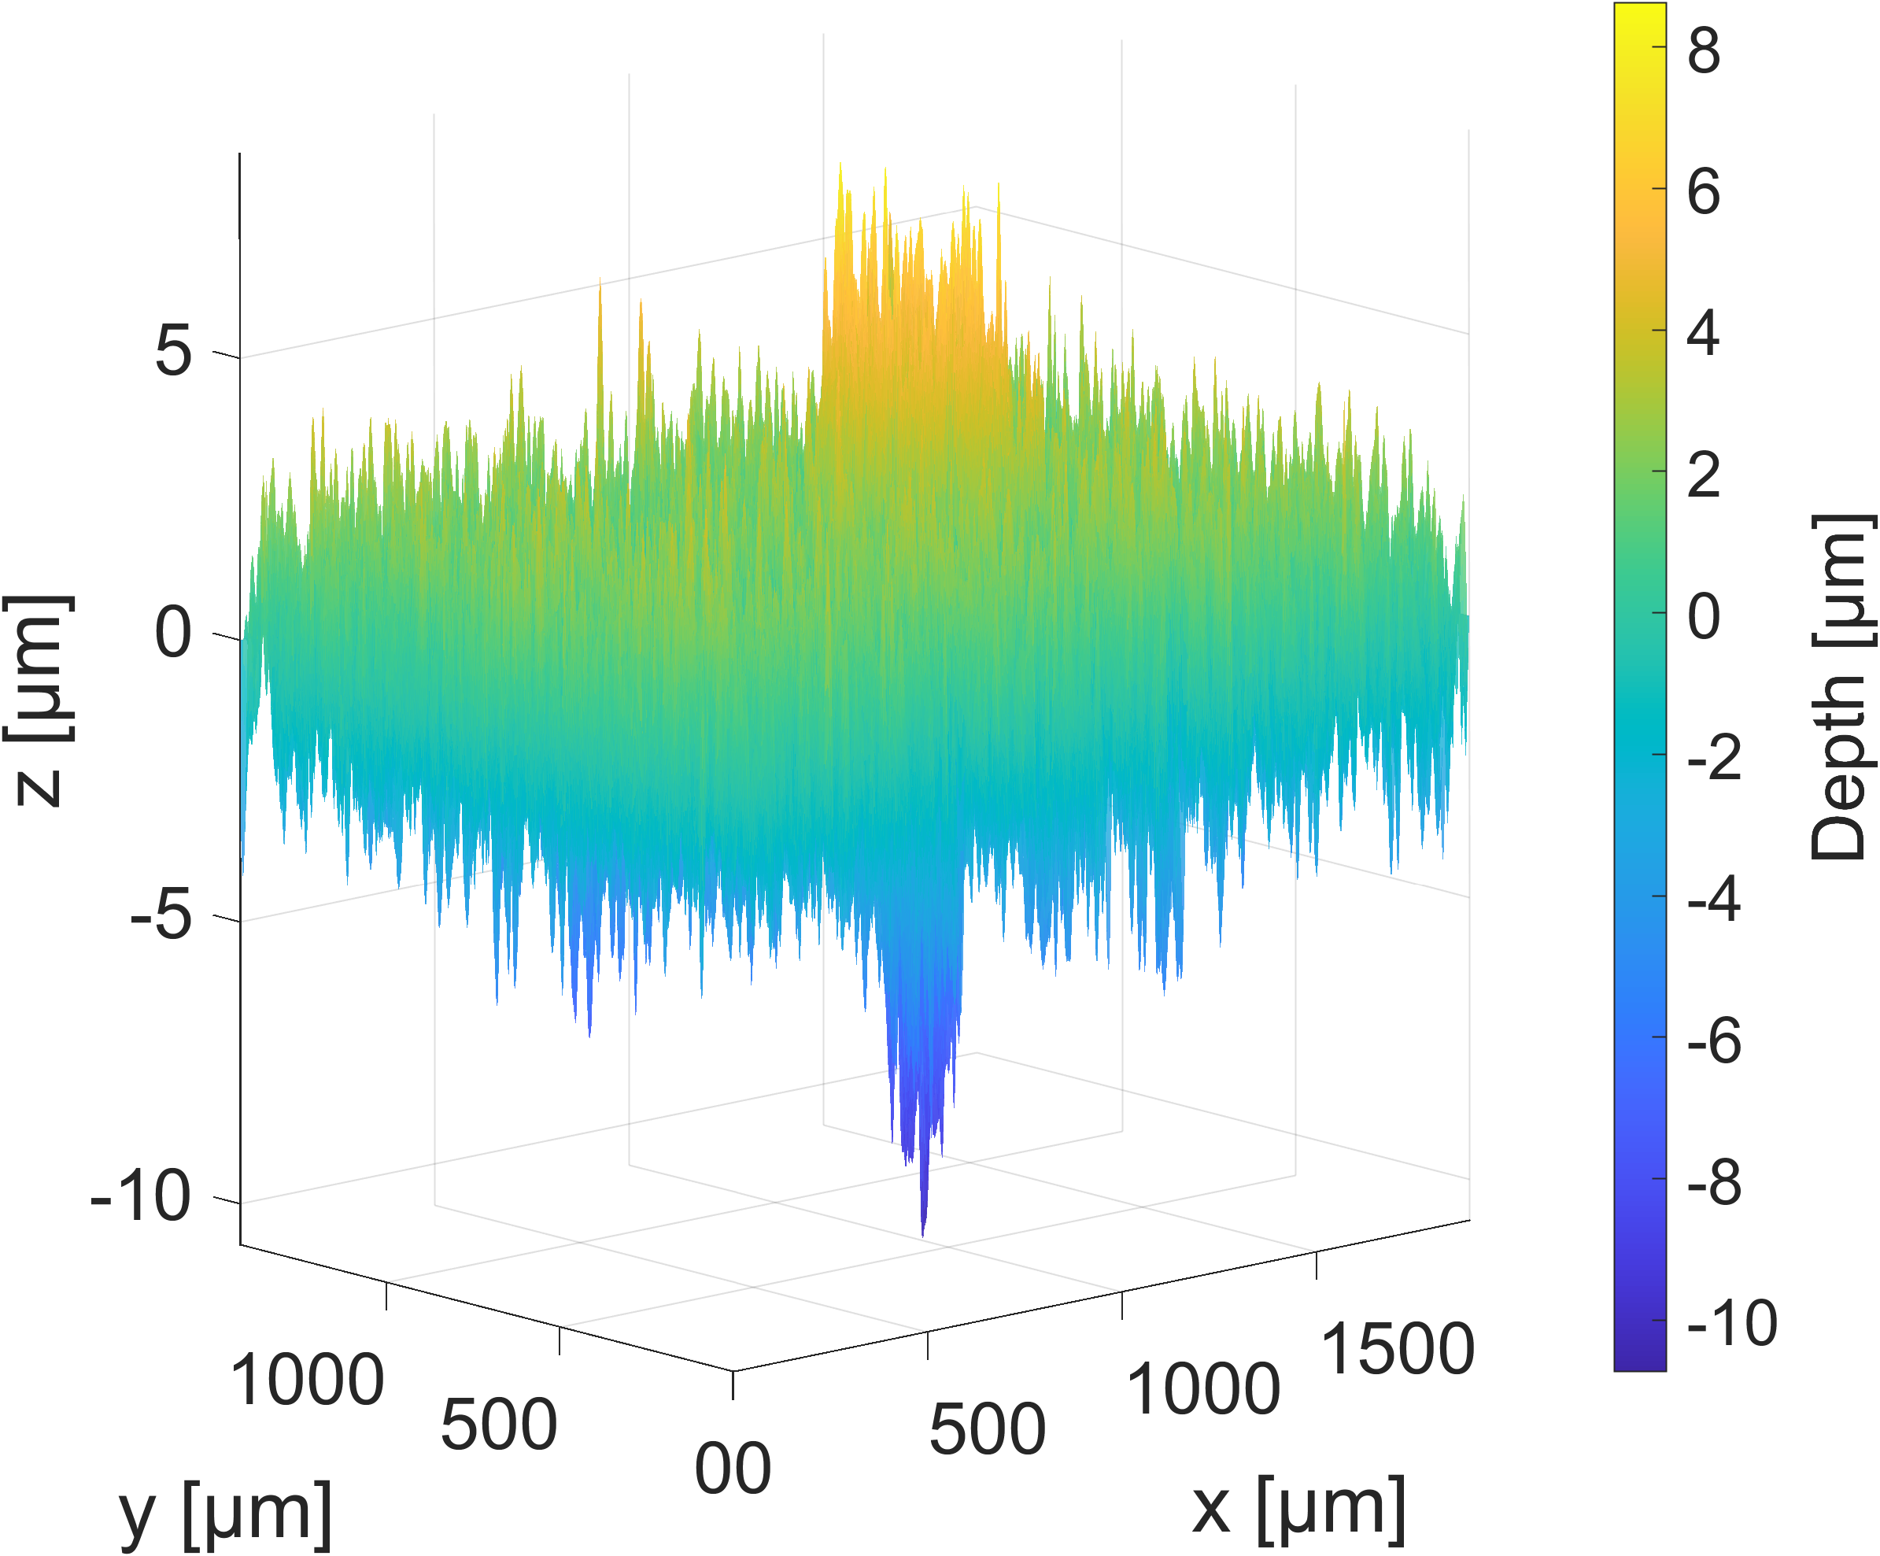
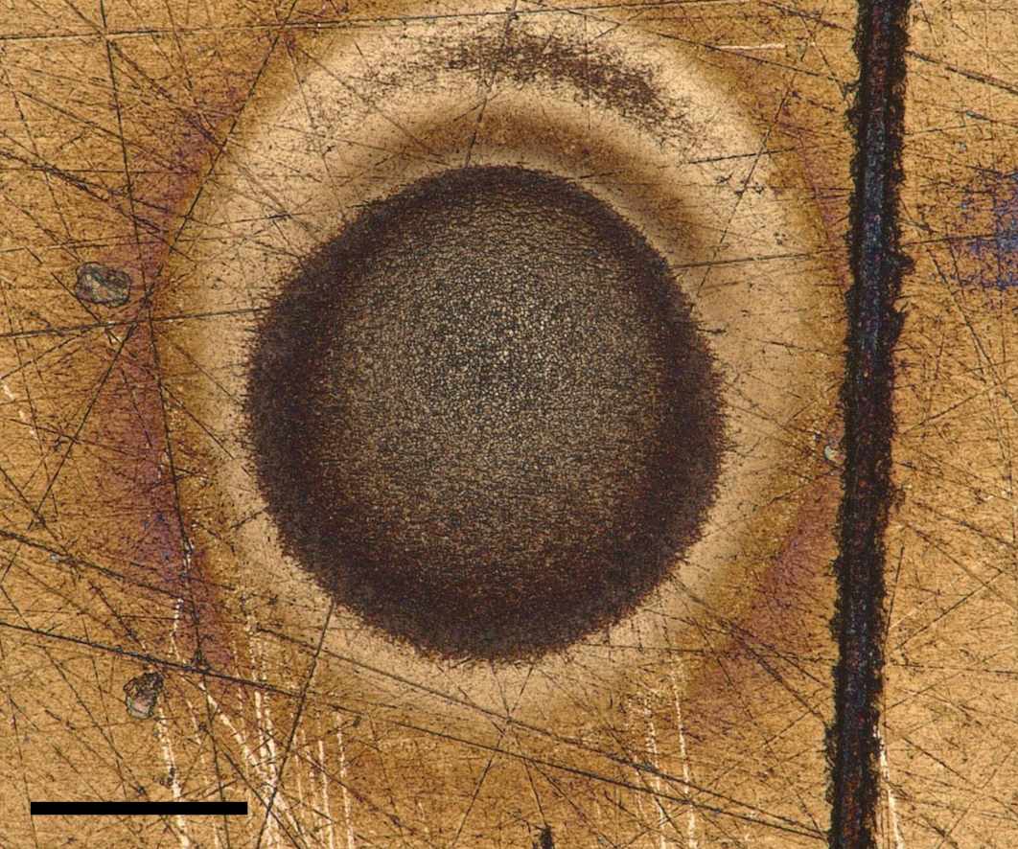
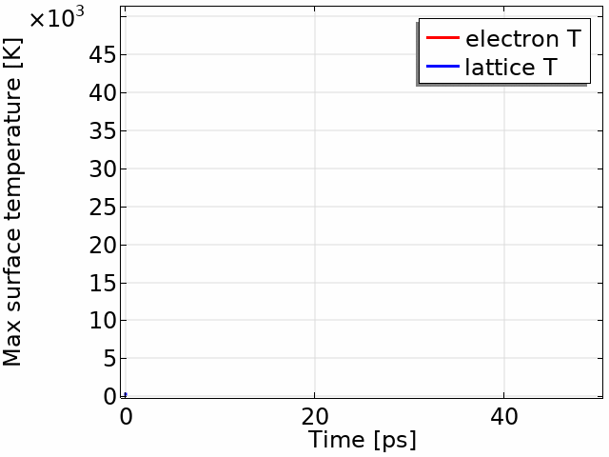
Picosecond laser ablation modeling
Results: model validation and max T evolution
Experimental validation: laser irradiation of samples at CNR-ISTP Bari (only tungsten)
Yb laser
τ_{L} = 10 ps
λ = 1030 nm
RR = 10 Hz
Measurement chamber
Low p environment (≈ 1 mbar)
Ar atmosphere
Optical profilometer
Optical microscope
1.35 mJ
64 pulses
100 μm
CNR-ISTP Bari
11

Slide 13
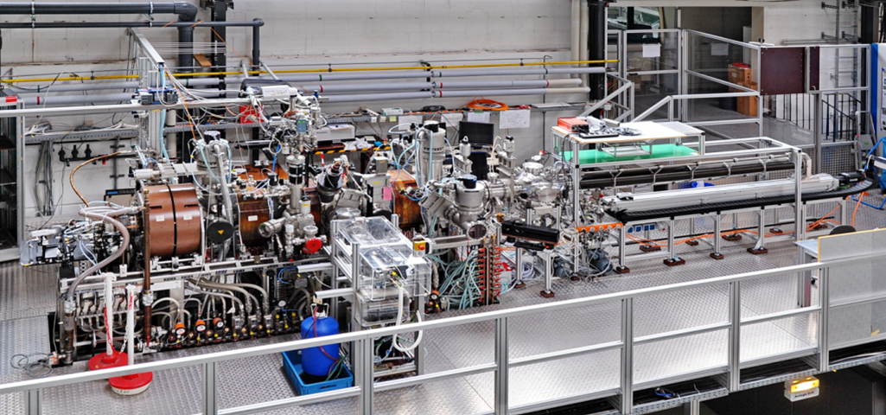

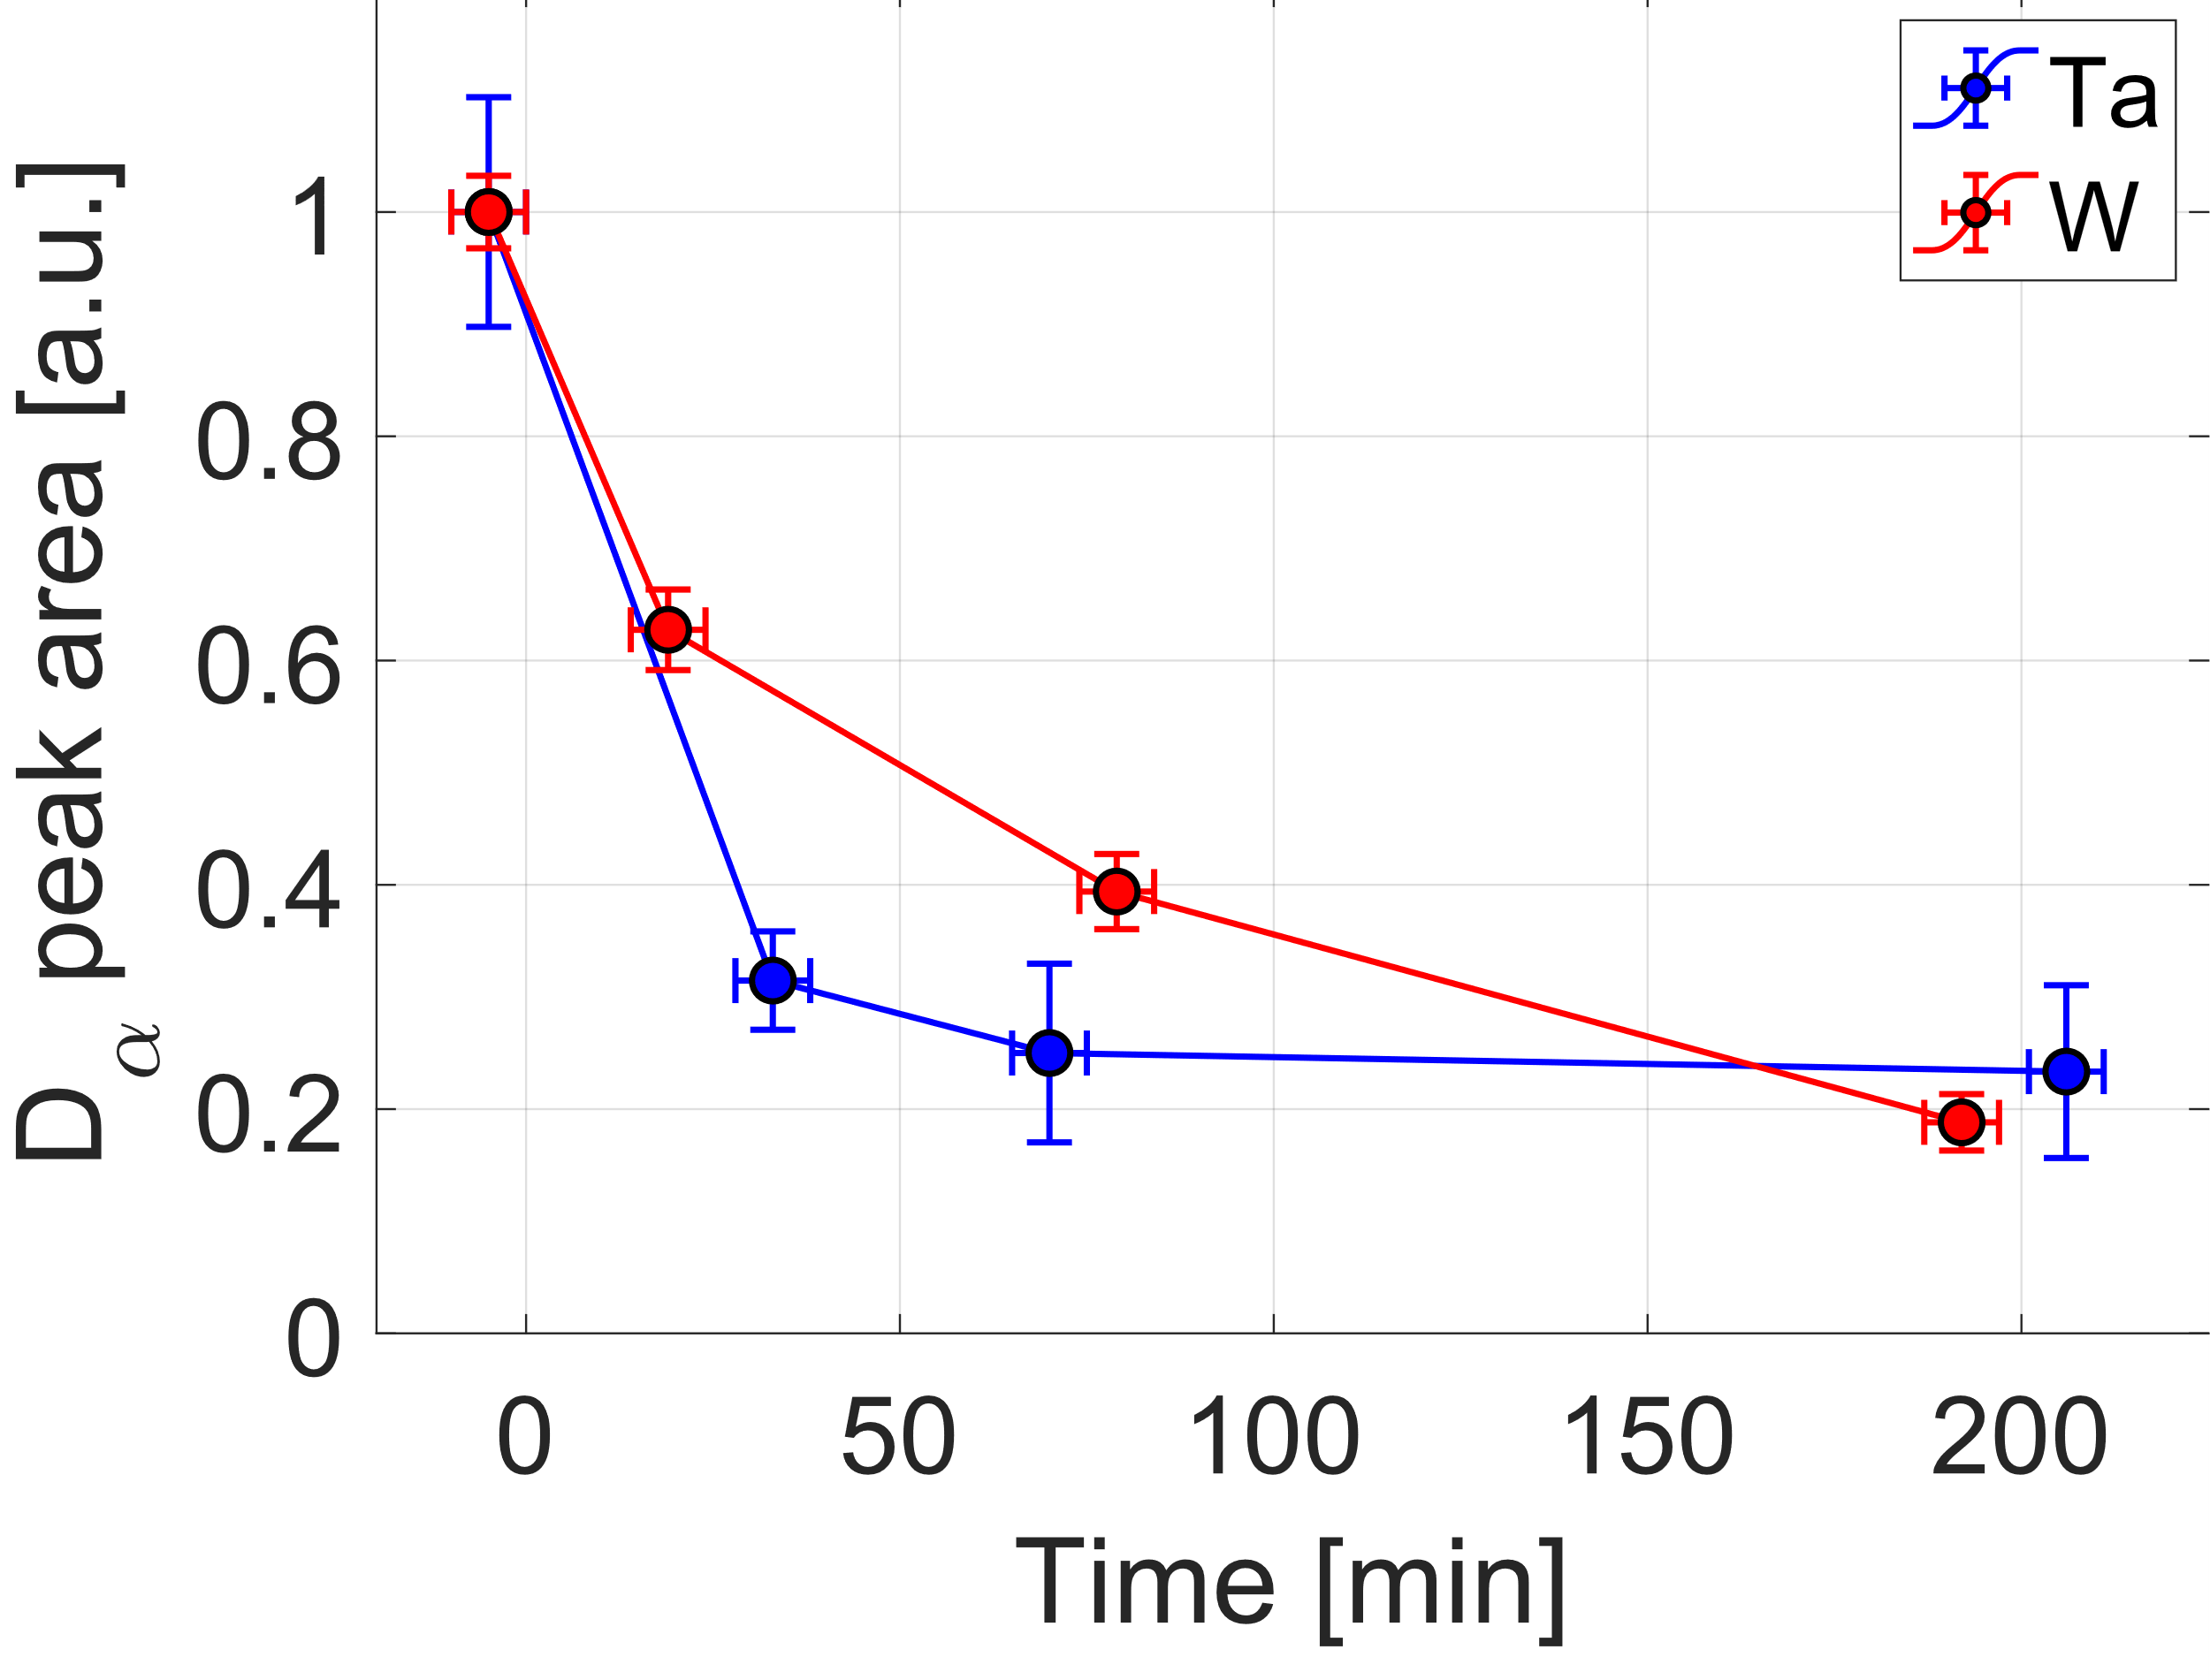
In-situ LIBS retention measurements on the PSI-2 linear device
Objective of the activity: gain practical experience with in-situ LIBS on linear plasma devices
In-situ measurements of short-term D retention using LIBS
W (reference PFC material)
Ta (superior resistance to He-induced damages, higher retention expected)
Exposure parameters
Measurements for successive times
Fitting and integration of D_{α} peak
PSI-2 LPD
Exp time [min] | 190
Ion fluence [m⁻²] | 3.3∙10²⁵
E_{ions} [eV] | 80
T_{samples} [°C] | 250
6 m long machine
High-current arc-discharge source
~6 cm plasma column
Controlled sample exposure (bias voltage, sample temperature)
Experimental goals:
Reconstruct D outgassing curves
Compare results for W with Ta, for which worse retention properties are expected
12

Slide 14

Conclusions
This work is based on a combined approach (preliminary design, modeling as support activity, experiments)
Individuation of suitable components for an in-situ LIBS on BiGyM (ps EKSPLA laser, Isoplane 320 spectrometer)
Preliminar design of LIBS optical path (8 m, 3 fixed mirrors, 1 steering mirror, focusing lens)
Development of a numerical model for ns laser ablation and successful validation for W and Si
Development of a numerical model for ps laser ablation and successful validation for W
In-situ LIBS measurements for short-term D retention assessment, highlighting differences between W and Ta
Future developments
Modeling activity: introduction of gas dynamics and ionization equations → prediction of plasma plume characteristics
Diagnostics development:
Optical path construction
Diagnostics commissioning
First measurements
Late summer 2026
Oct-Nov 2026
End of 2026
13

Slide 15
Acknowledgments
CNR-ISTP Milano
A. Cremona, A. Uccello, J. Scionti, I. Casiraghi, and the GyM team
CNR-ISTP Bari
G. Dilecce, A. Hussain, P. F. Ambrico, D. Aceto
Forschungszentrum Jülich (FZJ)
S. Brezinsek, Y. Rongxing, G. Sergienko, D. Matveev, E. Wüst, C. Kawan, S. Möller, and the active/passive spectroscopy group
CNR-ICMATE Milano
D. Ripamonti
ENEA Frascati
M. Iafrati, M. Alonzo, S. Almaviva
14

Slide 16
Backup slides

Slide 17
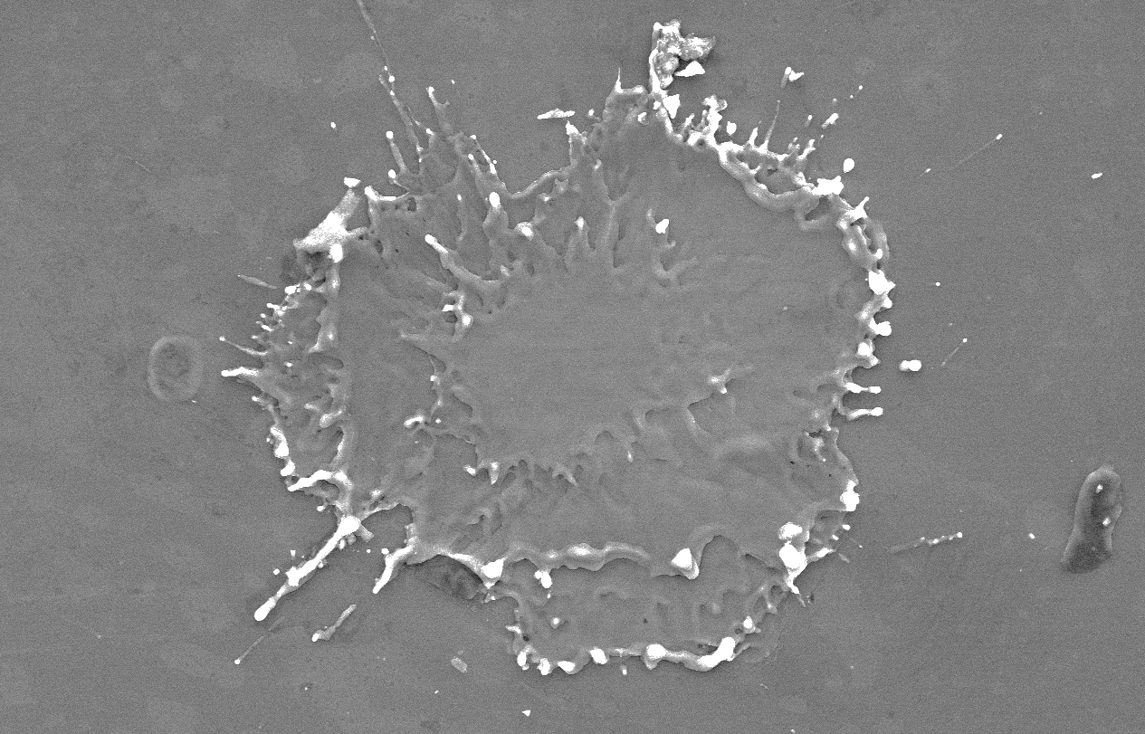
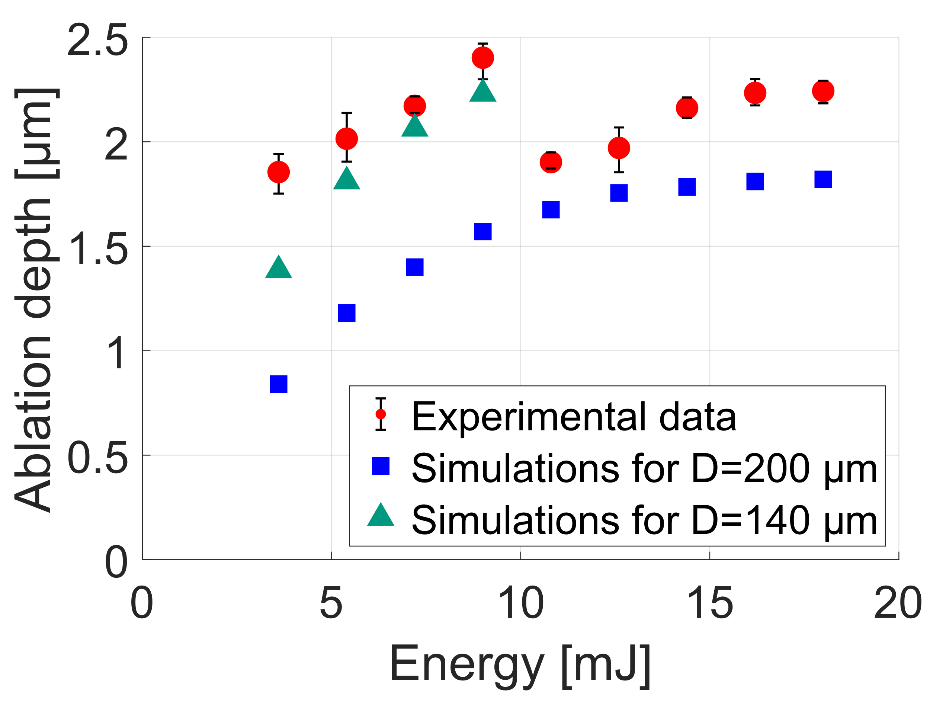
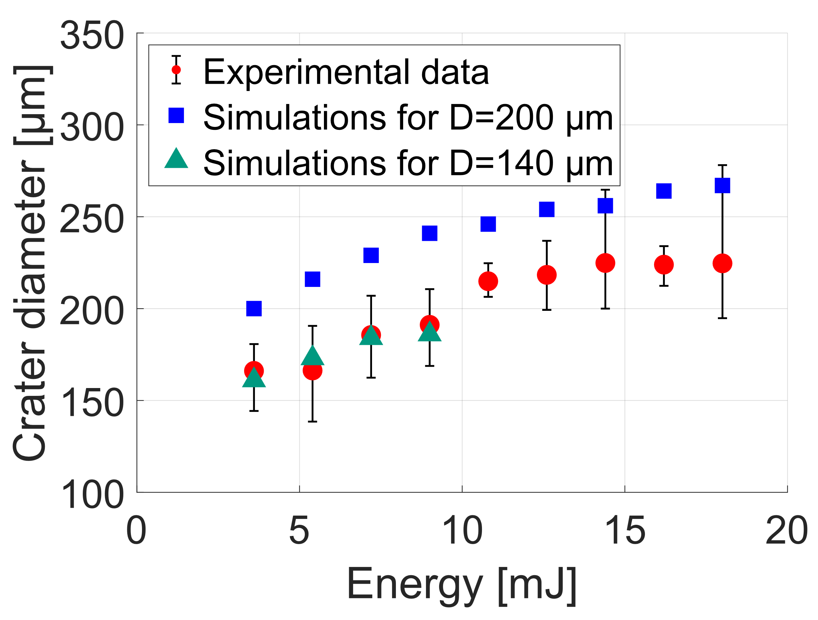
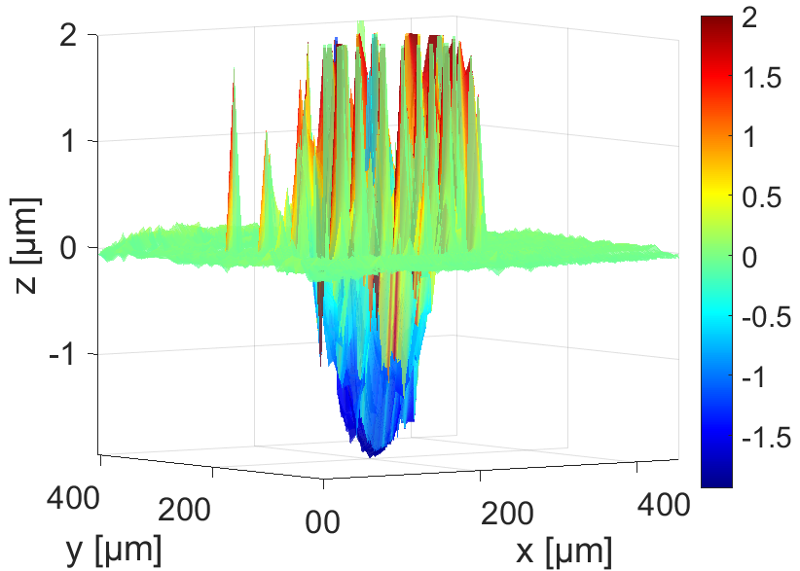
Nanosecond laser ablation modeling
Results for silicon
Experimental validation: laser irradiation of samples at CNR-ISTP Bari
Crater surface analysis - Si
Signs of violently expelled material (phase explosion)
2 sets of simulations to take into account an experimental spot size variation
SEM
E = 3.6 mJ 1 pulse
CNR-ICMATE
50 μm
Mechanical profilometer
Nd:YAG laser
τ_{L} = 10 ns
λ = 1064 nm
RR = 10 Hz
2 materials
Tungsten
Silicon

Slide 18
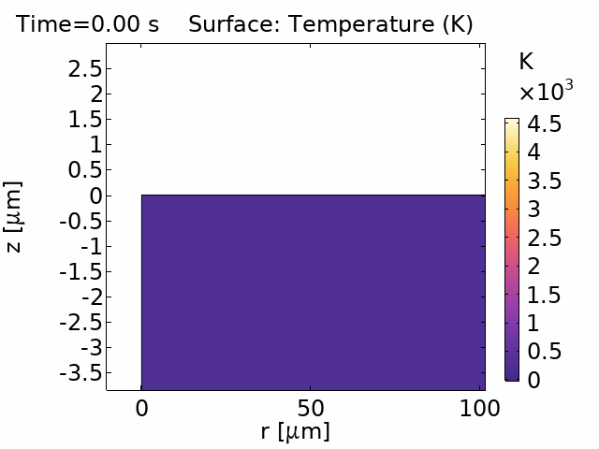
Nanosecond laser ablation modeling
Results for silicon
Experimental validation: laser irradiation of samples at CNR-ISTP Bari
Crater surface analysis - Si
COMSOL® T field
E = 3.6 mJ
SEM
E = 3.6 mJ 1 pulse
CNR-ICMATE
50 μm
Mechanical profilometer
Nd:YAG laser
τ_{L} = 10 ns
λ = 1064 nm
RR = 10 Hz
2 materials
Tungsten
Silicon
Molten region extending 500 nm below crater bottom

Slide 19
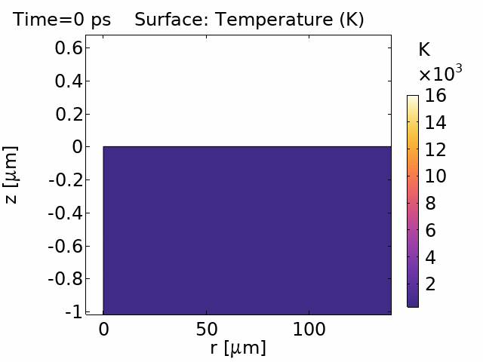
Picosecond laser ablation modeling
Results: lattice T evolution
Experimental validation: laser irradiation of samples at CNR-ISTP Bari (only tungsten)
E = 3.4 mJ
Yb laser
τ_{L} = 10 ps
λ = 1030 nm
RR = 10 Hz
Measurement chamber
Low p environment (≈ 1 mbar)
Ar atmosphere
Optical profilometer
Optical microscope
1.35 mJ
64 pulses
ns laser ablation, F=20 J/cm²
Molten region extended 700 nm below crater bottom
ps laser ablation, F=12 J/cm²
Molten region extended 100 nm below crater bottom
100 μm
CNR-ISTP Bari

Slide 20
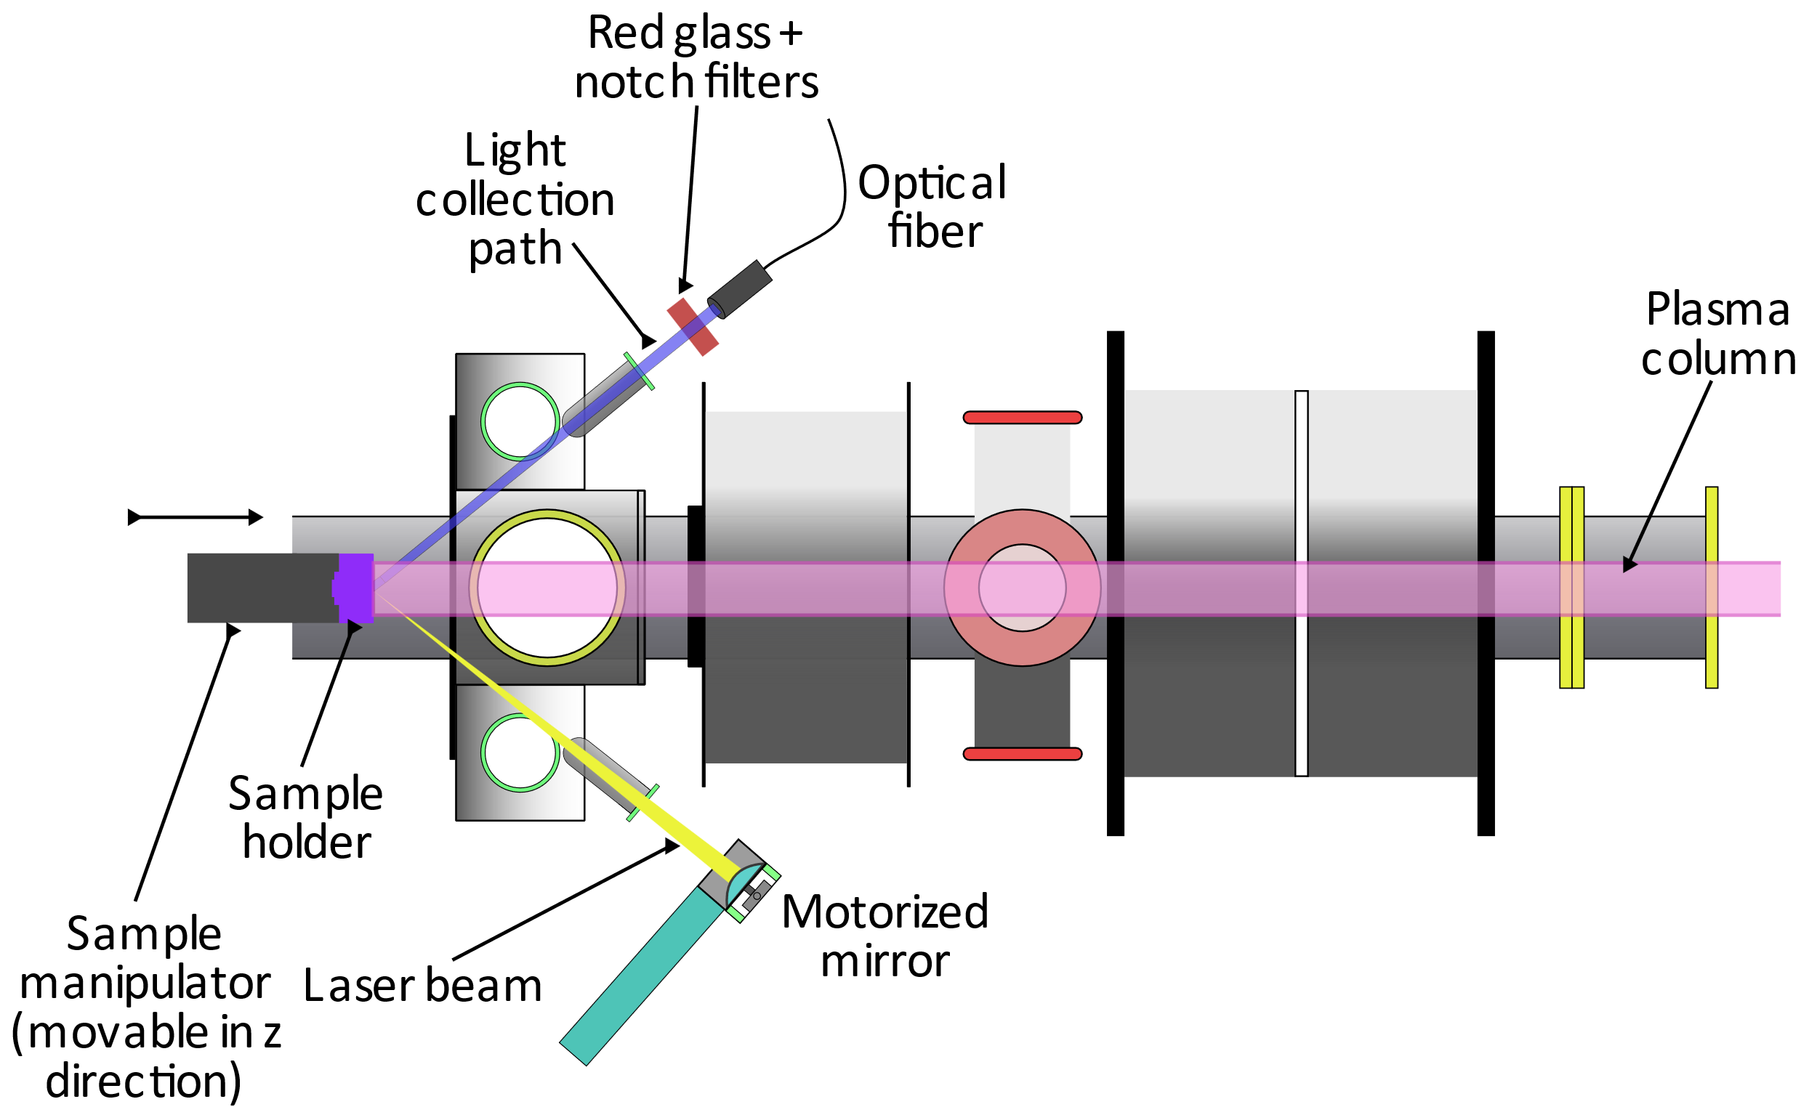
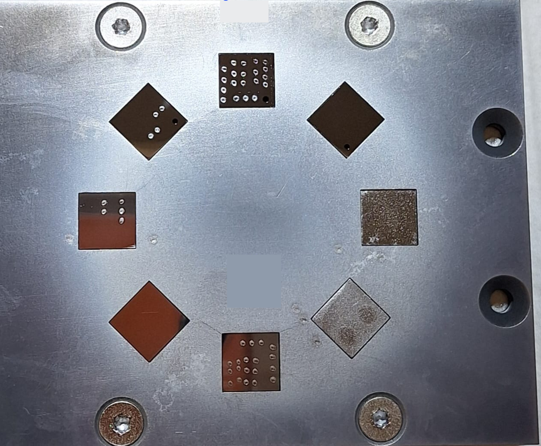
In-situ LIBS retention measurements on the PSI-2 linear device
Objective of the activity: gain practical experience with in-situ LIBS on linear plasma devices
PSI-2 LPD
Exp time [min] | 190
Ion fluence [m⁻²] | 3.3∙10²⁵
E_{ions} [eV] | 80
T_{samples} [°C] | 250
In-situ LIBS diagnostics
PSI-2 sample holder
6 m long machine
High-current arc-discharge source
~6 cm plasma column
Controlled sample exposure (bias voltage, sample temperature)
In-situ measurements of short-term D retention using LIBS
W (reference PFC material)
Ta (superior resistance to He-induced damages, worse retention properties expected)
Experimental goals:
Reconstruct D outgassing curves
Compare W with Ta, for which worse retention properties are expected

Slide 21
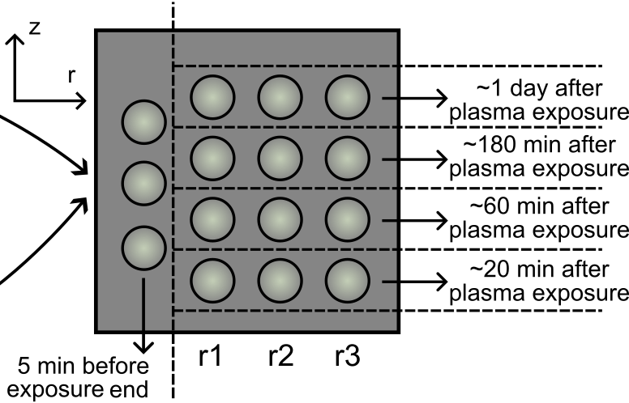
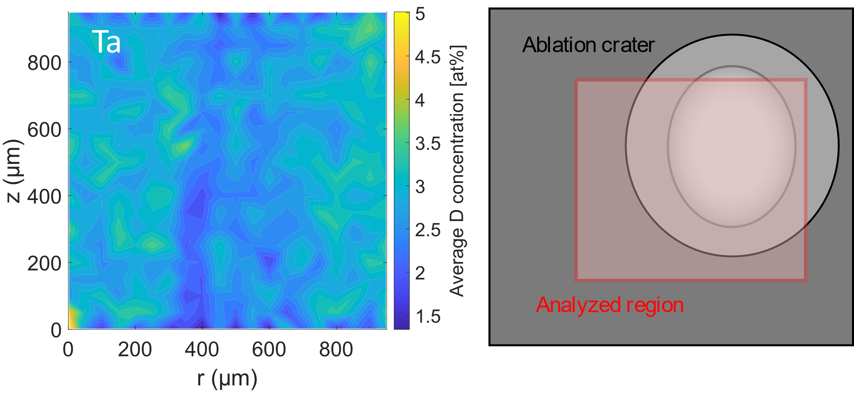
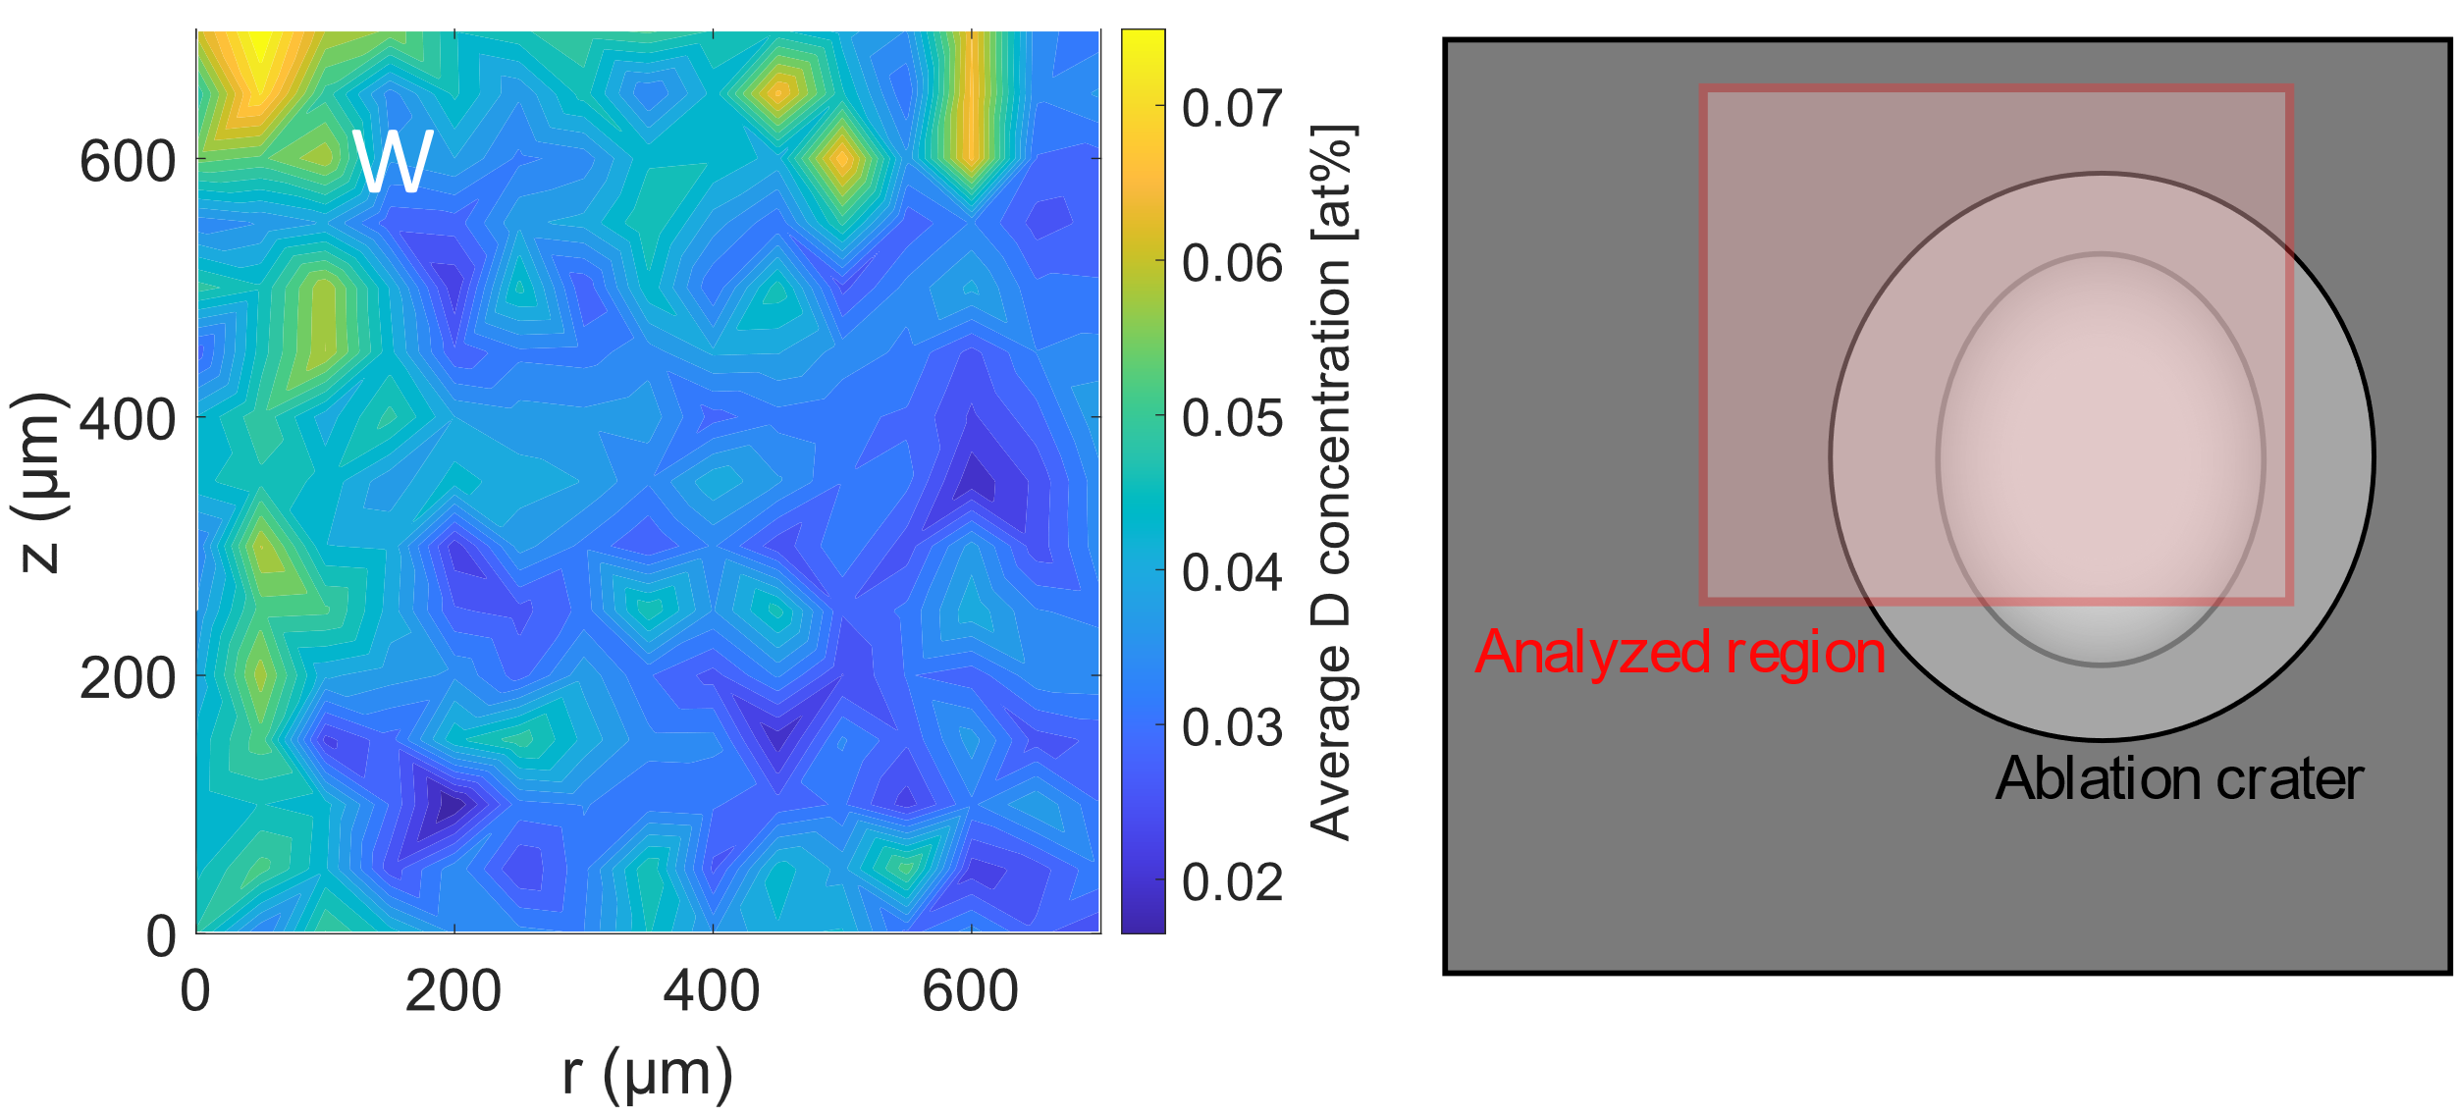
In-situ LIBS retention measurements on the PSI-2 linear device
Normalized comparison W-Ta
Each point is a radial average
W: faster decrease for long times
Ta: higher outgassing for short times
D concentration derived from an ion beam technique (NRA)
LIBS measurements for successive times
Radial dependence of ion flux → measurements at different radial positions
Identification of the D_{α} peak for each spectrum
Peak fitting, numerical integration, and reconstruction of the outgassing curves
No quantitative information about D concentration

Slide 22
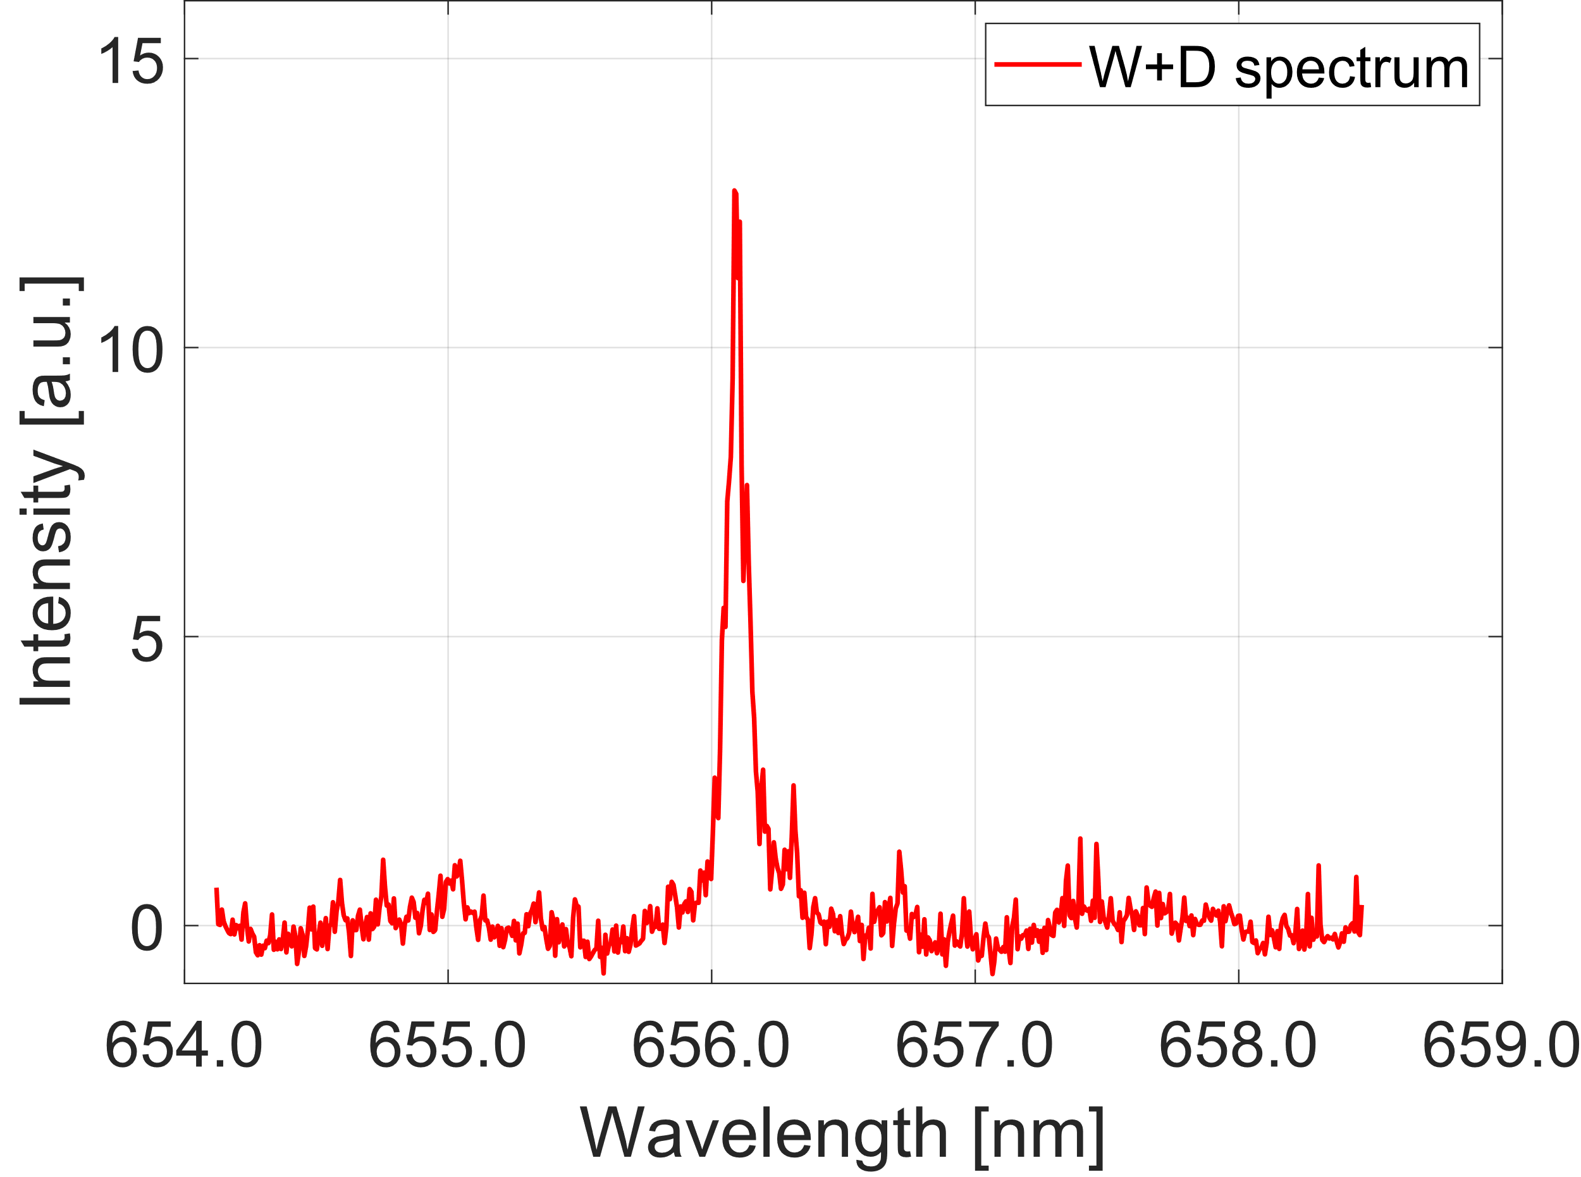
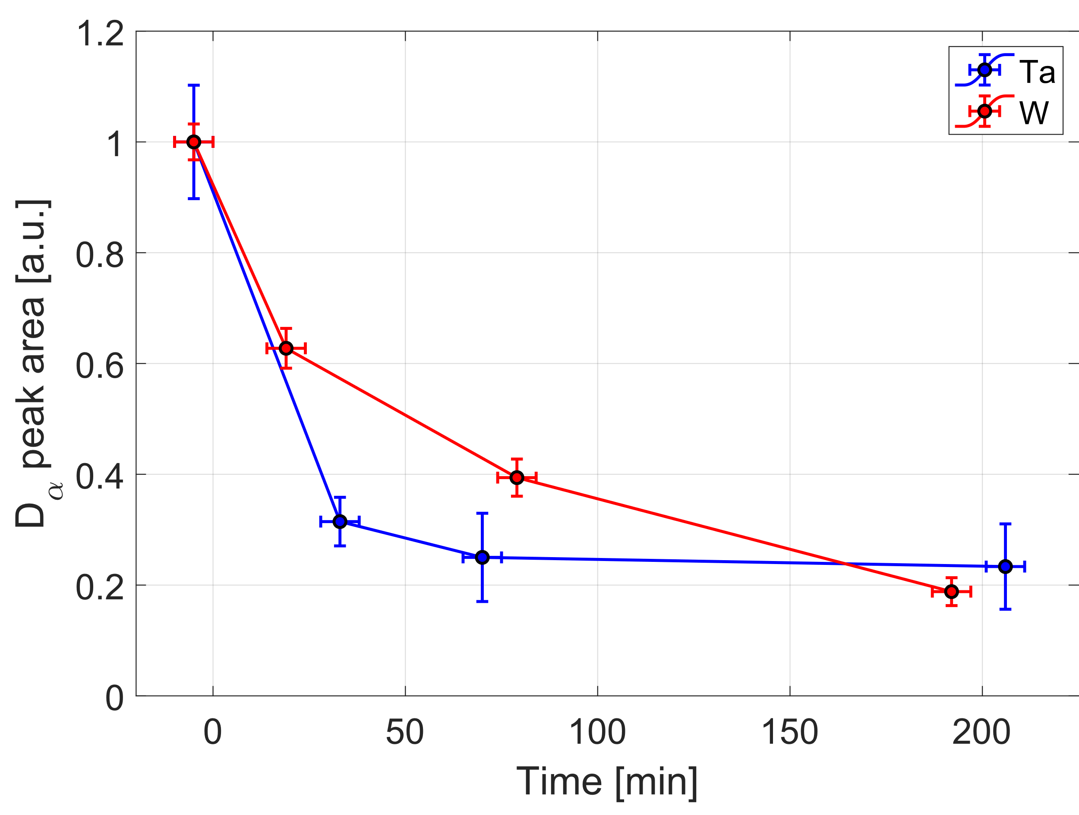
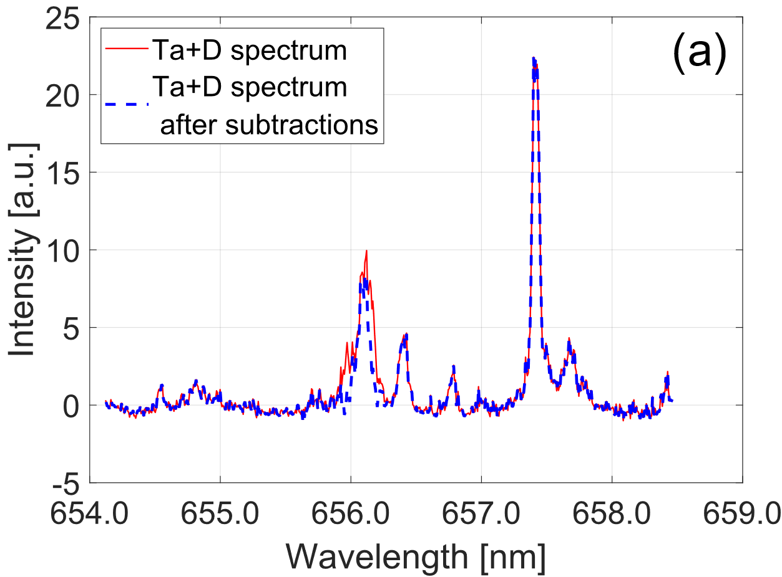
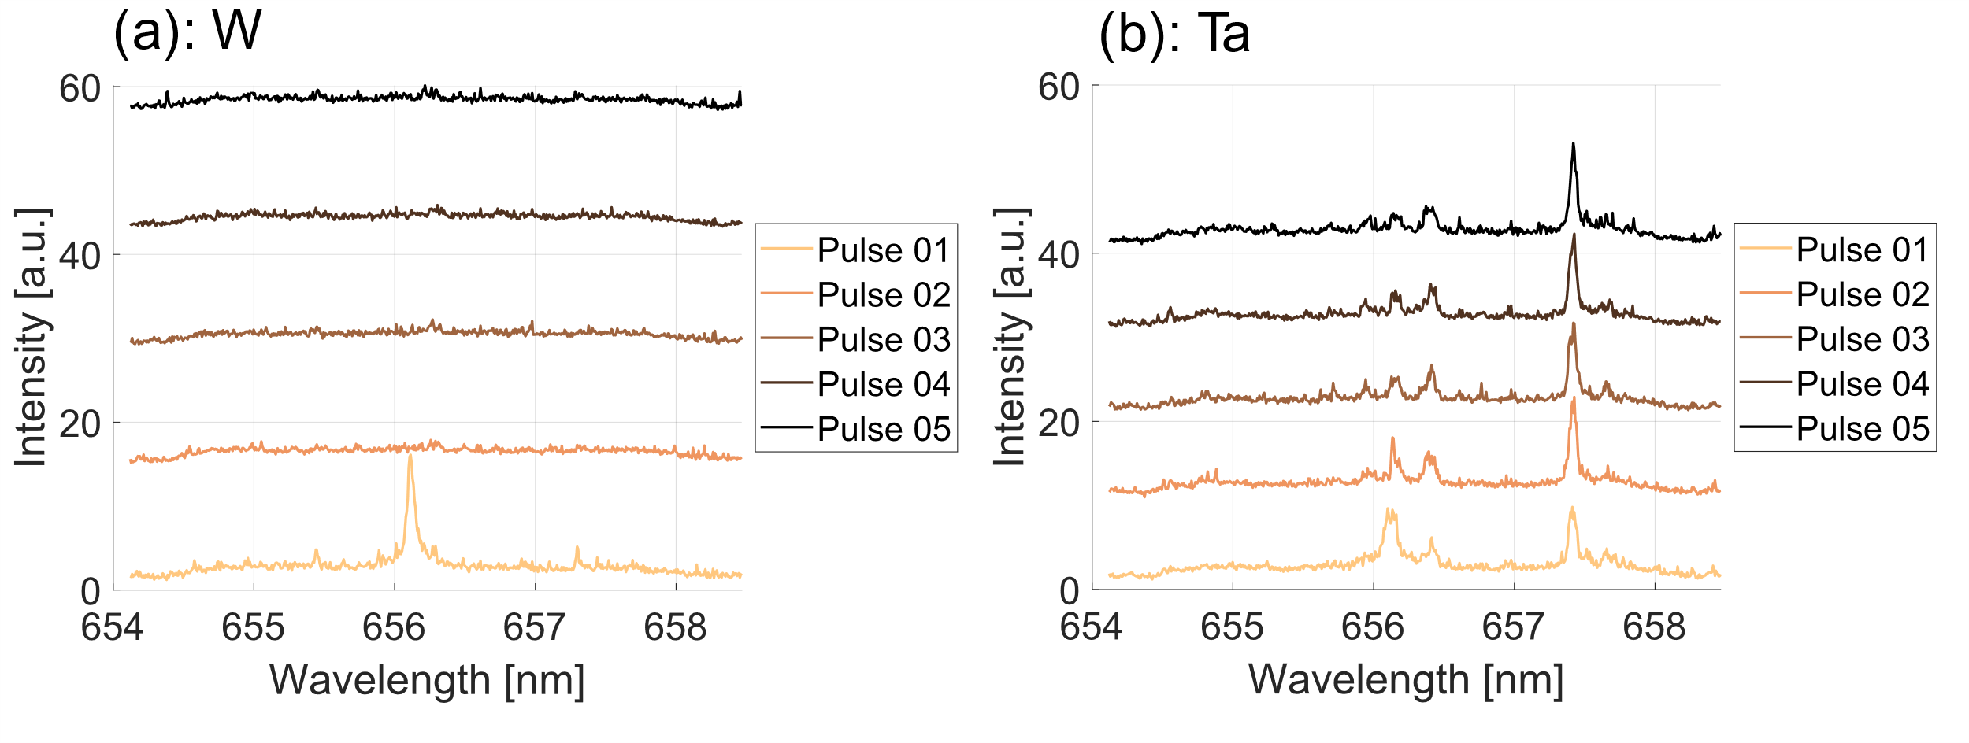

In-situ LIBS retention measurements on the PSI-2 linear device
Each point is a radial average
W: faster decrease for long times
Ta: higher outgassing for short times
No quantitative information about D concentration
D_{α}: 656.1 nm
W: direct D peak individuation
LIBS measurements for successive times
Different radial positions because of radial radial flux variations
Peak fitting: pseudo-Voigt function
Ta: subtraction procedure
$$A∙\left\{η\frac{1}{1+4{\left(\frac{x−x_{0}}{w}\right)}^{2}}\right.+$$
$$\left.+(1−η)∙\exp\left[−4\ln{2}\frac{{\left(x−x_{0}\right)}^{2}}{w^{2}}\right]\right\}$$
D_{α}: 656.1 nm
weight parameter
Center of distribution
width
Probable presence of D into the bulk

Slide 23
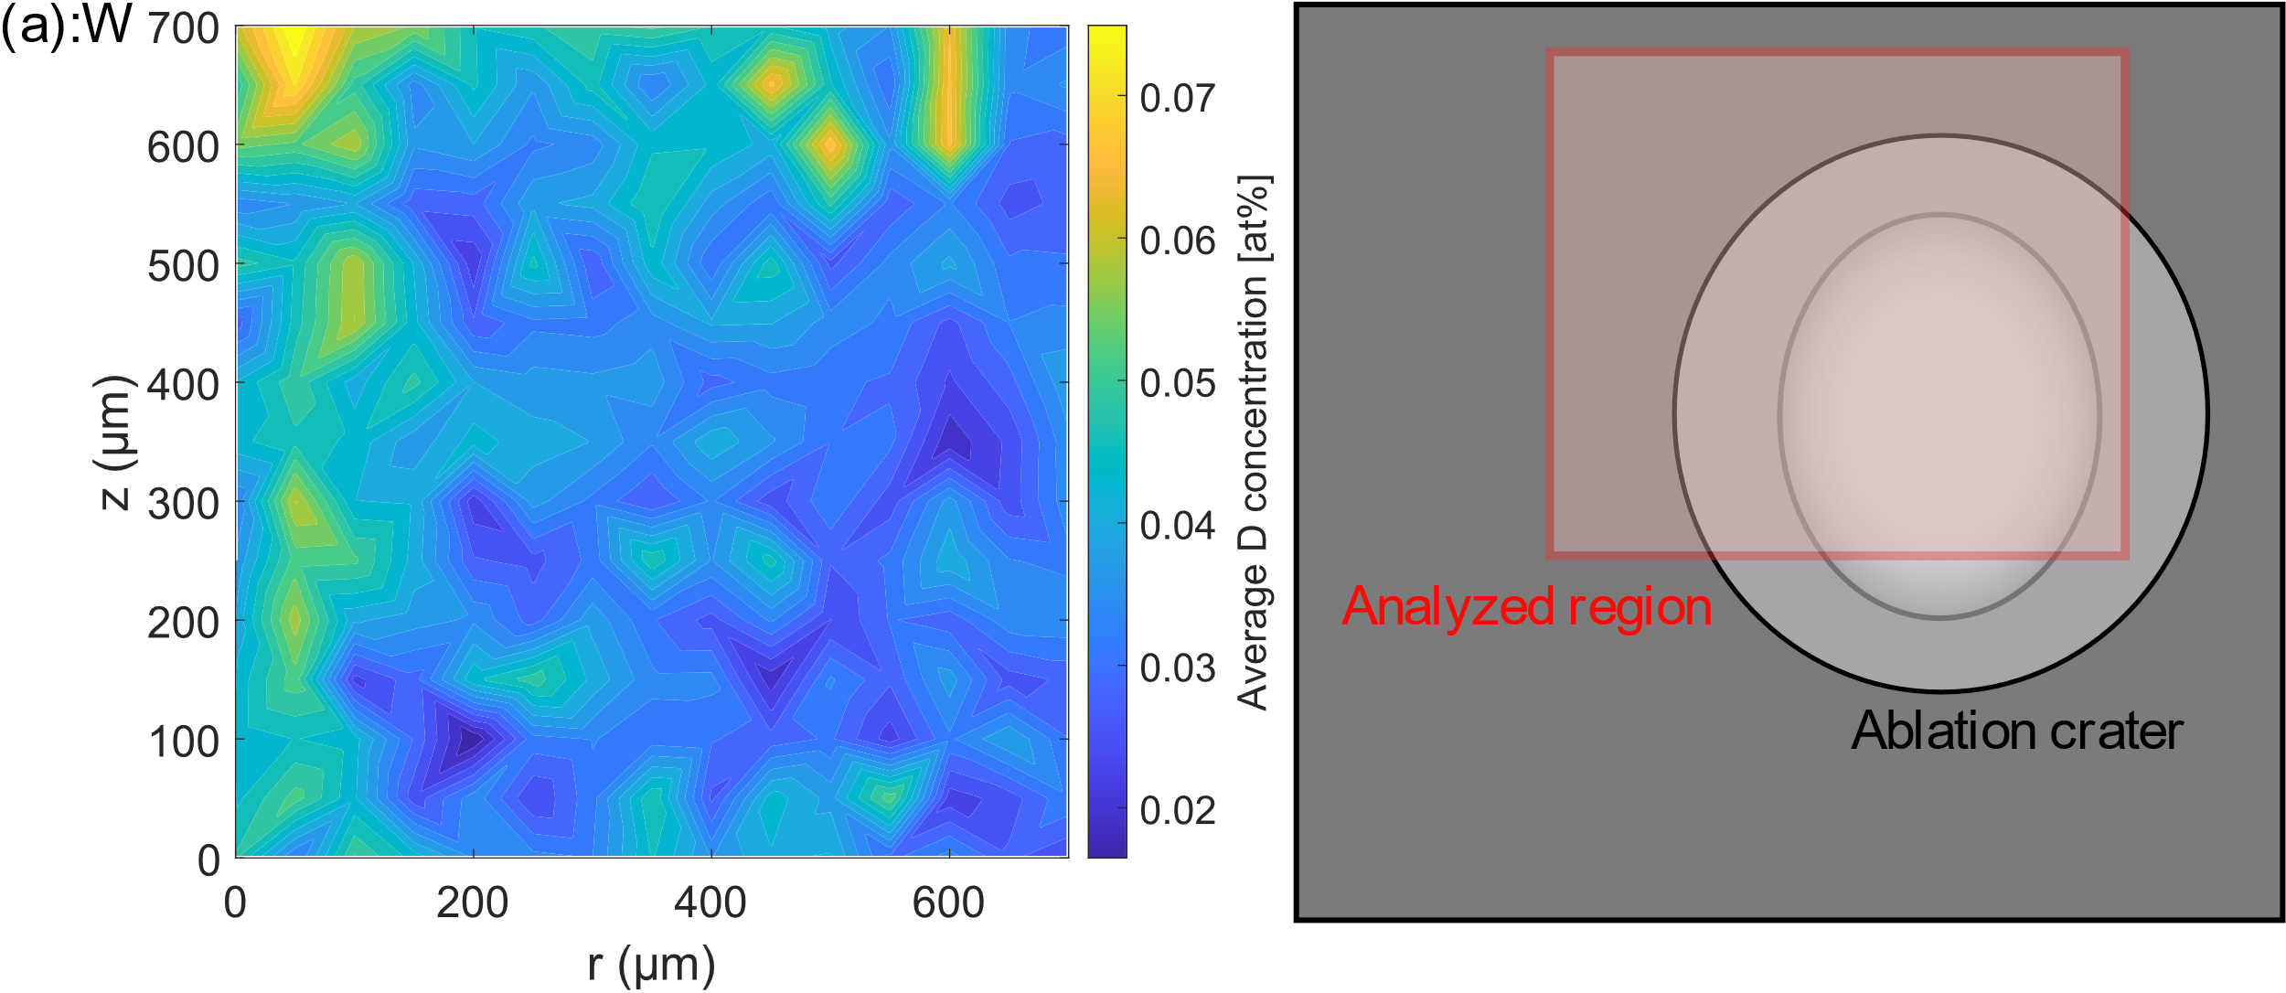



In-situ LIBS retention measurements on the PSI-2 linear device
W
Nuclear Reaction Analysis (NRA) measurements: absolute quantification of long-term D retention
Decreasing concentration from 0.15% to 0.05% going into the bulk
Average concentration for a region of area 150×150 μm
Ta
Higher average relative concentration than W
Increasing concentration from 2.5% to 4.5% going into the bulk
→ Strong contribution of bulk retention mechanisms

