Slide 1
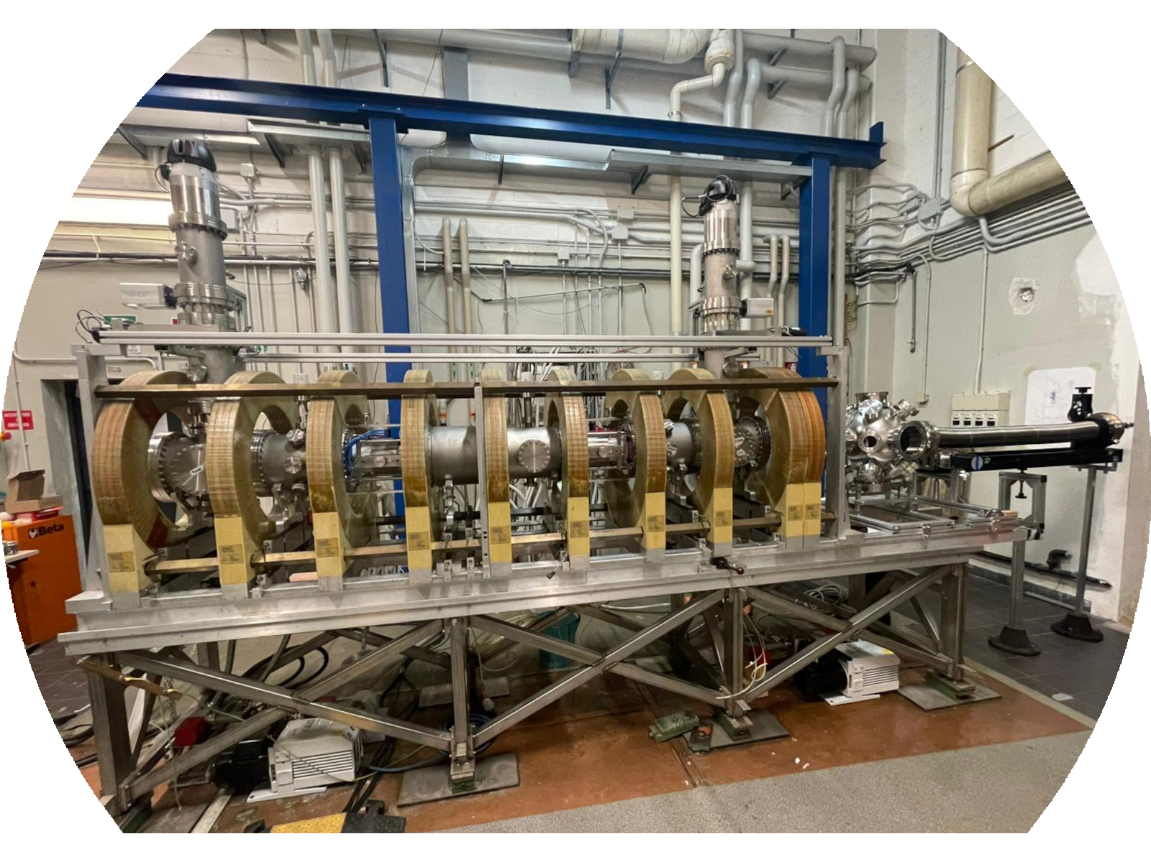

I. Casiraghi & J. Scionti
Helicon Wave Propagation and Plasma-Neutral Modelling for the BiGyM Linear Device
NEFERTARI final workshop
Orto Botanico Università di Padova / Area della Ricerca CNR Padova
March 25 – 27, 2026
Istituto per la Scienza e Tecnologia dei Plasmi, CNR, 20125 Milano, Italy

Slide 2

Outline
BiGyM: the new linear plasma device
    Motivation
    Device upgrade
BiGyM modelling activities
Plasma-neutral modelling using SOLPS−ITER
    Validation against RAID data
    Predictive modelling of BiGyM
Helicon source modelling using COMSOL
    Sensitivity analysis
    Alternative layouts
Conclusions & Future developments
BiGyM: the new linear plasma device
    Motivation
    Device upgrade
BiGyM modelling activities
Plasma-neutral modelling using SOLPS−ITER
    Validation against RAID data
    Predictive modelling of BiGyM
Helicon source modelling using COMSOL
    Sensitivity analysis
    Alternative layouts
Conclusions & Future developments
WP7
1

Slide 3
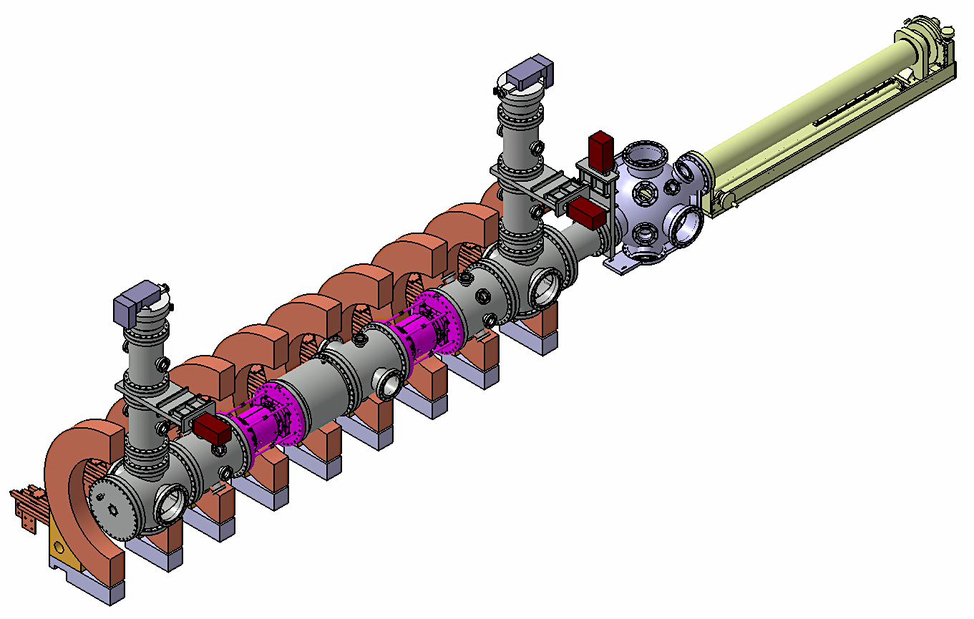
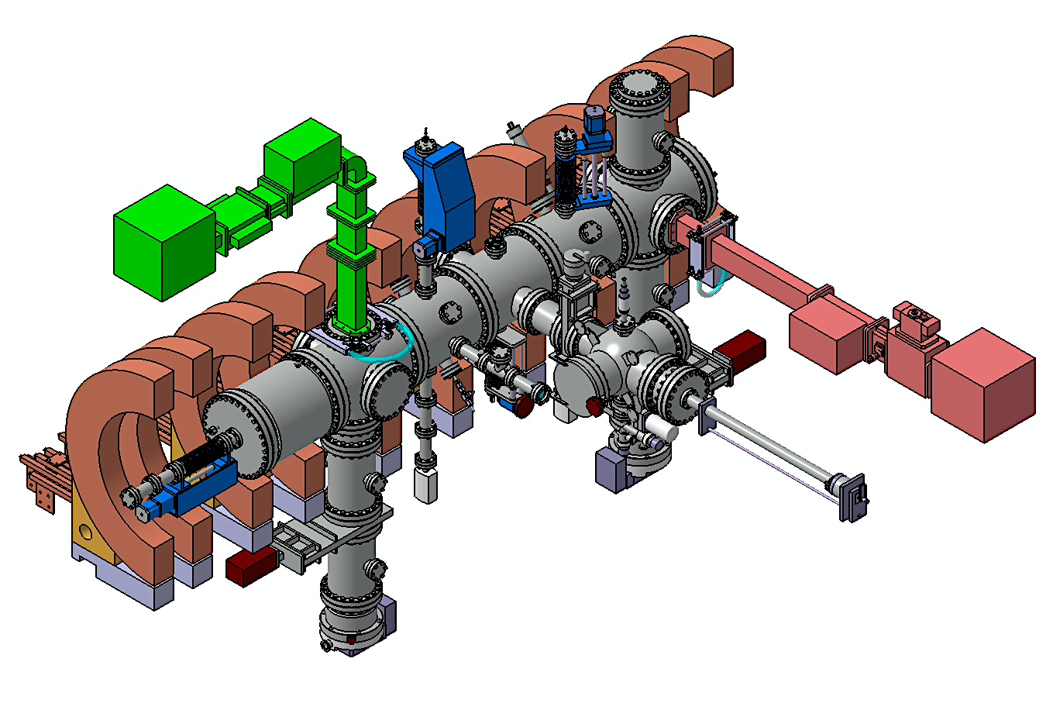
Motivation
For future nuclear fusion reactors, plasma–material interactions (PMIs) are a critical issue.
  PMIs are widely investigated in linear plasma devices (LPDs).
Device upgrades from GyM to BiGyM aim to
          boost performance for divertor–relevant PMI studies
          extend the material and physics research field
GyM
BiGyM
2

Slide 4
Device upgrade
Two new helicon plasma sources (birdcage antennas)
A new axial sample exposure system
A LIBS (Laser–Induced Breakdown Spectroscopy)
A new infrared camera
Upgrade of vacuum system
GyM
BiGyM
3

Slide 5
Modelling activities in support of BiGyM
The modelling activities include
      Plasma-neutral modelling using SOLPS-ITER
      Helicon antenna modelling using COMSOL
      Laser ablation modelling using COMSOL
      Material erosion modelling with ERO2.0
and support the BiGyM project for
      the machine layout definition
      the choice of suitable experimental setup
      predicting operational conditions
4

Slide 6
SOLPS−ITER modelling
SOLPS−ITER
Code package developed for tokamak plasma edge simulations, recently adapted to the LPD geometry.*
Axial symmetry was adopted in these LPD simulations.
B2.5
SOLPS−ITER modelling of RAID plasma
  SOLPS–ITER modelling approach is validated (matched experimental data)
  proper constraints for BiGyM runs
SOLPS−ITER modelling of BiGyM plasma
  Reliable predictions in similar conditions, investigating different
      Gas species
      Gas injection locations
      Magnetic field configurations
plasma
background
2D multi-fluid
plasma transport
code
EIRENE
3D kinetic
Monte Carlo
neutral transport
code
sources for plasma fluid equations
S. Wiesen et al (2015) Journal of Nuclear Material 463 480-484
*M. Sala et al (2020) Plasma Phys. Control. Fusion 62 055005
5

Slide 7
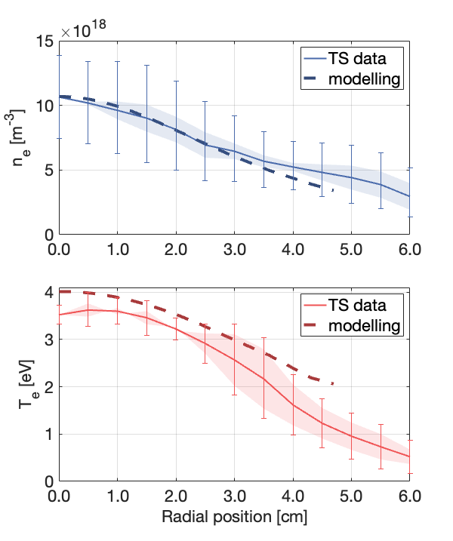
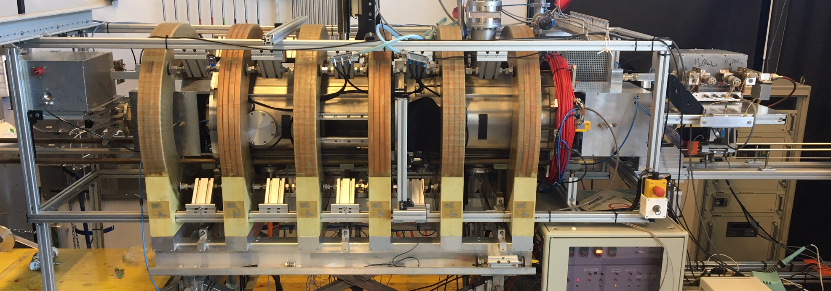

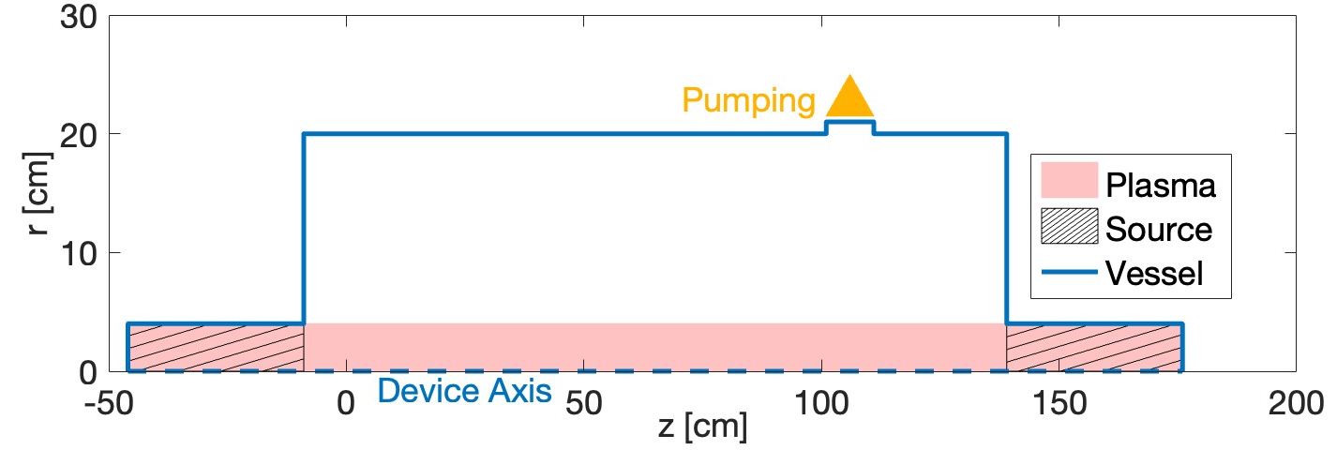
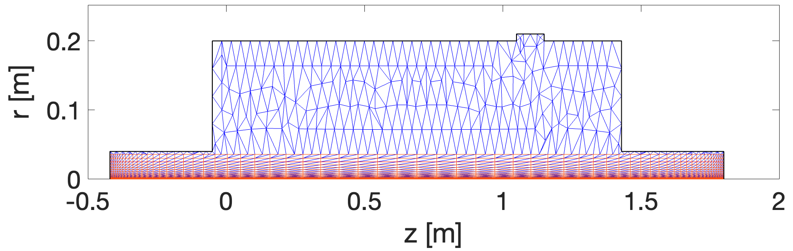
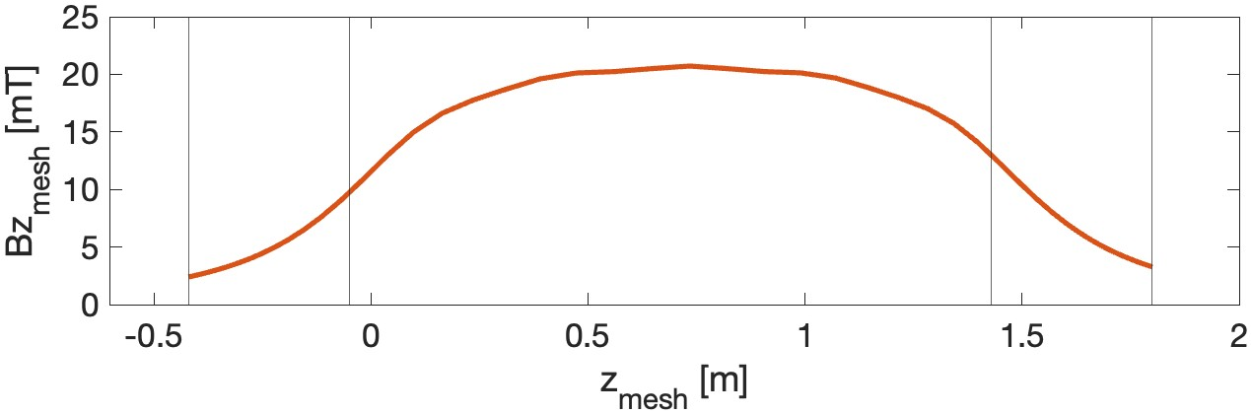
RAID (Resonant Antenna Ion Device) — Case study
Measured plasma profiles
Helium plasma with
3 mT ≲ B ≲ 20 mT
Ⲅ_{puff} = 58 sccm
S_{pump} ∼ 150 L/s
Power density distribution
Total P_{injected} = 3 kW
Axially constant
Radially gaussian
Modelling
scheme
Puffing
Pressure measurements
Thomson Scattering
Plasma domain
Neutral domain
∼90%
absorbed
Thomson
Scattering
[at z=0.79m]
EIRENE grid
source
source
B2.5 grid
+
Measured neutral pressure ≈ 0.8 Pa
I_{nom} = 150A
6

Slide 8
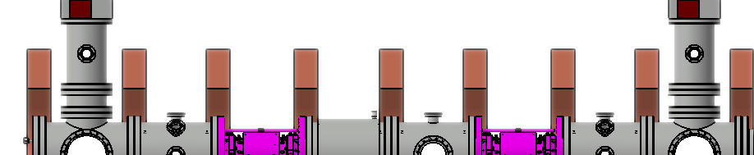
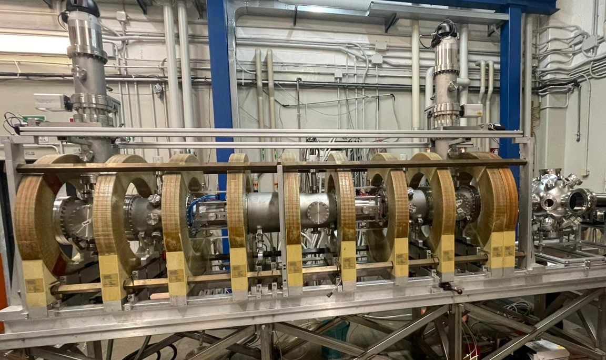

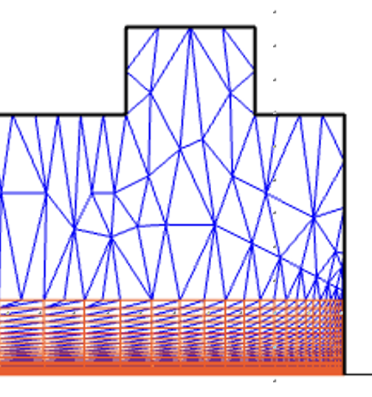
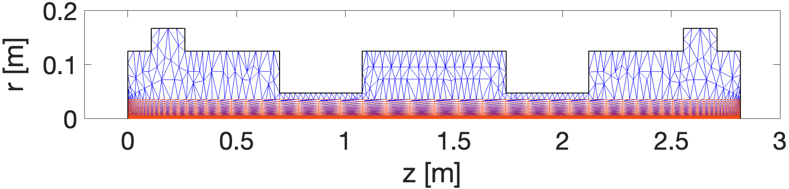
BiGyM plasmas
First plasma in June 2026
Puffing
EIRENE grid
B2.5 grid
7

Slide 9
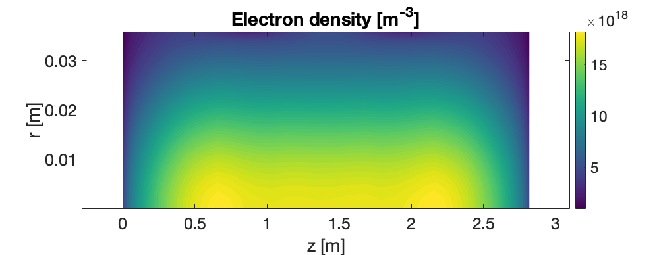
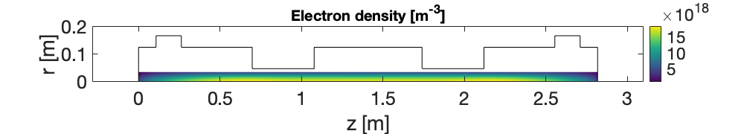
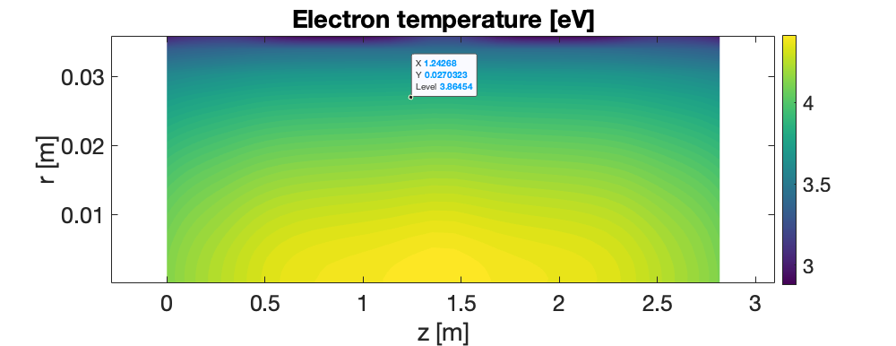
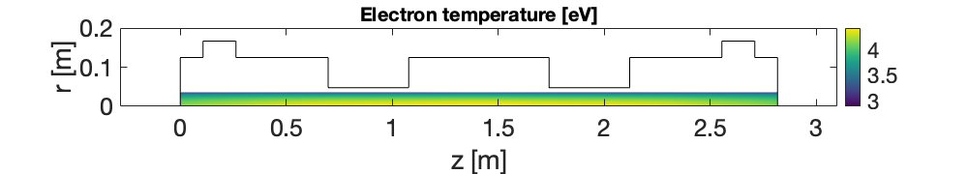
BiGyM helium plasmas
Ⲅ_{puff} = 32 sccm
S_{pump} ∼ 420 L/s
Power density distribution
P_{absorbed} = 3 kW x 0.90
Axially constant
Radially gaussian
8

Slide 10

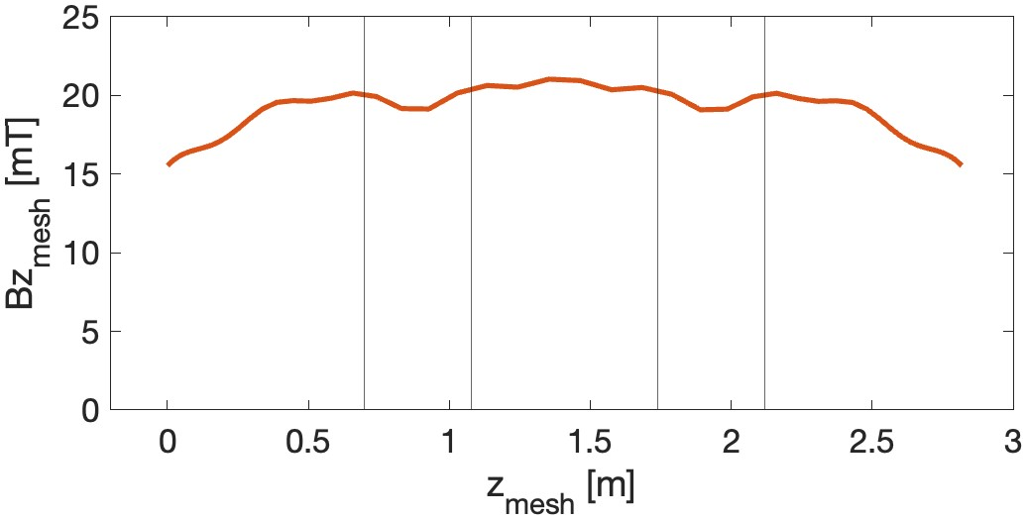
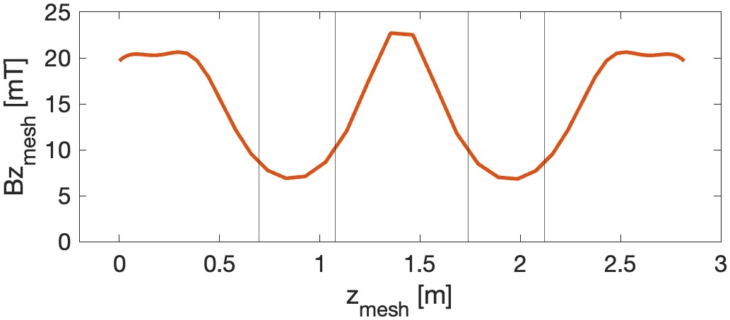
BiGyM helium plasmas: different magnetic configurations
MC1: quasi−uniform field along axis
MC2: lower field in the source regions
160 A x 9 coils
220 A x 4 coils + 330 A x 1 coil
16 mT ≲ B ≲ 20 mT
6 mT ≲ B ≲ 23 mT
source
source
source
source
MC1
MC2
9

Slide 11
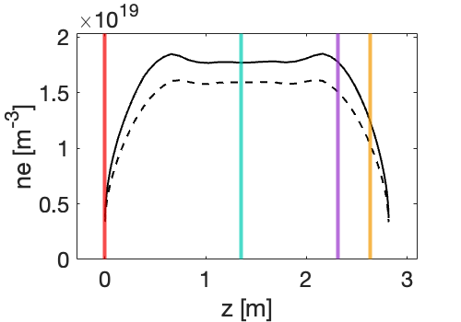
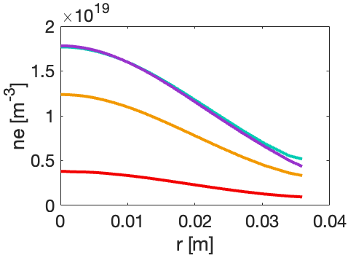
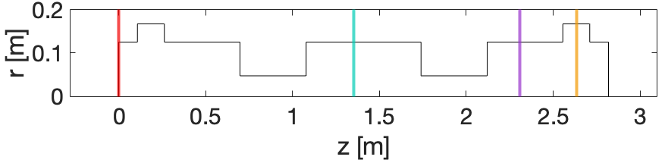
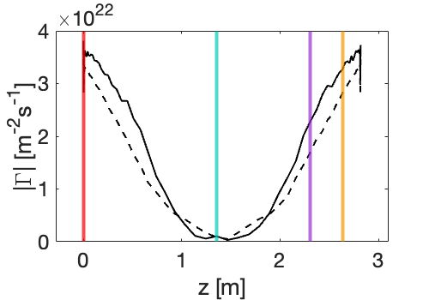
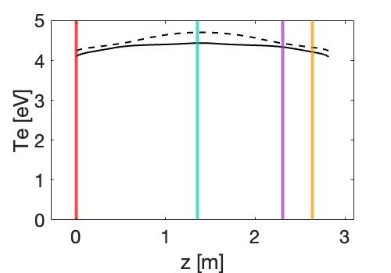
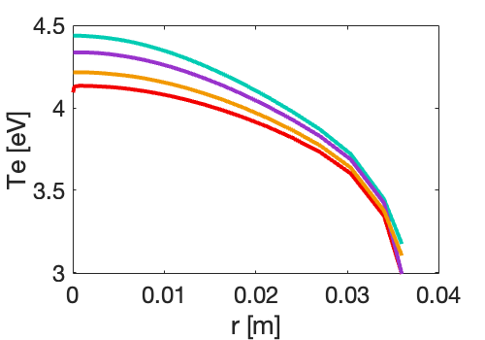
BiGyM helium plasmas: different magnetic configurations
Axial profiles
Radial profiles
MC2
Electron Density
r = 0 m
MC1
MC2
Good symmetry left−right
Small effect of B configuration on Te and ne (≲ 15%),
at a fixed absorbed power density
MC1
MC2
MC2
Particle flux
Electron Temperature
r = 0 m
MC1
MC2
r = 0 m
10

Slide 12
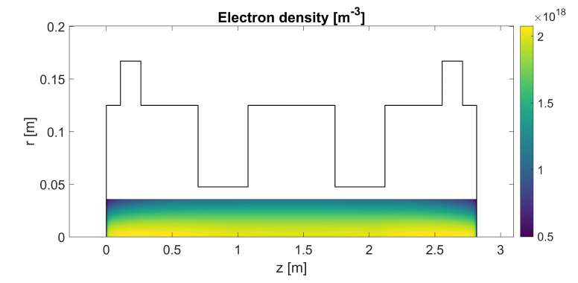
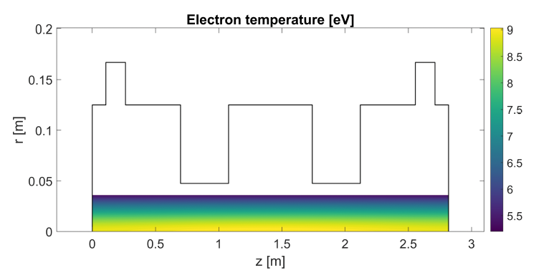
BiGyM argon plasmas
Ⲅ_{puff} = 32 sccm
S_{pump} ∼ 290 L/s
Power density distribution
P_{absorbed} = 3 kW x 0.90
Axially constant
Radially gaussian
11

Slide 13
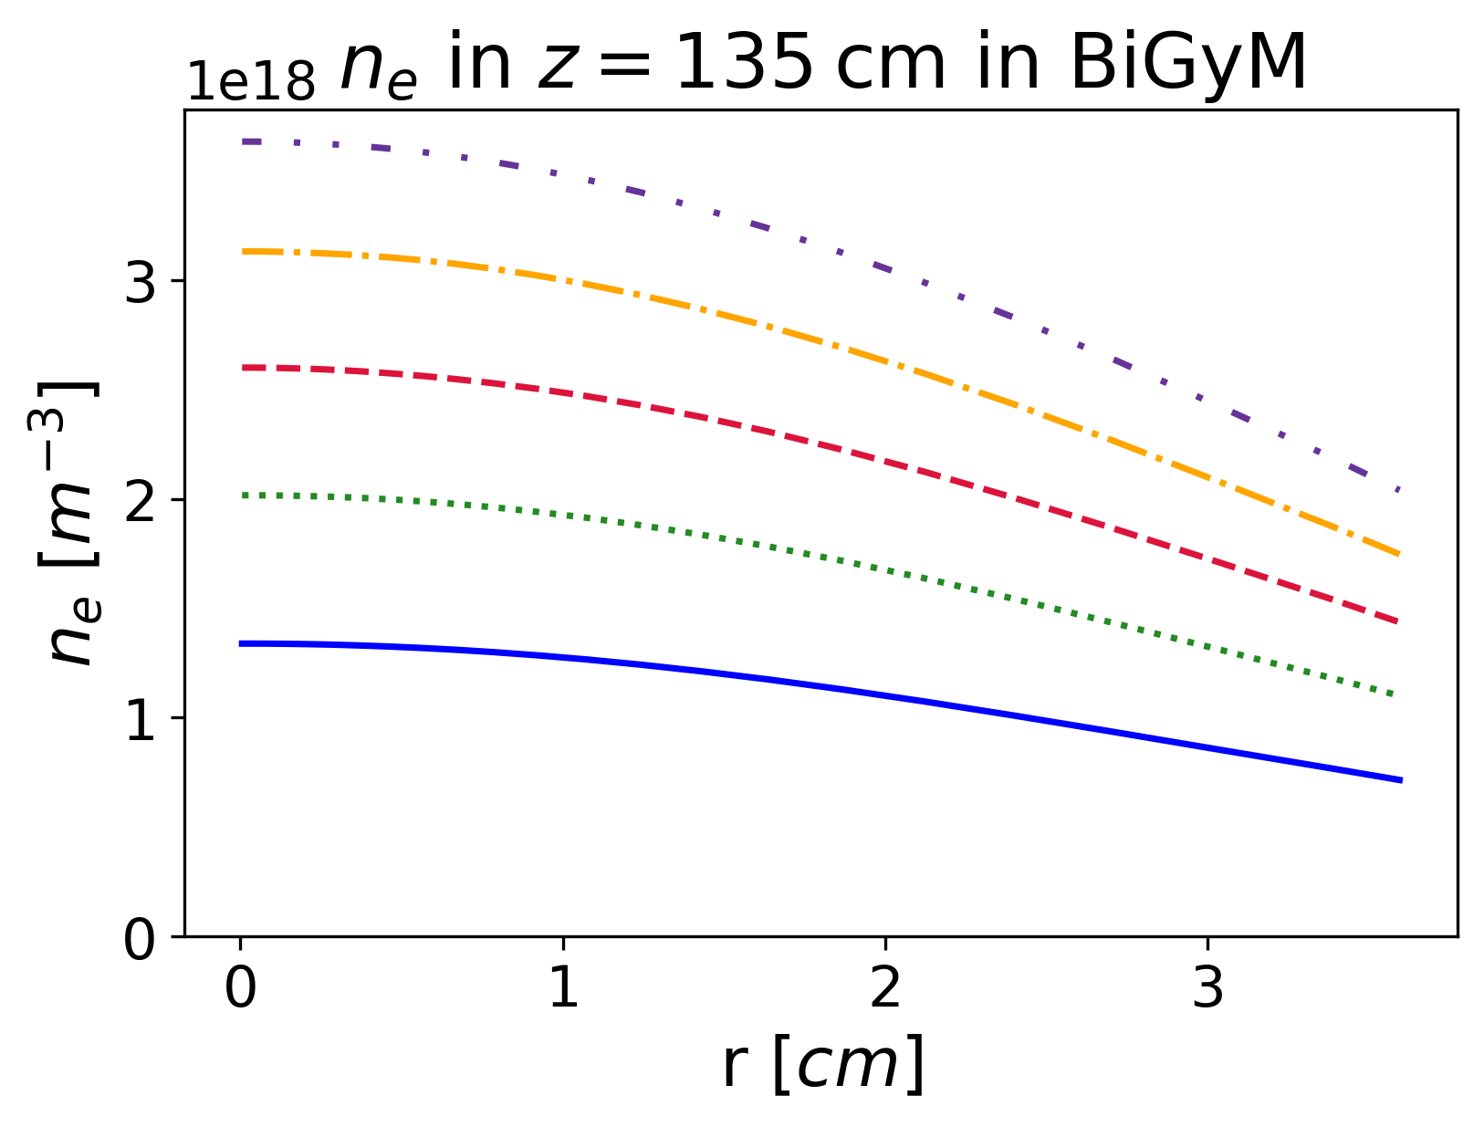
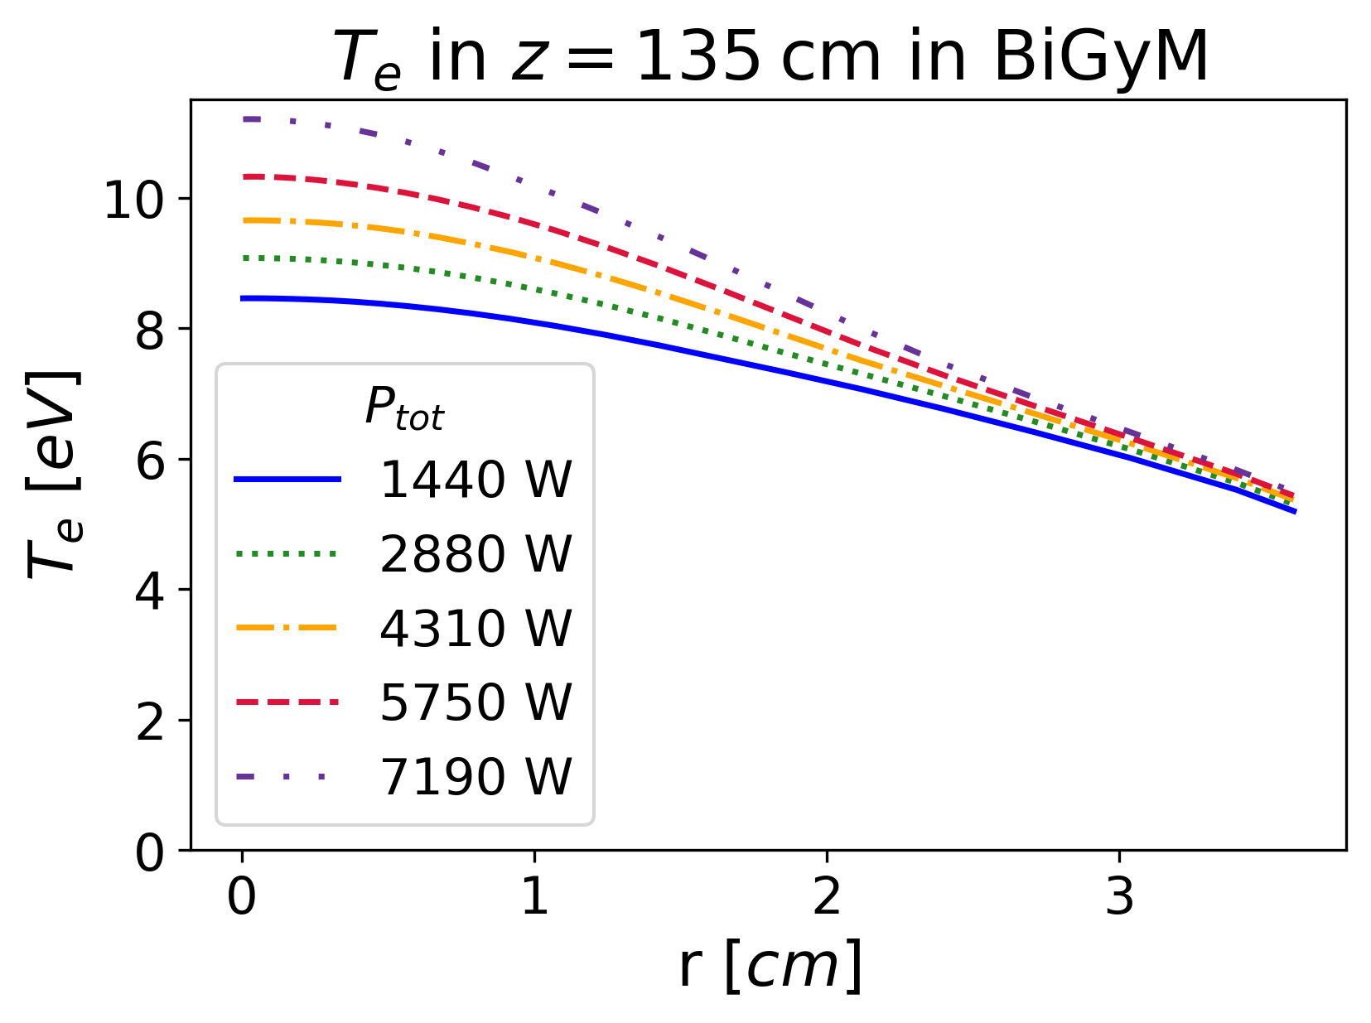
BiGyM argon plasmas
Ⲅ_{puff} = 32 sccm
S_{pump} ∼ 290 L/s
Power density distribution
P_{absorbed} = 3 kW x 0.90
Axially constant
Radially gaussian
By doubling the absorbed power, ne increases by about 70%, while Te increases by approximately 10%.
Relevant impact of absorbed power on plasma profiles, but order of magnitude is not affected.
Dependence of plasma profiles on absorbed power was investigated.
P_{abs}
12

Slide 14
High−density plasma discharges are predicted,
meeting the device upgrade targets.
Neon plasmas (values on axis)
ne ≈ (1.5–2.0) x 10¹⁹ m⁻³
Te ≈ 4–5 eV
Particle flux ≲ 3.5 x 10²² m⁻³
Argon plasmas (values on axis)
ne ≈ (1.5–2.0) x 10¹⁸ m⁻³
Te ≈ 9 eV
Particle flux ≲ 6 x 10²¹ m⁻³
Comparison of plasma parameters predicted by SOLPS−ITER with BiGyM experimental data, once available
13

Slide 15
Outline
BiGyM: the new linear plasma device
    Motivation
    Device upgrade
BiGyM modelling activities
Plasma-neutral modelling using SOLPS−ITER
    Validation against RAID data
    Predictive modelling of BiGyM
Helicon source modelling using COMSOL
    Sensitivity analysis
    Alternative layouts
Conclusions & Future developments
WP7
14

Slide 16
Objective
Study the helicon wave propagation in BiGyM
Assess the new sources performance
Validate the proposed layout
COMSOL
Sample holder
15

Slide 17
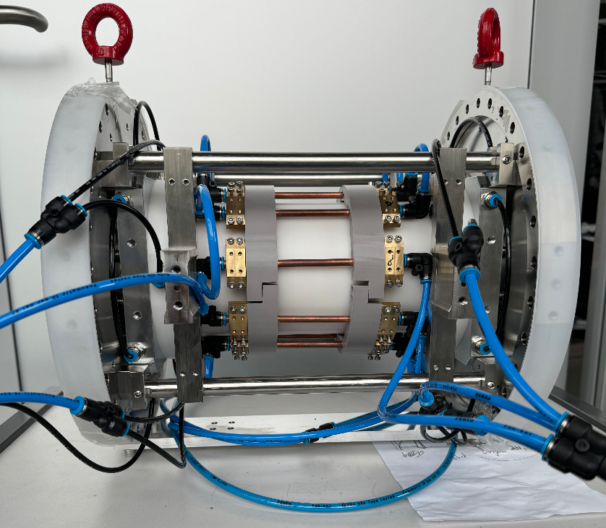
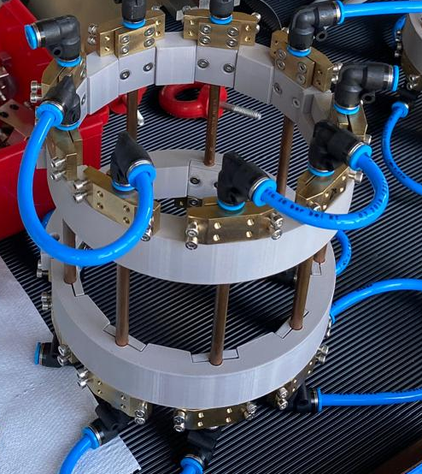
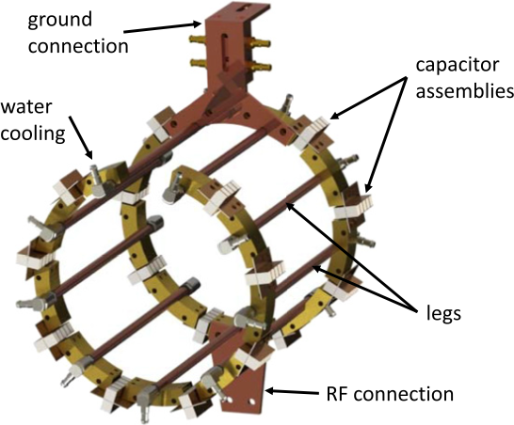
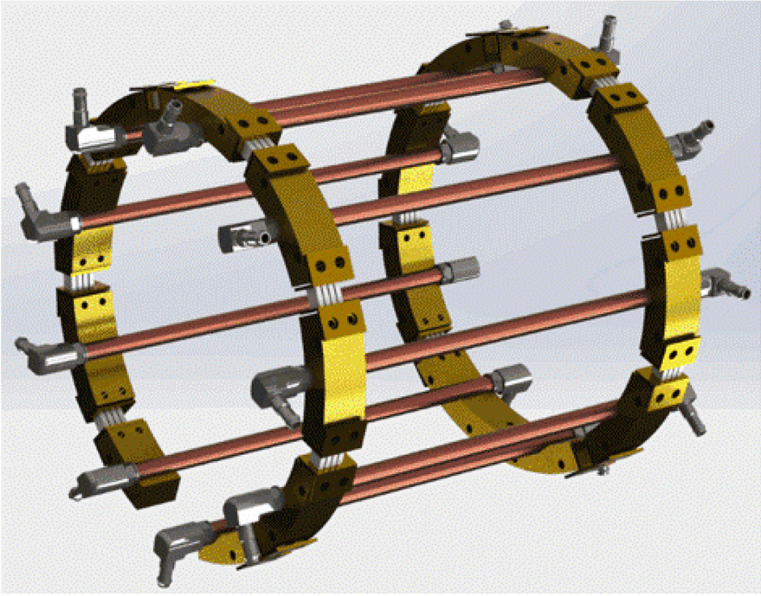

New sources: Radio-frequency antennas
Double-walled ceramic tube
 | GyM | BiGyM
Frequency | 2.45 · 10³ | 13.56 | MHz
Power | -> 4.5 | -> 20 | kW
Ion flux | 10²¹ | 10²³ | m⁻²s⁻¹
Plasma density | 10¹⁷ | 10¹⁹ | m⁻³
Coil magnetic field | 87.5 | ≈20 | mT
*
Nine copper legs (cooling pipes)
13 cm
High Q mica capacitors
Open network antenna
SPC Spin-off
15 cm
* Ph. Guittienne et al, Resonant Network Antennas for Radio-Frequency Plasma Sources. IOP Series in Plasma Physics. IOP Publishing, 2024
16

Slide 18
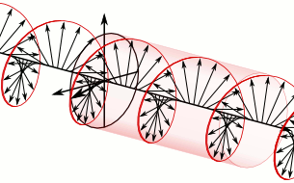


Helicon waves?
1960s → first experimental observations: Bowers. Theory developed by Chen
Low frequency right−handed bounded whistler waves propagating in a magnetized plasma
Cyclotron frequencies
Dispersion relation
High density plasma
Pasma uniformity
Real input impedance (50 Ω) -> low power dissipation, cable flexibility
Elongated columnar plasma -> reduced plasma "wetting" (side walls)
Large plasma volume coupling
B₀
17

Slide 19

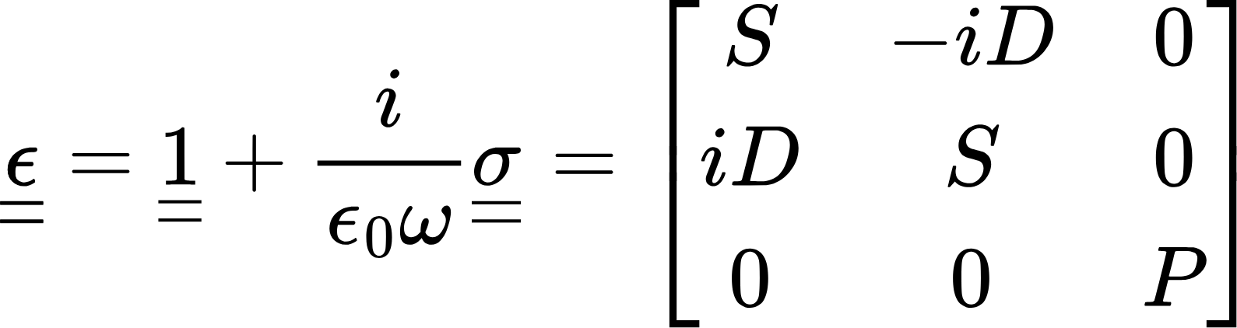

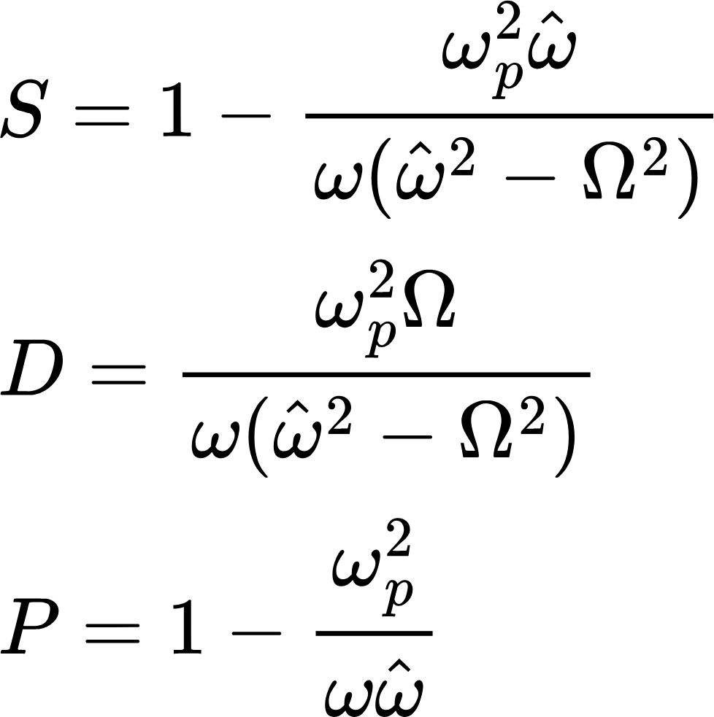
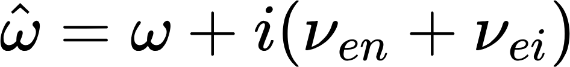
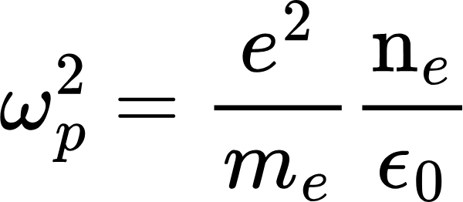
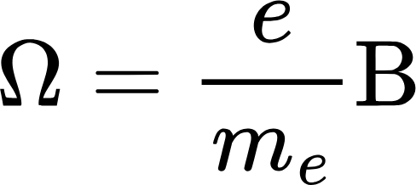

Model: theory
Hydrogen plasma
Boundary conditions
Cold plasma Stix tensors
BiGyM axis
Effective collision frequency
Plasma frequency
Coil B-field
Plasma treated as a static user-defined anisotropic medium!
18

Slide 20
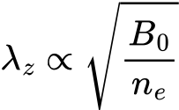



Model validation
Dispersion relation:
Constant
Figure of merit
Power density that the wave deposits at the sample location
RAID
“effective” density:
Line average
19

Slide 21
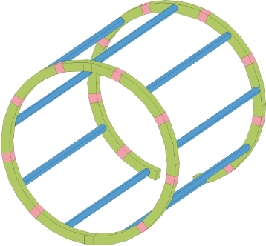
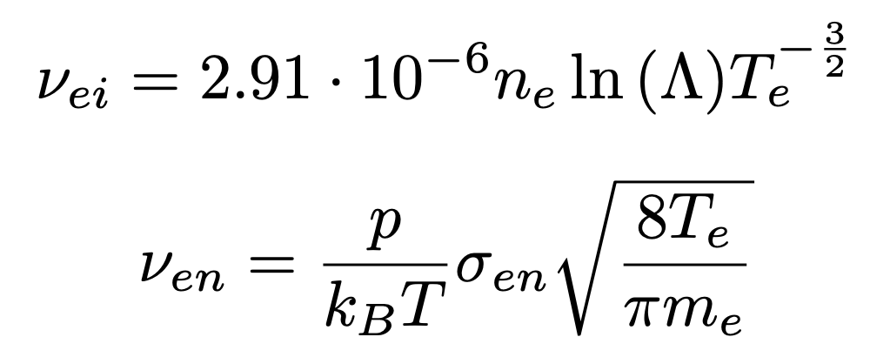

Collisions & “free” parameters
Feeding ring
: feeding ring on the left
Simulation parameters
*
Power (each antenna) | 1.5 | kW
Gas (hydrogen) pressure | 0.3 | Pa
Gas temperature | 400 | K
ne (radially gaussian, FWHM = 5 cm) peak value | 10¹⁸ | m⁻³
T_{e} (uniform) | 5 | eV
Magnetic field plateau value | 18 | mT
* Ph Guittienne et al, Helicon wave plasma generated by a resonant birdcage antenna: Magnetic field measurements and analysis in the raid linear device. Plasma Sources Science and Technology, 30(7):075023, jul 2021
20

Slide 22
Antennas orientation – Coil magnetic field
Best orientation
21

Slide 23

Antennas orientation – Parameters
In the ranges of expected physical parameters -> (green curve) is the best orientation
22

Slide 24
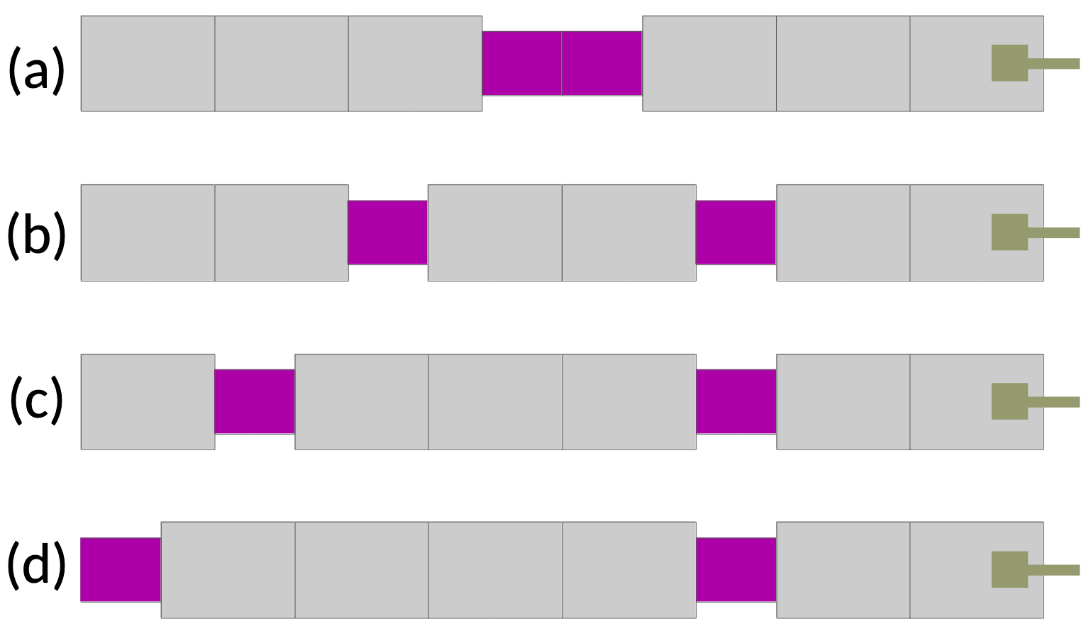
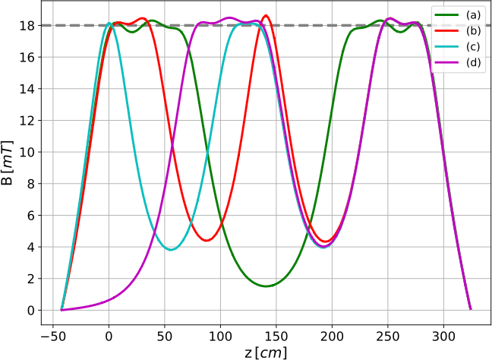
Alternative layouts – Magnetic fields
Average Q over a line
23

Slide 25
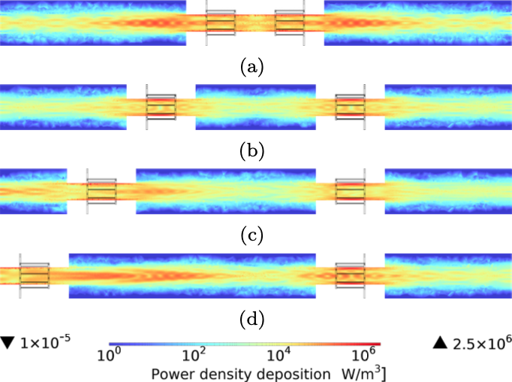
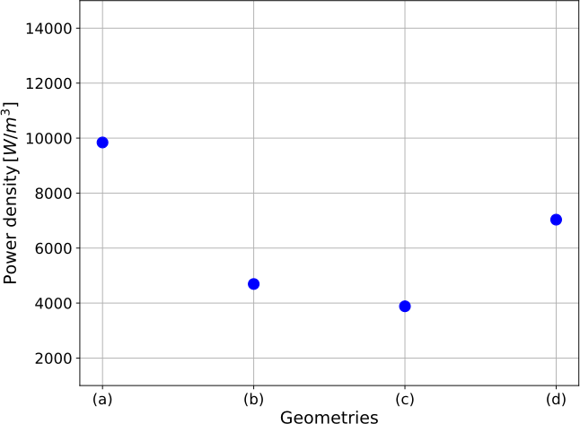
Alternative layouts – Power densities
Best layout
(a) is the best layout, however -> Potential thermal load issue!
24
Notes:
ù

Slide 26
Summary and outlooks
Model for studying helicon wave propagation in a static user-define plasma
Investigate antennas orientation impact on density power deposited at the sample
Assess the proposed BiGyM layout
Investigate other plasmas (Ar, He, …)
Relax assumptions (radial density profile, full 3D coil magnetic field, …)
Iterations with plasma evolution modelling codes (SOLPS-ITER)
Benchmark with experimental data
25
Notes:
Plsma

Slide 27
Back−up slides

Slide 28
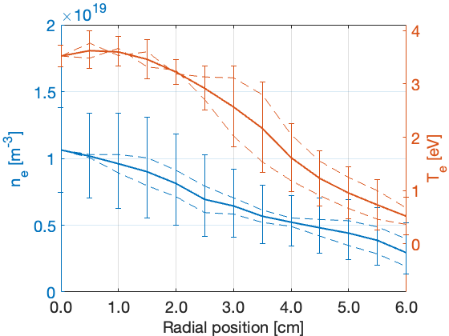
RAID experimental data
Thomson
Scattering
[at z=0.79m]

Slide 29
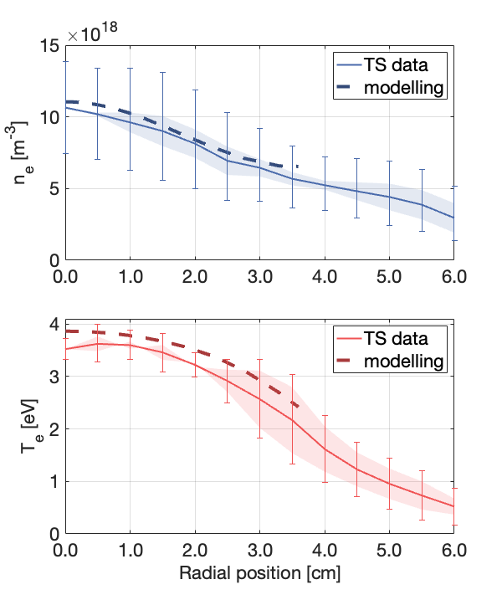
RAID experimental data vs SOLPS−ITER modelling

Slide 30
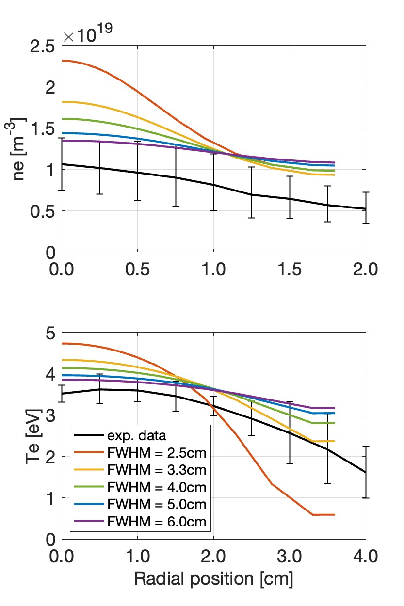
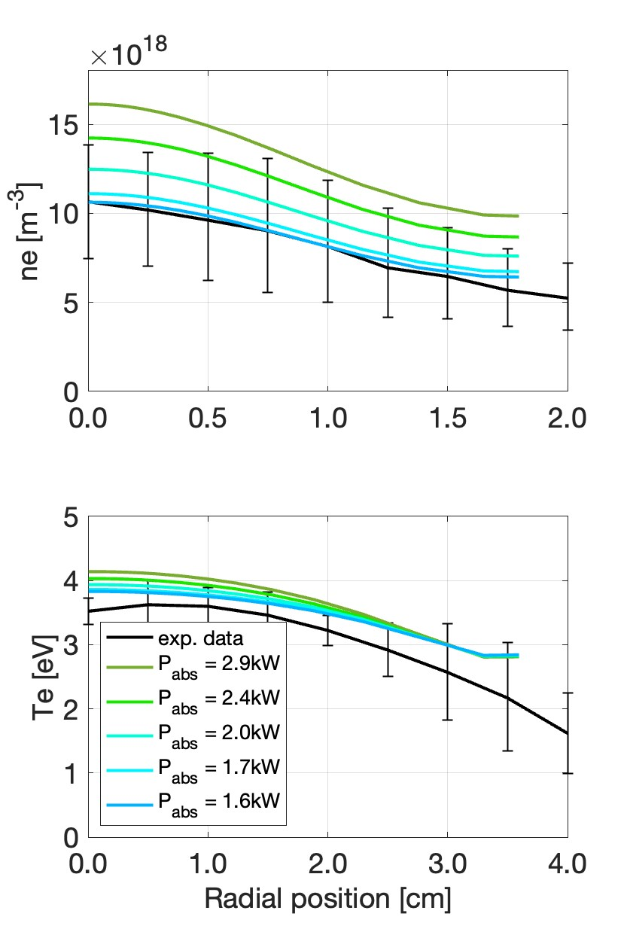
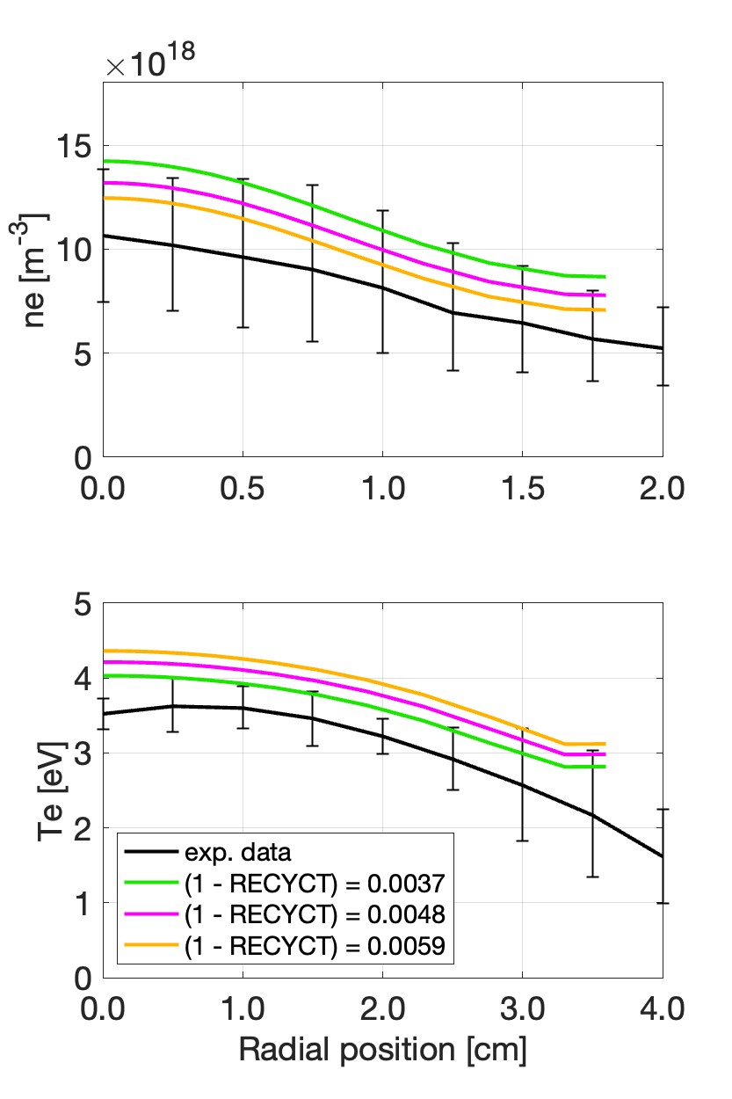

Sensitivity studies for RAID plasma
Power density gaussian width
Absorbed power
Absorption at pump. surface
Particle diffusion
P_{abs} ≈ 2.8 kW
1−RECYCT = 0.0037
D_{n} = 0.5m²/s
FWHM ≈ 4.0 cm
1−REC. = 0.0037
D_{n} = 0.5m²/s
P_{abs} ≈ 2.4 kW
FWHM ≈ 4.0 cm
D_{n} = 0.5m²/s
P_{abs} ≈ 1.7 kW
FWHM ≈ 4.0 cm
1−REC. = 0.0037

Slide 31






SOLPS-ITER: assessment of plasma parameters at sample-holder location
220 A
220 A
0 A
0 A
330 A
0 A
0 A
220 A
220 A
3e22 m⁻²s⁻¹
at sample-holder
Radial profiles

Slide 32



3000W, sig=0.024, REC=0.9985
2700W, sig=0.024, REC=0.9985
2700W, sig=0.021, REC=0.9985

Slide 33


Gas injection position
Puffing [Option B]
Varying the gas injection location leads to
differences between left/right side of the device in terms of neutral pressure of
→ ∼ 20% for option A
  → ∼ 0% for option B
negligible plasma profile variations
Puffing [Option A]
Gas injection option B

Slide 34
Investigated BiGyM B−field configurations

Slide 35


Good symmetry left−right in BiGyM

Slide 36


Parameter scans for RAID plasma
Particle diffusion
Energy transport coefficient
Varying the energy transport coefficient χ_{e} has a very small effect.

