Slide 1
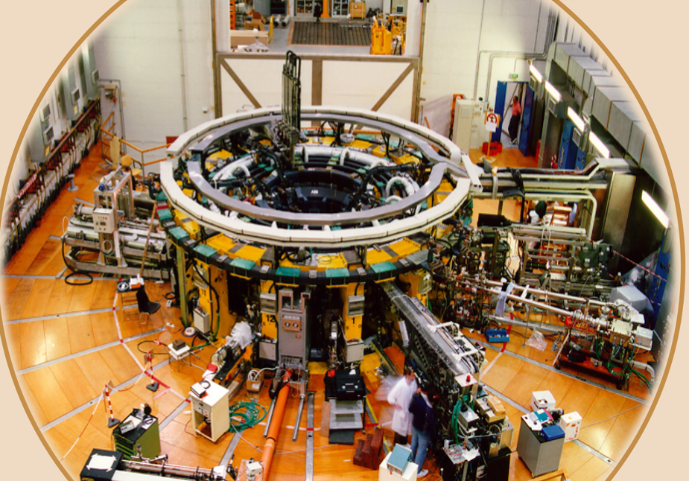
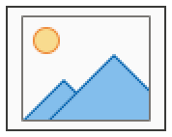
Advanced plasma edge measurements with the Thermal Helium Beam diagnostic
M. La Matina, M. Agostini, M. Ugoletti, M. Fincato, E. Girotto, L. Carraro, M. Zuin
ISTP workshop - NEFERTARI
March 26, 2026

Slide 2
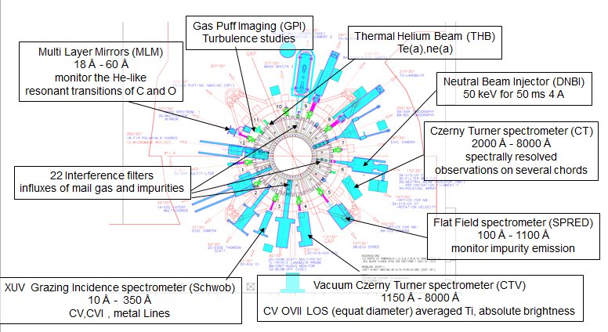
Layout of spectroscopic diagnostics in RFX-mod2
UV – x-rays
Visible light

Slide 3
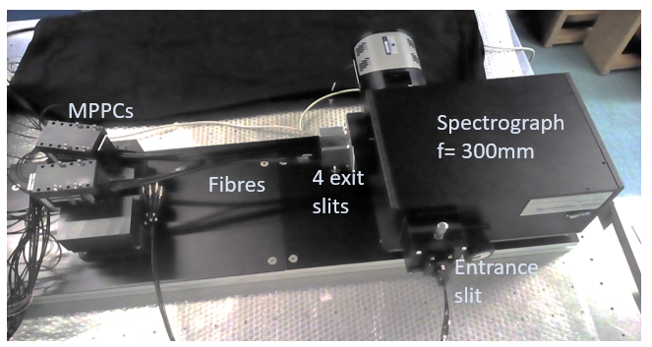
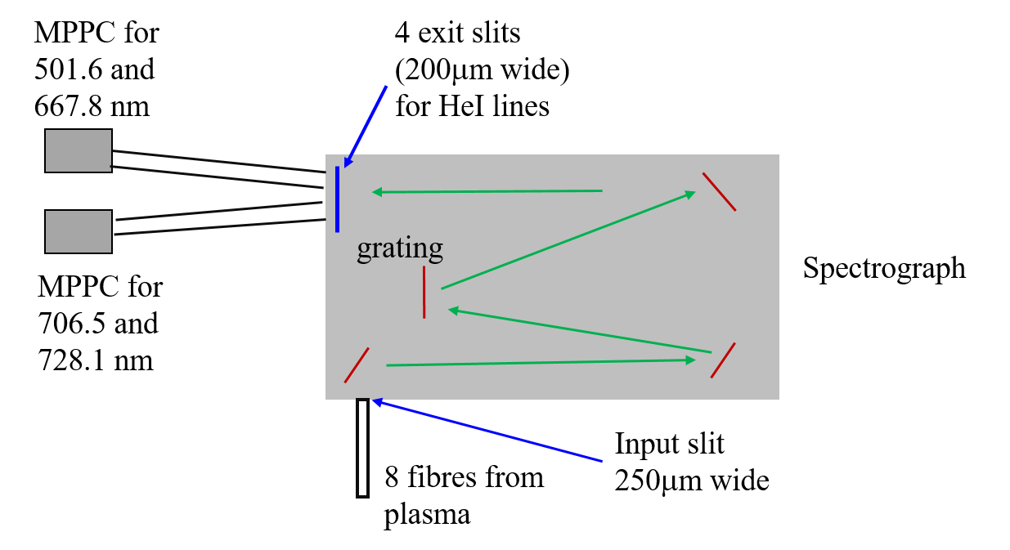
THB: Thermal Helium Beam
Thermal helium beam (THB) is a spectroscopic diagnostic based on the line ratio technique (Goto CR model) for estimating the electron density and temperature in the edge and divertor region of fusion plasmas
Helium is puffed in the plasma edge
4 HeI lines are measured:
501, 667, 706, and 728 nm
[M. Agostini, RSI, 2020]

Slide 4
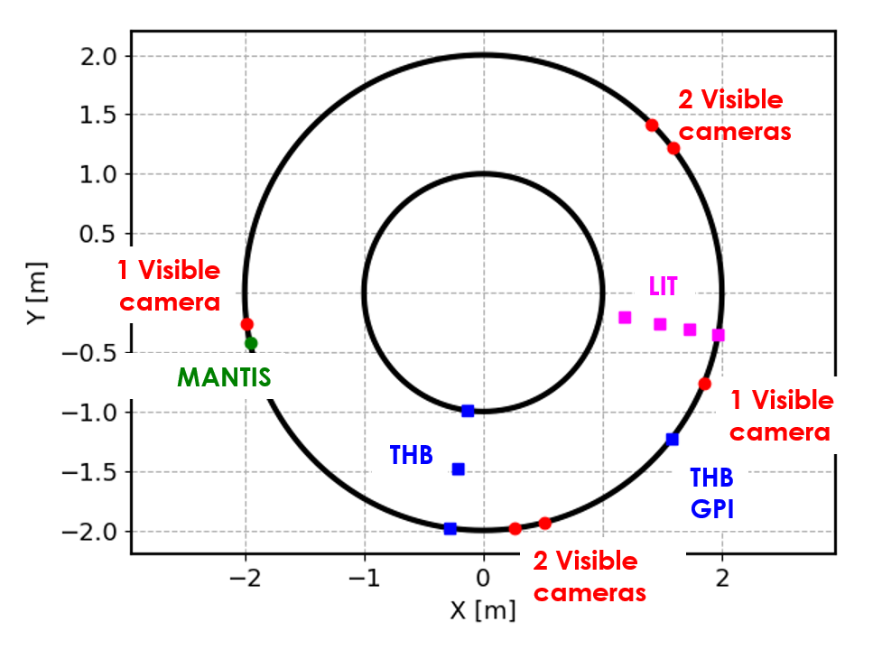
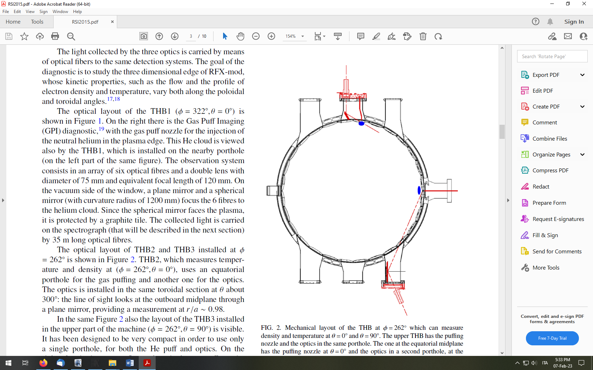
GPI
THB1
THB2
φ=322° θ=0°
THB5
THB3
4 radial LoS
φ=262° θ=0,90,180,270°
THB4

Slide 5
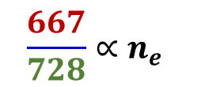
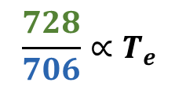


effect of the radiation trapping of ultraviolet resonance lines not considered
BUT
Measure a fourth line at 501 nm and evaluating the ratio
To convert the line ratios in n_{e} and T_{e}, collisional radiative models (CRM) are used

Slide 6
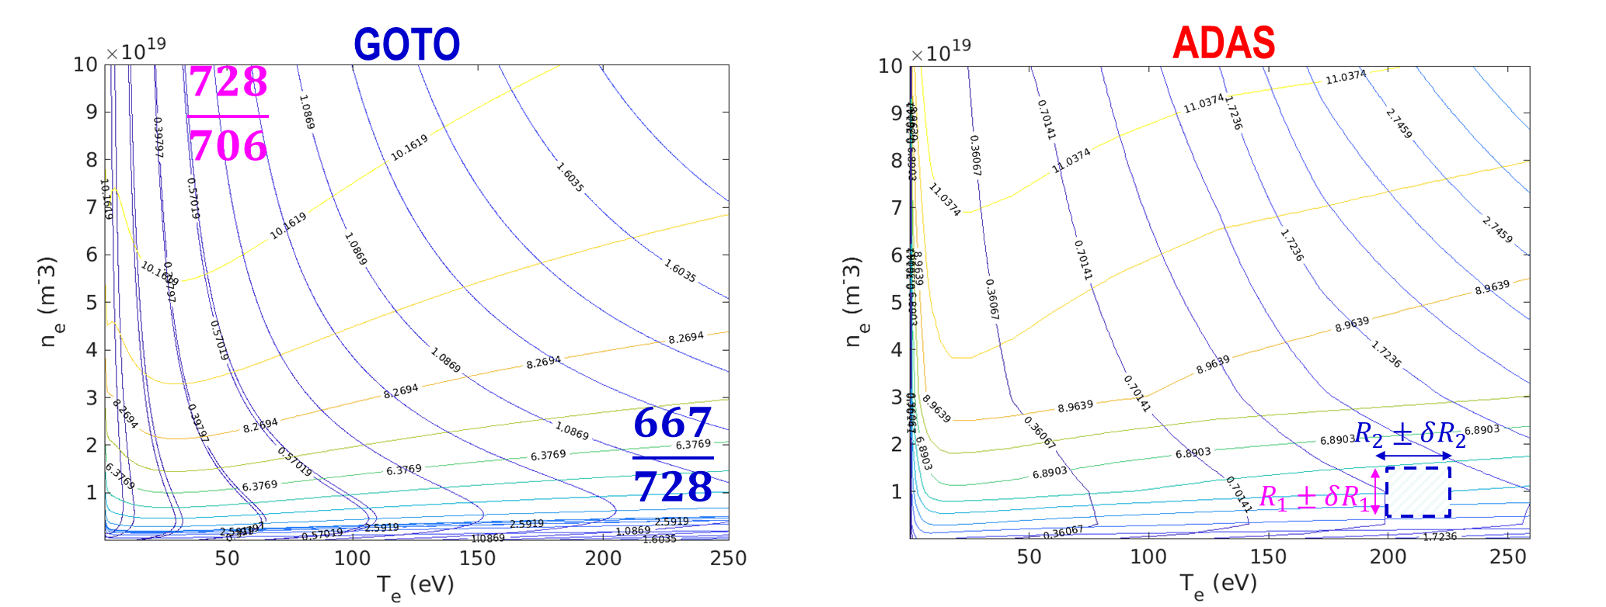
2 RATIOS :
optimized version of ADAS dataset
[H. P. Summers, AIP Conf. Proc. 2011]
3 RATIOS :
Goto CR model [M. Goto and K. Sawada, J. Quant. Spectrosc. Radiat. Transfer , 2011] photoexitation rate due to reabsorption is treated as a fitting parameter along with Te and ne

Slide 7
Experimental validation of the role of photon re-absorption @TCV

Slide 8
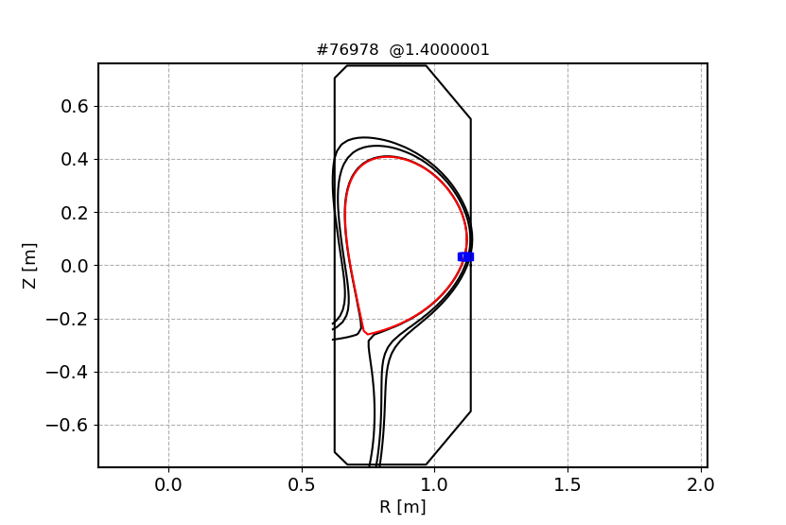
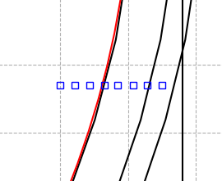
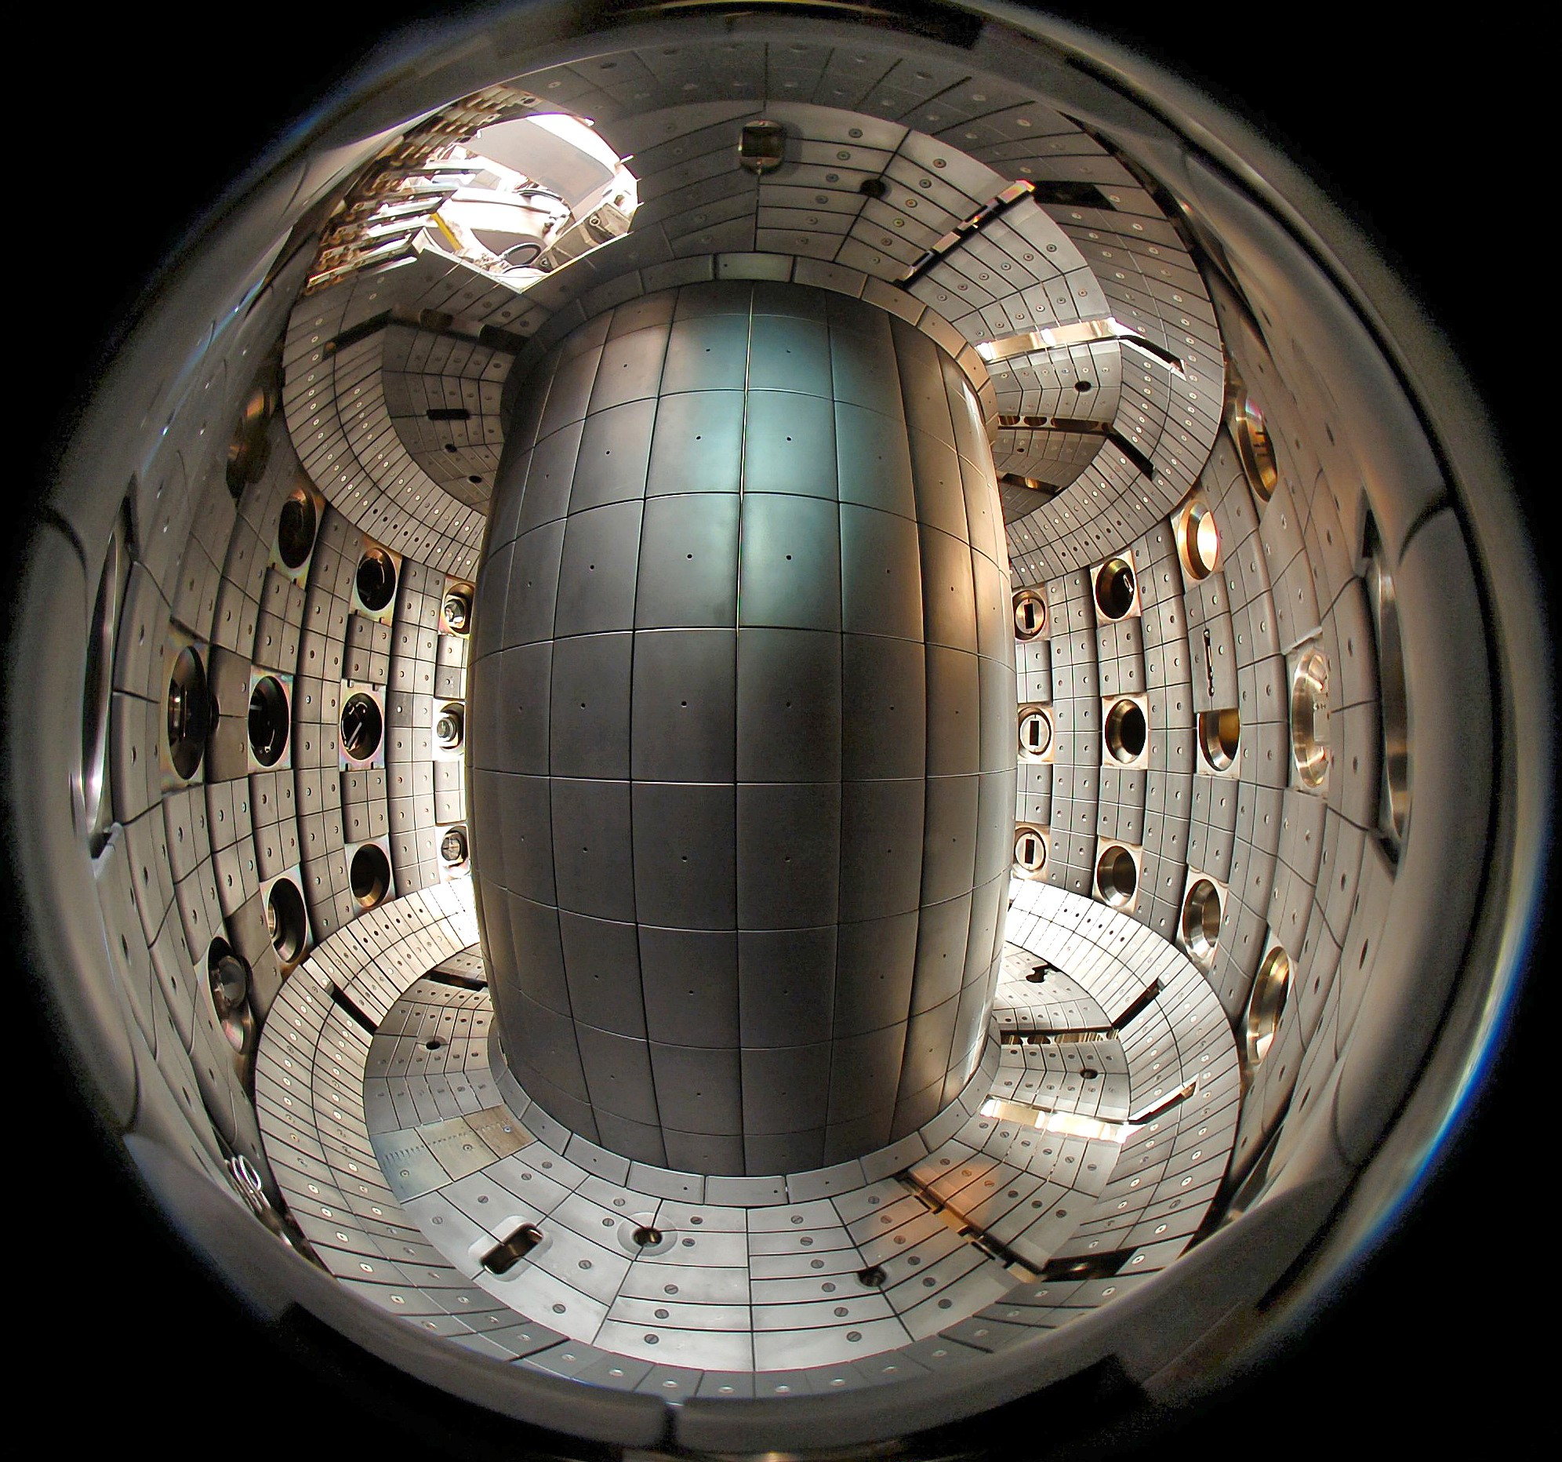
The newly designed THB with 3 line ratios has been tested for the first time at the TCV tokamak
Spatial resolution 5 mm
Acquisition rate 1 MHz

Slide 9
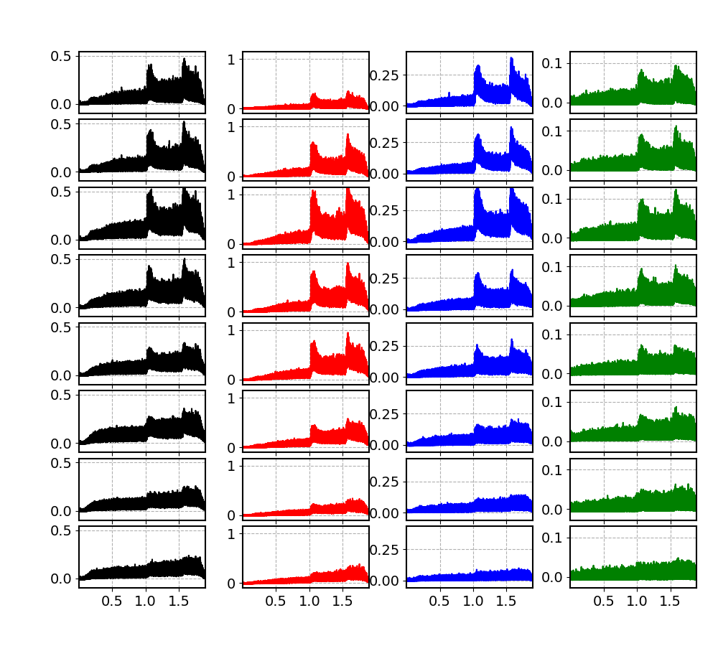
501 nm
667 nm
706 nm
728 nm
I [V]
These are examples of raw signals from the THB diagnostic.
I [V]
I [V]
The signals for the four lines are collected for 8 different LoS
I [V]
I [V]
This shot is characterized by two gas puffings
I [V]
I [V]
The brightest line is the one at 667 nm
I [V]
t [s]
t [s]
t [s]
t [s]

Slide 10
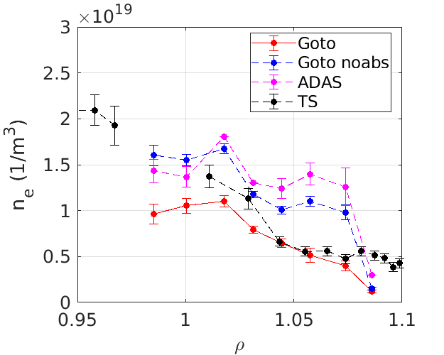
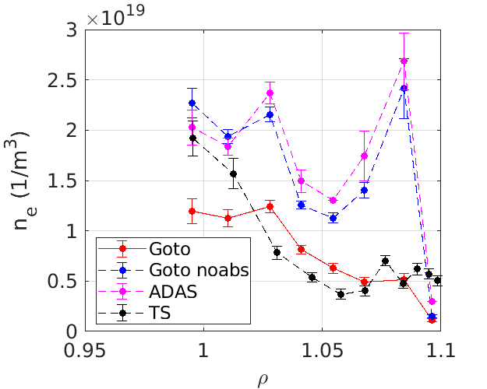
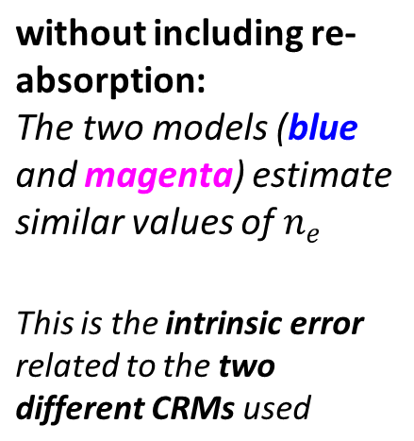
Plasma edge
Scrape-off-layer
Plasma edge
Scrape-off-layer
[M. Ugoletti, RSI, 2024]

Slide 11
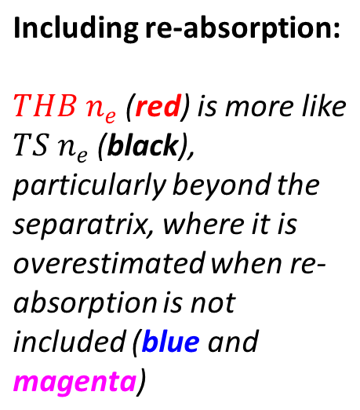
Plasma edge
Scrape-off-layer
Plasma edge
Scrape-off-layer
[M. Ugoletti, RSI, 2024]

Slide 12
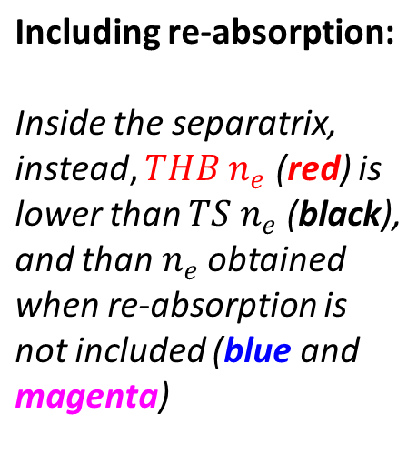
Plasma edge
Scrape-off-layer
Plasma edge
Scrape-off-layer
[M. Ugoletti, RSI, 2024]

Slide 13
Experimental application:
Analysis of High-confinement mode pulses @TCV

Slide 14
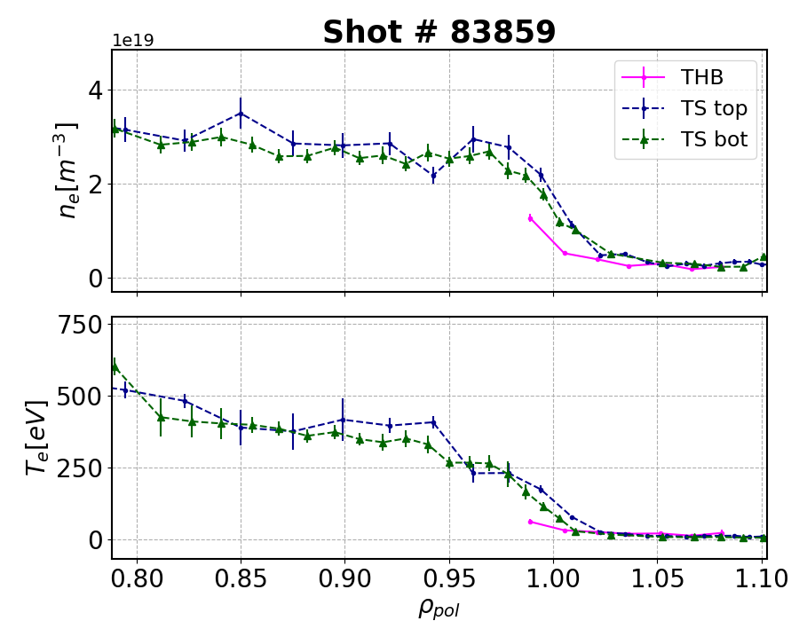
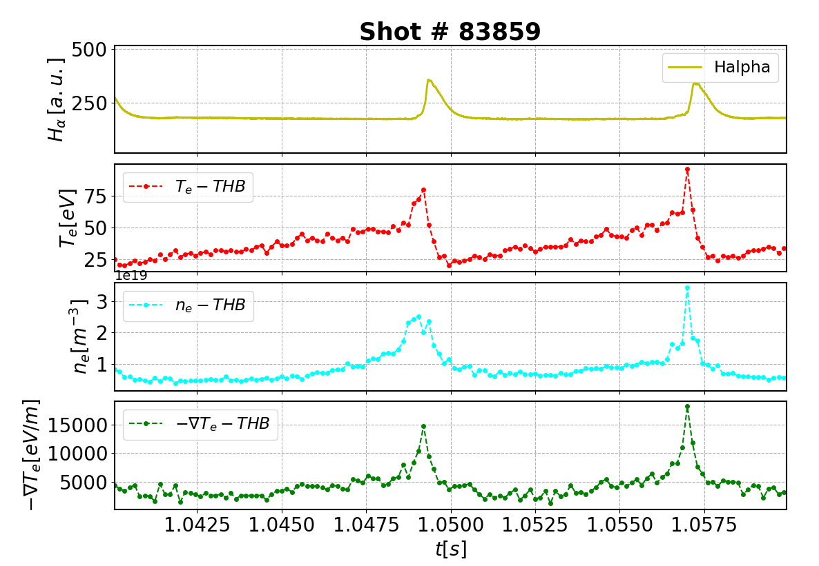
Analysis of High-confinement mode pulses @TCV
Inter-ELM profiles
Profiles evolution in the ELM cycle
ρ = 0.99
ρ = 0.99
[M. La Matina, EPS, 2025]

Slide 15
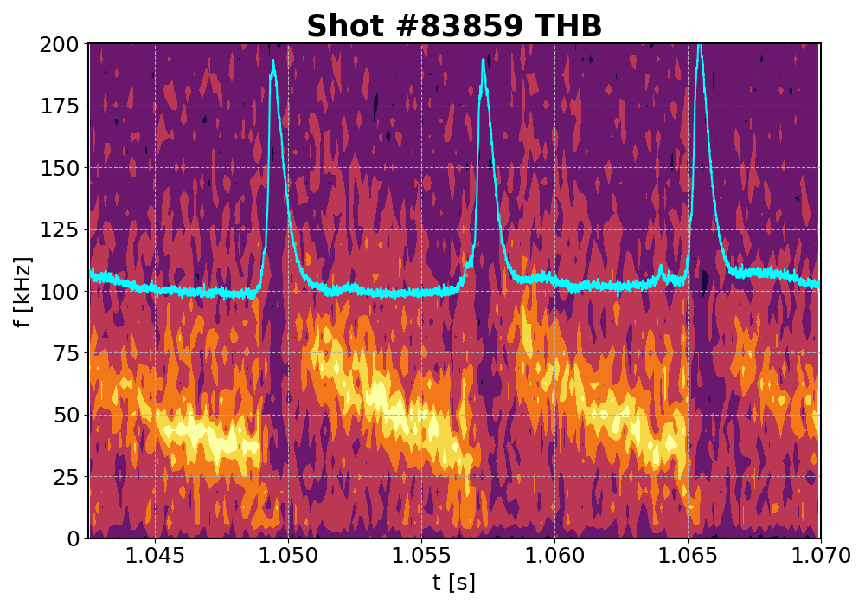
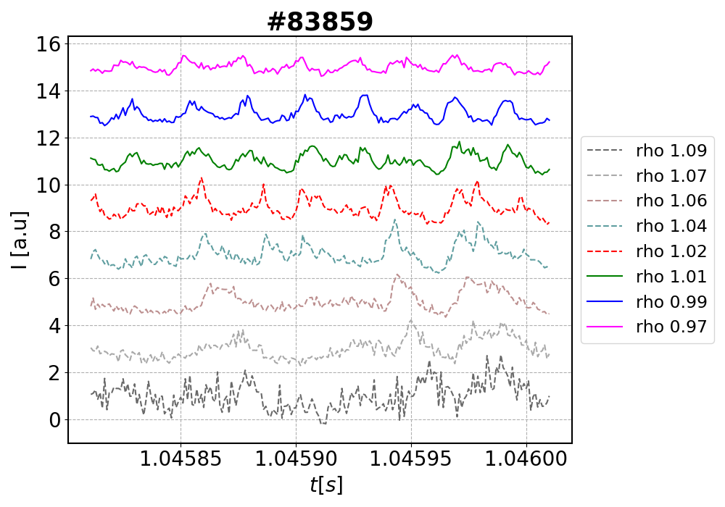
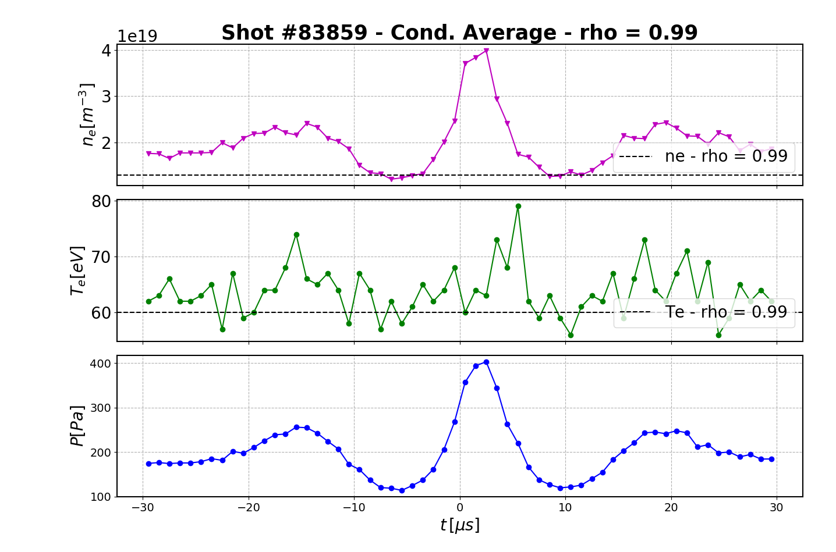
time range of a few μs
Mode detected only in the inter-ELM phase, with a chirping frequency during the ELM cycle
It has been characterized as a fluctuation mostly in n_{e}
[M. La Matina, PPCF, 2025]

Slide 16
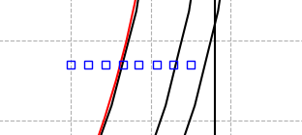
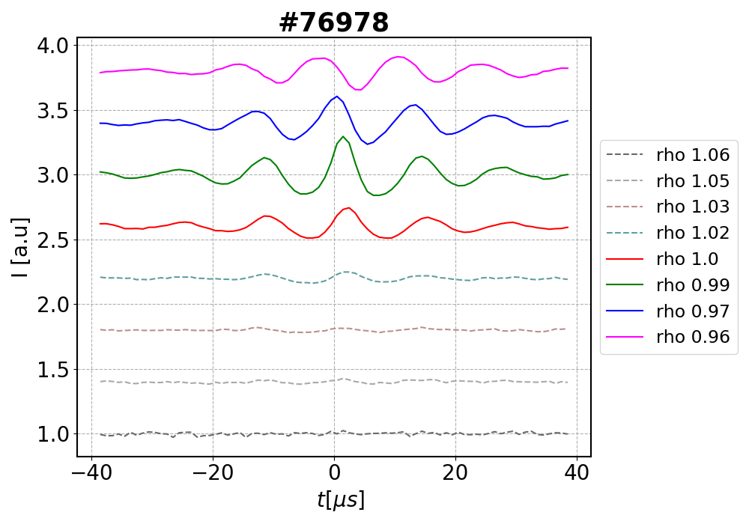
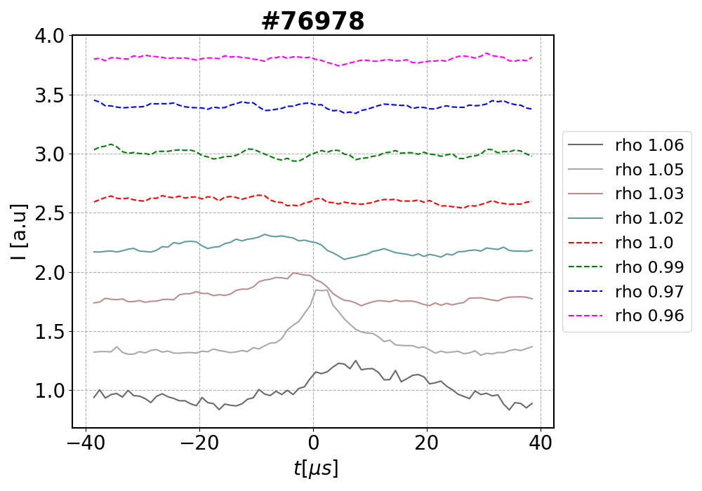
Conditional average on the peaks of the mode in LoS ρ = 0.99
Conditional average on the turbulent structures in LoS ρ = 1.05
[M. La Matina, PPCF, 2025]
[M. La Matina, PPCF, 2025]

Slide 17
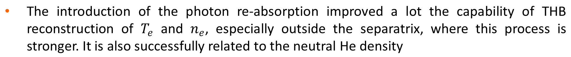
The newly designed THB with 3 line ratios is for the first time tested on experimental data @TCV. All the 4 measured lines are well isolated and free of impurity lines.
The THB has been used to study High confinement modes at TCV, obtaining a good representation of the ELM cycle, as well as the characterization of inter-ELM modes
Now it is ready to be used @RFX-mod2, with radial profiles and poloidal reconstruction
Thank you for your attention!

