Slide 1
Integration of the Pulse Discharge Cleaning system in RFX-mod2
F. Santoroª, N. Ceccatoª, A. Maistrelloª, L. Baseggioª, E. Zerbettoª, L. Grando^{a,b}, S. Peruzzo^{b}
ªConsorzio RFX (CNR, ENEA, INFN, Università di Padova, Acciaierie Venete SpA), Padova, Italy
^{b}CNR - Istituto per la Scienza e Tecnologia dei Plasmi, Padova, Italy
NEFERTARI final workshop
Padova, 25-27 March 2026

Slide 2
Purpose of the Pulse Discharge Cleaning (PDC)
Cleans the inner wall of the RFX plasma vessel by means of low current plasma (50 kA), lasting few milliseconds
Pulses at a fast repetition rate (~0.5 Hz) to allow the impurities to be removed before their reabsorption into the wall
Heats the first wall up to temperatures higher than 180 °C
Different power supply systems from those utilized during the 2 MA operation, because the duty cycles and number of shots (10⁵ for operation at 2 MA, 10⁷ for the PDC) in the two cases are very different

Slide 3
Motivation of the work
The current system was installed in the early 2000s for RFX-mod, the previous iteration of the experiment, however its completion, including the connection to the magnets of RFX-mod and its full commissioning, never took place
In the last few years, in view of the start of operations of RFX-mod2, a significant effort has been conducted to bring this system to operational readiness

Slide 4
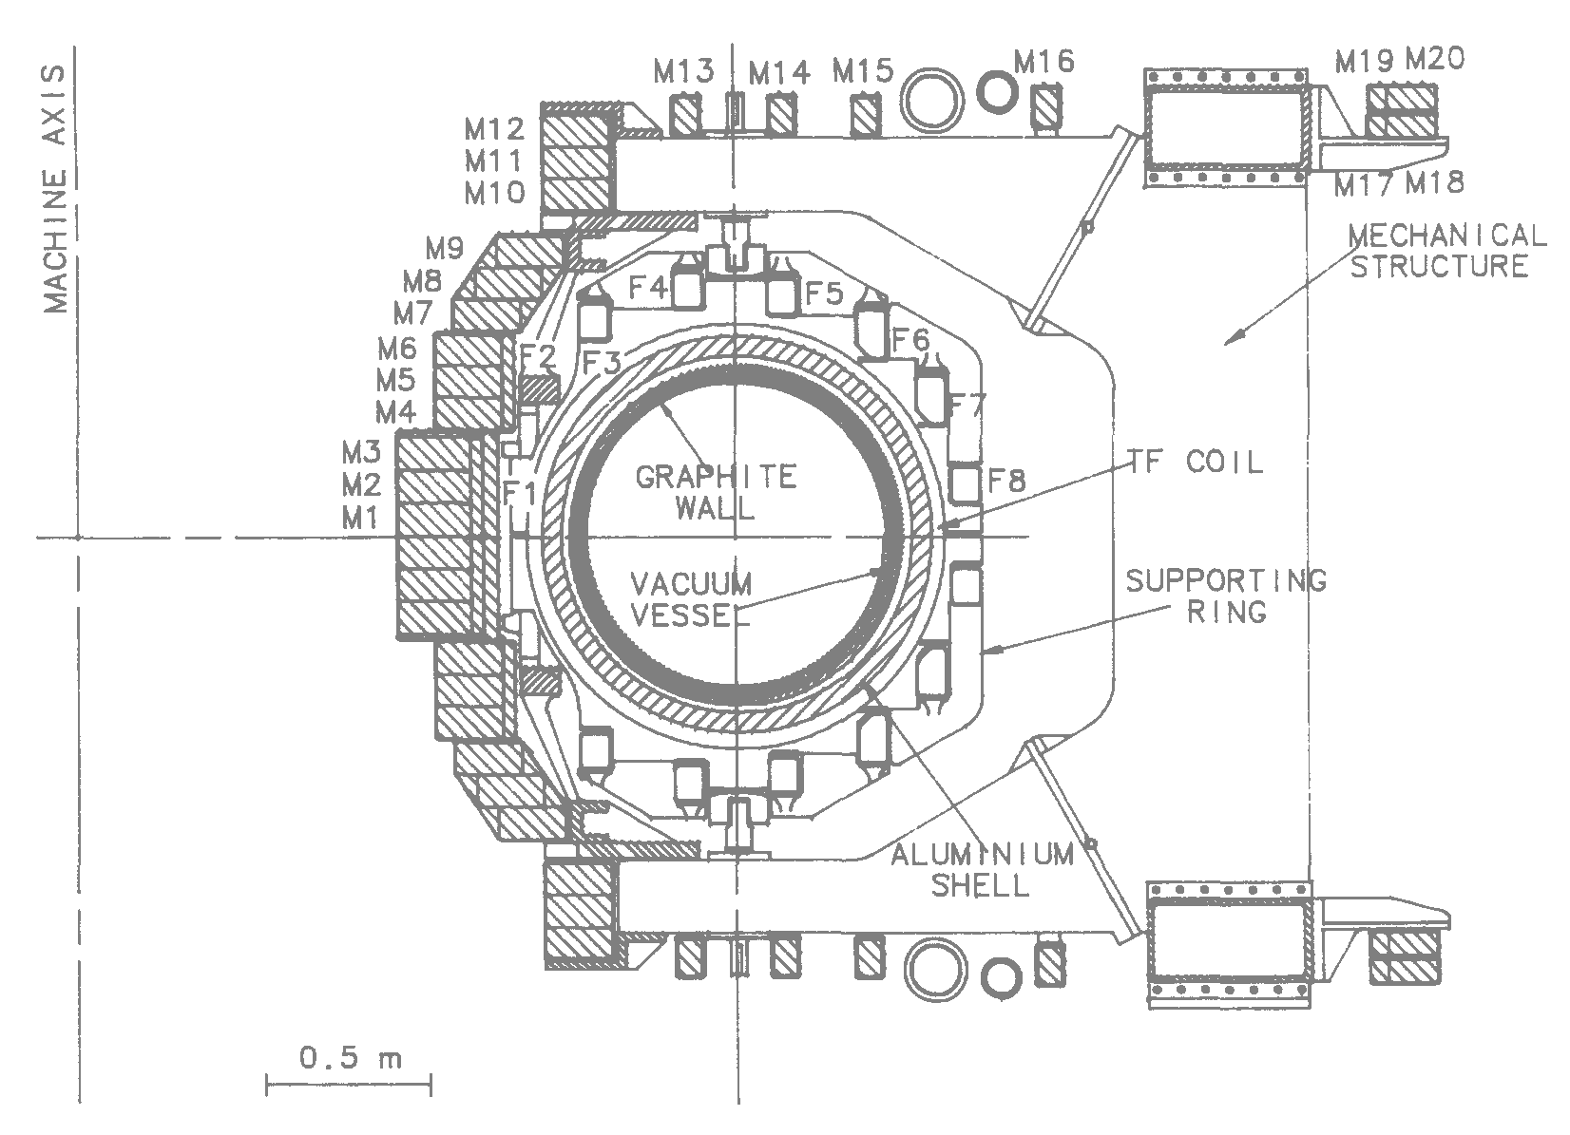
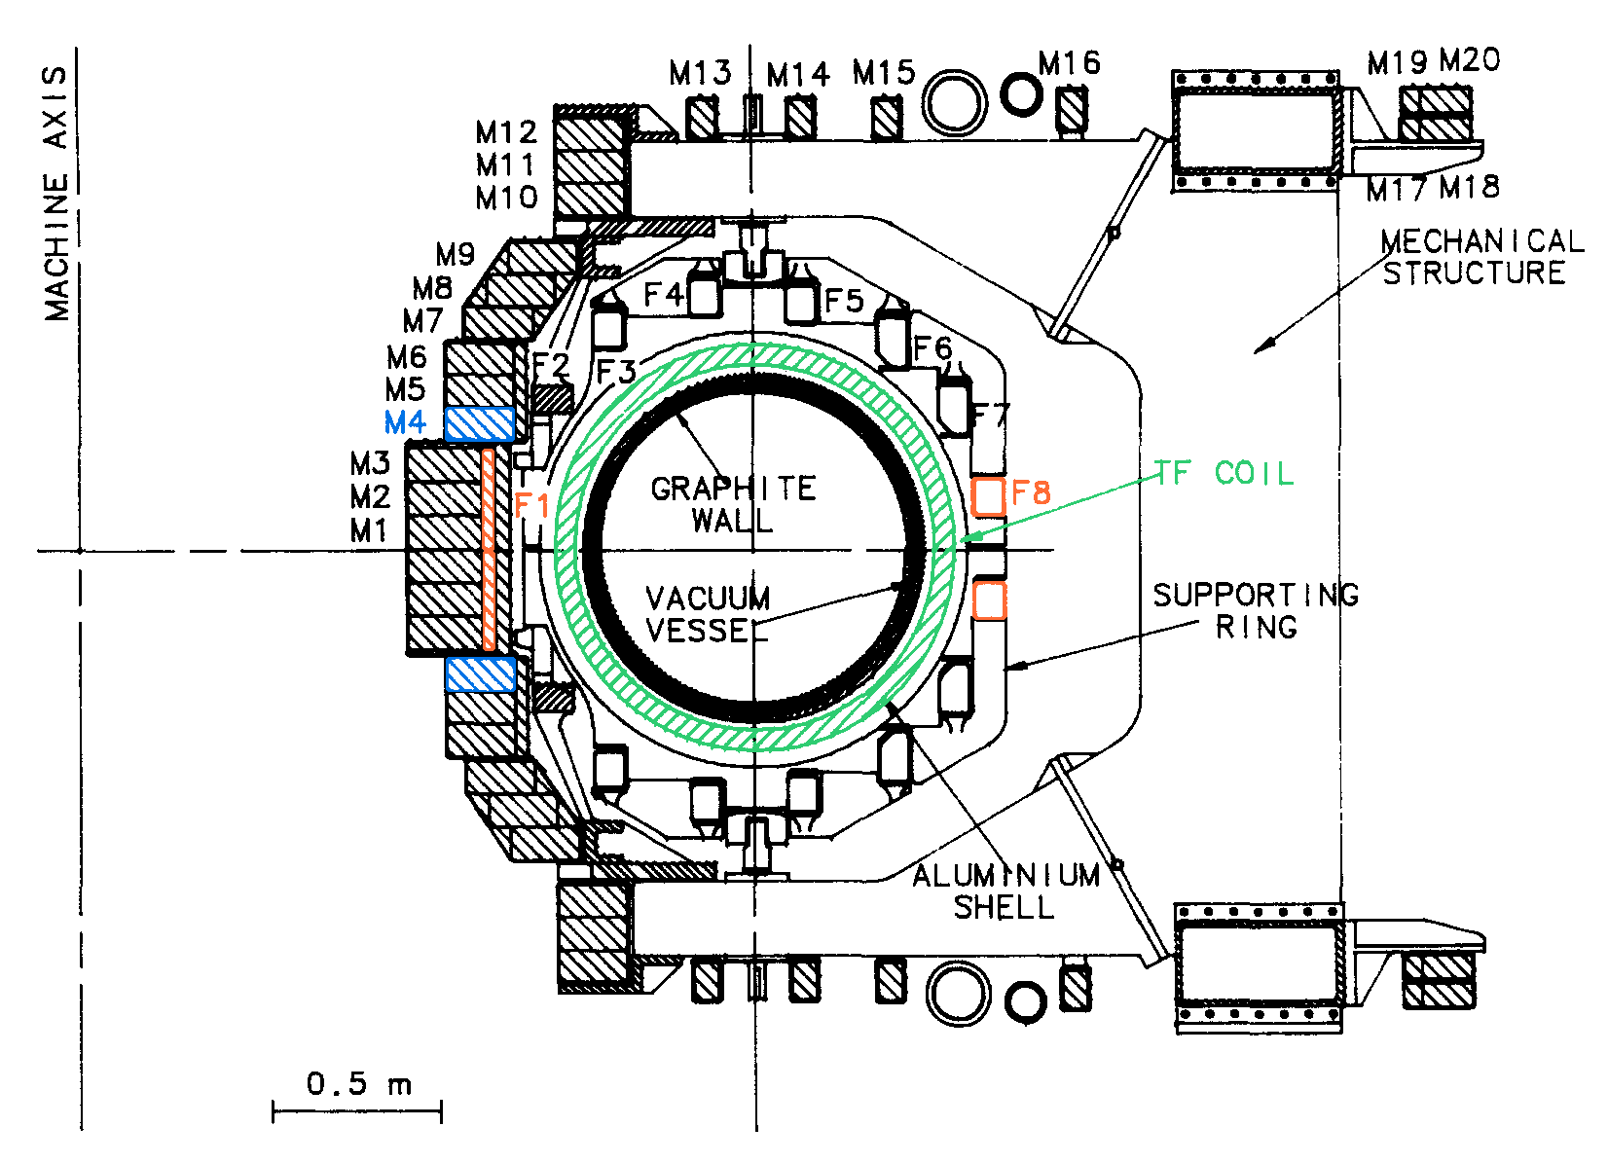

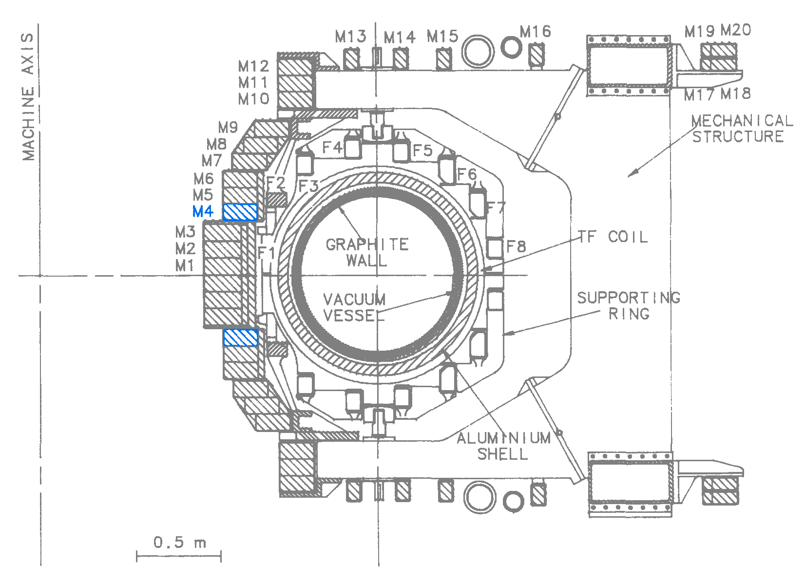
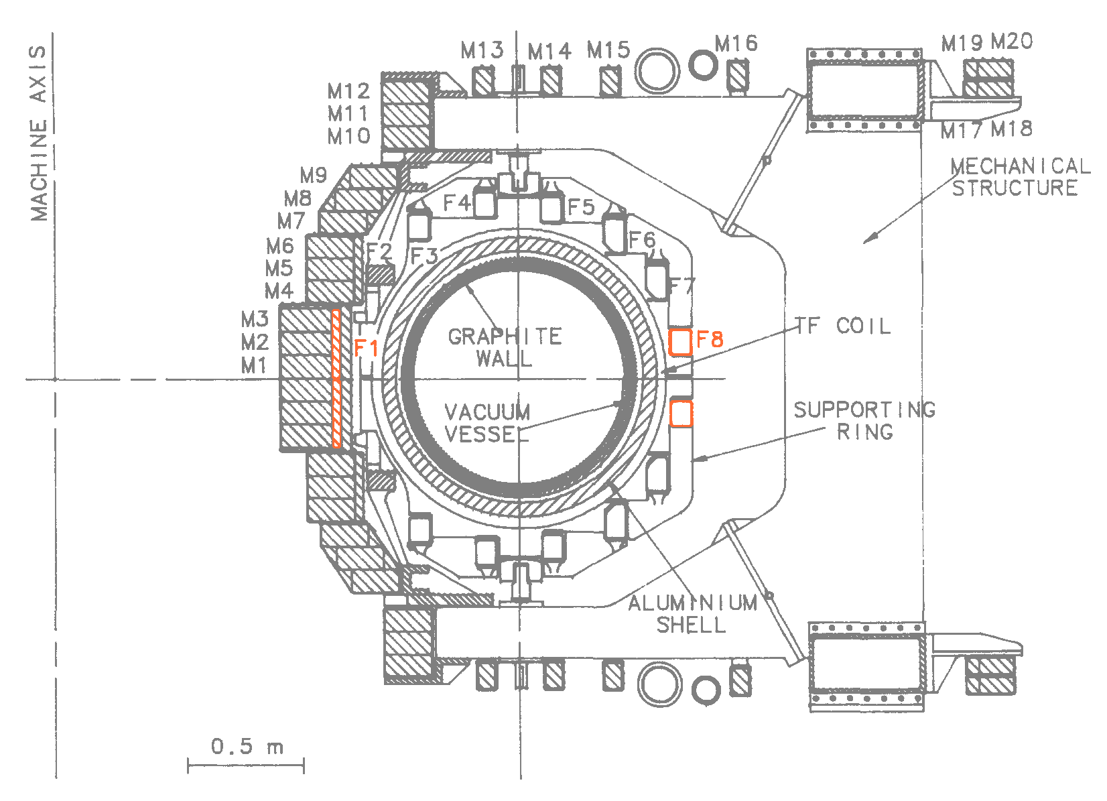
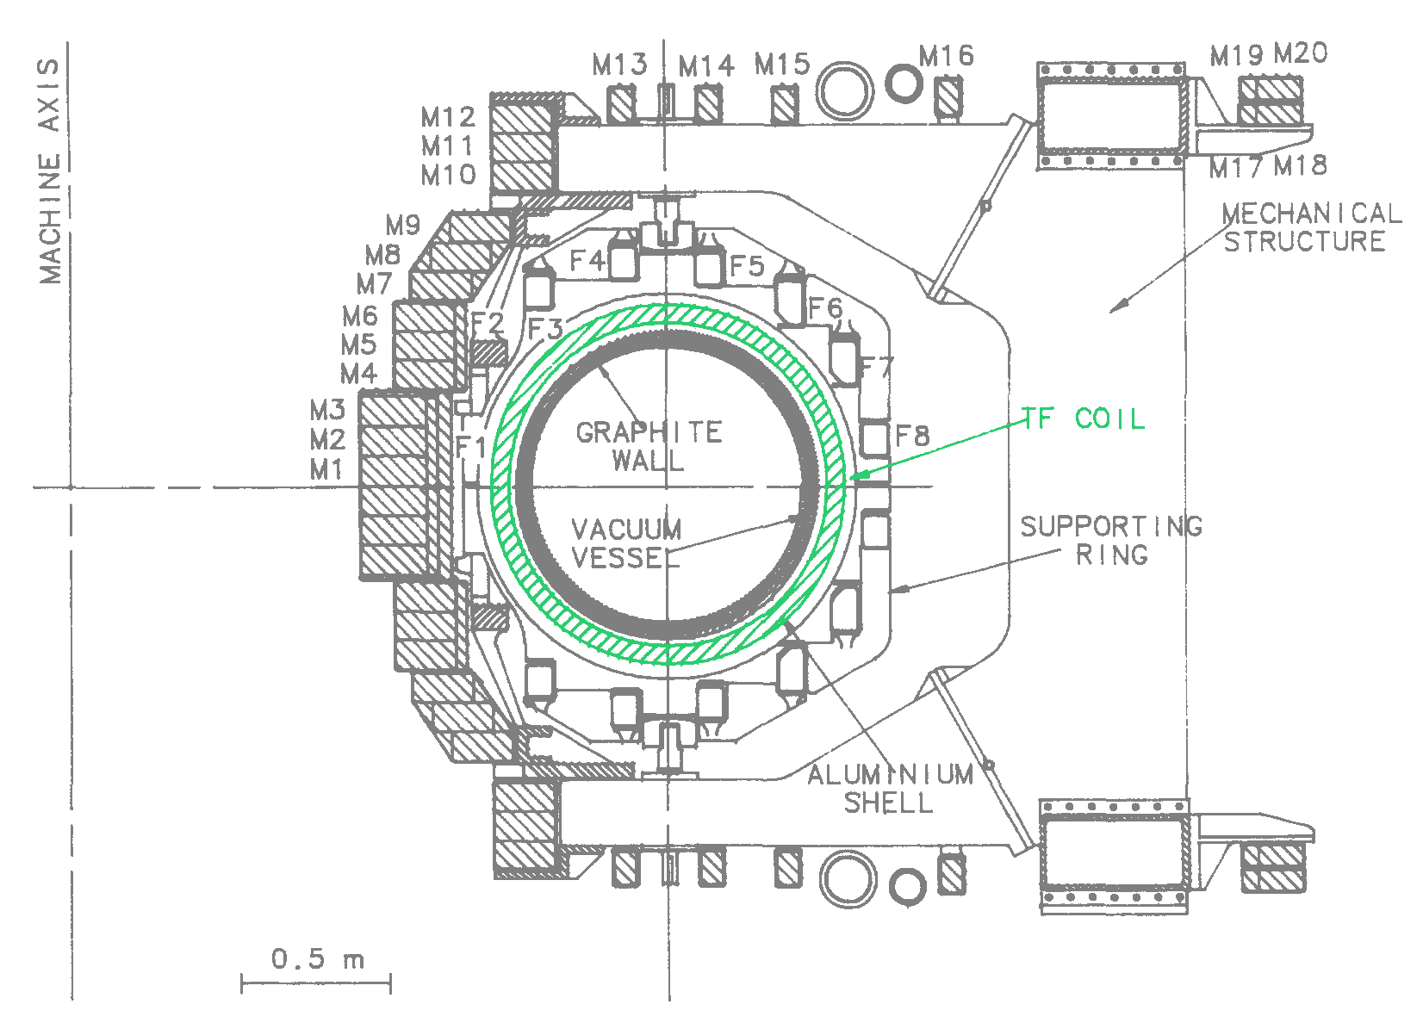
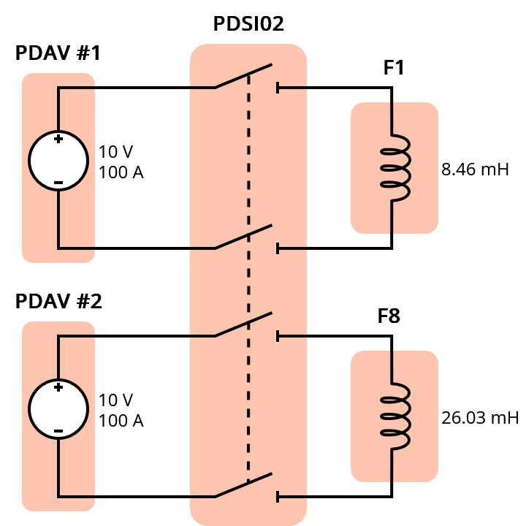
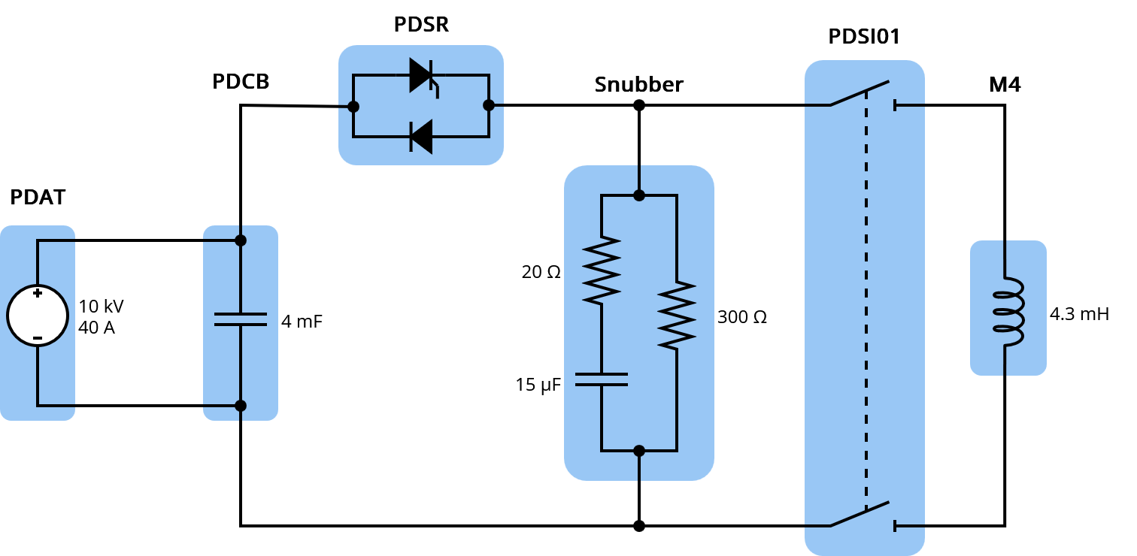
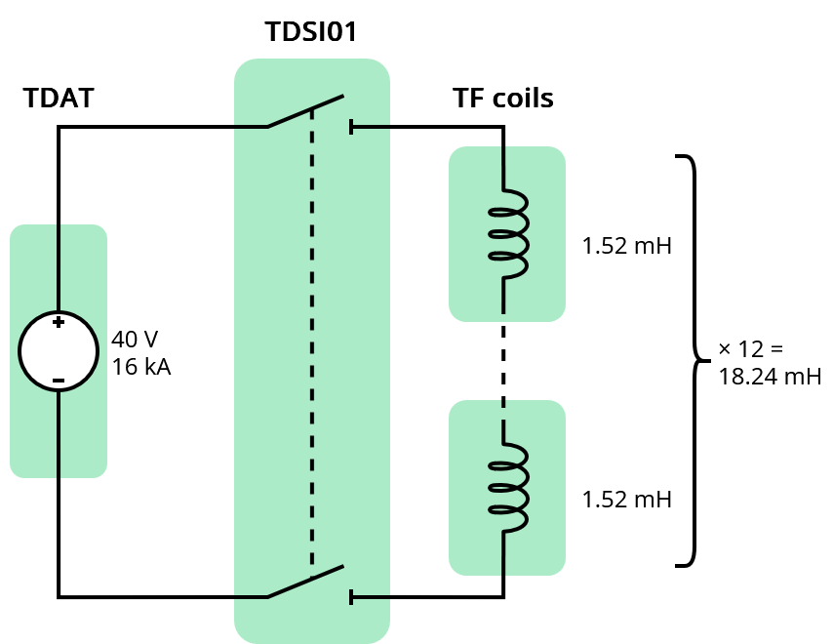
Overview of the PDC Power Supplies
TDAT: feeds all Toroidal field coils to produce a static magnetic field of 50 mT
PDAT+PDSR+PDCB: generate the plasma discharge by feeding one of the Magnetizing coils with an oscillating pulse
PDAV: feeds two Field Shaping coils to produce a vertical magnetic field to facilitate the plasma discharge

Slide 5
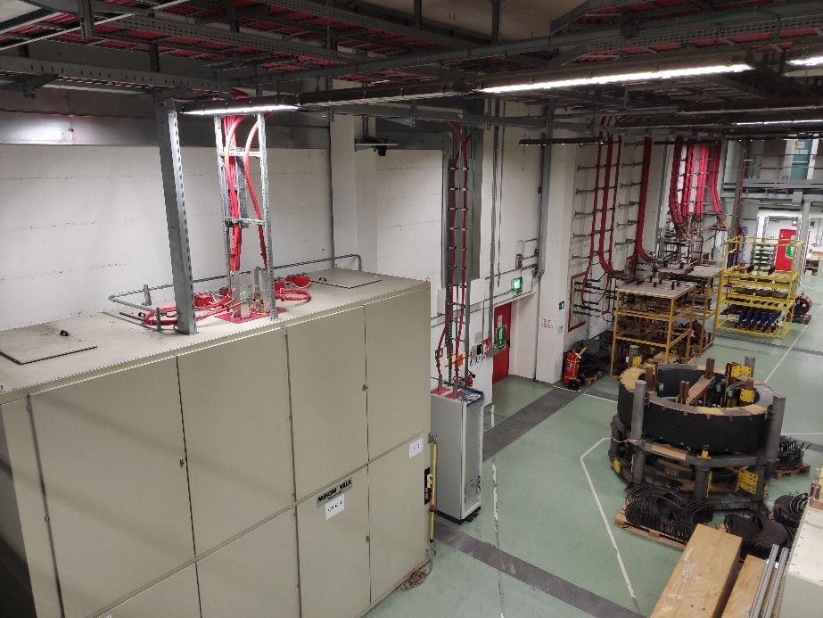
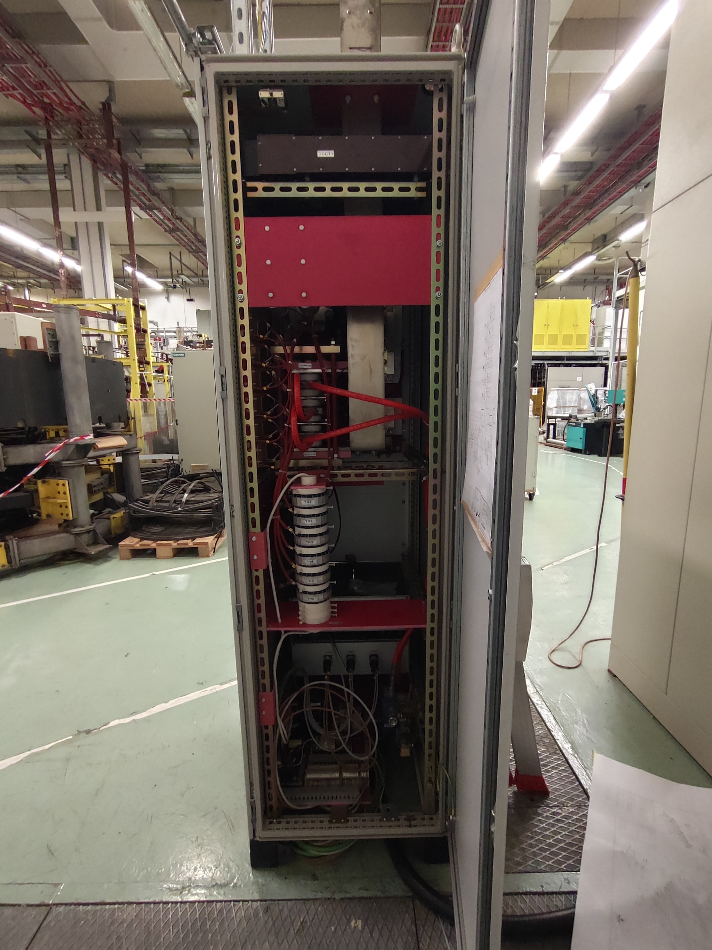
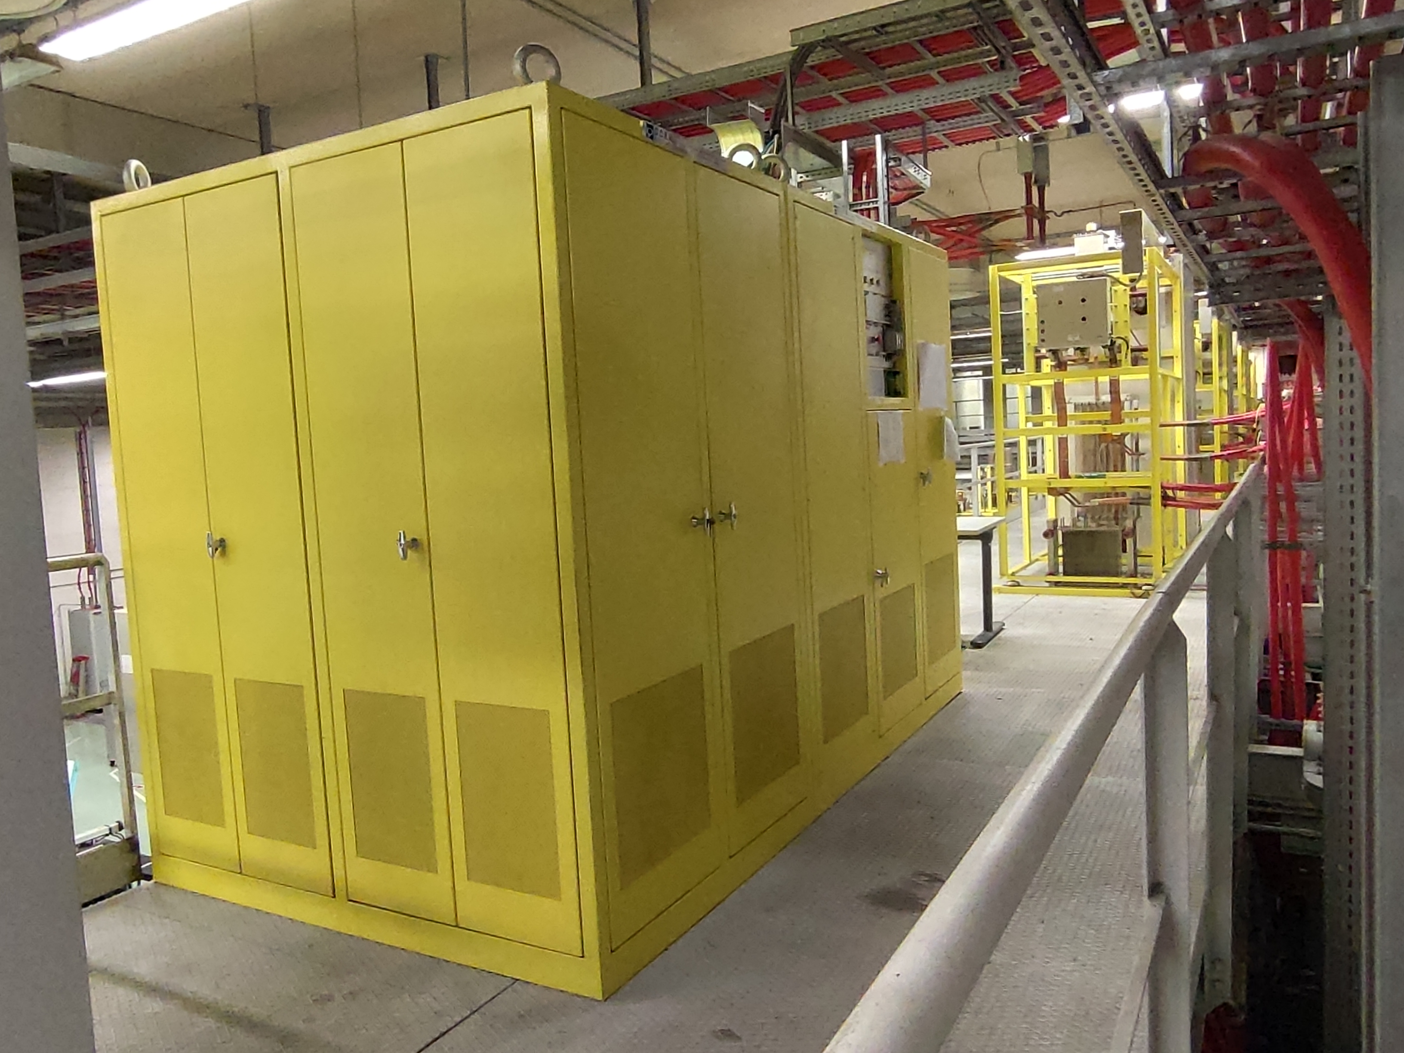
Overview of the PDC Power Supplies
PDSR
Snubber
PDCB
PDSR
PDAT

Slide 6
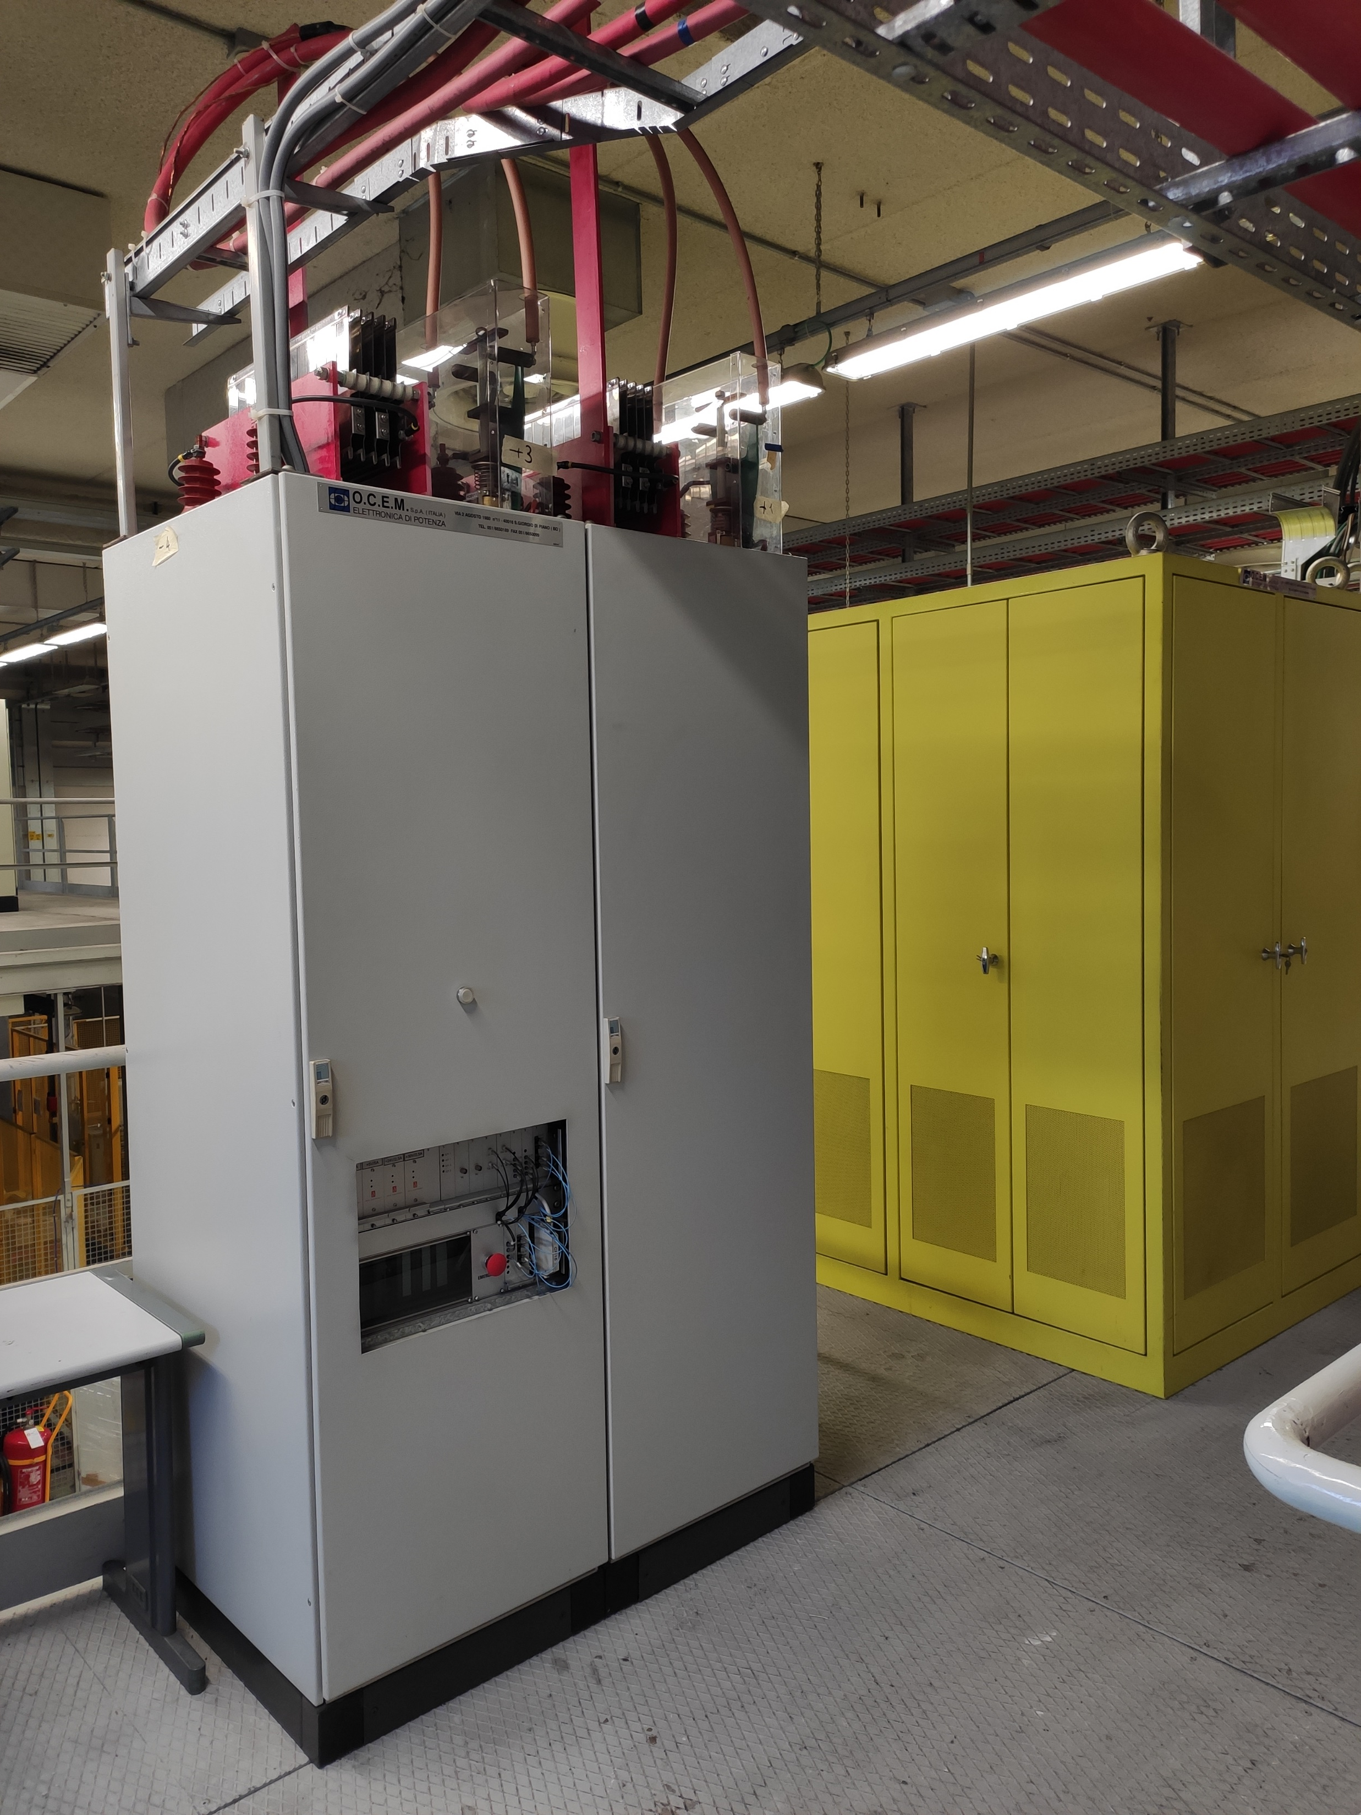
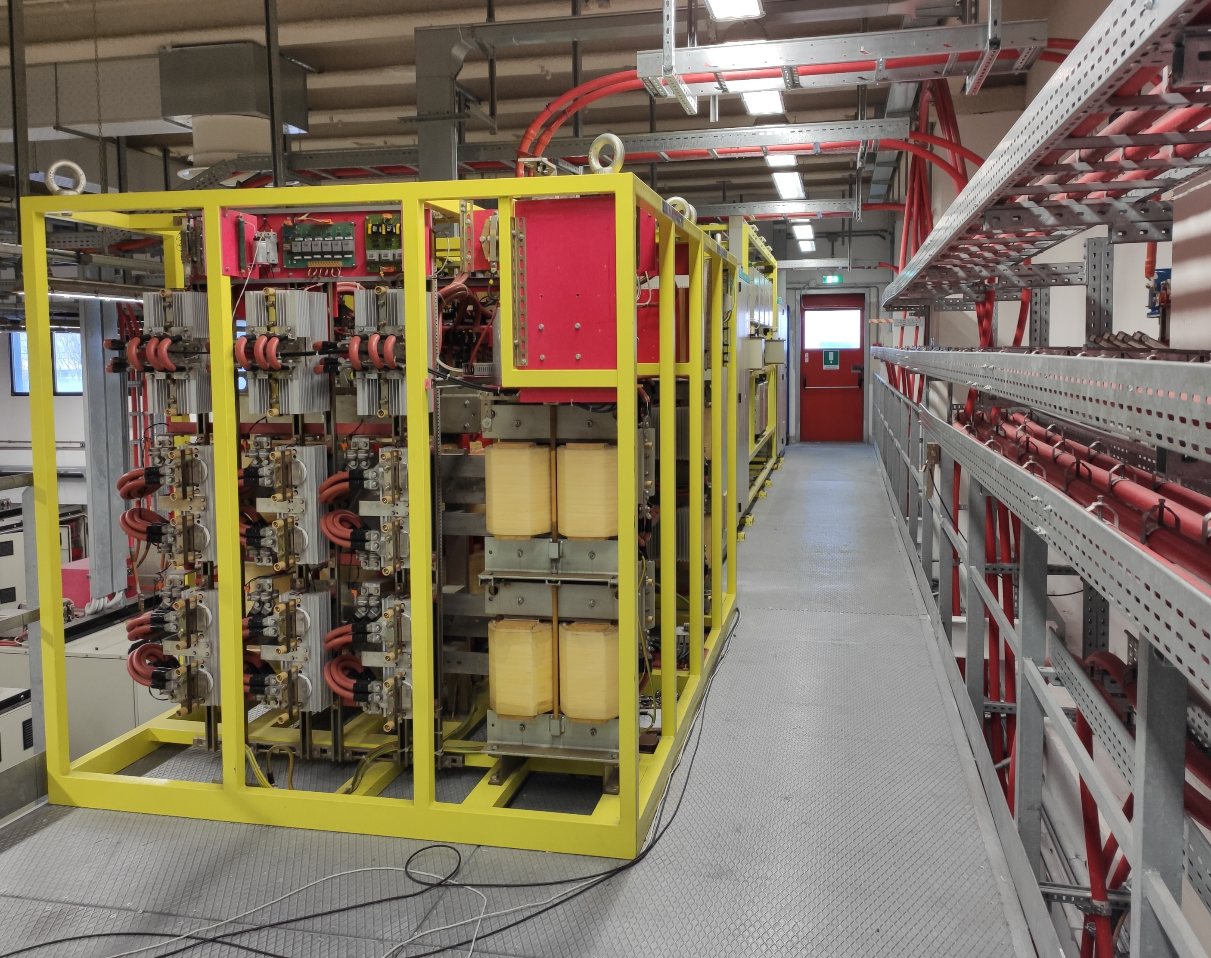
Overview of the PDC Power Supplies
PDAV
TDAT

Slide 7
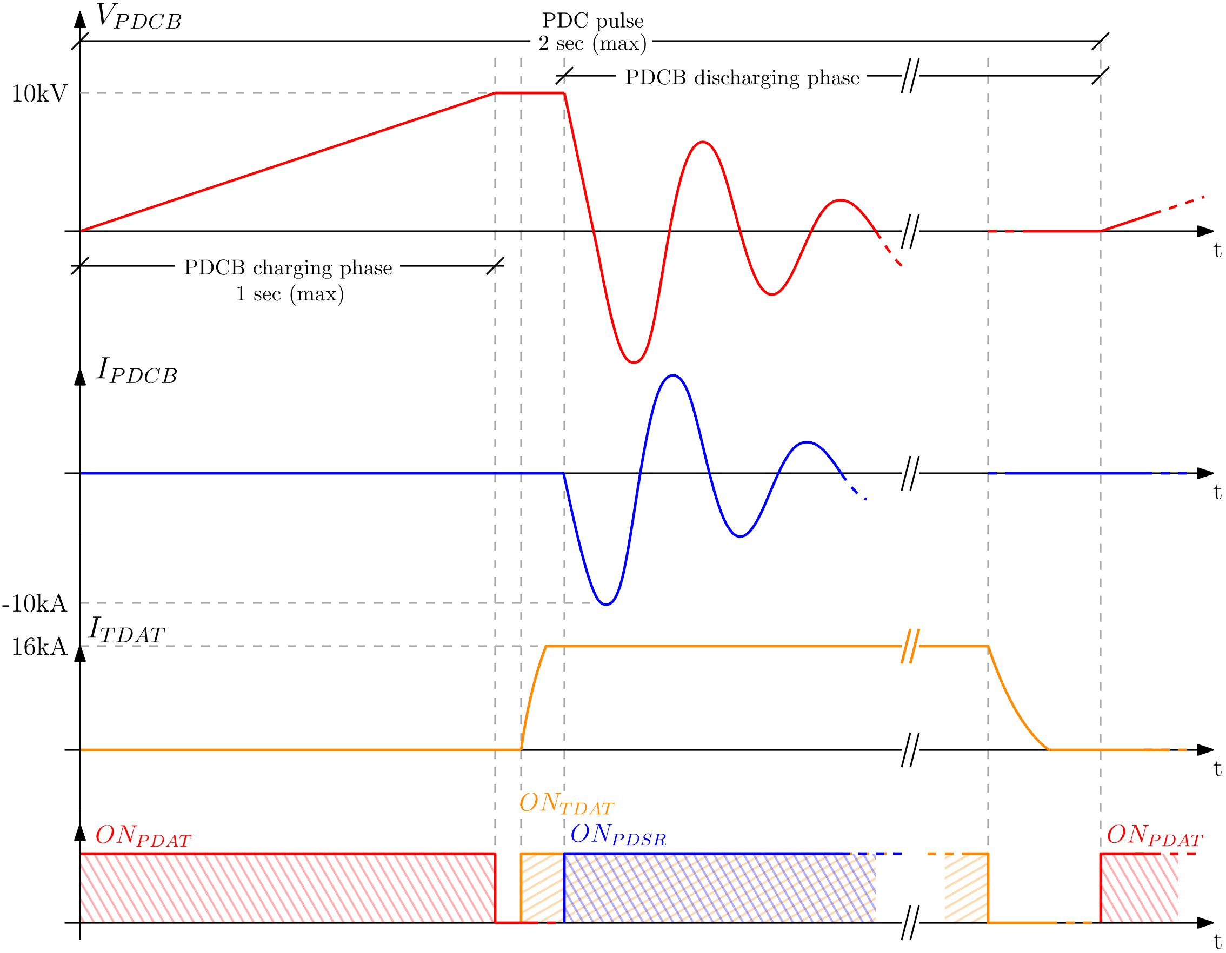
Operation of the PDAT-PDCB-PDSR
The PDAT converter charges the capacitor bank (PDCB)
Once charged, the static switch (PDSR) closes, triggering an oscillating current discharge of up to 10 kA
This generates a magnetizing flux variation that induces a plasma current of about 50 kA
From: M. Faoro, “RFX-mod2 Pulse Discharge Cleaning: review of the design and modelling”, 2024

Slide 8
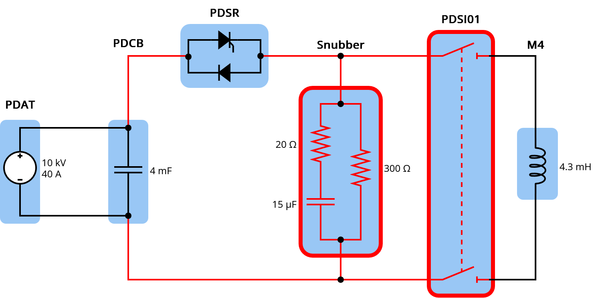
New components procured via PNRR
Components procured:
PDSI01: medium-voltage disconnectors to isolate the PDC power supplies from the magnets during normal experimental operation
Medium-voltage cable connections, some previously missing
Snubber circuit, to reduce the voltage derivative on the magnetizing magnet during PDC operation
New components highlighted in red

Slide 9
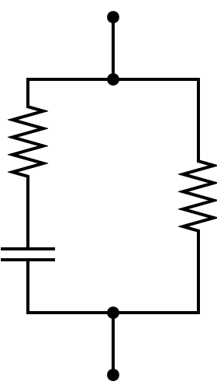
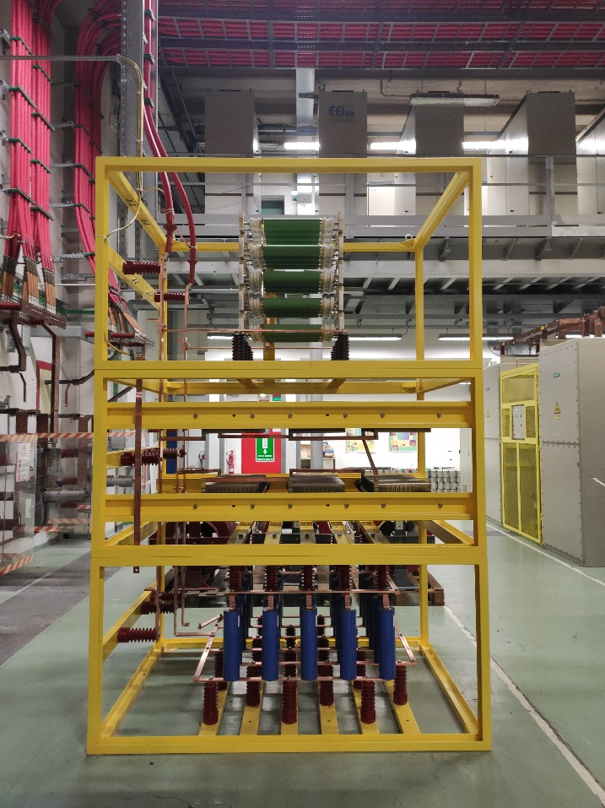
Procured components: Snubber
Rated 10 kV, 10 kA, with a duty cycle of 0.01 s every 2 s
20 Ω
300 Ω
15 μF

Slide 10
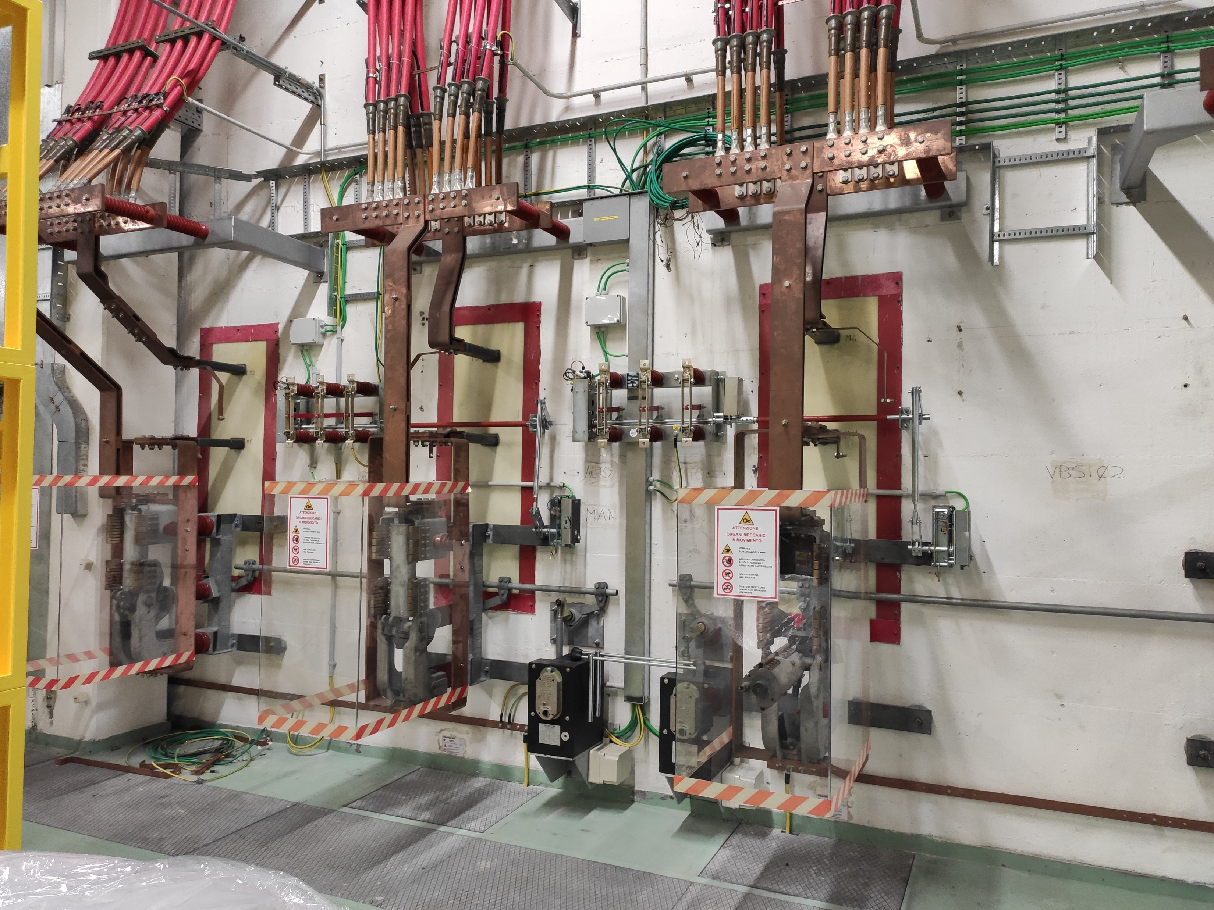
Procured components: PDSI01
Composed by two three-phase MV disconnectors, motorised
Rated 12 kV, 630 A (dc)

Slide 11
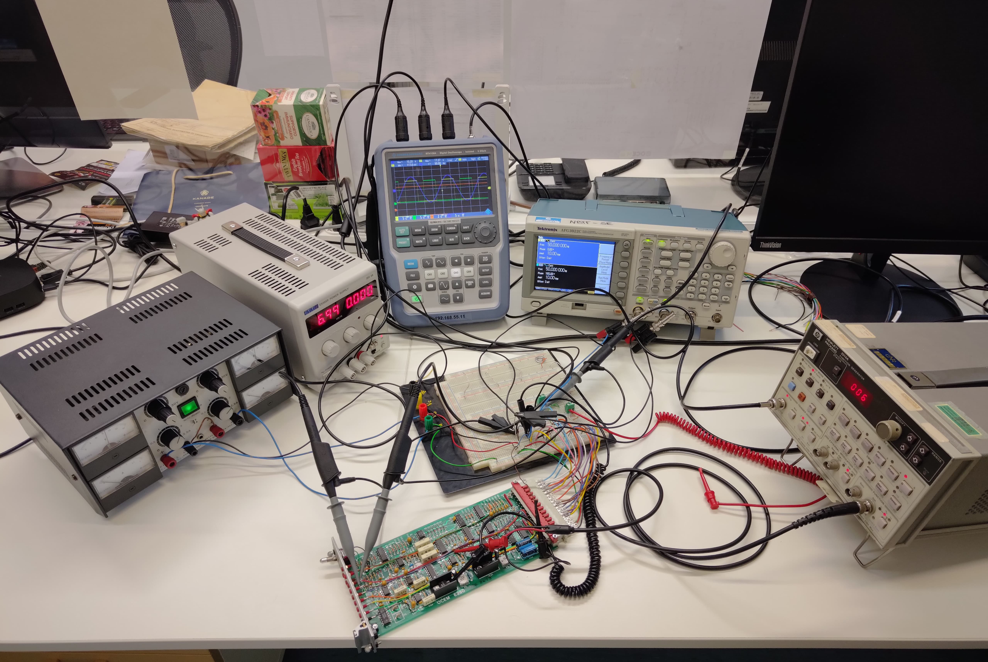
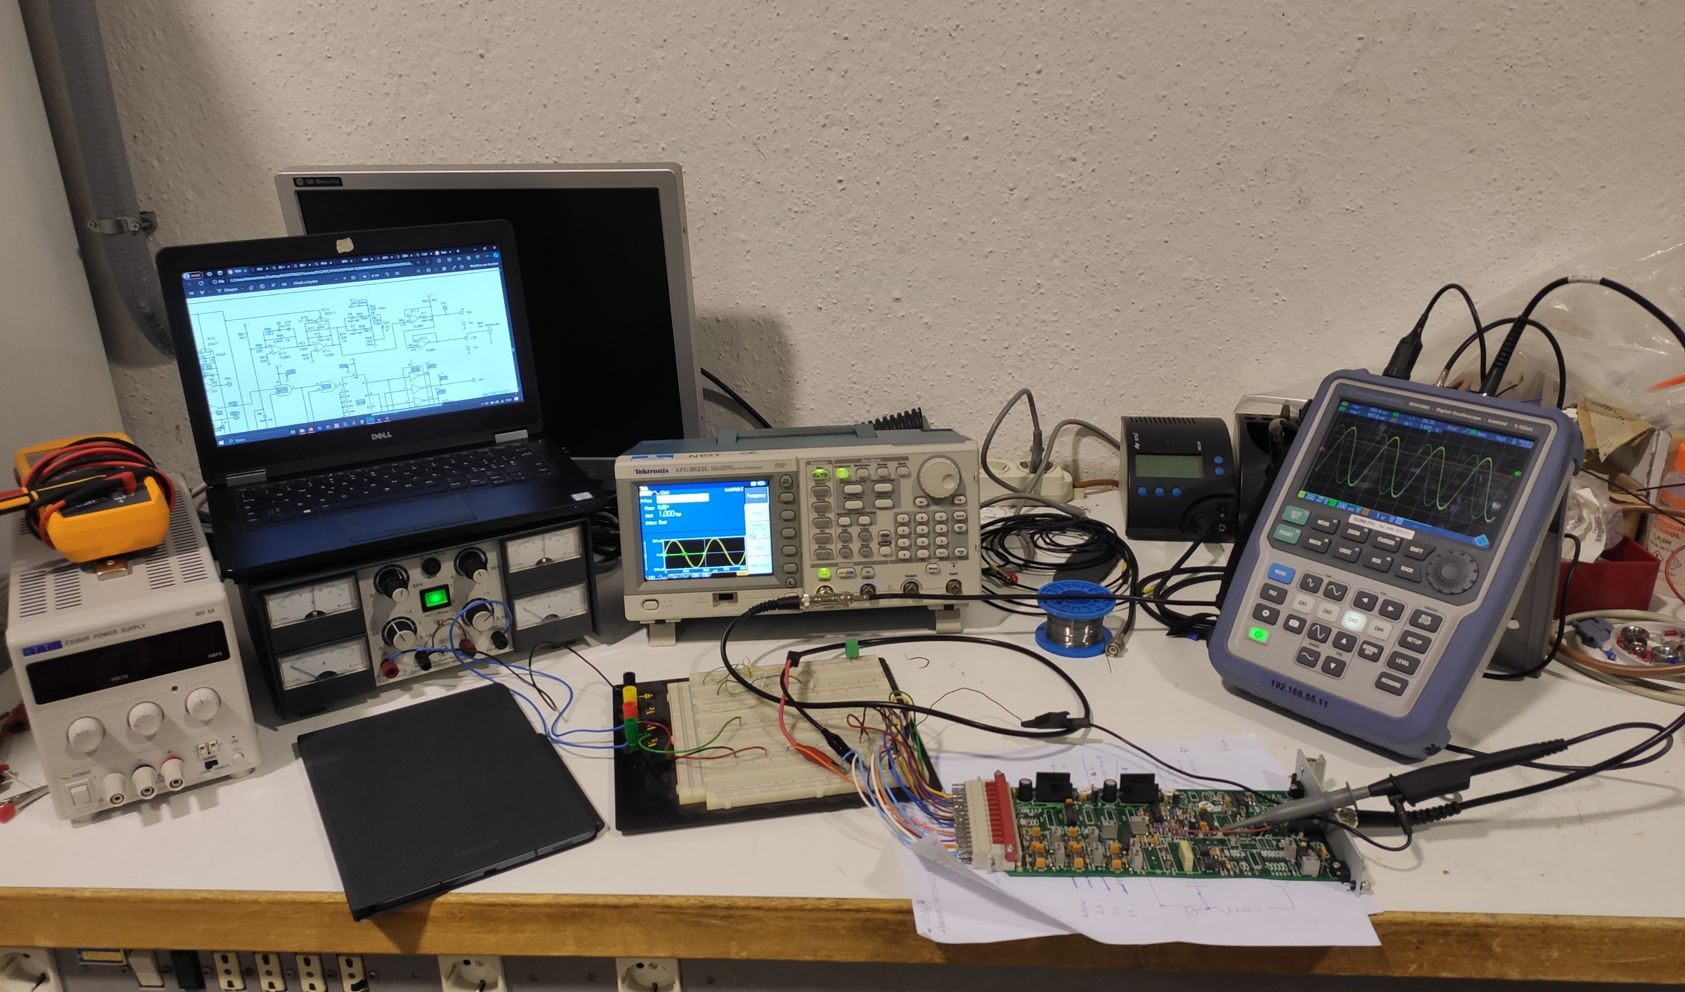
Commissioning: from the electronic boards
Limited documentation available on the operation of the original system components
Part of the analogue electronic boards tested to understand their function and perform troubleshooting
Successful no-load power-up of the PDC with no faults detected
From: M. Faoro, “RFX-mod2 Pulse Discharge Cleaning: review of the design and modelling”, 2024

Slide 12
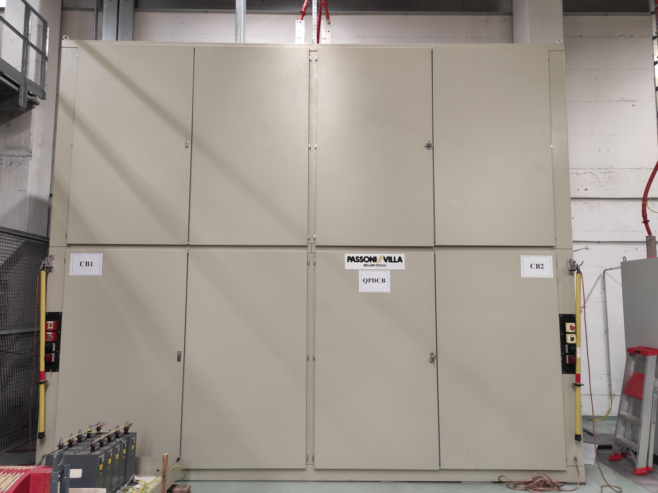
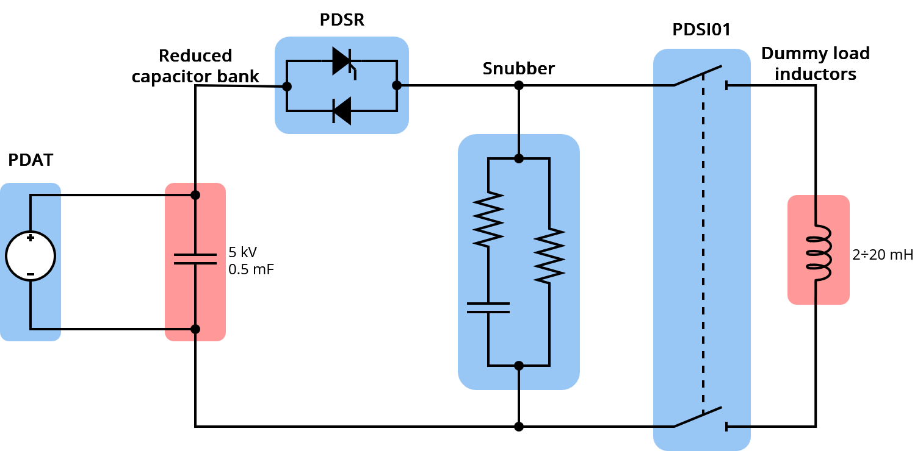
Commissioning: test setup
Poloidal circuit tested with power, with reduced energy and dummy load
From 10 kV, 4 mF (200 kJ) to 5 kV, 0.5 mF (6.25 kJ)

Slide 13
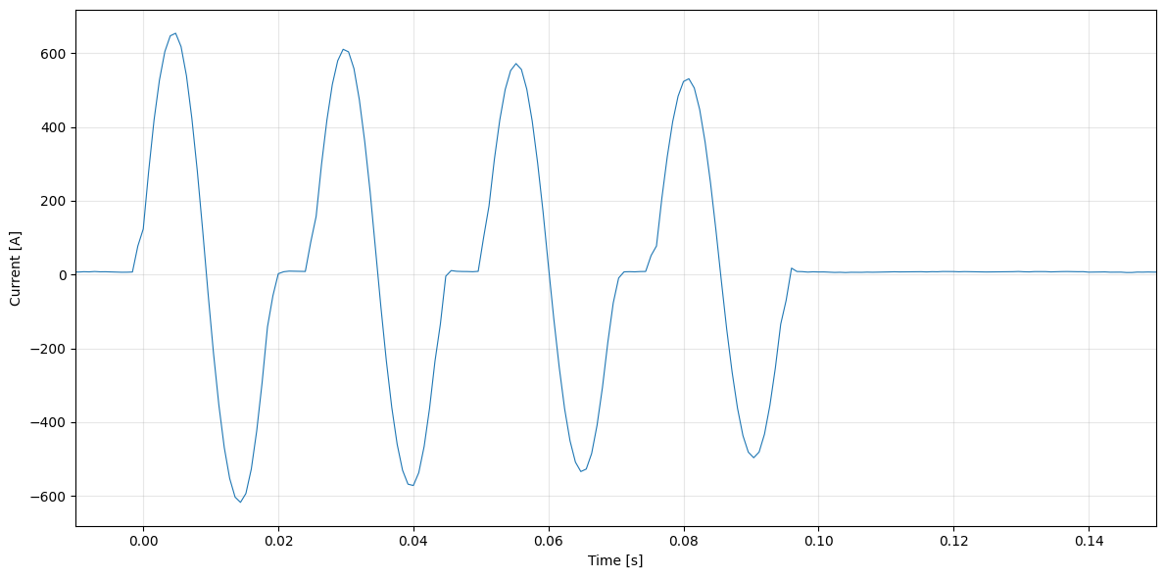
Commissioning: first results
The measured current in the dummy load confirms that the PDC produced the expected oscillating discharge
Due to the reduced capacitor bank, the current is lower than the nominal 10 kA

Slide 14
Conclusions & next steps
PDC system of RFX-mod2 currently under recommissioning
Missing electrical components procured and installed thanks to PNRR funding
Extensive reverse engineering carried out to understand operating principles and troubleshoot the system
Preliminary tests at reduced ratings confirm correct system operation
Next step: tests at full ratings before RFX-mod2 experimental campaign

