Slide 1
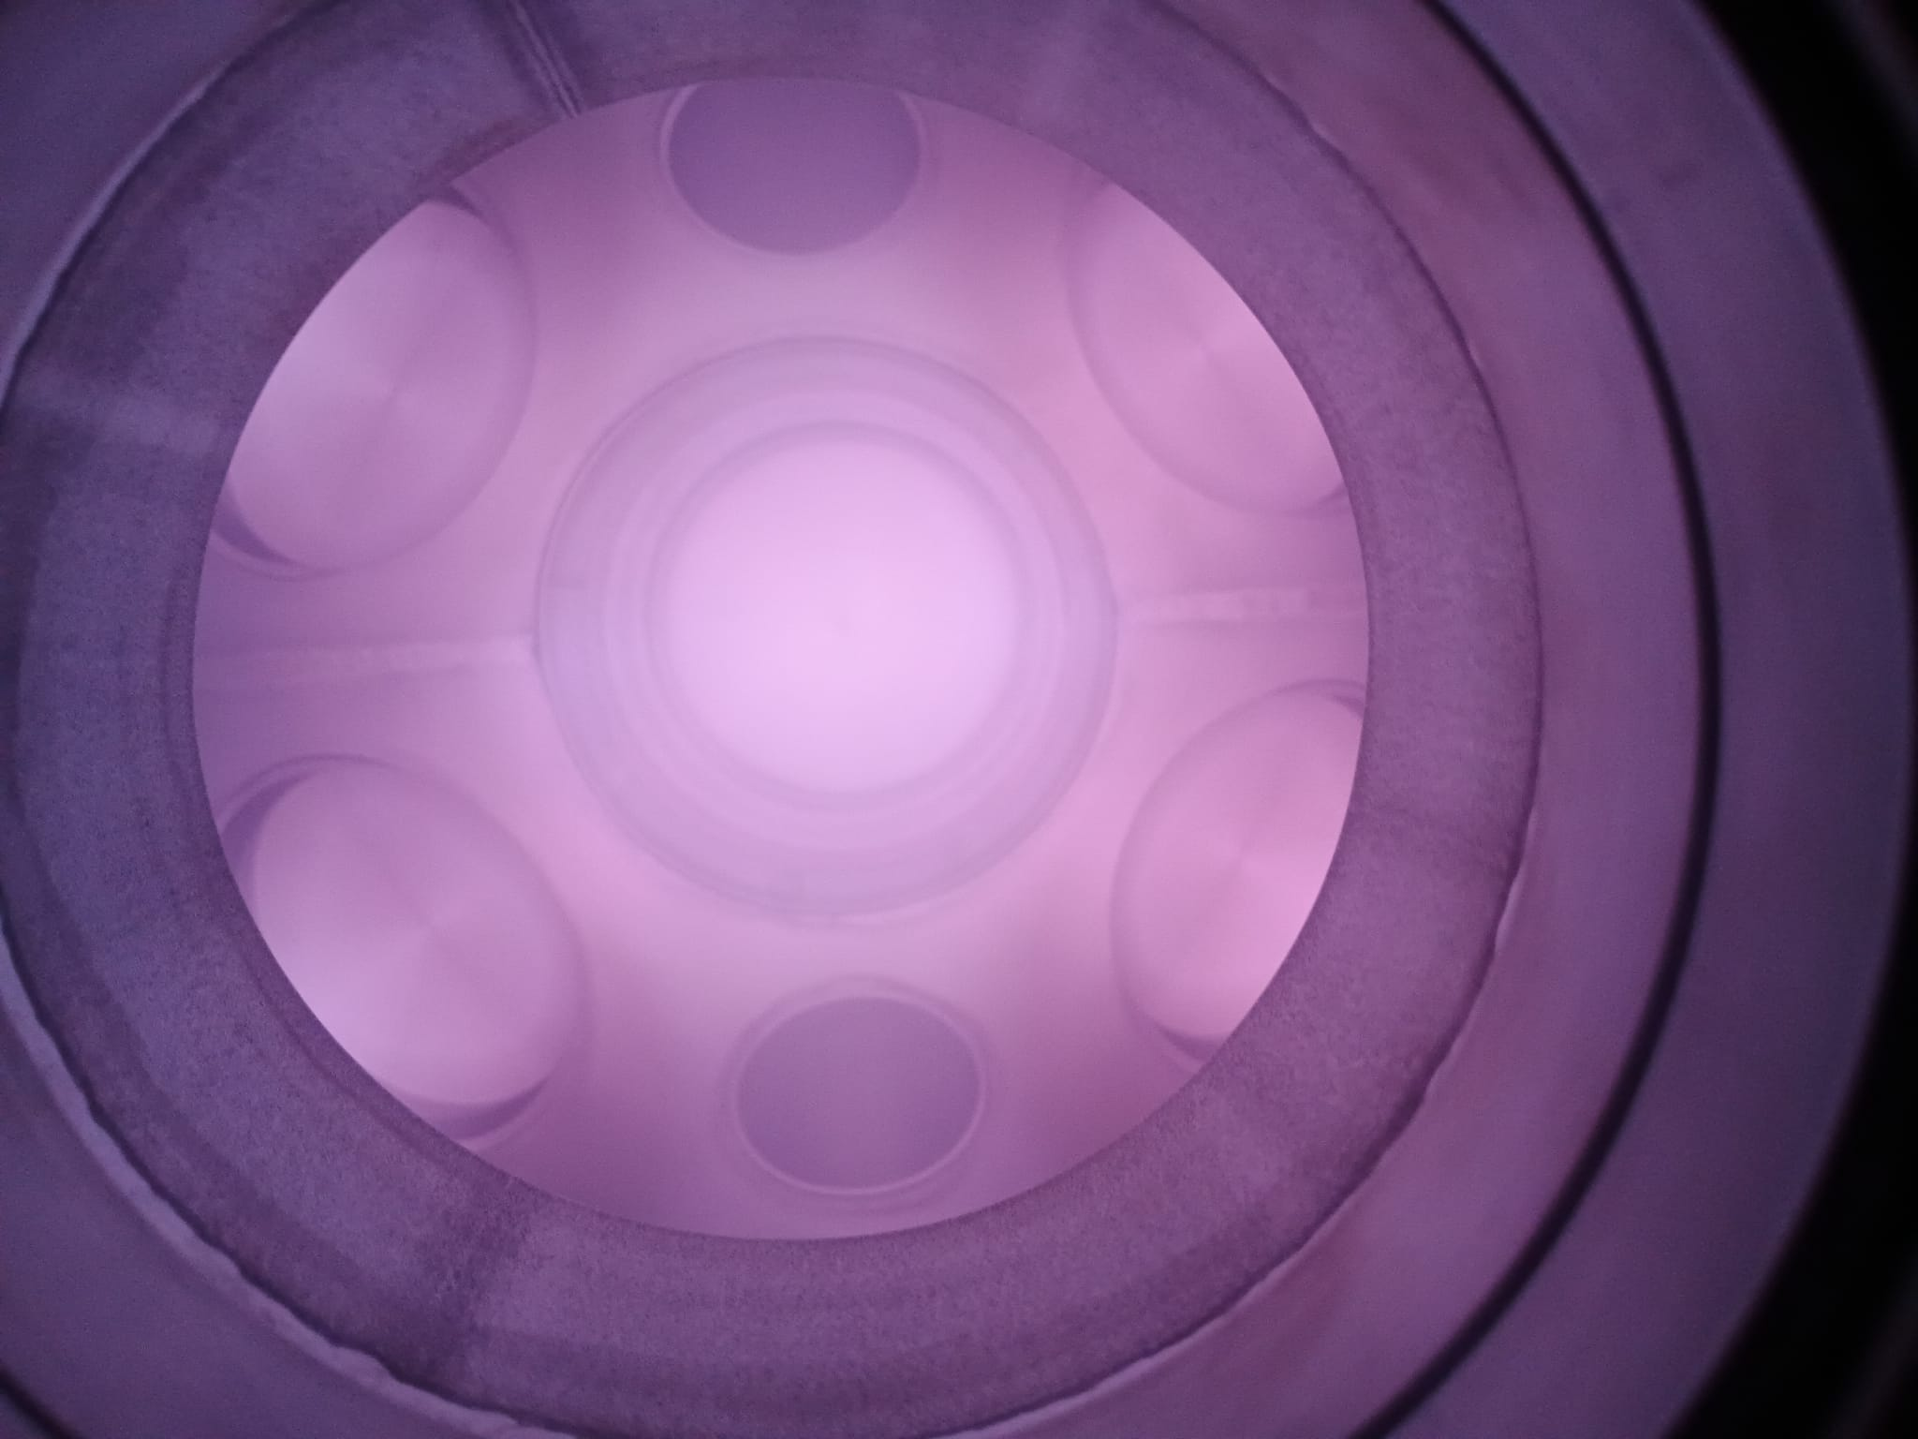

WP9 - Research and Development of optical plasma diagnostics and modelling for fusion
Padova, 25-27 Marzo 2026
Giorgio. Dilecce
Paolo Francesco Ambrico
Pierpaolo Minelli
Vincenzo Laporta
Domenico Bruno
Maria Rutigliano
Francesco Taccogna
Olga De Pascale
TD: Domenico Aceto
Antonio Panarese
PhD: Arshad Hussain

Slide 2
ISTP – sede di BARI
Non-equilibrium gas discharges
diagnostics
modeling
Optical Emission Spectroscopy
Laser Spectroscopy
Laser-Induced Breakdown Spectroscopy (LIBS)
D⁻ sources
Divertor
Our pre-existent expertise matching NEFERTARI issues

Slide 3
Experimental Structure
Projection of our expertise in the optical diagnostics of gas discharges onto applications to fusion-relevant studies
Development of new diagnostic strategies
Local test facilities for diagnostics to run at low cost and everyday
Optical Emission Spectroscopy (OES)
Laser Spectroscopy – (LIF-TALIF)
Laser-Induced Breakdown Spectroscopy (LIBS)

Slide 4
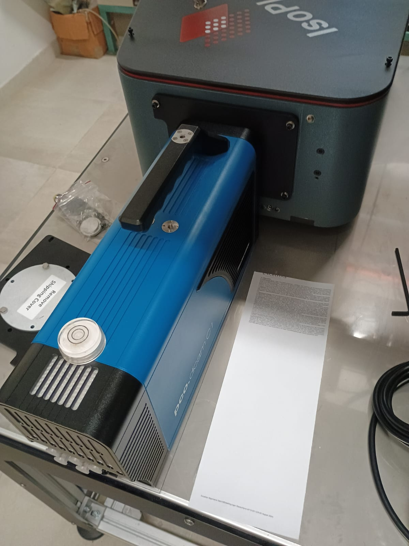
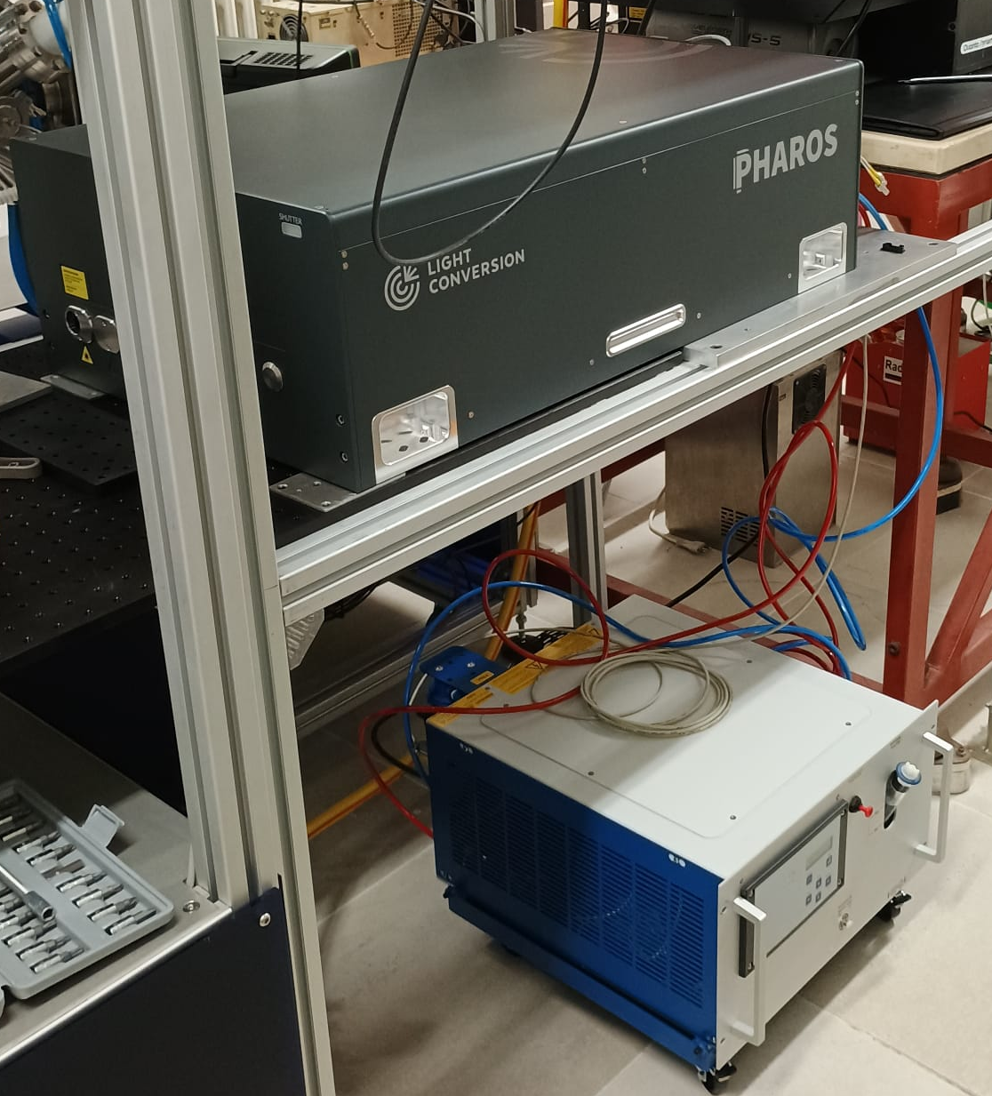
Laser Induced Breakdown Spectroscopy - LIBS
I-Cmos Camera
ISO-plane spectrograph
400 fs – 10 ps pulse
4 mJ E/pulse
Scope: fuel retention in plasma facing materials
Technique: depth profilometry in plasma-facing tiles
Problems:
crater shape
single shot
spectral resolution

Slide 5
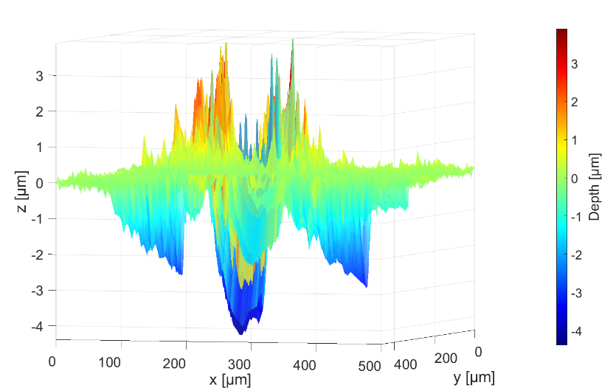
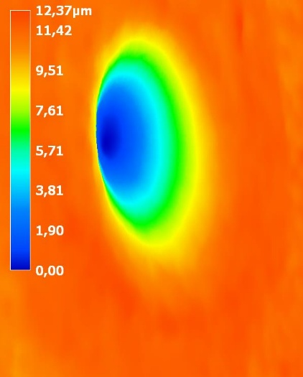
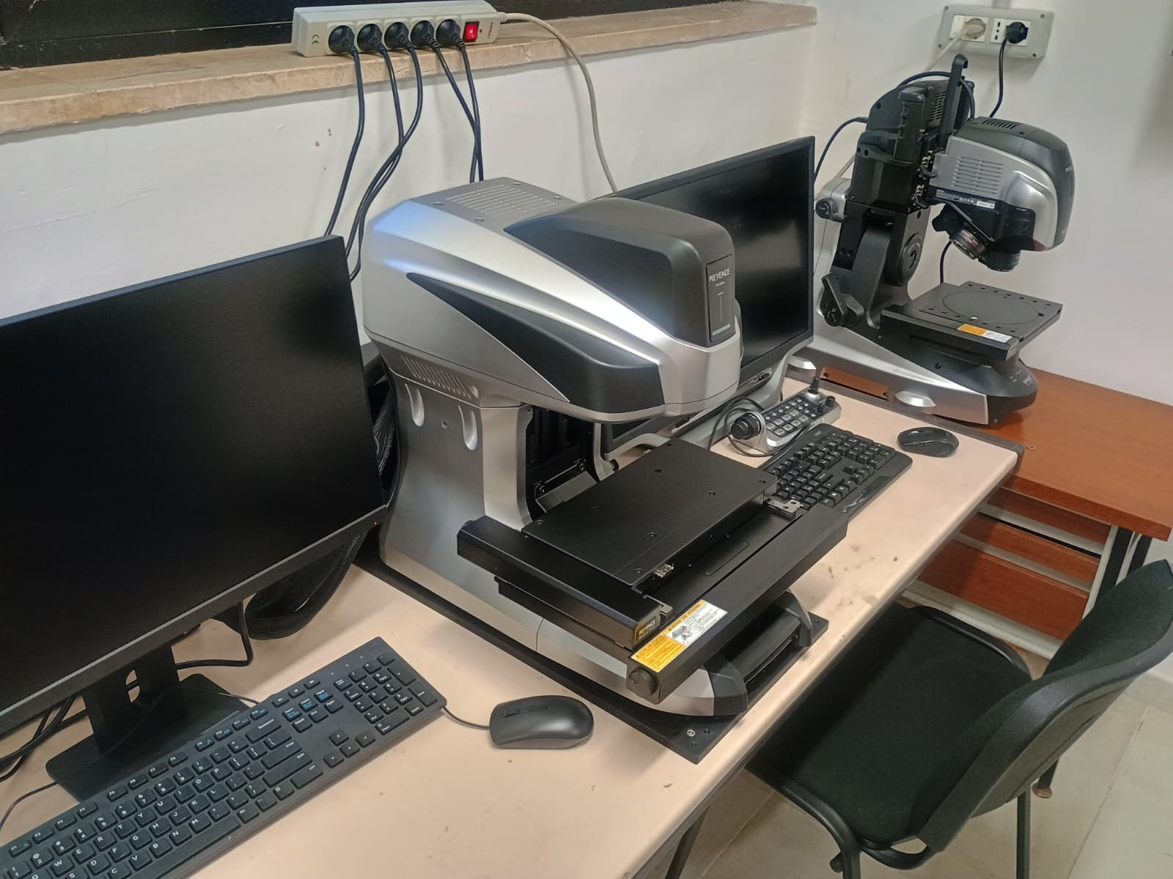
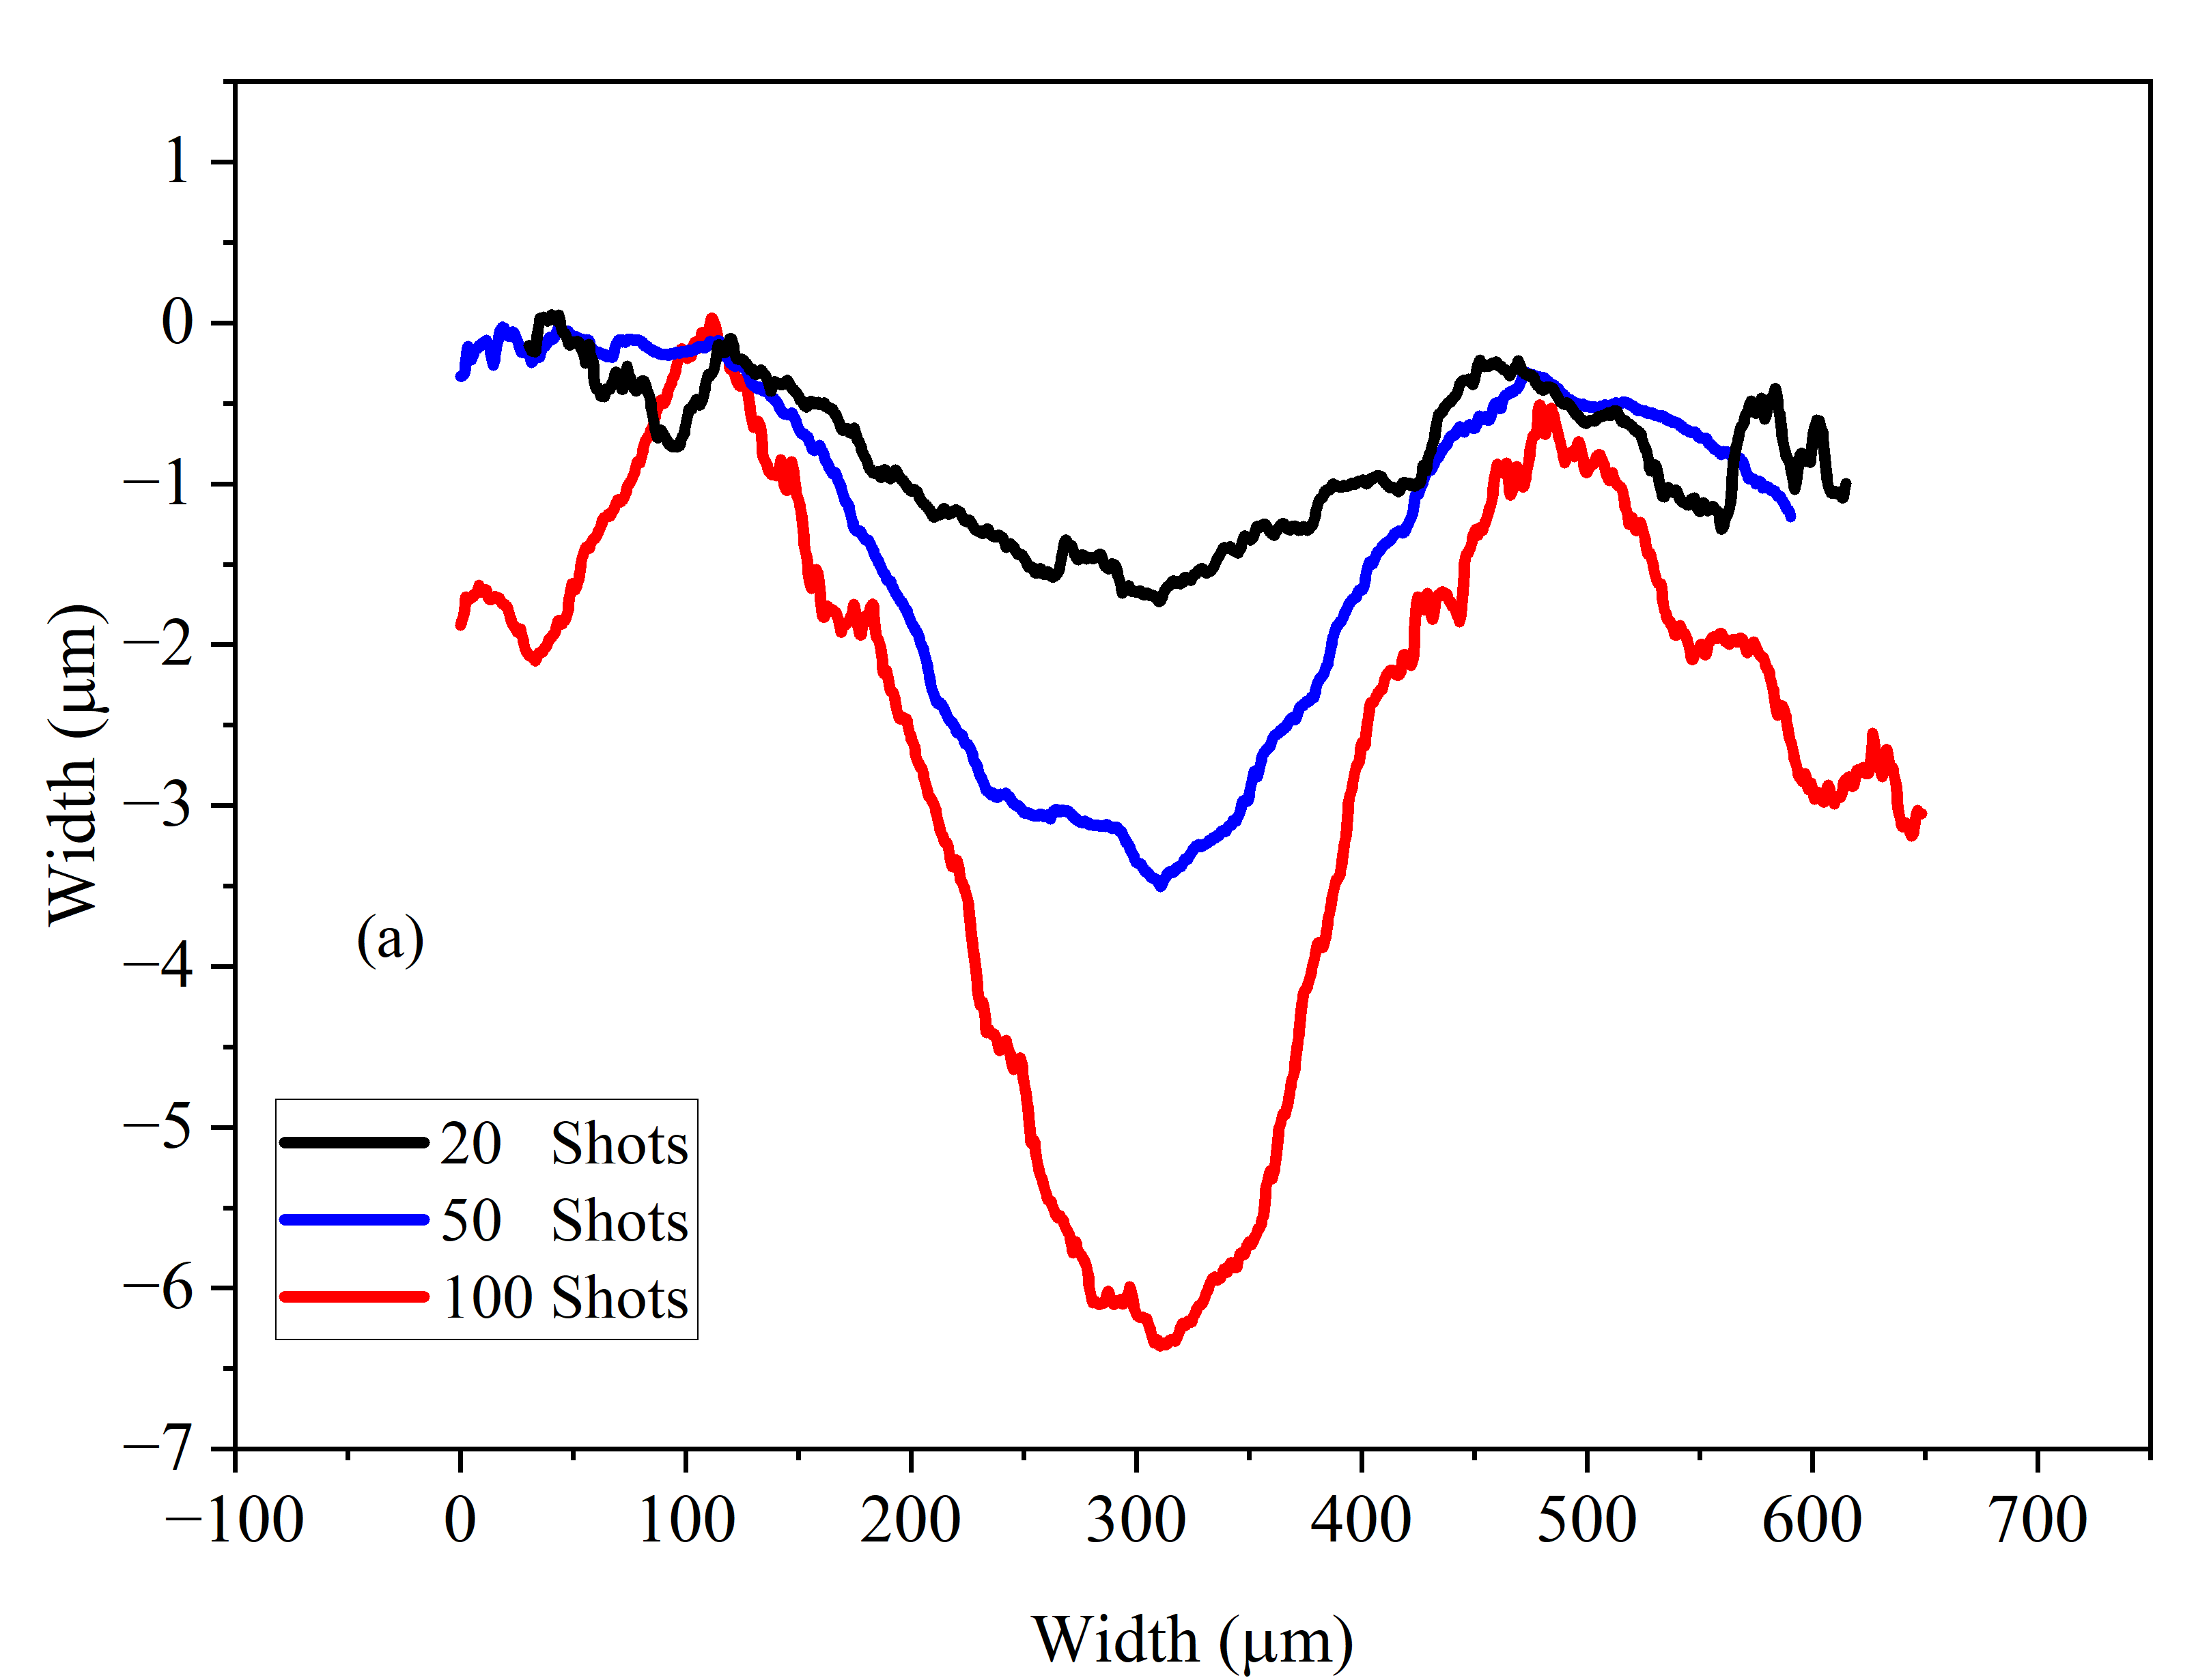
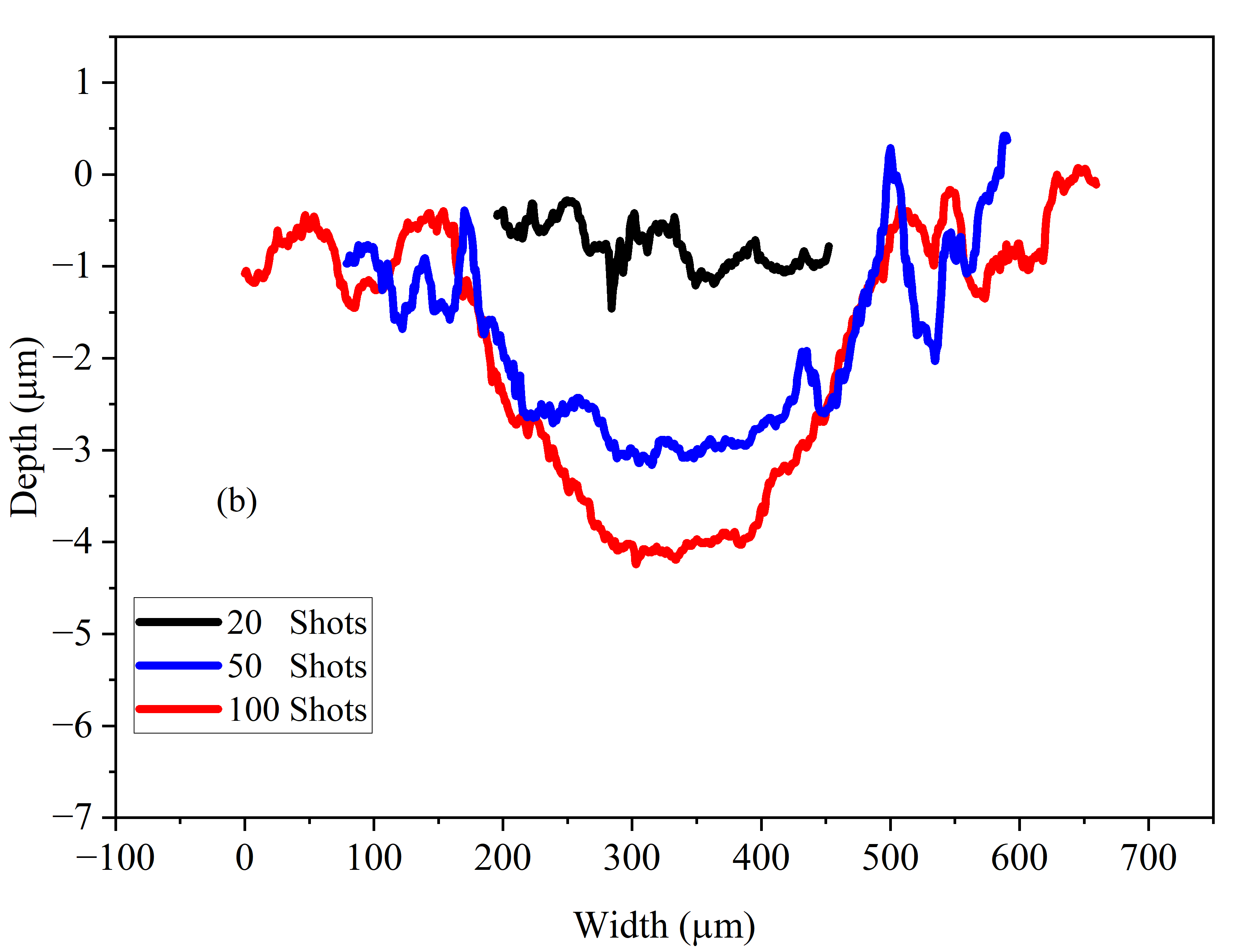
Laser Induced Breakdown Spectroscopy - LIBS
craters
10 ns 400 fs
Optical microscope and profilometer
400 fs 10 ps

Slide 6
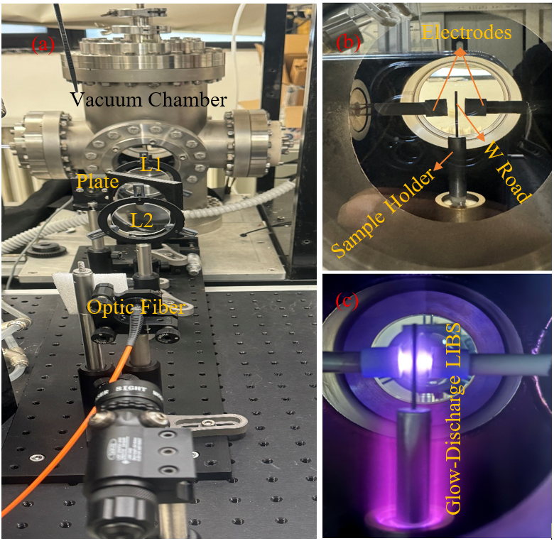
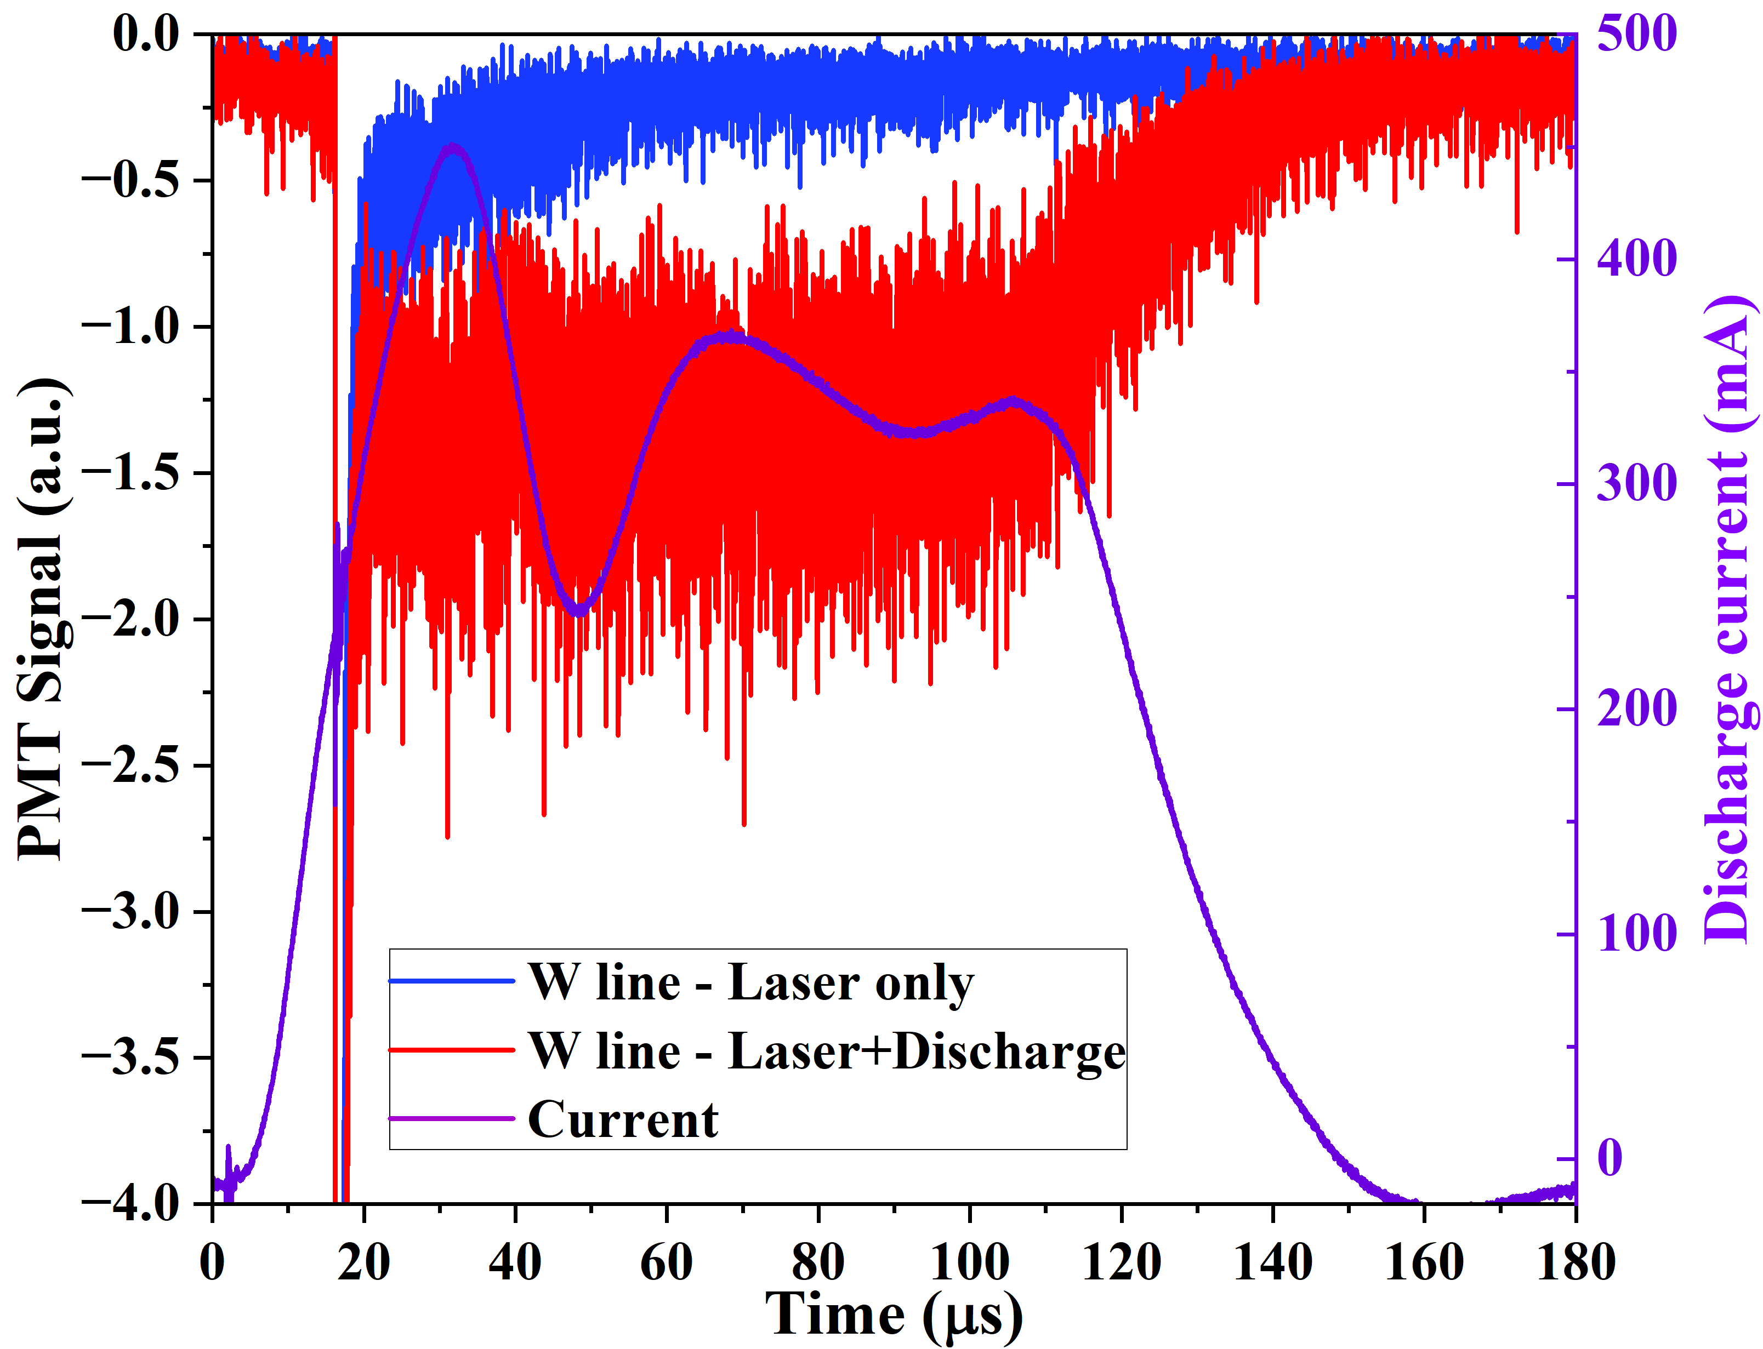
Laser Induced Breakdown Spectroscopy - LIBS
Single-shot and spectral separation: increase the signal
Low-pressure Glow Discharge –assisted LIBS

Slide 7
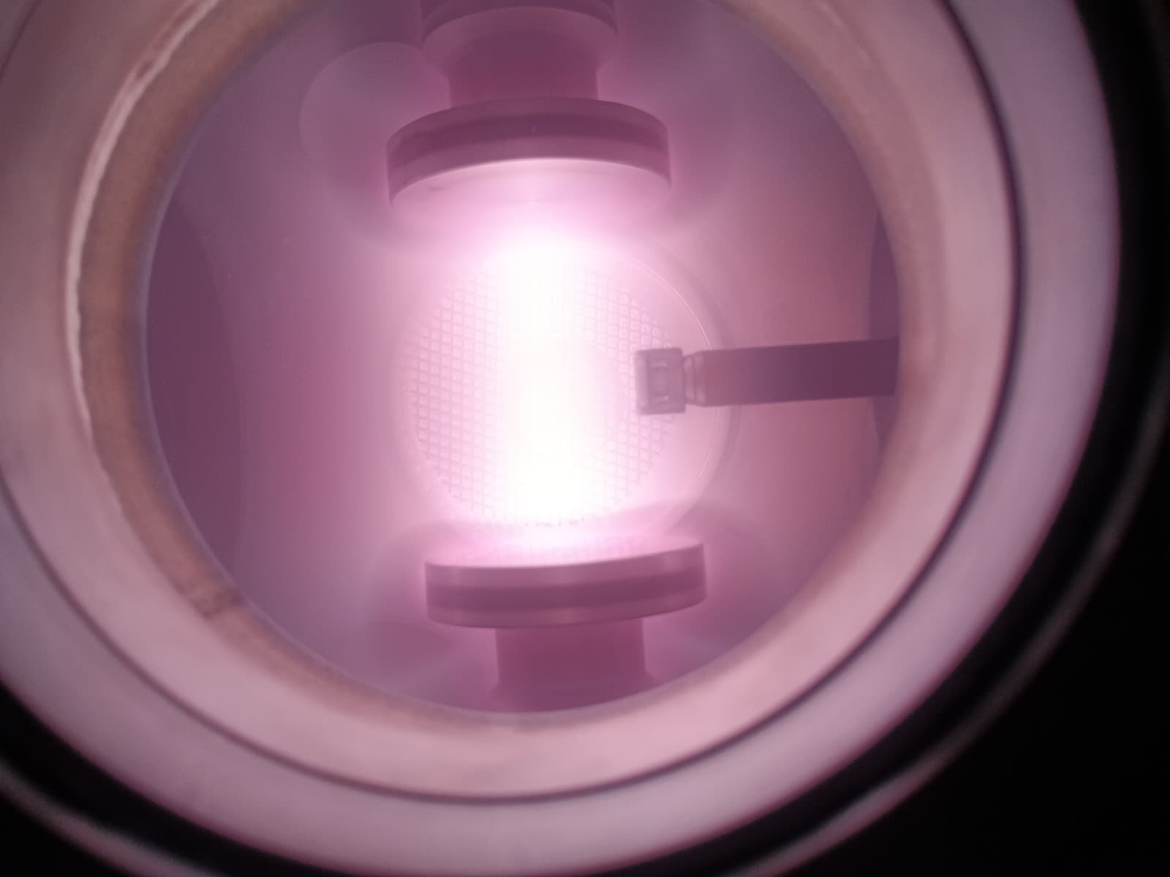
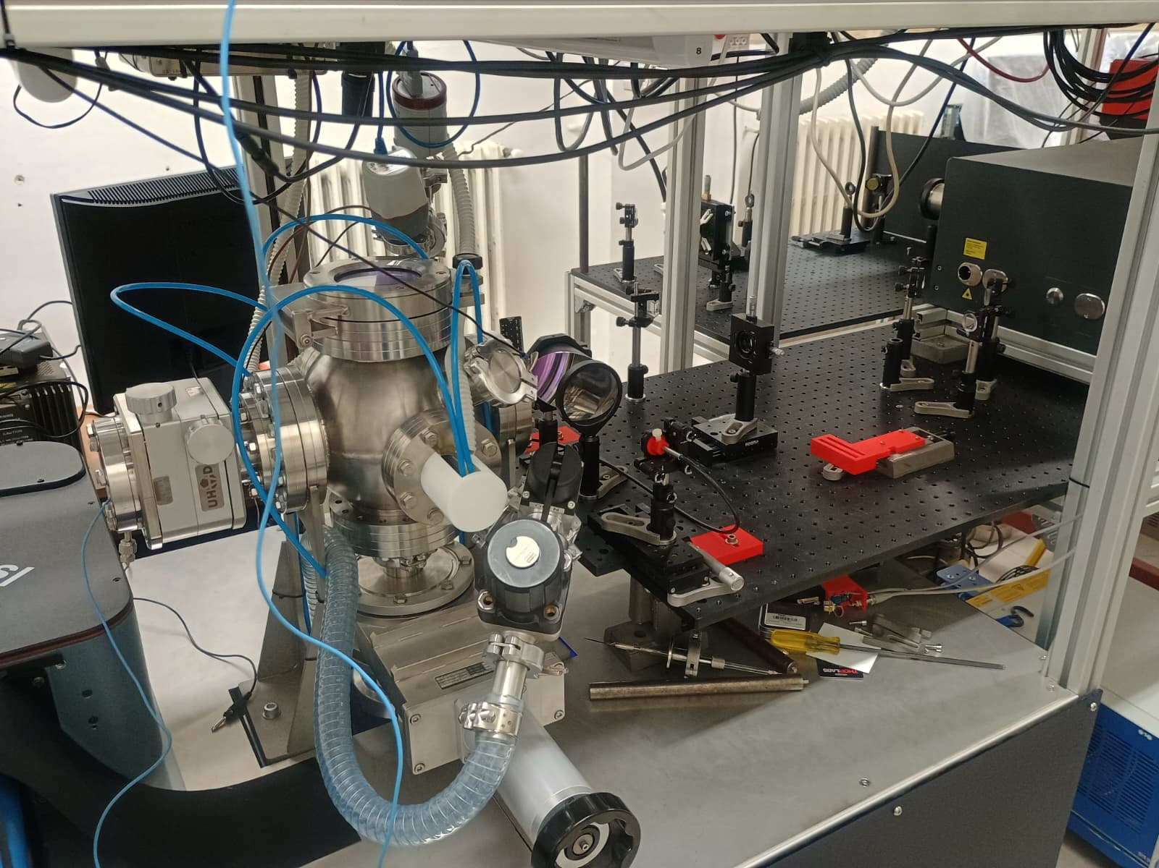
Laser Induced Breakdown Spectroscopy - LIBS
Deuterium loading test facility

Slide 8
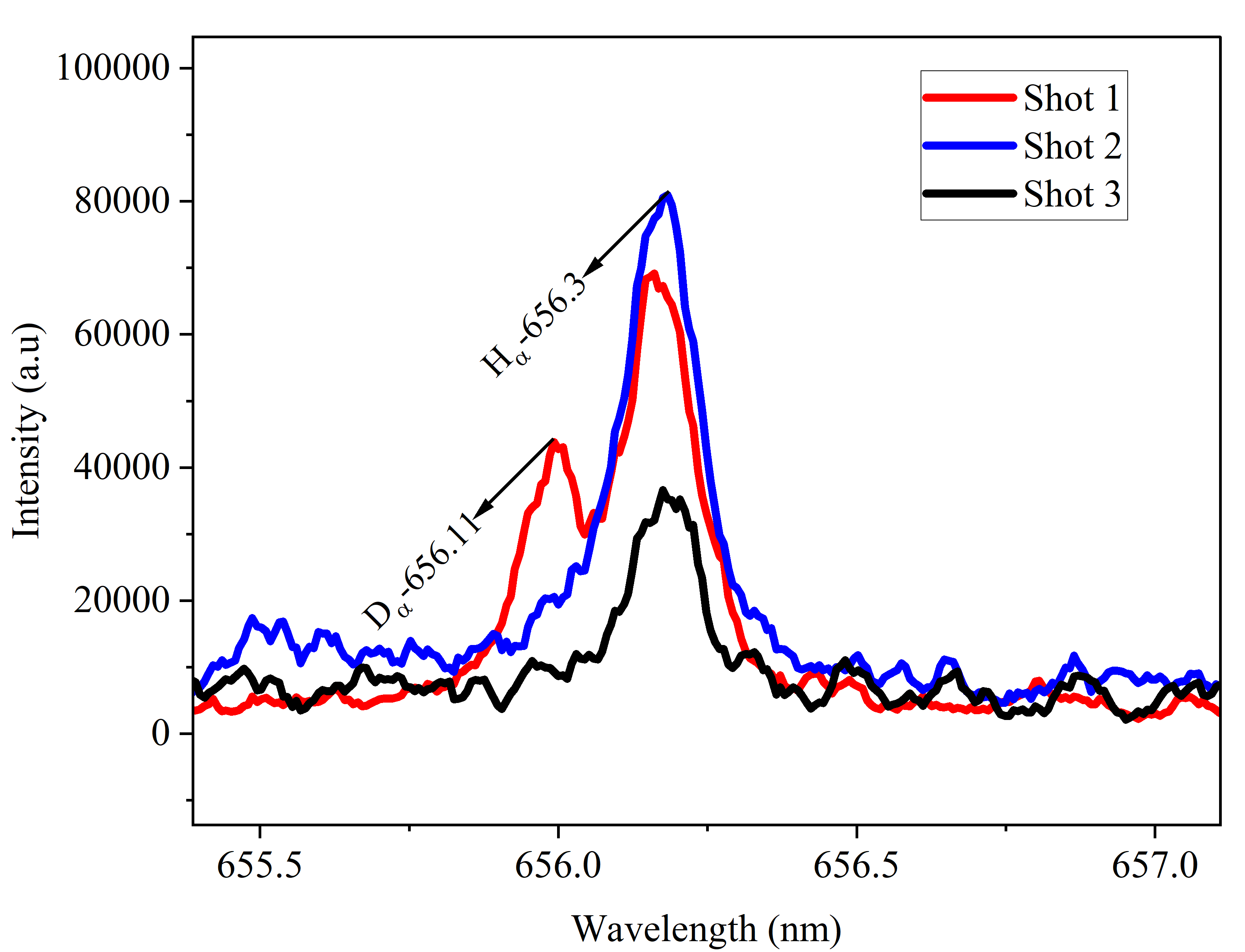
Laser Induced Breakdown Spectroscopy - LIBS
Deuterium loading test facility
PhD Thesis
Arshad Hussain
Thursday afternoon

Slide 9
OES and Laser Spectroscopy
Optical Emission Spectroscopy, to support CR models of hydrogen emission. The relevant instrumentation is a fast gated optical spectrograph
Laser Spectroscopy studies
kinetics of electronic states of hydrogen, to support the CR models, for which a tuneable ps OPO laser has been acquired.
Analytical application of Laser Induced Fluorescence (LIF) to the detection of transient species and, in particular H atoms, for which a ns tuneable laser has been acquired capable of wavelengths down to 204 nm.

Slide 10
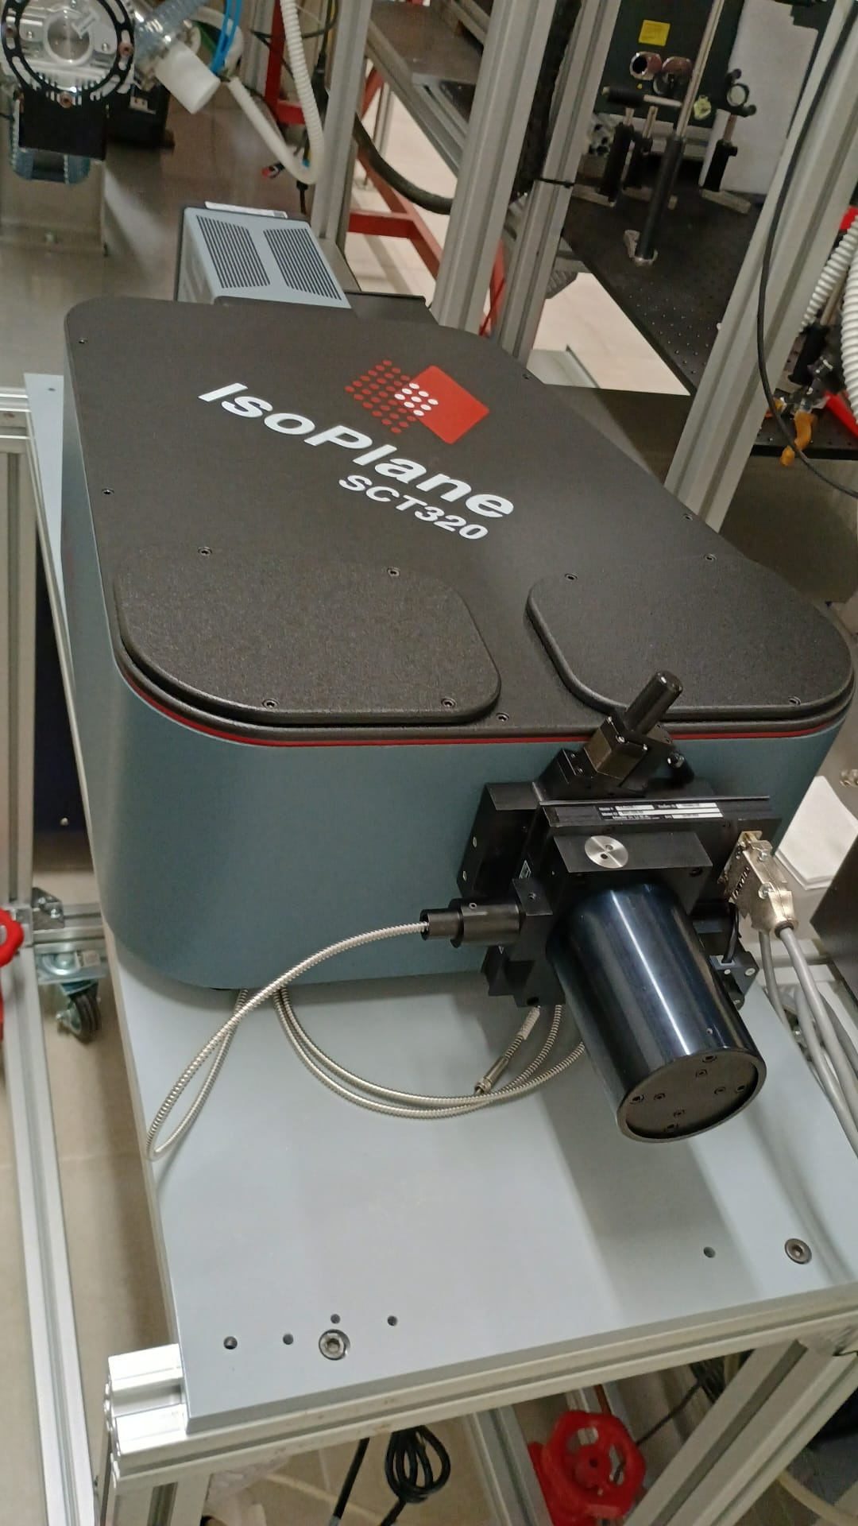
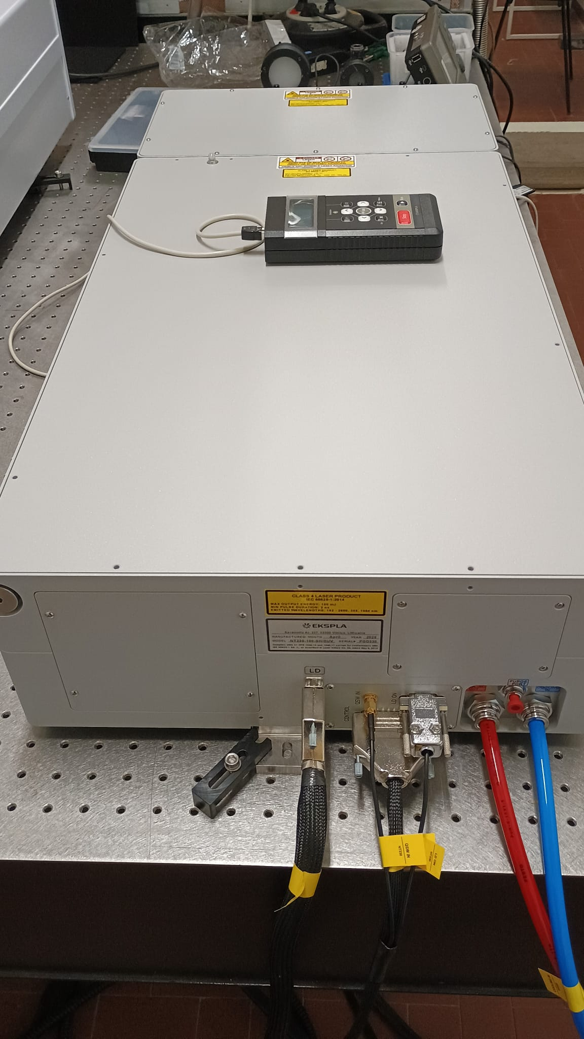
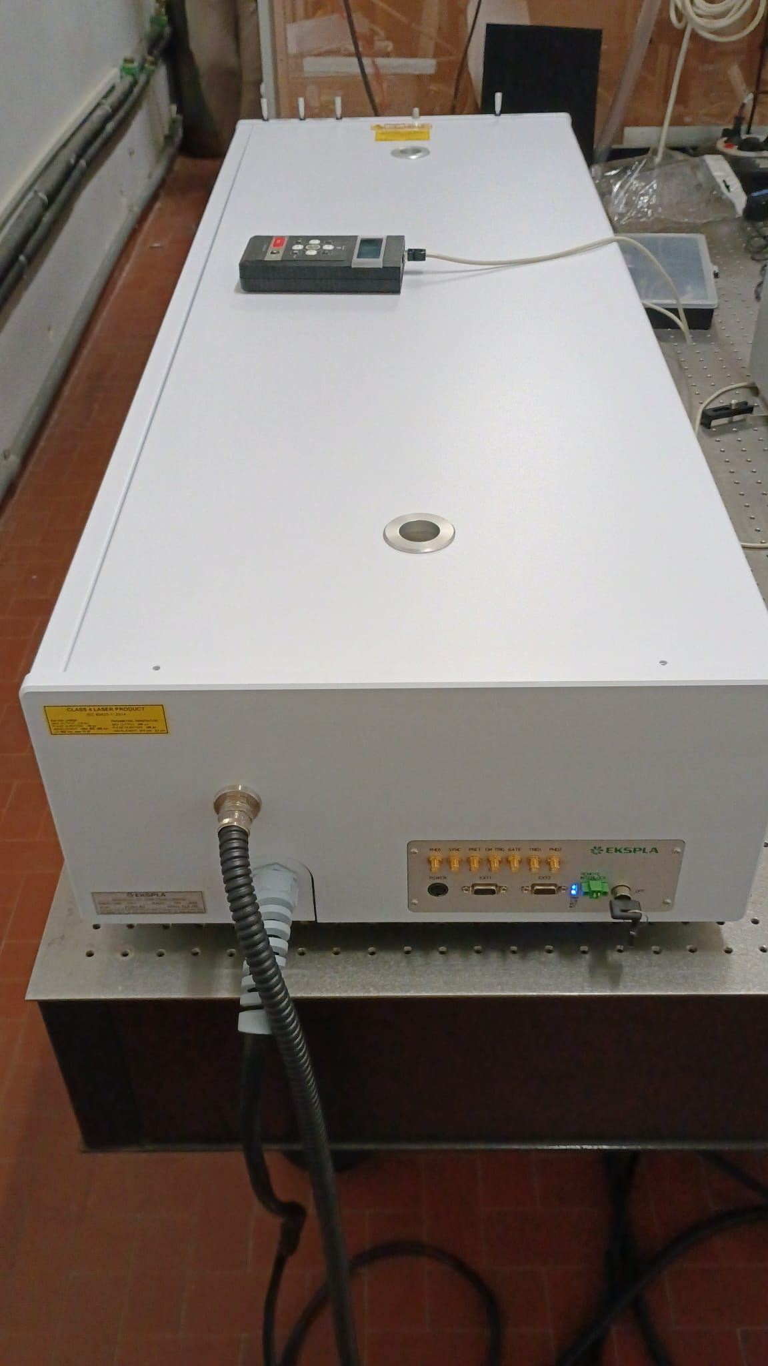
OES and Laser Spectroscopy

Slide 11
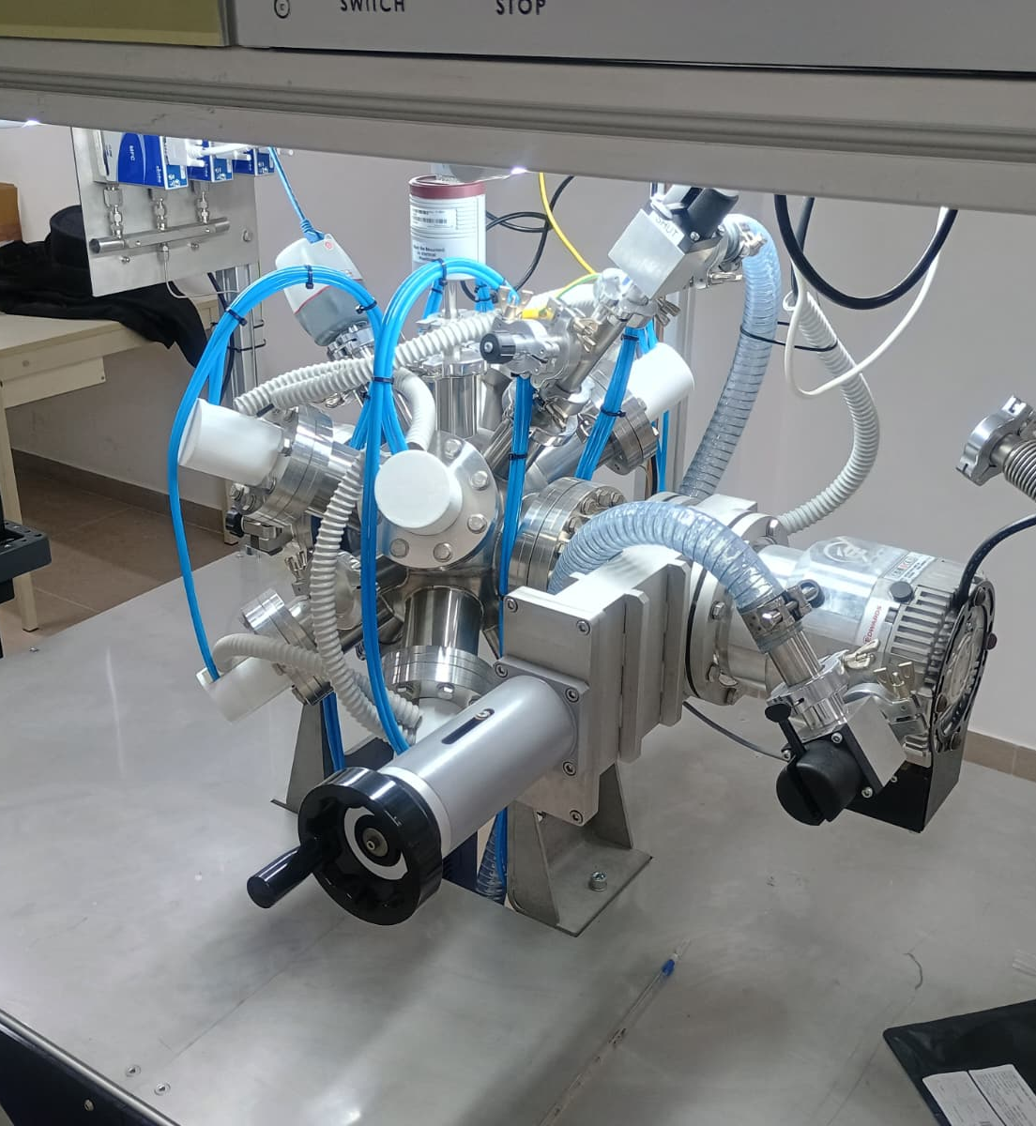
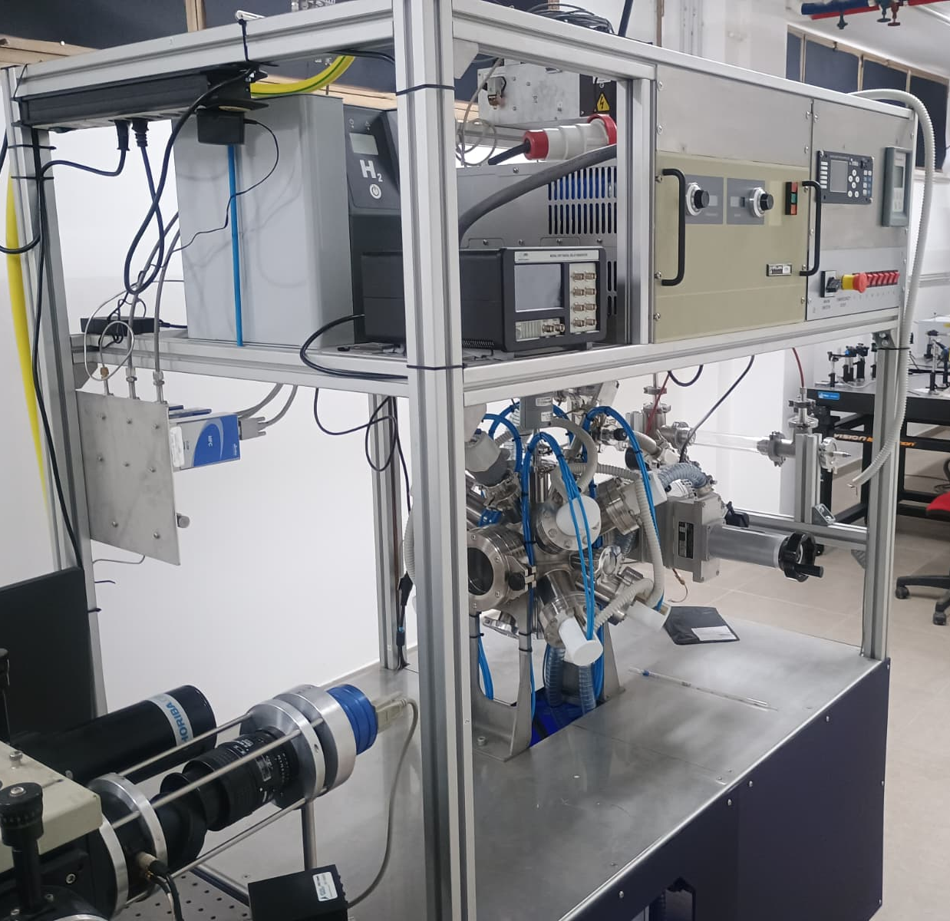
Test facility

Slide 12
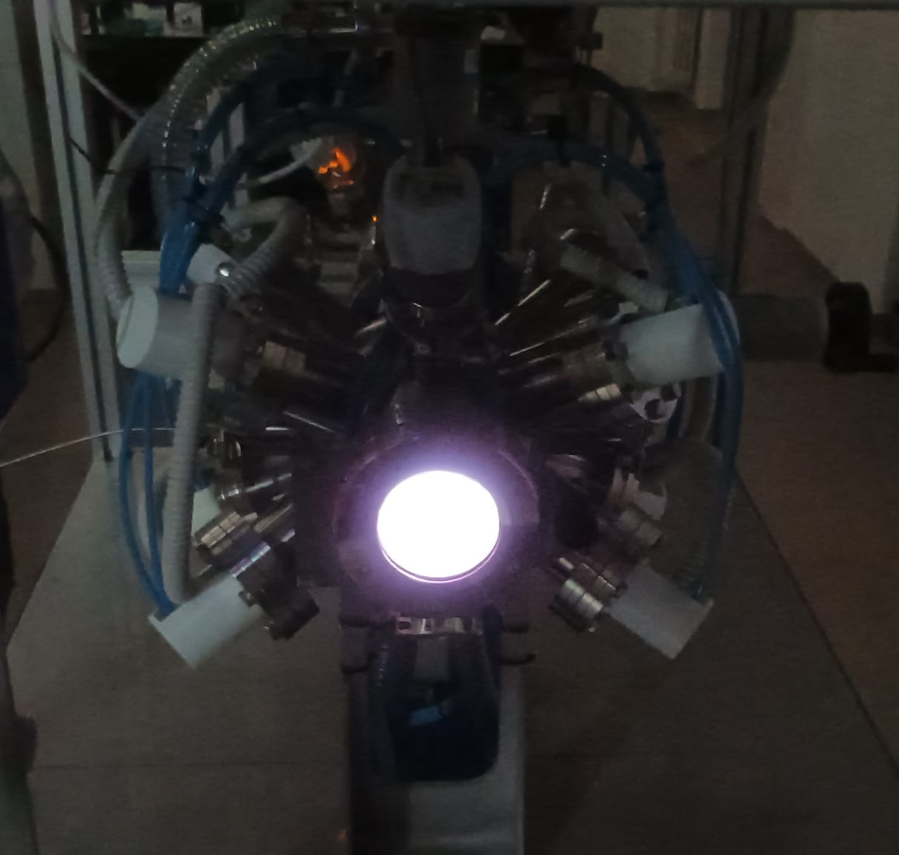

Test facility
Padova, 25-27 Marzo 2026

Slide 13
OES –LIF and Test Facility
TD
Domenico Aceto
Thursday afternoon

Slide 14
Computational Lab
2D PIC-MCC model of the space-charge region close to the divertor wall
PIC – MCC code:plasma dynamics within SPIDER
two workstations where the codes can be tested prior to launching them on large supercomputers.
Francesco Taccogna – Thursday afternoon

Slide 15
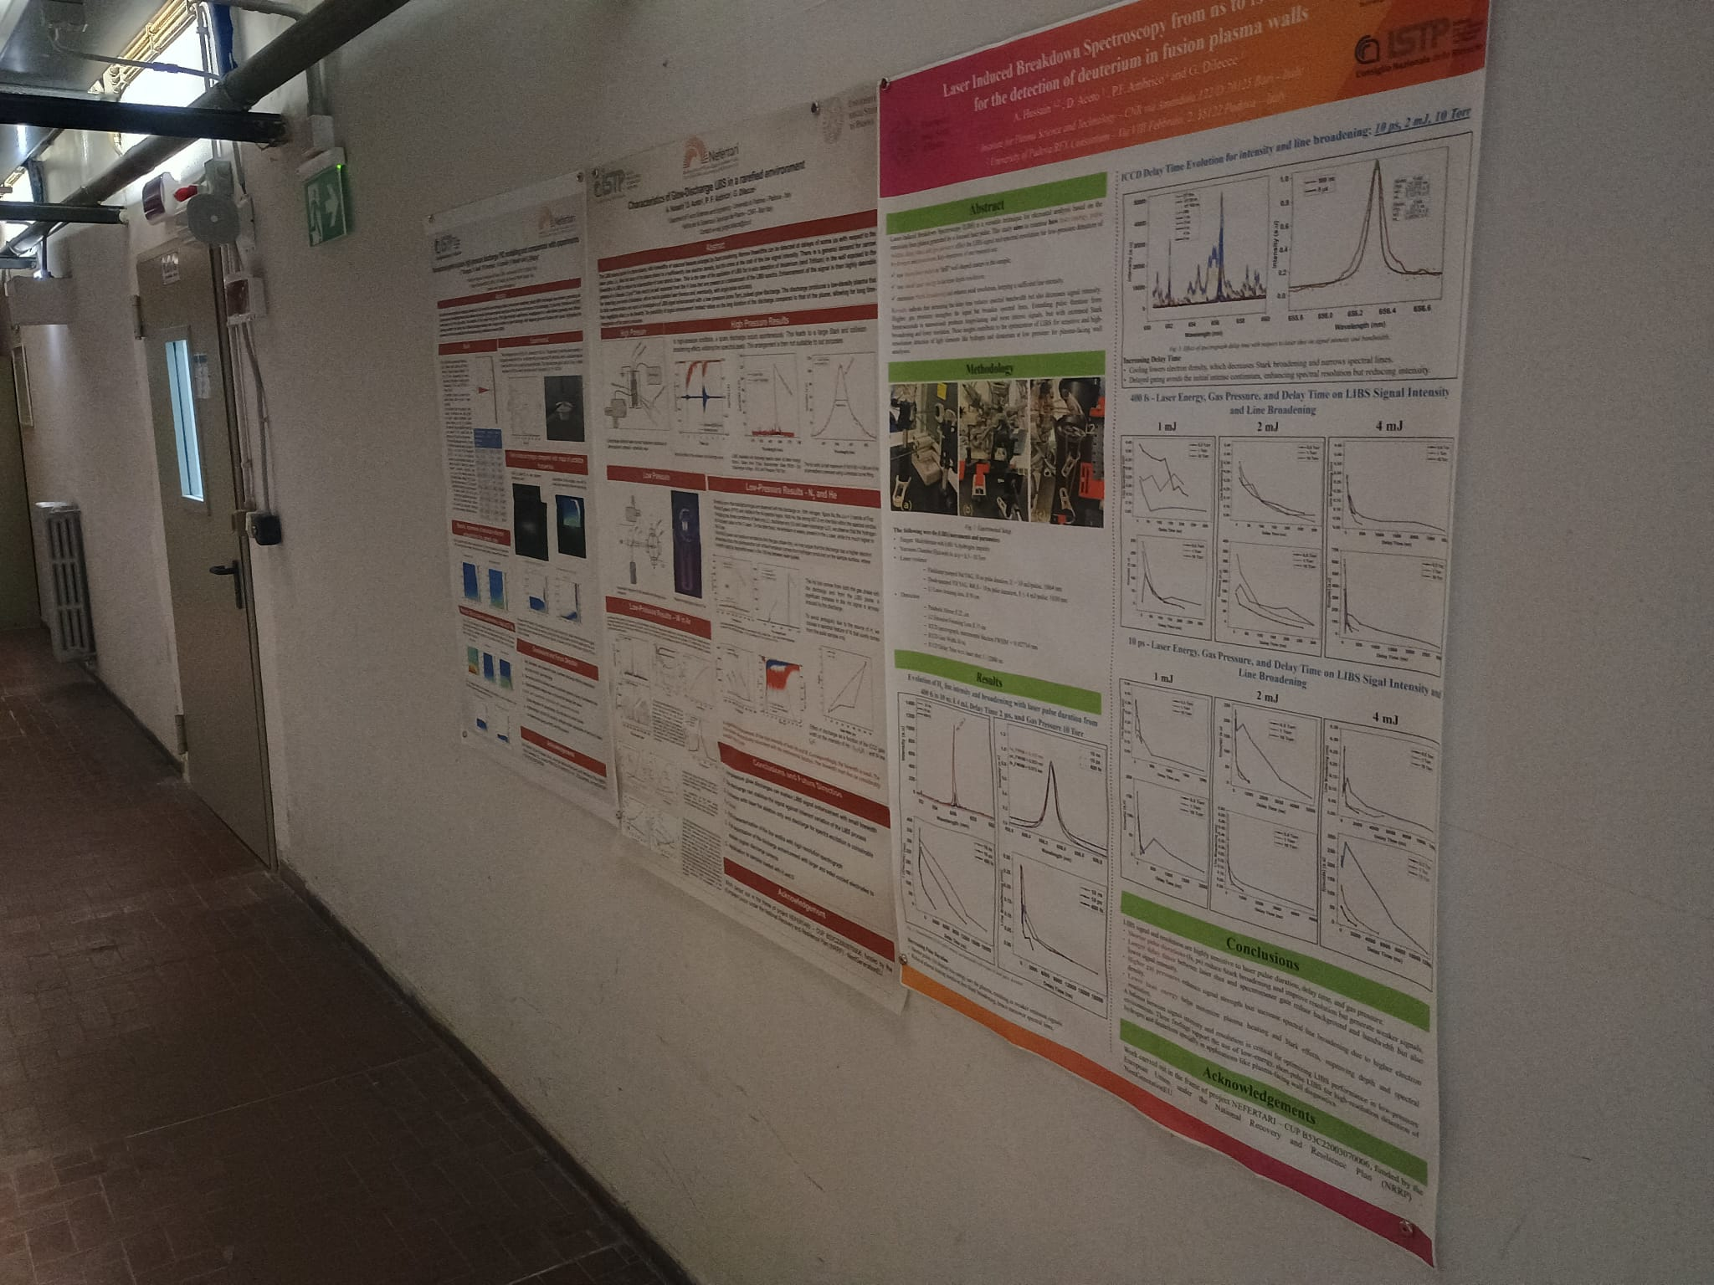
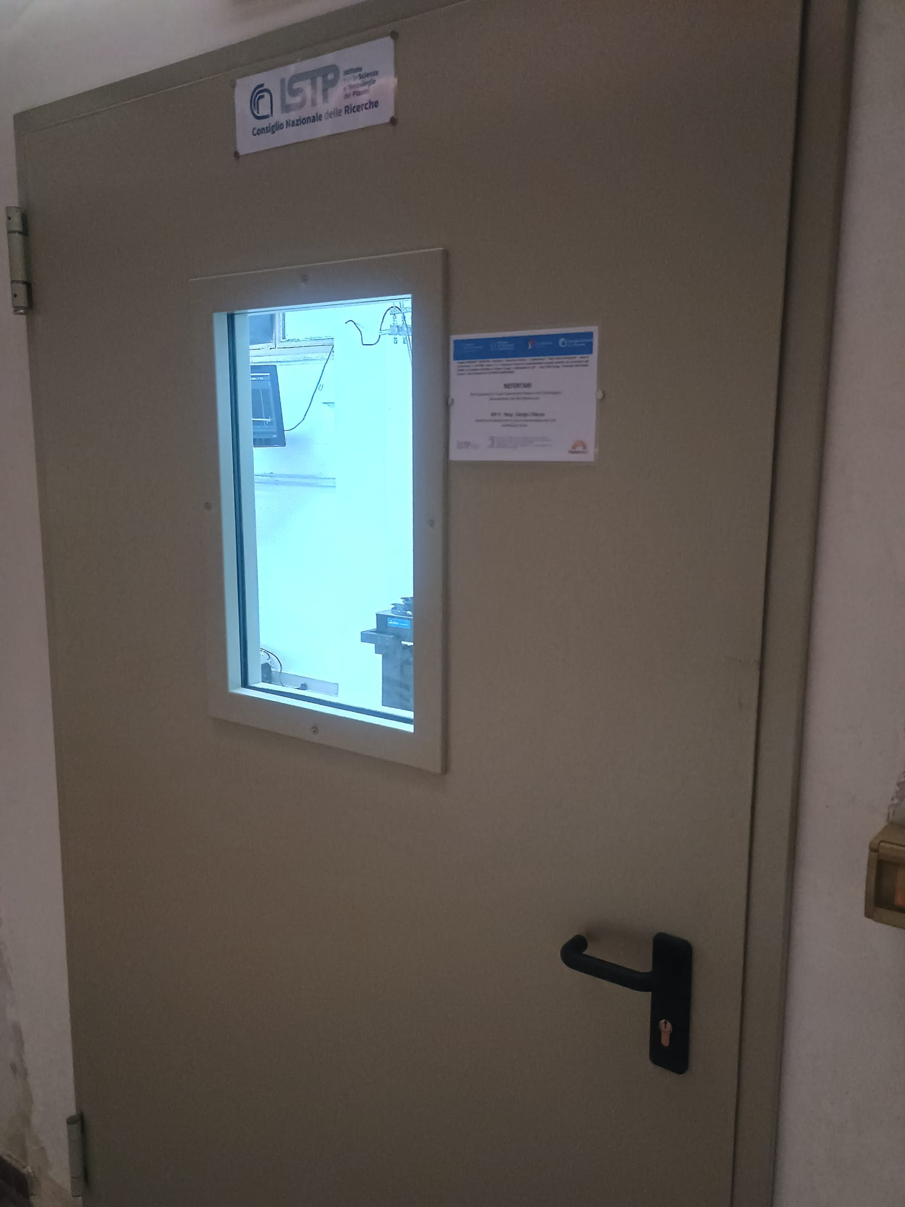
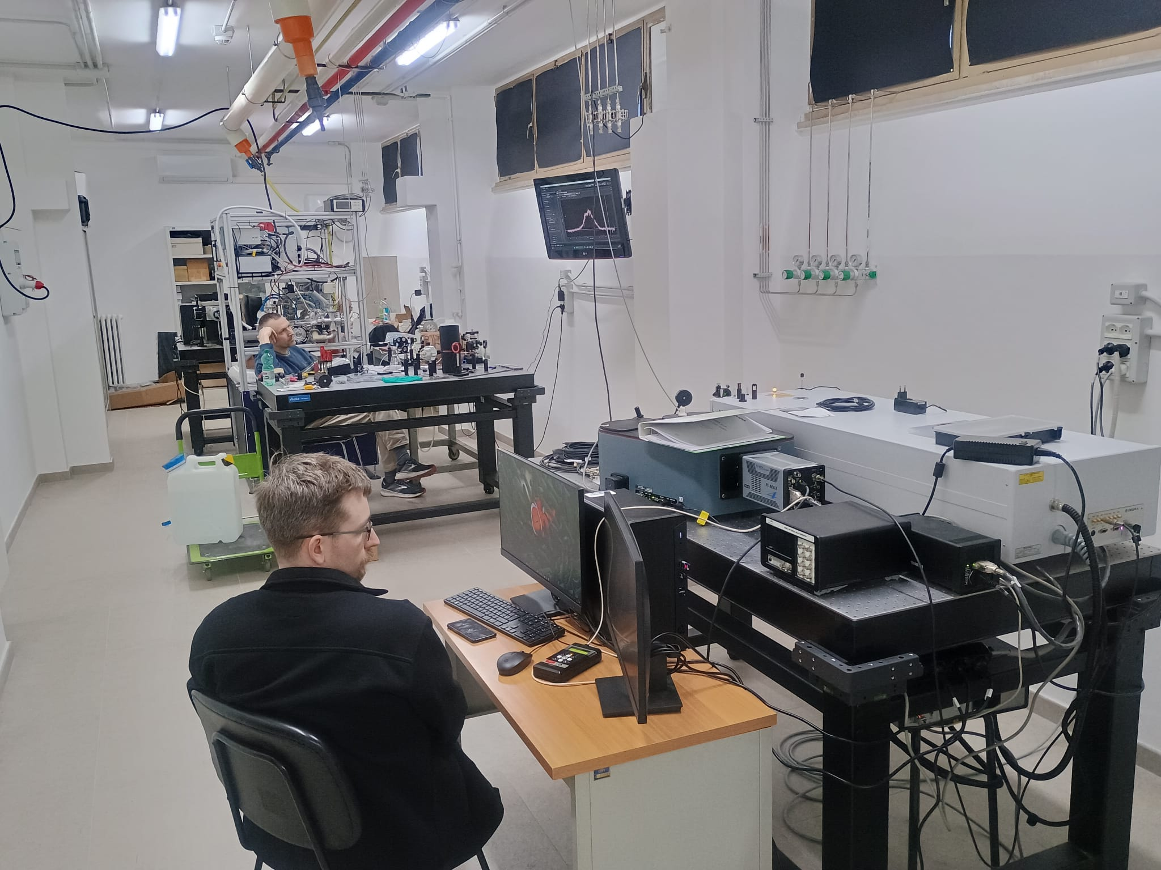
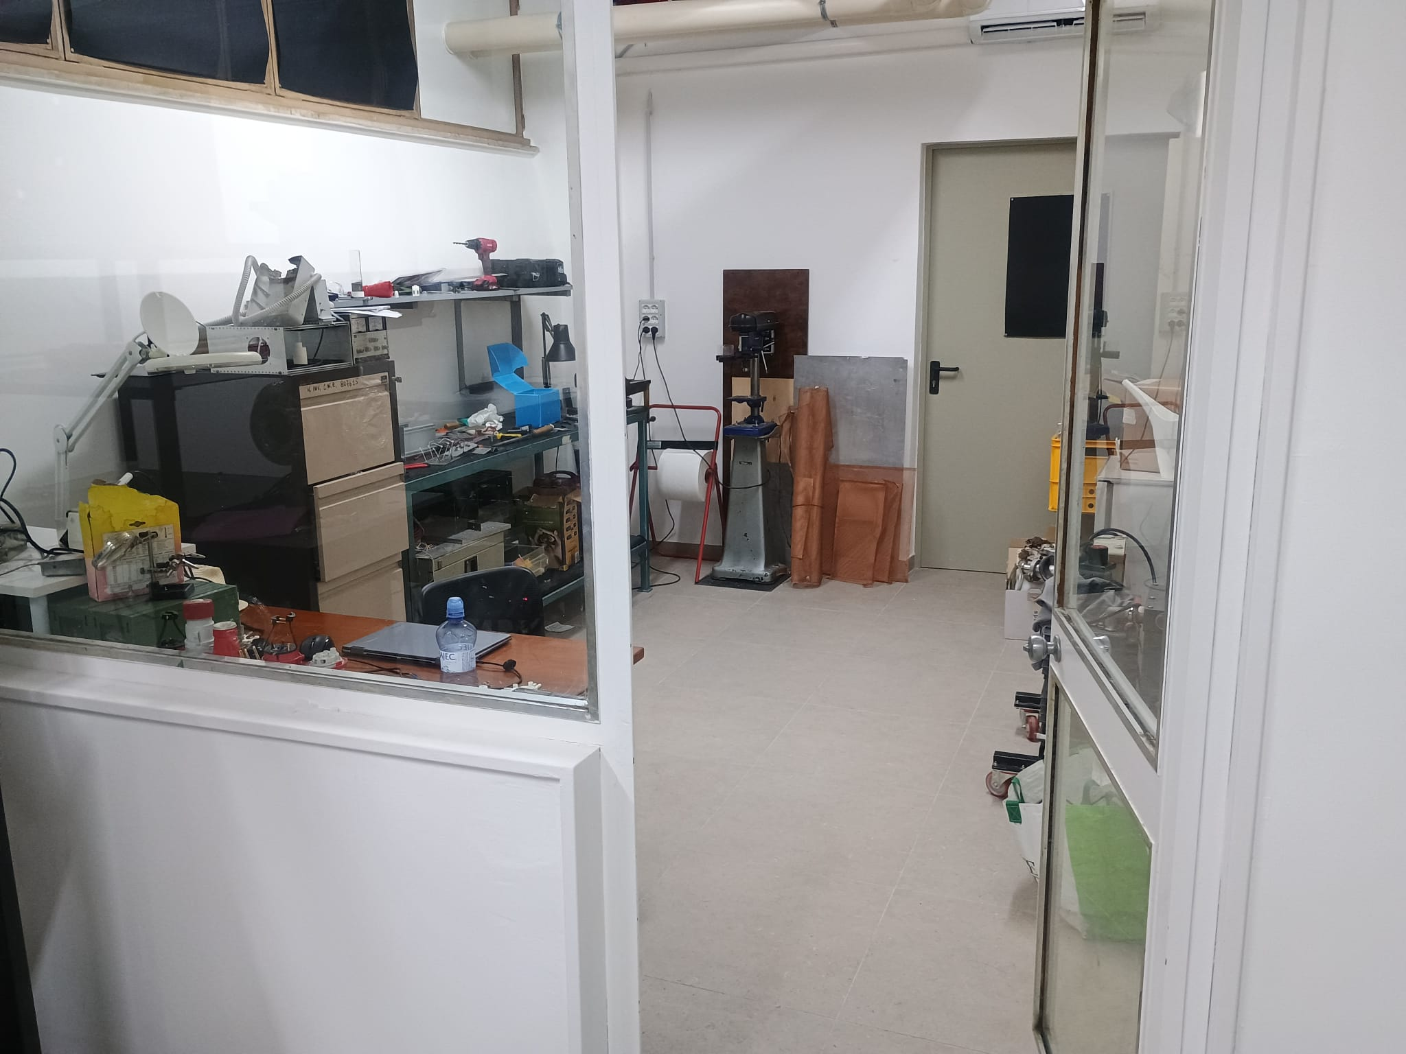
ISTP – sede di BARI: nuovi spazi nel Dipartimento di Fisica

Slide 16
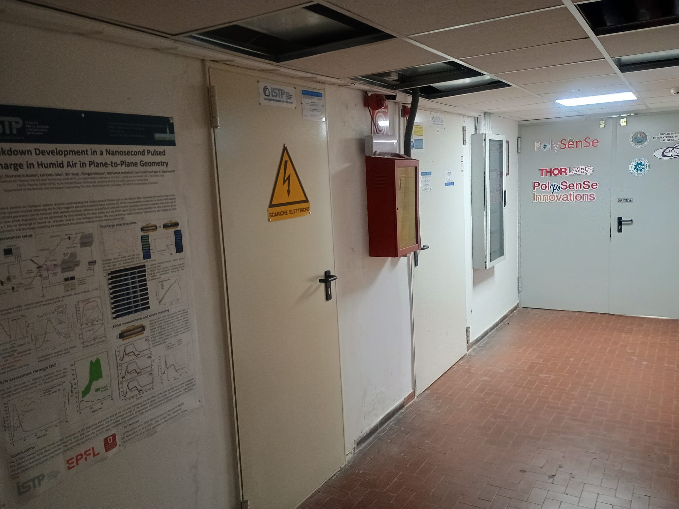
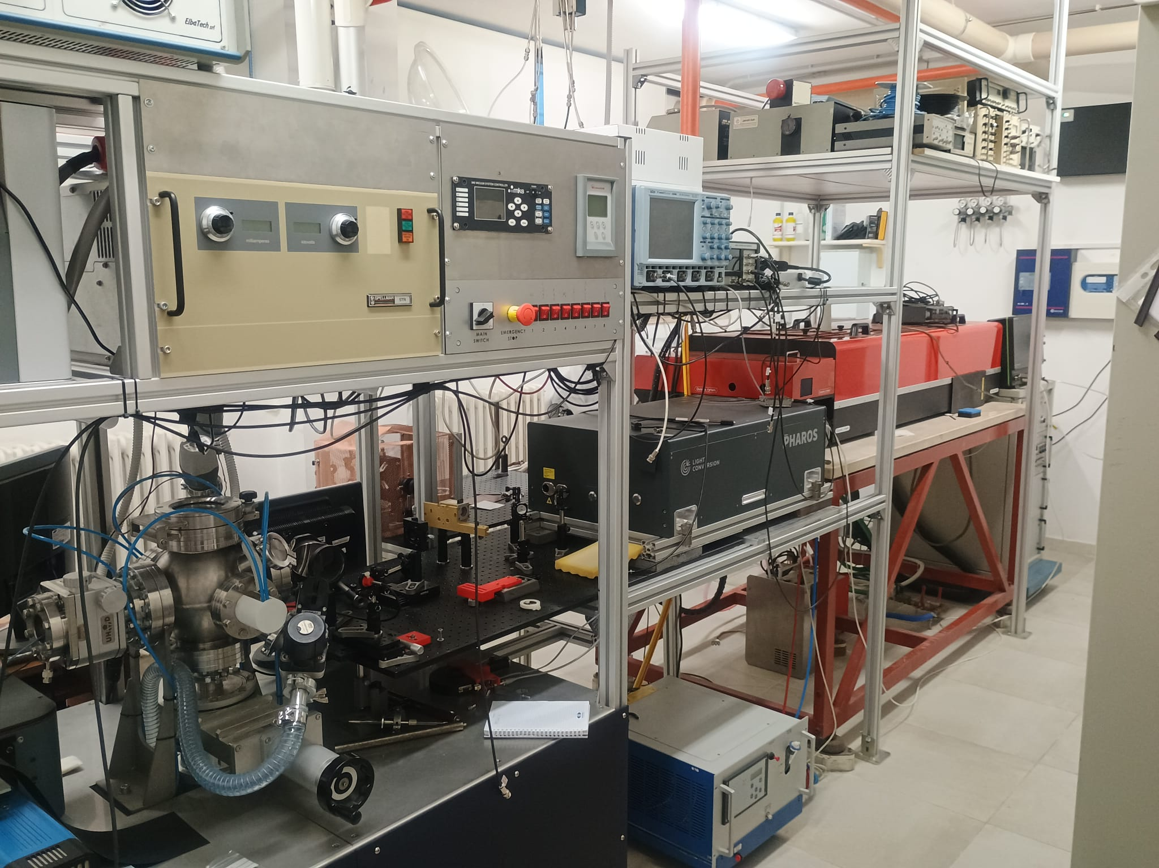

ISTP – sede di BARI: nuovi spazi nel Dipartimento di Fisica

Slide 17
ISTP – sede di BARI: nuovi spazi nel Dipartimento di Fisica
Presenza pre-NEFERTARI:
Un laboratorio di circa 40 m²
Attività didattica per il corso di laurea in Physics:
Corso Laboratory of Plasma Physics di 3 CFU – titolare Giorgio Dilecce;
Corso Physics of Space Electric Propulsion , 3 CFU – titolare Francesco Taccogna
Corso Nuclear Fusion Technologies collaborazione con il docente sui fondamenti di fisica dei plasmi – Francesco Taccogna.
Post-NEFERTARI……………………..

Slide 18
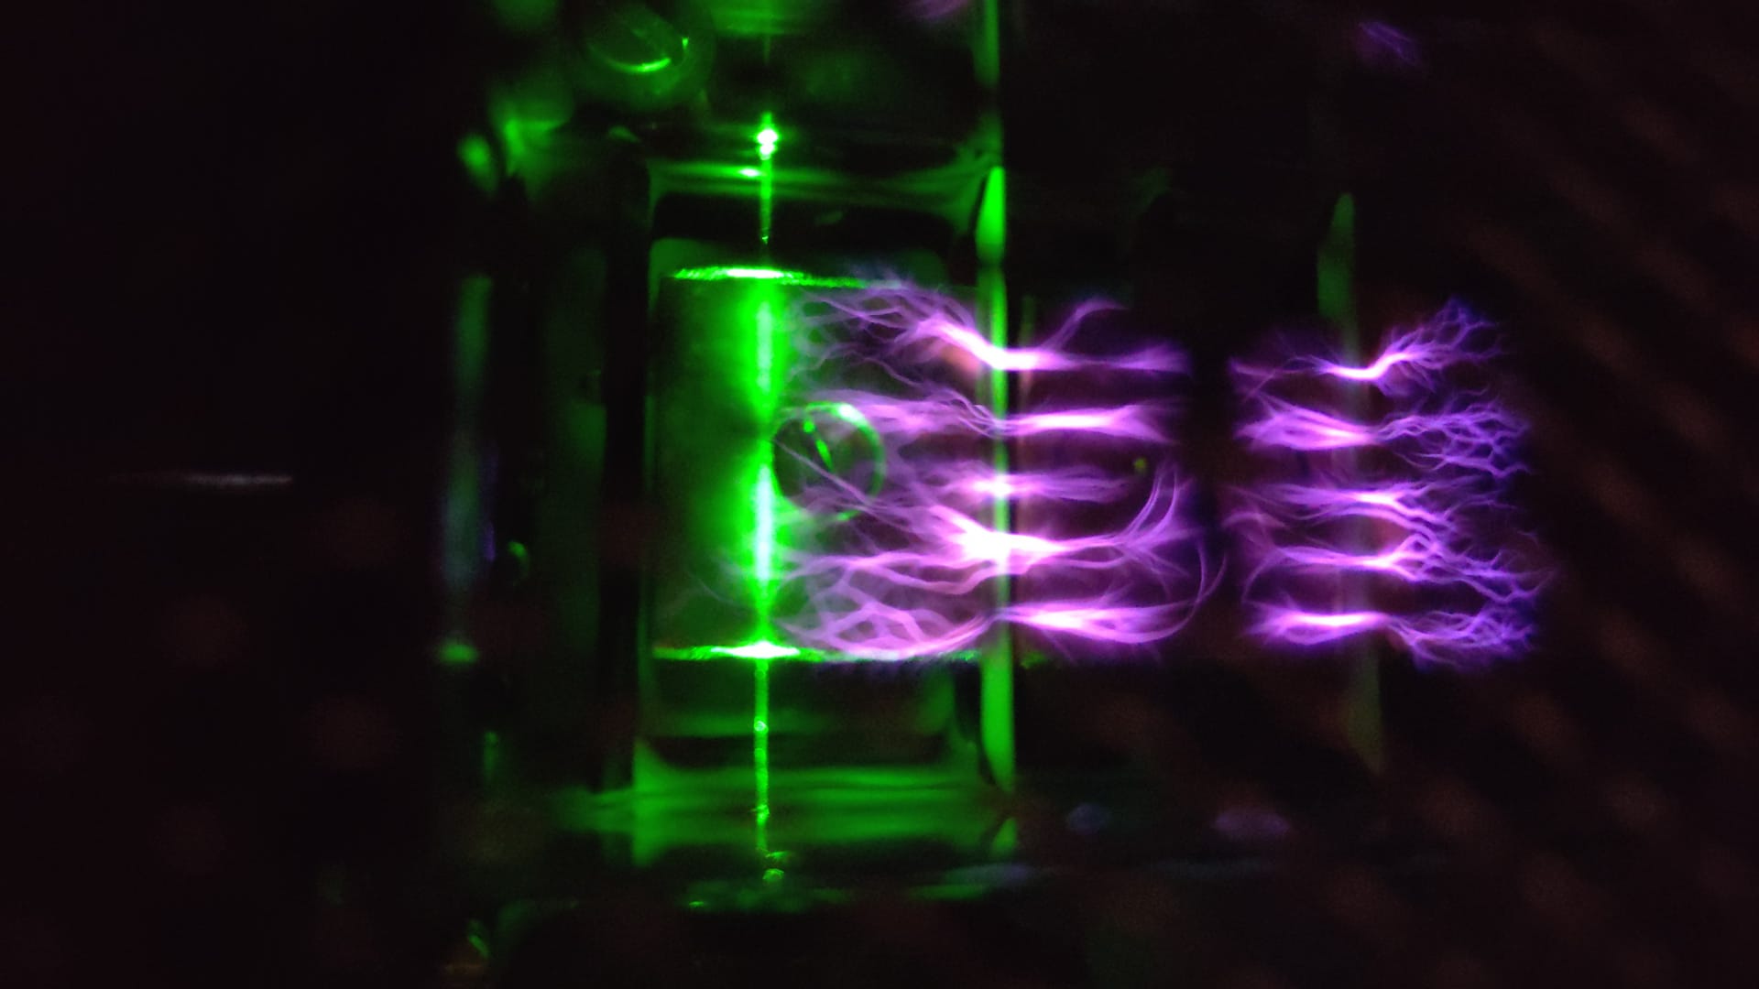
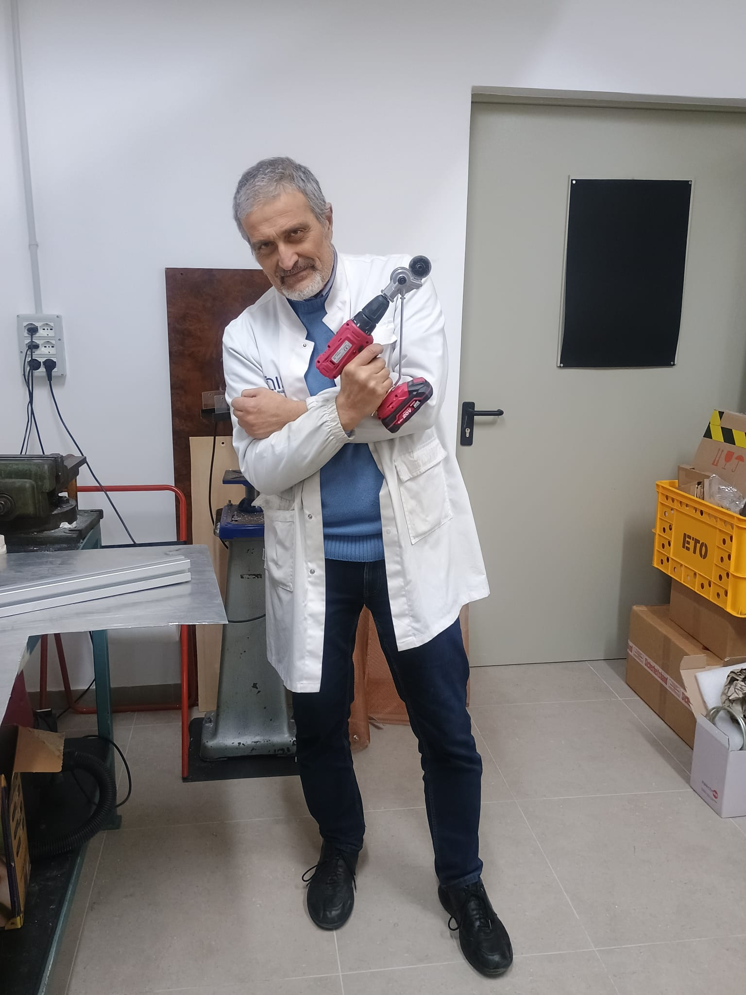
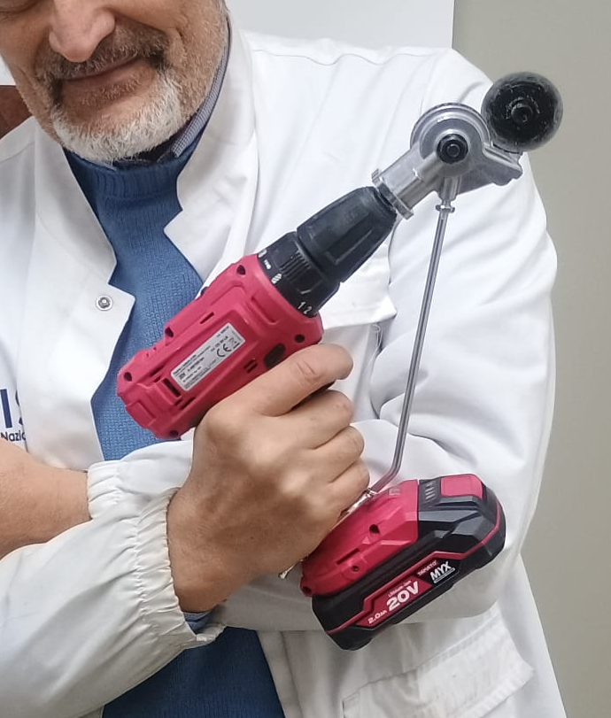
Quella di prima era la diapositiva n. 17…….
(non ci credo, ma pare porti sfortuna anche a chi non ci crede)
Concorso a premi per teorici: indovinacosac’ènellafoto

