Slide 1
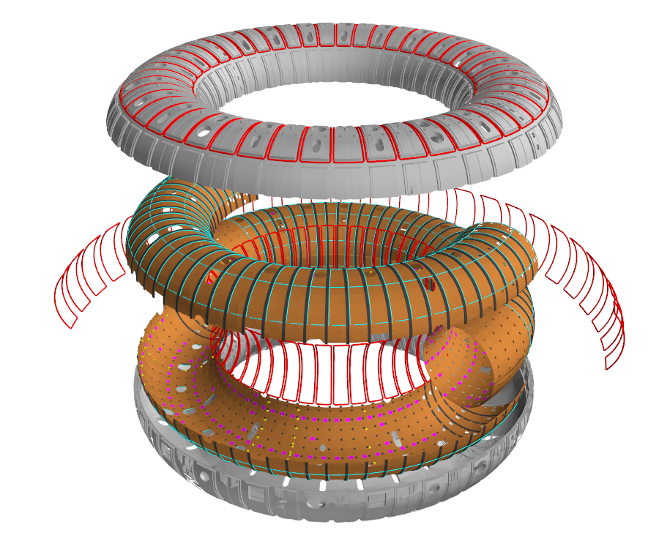
The RFX-mod2 experiment
CUP: B53C22003070006
L. Marrelli and the RFX-mod2-team
NEFERTARI Final Workshop
Padova, 22-25/3/2026

Slide 2
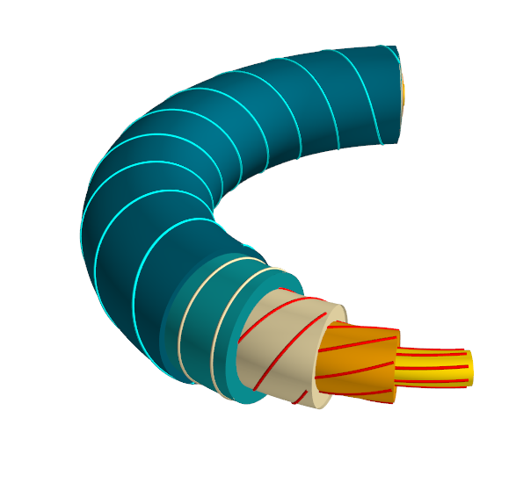
RFX-mod2 is a Reversed Field Pinch
RFX-mod2 is the second modification of the Reversed Field eXperiment which is a Reversed Field Pinch (RFP) (R=2m,a=0.49)
Paramagnetism: Bulk B-field self-generated by plasma.
Field Reversal: Inverted edge pitch (Cyan vs. Red lines)

Slide 3
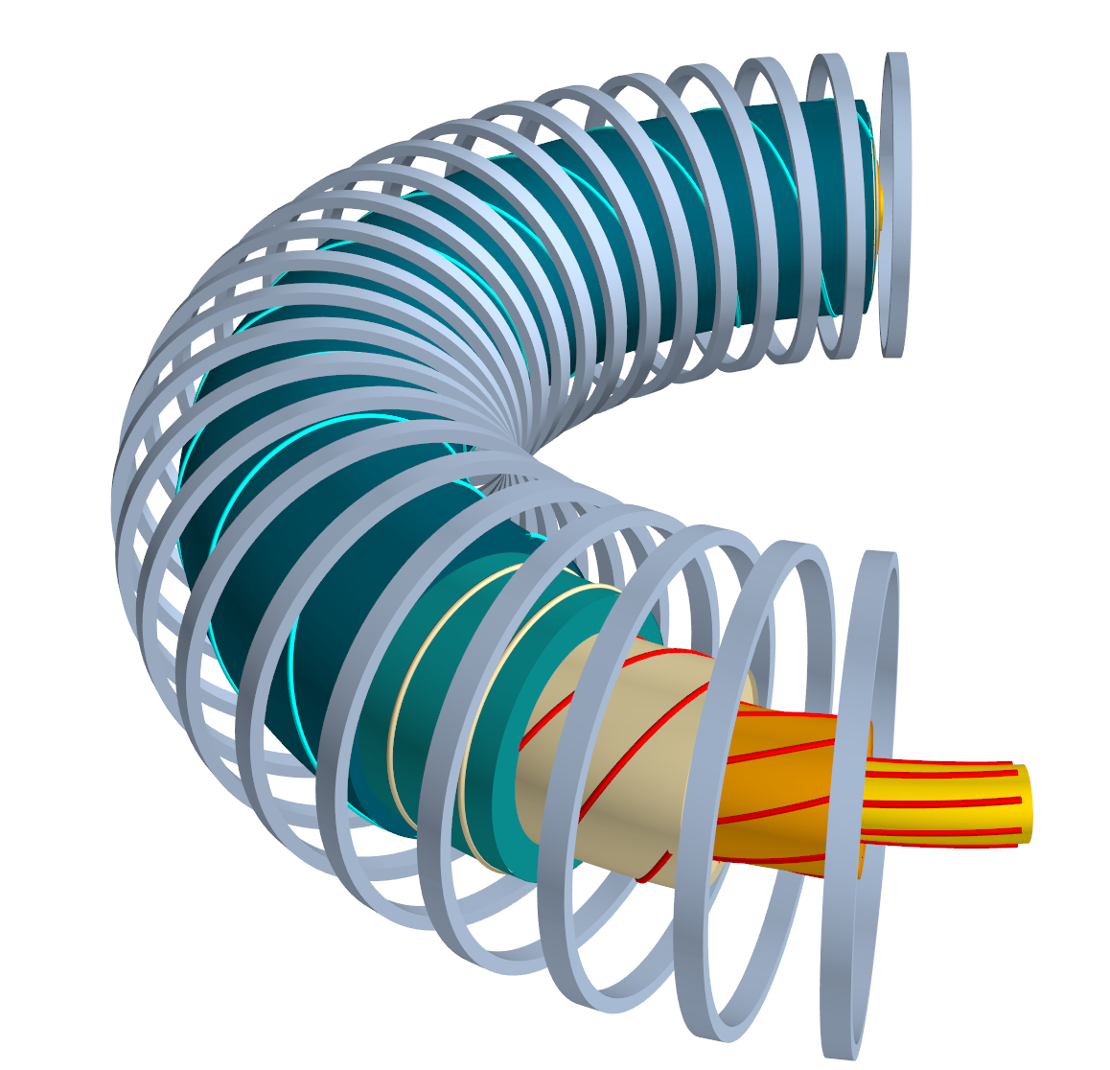
RFX-mod2: Toroidal field Coils
RFX-mod2 is the second modification of the Reversed Field eXperiment which is a Reversed Field Pinch (RFP) (R=2m,a=0.49)
Paramagnetism: Bulk B-field self-generated by plasma.
Field Reversal: Inverted edge pitch (Cyan vs. Red lines)
Toroidal Field Coils: Low Engineering Demand
Reduced External Field: Plasma-generated bulk field.
Moderate Mechanical Stress: Low Lorentz forces on windings

Slide 4
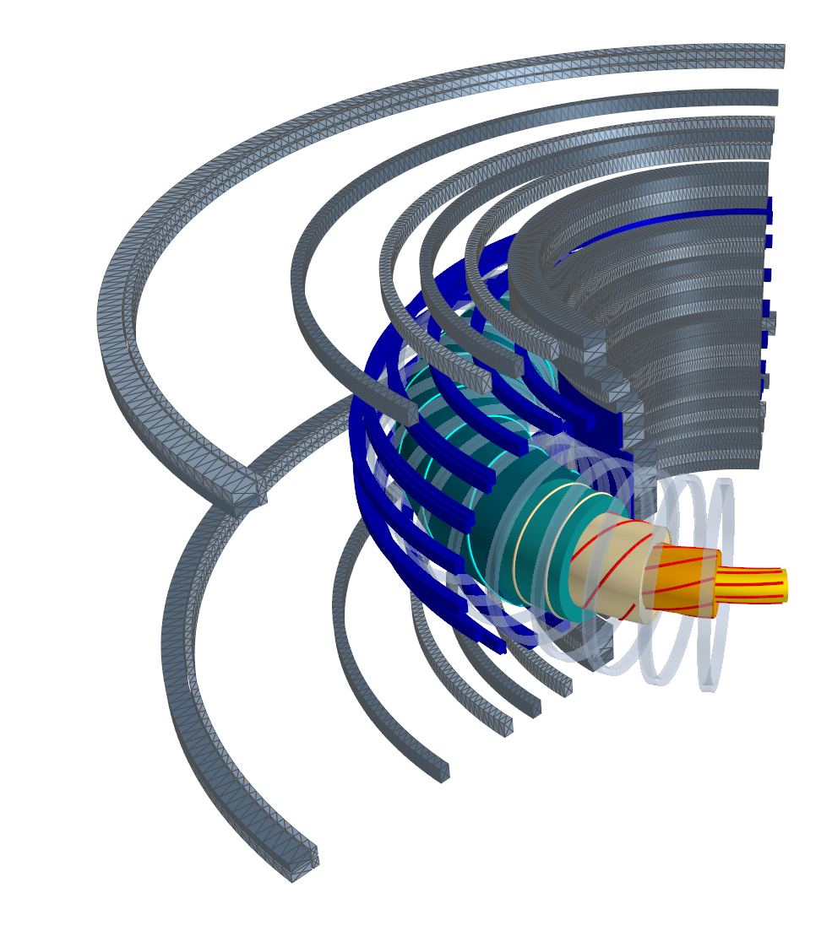
RFX-mod2: Poloidal Field Coils
RFX-mod2 is the second modification of the Reversed Field eXperiment which is a Reversed Field Pinch (RFP) (R=2m,a=0.49)
Paramagnetism: Bulk B-field self-generated by plasma.
Field Reversal: Inverted edge pitch (Cyan vs. Red lines)
Toroidal Field Coils: Low Engineering Demand
Reduced External Field: Plasma-generated bulk field.
Moderate Mechanical Stress: Low Lorentz forces on windings
Poloidal field coils: Air core high flux swing (15 Vs)
Pure Ohmic Heating: No auxiliary heating required for RFP

Slide 5
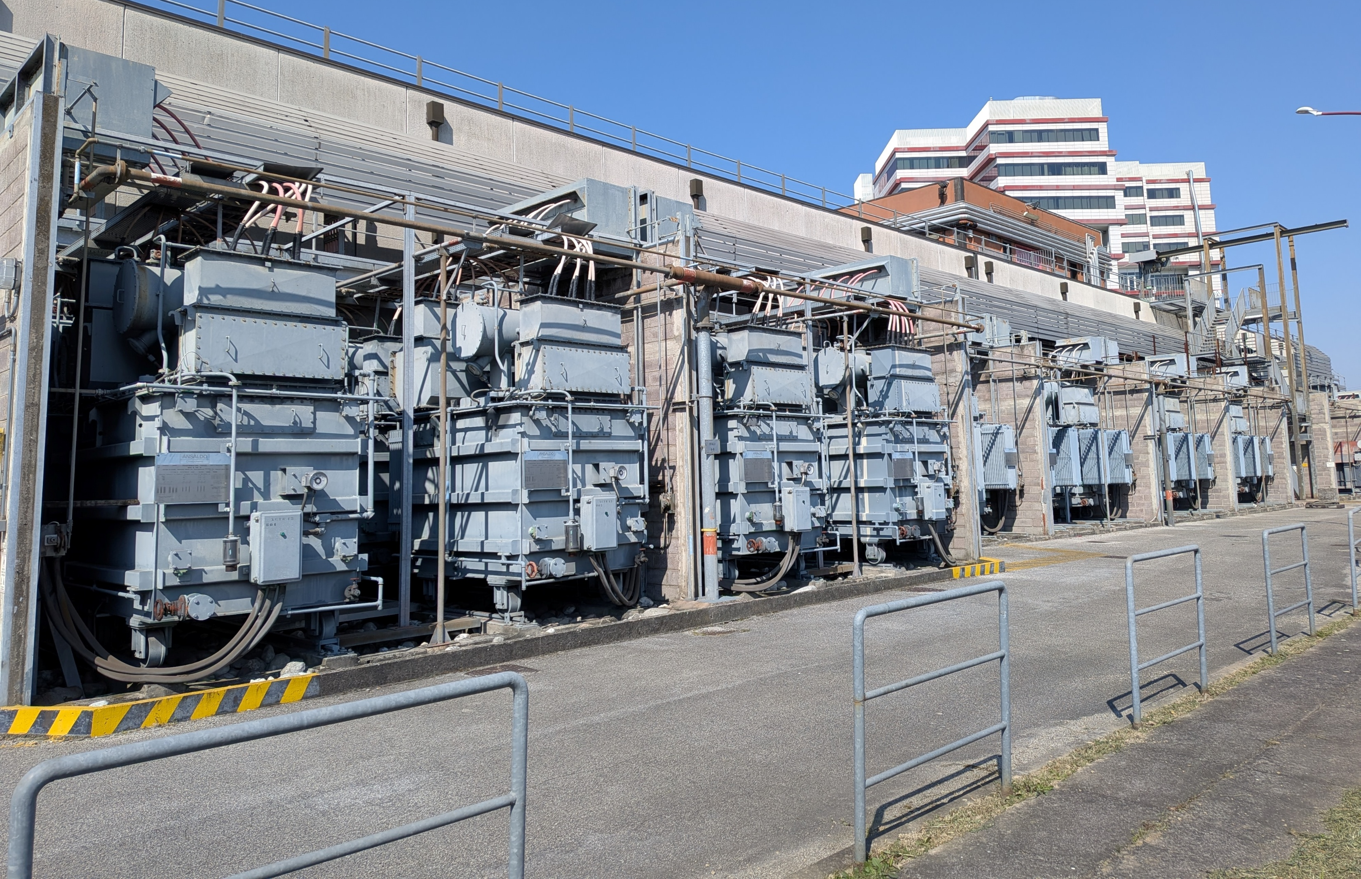
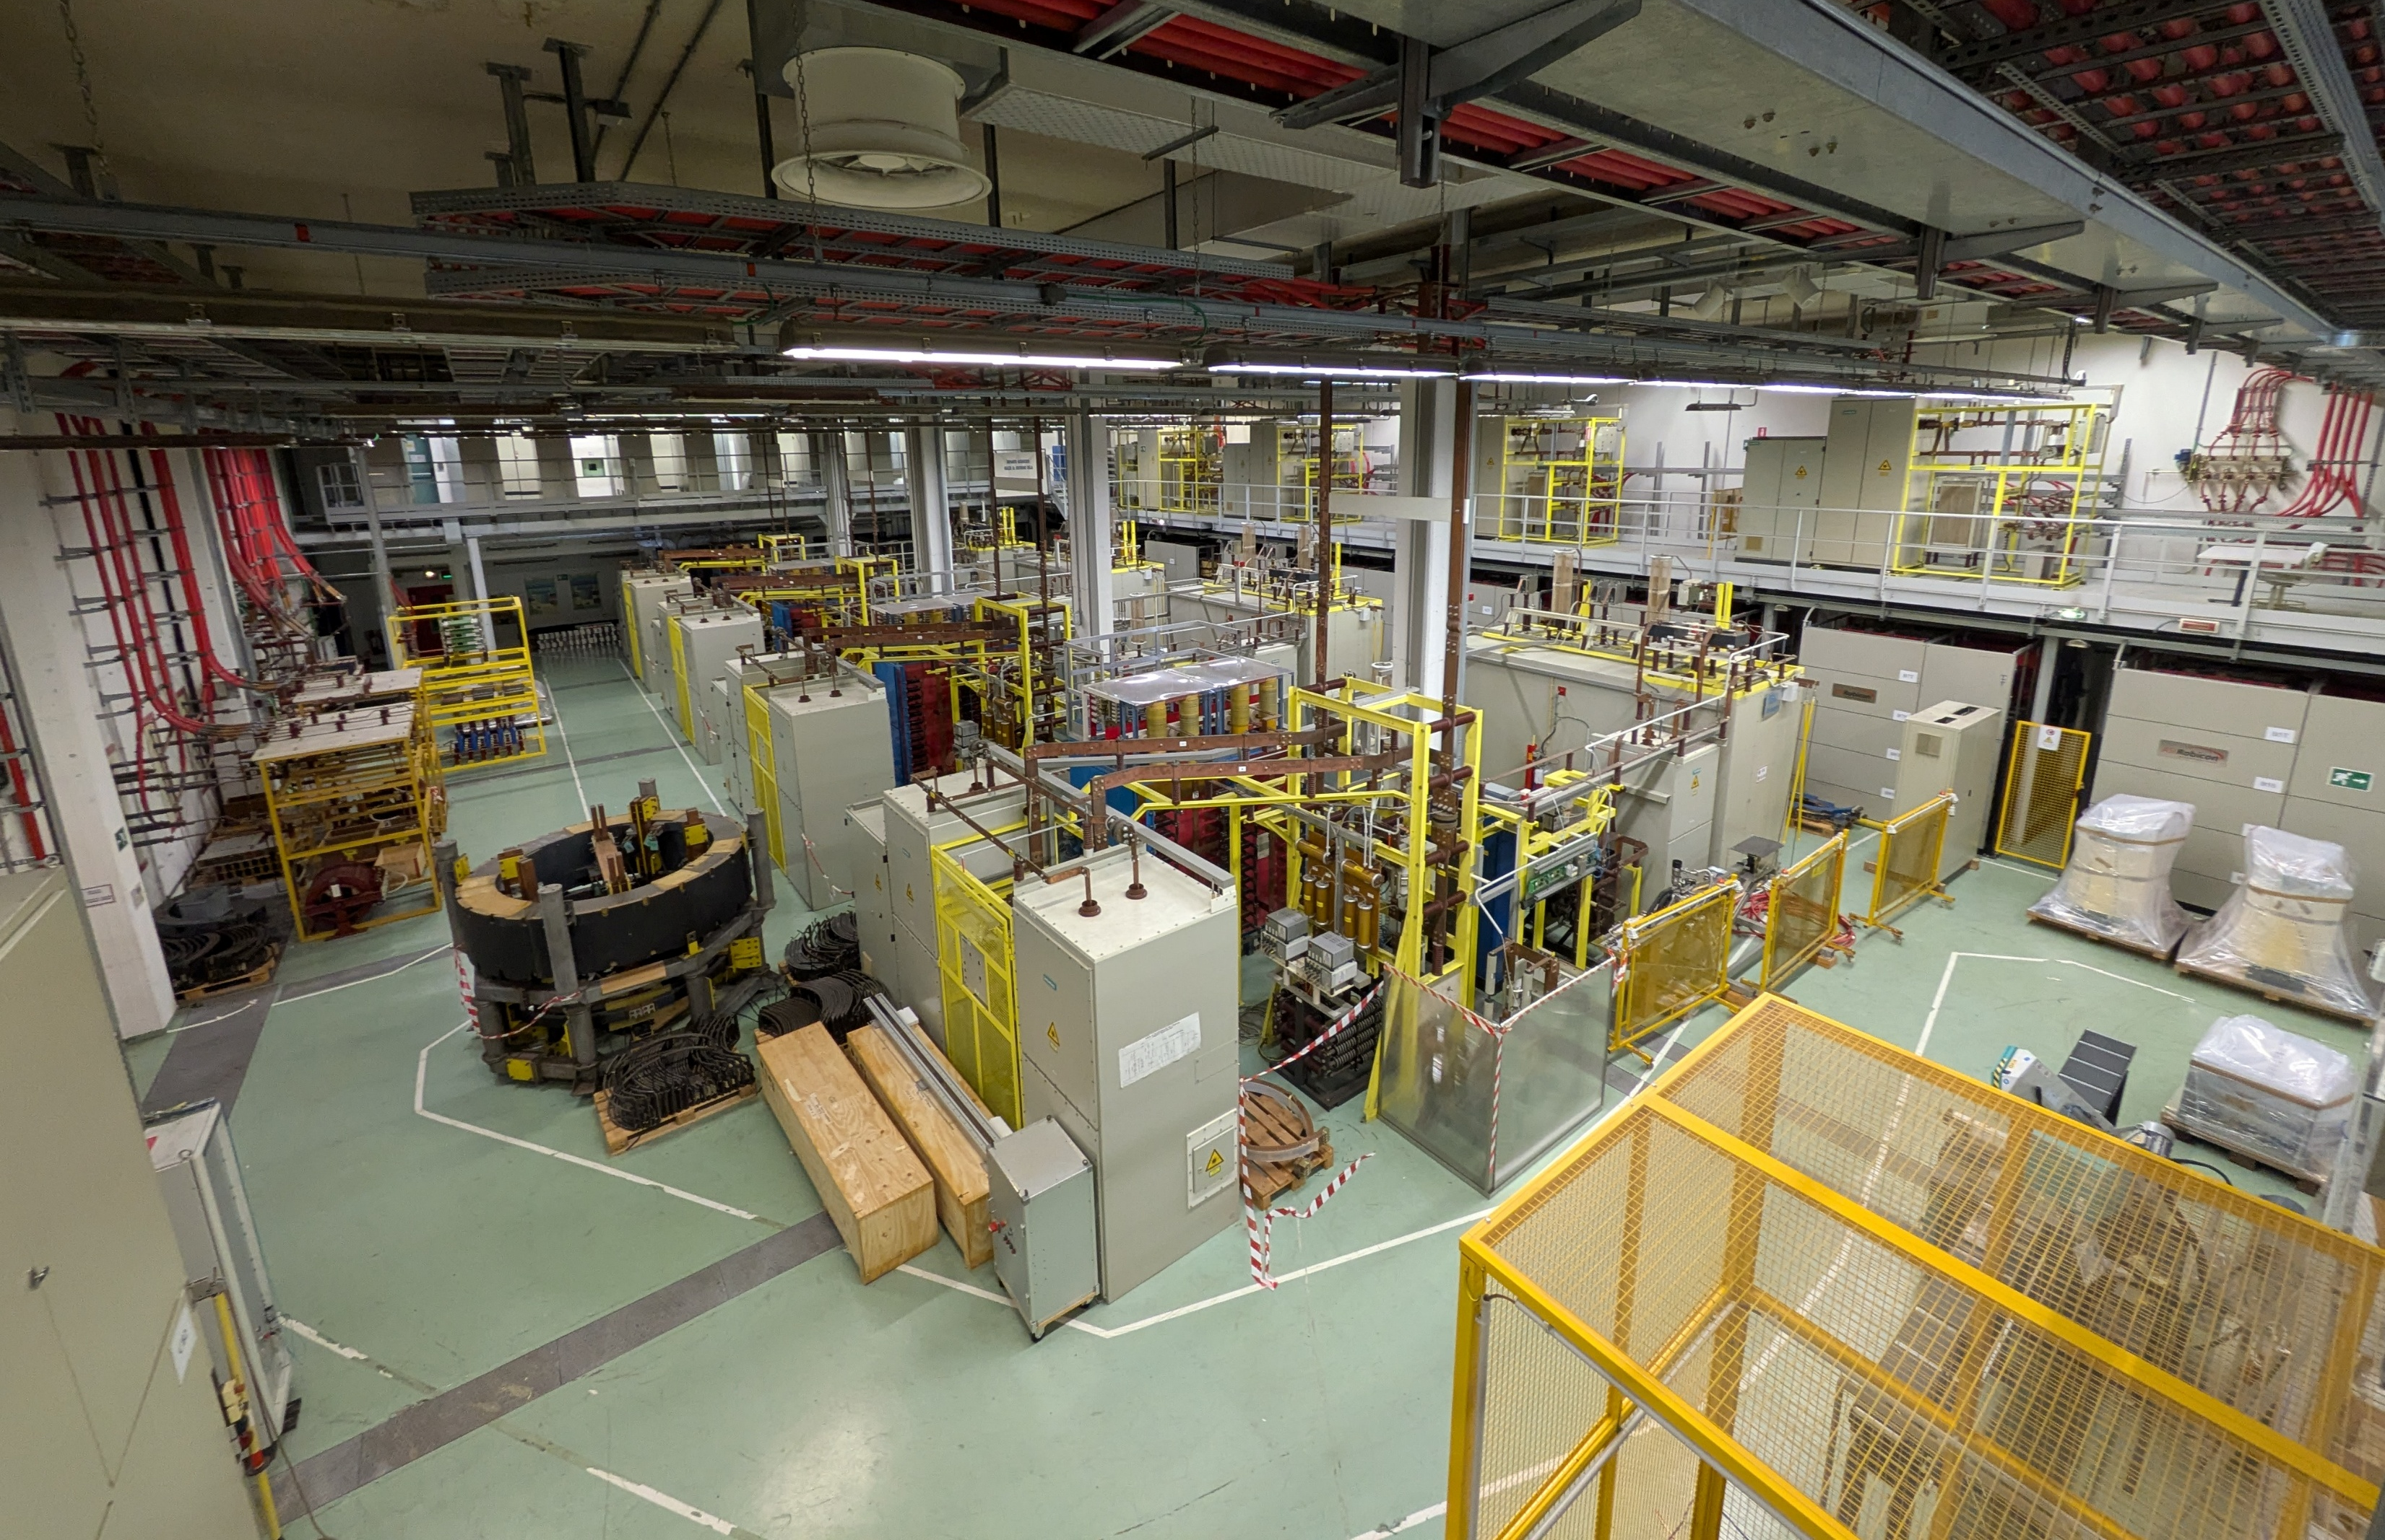
RFX-mod2: Power supplies
RFX-mod2 is the second modification of the Reversed Field eXperiment which is a Reversed Field Pinch (RFP) (R=2m,a=0.49)
Paramagnetism: Bulk B-field self-generated by plasma.
Field Reversal: Inverted edge pitch (Cyan vs. Red lines)
Toroidal Field Coils: Low Engineering Demand
Reduced External Field: Plasma-generated bulk field.
Moderate Mechanical Stress: Low Lorentz forces on windings
Poloidal field coils: Air core high flux swing (15 Vs)
Pure Ohmic Heating: No auxiliary heating required for RFP
Versatile MW-class power plant featuring modular ac/dc units

Slide 6
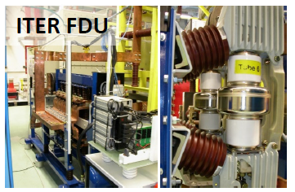
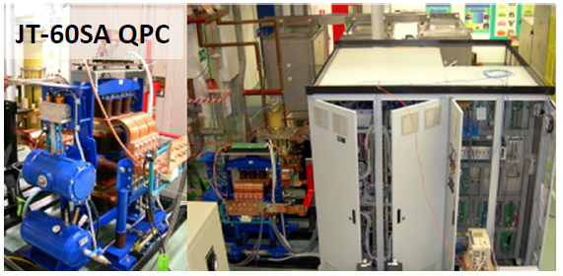
RFX-mod2: high power test facility
RFX-mod2 is the second modification of the Reversed Field eXperiment which is a Reversed Field Pinch (RFP) (R=2m,a=0.49)
Paramagnetism: Bulk B-field self-generated by plasma.
Field Reversal: Inverted edge pitch (Cyan vs. Red lines)
Toroidal Field Coils: Low Engineering Demand
Reduced External Field: Plasma-generated bulk field.
Moderate Mechanical Stress: Low Lorentz forces on windings
Poloidal field coils: Air core high flux swing (15 Vs)
Pure Ohmic Heating: No auxiliary heating required for RFP
Versatile MW-class power plant featuring modular ac/dc units
Qualification tests for ITER Fast Discharge Units FDU (70kA,24kV), JT-60SA Quench Protection Unit QPC (25 KA, 4kV) and development of next step reactors Magnetic Energy Storage and Transfer system (MEST)

Slide 7
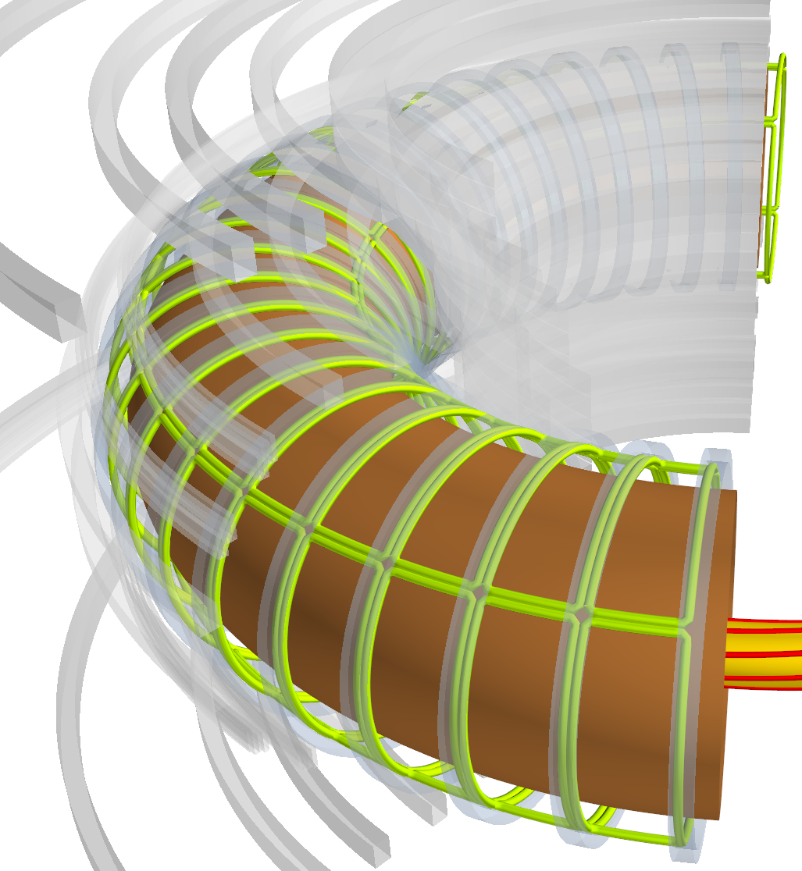
RFX-mod2: active control
RFX-mod2 is the second modification of the Reversed Field eXperiment which is a Reversed Field Pinch (RFP) (R=2m,a=0.49)
Paramagnetism: Bulk B-field self-generated by plasma.
Field Reversal: Inverted edge pitch (Cyan vs. Red lines)
Toroidal Field Coils: Low Engineering Demand
Reduced External Field: Plasma-generated bulk field.
Moderate Mechanical Stress: Low Lorentz forces on windings
Poloidal field coils: Air core high flux swing (15 Vs)
Pure Ohmic Heating: No auxiliary heating required for RFP
Versatile MW-class power plant featuring modular ac/dc units
Active control of MHD instabilities; (J.D. Lawson 1977 proposal)
3mm thick copper shell
48x4 independent coils
J.D. Lawson, (1977) Reversed Field Pinch Reactor Studies. Part I., Physical Principles, CLM-R171
C.M. Bishop, (1989) Plas. Phys. Contr. Fus, 31, 1179

Slide 8
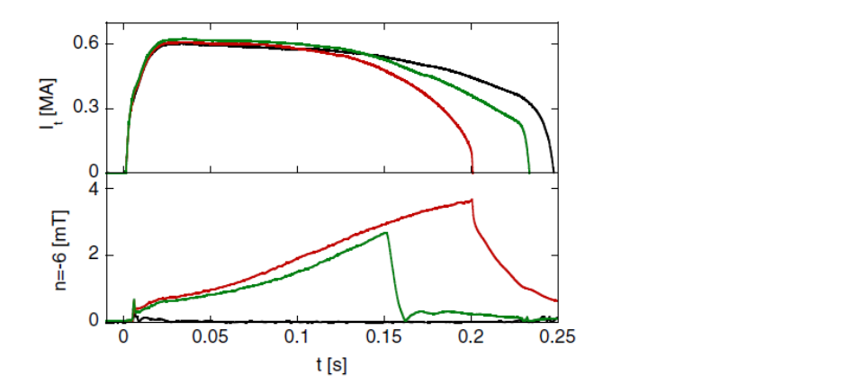
RFX-mod results: multiple Resistive Wall Modes stabilization
RFX-mod proved that multiple RWMs can be simultaneously suppressed [1,2]
Without Control
Controlled after 150ms
Fully controlled
[1] S.Ortolani, Active MHD control experiments in RFX-mod. Plas Phys Contr Fus. 2006;48(12B):B371
[2] Bolzonella T, et al. Resistive-Wall-Mode Active Rotation in the RFX-Mod Device. Phys Rev Lett 2008; 101: 165003

Slide 9

RFX-mod-results: highest plasma current for an RFP
Reversed-Field pinch 2 MA plasma current target level was achieved in RFX-mod thanks to
Advanced mode control strategies [2]
Power supplies configuration flexibility [1] (15.8 Vs flux swing)
Power supply reconfiguration [1]
Advanced ModeControl [2]
Simple Virtual Shell [3]
No MHD control
[1] Novello, et al (2011). "Enhancement of the power supply systems in RFX-mod towards 2 MA plasma current". ''Fusion Engineering and Design'' 86: 1393-1397,
[2] Zanca, Marrelli, Manduchi, Marchiori (2007). "Beyond the intelligent shell concept: the clean-mode-control". ''Nuclear Fusion'' 47: 1425-1436.
[3] Ortolani and RFX-mod team, (2006) Plasma Physics and Controlled Fusion 48, B371

Slide 10
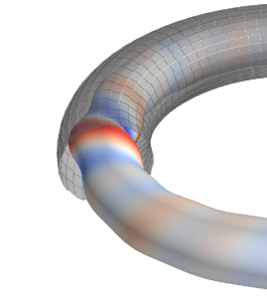
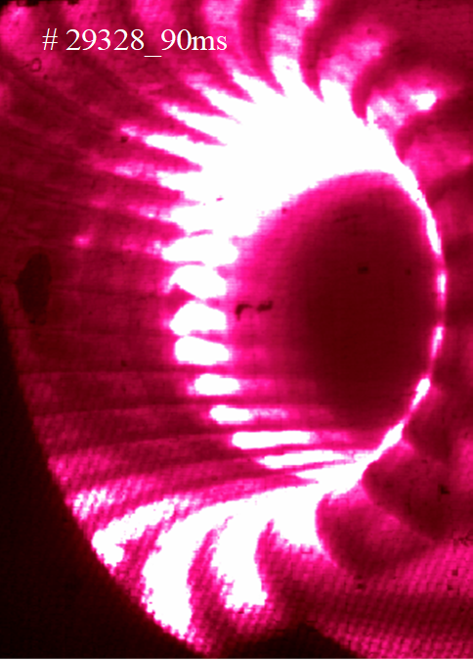
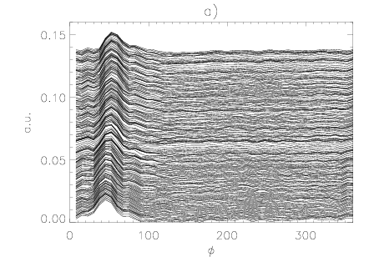
RFX-mod results: From Multiple Helicity
At low plasma currents many tearing modes are present, spooling performances and generating localized bulging of the plasma column.
RFX (and RFX-mod with non optimal control)

Slide 11
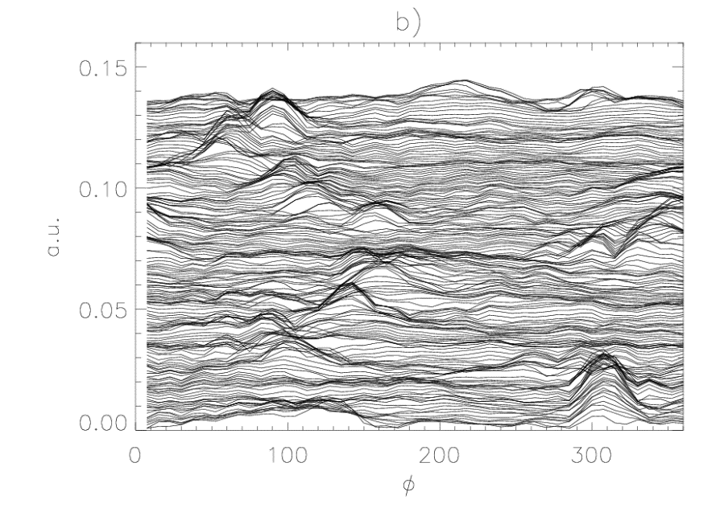
RFX-mod results: From Multiple Helicity
At low plasma currents many tearing modes are present, spooling performances and generating localized bulging of the plasma column.
RFX-mod was able to partially mitigate wall locking by slowly rotating the bulging
RFX (and RFX-mod with non optimal control)
RFX-mod with Advanced Mode Control

Slide 12
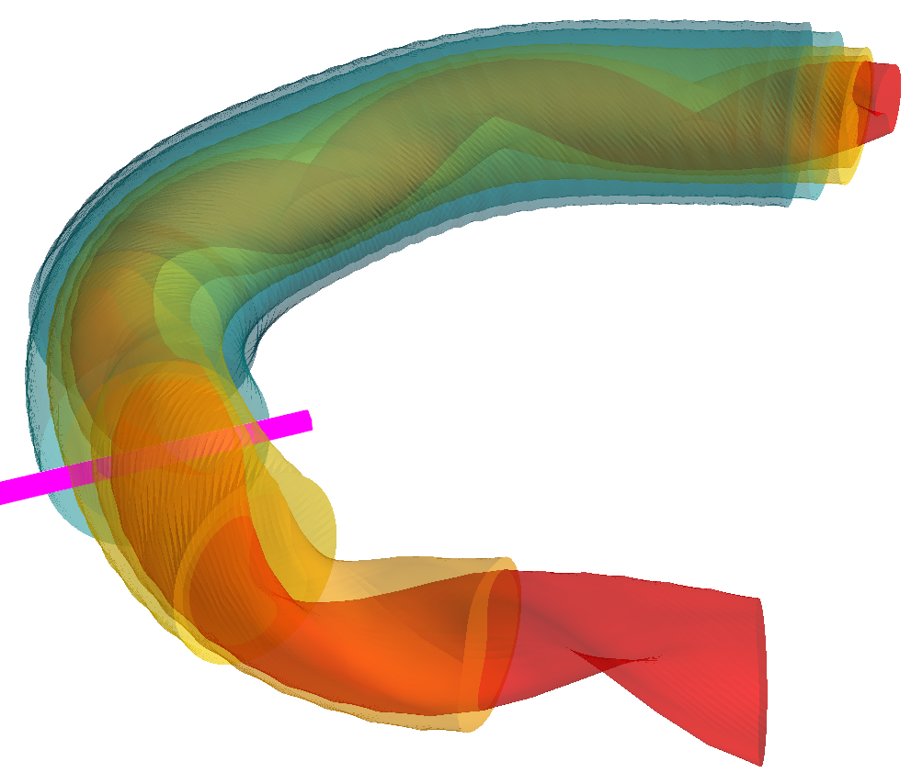
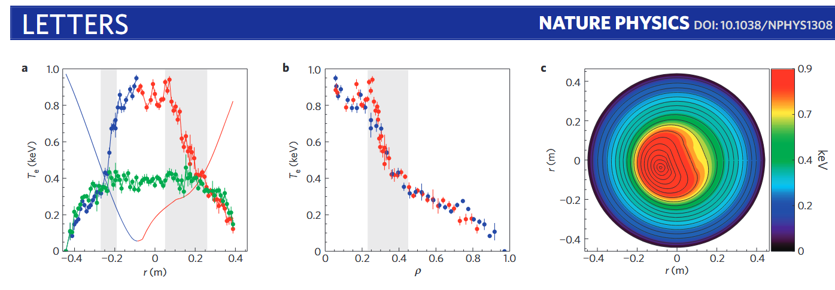
RFX-mod results: From Multiple Helicity to Quasi single Helicity
At high plasma currents (Ip > 1MA) one tearing mode dominates and the core plasma becomes helical with internal transport barriers
Lorenzini, (2009). "Self-organized helical equilibria as a new paradigm for ohmically heated fusion plasmas". ''Nature Physics'' 5: 570-574.

Slide 13
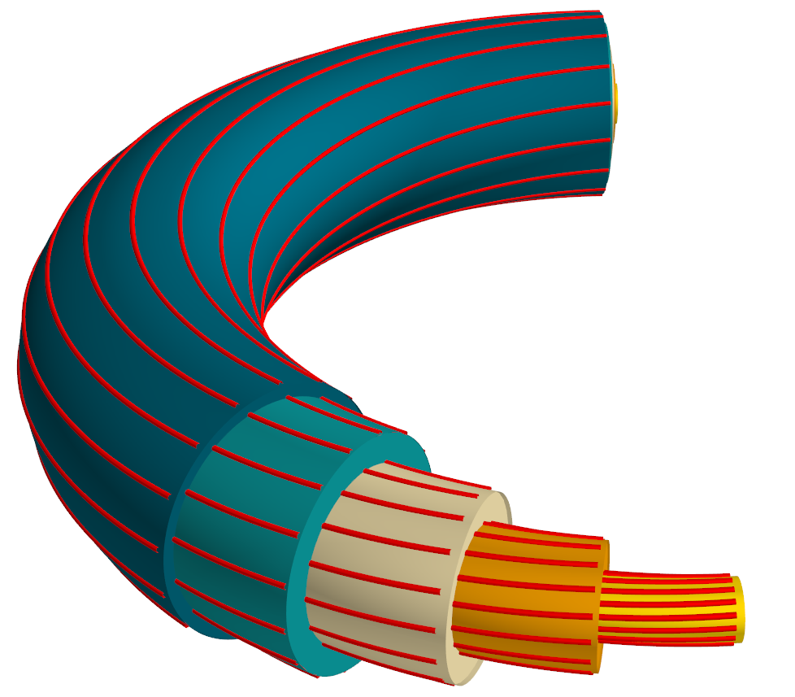
RFX-mod as a ohmic tokamak, Very Low q and Ultra Low q
Thanks to TF coils design (0.5T for 1 s) and active feedback
RFX-mod also operated below the q(a)<2 limit [1]
Performed disruption prevention studies [2]
Performed runaway mitigation with RMP [3]
[1] Zanca P, et al.. Plasma Phys Control Fusion. 2012 Sep 1;54(9):094004
[2] Zanca P., et al. (2015). "An active feedback recovery technique from disruption events induced by m = 2, n = 1…, Nuclear Fusion 55: 043020.
[3] Gobbin, et al (2024). "Runaway electron mitigation by 3D fields application in ASDEX upgrade, COMPASS, and RFX-mod". ''Frontiers in Physics'' 12

Slide 14
RFX-mod: shaped tokamak
Reconfigurable connections to field shaping coils allow shaping
Positive and Negative Triangularity
Single (upper and lower) Null, Double Null, Snow Flake
D. Abate, Plasma Phys. Control. Fusion 62, 085001 (2020)

Slide 15
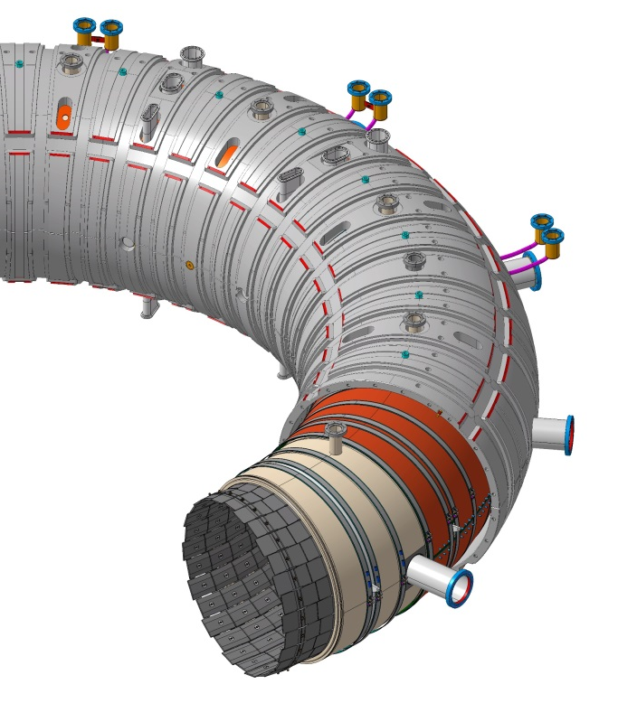
From RFX-mod
RFX-mod performances were limited by the highly resistive Inconel Vacuum Vessel, causing wall locking of multiple Tearing Modes and subsequent localized Plasma Wall Interaction
RFX-mod
Mechanical support structure
Passive stabilizing Cu shell
Vacuum vessel
First wall (graphite)

Slide 16
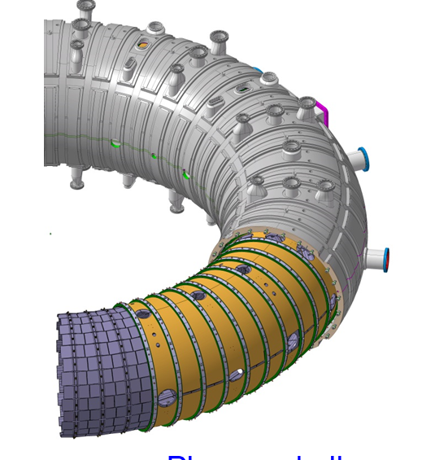
From RFX-mod to RFX-mod2
RFX-mod performances were limited by the highly resistive Inconel Vacuum Vessel, causing wall locking of multiple Tearing Modes and subsequent localized Plasma Wall Interaction
Thanks to POR FESR regional funding «MIAIVO», RFX-mod have been modified to remove the Inconel Vessel
RFX-mod
RFX-mod2
Mechanical support structure
Passive stabilizing Cu shell
Vacuum vessel
First wall (graphite)

Slide 17
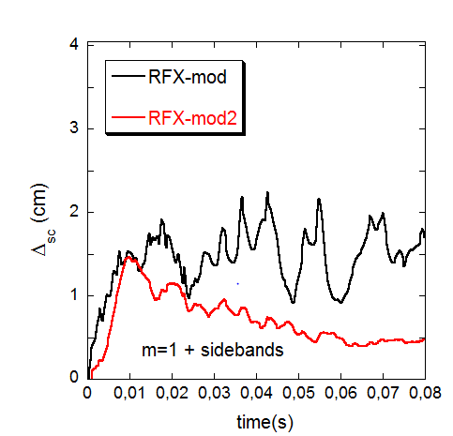
RFX-mod2 expectations
With the new boundary the localized edge deformation decreases by a factor 3
Zuin, et al (2017). Nuclear Fusion 57: 102012.

Slide 18
RFX-mod2 expectations
With the new boundary the edge deformation decreases by a factor 3
Wall locking is simulated to occur at 500-800 kA (instead of 100-150kA)
RFX-mod2 Copper
RFX-mod Inconel
Zuin, et al (2017). Nuclear Fusion 57: 102012.
Marrelli L, et al.,. Nuclear Fusion. 2019 Jul 1;59(7):076027

Slide 19
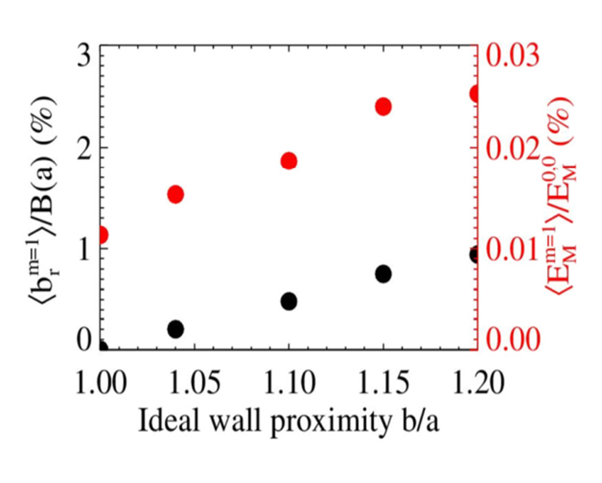
RFX-mod2 expectations
With the new boundary the edge deformation decreases by a factor 3
Wall locking is simulated to occur at 500-800 kA (instead of 100-150kA)
25% reduction of tearing mode energy
RFX-mod2 Copper
RFX-mod2
RFX-mod
RFX-mod Inconel
Zuin, et al (2017). Nuclear Fusion 57: 102012.
Marrelli L, et al.,. Nuclear Fusion. 2019 Jul 1;59(7):076027

Slide 20
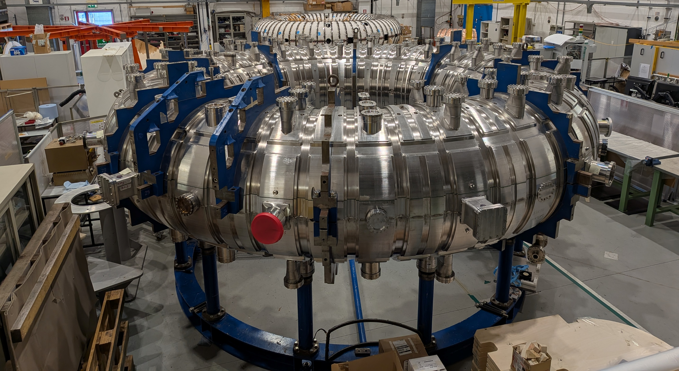
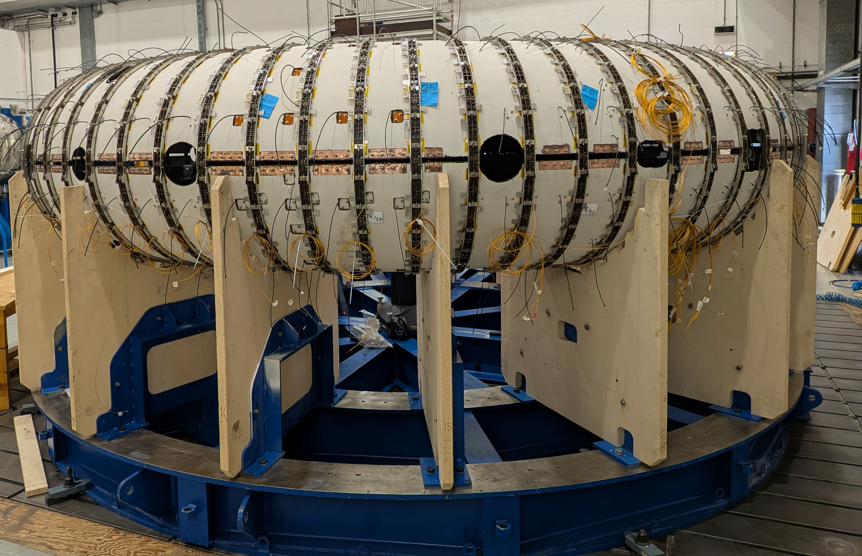
RFX-mod2: status of vessel complex reassembly
RFX-mod2 Vessel Complex components in the assembly hall

Slide 21
The NEFERTARI opportunity: plants revamping and key diagnostics
Revamped key auxiliary plants
Vacuum system (WP1)
Toroidal field power Supplies (WP1)
Wall conditioning systems: Glow Discharge (WP1) Cleaning and Pulse Discharge Cleaning (WP1)
Remote Manipulation (WP1)
Electromagnetic measurements and model based control (WP2)
Revamped and enhanced existing diagnostics; allows applications of codes for experiment interpretations
Edge diagnostics (WP3)
Core diagnostics (WP4 & WP5)
Foster the integration of expertise and pave the way for future common research
High Voltage Insulation (WP6)
Plasma Wall Interaction (WP7)
Neutron and SXR imaging diagnostics (WP8)
Spectroscopic diagnostics & advanced modelling (WP9)

Slide 22
RFX-mod2 research themes
Complete exploration of 2MA Reversed Field Pinch Exploit real-time control capabilities both for RFP and tokamak
Model based (machine learning) control algorithms
FEM, BEM of passive structures and plasma response
Non magnetic real-time plasma position control with reflectometry
Explore 3D physics in high current Reversed Field Pinch plasmas
Plasma Wall Interaction
MHD dynamics with controlled 3D boundary
Explore 3D effects in ohmic tokamak
Error fields
Experimental characterization of disruptions
electromagnetic induced forces direct measurements
Fundamental Plasma physics studies in multiple configurations
Edge turbulence and microinstabilities
Magnetic reconnection and particles accelerations
Transport barriers characterization

Slide 23
Spare Slides

Slide 24
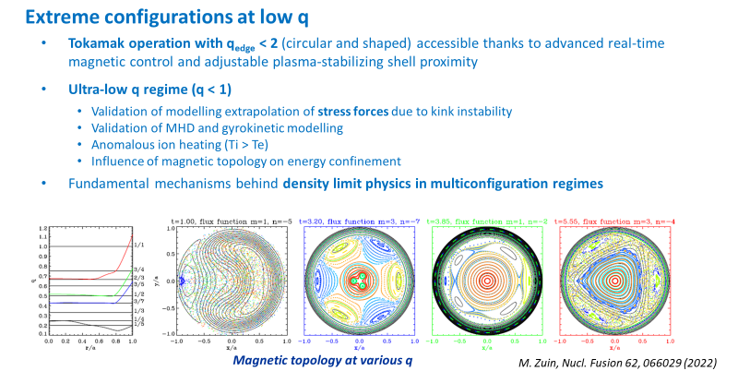

Slide 25
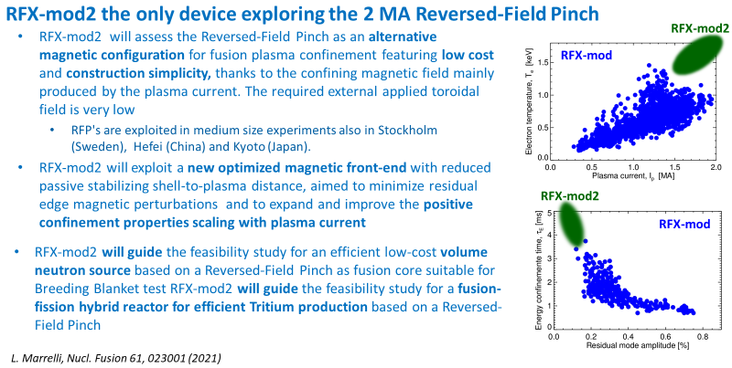

Slide 26
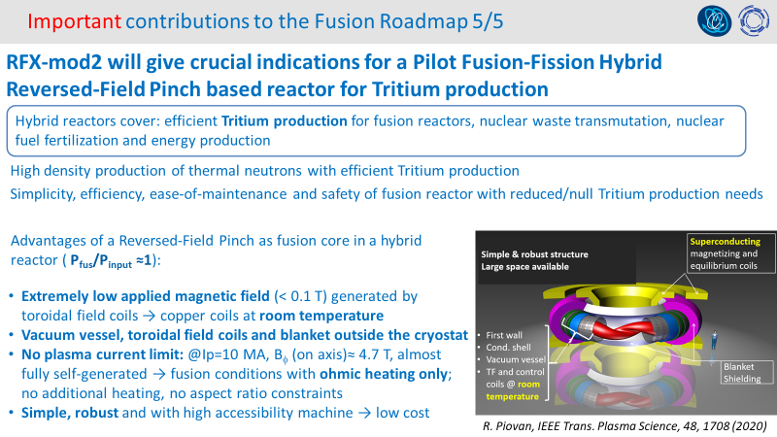

Slide 27
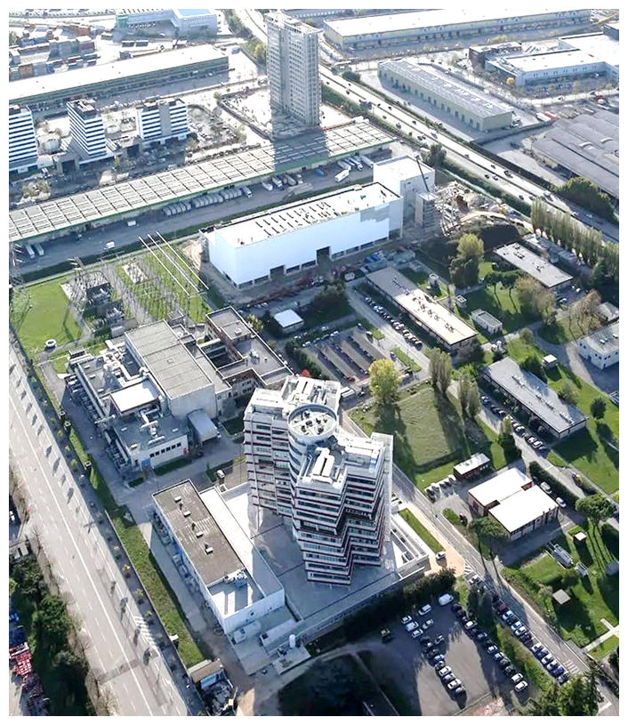
RFX @ Consorzio RFX
RFX was a toroidal device for magnetic confinement in Reversed Field Pinch (RFP) configurations
(R=2m,a=0.457)
Operated in 1991-1999
RFX was modified and became RFX-mod
Operated in 2004-2015

