Slide 1


Machine Learning at the Austrian Academy of Sciences - A thematic platform of the ÖAW -
Jan Odstrčilík (MLA²S) AI and Artworks
16.4.2026

Slide 2



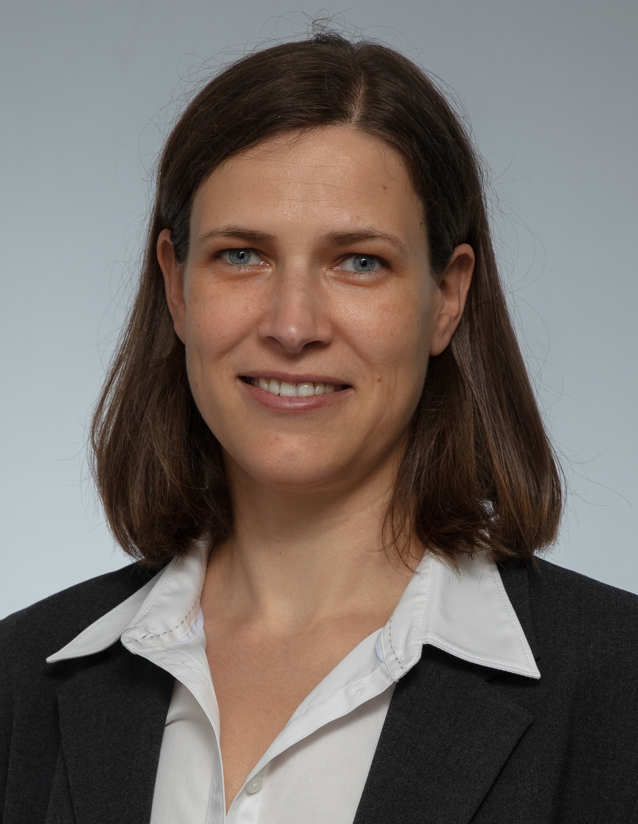
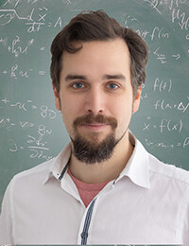
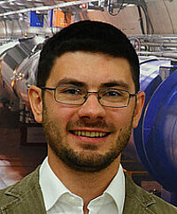

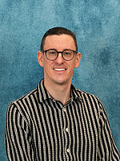



MLA²S – Machine Learning at the Austrian Academy of Sciences
MISSION
Initiated by
a catalyst of inter-institutional collaboration
regarding scientific machine learning (Theory, Development, and Application)
at the ÖAW and beyond
&
COORDINATORS
Kati Heinrich (IGF) Nicki Holighaus (ISF) Claudius Krause (MBI) Jan Odstrčilík (IMAFO) Claus Trost (ESI)
(since 03/25) coordinated with

Slide 3
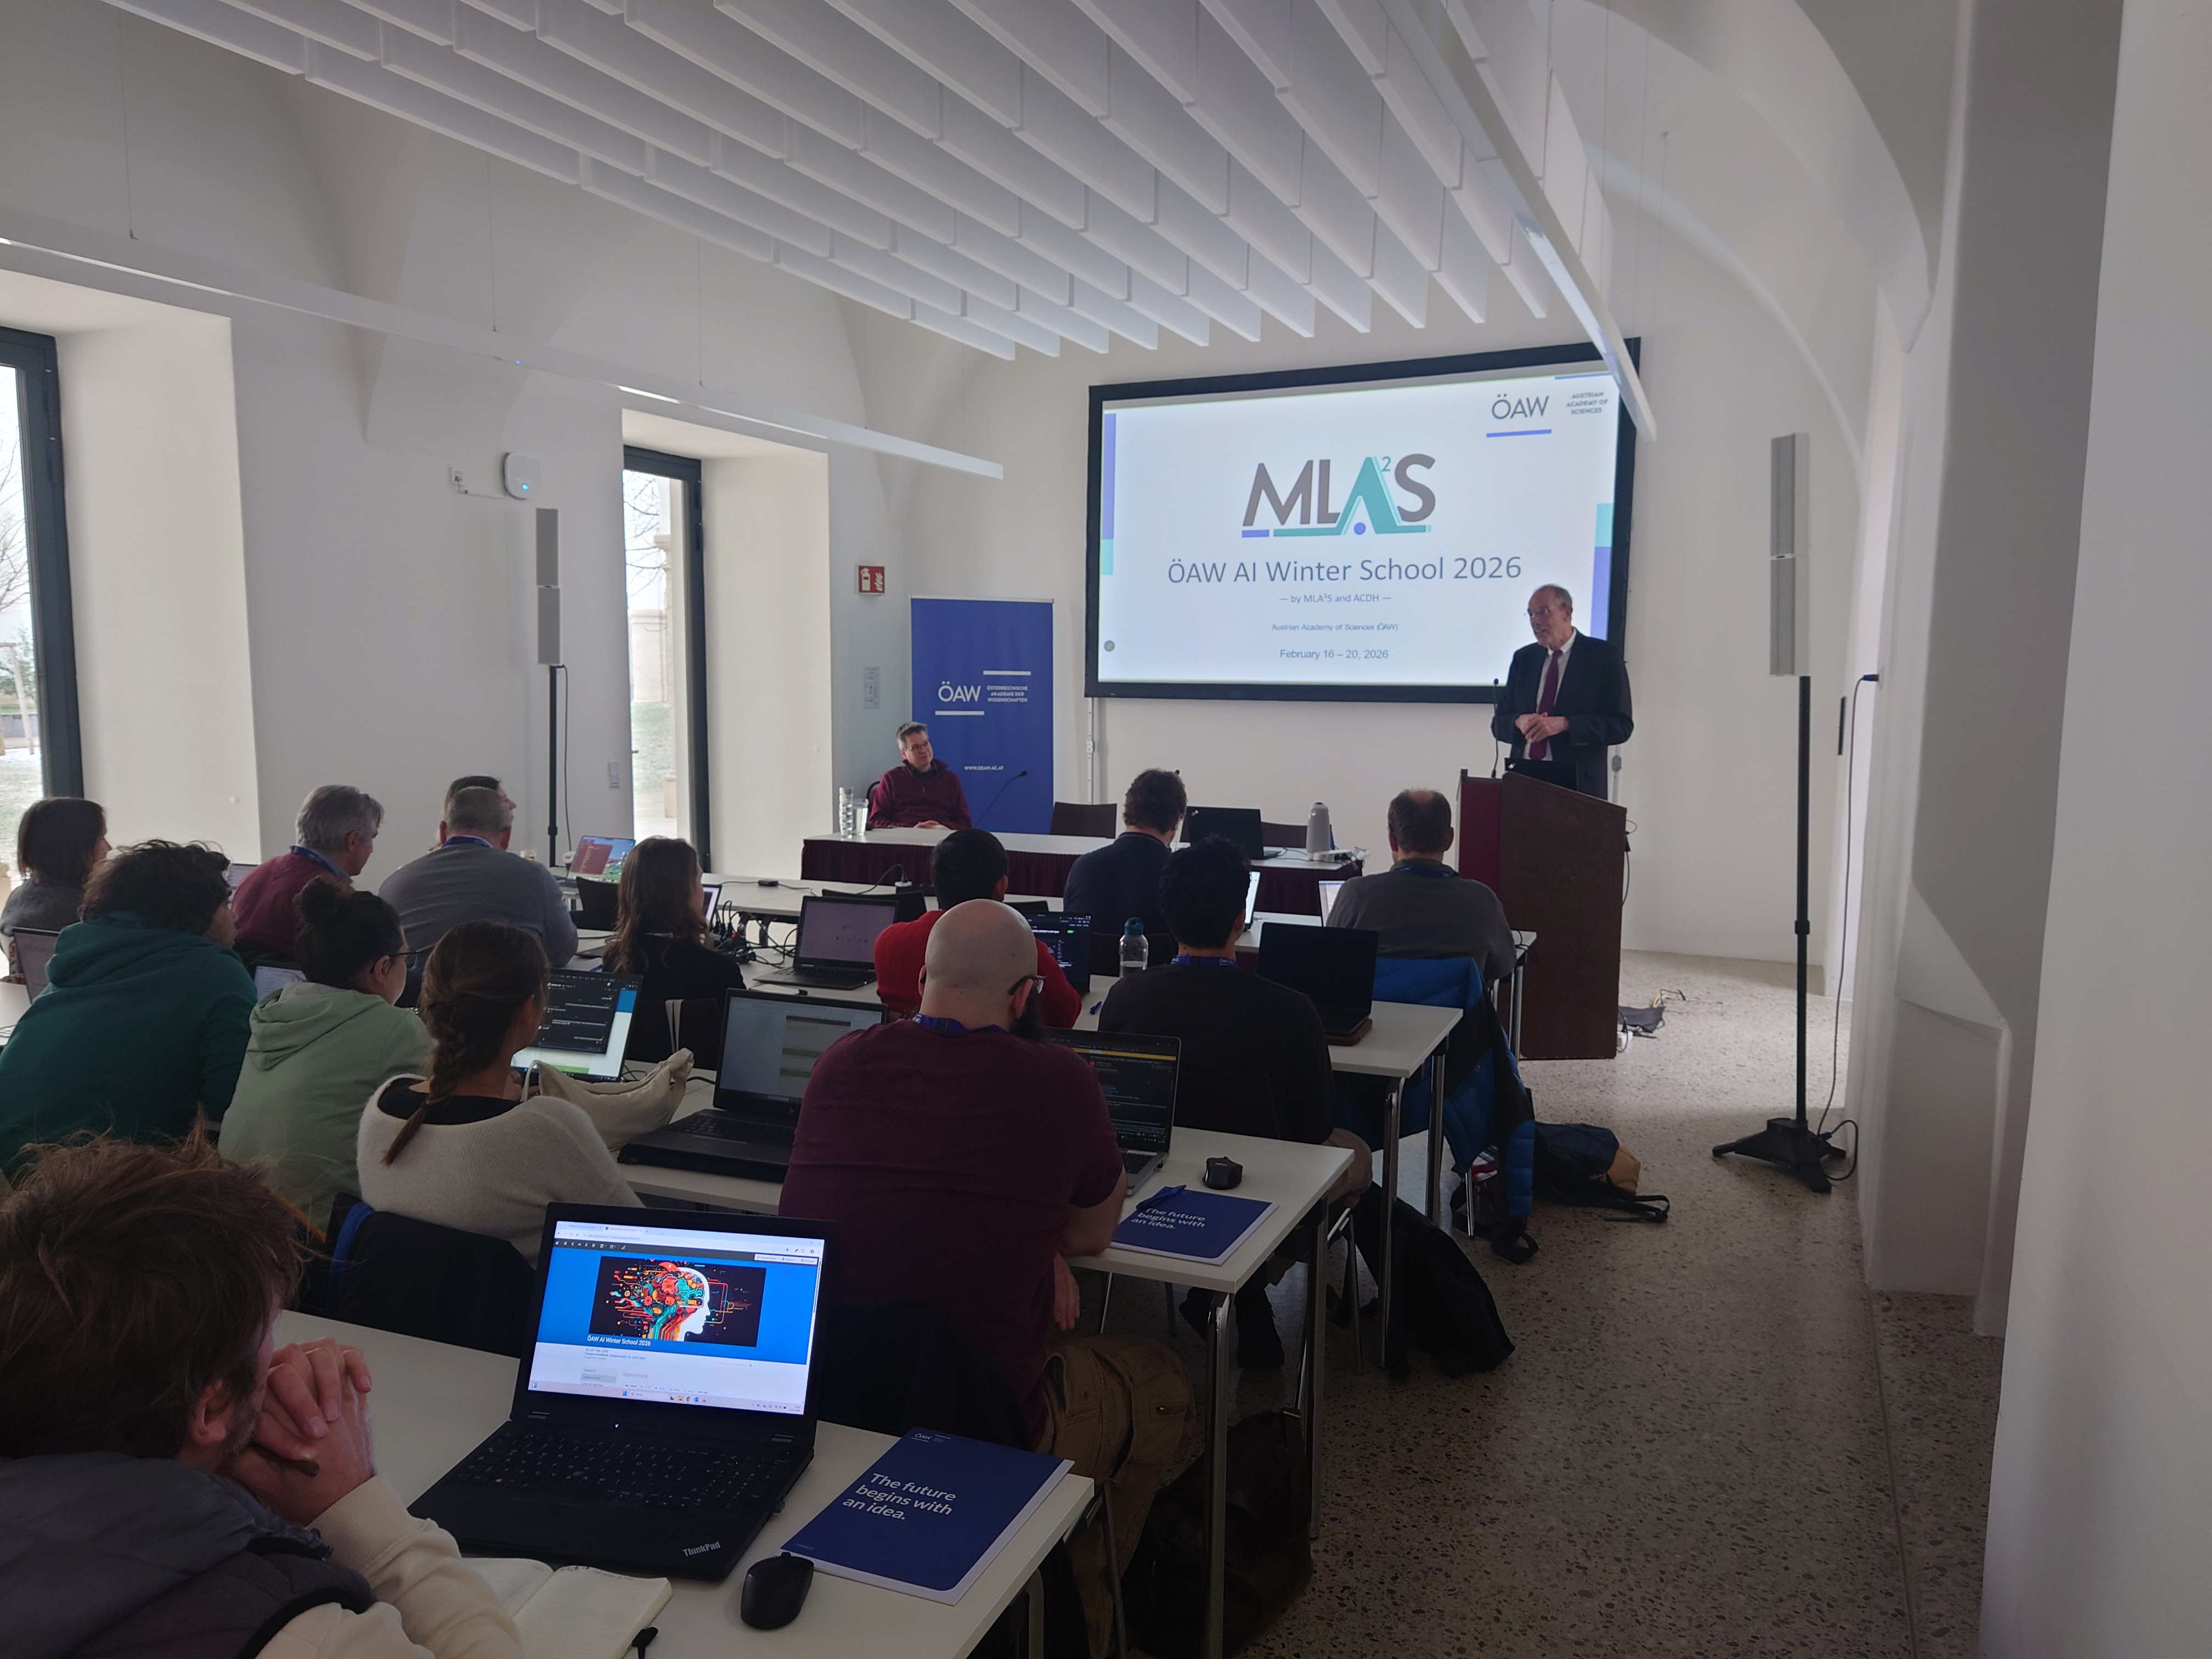
EVENTS
ANNUAL ÖAW AI WINTER SCHOOL
YEAR 2026 (16-20.02)
40 participants (21 GSK)
Lectures
Introduction to ML/AI
Vibe Coding & „Promptotyping”
Ethics and AI
From idea to final project (Code & Data management)
Explainability

Slide 4
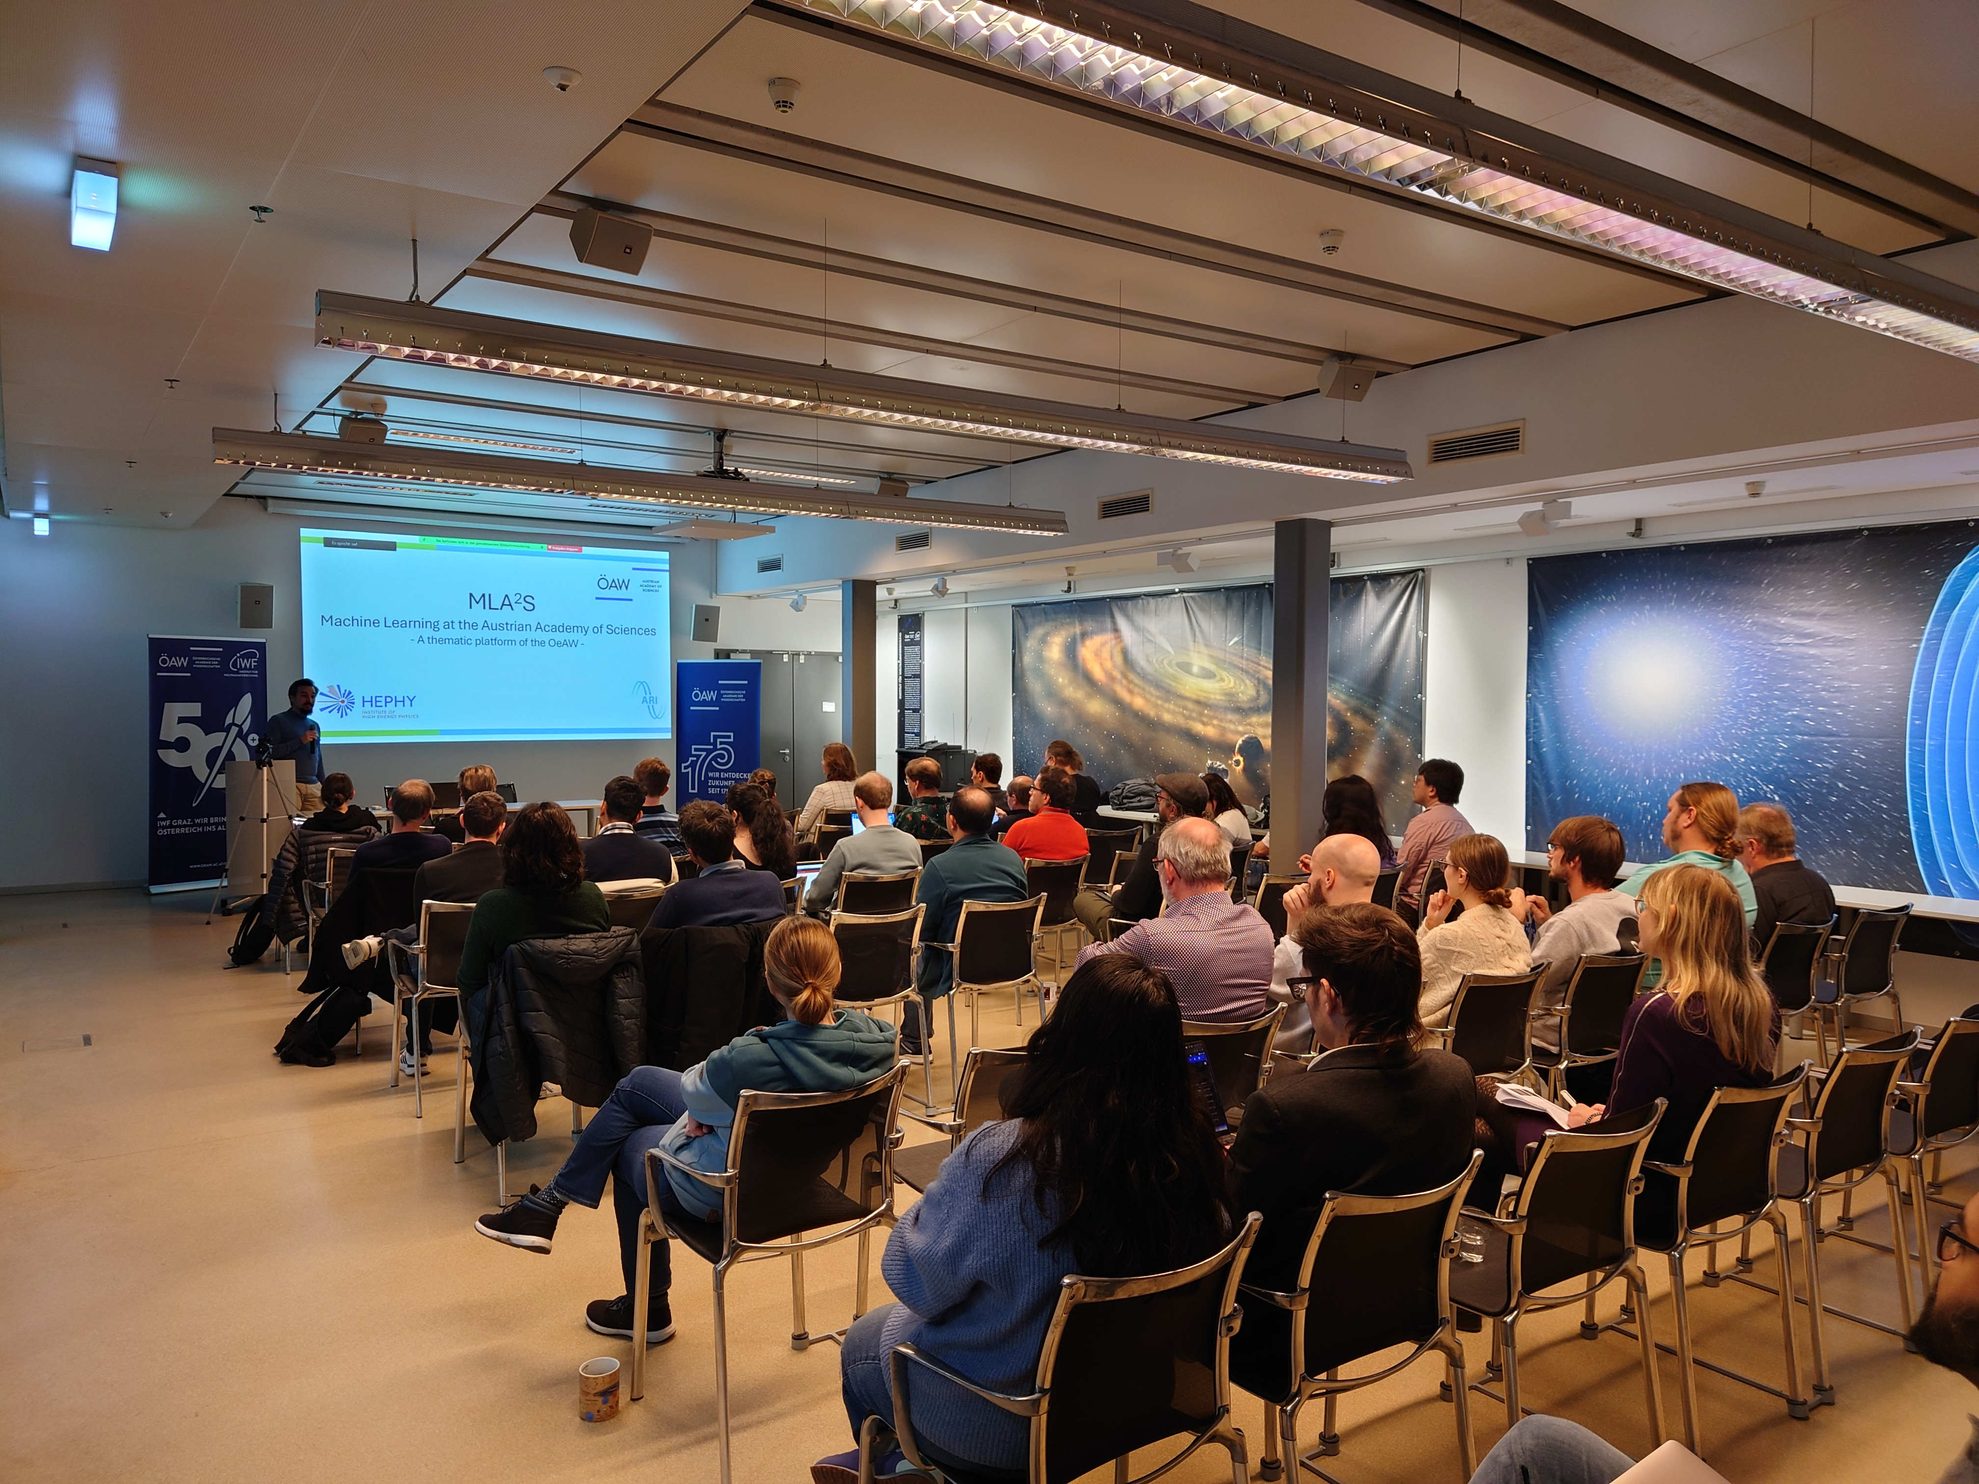
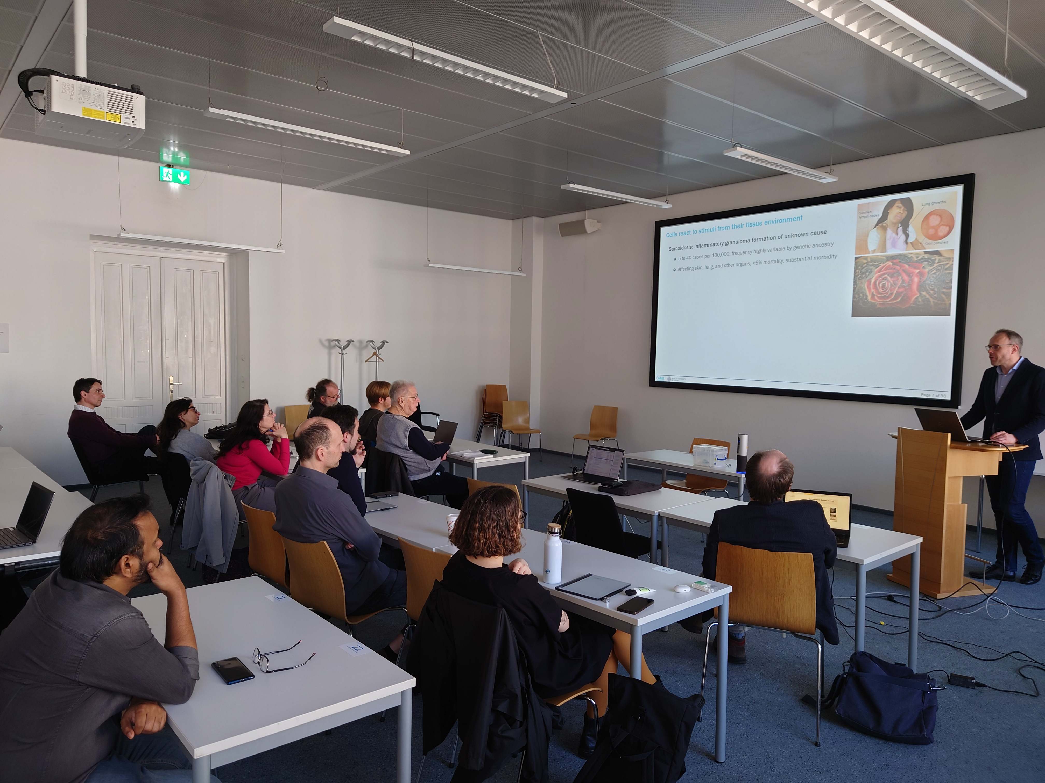

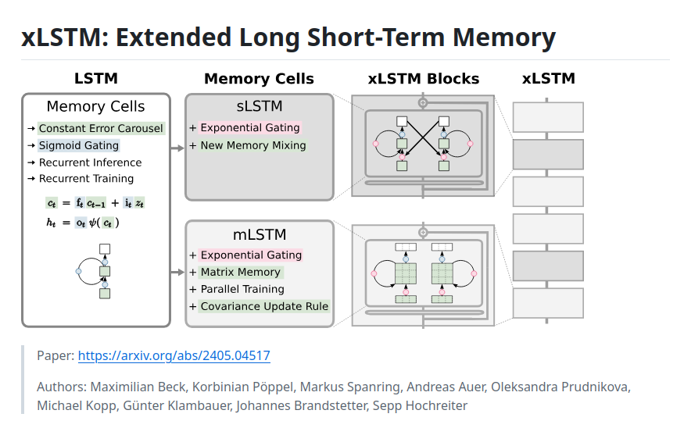
NETWORKING SEMINARS
bi-monthly
2 institutes present their AI-related research or plans
networking/socializing after scientific part
occasionally external speakers
SPECIAL SEMINARS

Slide 5
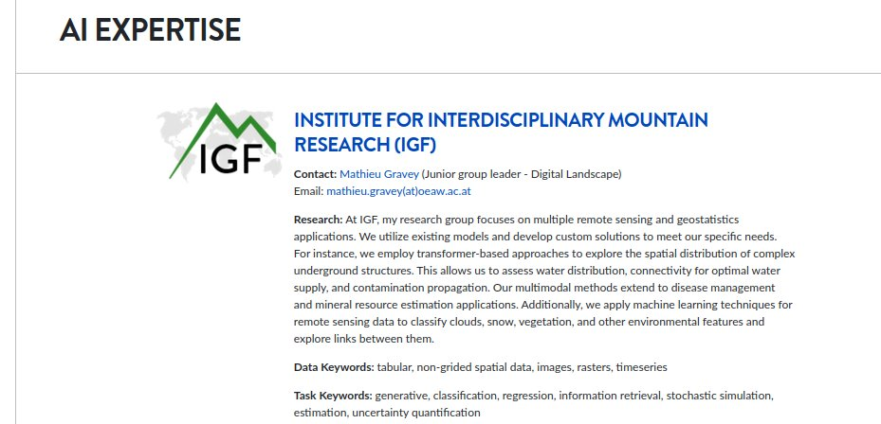

AI COMPETENCE
AI EXPERTISE
A resource for internal and external researchers to locate experts at the ÖAW
AI FEEDBACK
Regular exchange with CDSO Bernd Wachmann
Involvement in AI Factory Austria Proposal

Slide 6





AI SUPPORT
EVENT organisation
Financial
Organisational
VISITS / SHORT RESEARCH STAYS (coming)
Support for short stays at ÖAW for guest researchers
e.g., AI meets Humanities & Social Sciences Conference
23-25 June 2025
Austrian Academy of Sciences (Main Building, Dr-Ignaz-Seipel-Platz 2, Vienna)

Slide 7
STAY IN CONTACT...
via e-mail:
— or —
via website:
via bluesky:
past and upcoming events:
general questions, ideas, concerns:
https://lists.oeaw.ac.at/mailman/listinfo/mla2s
e-mail subject “subscribe” to mla2s-request@lists.oeaw.ac.at
https://www.oeaw.ac.at/mla2s/
#MLA2S
@mla2s-oeaw.bsky.social
https://indico.global/category/958/
mla2s-admin@oeaw.ac.at

