Slide 1
ICONCLASS
AI & Artworks: Object Detection, Image Classification and Iconographic analysis
Vienna, April 2026
https://indico.global/event/15085/overview
Etienne Posthumus ep@epoz.org

Slide 2
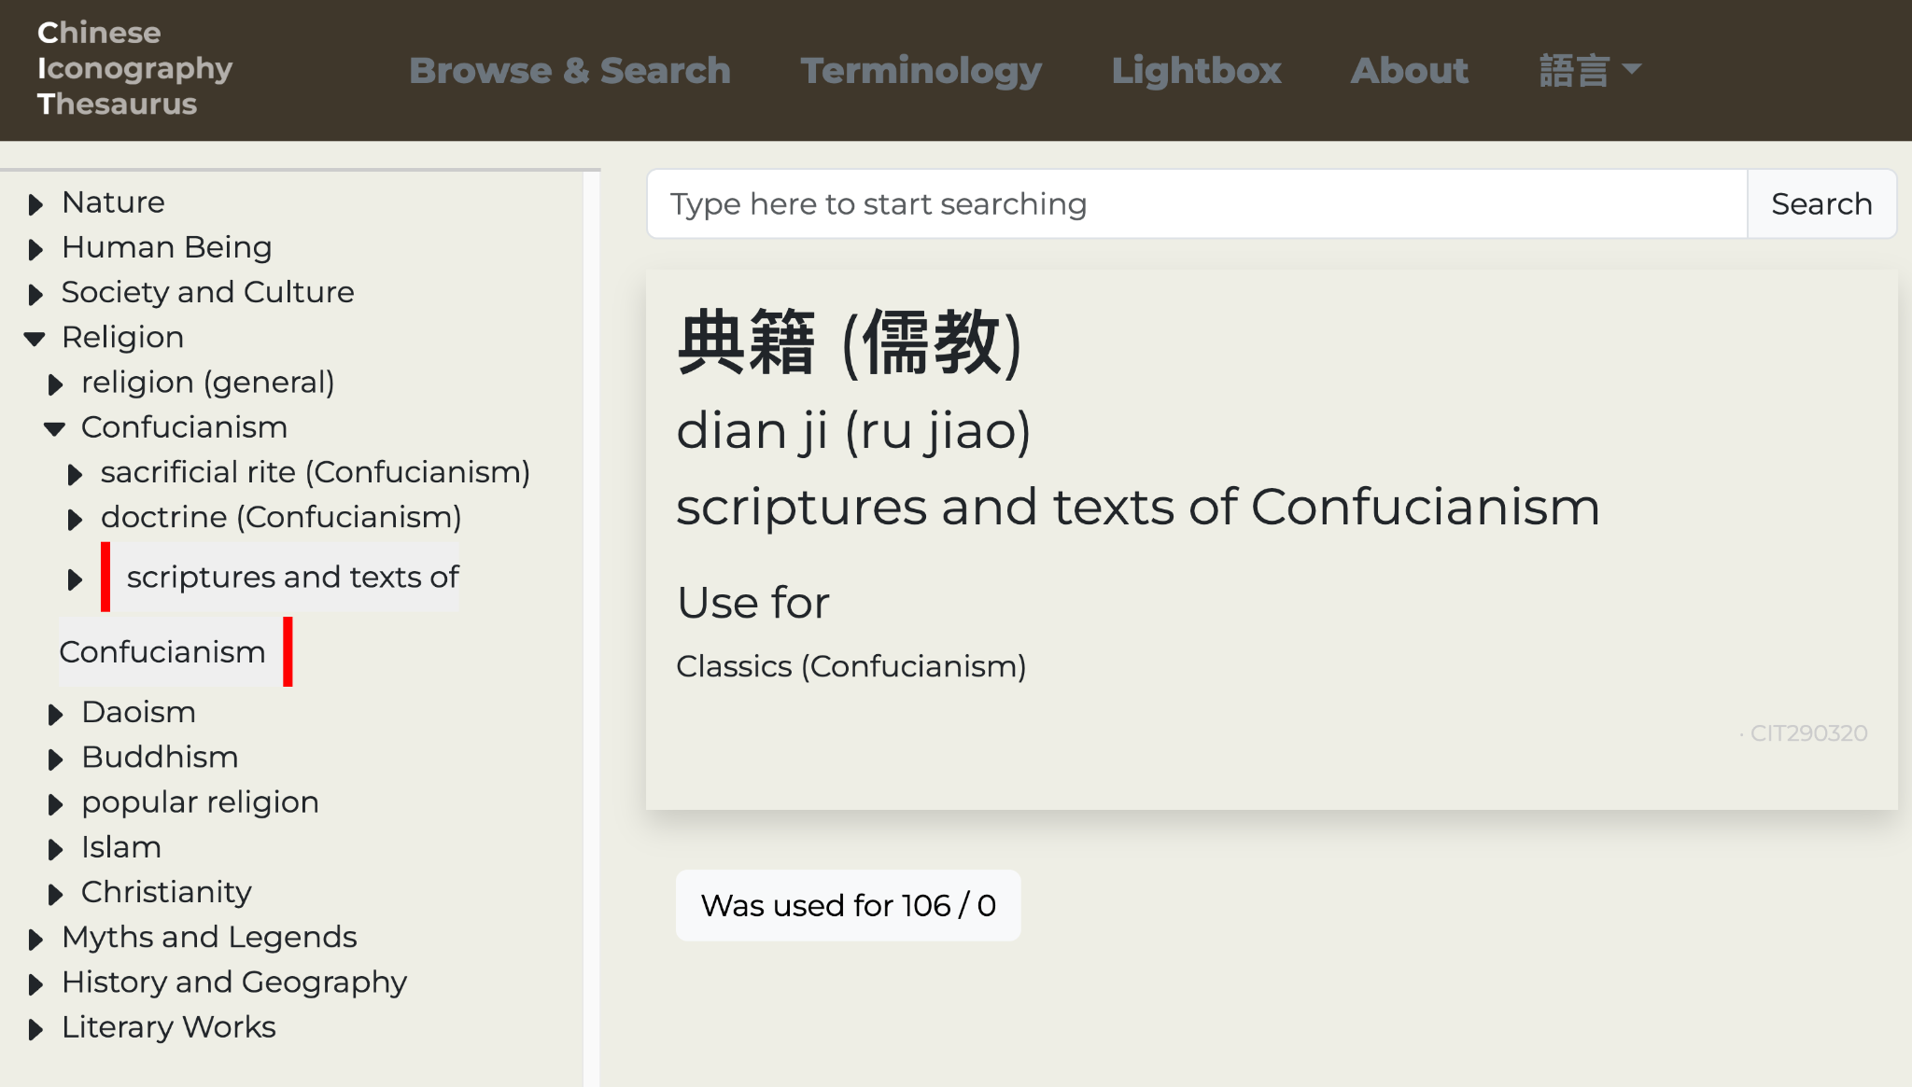
https://chineseiconography.org/

Slide 3
TL;DR
We added automatic classification to ICONCLASS using AI

Slide 4
TL;DR
We added automatic classification to ICONCLASS using AI
OK, so what?
But what does that mean? And how?

Slide 5
What do I want to share with you?
Understanding how we make automatic ICONCLASS suggestions
Announcing bildGRID and invite you to take part
Some idea of where we are (not) going with Agentic Iconography

Slide 6
Understanding how we make automatic ICONCLASS suggestions
Initial versions (from 2022 to current):
Found similar images via CLIP, gathered their notations and provided suggestions

Slide 7
Understanding how we make automatic ICONCLASS suggestions
Initial versions (from 2022 to current):
Found similar images via CLIP, gathered their notations and provided suggestions
Worked OK, at the time seemed impressive, but… not always very accurate.

Slide 8
Understanding how we make automatic ICONCLASS suggestions
Initial versions (from 2022 to current):
Found similar images via CLIP, gathered their notations and provided suggestions
Worked OK, at the time seemed impressive, but… not always very accurate.
And does not “see” what is on an image.

Slide 9
Understanding how we make automatic ICONCLASS suggestions
Approaches using LLMs with vision capabilities were lacklustre.

Slide 10
Understanding how we make automatic ICONCLASS suggestions
Approaches using LLMs with vision capabilities were lacklustre.
But in the last year has improved enormously. (even Open-weight models)

Slide 11
Understanding how we make automatic ICONCLASS suggestions
Now we:
Use LLM to describe an image.
Segment the descriptions and match them to ICONCLASS notations using textual embedding models
Use an LLM to verify the suggestions, and present to the end-user
OpenAI, Gemini, Anthropic

Slide 12
Understanding how we make automatic ICONCLASS suggestions
Now we:
Use LLM to describe an image.
Segment the descriptions and match them to ICONCLASS notations using textual embedding models
Use an LLM to verify the suggestions, and present to the end-user
OpenAI, Gemini, Anthropic Open-weight: Gemma4

Slide 13
Understanding how we make automatic ICONCLASS suggestions
Now we:
Use LLM to describe an image.
Segment the descriptions and match them to ICONCLASS notations using textual embedding models
Use an LLM to verify the suggestions, and present to the end-user
Initially SBERT, now EmbeddingGemma

Slide 14
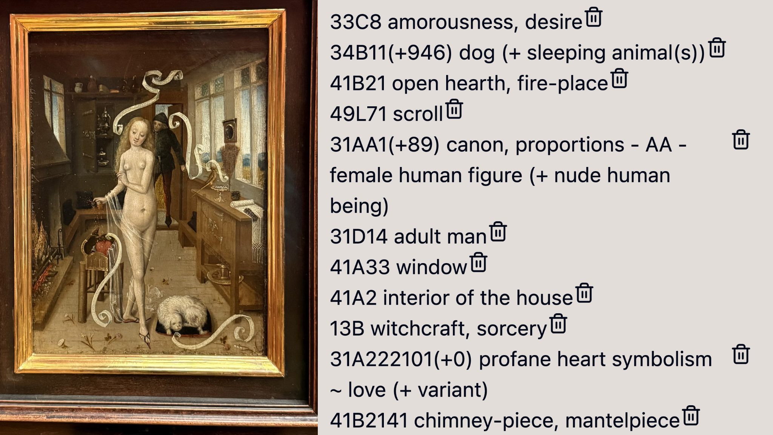
Initially SBERT, now EmbeddingGemma

Slide 15
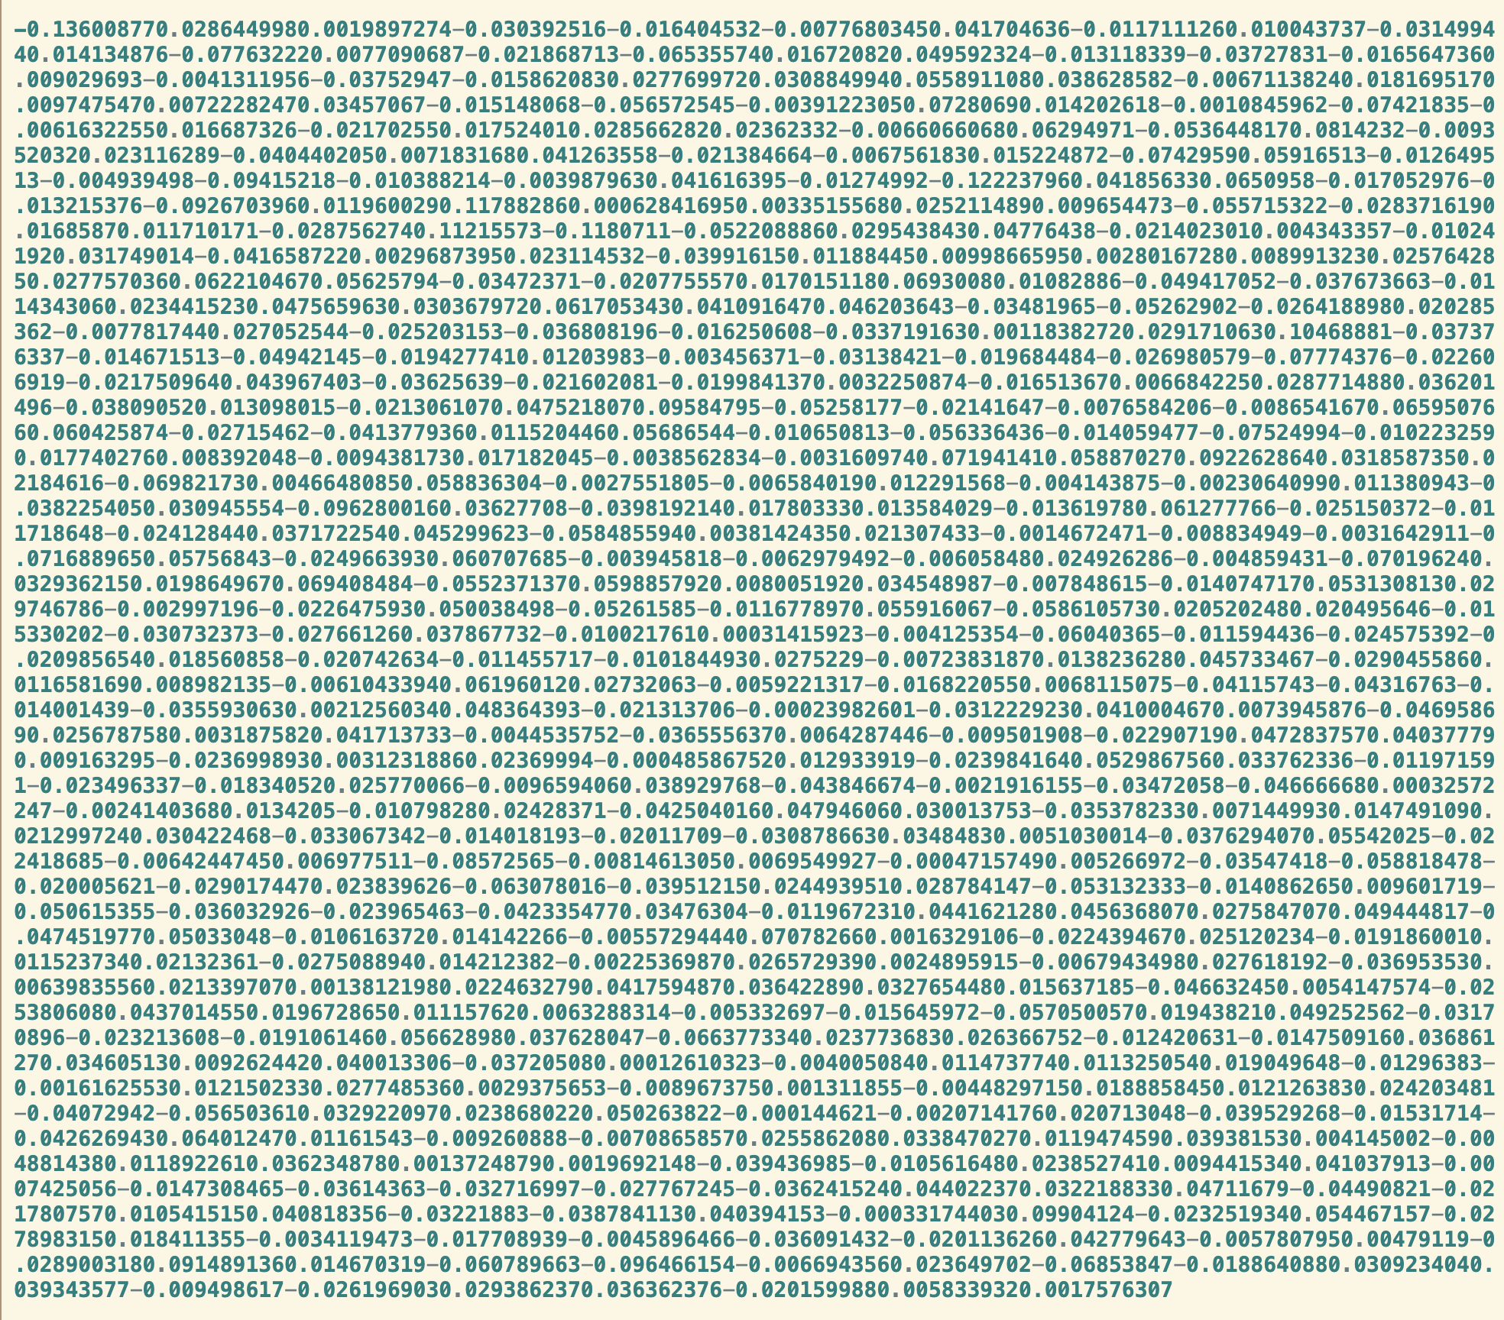
A brief explanation of “embeddings”
model.encode_query('festina lente')

Slide 16
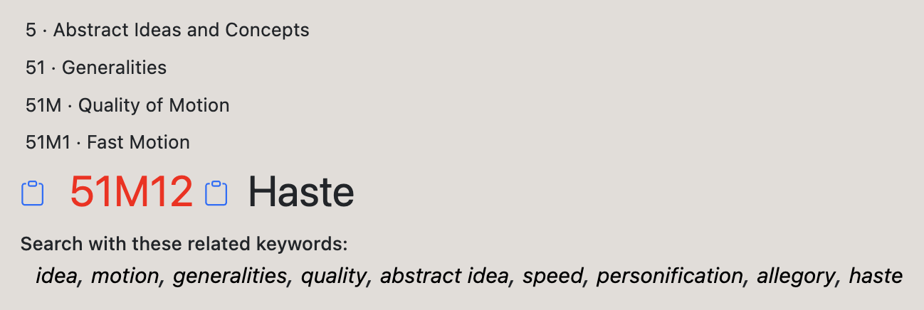
model.encode_query('festina lente')
51M12

Slide 17
Please join the ICONCLASS consortium

Slide 18
Please join the ICONCLASS consortium
So we can make bildGRID together
https://iconclass.org/help/upgrade

Slide 19
Agentic Iconography
🤯

Slide 20
My candle burns at both ends;
It will not last the night;
But ah, my foes, and oh, my friends—
It gives a lovely light!
Edna St. Vincent Millay, “Figs from Thistles: First Fig”
from Poetry 8, issue 3. (Chicago: Poetry Magazine, June 1918.)

