Slide 1






Object Detection for Visual Analysis of Medieval Charters
Decoration and Its Makers in Papal Documents
Florian Atzenhofer-Baumgartner and Martin Roland

Slide 2

Charters are written documents about acts of legal nature, issued
and authenticated in accordance to certain formal requirements
(translated by Daniel Luger based on Ahasver von Brandt)
Notes:
What is Monasterium.net? (45 sec)

Slide 3
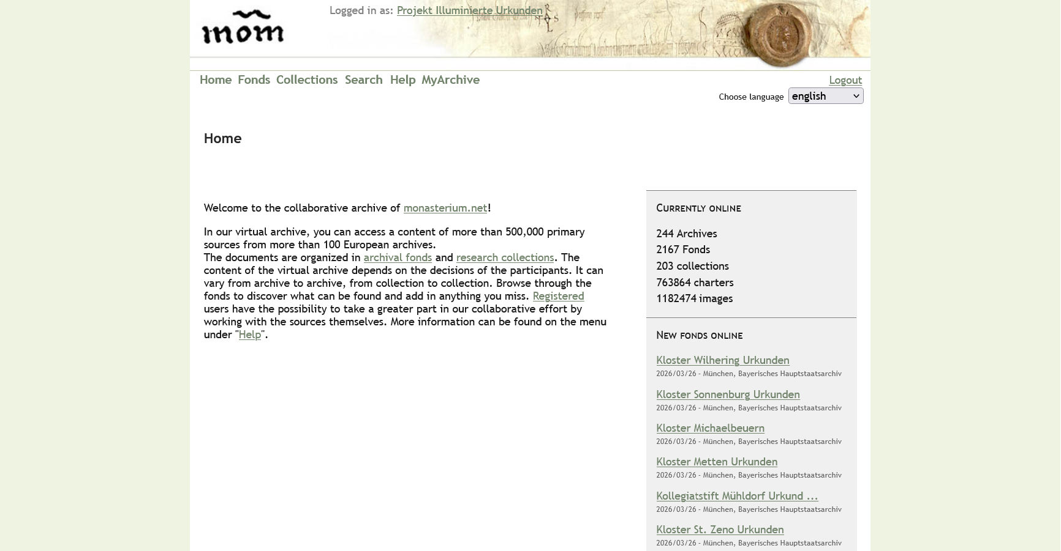
https://www.monasterium.net/mom/home

Slide 4
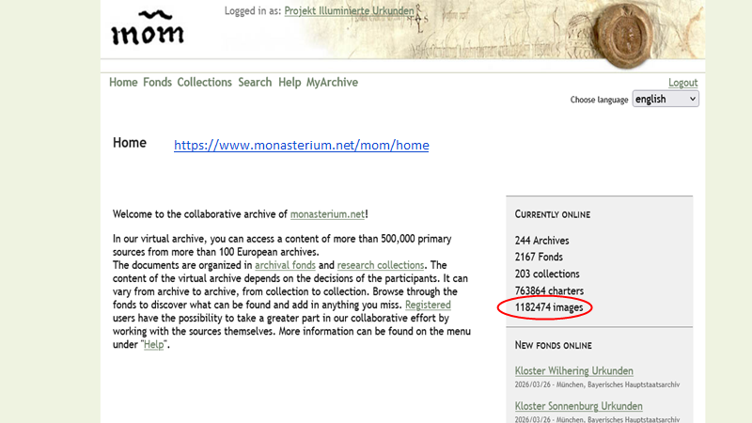

Slide 5
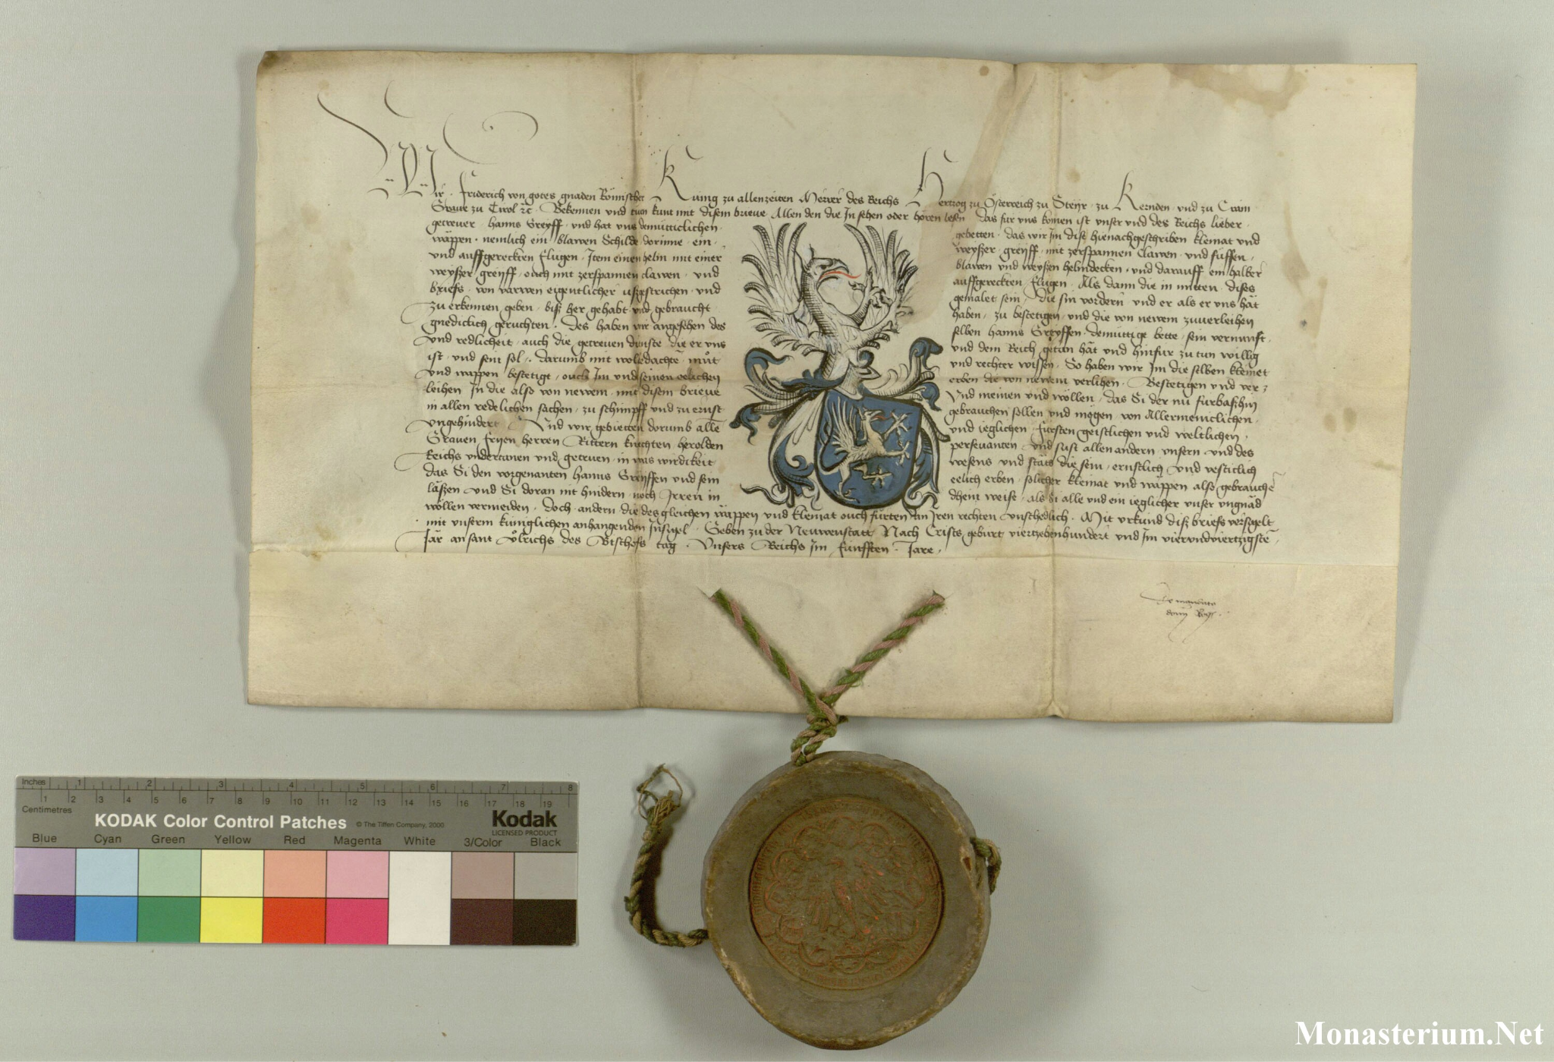
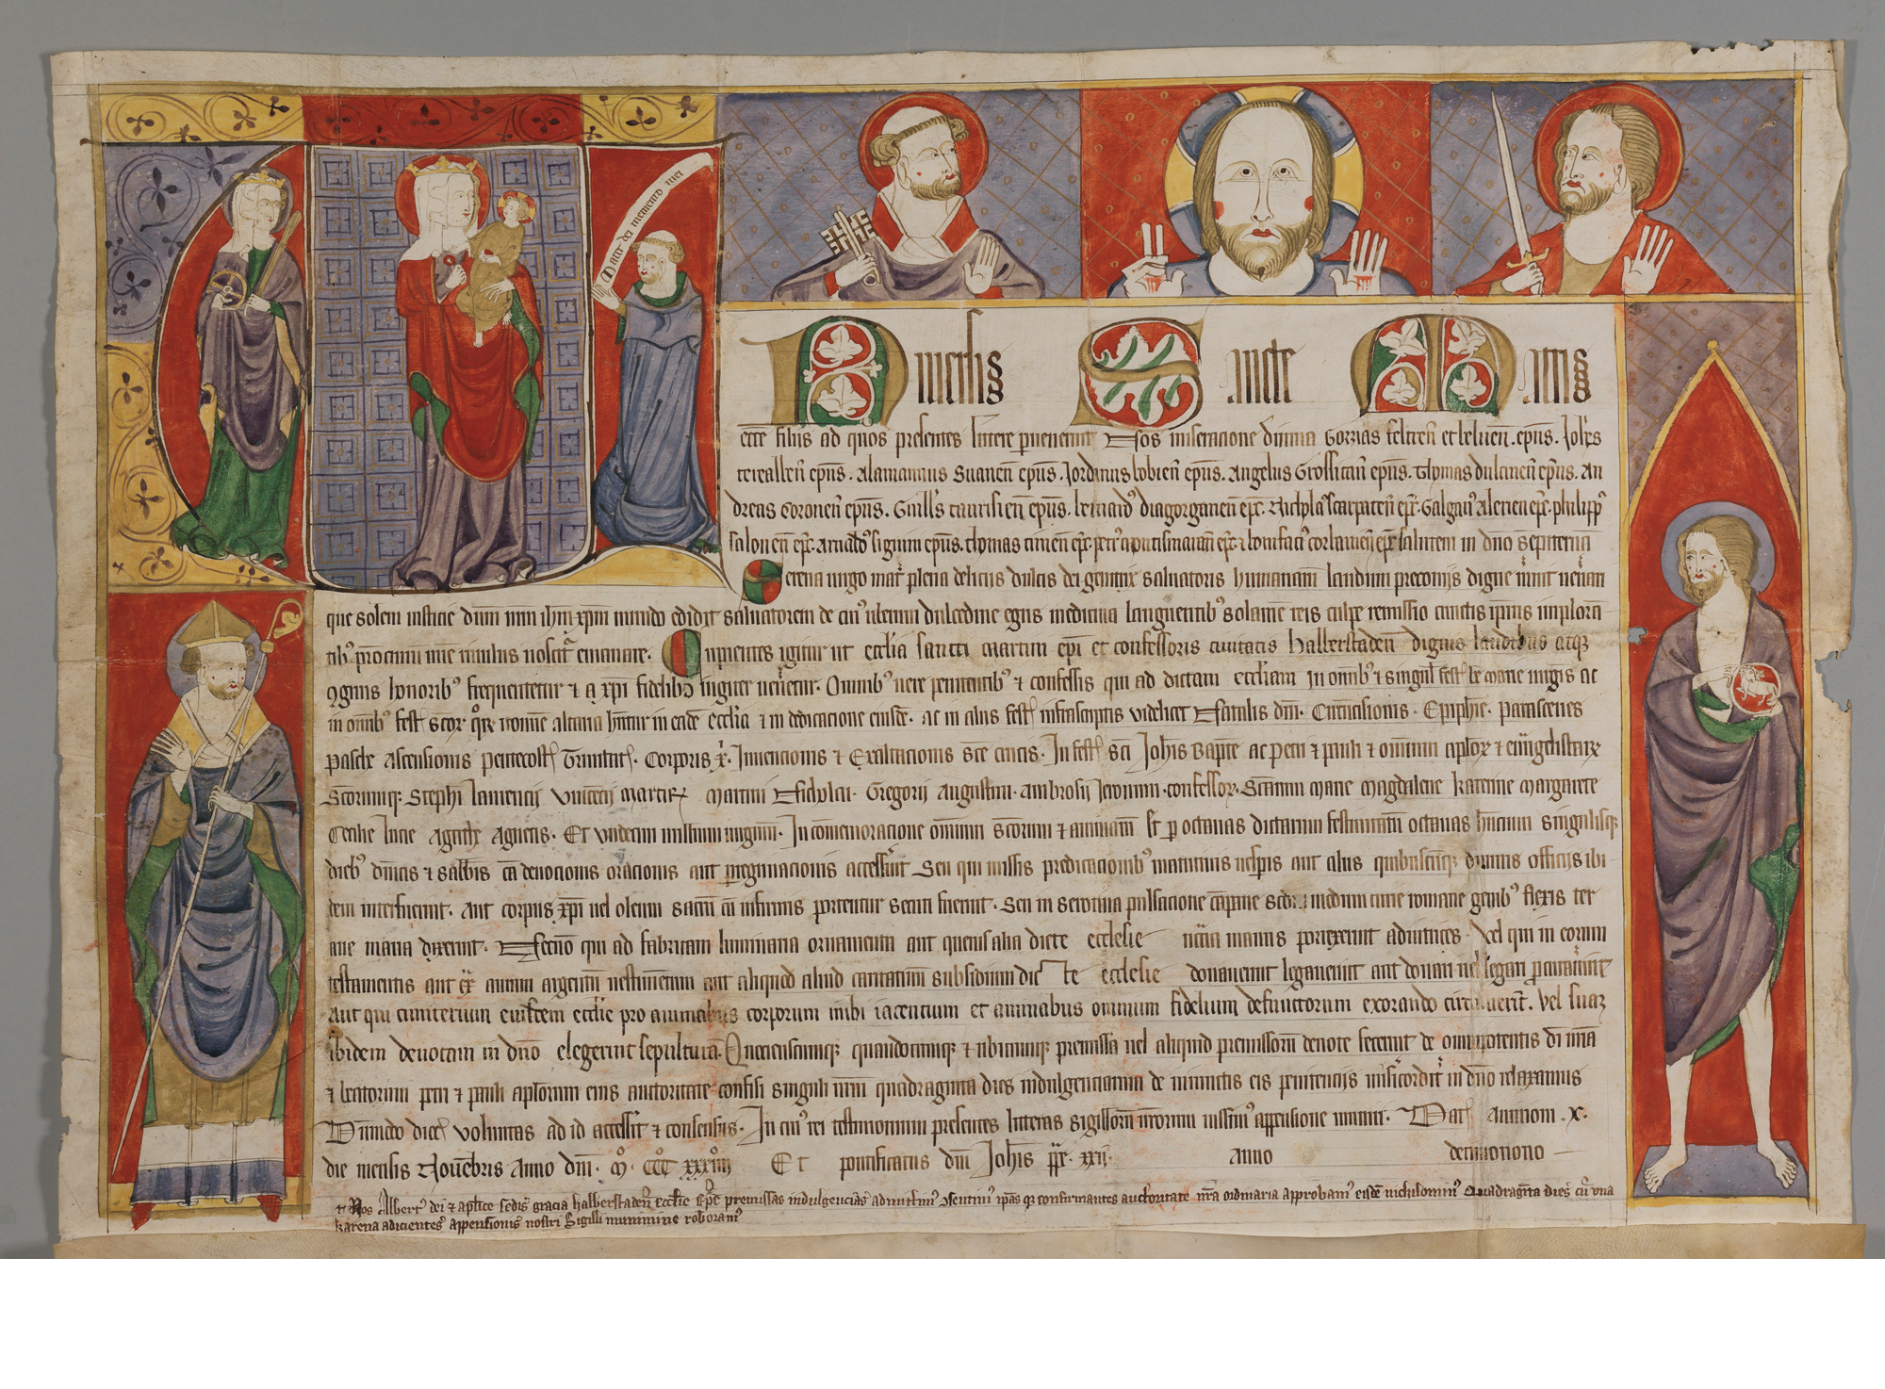
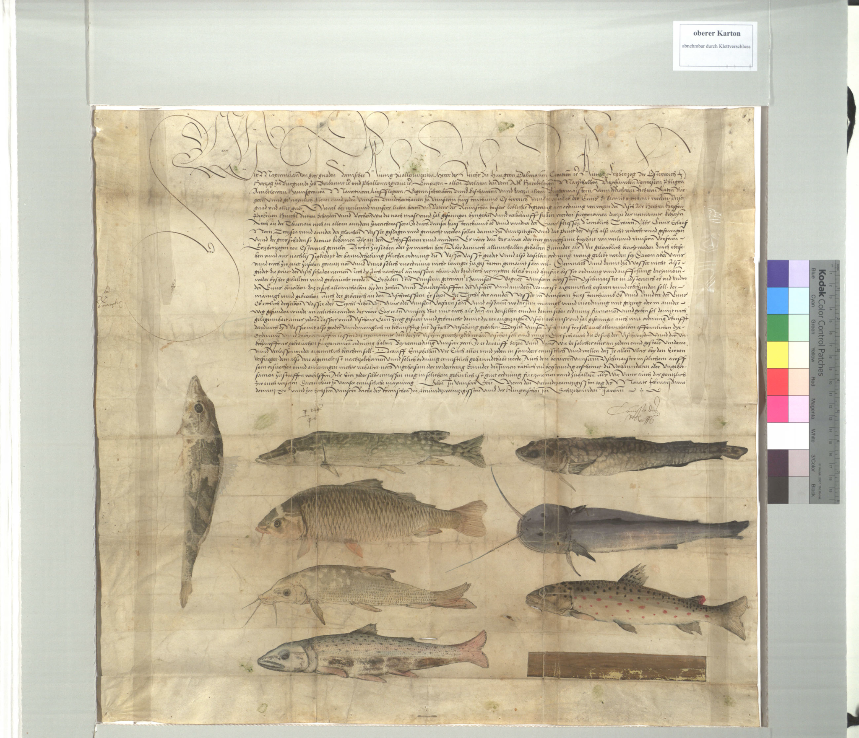
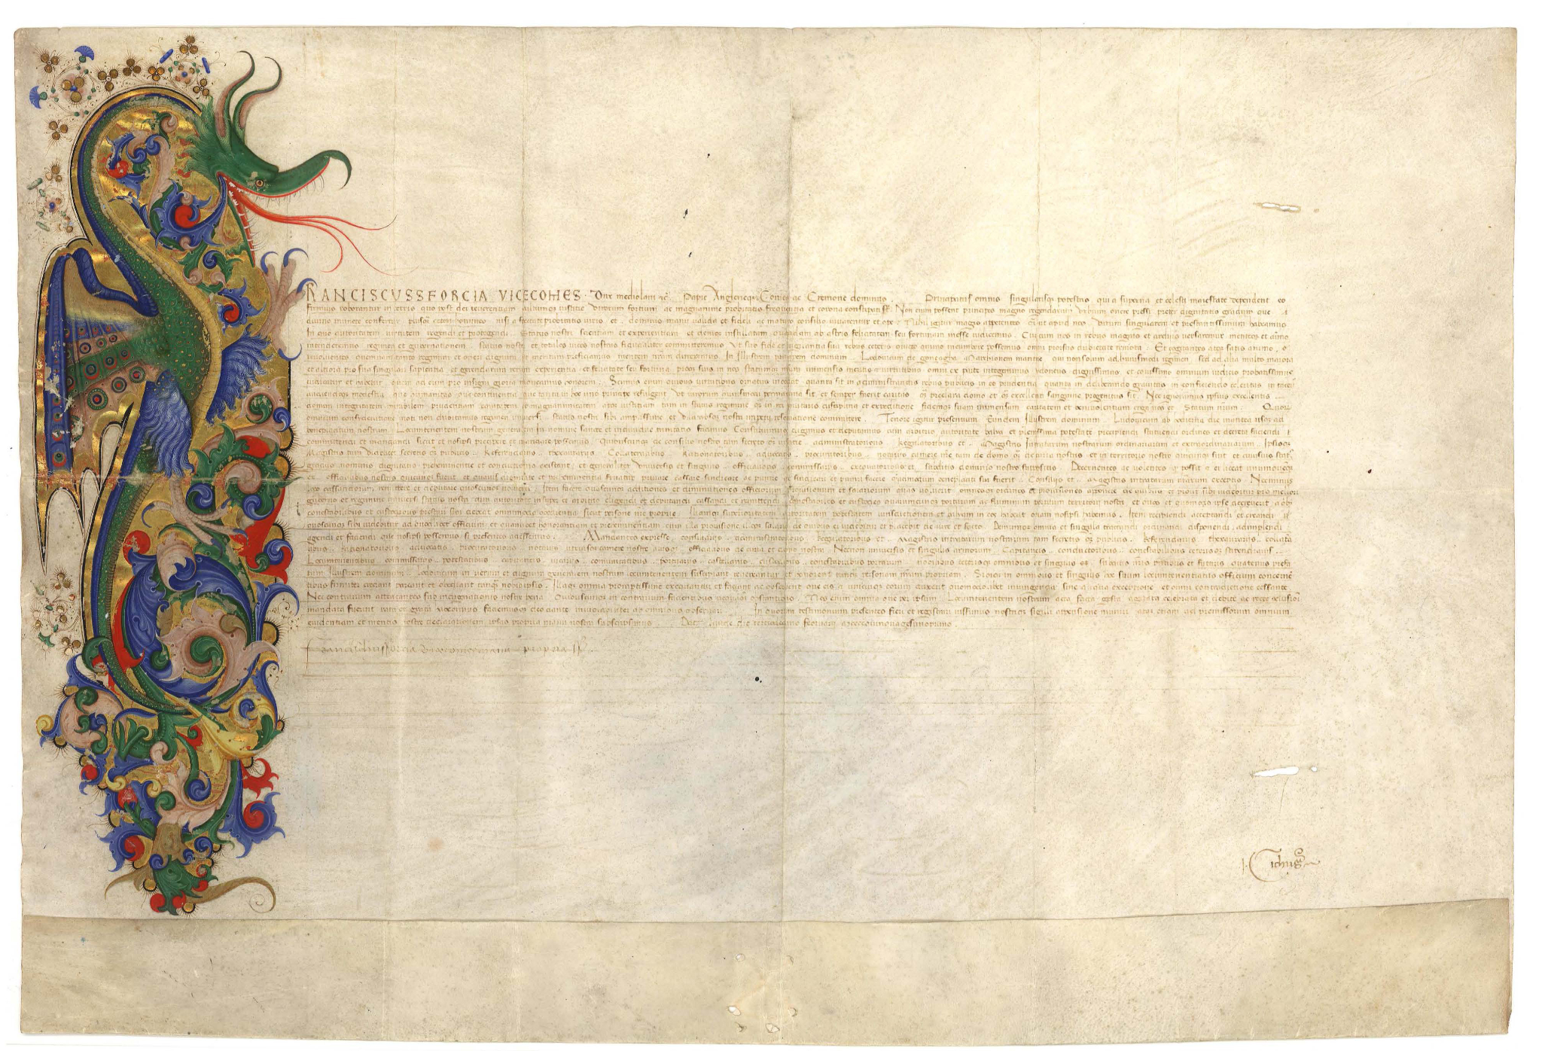
https://www.monasterium.net/mom/IlluminierteUrkundenWappenbriefe/1444-07-04_Goettweig/charter
https://www.monasterium.net/mom/IlluminierteUrkunden/1334-11-10_Nuernberg/charter
https://www.monasterium.net/mom/IlluminierteUrkunden/1451-02-03_Mantua/charte
https://www.monasterium.net/mom/AT-WStLA/HAUrk/5825/charter
Notes:
Crest letter: Crest Letter: König Friedrich IV. bestätigt Hans Greif das Wappen, Wiener Neustadt; 1444
https://www.monasterium.net/mom/IlluminierteUrkundenWappenbriefe/1444-07-04_Goettweig/charter
https://www.monasterium.net/mom/AT-WStLA/HAUrk/5825/charter
Fishing regulation issued by Maximilian I. am 24. Februar 1506.
Im Feber 1506 erlässt Maximilian I. eine Fischereiordnung für Ober- und Niederösterreich. Darin verweist er auf einen bestehenden Erlass seines Vaters, Friedrich III. (der AEIOU Typ) zu Art, Größe und Anzahl gefangener Fische und weist den obersten Fischereimeister Hanns Wagner zur Kontrolle an. Damit will man gegen die Überfischung der Donau vorgehen und insbesondere Jungtiere schützen soll → Rechteck rechts unten vermutlich Vorgabe für Maschenmindestgröße.
https://www.monasterium.net/mom/IlluminierteUrkunden/1451-02-03_Mantua/charter
This pet – at least pseudo-heraldic – which is basically the initial ‘F’ for ‘Franciscus’ is my absolute favourite. What is clear is that this charter was extremely important to the recipient, Lodovico Gonzaga, who paid for the exuberant decoration.

Slide 6



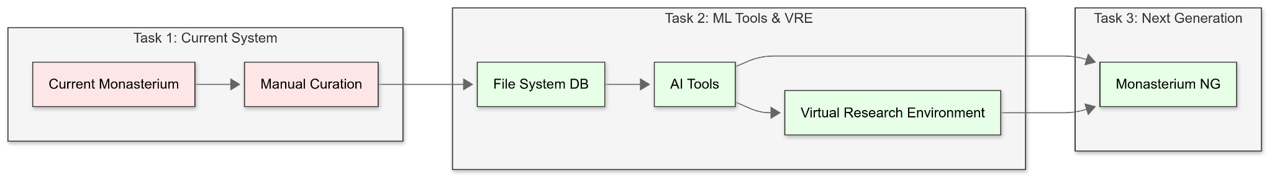
TL;DR:
We are building distant-reading tools and pipelines for diplomatists.
ATR
Retrieval
Kovács, T. (2025). FLAME: Formulaic Language Analysis in Medieval Expressions (Version 1.0.0) [Computer software]. GitHub. https://github.com/kreeedit/FLAME
Kovács, T. (2026). ANNIE: Annotation Interface for Named-entity & Information Extraction (Version 1.14) [Computer software]. GitHub. https://github.com/kreeedit/ANNIE
cf. Atzenhofer-B. (2026). Recommender Systems for Digital Humanities and Archives: Multistakeholder Evaluation, Scholarly Information Needs, and Multimodal Similarity. In Proceedings of the Nineteenth ACM Conference on Recommender Systems (pp. 1499-1505).
Notes:
What is DiDip? (45 sec)

Slide 7
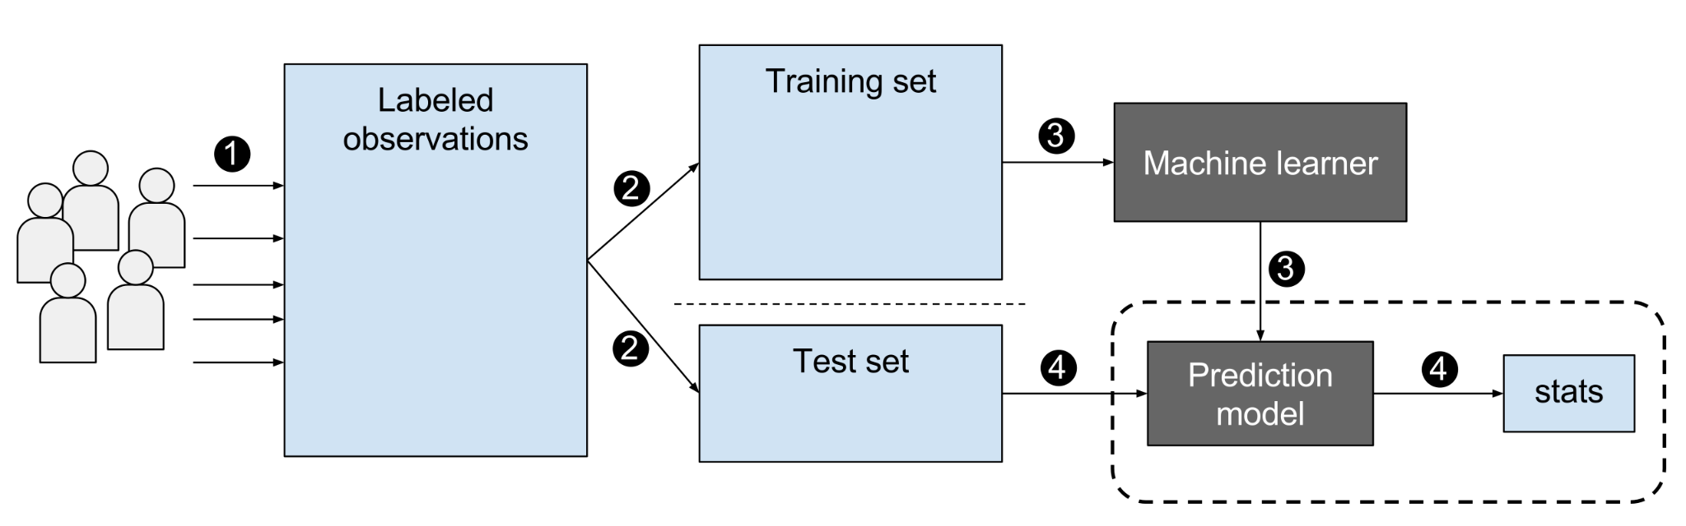
Object detection
https://commons.wikimedia.org/wiki/File:Supervised_machine_learning_in_a_nutshell.svg
Notes:
How to do object detection? (30 Sec)

Slide 8
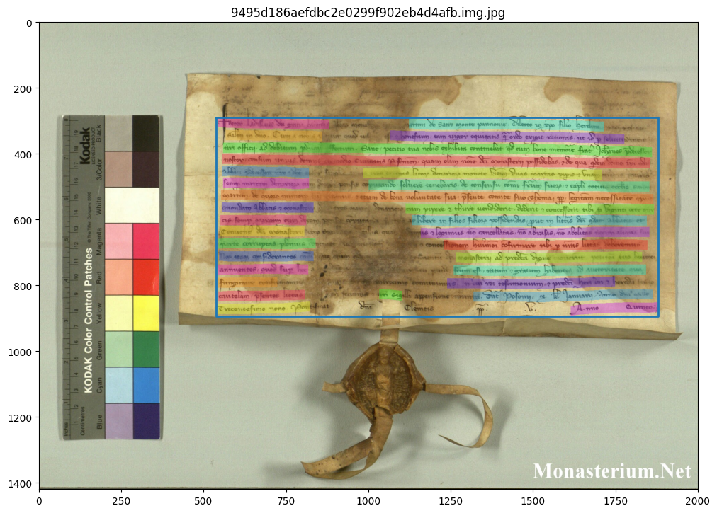
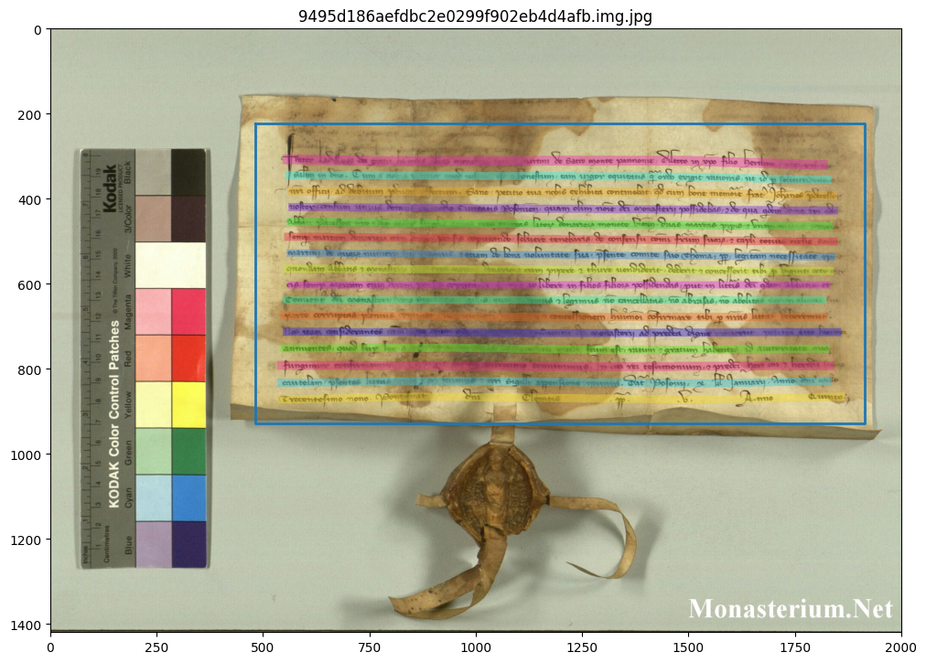
Object detection for general purposes
Transkribus | Monasterium.net
Figure: Performance comparison of line segmentation engines (selected, not indicative)
cf. Renet, N. et al (2026). ATR Pipeline (under review)
Notes:
Why do we do annotations? (45 sec)

Slide 9
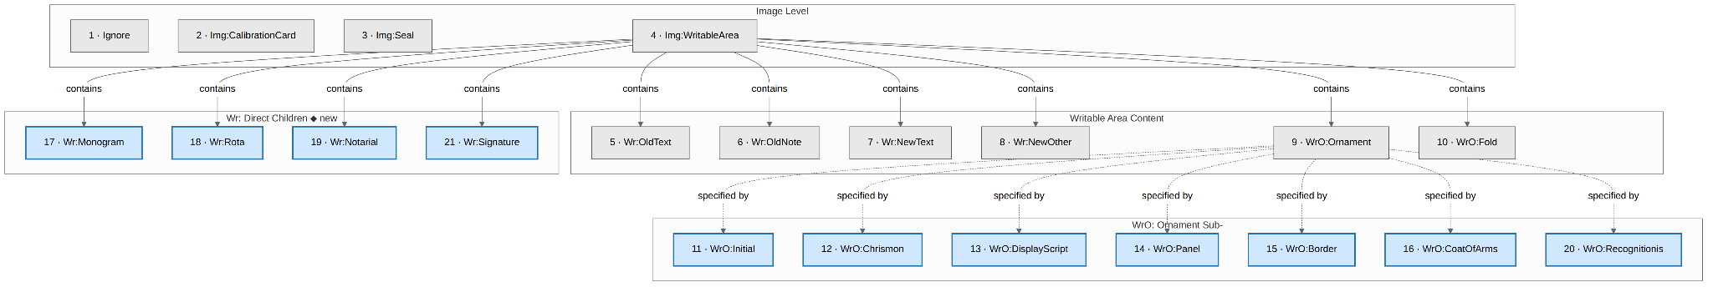
Towards specific use cases: Campaigns
From 10 to 21 classes.
Atzenhofer-Baumgartner, F. et al. (2026). Illuminated Charters and AI - Impact of Modernizing the Monasterium.net Platform. DHd 2026 Nicht nur Text, nicht nur Daten (DHd2026) (DHd2026), Wien, Österreich. https://doi.org/10.5281/zenodo.18703041
cf. Nicolaou, A. et al. (2023). Efficient annotation of medieval charters. In International Conference on Document Analysis and Recognition (pp. 284-295). Cham: Springer Nature Switzerland.
Notes:
Which annotations models have we trained, with with focus? (120 sec)

Slide 10
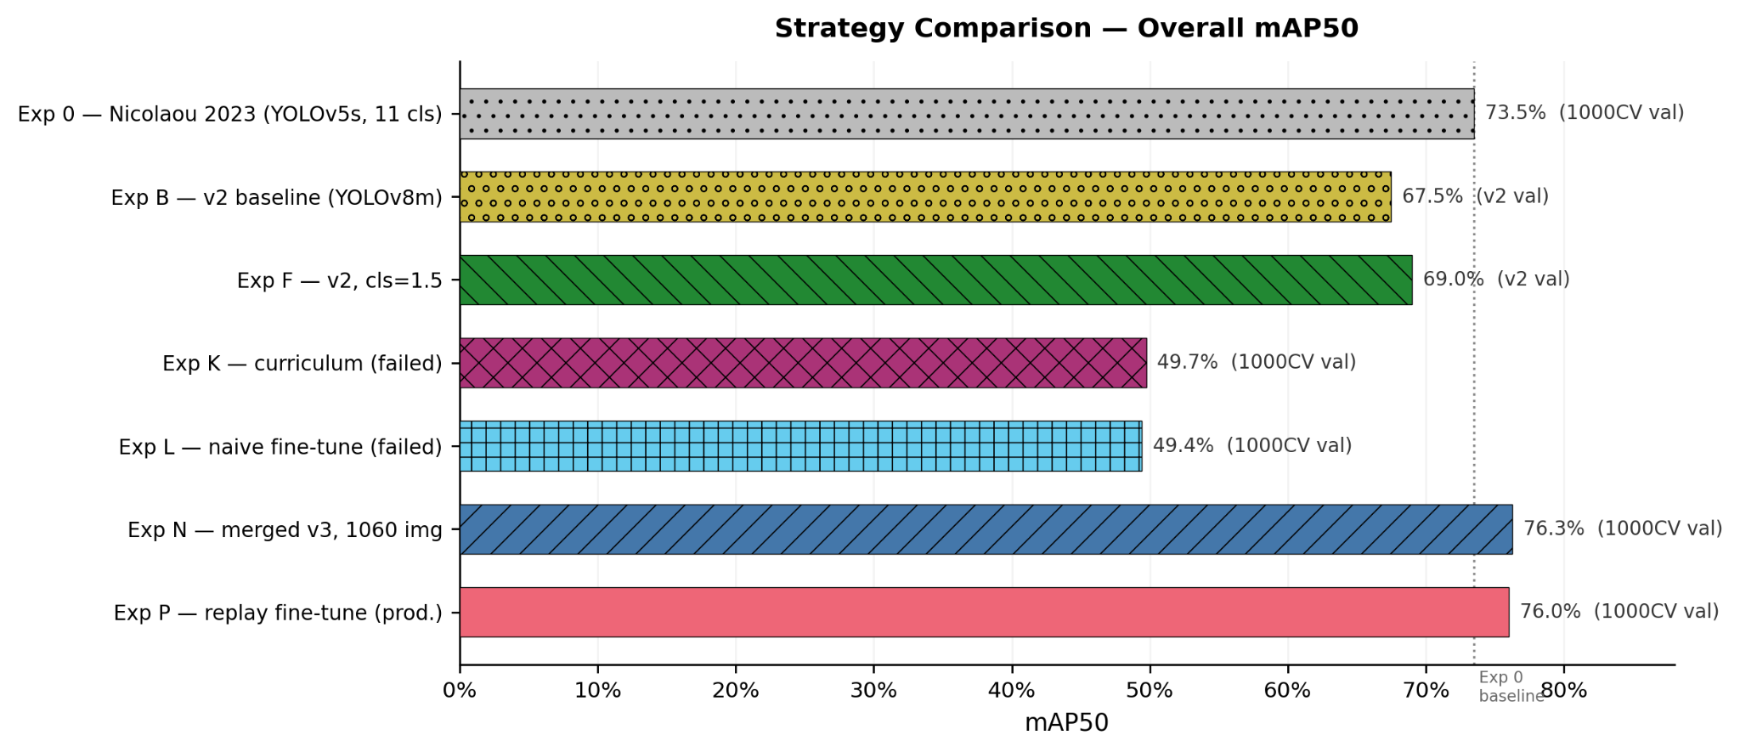

Towards specific use cases: Experiments
Powered by
DHinfra.at

Slide 11
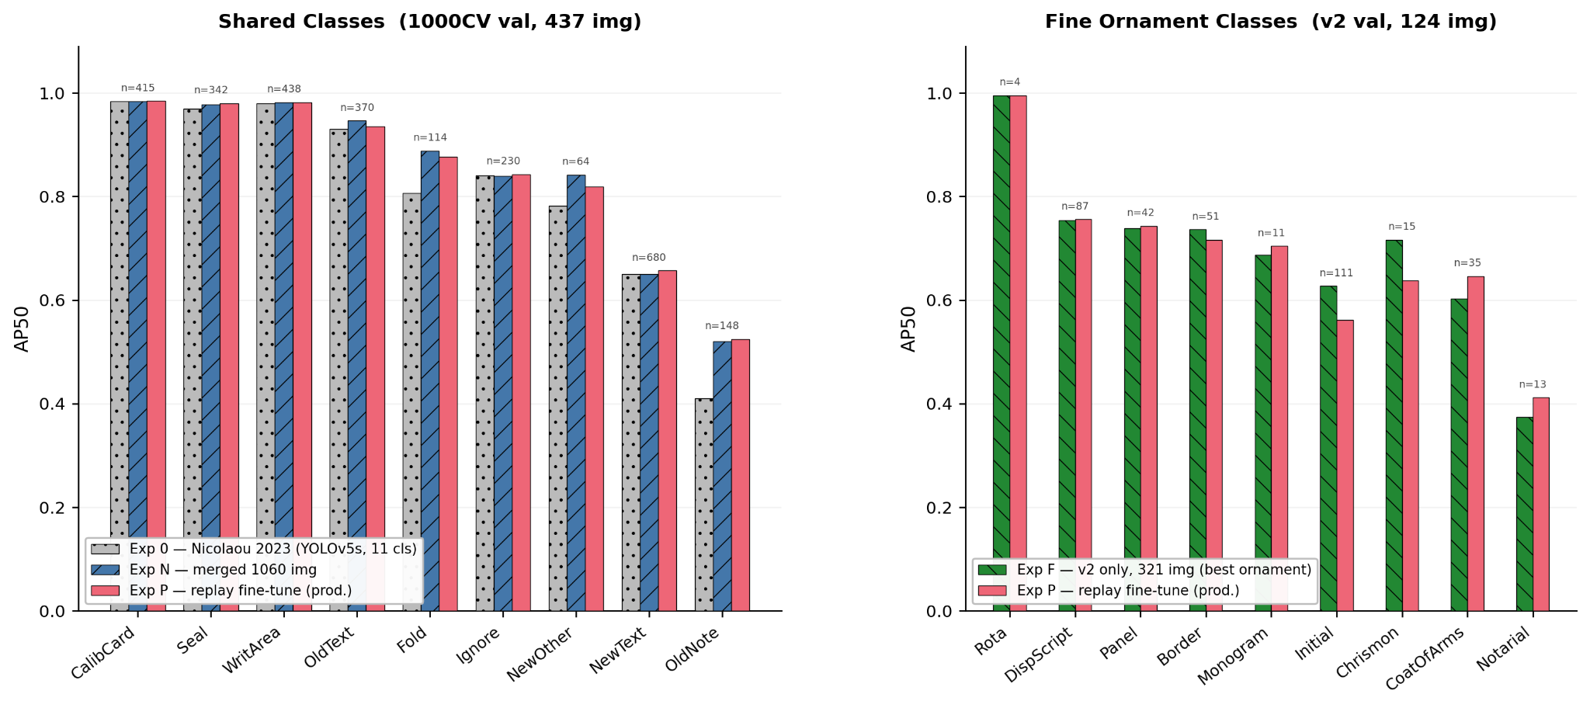
Towards specific use cases: Evaluations
Powered by
DHinfra.at

Slide 12





Downstream tasks using detections
Boxes and features
… as native objects / within editions
… as facets for browsing
… as ground truth for model training
… for re-ranking strategies
… for discovery mechanisms
Notes:
How can we use this for downstream tasks? (30 sec)

Slide 13
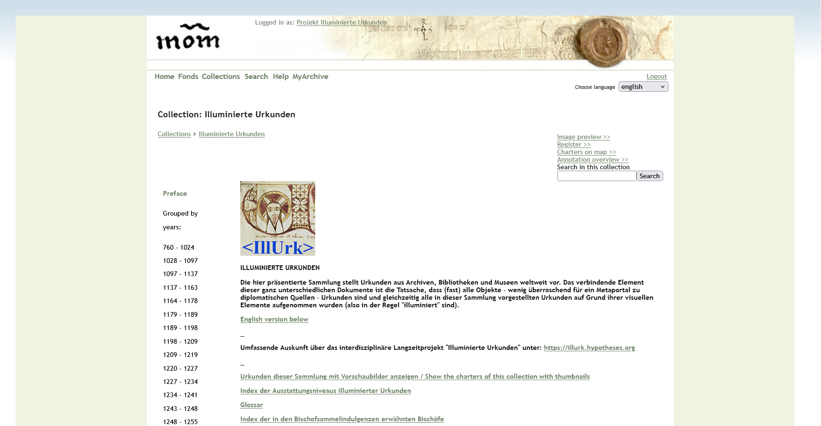
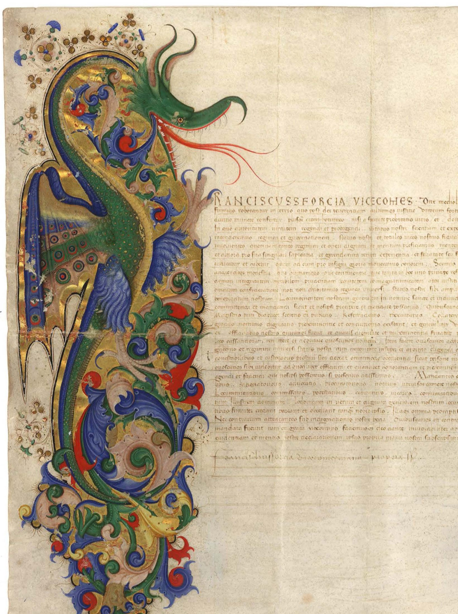
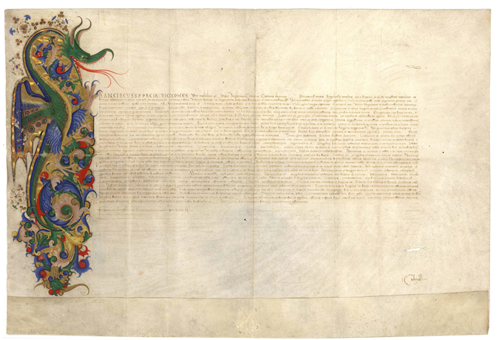
https://www.monasterium.net/mom/IlluminierteUrkunden/collection

Slide 14
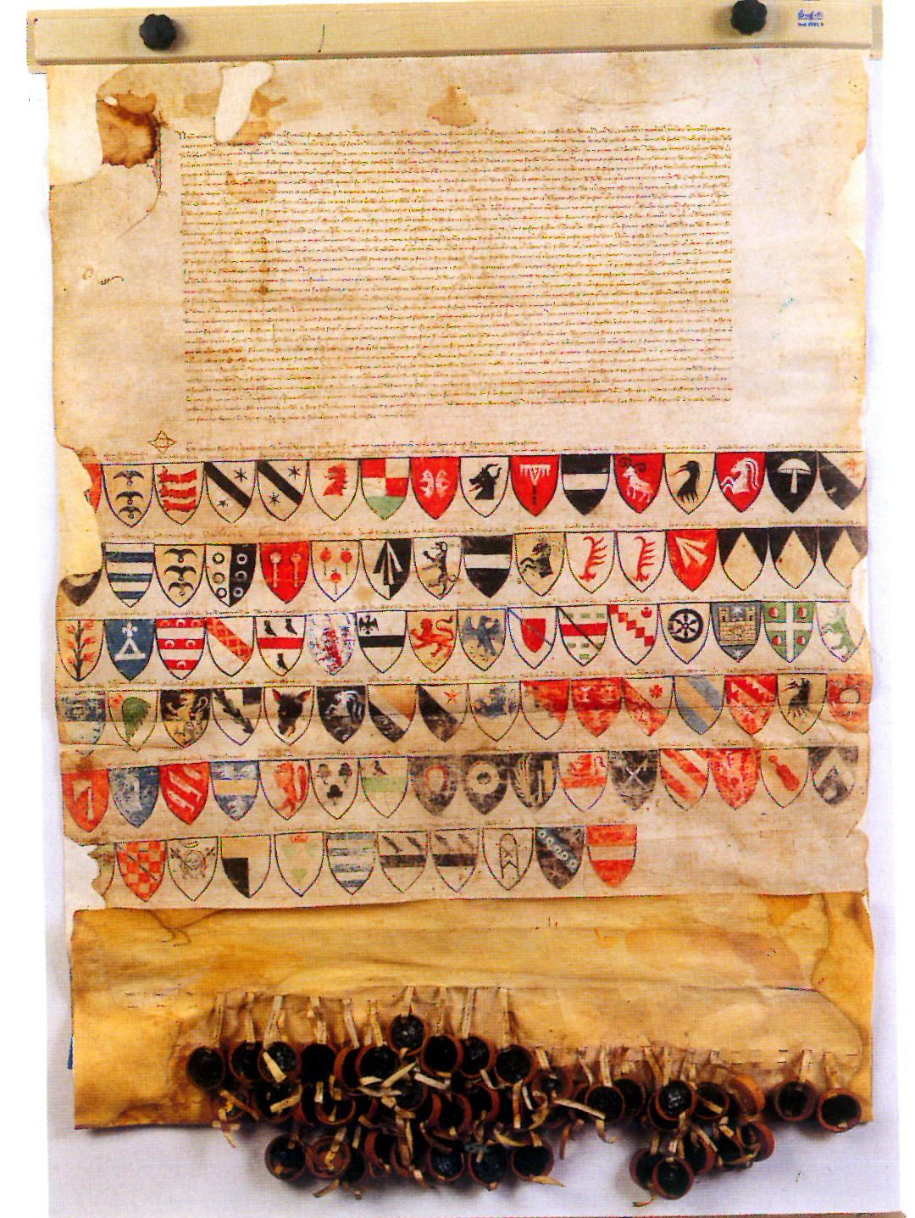
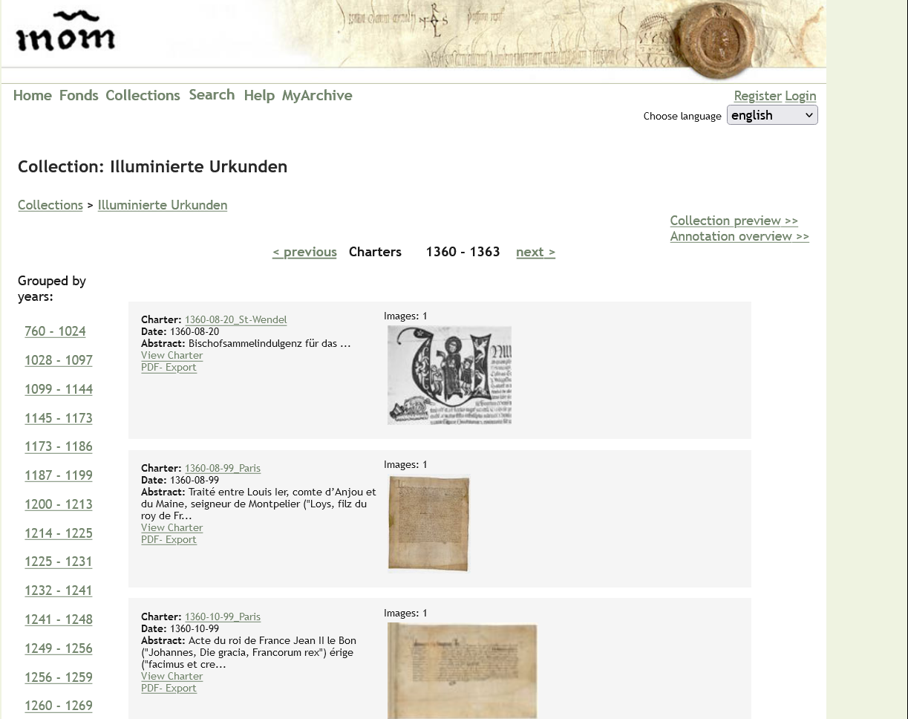
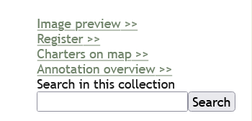
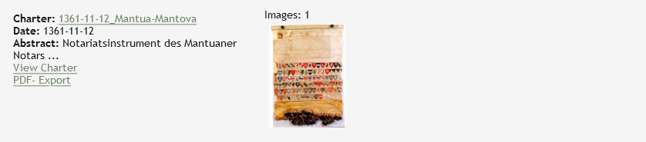
https://www.monasterium.net/mom/Illuminierte
Urkunden/images?block=52

Slide 15
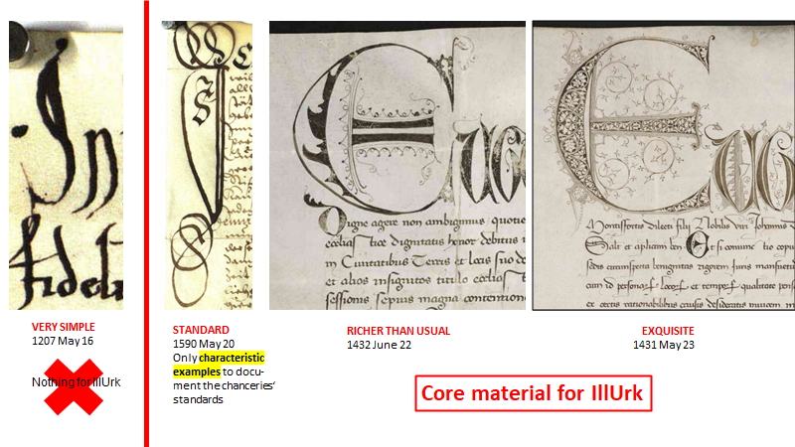

Slide 16
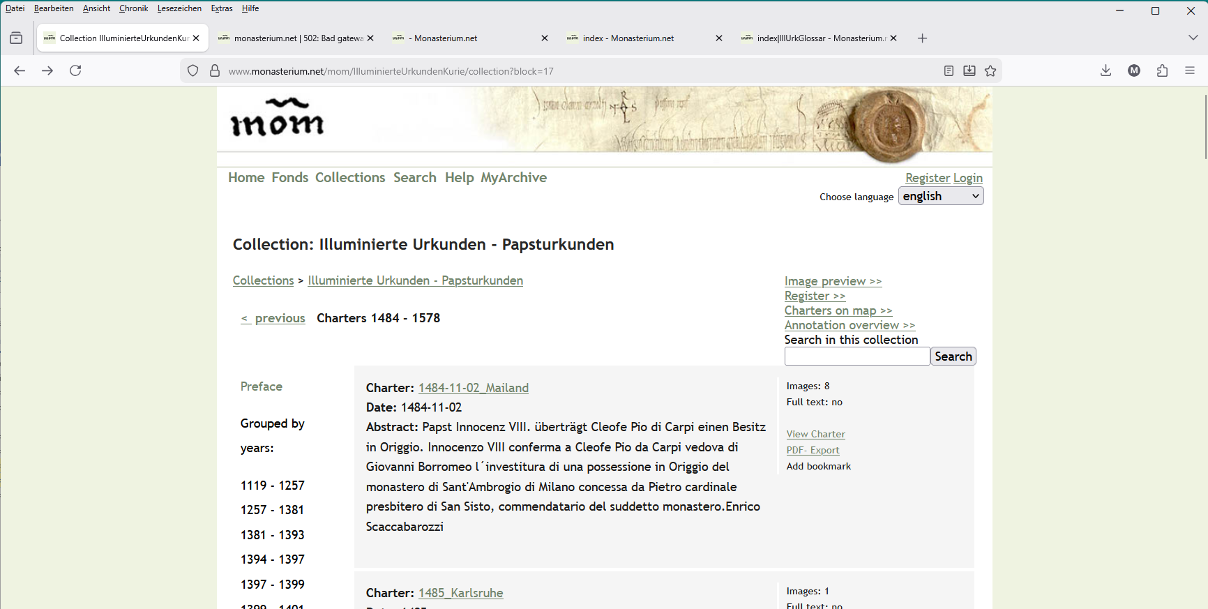

Slide 17
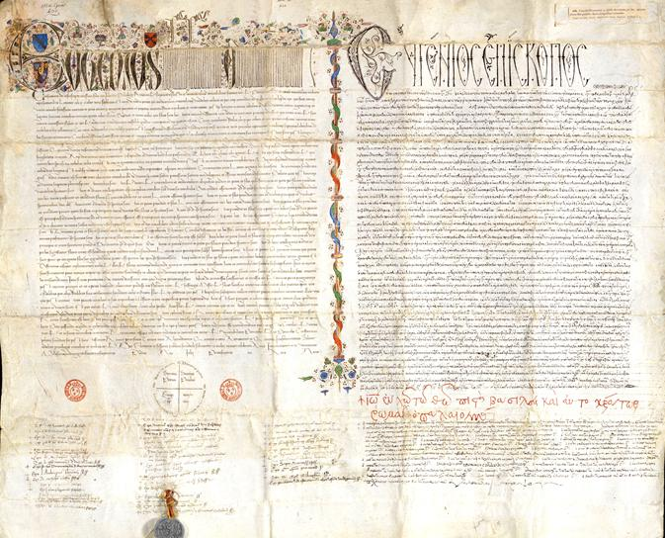
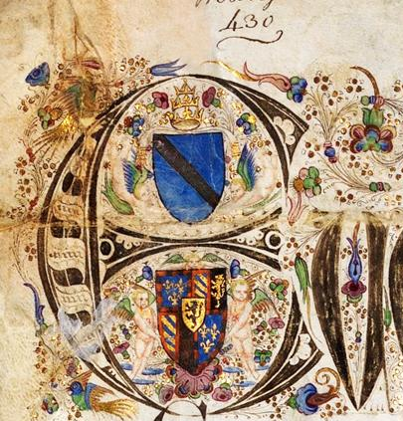
https://www.monasterium.net/
mom/IlluminierteUrkunden/
1439-07-06_Paris/charter

Slide 18
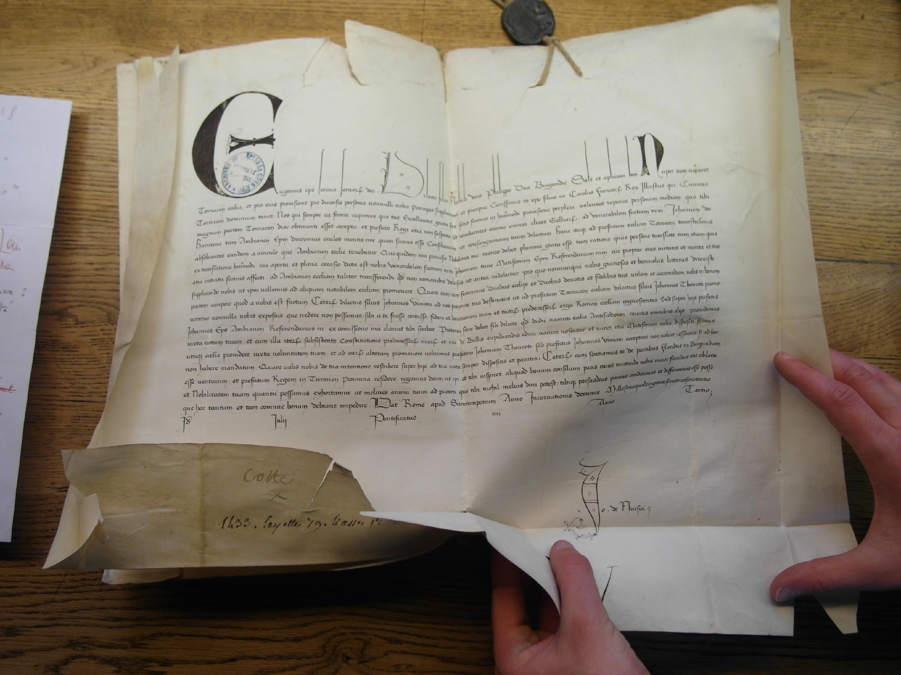
https://www.monasterium.net/
mom/IlluminierteUrkunden/
1433-07-15_Dijon/charter
Johannes
de Nursia

Slide 19
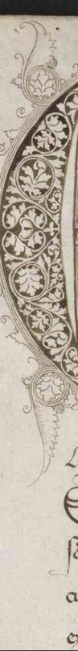
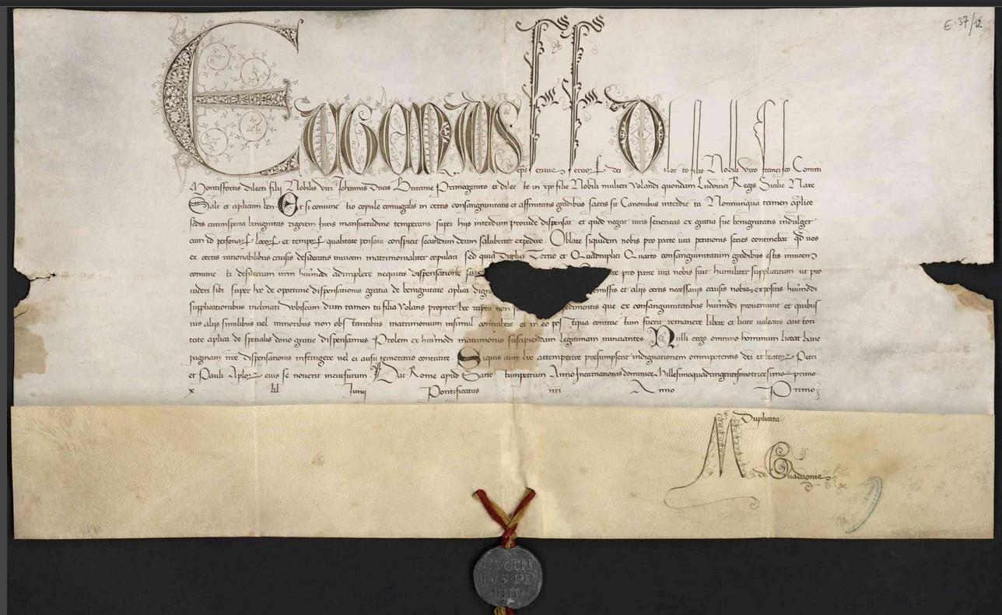
https://www.monasterium.net/
mom/IlluminierteUrkunden/
1431-05-23_Nantes/charter

Slide 20
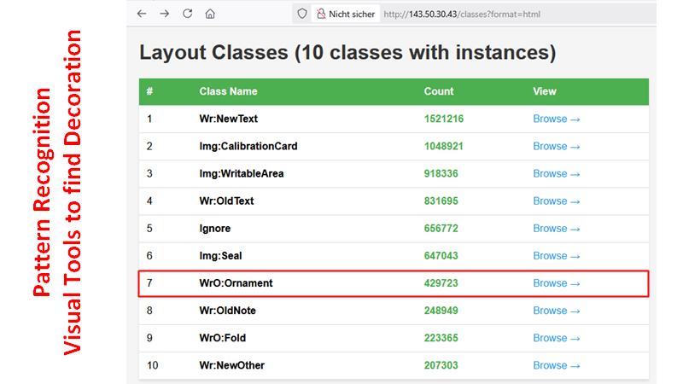

Slide 21
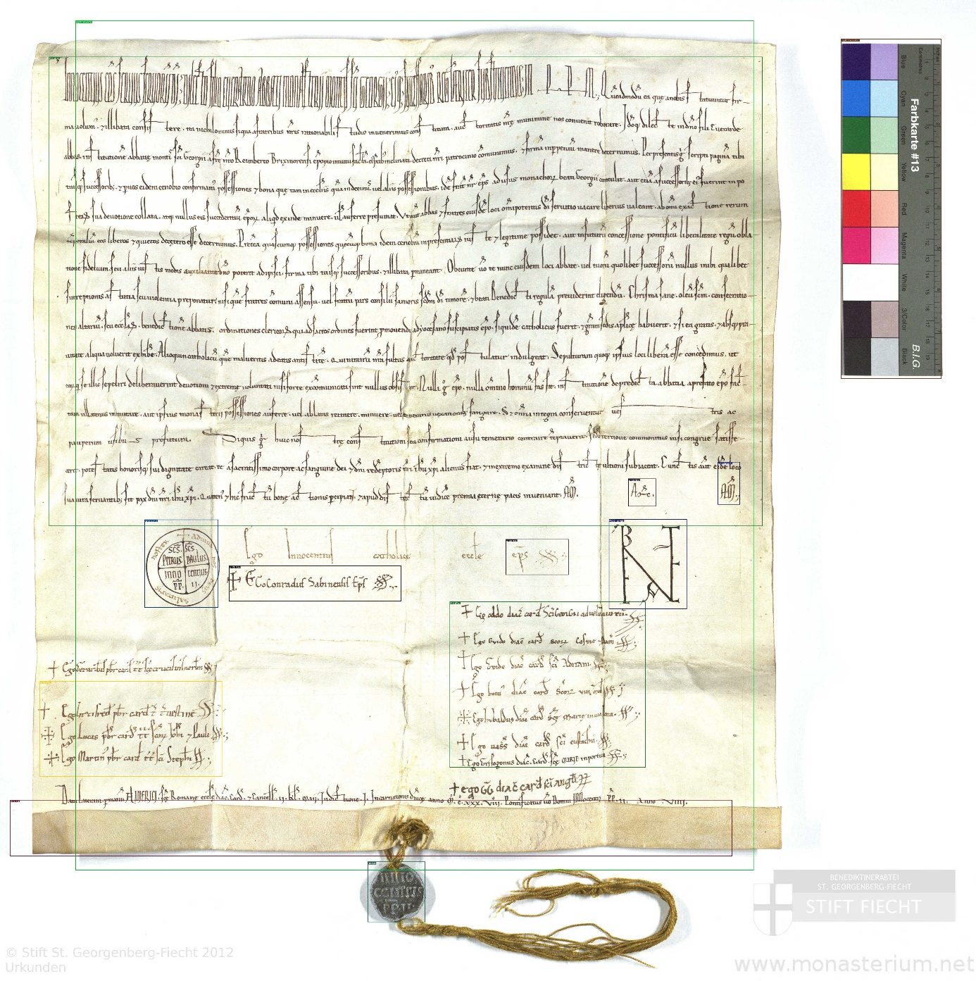

Slide 22
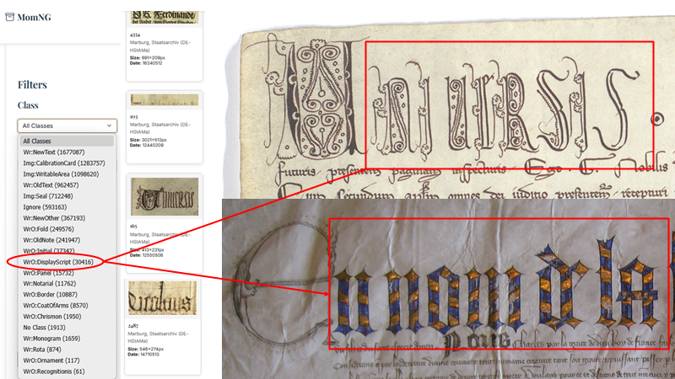

Slide 23
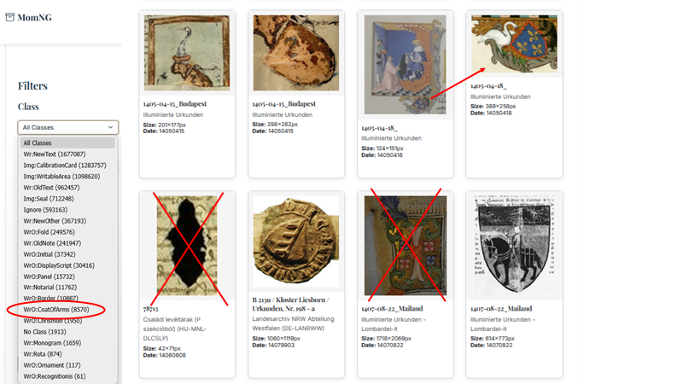

Slide 24
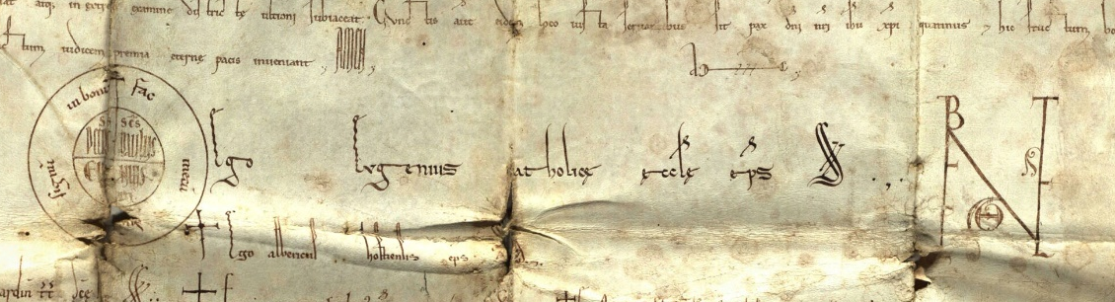
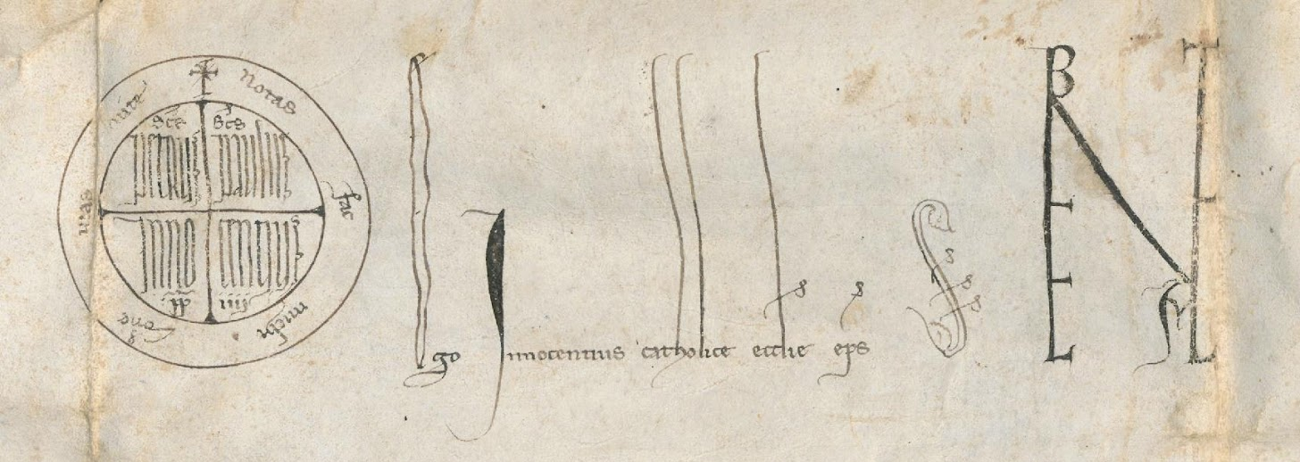
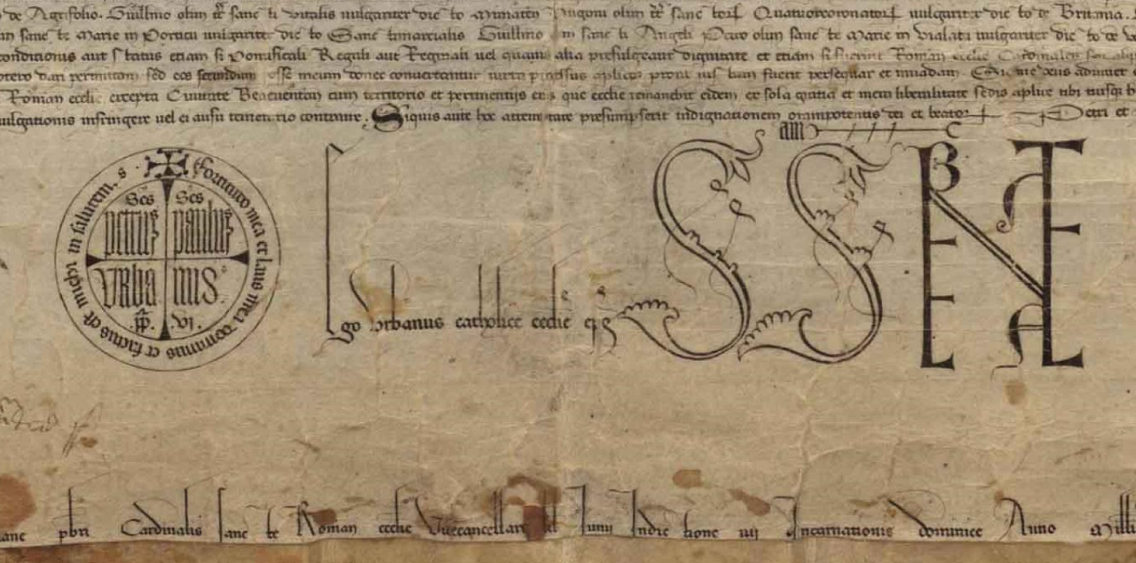
Charter Specific Signs: For Papal Documents „Rota“ and „Benevalete“
https://www.monasterium.net/
mom/IlluminierteUrkunden/
1146-05-04_Reichersberg/charter
https://www.monasterium.net/
mom/IlluminierteUrkunden/
1251-01-03_Innsbruck/charter
Rota
https://www.monasterium.net/mom/IlluminierteUrkunden/
1381-06-01_Valladolid/charter

Slide 25
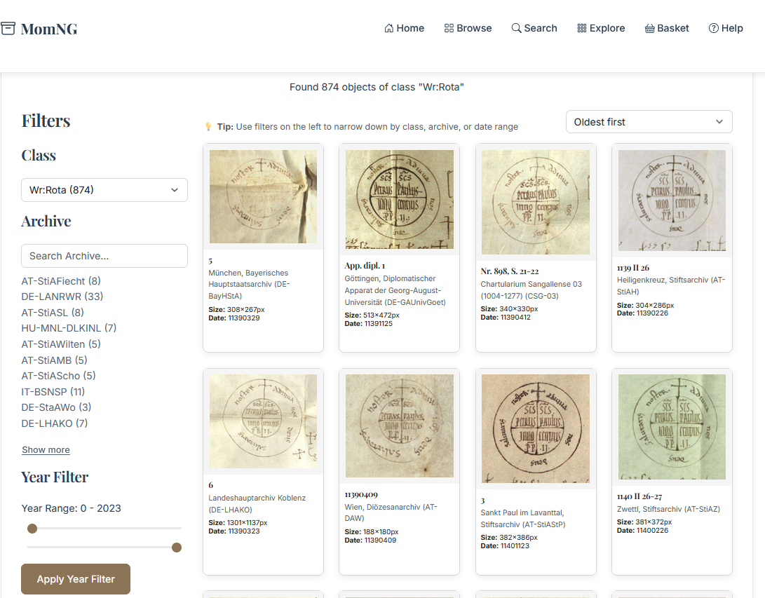

Slide 27
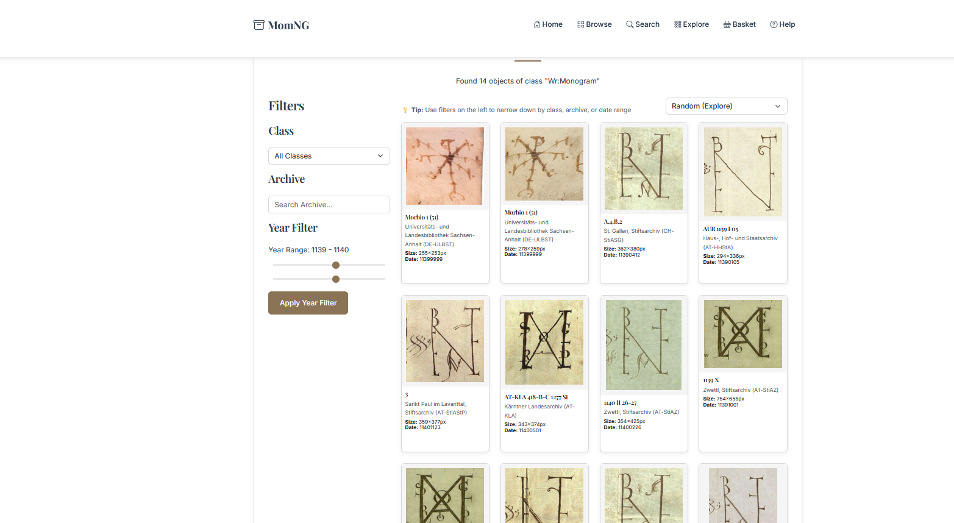

Slide 28
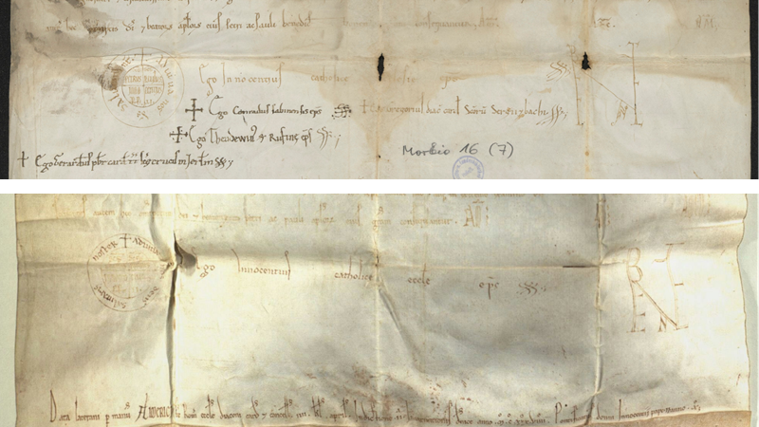

Slide 29
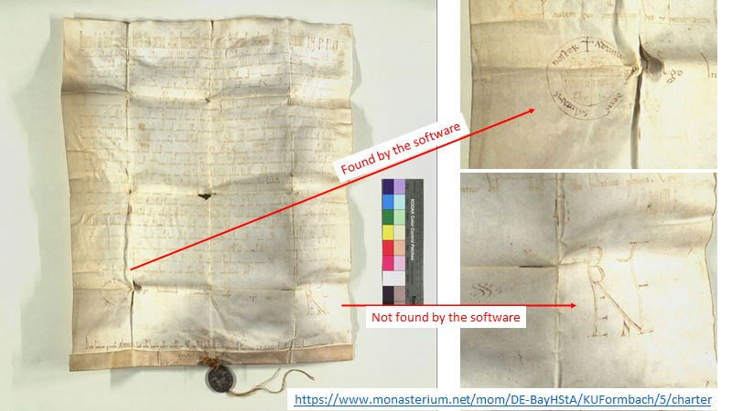

Slide 31
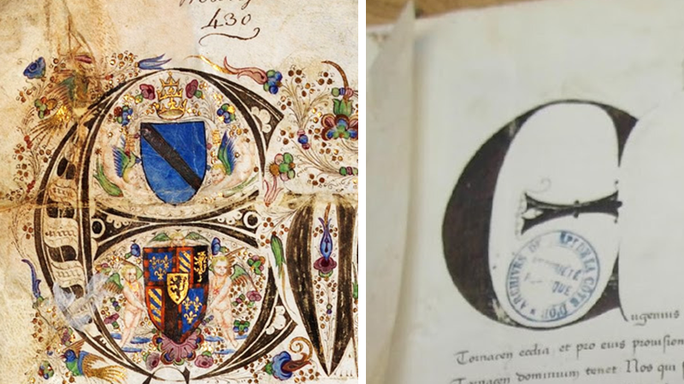

Slide 32
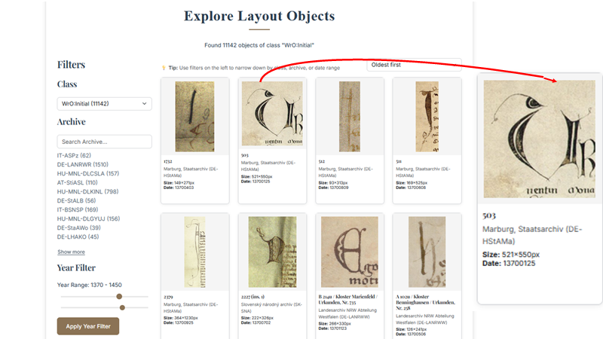

Slide 33
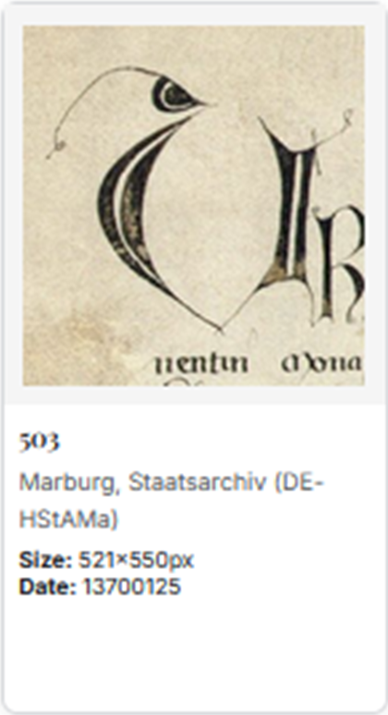
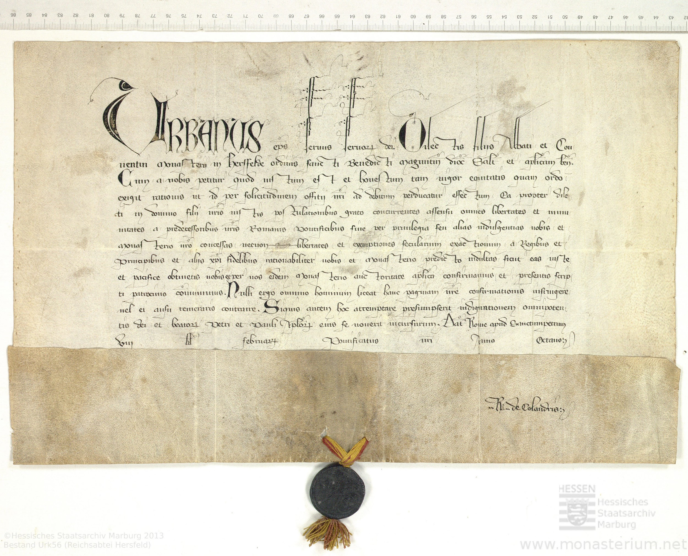
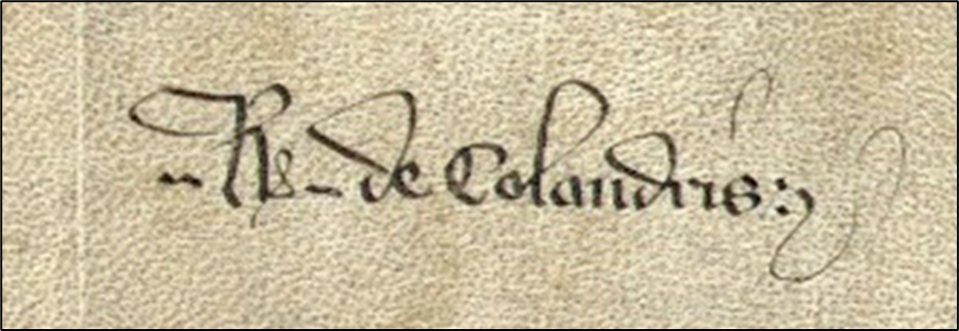

Slide 34
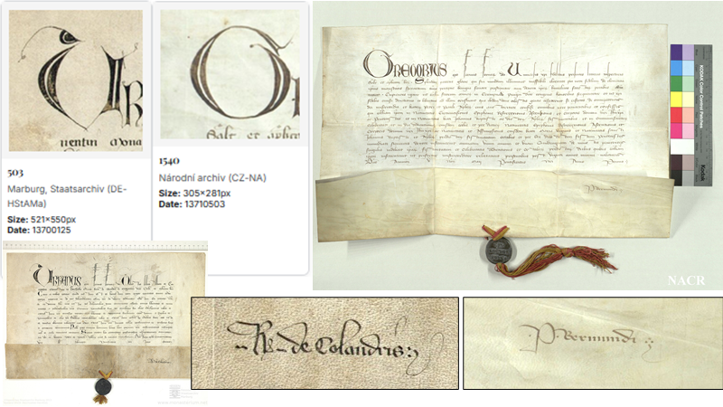

Slide 35
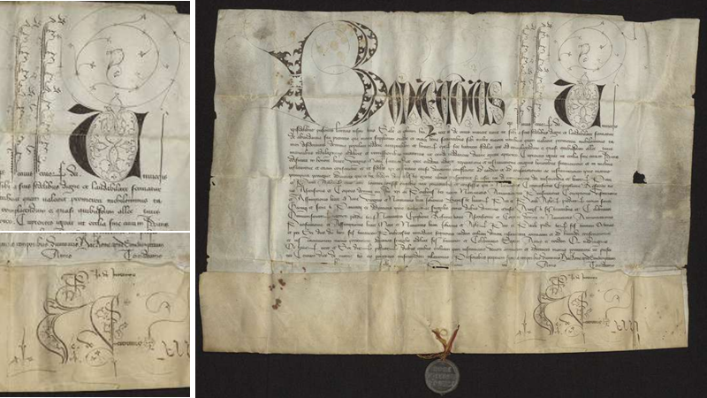

Slide 36
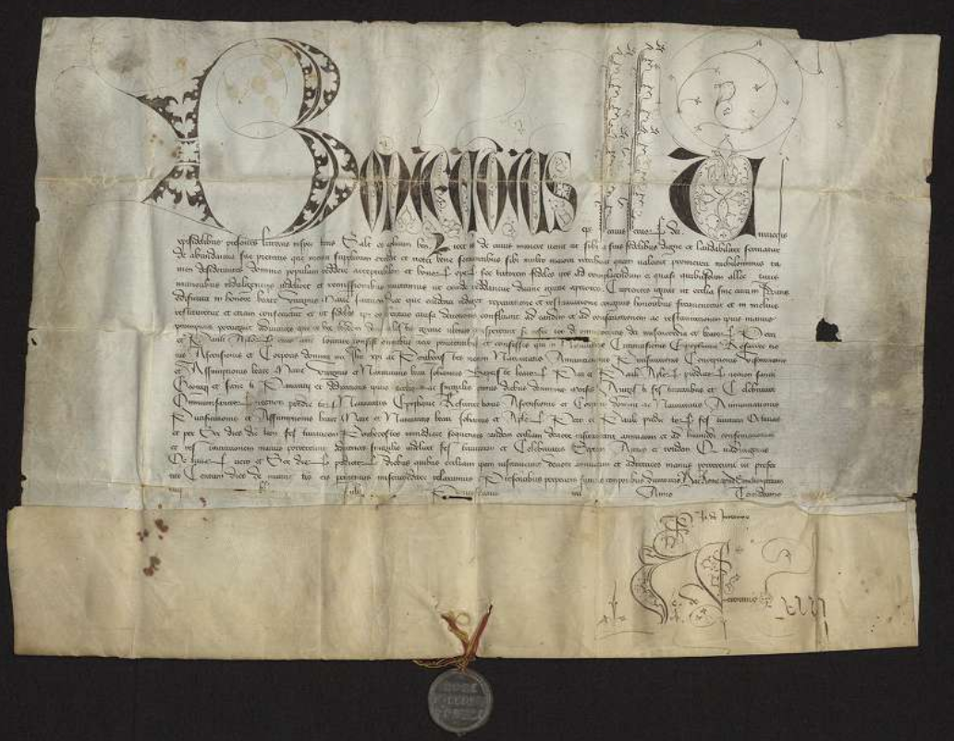
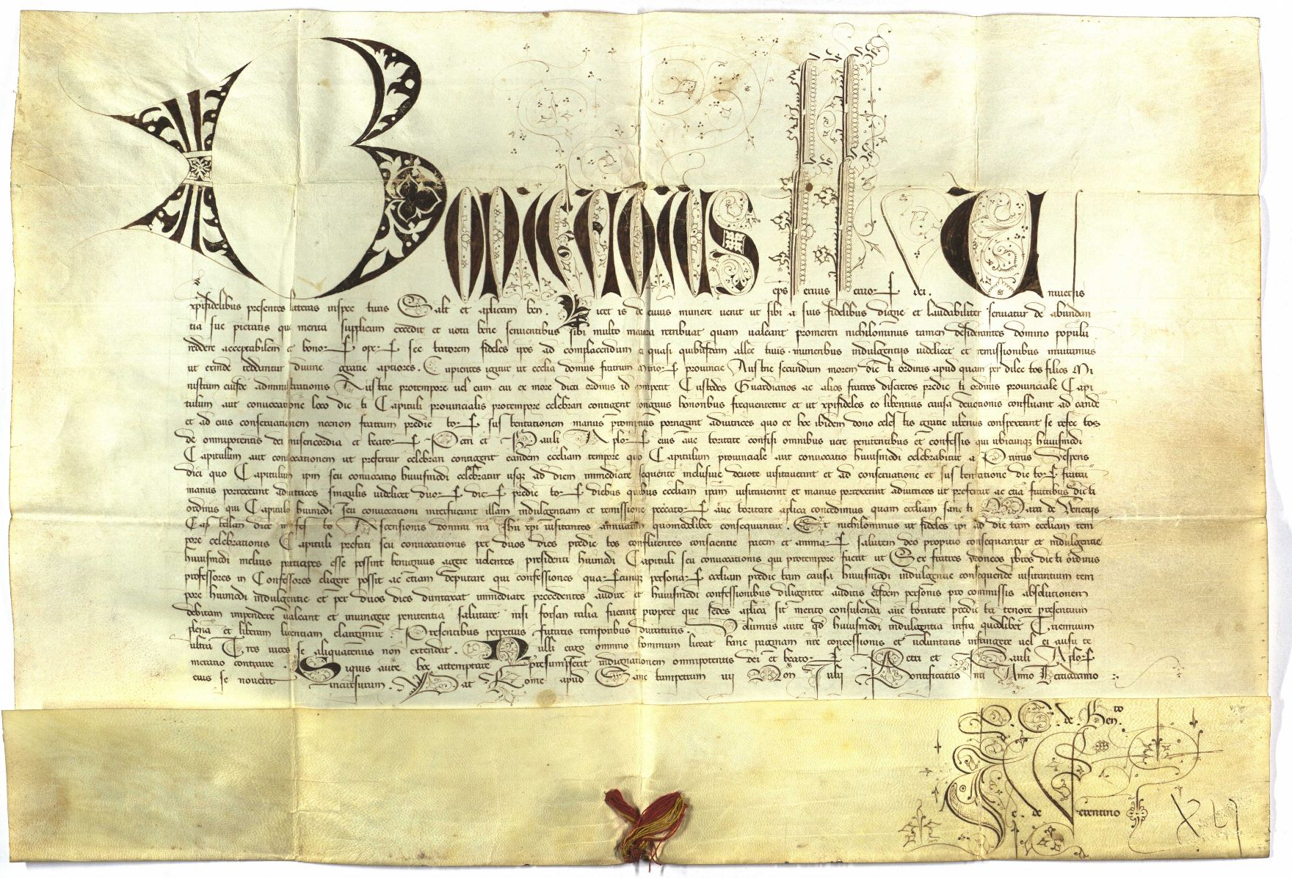

Slide 37
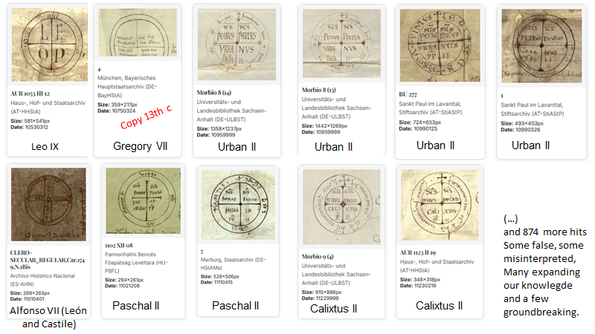

Slide 38
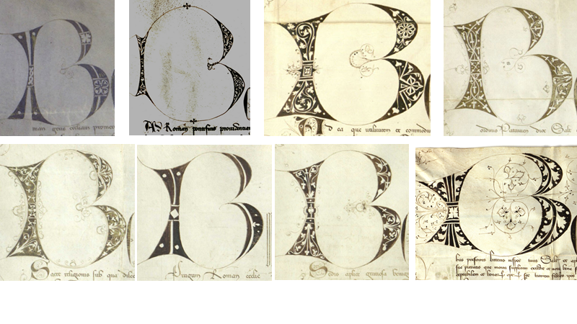

Slide 39
Object Detection for Visual Analysis of Medieval Charters
Decoration and Its Makers in Papal Documents
Florian Atzenhofer-Baumgartner and Martin Roland

Slide 40
Licensing
© Florian Atzenhofer-Baumgartner, University of Graz, 2026. atzenhofer@acm.org
© Martin Roland, Austrian Academy of Sciences, 2026
This presentation is licensed under CC BY-SA 4.0, except where noted.
Images of charters are copyright of the respective institution or individual as indicated. The material is republished under the illuminated charters collection via Monasterium.net. Some images are reproduced for academic purposes; copyright remains with the respective rights holders.

