Slide 1
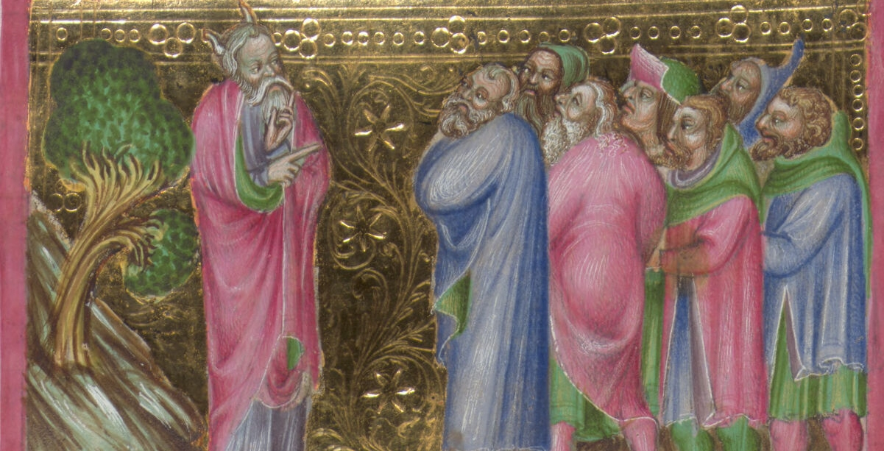





Beyond vision
Metadata-Augmented AI for Iconclass Classification in Medieval Manuscripts
DREW B. THOMAS, UNIVERSITY OF SALZBURG
JULIA HINTERSTEINER, AUSTRIAN NATIONAL LIBRARY

Slide 2
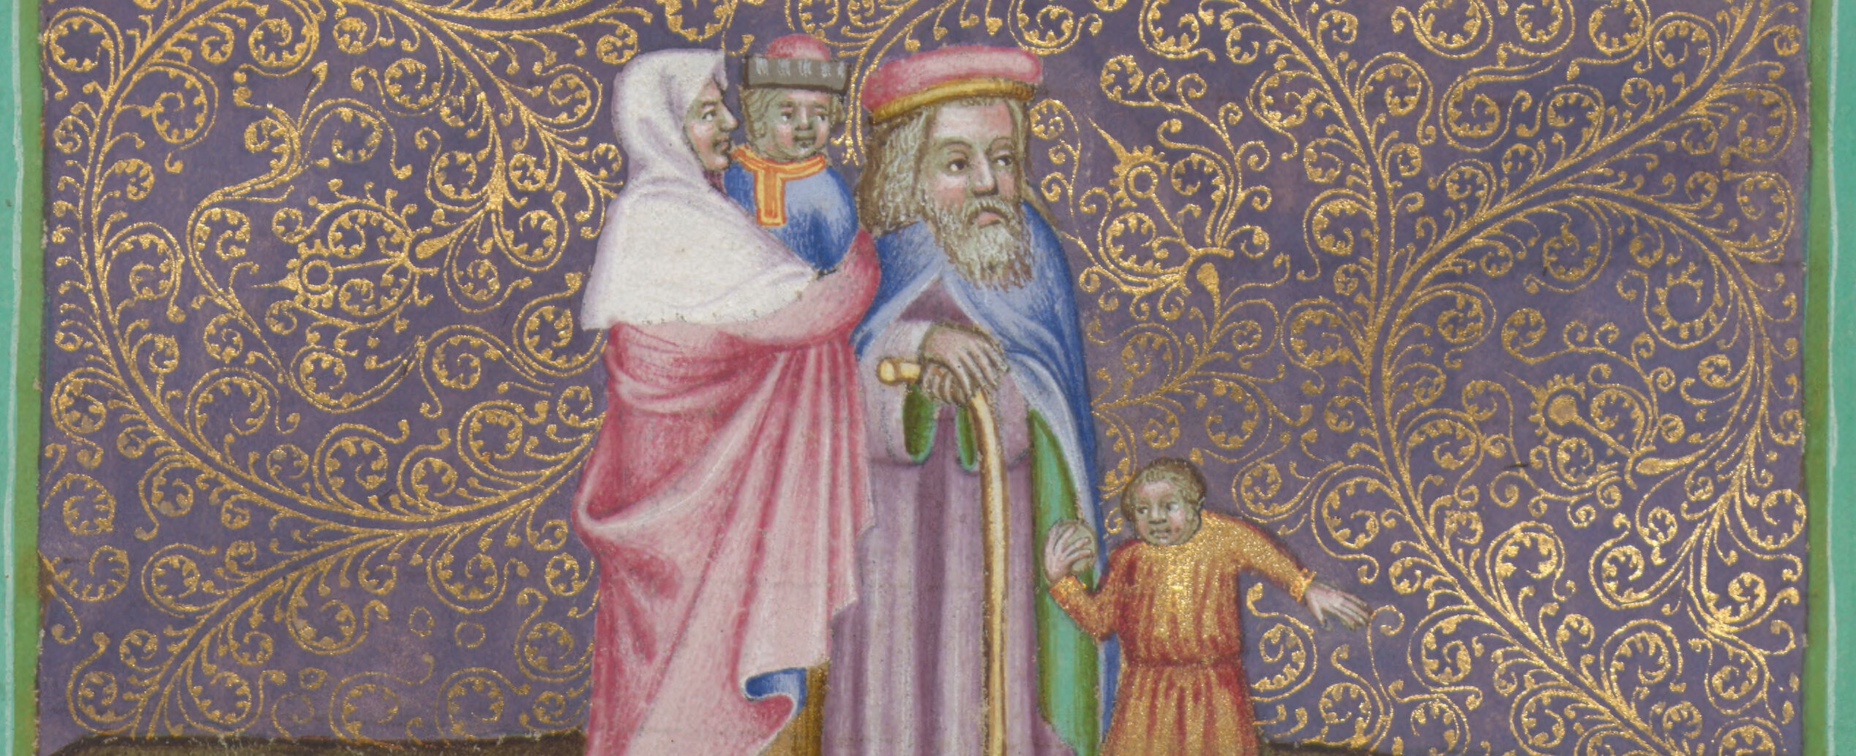






The problem
IMAGE
Manual Iconographic Classification Does Not Scale
Structured metadata is essential for interoperability
Iconclass = powerful but labor-intensive
Medieval manuscripts = high narrative density
Example: 654 miniatures in one manuscript
EXPERT
ICONCLASS
BOTTLENECK

Slide 3
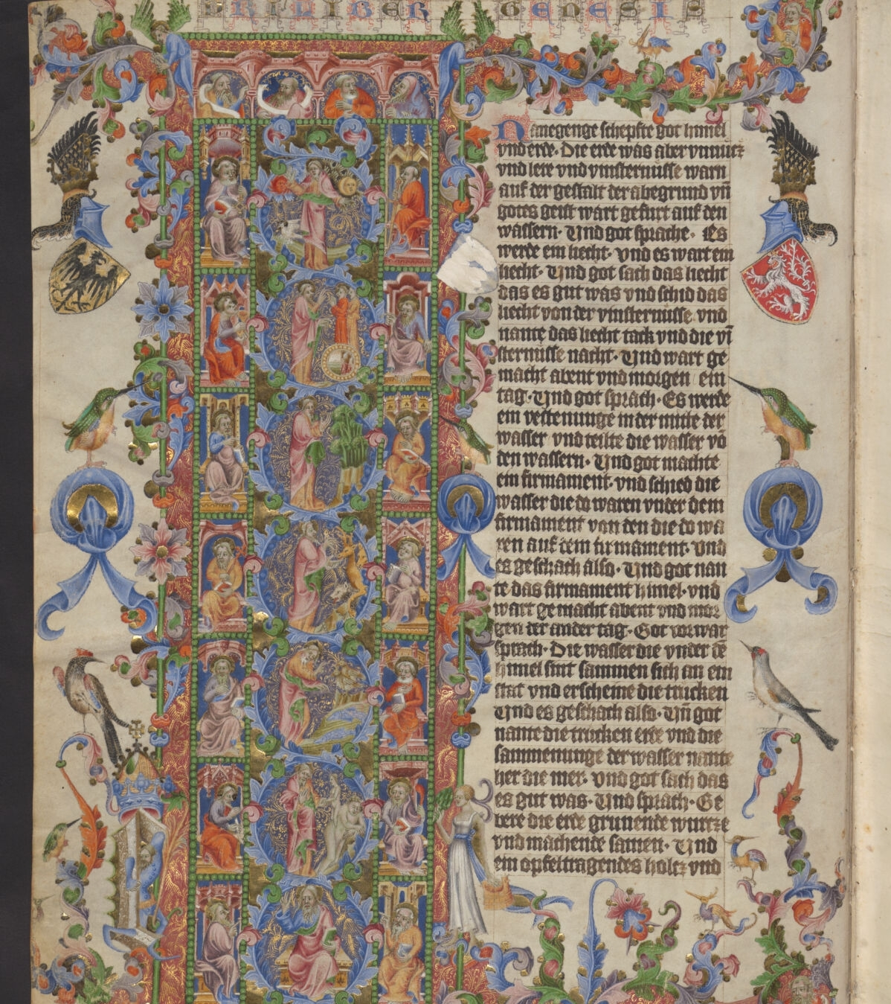
Case Study: The Wenzelsbibel
Commissioned by King Wenceslas IV
ca. 1389–1400, Prague
6 volumes, 1,214 folios
654 main miniatures
First programmatic German OT translation from the Vulgate
UNESCO “Memory of the World”

Slide 4
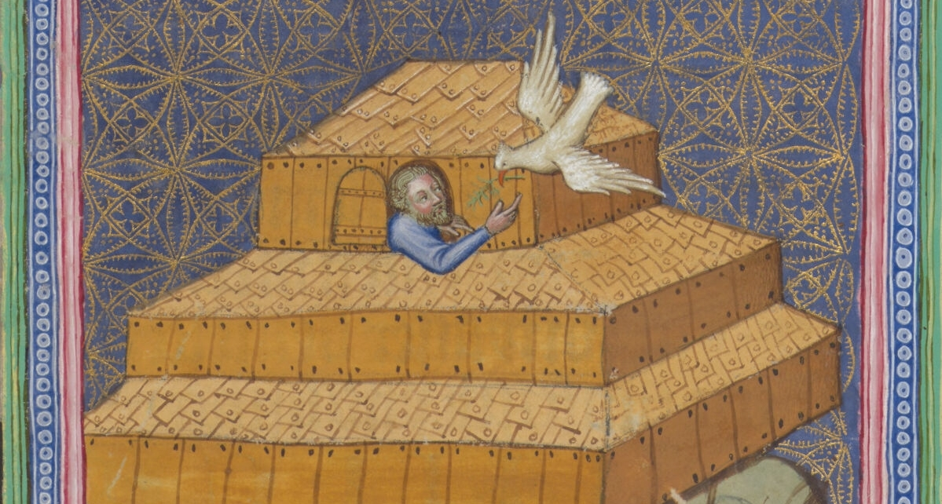
WHAT IS ICONCLASS?
International hierarchical classification system
Multi-level codes
Multilingual, widely adopted
Enables cross-collection linking
7 Bible
Old Testament
71B Genesis from the descendants of Cain and Seth to Abraham
71B3 Story of Noah
71B33 The Flood and destruction of mankind ~ story of Noah (Genesis 7:10 - 8:17)
71B332 The ark of Noah comes to rest on Mount Ararat
71B3322 Noah sends off a dove
71B33221 The dove returns with an olive branch ~ story of Noah

Slide 5
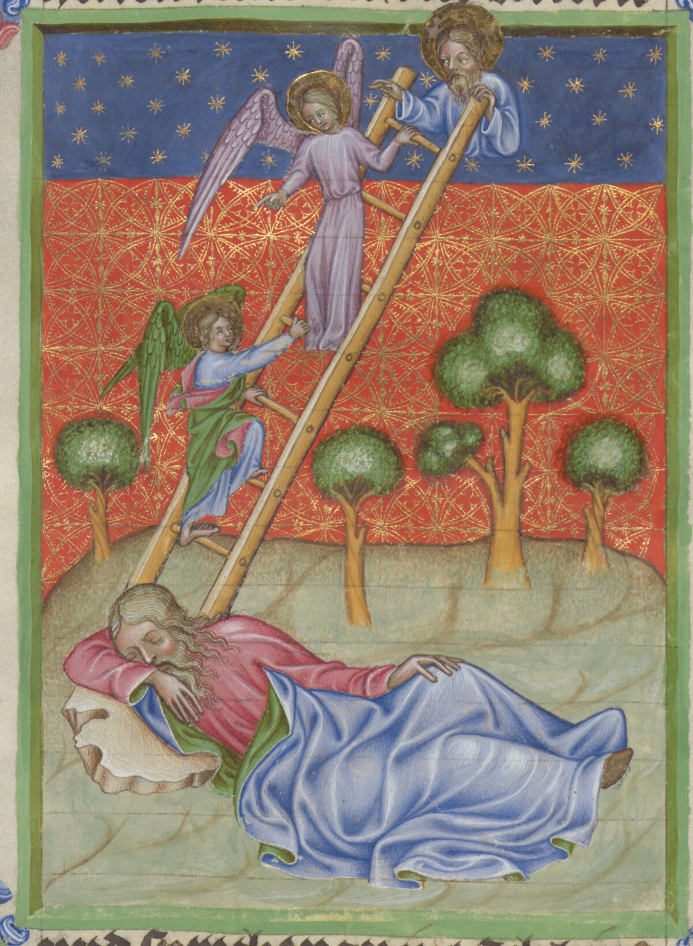
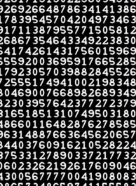
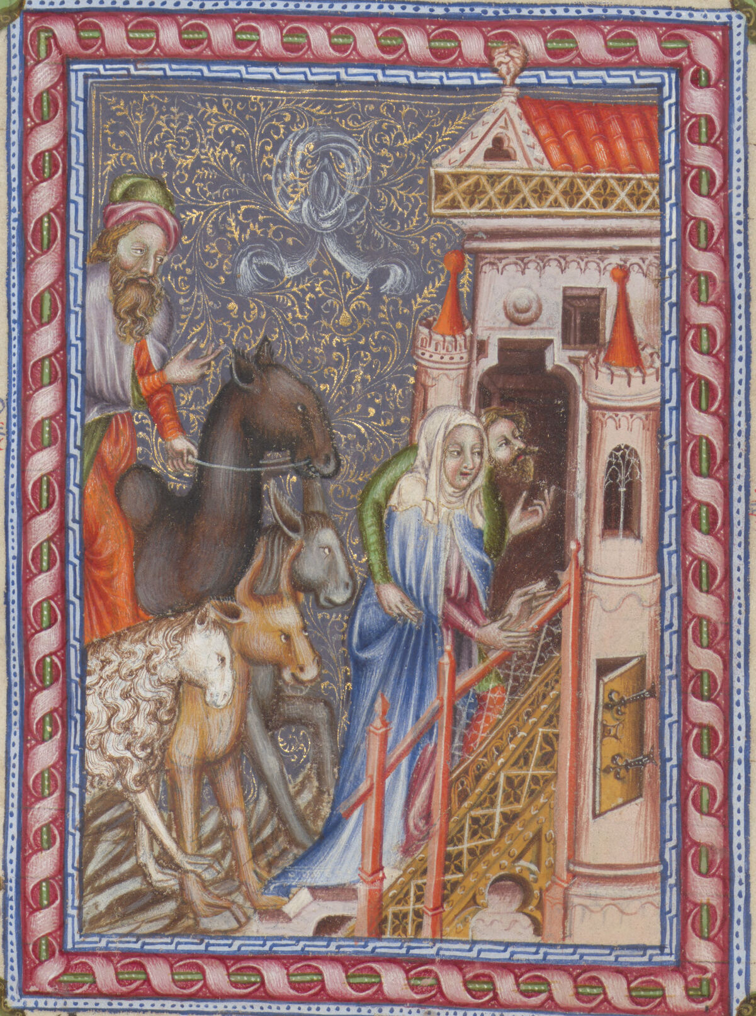
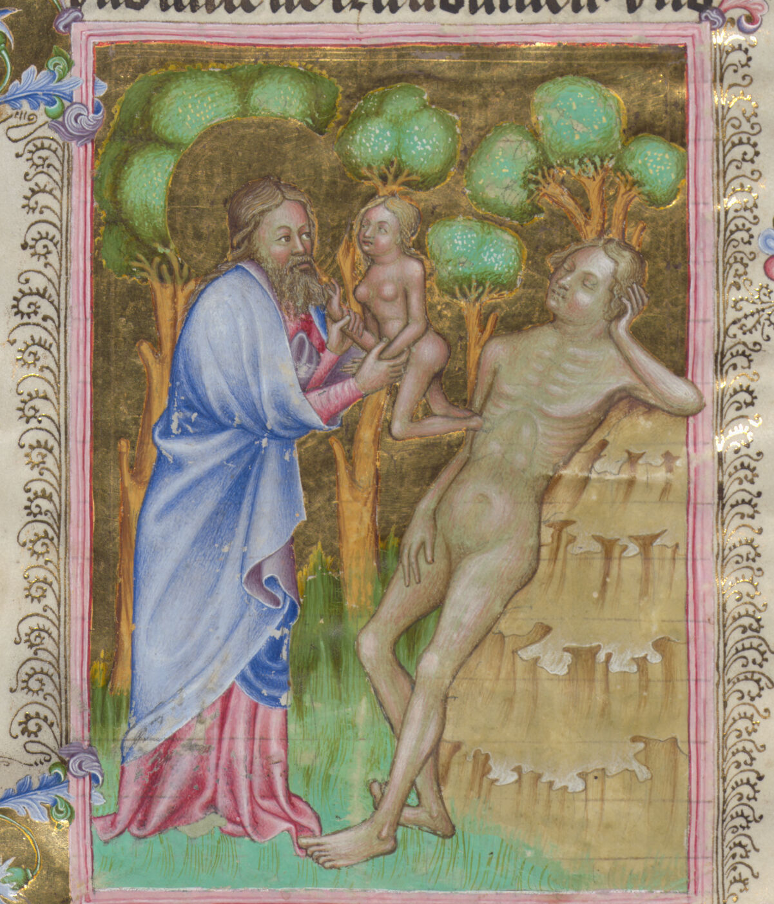

PRIOR APPROACHES
Jacob’s Ladder
CNNs
CLIP
Fine-Tuning

Slide 6
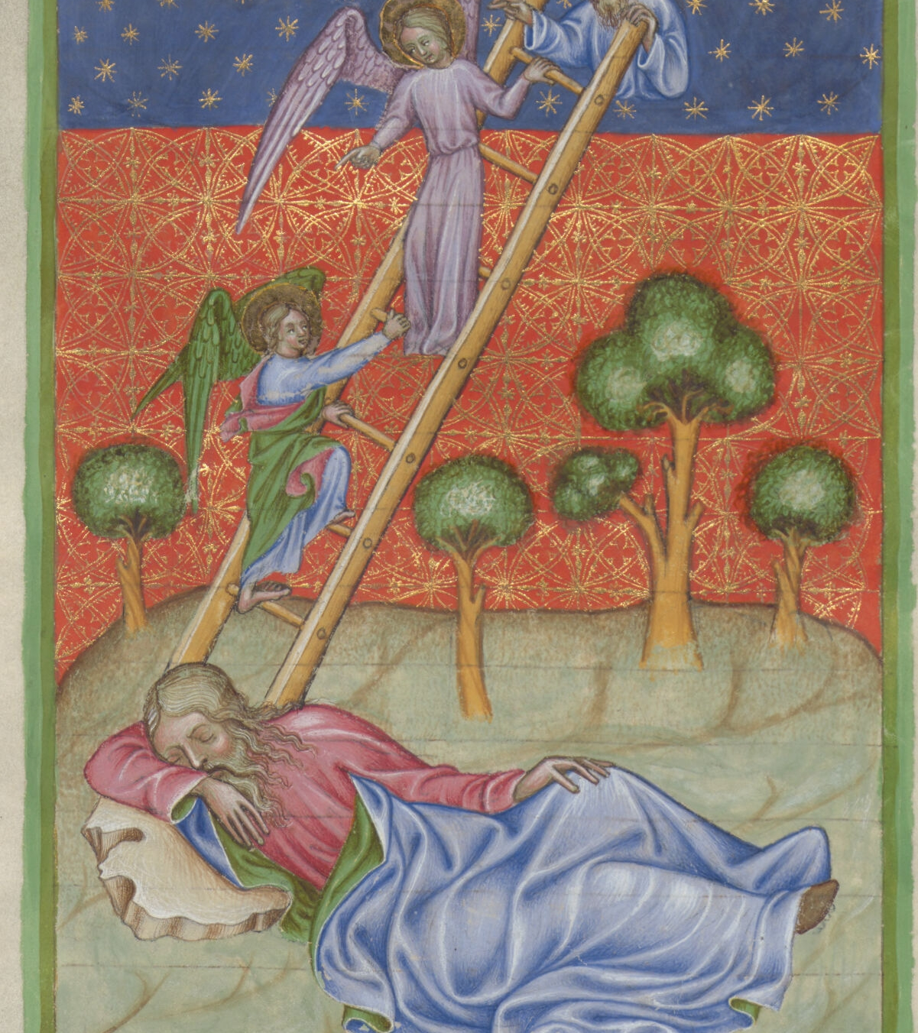

Our Solution:
The illustration shows Jacob lying on the ground asleep with his head on a stone, while a ladder rises to the sky beside him, upon which angels are ascending and descending, depicting Jacob's dream at Bethel. (GPT-4.1)
A Text-First RAG Pipeline
No model fine-tuning
No training dataset required
Uses LLM-generated descriptions
Retrieval-Augmented Generation (RAG)
Expert validation built in
71C3121 the dream of Jacob

Slide 7
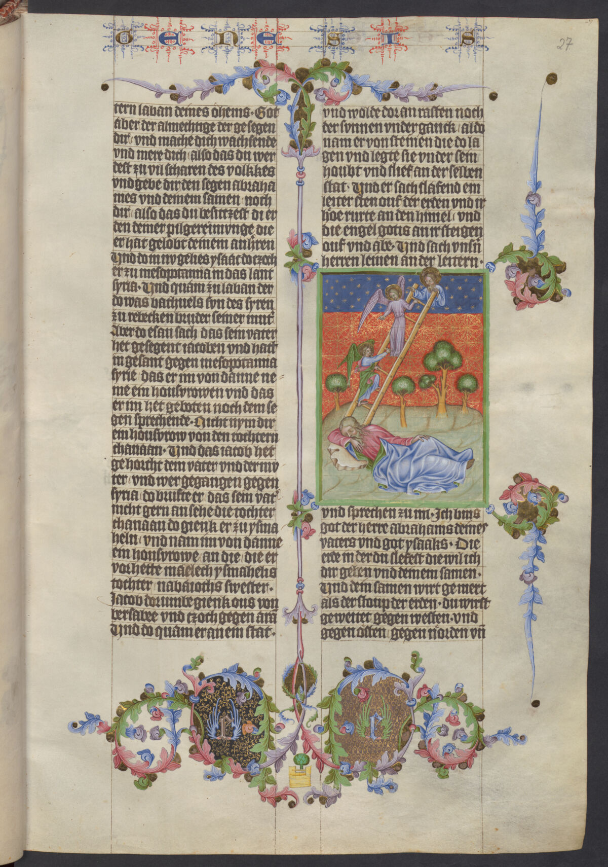
Input types

Slide 8
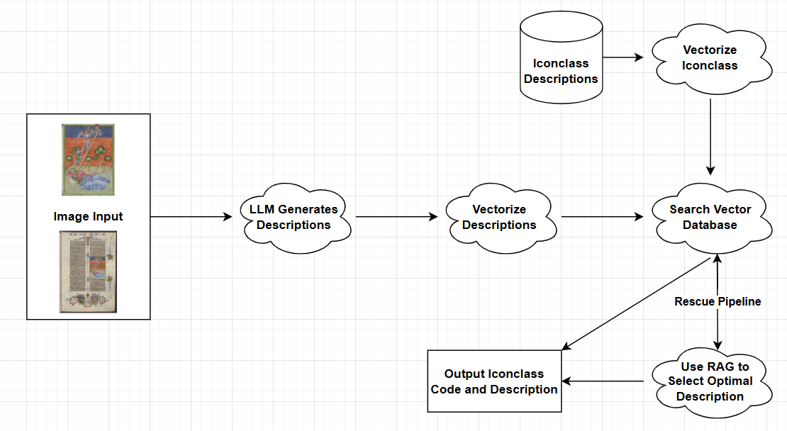
PIPELINE OVERVIEW

Slide 9
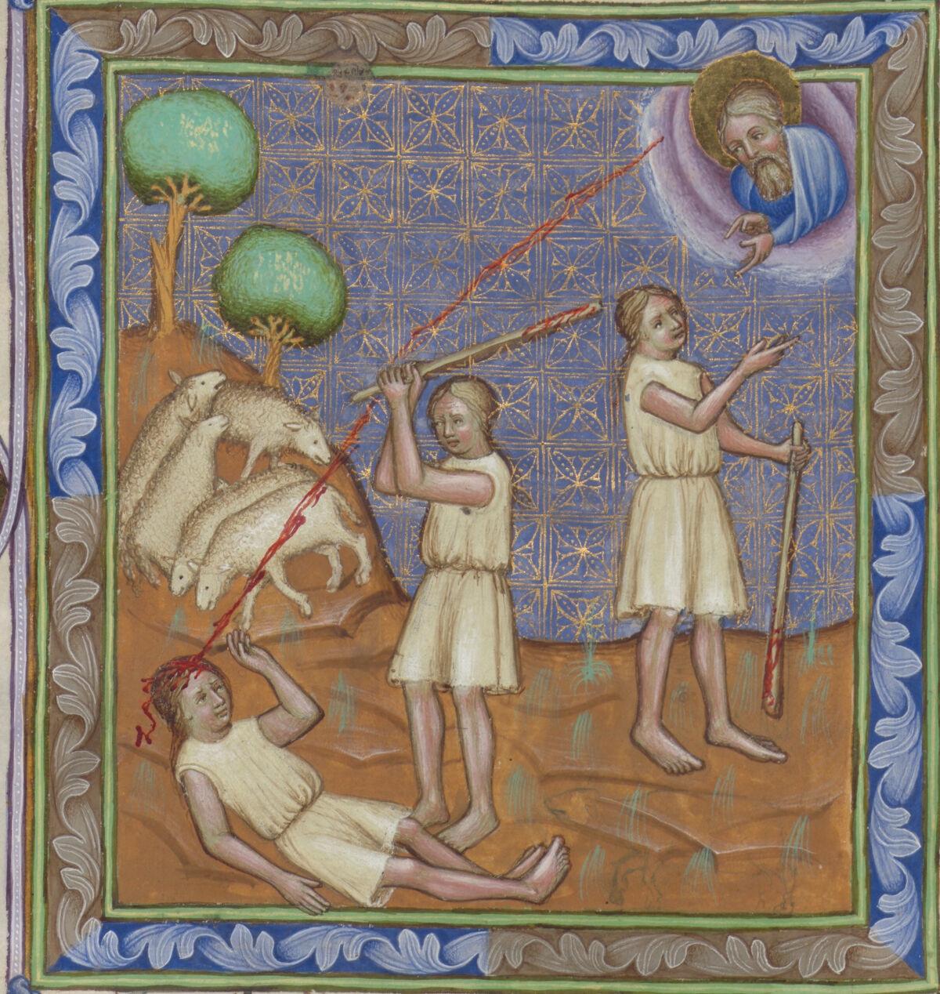
Best configuration
Full Page
GPT-4.1
OT Prompt
Basic Vector Database

Slide 10
Rescue pipeline
71C1: story of Abraham
↳ 71C11: story of Abraham (part I)
↳ 71C116: the battle of the kings and the rescue of Lot (Genesis 14:1-17)
↳ 71C1163: Sodom and Gomorrah are plundered; Lot is taken into captivity
↳ 71C12: story of Abraham (part II)
↳ 71C123: Lot and the two angels (Genesis 19:1-23)
↳ 71C1233: Lot entertaining the angels
↳ 71C12334: the two angels intervene and strike the mob that surround Lot's house with blindness
↳ 71C124: the destruction of Sodom and Gomorrah: Lot and his family flee to Zoar, carrying their belongings; an angel may be showing the way (Genesis 19:24-29)
↳ 71C125: Lot and his daughters (Genesis 19:30-38)
↳ 71C1252: Lot's daughters make their father drunk
↳ 71C12521: Lot's daughters lie with their father in turn
“None” option
Parent Levels
Hierarchical List

Slide 11
Rescue pipeline
Step 1: Send hierarchical list with broad levels removed
Step 2: Rescue step → If all 1*, check 7* and vice versa
Step 3: Only send broad parent levels
Step 4: Simply choose a biblical book
Step 5: Fall back to 71: Old Testament

Slide 12
Multimodal Enhancement
+ Jacob’s dream
+ Description
+ Jacob’s dream
+ Description

Slide 13
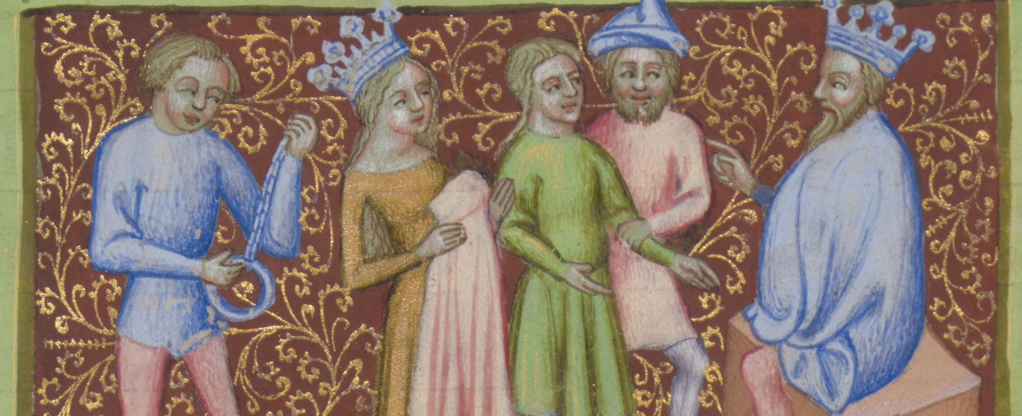
evaluation
PREDICTIONS MAY BE:
WE USED:
Fully correct
Partially correct
Correct at higher level only
Overly specific
Precision
Recall
F1-score
Weighted partial-match scoring
Truncation analysis

Slide 14

RESULTS
METHOD | PRECISION
OpenCLIP | 0.1694
Keyword | 0.4620
Page Image Only + RAG | 0.5978
Illustration + Title | 0.7640

Slide 15
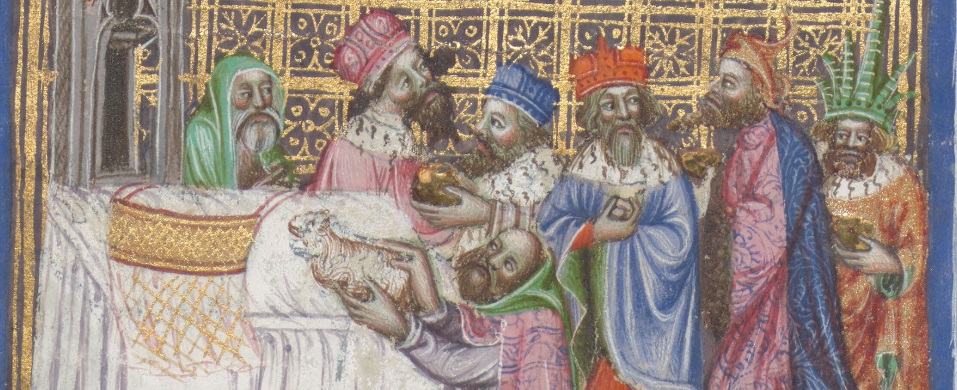
What about text alone?
Skip Image Step
Winner
No LLM Step 1
Title Alone
Title + Description
Title + Description
METHOD | PRECISION
Page Image Only + RAG | 0.5978
Illustration + Title | 0.7640
Title + Description | 0.7570

Slide 16
Truncation Analysis
Illustration + Title
LEVELS TRUNCATED | PRECISION | AVERAGE LEVELS LEFT
0 | 0.7637 | 6.31
1 | 0.8194 | 5.31
2 | 0.8698 | 4.32
3 | 0.9030 | 3.32

Slide 17
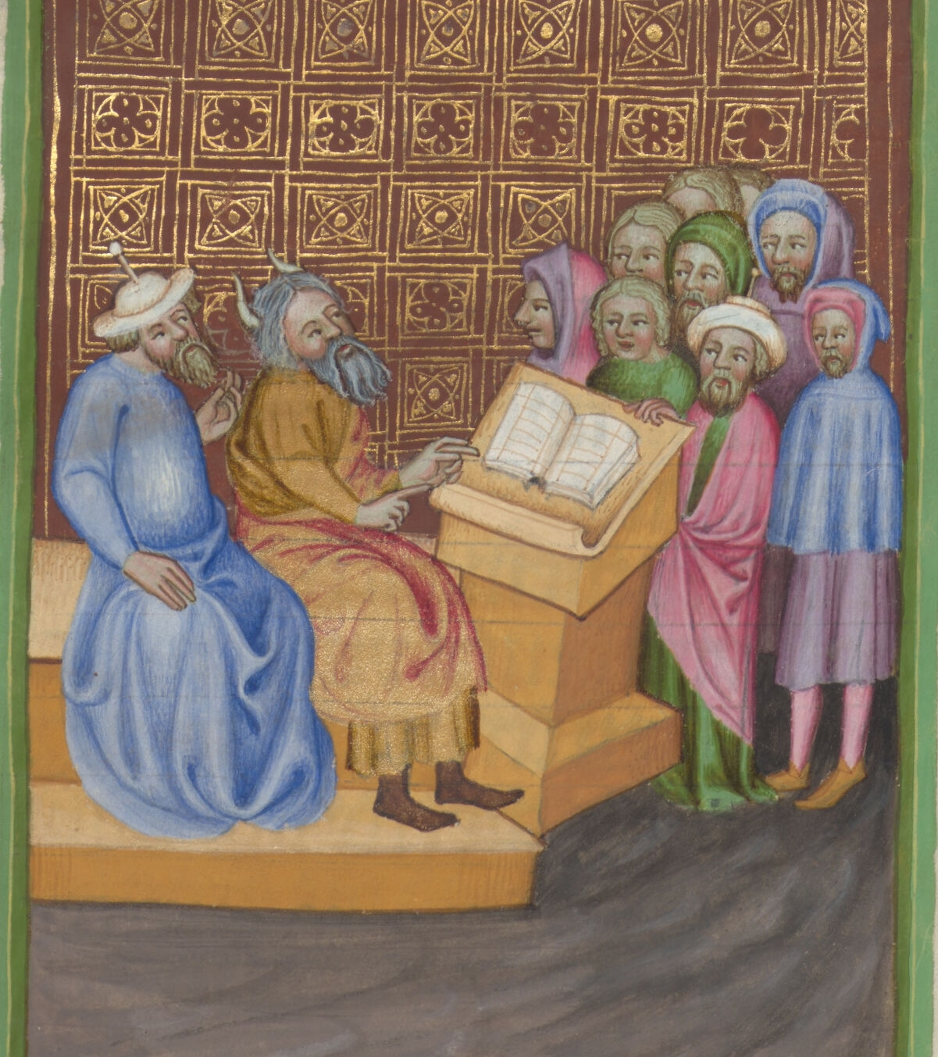
Text-first works
No training data required
Low on-site computational cost
Can supplement or replace with metadata
Works with large and small collections

Slide 18
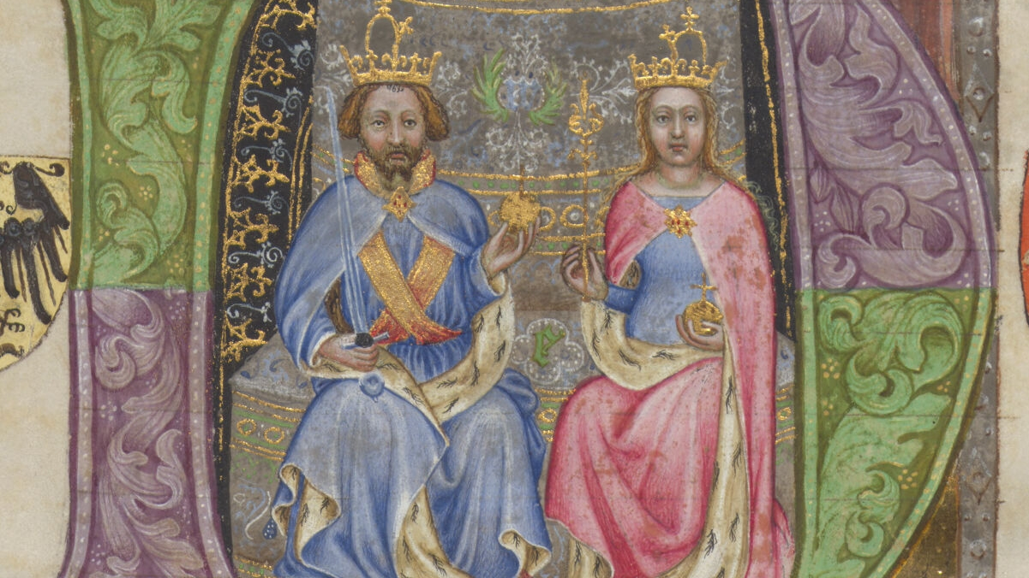
Thank you

