Slide 1

Image Analysis for Art Historical Research: Integrating AI into Digital Catalogues Raisonnés and Archives
“AI and Artworks Object Detection, Image Classification and Iconographic Analysis”
Dr. Kiersten Thamm
Head of Education and Communication
HPF Innovations gGmbH (Navigating.art)

Slide 3
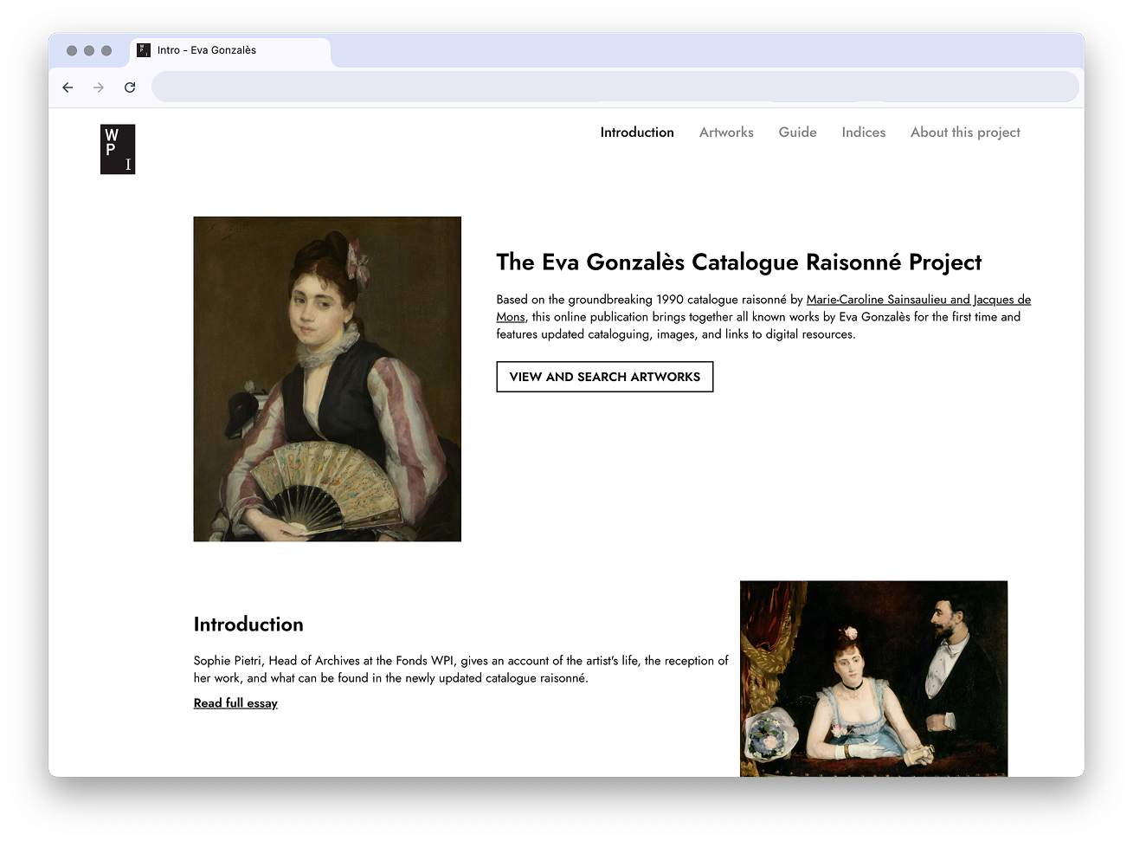

Slide 4
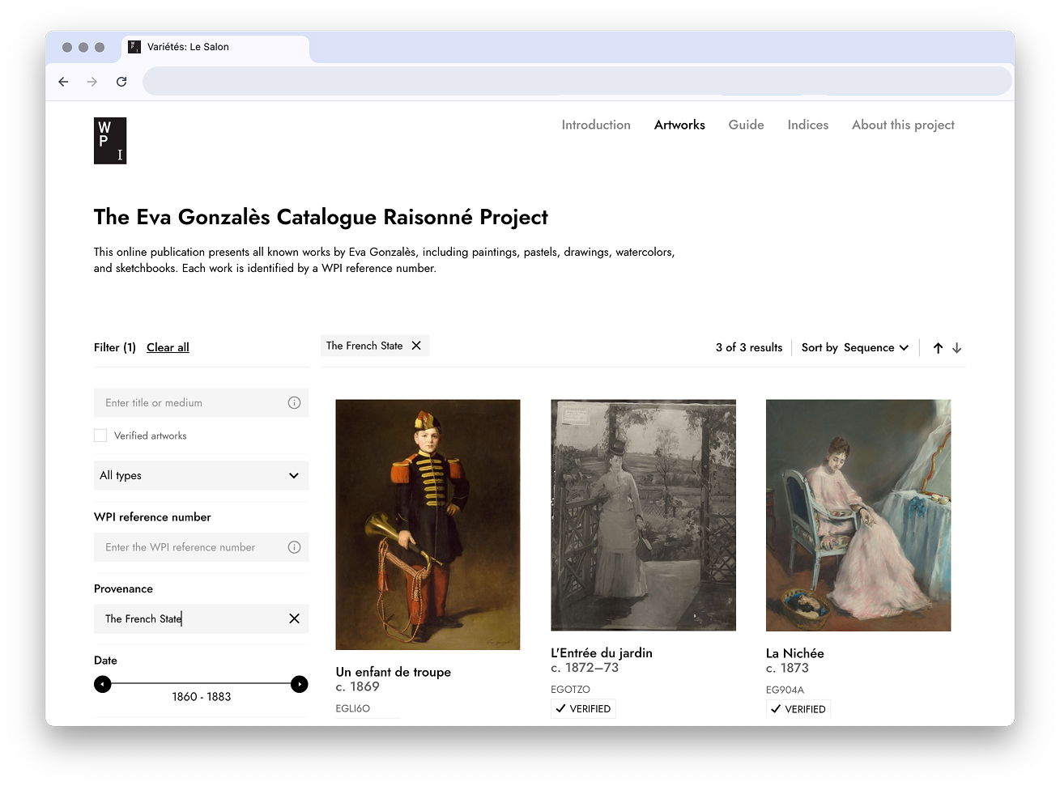

Slide 5
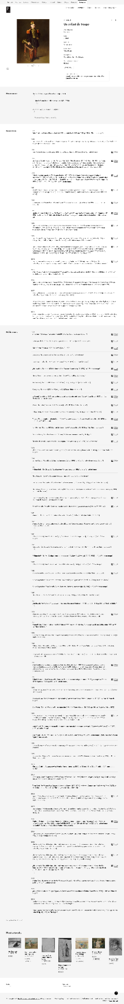
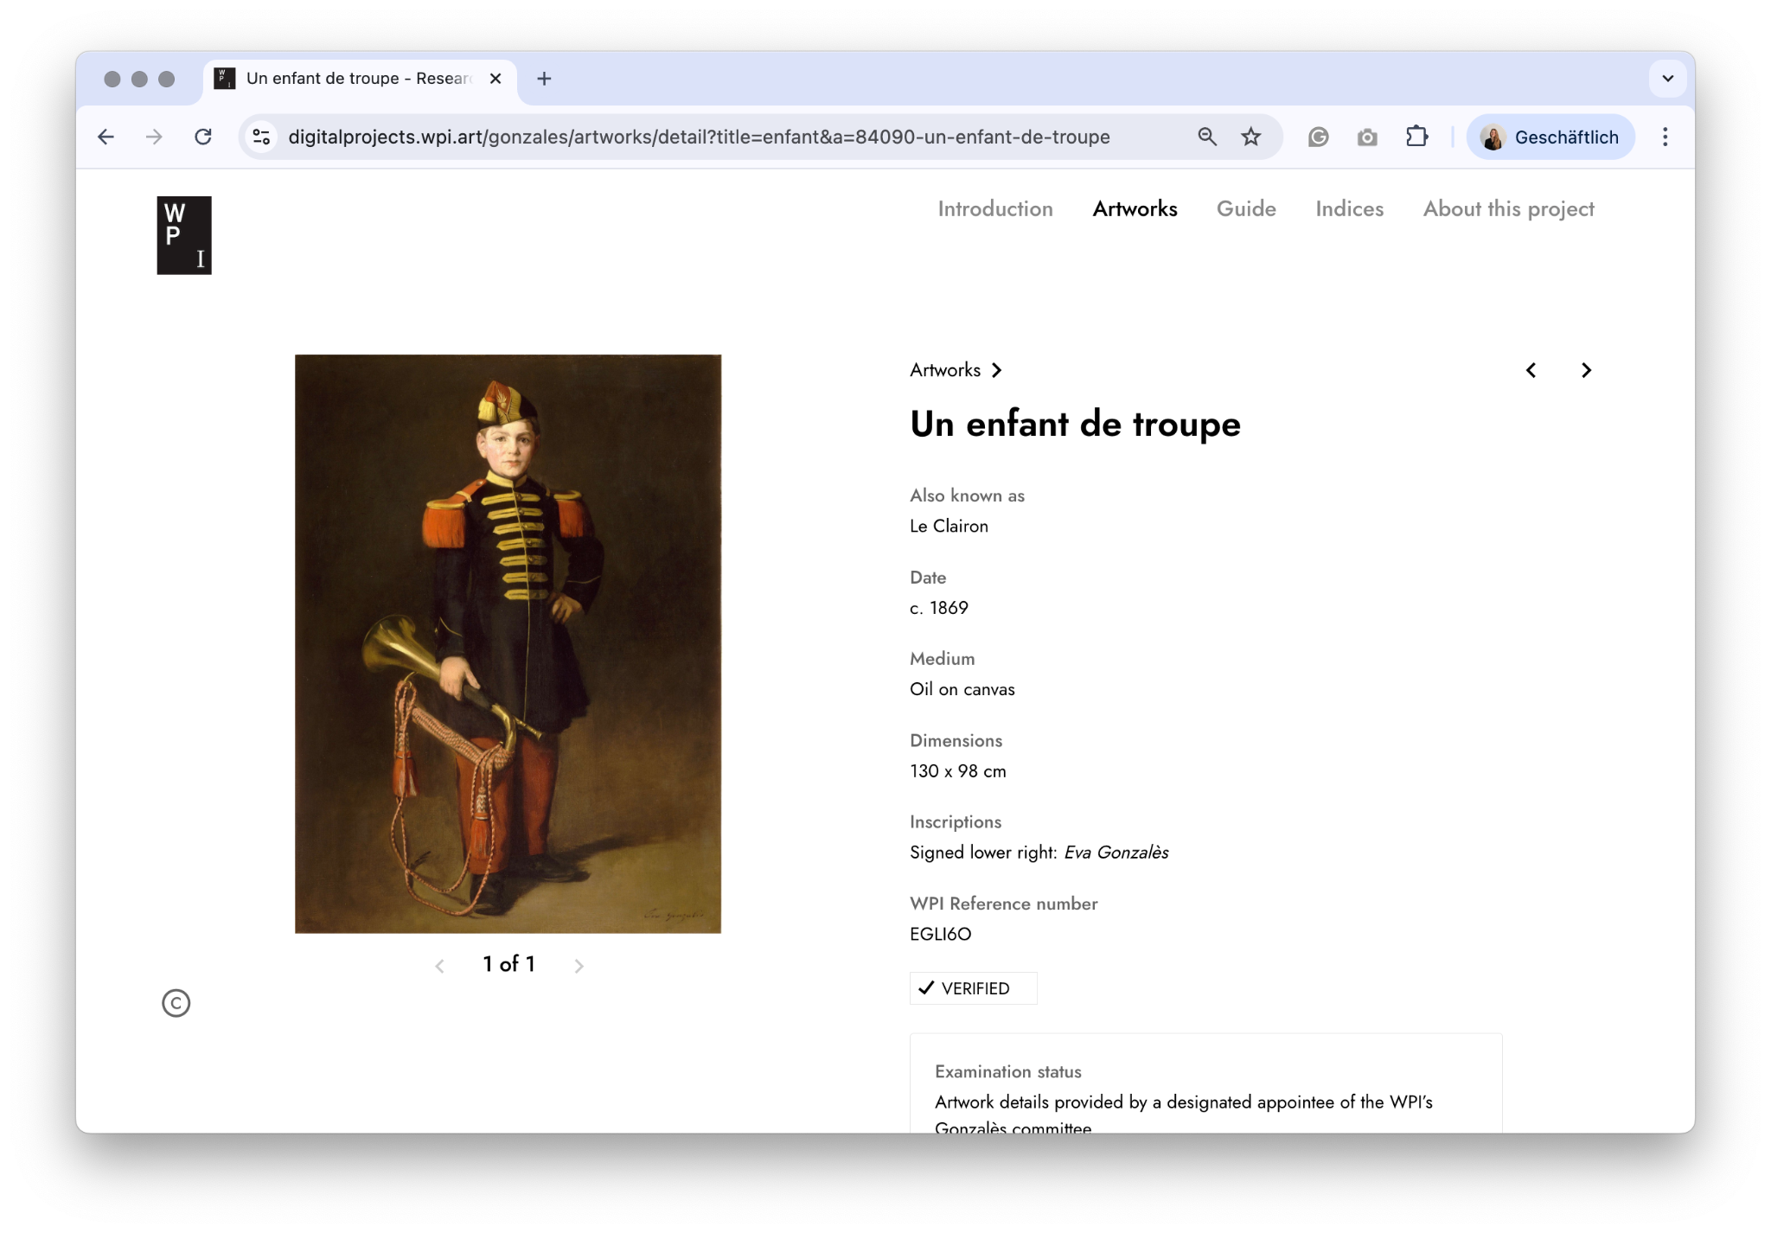

Slide 6
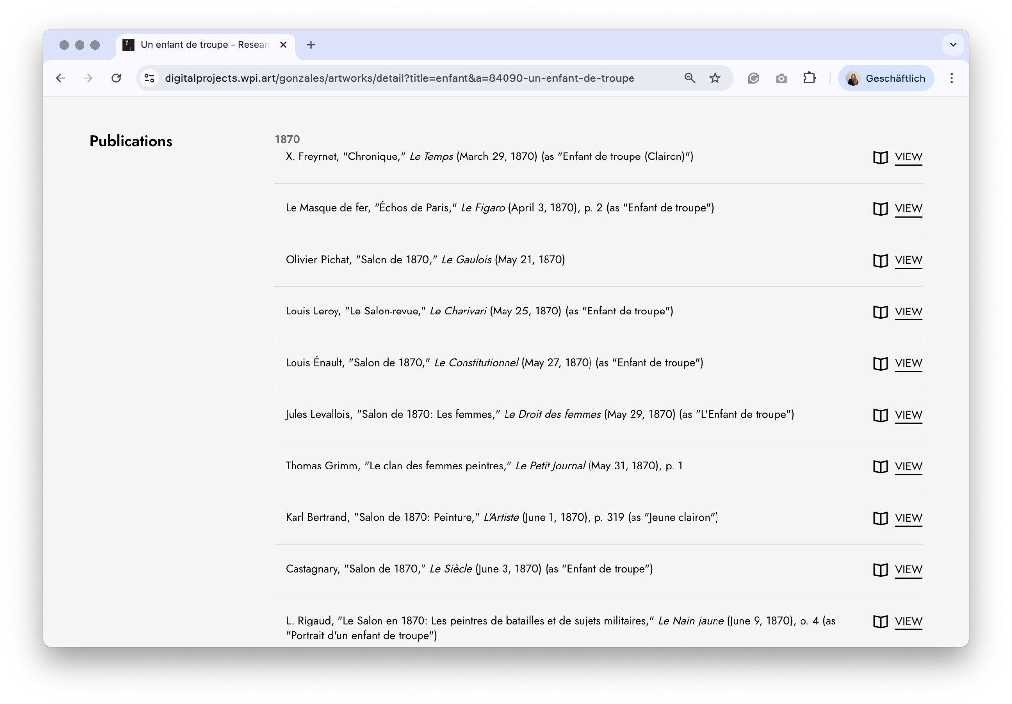

Slide 7
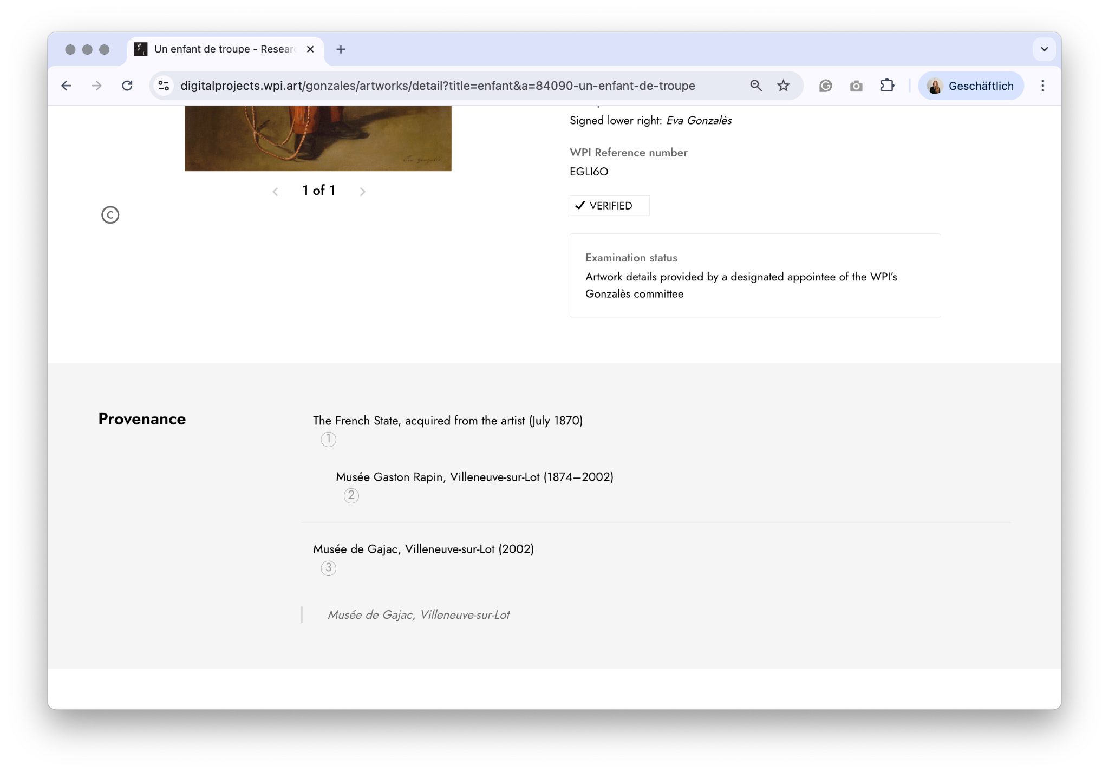

Slide 8
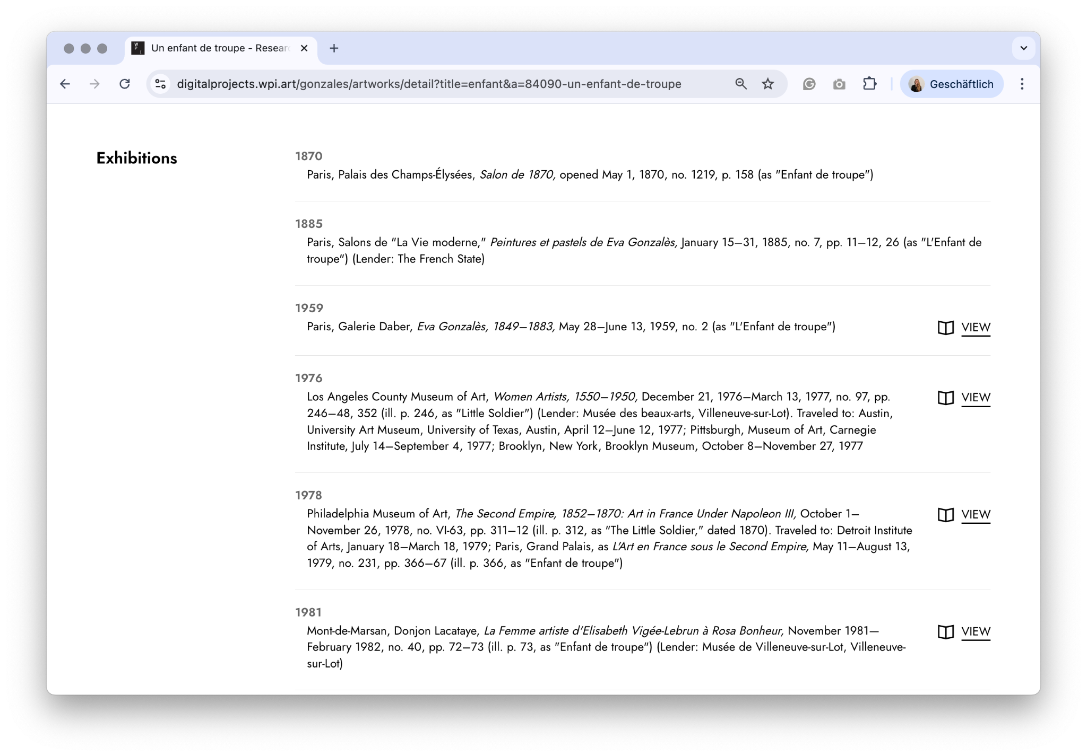

Slide 10
The more the better
Context matters
Respect copyright
Be uncertain honestly
We need to pay for it.

Slide 11
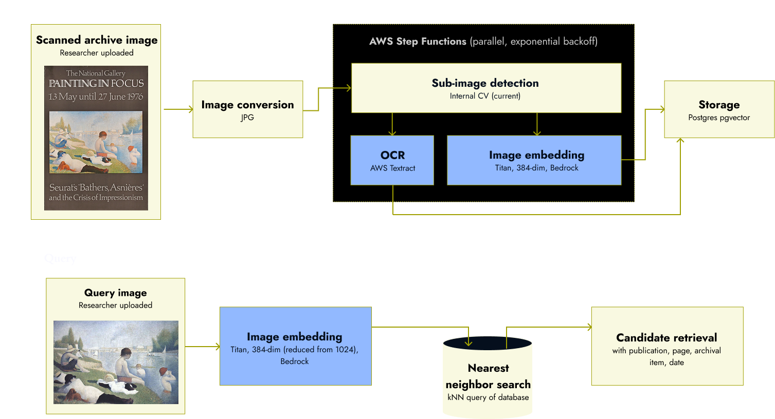
Managed AWS Self-hosted

Slide 12
Sub-image detection
(Inveral CV)
Image embedding generation
(Titan, 384-dim, Bedrock)
Scanned archival image
Image conversion to JPG
OCR
(AWS Textrack)
Storage
Postgres(pgvector)
Image of a painting
Image embedding generation
Candidate Retreiva with contextl

Slide 13
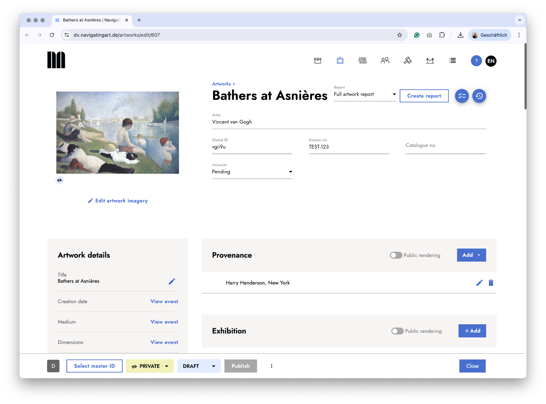

Slide 15
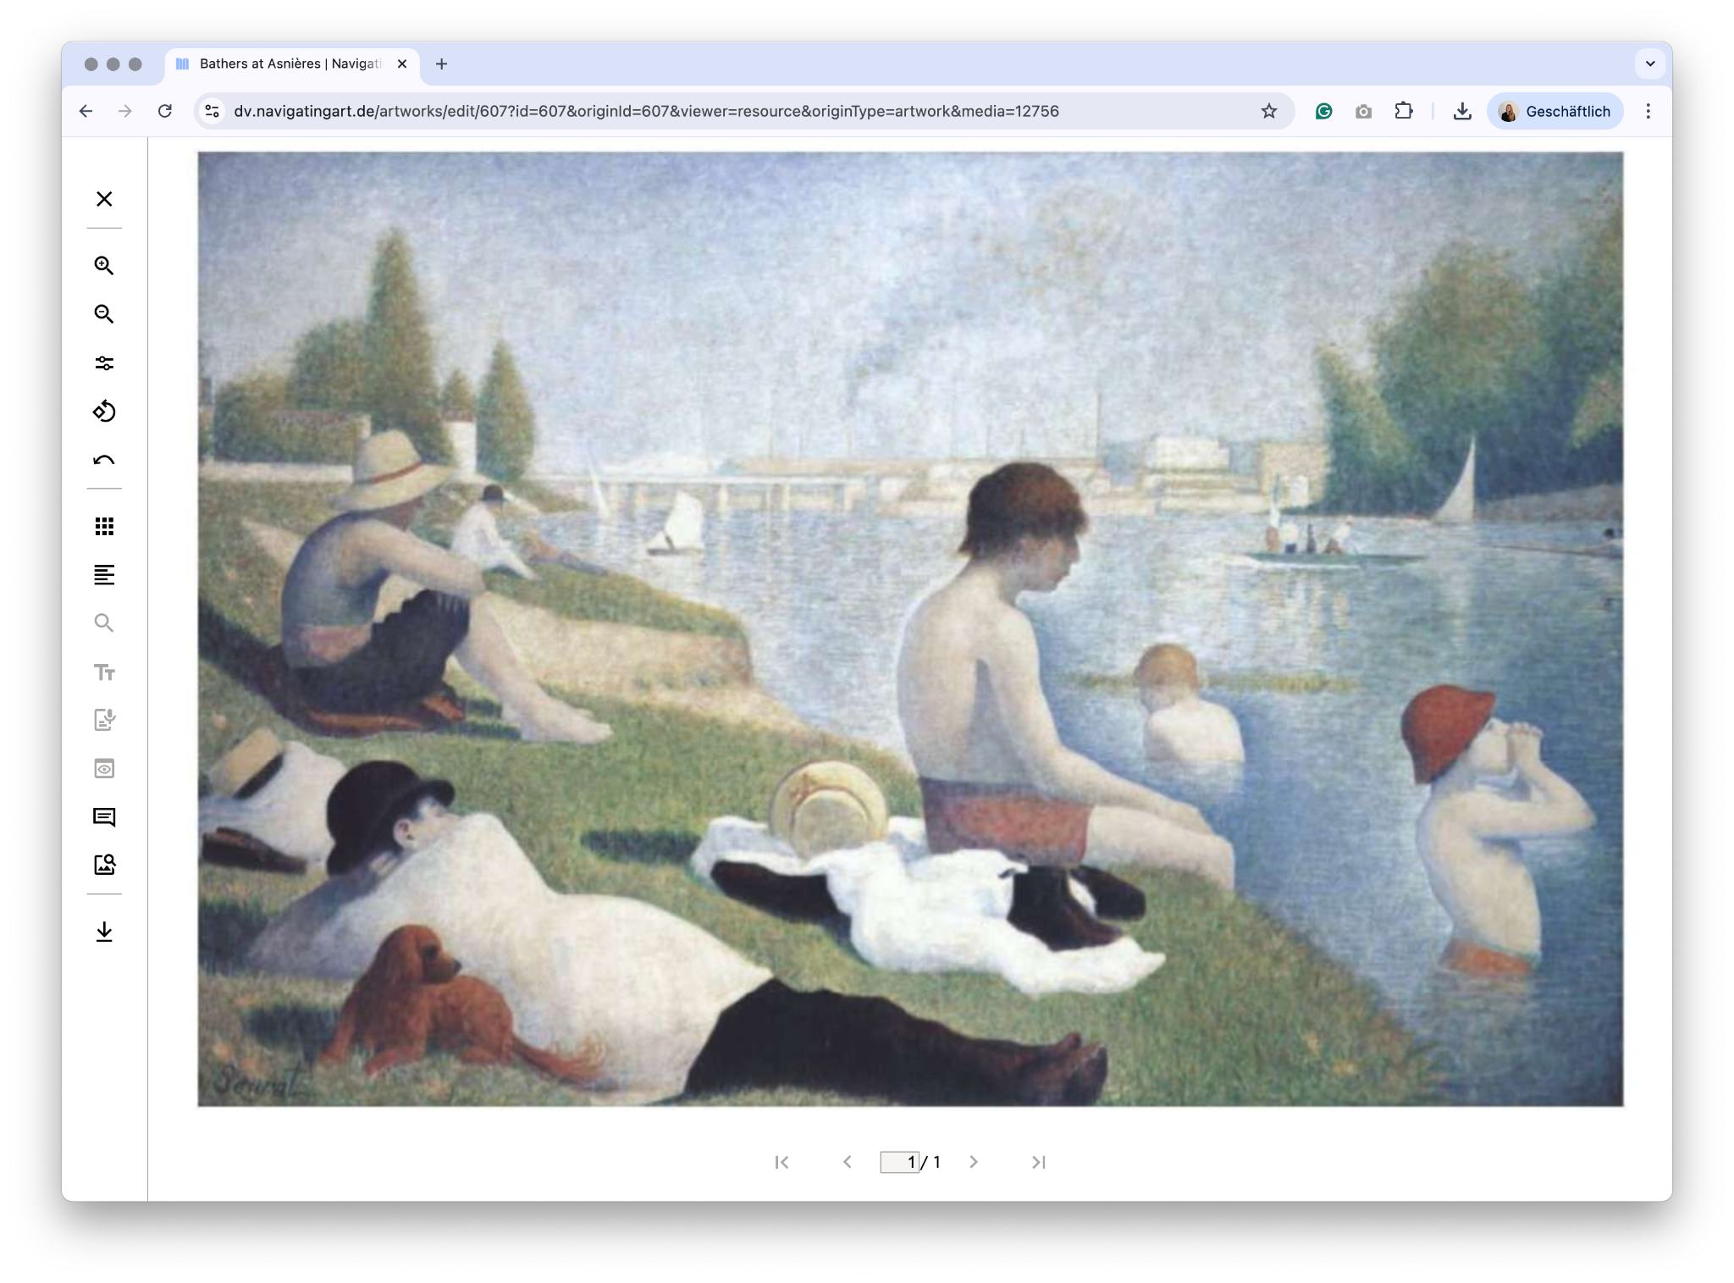

Slide 17
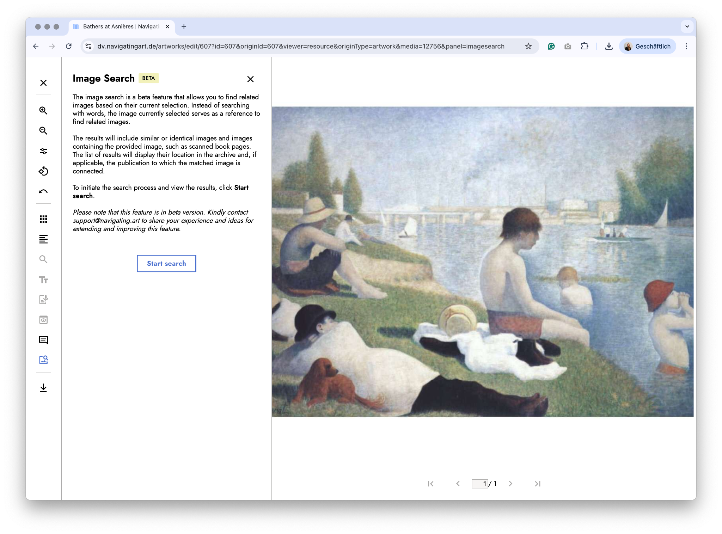

Slide 19
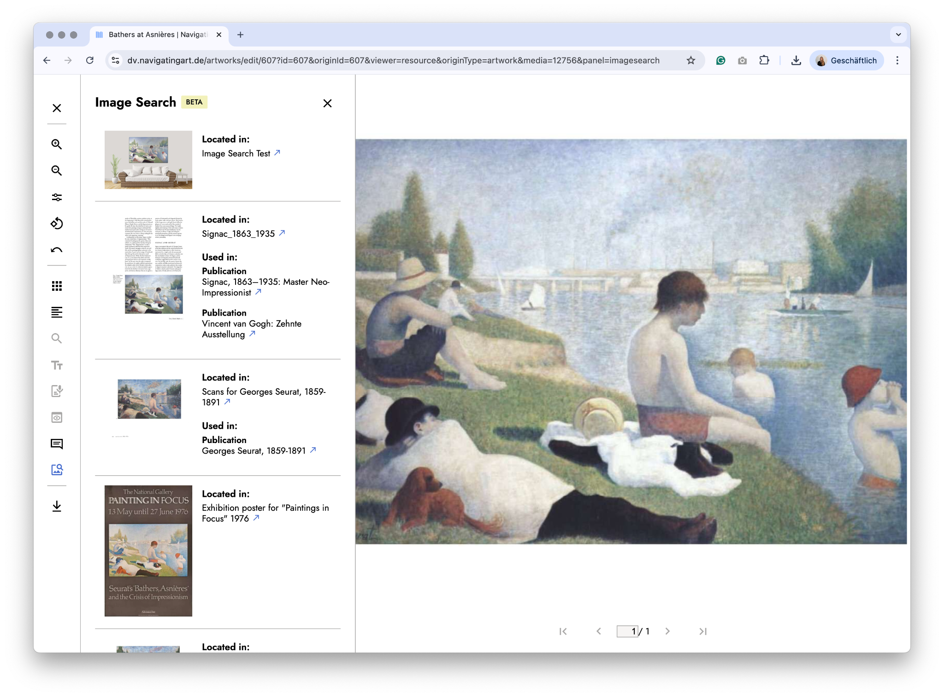

Slide 20


Slide 21
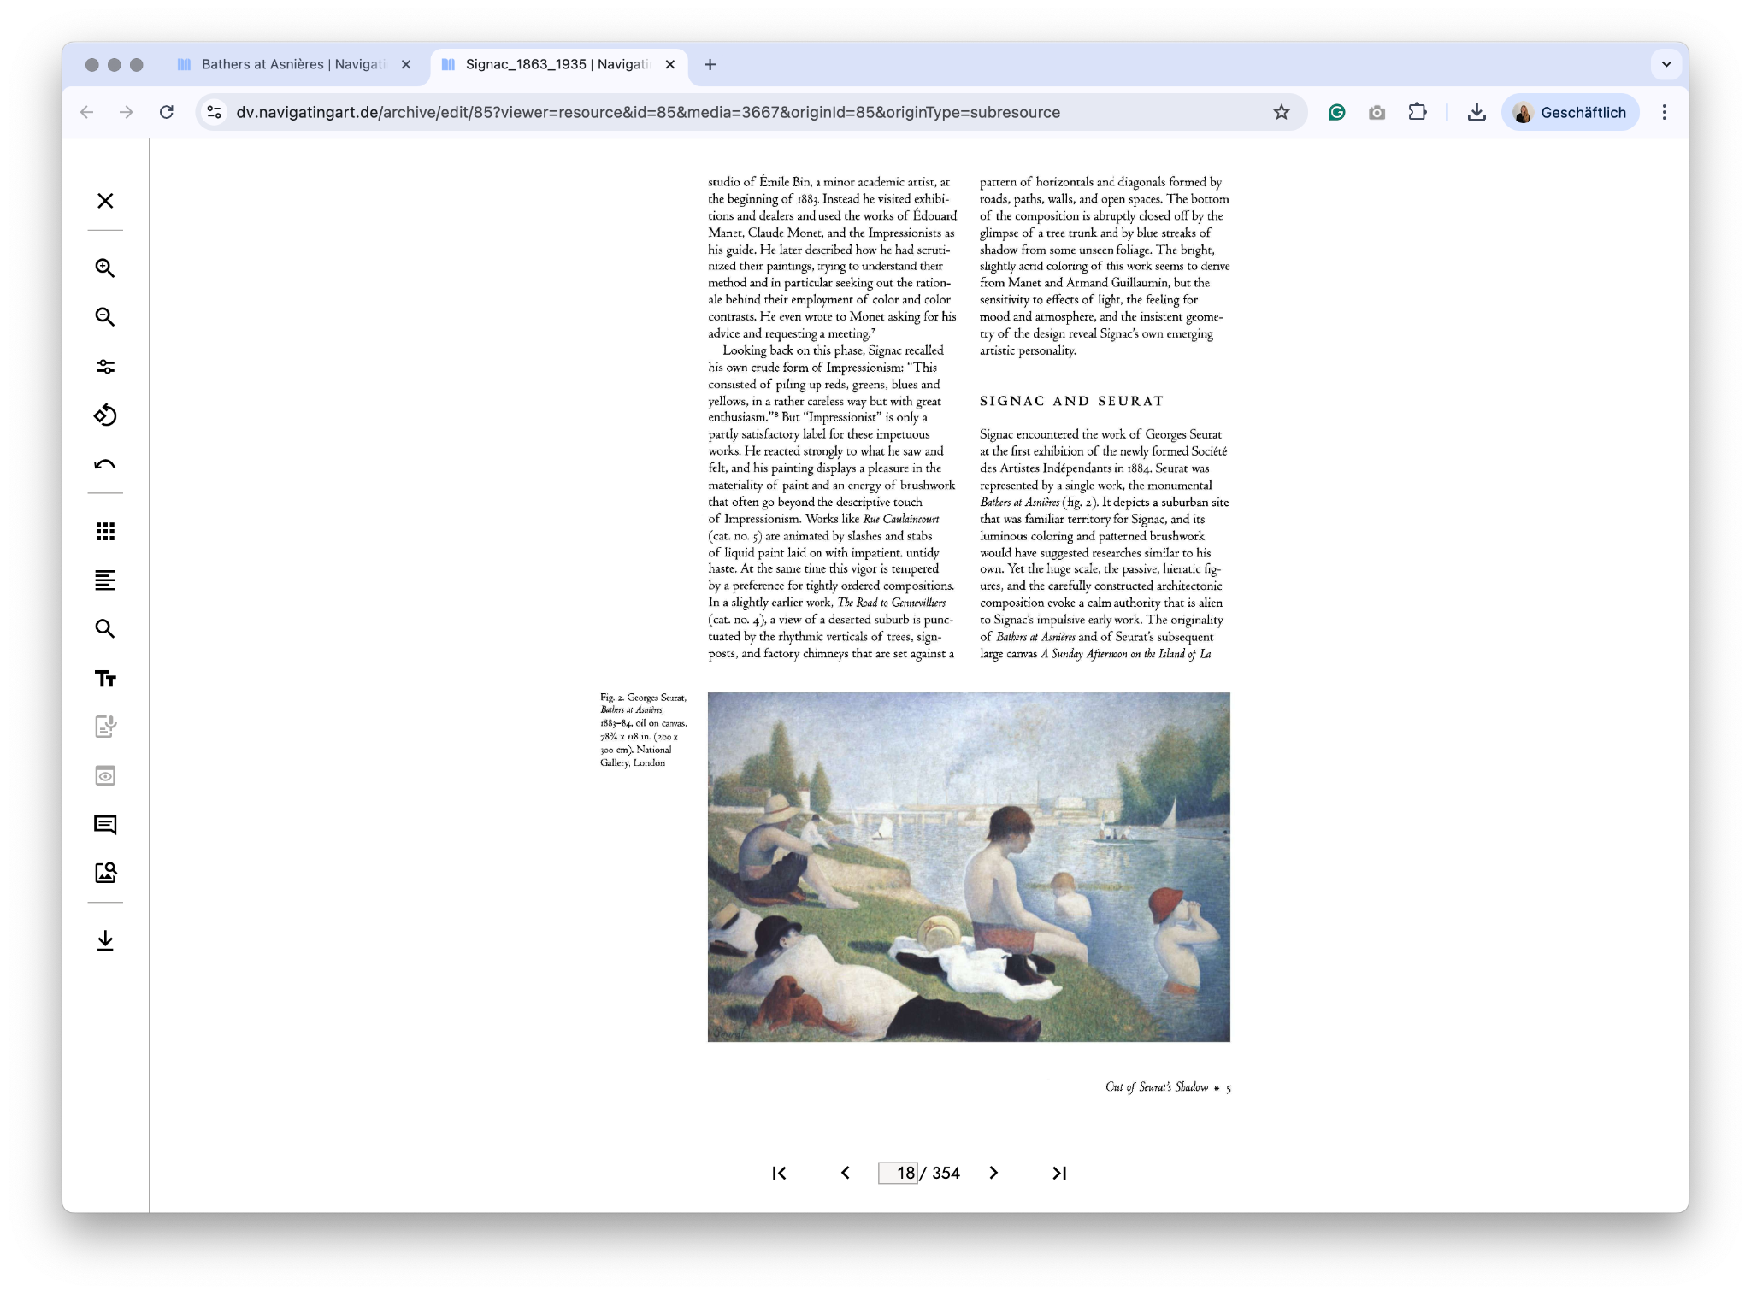

Slide 22
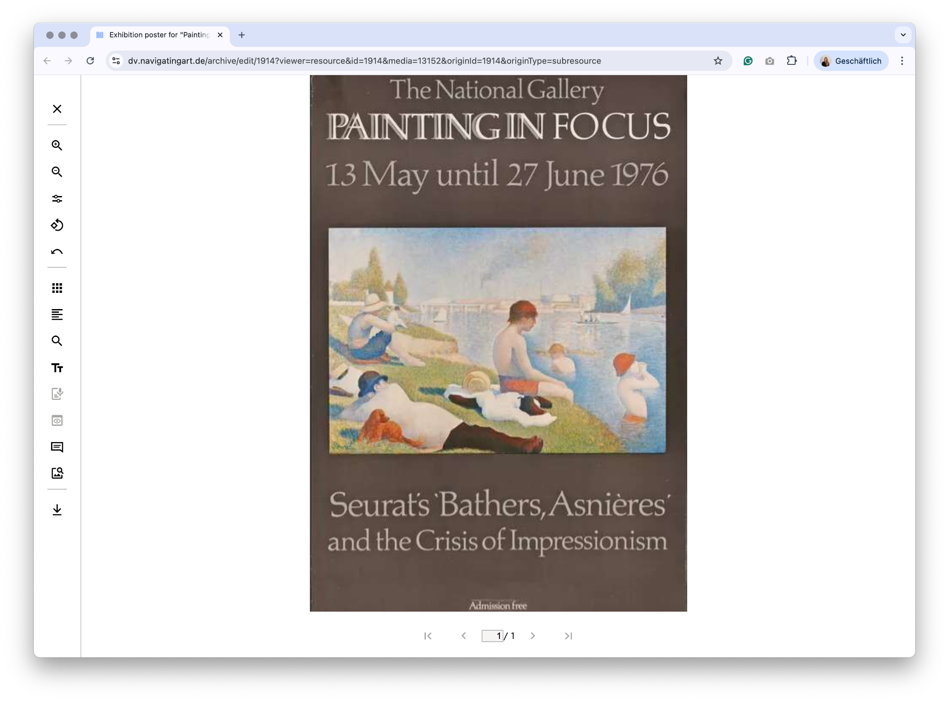

Slide 23
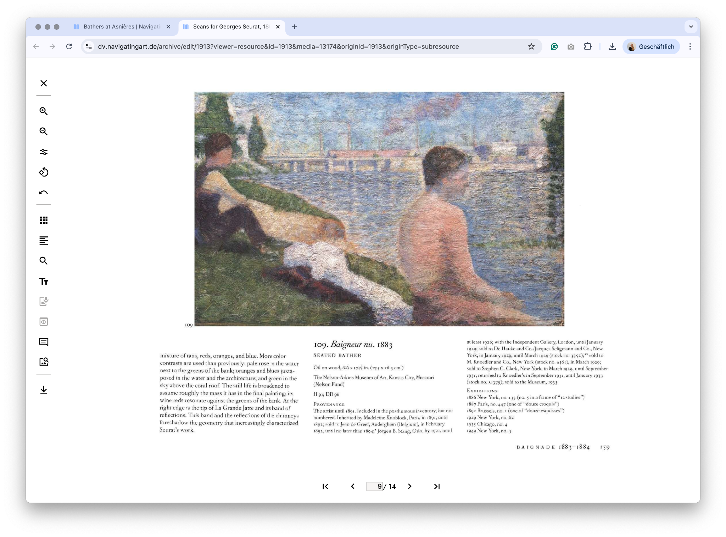

Slide 26
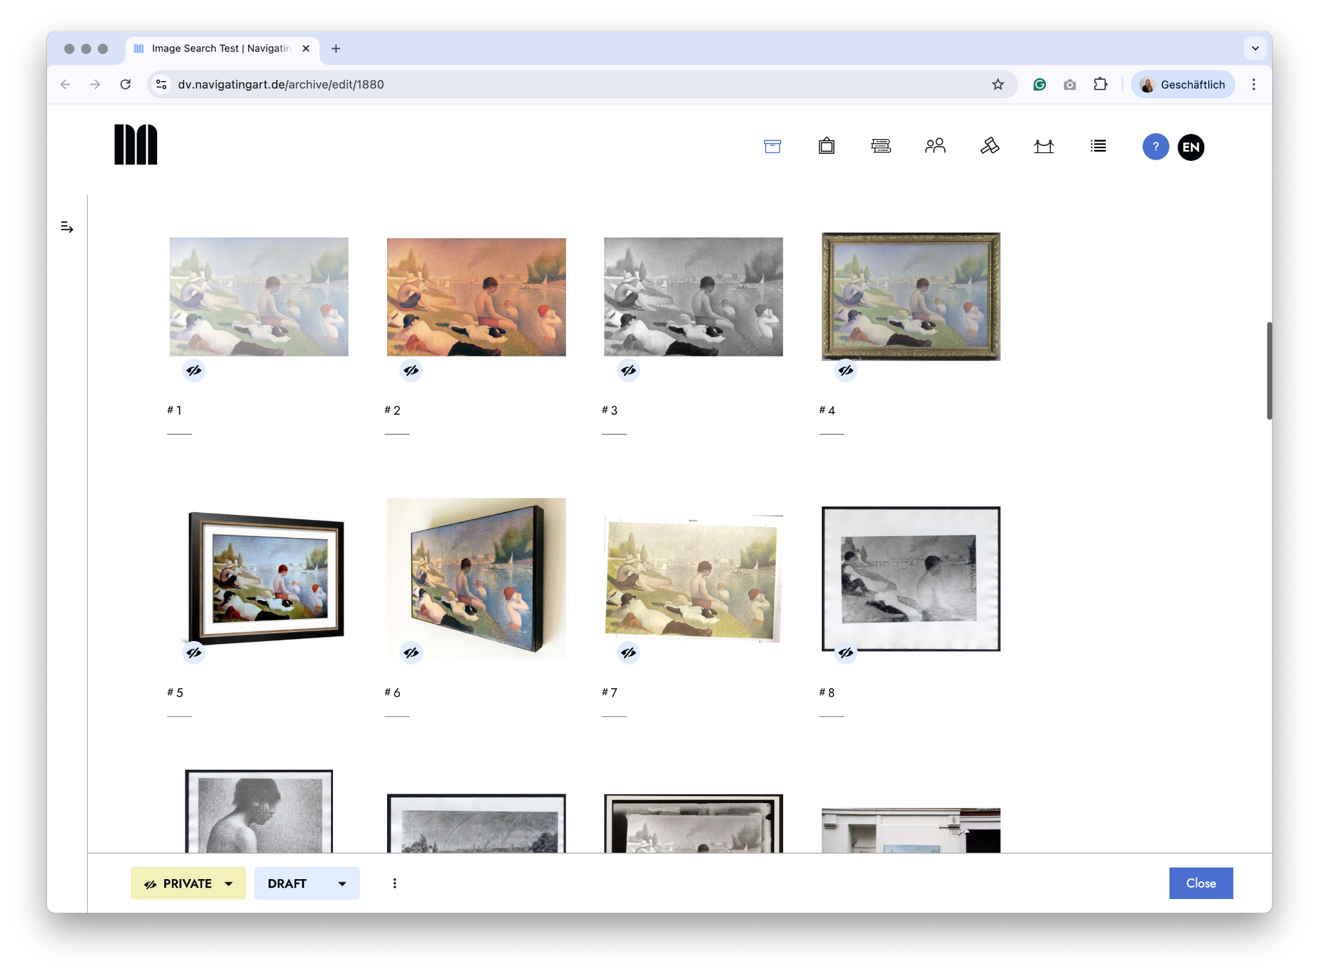

Slide 27
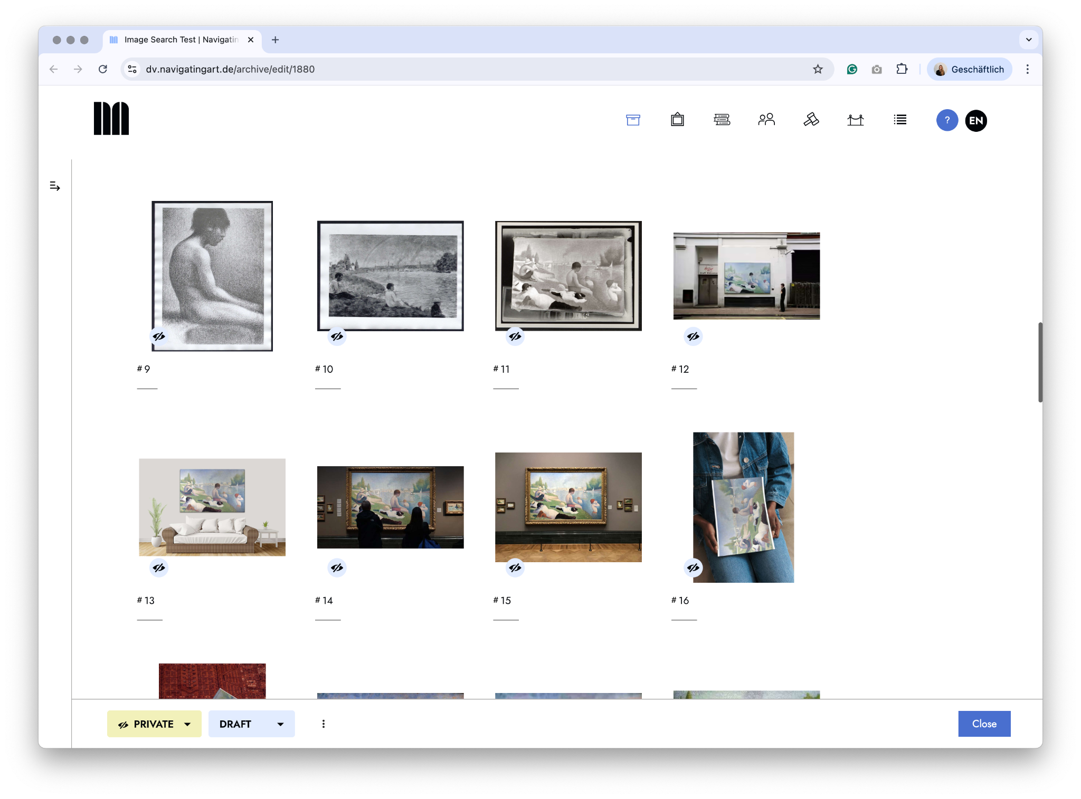

Slide 28
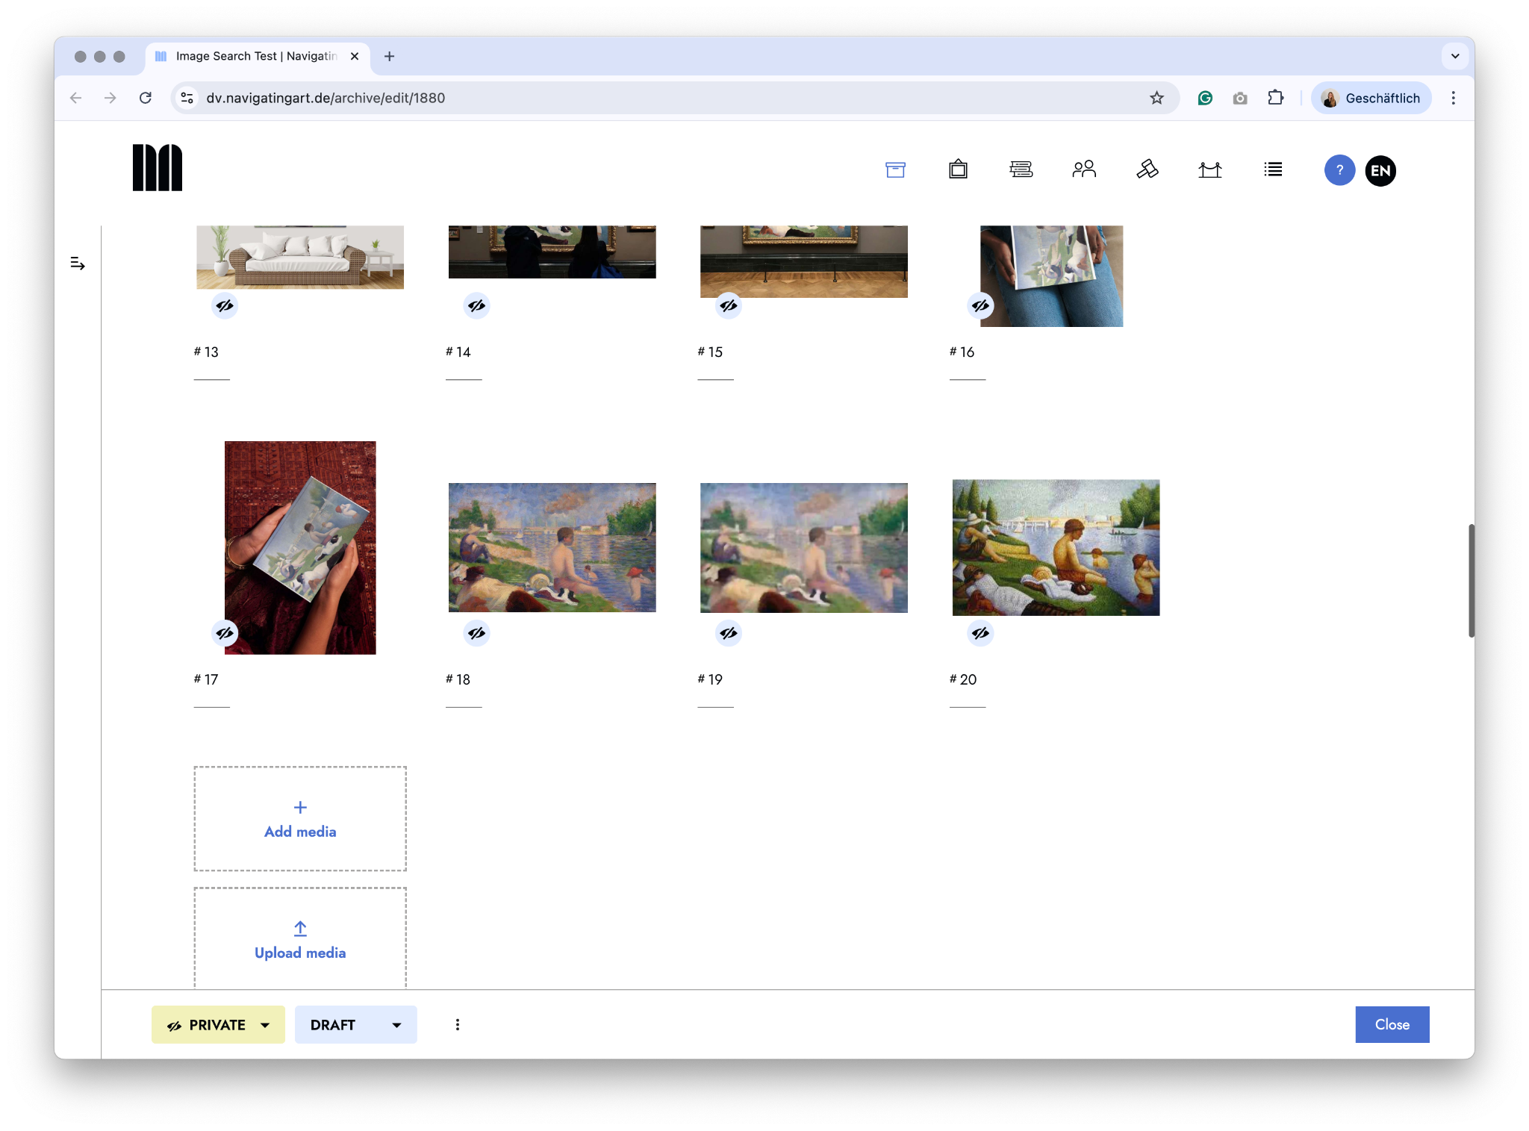

Slide 30
THANK YOU
Dr. Kiersten Thamm (me). kiersten.thamm@navigating.art
Katjana Berndt. katjana.berndt@navigating.art
Aditya Yadav. Aditya.yadav@navigating.art

