Slide 1
Using AI in Icon Analysis
AI and Artworks: Object Detection, Image Classification and Iconographic Analysis

Slide 2
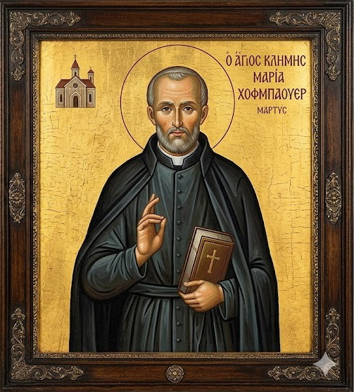
ΕἰΚΩΝ
The term comes from the Greek word ikon meaning image. An icon was originally a picture of Christ on a panel used as an object of devotion in the orthodox Greek Church from at least the seventh century on.
In Eastern Orthodox Christianity icon is a representation (as in a mural, a mosaic, or a painting on wood) of sacred events or especially of a sacred individual used as an object of veneration or a tool for instruction.
AI generated icon of St. Clement Mary Hofbauer, patron saint of Vienna

Slide 3
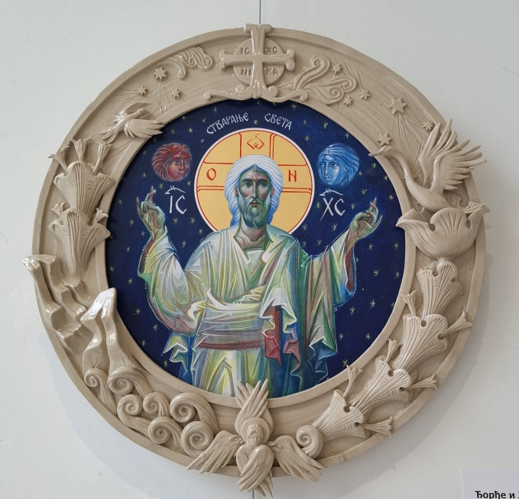
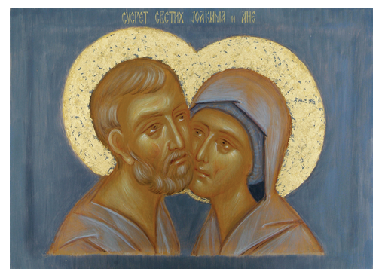
THE LIGHT OF THE LOGOS
International exhibition of sacred art held last year in Belgrade, Serbia
Authors are iconographers and contemprary artists
Icons are created on diverse surfaces in various techniques
Đorđe and Jelena Savić, The Creation of the World, acrylic on MDF, ceramics
Mara Ognjenović, The Meeting of Saints Joachim and Anne, egg tempera on panel

Slide 4
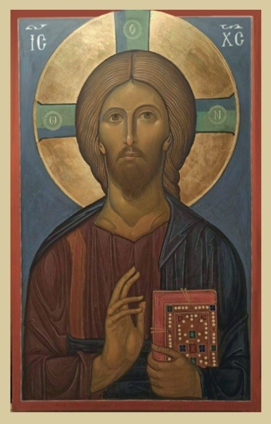
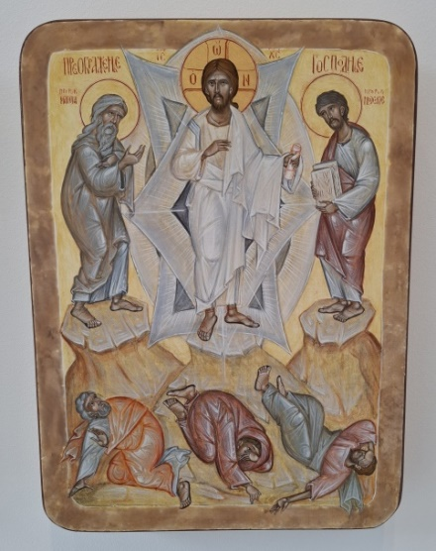
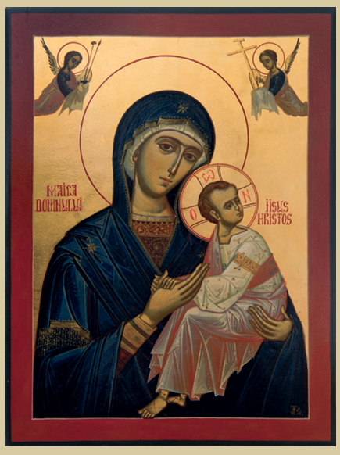
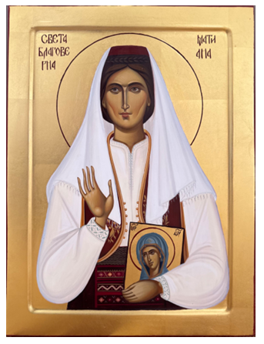
ICON
CLASSIFICATION
Jesus Christ
Virgin Mary
Saints
Collective icons
Siniša Trivić, The Transfiguration of the Lord, egg tempera on panel
Vladimir Bata Kidišević , Jesus Christ, egg tempera on wooden panel, gilding
Grigore Popescu-Muscel, Theotokos with Christ, egg tempera on panel
Andrea Simić, Saint Anna the Mother, egg tempera on panel with gilding

Slide 5
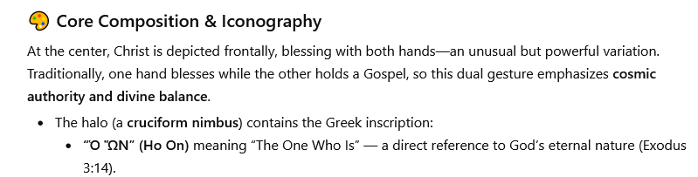
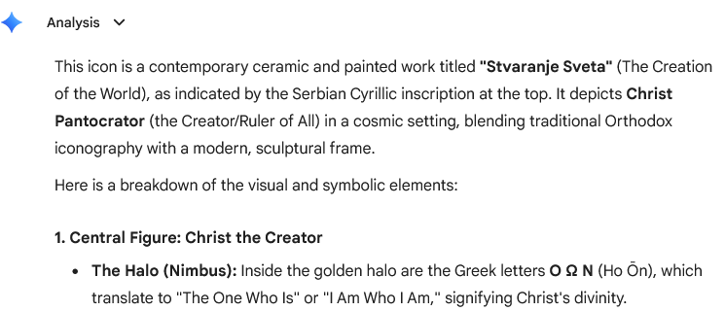
Could you please analyze this icon?
ChatGPT AI Art Analyzer
Gemini

Slide 6
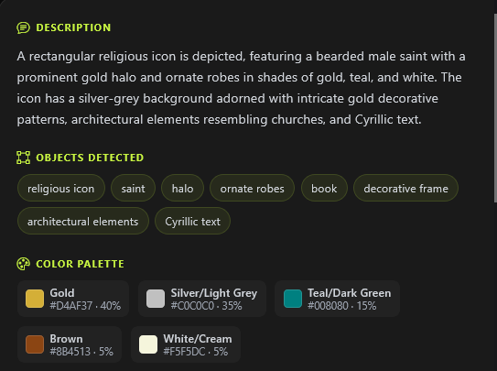
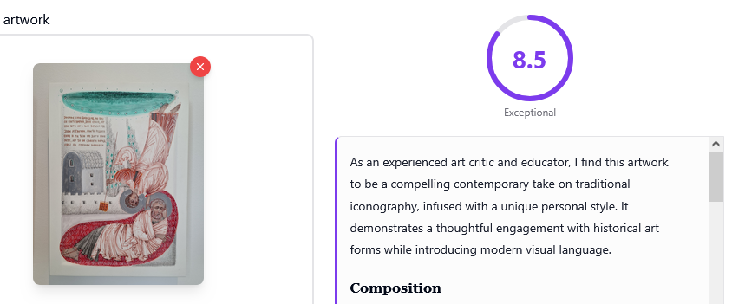
Analyze
Image
PANDA PIXEL
ART HELPER

Slide 7
STRENGTHS OF AI ART ANALYSIS
COLORS AND THEIR SYMBOLISM
AI effectively detects colors and their nuances, as well as their meaning in a specific detail, object, figure, or artwork as a whole.
GESTURES AND POSTURE OF THE SUBJECT
All gestures are accurately described and correctly identified, with their names in iconography stated.
GARMENTS AND DRAPERY
AI correctly identified all clothing items applying specific terms used in religion and iconography.
COMPOSITION
Composition and simmetry are identified with remarkable accuracy.

Slide 8
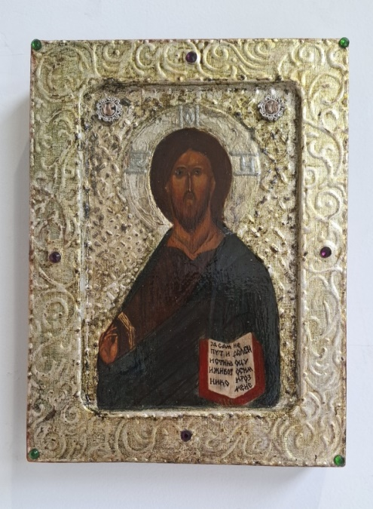
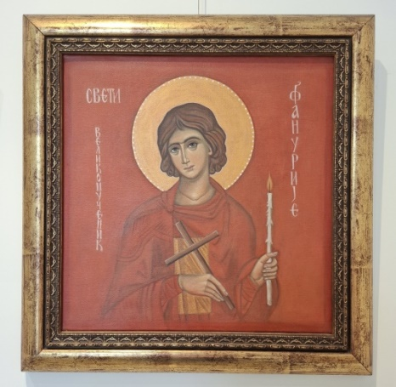
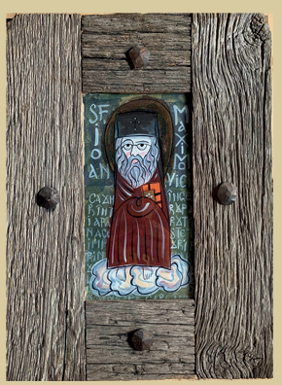
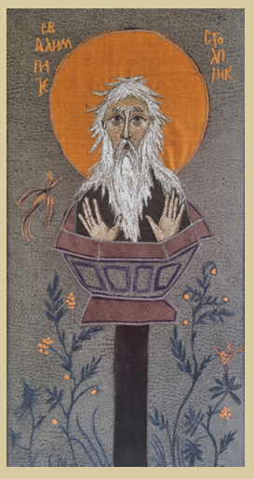
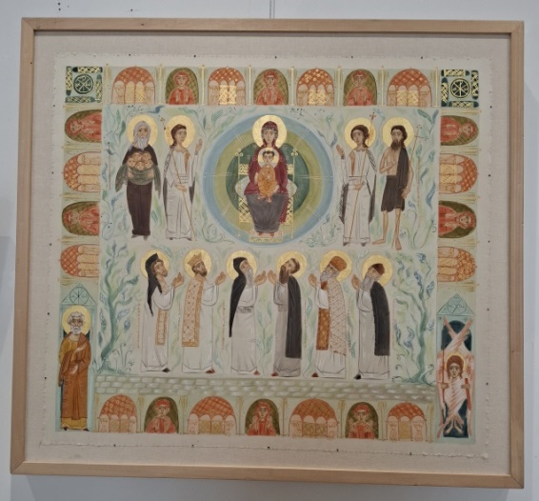
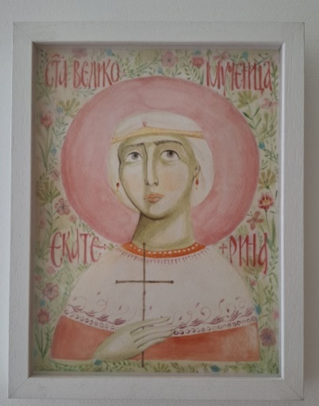
TEXTURE ANALYSIS
Ivana Bambić, Saint Phanourios, acrylic on canvas
Alin Bogdan Pater , Saint John of Shanghai, egg tempera on glass
Stefan Đurđanović, Christ the Savior, pigment on board, silver leaf, relief paste
Milica Mišić, Heavenly Liturgy: Saint Deacon Avakum, Prince Lazar, Saint Simeon, Saint Sava, Saint Bishop Nikolaj of Žiča, and Saint Justin of Ćelije offer prayers before the throne of the Most Holy Theotokos and Our Lord Jesus Christ, egg tempera on silk
Marija Vukosavljević , Saint Alypius the Stylite, embroidery
Višnja Devrnja, Saint Catherine the Martyr, watercolor

Slide 9
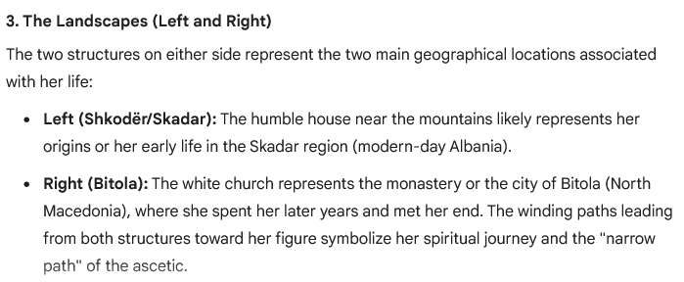
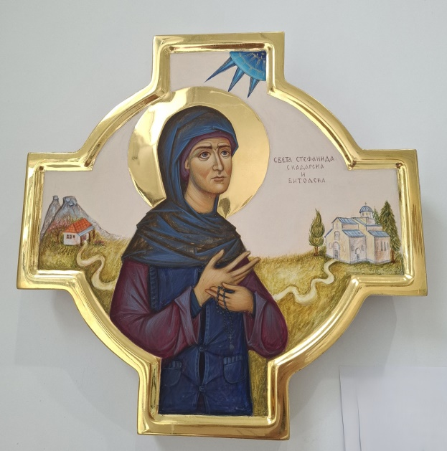
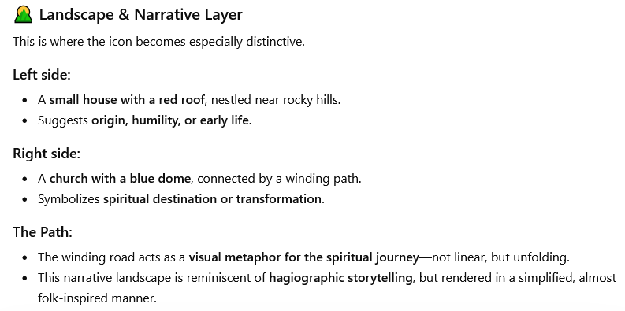
TEXTUAL INFORMATION ANALYSIS
Suzana Parenta, Saint Stephanida of Skadar and Bitola, egg tempera on linden panel, burnished 24k gold

Slide 10
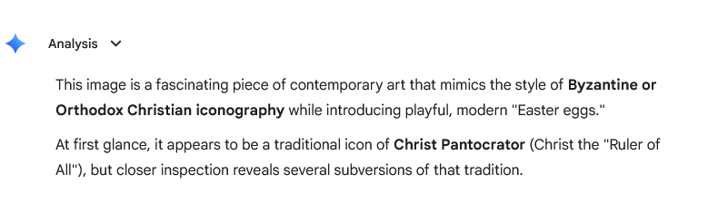
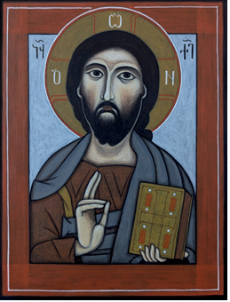
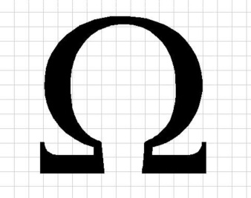
“Iconography Meets Modern Tech Satire”
The Greek letter omega, often paired with alpha , represents Christ in Orthodox Christianity as the "Beginning and the End," signifying his eternal nature (Revelation 22:13). It is typically depicted flanking Christ’s head on icons or in the cross-monogram .
Jeffrey Gomez, Christ Pantocrator, egg tempera (Philippines-Romania)

Slide 11
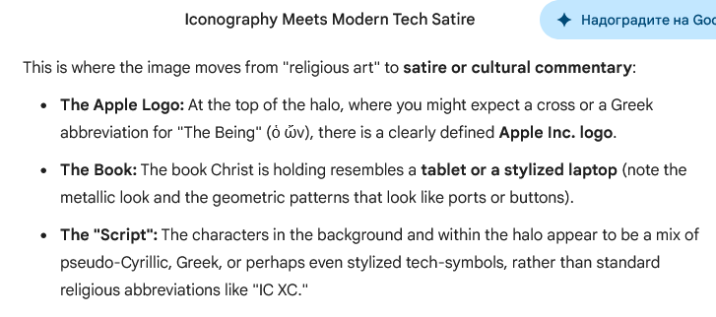
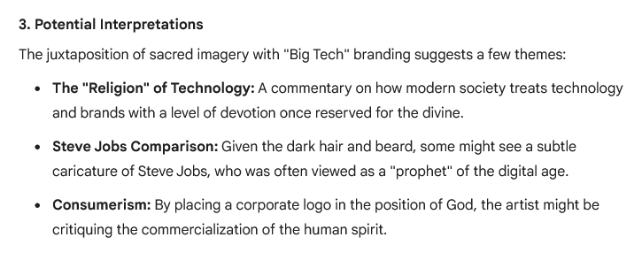

Slide 12
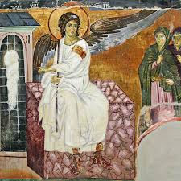
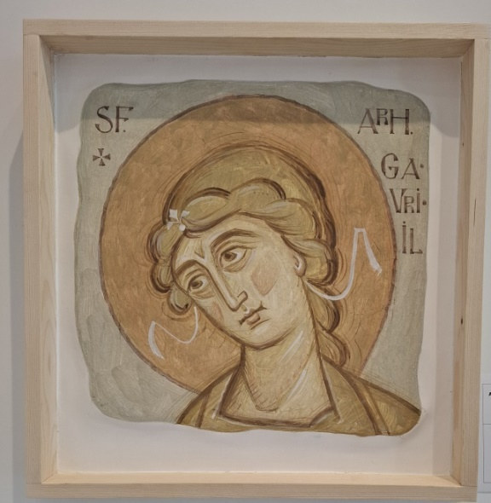
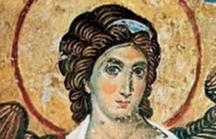
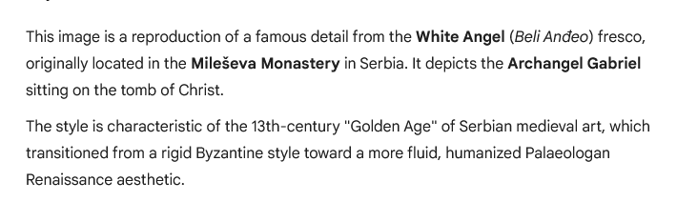
Is this reproduction?
Andrei Florin Musat , Arhanghel Gabriel, fresco
Gemini

Slide 13
Thank you for your attention!
Vielen Dank für Ihr Aufmerksamkeit!
ljudmiladjukic@gmail.com

