Slide 1
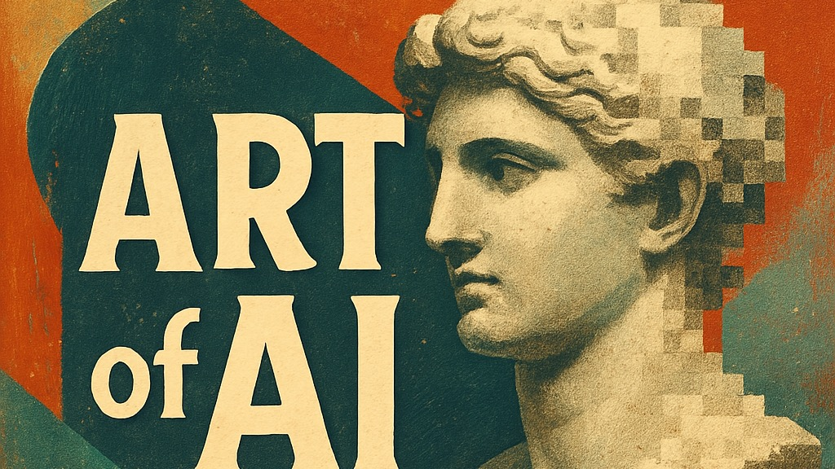
Learning from Small Data: Adapting Pretrained Diffusion Models for 17th Century Painting
Katarina Mohar, France Stele Institute of Art History, ZRC SAZU
AI and Artworks: Object Detection, Image Classification and Iconographic Analysis
Vienna, 16th April 2026

Slide 2
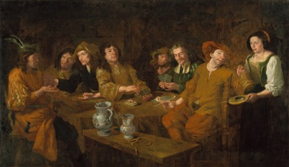
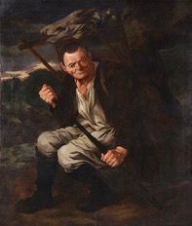
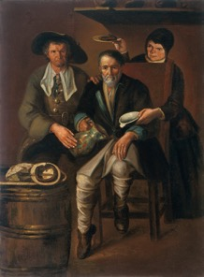
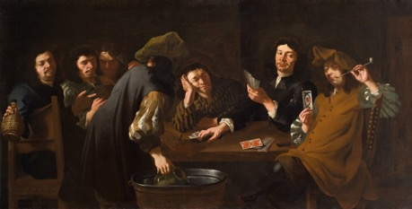
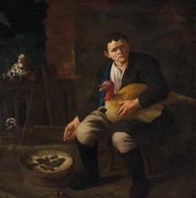
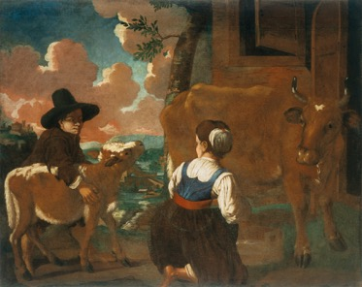
Joannes Almenak (c. 1640 – after 1684)
All images: ©️ National Gallery of Slovenia
Preserved paintings:
Copies after lost originals:
The Card Players I
The Peddler
Shepherd and Shepherdess
The Card Players II
Boy with a Turkey
A Peasant Family

Slide 3
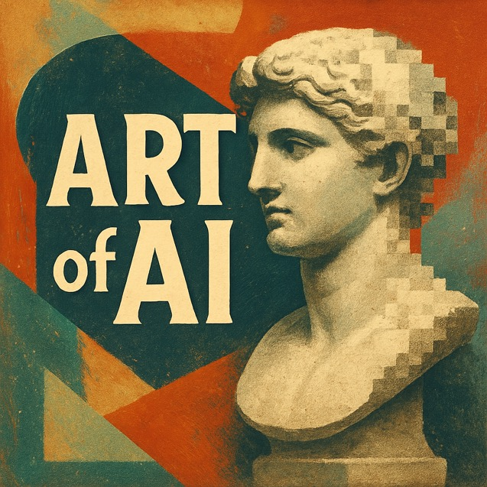
ARTofAI Project
Tools of the Future for Research of the Past. The Use of Generative Image Models for Humanities
@ ZRC SAZU, France Stele Institute for Art History, 2023–2026
Interdisciplinary team: art historians, computer scientist, philosopher
Main question: Can diffusion models, fine-tuned on very small datasets, support the study of damaged, fragmentary, or lost artworks?
Approach: AI as a tool for controlled speculation, not a replacement for expertise
Focus: style learning, recurrent visual patterns, speculative visual hypotheses

Slide 4
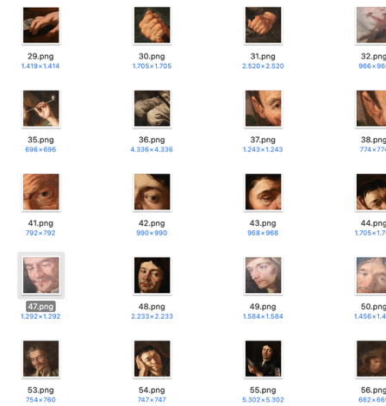
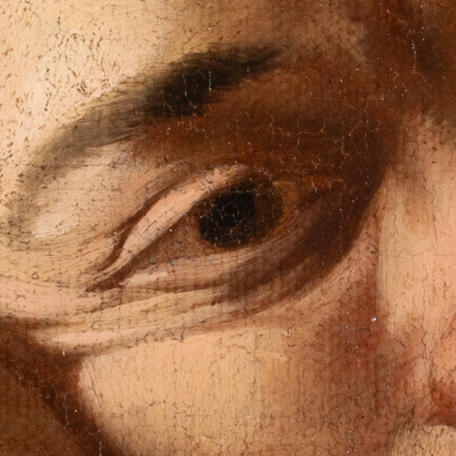
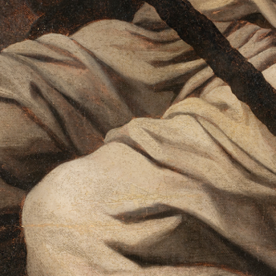
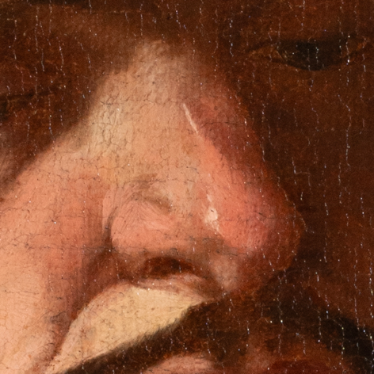
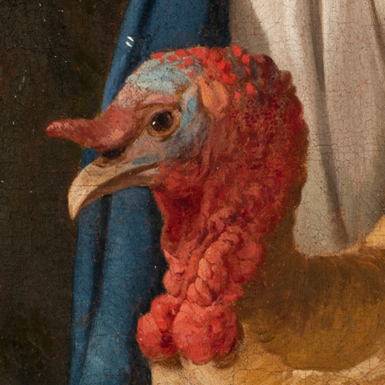
Training Data: Images
High-quality, rights-cleared images
Segmented into fragments: faces, hands, objects, details.
Corpus: 4 preserved paintings → 99 fragments

Slide 5
Training Data: Captions
We tested four caption types:
        Simple – short, human-written labels
        Expert – art-historical descriptions
        VLM – AI-generated sentences
        CLIP Tags – AI-generated keywords)
Initial hypothesis: richer captions might affect what the model learns
Almenak: Boy with a Turkey, fragment/detail ©️ NG Sl
Simple: “turkey head eyes neck”
Expert: “A turkey, 17th century, genre painting, highly realistic, low-life genre, resembling Giacomo Ceruti, resembling Michiel Sweerts”
VLM: “The image is a close-up of a turkey's head and neck ... red feathers, which appear to be roosters ... realistic style ...”
CLIP: “a painting of a turkey ... Rembrandt ... anthropomorphized chicken ... the bird is wearing a bowtie ... walter white, 18th century ...”

Slide 6
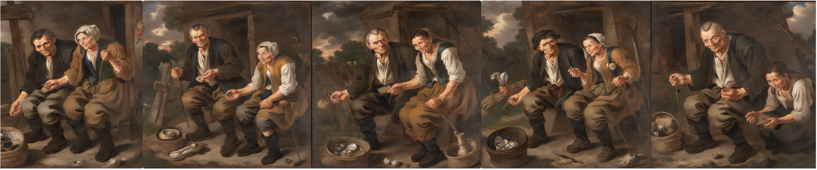
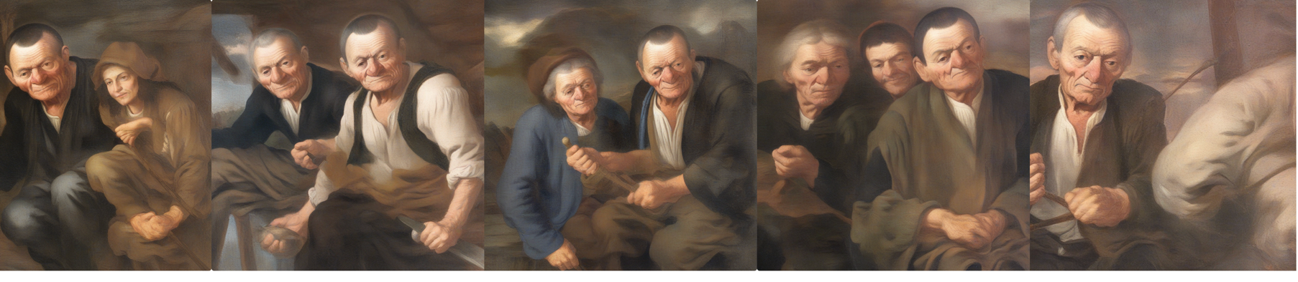
LoRA vs. DreamBooth: Expert Evaluation
7 expert evaluators, paired comparison study
LoRA preferred over DreamBooth in:
          73.8% of coherence judgments
          69.0% of composition judgments
          66.7% of style judgments
LoRA
DreamBooth

Slide 7

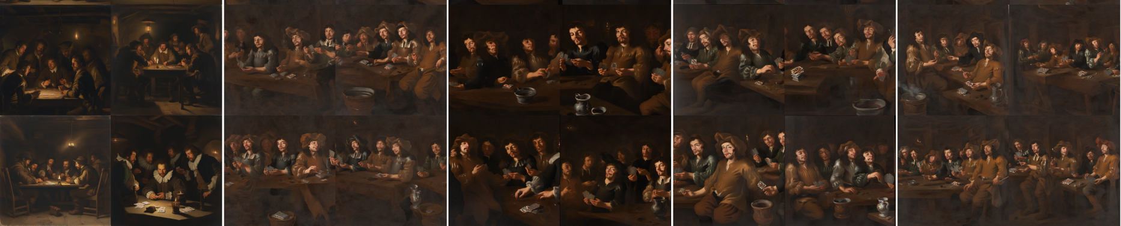
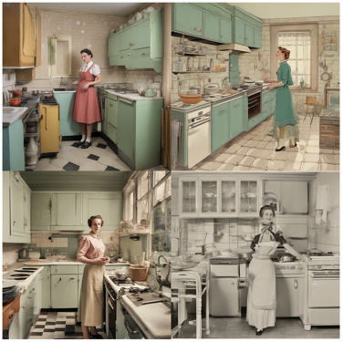
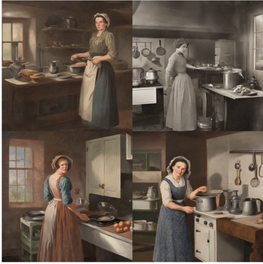
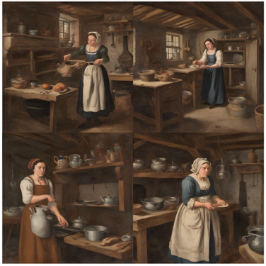
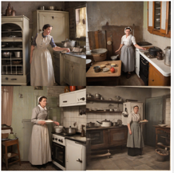
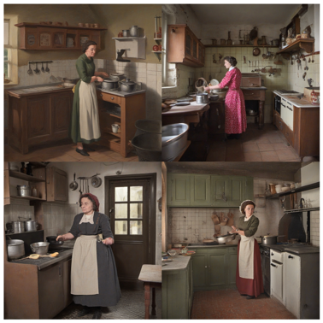
LoRA: Visible Stylistic Shift
Outputs often shifted away from the base model
Shared tendencies across caption types
Closer to Almenak’s palette, light, and surface treatment
Caption type had little visible effect on style
Almenak: The Card Players I
Base model
Simple
VLM
Expert
CLIP
Notes:
Prompt: A group of men playing cards in a smoky tavern interior, candlelit and dim, in a Flemish Baroque genre painting with visible brushwork, chiaroscuro lighting, and earthy palette in style of almnk

Slide 8
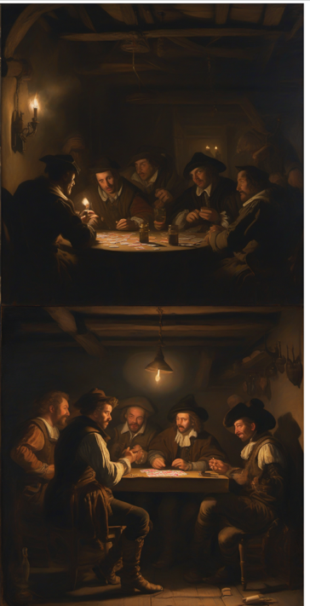
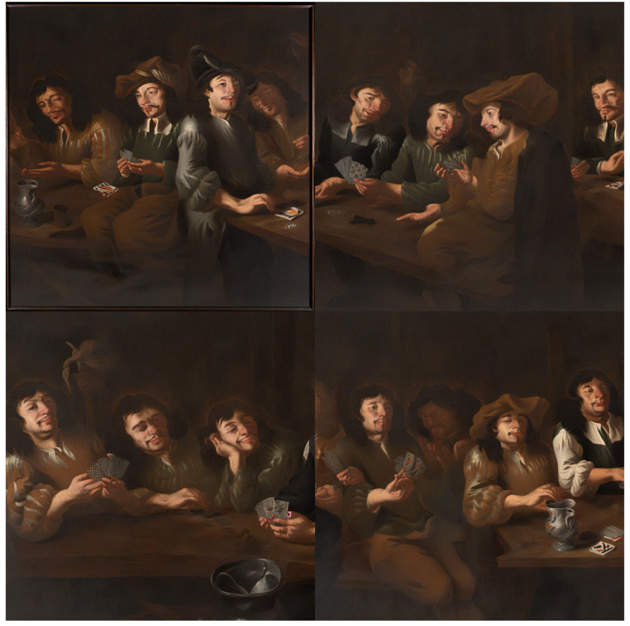
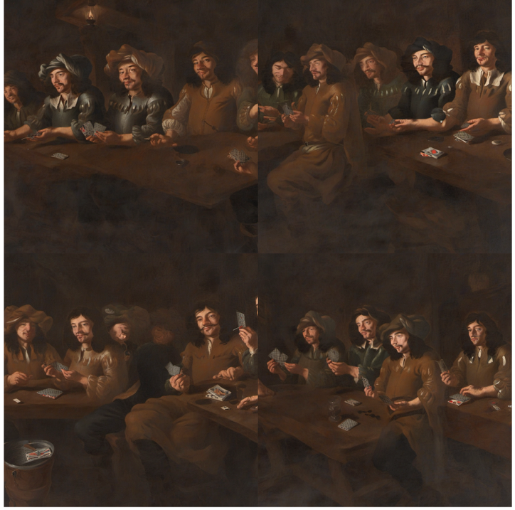
Almenak: The Card Players II
Base model CLIP Captions Simple Captions
Prompt: A group of men playing cards in a smoky tavern interior, candlelit and dim, in a Flemish Baroque genre painting with visible brushwork, chiaroscuro lighting, and earthy palette

Slide 9
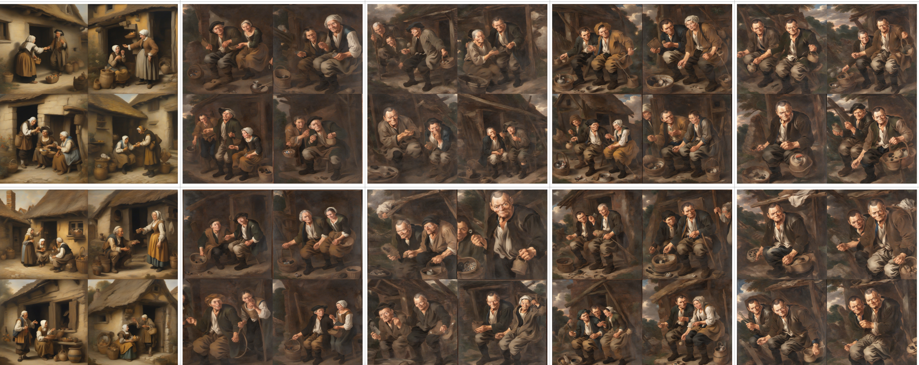

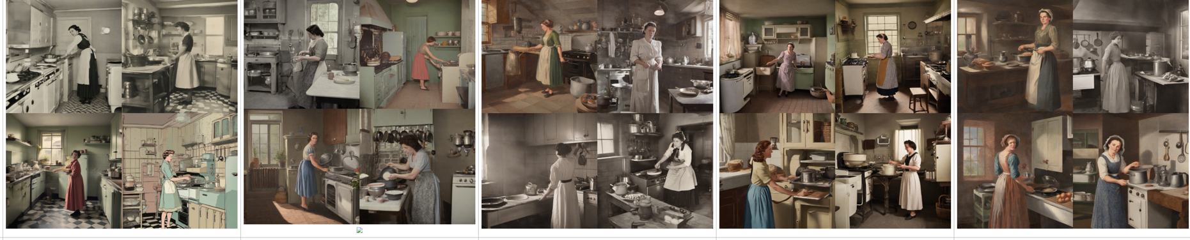
Captioning: Weak Effect on Style, Stronger on Content
No major stylistic difference between caption sets
Differences appeared more clearly in semantic behaviour
Simple / VLM often showed more literal reuse of training fragments
Expert / CLIP sometimes allowed more flexible recombination
Captioning seemed to shape content more than style
Almenak: The Peddler
Base model CLIP VLM Expert Simple
+
Notes:
An elderly peddler showing trinkets to a peasant woman outside a cottage

Slide 10
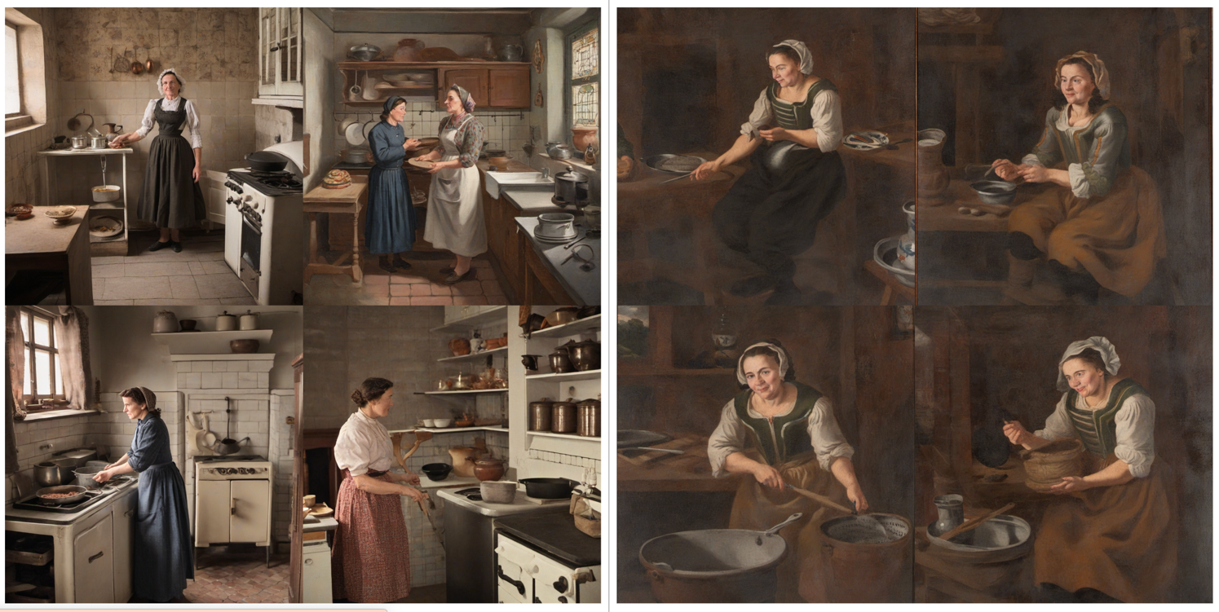
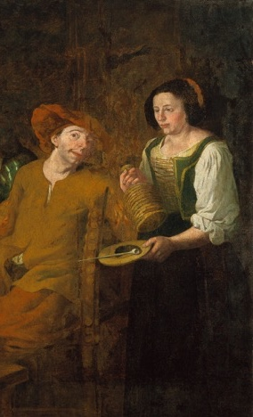
Expert Captions Simple Captions Training Data
Prompt: A woman in a 20th Century kitchen
Almenak: The Card Players I (detail)

Slide 11
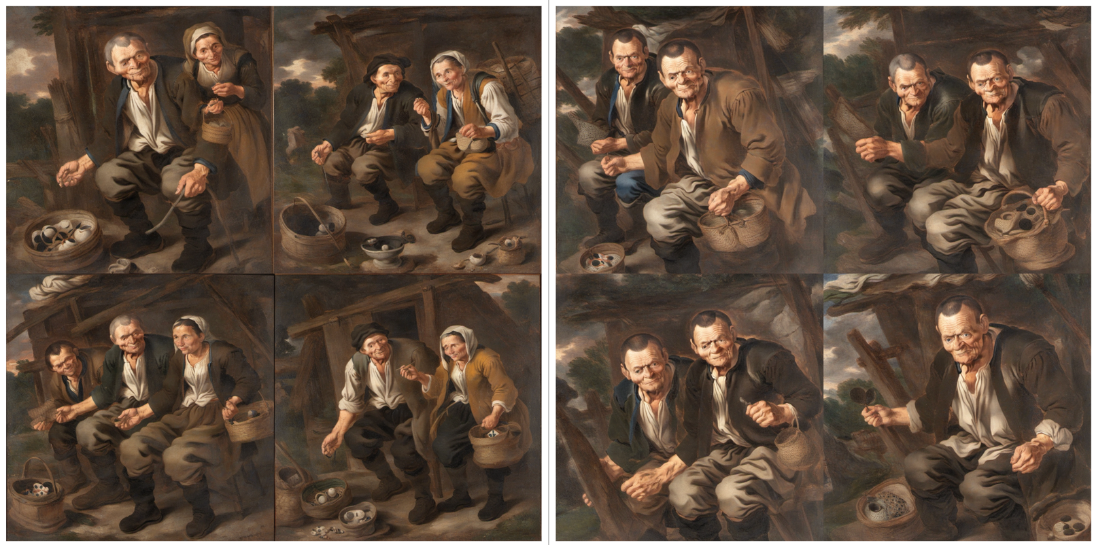
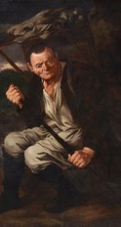
Expert Captions Simple Captions Training Data
Almenak: The Peddler (detail)
Prompt: An elderly peddler showing trinkets to a peasant woman outside a cottage, depicted in the style of a 17th-century oil painting, with expressive gestures, ochre tones, and soft painterly edges

Slide 12
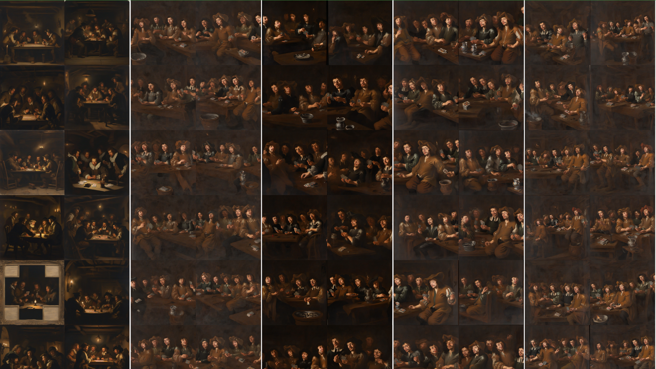
What the Experiment Clarified
Even very small corpora can shift a pretrained diffusion model
LoRA worked better than DreamBooth
Captioning shaped semantic orientation more than style
Composition remained the major unresolved issue
With small datasets, structure matters as much as quantity

Slide 14
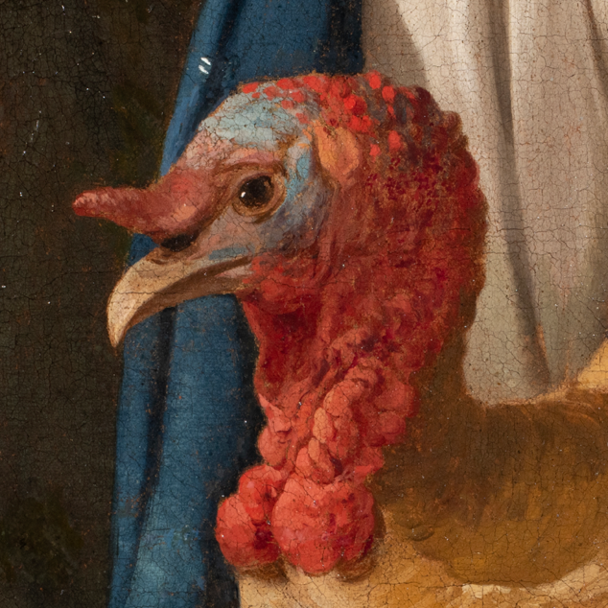
The Dataset
Image Corpus:
99 fragments cropped from 4 preserved works
Captions created in 4 distinct styles:
Simple (Human)
Expert (Art Historian)
VLM (AI-generated full sentence descriptions)
CLIP Tags (AI-generated keywords/textual tags)
Simple: turkey, head, eyes, neck
Expert: A turkey, 17th century, genre painting, highly realistic, low-life genre, resembling Giacomo Ceruti, resembling Michiel Sweerts
VLM: The image is a close-up of a turkey's head and neck. The turkey is facing towards the left side of the image, with its head turned slightly to the right. The head of the turkey is covered in red feathers, which appear to be roosters. The feathers are arranged in a rooster-like pattern, with some overlapping each other. The beak is slightly open, and the eyes are looking directly at the viewer. The background is a dark blue, and there is a white curtain visible in the background. The painting is done in a realistic style, with loose brushstrokes and vibrant colors.
CLIP: a painting of a turkey, high detail baroque oil painting, detailed baroque oil painting, ( rembrandt ), anthropomorphized chicken, the bird is wearing a bowtie, giuseppe arcimboldo walter white, 18th century oil painting, 18th century oil painting, coxcomb, with the beak of an eagle, flemish painting

Slide 15
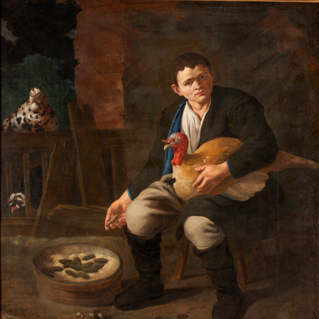
Simple: boy turkey sitting face gestures background
Expert: Painting, oil on canvas, depicting a boy of approximately 15 years of age, sitting in a dark courtyard and feeding a turkey. A boy has a sad and numb expression on his face. Realistic portrayal of working boy, and a portrayal of poverty. In the back of the painting two hens are depicted. In the style of Italian genre painting. Inspired by Flemish and Dutch Caravaggisti. Genre scene from the second half of the 17th century, low life genre. Brown and earthy colour palette.
CLIP: a painting of a man holding a chicken, inspired by David Teniers the Younger, inspired by David Teniers the Elder, inspired by David Teniers III, inspired by Pieter Lastman, inspired by Pieter Claesz, inspired by Jan Steen, dutch golden age painting, inspired by Friedrich von Amerling, by David Teniers III, inspired by Willem van Aelst
VLM: The image is a painting of a young man sitting on a chair with a rooster in his lap. The man is wearing a black jacket, white pants, and black boots. He has a serious expression on his face and is looking directly at the viewer. The rooster is a light brown color with a red comb and is resting its head on the armrest of the chair. In front of the man, there is a wooden bowl filled with black pebbles. Behind the man is a brick wall with a window and a wooden bench. On the left side of the image, there are two chickens sitting on the bench. The painting is done in a realistic style with loose brushstrokes and vibrant colors.

