Slide 1

Dr. Barbara Tramelli
Free University of Bozen, Italy
AI and Automatic Visual Recognition: Some Thoughts on the New Digital
Methodologies for Image Retrieval

Slide 2
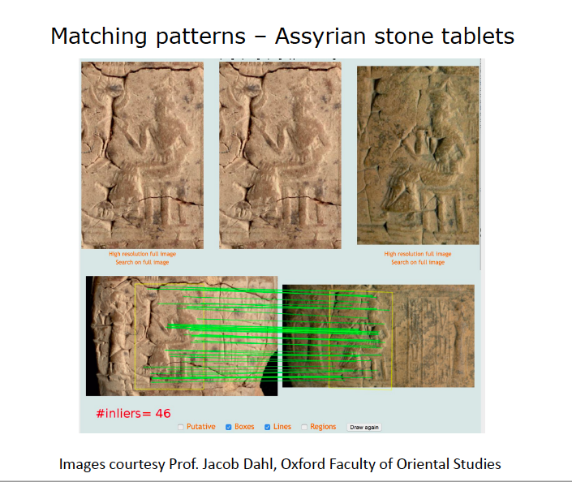
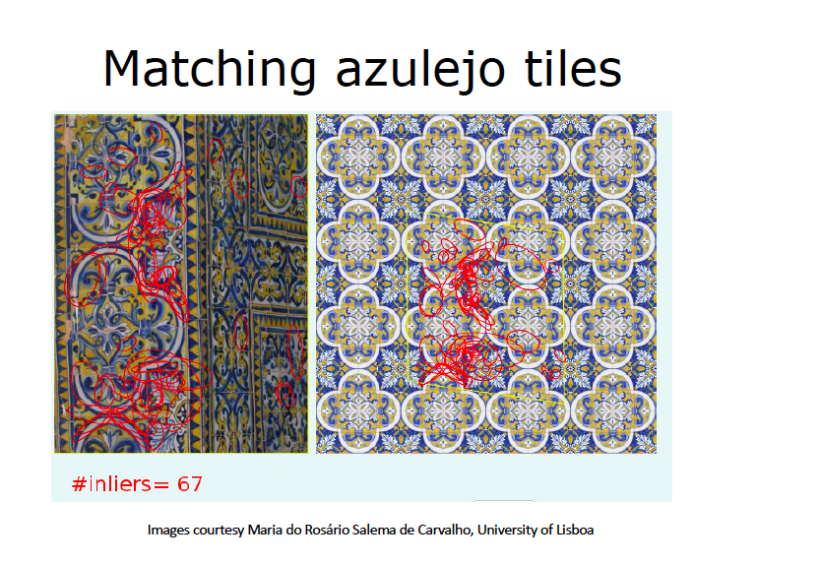
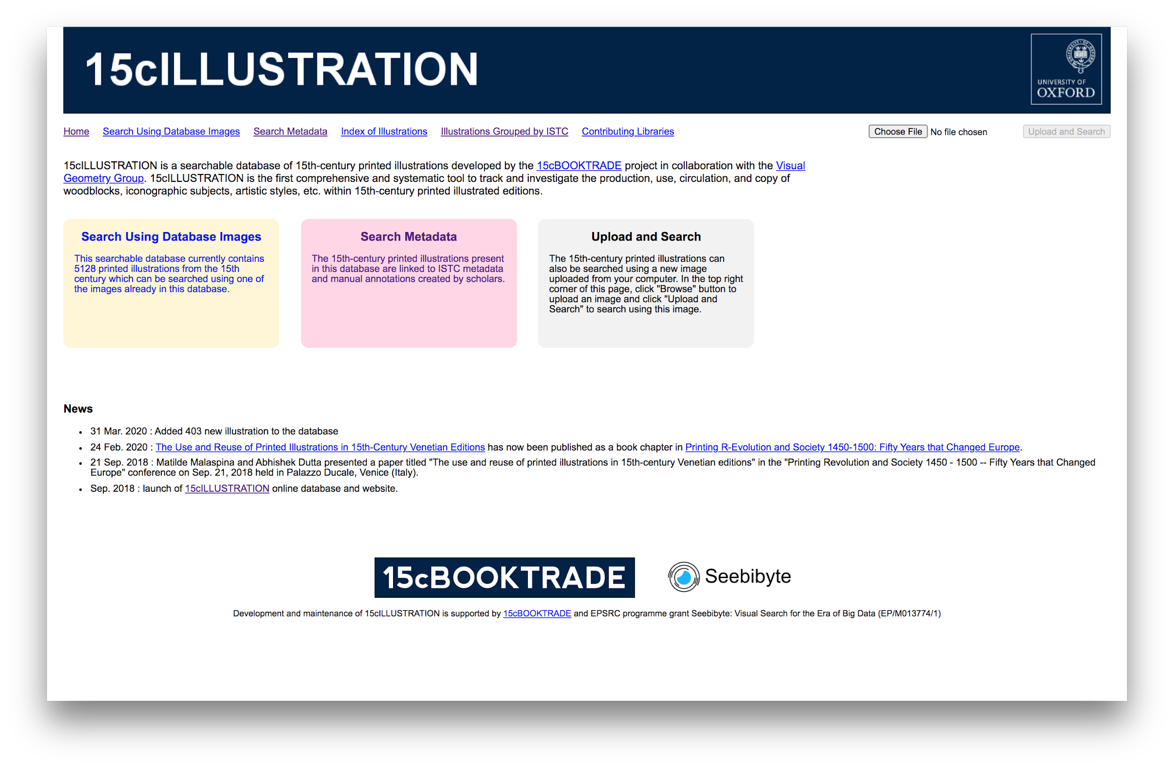

Slide 3
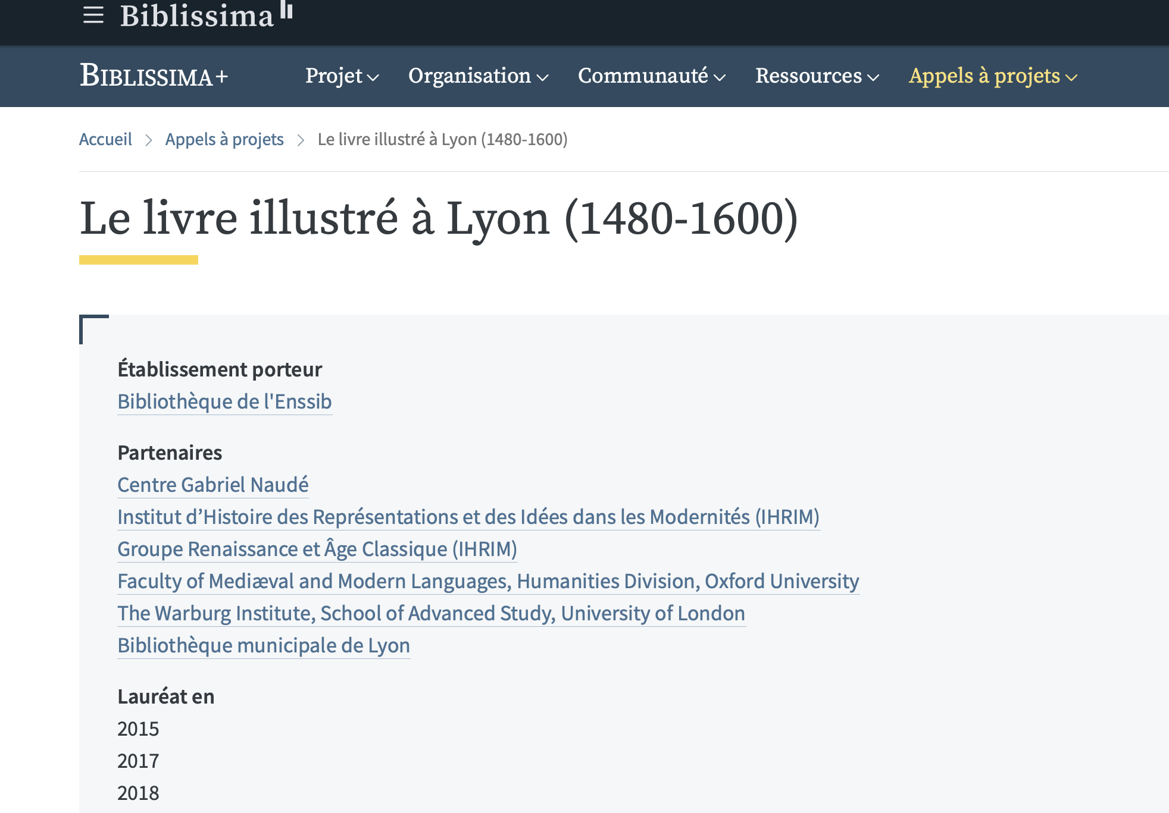

Slide 4
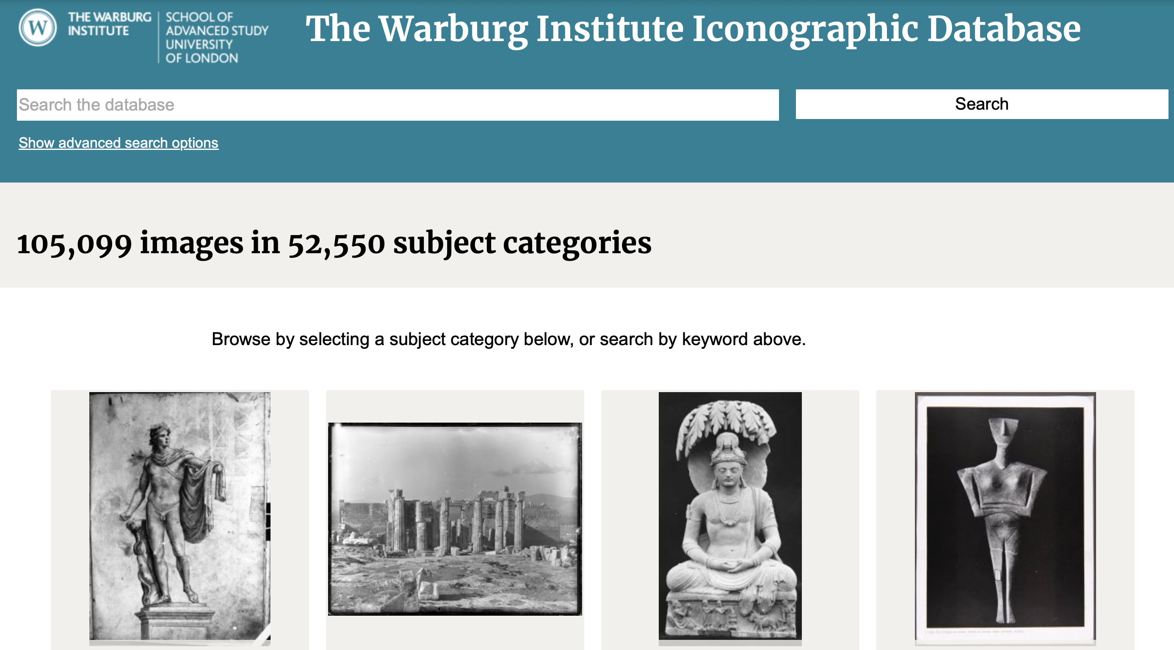

Slide 5
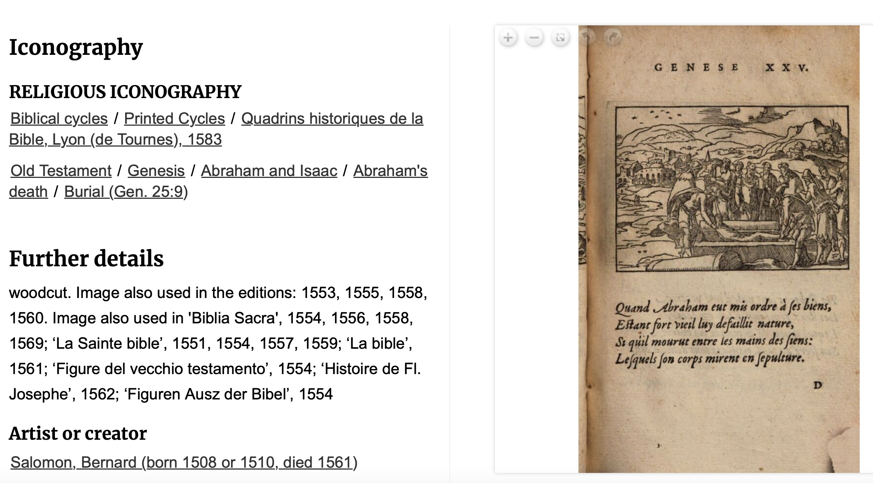

Slide 6
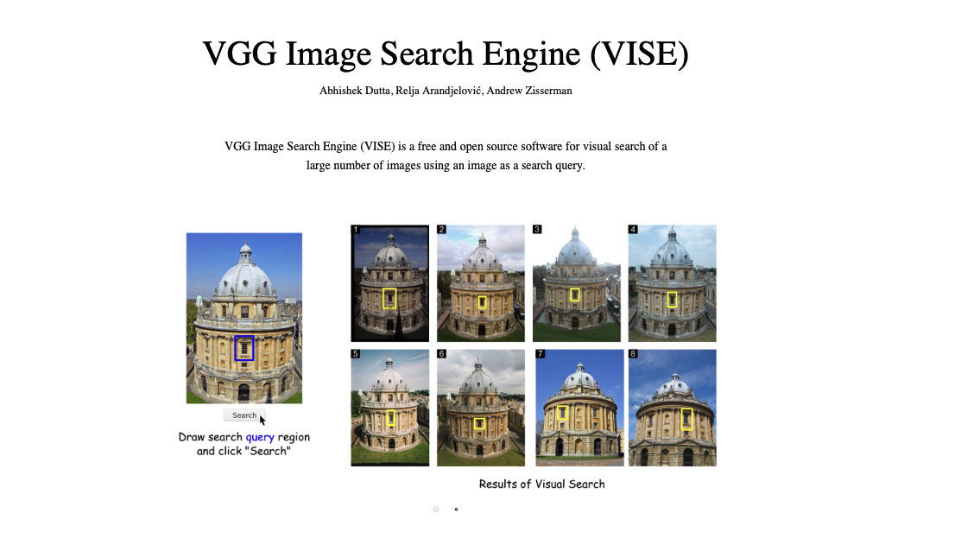

Slide 7
Notes:
The Project Giles and Alexandra
Broadside ballads, printed cheaply on one side of a sheet of paper from the earliest days of printing, contain song-lyrics, tunes and woodcut illustrations and bear news, prophecies, histories, moral advice, religious warnings, political arguments, satire, comedy and bawdy tales. Sold in large numbers on street-corners, in town-squares and at fairs by travelling ballad-singers and pinned on the walls of alehouses and other public places, they were sung, read and viewed with pleasure by a wide audience, but have been handed-down to us in only small numbers.
The Bodleian Library at the University of Oxford holds nearly 30,000 songs, many of them unique survivals, printed from the 16th to the 20th Centuries. Digital facsimiles and an online database were first made accessible in 1999. Broadside Ballads Online updates that database and links it to other resources.
The English Broadside Ballad Archive based in the Early-Modern Center at the University of California, Santa Barbara specialises in ballads of the 17th century and provides full-text transcriptions, as well as images and catalogue records, of over 4,000 ballads.
The Vaughan Williams Memorial Library, based at the English Folk Song and Dance Society headquartered at Cecil Sharp House in London, maintains the Roud Broadside Index of references to songs which appeared on broadsides, chapbooks, songsters, and other cheap print publications, up to about 1920. Linked to the Roud Folk Song index, this provides a survey of the ballad tradition through its publishing history.
All data published on this site is licensed under a Creative Commons Attribution-NonCommercial-ShareAlike 3.0 Unported License.
A representation of the Broadside Ballads Online data as RDF can be downloaded here

Slide 8
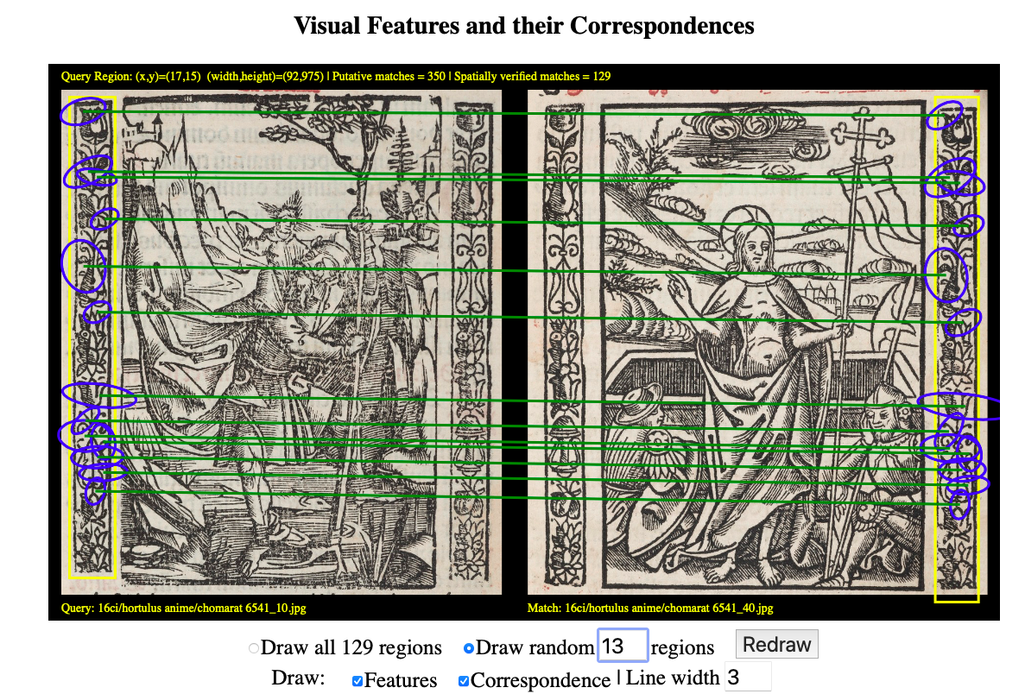

Slide 11
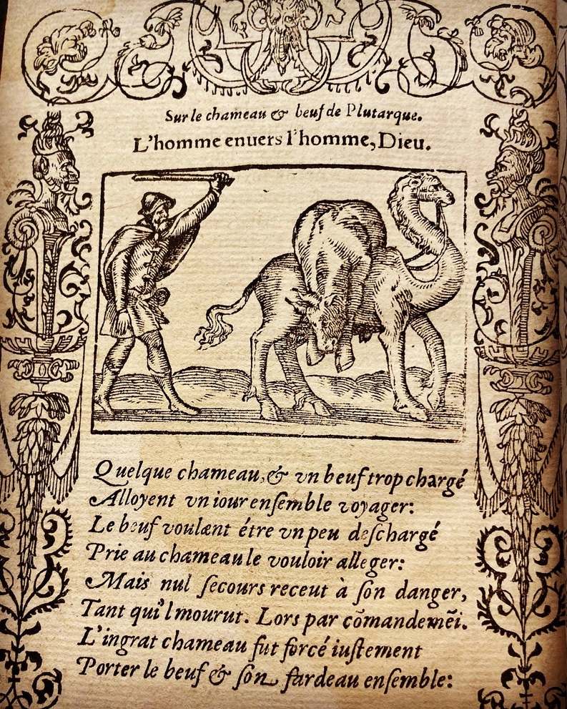

Slide 13
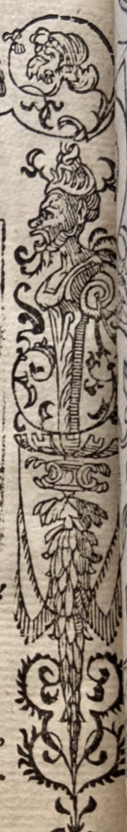

Slide 18
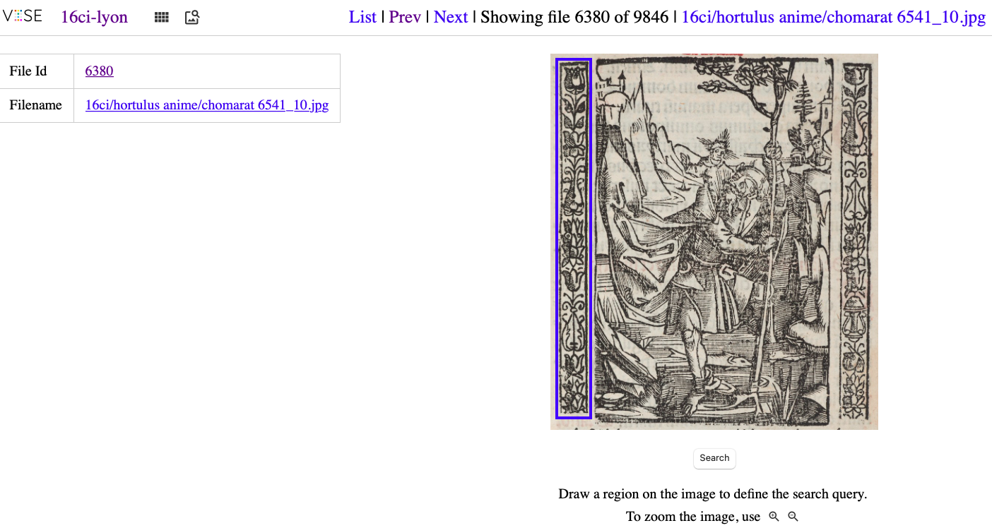

Slide 19
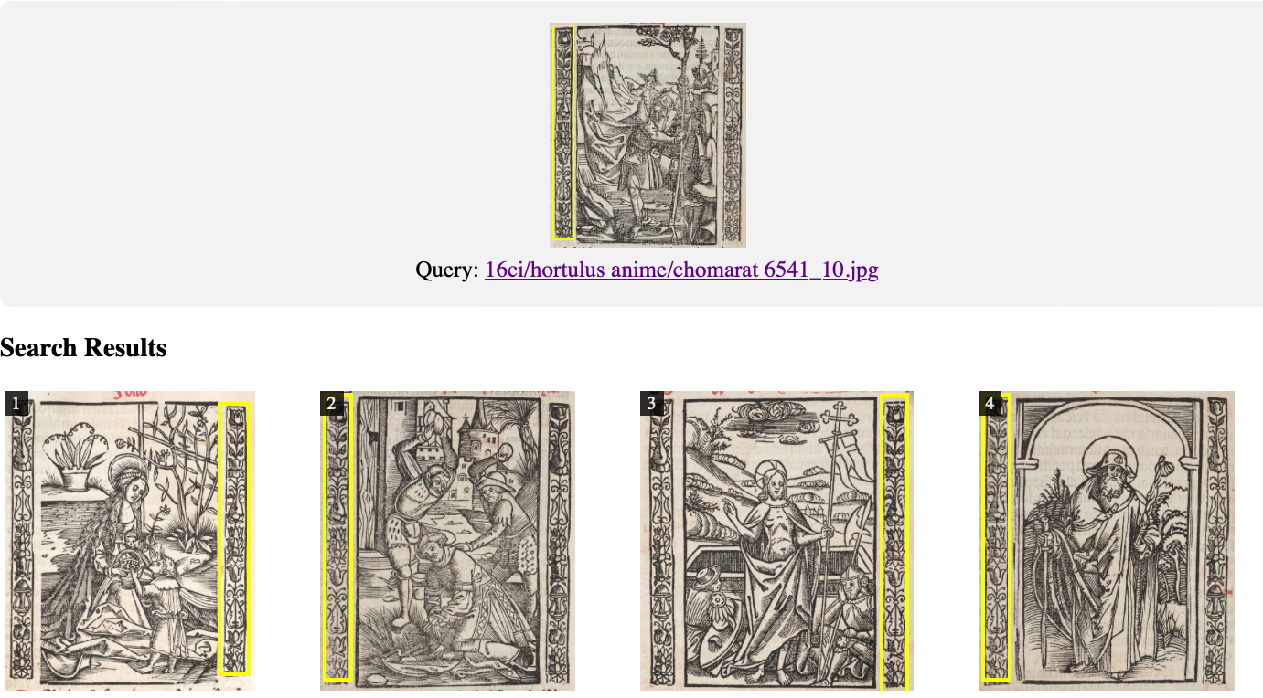

Slide 20
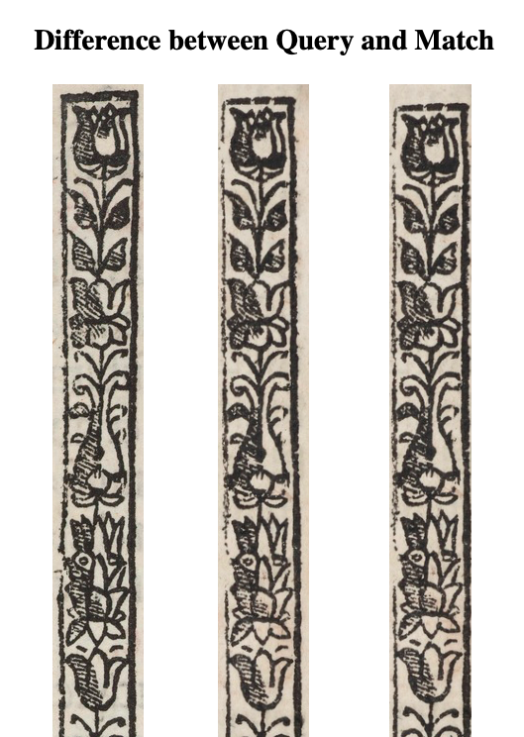

Slide 23
Tool able to combine:
Instant search (using visual regions)
Metadata search (using textual metadata, bibliographic and descriptive)
Comparative search (upload your own image and search the database)

Slide 24
OBIETTIVI RAGGIUNTI:
- FAMILIARIZZAZIONE CON I DATABASE TRADIZIONALI E CON I NUOVI DEMO (VISE, WISE)
- CONFRONTO CRITICO TRA:
1. DATABASE TRADIZIONALI E NUOVI SOFTWARE
2. SOFTWARE DI RICONOSCIMENTO »TRADIZIONALI» E NUOVI DEMO CHE UTILIZZANO L’AI
-IDENTIFICAZIONE DI SOMIGLIANZE E DIFFERENZE TRA I SOGGETTI ICONOGRAFICI SCELTI

Slide 25
Notes:
De materia medica

Slide 26
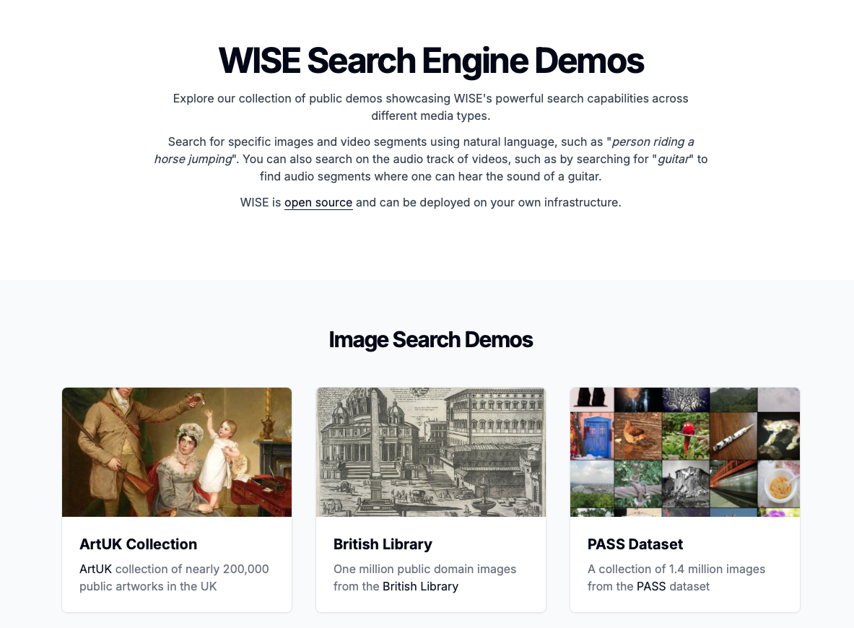
Homepage del WISE searching demo
https://www.robots.ox.ac.uk/~vgg/software/wise/demo/
Barbara Tramelli_UNIBZ

Slide 27
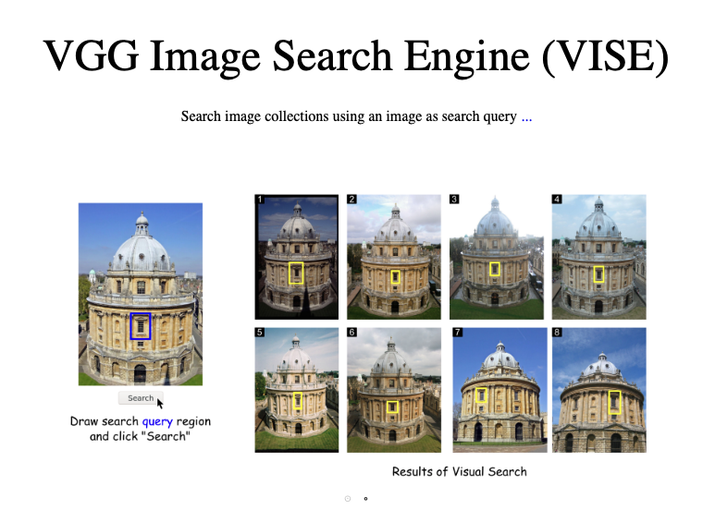

Slide 28
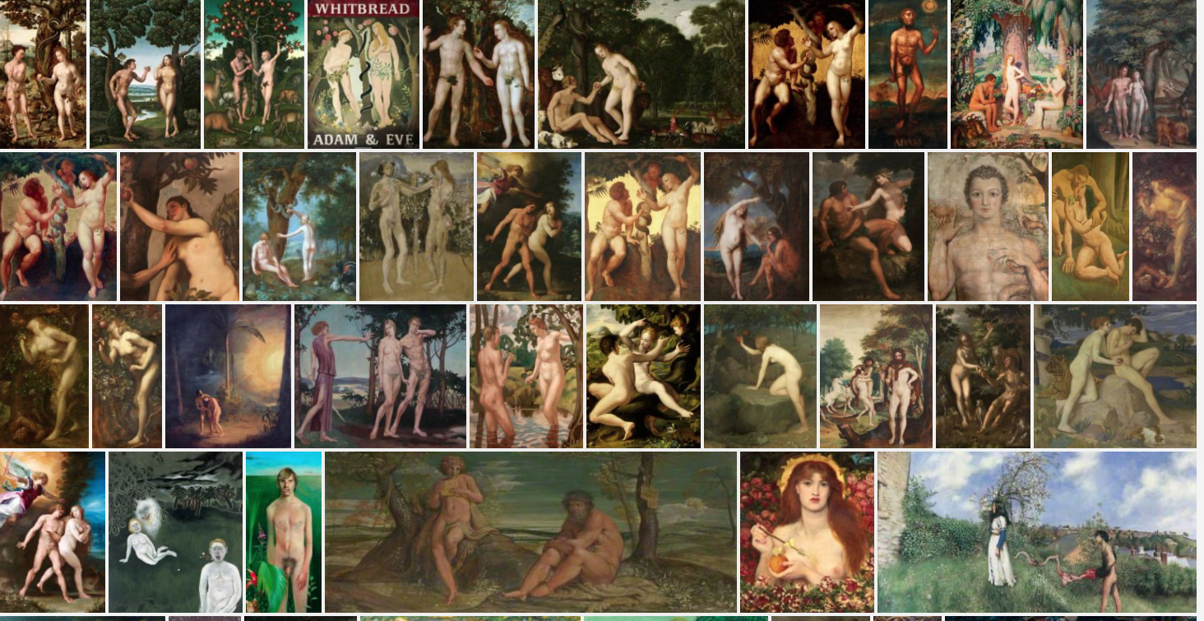
Alcune keywords: Adam and Eve, Adam tempting Eve
Barbara Tramelli_UNIBZ
28 | 15

Slide 29
Analysis of the results
Interpretation of generated data

Slide 30
Metadata standardization

Slide 31
Metadata standardization
Effectiveness of the tools

Slide 32
Metadata standardization
Effectiveness of the tools
Reliance on existing datasets

Slide 33
Ongoing work …
Technical
  Build an online interface to allow research scholars to add/edit/delete descriptive metadata
  Advanced search mode for researchers who may have more complex search queries
  Combine both text metadata search and visual search
  Add new images to the collection (e.g. Netherlands, Germany)
    Challenge: existing metadata exists in different forms (doc, csv, xml, sql)
Research
  Suitable bibliographic metadata source for the 16th century
  Harmonisation of descriptive metadata (Iconclass/Warburg…?)
  Implement structured processes to populate the database with further images and metadata (collaborations with libraries, institutions and scholars)
  Create a network of editors and scholars working in the field who may be interested in contributing (images, metadata, ideas, feedbacks, support, etc)
  Finding standards for the Iconographic Indexation of Images

Slide 34
THANK YOU
barbara.tramelli@unibz.it

