Slide 1

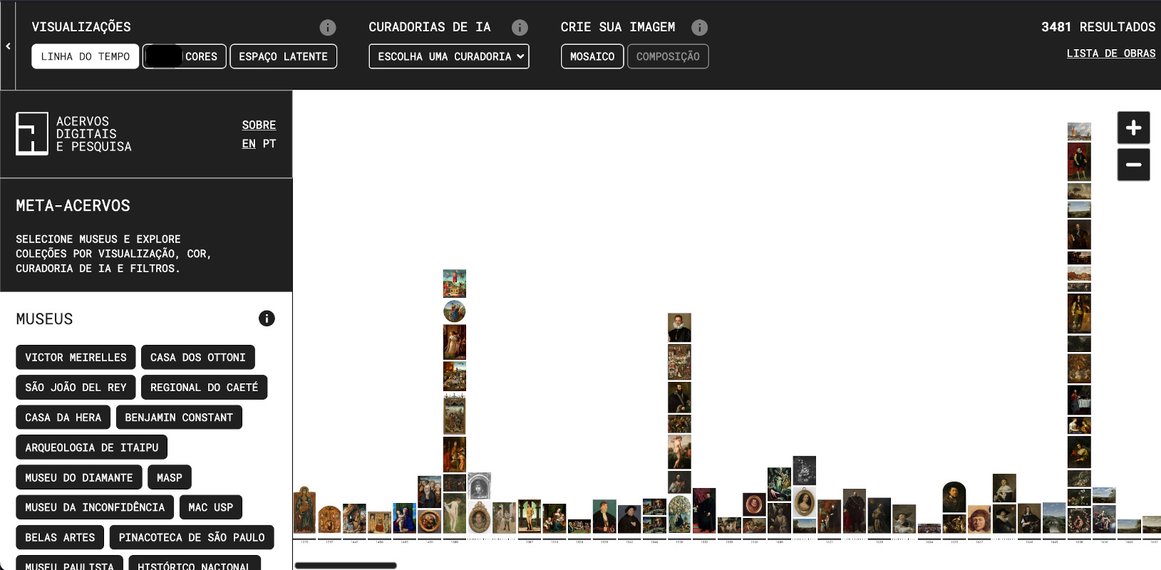
Meta-Acervos
Giselle Beiguelman
Ana G. Magalhães
Thiago Hersan
AI and Artworks - Vienna, Austria - 16-17 APR. 2026
Giselle Beiguelman, Ana G. Magalhães, Thiago Hersan - 2026

Slide 2
Digital archives
GLOBAL SOUTH
Decolonization
Right to Memory
Access/ Democratization

Slide 3
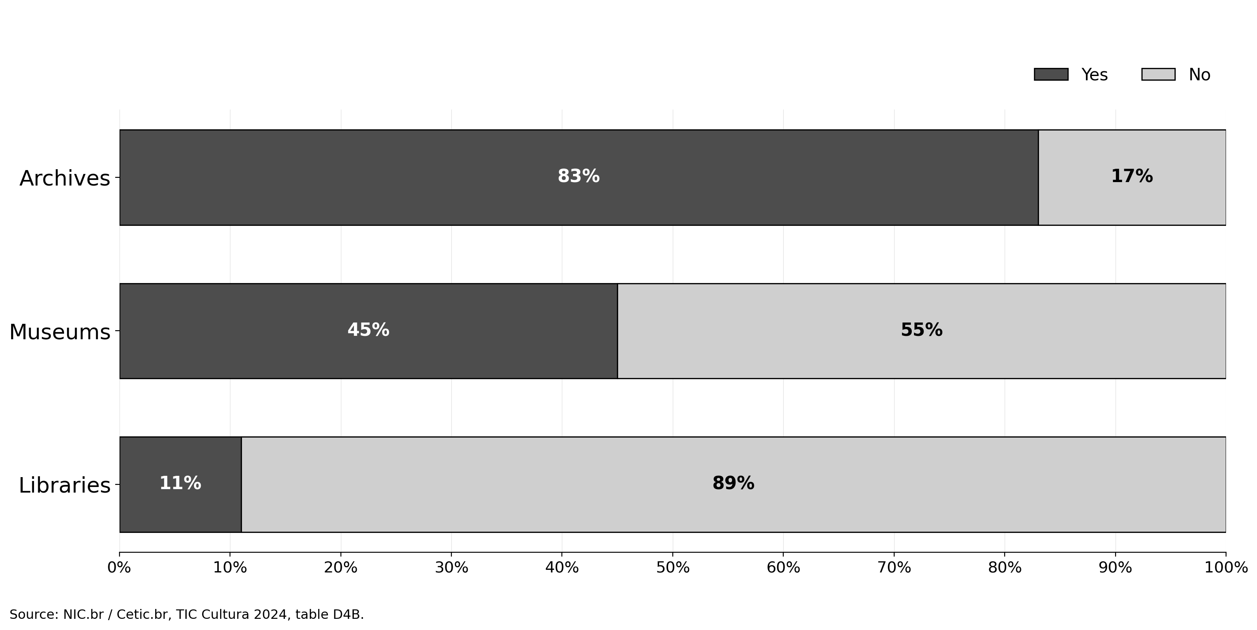
Digital Collections Made Available Online to the Public

Slide 4
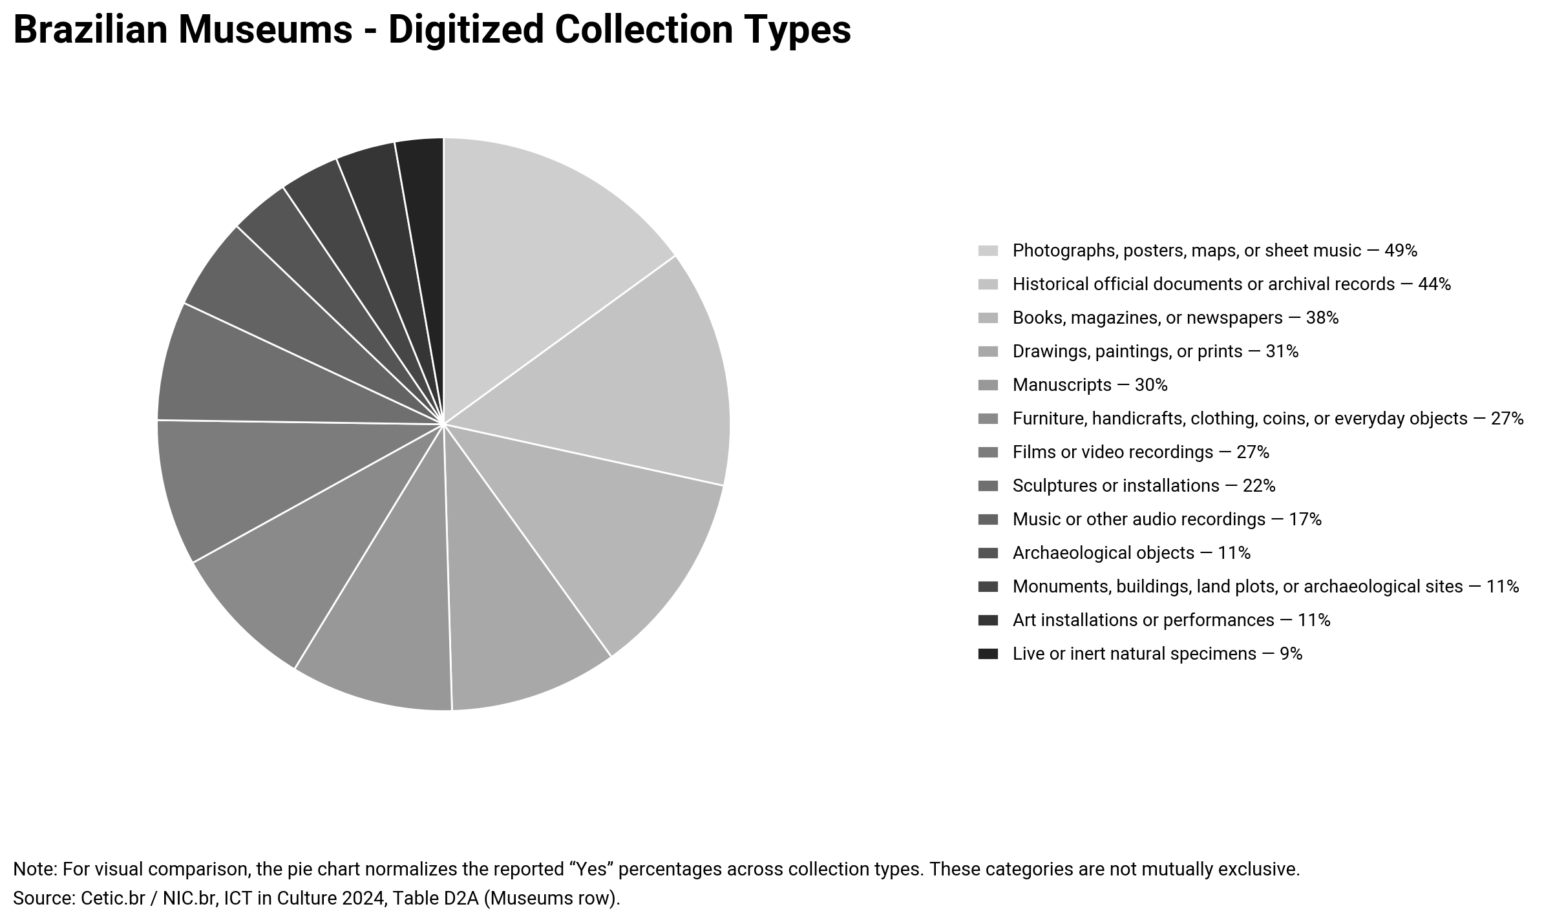

Slide 5
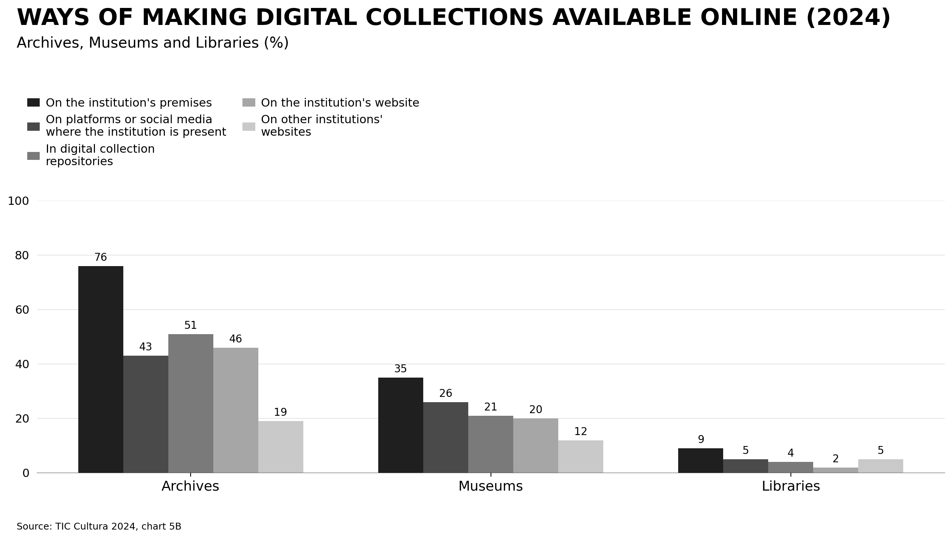

Slide 6
Brazilian Digitized Collections in Numbers
Compared to International Collections
Museu do Ipiranga (MP-USP) | Biggest and oldest historical museum in the country | 33.500 items online
Brasiliana Museus | Database from the Ministry of Culture of Brazilian | 20.000 items online
Smithsonian | Oldest network of museums in the United States | 18 million items online
Europeana | European Union digitized collections | 60 million items online
Instagram | Private social network | 50 billion images

Slide 7
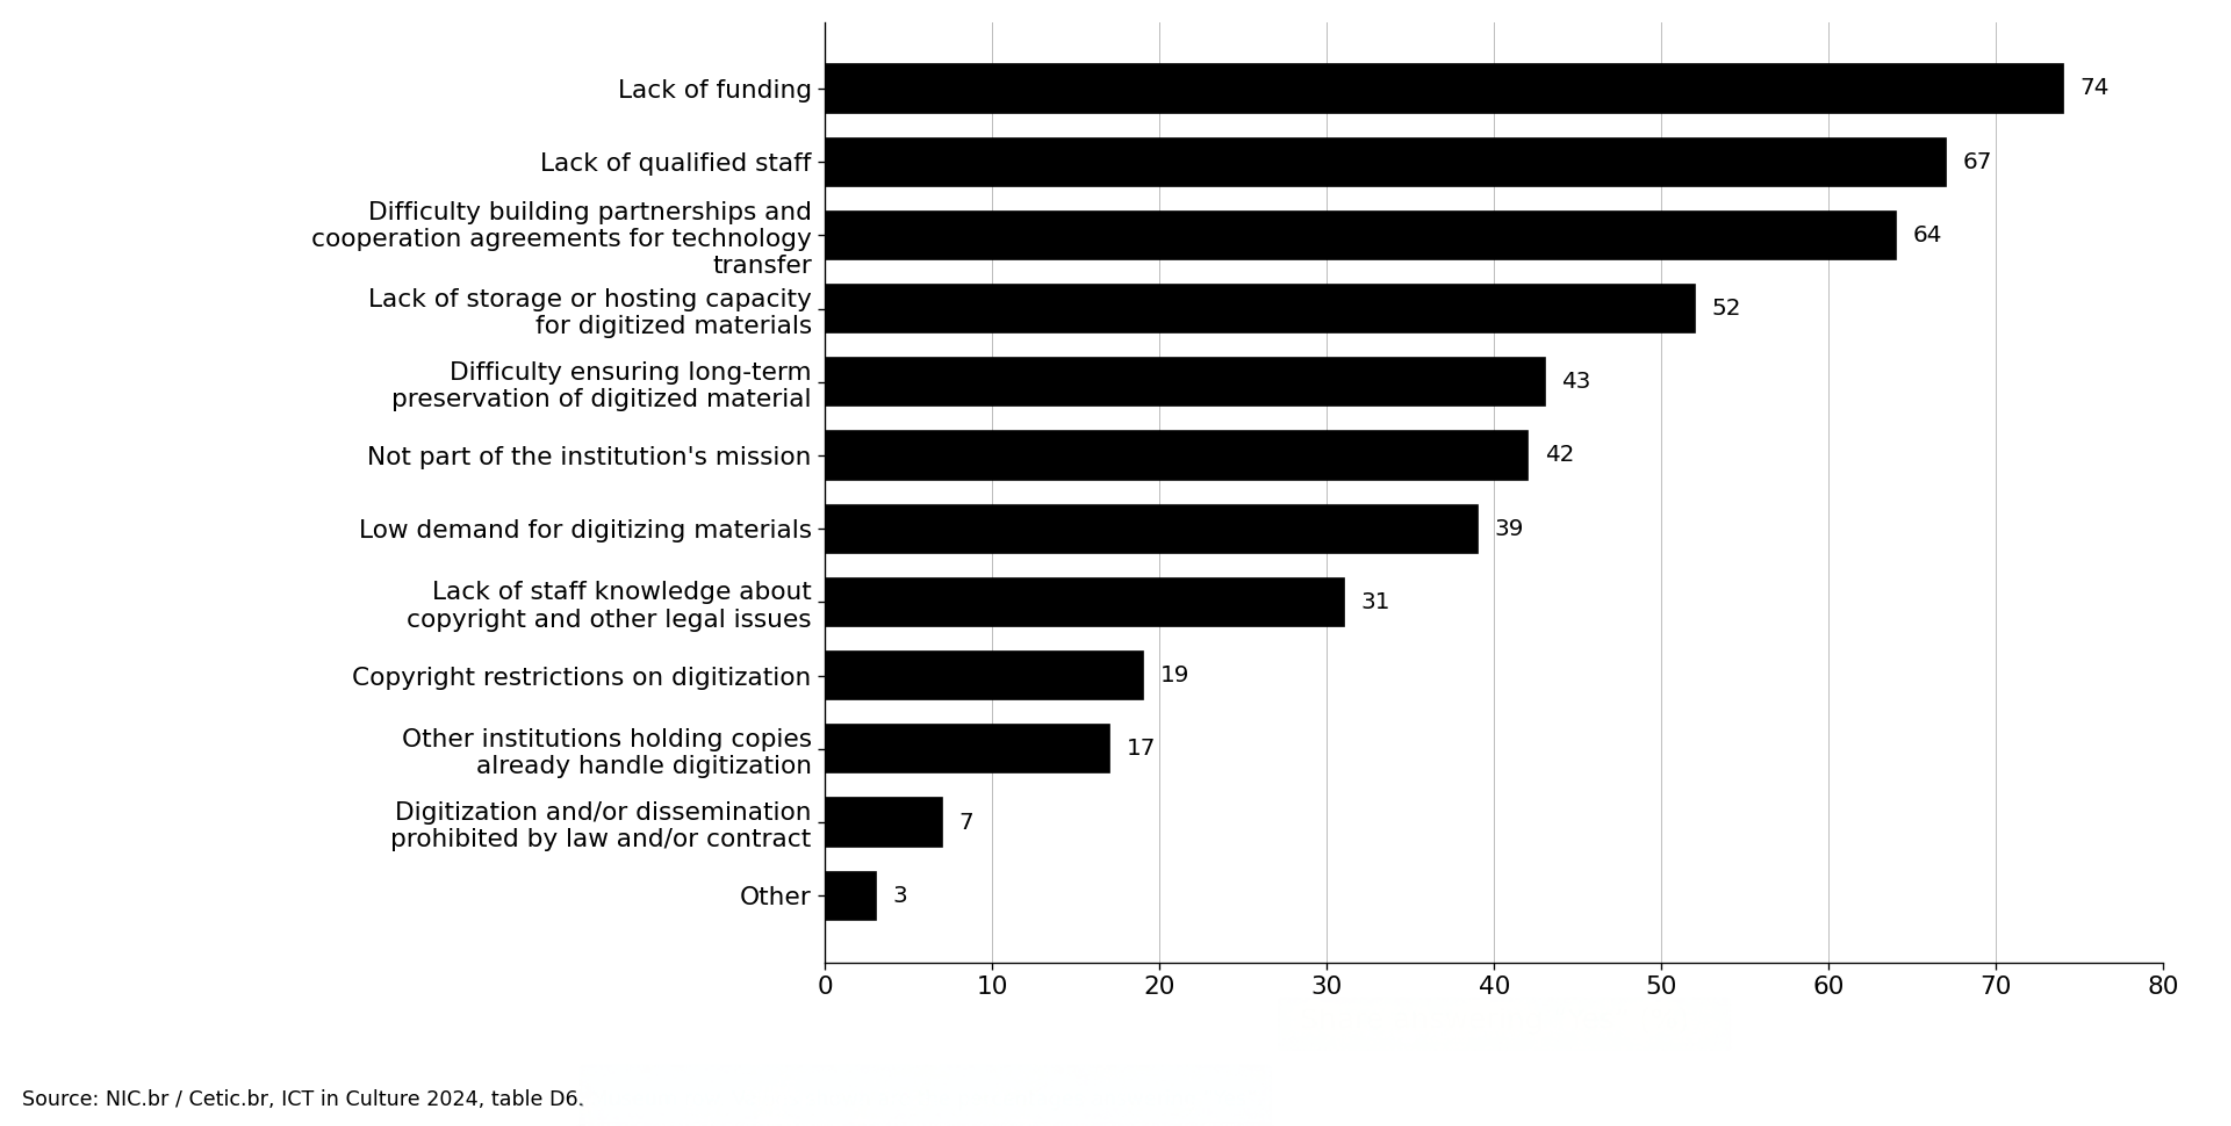
Brazilian Museums by Main Difficulty in Digitizing Collections

Slide 8
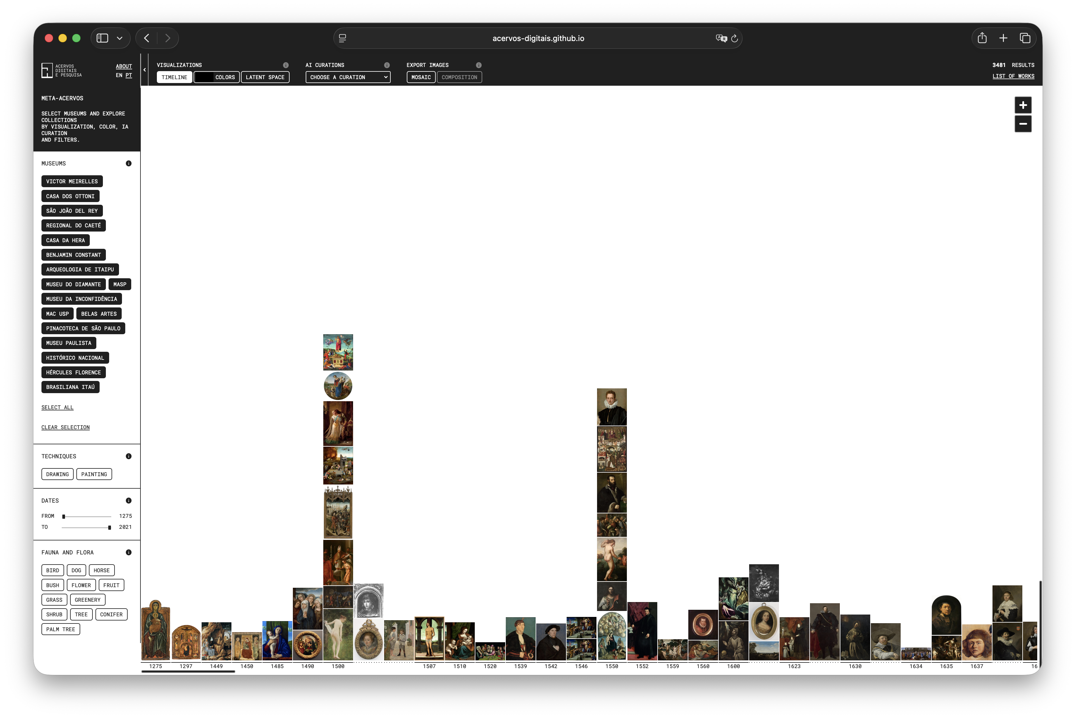

Slide 9
Sources
Wikipedia GLAM - Museu Paulista -USP
Brasiliana Museus - IBRAM
MAC-USP

Slide 10
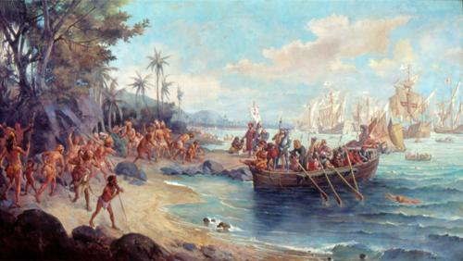
Metadata, pre-processing, object detection
Wikipedia:
id: Q24284124
categories: painting
image: url
title: Landing of Pedro Álvares Cabral in Porto Seguro
creator: Oscar Pereira da Silva
depicts: discovery of Brazil, nudity, priest, Pedro Álvares Cabral, cross, sea, tree, hat, Porto Seguro, forest, women, ships, children, historical painting, Portuguese, native american, ….

Slide 11
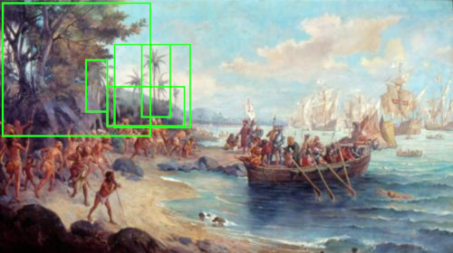

Metadata, pre-processing, object detection
LLM: environment: beach, mountain, trees
nature: water
objects: quiver, rope, net, sword, gun, shovel,
boats, sails, arrows, helmets, canoe, flag, shield, rake, bow, armor
people: natives,
plants: trees,
caption: The image depicts a scene of conflict between European colonizers and indigenous people on a beach, with boats and canoes in the background.
colors

Slide 12
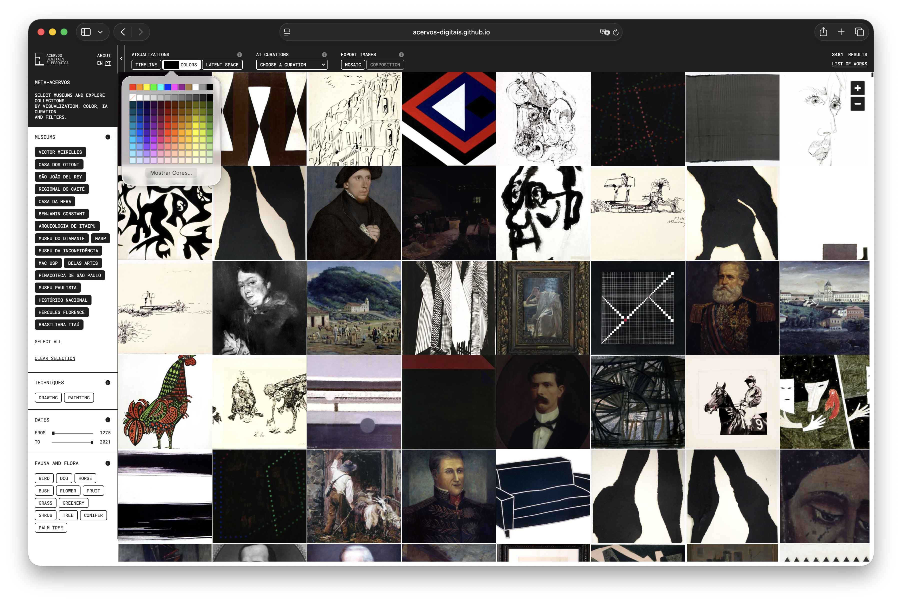

Slide 13
[ x₀, x₁, x₂, … ]
depicts: discovery of Brazil, nudity, priest, boat, palm tree, …
[ x₀, x₁, x₂, … ]
description: The image depicts a scene of conflict between …
[ x₀, x₁, x₂, … ]
Embedding Database
…

Slide 14
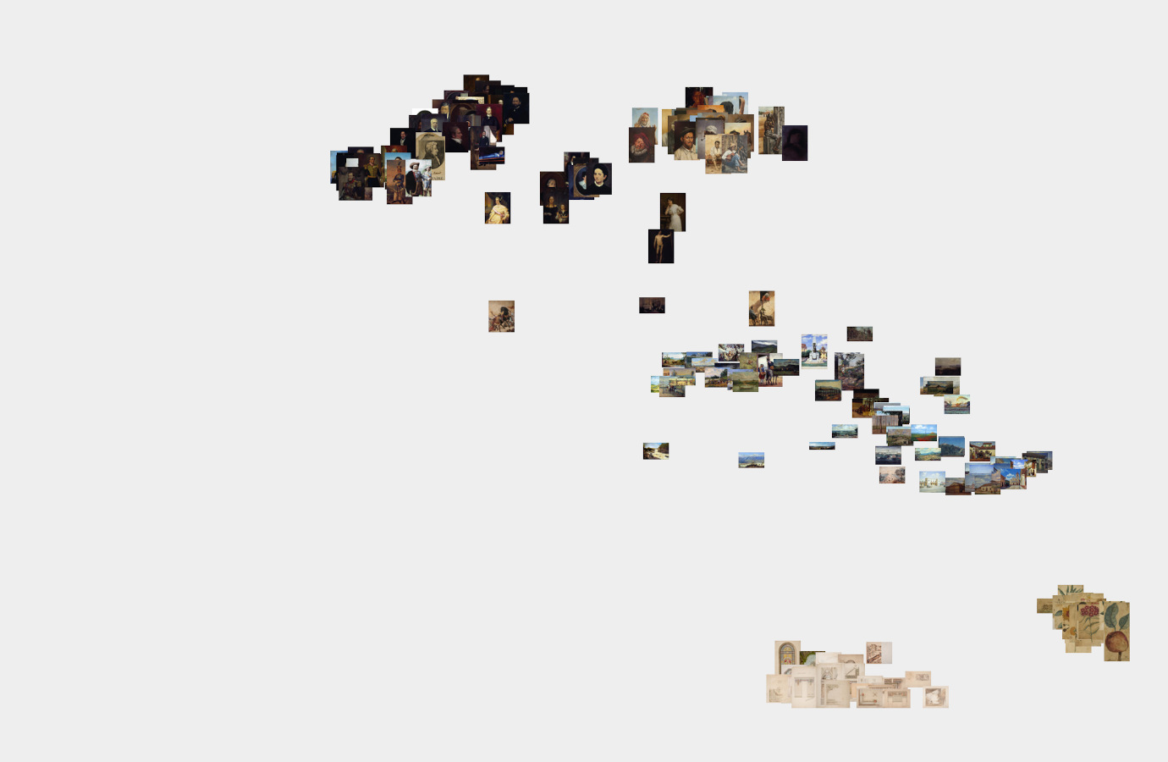
Clustering
Embedding Database

Slide 15
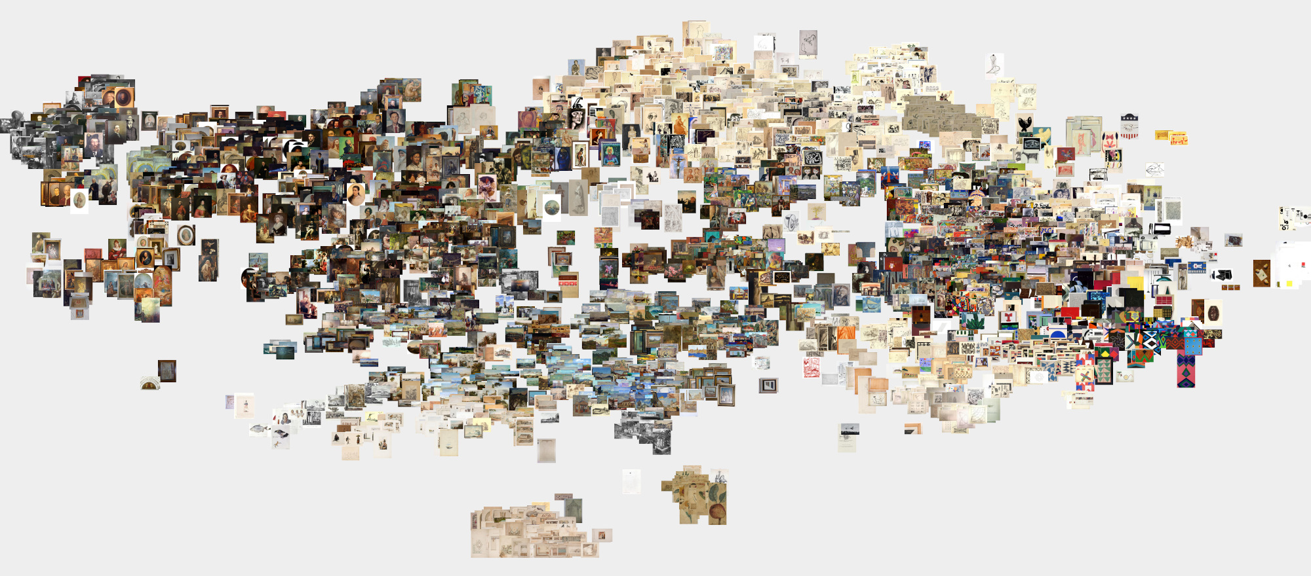
Latent Space

Slide 16
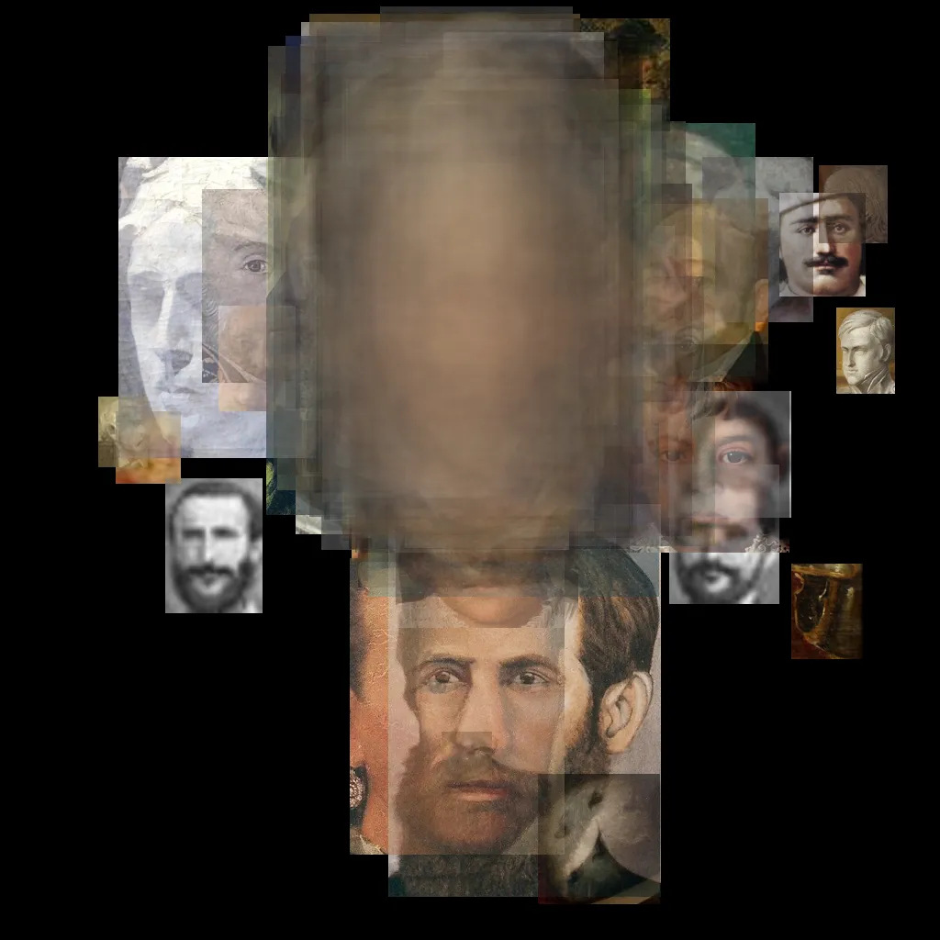
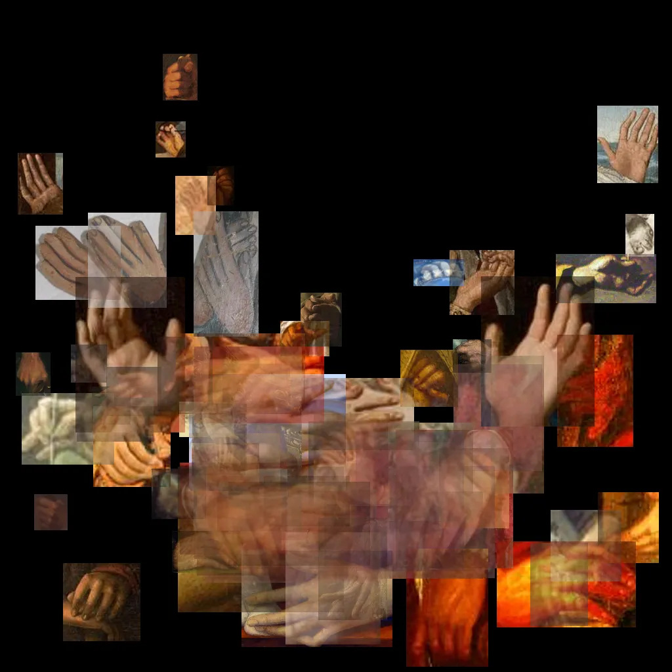
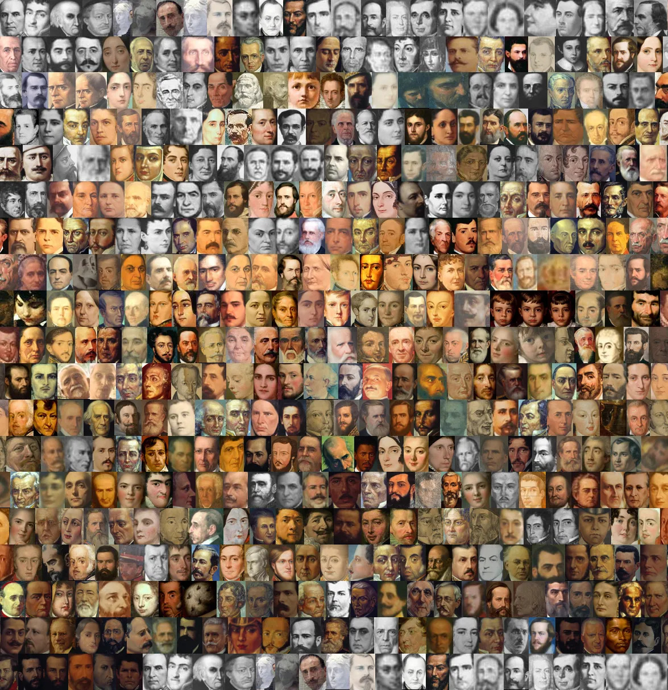
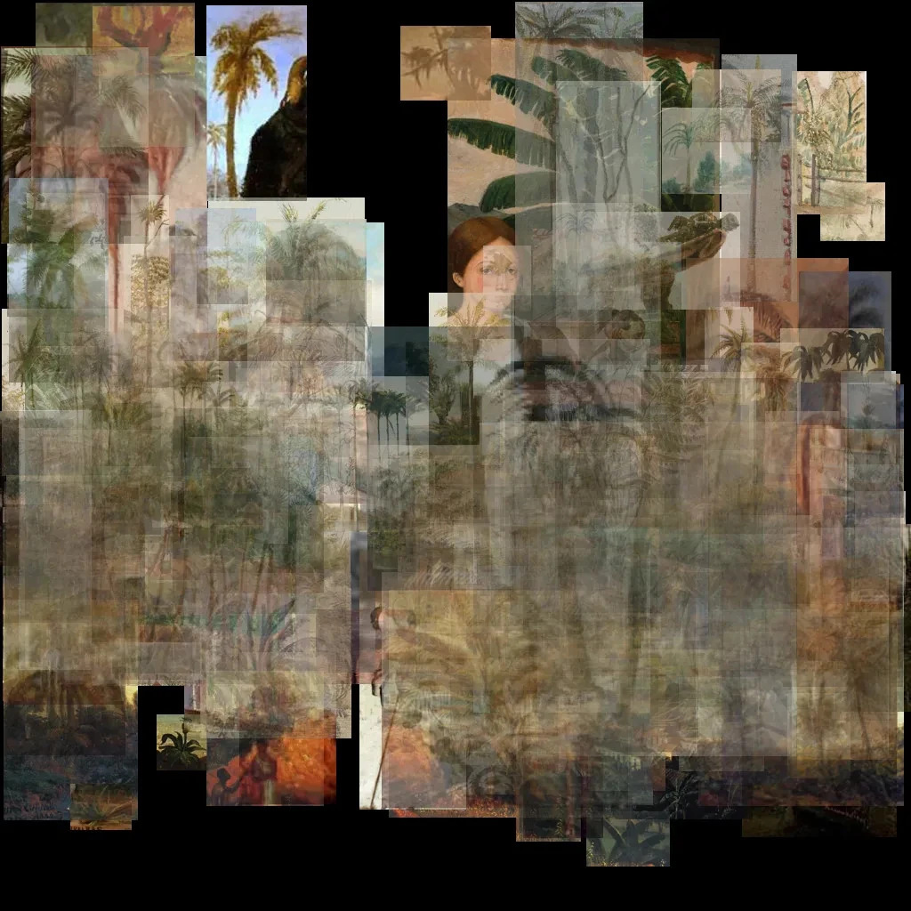
Mosaics

Slide 17
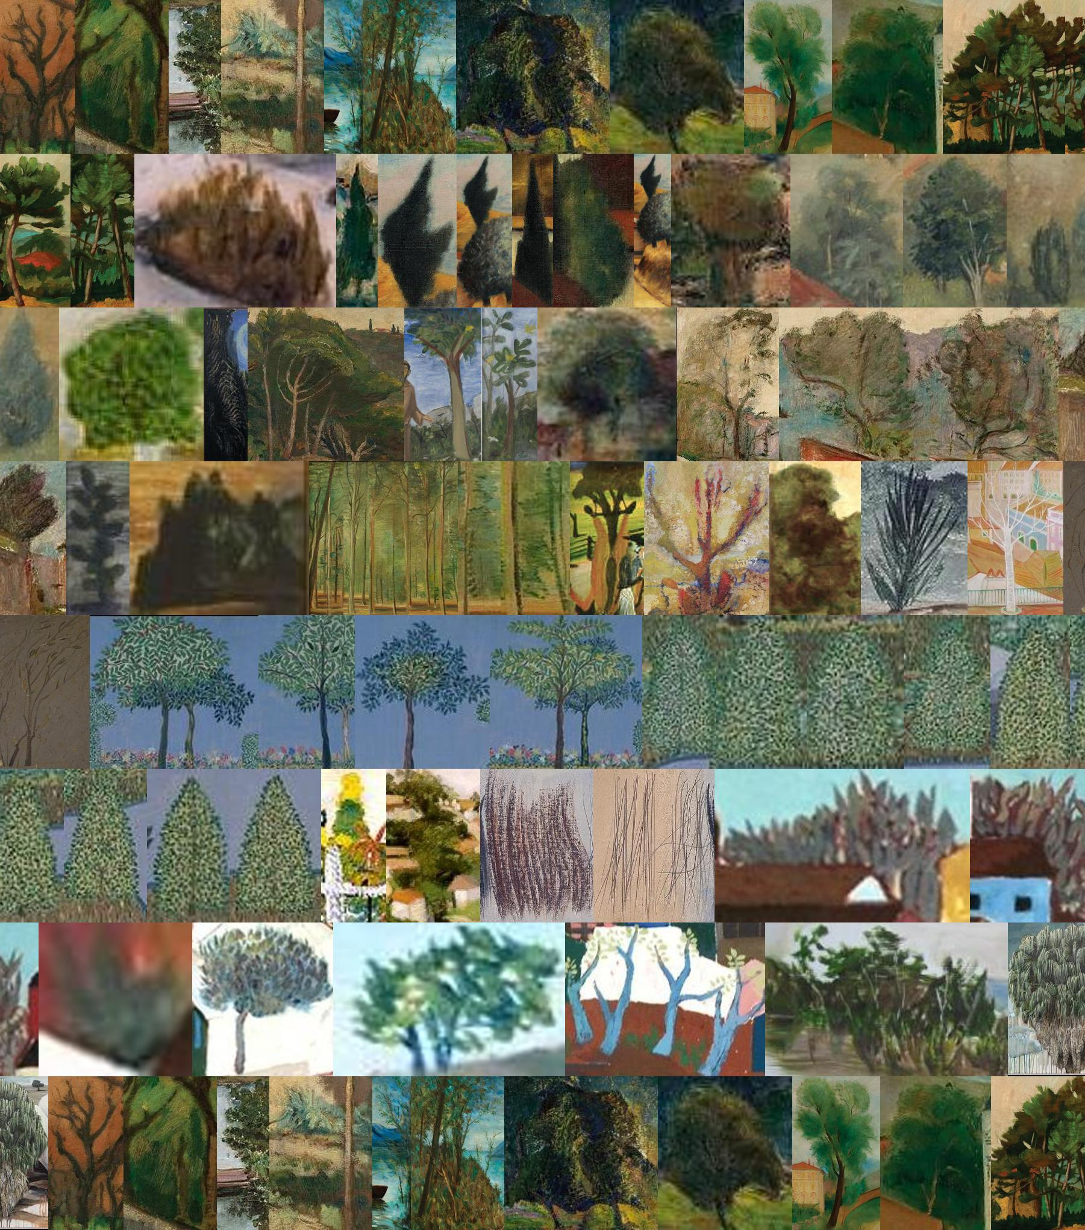
Just Collection of MAC USP; Conifer; only painting:
42 works
Red arrows: sectioning of computational vision in various parts (identifying every tree depicted in the work by Elisa Martins da Silveira)
Blue arrow: abstract work by Hans Hartung that the machine reads as a conifer
Notes:
Example of a mosaic with a very contained search: only MAC USP painting collection available at Meta-Acervos + Conifer. The red arrows are the sections of only one painting, by so-called “naïf”/self-taught Brazilian artista Elisa Martins da Silveira. The blue arrow, instead are two sections taken from an abstract painting by French painter Hans Hartung

Slide 18
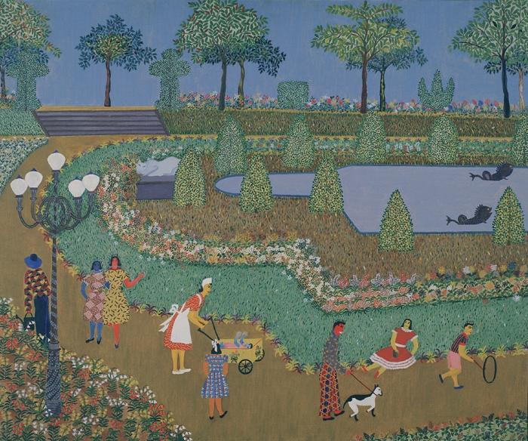
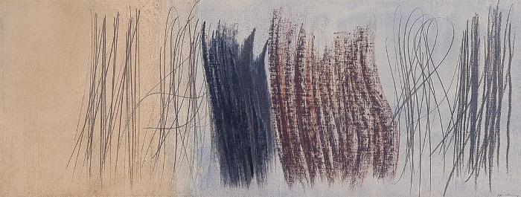
Hans Hartung, Untitled, 1961-64, oil on canvas, MAC USP
Elisa Martins da Silveira, “Praça Paris”, 1953, oil on canvas, MAC USP
Notes:
This is to show how the two paintings look like.
Some background about the artists:
Elisa Martins da Silveira was a Brazilian self-taught painter, who emerged in the framework of the São Paulo Biennial - which had a consistent presence of self-taught artists in the Brazilian delegation (in SP and in Venice at the time). Very little is known about her.
Hans Hartung, instead, is very well-known for his lyrical/non-geometrical abstract works, for which he became famous in the 1950s.
Both works, despite their totally different styles, backgrounds and motifs, were presented in the context of the São Paulo Biennial iterations of the 1950s/60s.

Slide 19
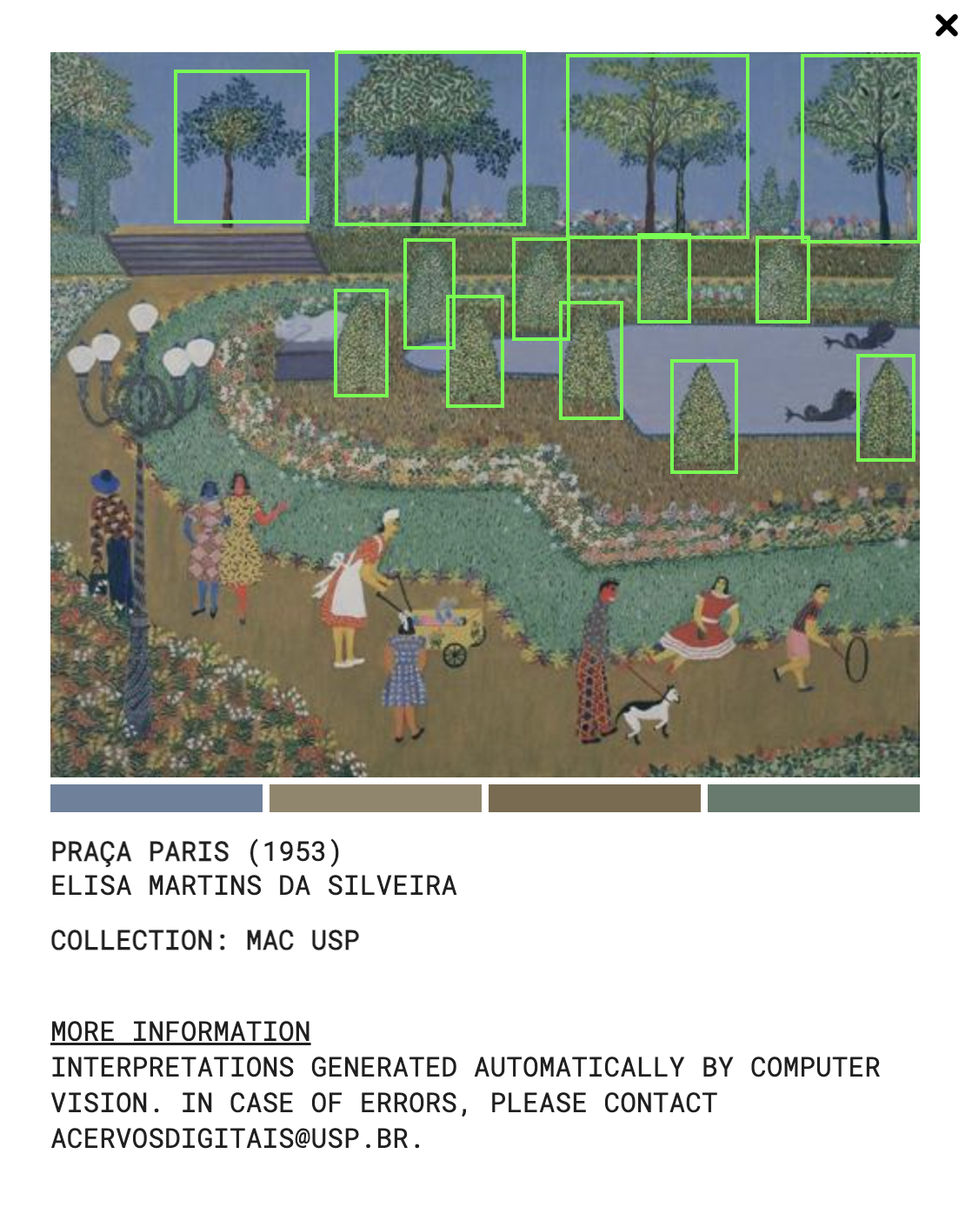
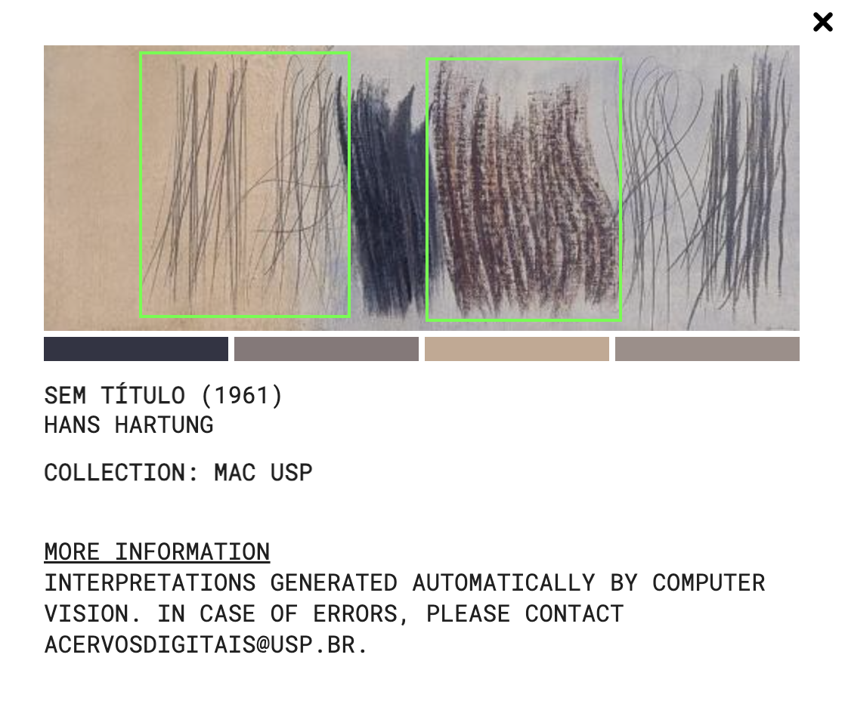
Notes:
Here is just for one to see how computational vision mapped what it understood as “conifer” in both paintings. It seemed to have been very precise in mapping all the trees in Silveira’s painting (though they are clearly different species, and the ones in the background don’t seem to be conifers). But it read two sets of Hartung’s brushstrokes and traces as being conifers. This allows us to ask some questions:
in the universe of data available, what kind of image (and shape) the machine is using to make its search for conifers?
though Silveira’ painting is figurative, both works are not photographs and imply a process of abstraction of forms/shapes, though they are also very, very distinct from one another.
this kind of “homogenization” process of the mosaic might open to other possibilities in the field of art history. For instance, these two works shared the same Zeitgeist, so to speak - the framework of artistic debate on modern art, IN BRAZIL, in the 1950s/early 1960s, at the same time deconstructing a narrative of Brazilian modern art at the time as being totally engaged with experimentations in geometrical abstraction and concrete/constructivist references.

Slide 20
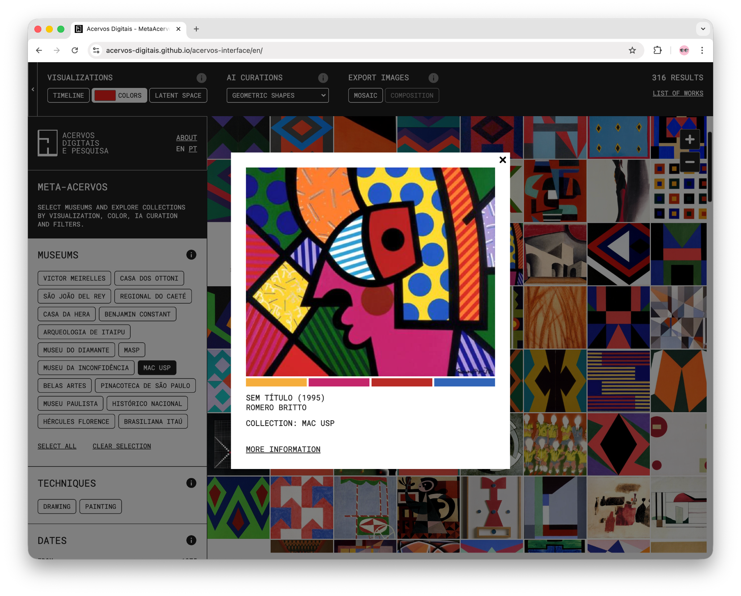
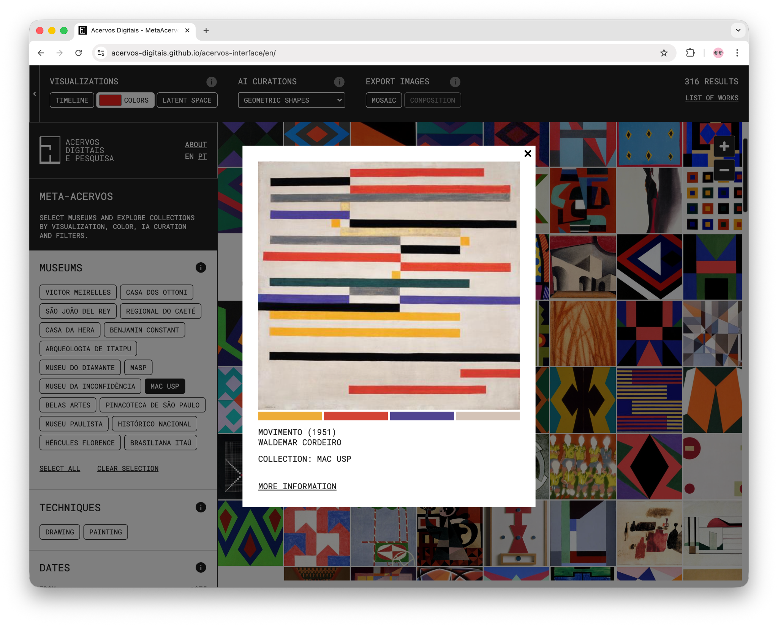
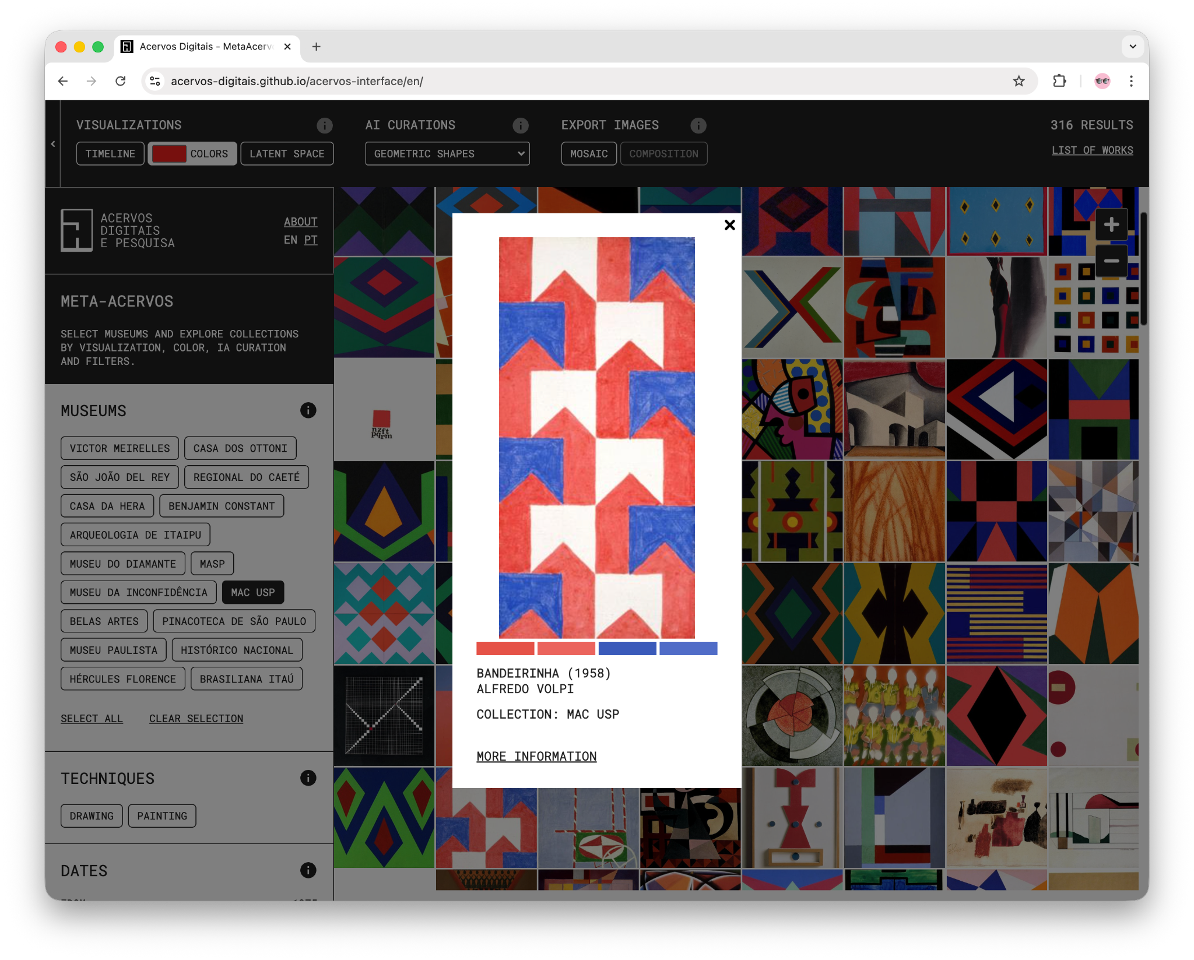

Slide 21
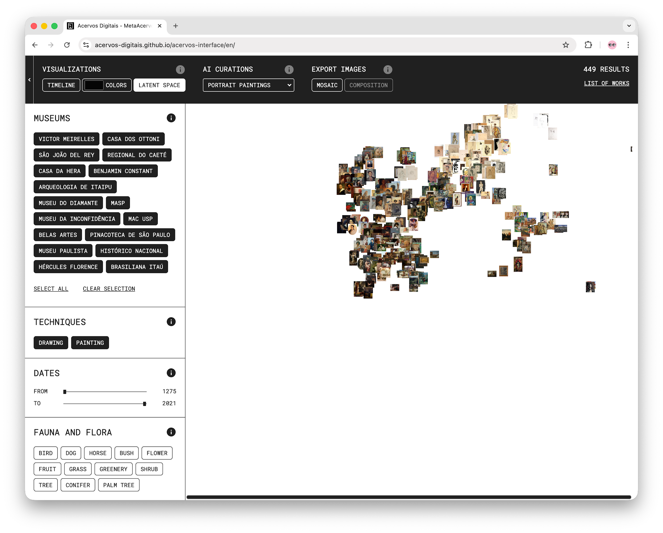
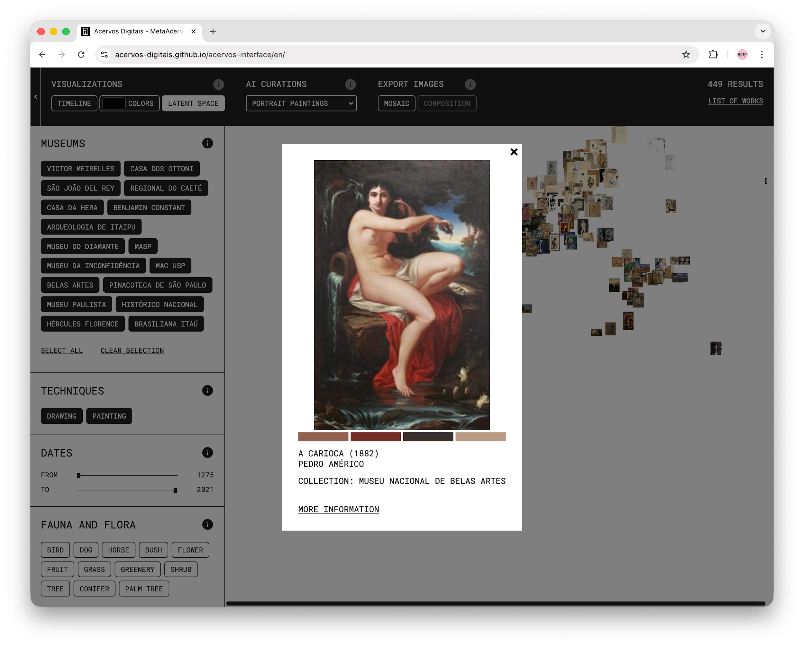
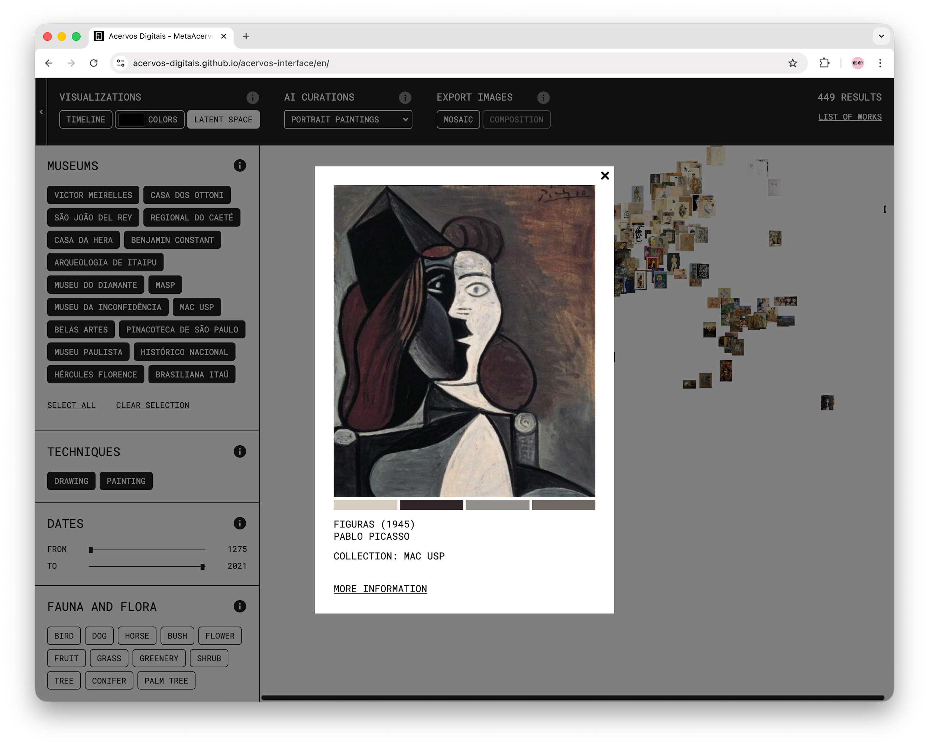

Slide 22


@acervos_digitais
@gbeiguelman
@anagoncalvesmagalhaes
@thiagohersan

