Slide 1


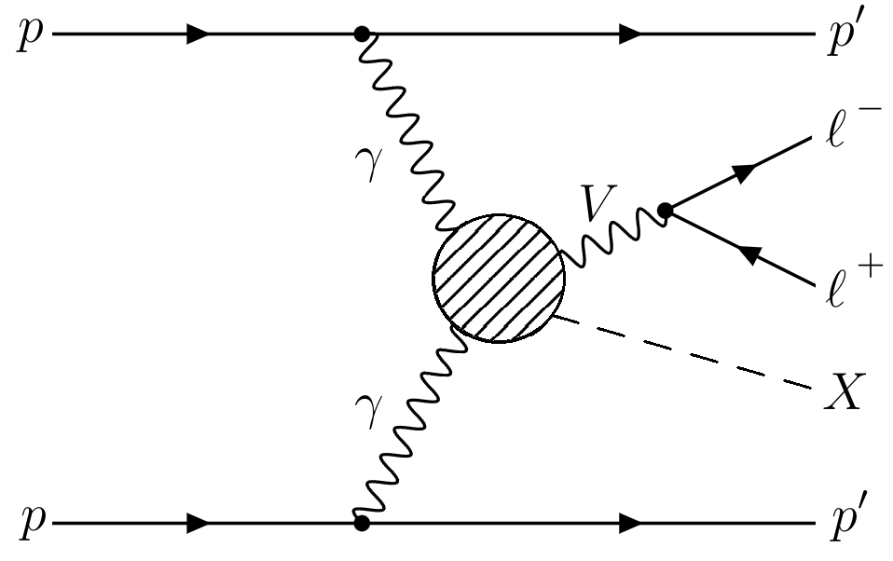
Search for missing mass in proton-tagged dilepton events with the ATLAS detector and the AFP spectrometer
Josh Lomas
University of Birmingham
22/07/2026

Slide 2
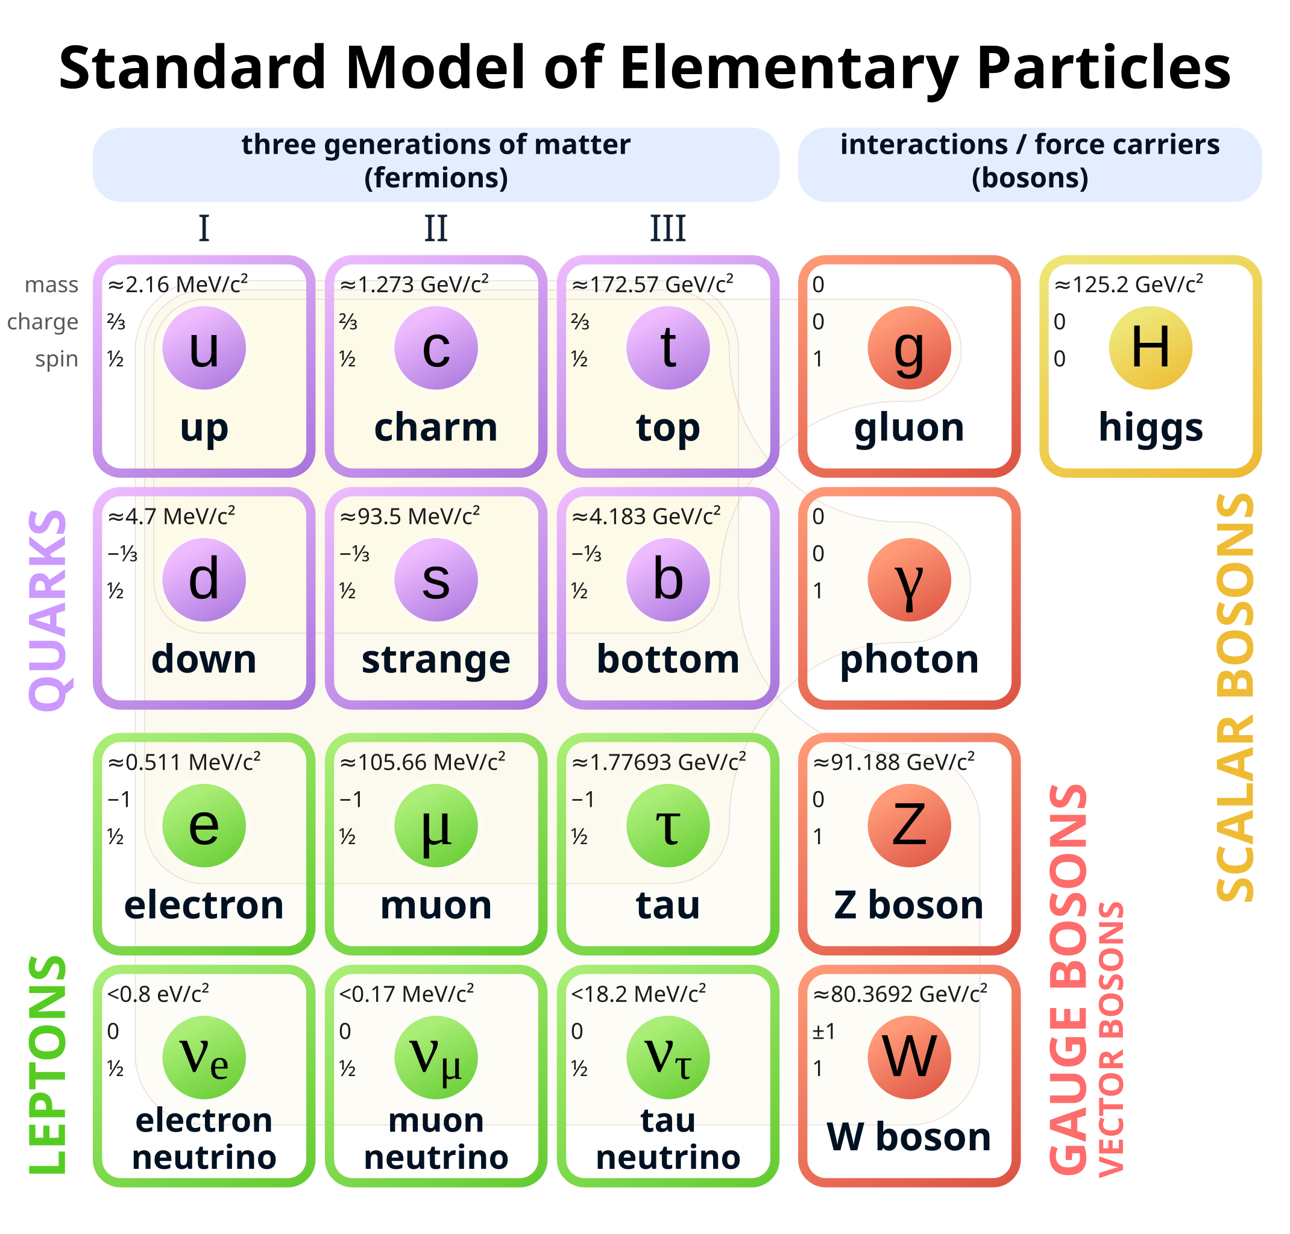
Introduction
The Standard Model is our best current understanding of the fundamental structure of the Universe
Includes all particles so far discovered
Incorporates three of the four fundamental forces
Explains the mass of particles
Agrees with the majority of experimental measurements
However, it falls short in several places, e.g.
Why is there more matter than anti-matter?
What is dark matter/energy?
How does gravity fit in?
Do neutrinos have mass?
We need to explore new phase spaces to search for Beyond the Standard Model physics

Slide 3
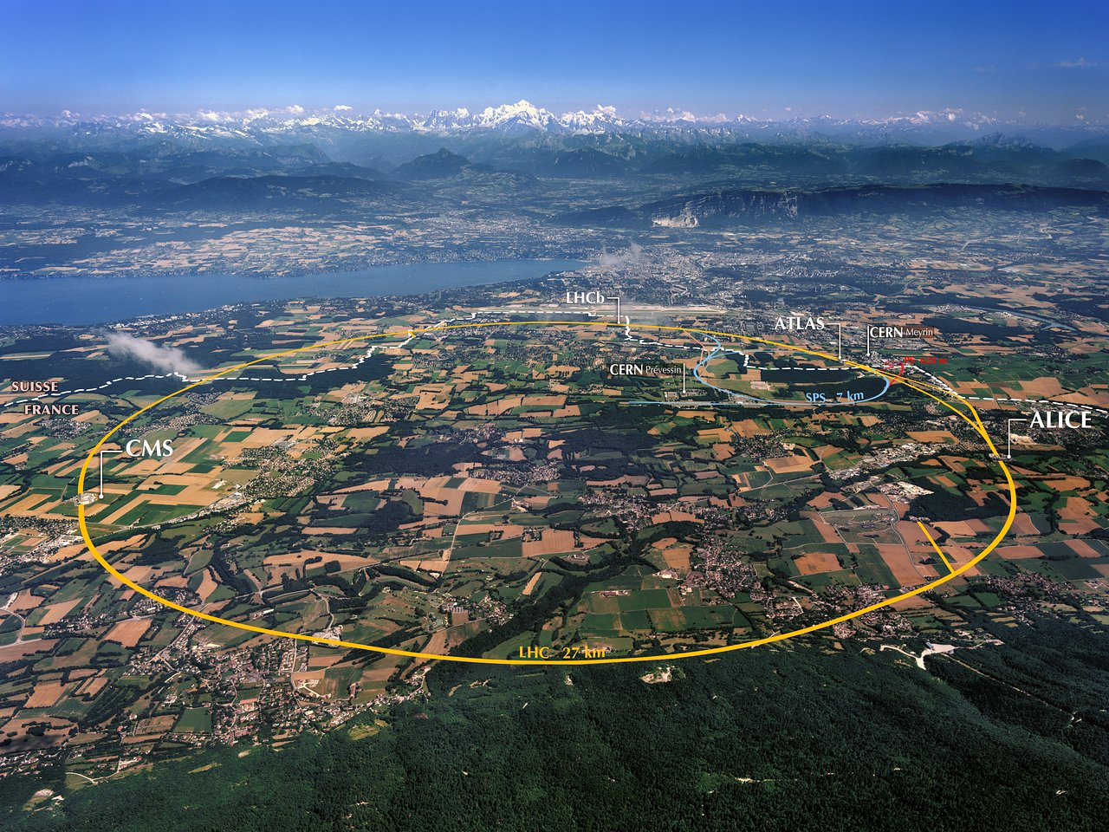
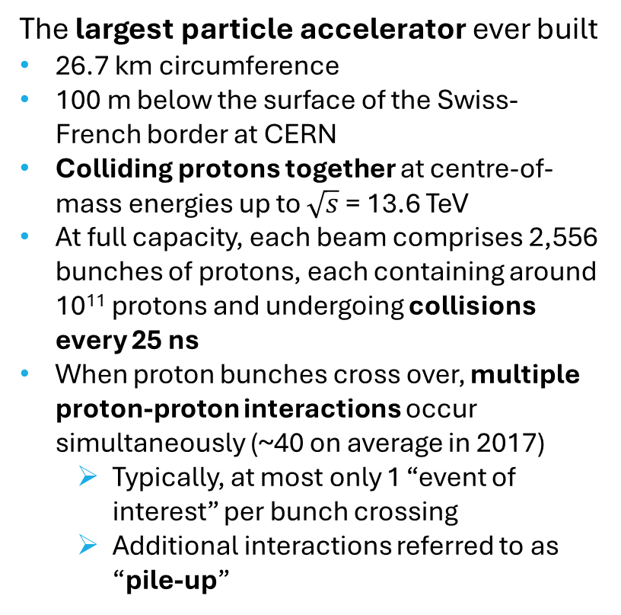
Large Hadron Collider (LHC)
The largest particle accelerator ever built
26.7 km circumference
100 m below the surface of the Swiss-French border at CERN
Colliding protons together at centre-of-mass energies up to $\sqrt{s}$ = 13.6 TeV
At full capacity, each beam comprises 2,556 bunches of protons, each containing around 10¹¹ protons and undergoing collisions every 25 ns
When proton bunches cross over, multiple proton-proton interactions occur simultaneously (~40 on average in 2017)
  Typically, at most only 1 “event of interest” per bunch crossing
  Additional interactions referred to as “pile-up”
Several detectors positioned around the beamline to record the products of proton-proton collisions

Slide 4
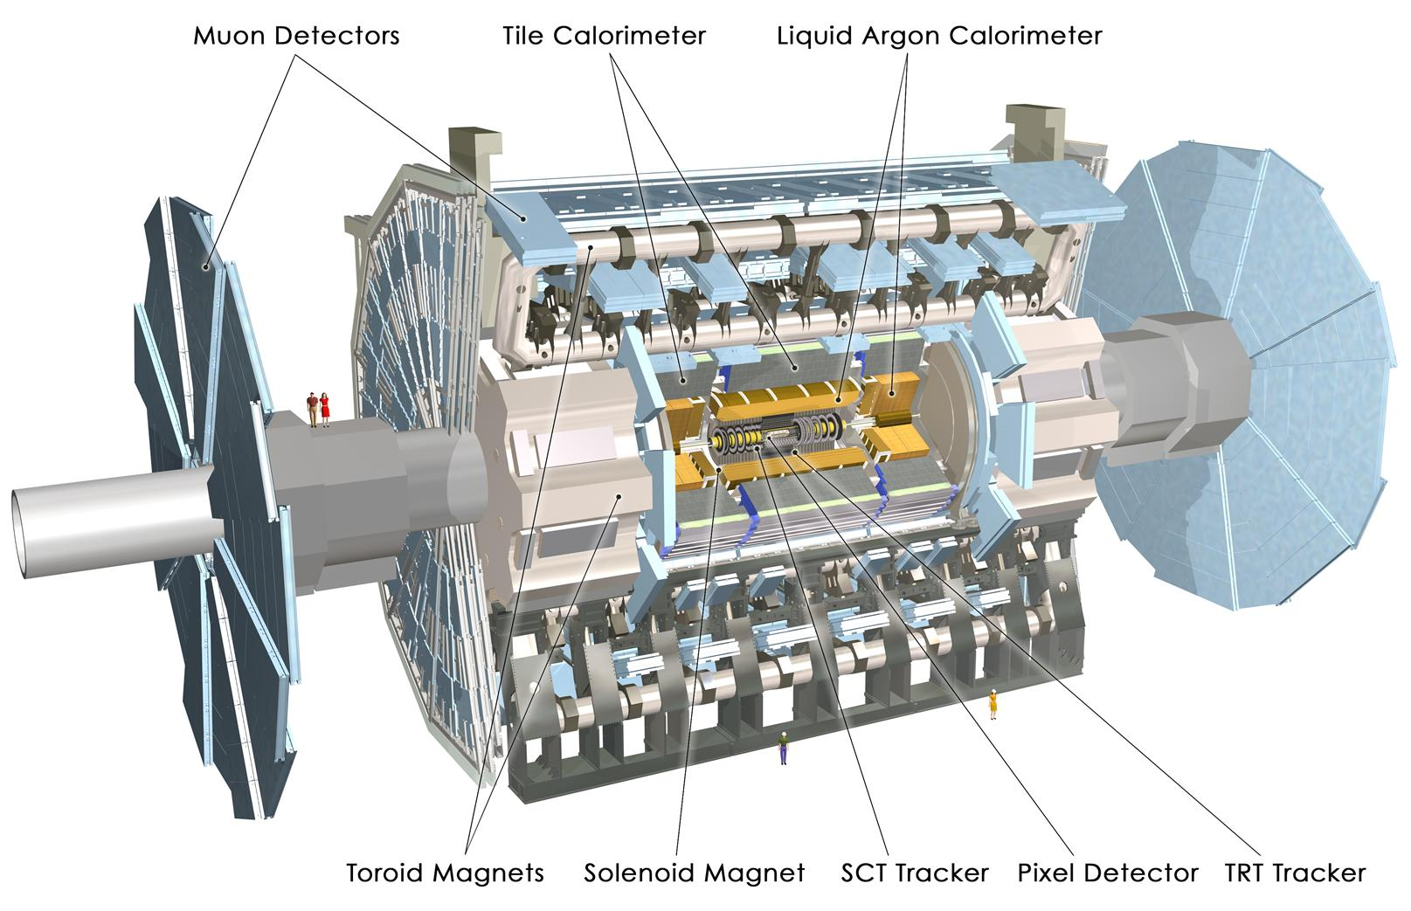
The ATLAS Detector
A Toroidal LHC ApparatuS (ATLAS) is one of two large general-purpose particle detectors at the LHC
Cylindrical design to cover almost the entire solid angle around the interaction point
Made up of a series of concentric layers, each detecting a different component of the interaction products:
  Inner Detector (Pixel, SCT, TRT): measures the trajectories and momenta of charged particles
  Calorimeters (ECal and HCal): measures the energy of EM and hadronic particles, respectively
  Muon Spectrometer: measures the momenta of muons
  Solenoid and toroid magnets to curve charged particle trajectories

Slide 5
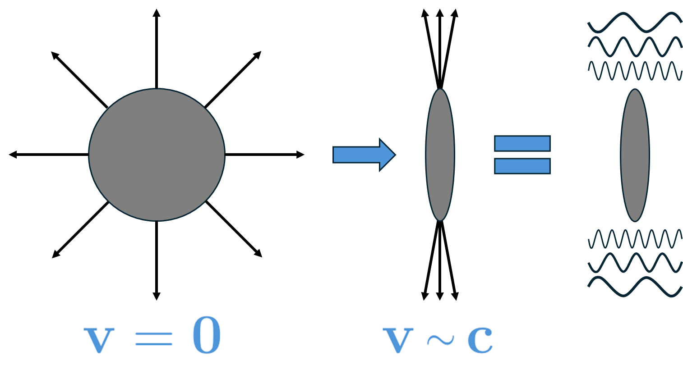
Photon-Photon Collisions
One largely unexplored area of particle physics is photon-photon collisions
At ultra-relativistic speeds (e.g. at the LHC) the EM field around protons is compressed to resemble a flux of photons
When protons narrowly miss each other at the ATLAS IP, these photons can interact to yield central production of particles
  Proton quantum numbers are unchanged
  For low-Q² interactions they can remain intact
  Continue down the beam at a scattered angle due to energy loss

Slide 6
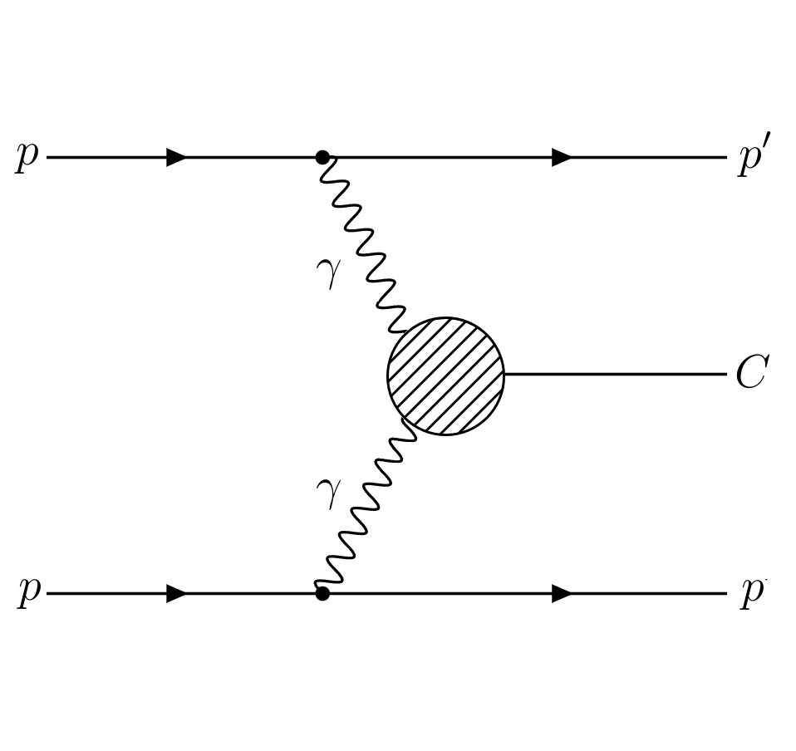
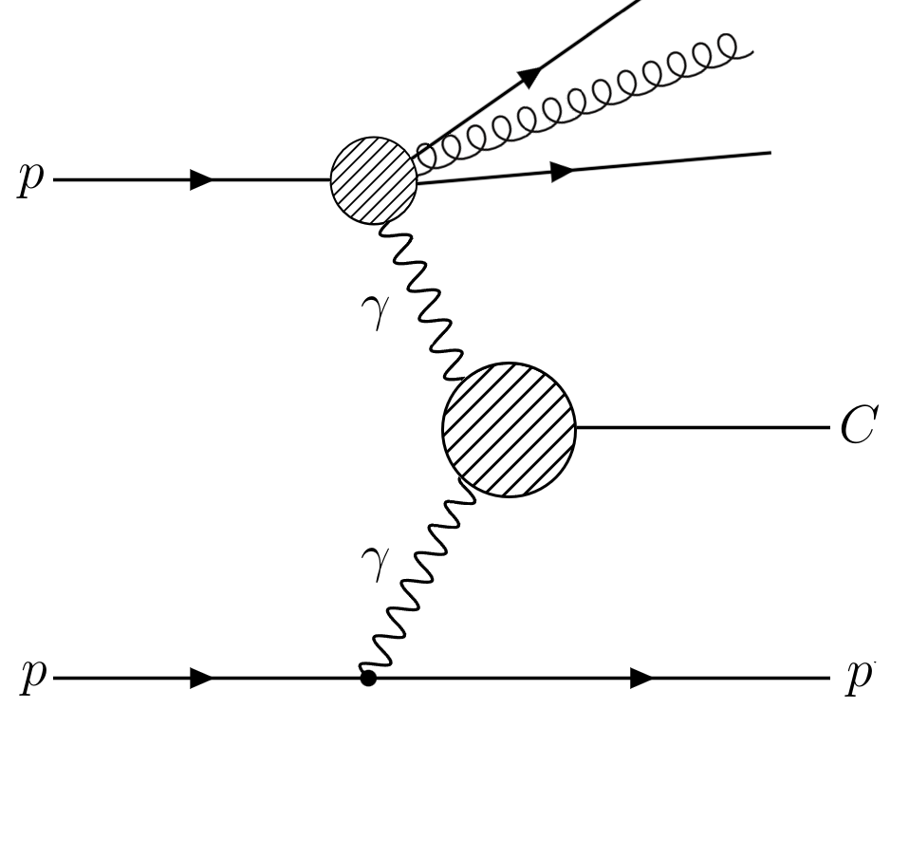
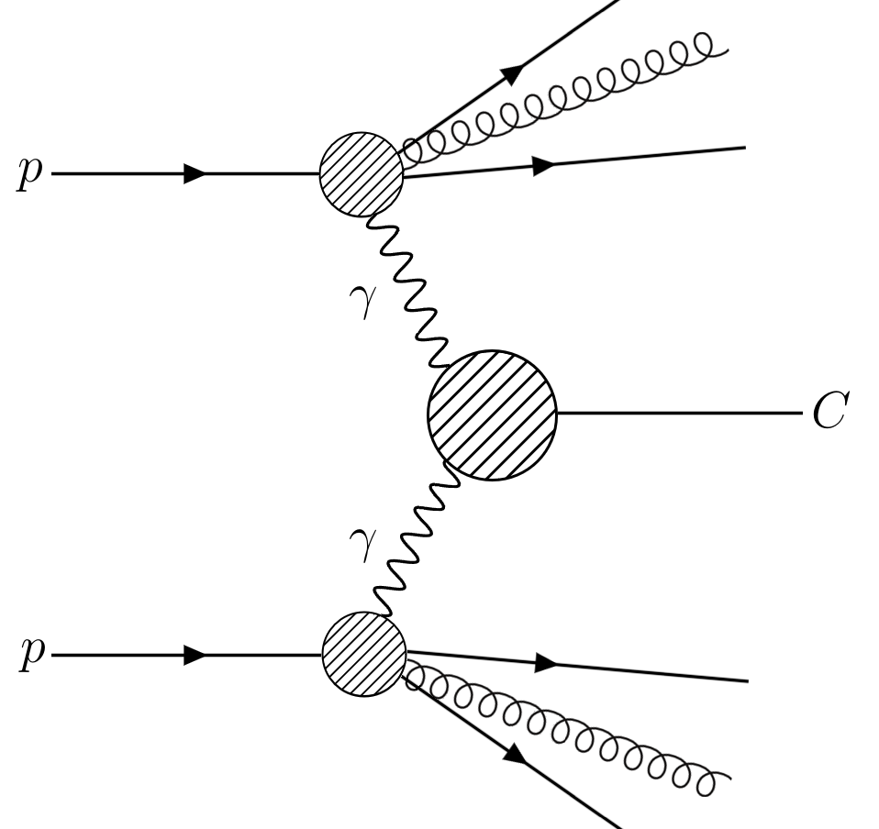
Intact and Dissociated Final State Protons
If both protons remain intact (elastic interaction), central signature is exclusive
  Contains only centrally produced particles (η~0) and outgoing protons (high-η)
  Leaves rapidity gap in low to mid-rapidity region
  Energy in central production exactly equal to energy lost by protons
Outgoing protons can become excited and break apart into hadronic showers
  No longer simple to constrain the energy of the central system
If BSM particles are centrally produced and not detected by ATLAS, their mass will be “missing” from the central energy predicted by the proton energy loss
Exclusive process
Elastic-elastic (EE)
Single dissociative (SD)
Double dissociative (DD)

Slide 7
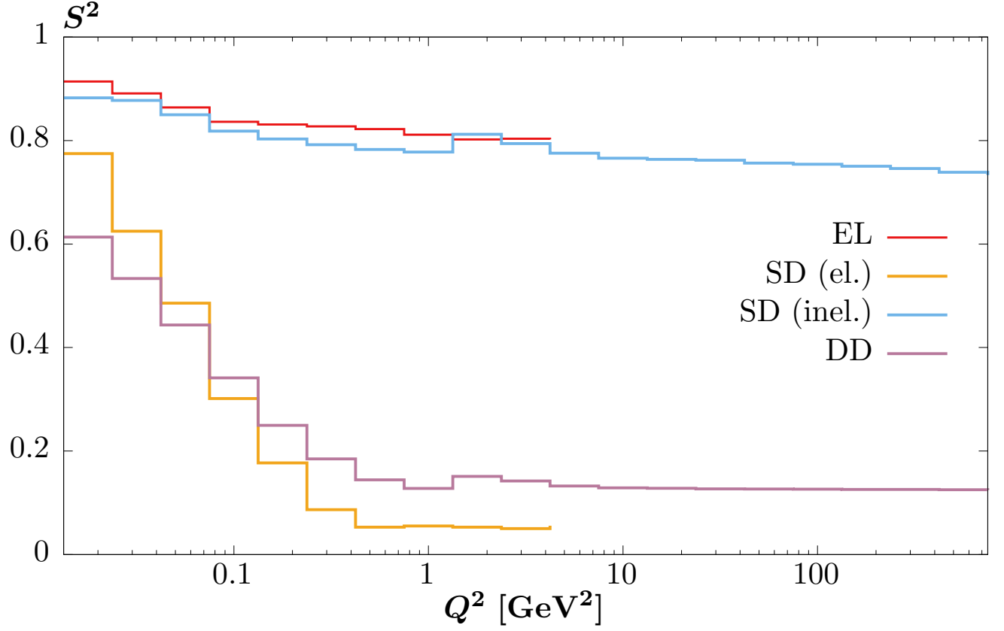
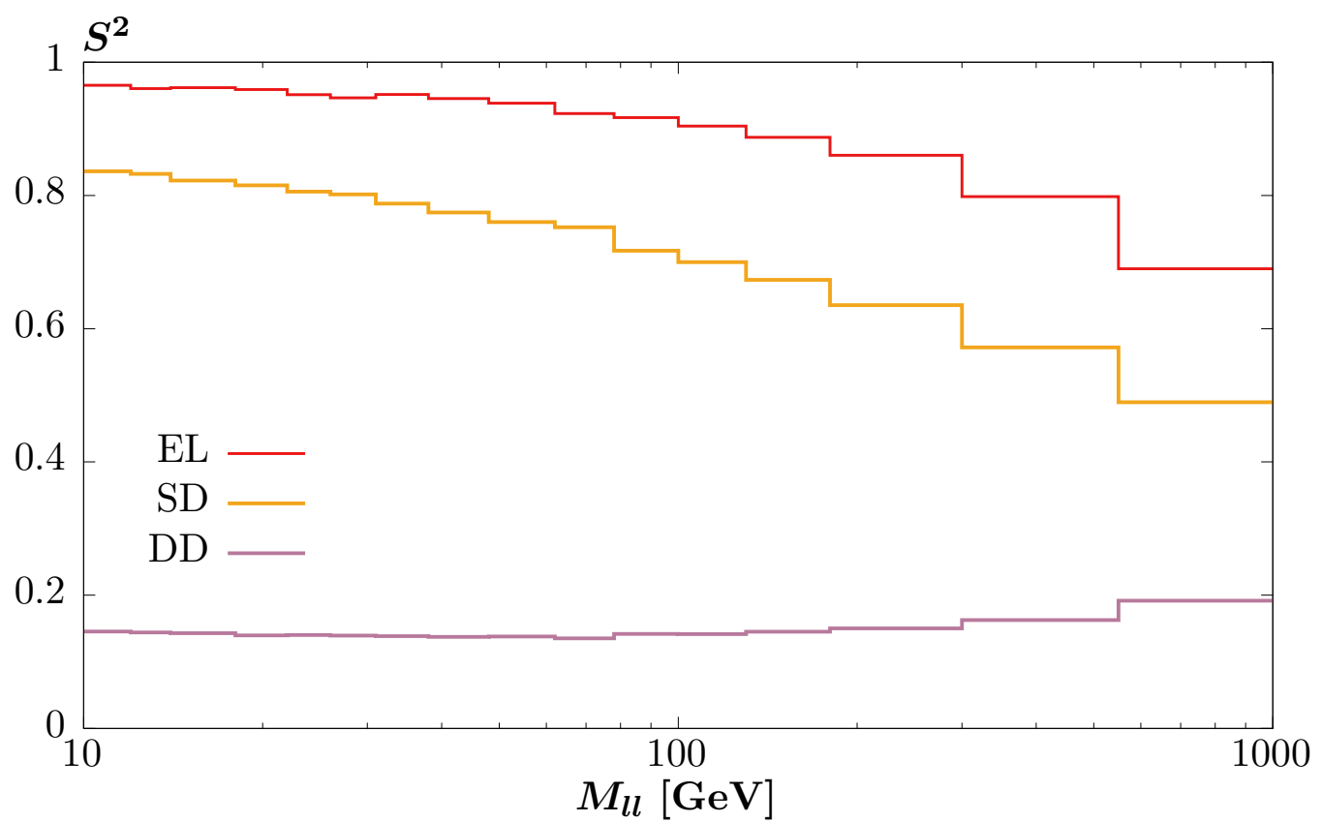
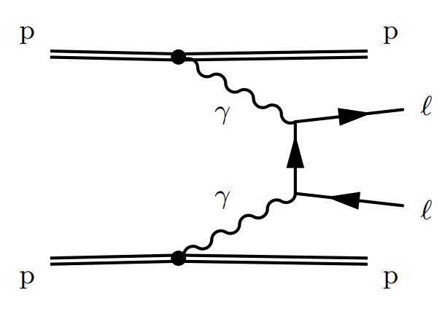
Soft-Survival
Protons can undergo further interactions following elastic photon exchange
  Produces additional particles at low to mid-rapidity “killing” the rapidity gap
  Probability that this does not happen is parametrised by the soft-survival probability S ≤ 1
Dependent on momentum transfer Q² and properties of central system e.g. dilepton mass for photon-induced dilepton production:
Reduces the cross section of exclusive photon-induced processes
2007.12704

Slide 8
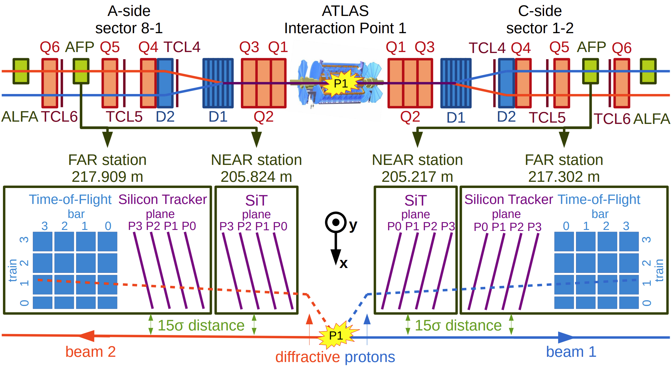
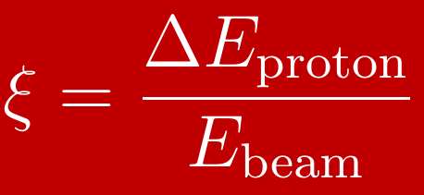
ATLAS Forward Proton (AFP) Spectrometer
How do we measure the energy lost by protons which interact via photon exchange?
  Protons are scattered at small angles (O(μrad)) proportional to their energy loss
  Position detectors far down the beamline where transverse deflection is significant
Proton fractional energy loss:

Slide 9
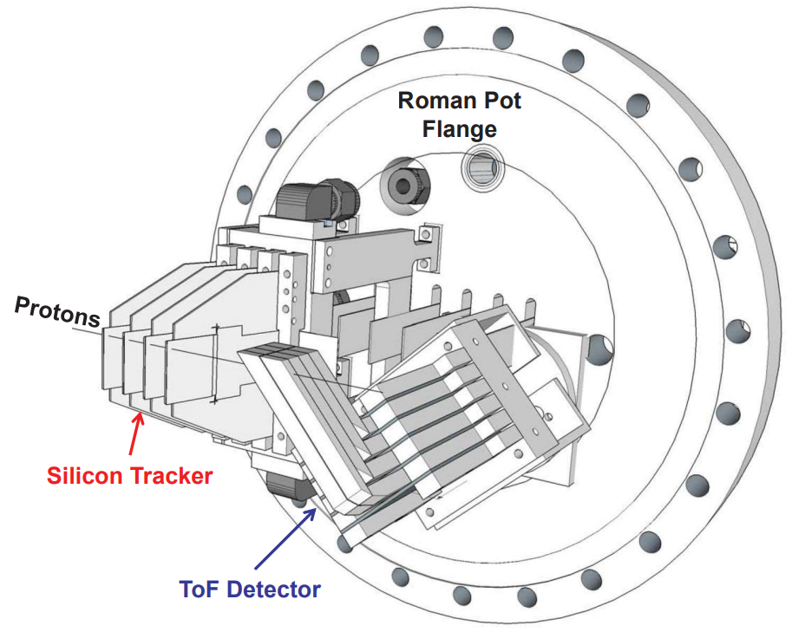
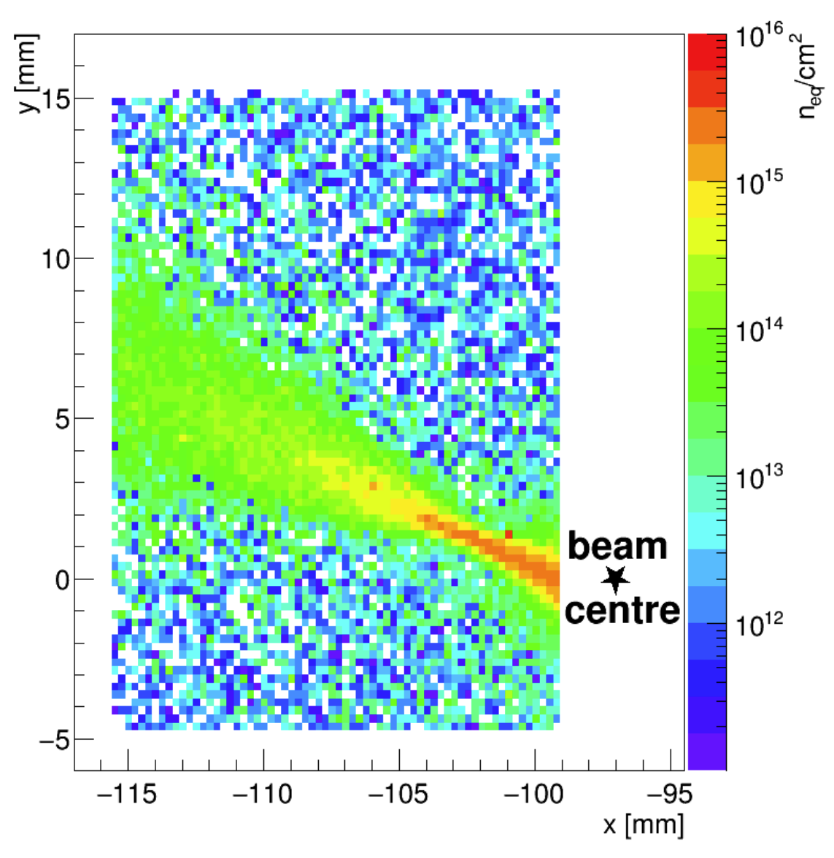
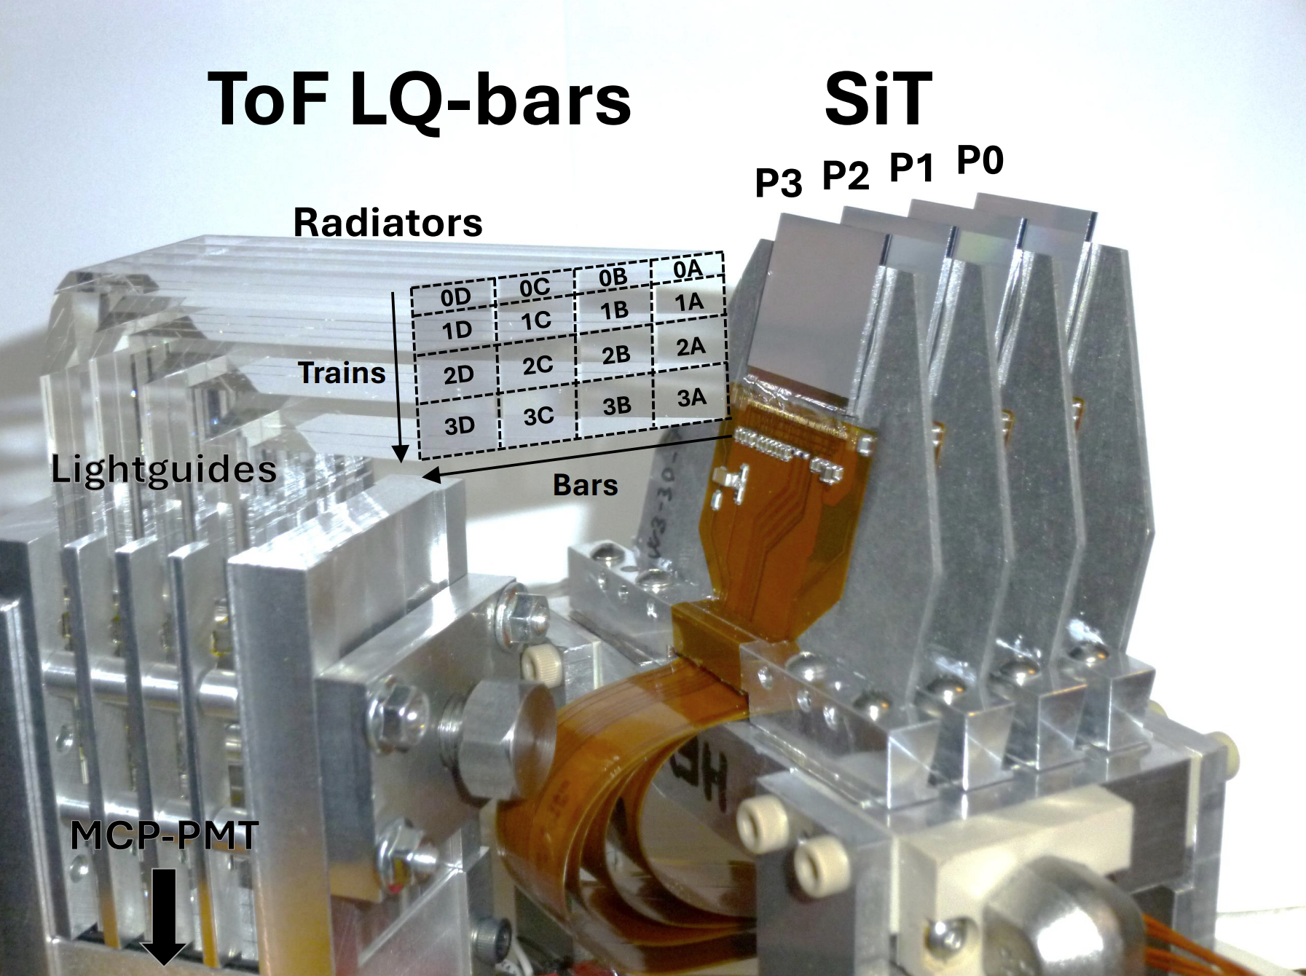
AFP
Roman Pots (RPs)
Each station mounted on moveable RP
Allows detectors to approach with 2 mm of the beam
Silicon Trackers (SiT)
Measure incident proton trajectories
Two stations (NEAR and FAR) per side
Four 3D silicon pixel sensors per station
Need to withstand up to 3 × 10¹³ n_{eq}/cm² per fb⁻¹ collected
336 × 80 pixels in x-y direction
50 × 250 μm² per pixel
Tilted 14° about y axis to improve resolution
Time of Flight (ToF)
Measure arrival time of protons at O(10) ps precision
  Reconstruct vertex position at IP
Cherenkov detector
L-shaped light-guiding quartz bars
4 bars parallel to beam = train
4 trains per station
Light collected by MCP-PMT for readout

Slide 10
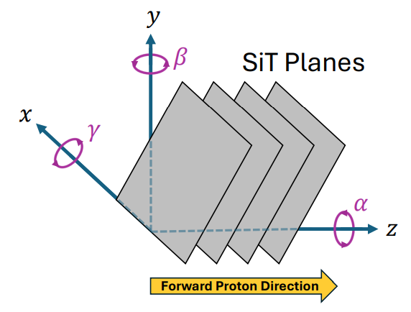
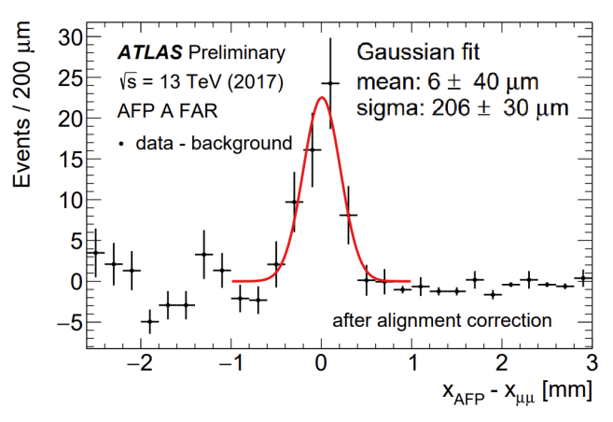
AFP Alignment
Measurement with AFP requires precise alignment of the detector components:
Local (Interplane) Alignment
Global Alignment
Alignment of the 4 sensor planes within a given SiT station
Each plane has 6 d.o.f.:
x and y translation and z rotation most important
Alignment of the 4 AFP stations with the central ATLAS detector
Raw track position
SiT module position
Beam position – measured in special runs
Roman pot position – distance of insertion
In-situ correction – from analysis of dimuon events
Iterative procedure performed on reconstructed tracks
Calculate residual between track and cluster centres
  Perform fit to minimise residuals
  Repeat

Slide 11
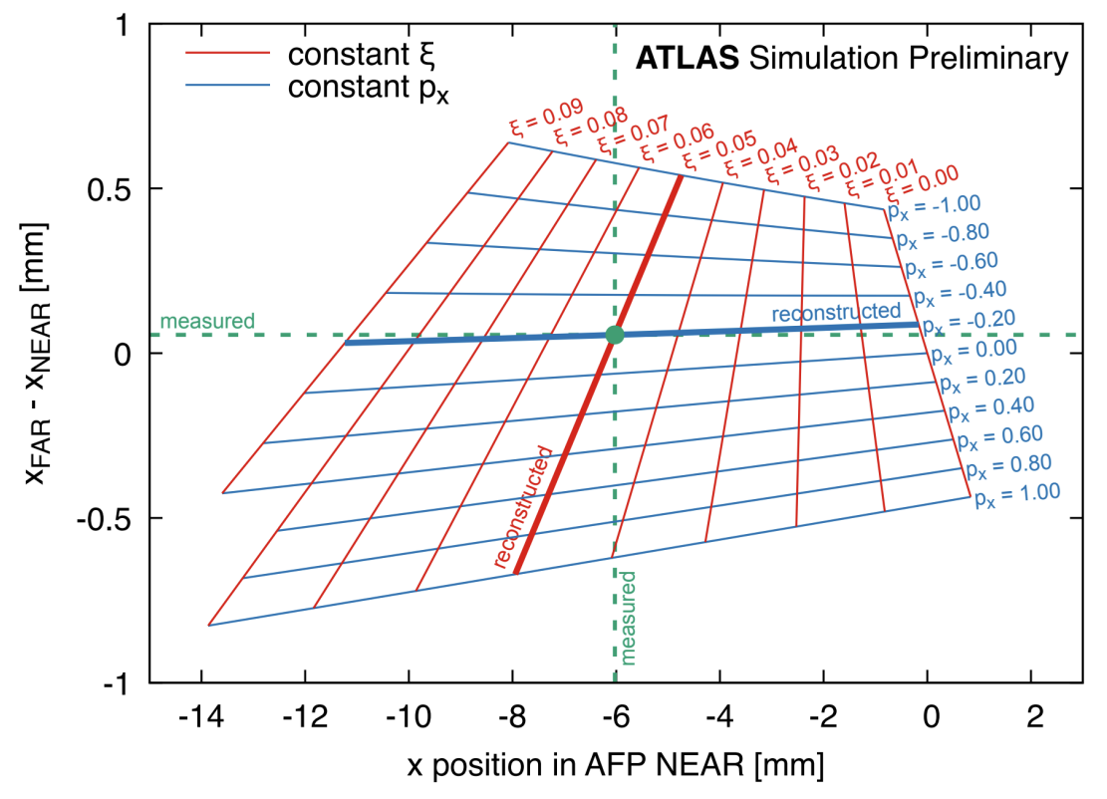
Forward Proton Reconstruction
Proton fractional energy loss:
Coordinates: charge-weighted average of hits
Interplane alignment correction applied
Coordinates: linear regression of cluster positions
Global alignment correction applied
Take NEAR station x and Δx slope between stations
Unique mapping between (x, Δx) and (p_{x}, ξ) of proton
SiT pixel hits
SiT clusters
Tracks
Protons
Hits recursively combined with neighbours
At least two clusters in SiT station combined
Tracks in both NEAR and FAR stations combined
Selection: only consider neighbours in x direction
Selection: x-y separation of clusters < 0.5 mm
Selection: distance between tracks in x-y plane < 2 mm
AFP acceptance: 0.02 < ξ < 0.12

Slide 12
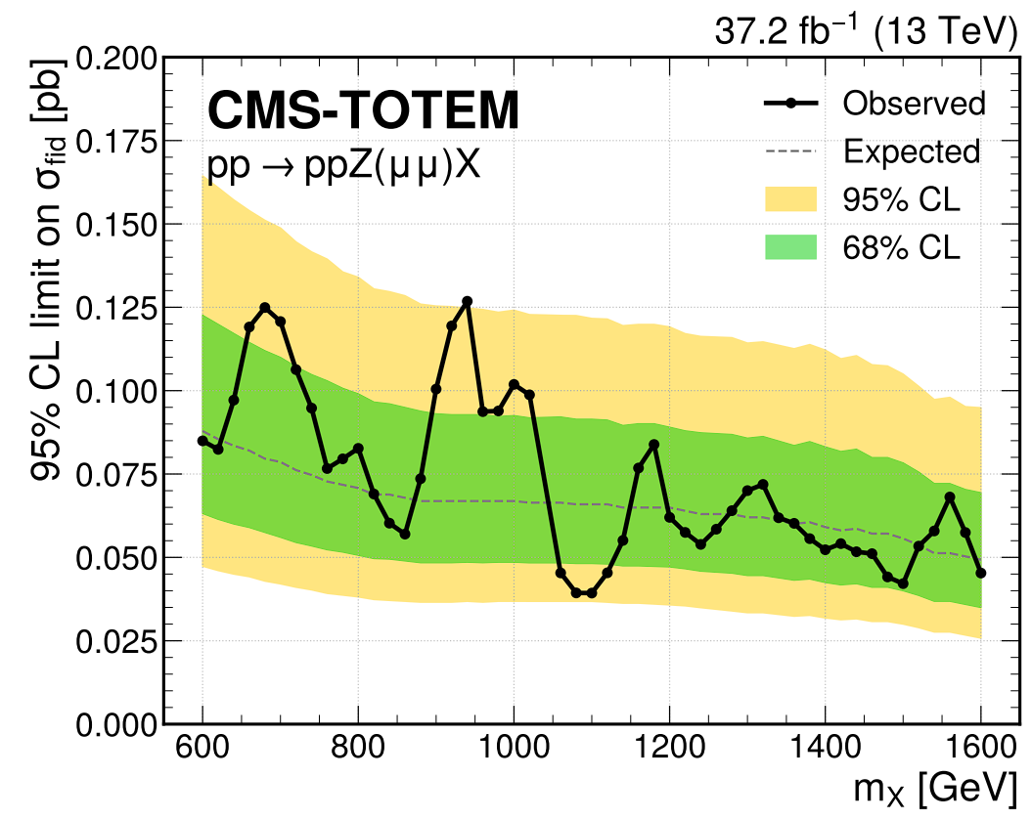

Analysis Motivation
Forward proton measurements from AFP allow calculation of full four-momentum of the central interaction in elastic photon-exchange processes
Compare to central system measured by ATLAS to determine what’s missing
  Could reveal BSM particles not detectable by ATLAS e.g. dark matter, SUSY, etc.
Perform search for missing mass X produced alongside visible boson-like V decaying to leptons
  Reconstruct mass of X and perform search for narrow resonance
Equivalent analysis published by CMS
No significant excess observed, limits set on signal cross section

Slide 13
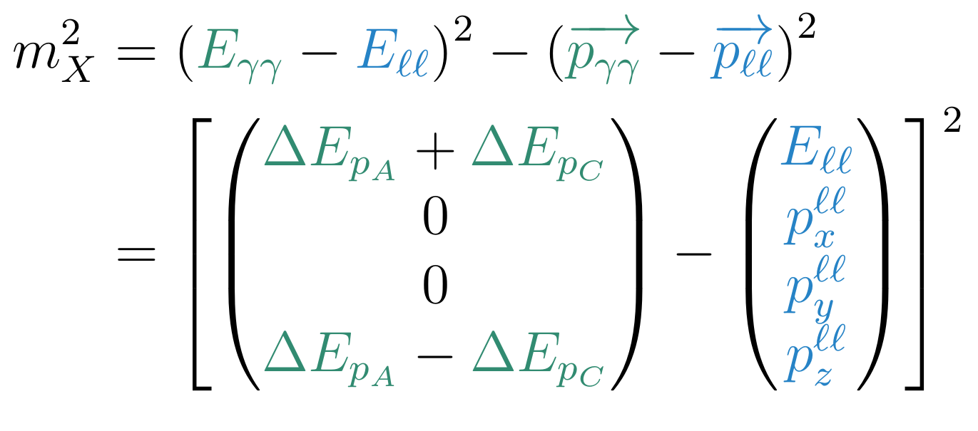


Missing Mass Method
The missing mass present in each event is calculated as:
where ΔE_{pA} and ΔE_{pC} are the energy losses of the protons detected on AFP sides A and C respectively and we assume that the transverse momenta of the photons is negligible.
Improves over ATLAS missing transverse energy as it includes the longitudinal component
AFP
ATLAS
Resolution measured to be ~50 GeV across the measured range

Slide 14
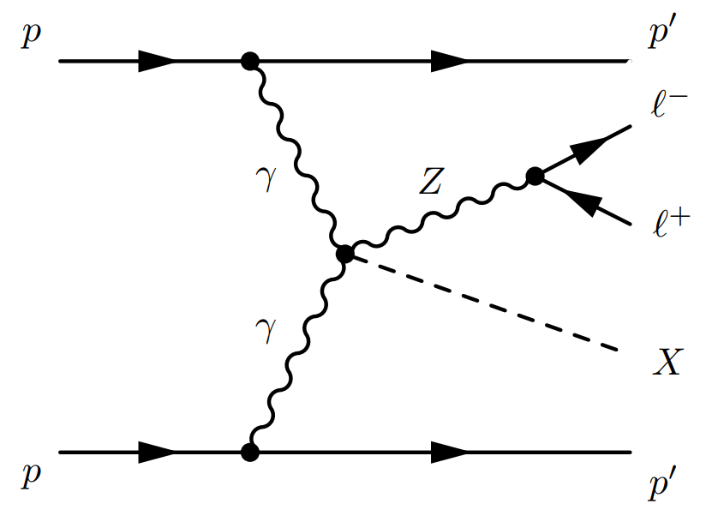
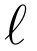
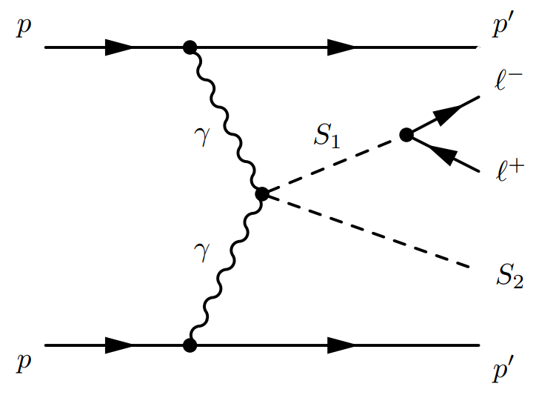
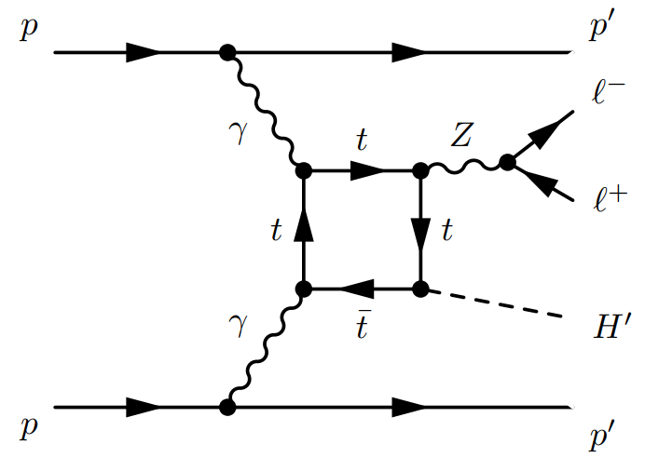
Signal Simulation
Comparison between two generators using very different assumptions on underlying processes:
Standalone SuperChic and MadGraph within Athena
SuperChic: 300 ≤ m_{X} ≤ 900 GeV
MG ALP: 200 ≤ m_{X} ≤ 800 GeV
MG ZH: 100 ≤ m_{X} ≤ 800 GeV
l = electron or muon
SuperChic (Simple dedicated generator):
New process implemented, simple direct simulation
Short-lived
MadGraph (ALP production):
Testing axion-like particle process with two ALPs: One long-lived (X) and the other (V) decaying to leptons
Long-lived
MadGraph (Higgs derivation):
Custom Higgs mass, forced to not decay to mimic our X particle
Setting limits on each model separately
Example LO diagram

Slide 15
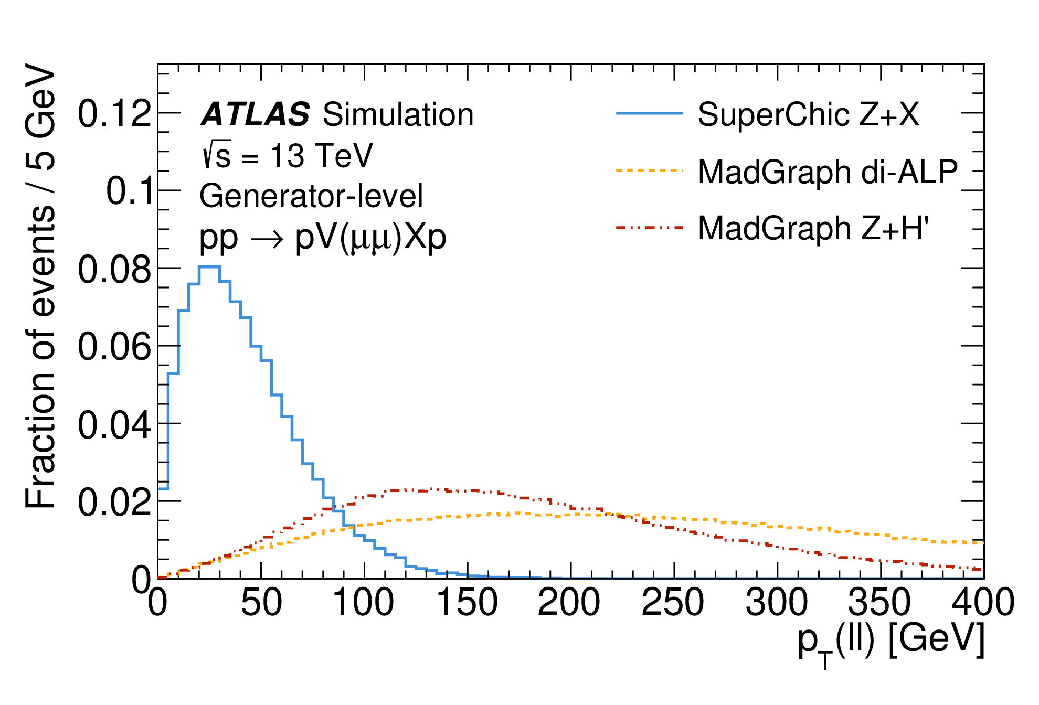
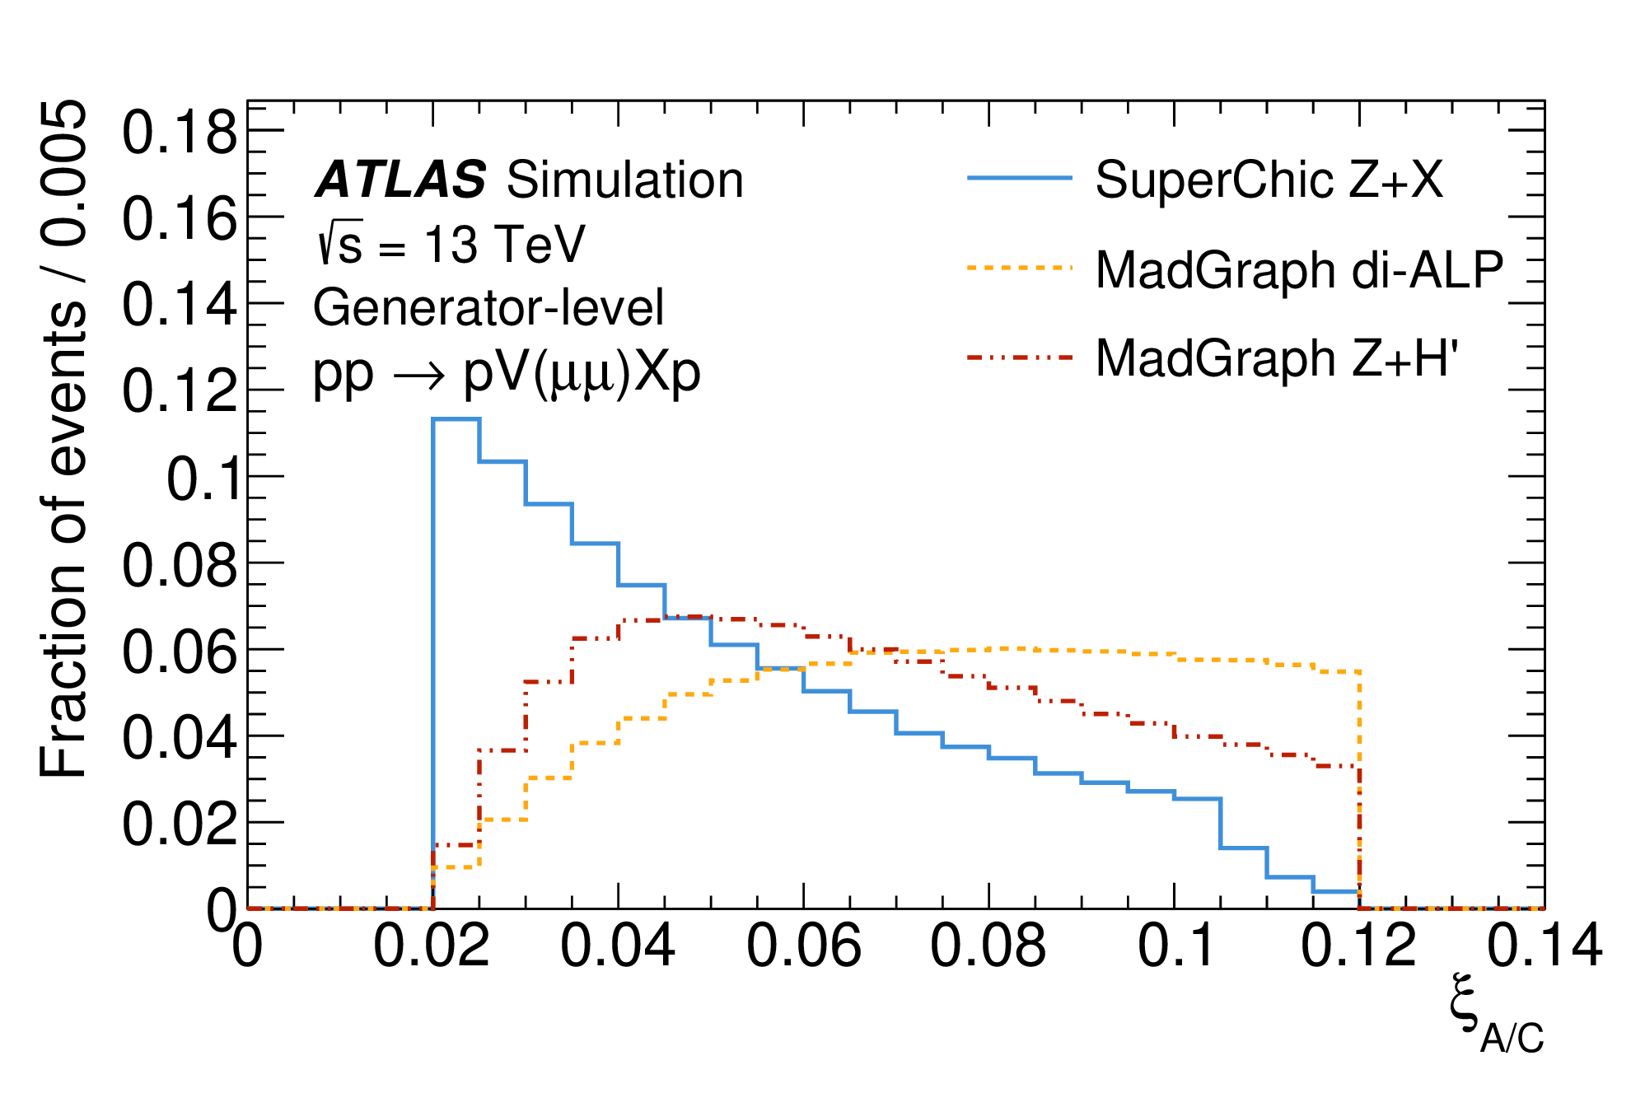
Signal Kinematic Comparison
Kinematic comparison between signal models with m_{X} = 500 GeV at generator level:
MadGraph models have significantly higher dilepton p_{T}
  Balanced by higher skew of proton ξ distribution
Dilepton and missing mass distributions well matched with equivalent widths
Dilepton p_{T}
Proton ξ
Wide range of phase space covered by the three models

Slide 16
Data
Only 2017 data available for AFP in Run 2
  In 2015, AFP was not yet operational
  In 2016, AFP was inserted only on side C
  In 2018, data was recorded with AFP but was incorrectly synchronised with ATLAS
46.9 fb⁻¹ recorded by ATLAS in 2017:
46.9 fb⁻¹
32.0 fb⁻¹
26.0 fb⁻¹
19.2 fb⁻¹
14.7 fb⁻¹
Remove low efficiency runs
AFP insertion
ATLAS GRL
AFP GRL
Loosest available unprescaled single and dilepton triggers applied
All stations inserted to nominal data-taking positions
At least two SiT planes in each station have high voltage on
Data Acquisition system is fully functional

Slide 17
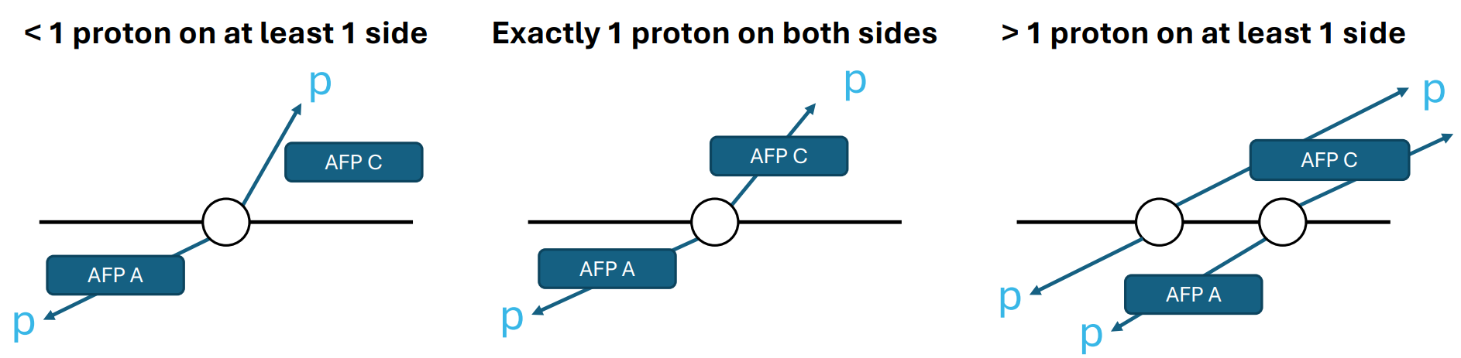
Pre-Selection
Define pre-selection to create sample for data-driven background modelling and studies during the analysis:
Require at least two same-flavour, opposite sign leptons (e⁺e⁻ or μ⁺μ⁻)
Require exactly one proton per side
Reconstruct missing mass using one proton per side
(assuming they are the correct protons)
Cannot reconstruct missing mass without protons on both sides
No way to select between multiple protons on the same side

Slide 18
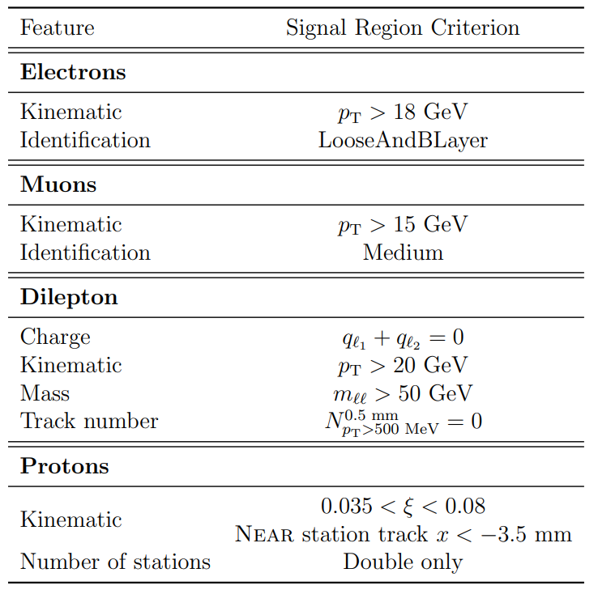
Signal Selection
Define signal selection to optimise signal-to-background ratio and use for final fits:
Loose lepton requirements to maximise statistics
Impose loose dilepton mass cut to remove quarkonia and dilepton p_{T} cut to remove background
Tight proton ξ requirement corresponds to region where efficiency is well understood
Track veto (in a few slides)

Slide 19
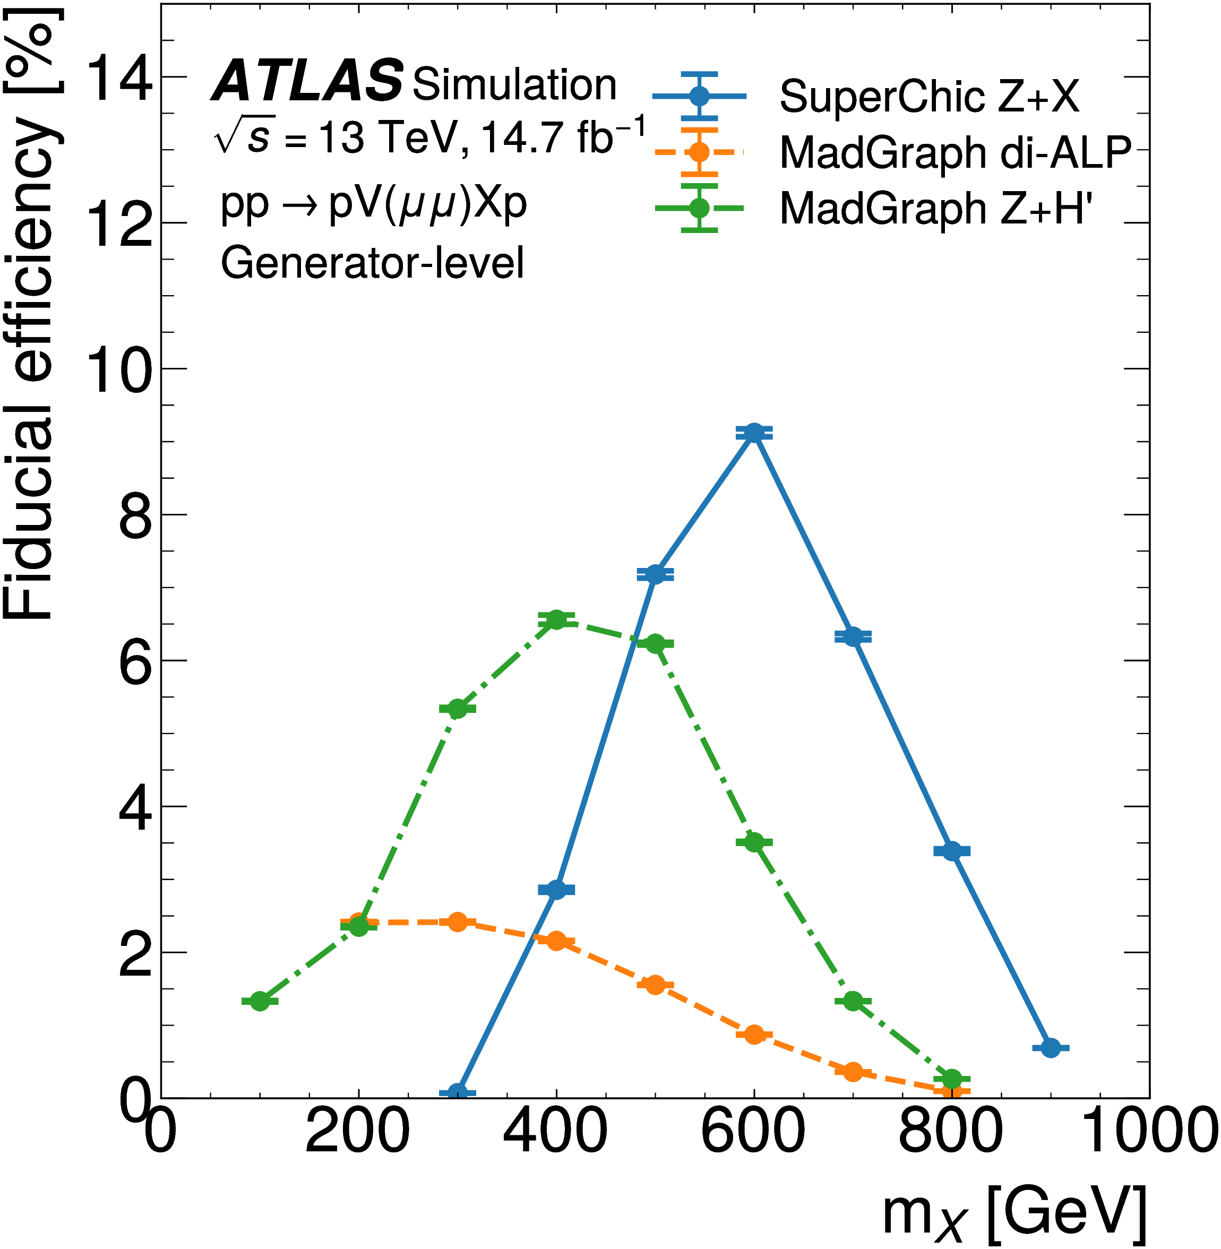
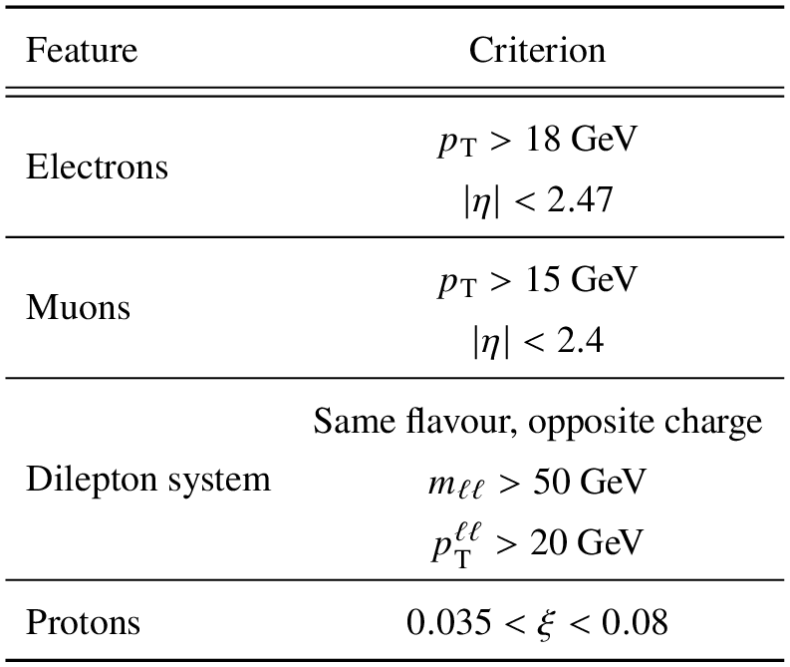
Fiducial Selection
Define fiducial selection similar to signal selection
Applied at generator-level to simulated signal samples
Reduces search phase space to the one which our detectors are sensitive to
Events falling outside fiducial selection considered as additional background component
Generator level ξ cut greatly reduces background from incorrectly selected protons (more in a few slides)
Fiducial selection efficiency for each signal model and mass

Slide 20
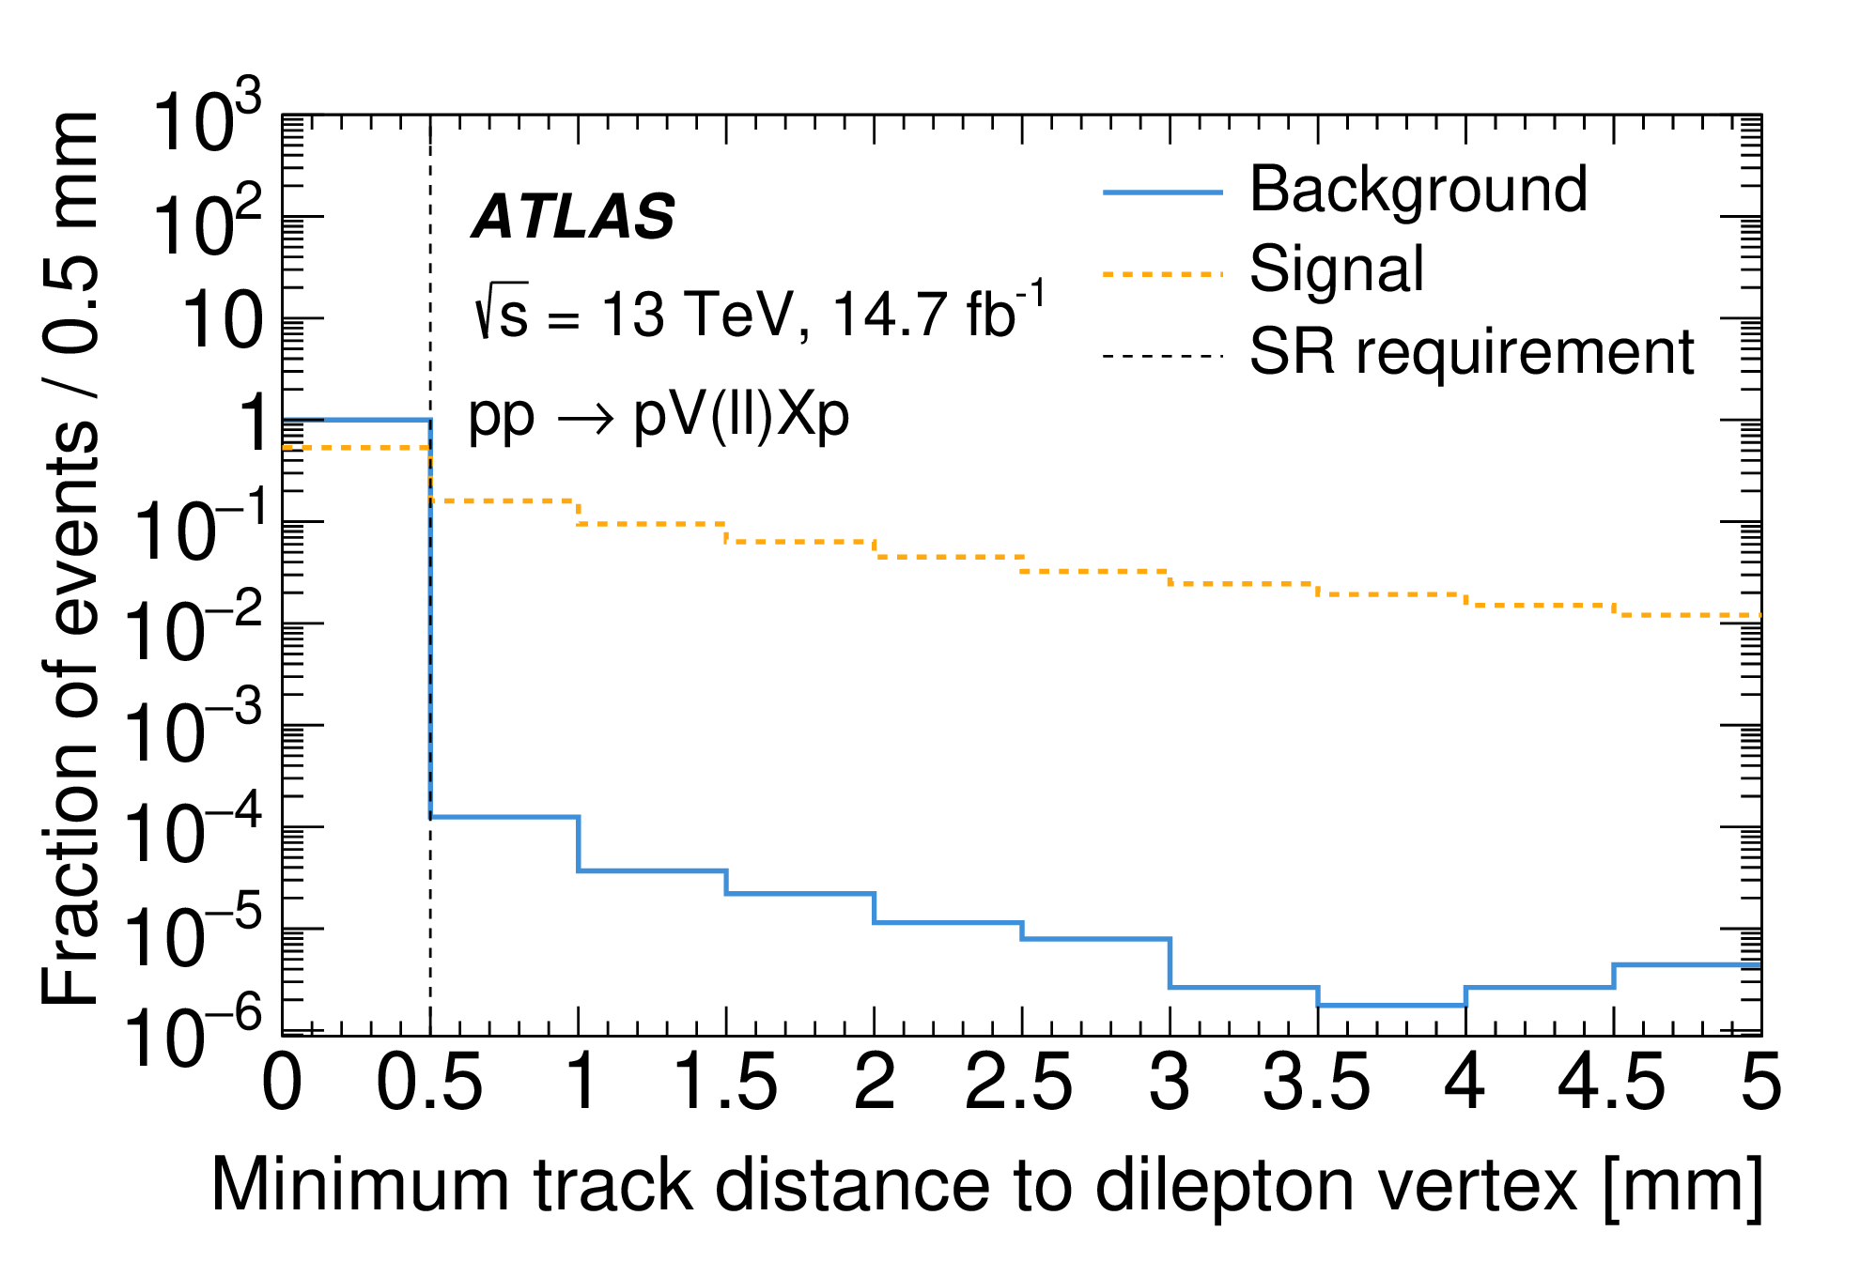
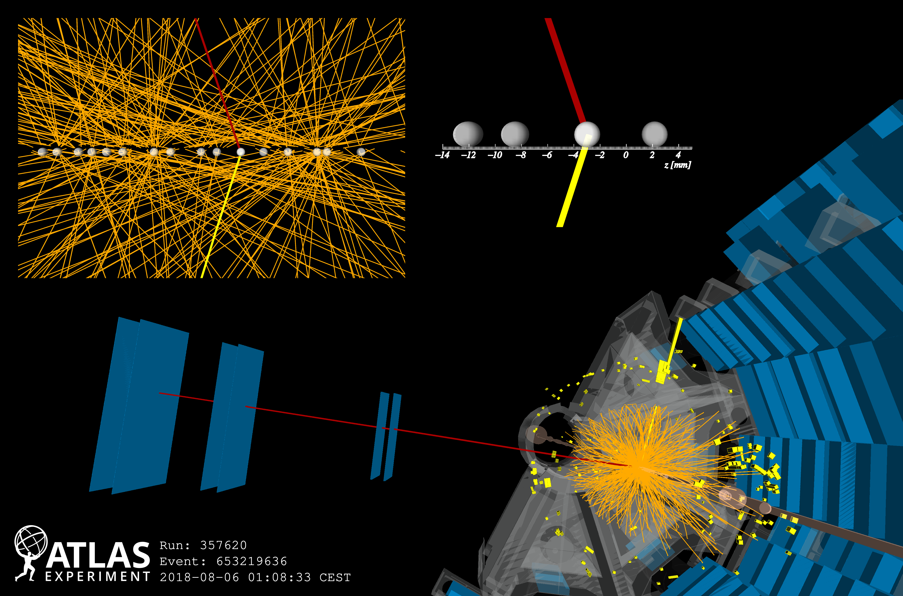
Track Veto
High track density resulting from multiple overlapping interactions
Require a clear window (no other tracks) around dilepton vertex
Distance of the closest additional inner detector track to the dilepton vertex
Significant reduction in non-exclusive backgrounds even with small window size
Signal efficiency much higher due to no additional event components – only loss is due to random intercept by tracks from pile-up interactions

Slide 21
Low-p_{T} Tracks
Standard “high-p_{T}” ATLAS tracks have p_{T} > 500 MeV
Many background processes have soft tracks below this threshold
Including “low-p_{T}” tracks could greatly enhance the power of the track veto
New technique now available for track reconstruction down to p_{T} > 100 MeV (described in ATL-COM-PHYS-2024-270)
Computationally expensive and slow process
Performed on filtered sample with maximum of 15 high-p_{T} tracks within track veto window
Projection:
Up to 5 times improvement in background rejection
Only 20% additional loss of signal
Up to 2 times improvement in sensitivity
Reality:
Extremely low statistics in data and signal samples
Unstable fitting requiring increased bin widths
Degraded any potential improvement ☹

Slide 22
Low-p_{T} Tracks
Standard “high-p_{T}” ATLAS tracks have p_{T} > 500 MeV
Many background processes have soft tracks below this threshold
Including “low-p_{T}” tracks could greatly enhance the power of the track veto
New technique now available for track reconstruction down to p_{T} > 100 MeV (described in ATL-COM-PHYS-2024-270)
Computationally expensive and slow process
Performed on filtered sample with maximum of 15 high-p_{T} tracks within track veto window
Huge potential for a future analysis with a larger dataset!
Projection:
Up to 5 times improvement in background rejection
Only 20% additional loss of signal
Up to 2 times improvement in sensitivity
Reality:
Extremely low statistics in data and signal samples
Unstable fitting requiring increased bin widths
Degraded any potential improvement ☹

Slide 23
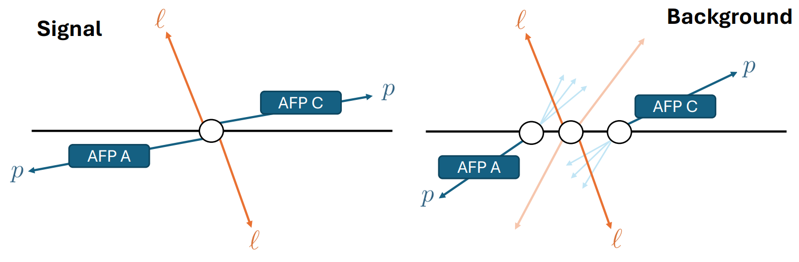
Background Modelling
Dominant background in combinatorial background
Central dilepton systems from SM processes wrongly combined with unassociated protons from independent pile-up interactions
Central dileptons come from several SM processes:
Z+jets
Top quark production: Wt and ttbar
Diboson production: WW, WZ and ZZ
Photon-induced dilepton production: ll and WW
Misidentified (fake) leptons
Protons originate mainly in single-diffractive (QCD Pomeron exchange) processes between pile-up protons
Modelled using data-driven event mixing procedure:
No simulation required
No scale factors or corrections
Only systematics come from normalisation and statistical uncertainty

Slide 24
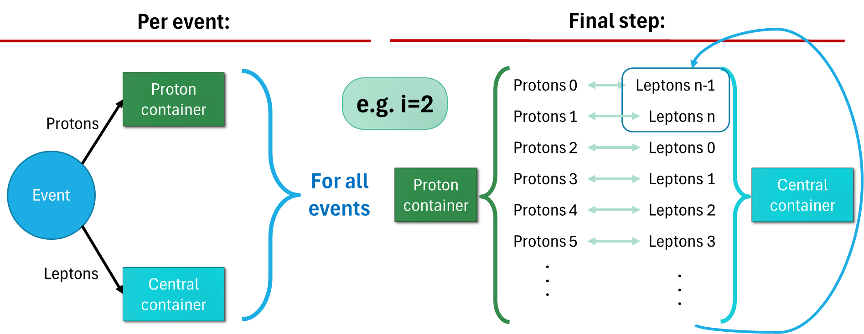
Event Mixing
Primary background in AFP analyses is combinatorial
  Formed by incorrect combination of protons with uncorrelated central interaction
Easily and accurately modelled using data-driven approach event-mixing:
D
Select even shift i between 1 and N-1 (N = sample size)
Separate central and proton component of each event
Shift central components by i positions along the dataset
Recombine shifted event components
Mixed event components are uncorrelated as in background

Slide 25
Background Modelling
Dominant background in combinatorial background
Central dilepton systems from SM processes wrongly combined with unassociated protons from independent pile-up interactions
Central dileptons come from several SM processes:
Z+jets
Top quark production: Wt and ttbar
Diboson production: WW, WZ and ZZ
Photon-induced dilepton production: ll and WW
Misidentified (fake) leptons
Protons originate mainly in single-diffractive (QCD Pomeron exchange) processes between pile-up protons
Can average over several mixed samples with different event-shifts to create high statistics background model
We use 2 ≤ i ≤ 101 ~1% uncertainty
Modelled using data-driven event mixing procedure:
No simulation required
No scale factors or corrections
Only systematics come from normalisation and statistical uncertainty

Slide 26
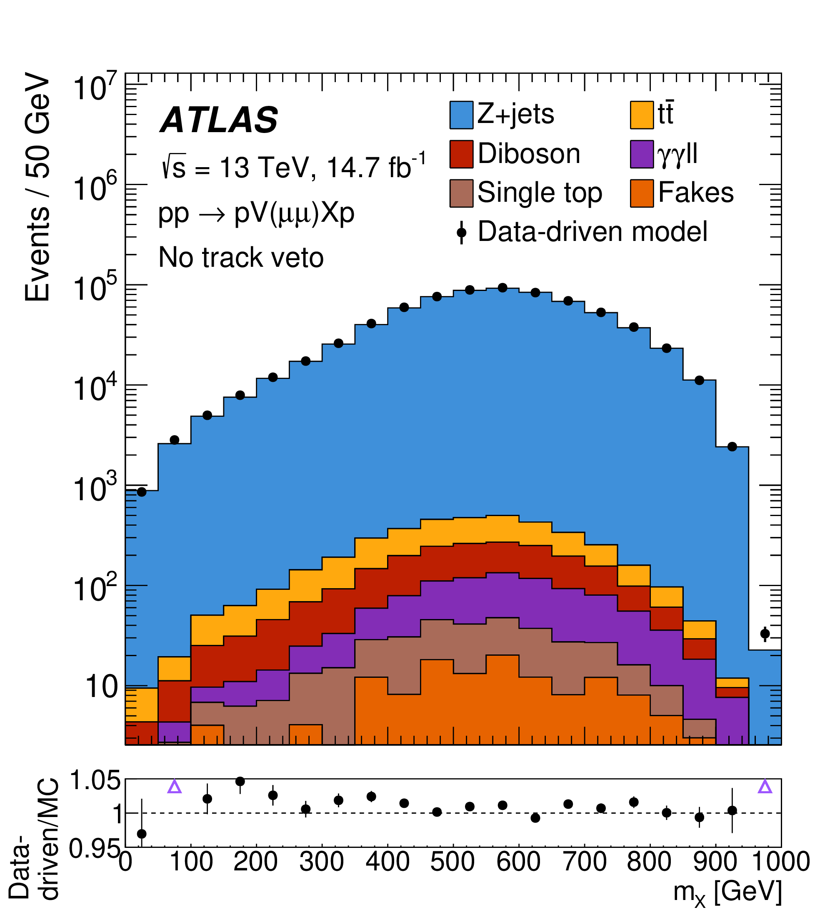
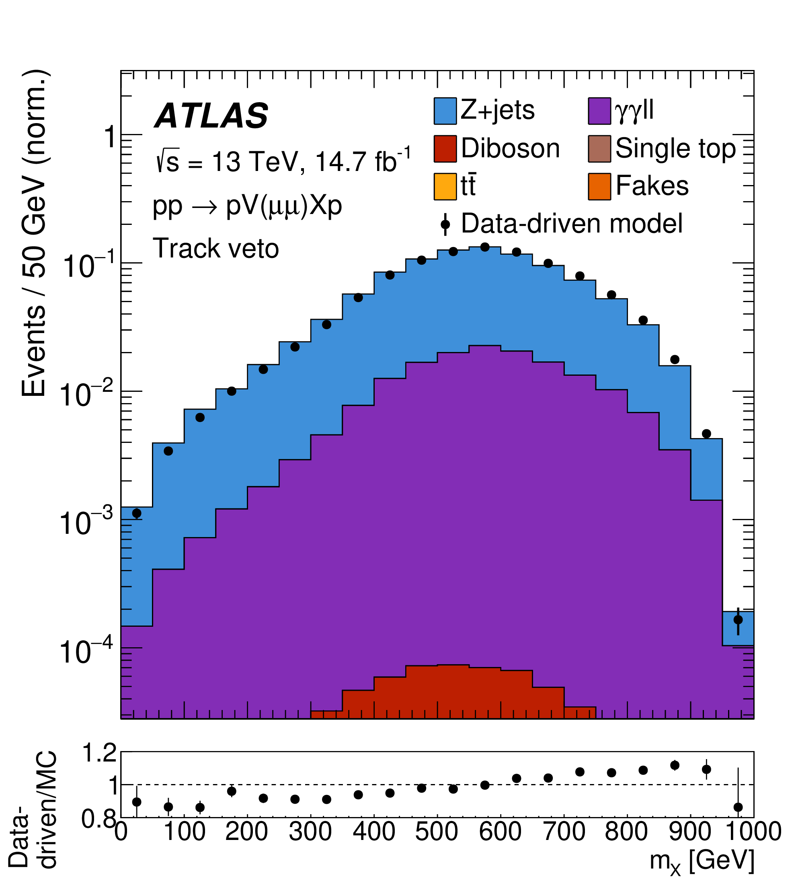
Background Validation with MC
Create secondary background model using MC simulation to validate data-driven model
Simulate central SM processes
Overlay database of randomly assigned pile-up protons taken from 2017 data
Model fake lepton contribution using same-sign lepton selection on data
Excellent agreement observed
Data-driven model validated for use in final fits
Distributions after track veto are normalised due to known mismodelling of underlying event
Still good agreement

Slide 27
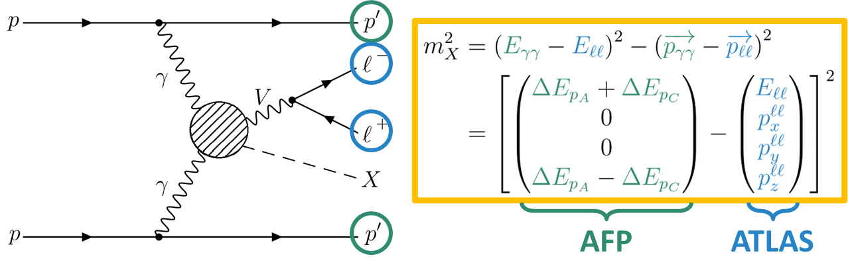
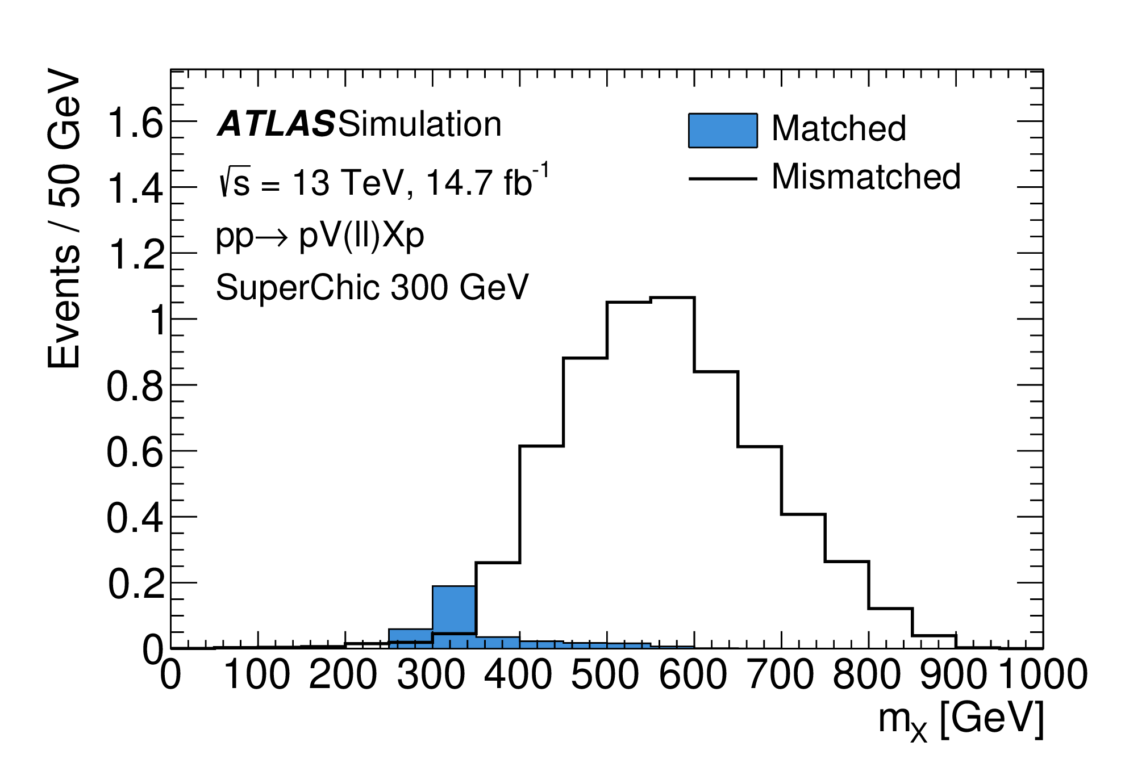
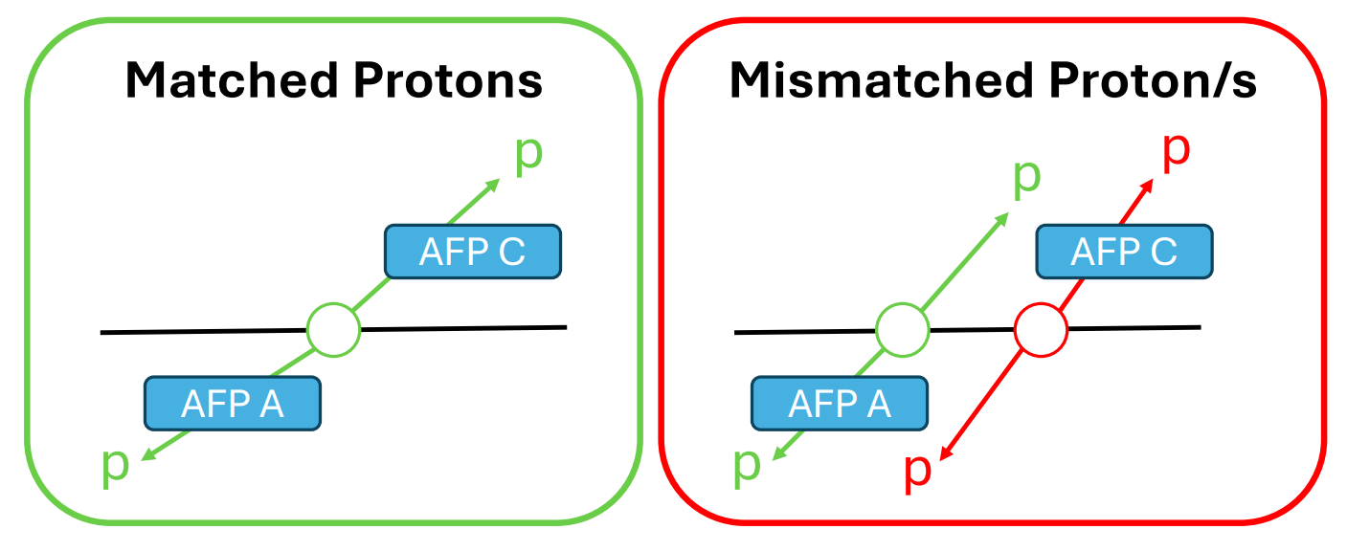
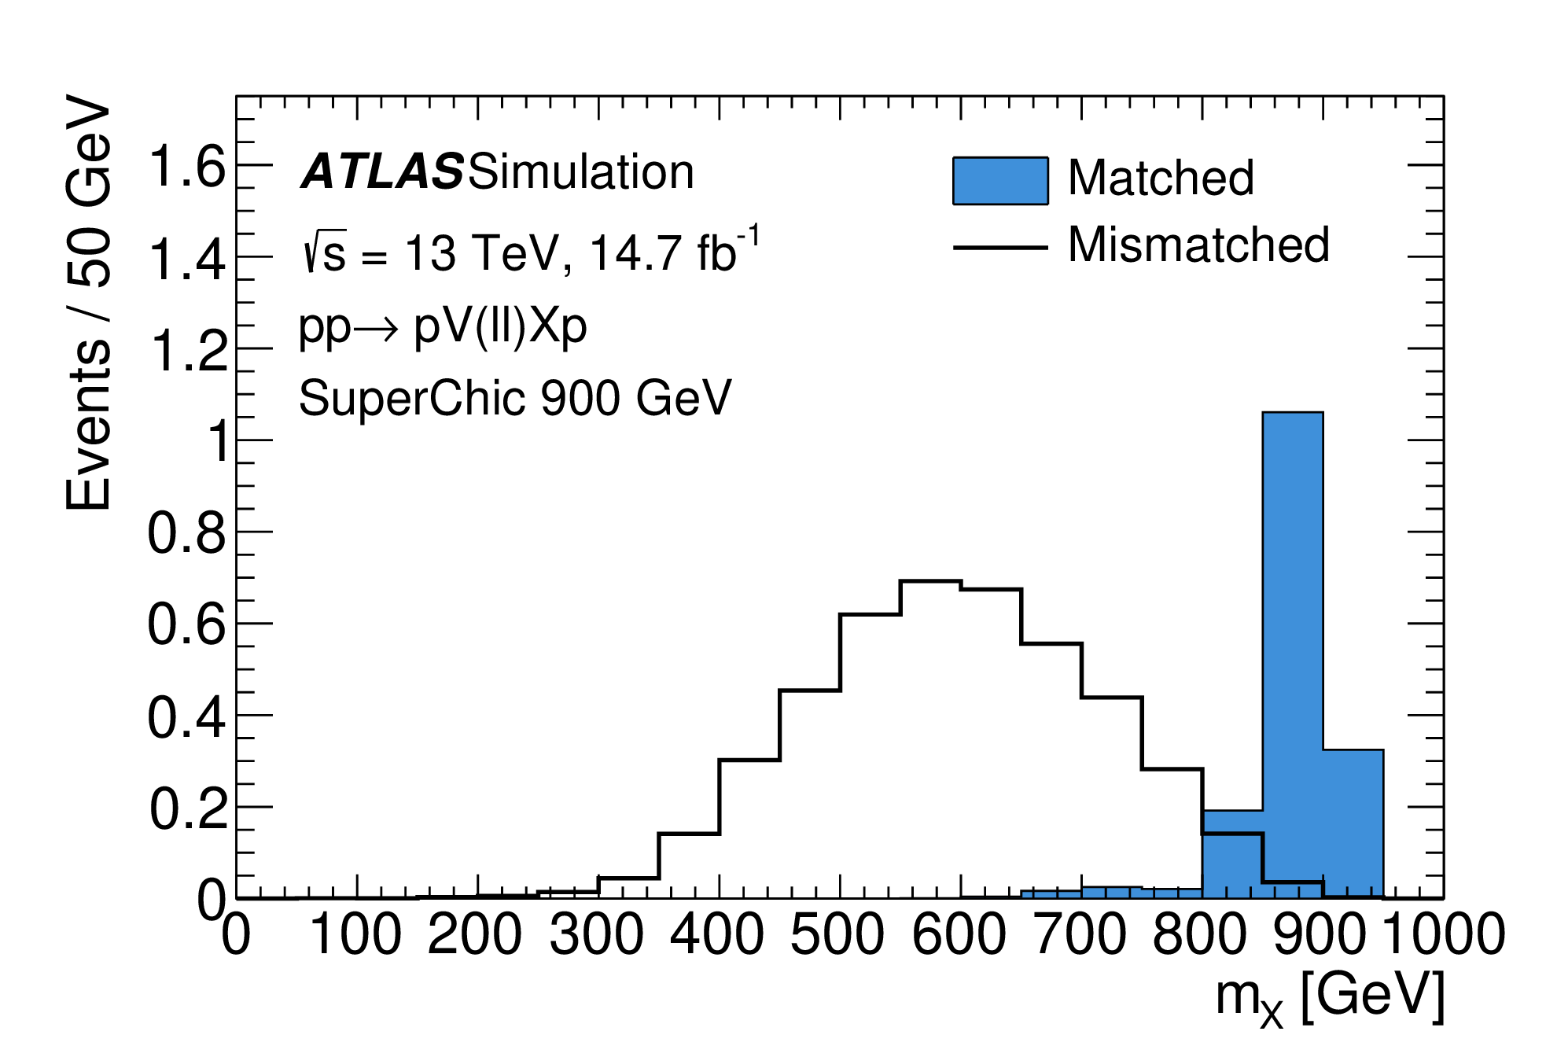
Signal-Induced Background
Significant amount of pile-up protons detected in AFP
Signal protons can go undetected due to being outside AFP acceptance or detector inefficiency
Pile-up proton detected in its place will be accepted by the selection as a signal proton
D
Causes inaccurate reconstruction leading to significant smearing of the signal peak in the model (values away from signal peak):
Effect becomes large at extreme values of m_{X}, especially high values
  More likely for signal protons to fall outside AFP acceptance
Dominantly occurs for events outside the fiducial selection
These events are included as an additional background component

Slide 28
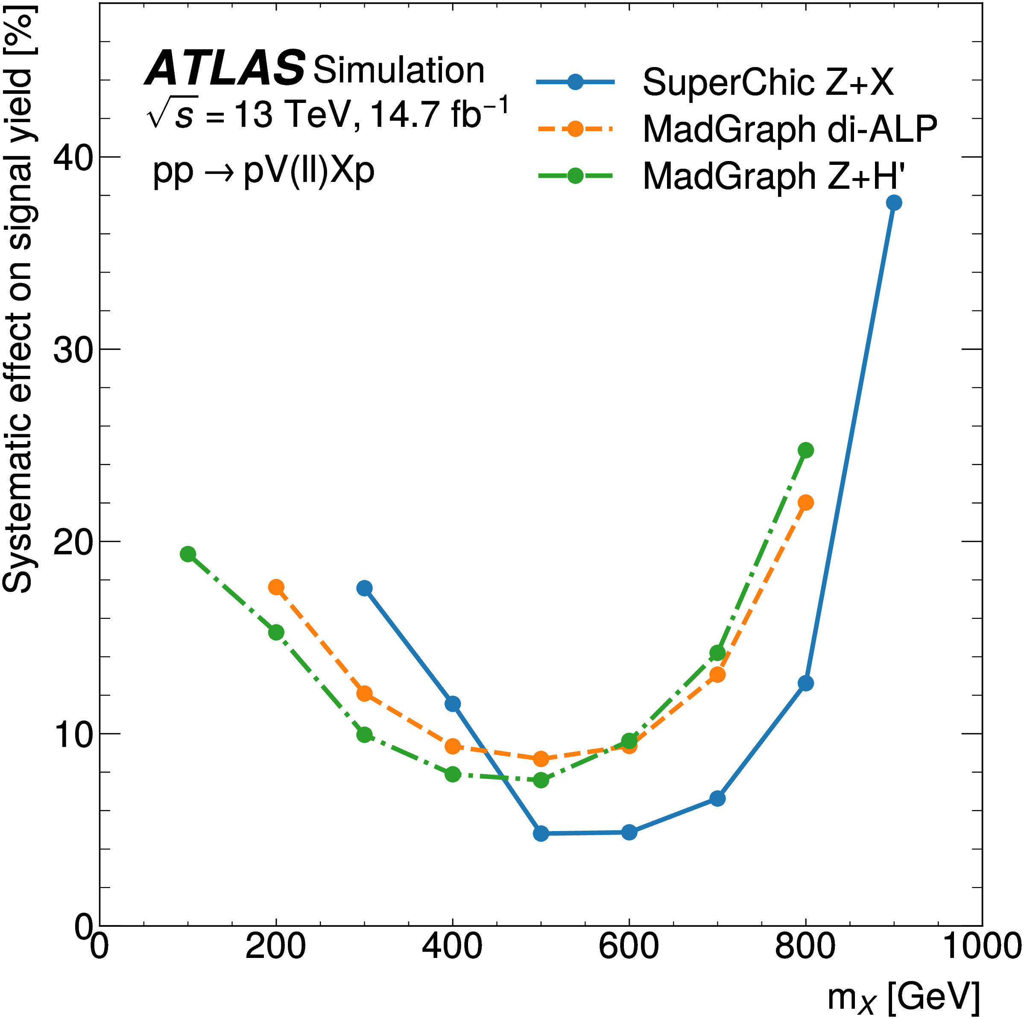
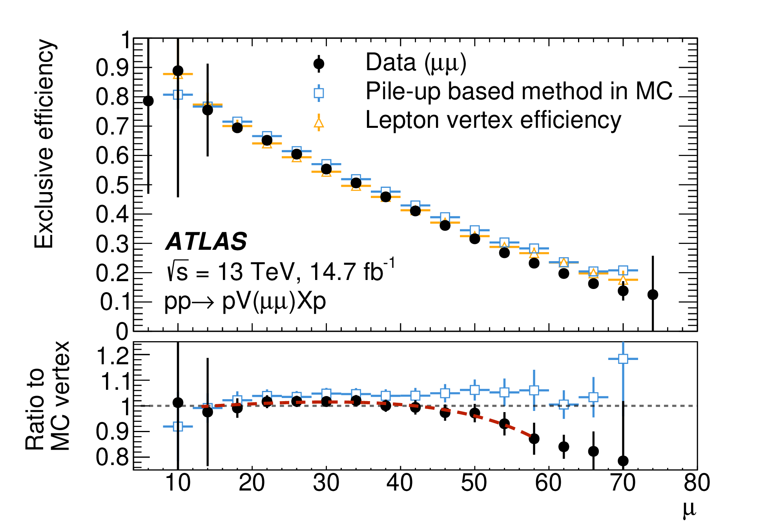
Systematics
Dominant systematic uncertainties arise from track veto and AFP in signal simulation:
Uncertainty on signal efficiency of track veto
Taken from difference between estimates obtained using two different methods
Proton transport: Modifies beam slope by ±50 μrad
Global alignment: Modifies global alignment of AFP stations by ±300 µm in x
Smearing: Modifies width of distribution used to smear truth-level proton data by ±0.05 mm
Large variation in dominant proton systematics across signal mass range
e.g. proton transport:
Uncertainties in AFP simulation

Slide 29
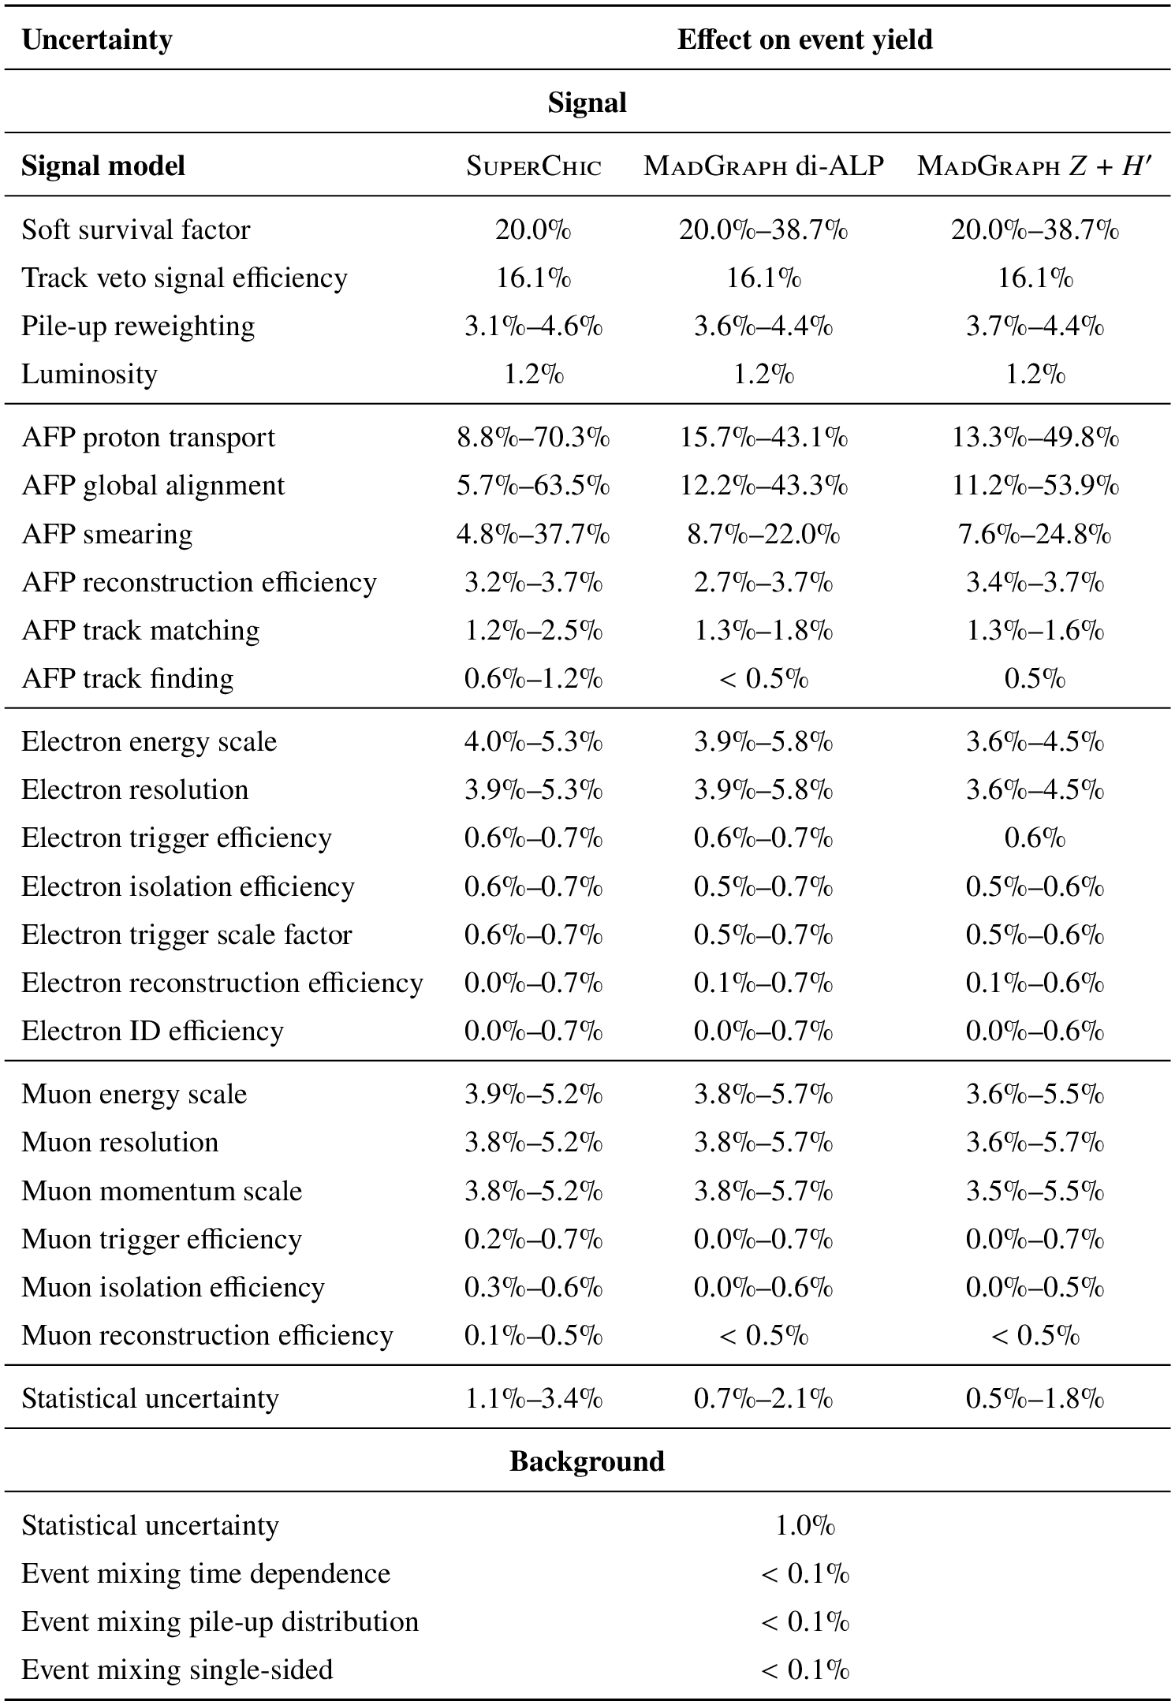
Systematics – Soft-Survival
Estimated effect of soft-survival on signal yield using photon-induced dilepton events simulated in SuperChic
Only considered for the SuperChic models since the generator implements this effect
Scale factor applied as systematic variation for MadGraph models
SS-on
Ratio fitted to linear parametrisation
S = 0.9387 - 0.000365 m_{sys}
Applied event-by-event to signal
=
SS-off
Systematic for SuperChic taken from studies of dilepton exclusive production
(arXiv:1708.04053, arXiv:2009.14537)

Slide 30
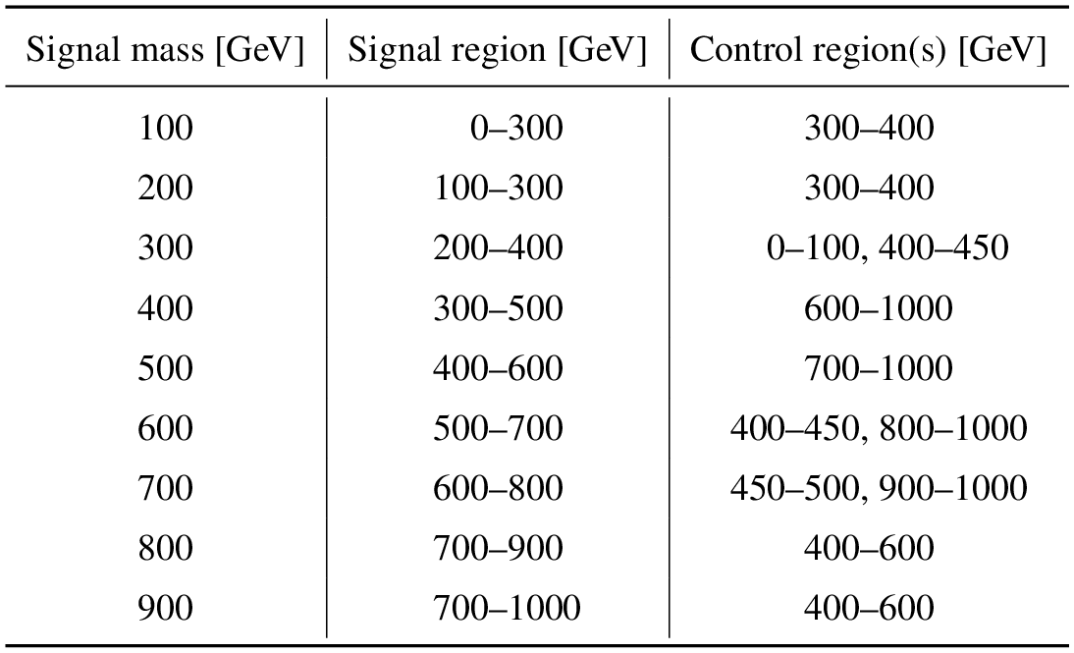
Statistical Analysis
Originally used 50 GeV bins across full 0 ≤ m_{X} ≤1000 GeV range
  Due to low data and signal model statistics in signal region, switched to single bin approach using mass window around hypothesised signal mass:
Removed fit stability issues
Mass window reduced signal-induced background to negligible levels
Reduction in sensitivity (up to factor of 2)
Wider bins required at tail masses

Slide 31
Control Regions
Data-driven background model normalised with respect to a control region, to avoid bias from potential signal contamination in the data:
  Defined as m_{X} range outside the signal mass window for each signal model
  ~100 GeV gap imposed on either side for most mass points to ensure no signal contamination
  Control region range extended for low signal mass due to low statistics
Approach verified using signal injection tests
  Signal injected into data had no effect on resulting background normalisation
Simultaneous fit performed across signal and control regions

Slide 32
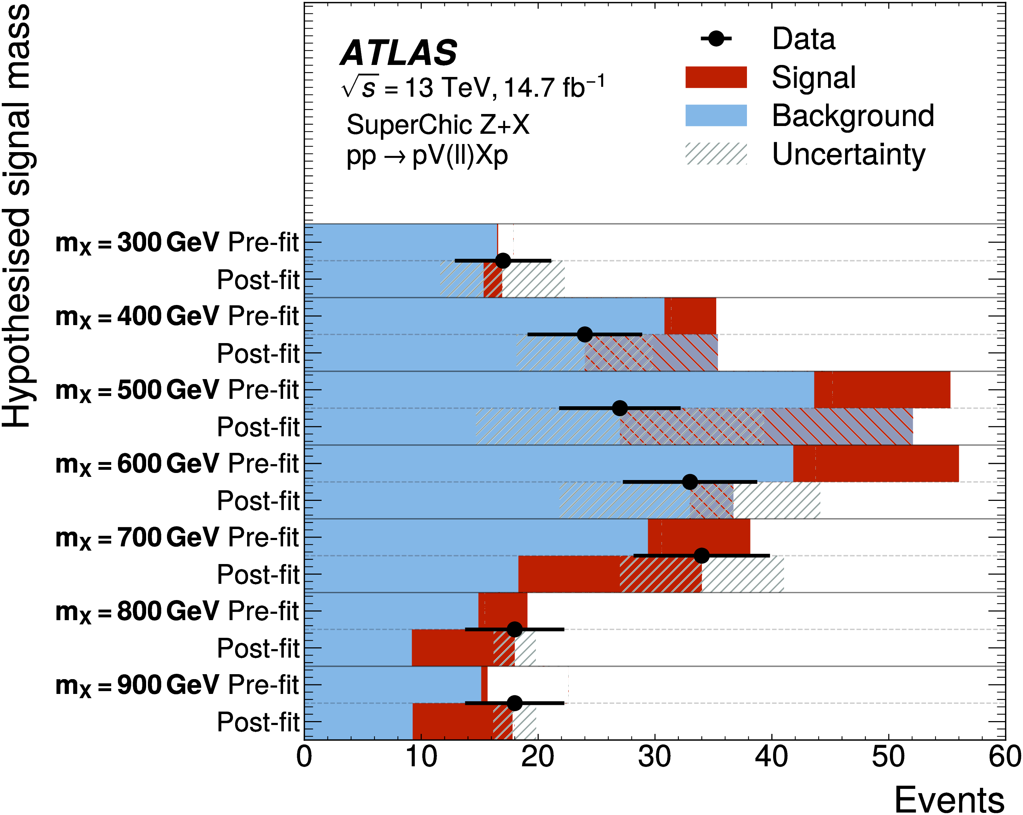
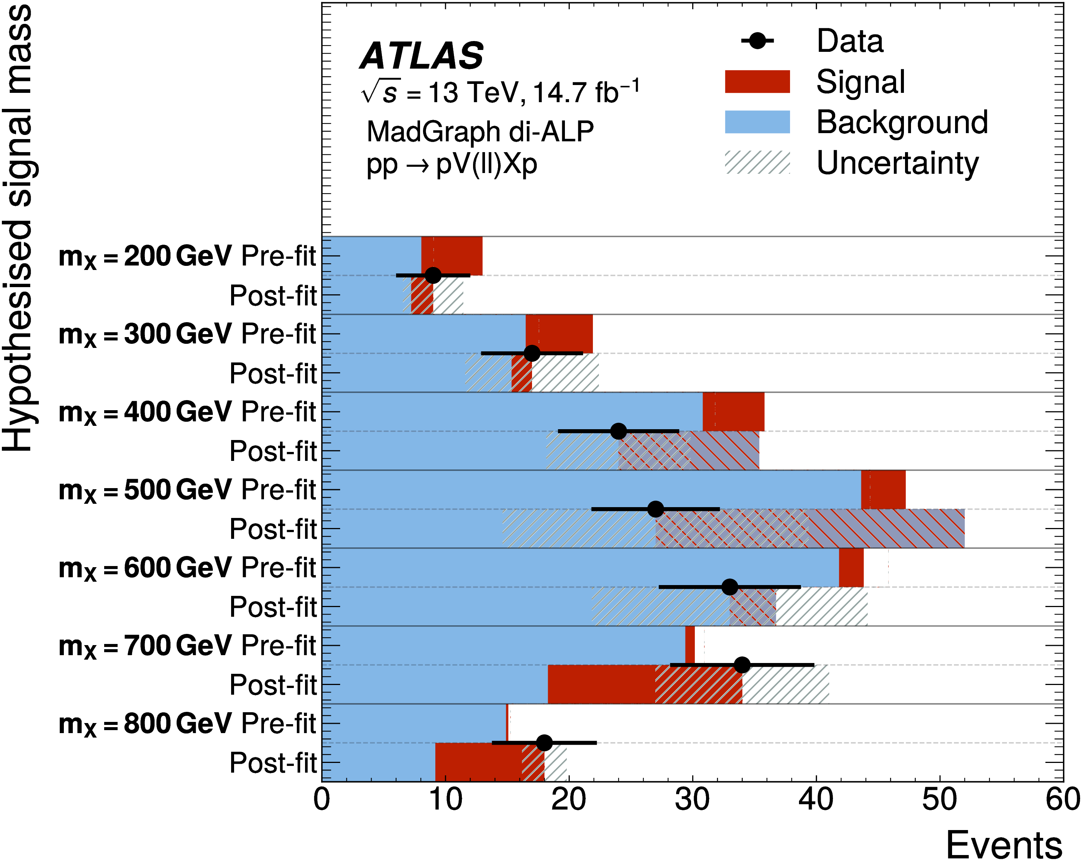
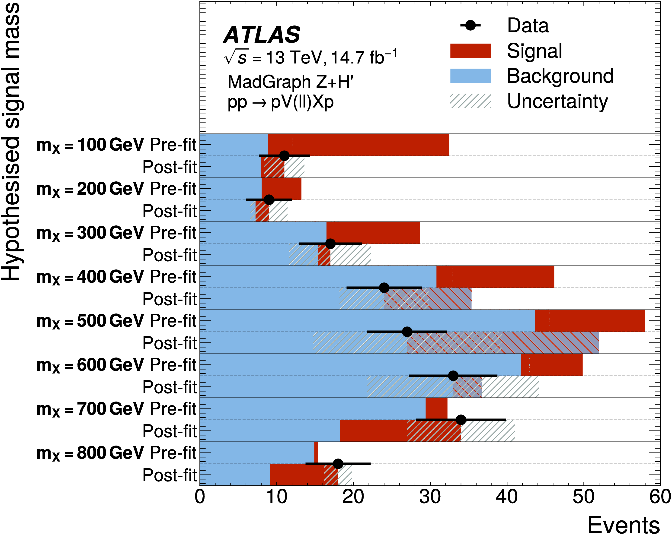
Results
Perform likelihood fit between observed data and signal + background model
Simple fits due to single-binned approach
Pre and post fit distributions for each signal model and mass:
Pre-fit signals are normalised to 50 fb for reference
Equal number of cases with excess and lack of observed data compared to background prediction – no significant signal observed

Slide 33
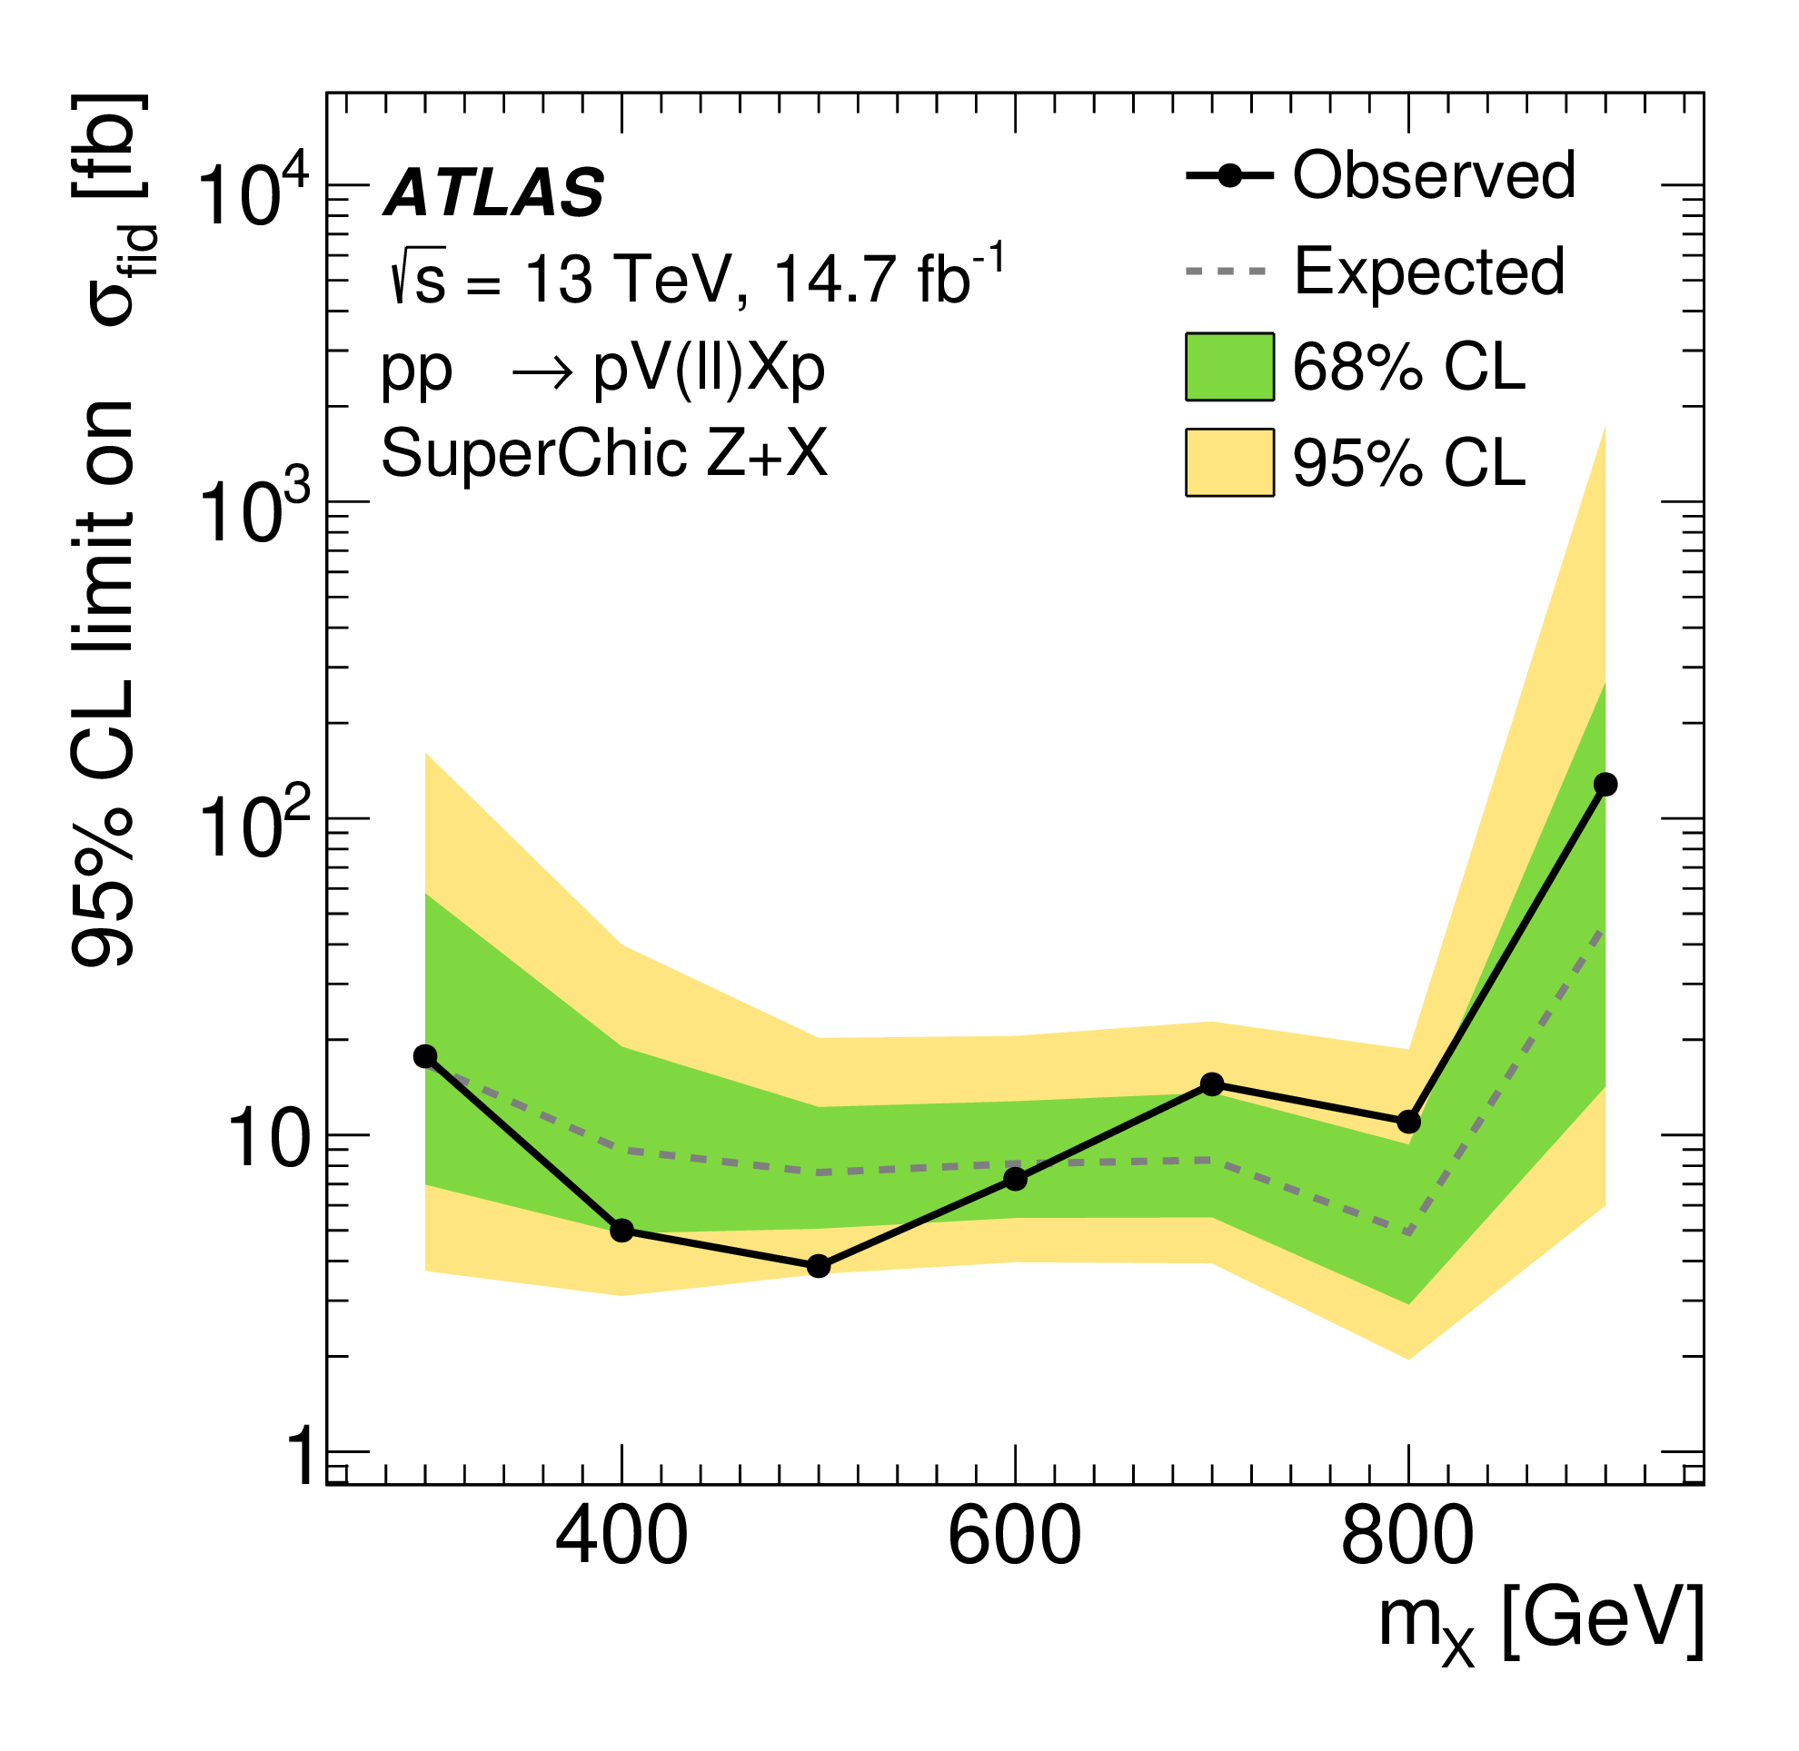


Results – Signal Cross Section Upper Limits
No significant deviations from SM so upper limits are set at 95% CL on the signal fiducial cross section for each model with CL_{s} method
Very similar limits around O(10) fb obtained for each model despite significant difference in kinematics

Slide 34

Results – CMS Comparison
Compare to limits from similar CMS analysis
Use SuperChic Z+X model – designed to be equivalent to the CMS model
Scale ATLAS limits to CMS’s fiducial region
Compare results with no soft-survival included
CMS have larger dataset (37.2 fb⁻¹ vs 14.6 fb⁻¹)
CMS CT-PPS detector has much higher upper limit on proton ξ than AFP (0.20 vs 0.12)
  Much higher missing mass limit ~1.6 TeV
Improvement in sensitivity observed for several common mass points
  Mainly thanks to track veto selection
Limits obtained at lower signal masses

Slide 35


Results – Model Independent Limits
Additionally obtained model-independent upper limits at 95% CL on the visible cross-section
Visible cross-section = cross-section × acceptance × efficiency for BSM processes
Generic signal model used with 50 GeV width in single-bin fits
Limits obtained both with and without the track veto applied, to allow for non-exclusive signals
Exclusive limits obtained down to below 1 fb!
High level of sensitivity to a wide range of potential BSM physics

Slide 36


Paper in JHEP Coming Soon!
Paper now publicly available in arXiv! [2603.20837]
Accepted by JHEP in June and awaiting publication!
Full analysis team:

Slide 37


Summary
The first ATLAS analysis to search for
BSM physics by reconstructing the
missing mass spectrum using AFP
Three independent signal models tested, with varying kinematics
Very high background suppression achieved using track veto selection to significantly improve sensitivity
Data-driven background model using event mixing of central (ATLAS) and proton (AFP) event components – validated using MC
Dominant systematics from AFP and background normalisation
Obtained O(10 fb) upper limits on signal cross section for all models
  Additional model-independent limits on the visible cross section for BSM physics obtained down to ~1 fb
Paper now publicly available in arXiv! [2603.20837]
Accepted by JHEP in June and awaiting publication!
Up to 280 fb⁻¹ of data recorded in Run 3 for a future version of this analysis!

Slide 38
Back-up

Slide 39
AFP Simulation
Dedicated fast simulation developed separated from central ATLAS simulation:
  Simulates transport of truth-level protons through LHC beam optics to AFP
  Kinematic smearing applied to simulate reconstruction resolution in AFP
  Can be simulated down to silicon hit clusters or tracks

Slide 40


Signal Kinematic Comparison
Kinematic comparison between signal models with m_{X} = 500 GeV at reconstructed level:
Proton ξ range highly restricted by reconstructed-level selections
Dilepton p_{T}
Proton ξ
Wide range of phase space covered by the three models

Slide 41

Object Selection
Selections applied to physics objects used in analysis:
Track-to-vertex association cuts
Single-station reconstruction is less precise proton reconstruction used when there is only a single track in the FAR station

Slide 42

Background Validation with MC
Create secondary background model using MC simulation to validate data-driven model
Simulate central SM processes
Overlay database of randomly assigned pile-up protons taken from 2017 data
Model fake lepton contribution using same-sign lepton selection on data
Excellent agreement observed
Data-driven model validated for use in final fits

Slide 43

Background Track Veto Effect
Estimated effect on the background composition after applying the track veto
Quark-induced backgrounds with additional underlying event activity are heavily suppressed
Exclusive photon-induced backgrounds become as large as Z+jets
Distributions are normalised due to known mismodelling of underlying event
Good agreement still observed
Comparison is less direct due to modelling issue

Slide 44

Track Veto Signal Efficiency Closure
Comparison between closure study in muon and electron channels
Higher uncertainty observed in electron channel
  Attributed to Bremsstrahlung emission from signal electrons and larger effects from track-to-vertex matching requirements, due to poorer 𝑒𝑒 vertex resolution
Muon Channel
Electron Channel
D
50.6 ± 0.3%
50.4 ± 0.3%
12%
16%

Slide 45
Systematics – Central
Several systematic uncertainties relating to the central event are considered
Uncertainty on signal efficiency of track veto
Taken from difference between estimates obtained using two different methods
All standard electron/muon uncertainties relating to MC considered for signal samples

Slide 46
Systematics – Forward
Several systematic uncertainties relating to AFP and forward proton reconstruction are considered
Changes to proton reconstruction methodology
Uncertainties in simulation
Proton transport: Modifies beam slope by ±50 μrad
Global alignment: Modifies global alignment of AFP stations by ±300 µm in x
Smearing: Modifies width of distribution used to smear truth-level proton data by ±0.05 mm
Reconstruction efficiency: measured at 92 ± 2%
Track matching: decrease maximum transverse distance between proton tracks to 1 mm.
Track finding (distance): decrease maximum cluster separation in track to 0.4 mm
Track finding (clusters): increase minimum clusters in track to 3
Cluster neighbouring: expand search for neighbouring hits to include y direction
Large variation in dominant proton systematics across signal mass range
e.g. proton transport:
Verified expected effects on data

Slide 47
Systematics – Modelling
Several sources of background modelling uncertainty considered:
  Statistical uncertainty estimated with bootstrapping = 1%
  Pile-up distribution - negligible
    Variation in interactions per bunch crossing across the dataset
  Single-diffractive backgrounds - negligible
    Effect on mixing strategy (single vs double-sided) on background shape
  Pile-up variation in event-mixing - negligible
    Difference in pile-up between each component of mixed background
Signal modelling uncertainties
  FSR, parton showering – negligible
  Soft-survival probability (next slide)

Slide 48




Data and Background Model Comparison
Comparison between data and background model
  Only preselection requirements applied
  Dilepton pair p_{T}, dilepton mass m_{ll}, proton ξ and missing mass m_{X}
  Compared to expectations for a 500 GeV SuperChic Z+X signal with a cross section of 50 fb (+additional overlay with signal scaled up by a factor of 10,000)

Slide 49




Data and Background Model Comparison
Comparison between data and background model
  All signal region requirements applied
  Dilepton pair p_{T}, dilepton mass m_{ll}, proton ξ and missing mass m_{X}
  Compared to expectations for a 500 GeV SuperChic Z+X signal with a cross section of 50 fb (+additional overlay with signal scaled up by a factor of 100)

Slide 50


Acceptance × Efficiency
Acceptance times efficiency for each signal model with respect to the full signal selection, including the track veto and mass window, relative to events passing the fiducial selection:

Slide 51



Mismatched Signal Proportions
Proportion of simulated signal events within the mass window applied at each hypothesised signal mass, which fall outside the fiducial selection:
Muon Channel
Electron Channel
Combined Lepton Channel

Slide 52



Mismatched Signal Proportions
Systematic ranking plots for each signal model with m_{X} = 500 GeV, in the combined lepton channel
Soft-survival, track veto efficiency and AFP optics and alignment consistently highest ranked
SuperChic Z+X
MadGraph di-ALP
MadGraph Z+H'

Slide 53



Soft-Survival - Uncertainty
arXiv:2009.14537
arXiv:1708.04053
Di-lepton + AFP paper
Di-muon exclusive production differential cross-section measurements
  Maximum deviation of around 20%
Average deviation also around 20% across the two channels

Slide 54

CMS Fiducial Selection
CMS also set their limits relative to a fiducial volume defined by the following selection:
In our original comparison we were using a much wider fiducial volume (no cuts except ξ < 0.15) so our results look worse by comparison – we can calculate the conversion

Slide 55



CMS Model Comparison
The models are based on equivalent parameterisations:
CMS generator-level distribution (applied corrections to account for detector inefficiency):
SuperChic
CMS Model
CMS signal in/outside of fiducial volume
Smeared tail due to insertion of pile-up protons (similar to our simulation)

Slide 56


Model Independent Limit Tables
Model-independent limits for a range of generic signals, both with and without the track veto selection applied:
Without track veto
With track veto

