Slide 1



Particle Physics Department
Sinead Farrington
Notes:
The abstract pattern can be removed or repositioned if required. Be careful to ‘Send to Back’ so that it does not obscure any important information.

Slide 2
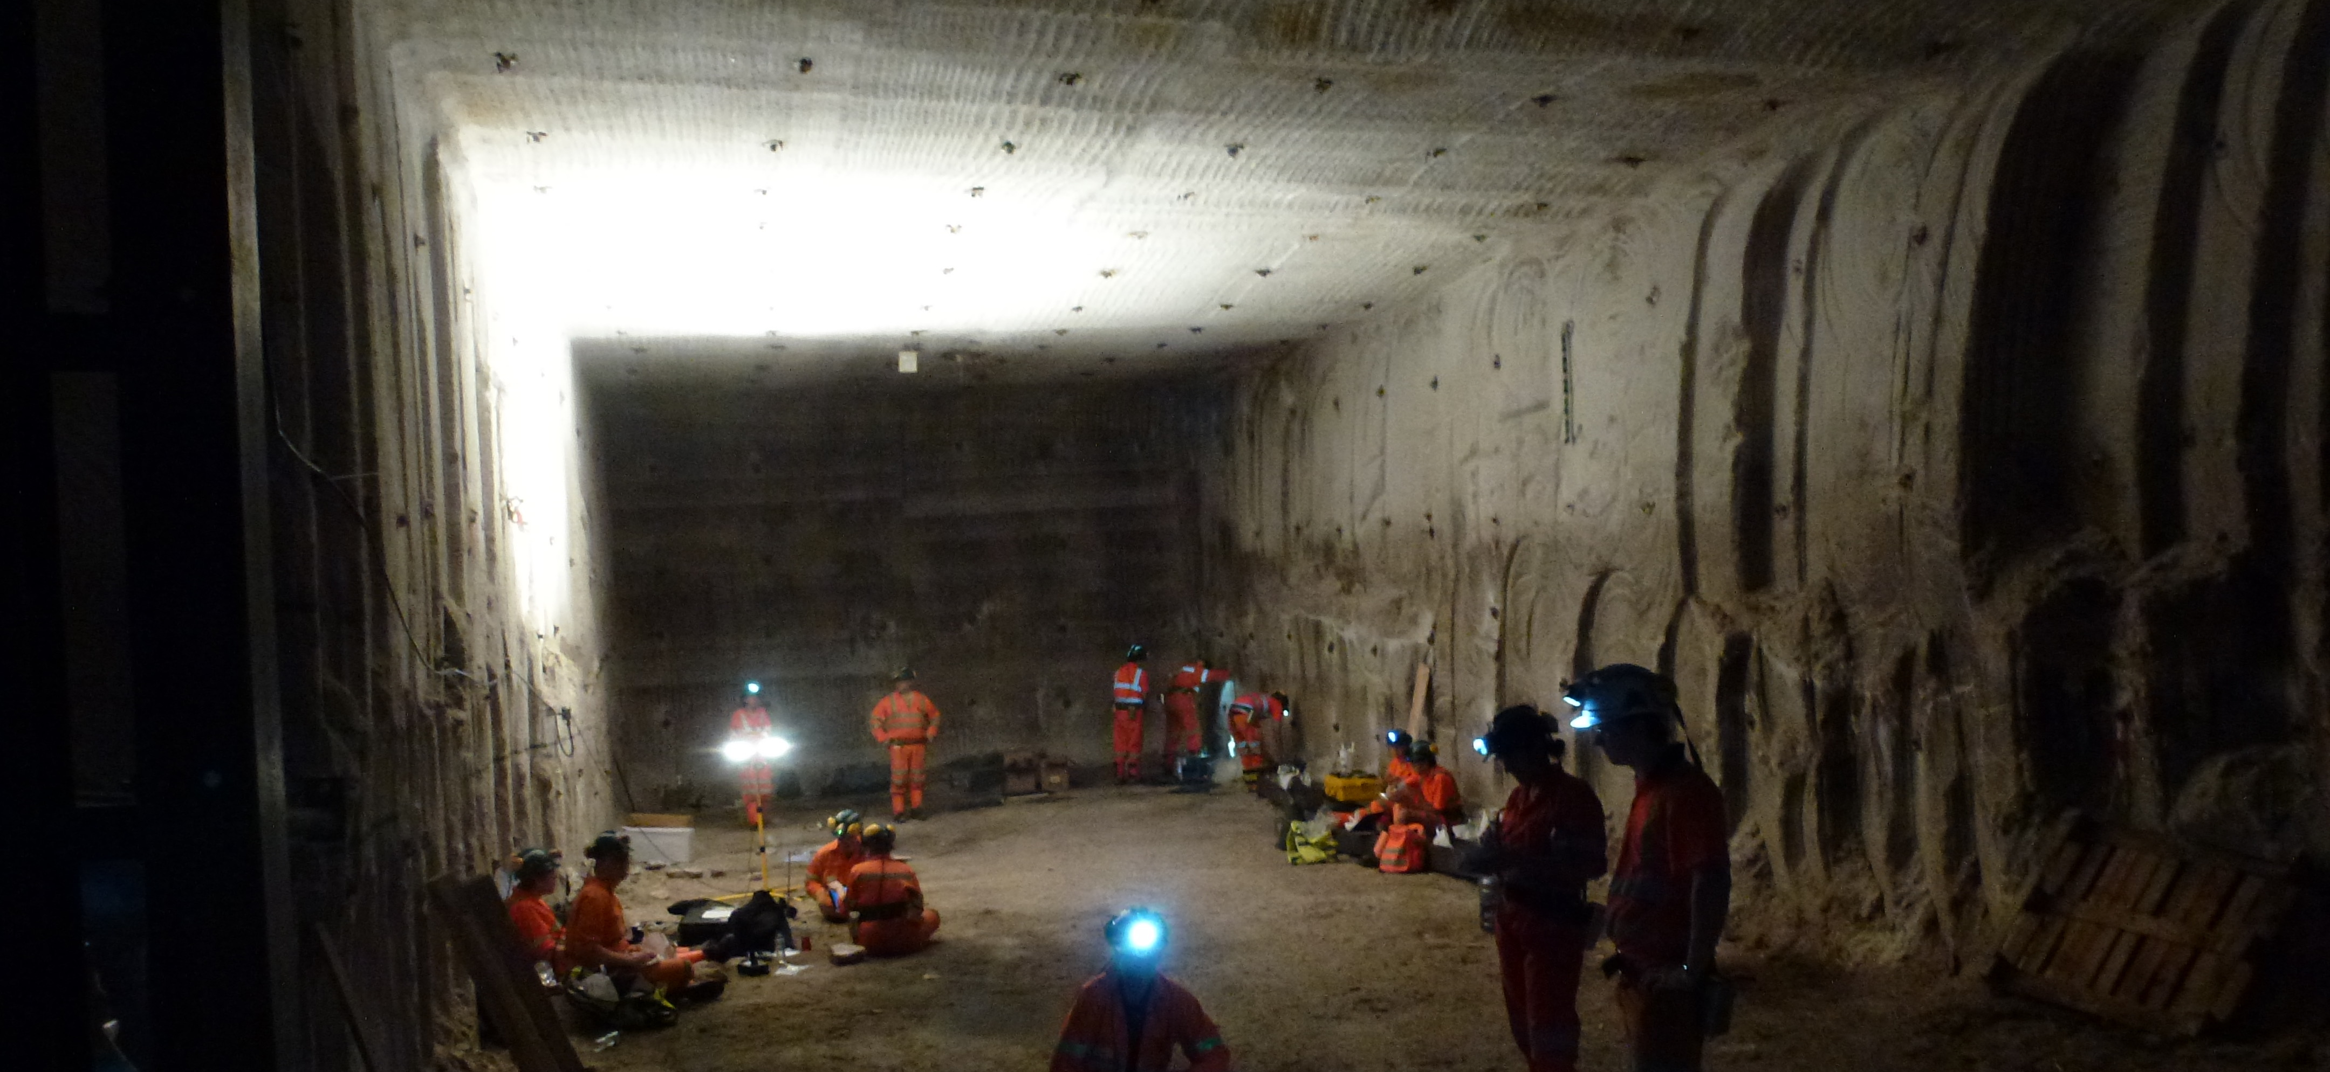
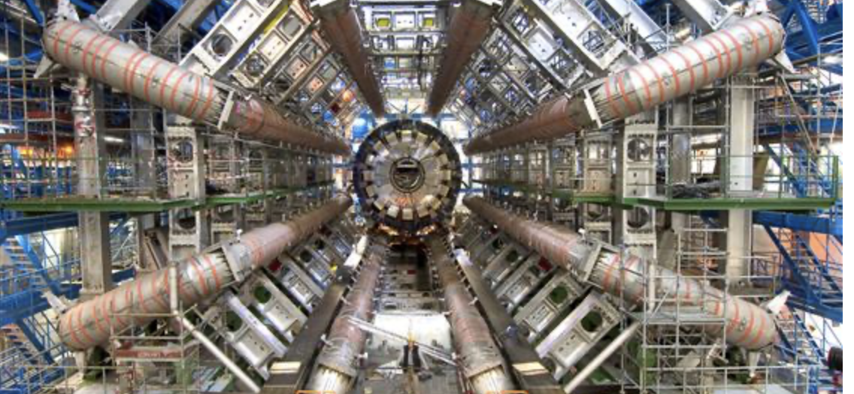
What is PPD
~100 staff, many permanent
~56 senior scientific staff
~5 senior joint with universities ~19 postdoctoral staff
~20 PhD students
~7 project manager experts
~6 program support staff
Underpin UK Particle and Astroparticle physics
Construction of experiments and upgrades
Computing infrastructure and software
Exploitation and operation
Project management
UK community role (technical and admin)
Operating the only deep underground research facility in the UK through ~20 FTE staff based in Yorkshire
Staff based at CERN, (Japan, USA) to construct and operate experiments
Notes:
To replace photo with one of your own. 1) Send the geometric shape overlay to the back – Right-Click > Send to Back > Send to Back. 2) Replace image – use the guides provided to correctly position it. 3) Send your image to the back so that the geometric overlay re-appears over the image. Remember to delete the image credit if using your own image.

Slide 3

PPD Locations
STFC Rutherford Appleton Laboratory
Boulby Underground Laboratory
STFC Daresbury Laboratory
Internationally: several staff in CERN, US, Japan
Boulby
Daresbury Laboratory
Rutherford Appleton Laboratory

Slide 4
National Lab context
Accelerator Science and Technology Centre
Central Laser Facility
Hartree Centre
ISIS Neutron and Muon Source
National Quantum Computing Centre
Particle Physics Department including Boulby Underground Laboratory
RAL Space
Scientific Computing Department
Technology Department
UK Astronomy Technology Centre

Slide 5
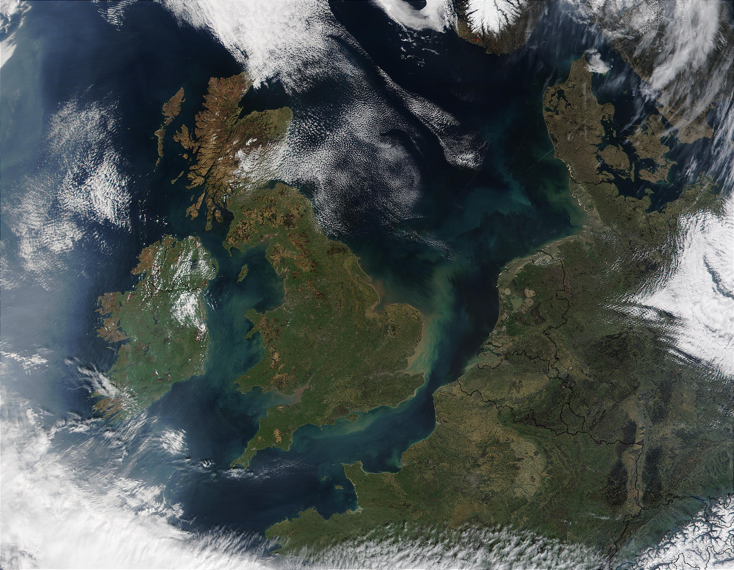

STFC sites
across the UK

Slide 6
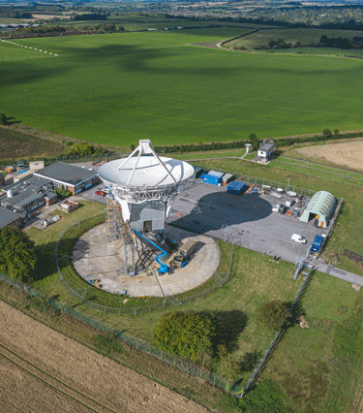
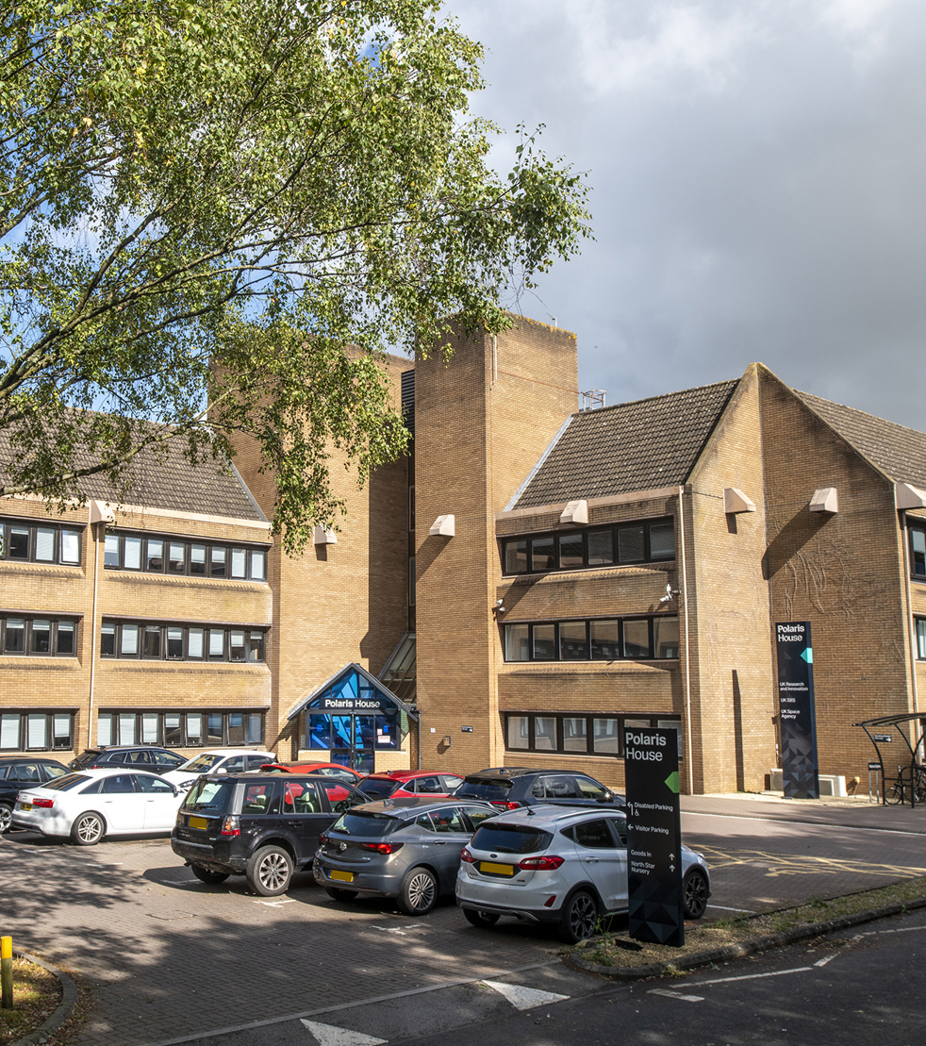
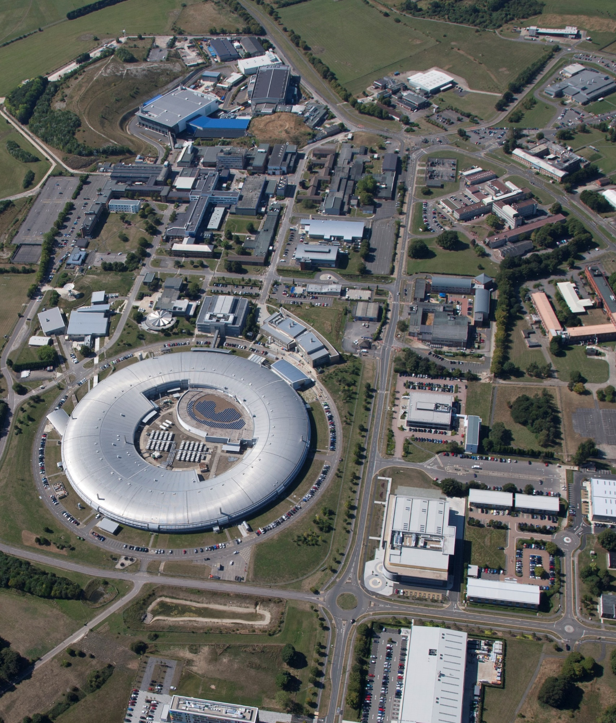
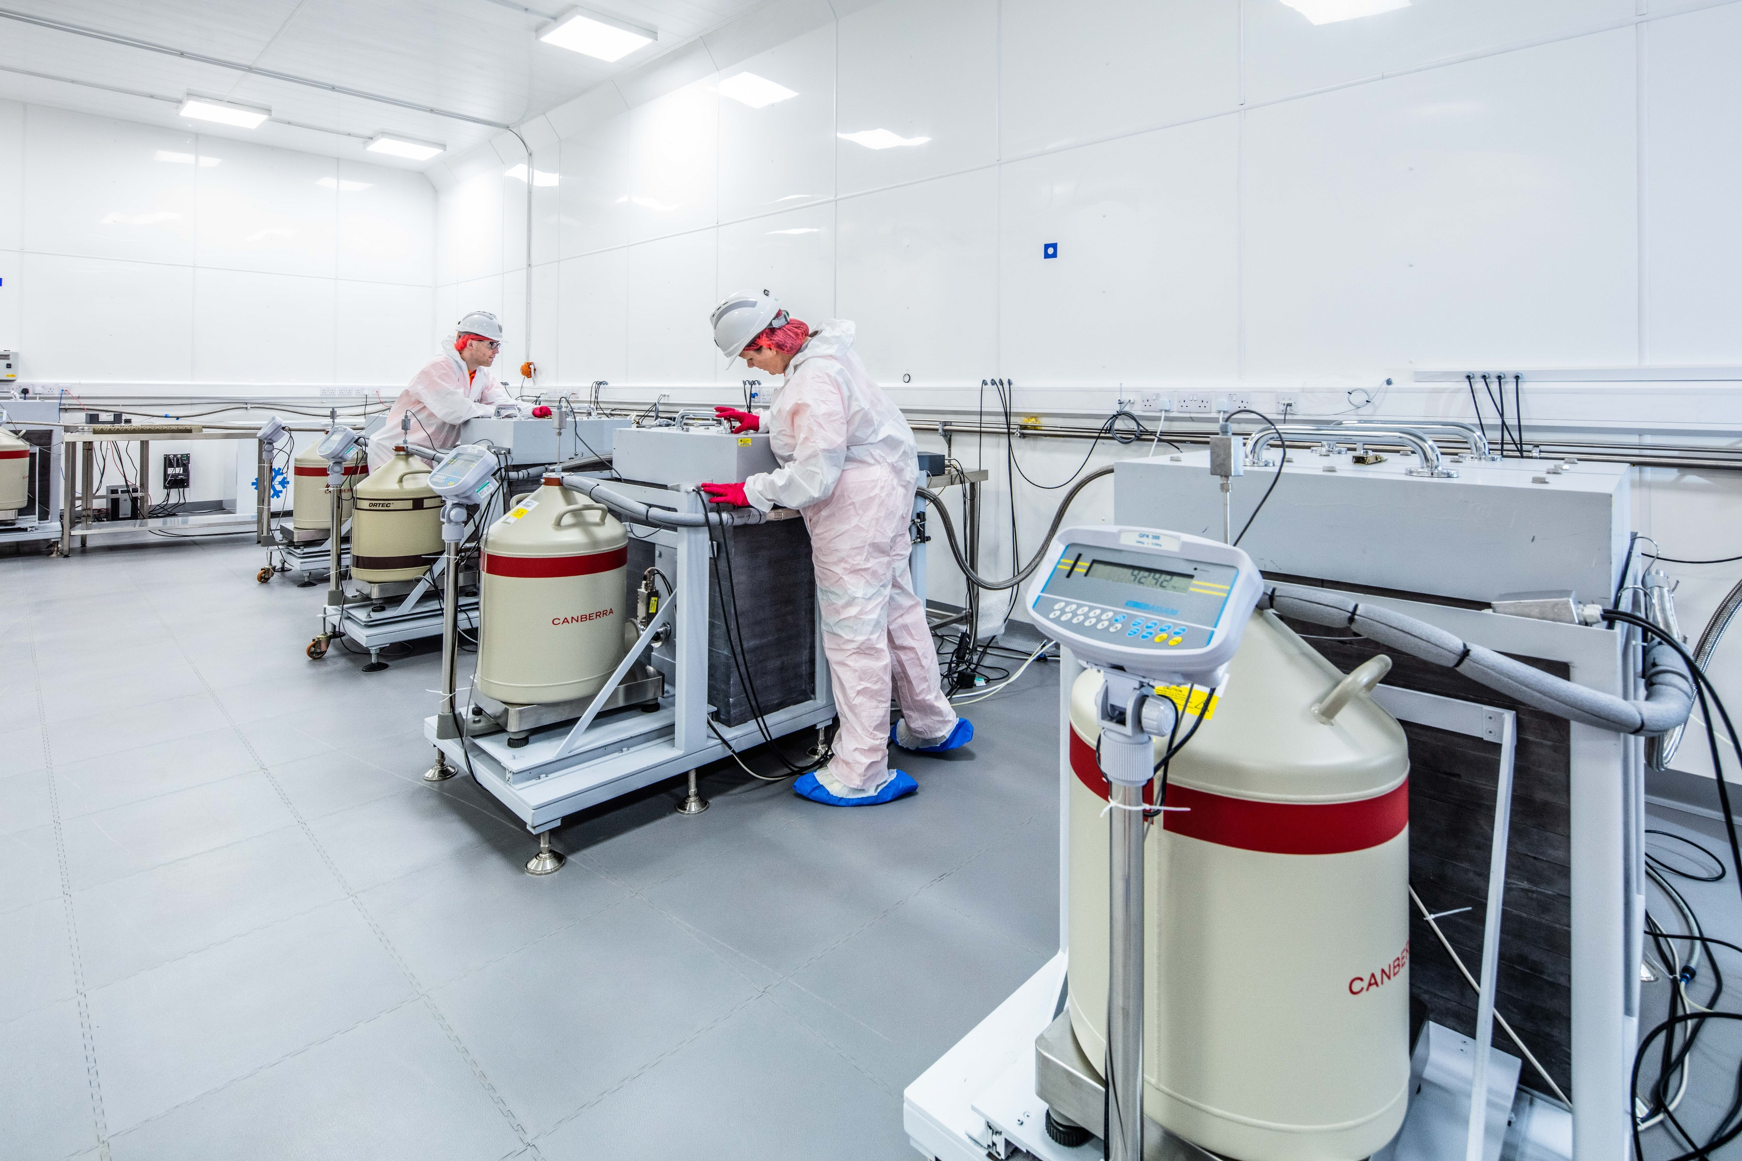
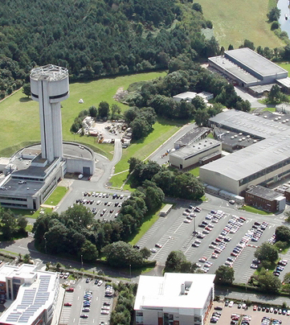
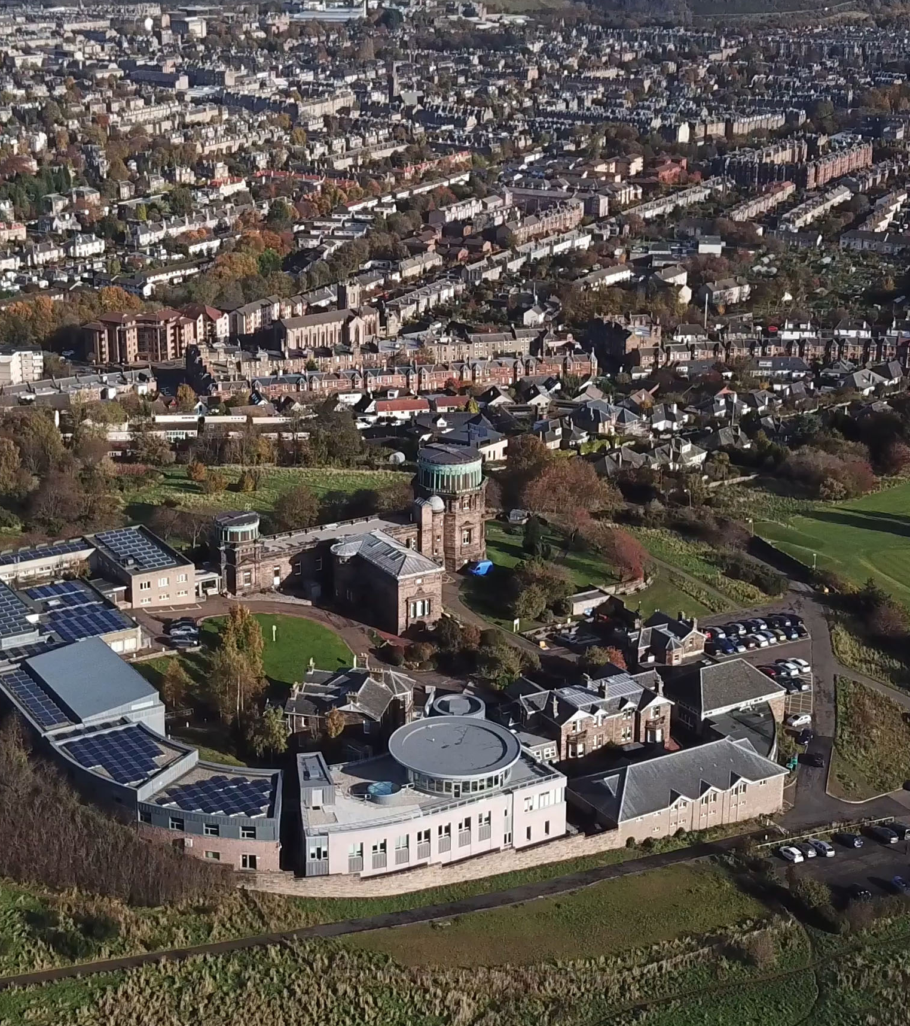
STFC sites
across the UK
Rutherford Appleton Laboratory
near Didcot, Oxfordshire
~2300 STFC staff
International multidisciplinary research infrastructures and facilities
Harwell science & innovation campus – 7500+ people and 220+ businesses
Clusters – Space, Energy, Quantum, HealthTec, Defence

Slide 7
STFC sites
across the UK
Daresbury Laboratory
in the Greater Liverpool City Region
~700 STFC staff
Internationally-renowned engineering, cryogenics and e-infrastructure expertise
SciTech Daresbury campus – 2000+ people and 160+ businesses
Clusters – Digital, HealthTec, Space

Slide 8
STFC sites
across the UK
UK Astronomy Technology Centre
at the Royal Observatory, Edinburgh
~130 STFC staff
Centre of excellence for the development of scientific instrumentation and facilities for ground- and space-based astronomy
Higgs Centre for Innovation – £23M investment raised, 26 companies incubated over six years

Slide 9
STFC sites
across the UK
Boulby Underground Laboratory
Saltburn-by-the-Sea, North Yorkshire
~15 STFC staff
UK’s deep underground science laboratory
1.1km underground in a working salt mine
A unique environment for multidisciplinary science: almost completely free from background radiation

Slide 10
STFC sites
across the UK
Chilbolton Observatory
Hampshire
~5 STFC staff
Meteorological measurements
Radio and microwave propagation experiments
Satellite tracking and communication

Slide 11
STFC sites
across the UK
Polaris House
Swindon, Wiltshire
~110 STFC staff
UKRI Head Office
Home to STFC Programmes Directorate and Strategy, Planning & Communications functions
Management of >£585M STFC budget

Slide 12
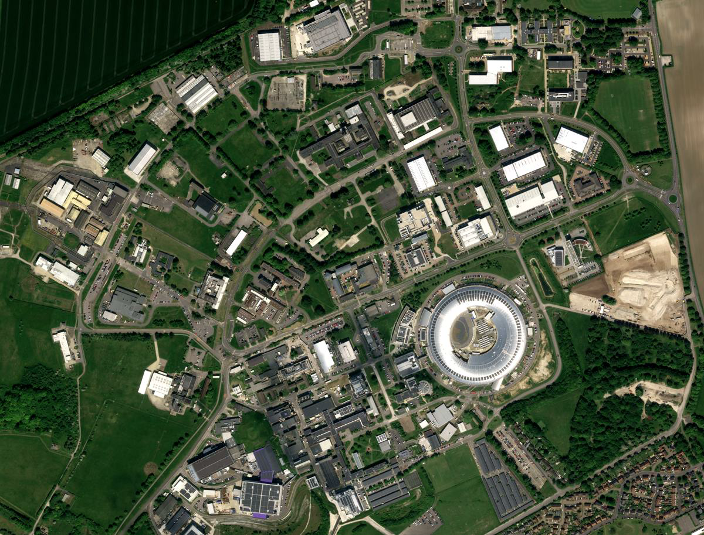
700-acre site
220+ organisations
7,500+ people
60+ nationalities represented
Faraday Institution
National Satellite Test Facility - STFC
RAL Space - STFC
Highly connected: 70% of organisations collaborated with another business or facility
Satellite Applications Catapult - IUK
Advance - MRC
Advance – MRC Harwell
ESA/STFC Business Incubation Centre
Supporting ‘grow-on’ and scale-up businesses: over £1.43Bn investment raised & IPOs
Mary Lyon Centre - MRC
UK Health Security Agency
Nucleic Acid Therapy Accelerator
European Space Agency ECSAT
Incubating early-stage businesses: ESA BIC UK has over 92% business survival rate, incubate and alumni companies generate ~£300M GVA annually
National Quantum Computing Centre – EPSRC/STFC
Driving economic growth: over 63% of organisations export products or services
Diamond Light Source
Rosalind Franklin Institute - EPSRC
ISIS Neutron & Muon Source - STFC
Research Complex at Harwell
Extreme Photonics Application Centre - STFC
Central Laser Facility - STFC

Slide 13
PPD Links with other Departments
Technology Department
Source of all engineering effort
Major involvement with ATLAS Upgrades
Complete outsource for the DUNE APA production
Runs the microelectronics support centre (MSC), giving us significant resource in terms of software access
Others
Scientific Computing operates the Tier-1 Computing facility for the UK, funded through PPD and Programs directorate for 17FTE
ISIS has previously hosted the MICE experiment, but is now also hosting our Cold Radon Emanation Facility, as well as the MIGDAL experiment
RAL Space has formed a close link over activities relating to AION
NQCC: dilution fridge at Boulby to be twin of one on the surface at RAL
Notes:
Much of our operation is linked into the UK PPAN program and thus defined by Programs directorate spending with advice from Science Board

Slide 14
UK Particle Physics Program Delivery
LHC: (ATLAS, CMS, LHCb)
ATLAS, CMS upgrades
large-scale silicon detector, software, readout, calorimeter
Also LHCb upgrade R&D
DUNE and HyperK
Dark matter detectors and underground lab
Computing (UK WLCG contribution)
Small scale R&D
Maintains our skills base and in some cases delivers science in R&D
Exploitation of the data; maintenance and operations
Engineers all reside in the Technical Department
Some computing staff in Scientific Computing Department
Notes:
Much of our operation is linked into the UK PPAN program and thus defined by Programs directorate spending with advice from Science Board

Slide 15
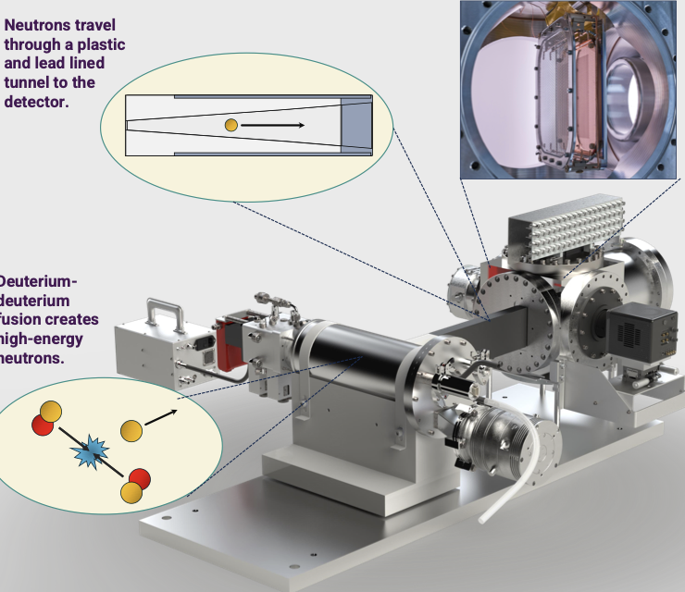
Delivery includes ideas (just two examples…)
Migdal
AI ML on FPGAs
Notes:
Much of our operation is linked into the UK PPAN program and thus defined by Programs directorate spending with advice from Science Board

Slide 16
What we do
Facilities
Cold Radon Emanation Facility (CREF, including a warm replica at Boulby)
Boulby Underground Germanium Screening (BUGS)
Total owned lab space near 500m^2, including a small workshop, computing infrastructure, a small cleanroom, a dark lab
Another ~250m^2 of cleanroom operated through TD, providing for all kinds of electronics assembly and testing
Interesting equipment available
Laser equipment for LGAD testing, currently measuring to less than 10ps jitter
X-ray irradiation facility for ASIC irradiation
Wafer probing facility
TCAD infrastructure (Compute with >128GB RAM) – complex 3D simulation capability
Climate chambers to large sizes (m^3)
Equipment to support all forms of electronics testing

Slide 17
Skills
Silicon construction (typically some construction and often national integration): currently ATLAS ITk, EIC, some LHCb R&D
Many with an electronics and software background, e.g.:
Wafer probing
FPGA programming
GPU (and general accelerator) programming
TCAD simulation
Two large Trigger groups (ATLAS and CMS)
Magnetic shielding to lowest fields from nEDM heritage
Many with 20+ years in the field providing:
UK Principal Investigators for various experiments (ATLAS Upgrade, CMS)
International Project leads (ATLAS Strip Upgrade [<10y post-doctorate], LHCb RICH)

Slide 18
Vision – a work in progress
Caveat: I want to set a strategy that engages
The expertise in the department in its own future “Director’s Discussions”
The community in PPD’s future: University head of group discussions
That said, my vision for PPD:
Hub of expertise in particle physics technology (hardware, software, operation, exploitation, project management)
Maintains and builds unique capability, distinct from universities – plan staffing needs wrt future projects
In partnership with universities – strategic secondments, CASE studentships, Industrial liaison
PPD puts its expertise to use in novel areas (quantum, AI)
And in doing so, opens unique intellectual opportunities in quantum science onsite
PPD: STFC’s in-house experts in particle physics exploitation, technology and project management
To be a strong and clear voice on the UK vision for international PP, influencing future collider choices, and to positioning the UK for leadership in future PP experiments.
To be host to a fully funded and operational international facility, housing an international dark matter experiment and quantum experiments at Boulby.
To be a strong partner in a network of national labs hosting science on their own sites in addition to collaborating in international facilities overseas
Notes:
Much of our operation is linked into the UK PPAN program and thus defined by Programs directorate spending with advice from Science Board

Slide 19
Opportunities
PPD – working with other national lab departments – has capabilities to deliver on STFC and national strategies on AI, Quantum…
European Strategy Particle Physics Update 2025 (SF in ESG as RAL rep along with two others from UK)
Future collider: majority of PPD expertise: DAQ, silicon, calorimeter, software and more: workforce question for 10-15 years from now
UK community has the lead in quantum experiments – how to maximise this?
Site of next DM experiment?
Boulby: UK proposes to host largest scale “rare observatory” international experiment XLZD – rule in or out large class of most likely DM candidates among other science
With many opportunities beyond (quantum, geology…)
On-campus science: ISIS (neutrinos, kaons), Migdal… other table-top experiments? (quantum?)
A new director is a new opportunity to look at our interaction with universities – on-campus presence (sabbatical? Secondment?); large and small scale project formation,
Notes:
Much of our operation is linked into the UK PPAN program and thus defined by Programs directorate spending with advice from Science Board

Slide 20
Discussion?
Delivery of projects – on time and on budget
National coordinated effort on outreach? (while maintaining each institute identify as a matter of priority)
National list of equipment
National training program pooling lab and universities’ expertise
How does your department interact with PPD and are there ways you’d like to change that?
Interact with other national labs?
Notes:
Much of our operation is linked into the UK PPAN program and thus defined by Programs directorate spending with advice from Science Board

Slide 21






Science and Technology Facilities Council
@STFC_matters
Science and Technology Facilities Council
Notes:
The abstract pattern can be removed or repositioned if required. Be careful to ‘Send to Back’ so that it does not obscure any important information.

Slide 22
Science at Boulby workshops
Bioscience@Boulby workshop: https://indico.stfc.ac.uk/event/1058/
Quantum@Boulby Workshop: https://conference.ippp.dur.ac.uk/event/1372/
Also Geoscience@Boulby

Slide 23
What we do
Experimental involvement
CERN based: ATLAS, CMS, LHCb, Faser
Including the ATLAS Strip Upgrade PI, the UK ATLAS Upgrade PI, CMS PI until recently, LHCb RICH Pl
Neutrinos: DUNE, Hyper-K/Super-K/T2K, TD produces targets for all
Dark Matter: XLZD, LZ, Darkside-20k, MIGDAL
Other: EPIC (@EIC)
Development activity
Liquido/Cloud, investigating novel neutrino detection
ASIC and sensor design: 28nm amplifiers for LGADs (through TD), LGAD industrial development (currently showing <10ps timing resolution), flexible CMOS investigations
AION – participation in development of Atom interferometry in collaboration with MAGIS
Muon collider
Notes:
Did I spell Mages right?

