Slide 1
Multi-messenger Astronomy
A proseminar about partical- and astroparticalphysics
by Béla Wohlers
2025

Slide 2
Content
Overview
Messengers
Coordination
Science
Future

Slide 3
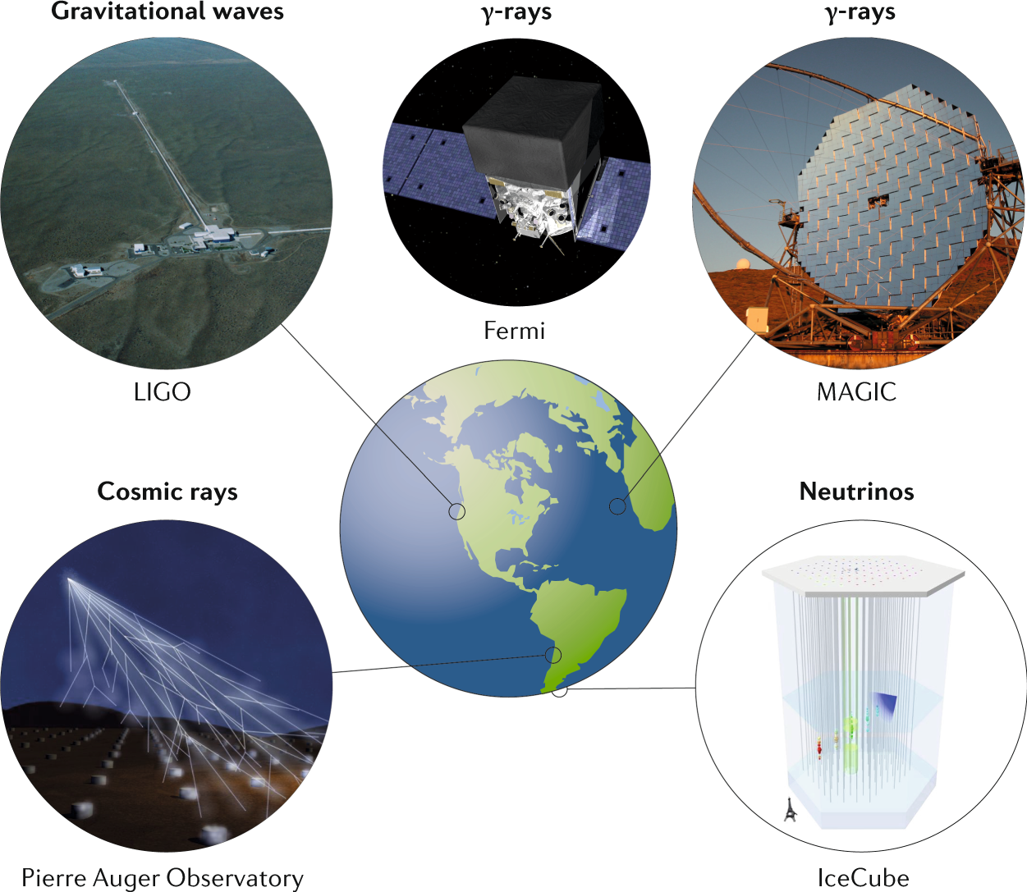
Overview
Coordinated astronomy with multiple messengers:
  Photons
  Neutrinos
  Gravitational waves
  Cosmic rays
Complementary information
Source: Multi-Messenger Astrophysics. 2019. P. Mészáros, D. Fox et al.

Slide 4
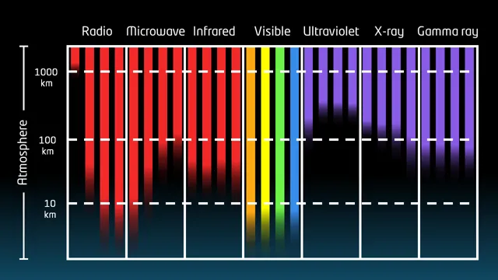
Photon Messengers
Electromagnetic spectrum [radio ‭→ gamma]
Different wavelength:
  Correspond to different phenomena
  Atmospheric absorption
interesting Sources:
  Collisions of massive objects
  Supernova
  Gamma-ray bursts
  Active Galactic Nuclei
  Pulsars
  ...
Source: STScI/JHU/NASA

Slide 5
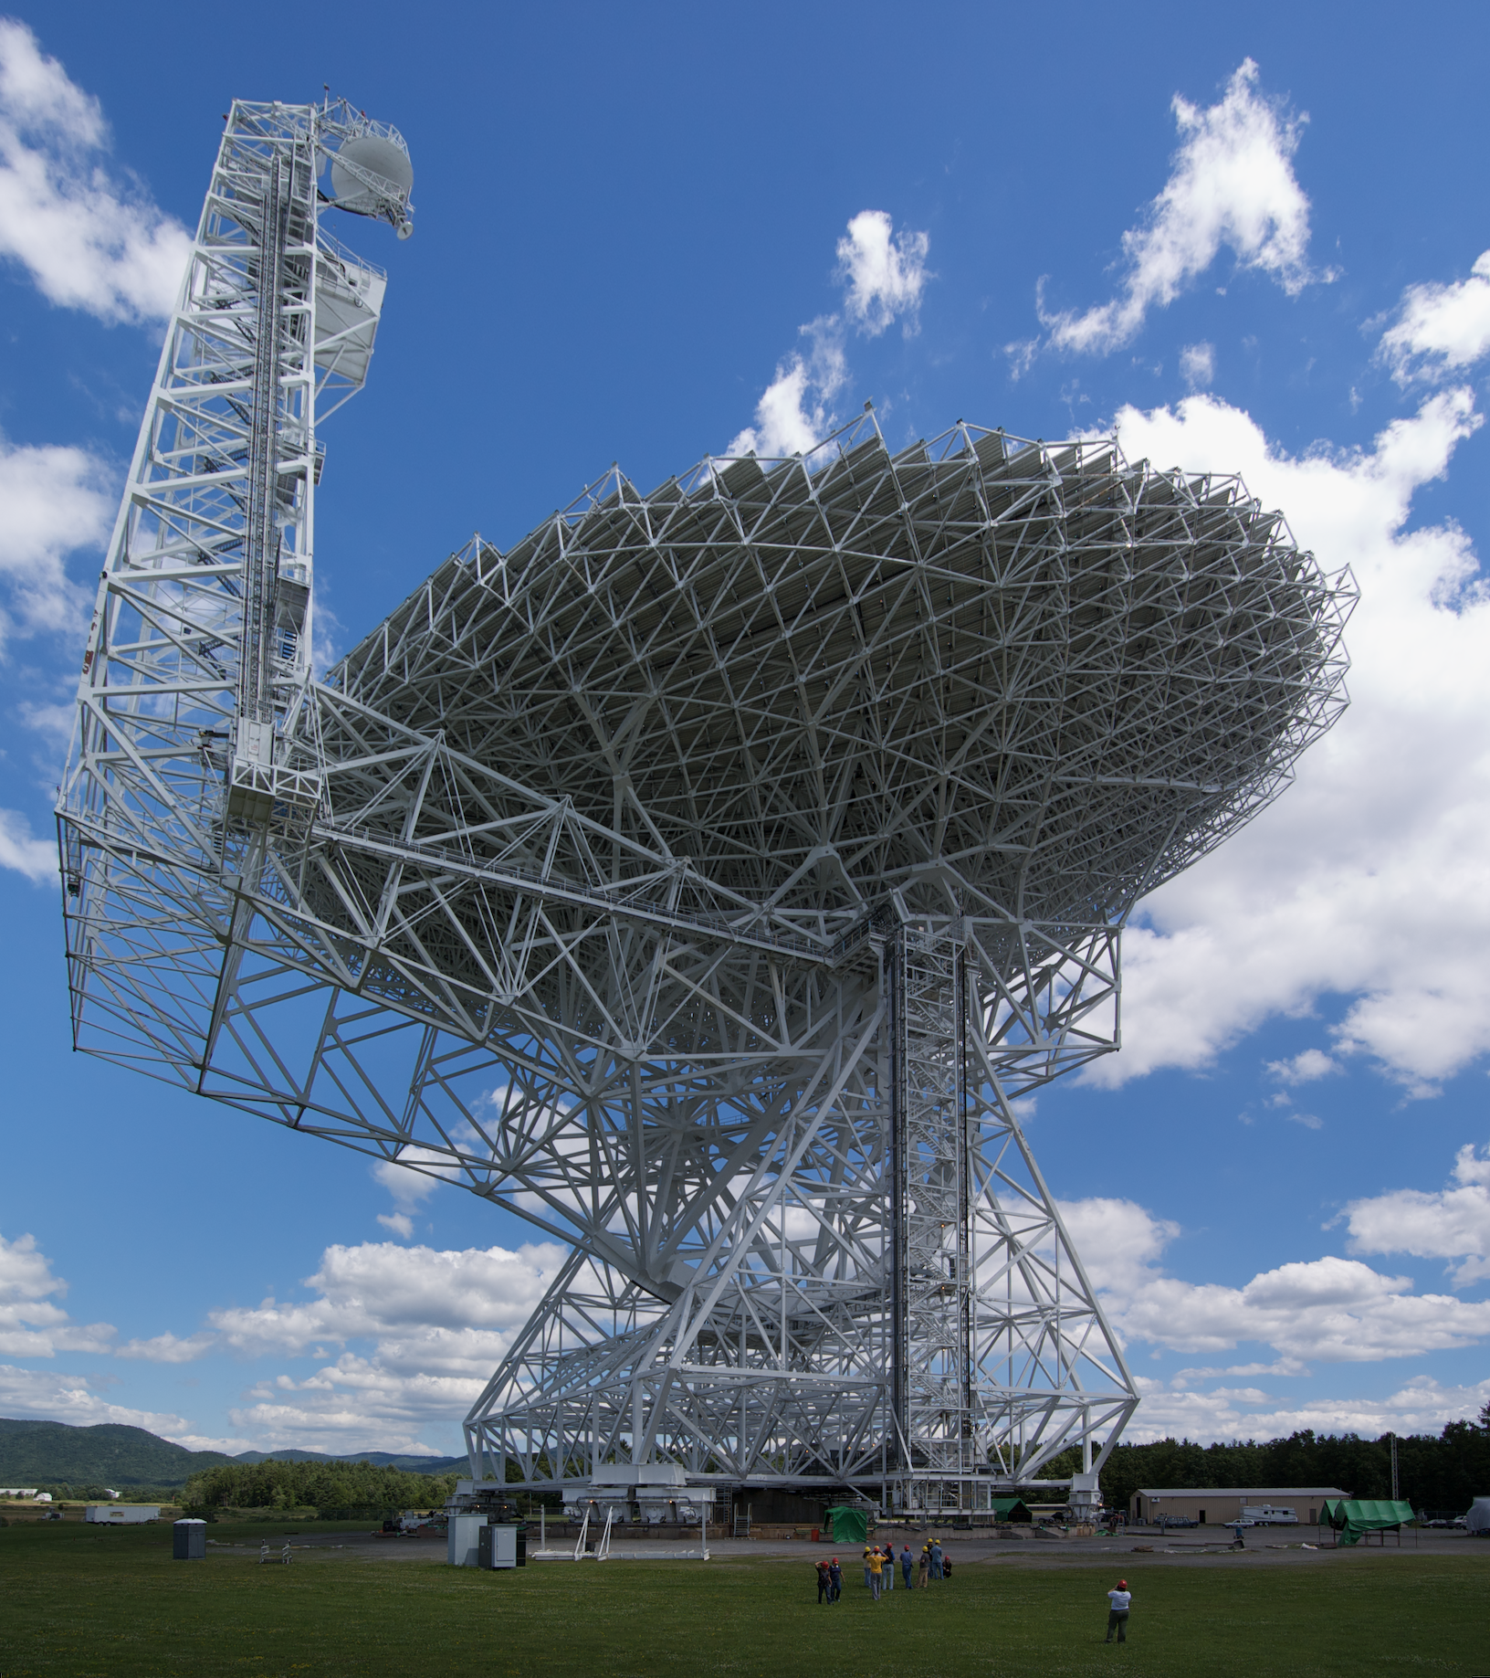
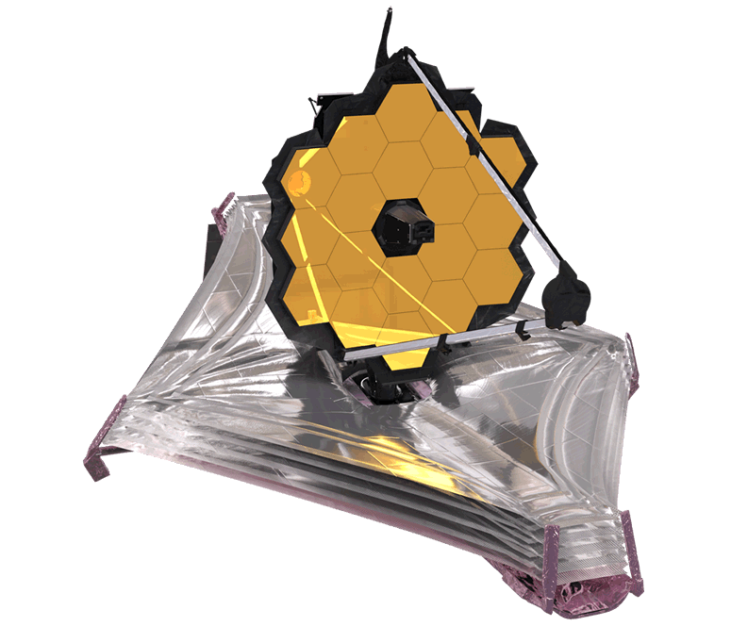
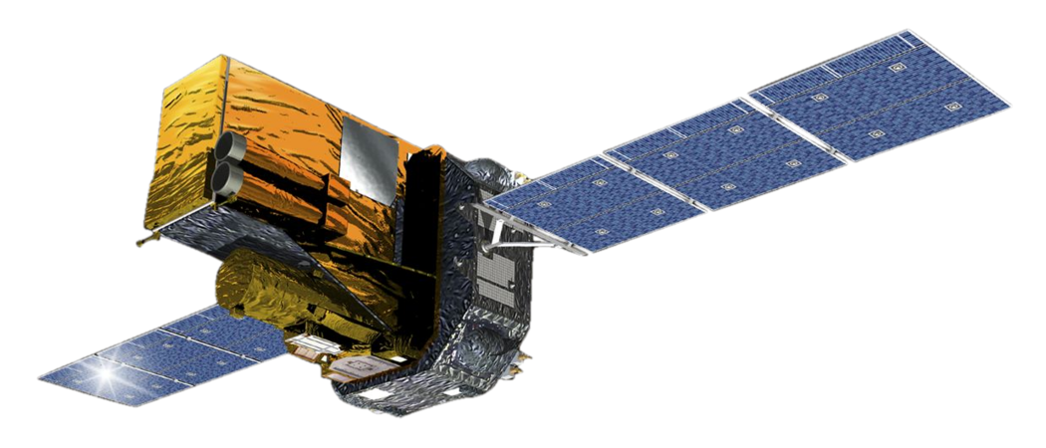
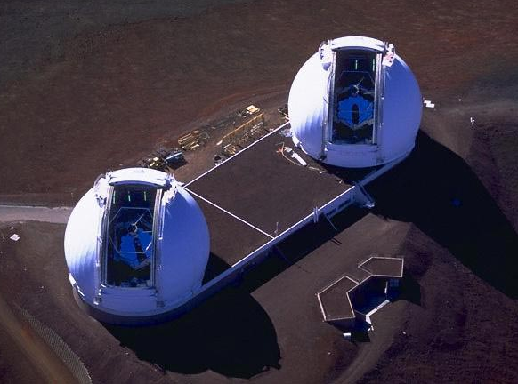
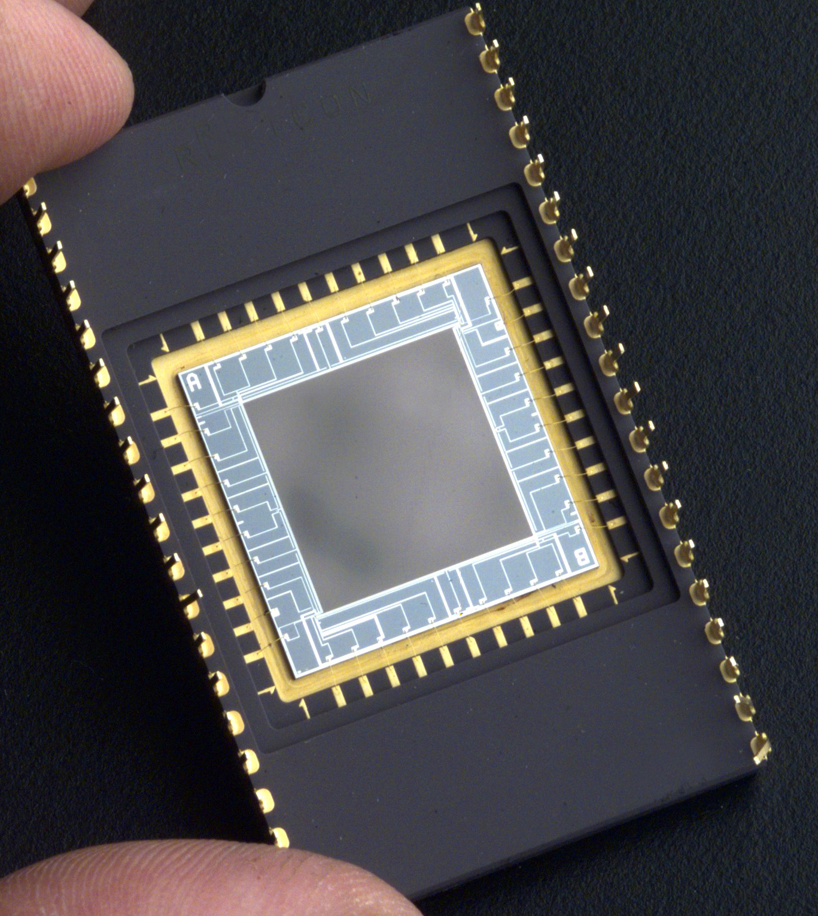
Electromagnetic detection
Space based
  Atmospheric absorption
  Atmospheric noise
Ground based
  Oldest type of astronomy
  Many detectors
Great variant in telescopes
  Mirrors
  CCD
  Lenses
  Scintillator and particle shower for gamma
JWST
Green Bank Telescope
INTEGRAL
Keck

Slide 6
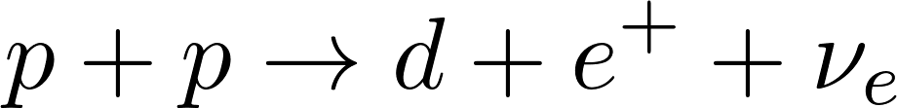



Neutrinos
Very low mass – not charged
Near c and unaffected by em-fields
Sources:
  Solar, earth, atmosphere and reactors
  Cosmic rays
  Supernovae
  Blazar and AGN jets
  NS merger

Slide 7
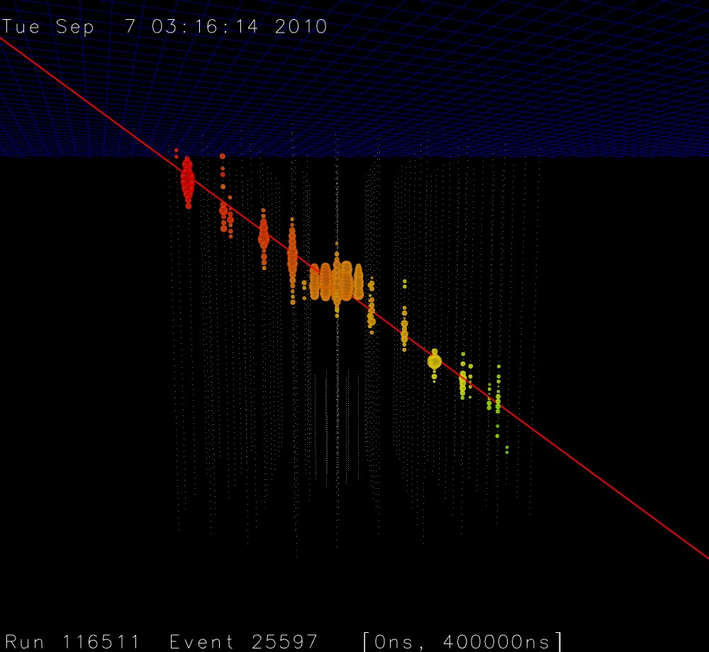
Neutrino observatories
only viable detection via the weak force
Cherenkov radiation detection
multiple mediums – big detectors
  Ice, water
  ultra pure chemicals
IceCube – Antarctica
Multiple see based telescopes like KM3NeT
Source: IceCube Collaboration

Slide 8
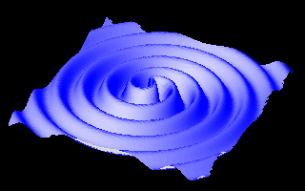
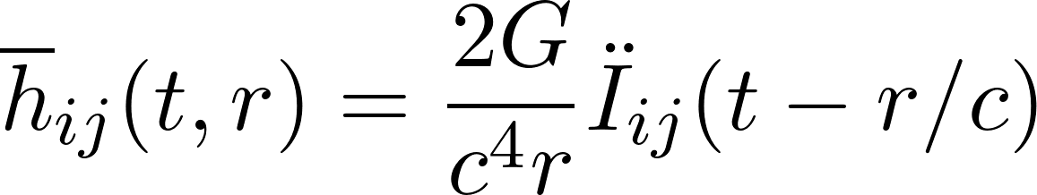
Gravitational waves
gravitational radiation based on General relativity
Sources:
  Merger of massive objects
  Binaries
  core-collapsing supernova [1]
Source: Nasa (PD)

Slide 9
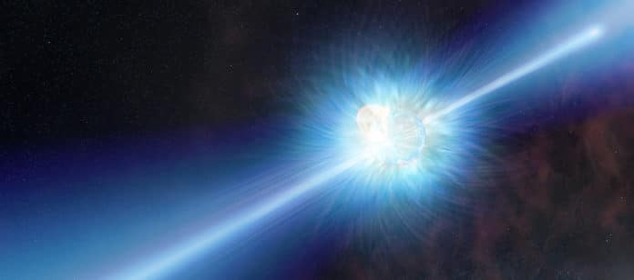

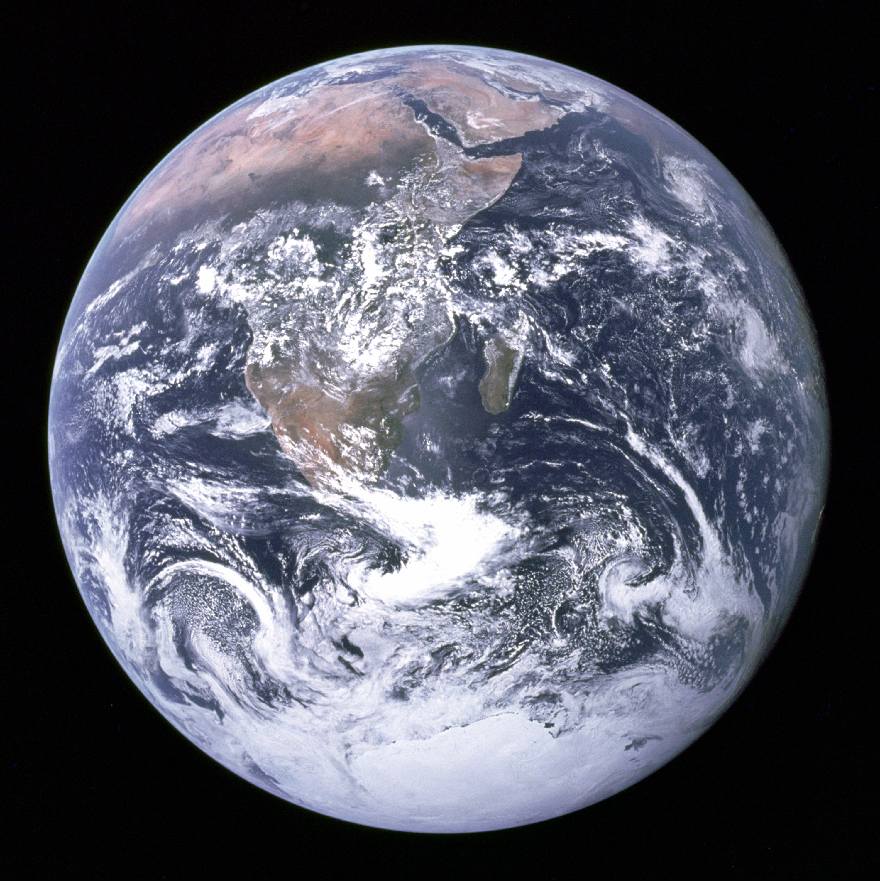
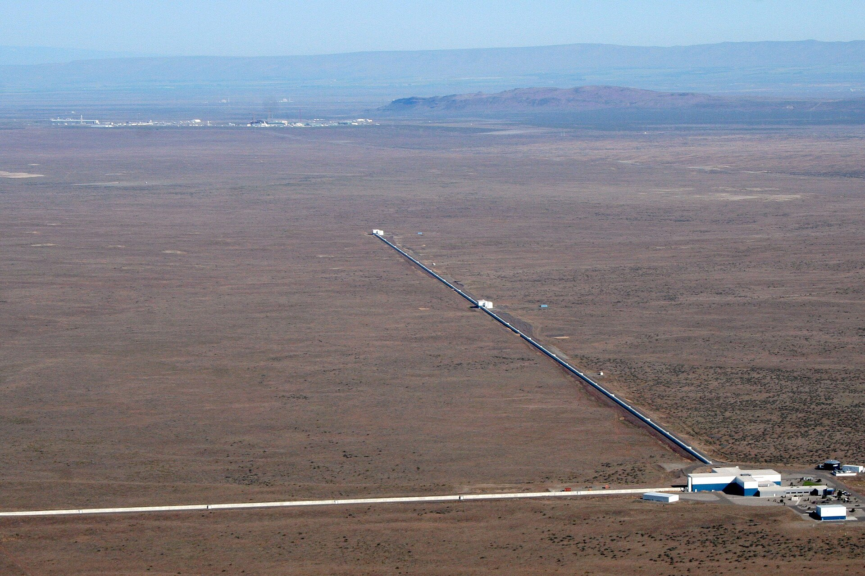
Gravitational wave detection
Interferometers
ms-pulsars
Observed: merger
MM-A problem: BH merger produce little EM
Currently many ground based interferometers
Source: LIGO

Slide 10
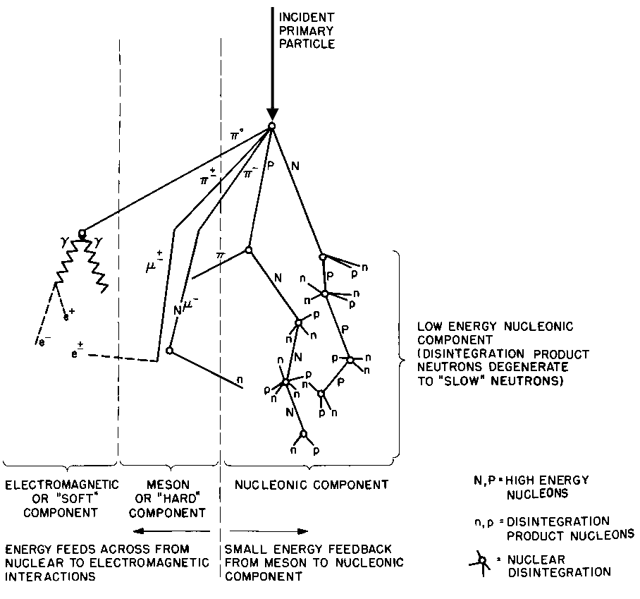
Cosmic rays
Protons 87%
Helium nuclei 12%
Heavy nuclei ≈1%
Very rare: electrons
Charged – complex origin determination
Mostly 10⁷eV - 10¹⁰eV
Very rare >10¹⁹eV - GZK cutoff
Theorized origins:
  AGN
  Neutrino stars
Source: NOAA (PD)

Slide 11
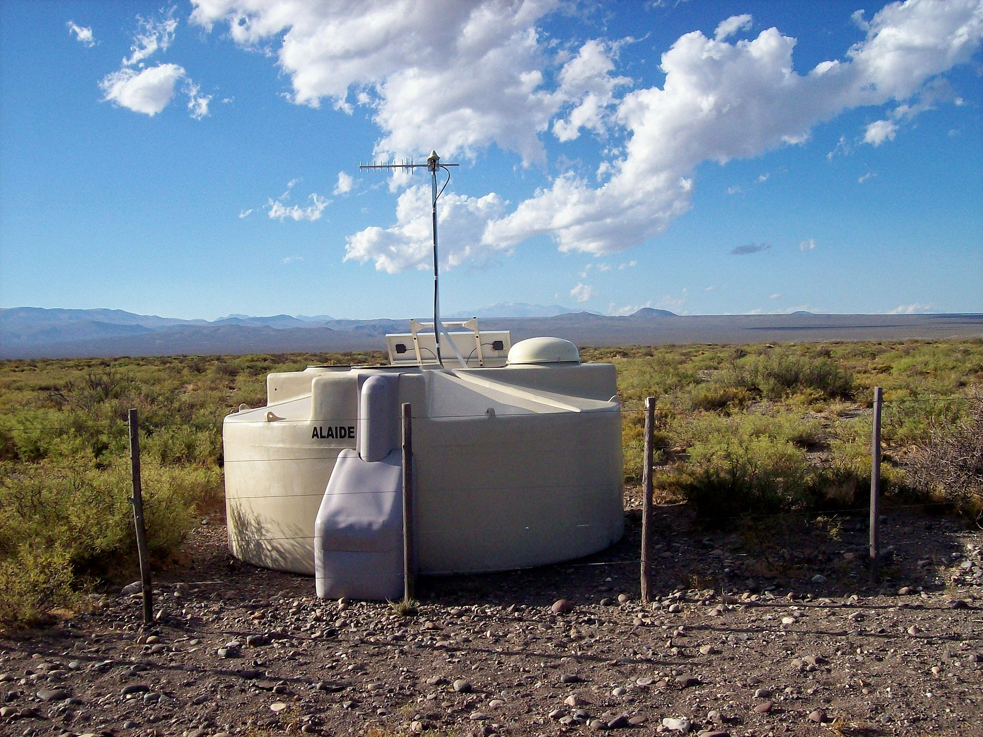
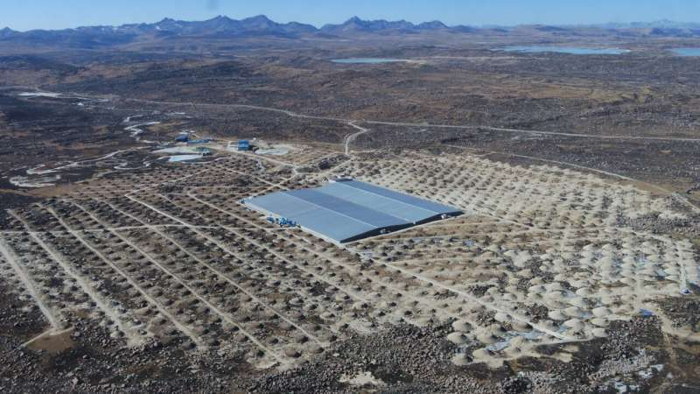
Cosmic Ray Detection
Direct detection in orbit
Secondary air shower observation
Observation of nitrogen exaltation in atmosphere
Pierre Auger Observatory
  3,000 km
LHAASO
Source: public domain
Source: IHEP(CAS)

Slide 12

SNEWS
Neutrino detectors for "near" supernovae
SN projected to generate 10⁵⁸ neutrinos
Search since 2005
Unsurprisingly no SN detection
Last and only SN – neutrino coincidence: SN 1987A (LMC)

Slide 13
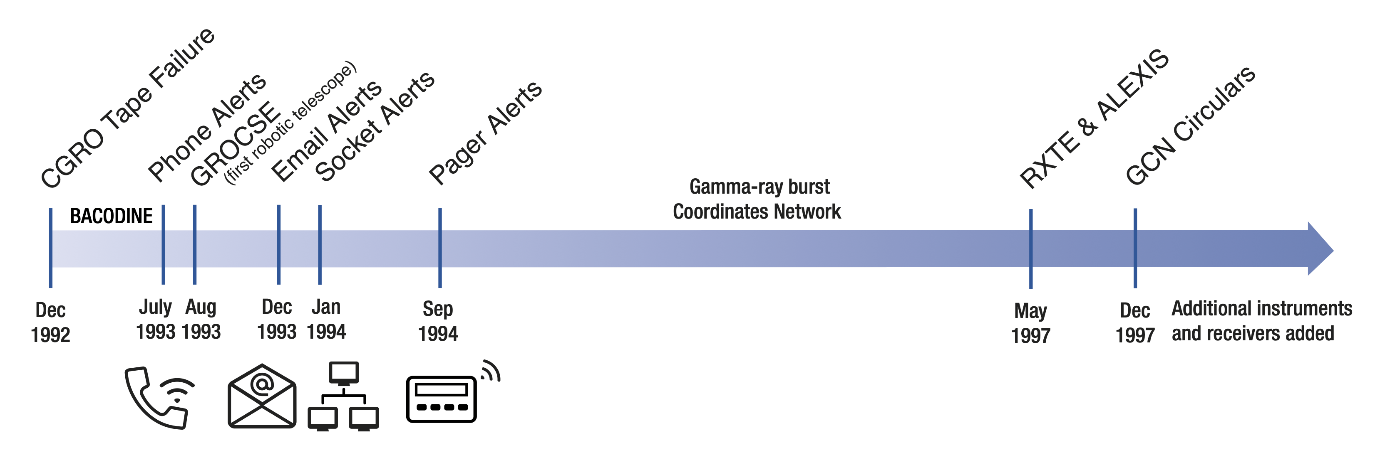
General Coordinates Network (GNS)
Previously: Gamma-ray burst Coordinates Network
Transients alerts (GW, Neutrino, GRBs, FRBs...)
Human and machine notices (VOEvent)
Source: NASA

Slide 14
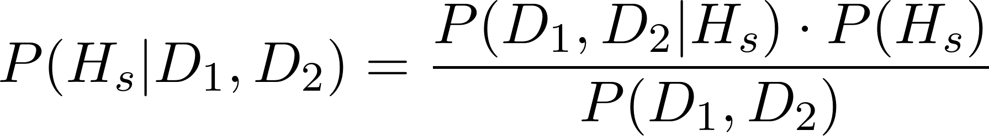
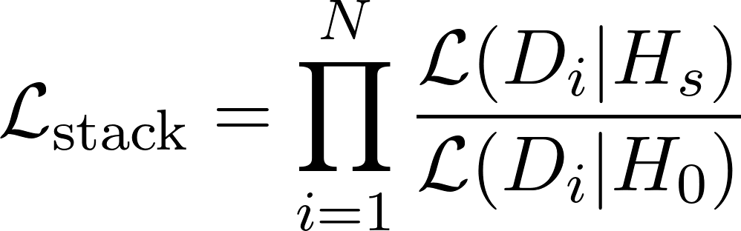
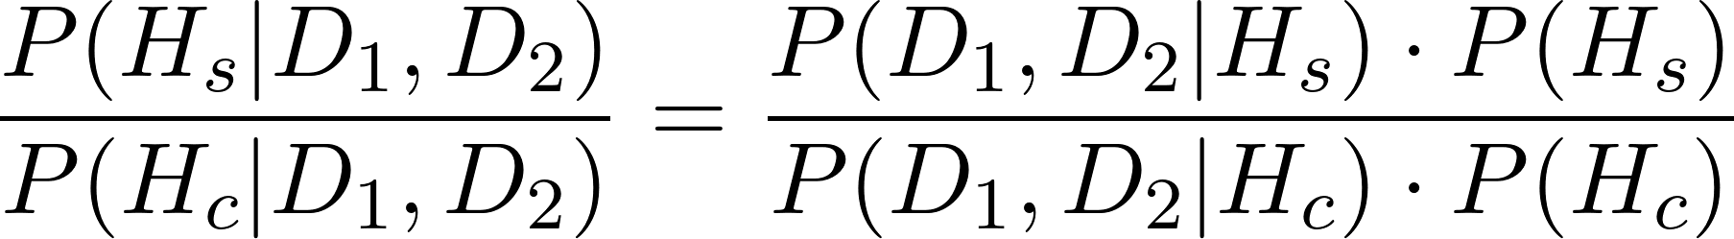
Statistical methods
Time and radial dependency
Context
Complex data analysis
Bayesian Hypothesis Testing:
Stacking:

Slide 15
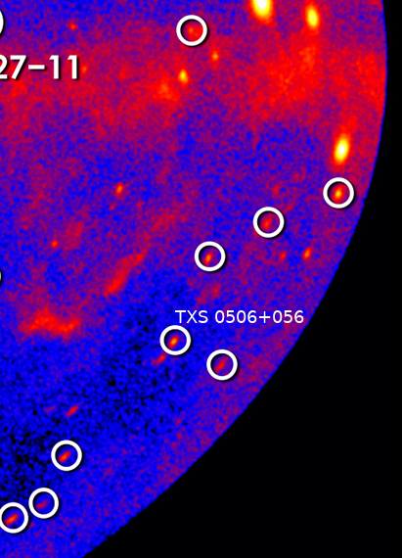
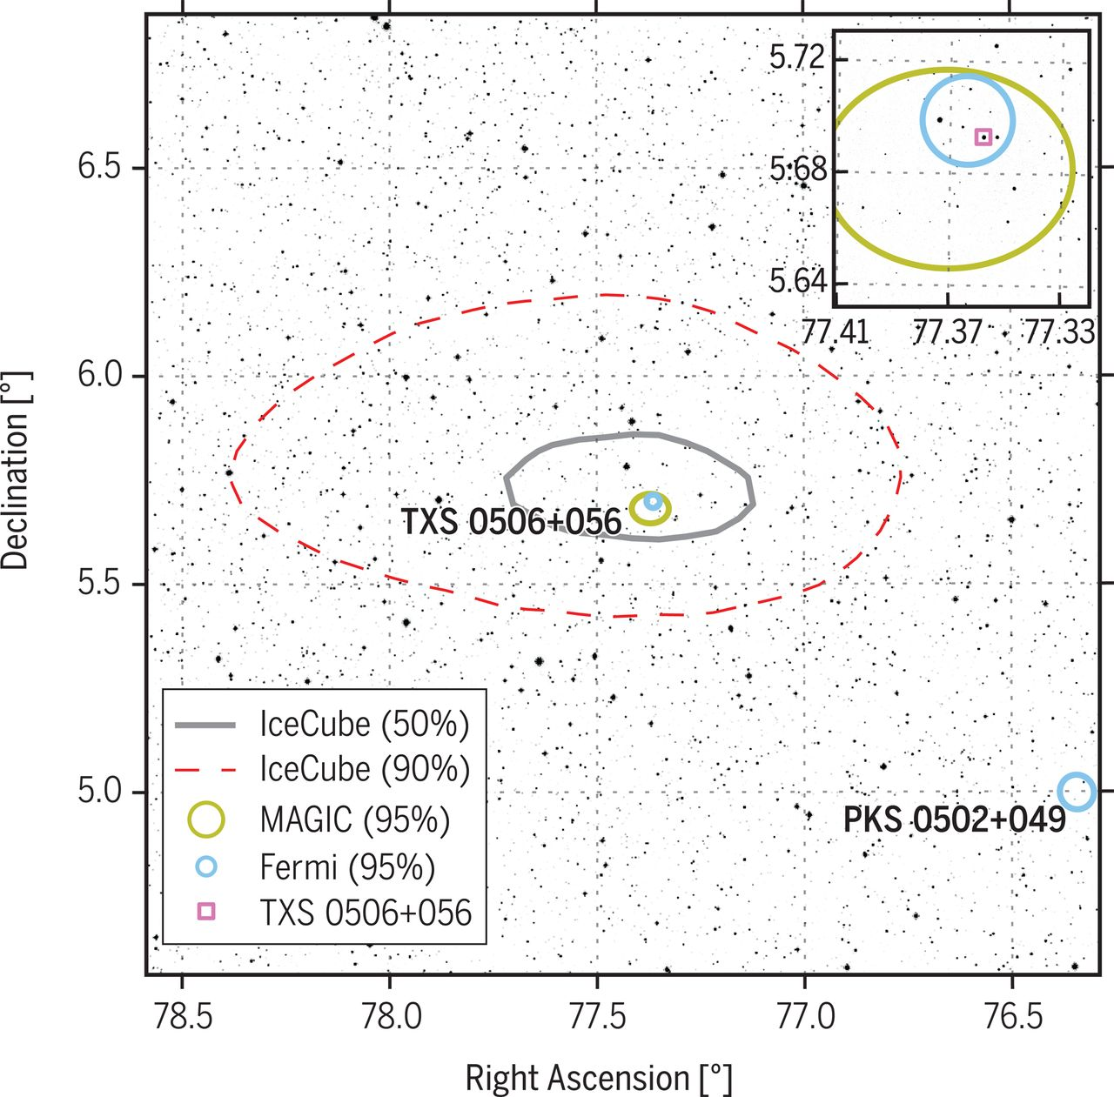
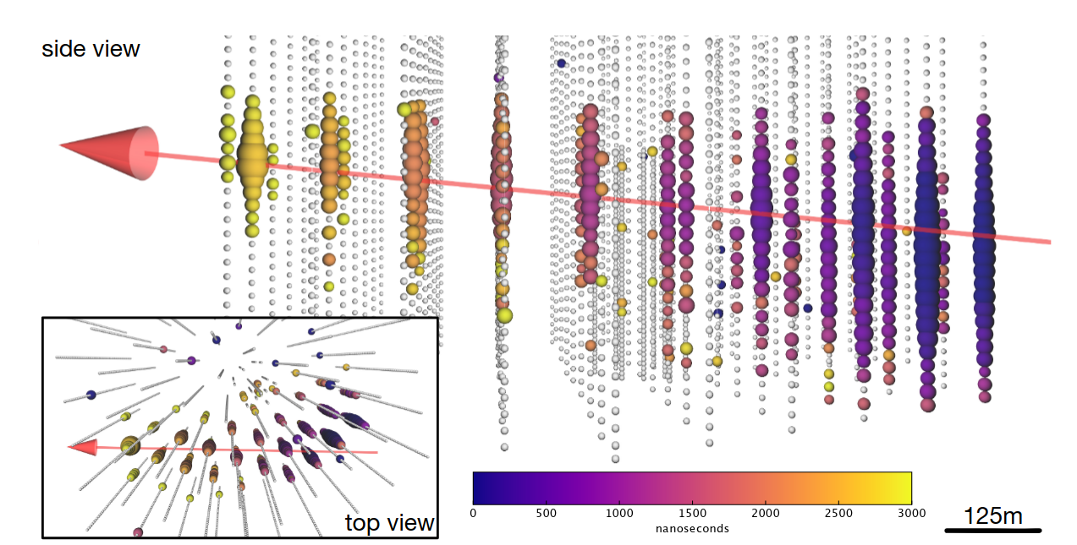
TXS 0506+056
Blazar – AGN
Gamma rays
Coincidence with IceCube-170922A
290 TeV Neutrino
No measured cosmic rays
Source: FGST (PD)
[1]
[1]

Slide 16
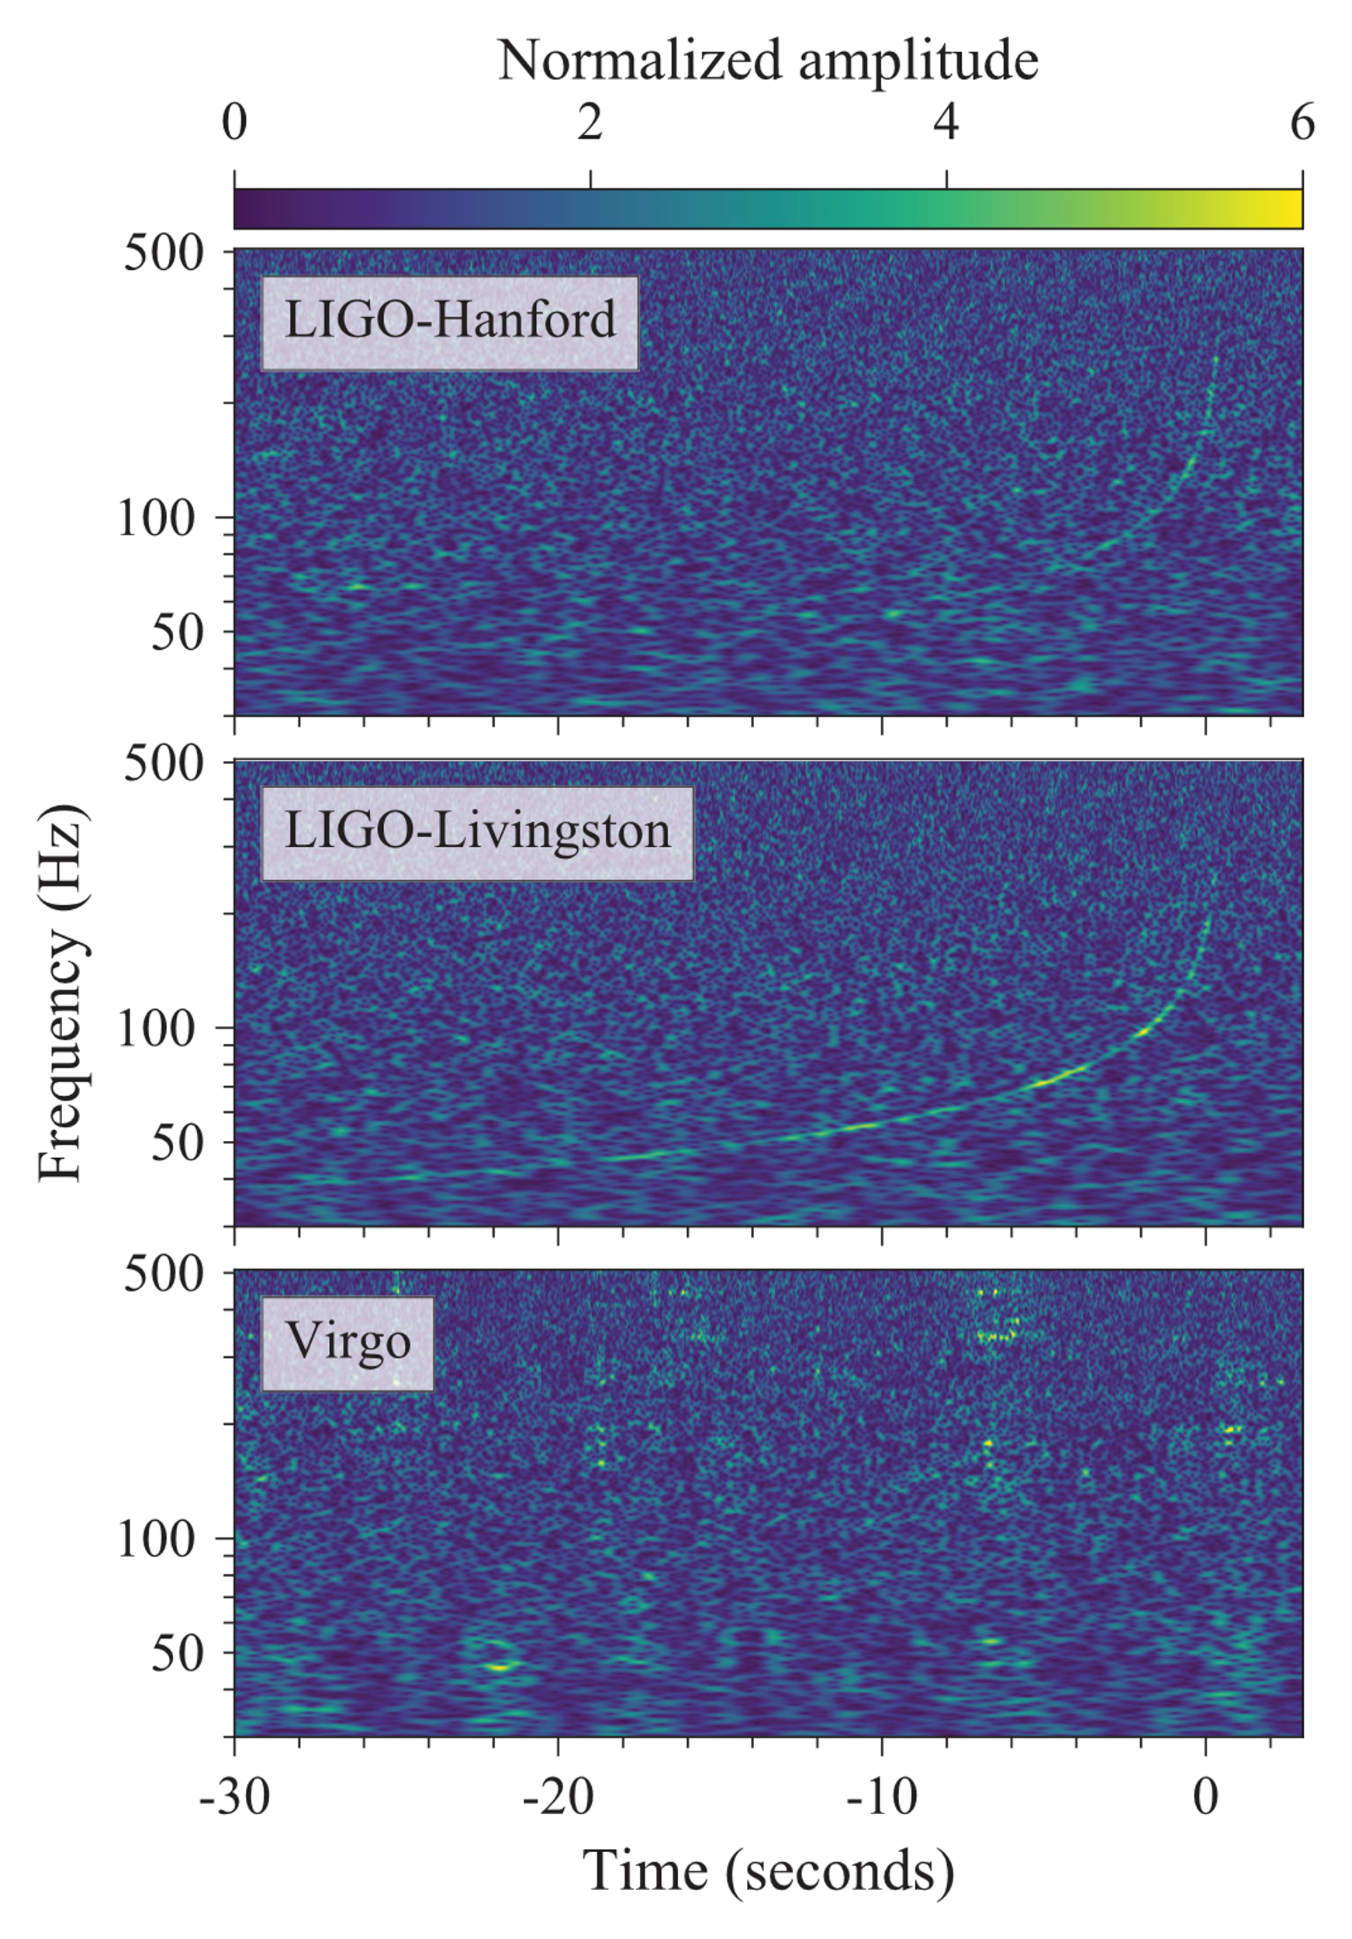
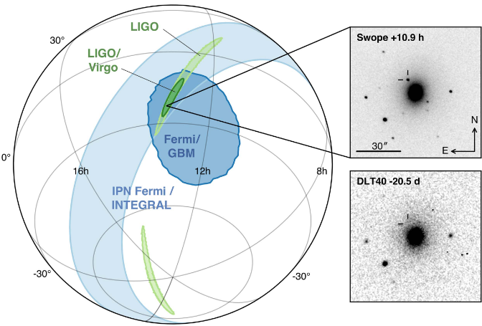
GW170817
Binary neutron star merging
Till now the only GW with observed electromagnetic coincidence
[1] CC BY 3.0

Slide 17
Multi-messenger astronomy till now
Existing (working) infrastructure
Only few confirmed events
  GW speed [2]
  r-process in NS merger [1]
Some candidate events
A lot of Data

Slide 18
Future Science
Close supernovae
NS-BH merger with EM
Cosmic particle accelerator (UHECRs)
Test fundamental Physics and models
GW and neutrino astronomy is young
3-messenger events
...many exotic phenomena

Slide 19
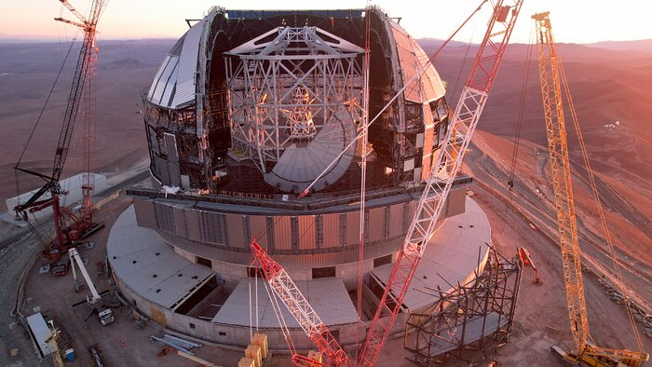
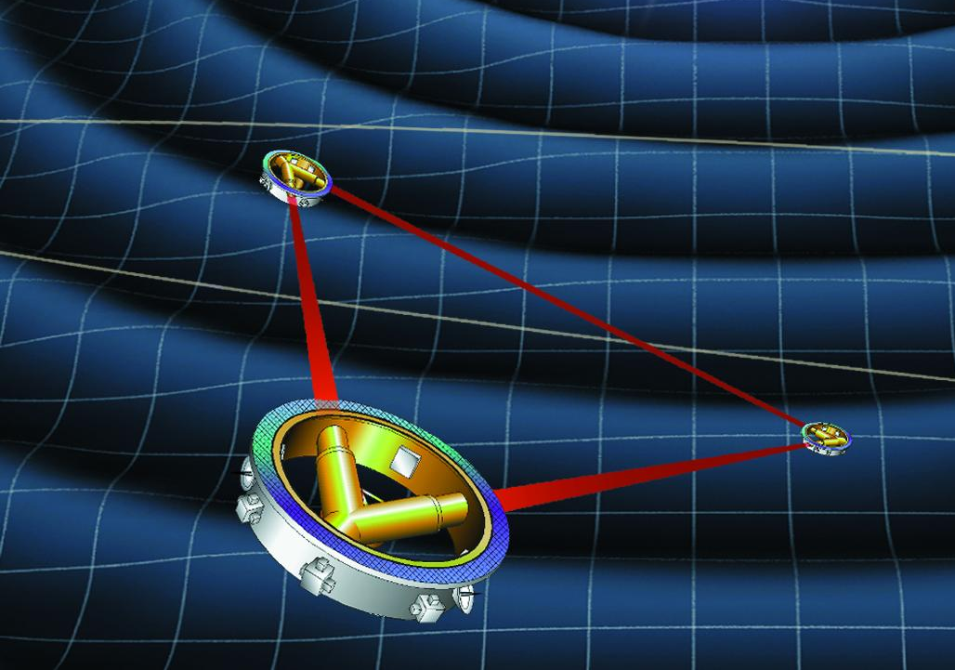
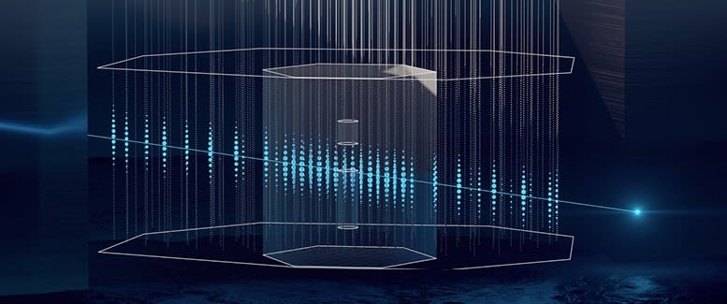
Future Detectors
Future gravitational wave detectors:
  space based GW-detectors: e.g. LISA
Future Photon Observatories
  Mostly bigger/better into the 30s
  Big mirror telescopes e.g. ELT,TMT...
  Radio: SKA
  Space: ATHENA, Roman...
Future Neutrino Observatories:
  IceCube-Gen2
  KM3NeT
Future Cosmic Ray Missions:
  Space only for lower energies
  Expansion for ground and balloon based projects
Source: ESO (CC)
Source: DESY
Source: NASA

Slide 20
Thanks for listening! Questions?

