Slide 1
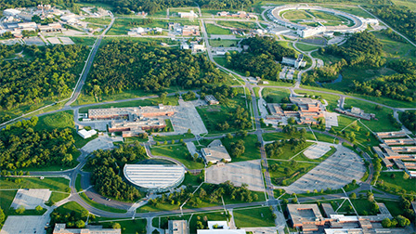
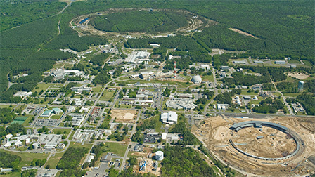
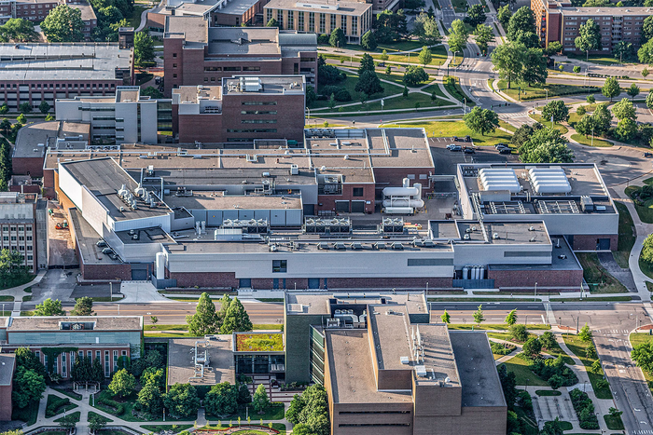
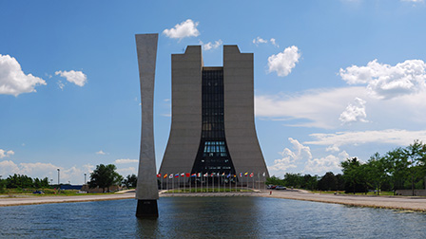
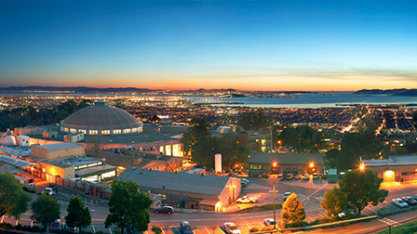
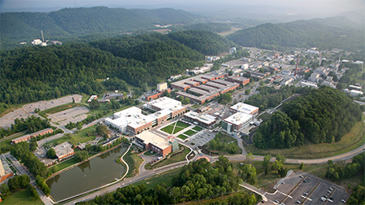
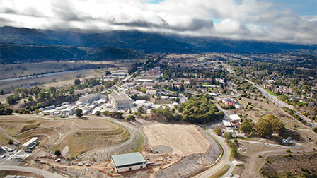
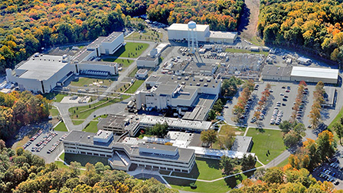
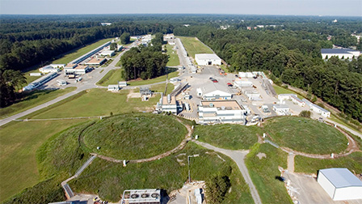
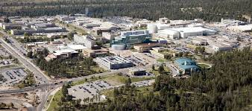
Accelerator Workforce Development
DPF Community Forum
Fulvia Pilat
July 31-August 1, 2025

Slide 2
The HEP workforce has been a focus of the recently released EPP2024 report
Trends: Decrease in US school-age population
Decrease in international scholars
Decrease in funding
Decrease in general stem preparation
Finding: Elementary particle physics is competing with other scientific fields for resources and also with industry for talent.
Conclusion: Three workforce issues are threatening the future of particle physics: the morale of
early-career scientists; a shortfall in the number of accelerator scientists; and growing barriers
to international exchanges. It is essential to the future of elementary particle physics in the
United States that it address its workforce issues.
Recommendation 6: The federal government should provide the means, and the particle physics community should take responsibility for recruiting, training, mentoring, and retaining the highly motivated student and postdoctoral workforce required for the success of the field’s ambitious science goals.

Slide 3
Contributors to this talk
Overall task force coordinator:
Christine Clarke,
SLAC, Doe Detailee
Argonne National Laboratory
Brookhaven National Laboratory
Phillippe Piot
Walter Wittmer
Mark Palmer
Luisella Lari
Elke Arenholz
Michiko Minty
Facility for Rare Isotope Beams
Jie Wei
Andreas Stolz
Fermi National Accelerator Laboratory
Sam Posen
Alexander Valishev
Marc Kaducak
Jefferson Lab
Eduard Pozdeyev
Andrei Seryi
Volker Ziemann
Lawrence Berkely National Laboratory
Cameron Geddes
Larry Phair
Los Alamos National Laboratory
Bruce Carlsten
Oak Ridge National Laboratory
SLAC National Accelerator Laboratory
Fulvia Pilat
Glen Johns
Mei Bei
John Schmerge
Princeton Plasma Physics Laboratory
Tim Meyer

Slide 4
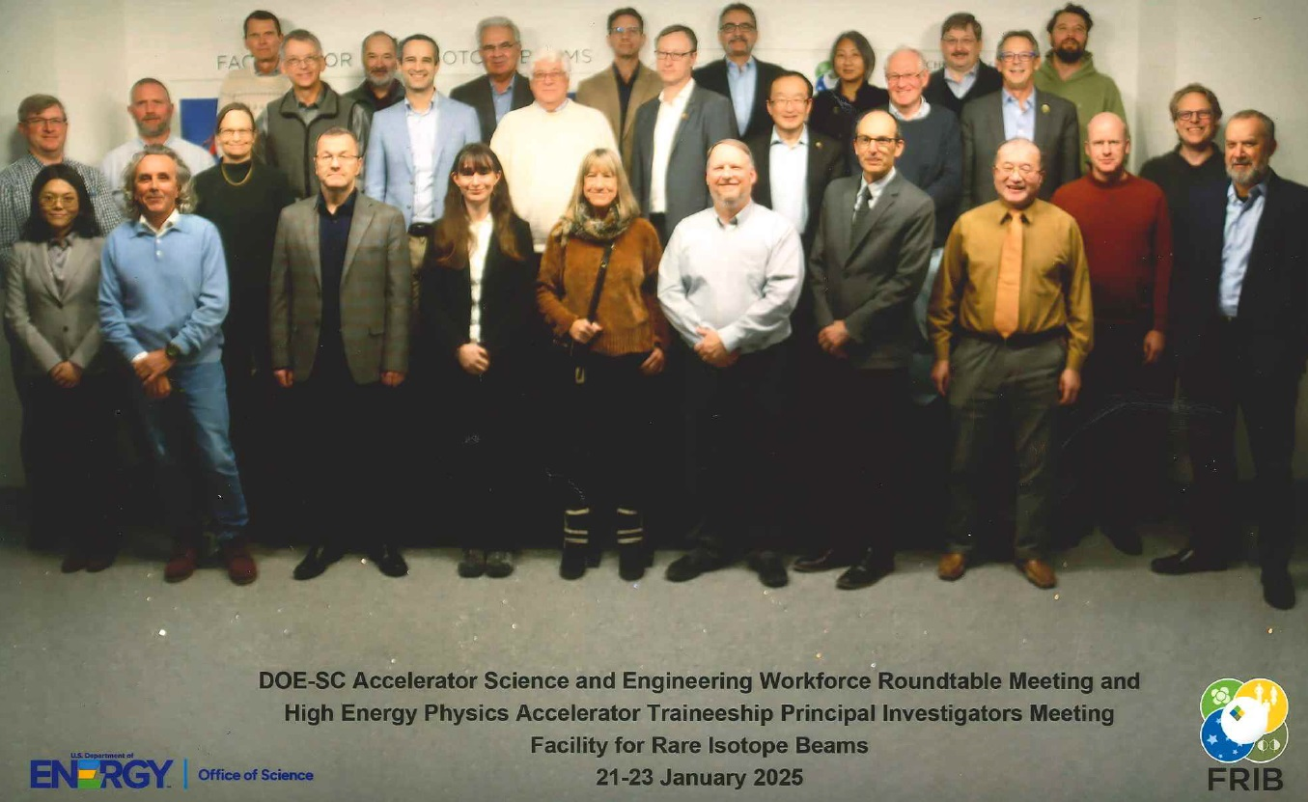
Accelerator Science and Engineering Workforce Roundtable
9 DOE Labs + 1 DOE User Facility met in January 2025 at FRIB (MSU)
Produced a census of the current Accelerator Workforce at the labs
Exchanged projections for lab future needs
Discussed best practices in
  Training
  Recruitment
  Retention
Planned next steps
  Engaging industry and universities
Warmest thanks to our host- Michigan State University!

Slide 5
Census Overview
8 DOE SC National Laboratories
1 University-based facility
1 DOE NNSA National Laboratory
14 Office of Science User Facilities
>4100 members of the Accelerator workforce

Slide 6
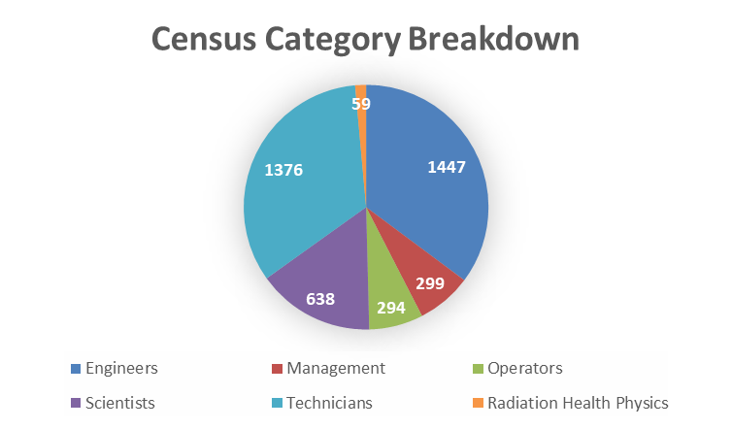
Census Data
Definition of Accelerator Science and Technology workforce:
  Workforce members that are capable to design, construct and operate significant accelerator-based scientific facilities
  The workforce needed is ultimately larger
    including professional administrators, business managers, HR, procurement, IT and cybersecurity, crafts, security…
    we are focused on skills that are unique to accelerators
Engineers and Technicians combined are 69% of the accelerator workforce
Electrical engineers: 14%
Engineering Technicians: 17%
Physicists: 11%
Mechanical engineers: 9%

Slide 7
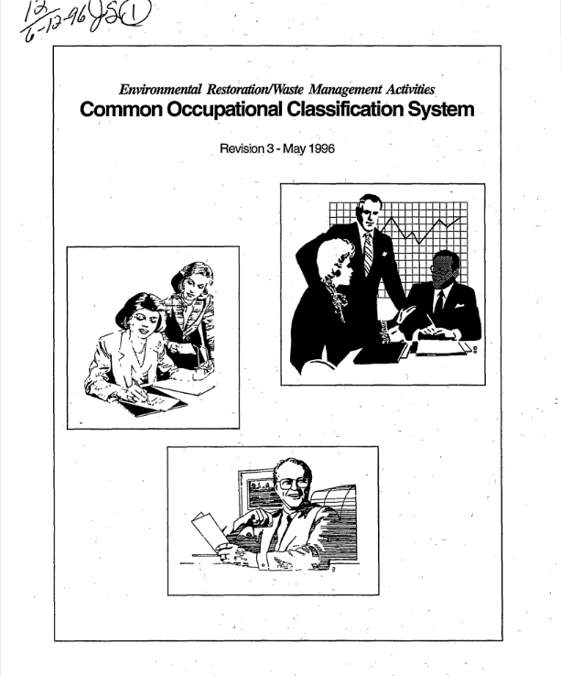
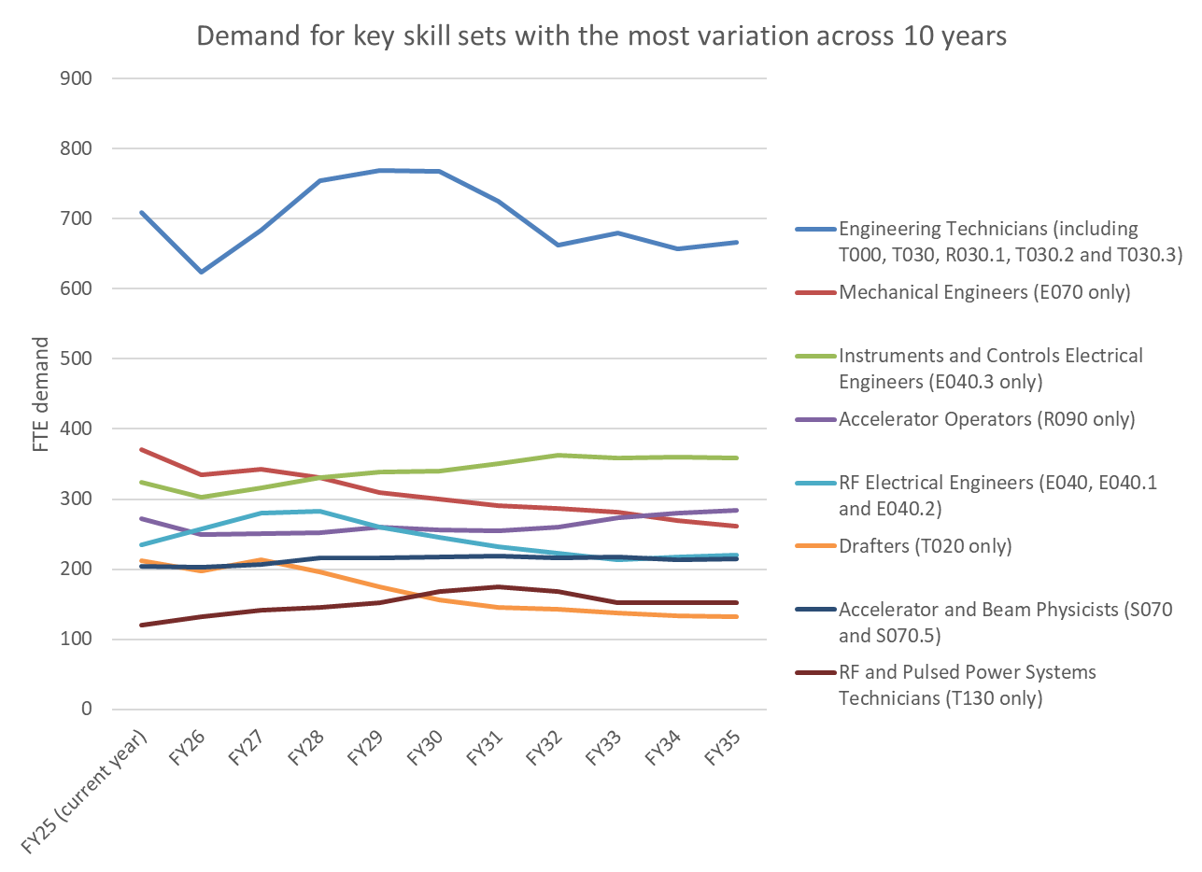
10-year projection of accelerator workforce demand
Each Lab produced a 10-year projection of the workforce demand using a common taxonomy
We modified an existing taxonomy to add accelerator-specific occupations and specialisms
Data allows plots of workforce FTEs, by Lab, occupation, and expertise
Combined data set from all 10 labs was shared with labs and DOE
“Common Occupational Classification System”
  1996
  DOE Office of Environmental Restoration and Waste Management
  https://www.osti.gov/biblio/243454

Slide 8
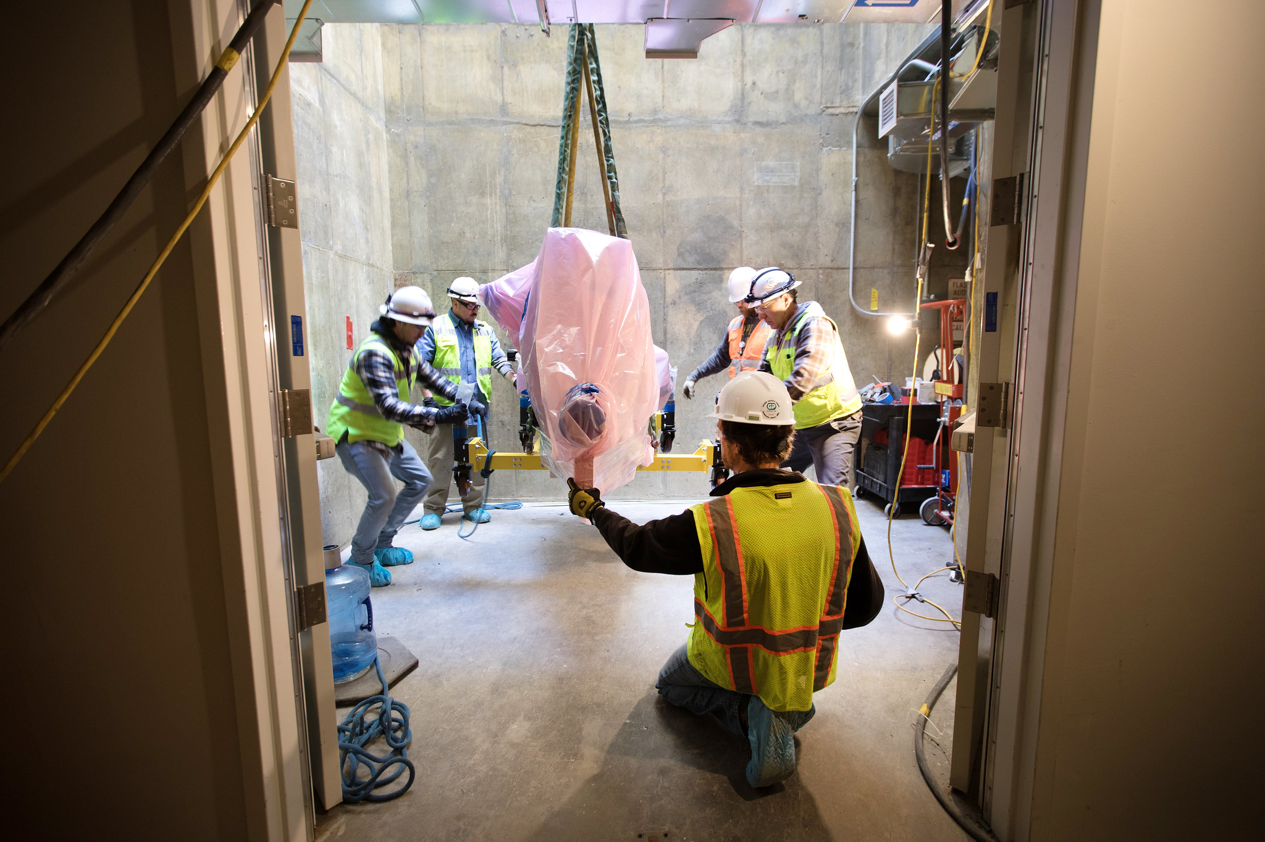
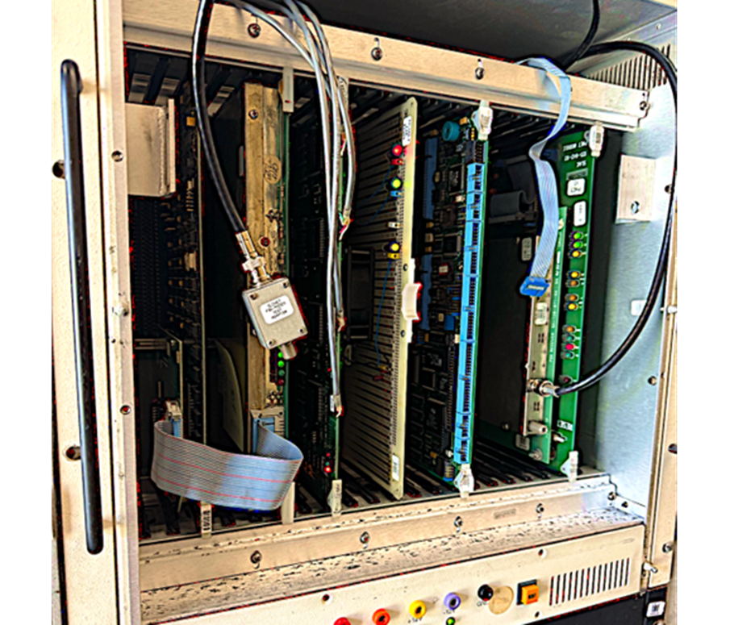
Lab workforce needs projection
Important for internal lab planning
Large projects drive ebb and flow
Laboratory staff re-train to align with lab priorities
New accelerators or accelerator upgrades creates peaks and troughs in demands
Large impact on engineers and technicians which are in higher demand in construction phases than design or operation
It is vital to maintain a core workforce at the laboratory that carries forward institutional knowledge so there is a preference to re-train.
Courses in project management and technical fields are critical to retrain workforce to align with new lab thrusts.

Slide 9
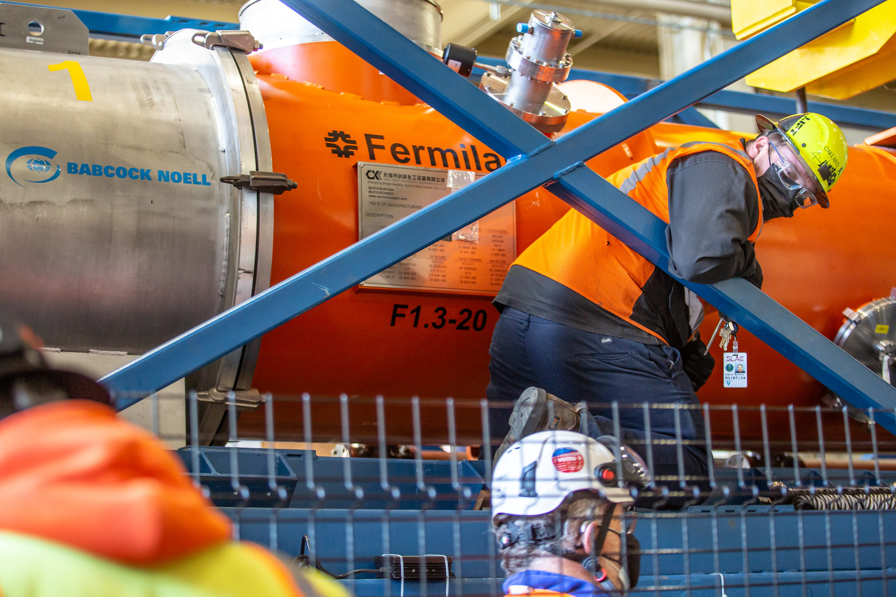
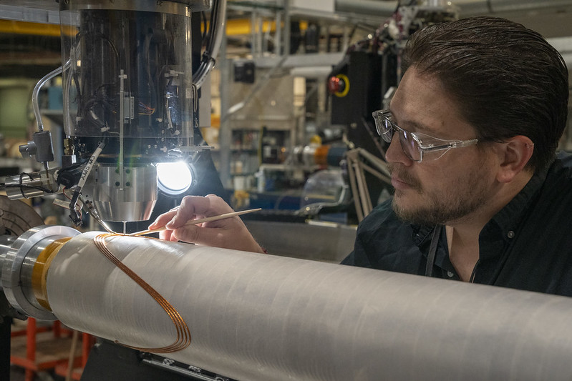
Lab workforce needs projection
Important for coordinated lab approach
Laboratories join forces to make projects a success
Laboratories steward unique core competencies
Billion-dollar projects require a multi-lab approach
E.g. Cryomodule and cryoplant experts at Fermilab and Jefferson Lab critical for LCLS-II (at SLAC) success
Each lab has a set of core competencies unlike any other lab. Many specialisms take decades to develop
Sharing specialist resources across institutions is important for innovative R&D and to develop the next generation machines

Slide 10
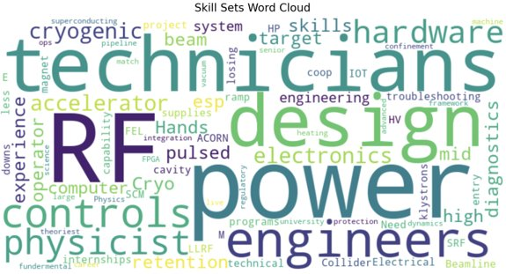
Critical and Endangered Skills
The roundtable identified common workforce pain points across the labs
Common themes:
  Need accelerator technicians
  Need RF Power Engineers
  Need accelerator scientists and engineers to design future accelerators
Needed: Hands-on experience with accelerators and being able to work with the legacy hardware the labs are built upon
Labs can coordinate efforts towards training the next generation of workers

Slide 11
Best Practices in Training
[University Research]
Skill exchange between labs
Traineeships
Apprenticeships
Intentional Mentorship and Succession Planning
Retraining
R&D and test facilities

Slide 12
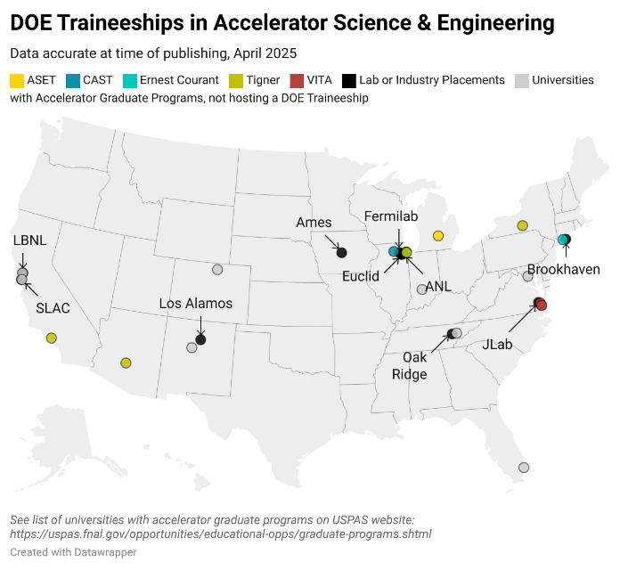
Best Practices in Training
[University Research]
Skill exchange between labs
Traineeships
Apprenticeships
Intentional Mentorship and Succession Planning
Retraining
R&D and test facilities
For scientists and engineers
DOE Office of Science funds five traineeship programs across twelve universities
Supports grad students for two years towards a Master’s or PhD in critical areas of accelerator science and engineering
161 students enrolled to-date since FY17
20 graduated with PhD, 25 graduated with Master’s, 102 still working towards degree
Includes a lab (or industry) placement

Slide 13
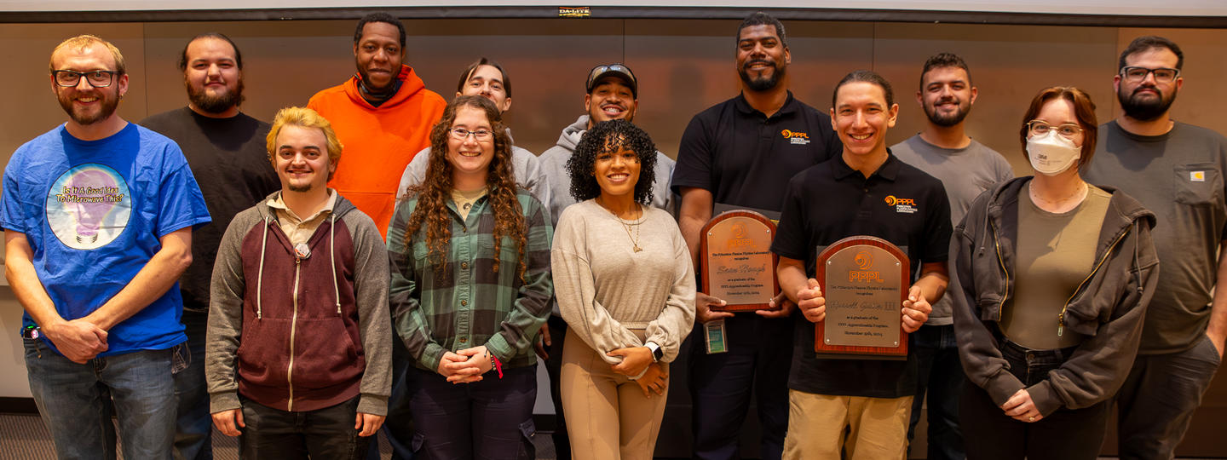
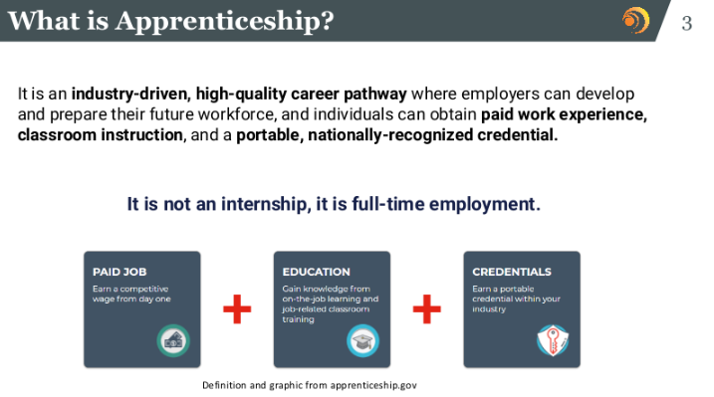
Best Practices in Training
https://www.pppl.gov/work-with-us/apprenticeships#HowTheProgramWorks
[University Research]
Skill exchange between labs
Traineeships
Apprenticeships
Intentional Mentorship and Succession Planning
Retraining
R&D and test facilities
For technicians
ORNL, JLAB, ANL, Ames among first cohort of labs joining PPPL under DOE-SC initiative

Slide 14
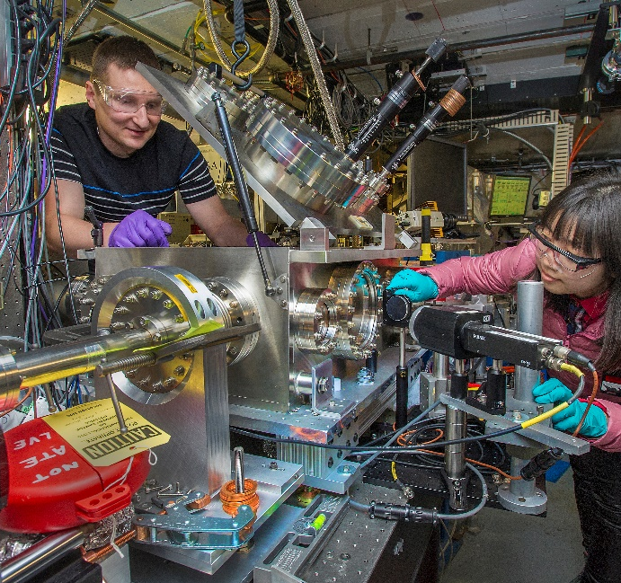
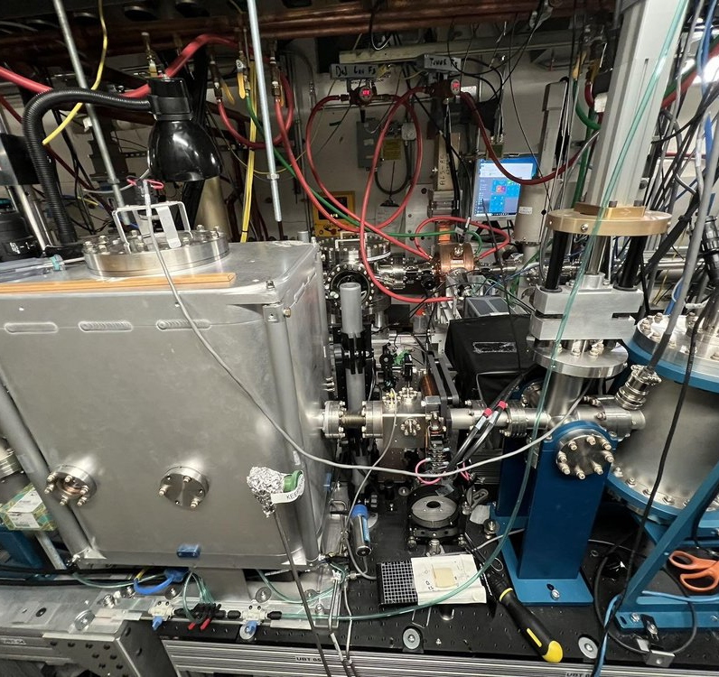
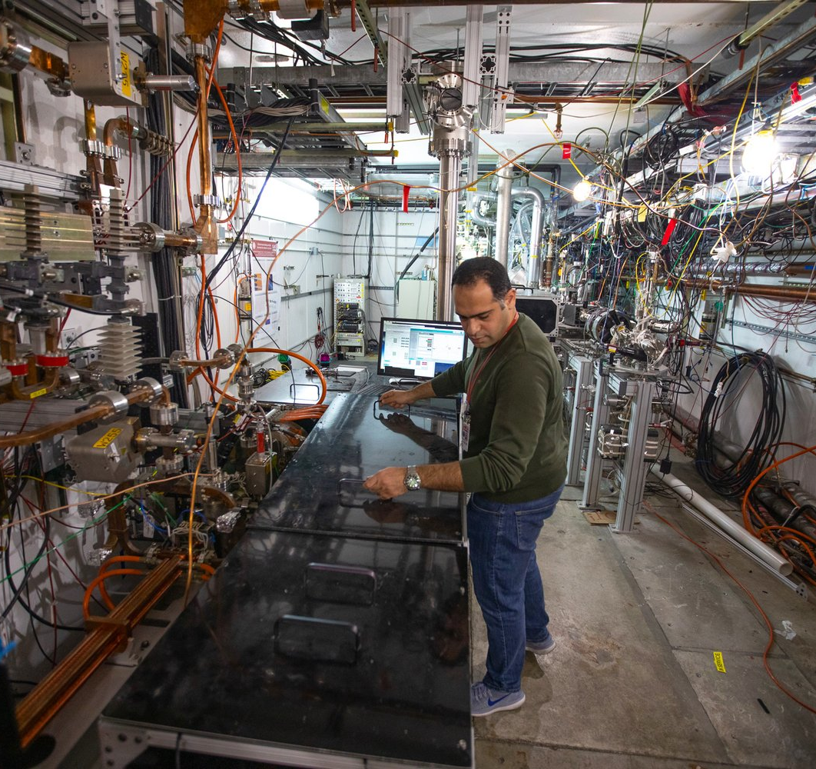
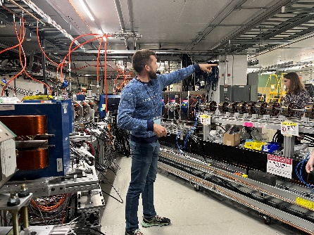
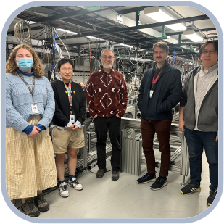
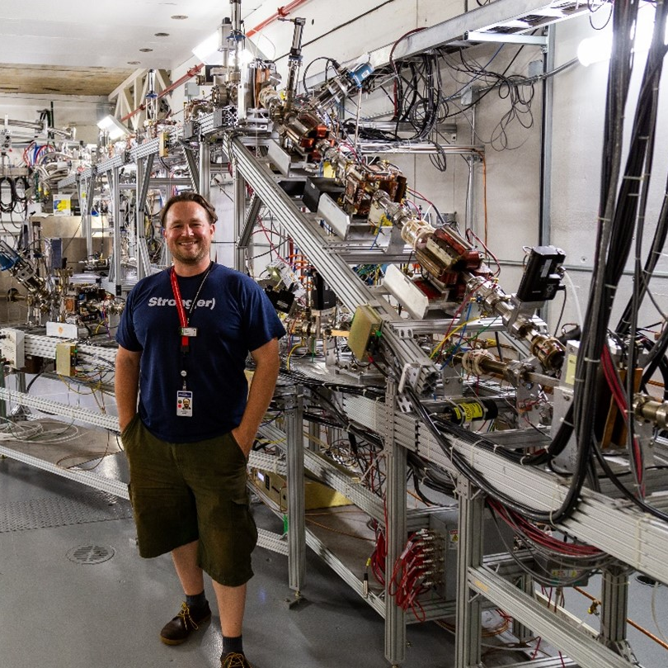
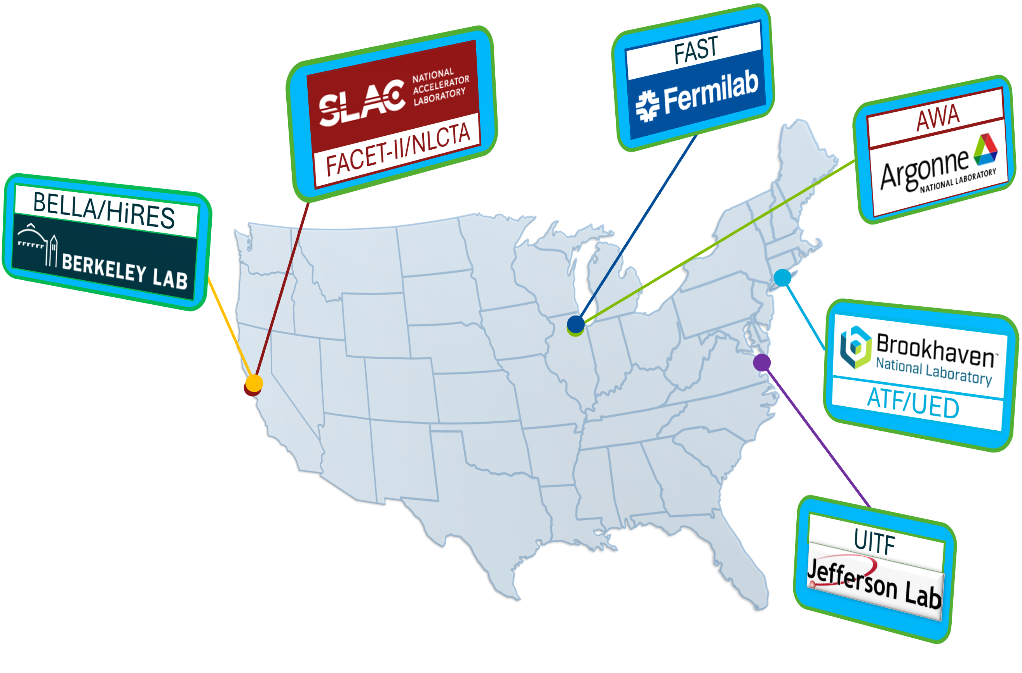

Best Practices in Training
[University Research]
Skill exchange between labs
Traineeships
Apprenticeships
Intentional Mentorship and Succession Planning
Retraining
R&D and test facilities
Long term R&D coupled with facilities for hands-on experience
Small-scale facilities needed to provide a suitable error tolerant space for workforce development
Access to the facilities is facilitated through a new program (BeamNetUS)

Slide 15
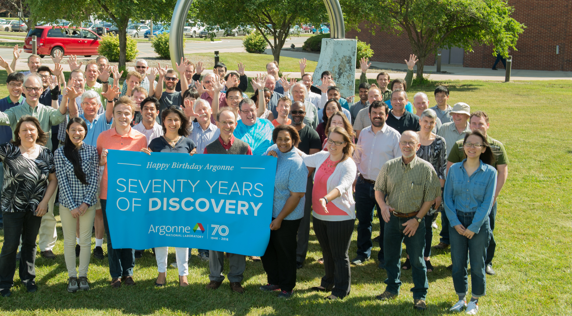
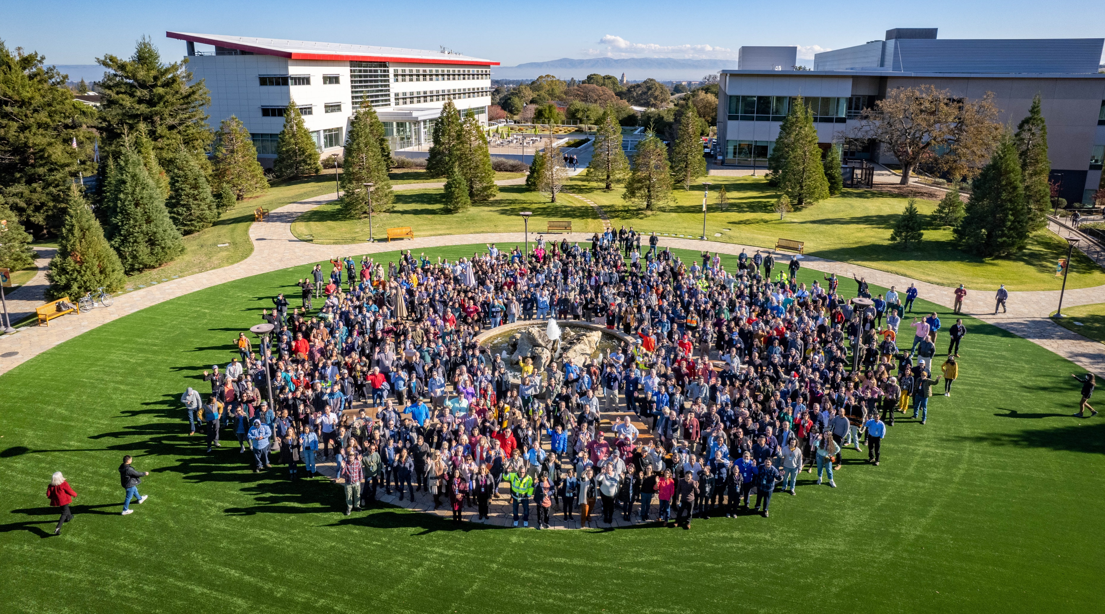
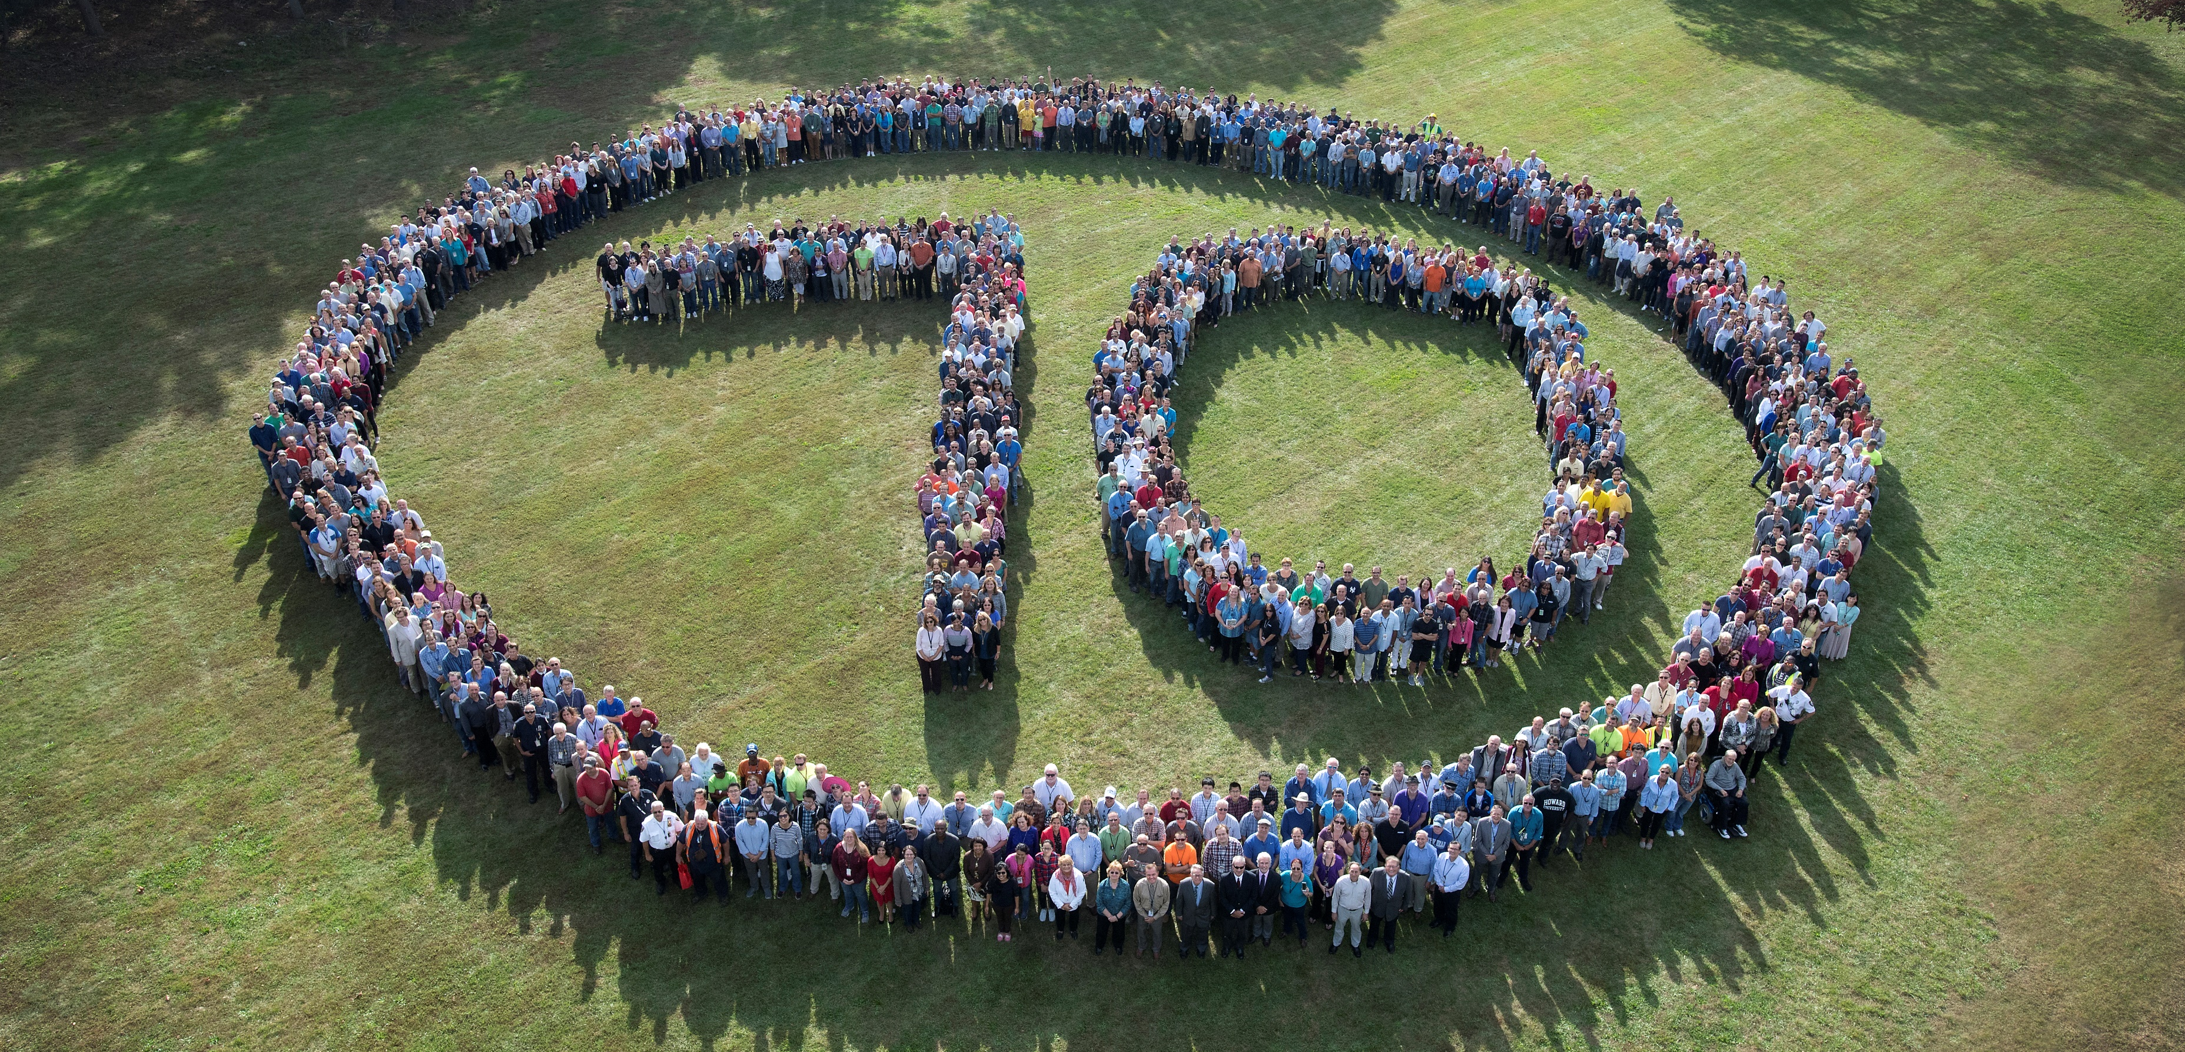
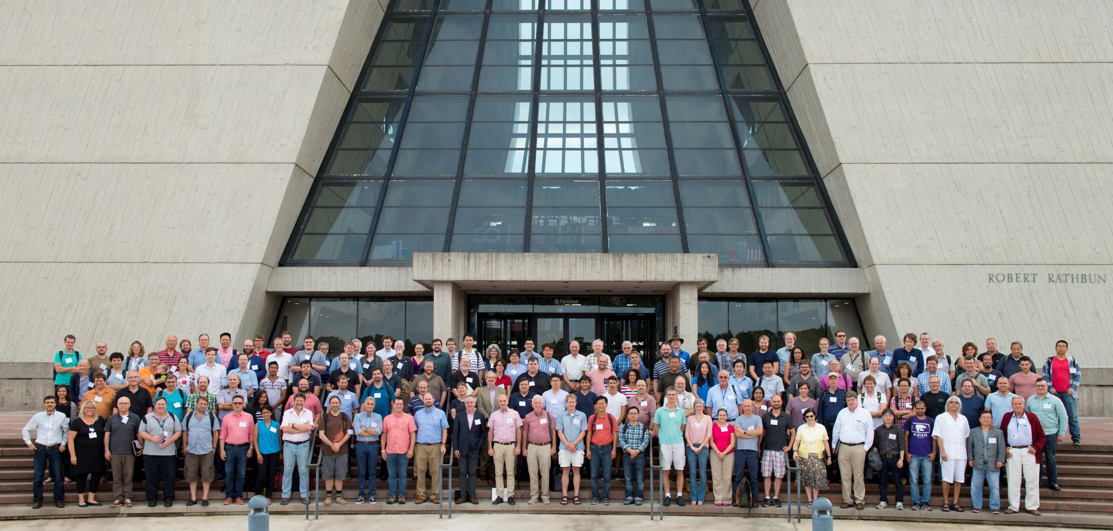
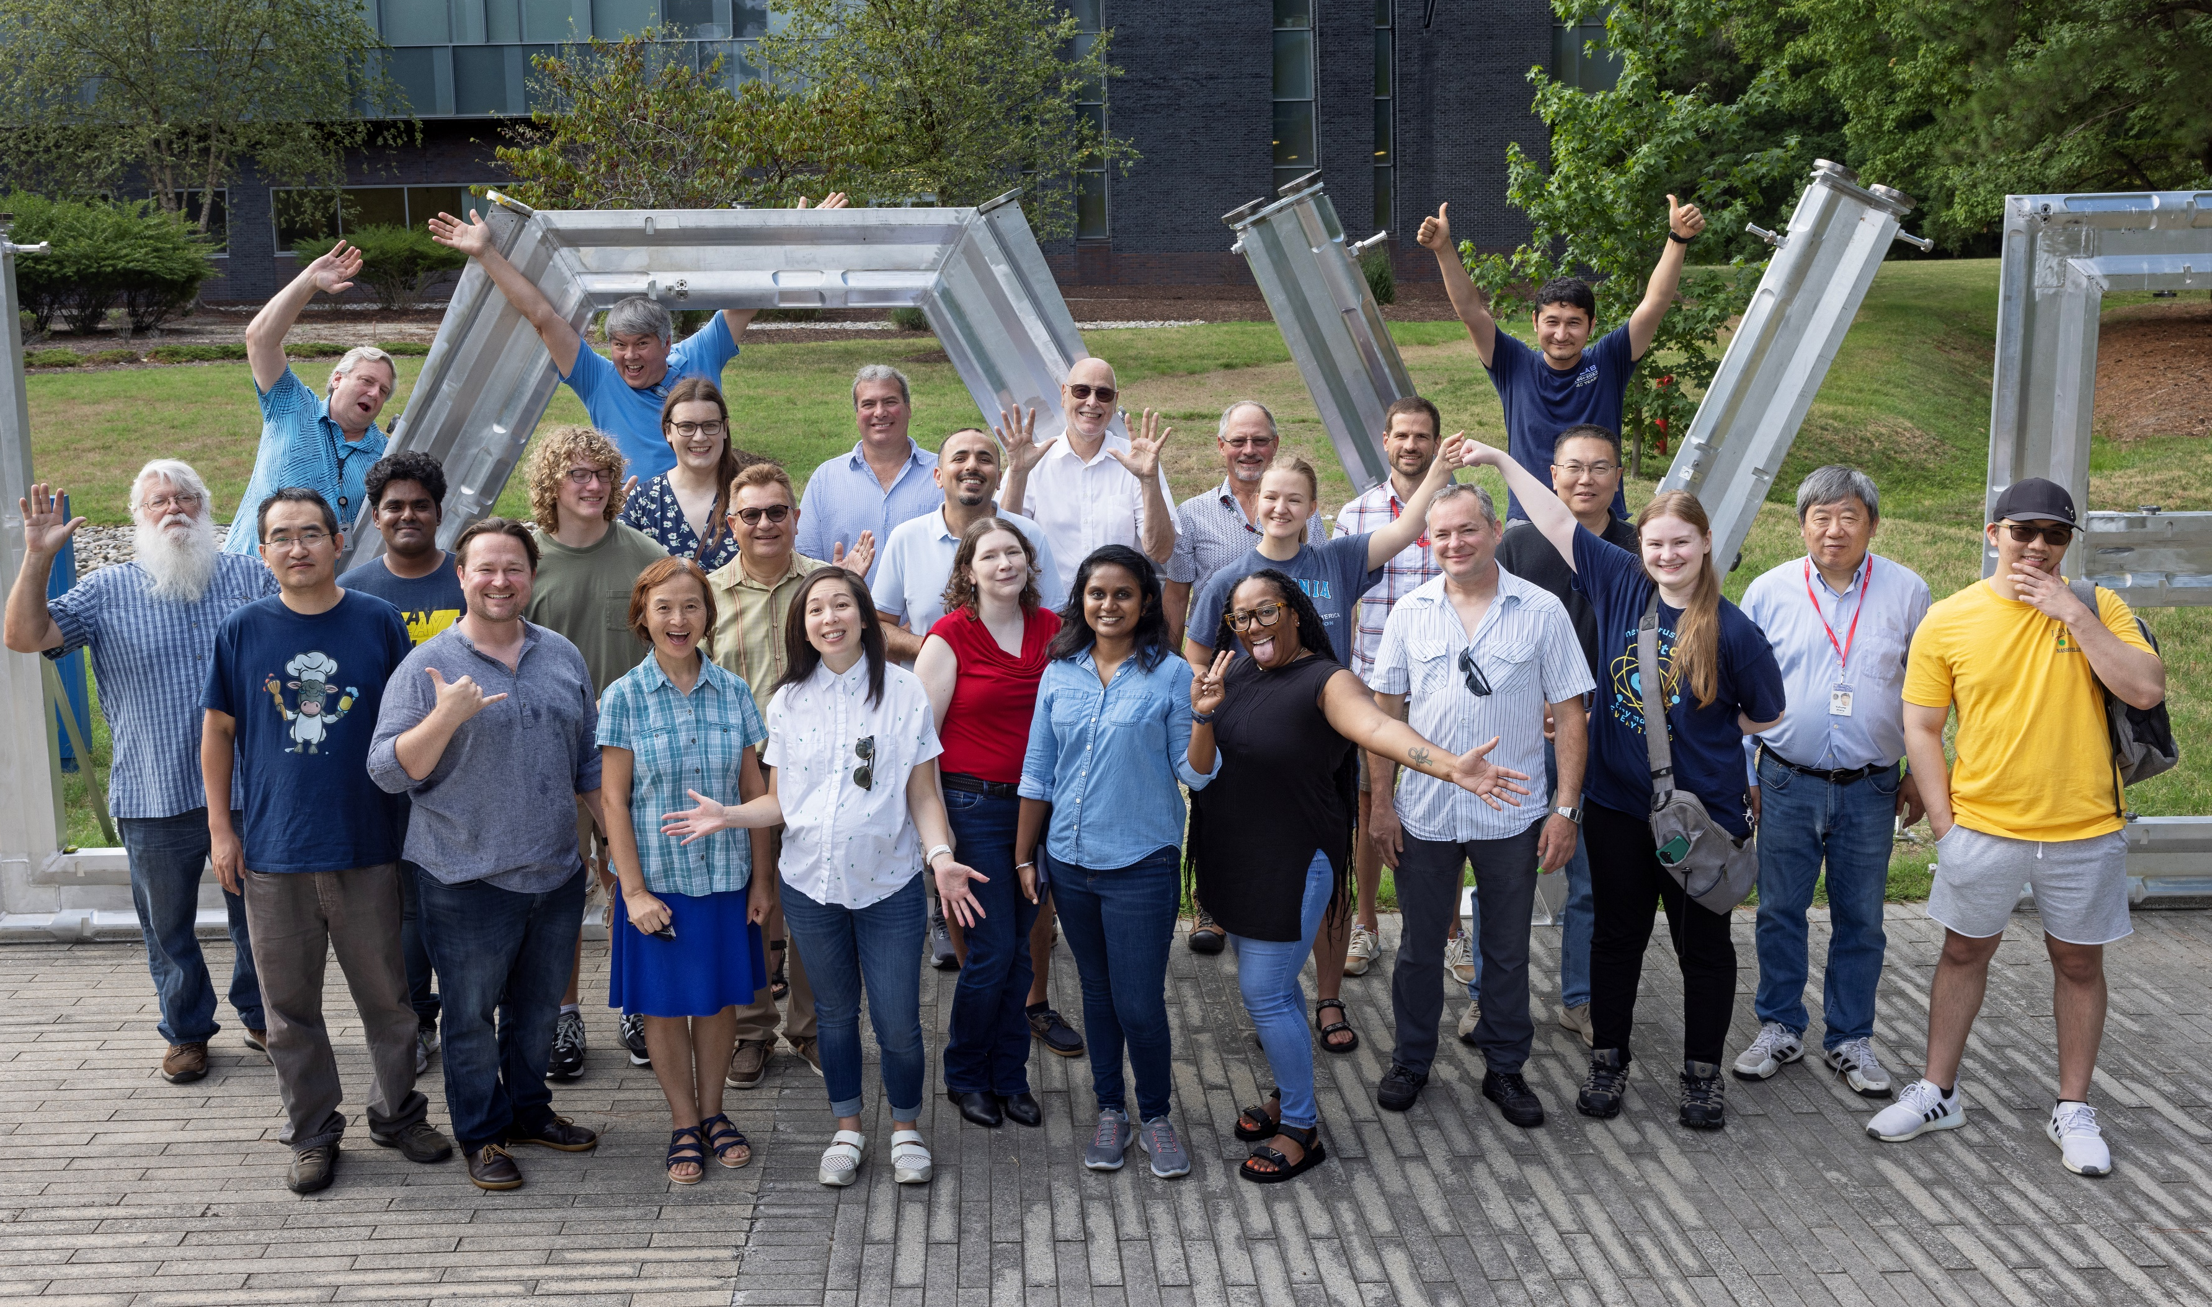
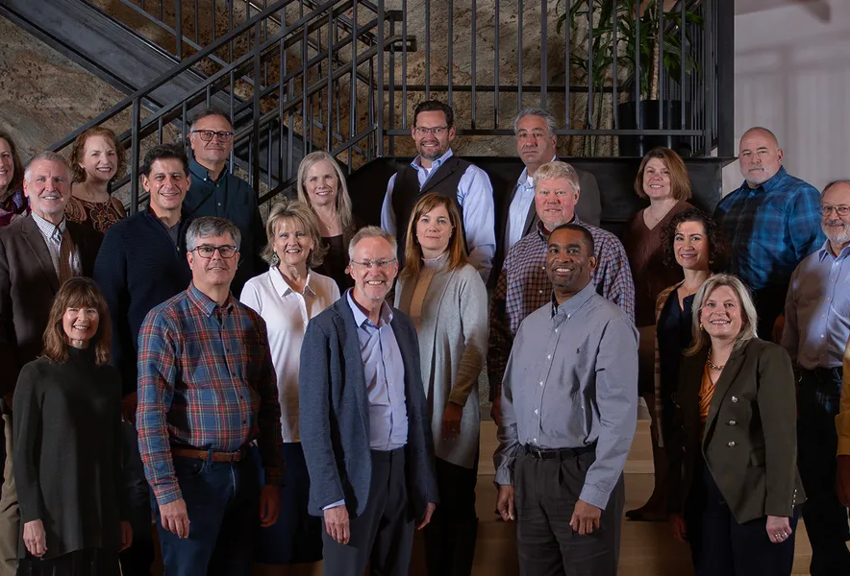
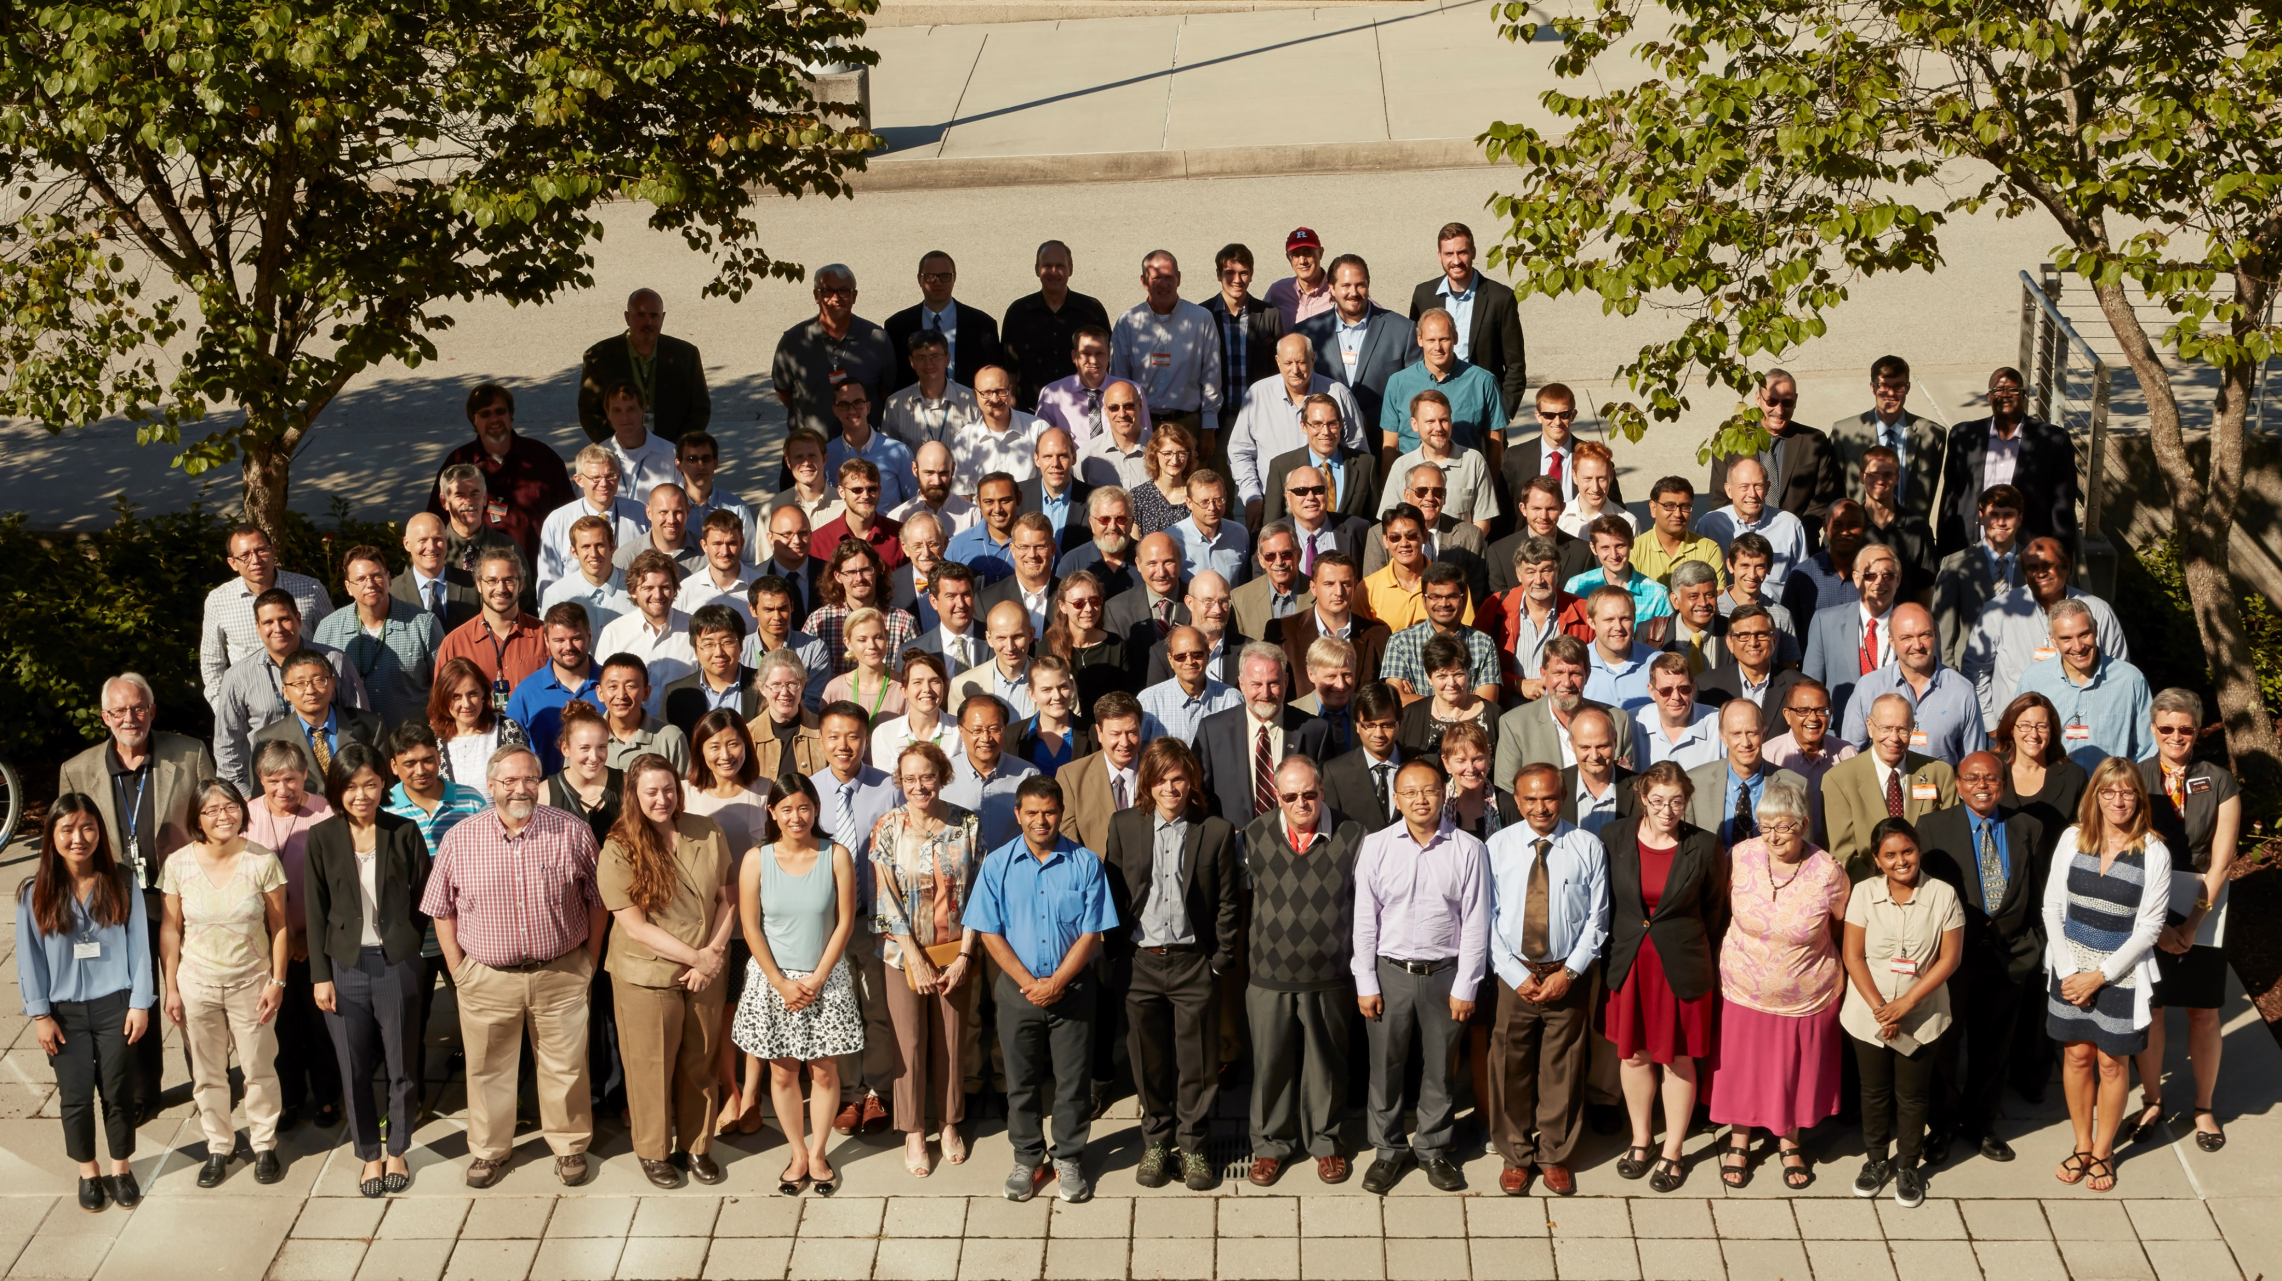
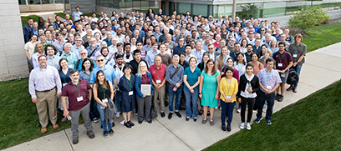
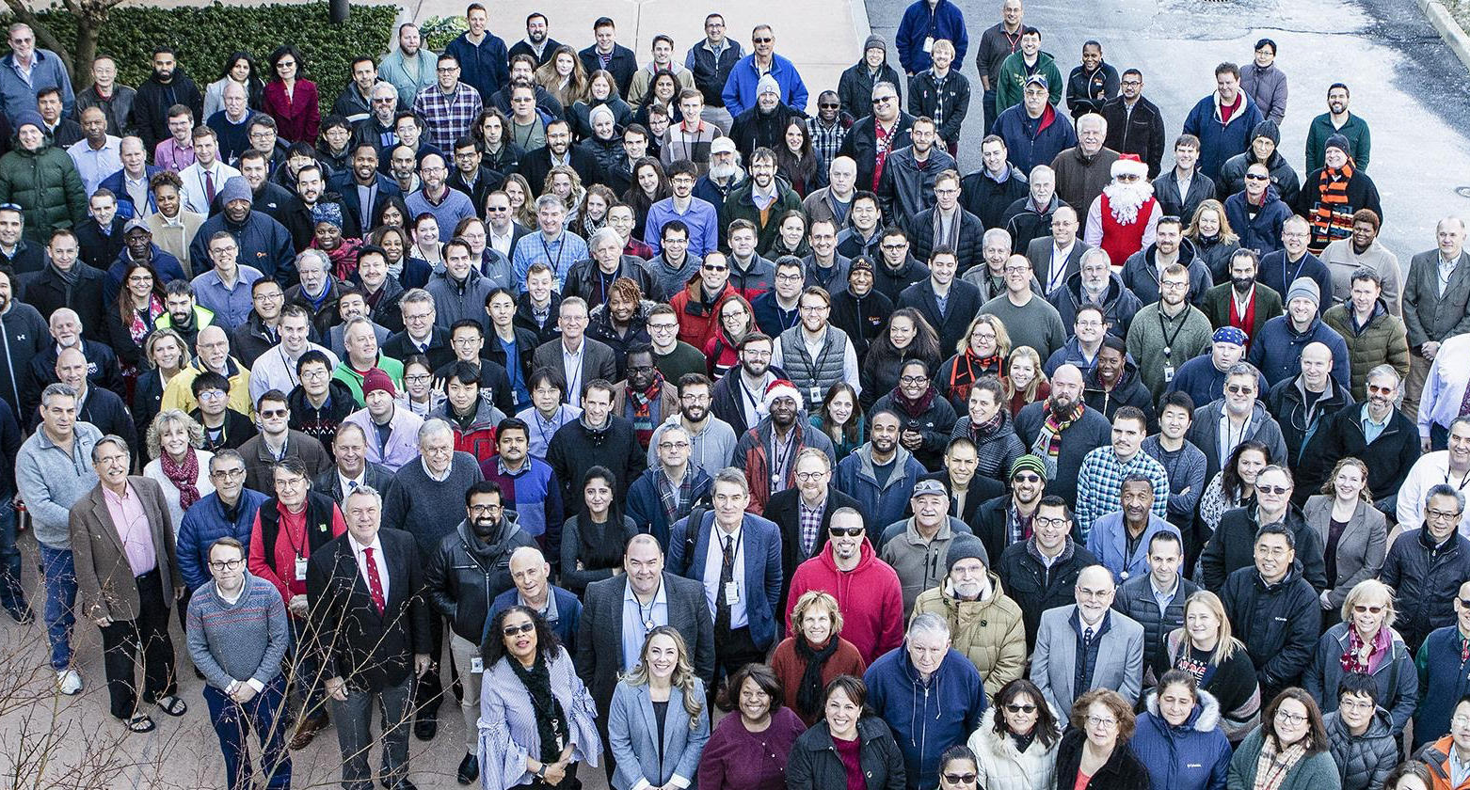
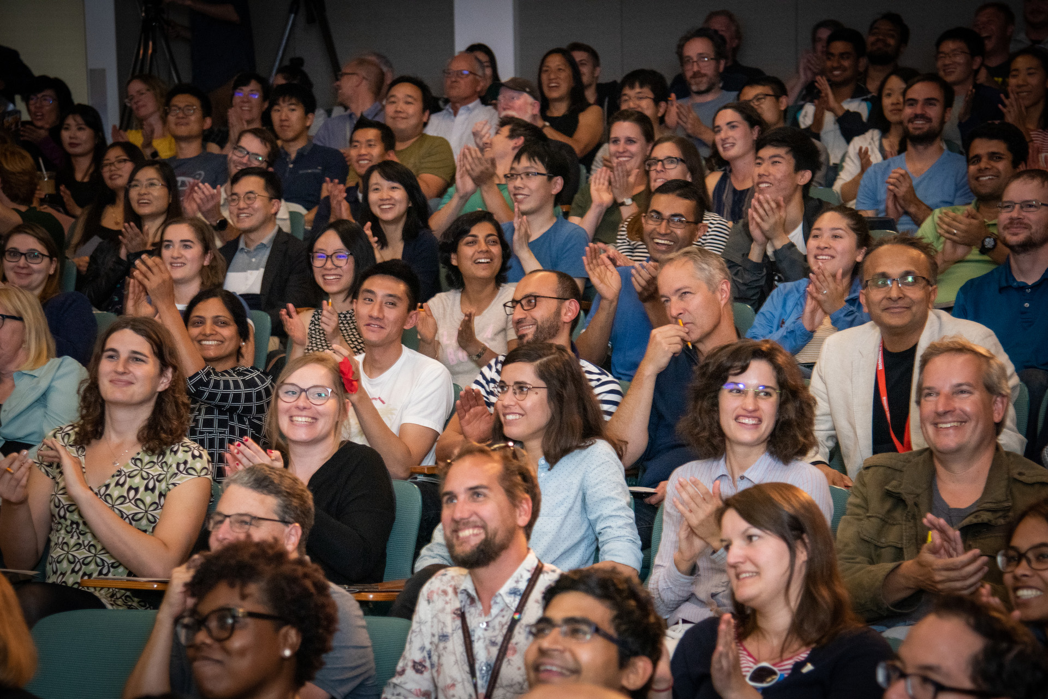
Best Practices
Recruitment best practices:
Hire from large pool +navy/military
Connect to universities and community colleges
Hire for potential + train
Support clear career path
Use fellowship and recognition awards
Retention best practices:
Rotate staff + encourage multi-disciplinary teams
Vision and community
Stability and advancement
Skill development opportunities
Intensify R&D opportunities

Slide 16
Next Steps
The roundtable will continue as an ongoing Integrated Planning Group
A top priority is to develop a sustainable organizational structure and mechanism that will enable and strengthen the sharing of resources and tools between the Labs
Goals for the next year:
  Strengthen ties between university programs and National Laboratories/User Facilities to develop an accelerator workforce that is well-matched to laboratory hiring needs
  Understand and help industry develop and retain capabilities for accelerator components
  Predict the workforce demands of industry that has implications for laboratory workforce and university programs
  Regular updates of census
→ Intent is to continue this effort and expand to a wider accelerator ecosystem

