Slide 1

Report from the
Open Symposium
European Strategy for Particle Physics
2026 Update
Mike Tuts
DPF
July 31, 2025

Slide 2
Background & Context
The European Strategy for Particle Physics (ESPP) is the equivalent of our US P5 process as input to the long-term future of the field starting in 2006
  2006: LHC, discussion of LHC luminosity upgrade, accelerator technology R&D, coordination with ILC
  2013 update: High luminosity LHC, need for post-LHC program
  2020 update: FCC feasibility study
  2026 update: Recommendations for the next flagship project at CERN (preferred collider option and possible prioritized alternatives and areas of priority for exploration complementary to colliders) – the Venice meeting was the equivalent of our Snowmass process to provide community input
Mandated by the CERN Council, the European Strategy Group (ESG) develops recommendations submitted to the Council for an update of the European Strategy with:
  Input of the particle physics community
  Status of implementation of the 2020 Strategy update
  Recent accomplishments (e.g. LHC results, HL-LHC progress, FCC Feasibility Study,…)
  International landscape of the field

Slide 3
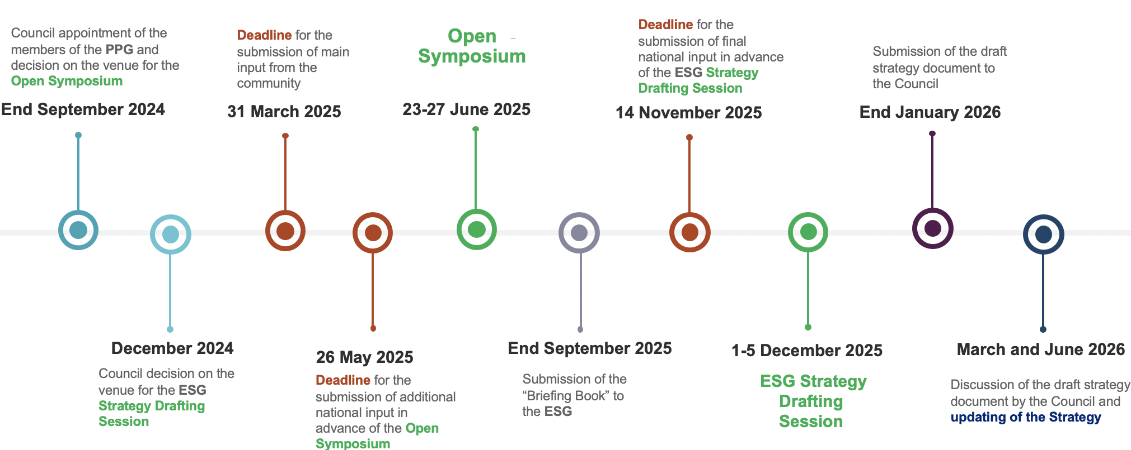
Timeline for 2026 Strategy Update
Venice

Slide 4
The Process
On February 27, 2025 Hugh Montgomery gave a detailed presentation on the process, so I will simply refer to his presentation(and some backup slides) (https://indico.global/event/13796/contributions/121227/attachments/56429/108450/Montgomery%20dpf_2025.02.27.pdf)
In summary the European Strategy Group (ESG) has the following components
  Strategy Secretariat (Karl Jakobs, chair + chairs of SPC, LDG, ECFA) – Organizes and runs the ESPP process
  The Physics Preparatory Group (PPG) – Collects input from the community, organizes the Open Symposium, prepares the briefing book as input for the ESG
    Has on US representative (Anadi Canepa)
    Has 9 working groups covering physics topics, technology areas of accelerators, detector technologies and computing
    For each physics area they provide a comparative assessment of the physics potential for proposed projects at the working group level
  European Strategy Group (ESG) – Prepares the Strategy Document for Council
    Has one US representative (MT)
    Has 8 working groups (WG): WG1 national input (incl Anadi Canepa); WG2 project comparison (includes MT); WG3 implementation of strategy; WG4 relations with other fields of physics; WG5 sustainability and environmental impact; WG6 public engagement, education, communication; social and career aspects for next generation; knowledge and technology transfer
  ECFA questions for national input – see slide on WG1 for the questions and responses

Slide 5
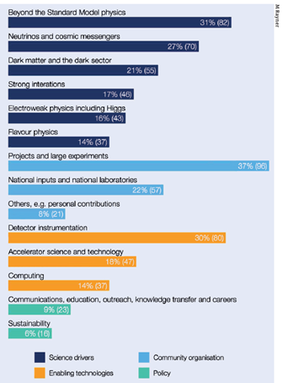
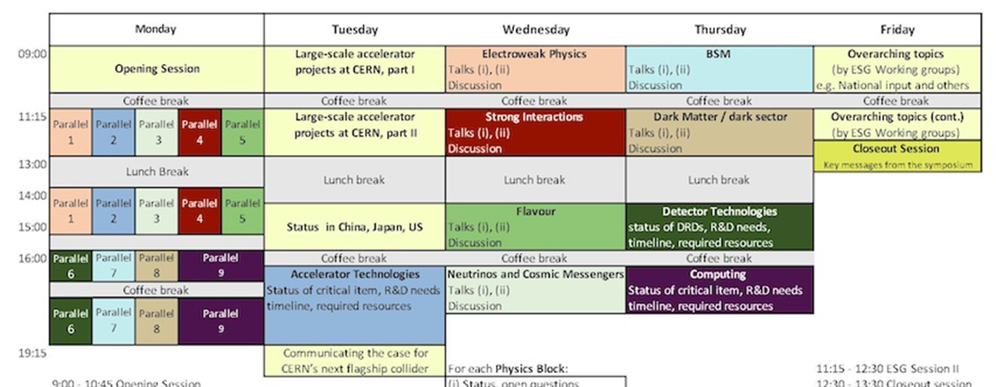

Venice Symposium (June 23-27, 2025)
Arranged by PPG to provide input for their deliberations, leading to the Briefing Book which forms the input for the ESG
  263 contributions received by 3/31/25 deadline (+3 new and updates by 5/26/25) https://indico.cern.ch/event/1439855/contributions/
  71 Parallel talks on first day + 52 plenary talks over all days
3
3
3
3
5
3
4
3
4
5
4
3
3
3
1
2
3
2
2
4
3
3
3
4
4
3
8
4
3
5
6
3
6
3
50 contribution line
2

Slide 6
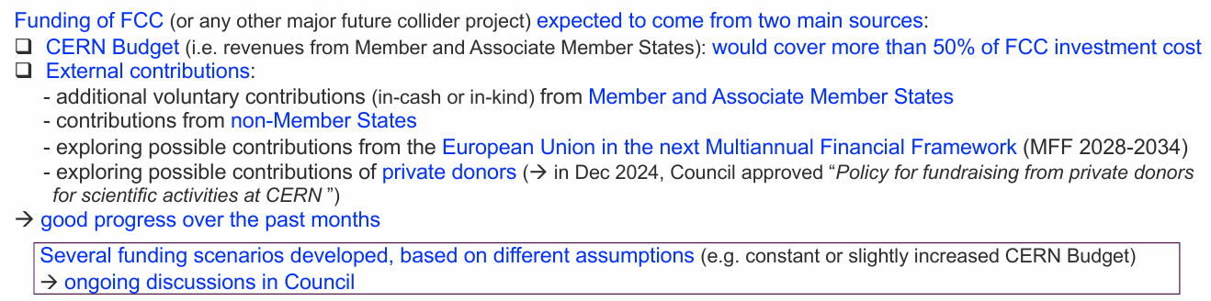
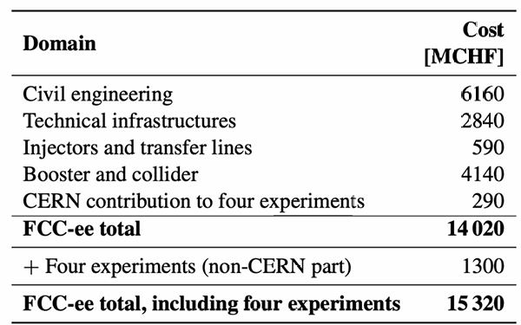
Opening Plenary
Day 1
Implementation of the 2020 update of the European Strategy (Fabiola Gianotti)
  “Europe, together with its international partners, should investigate the technical and financial feasibility of a future hadron collider at CERN with a centre-of-mass energy of at least 100 TeV and with an electron-positron Higgs and electroweak factory as a possible first stage” => FCC Feasibility Study delivered March 2025 (~1200 pages)
  Many aspects presented in talk: accelerator R&D plan; other complementary
  experiments; theory support; detector R&D; computing; synergies; global projects
The successful completion of the high-luminosity upgrade of the machine and detectors should remain the focal point of European particle physics, together with continued innovation in experimental techniques.

Slide 7
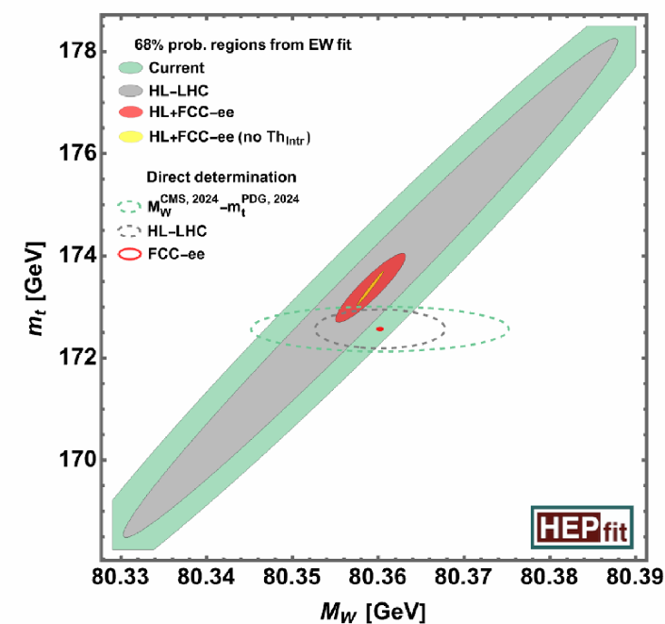
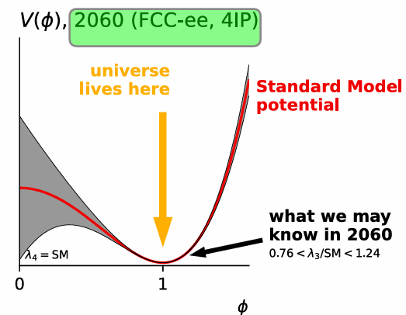
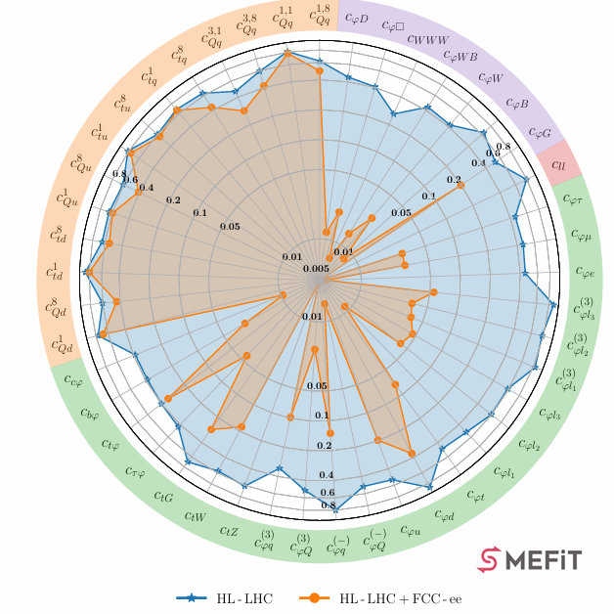
Opening Plenary - Physics
Day 1
Outstanding questions in particle physics (Eric Laenen)
  “There are outstanding ideas in all areas of particle physics! “
  “To explore these and gather knowledge we need a broad diverse programme”
  “Need input from HL-LHC, a new flagship collider, a wide variety of other experiments, and neighbouring fields.”
  “From theory we need many ideas and methods to explore new regimes. “
  “A bright future is possible. Let us realize it!”
“The great increase in precision from upcoming measurements must be matched by theory:
• Need percent-level accuracy for HL-LHC predictions. For some FCC/LC/etc predictions need per-mille level. In recent years enormous progress, due to new inventions, computing power.
• Numerical, and computer algebra (Mathematica, FORM,..) Mathematics has been a source of outstanding ideas”
“closure” test of SM
Higgs potential
New Physics sensitivity via EFT
Theoretical precision

Slide 8
Plenary sessions
It is impossible to summarize 52 Plenary talks, so
  Click links (the underlined words) to go to the actual Venice presentations
  A brief summary based on the conclusion slides for the talks, note these are in the words of the proponents – the PPG and ESG job is to evaluate and compare the proposed projects on an equal footing and a lot of that work begins in earnest now after the Venice symposium input
In that spirit follows a whirlwind tour, skipping a lot, which can be found in backup by clicking the links below or on the following slides
  Communicating the case for CERN’s flagship – across the spectrum of society
  Computing – challenging but achievable with common projects and R&D support
  Accelerator Technologies – R&D progress, challenges to high luminosity

Slide 9
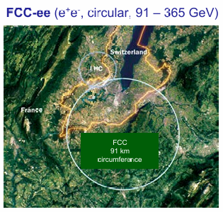
Large Scale Accelerator Projects at CERN
Day 2
FCC-ee (Michael Benedikt)
  Feasibility study report delivered to ESPP;
  Coherent baseline design for FCC integrated program developed with well-advanced territorial implementation scenario, inline with desired CE construction start by 2032/33;
  FCC-ee design level enables moving towards technical design and prototyping phase, well aligned with overall schedule towards preparing input for potential project decision by 2028.
FCC-hh (Frank Zimmerman)
  FCC-hh as FCC’s 2nd stage, possibly based on HTS, could start operation in ~2074; it will be a formidable machine, SR leveling etc.
  FCC-hh based on 14T Nb3Sn magnets could start operation in ~2055, centre-of-mass energy ~85 TeV, as a standalone project
  Higher magnet temperature 4.5K, or even 10K (HTS), reduces the electrical power required; important for societal acceptance
  Worldwide HTS conductor development driven by other fields & applications is expected to lower the cost of future HTS magnets

Slide 10
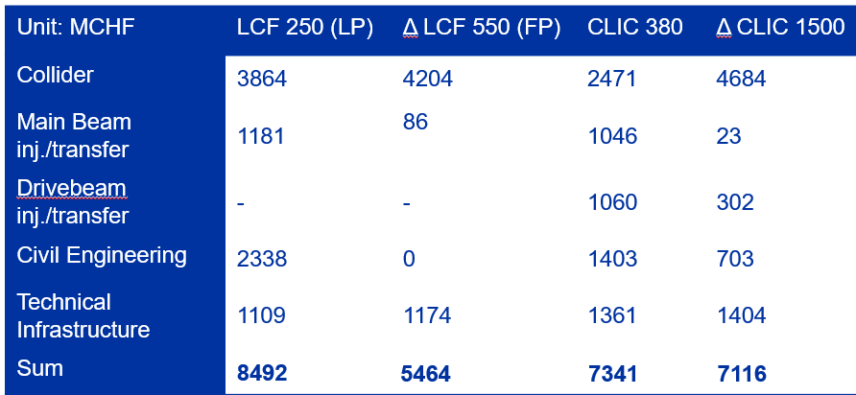
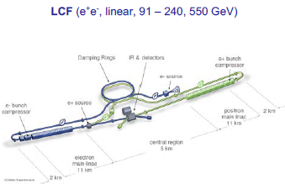
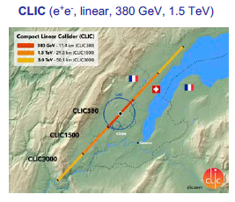
Large Scale Accelerator Projects at CERN
Day 2
A linear Collider at CERN (Steiner Stapnes)
  A Linear Collider at CERN has a very attractive and broad physics programme and is a very flexible facility
  A Linear Collider as a staged project can be implemented at 7-9 BCHF for the first stage
  Upgrading to - at least - 550 GeV is possible, to be implemented taking into account physics and resources as the programme and field evolve
  A ~3 year programme is suggested to establish a LC baseline, building on and extending existing international collaborative R&D
  An LC can be completed in parallel with the HL LHC programme (to the extent resources allow)
  There are many opportunities for international support (technology and capabilities) in the preparation phases and during a potential construction

Slide 11
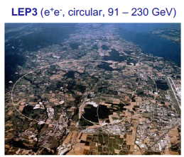
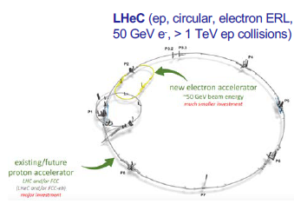
Large Scale Accelerator Projects at CERN
Day 2
LEP3 (Jim Virdee) – an intermediate step to a flagship project
  If FCC is deemed to be not feasible financially, then the intermediate solution en-route to the next collider that will probe √ ŝ ~10 TeV must be significantly less costly than the FCC-ee – LEP3 cost ~3.8B
  LEP3 reasonable backup solution: Compared to the linear e+e− colliders proposed, LEP3 provides similar luminosity for ZH production, higher luminosity at lower energies and options for multiple experiments, all at a much lower cost
  Leaves room (time, budget, resources) for further development of THE machine that can probe directly the energy frontier at a √ŝ ~ 10 times LHC
  A real strategy for Europe, when resorting to such a plan “B” MUST include a long-term plan beyond LEP3, as well
LHeC (Jorgen D’Hondt) – an intermediate step to a flagship project
  A high-energy, high-luminosity electron-proton collider at the LHC is an impactful alternative collider with excellent results in the Higgs, EW, top quark and QCD sectors on an interesting timeline
  LHeC boosts the scientific return of the LHC, and is essential for any future high energy hadron-collider program
  To achieve the best physics for the least power, the Energy Recovery Linac technology is to be further developed to enable such an electron-proton collider.

Slide 12
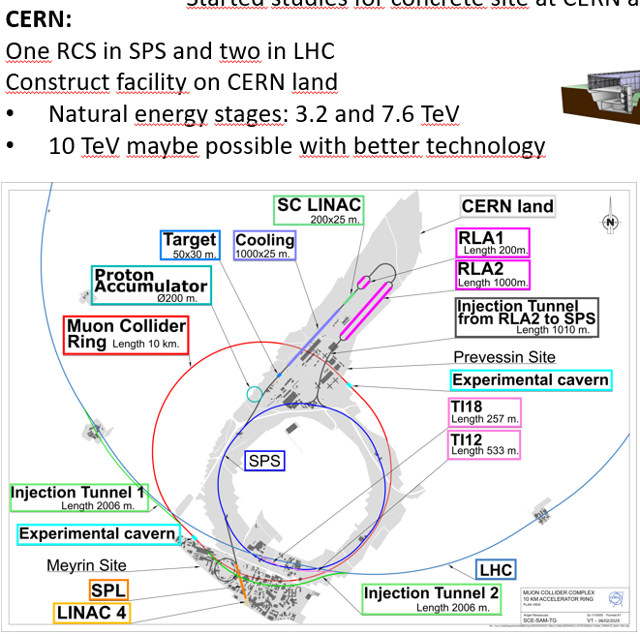
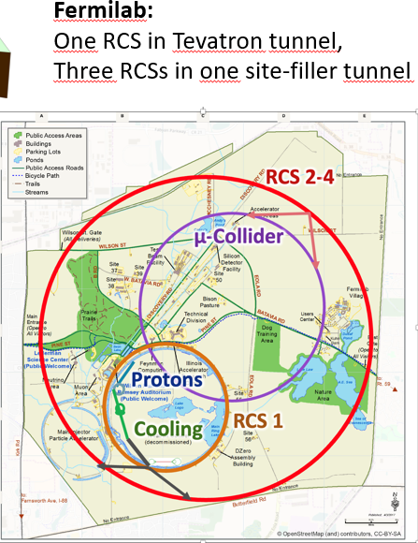
Large Scale Accelerator Projects at CERN
Day 2
Muon Collider (Daniel Schulte)
  Excellent technical progress has been made, in spite of resource limitations
    Supported by review committees from LDG, MuCol, and International Advisory Committee reviews
  IAC review (last week):
    During its current IMCC review, the IAC was highly impressed by the significant progress and the marked improvement in the robustness and quality of the studies. The muon collider presents an extraordinary technical opportunity, and encouragingly, all major technical challenges are being actively tackled. In particular, launching and supporting a cooling demonstrator and test stands as soon as possible will be crucial to sustaining this strong momentum.
  Now need the support of the ESPPU and others for this global R&D programme
Linear Collider Vision: future perspectives with advanced technologies (Jenny List)
  We need a new e+e- collider to study the Higgs - now
  a Linear Collider has decisive advantages:
    particle physics: polarisation & high-energy reach
    strategically: well-understood technology and staged approach allow fast start; flexible and responsive to future physics developments
    technologically: flexible upgrades with advanced accelerator technologies
    for the next-to-next step: support R&D towards 10-TeV pCM scale

Slide 13
International Status - China
Day 2
Status and plans for the realization of the Circular Electron Positron (CEPC) and other large-scale projects in China (Yifang Wang)
  CEPC addresses most pressing & critical science problems in particle physics，provides early Higgs(W,Z) factories to the world HEP community
  Accelerator design and technology R&D are reaching maturity, TDR completed, ready for construction in ~2 years
  Reference detector TDR is under preparation now, to be completed by mid of this year for the proposal of the 15th 5-year plan
  Call for collaborations and proposals once CEPC is (preliminary) approved (~CD0)
  We will work with the community to maximize the internationalization of CEPC, and support other projects worldwide

Slide 14
International Status - Japan
Day 2
Status and plans for the realization of the International Linear Collider (ILC) and other large-scale projects in Japan (Shoji Asai)
  We have Diversity in Science Program / Application: SuperKEKB/Belle II recorded the highest Luminosity; J-PARC for neutrino achieves 900kW. Construction of Hyper-K & power UG are on going; we aim to start at 2028 (budget / schedule); MLF 1MW achieved; Quantum is also important field
  KEK/IDT/ILC-JAPAN collaborate tightly to make leading efforts to realize the ILC as global project
  ILC Technology Network (ITN) is on-going / OPEN discussion for global collaboration
  The following issues to be considered for the overall timescale of ILC
    ITN work packages are for two to four years
    Given ITN, the preparatory phase could be less than what was considered for the Pre-lab proposal, i.e. four years, for the accelerator and site related work
    MEXT funding programme for the accelerator R&D is planned for five years
    For entering the preparatory phase, concerned government authorities, not only Japanese but also the European and the US, must become ready to discuss the ILC specific matter
    P5 discussion in the US and FCC feasibility studies at CERN will have an impact

Slide 15
International Status - US
Day 2
Large-scale particle physics projects in the US and plans for participation in projects outside (Hitoshi Murayama)
    The P5 recommendations
    Developments since P5: Higgs Factory Coordination Consortium (HFCC); US Muon Collider Collaboration; 10TeV Wakefiled Collider Design Study; DUNE
    US input to ESG white papers (the DPF created a repository for those)
  #230 US National Input to the European Strategy Update for particle physics (Executive Committee, DPF) #202 U.S. Higgs Factory Coordination Consortium input to ESG on CERN's future collider options (HFCC) – presentation today (2:35pm EDT) “Status of Higgs Factory Studies” (Tor Raubenheimer)
  #152 United States (US) Muon Collider Community White Paper for the European Strategy for Particle Physics Update – presentation today (3:15pm EDT) “Status of Muon Collider Studies” (Tova Holmes)
  #118, #119, #120, #121 DUNE Physics/Phase II Detectors/European Contributions/Software&Computing
  #98 Design Initiative for a 10 TeV pCM Wakefield Collider - presentation today (3:55pm EDT) “Status of 10 TeV Wakefield Collider Studies” (Spencer Gessner)
  #91 United States Early Career Researchers in Collider Physics input to the European Strategy for Particle Physics Update (Oz Amran, Grace Cummings)
  Elementary particle Physics: The Higgs and Beyond (National Academy Report) - presentation today (11:35 pm EDT) “The National Academies Report” (Maria Spiropulu)

Slide 16
Accelerator Technologies
Day 2
Challenges towards high luminosity for proposed colliders (Gianluigi Arduini)
  FCC-ee, CLIC, LCF propose designs for e+/e- colliders with similar level of complexity, challenges, readiness. LEP3 at pre-conceptual design level. All the proposals have challenging targets
  Circular colliders offer the possibility to serve more experiments and more flexibility for the operation at different energies at high luminosity. Beam-beam and intensity (e.g. electron cloud) effects are challenging but there is extensive experience
  SuperKEKB, and potentially DAFNE, provide vital experience for FCC-ee/LEP3 in further understanding and addressing potential limitations and devising solutions
  Linear colliders can operate at higher energies, still limited at the ~TeV energy. Rely on sophisticate feedbacks/feedforwards as demonstrated by SLC experience. Positron production is challenging (particularly for LCF). They deliver polarized beams (at least e-)
  ATF is a test bed for addressing challenges related to nanobeams (IP size and IP position stabilization, reproducibility) for single beam, scaling to LC for impedance effects non-trivial
  Next generation high energy hadron colliders challenges are mostly technological and related to HFM, cryogenics, vacuum
  Muon colliders could be an option for achieving high energy lepton collisions but are not at the level of maturity of the other proposals at present
  Particularly critical is the demonstration of the 6D cooling. A variety of technological challenges are associated with the various acceleration steps. Start-to-end simulation tools need to be further developed to validate the overall performance of MCs. Neutrino flux mitigation remains a critical issue, particularly with regard to its impact on potential host sites and public acceptance

Slide 17
Physics Plenaries
Once again, in the interests of time, it is impossible to even show one slide for each physics area session (usually with two speakers, experimentalist and theorist) so I included
  BSM
  Dark sector
…and unfortunately left the following to the backup, just click below to go to those backup slides (even so they are one slide summaries)
  Electroweak – data sizes and timescales; complementarity precision & high energy results
  Strong interactions – strong coupling, hot and dense QCD
  Flavor Physics – flavor puzzles, BSM sensitivity
  Neutrinos and Cosmic messengers – exploring neutrino sector and complementary ways to probe particle physics at high energies and small couplings

Slide 18
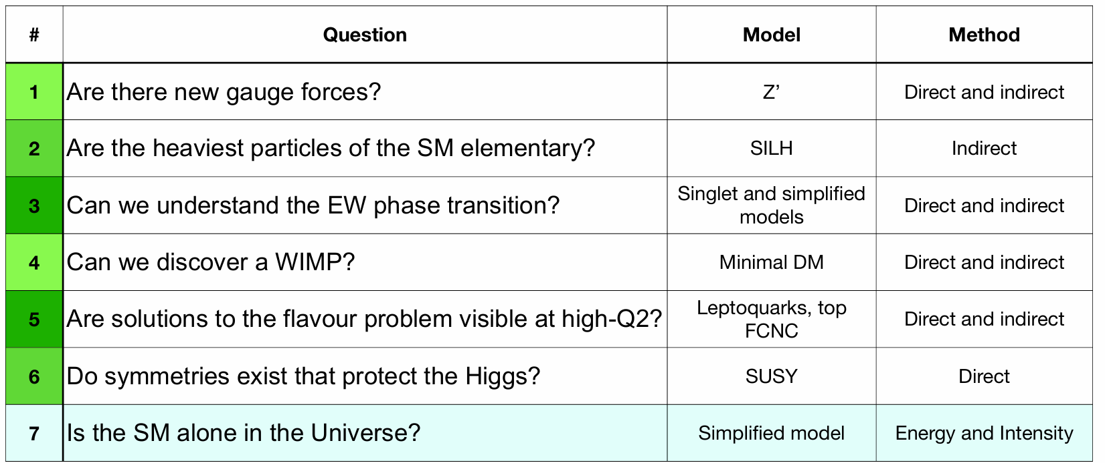
BSM
Day 4
BSM Physics
  Status and open questions in physics beyond the standard model (Fabio Maltoni)
    We do not have a clear indication or rock-solid theoretical argument on where new physics lies, necessary to address open fundamental issues
    A future collider programme is needed that can fully leverage on precision and energy, covering the widest range of observables at different scales, (below, at and above the weak scale), and that can significantly sharpen our knowledge of SM phenomena
  Experimental programs to address open issues in BSM physics (Rebeca Gonzalez Suarez)
    Topics: New Gauge forces; Compositeness; Extension of the minimal real scalar sector giving 1st order EW phase transition and possibly stability; Minimal dark matter (WIMP) global; Flavor; Symmetries as a solution of the Higgs naturalness problem; SUSY and other models (such as neutral naturalness); Portals
    Very rich landscape of BSM possibilities at future colliders
    Interplay between: Ultimate indirect sensitivity from extremely high precision measurements in the EWK sector; Direct access to new physics in a wide range of masses and coupling scales

Slide 19
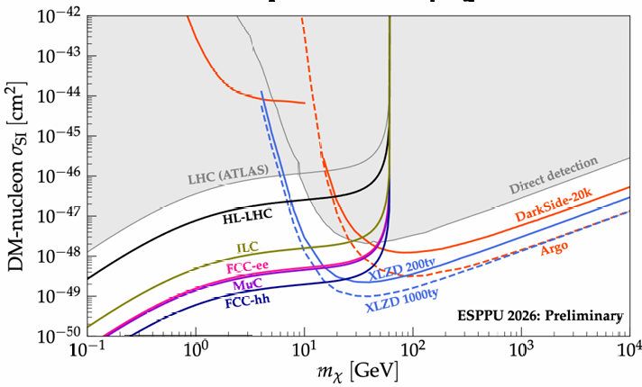
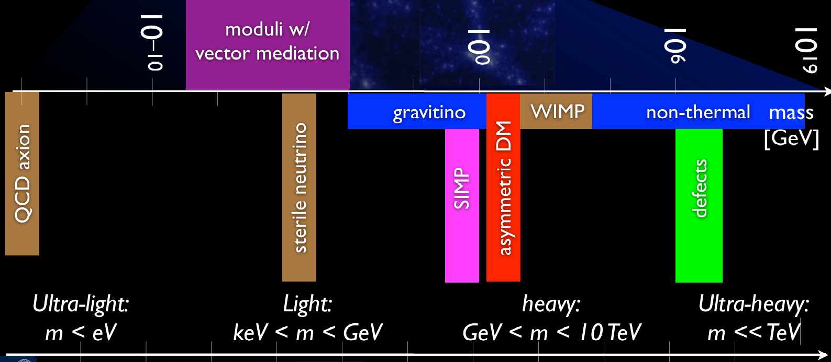
Dark Sector
Day 4
Dark Matter/ Dark Sector
  Status and Open Questions in Dark Matter and DM Sectors (Matthew McCullough)
    Theoretical perspectives motivated by portals: Higgs; Dark Photon; ALP; Neutrino
    Need to hedge, through breadth of programme, for future evolution of pheno landscape
    It’s not that we don’t know where to look. It’s that we do know there are many places we should look
Higgs portal – Majorana DM
  Experimental programmes to address open issues in Dark Matter and Dark Sector Physics (Jocelyn Monroe)
    Covered: cosmological & indirect detection; direct detection; accelerator production
    New technologies and ideas deployed in experiments across all scales — strong incubator for creativity in experimental approaches, new analysis strategies, and technology innovation
    Important progress has been, and will continue to be, made by relatively small/rapid projects. This is great for training and skills development
    Dark Matter and Dark Sectors have important complementarity across a (uniquely) broad range of non-accelerator and accelerator-based experimental techniques - Strong support in ESPP inputs for diversity of experiments/ techniques

Slide 20
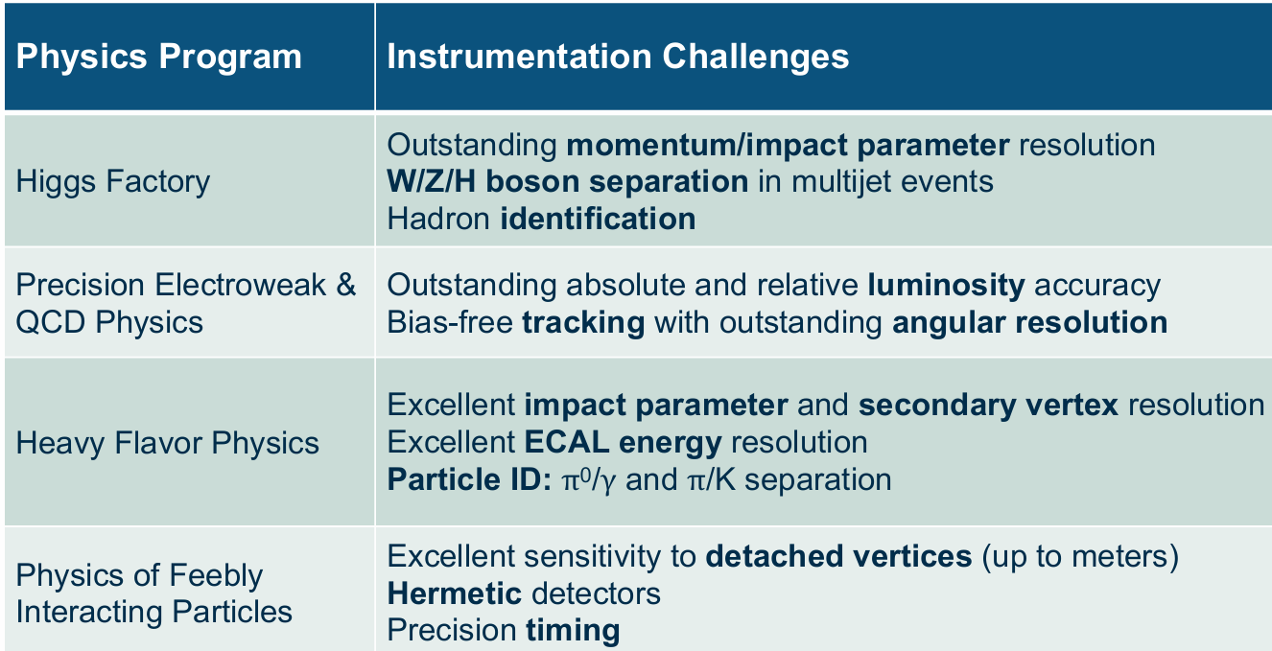
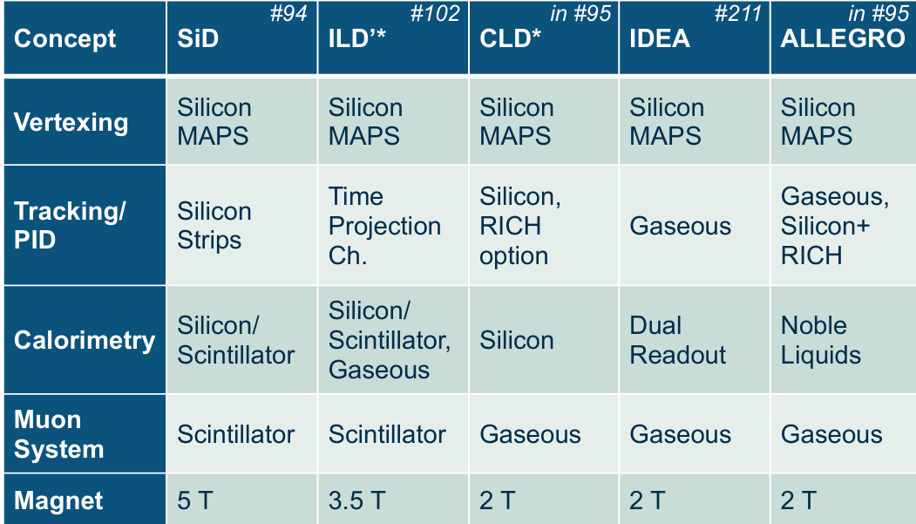
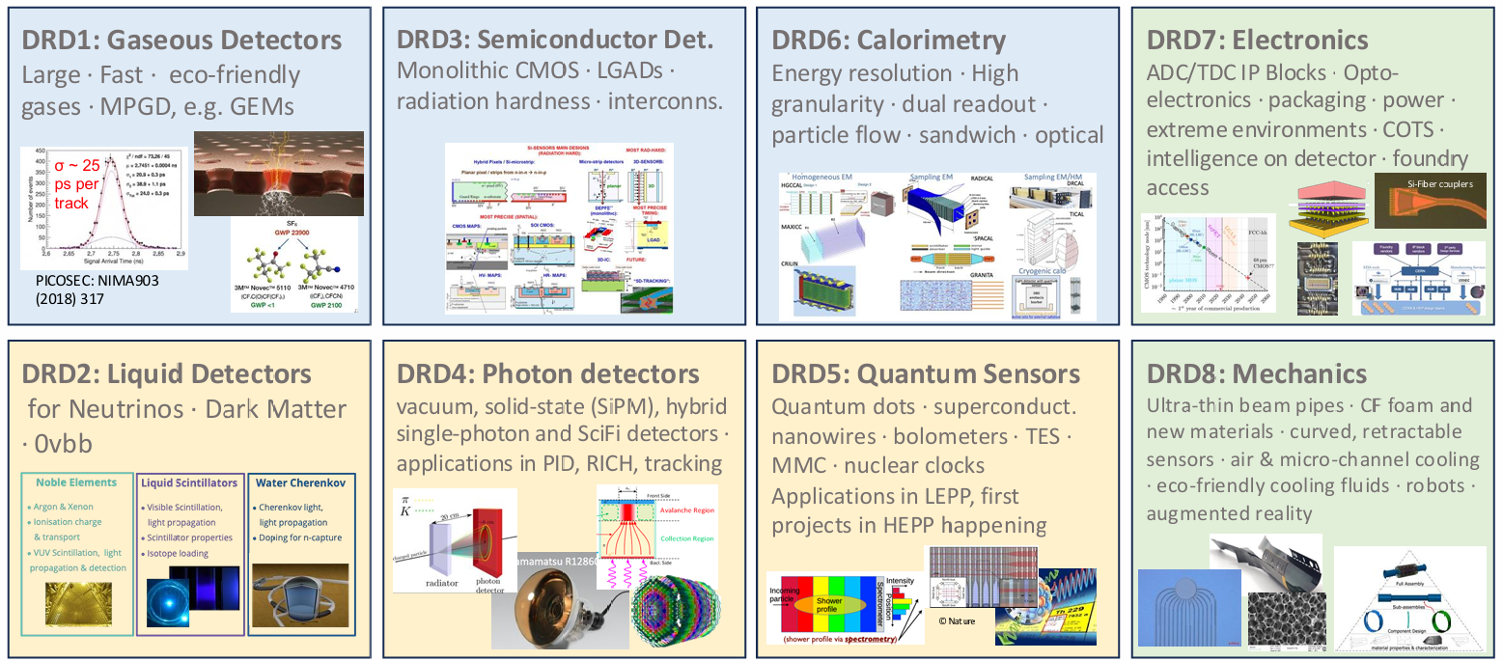
Detector Technology
Day 4
Detector Technologies
  Tools for Discovery: Instrumentation Requirements for Future Projects (Ulrich Husemann)
    Useful metrics to evaluate instrumentation projects in detail: key performance indicators (KPIs) and technology readiness levels (TRLs)
    This presentation is less quantitative: Which future projects drive instrumentation development? Which technologies are required on which timescale? Who will work on instrumentation?
    Significant technological limitations and challenges to overcome for future projects
    New ideas, may turn out as potential game changers (AI, second quantum revolution)
    Community showed willingness and ability for transformation → to be further developed
  From ECFA Detector Roadmap to DRD Collaborations and beyond (Thomas Bergauer)
    DRD collaborations are still in their infancy
    Evolve on a coherent work program over the next years
    Expected to grow once the LHC Phase-II Upgrades are finished
    Engage with funding agencies to secure funding via MoU’s

Slide 21
ESG Working Groups (WG)
In the interests of time I will only show summary slides for the plenary talks for
  WG1 – National inputs
  WG2a – Accelerator project comparisons
The others can be found in the back, or click on the links below to take you to those slides
  WG3 – Role of European National labs and Strategy implementation
  WG4 – Relations with other fields of physics
  WG5 – Sustainability and environmental protection
  WG6 – Communication, outreach and career aspects
  WG7 – Early career researchers (ECR) perspectives; they are the future, eager for a decision
  WG8 – Knowledge and technology transfer

Slide 22
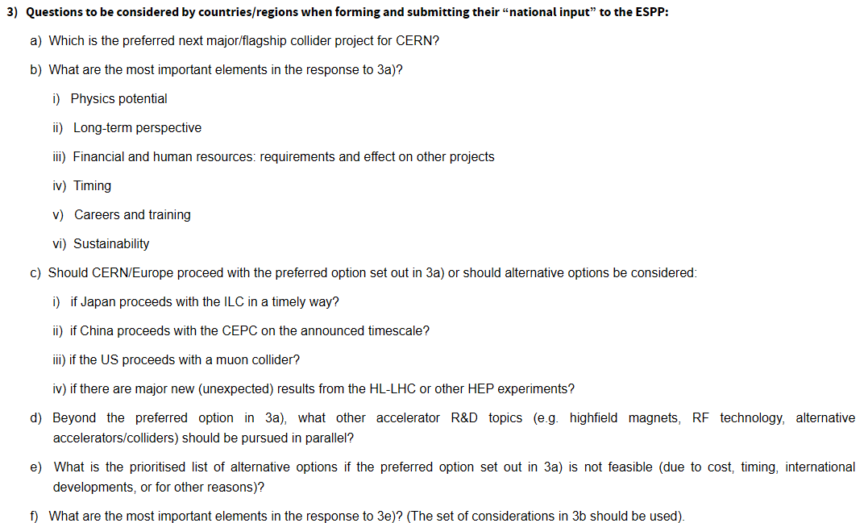
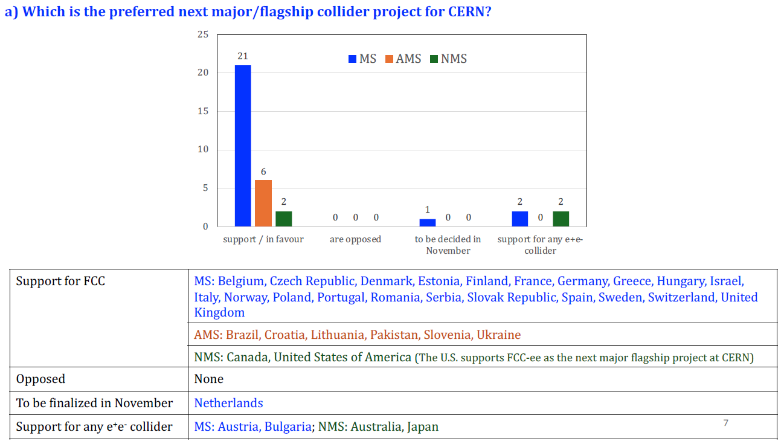
ESG Working Group 1 – (a)
Day 5
National Inputs (Calin Alexa, WG1)
(a) Which is the preferred next major/flagship collider project for CERN?
Click on yellow highlights to go to backup detail slide
Legend
MS = member states
AMS = Associate member states
NMS = Non-member states
US did not provide prioritized list to (e)
US NATIONAL INPUTS to Questions
#230 US National Input to the European Strategy Update for particle physics (Executive Committee, DPF) Click for detail
#202 U.S. Higgs Factory Coordination Consortium input to ESG on CERN's future collider options (HFCC) Click for detail

Slide 23
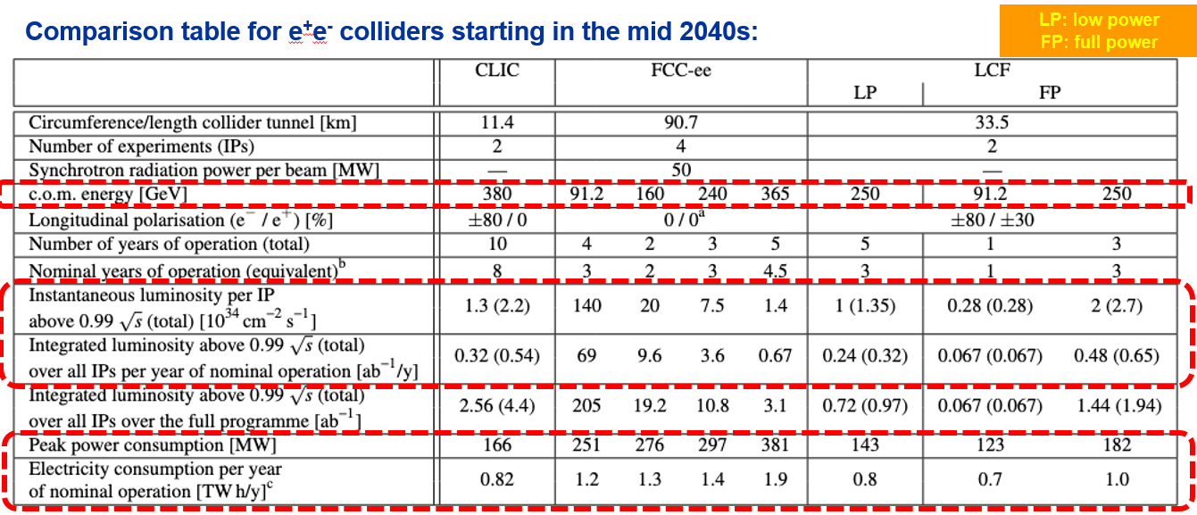
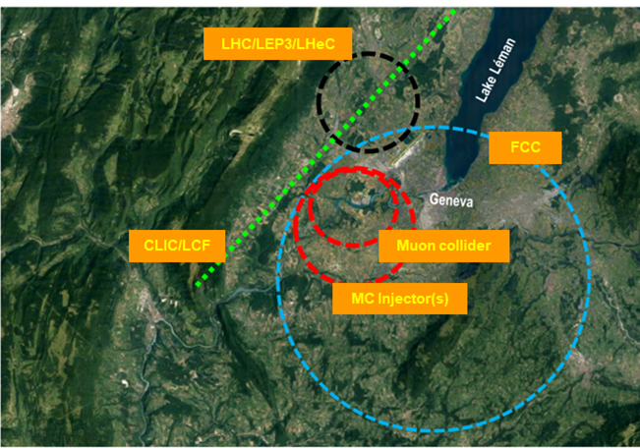
ESG Working Group 2a
Day 5
Project Comparison (first attempt) (Gianluigi Arduini, WG2a)
  Important input from Future Colliders Comparative Evaluation (#281) developed metrics for comparison and made summaries of FCC-ee and alternative options, credible and consistent timelines and first time to physics
    Operation start in mid-2040s: CLICL 380 Gev; FCC-ee; LCF@CERN 250 GeV
    And their evolution outside that timeframe: CLIC energy upgrades; FCC-hh; LCF@CERN energy upgrades
    Muon collider deemed outside the above timeframe
    Also included: proposed resuse of LHC tunnel (LEP3, LHeC); international landscape (CEPC, ILC 250 GeV in Japan)
  Next steps: Need to review cost estimates and associated uncertainties in the report with the help of a panel of experts. Make sure construction costs and their uncertainties, risks, and timelines are assessed in similar fashion across all projects

Slide 24
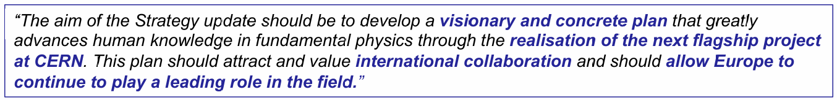
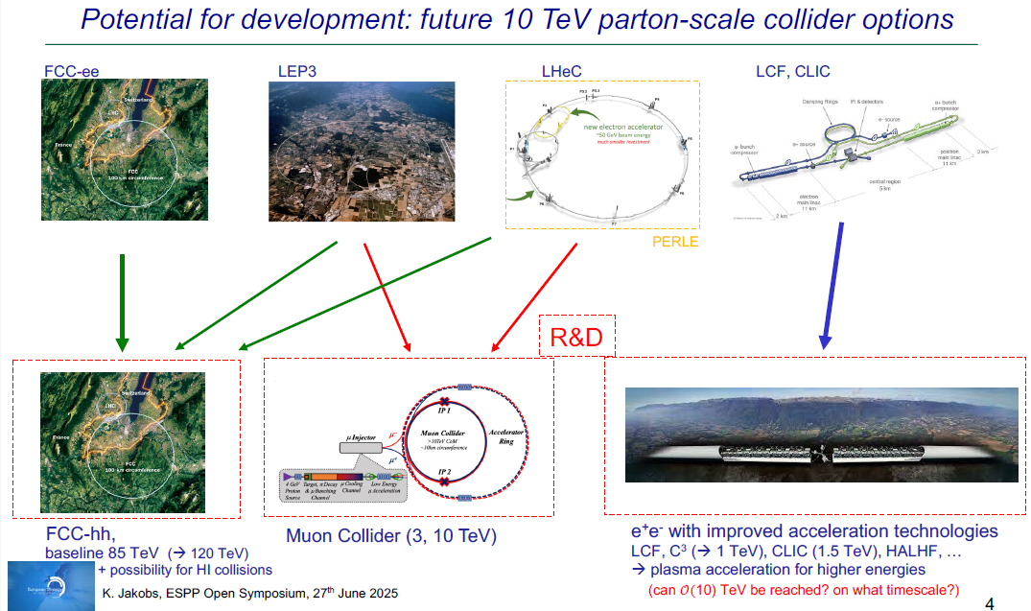
Closeout
Day 5
Closeout by ESG Chair, Karl Jakobs

Slide 25
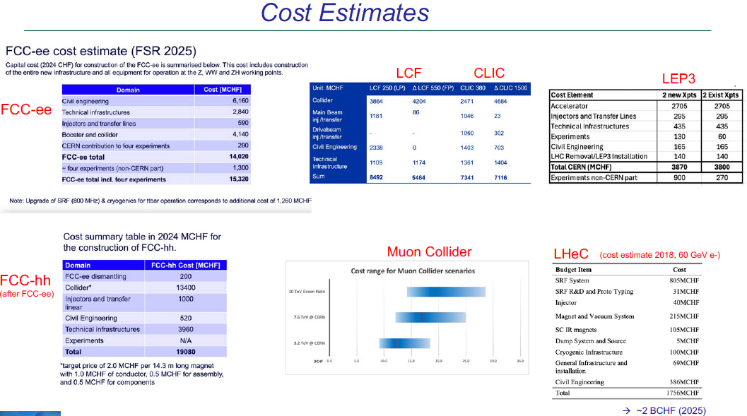
Closeout
Day 5

Slide 26
Closeout – Final Words
Day 5
Over the past years very significant progress has been made towards the realisation of the next flagship project at CERN
  FCC: Successful completion of the Feasibility Study; No technical showstoppers identified
  Overwhelming support for the integrated FCC-ee/hh programme by the HEP communities in the CERN Member and Associate Member states and beyond
  The strong support is largely based on the superb physics potential and the long-term prospects (FCC-ee /hh)
  Discussions on the financial feasibility are ongoing (CERN management and Council)
Discussions on the prioritisation of alternative options are ongoing
  Linear colliders (LCF, CLIC) present, as well, mature options for a Higgs factory at CERN
  LEP3 and LHeC could be considered as “intermediate” collider projects
  The differences in the physics potential (-> Physics Briefing Book), review of the technical readiness and the final input from the national HEP communities (due by 14 Nov.) will be important ingredients in the final recommendations by the European Strategy Group
Keeping a strong complementary physics programme beyond colliders is essential
  The areas of Neutrino Physics, Dark Matter Search experiments, astroparticle (covered by the APPEC Roadmap) and nuclear physics experiments (covered by the NuPPEC Long Run Plan) are also important to complement the future collider programme

Slide 27
Next Steps – from ESG
(i) Physics potential
  The Physics Preparatory Group (PPG) will release the Physics Briefing Book on 30 September. In addition to presenting an assessment of the European particle physics, it will also compare the physics potential of the various flagship proposals.
(ii) Assessment of the proposed flagship projects
  The European Strategy Group (ESG) has set up a working group (ESG WG 2a) to carry out a comparison of the proposed projects. In addition to ESG members, external accelerator experts have been invited to contribute to the review process. The evaluation will focus on the technical readiness, the time and cost estimates as well as on the performance parameters. It will be conducted over the next two months and it is foreseen that the major findings will be released around mid-October.
(iii) Input from the national HEP communities
  As communicated earlier, we offer the possibility for the national HEP communities to give their final input on the preferred option and alternatives for the flagship accelerator project at CERN. With the Physics Briefing Book and the project assessment report the national communities will have the full information available. [Deadline Nov 14 2025]
We very much hope and encourage the national communities to profit from this opportunity and to send final input for consideration in the drafting session in early December.

Slide 28
Backup Material

Slide 29
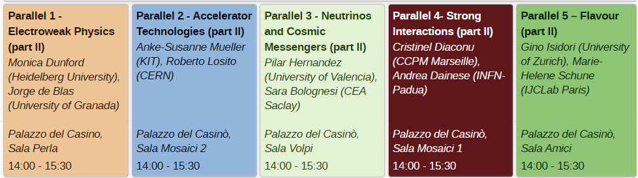
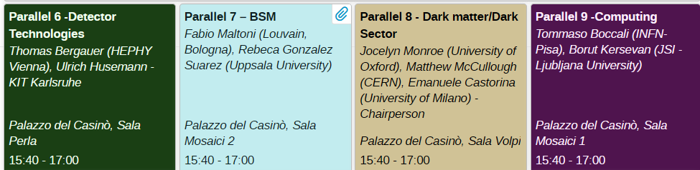
Parallel Sessions
Day 1
Return
Way too much to cover here, the PPG will use this input for the Briefing Book
Morning sessions
11:15-13:00
14:00-15:30
Afternoon/Evening
sessions
15:40-17:00
17:20-19:15

Slide 30
Communicating the case for CERN’s flagship
Day 2
Return
Challenges and opportunities (Arnaud Marsollier)
  Many national inputs highlight the importance of communications for a next flagship project
  We’ve been successful with the LHC, but we will need to do more
  Especially, we will need a strong and coherent narrative to be relevant – not only a strong scientific case
  We can tackle this together, coordination will be of paramount importance
  Networks exist to support upcoming activities, but should be strengthened: EPPCN, IPPOG, collaborations etc. and will need to commitment of the overall community to develop more direct outreach
  All scientists should engage with all kind of audiences: politicians, media, general public etc
Targeting the message (Matthew Chalmers)
  Spark a sense of strategic urgency by conveying the scientific, technological and socioeconomic importance of an unprecedented global research infrastructure in Europe for the 21st century
  HEP pushes the limits of technology & innovation and inspires & trains new generations, driving progress and synergies across disciplines
  People are innately fascinated by the big questions in physics. Tell them what it is that we have learned about the universe, and why it’s exciting to explore further

Slide 31
Accelerator Technologies - II
Day 2
Return
Accelerator Technology R&D for proposed colliders (Phil Burrows)
  Excellent progress has been made on accelerator R&D since ESPPU 2020:
    Via large projects – well defined technical/performance needs
    Across a broader front of technical issues with wide impact (synergies beyond PP)
  Coordination on R&D within Europe has been strengthened via LDG Roadmap
  Strong collaboration with international partners (N. America, Asia …)
  Looking to the future …
Challenges for high intensity accelerators (Chris Rogers)
  Two classes of limit – (A) losses during acceleration and (B) load on beam intersecting devices
  (A) As intensity increases, beam-destructive forces increase i.e. harder to control the beam
  (A) Meanwhile as intensity increases, fractional loss must decrease to maintain 1 W/m
  (B) Must withstand huge energy
  (B) Energy of a speeding truck hitting device every second

Slide 32
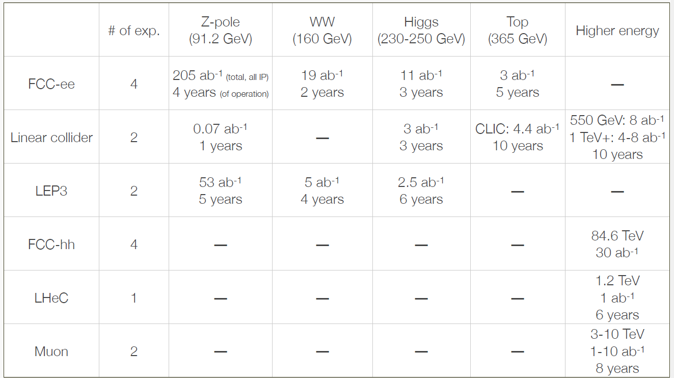
Electroweak
Day 3
Return
Electroweak Physics
  The Electroweak physics landscape beyond the LHC: Open questions and exploration at future colliders (Monica Dunford)
    Higgs couplings; Top; Higgs self-coupling; Weak couplings
  Characterization of the Electroweak sector at Future Colliders - Comparative Assessment (Jorge de Blas)
    We need the most precision we can get over the widest set of measurement possible
    The key word is complementarity: consistency of high-energy results with low-energy precision measurements can bring extra information
    How much experimental precision? Short answer would be “as much as possible” but
    If we can overcome these challenges, what still matters most it to have a large array of measurements that can be used to characterize the origin of an eventual NP signal
    Finally, we should keep in mind that we can still find something at the LHC! What’s next?

Slide 33
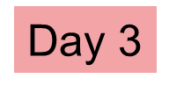
Strong Interactions
Return
Strong Interactions
  Open questions and experimental prospects: precision QCD & internal structure of protons and nuclei (Cristinel Diaconu)
    The strong coupling is the least known amongst the four forces, “the permille plan”: Reaching 0.1% requires FCCee (1012 Z bosons), Lattice, LHeC
    Precision stress tests of the SM (EW, Higgs Yukawas/BSM, top) require NnLO+NnLL pQCQ and significant progress in NP-QCD (had, color rec.)
    Hadron structure is a fundamental scientific question and limits important EW measurements and searches - DIS machines EIC, LHeC will refine the measurements and step into unexplored areas. The phase space will be further explored processes/experiments (neutrinos)
    The strong force is a unique laboratory for the interface between perturbative and non-perturbative and collective effects (low x/saturation, nPDFs, HI)
  Open questions and experimental prospects: Hot and dense QCD & QCD connections (hadronic, nuclear and astrophysics) (Andrea Dainese)
    Very rich physics programme ahead in non-perturbative QCD: High-temperature QCD; Hadron nature (exotica) and interactions
    HL-LHC: unique machine for these areas of QCD: New detectors with frontier sensor technologies and maximising heavy-ion luminosity
    SPS, FAIR: high rates, versatility, and “LHC-driven” sensor technologies
    FPF, HIE-ISOLDE: perfect example of far-reaching QCD and of scientific synergy
    FCC-hh: novel studies in high-TQCD and closer to UHECR conditions

Slide 34
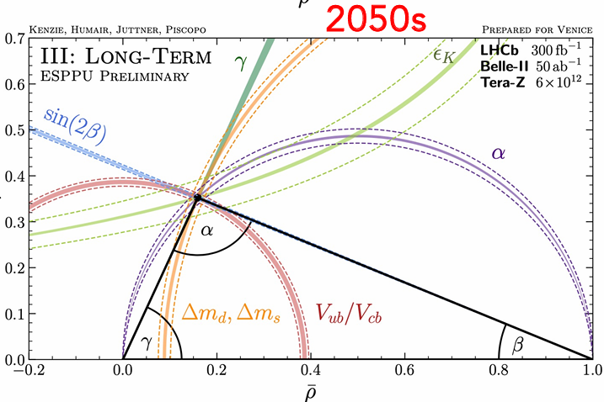
Flavor Physics
Return
Flavor physics
  Status and open questions in flavour physics (Gino Isidori)
    The Standard Model flavour puzzle
    The New Physics (NP) flavour puzzle
    The flavour of the SM-EFT
    NP-sensitive flavour transitions
    A closer look at FCNCs, LFU ratios &EDMs
    Generic bounds on NP scales
    Bounds under motivated flavor assumptions
    An explicit example of flavour-EW interplay
  Experimental programs to address open issues in flavour physics (Marie-Helene Schune)
    Flavour physics is a very diversified field with unique & wide-range sensitivity to physics beyond the SM and a rich program of small/middle/large size experiments
    For B/D/t physics: major improvements with the full exploitation of the available facilities up to 2040s: importance of LHCb-UII and Belle-II (nice complementarity between LHCb,ATLAS/CMS and Belle-II); For 2050s perspective what matters is the number of Z⁰ and having detector(s) Heavy Flavour compliant so 5x10⁹ Z⁰ is not enough to be competitive but FCCee with 6x10¹² Z⁰ (or more!) would have a major impact

Slide 35
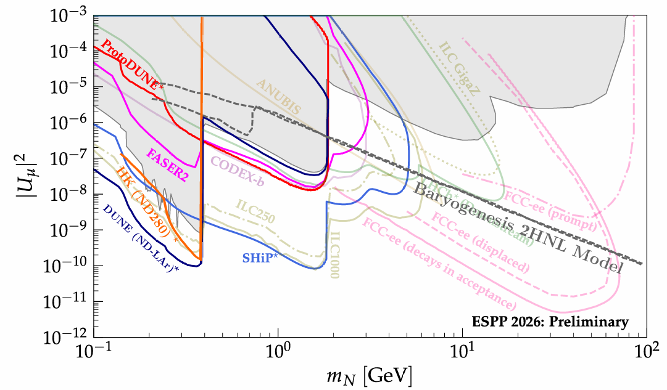
Neutrinos and Cosmic Messengers
Return
Neutrinos and Cosmic Messengers
  Open Questions in Neutrino Physics (Pilar Hernandez)
    Neutrino masses and mixing
    Understand flavour, CP, B/L
    Neutrinoless double beta decays
    Neutrino exploration of New Physics
    The neutrino sector is an unfinished endeavour in particle
    physics and a compelling hint of new physics. An ambitious
    experimental neutrino program is luckily underway…
  Measurements of neutrino properties in the SM and beyond (Sara Bolognesi)
    Oscillations experiments: MO, CPV, PMNS precision + BSM reach. Improved control of systematics and combination of experiments are game changers
    Neutrino rich physics case beyond oscillations from very low-E: CEvNS, SuperNovae, … to very high-E: forward neutrinos at HL-LHC, astrophysics sources
    Neutrino masses in lab: major technological challenge to go beyond present generation
    0νββ: the most compelling BSM physics case. A big technological challenge: R&D should continue
  Cosmic Messengers for Particle Physics (Valerie Domke)
    Astrophysical messengers: em radiation, neutrinos, cosmic rays, gravitational waves
    Cosmic relics: CMB, largescale structure
    Complementary ways to probe particle physics at high energies and small couplings
Heavy Neutral Leptons

Slide 36
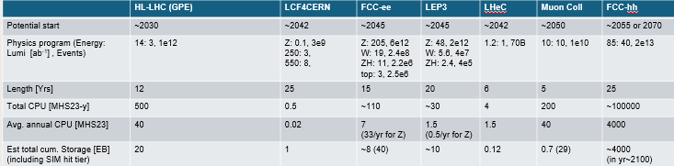
Computing
Day 4
Return
Computing
  Computing in HEP: how we got here and needs for the next decade (Tommaso Boccali)
    The landscape “till the end of LHC” is sketched and is not unfeasible, provided an intense and continuous R&D in computing. In its absence, the required computing will exceed the available capacities by several factors
    Common projects [and their financial / personpower sustainability] are key to a viable HEP computing: Software stacks (Geant4, ROOT, generators, analysis stacks, …); Infrastructures (the WLCG and its evolution); Solutions with other initiatives and sciences (other HEP, GW, Astro…); with other [national|continental|global] level initiatives. For example in QT, AI, HPC, …
  HEP Computing Needs and Ideas for the Next Generation Initiatives (Borut Kersevan)
    We can conclude that for all of the projects, meeting the computing requirements is feasible: the needs can be accommodated by ‘evolution’ without the needs for technological breakthroughs. However, in order to achieve this, one needs to assume a continuous R&D and sustained activity throughout the years!
    All the projects assume the WLCG will continue providing the existing functionality for distributed computing even after the end of the LHC program!

Slide 37
ESG Working Group 1 – (b)
Day 5
Return
(b) What are the most important elements in the response to 3a)? i) Physics Potential; ii) Long-Term Vision; iii) Financial and human resources: requirements and effects on other projects; iv) Timing; v) Careers and training; vi) Sustainability
  The FCC project is widely supported for its outstanding physics potential and long-term strategic value.
  The investment is expected to yield long-term scientific and technological returns while maintaining Europe’s leadership in particle physics.
  Human resources development is considered a key aspect.
  Risks related to a potential post-HL-LHC gap in accelerator activity is noted, with concerns raised about knowledge loss.
  The challenges of early-career researchers are recognized as important.
  Sustainability is widely considered to be a foundational principle.

Slide 38
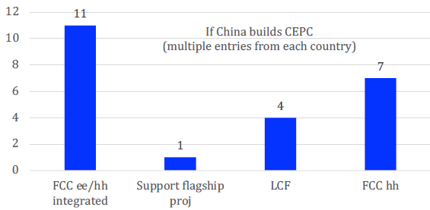
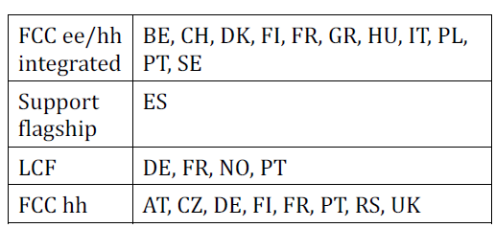
ESG Working Group 1 – (c)
Day 5
Return
(c) Should CERN/Europe proceed with the preferred option set out in (a) or should alternative options be considered?
  (i) If Japan proceeds with the ILC in a timely way
    National inputs that consider a potential ILC in Japan, consistently favour maintaining the FCC project
  (ii) If China proceeds with the CEPC on the announced timescale
  (iii) If the US proceeds with a muon collider
A muon collider faces higher technical risks and a longer development timeline. By and large, national MS HEP community inputs see no reason to change the choice of preferred collider.
The P5 has suggested budget scenarios where both the muon collider demonstrator and the FCC-ee could be accommodated with minimal conflicts expected. A potential U.S. hosted muon collider will likely follow the completion of the FCC-ee construction. Given this, a planned muon collider effort in the U.S. should not influence the decision to move forward with the FCC-ee program at CERN.
At the request of the DOE and the NSF, the National Academies conducted a study to explore the long-term goals and future ambitions for particle physics. The recently-released study also envisions a dedicated U.S. national R&D program, with international coordination, including a muon collider technology demonstrator within the next 20 years as well as participation in the international Future Circular Collider Higgs factory currently under study at CERN.
  (iv) If there are major new (unexpected) results from the HL-LHC or other HEP experiments
Although some Member States acknowledge that the HL-LHC or other experiments might yield surprises and consider a possible extension of the HL-LHC, there is a strong agreement that any delay would be detrimental to the overall scientific program of CERN.

Slide 39
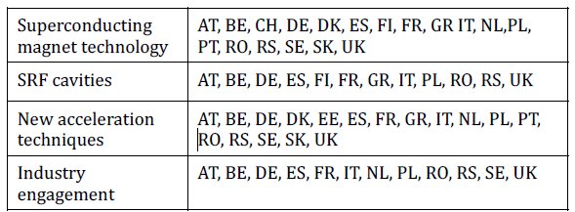
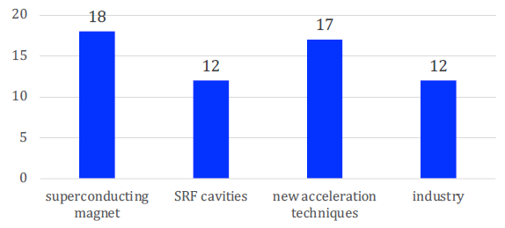
ESG Working Group 1 – (d)
Day 5
Return
(d) Beyond the preferred option, what other accelerator R&D topics?
  Continued innovation in superconducting magnet technology, especially using HTS, is deemed essential for collider performance limits to be pushed.
  High-performance SRF cavities are regarded as foundational for linear and circular accelerators, with research targeted at higher gradients and quality factors and industrial application transition.
  Groundbreaking methods such as Plasma Wakefield Acceleration, Muon Acceleration and Cooling, Energy Recovery Linacs, and Terahertz Acceleration are to be invested in, requiring extensive R&D and demonstration facilities.
  Industry engagement is to be strengthened to accelerate technology transfer and innovation. Accelerator R&D benefits beyond particle physics - to medicine, energy, and other infrastructures - are to be highlighted to support investment.
  Among the accelerator R&D priorities, the U.S. has focused on superconducting magnet technology, high-performance SRF cavities, and new acceleration techniques. (not counted in the histogram)

Slide 40
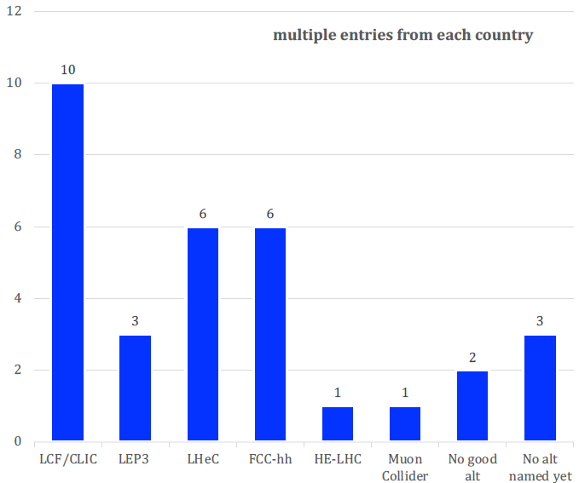
ESG Working Group 1 – (e)
Day 5
Return
(e) What is the prioritised list of alternative options if the preferred option is not feasible?
  Ten countries (DE, ES, FI, FR, NO, PL, PT, SE, RS, SK) list a linear collider at CERN as the second-best choice, with one (FI) mentioning the need for it to be affordable and another (UK) highlighting it as a viable strategic alternative. Two (DE, ES) of these countries highlight the benefits of polarized beams, the potential for two interaction points, and its ability to be upgraded.
  Two countries (CH, HU) see no reason for another option, as they would be equally costly.
  Three countries (BE, GR, UK) mention LEP3 as a genuinely less costly alternative to the FCC-ee
  No prioritised alternatives have been named yet by three other countries (CZ, DK, SK). The U.S. national input did not express a prioritized list
  Two countries (AT, NL) aren't yet committed to a preferred option. One country (NL) suggests a feasibility study for at least one alternative to the FCC-ee.
  A muon collider would be the top alternative for one country (GR), and an option for later consideration for two others (RS, NO). For other countries, it's seen as interesting but not yet ready.
  Six countries (BE, DE, FR, NL, SE, UK) support the LHeC, mostly as an intermediate project.
  Hadron collider options are also mentioned by five other countries (DE, IT, RS, GR, UK). One country (RO) brings up a lower energy hadron collider with an ep collision option.

Slide 41
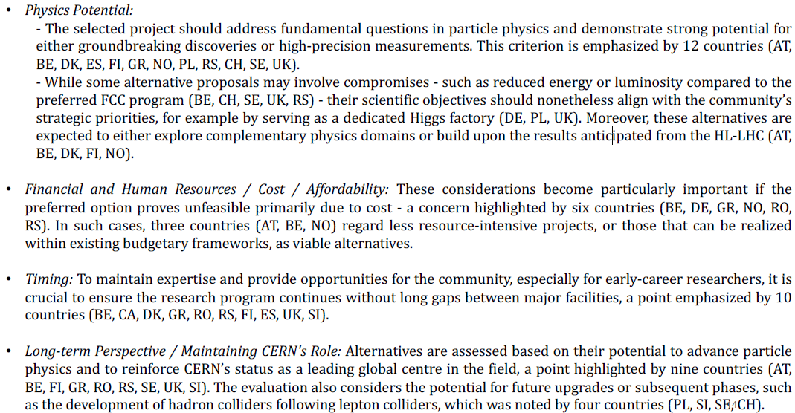
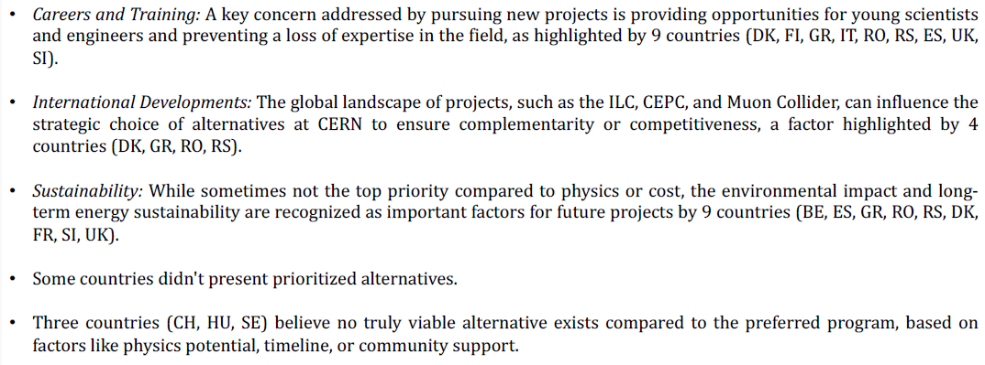
ESG Working Group 1 – (f)
Day 5
Return
(f) What are the most important elements in the response to (e)? Details
  More nuanced, as you can see below, but includes:
    Physics potential; Financial and Human resources/cost/affordability; Timing; Long-term perspective / Maintaining CERN’s role; Careers and Training; International developments; Sustainability

Slide 42
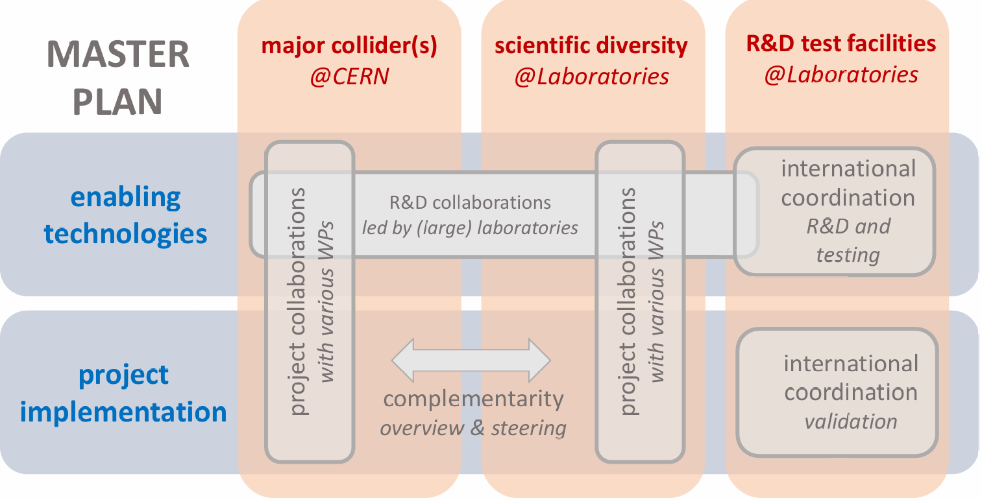
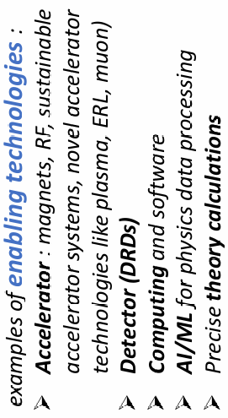
ESG Working Group 3
Day 5
Return
Role of national labs, strategy implementation (Achille Stocchi, WG3)
  ESPPU 2020 recs:
    The definition and the execution of the Accelerator Roadmap under the responsibility of the LDG
    The creation of the DRD groups under the responsibility of the ECFA
  11 Large Particle Physics Laboratories (LPPL) – grouped in the Large Particle Physics Laboratory Directors Group (LDG)
    CIEMAT, DESY, Daresbury, IJCLAB, IRFU, LNF, LNGS, Nikhef, PSI, RAL and CERN
  Provided many examples of LPPL strengths… and possible improvements captured in WG3 master plan
    Expanding global accelerator R&D
    Fostering collaborations for a next generation
    collider facility
    Strenthening the diversity of the physics programme
    Enhancing detector R&D and infrastructure

Slide 43
ESG Working Group 4
Day 5
Return
Relations with other fields of physics (Marek Karliner, WG4)
  Received ESPP inputs from member states on additional activities CERN should consider in: nuclear (NP); astroparticle (AP); medical (MP)
    GW, DM, ν, cosmic rays, γ factory, synergies with EIC, storage of very large data sets, improve PET sensitivity via quantum entanglement
  Summary of many member state (MS) inputs
    Need to balance these proposals vs. already stretched resources and focus on core business of CERN, i.e. collider physics & maintain non-collider program in PP
    CERN should maintain involvement in exp. NP & AP at current level
  Summary of some MS inputs
    enhance engagement in AP via ν-like platform
    some others: cryogenics platform, NP, MP...
  Consensus (based on majority on national inputs including APECC & NuPECC
    existing non-collider experiments at CERN should be supported, as long as they do not take too many resources away, but CERN should not engage in additional non-particle physics experimental and/or hardware activities, unless they have a significant added value for its main mission, to carry out accelerator-based research, as specified by the CERN Convention
  CERN Theory (TH)
    support of CERN experimental activity
    attract the brightest TH talents, maintain leading position in TH HEP worldwide
    many areas of NP & AP potentially of central importance to HEP
  Must support iNSPIRE HEP database

Slide 44
ESG Working Group 5
Day 5
Return
Sustainability & Environmental Protection (Tadeusz Lesiak, WG5)
  Sustainability assessment based on analysis of 3 aspects – society, economy and environment
  Discusses issues for HEP accelerators, HEP detectors, HEP computing, HEP travel,…
  The WG welcomes and underlines many good examples of R&D efforts of HEP community revolving around technological advances (accelerators, detectors, computing…) towards mitigating CO2 emissions as much as possible; these efforts should be continued and strengthened
  The evaluation of future HEP projects should take into account principles of environmental sustainability
  In particular, future projects need to compute the full Life Cycle Analysis (LCA) of all accelerator and detector components
  The lab environmental reports/strategies should be periodic, public and envision ambitious emissions targets
  CERN, with its global status and visibility, should seize the opportunity and be an international role model by achieving emissions reduction beyond its current targets, demonstrating our field's commitment; in particular, pursue active sustainability actions (buildings, heat reutilization…) with adequate funding
  Laboratories and funding agencies should be proactive in encouraging and providing opportunities for their staff members to contribute to addressing and communicating the environmental crisis
  The WG will consider the proposal of a „sustainability charter” that could be voluntarily included in institutions’ rules and regulations
  HEP detectors: all efforts aimed at implementation of „eco” gases in our detectors and cooling systems, should be supported
  HEP computing: sustainability should be integrated into hardware and software practices
  We should enable and encourage environmentally friendly business travel, commuting, and methods of collaboration by reorganizing them in more environmentally friendly ways, while not neglecting the advantages of direct interactions between researchers
  Enable and encourage practices that minimize food-related negative environmental impacts
  Existing research sites be managed and future sites designed to enhance habitat diversity, halt local biodiversity loss, minimize water use, and encourage natural water cycles

Slide 45
ESG Working Group 6
Day 5
Return
Communication, Outreach, Career aspects (Pierre Van Mechelen, WG6)
  Instrumentation & link with industry
    Strengthen training in instrumentation, and in transferable and entrepreneurial skills
    Establish closer ties to industry, including industry placement of PhD students and hirings from industry into instrumentation jobs
  Early Career Researcher (ECR) career perspectives
    Short-term contracts, frequent relocations, and uncertain job perspectives weigh in on ECR’s mental health and work-life balance.
    Activities in computing, accelerators, instrumentation not always well recognized
    Not clear whether these practices ensure that we keep the best talents in the field.

Slide 46
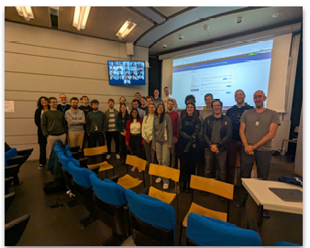

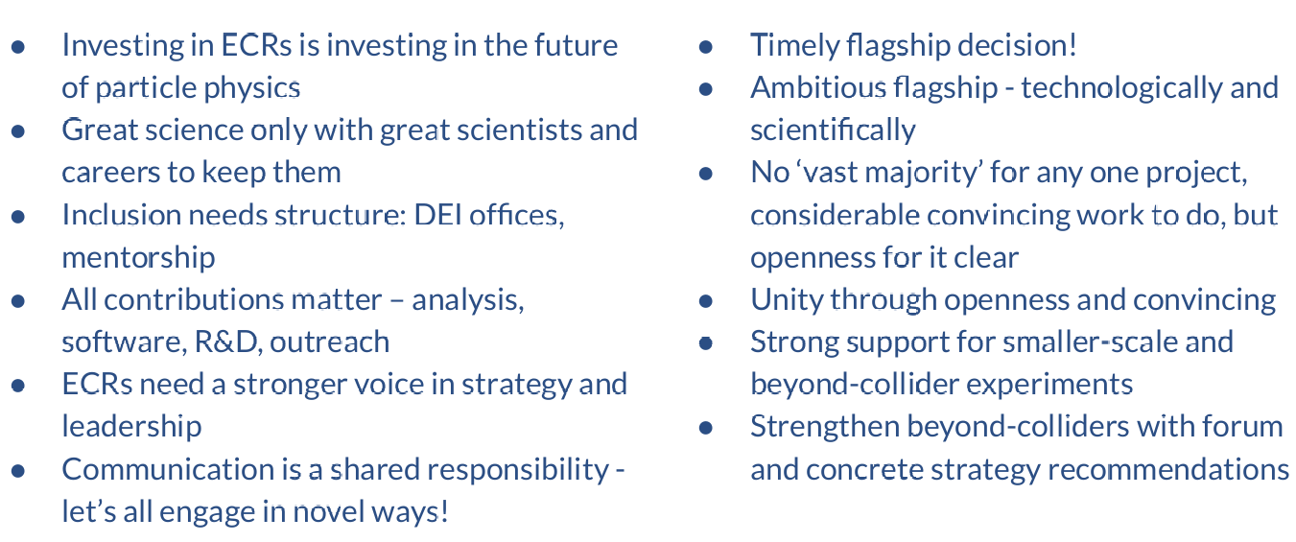





ESG Working Group 7
Day 5
Return
Early Career Researchers (ECR) perspectives (Christina Dimitriadi, Ulrich Einhaus, WG7)
  Held survey, workshops, symposium and seminar
  Produced 100 page document and 10 page executive summary (#42) for Venice symposium
  55 recommendations
  Conclusions:

Slide 47
ESG Working Group 8
Day 5
Return
Knowledge and technology transfer (Richard Brenner, WG8)
  It is important to harvest the technologies developed by the brilliant people in HEP wherever possible so that society at large benefits
  The potential is large but a systematic approach to maximising it is needed
  Unfortunately, there were very few submissions on this topic
  The different proposed future accelerators offer varying (large!) potential for knowledge and technology transfer
  We will prepare a questionnaire to understand how the various projects are approaching this issue, and what the (up to 3) key technologies are that are expected to have a large potential
  The first questionnaires related to accelerator technologies will be sent shortly and then the work of this group will start
    We are considering doing the same for the DRDs
  Goal should be to derive recommendations and guidelines for the knowledge transfer (KT) setup within projects

Slide 48
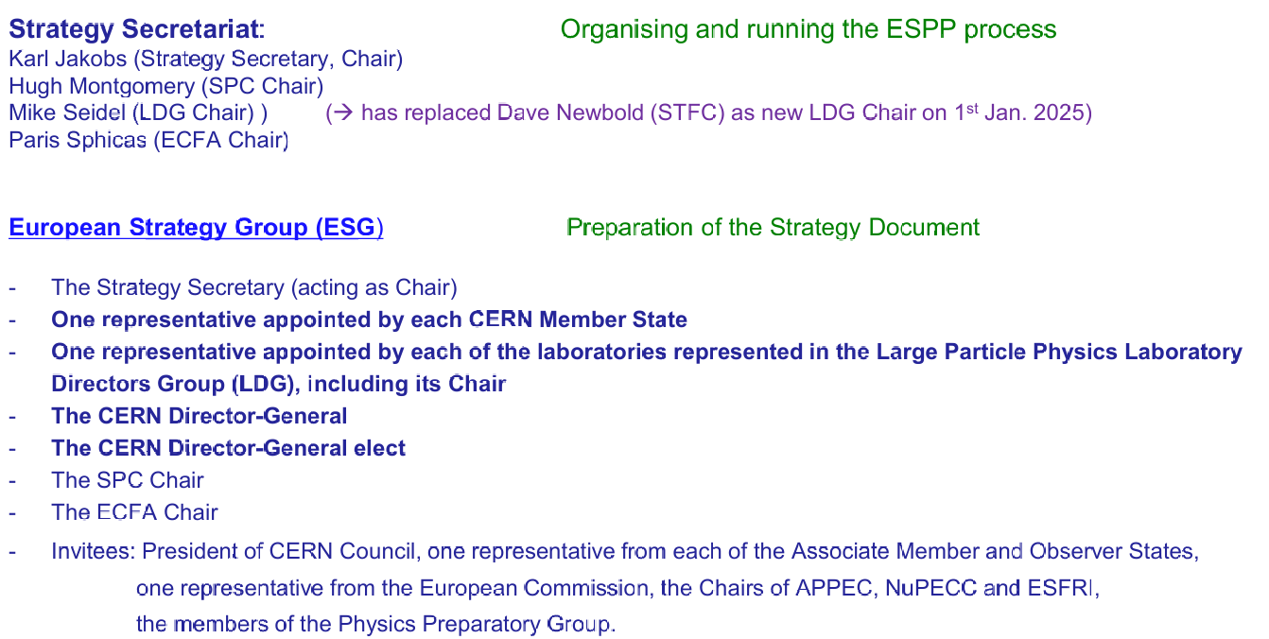
Secretariat & ESG Makeup
(from Mont’s presentation to DPF)
Return

Slide 49
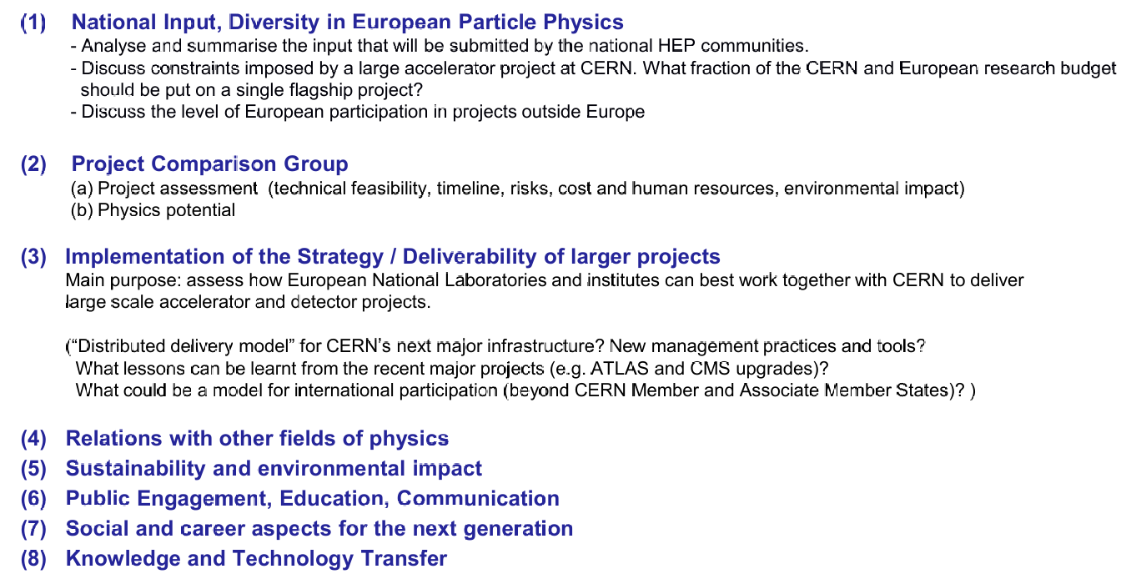
ESG Organization
Return

Slide 50
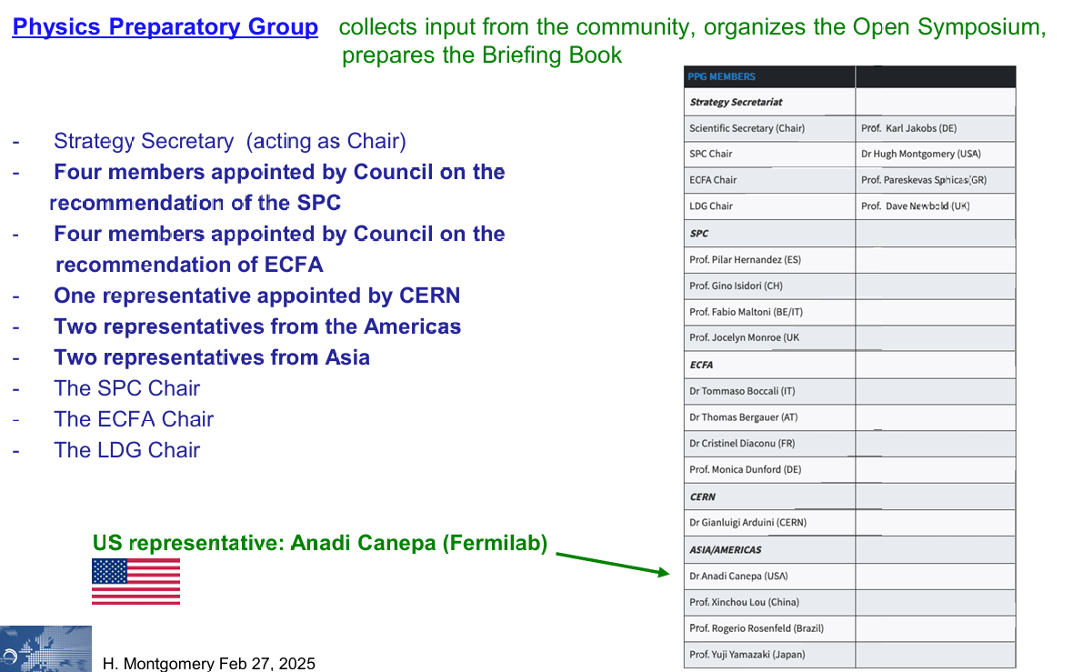
PPG Makeup
Return

Slide 51

PPG Organization
Return

Slide 52


US National Input to WG1 – DPF
Return

Slide 53



US National Input to WG1 - HFCC
Return

Slide 54



US Technical Capabilities - Experiments
From HFCC document

Slide 55



US Technical Capabilities - Accelerators
From HFCC document

