Slide 1

Fermi National Accelerator Laboratory
Director Search
Stakeholder Feedback Session
DPF Community Forum
July 31, 2025

Slide 2
SEARCH COMMITTEE STEERING COMMITTEE
Committee Leadership
Paul Kearns - (Chair); Laboratory Director, Argonne National Laboratory
Mark Thomson – (Vice-Chair); CERN Director-General designate, Professor Experimental Particle Physics, Cavendish Laboratory – University of Cambridge; (Former) Executive Chair of Science and Technology Facilities Council
FFDG Members/Board
Jack Anderson – Interim Vice President for National Laboratories, University of Chicago
John Mester – President & Chief Executive Officer, Universities Research Association
Cherry Murray - Professor of Physics and Deputy Director for Research, Biosphere2 at the University of Arizona; former Director of the Department of Energy’s Office of Science
Tracey Quinn, (Committee Liaison), Associate Vice President, Office of National Laboratories, University of Chicago; Corporate Secretary, FFDG
Support to Committee:
Gayle Maloney, Board Relations Strategist, Office of National Laboratories, University of Chicago
Executive Recruitment Firm – Opus Partners

Slide 3
SEARCH COMMITTEE MEMBERSHIP
Sekhar Chivukula, Distinguished Professor of Physics, University of California, San Diego
Jay Gambetta, Vice President of Quantum and IBM Fellow, IBM
Andrea Ghez, Professor of Physics, UCLA; 2020 Nobel Laureate in Physics; Director, UCLA Galactic Center Group
Doon Gibbs, Emeritus and Former Director, Brookhaven National Laboratory
Karsten Heeger, Chair and Professor of Physics, Yale University; Co-Chair, Particle Physics Project Prioritization Panel (P5)
Beate Heinemann, Chair, Board of Directors, Deutsches Elektronen-Synchrotron (DESY)
Joe Incandela, Distinguished Professor and Former Vice Chancellor for Research, UCSB; Former Spokesperson, CMS
Jonathon Jarvis, Director, Accelerator Research Division, Fermilab
Patty McBride, Distinguished Scientist, Fermilab
Chris Mossey, Member, Board on Infrastructure and the Constructed Environment, National Academies of Sciences, Engineering and Medicine; Former Deputy Director, LBNF-DUNE-US, Fermilab
Jen Raaf, Senior Scientist and Division Head, Neutrino Division, Fermilab

Slide 4
NOTIONAL PROCESS & TIMELINE
Oct
2024
Contract Award
Oct-Dec 2024
Contract Transition
Jan
2025
New Contract start
Lia Merminga steps aside. Young-Kee Kim appointed as Interim LD
Mar - May
2025
Search Committee formation
Parameters of search defined
May - June 2025
Position posting; new website
Stakeholder engagement
Jun – Jul 2025
Sourcing of candidates
Development of leading candidate list
Initial interviews
Jul-Aug 2025
Due diligence & complete
interviews
Develop report &
submit final recommend-dation(s)
Aug-Sep
2025
Finalist Interviews by FFDG
FFDG agrees on finalist
Sep
2025
Ongoing vetting and DOE coordination
Oct
2025
Approval of Finalist by FFDG Board Chair
Outreach to S-1
Oct-Nov
2025
Offer Extended
LD appointed/. announced
Dec 2025 -
Jan 2026
New LD starts

Slide 5
STAKEHOLDER ENGAGEMENT
Date | Stakeholder Group
Ongoing | Outreach to DOE – FSO, HQ, HEP
5/19/25 | Fermilab Senior S&T Leaders
5/19/25 | Fermilab Capital Projects Managers
5/19/25 | Fermilab Senior Operations Managers
5/22/25 | CMS Stakeholders
5/23/25 | DUNE – US Stakeholders
5/28/25 | Fermilab Key Personnel
5/28/25 | FFDG Institutional and Academic Commitment Partners
6/18/25 | Fermilab Distinguished Scientists
6/20/25 | DPF Online Community (Division of Particles and Fields – part of APS)
6/20/25 | P5 Committee
6/24/25 | Engineering Coordination Council
6/24/25 | Fermilab Retiree Engagement Board (REB)
7/1/25 | Fermilab Applied Physics & Superconducting Technology Division
7/11/25 | Fermilab Scientist Advisory Council (SAC)
7/16/25 | Neutrino Division
7/17/25 | Fermilab’s Users & Affiliates (UAEC)
7/24/25 | Community Advisory Board
7/30/25 | US Muon Collider Community
7/31/25 | APS- DPF Particle Physics Community Meeting

Slide 6
EXPECTATIONS
Provide candid but constructive feedback
Respect one another
Listen to what others are saying
Take turns; allow everyone to express themselves
Avoid person-specific references
Share forward-looking information
Feedback shared should be kept in confidence
If virtual, please keep your camera on

Slide 7
QUESTIONS
What do you see as the short term (next 2-3 years) and long-term
(5-10 year) priorities for the next director?
What do you believe is the most significant issue for the next director to address and/or the greatest challenge the director will face?
What do you feel are the most critical characteristics/qualities needed in the next laboratory director?
Is there anything else you think the Search Committee should consider/know?

Slide 8
Thank you
for your time & thoughtful feedback

Slide 9
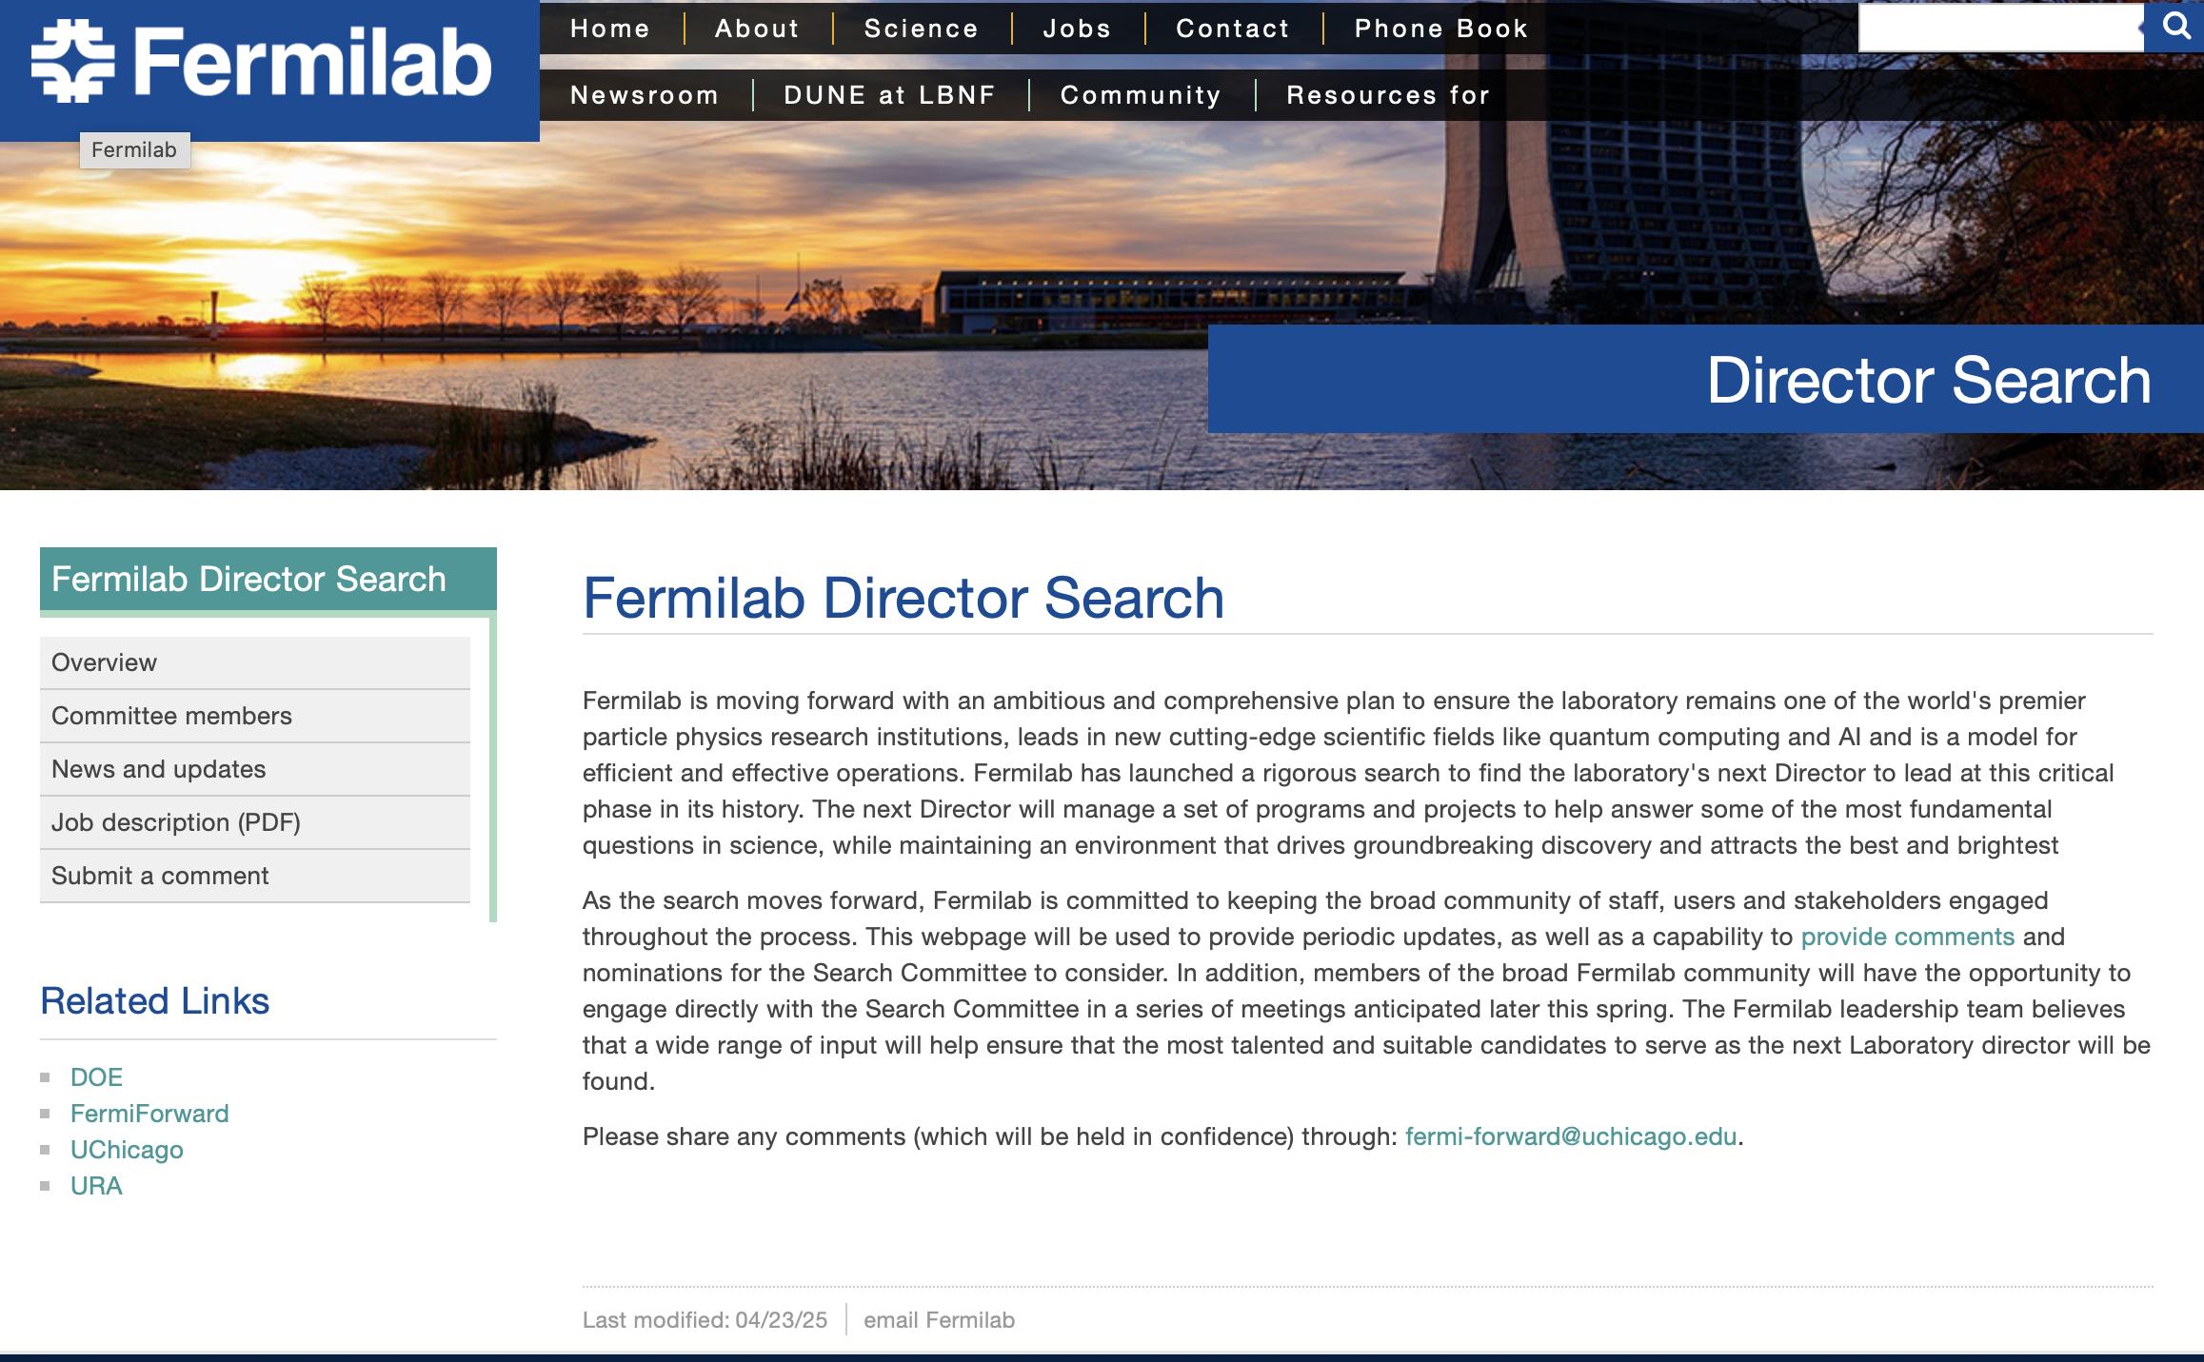
FERMILAB DIRECTOR SEARCH WEBSITE
Detailed information about the Fermilab Director Search, including opportunities to provide feedback and comments, is available on the official Fermilab Director Search website:
https://www.fnal.gov/pub/directorsearch/index.html

Slide 10
BACK UP SLIDES

Slide 11
DIRECTOR JOB DESCRIPTION
Working in partnership with the Department of Energy, the Fermi Forward Discovery Group, LLC (FFDG), and the FFDG Board of Directors, the next leader to serve as Fermilab’s Director will be responsible for leading and managing the Laboratory’s extraordinary staff, exceptional scientific programs and operational support systems, and for fostering and developing relationships with Fermilab’s global stakeholders and partners, including the broader high energy physics community. The Director will represent and serve as the voice of the global high energy physics community as well as championing the laboratory’s emerging science initiatives. The Director will also be the proponent for achieving excellence in operational and business systems necessary for the delivery of the scientific program.
The new Director will lead the execution of the scientific vision for Fermilab, including responsibility for DUNE, an international flagship experiment to unlock the mysteries of neutrinos. The Director will also ensure the successful development of the LBNF project, which is closely coupled to the DUNE experiment and is currently under construction at Fermilab and at the Sanford Underground Research Facility in South Dakota. The Director will also be responsible for Fermilab’s broader research programs and projects, including the laboratory’s major science initiatives.
In addition to these programmatic imperatives, the Director will play a pivotal role in championing the Laboratory’s emerging scientific initiatives—including efforts in artificial intelligence, quantum science, and microelectronics—which are critical to maintaining and expanding Fermilab’s relevance and impact across the broader scientific and technological landscape.

Slide 12
DIRECTOR JOB DESCRIPTION (continued)
The Director will build and maintain strong support for Fermilab’s associated projects and programs from the global scientific community and secure the resources to execute the vision from the Department of Energy and other sponsors. The Director will also seek to expand Fermilab’s research portfolio into new domains of science and technology in collaboration with other national laboratories and research institutions in the US and abroad.
Because of the scale and breadth of the Fermilab programs, the Director will be expected to cultivate the international participation and resources that will play an increasingly critical role in the future of the Laboratory and its science while maintaining US research security.
The Director will be accountable for fostering a positive organizational culture that is conducive to
ground-breaking research and development, driving execution, attracting and retaining an
outstanding and engaged workforce, and delivering results in an environment striving for
operational excellence and efficiency.

Slide 13
DIRECTOR
CRITICAL LEADERSHIP CAPABILITIES
Visionary and Impactful Leadership
The ability to conceive a compelling future-oriented vision for Fermilab, focused on enduring impact, and effectively communicate it to the laboratory’s multiple internal and external stakeholders; The ability to motivate, unify and engage these stakeholders around a shared purpose and mission, and to exercise strategic thinking, empathy, and effective communication, foster a culture of innovation and excellence in science and operations that aligns with the envisioned future.
Execution and Driving Results
The ability to translate plans and strategies into tangible actions, in which goals are achieved within budgetary and fundraising considerations. This includes planning, organizing, and motivating the internal and external stakeholders to effectively execute the mission, while also assessing progress, adapting to challenges, identifying areas for improvement and ensuring accountability for progress. The ability to define the desired outcome, identify key actions, allocate resources effectively to achieve goals, monitor progress and drive continuous improvement. The ability to bring highly impactful, complex, and visible projects to fruition and to advance the field of high energy and particle physics, emerging scientific initiatives and institutional partnerships.
Adaptability, Resilience & Change Management
The ability to exercise adaptability, resilience and change management to help the laboratory team and stakeholders navigate uncertainty, embrace transformation, and successfully execute the laboratory’s mission through transitions.
Decision-making
The ability to exercise effective decision-making, by selecting the best course of action from available options, including the methodology to identify the problem, gathering information, evaluate options, and then making a timely choice, considering potential consequences and risks. The ability to communicate decisions clearly and considering the impact on the team, the organization and stakeholders. The ability to learn from experience and change course, if necessary.

Slide 14
CHARGE TO COMMITTEE
The ideal candidate will be exceptional in seven primary categories:
The candidate will have a record of visionary leadership, strategic thinking and planning, and leadership experience and accomplishments, particularly in a DOE National Laboratory or other complex research setting.
The candidate will be recognized for scientific excellence through a demonstrated track record of scientific achievement, international collaboration and strong credentials, and will have the skills and attributes to represent and serve as voice of the global High Energy and Particle Physics field, as well as to serve as a champion of the laboratory’s emerging science initiatives.
The candidate will have a strong working knowledge of DOE missions, priorities, organizations and programs.
The candidate will have a record of successfully delivering large science programs, and will demonstrate the ability to lead a large, complex organization with multiple stakeholders and significant operational and financial complexity. The candidate will also reflect the ability to integrate, align and balance operational and scientific objectives and initiatives.
The candidate will possess the skills necessary to communicate directly and effectively with multiple constituencies, including the Department of Energy, other appropriate federal, state and global funding agencies, business and industry, university and research groups, the media, elected officials and their staffs in Washington, D.C., the States of Illinois and South Dakota, and the Midwest region. The candidate will also have the skills to cultivate vibrant and productive collaborations with Fermilab’s multiple international partners.
The candidate will also have a demonstrated track record of attracting, motivating, and retaining world-class scientific and operational talent, building a productive organizational culture, and developing future scientific and technical leaders.
The candidate will have the ability and willingness to hold a DOE security clearance.

