Slide 1


Harnessing the Quantum Zeno Effect in superconducting qubits for particle detection
October, 2025
Olivia Seidel (UTA), Sara Sussman (FNAL), Jonathan Asaadi (UTA), Daniel Bowring (FNAL)
Notes:
Put name and talk title on slide

Slide 2












Leveraging a fundamental quantum mechanics effect to develop robust qubit-based particle sensors
Trail guide to finding a background suppressed overlook:
1. We can use qubits as particle detectors (for free, thanks quantum computing!)
Olivia Seidel

Slide 3

Leveraging a fundamental quantum mechanics effect to develop robust qubit-based particle sensors
Trail guide to finding a background suppressed overlook:
1. We can use qubits as particle detectors (for free, thanks quantum computing!)
2. What a superconducting qubit is and how it can be used for sensing
Olivia Seidel

Slide 4

Leveraging a fundamental quantum mechanics effect to develop robust qubit-based particle sensors
Trail guide to finding a background suppressed overlook:
1. We can use qubits as particle detectors (for free, thanks quantum computing!)
3. Nefarious backgrounds to a particle event,
“Two Level Systems”
2. What a superconducting qubit is and how it can be used for sensing
Olivia Seidel

Slide 5

Leveraging a fundamental quantum mechanics effect to develop robust qubit-based particle sensors
Trail guide to finding a background suppressed overlook:
1. We can use qubits as particle detectors (for free, thanks quantum computing!)
3. Nefarious backgrounds to a particle event,
“Two Level Systems”
2. What a superconducting qubit is and how it can be used for sensing
4. The Quantum Zeno Effect and how we can leverage it
Olivia Seidel

Slide 6


Leveraging a fundamental quantum mechanics effect to develop robust qubit-based particle sensors
Trail guide to finding a background suppressed overlook:
1. We can use qubits as particle detectors (for free, thanks quantum computing!)
3. Nefarious backgrounds to a particle event,
“Two Level Systems”
5. A background free overlook
2. What a superconducting qubit is and how it can be used for sensing
4. The Quantum Zeno Effect and how we can leverage it
Olivia Seidel

Slide 7
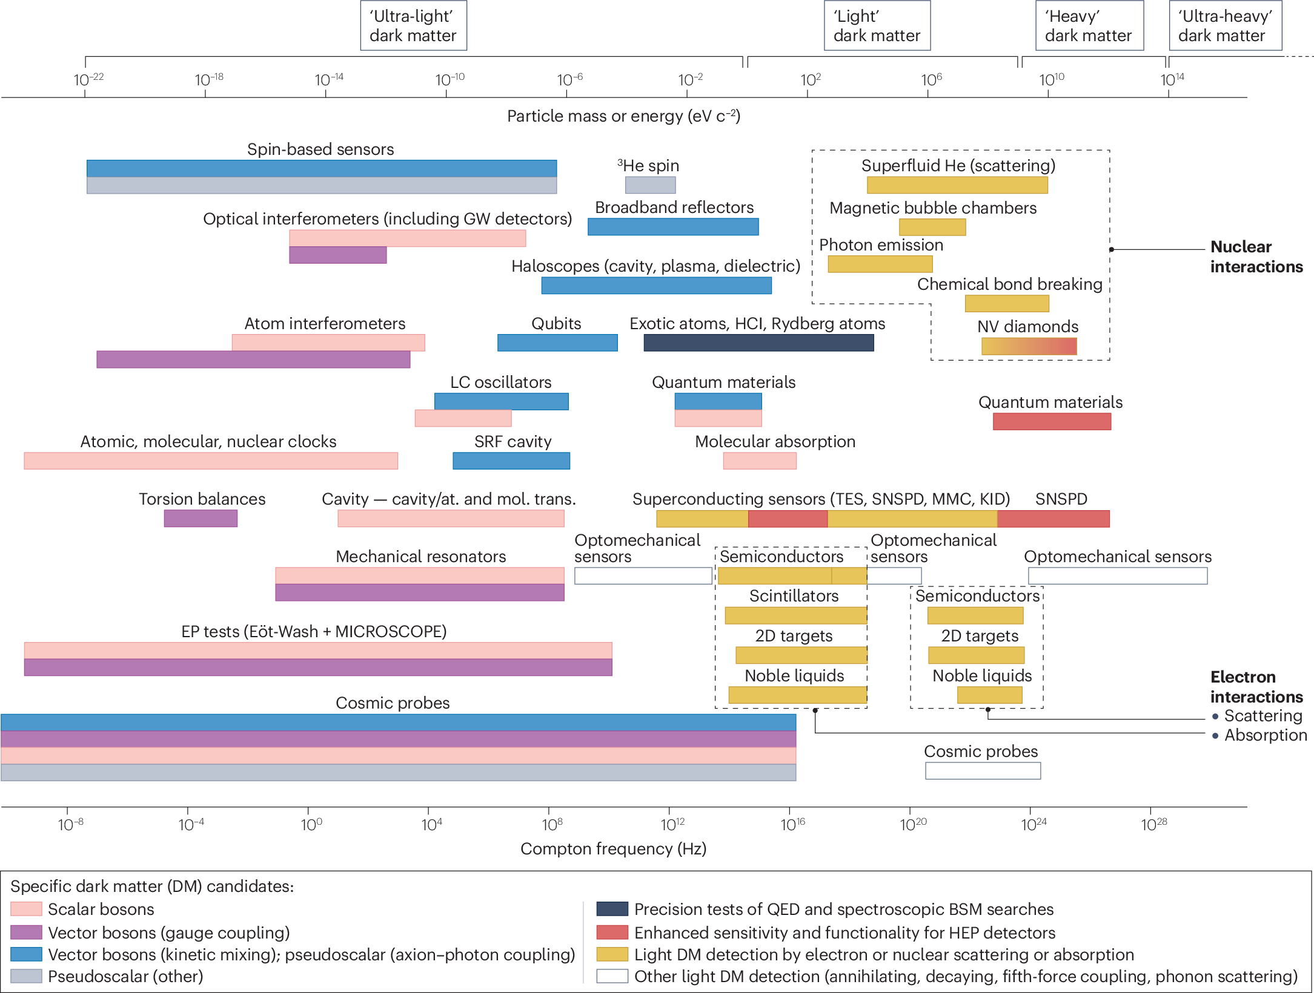
The next generation of breakthroughs in physics will come from very sensitive detectors
Direct detection dark matter techniques
SC qubit-based sensors enable meV detection
Olivia Seidel
10.1038/s42254-024-00714-3
Notes:
Directly absorbing DM into qubit, might be misleading
Make sure this isnt blurry
Difference between wavelength and particle like dark matter

Slide 8








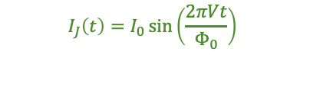
Superconducting qubits are promising candidates for low energy detection
Superconducting qubit
LC circuit
+
+
e-
$$I_{J}\left(t\right)=I_{0}\sin\left(\frac{2πVt}{Φ_{0}}\right)$$
-
-
e-
I
e-
t
e-
$$ΔE=ℏω=\frac{ℏ}{\sqrt{LC}}$$
$$E_{J}=\frac{I_{0}Φ_{0}}{2π}$$
Binding energy of cooper pairs sets energy sensitivity
Supercurrent sets the qubit frequency
$$\hat{H}=\frac{\hat{Q^{2}}}{2C}+\frac{\hat{Φ^{2}}}{2L}$$
$$\hat{H} =\frac{\hat{Q^{2}}}{2C}+E_{J}\cos\left(\hat{δ}\right)$$
$$|0⟩$$
$$|1⟩$$
Olivia Seidel
$$|0⟩$$
$$|1⟩$$

Slide 9
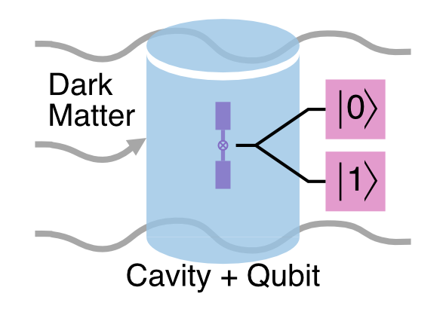
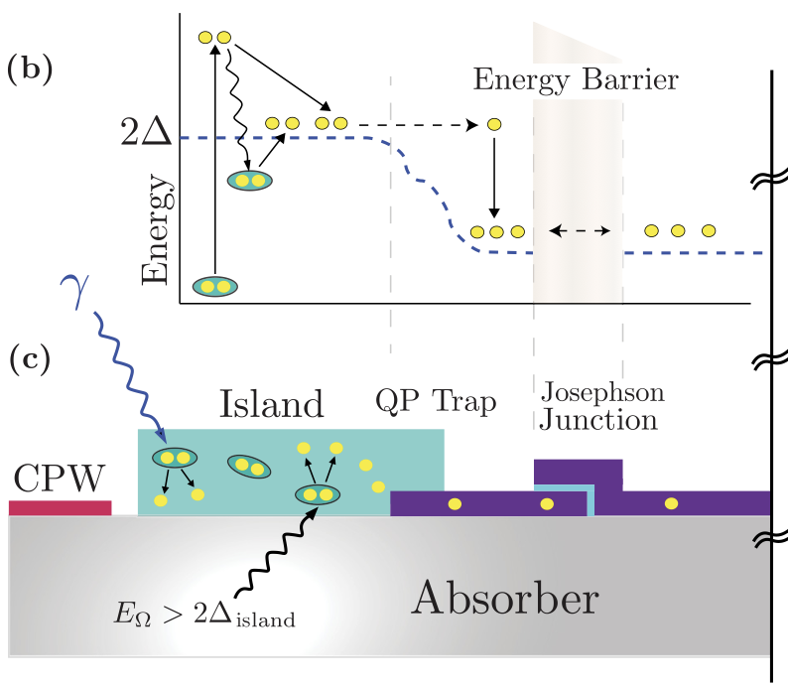
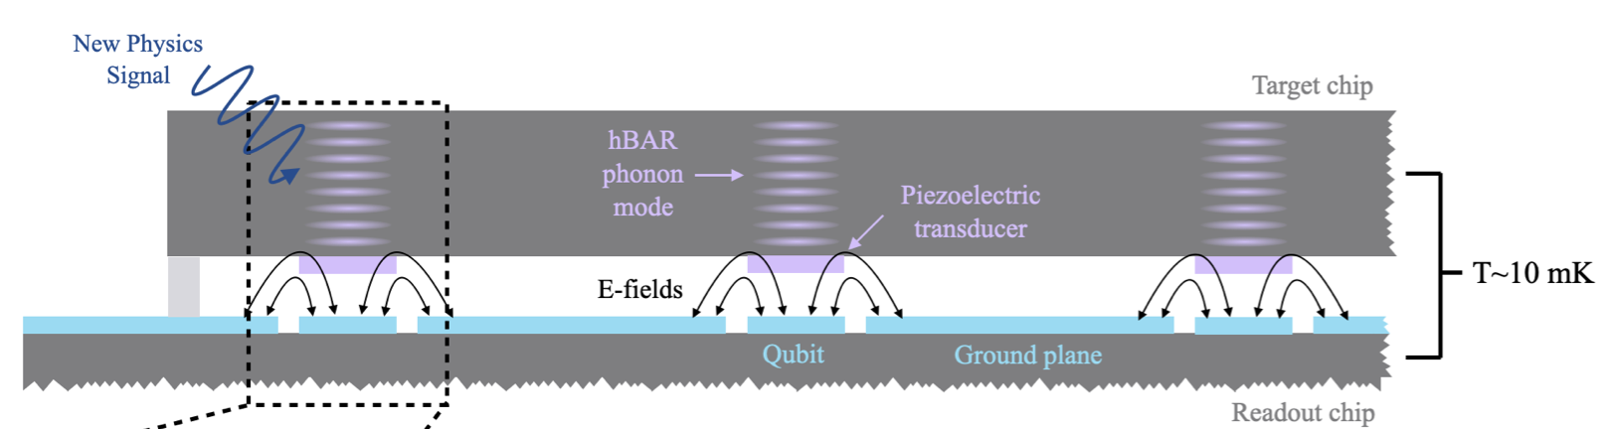
Proposed sensing schemes using SC qubits
Cavity based hidden photon searches
Superconducting Quasiparticle-amplifying transmons (SQUATs)
https://news.fnal.gov/2021/04/sensitive-qubit-based-technique-to-accelerate-search-for-dark-matter/
10.1103/PhysRevLett.126.141302
High-overtone Bulk Acoustic Resonators (HBARs)
Olivia Seidel
10.1103/PhysRevApplied.22.054009
10.48550/arXiv.2410.17308
Notes:
Electrodes are driven at microwave frequencies with a piezo film between them, and acoustic waves are generated between the electrodes through the film. A qubit is coupled to the piezo film and the microwave sets the qubit frequency. A tiny disturbance, like stress or a phonon etc, cause that frequency to shift -just put arxiv number below
-say axion/dark photon (can do both)

Slide 10
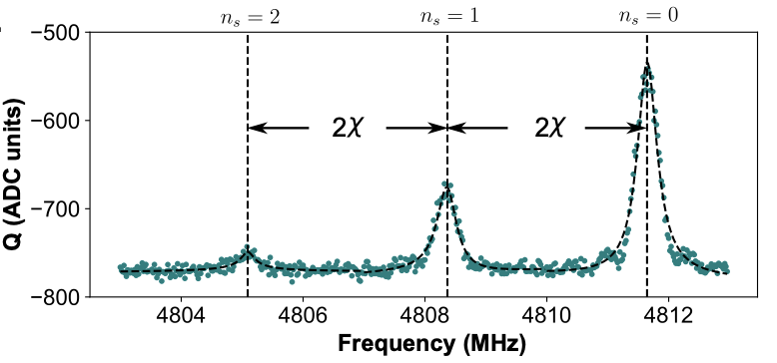
All of these sensing mechanisms use qubit frequency shifts as the detection medium
Cavity based hidden photon searches
Quasiparticles shift the qubit frequency through tunnelling The qubit frequency stark shifts by discrete amounts depending on the number of photons in the resonator (https://arxiv.org/pdf/2501.06882)
Superconducting Quasiparticle-Amplifying Transmons (SQUATs)
High-overtone Bulk Acoustic Resonators (HBARs)
Quasiparticles shift the qubit frequency through tunnelling events (10.1103/PhysRevApplied.22.054009)
Olivia Seidel
Phonons modulate the qubit frequency via piezoelectric coupling (10.1103/PhysRevX.14.031023)
Notes:
2 delta cutoff

Slide 11
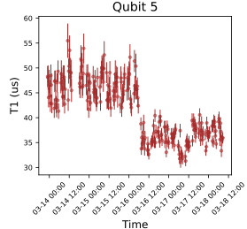
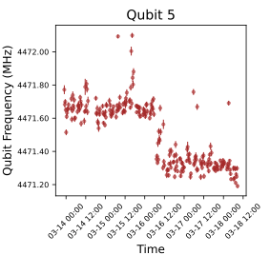
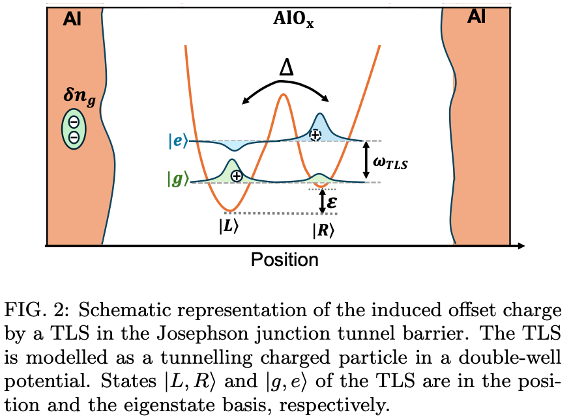
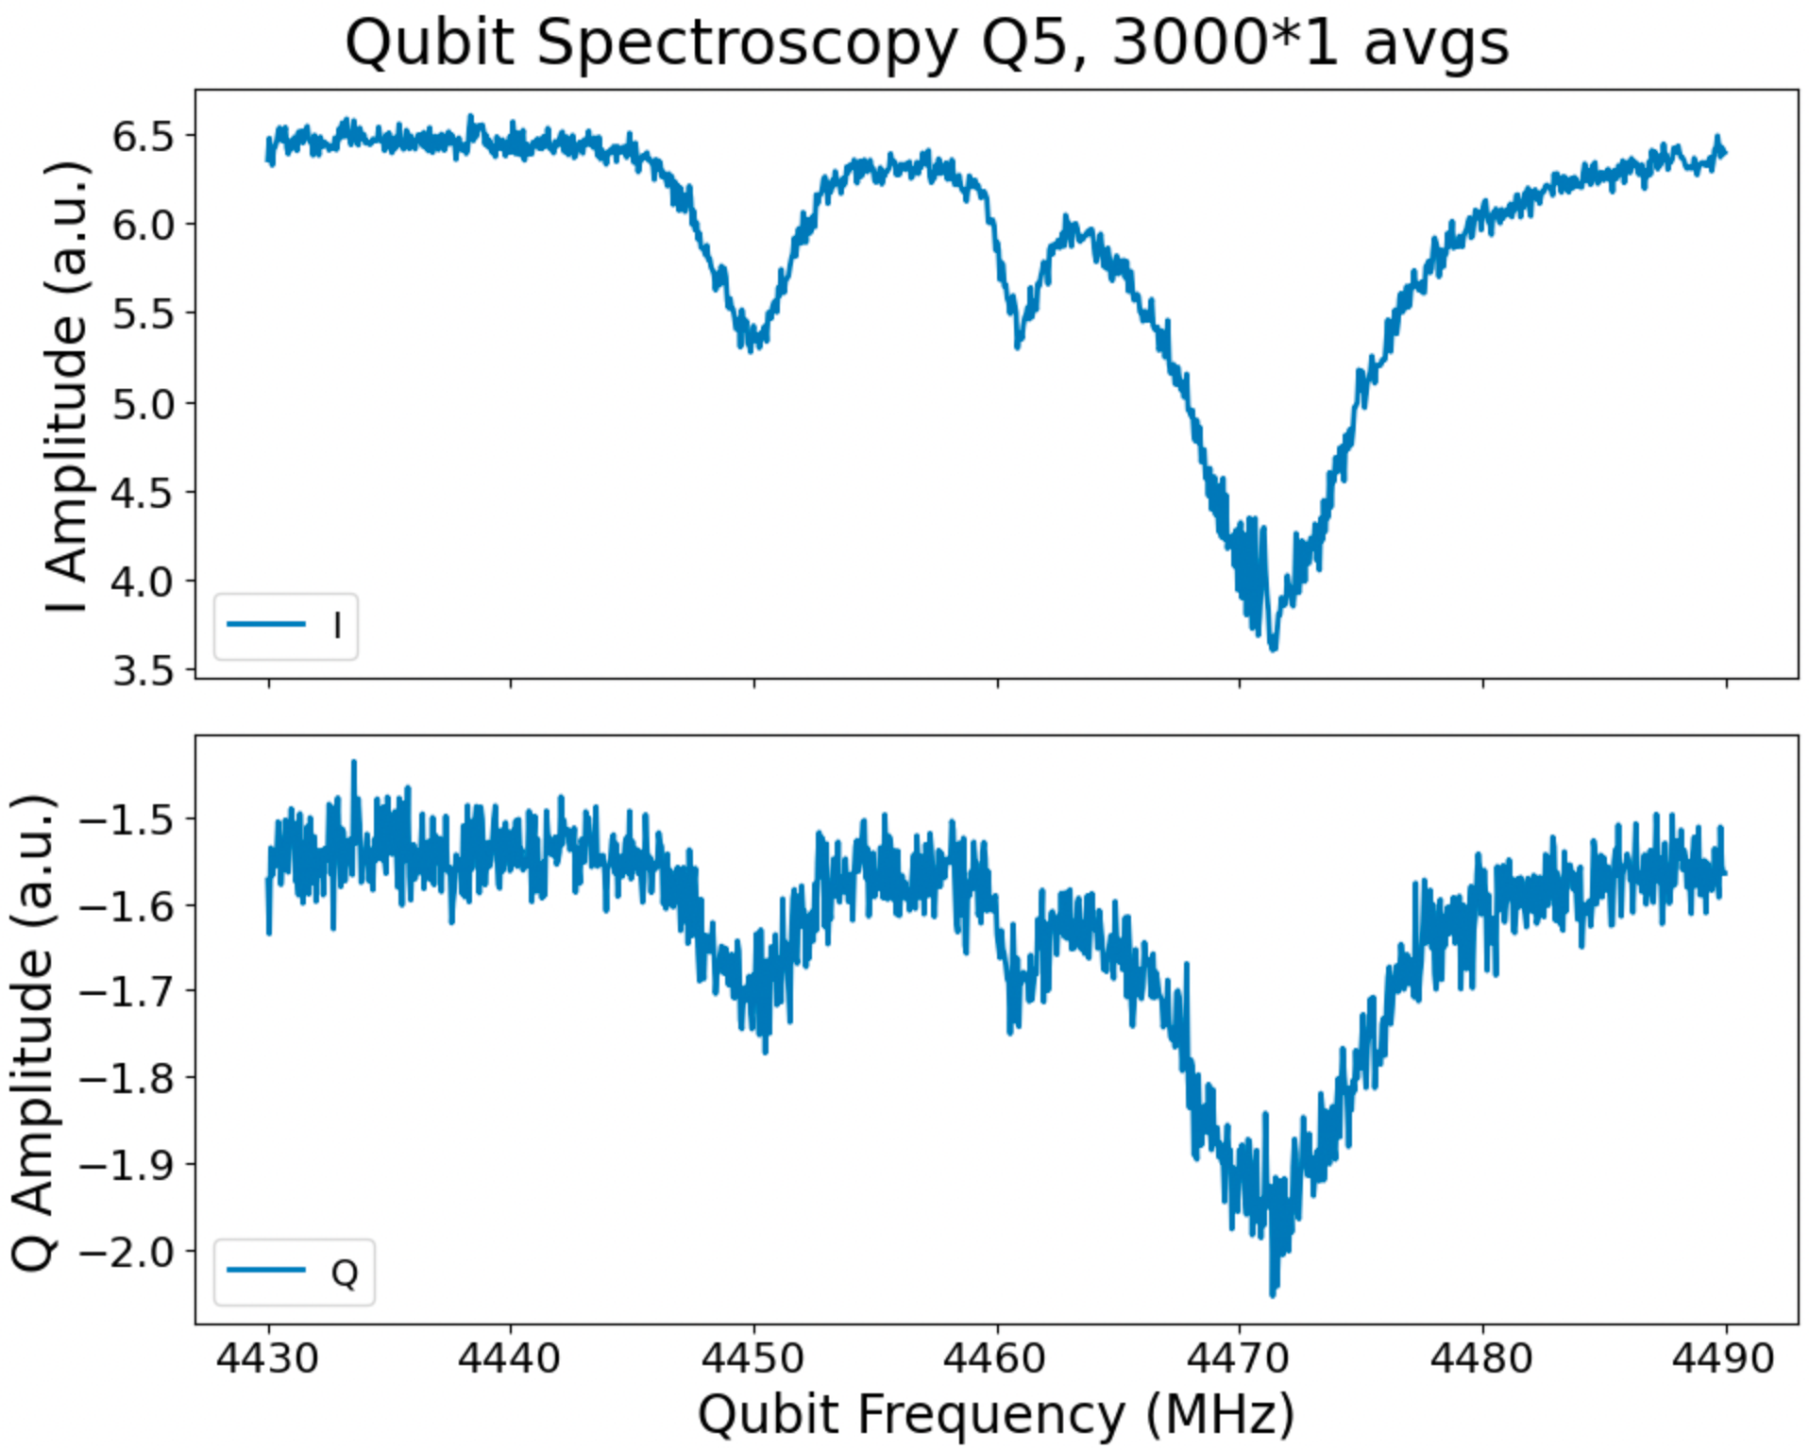
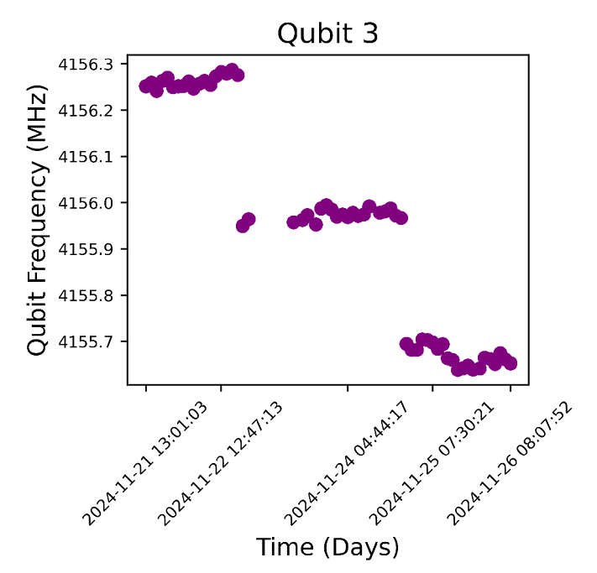
An insidious source of backgrounds: Two Level Systems (TLSes)
QUIET runs 4/7
Two-Level Systems (TLSes) are quantum systems caused by material defects in the proximity of superconducting qubits:
10.1103/PhysRevLett.133.160602
They change the qubit frequency and coherence times ☹
Olivia Seidel
TLS
Two photon Transition
Qubit
Notes:
Mention QUIET here what it is
Preliminary
Photon frequency

Slide 12
TLSes are everywhere
TLSes show up at many frequencies and change depending on the local electric environment, as well as strain environments
There have been some efforts to mitigate their effects in QC and Quantum sensors, like cleaner fab or removing the resonator [1][4]
Olivia Seidel
10.1038/s41534-019-0224-1
Notes:
Say "one group found this"
SQUATs: The qubit frequency flipping between two values consistently due to a TLS can drown out a signal. Switching rate wont have the same time decay as switching from a particle interaction, but if a TLS is dominating the switching is can drown out a potential signal.
SQUATs: Rapid TLS-induced jitter on a given qubit frequency makes it harder to resolve discrete jumps in frequency
Cavity-based Axion searches: Rapid TLS-induced frequency shifting causes qubit linewidth broadening that can make it hard or impossible to resolve number states
Cavity-based Axion searches: Additional peak that can interfere with spectroscopic determinations of resonator occupation number.
HBARs: TLSes can cause the qubit frequency to shift, and directly mimic what it would look like if something perturbed the resonant field driving the qubit.

Slide 13
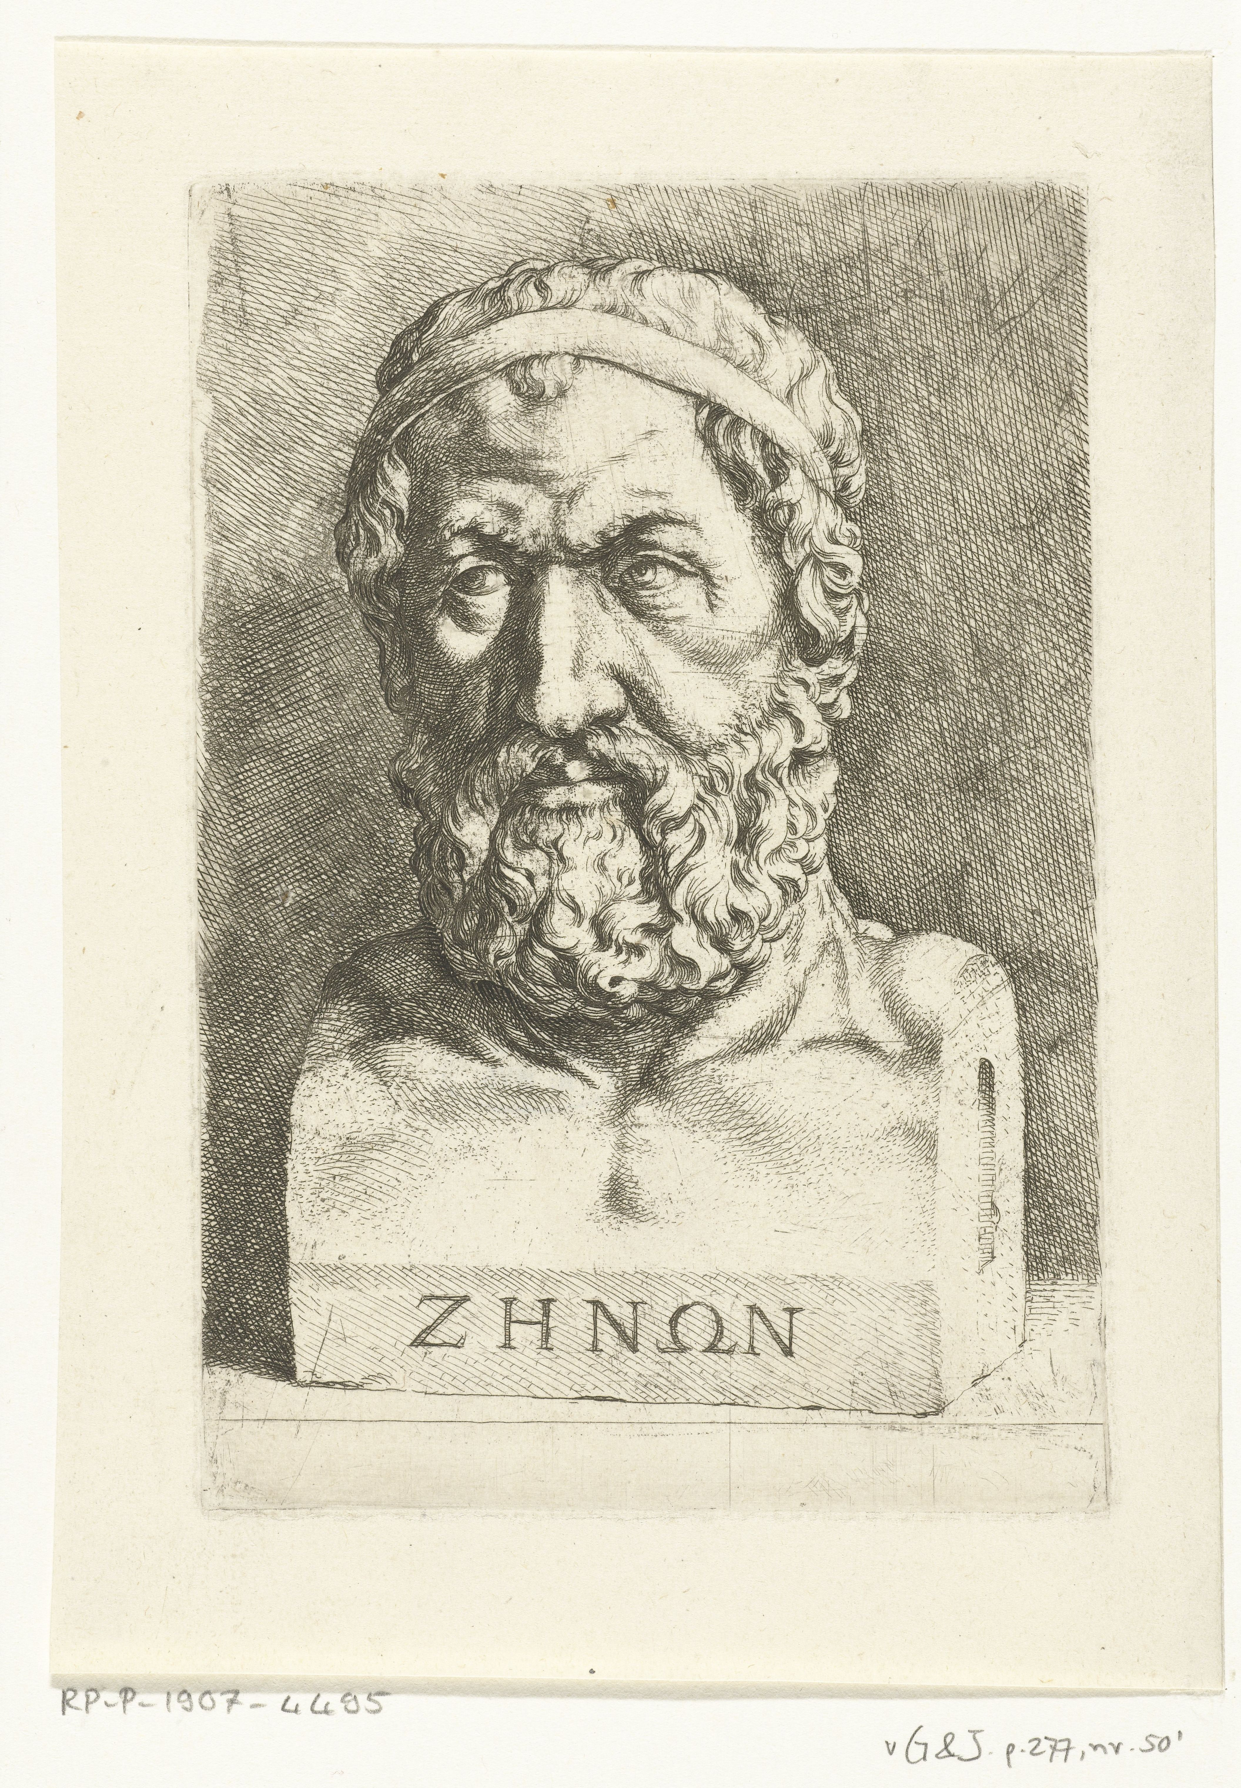







Method to constrain quantum systems: the Quantum Zeno Effect
$∆t= T$/32
$∆t= T$/16
$∆t= T$/4
$∆t= T$/8
$∆t= T$/2
https://en.wikipedia.org/wiki/Zeno_of_Elea
How the ancient Greeks solved quantum problems
Olivia Seidel
Notes:
Comparing magnitude of time to frequency--> change

Slide 14


Method to constrain quantum systems: the Quantum Zeno Effect
$∆t= T$/32
$∆t= T$/16
$∆t= T$/4
$∆t= T$/8
$∆t= T$/2
https://en.wikipedia.org/wiki/Zeno_of_Elea
How the ancient Greeks solved quantum problems
Measure
Measure
Measure
Measure
Measure
Measure
Measure
Measure
Measure
$$∆t ≫ω_{Q}$$
Qubit evolves
Qubit evolves
Qubit evolves
$$∆t≪ω_{Q}$$
Qubit doesn’t get the chance to evolve
Olivia Seidel
Notes:
Comparing magnitude of time to frequency--> change

Slide 15
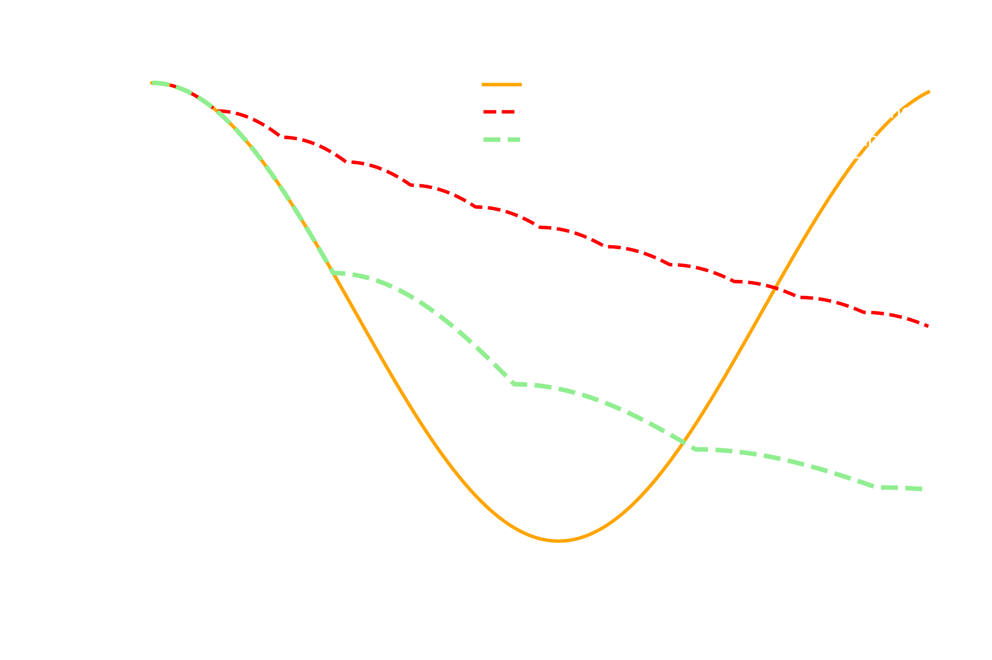


Method to constrain quantum systems: the Quantum Zeno Effect
z
$$|0⟩$$
Lab frame:
y
x
Olivia Seidel
$$|1⟩$$
Notes:
Mention how this is arbitrary units

Slide 16
Method to constrain quantum systems: the Quantum Zeno Effect
z
z
$$|0⟩$$
$$|0⟩$$
Lab frame:
y
x
Olivia Seidel
$$|1⟩$$
$$|1⟩$$
Notes:
The quantum zeno effect is cool. We can constrain a qubit using it, hey look at these cool rabi plots, and cite a bunch of literature emerging about this showing how to leverage it to stabailze idle qubits

Slide 17
Method to constrain quantum systems: the Quantum Zeno Effect
z
z
$$|0⟩$$
$$|0⟩$$
Lab frame:
y
x
Olivia Seidel
$$|1⟩$$
$$|1⟩$$
Notes:
The quantum zeno effect is cool. We can constrain a qubit using it, hey look at these cool rabi plots, and cite a bunch of literature emerging about this showing how to leverage it to stabailze idle qubits

Slide 18
Method to constrain quantum systems: the Quantum Zeno Effect
z
z
$$|0⟩$$
$$|0⟩$$
Lab frame:
y
x
Olivia Seidel
$$|1⟩$$
$$|1⟩$$
Notes:
The quantum zeno effect is cool. We can constrain a qubit using it, hey look at these cool rabi plots, and cite a bunch of literature emerging about this showing how to leverage it to stabailze idle qubits

Slide 19
Method to constrain quantum systems: the Quantum Zeno Effect
z
z
$$|0⟩$$
$$|0⟩$$
Lab frame:
y
x
Olivia Seidel
$$|1⟩$$
$$|1⟩$$
Notes:
The quantum zeno effect is cool. We can constrain a qubit using it, hey look at these cool rabi plots, and cite a bunch of literature emerging about this showing how to leverage it to stabailze idle qubits

Slide 20


Method to constrain quantum systems: the Quantum Zeno Effect
z
z
$$|0⟩$$
$$|0⟩$$
z
$$|0⟩$$
Lab frame:
y
y
Lab frame:
x
x
Olivia Seidel
$$|1⟩$$
$$|1⟩$$
$$|1⟩$$
Notes:
The quantum zeno effect is cool. We can constrain a qubit using it, hey look at these cool rabi plots, and cite a bunch of literature emerging about this showing how to leverage it to stabailze idle qubits

Slide 21
Method to constrain quantum systems: the Quantum Zeno Effect
z
z
$$|0⟩$$
$$|0⟩$$
z
$$|0⟩$$
Lab frame:
y
y
Lab frame:
x
x
Olivia Seidel
$$|1⟩$$
$$|1⟩$$
$$|1⟩$$
Notes:
The quantum zeno effect is cool. We can constrain a qubit using it, hey look at these cool rabi plots, and cite a bunch of literature emerging about this showing how to leverage it to stabailze idle qubits

Slide 22
Method to constrain quantum systems: the Quantum Zeno Effect
z
z
$$|0⟩$$
$$|0⟩$$
z
$$|0⟩$$
Lab frame:
y
y
Lab frame:
x
x
Olivia Seidel
$$|1⟩$$
$$|1⟩$$
$$|1⟩$$
Notes:
The quantum zeno effect is cool. We can constrain a qubit using it, hey look at these cool rabi plots, and cite a bunch of literature emerging about this showing how to leverage it to stabailze idle qubits

Slide 23
Method to constrain quantum systems: the Quantum Zeno Effect
z
z
$$|0⟩$$
$$|0⟩$$
z
$$|0⟩$$
Lab frame:
y
y
Lab frame:
x
x
Olivia Seidel
$$|1⟩$$
$$|1⟩$$
$$|1⟩$$
Notes:
The quantum zeno effect is cool. We can constrain a qubit using it, hey look at these cool rabi plots, and cite a bunch of literature emerging about this showing how to leverage it to stabailze idle qubits

Slide 24
Method to constrain quantum systems: the Quantum Zeno Effect
z
z
$$|0⟩$$
$$|0⟩$$
z
$$|0⟩$$
Lab frame:
y
y
Lab frame:
x
x
Olivia Seidel
$$|1⟩$$
$$|1⟩$$
$$|1⟩$$
Notes:
The quantum zeno effect is cool. We can constrain a qubit using it, hey look at these cool rabi plots, and cite a bunch of literature emerging about this showing how to leverage it to stabailze idle qubits

Slide 25
Method to constrain quantum systems: the Quantum Zeno Effect
z
z
$$|0⟩$$
$$|0⟩$$
z
$$|0⟩$$
Lab frame:
y
y
Lab frame:
x
x
Olivia Seidel
$$|1⟩$$
$$|1⟩$$
$$|1⟩$$
Notes:
The quantum zeno effect is cool. We can constrain a qubit using it, hey look at these cool rabi plots, and cite a bunch of literature emerging about this showing how to leverage it to stabailze idle qubits

Slide 26


Method to constrain quantum systems: the Quantum Zeno Effect
z
z
$$|0⟩$$
$$|0⟩$$
z
$$|0⟩$$
z
$$|0⟩$$
Lab frame:
y
y
y
x
x
x
Olivia Seidel
$$|1⟩$$
$$|1⟩$$
$$|1⟩$$
$$|1⟩$$
Notes:
The quantum zeno effect is cool. We can constrain a qubit using it, hey look at these cool rabi plots, and cite a bunch of literature emerging about this showing how to leverage it to stabailze idle qubits

Slide 27
Method to constrain quantum systems: the Quantum Zeno Effect
z
z
$$|0⟩$$
$$|0⟩$$
z
$$|0⟩$$
z
$$|0⟩$$
Lab frame:
y
y
y
x
x
x
Olivia Seidel
$$|1⟩$$
$$|1⟩$$
$$|1⟩$$
$$|1⟩$$
Notes:
The quantum zeno effect is cool. We can constrain a qubit using it, hey look at these cool rabi plots, and cite a bunch of literature emerging about this showing how to leverage it to stabailze idle qubits

Slide 28
Method to constrain quantum systems: the Quantum Zeno Effect
z
z
$$|0⟩$$
$$|0⟩$$
z
$$|0⟩$$
z
$$|0⟩$$
Lab frame:
y
y
y
x
x
x
Olivia Seidel
$$|1⟩$$
$$|1⟩$$
$$|1⟩$$
$$|1⟩$$
Notes:
The quantum zeno effect is cool. We can constrain a qubit using it, hey look at these cool rabi plots, and cite a bunch of literature emerging about this showing how to leverage it to stabailze idle qubits

Slide 29
Method to constrain quantum systems: the Quantum Zeno Effect
z
z
$$|0⟩$$
$$|0⟩$$
z
$$|0⟩$$
z
$$|0⟩$$
Lab frame:
y
y
y
Lab frame:
x
x
x
Olivia Seidel
$$|1⟩$$
$$|1⟩$$
$$|1⟩$$
$$|1⟩$$
Notes:
The quantum zeno effect is cool. We can constrain a qubit using it, hey look at these cool rabi plots, and cite a bunch of literature emerging about this showing how to leverage it to stabailze idle qubits

Slide 30
Method to constrain quantum systems: the Quantum Zeno Effect
z
z
$$|0⟩$$
$$|0⟩$$
z
$$|0⟩$$
z
$$|0⟩$$
Lab frame:
y
y
y
Lab frame:
x
x
x
Olivia Seidel
$$|1⟩$$
$$|1⟩$$
$$|1⟩$$
$$|1⟩$$
Notes:
The quantum zeno effect is cool. We can constrain a qubit using it, hey look at these cool rabi plots, and cite a bunch of literature emerging about this showing how to leverage it to stabailze idle qubits

Slide 31
Method to constrain quantum systems: the Quantum Zeno Effect
z
z
$$|0⟩$$
$$|0⟩$$
z
$$|0⟩$$
z
$$|0⟩$$
Lab frame:
y
y
y
Lab frame:
x
x
x
Olivia Seidel
$$|1⟩$$
$$|1⟩$$
$$|1⟩$$
$$|1⟩$$
Notes:
The quantum zeno effect is cool. We can constrain a qubit using it, hey look at these cool rabi plots, and cite a bunch of literature emerging about this showing how to leverage it to stabailze idle qubits

Slide 32
Method to constrain quantum systems: the Quantum Zeno Effect
We can suppress evolution our quantum system away from the poles on the Bloch sphere
z
z
$$|0⟩$$
$$|0⟩$$
z
$$|0⟩$$
z
$$|0⟩$$
Lab frame:
y
y
y
x
x
x
Olivia Seidel
$$|1⟩$$
$$|1⟩$$
$$|1⟩$$
$$|1⟩$$
Notes:
The quantum zeno effect is cool. We can constrain a qubit using it, hey look at these cool rabi plots, and cite a bunch of literature emerging about this showing how to leverage it to stabailze idle qubits. Check how to constrain a system rather than just having it slowly evolve down

Slide 33


Method to constrain quantum systems: the Quantum Zeno Effect
We can suppress evolution our quantum system away from the poles on the Bloch sphere
z
Rotating frame:
$$|0⟩$$
y
x
z
z
$$|0⟩$$
$$|0⟩$$
z
$$|0⟩$$
z
$$|0⟩$$
Lab frame:
y
y
y
x
x
x
Olivia Seidel
$$|1⟩$$
$$|1⟩$$
$$|1⟩$$
$$|1⟩$$
$$|1⟩$$
Notes:
The quantum zeno effect is cool. We can constrain a qubit using it, hey look at these cool rabi plots, and cite a bunch of literature emerging about this showing how to leverage it to stabailze idle qubits. Check how to constrain a system rather than just having it slowly evolve down

Slide 34
Method to constrain quantum systems: the Quantum Zeno Effect
We can suppress evolution our quantum system away from the poles on the Bloch sphere
z
Rotating frame:
$$|0⟩$$
y
x
z
z
$$|0⟩$$
$$|0⟩$$
z
$$|0⟩$$
z
$$|0⟩$$
Lab frame:
y
y
y
x
x
x
Olivia Seidel
$$|1⟩$$
$$|1⟩$$
$$|1⟩$$
$$|1⟩$$
$$|1⟩$$
Notes:
The quantum zeno effect is cool. We can constrain a qubit using it, hey look at these cool rabi plots, and cite a bunch of literature emerging about this showing how to leverage it to stabailze idle qubits. Check how to constrain a system rather than just having it slowly evolve down

Slide 35
Method to constrain quantum systems: the Quantum Zeno Effect
We can suppress evolution our quantum system away from the poles on the Bloch sphere
z
Rotating frame:
$$|0⟩$$
y
x
z
z
$$|0⟩$$
$$|0⟩$$
z
$$|0⟩$$
z
$$|0⟩$$
Lab frame:
y
y
y
x
x
x
Olivia Seidel
$$|1⟩$$
$$|1⟩$$
$$|1⟩$$
$$|1⟩$$
$$|1⟩$$
Notes:
The quantum zeno effect is cool. We can constrain a qubit using it, hey look at these cool rabi plots, and cite a bunch of literature emerging about this showing how to leverage it to stabailze idle qubits. Check how to constrain a system rather than just having it slowly evolve down

Slide 36
Method to constrain quantum systems: the Quantum Zeno Effect
We can suppress evolution our quantum system away from the poles on the Bloch sphere
z
Rotating frame:
$$|0⟩$$
y
x
z
z
$$|0⟩$$
$$|0⟩$$
z
$$|0⟩$$
z
$$|0⟩$$
Lab frame:
y
y
y
x
x
x
Olivia Seidel
$$|1⟩$$
$$|1⟩$$
$$|1⟩$$
$$|1⟩$$
$$|1⟩$$
Notes:
The quantum zeno effect is cool. We can constrain a qubit using it, hey look at these cool rabi plots, and cite a bunch of literature emerging about this showing how to leverage it to stabailze idle qubits. Check how to constrain a system rather than just having it slowly evolve down

Slide 37
Method to constrain quantum systems: the Quantum Zeno Effect
We can suppress evolution our quantum system away from the poles on the Bloch sphere
z
Rotating frame:
$$|0⟩$$
y
x
z
z
$$|0⟩$$
$$|0⟩$$
z
$$|0⟩$$
z
$$|0⟩$$
Lab frame:
y
y
y
x
x
x
Olivia Seidel
$$|1⟩$$
$$|1⟩$$
$$|1⟩$$
$$|1⟩$$
$$|1⟩$$
Notes:
The quantum zeno effect is cool. We can constrain a qubit using it, hey look at these cool rabi plots, and cite a bunch of literature emerging about this showing how to leverage it to stabailze idle qubits. Check how to constrain a system rather than just having it slowly evolve down

Slide 38
Method to constrain quantum systems: the Quantum Zeno Effect
We can constrain our quantum system to a subsection of the Bloch sphere
z
z
$$|0⟩$$
$$|0⟩$$
z
$$|0⟩$$
z
$$|0⟩$$
Lab frame:
y
y
y
x
x
x
Olivia Seidel
$$|1⟩$$
$$|1⟩$$
$$|1⟩$$
$$|1⟩$$
Notes:
The quantum zeno effect is cool. We can constrain a qubit using it, hey look at these cool rabi plots, and cite a bunch of literature emerging about this showing how to leverage it to stabailze idle qubits. Check how to constrain a system rather than just having it slowly evolve down

Slide 39
Method to constrain quantum systems: the Quantum Zeno Effect
We can constrain our quantum system to a subsection of the Bloch sphere
z
$$|0⟩$$
y
x
z
z
$$|0⟩$$
$$|0⟩$$
z
$$|0⟩$$
z
$$|0⟩$$
Lab frame:
y
y
y
x
x
x
Olivia Seidel
$$|1⟩$$
$$|1⟩$$
$$|1⟩$$
$$|1⟩$$
$$|1⟩$$
Notes:
The quantum zeno effect is cool. We can constrain a qubit using it, hey look at these cool rabi plots, and cite a bunch of literature emerging about this showing how to leverage it to stabailze idle qubits. Check how to constrain a system rather than just having it slowly evolve down

Slide 40
Method to constrain quantum systems: the Quantum Zeno Effect
We can constrain our quantum system to a subsection of the Bloch sphere
z
$$|0⟩$$
y
x
z
z
$$|0⟩$$
$$|0⟩$$
z
$$|0⟩$$
z
$$|0⟩$$
Lab frame:
y
y
y
x
x
x
Olivia Seidel
$$|1⟩$$
$$|1⟩$$
$$|1⟩$$
$$|1⟩$$
$$|1⟩$$
Notes:
The quantum zeno effect is cool. We can constrain a qubit using it, hey look at these cool rabi plots, and cite a bunch of literature emerging about this showing how to leverage it to stabailze idle qubits. Check how to constrain a system rather than just having it slowly evolve down

Slide 41
Method to constrain quantum systems: the Quantum Zeno Effect
We can constrain our quantum system to a subsection of the Bloch sphere
z
Rotating frame:
$$|0⟩$$
y
x
z
z
$$|0⟩$$
$$|0⟩$$
z
$$|0⟩$$
z
$$|0⟩$$
Lab frame:
y
y
y
x
x
x
Olivia Seidel
$$|1⟩$$
$$|1⟩$$
$$|1⟩$$
$$|1⟩$$
$$|1⟩$$
Notes:
The quantum zeno effect is cool. We can constrain a qubit using it, hey look at these cool rabi plots, and cite a bunch of literature emerging about this showing how to leverage it to stabailze idle qubits. Check how to constrain a system rather than just having it slowly evolve down

Slide 42
Method to constrain quantum systems: the Quantum Zeno Effect
We can constrain our quantum system to a subsection of the Bloch sphere
z
Rotating frame:
$$|0⟩$$
Zeno subspace
}
y
Post-selection
x
z
z
$$|0⟩$$
$$|0⟩$$
z
$$|0⟩$$
z
$$|0⟩$$
Lab frame:
y
y
y
x
x
x
Olivia Seidel
$$|1⟩$$
$$|1⟩$$
$$|1⟩$$
$$|1⟩$$
$$|1⟩$$
Can we do this with a TLS?
Notes:
The quantum zeno effect is cool. We can constrain a qubit using it, hey look at these cool rabi plots, and cite a bunch of literature emerging about this showing how to leverage it to stabailze idle qubits. Check how to constrain a system rather than just having it slowly evolve down

Slide 43
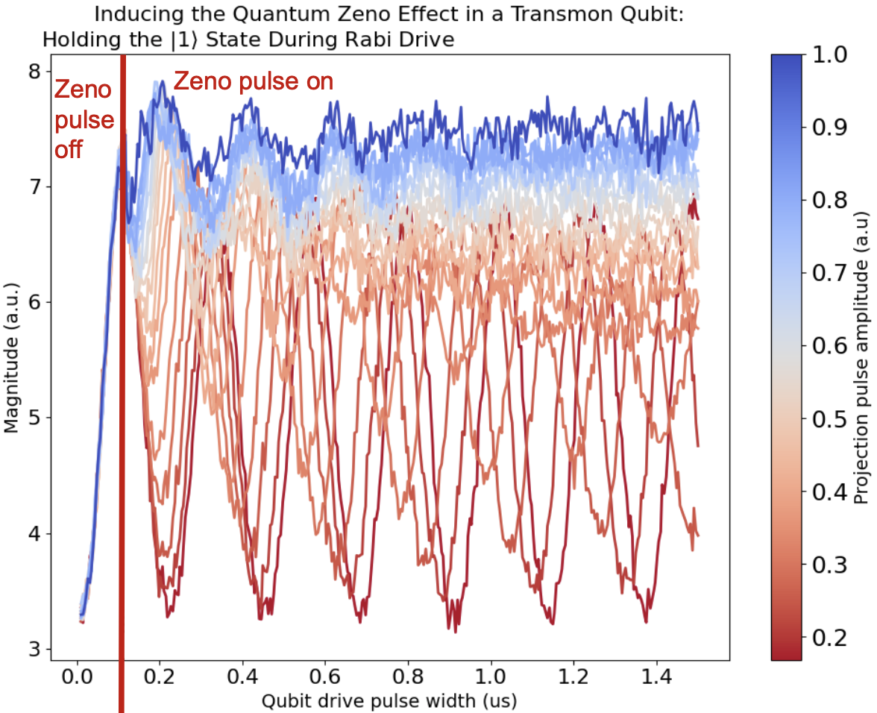
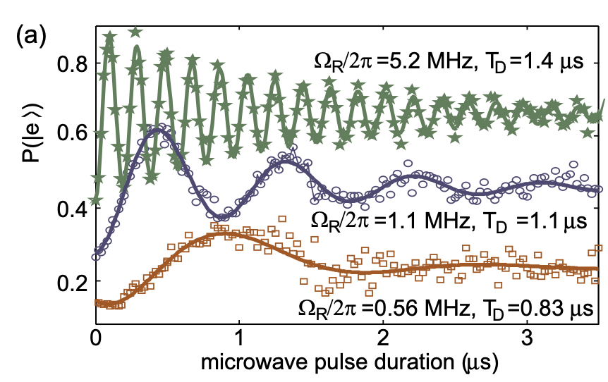
We have measured the QZE in the qubit's ‘two levels’
Similar to the qubit, a TLS is also a two level quantum system with a coherence time, and frequency
Preliminary
Rabi oscillations of a TLS (10.1103/PhysRevB.95.241409) 10.1126/sciadv.ado6240
Olivia Seidel

Slide 44
Roadmap
Steps towards stabilizing TLSes to better enable reliable quantum sensors:
Induce the QZE on the qubit
Induce the QZE on the qubit using photons in the resonator
Characterize a TLS
Rabi a TLS and get its T1 time, Track the amount of its instability
Stabilize TLS
Induce the QZE on The TLS and benchmark stabilization on the qubit frequency
Olivia Seidel
Rabi oscillations of a TLS (10.1103/PhysRevB.95.241409)
This shouldn’t happen while freezing the TLS

Slide 45
Conclusion
Superconducting based qubits offer potential for ultra-low energy particle detection
Two of the leading known sources of backgrounds:
Cosmic Rays
Defect Two Level Systems
(1) can be mitigated by going underground, (2) remains a limiting background to qubit-based sensing
The Quantum Zeno Effect constrains a quantum system, and could provide a method for constraining Defect Two Level Systems
This work aims to prove this idea
Thank you to the DOE and the Graduate Instrumentation Research Award committee for supporting this work!
Olivia Seidel

Slide 46
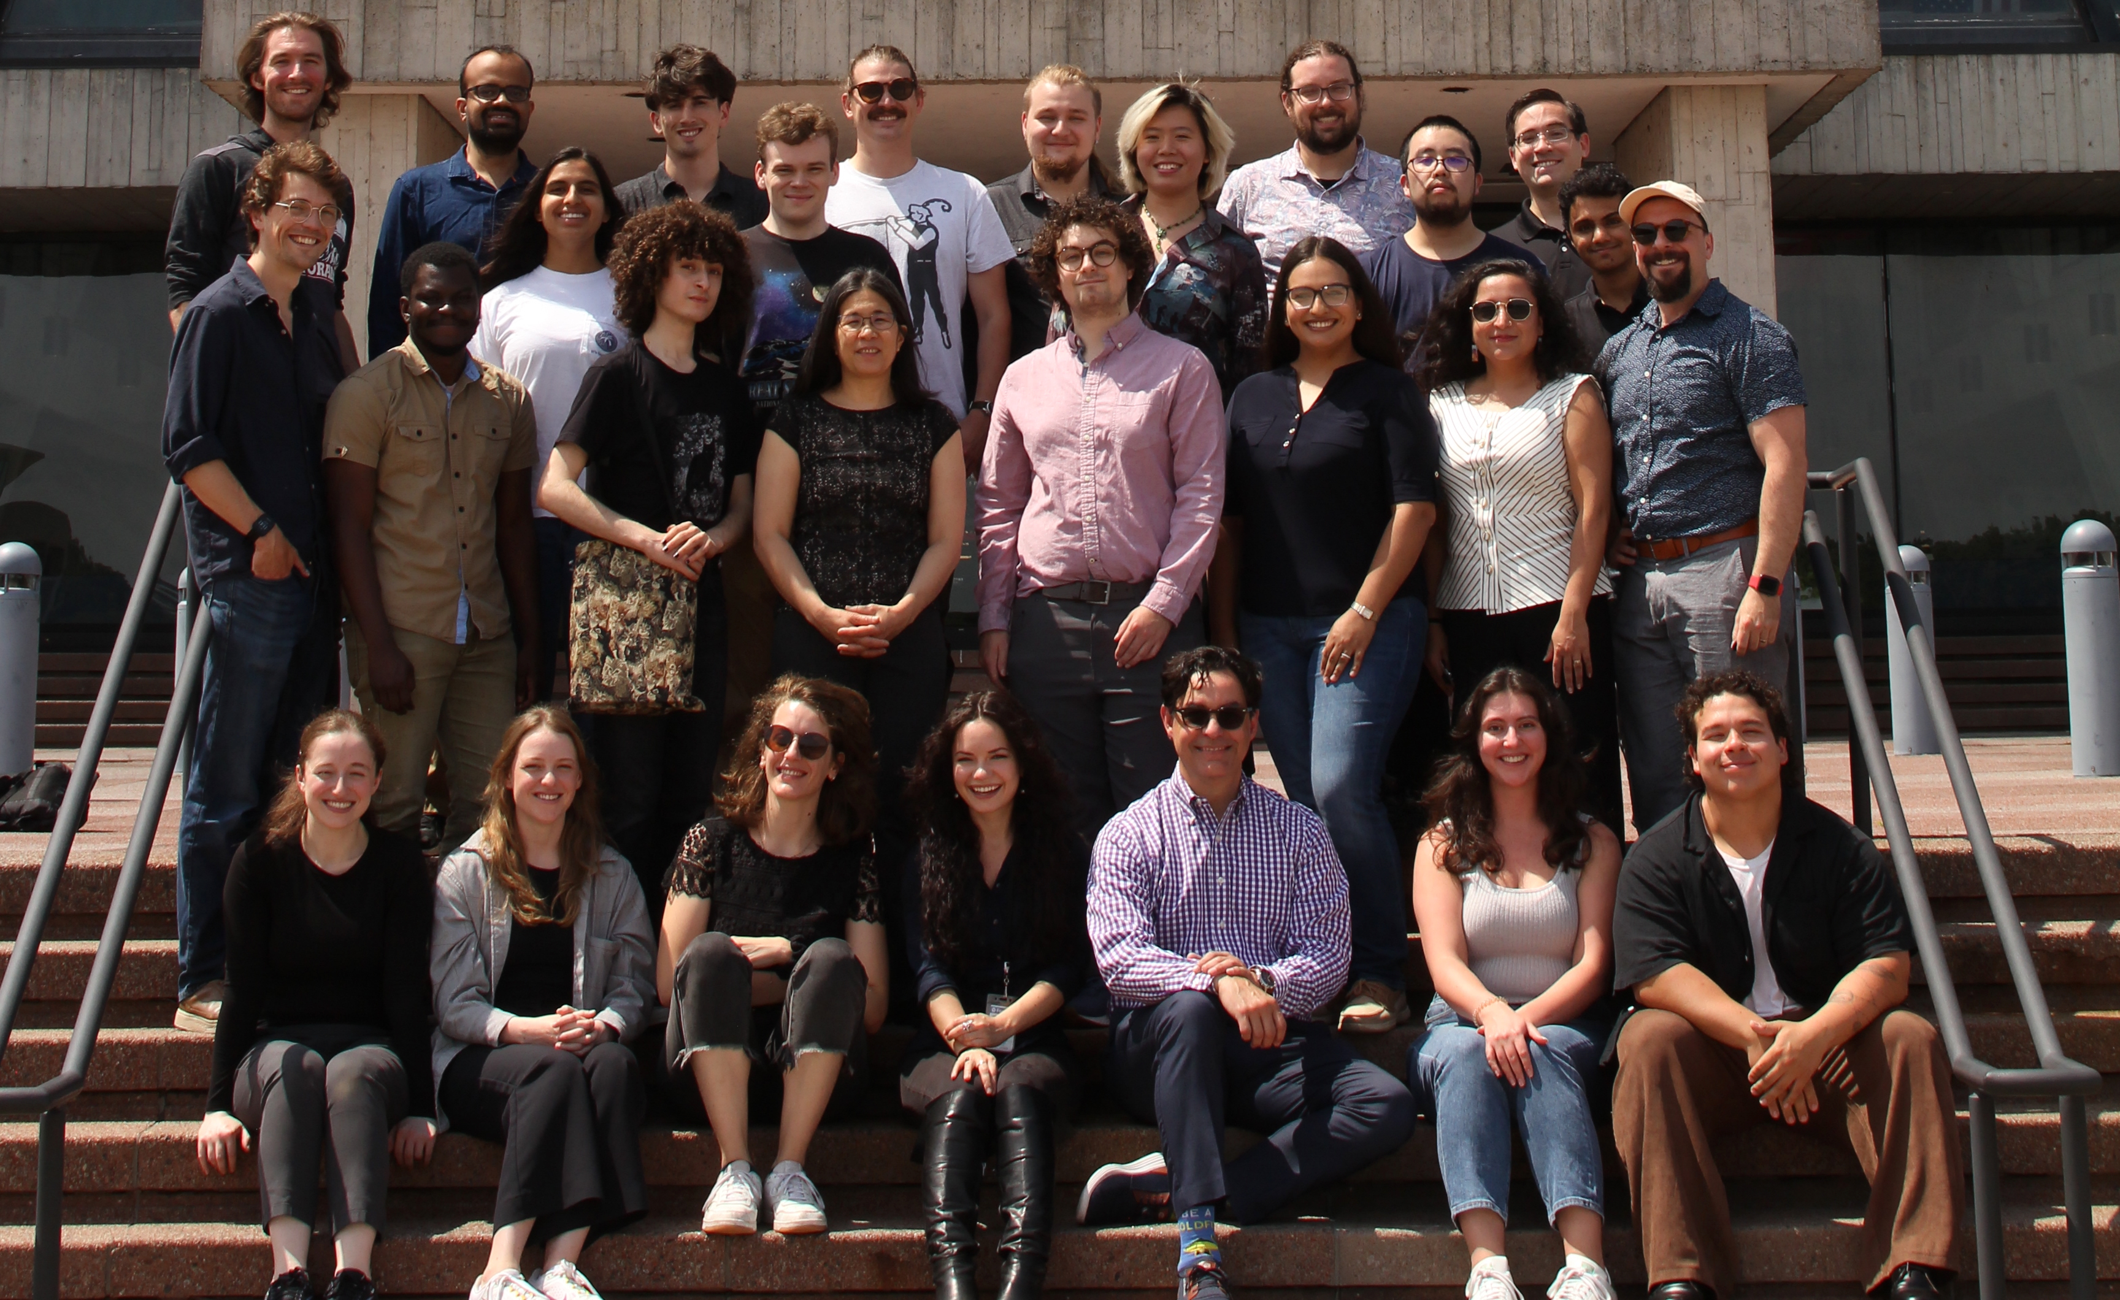
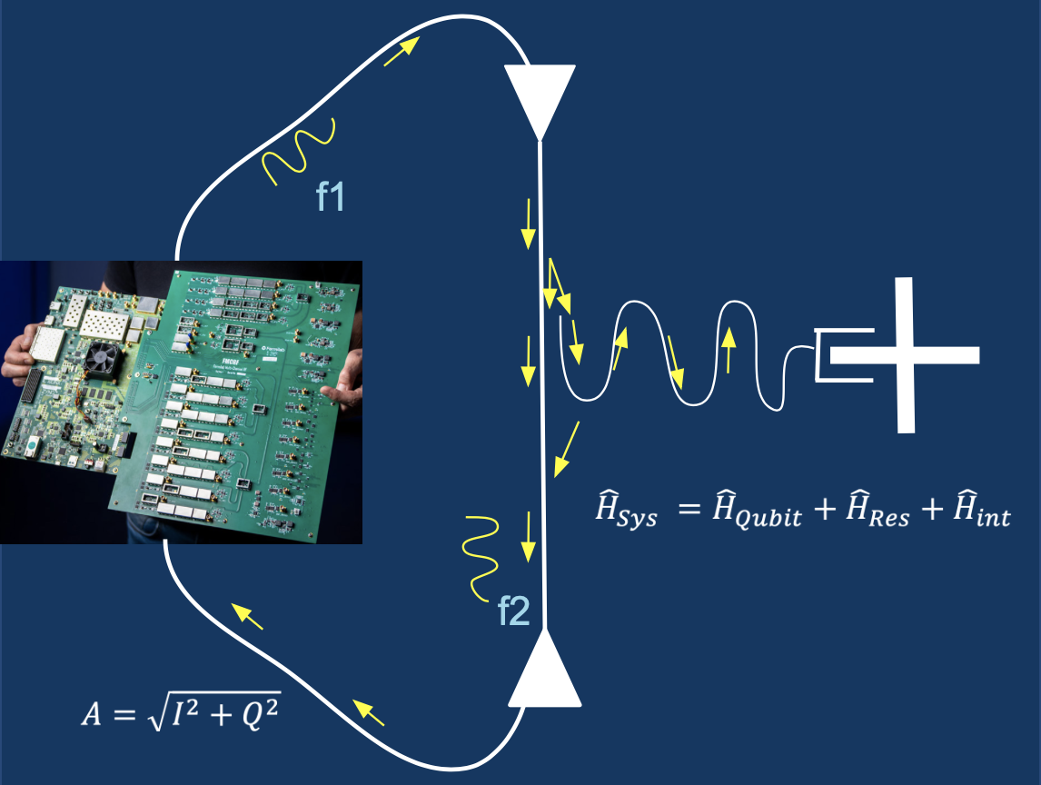
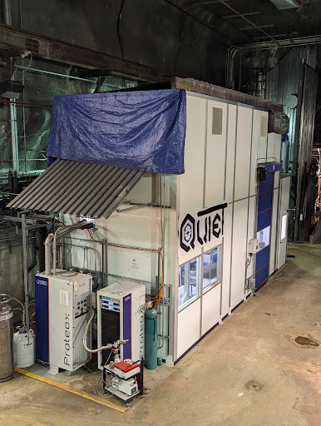
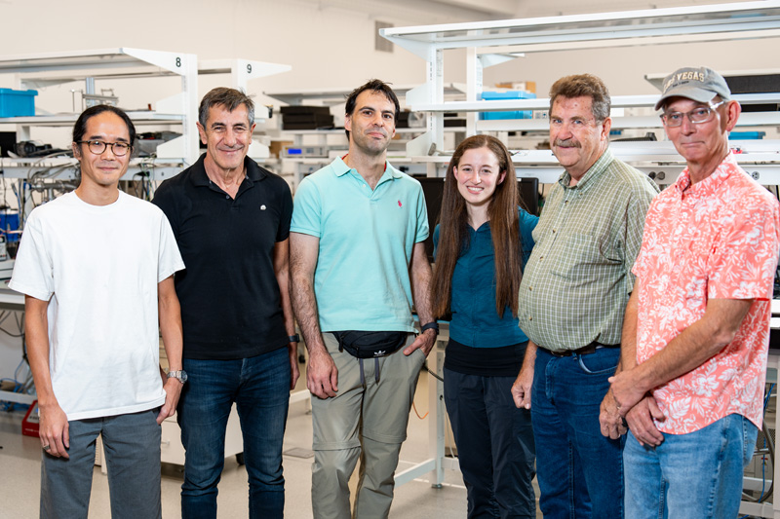
Thank you to the Fermilab CosmiQ and QICK teams!
Olivia Seidel

Slide 47
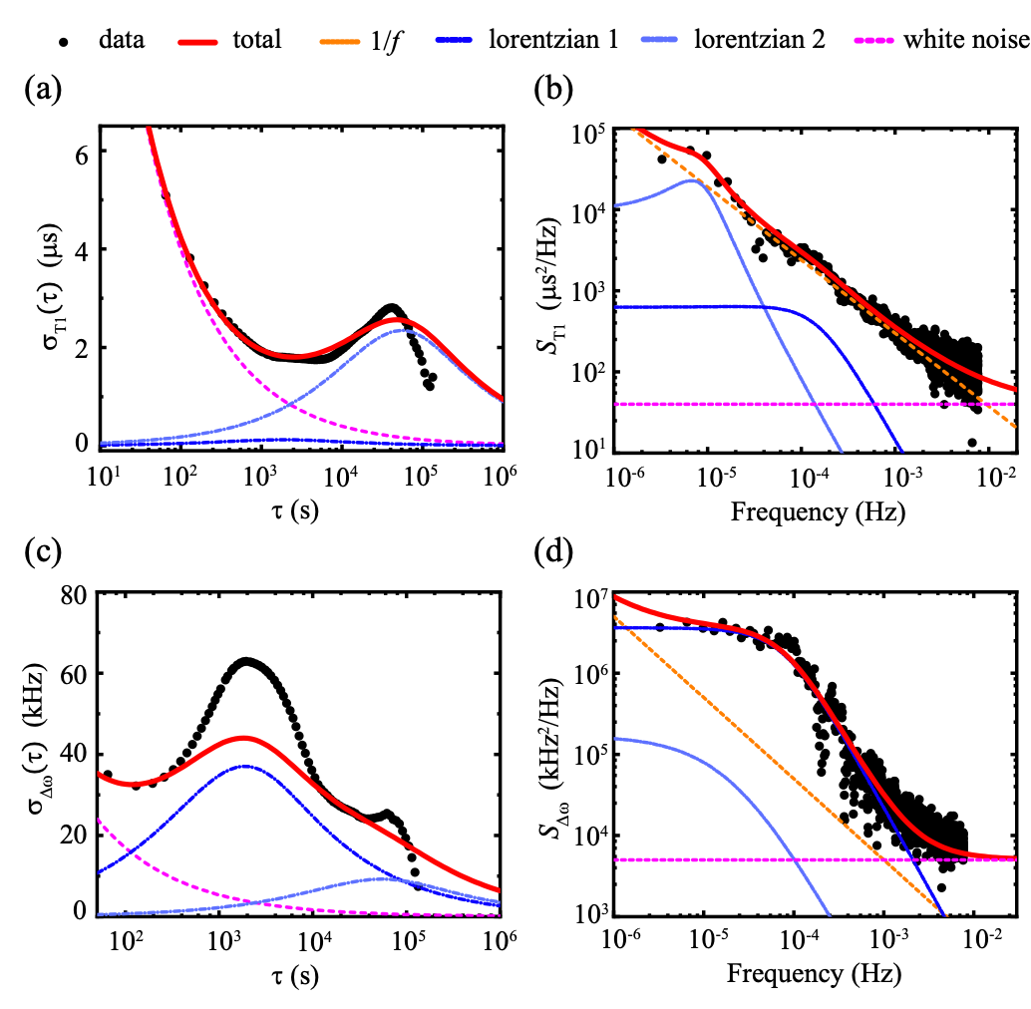
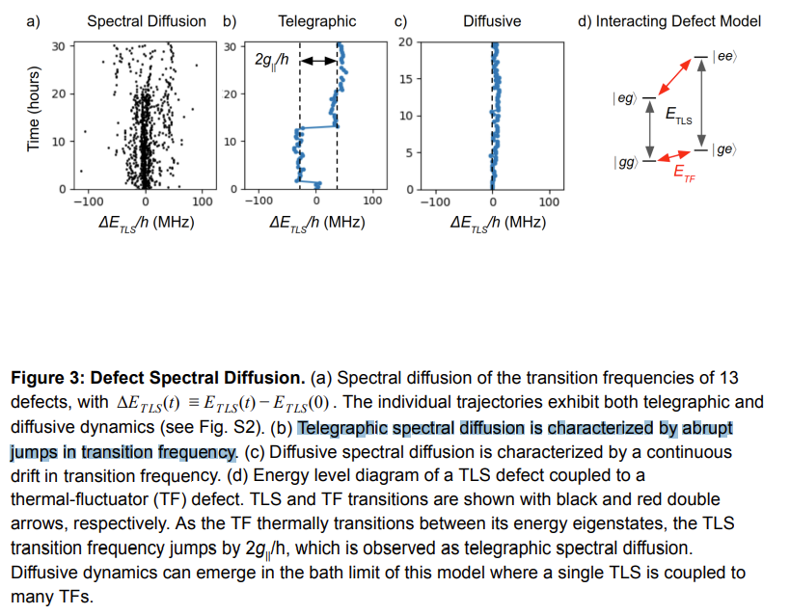
A second insidious source of backgrounds: Two Level Systems (TLSes)
Two-Level Systems (TLSes) are quantum systems caused by material defects in the proximity of superconducting qubits:
These shift the qubit frequency around, and coherence times
They can exhibit various types of TLS behavior (diffusive, telegraphic, etc)
If you are lucky, they will switch at a reliable rate. However, often, this doesn’t happen ☹
Olivia Seidel
Notes:
Remove right two

Slide 48
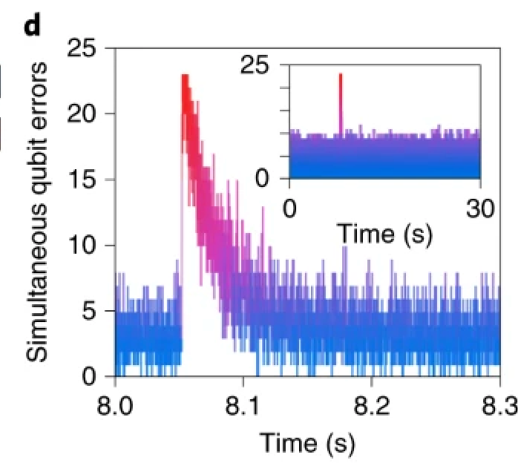
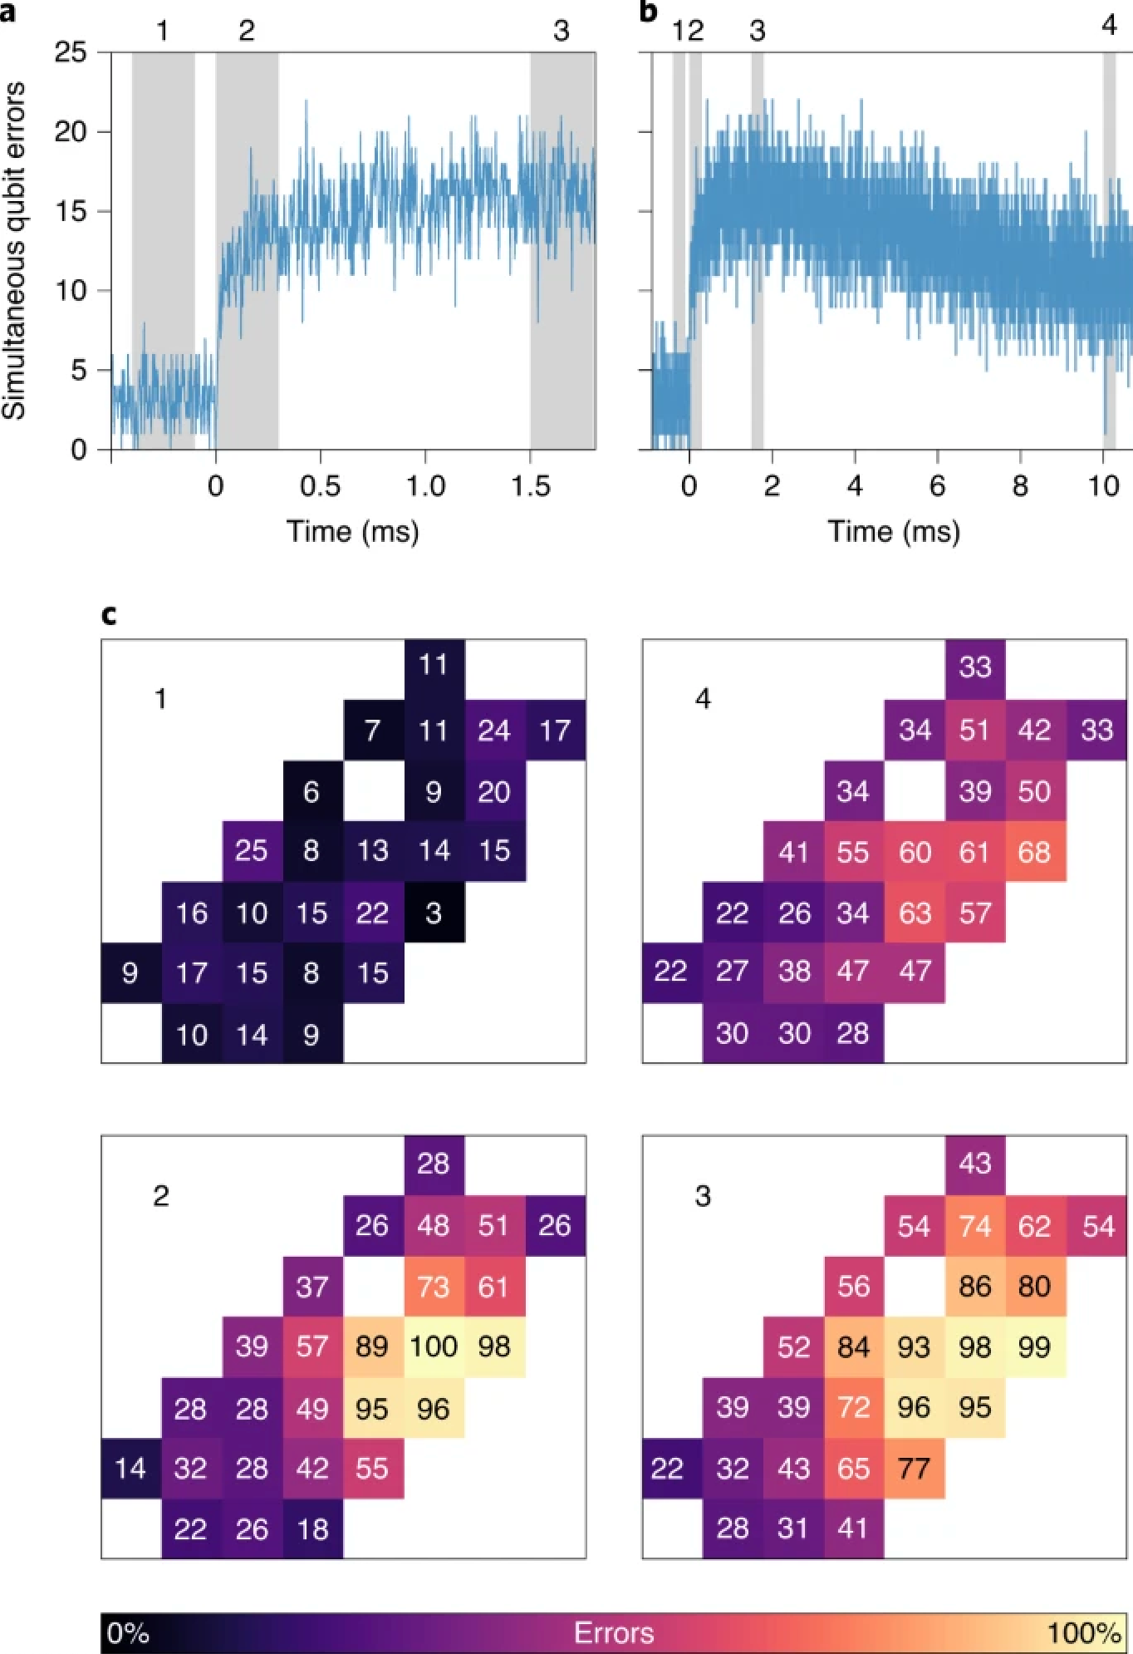
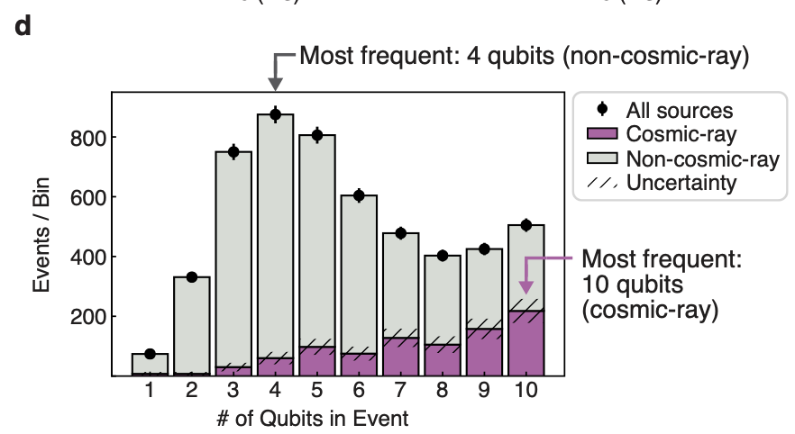
Qubits are great sensors, and are extra sensitive to cosmic rays
Cosmic Ray Induced Quasiparticles → Decoherence
Phonons break cooper pairs, which tunnel to JJ and cause suppression of T1
Cosmic rays found to account for 17.1 ±1.3% of spatiotemporally correlated events
Olivia Seidel
[6]
[5]

Slide 49
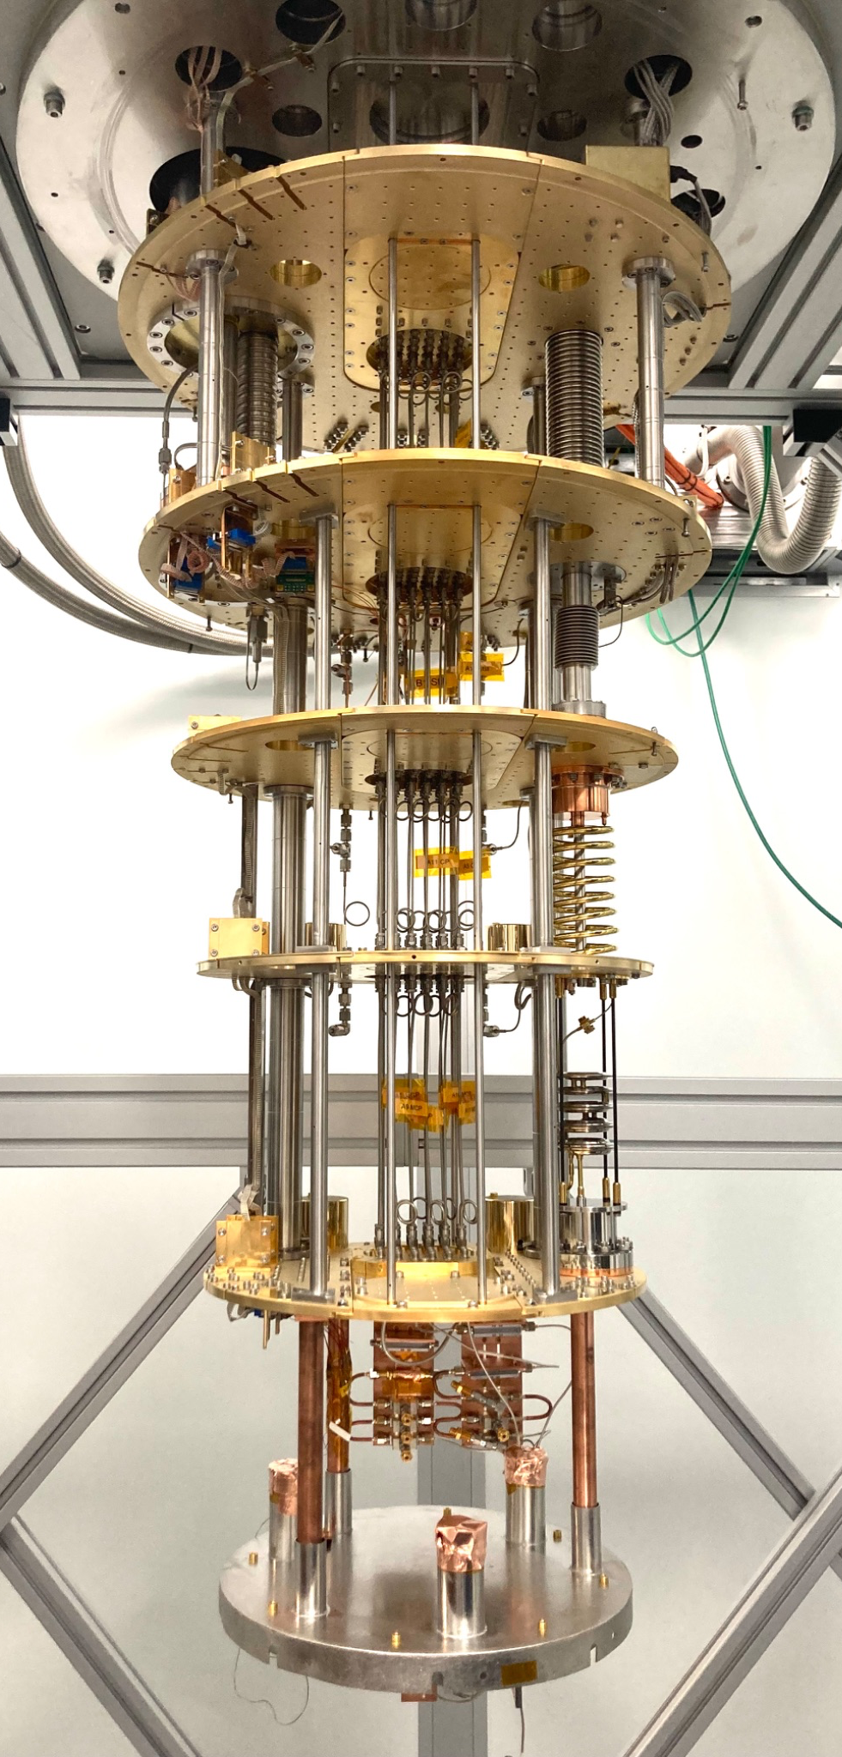
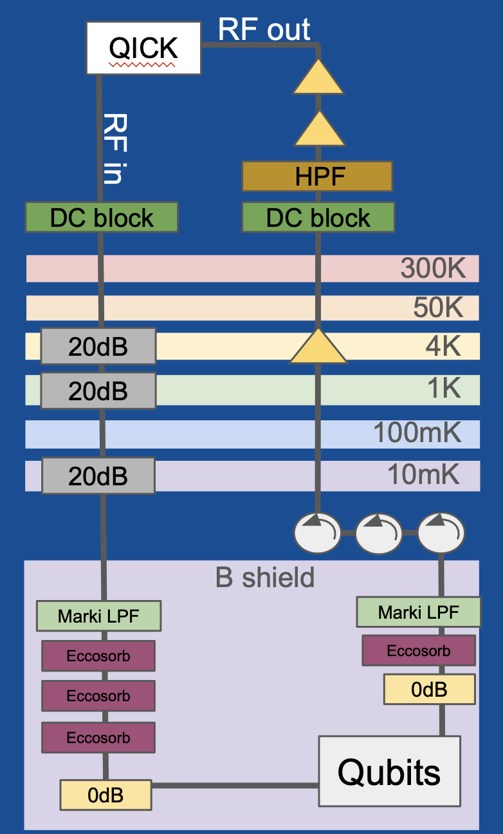
Cosmic ray solution: go 100m underground
Low background facility
99% reduction in muon flux when compared to surface level fridges!
Deepest QIS fridge in US (that we know of)
Olivia Seidel

Slide 50
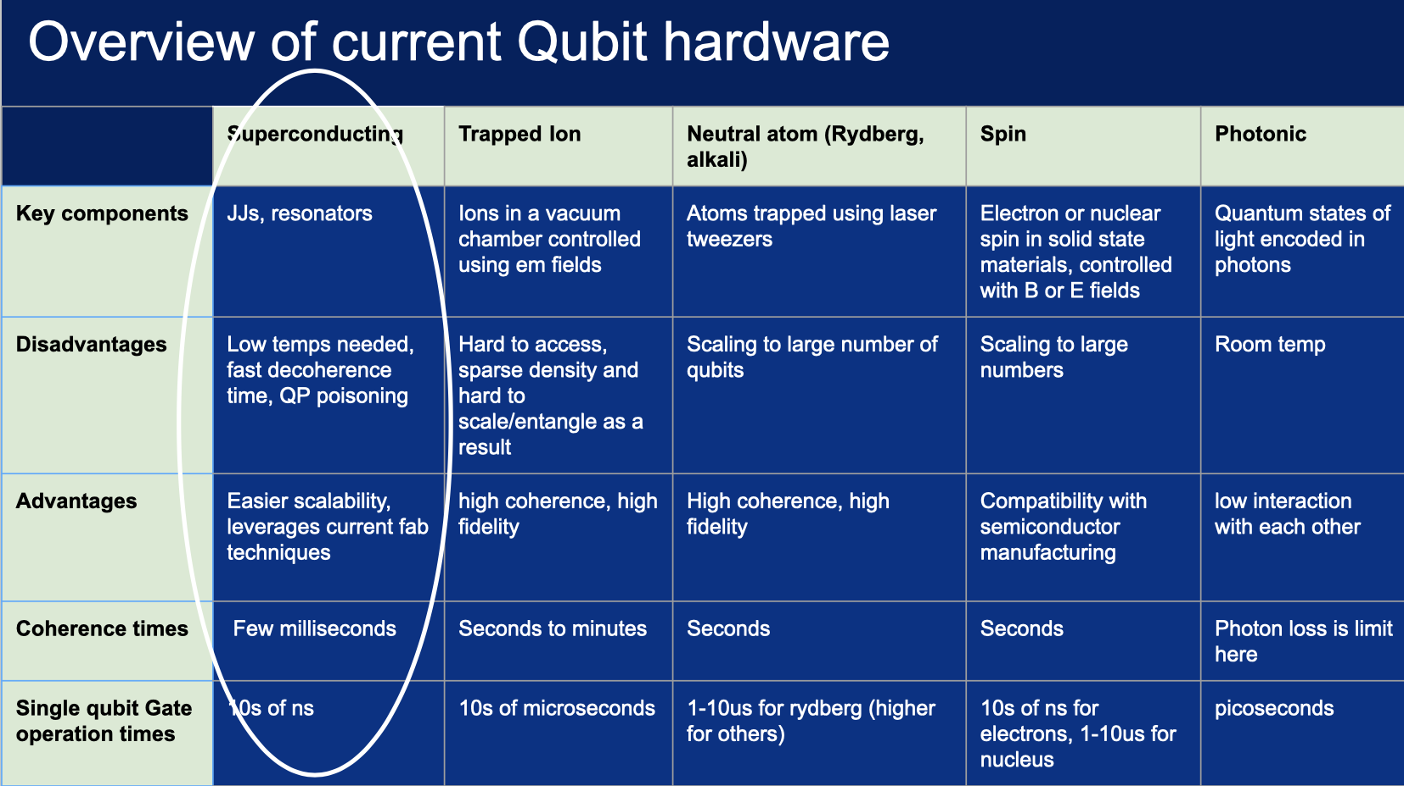
Complicated control architecture
Room temp
nanoseconds

Slide 51

How is the QZE different than decoherence?
Decoherence
Loss of Quantum Information (somehow)
QZE
Flux noise
Loss of Quantum Information via entanglement
Environmental
Experimenter
TLSes
Photons in the resonator
Pure dephasing is most fundamentally the loss of quantum information from the qubits perspective, and if it happens through entanglement its the QZE
Charge noise
External noise sources
Notes:
The QZE describes how entanglement changes the time dynamics of a quantum system, and when entanglement happens, so does decoherence/information loss (unless its to another qubit that you are tracking)
-say definition of entanglement

