Slide 1

Searching for Axions with Magnetic Resonance Force Microscopes
Presenter: Muhammad Hani Zaheer
Coauthors: Elham Kashi, Ryan Petery, Swati Singh

Slide 2
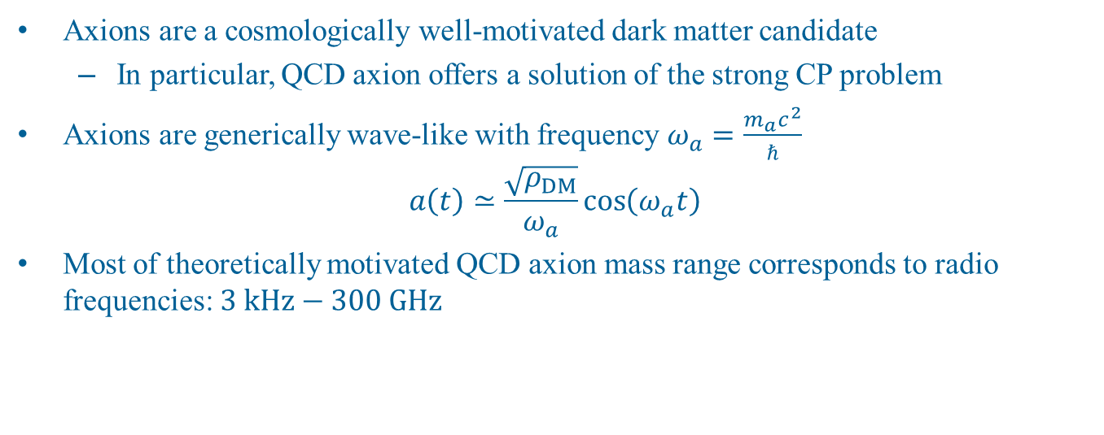
Axion Dark Matter
Axions are a cosmologically well-motivated dark matter candidate
  In particular, QCD axion offers a solution of the strong CP problem
Axions are generically wave-like with frequency $ω_{a}=\frac{m_{a}c^{2}}{ℏ}$
$$a\left(t\right)≃\frac{\sqrt{ρ_{DM}}}{ω_{a}}\cos\left(ω_{a}t\right)$$
Most of theoretically motivated QCD axion mass range corresponds to radio frequencies: $3 kHz−300 GHz$

Slide 3

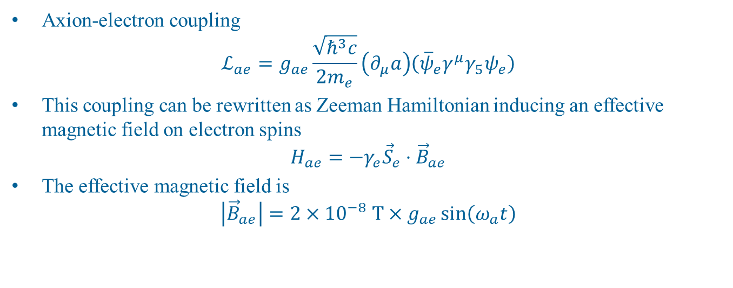



Axions as a Background Magnetic Field
$$e$$
$$a$$
Axion-electron coupling
$$ℒ_{ae}=g_{ae}\frac{\sqrt{ℏ^{3}c}}{2m_{e}}\left(∂_{μ}a\right)\left({\overline{ψ}}_{e}γ^{μ}γ_{5}ψ_{e}\right)$$
This coupling can be rewritten as Zeeman Hamiltonian inducing an effective magnetic field on electron spins
$$H_{ae}=−γ_{e}{\vec{S}}_{e}⋅{\vec{B}}_{ae}$$
The effective magnetic field is
$$\left|{\vec{B}}_{ae}\right|=2×{10}^{−8} T×g_{ae}\sin\left(ω_{a}t\right)$$
$$\overline{e}$$
Axion Wind
Other spin magnetometry based axion searches: QUAX, CASPEr, …
Notes:
The solar system orbits galactic center. In Earth’s frame of reference, the galactic ambient DM background passes through detectors at galactic velocities. This is the axion wind effect.

Slide 4
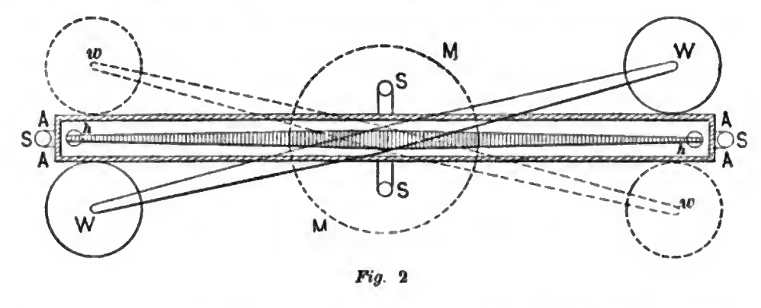
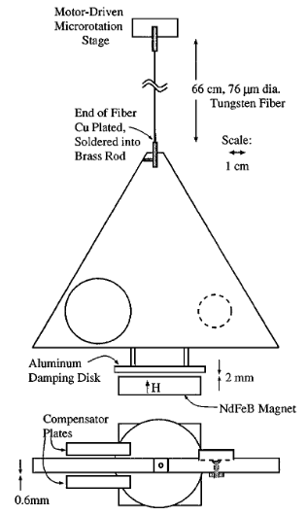
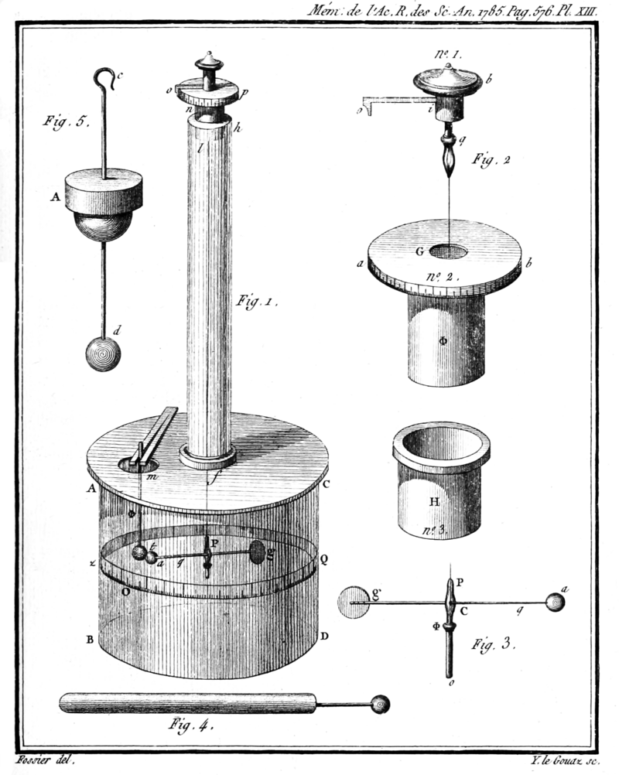
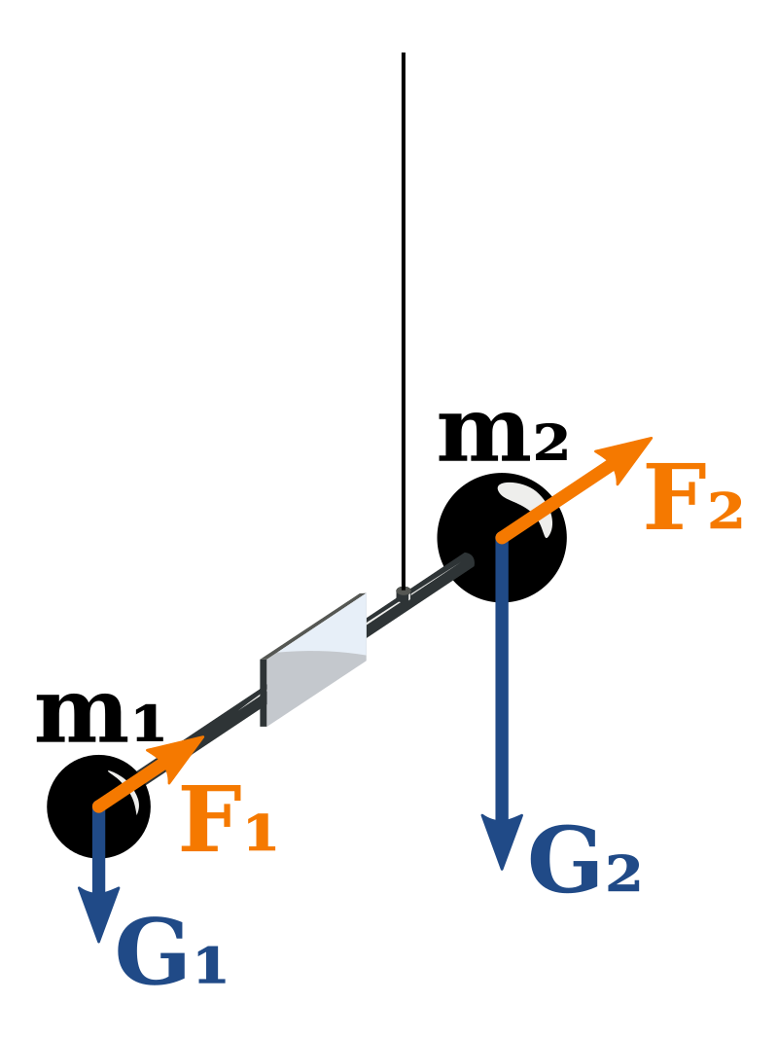
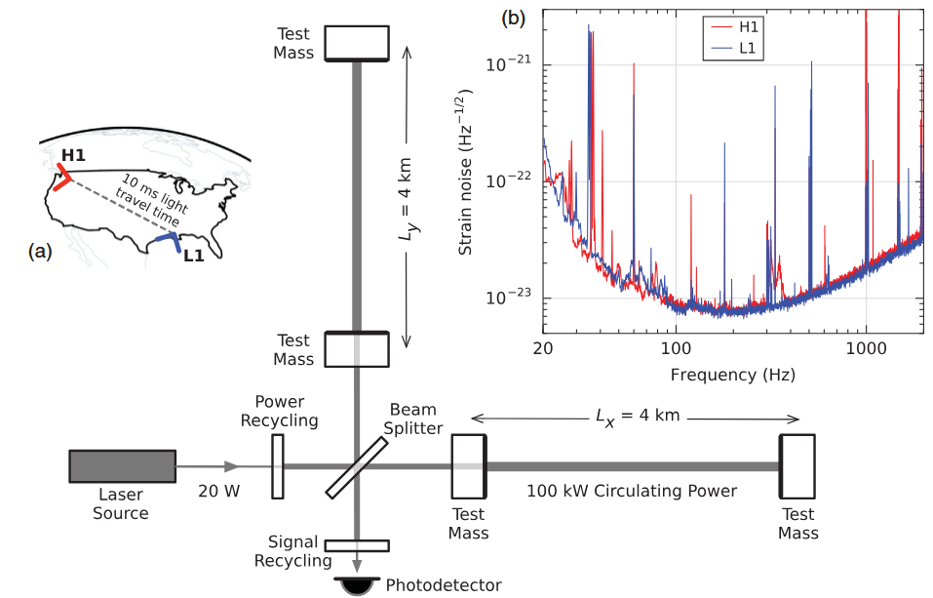
Mechanical Detection for Fundamental Physics
Cavendish
Gravitational Force
Casimir Force
1798
1997
1785
1885
2015
Coulomb Force
Eӧtvӧs
EP Test
Gravitational Waves (LIGO)
Notes:
Current EP tests and best constraints on some scalar couplings are due to modern versions of Eotvos EP test

Slide 5
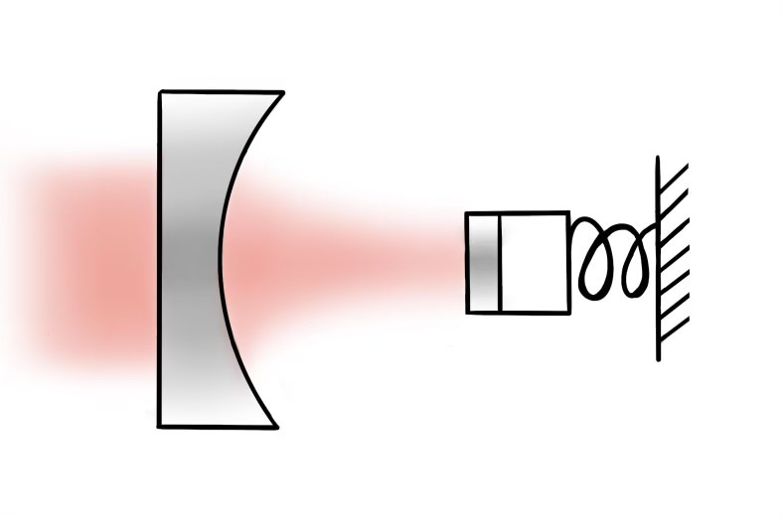
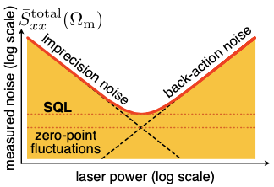
Mechanical Detection at SQL
Modern state-of-the-art mechanical detectors can operate at the standard quantum limit (SQL) or beyond
Low photon count: higher imprecision/shot noise due to quantum fluctuations
High photon count: higher back action noise from radiation pressure
Minimum readout noise happens at SQL
Aspelmeyer, et al, Rev. Mod. Phys. 86, 1391 (2014)

Slide 6
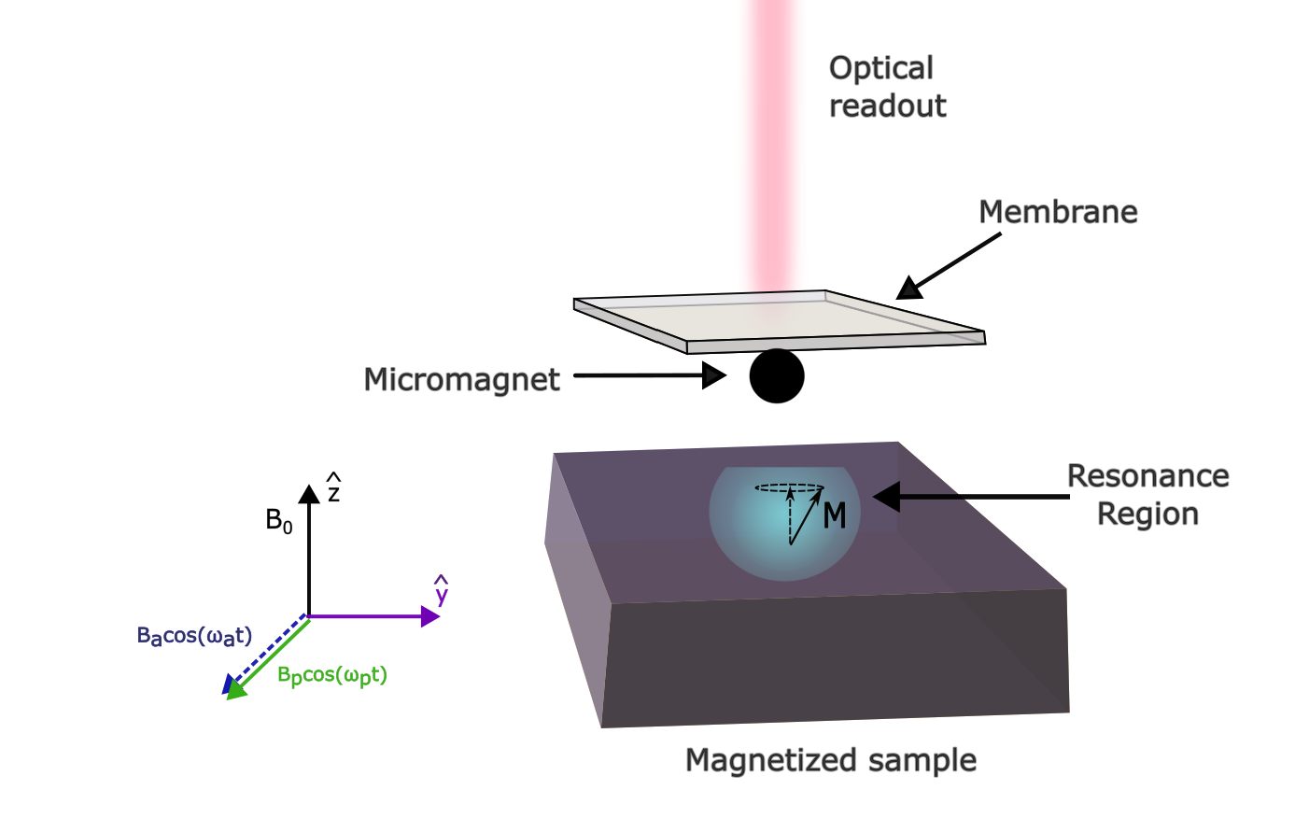
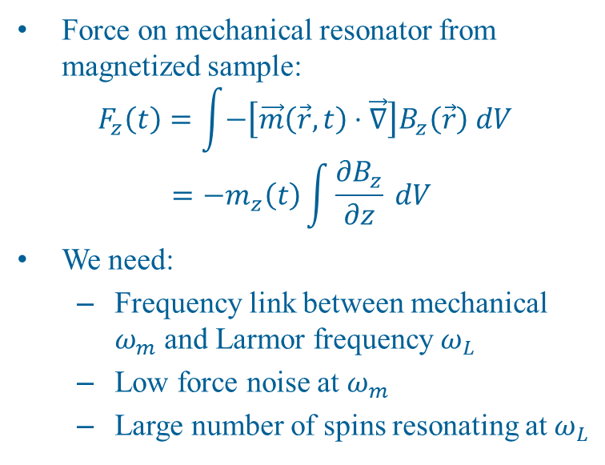
Magnetic Resonance Force Microscopy
Force on mechanical resonator from magnetized sample:
$$F_{z}\left(t\right)=\int{−\left[\vec{m}\left(\vec{r},t\right)⋅\vec{∇}\right]B_{z}\left(\vec{r}\right) dV} \\ =−m_{z}\left(t\right)\int{\frac{∂B_{z}}{∂z} dV}$$
We need:
  Frequency link between mechanical $ω_{m}$ and Larmor frequency $ω_{L}$
  Low force noise at $ω_{m}$
  Large number of spins resonating at $ω_{L}$
Sidles, et al, Rev. Mod. Phys., 67, 249 (1995)
Scozzaro, et al, J. Mag. Res., 271, 15 (2016)
Half, et al, Phys. Rev Appl., 15, L021001 (2021)

Slide 7
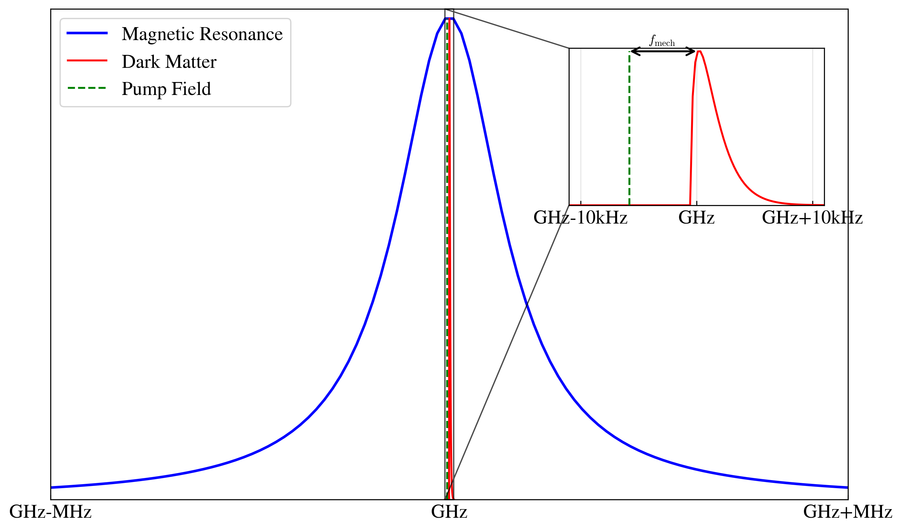
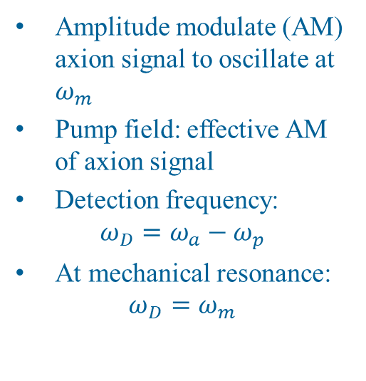
Frequency Down-Conversion Scheme
Amplitude modulate (AM) axion signal to oscillate at $ω_{m}$
Pump field: effective AM of axion signal
Detection frequency:
$$ω_{D}=ω_{a}−ω_{p}$$
At mechanical resonance:
$$ω_{D}=ω_{m}$$
Inspired by: QUAX Proposal 2015 [J. Phys.: Conf. Ser. 718 042051]

Slide 8
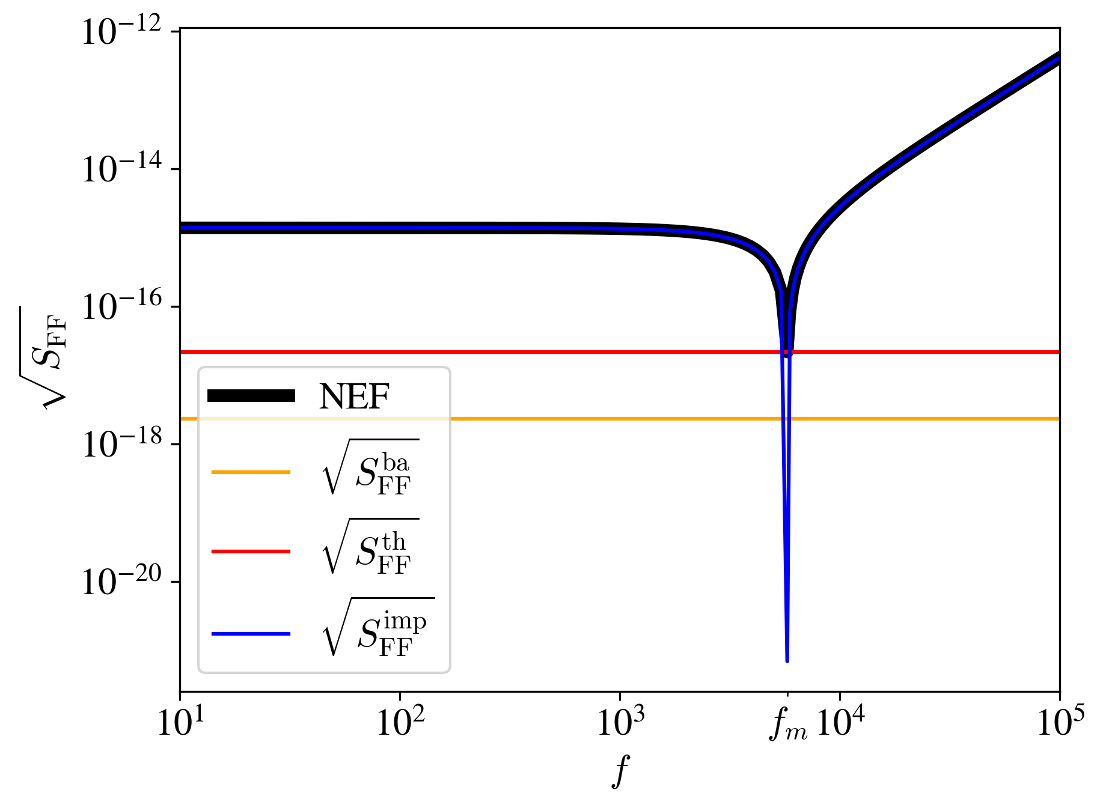
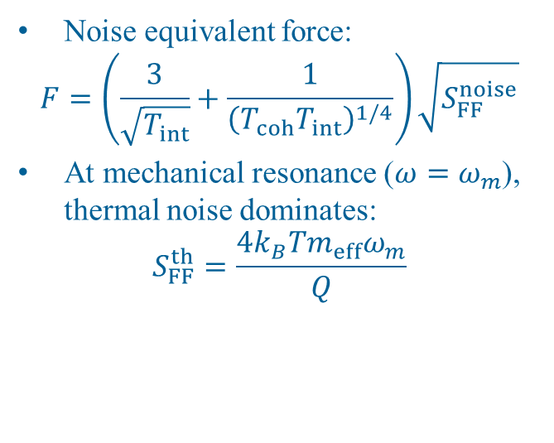
Force Noise
Noise equivalent force:
$$F=\left(\frac{3}{\sqrt{T_{int}}}+\frac{1}{{\left(T_{coh}T_{int}\right)}^{1/4}}\right)\sqrt{S_{FF}^{noise}}$$
At mechanical resonance ($ω=ω_{m}$), thermal noise dominates:
$$S_{FF}^{th}=\frac{4k_{B}Tm_{eff}ω_{m}}{Q}$$
Notes:
SNR=1. Minimum force we can measure = NEF.

Slide 9
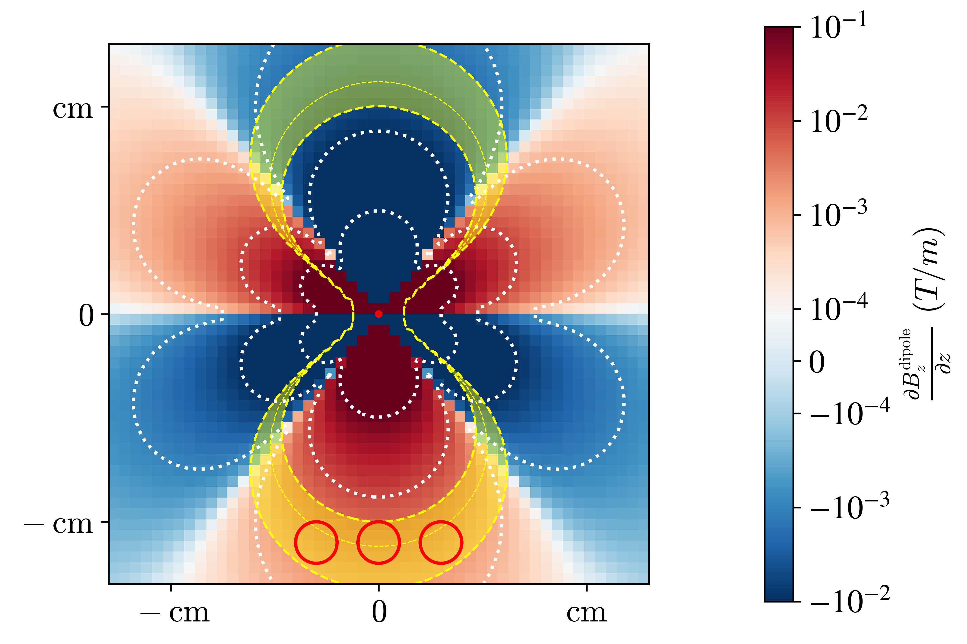
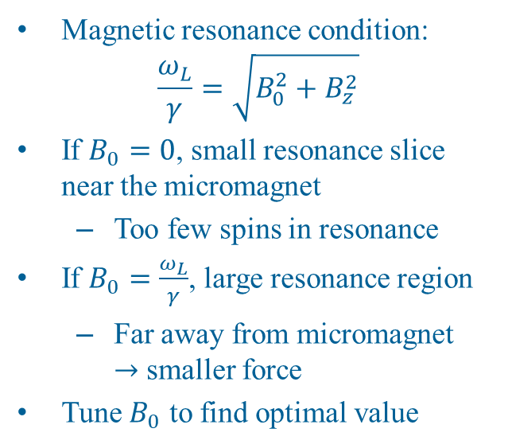
Maximizing Number of Resonating Spins
Magnetic resonance condition:
$$\frac{ω_{L}}{γ}=\sqrt{B_{0}^{2}+B_{z}^{2}}$$
If $B_{0}=0$, small resonance slice near the micromagnet
  Too few spins in resonance
If $B_{0}=\frac{ω_{L}}{γ}$, large resonance region
  Far away from micromagnet
  $→$ smaller force
Tune $B_{0}$ to find optimal value
10 YIG spheres: Crescini, et al. Phys. Rev. Lett. 124, 171801 (2020)

Slide 10
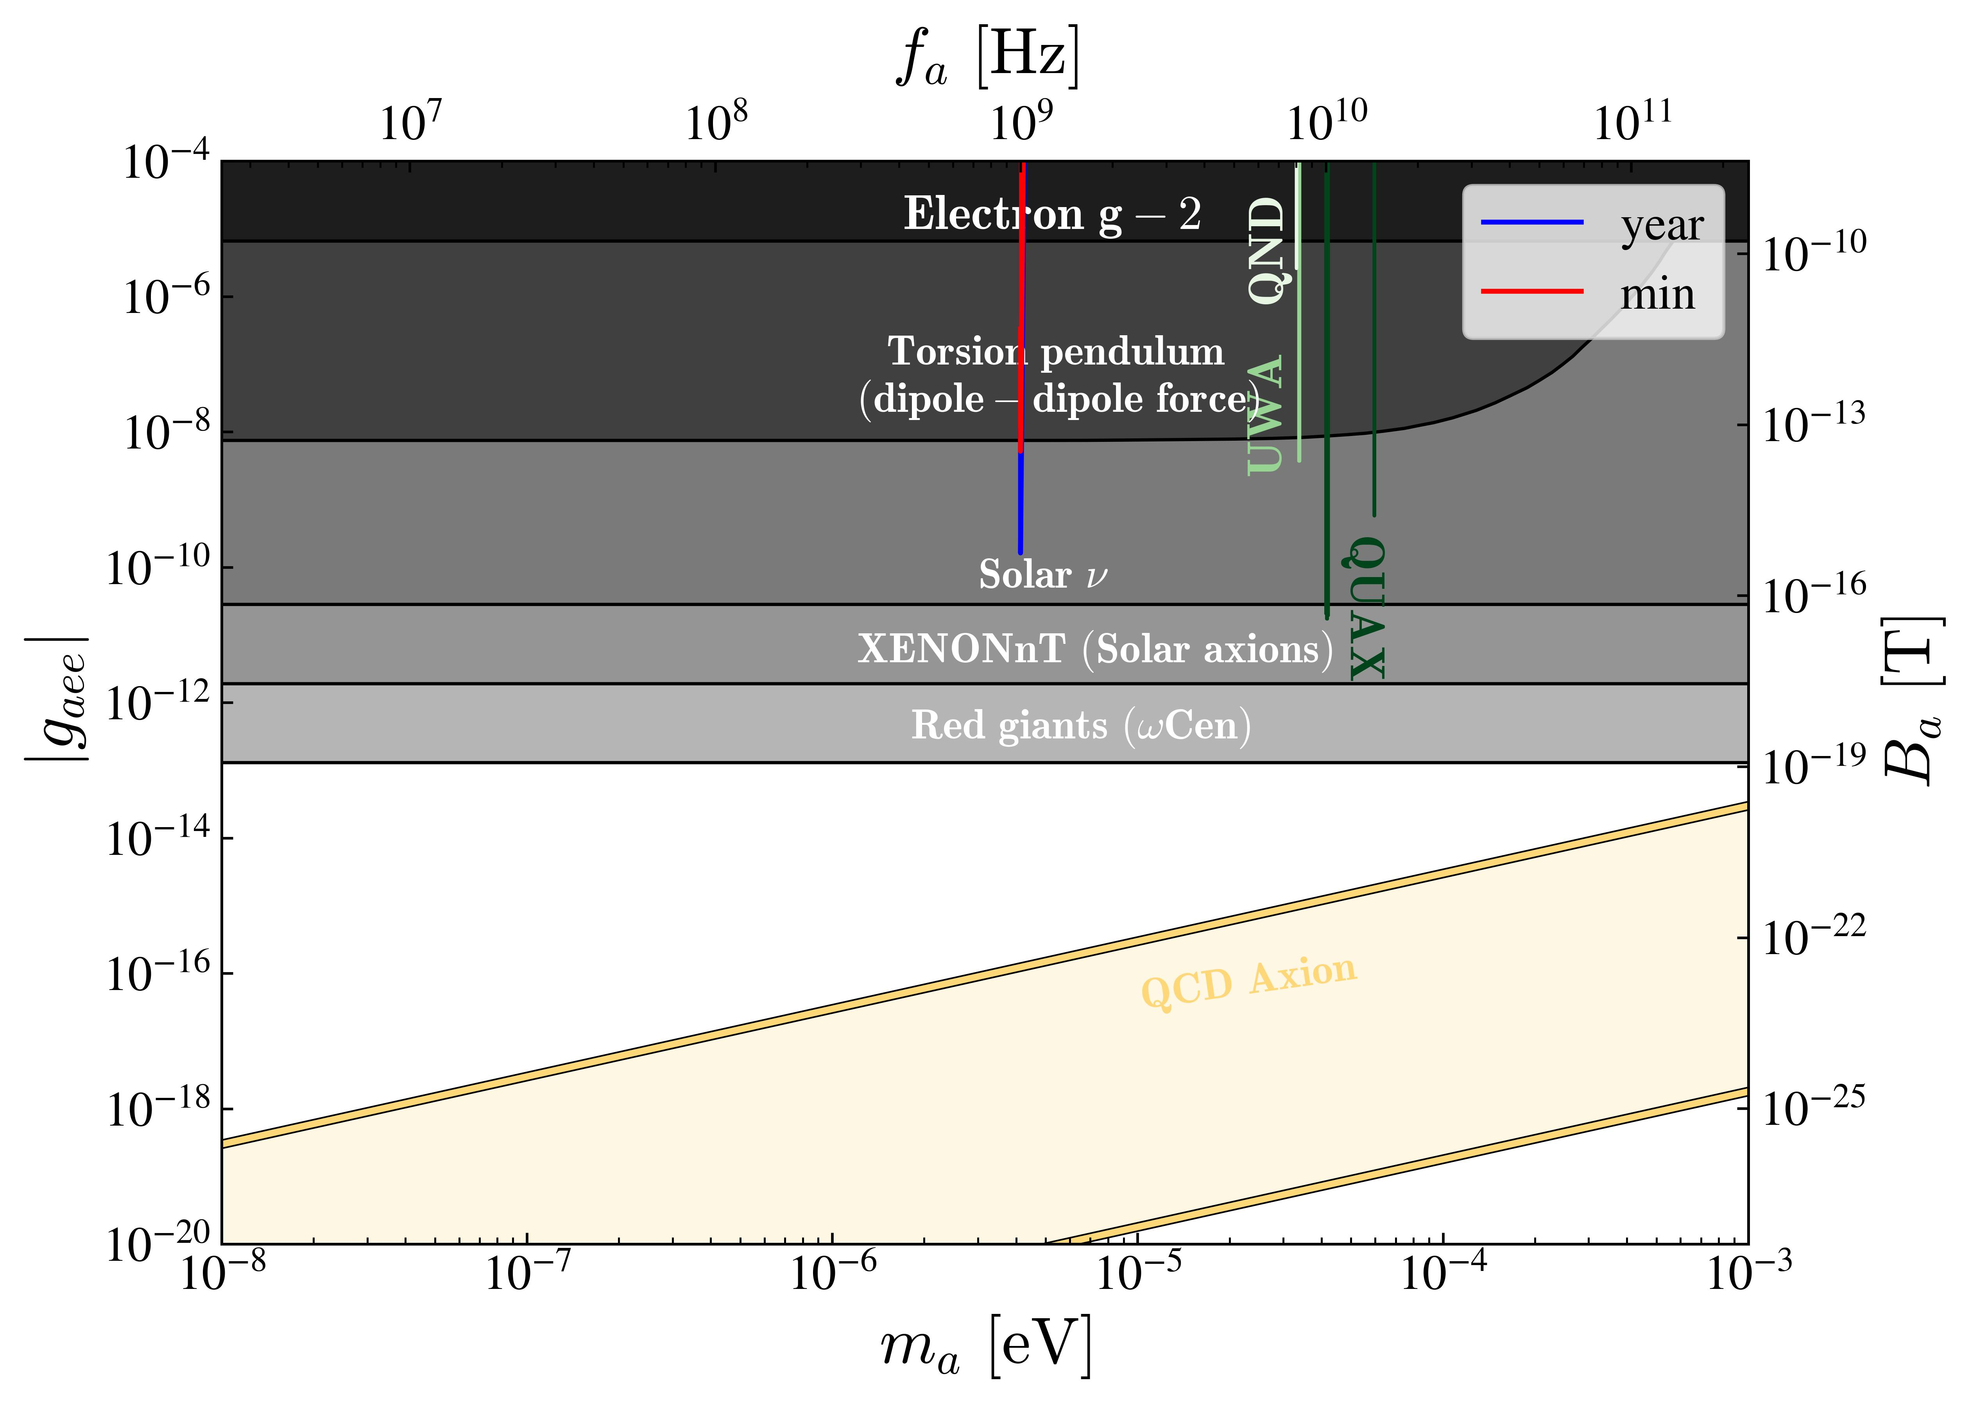
Axion-Electron Coupling

Slide 11
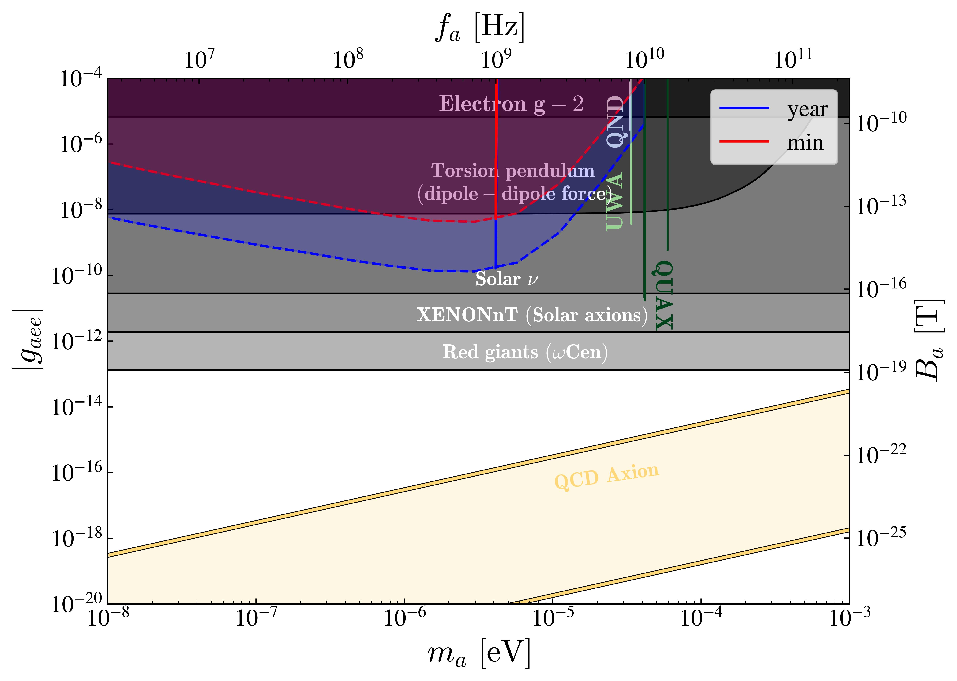
Axion-Electron Coupling
Notes:
Lower frequencies: lower B_0, thus lower polarization, thus lower magnetization of sample. Possible solution: Lower temperatures
Higher frequencies: Radiation damping. Possible solution: smaller samples.
Scan axion mass: Vary pump field frequency (and B_0)

Slide 12
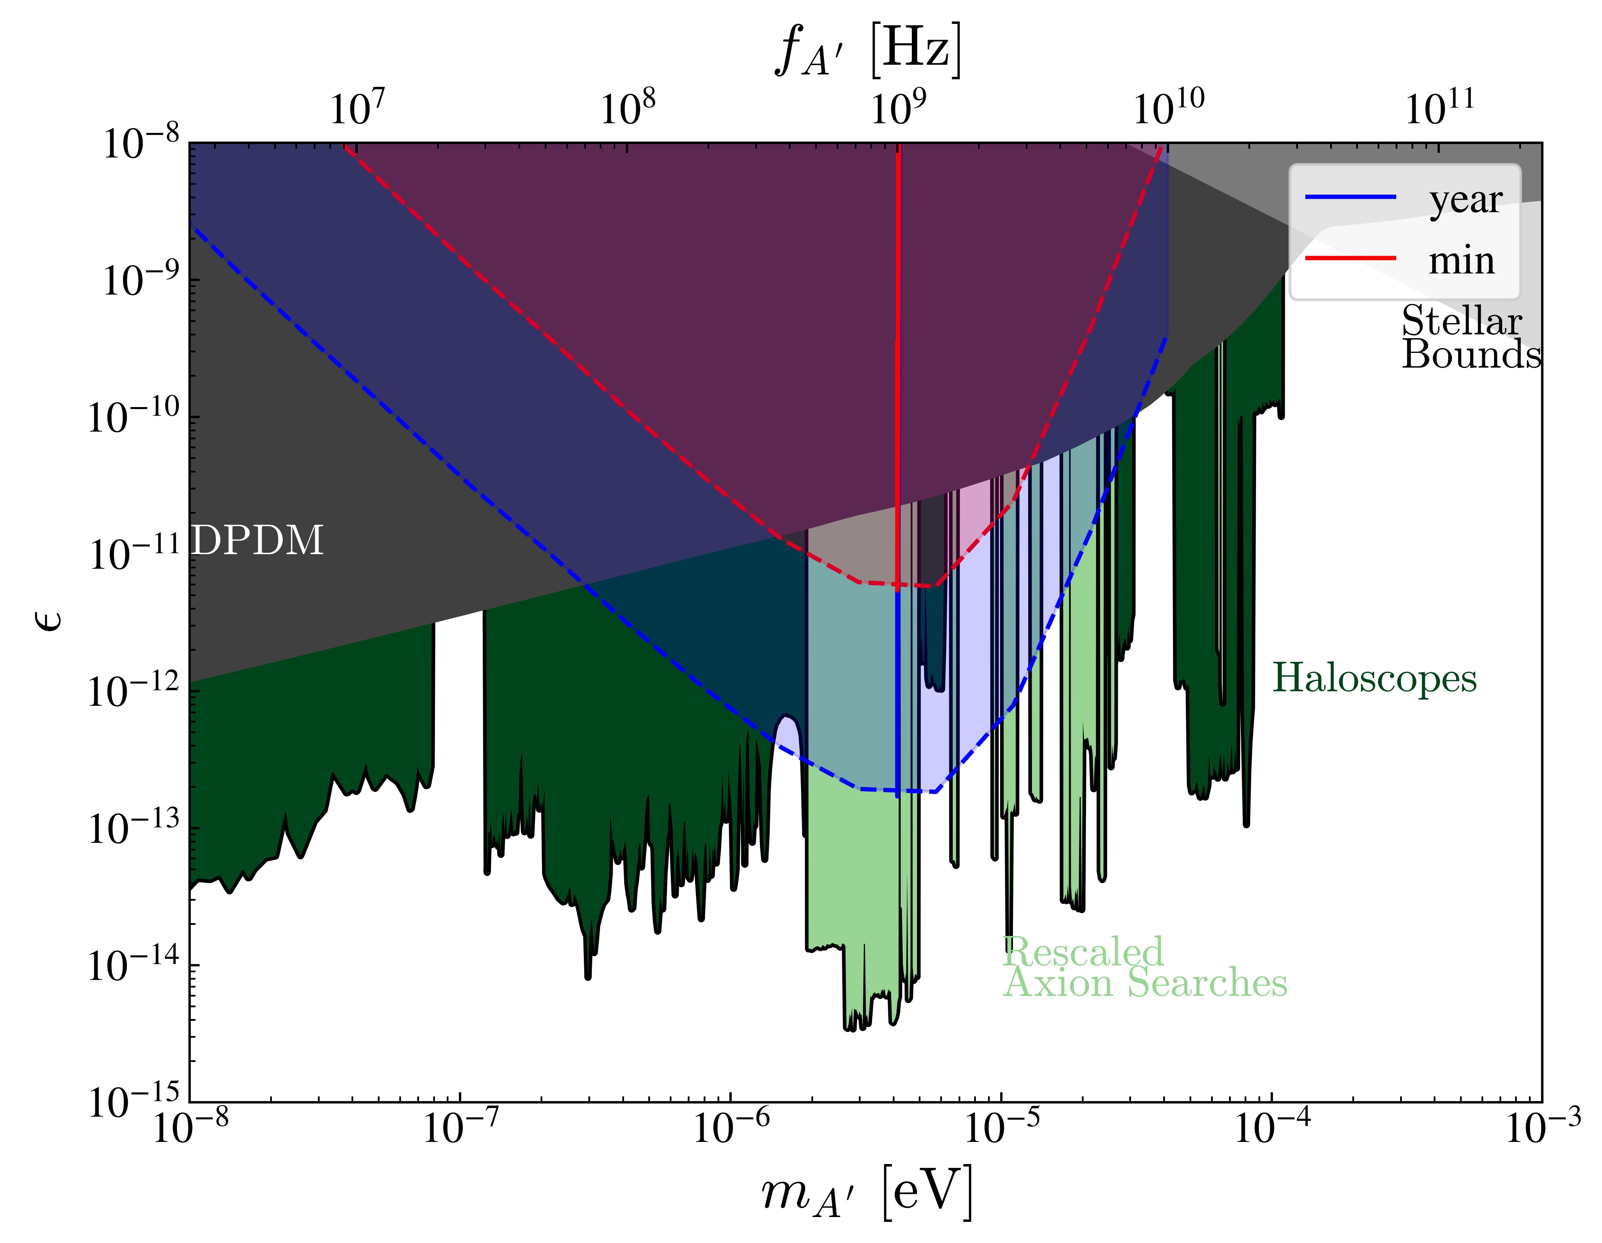
Dark Photon Kinetic Mixing Parameter

Slide 13
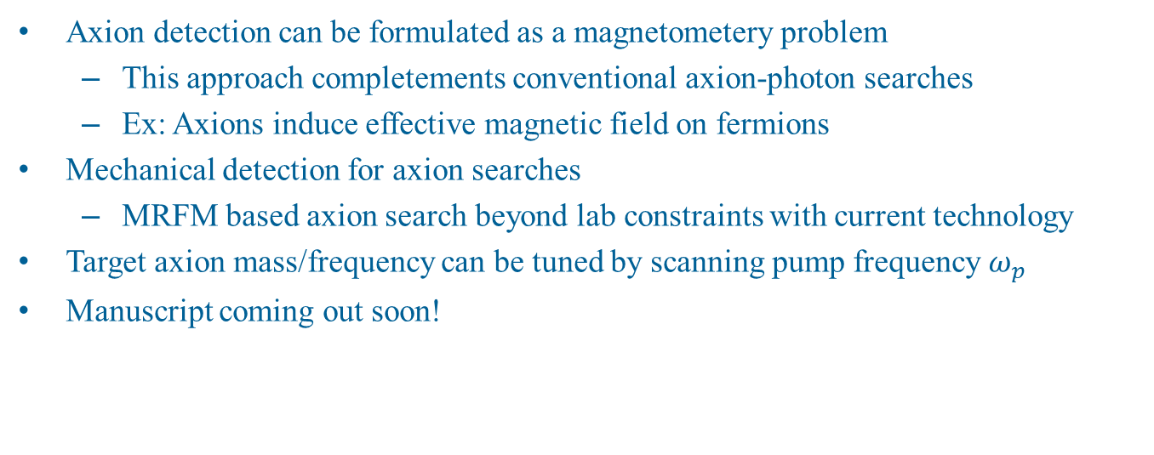
Conclusion
Axion detection can be formulated as a magnetometery problem
  This approach completements conventional axion-photon searches
  Ex: Axions induce effective magnetic field on fermions
Mechanical detection for axion searches
  MRFM based axion search beyond lab constraints with current technology
Target axion mass/frequency can be tuned by scanning pump frequency $ω_{p}$
Manuscript coming out soon!

Slide 14
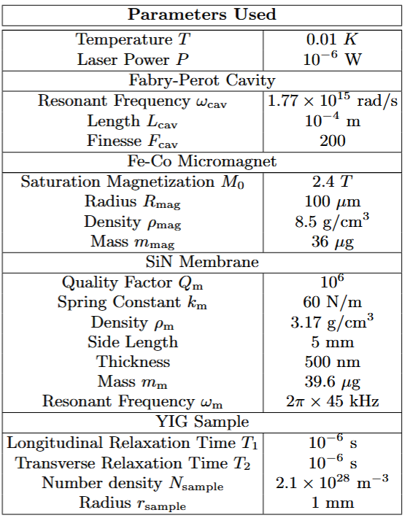
Table of Parameters

