Slide 1

Environmental Engineering for Qubit-Based Detectors
Daniel Molenaar
Illinois institute of Technology
CPAD 2025

Slide 2
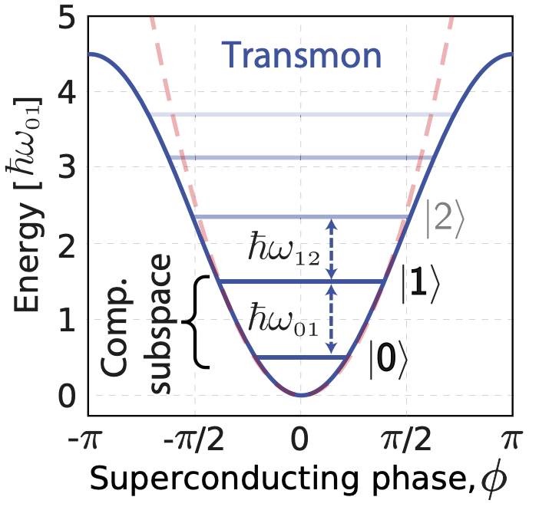
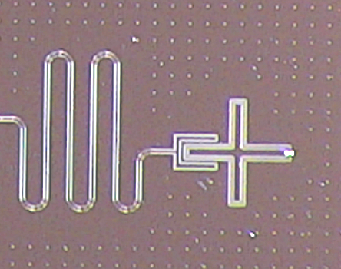
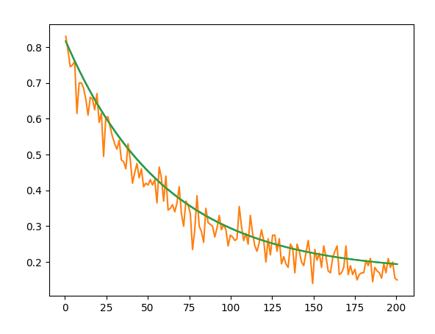
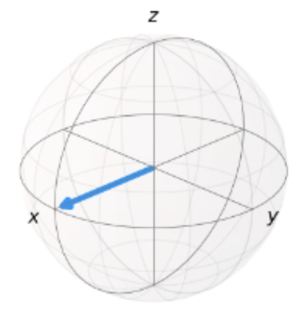


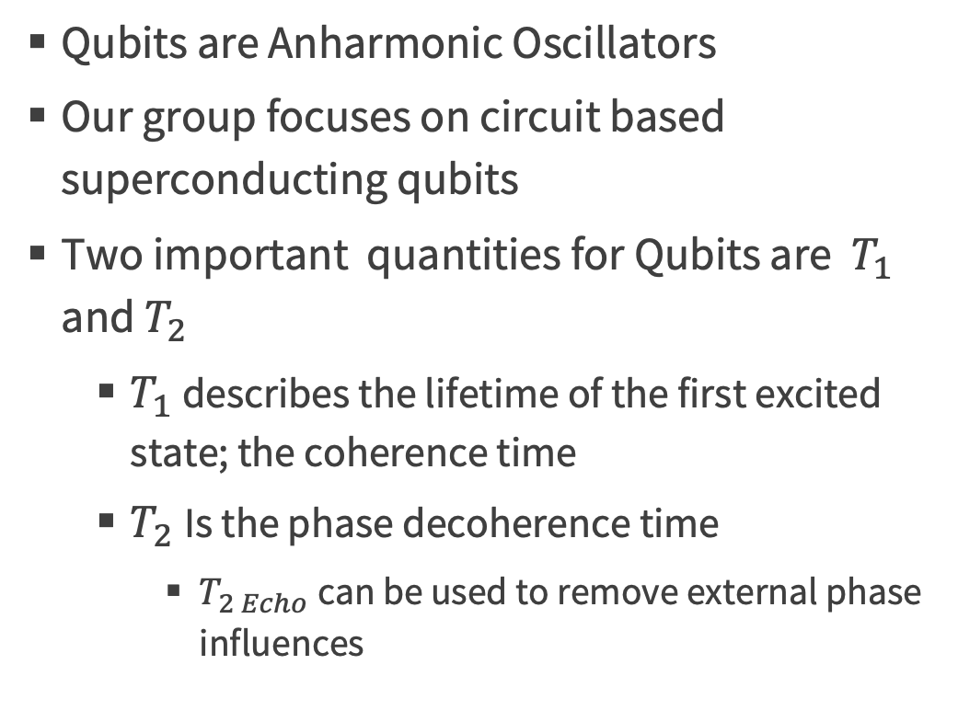
Qubit Basics
1904.06560
Qubits are Anharmonic Oscillators
Our group focuses on circuit based superconducting qubits
Two important quantities for Qubits are $T_{1}$ and $T_{2}$
$T_{1}$ describes the lifetime of the first excited state; the coherence time
$T_{2}$Is the phase decoherence time
$T_{2 Echo}$can be used to remove external phase influences
$T_{1}$ Curve
|0>
$$P_{excited}$$
Time (us)
|1>

Slide 3
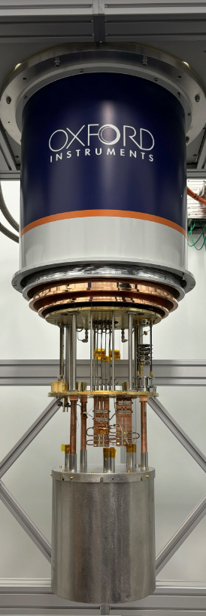
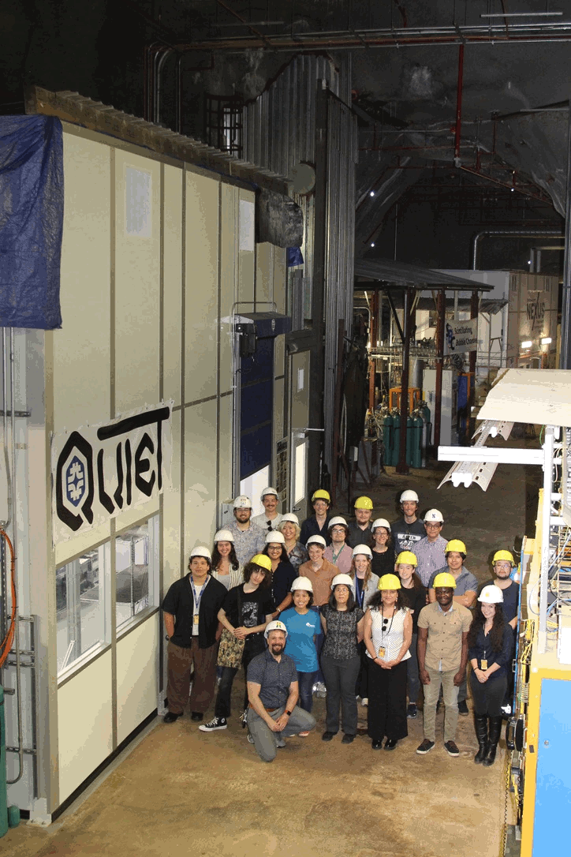
QUIET (Quantum Underground Instrumentation Experimental Testbed)
Located 100 meters underground in the Minos cavern at Fermilab
Provides a 100x reduction in cosmic ray muons
For a glimpse at some of our recent studies see Kester Anyang’s Talk
Oct 8, 2025, 11:45 AM Woodlands AB
CPAD 2025 Daniel Molenaar (IIT)

Slide 4
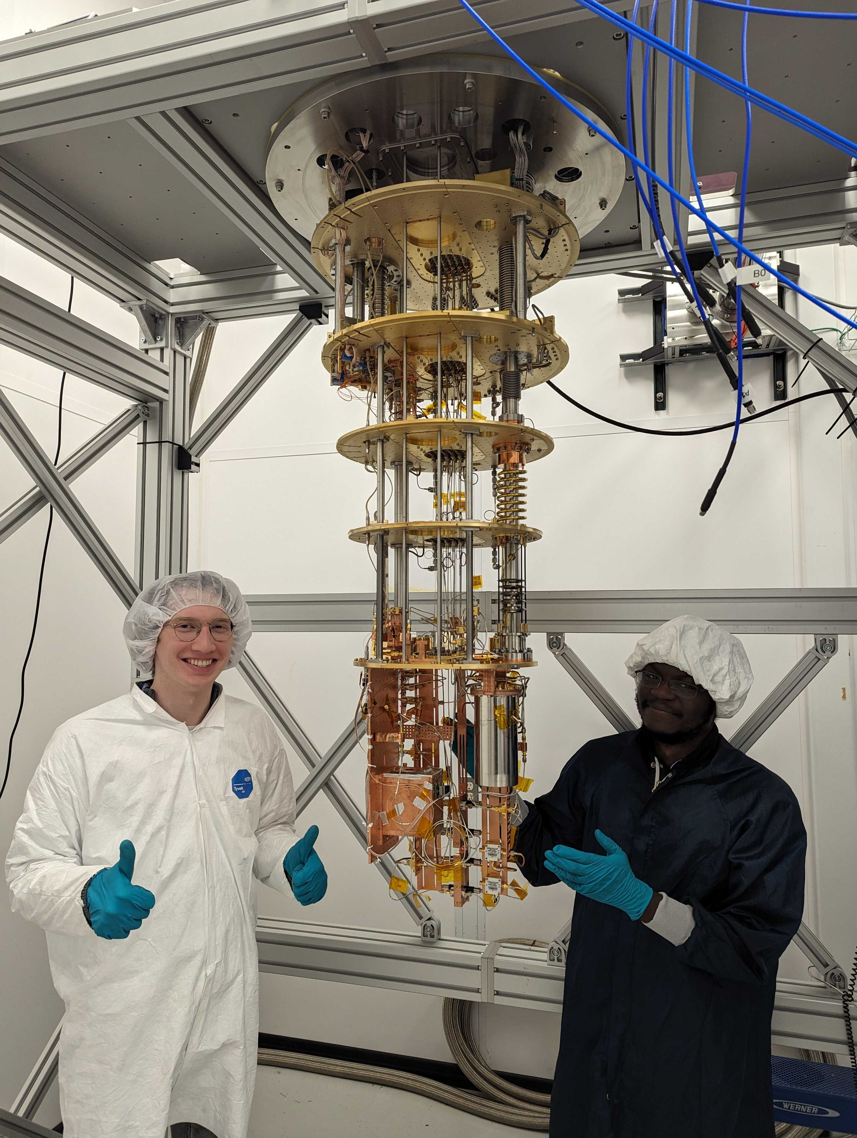
LOUD
Located on the surface at Fermilab
Same model fridge as QUIET allowing for simplified A-B tests
Currently LOUD is our test bed for a MEMS guided laser for qubit energy deposition studies
For more about this see Israel Hernández’s Talk
Oct 8, 2025, 11:15 AM Woodlands AB
CPAD 2025 Daniel Molenaar (IIT)

Slide 5
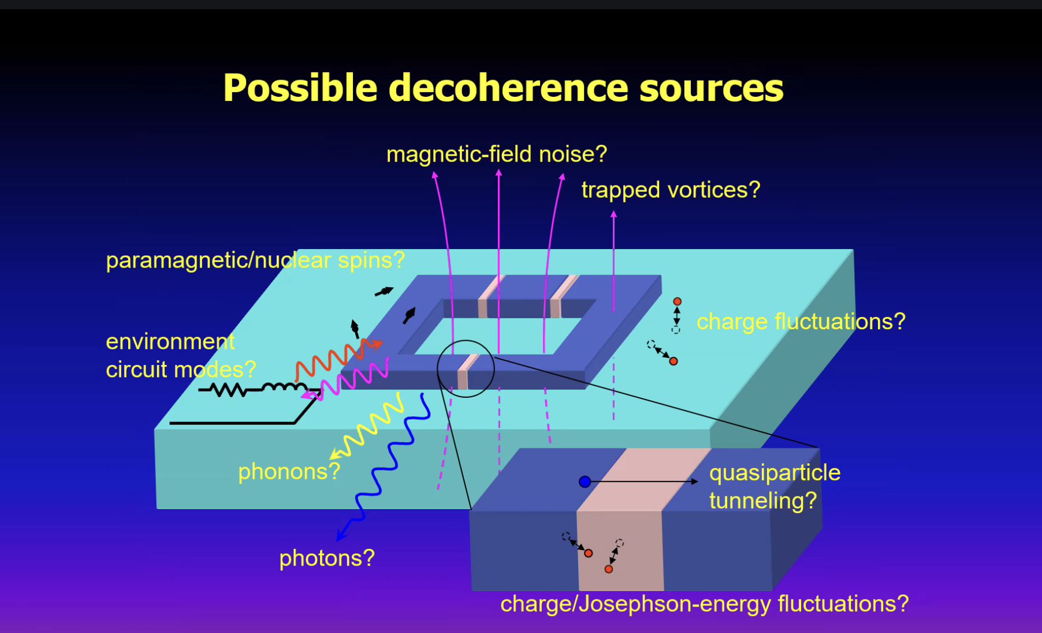
Environmental Background Sources
Problematic Backgrounds:
Temperature Fluctuations
Gamma Rays
Cosmic Rays
Vibrations
B(H) – Fields
IR Photons
And many more
Schematic from Yasunobu Nakamura’s Talk
University of Tokyo, RIKEN
Schematic from Yasunobu Nakamura’s Talk
University of Tokyo, RIKEN

Slide 6
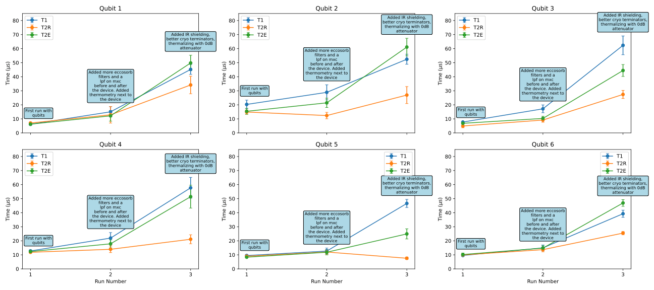
Impact of Shielding Filtering and thermalization on Qubits

Slide 7
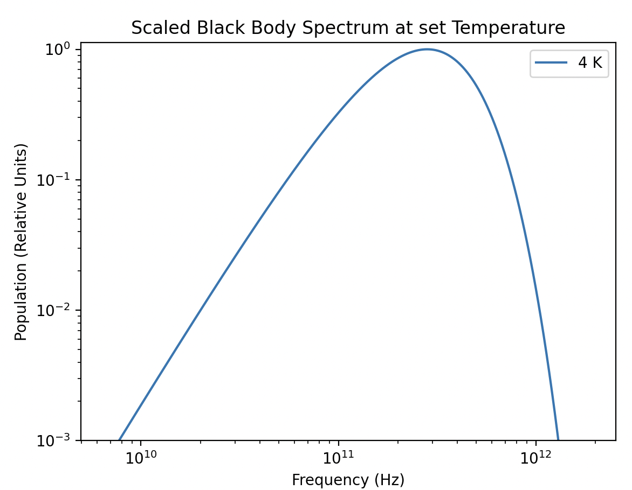
IR Photons
Generally we’re concerned about black body radiation leaking from higher temperature stages
IR photons have a small wavelength and can slip through cracks effectively
The 4K stage has significant blackbody emission from ~ 10 GHz – Thz
Al
Nb
Ta
Solutions: IR shields
IR absorbers (epoxy, foam)
More on this Shortly!

Slide 8
Optimal Shielding
Ideal shielding will generally follow the structure of:
Mu metal -> Superconducting -> IR shield
Mu metal is fantastic at redirecting static magnetic fields
Superconductors are good for more dynamic magnetic fields
IR shield Absorbs and thermalized IR radiation
See 2505.14274 for details
IR Photon
Static Mag Field
“Quicky” varying Mag Field
*Device
Mu metal
Superconductor
Copper with IR coating

Slide 9
Optimal Shielding
Effective shielding is tough to achieve. In general shields aim for:
Light tight
Vacuum compatible
Non-device specific (reusable)
Not radioactive
Non-magnetic
Effectively Thermalized
Many of these criteria seem “easy” to achieve but at closer inspection are very challenging or mutually exclusive
Let's look into “Light Tightness”

Slide 10

Problematic Seams
In a standard enclosure the device is sealed inside, this generally results in a seam
Indium wire is often used to create a
hermetic seal
Indium is weakly radioactive.
As a result, this is undesirable for dark matter and or rare event searches
*Device
*General Enclosure

Slide 11
Problematic Seams
We’re generally limited to two metal surfaces pressed against each other
At best this seam will have gaps on the order of the surface smoothness
(~150um is a reasonable worst case)
-> Clearly this sort of seam is not “light tight”
*Device
*General Enclosure

Slide 12
Problematic Seams
IR Photon
When photons encounter this seam, they see an impedance mismatch between free space and the flange
Some photons are reflected
Others pass into this region
Using HFSS, the transmission S21 of the transmitted photons can be simulated

Slide 13
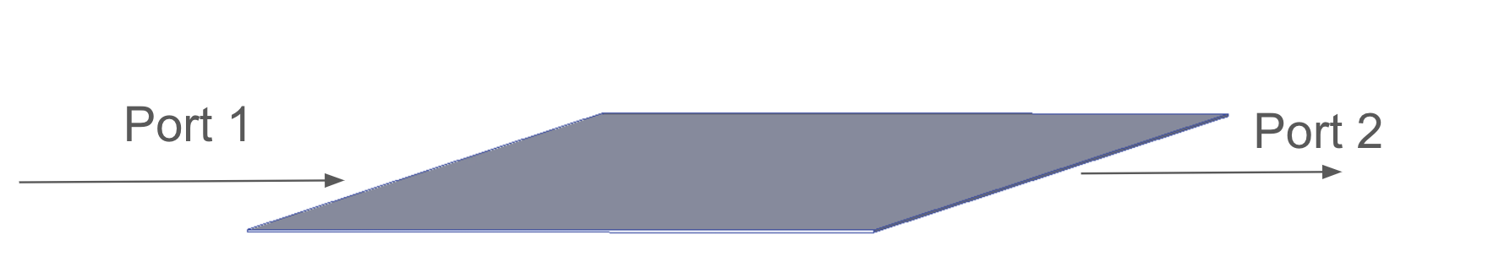
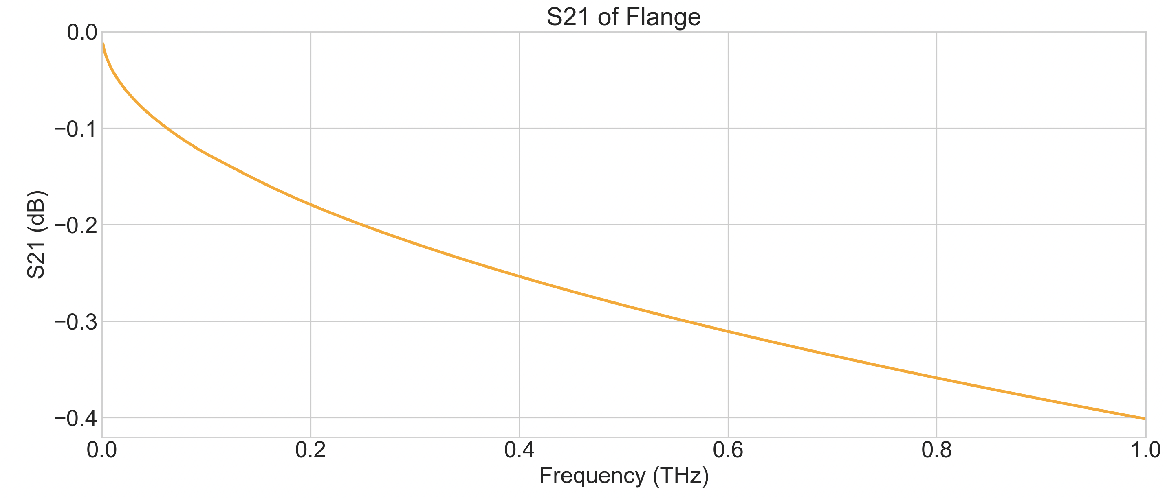
Simulating Seams
Here a thin slot with a thickness of 150 um was simulated in HFSS
Near perfect transmission!

Slide 14
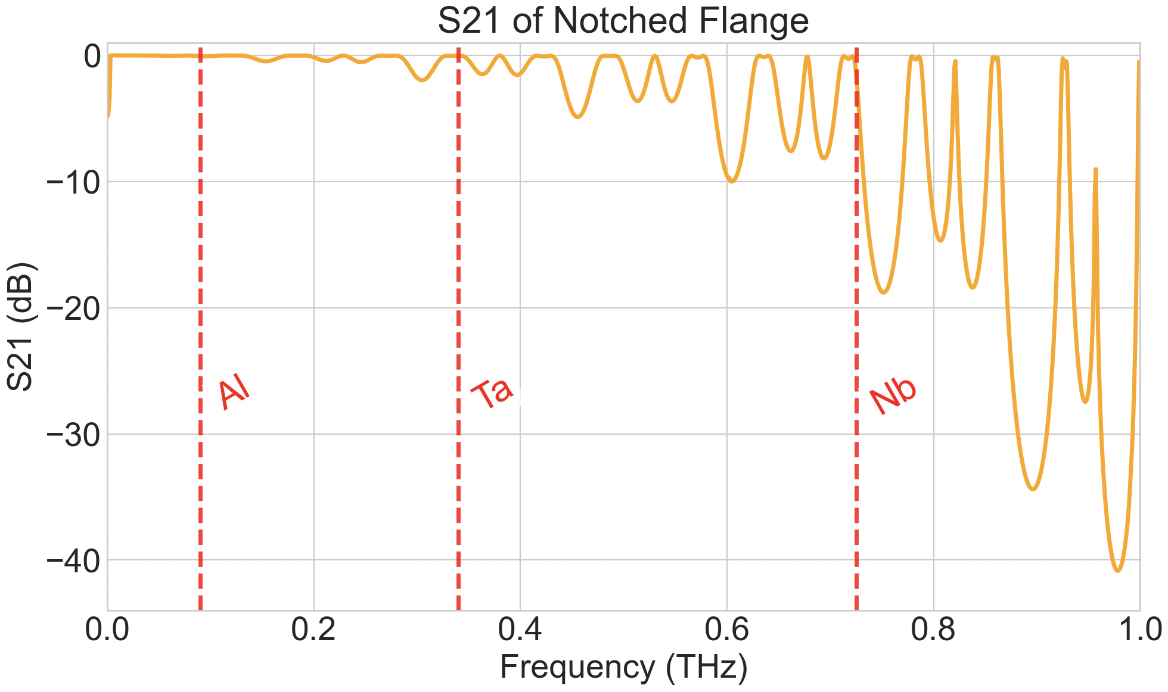

Common Mitigation: Notch
*This high frequency geography is highly notch dimension specific!

Slide 15
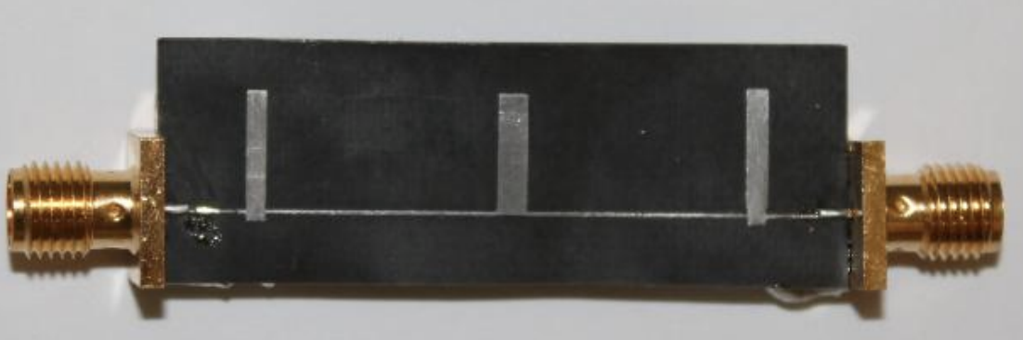
Flanges are generally unoptimized
Flanges are suboptimal for 1 Ghz- 1 THz
Notches kick in around 800 GHz
What can be done for <800 GHz?
A general solution comes from RF design and has been demonstrated by Yen-Yung Chang (Berkeley):
f
Stub Filters
https://ieeexplore.ieee.org/document/7394533
Currently I’m working with Yen-Yung to apply this technique and optimize it further to block lower frequency radiation and have favorable interactions with box modes

Slide 16



Stub Filter Basics
Impedance Mismatch + Resonances
IR Photon
$$Z_{1}$$
$$Z_{2}$$
$$Z_{3}$$
For More in depth details please go to Xinran Li’s talk on behalf of Yen-Yung: Oct 9, 2025, 2:00 PM. Woodlands AB RDC 7

Slide 17

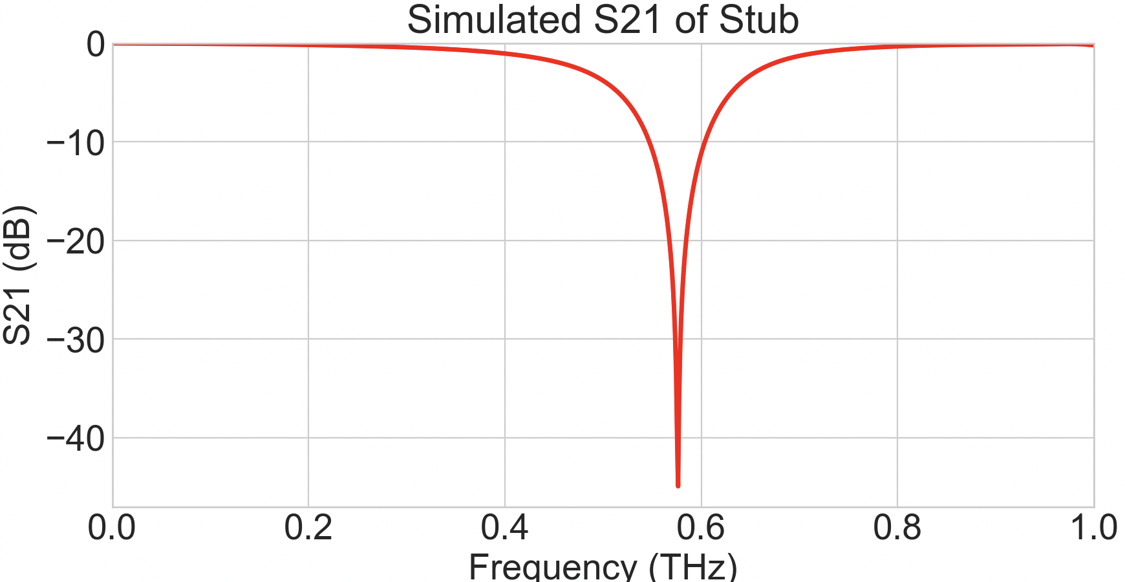


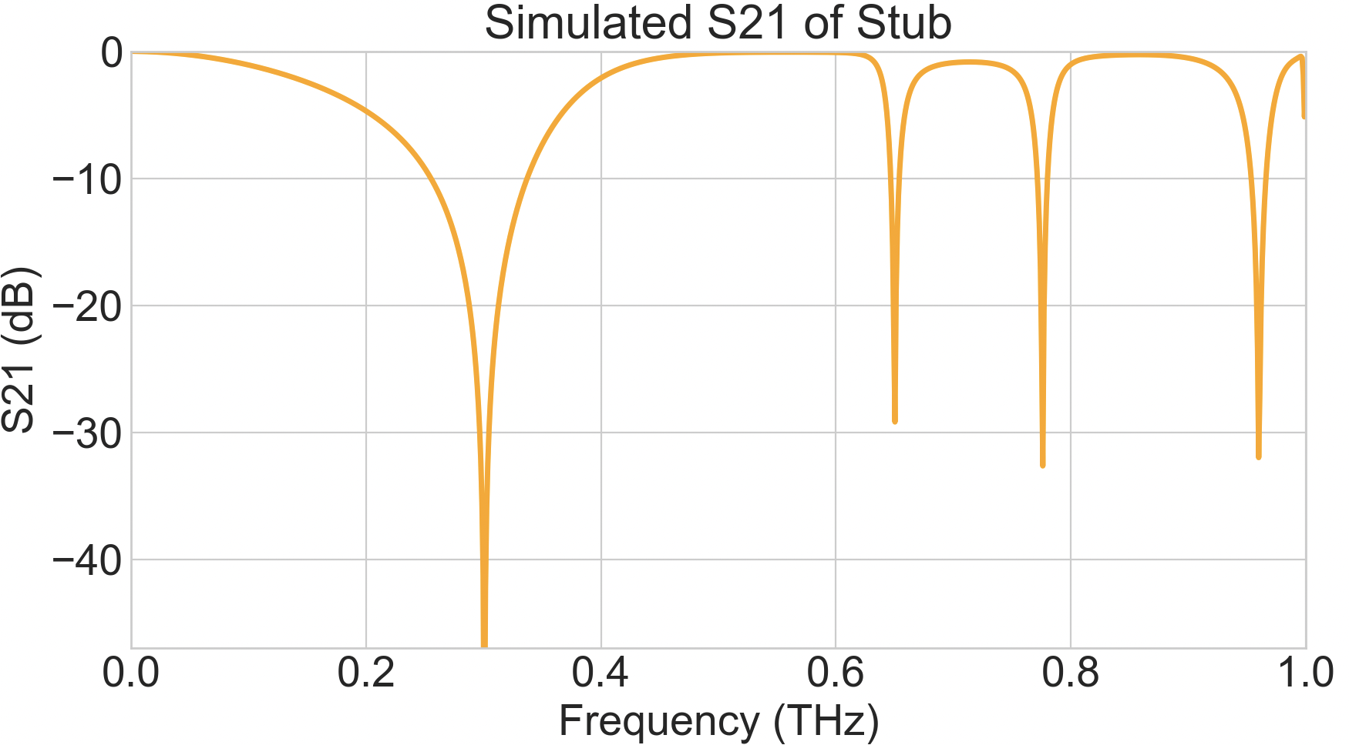
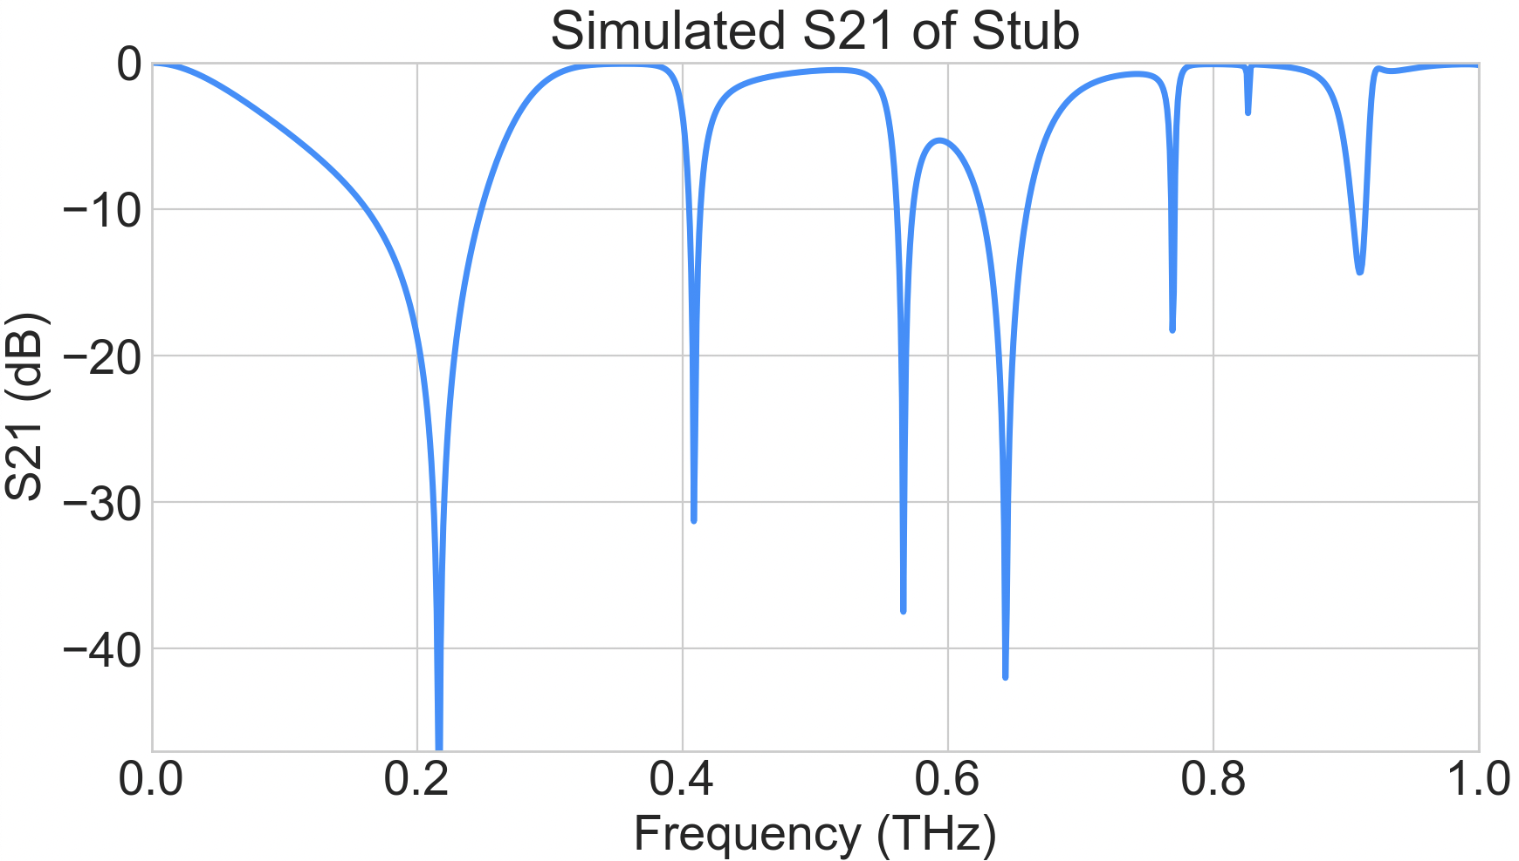
Stub Filters (<1mm)
Stub Filters can be applied to the flange geometry
Through stub parameters the transmission spectrum can be tuned!

Slide 18
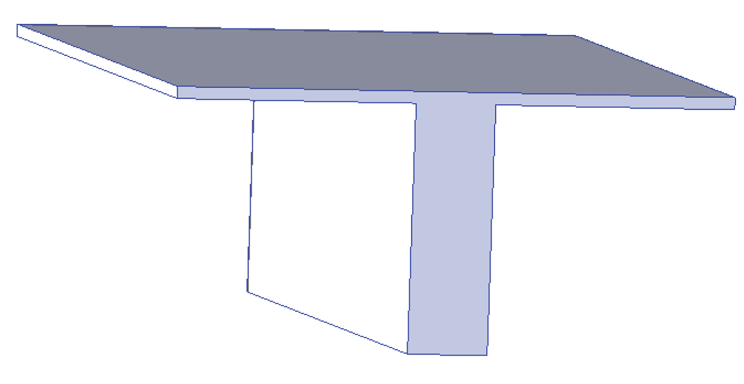
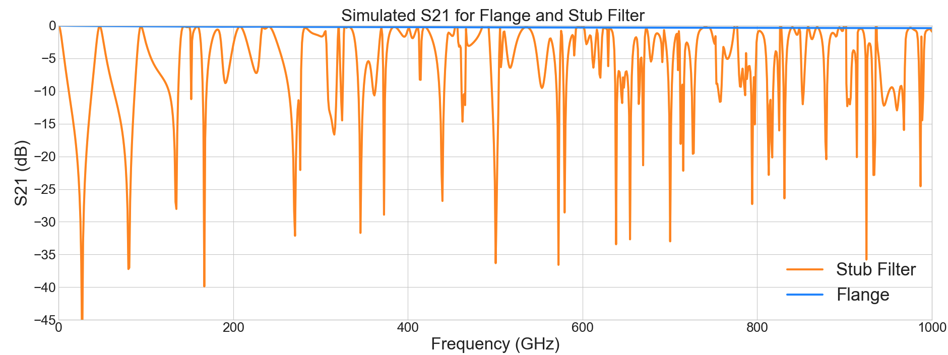
Larger Stubs (>1mm)
Larger stubs have a more intricate spectrum
Combining small and large stubs provides a toolbox for Terahertz regime filtering!

Slide 19
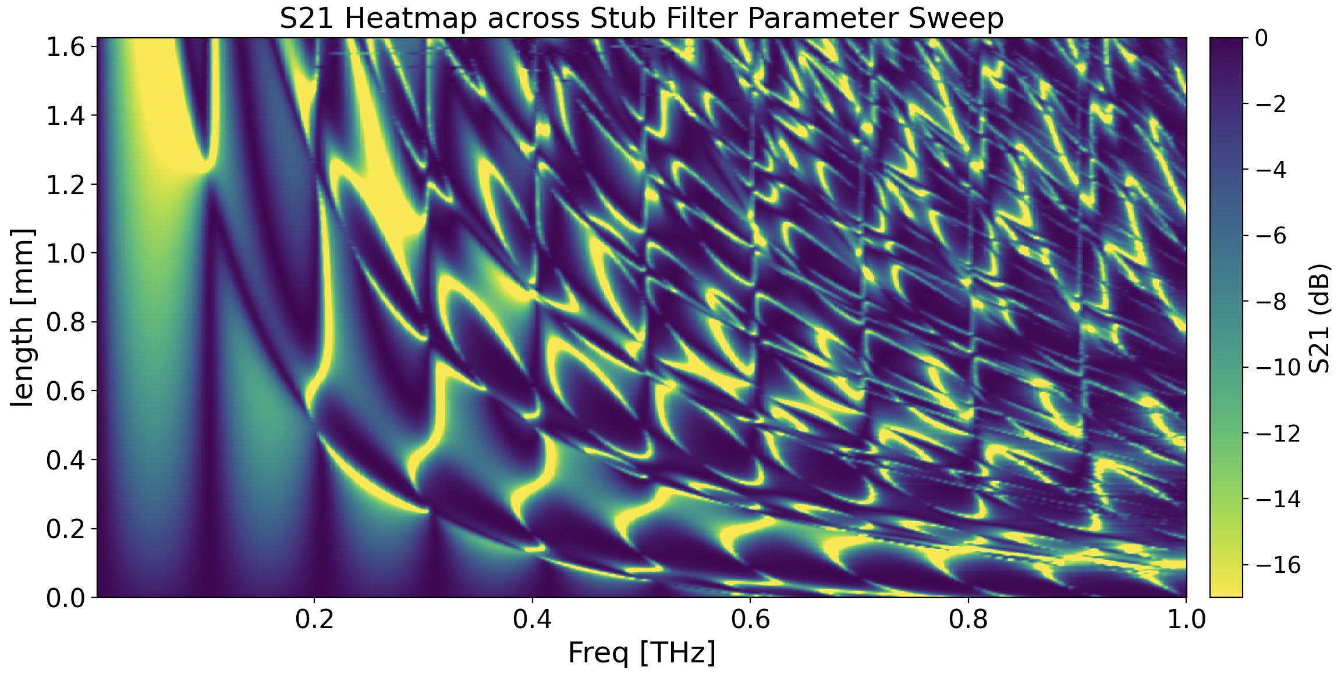
Stub Filter Parameter Space
Wealth of parameter space to tune the spectrum!

Slide 20
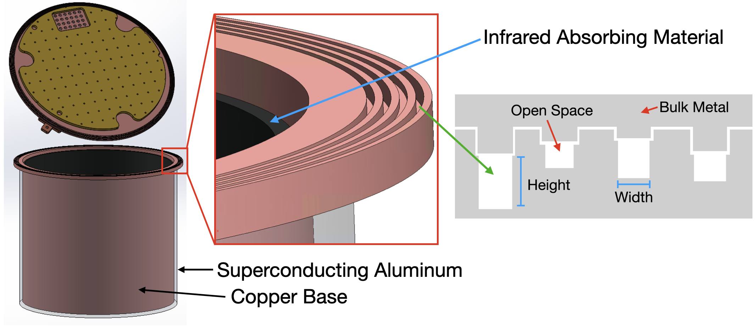
Stub Implementation
The scale of these filters is well suited for shielding and device enclosure
These filters can be retrofitted into an existing shield

Slide 21
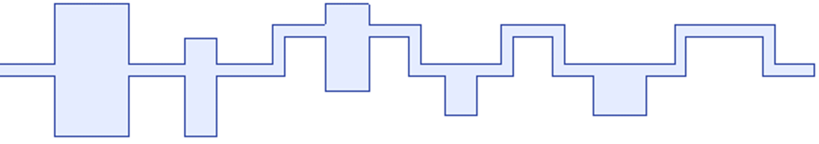
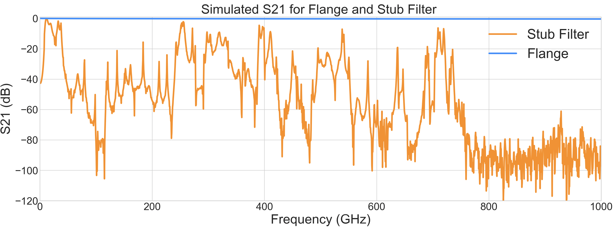
Stub Filter
Preliminary design made for the RF Box Consortium, currently finalizing the design before production

Slide 22
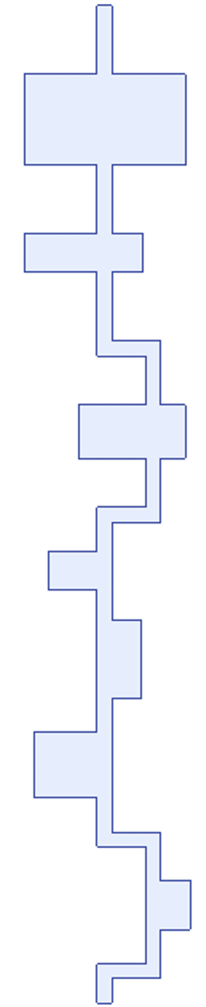
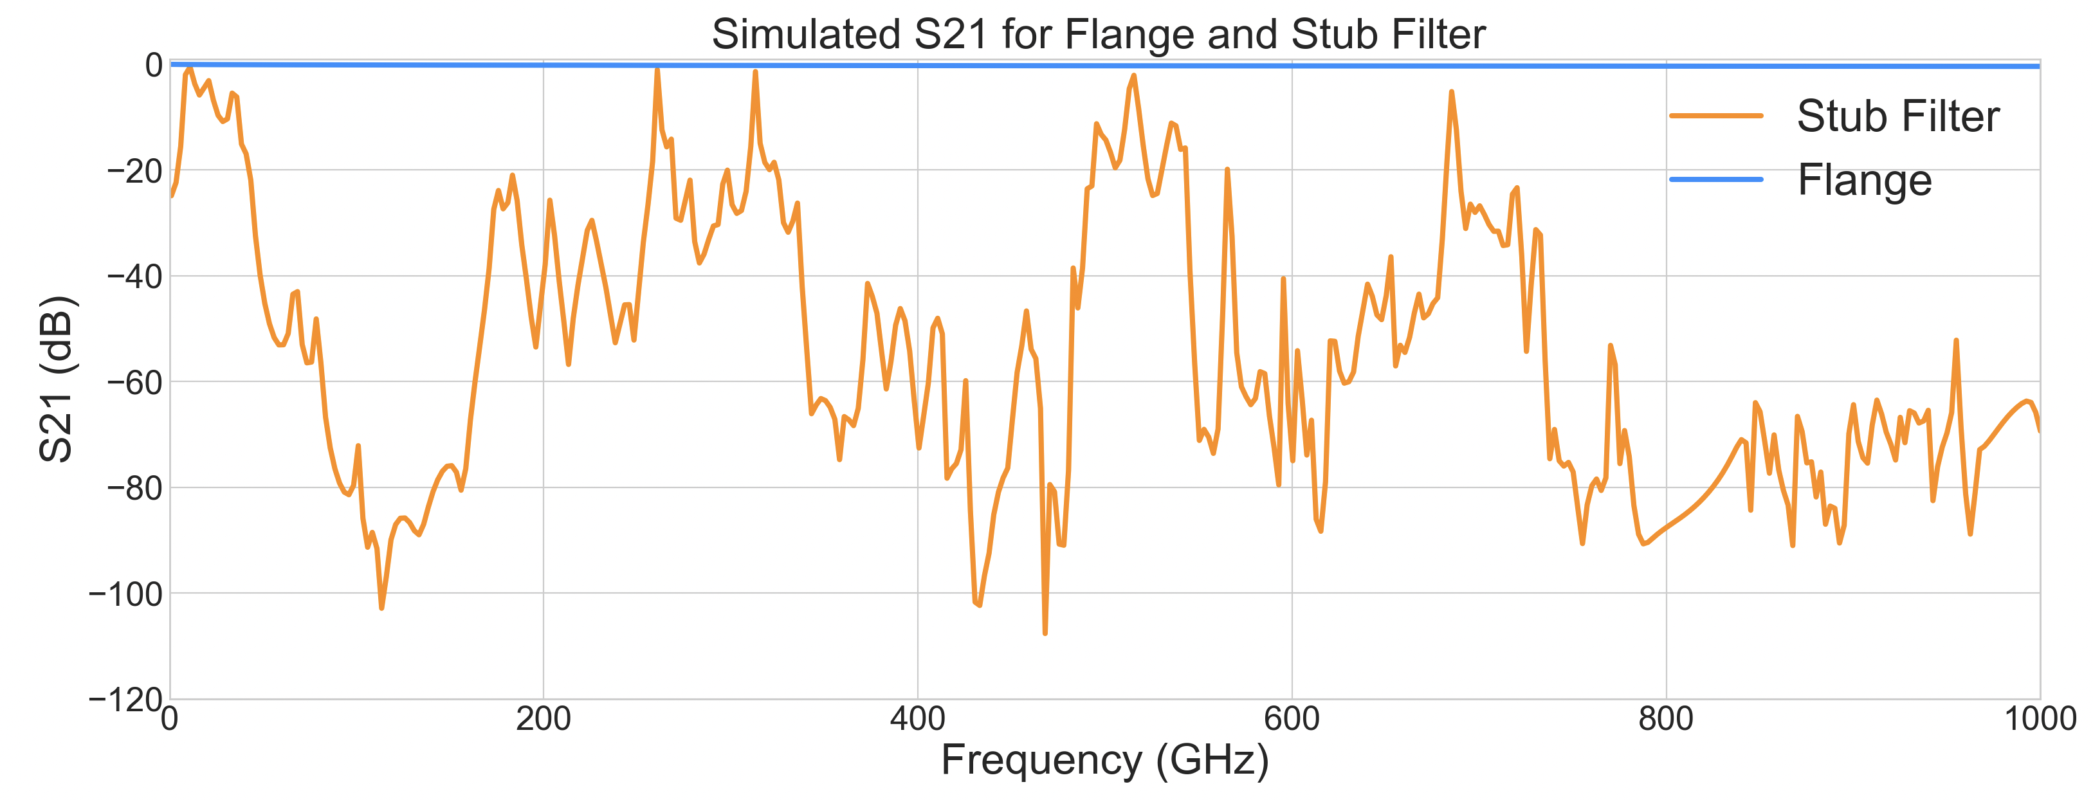
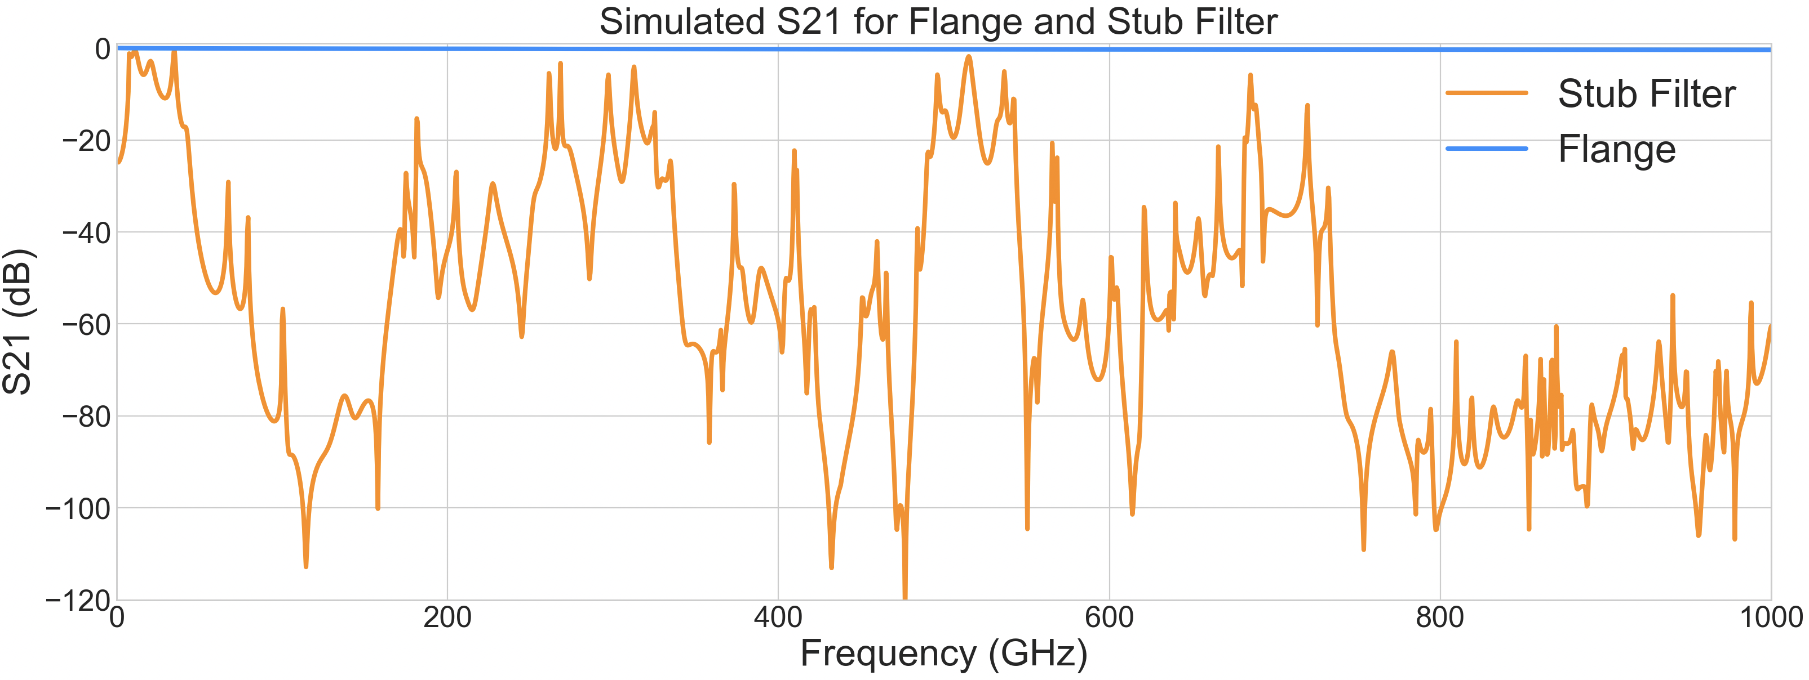
Stub Filter
Preliminary design made for the RF Box Consortium, currently finalizing the design before production
Slightly different meshing
750GHz+ inflated

Slide 23
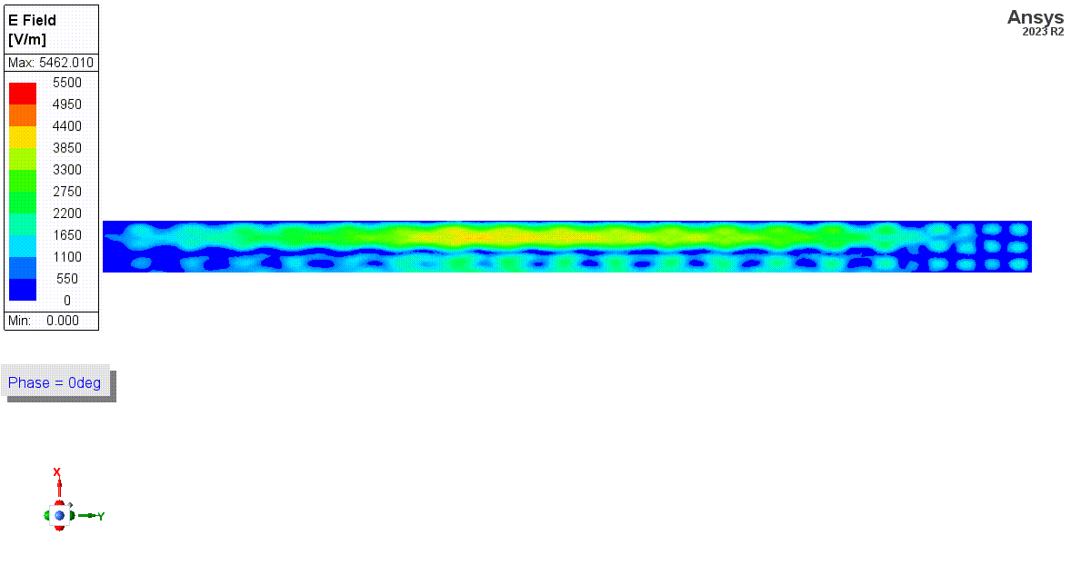
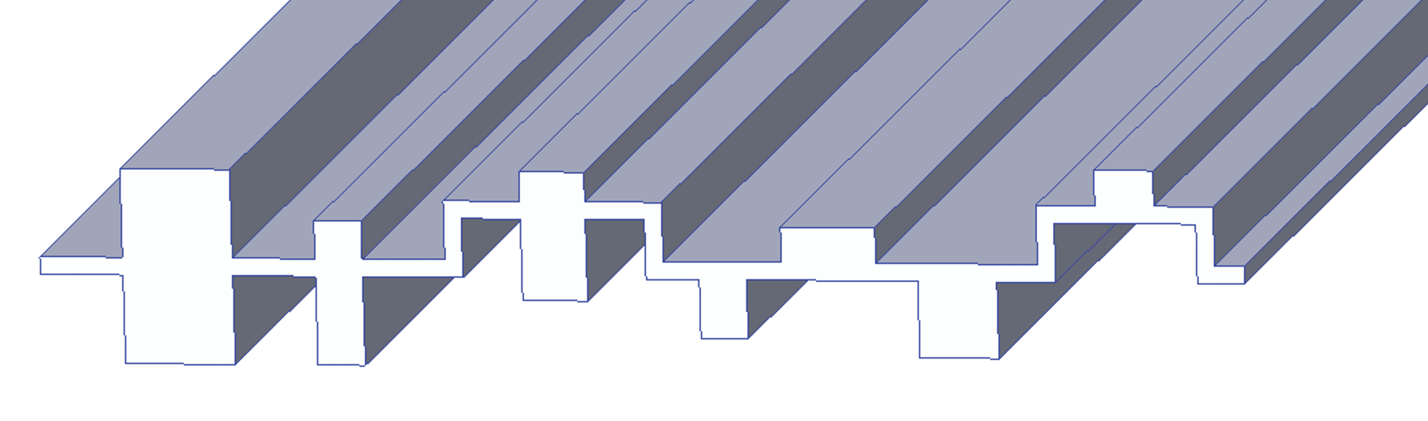
Resonant Mode Example
This is a cross section of the indicated Stub, Resonant Mode!
The resonances will appear as peaks in S21

Slide 24
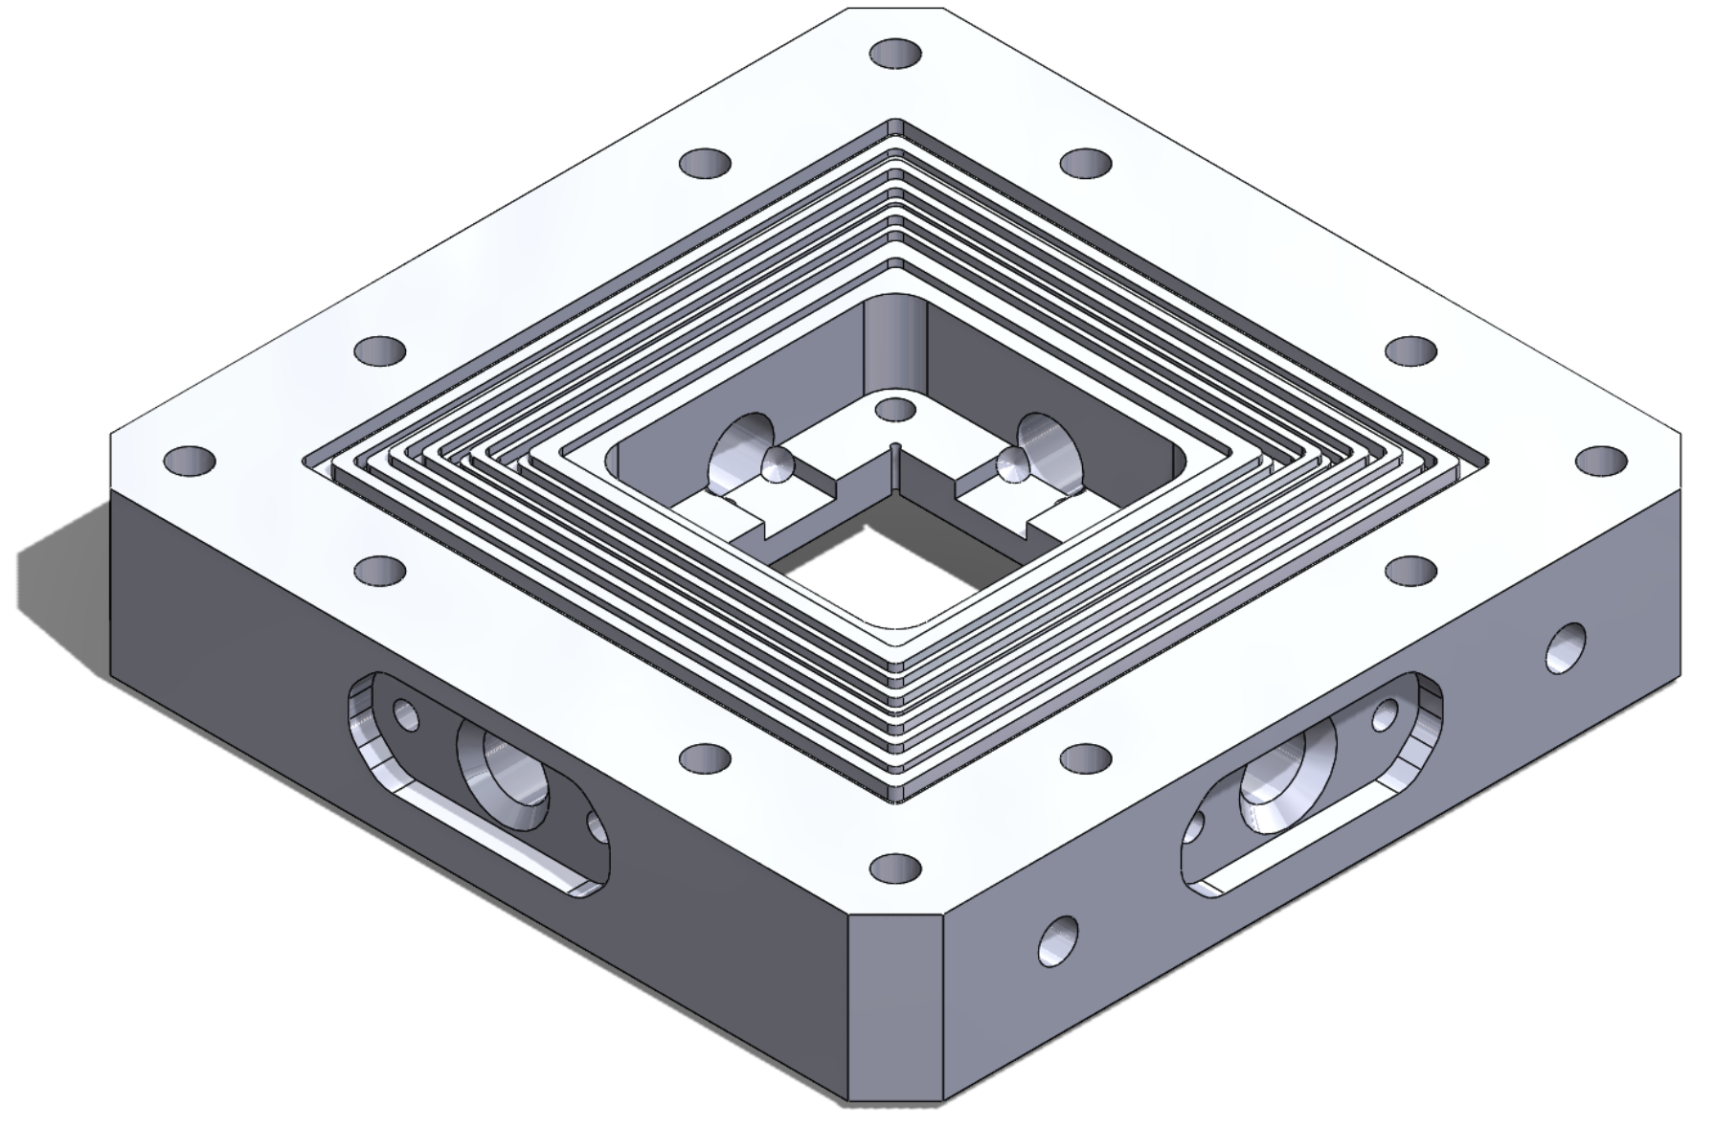
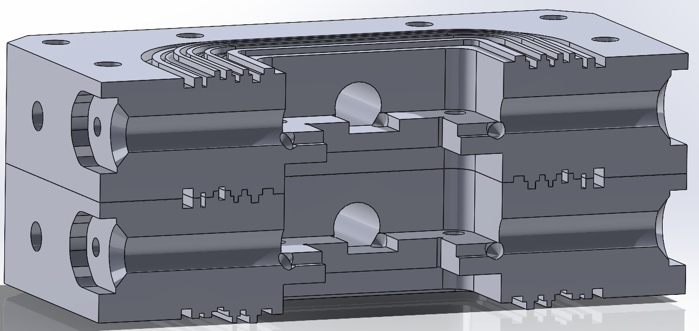








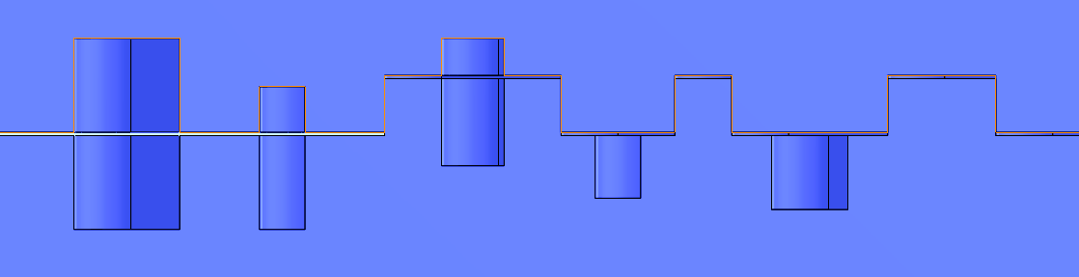
RF Box Consortium
Through this group we’re hoping to create a general device enclosure compatible with TES, Qubits, MKIDs, and other superconducting/quantum devices
Credit: Yashwanth Balaji & Arian Gashi of LBNL
For More in depth details please go to Xinran Li’s talk on behalf of Yen-Yung: Oct 9, 2025, 2:00 PM. Woodlands AB RDC 7

Slide 25
Conclusion
Improving backgrounds is important to push our devices performance
Shielding effectiveness improvements are expected through use of stub filters
Plans to implement the RF box and study qubit performance in QUIET are taking shape
Stay tuned for RF box results

Slide 26
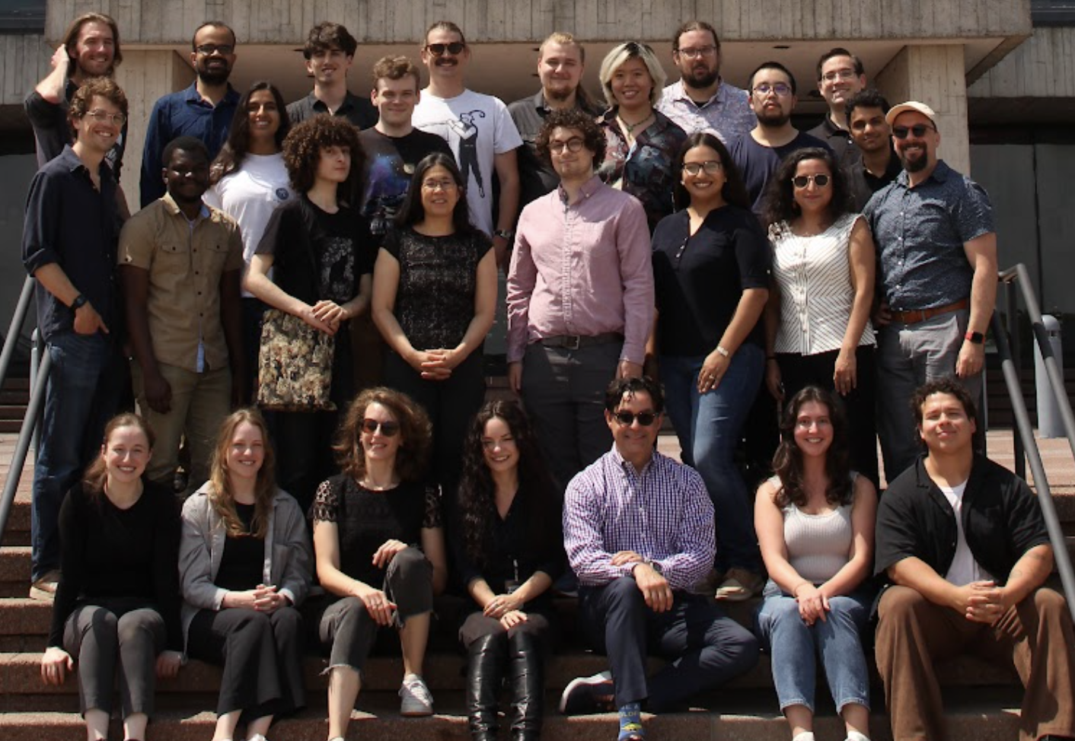
Acknowledgements
IIT: Rakshya Khatiwada (joint w/ FNAL), Kester Anyang, Israel Hernandez, Jialin Yu, Ziyu Cai
FNAL: Aaron Chou, Daniel Bowring, Gustavo Cancelo, Lauren Hsu, Daniel Baxter, Ryan Linehan, Sara Sussman, Dylan Temples
Northwestern University: Enectali Figueroa-Feliciano (joint w/ FNAL), Pratyush Patel, Emmanuela Celi, Grace Bratrud, Arianna Colón Cesaní, Alejandro Rodriguez, Firas Abouzahr
This material is based upon work supported by the U.S. Department of Energy, Office of Science, National Quantum Information Science Research Centers, Illinois Institute Of Technology.

Slide 27
Thank you!

Slide 28
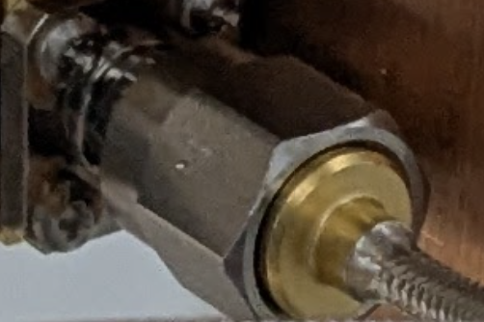
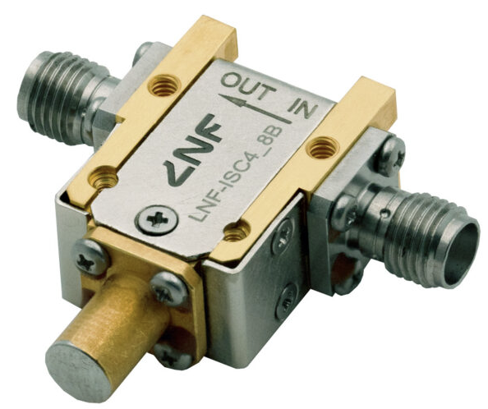
Magnetic Fields
common cryo components are often weakly magnetic
SMA connectors are made of stainless steel (magnetic) are common
Many copper SMA connectors contain a layer of nickel
Some passive components are innately magnetic (Circulators!
Solutions: Use non-magnetic lines*
Mag shields (Mu metal / superconducting)
Properly isolate natively magnetic components

