Slide 1
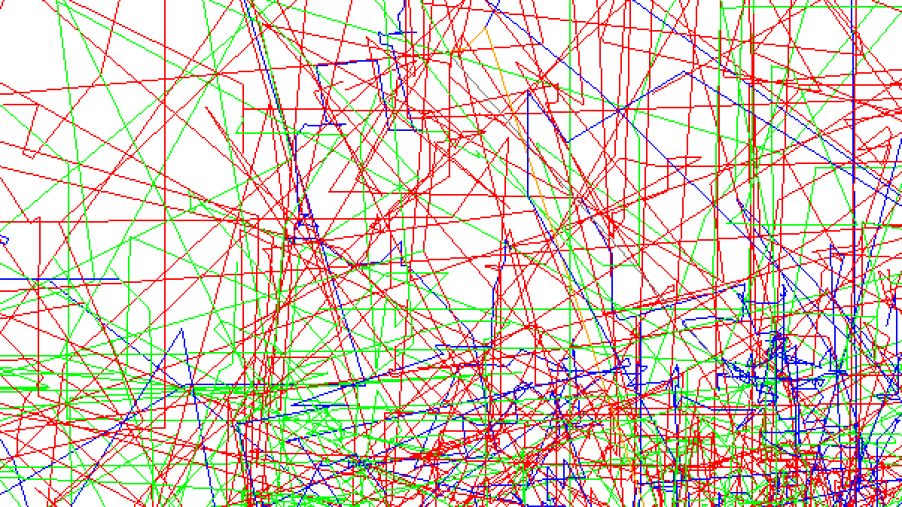




G4CMP
Simulations of
KIPM Detectors
Selby Q Dang
CPAD 2025 | 10/8

Slide 2
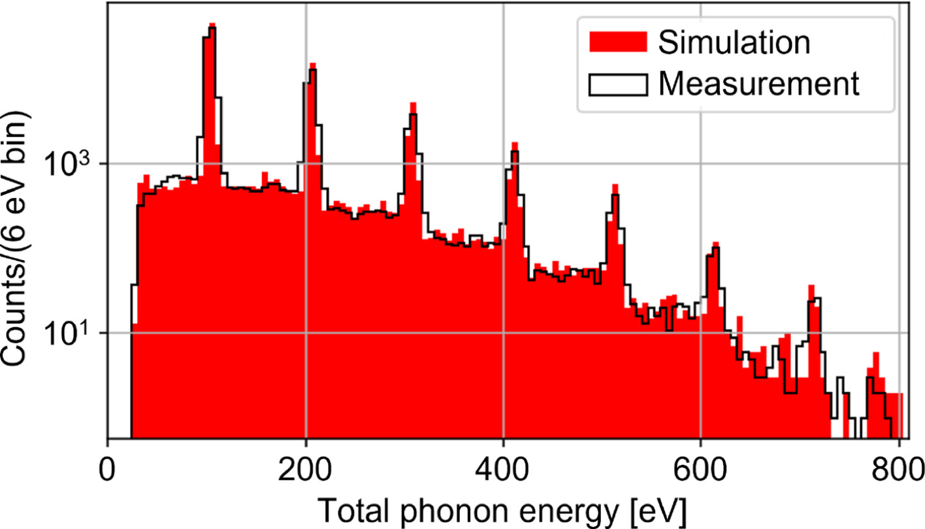
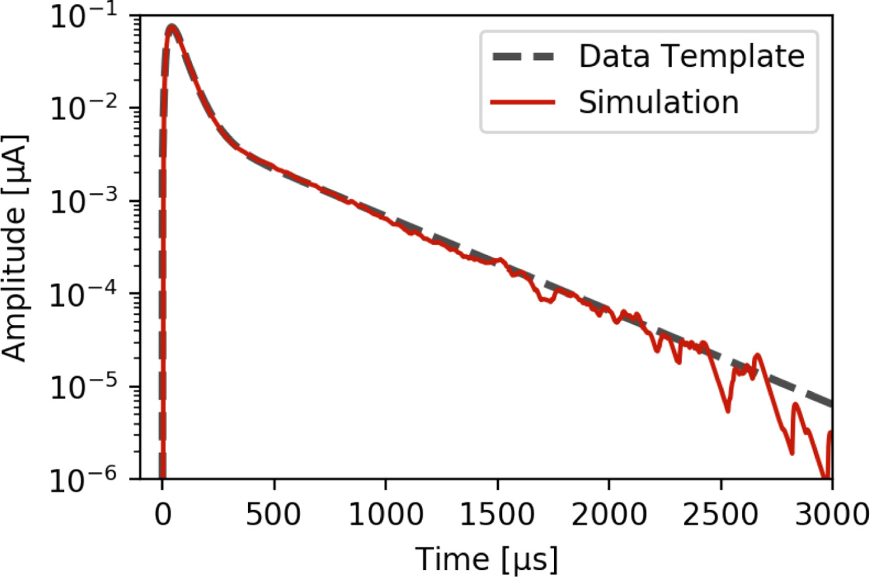
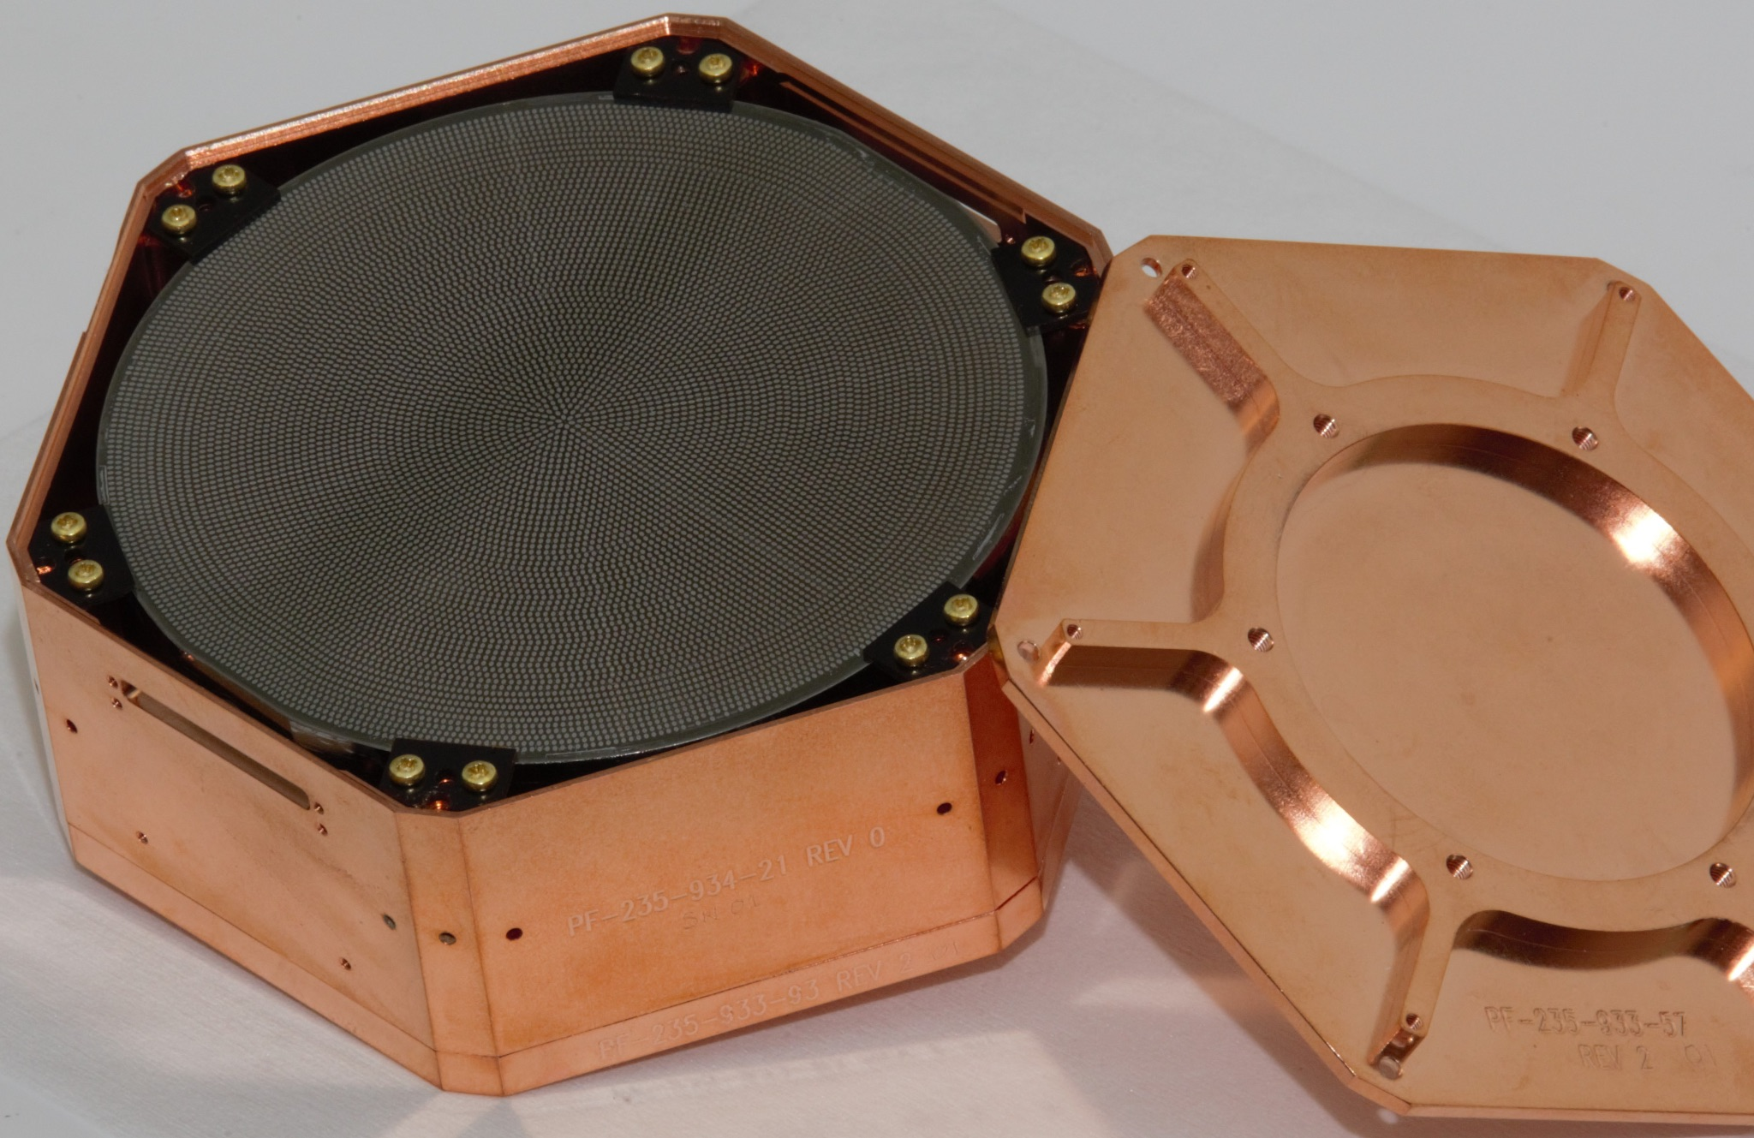
The Geant4 Condensed Matter Physics Package
https://github.com/kelseymh/G4CMP
Cryogenic detector simulation software using the Geant4 toolkit
Models phonon + charge production & transport in solid state volumes
Have been used in R&D for ultra-low threshold (single e-/h+ resolution) dark matter detectors
  Well-validated for SuperCDMS HVeV detectors (10 x 10 x 4 mm chip, 20% coverage with QET phonon sensors)
⊕ terminal
Aluminum sensor pads
Charge Propagation
NTL Phonon Emission
V_{bias}
Prompt Phonons
⊖ terminal
Aluminum sensor pads
https://doi.org/10.1016/j.nima.2023.168473
WIMP
‹#›
Notes:
G4CMP reproduces single e/h peaks, energy scale, and "background" due to charge trapping and trap ionization
As an example, we show a calibration spectrum measured
with a SuperCDMS HVeV device [14] in Fig. 6, compared to a
simulation of the spectrum with G4CMP. The peaks in the spec-
trum correspond to the total phonon energies of integer numbers
of e−/h+ pairs for a 100 V detector bias, from a single pair at
∼100 eV to seven pairs at∼700 eV. Charge trapping and impact
ionization can result in phonon energies corresponding to non-
integral numbers of e−/h+ pairs, tending to fill in the regions be-
tween the peaks. Because the phonon resolution of this device
is more than suﬃcient to cleanly resolve gaps between the e−/h+
pair peaks, the spectral shape is highly sensitive to and can be
used to fit for this device’s trapping and impact-ionization pa-
rameters [47, 48]. As Fig. 6 demonstrates, using the best-fit pa-
rameters in G4CMP allows for a reasonable simulation of this
device’s measured response.
Figure 6: Simulated phonon-response energy spectrum (red) for a SuperCDMS
HVeV detector operated with a 100 V bias and exposed to 635 nm (1.95 eV) cal-
ibration photons, compared to the measured spectrum (black) from Ref. [14].
The peaks correspond to integer numbers of e−/h+ pairs. Events with ener-
gies between the peaks are attributed to experiencing the eﬀects of charge trap-
ping and impact ionization. The parameters used to simulate these processes
in G4CMP were obtained by fitting the model in Ref. [48] to the measured
spectrum.
G4CMP + ODE reproduces shape of readout signal over four orders of magnitude
Underlying the HVeV data analysis is a de-
tailed understanding of the phonon pulse response. A 635 nm
(1.95 eV) laser produces events of known origin, which are used
to create a pulse-shape template for reconstructing the phonon
energy of events of unknown origin.
Parameter-optimized phonon pulse response simulated for an HVeV
device using G4CMP and the SuperCDMS Detector Monte Carlo (red solid),
compared to the pulse template constructed from HVeV laser calibration data
(black dashed).

Slide 3
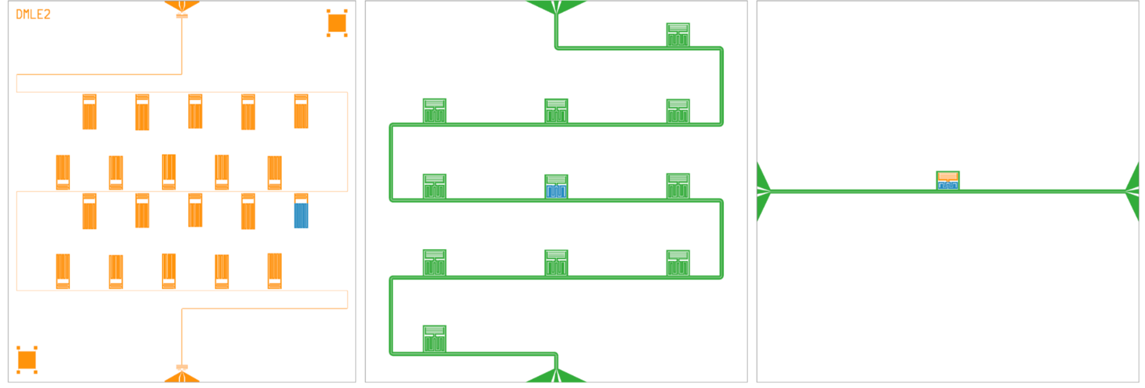
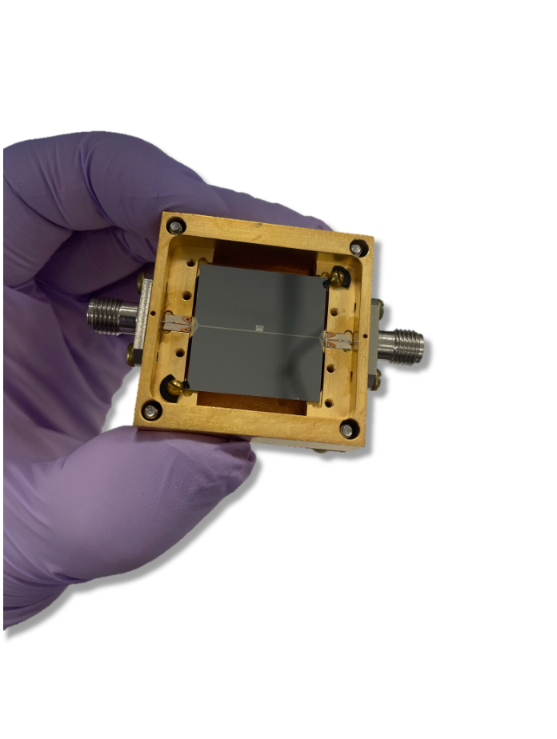
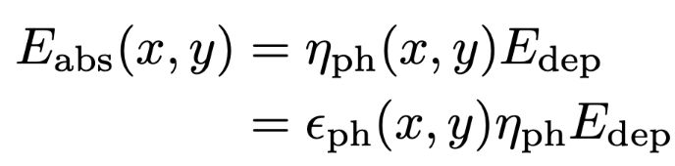
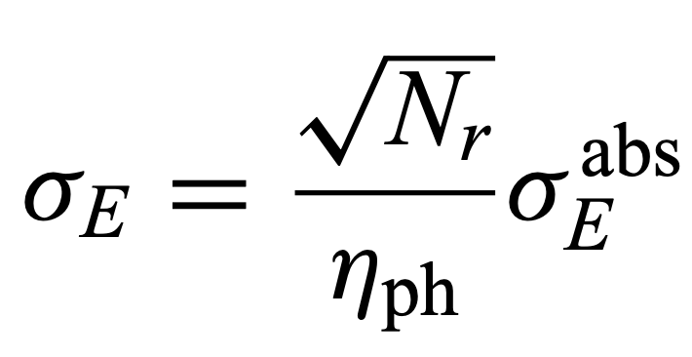
Kinetic Inductance Phonon-Mediated Detectors
https://arxiv.org/abs/2509.25544
Our KIPM (OW230427)
1mm x 2cm x 2cm Si chip
30 nm Al resonator, 70 nm Nb feedline
0.09% sensor surface area coverage
<13,695.6 μm³ active inductor volume
Fabricated at JPL by Osmond Wen and Bruce Bumble
KIPM detectors leverage kinetic inductance detectors (KIDs) to sense phonons in the substrate
Detection principle: phonons break Cooper pairs into quasiparticles → shift resonant frequency
Overall detector resolution is limited by low phonon collection efficiency!
doi.org/10.1103/PhysRevApplied.22.044045
number of resonators
resolution on energy deposited in the substrate
(hundreds of eV)
resolution on energy absorbed by the sensor
(few eV)
peak-normalized position-dependent efficiency
phonon collection efficiency (<1%)

Slide 4
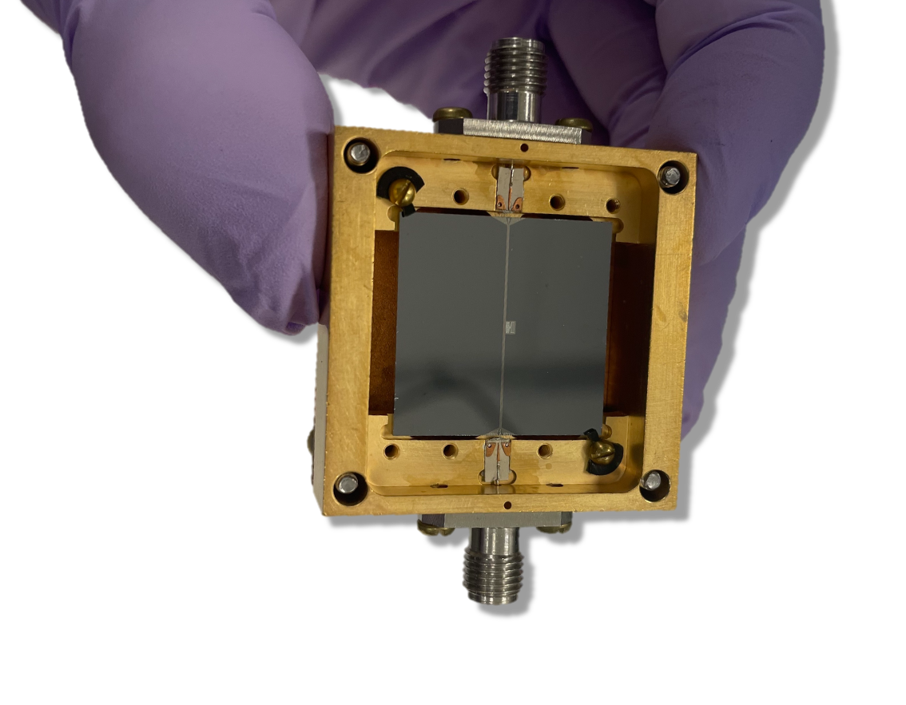
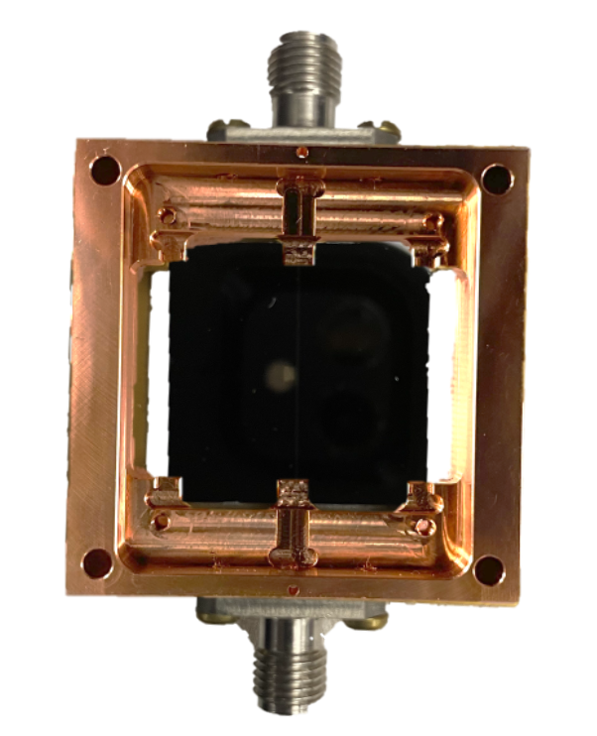
Phonon Exit Routes
Both the low efficiency and position dependence in phonon collection are symptomatic of some phonon loss mechanism(s).
Al resonator
polished faces
Nb feedline
side walls
Cu housing
front
back
Incident Particle
Cooper Pair
Quasiparticle (signal)
Quasiparticle (thermal)
Phonon (athermal)
Crystalline Substrate
Superconductor (sensitive)
Superconductor (dead metal)
Thermal mounts

Slide 5
Phonon Exit Routes
Both the low efficiency and position dependence in phonon collection are symptomatic of some phonon loss mechanism(s).
Nb feedline
front
back
Incident Particle
Cooper Pair
Quasiparticle (signal)
Quasiparticle (thermal)
Phonon (athermal)
Crystalline Substrate
Superconductor (sensitive)
Superconductor (dead metal)
Thermal mounts

Slide 6
Phonon Exit Routes
Both the low efficiency and position dependence in phonon collection are symptomatic of some phonon loss mechanism(s).
Cu housing
back
front
back
Incident Particle
Cooper Pair
Quasiparticle (signal)
Quasiparticle (thermal)
Phonon (athermal)
Crystalline Substrate
Superconductor (sensitive)
Superconductor (dead metal)
Thermal mounts

Slide 7
Phonon Exit Routes
Both the low efficiency and position dependence in phonon collection are symptomatic of some phonon loss mechanism(s).
side walls
back
front
back
Incident Particle
Cooper Pair
Quasiparticle (signal)
Quasiparticle (thermal)
Phonon (athermal)
Crystalline Substrate
Superconductor (sensitive)
Superconductor (dead metal)
Thermal mounts

Slide 8
Phonon Exit Routes
Both the low efficiency and position dependence in phonon collection are symptomatic of some phonon loss mechanism(s).
polished faces
back
front
back
Incident Particle
Cooper Pair
Quasiparticle (signal)
Quasiparticle (thermal)
Phonon (athermal)
Crystalline Substrate
Superconductor (sensitive)
Superconductor (dead metal)
Thermal mounts

Slide 9
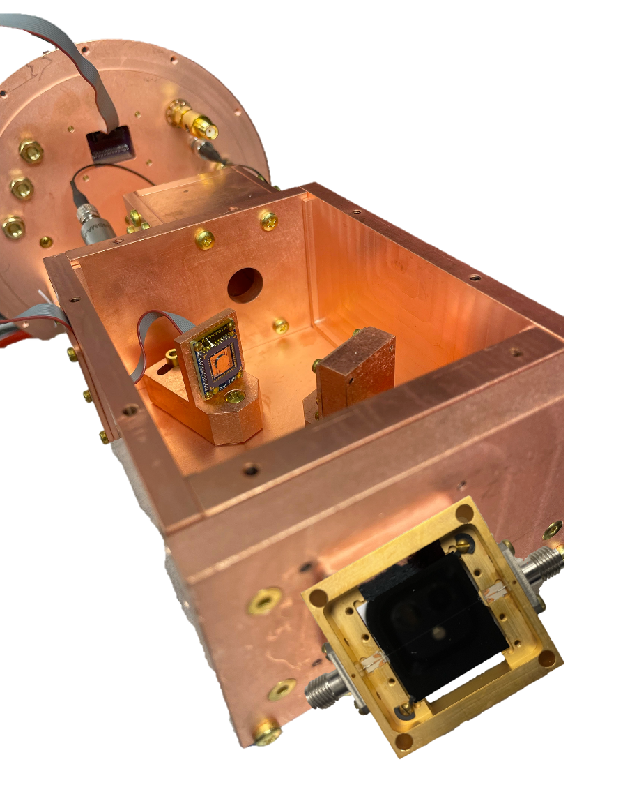
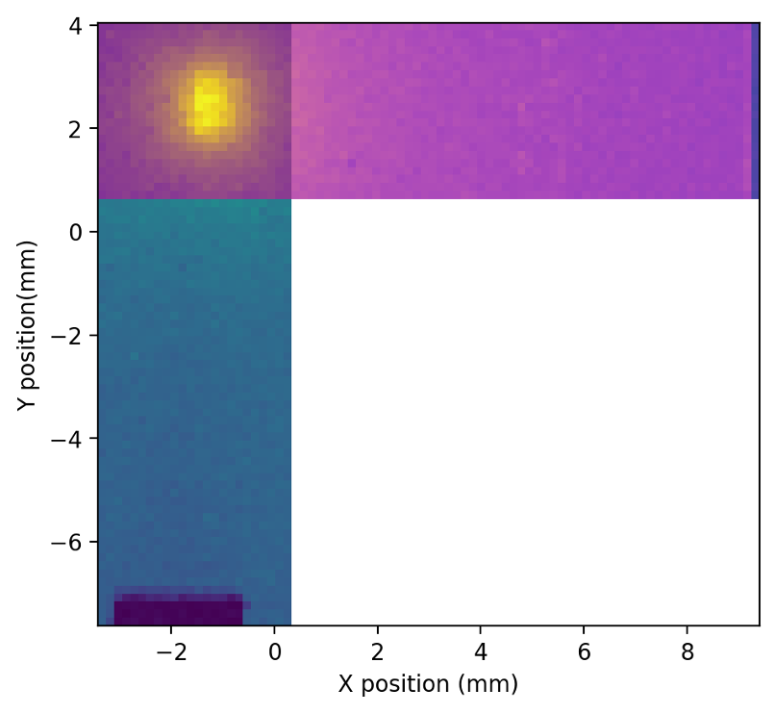
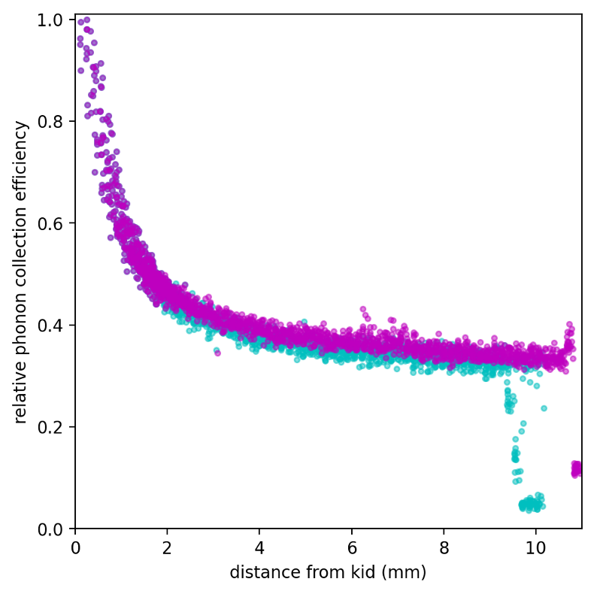
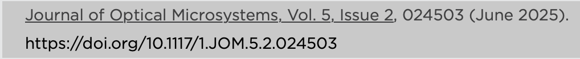
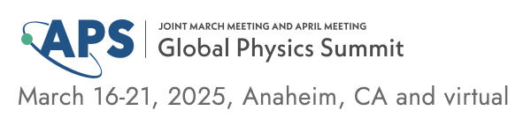
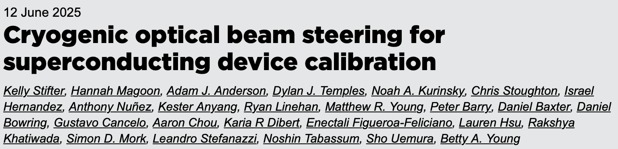
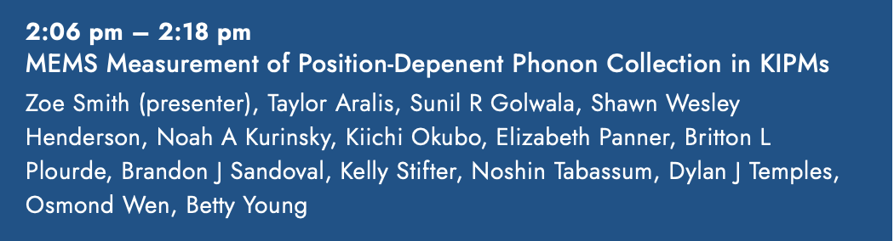
Spatial Phonon Responsivity Measurements
Measuring amplitude response over position helps us diagnose mechanisms of phonon loss.
Experimental setup:
Sweep position of the incident beam over the backside of KIPM chip
Pulsed measurement: 10 μs square wave pulses
→ measures athermal phonon collection
Notes:
bring up that we’re scanning position and looking at amplitude response

Slide 10
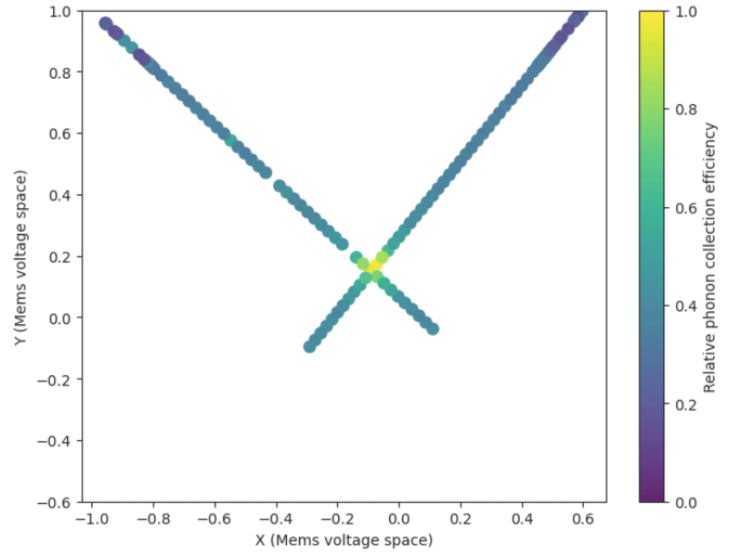
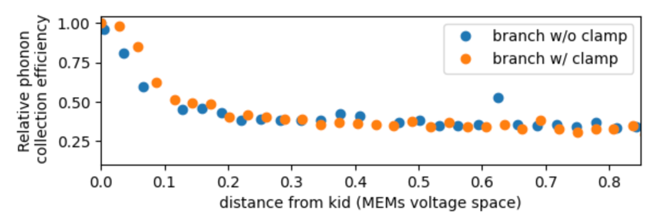
Spatial Phonon Responsivity Measurements
Measuring amplitude response over position helps us diagnose mechanisms of phonon loss.
Experimental setup:
Sweep position of the incident beam over the backside of KIPM chip
Pulsed measurement: 10 μs square wave pulses
→ measures athermal phonon collection
Notes:
bring up that we’re scanning position and looking at amplitude response

Slide 11
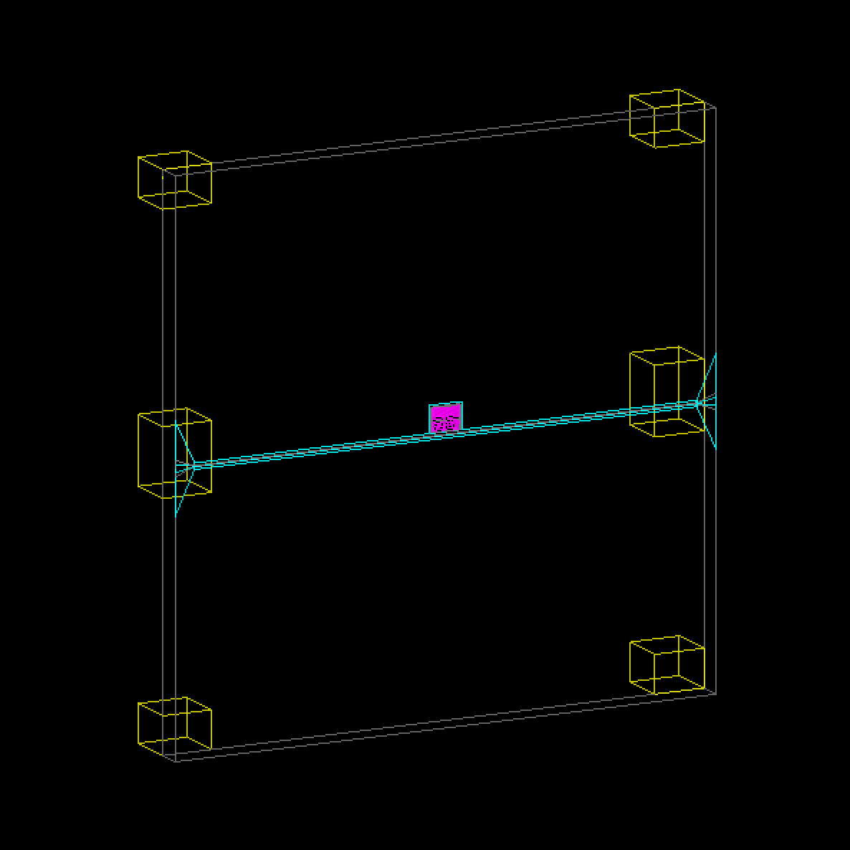
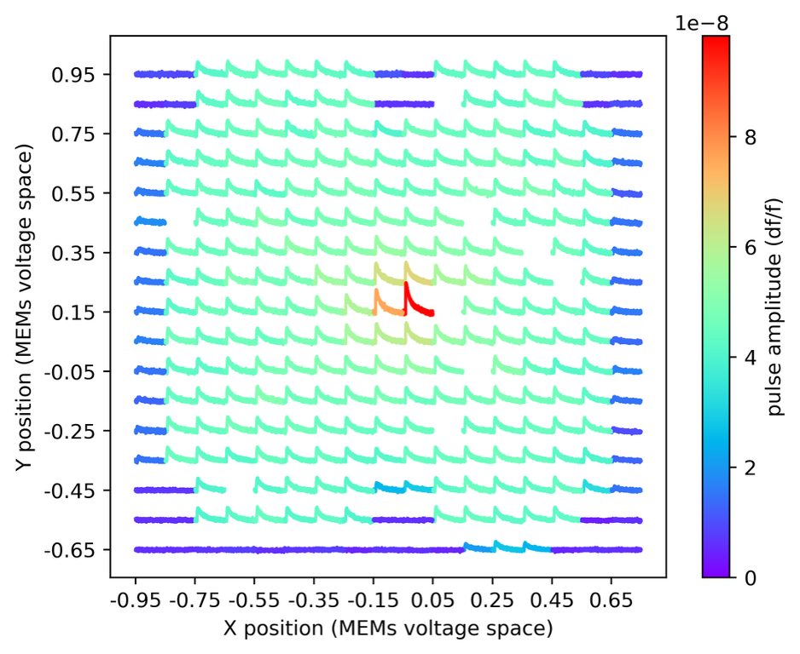
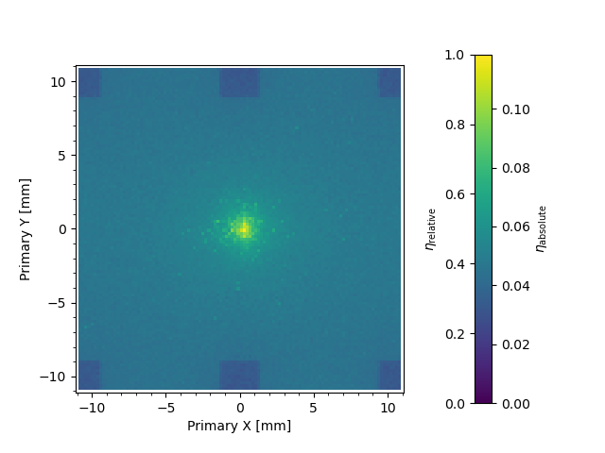
Big Picture
validation
data
What is the position dependence of our phonon collection efficiency?
How do the relative contributions of prompt/delayed phonon populations affect this position dependence?
How do different loss mechanisms affect this position dependence?
simulation
PRELIMINARY
intuition-building
Notes:
Write script for this slide

Slide 12
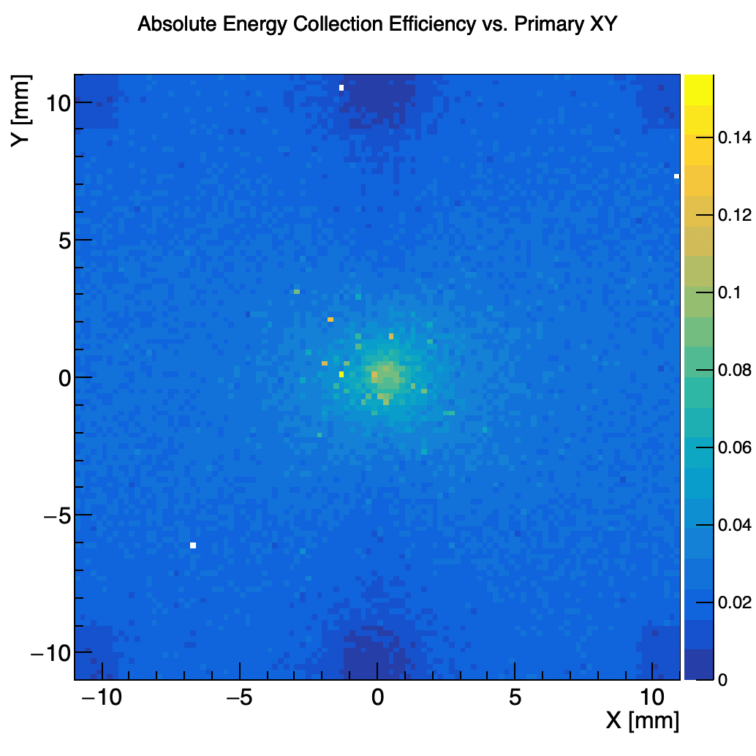
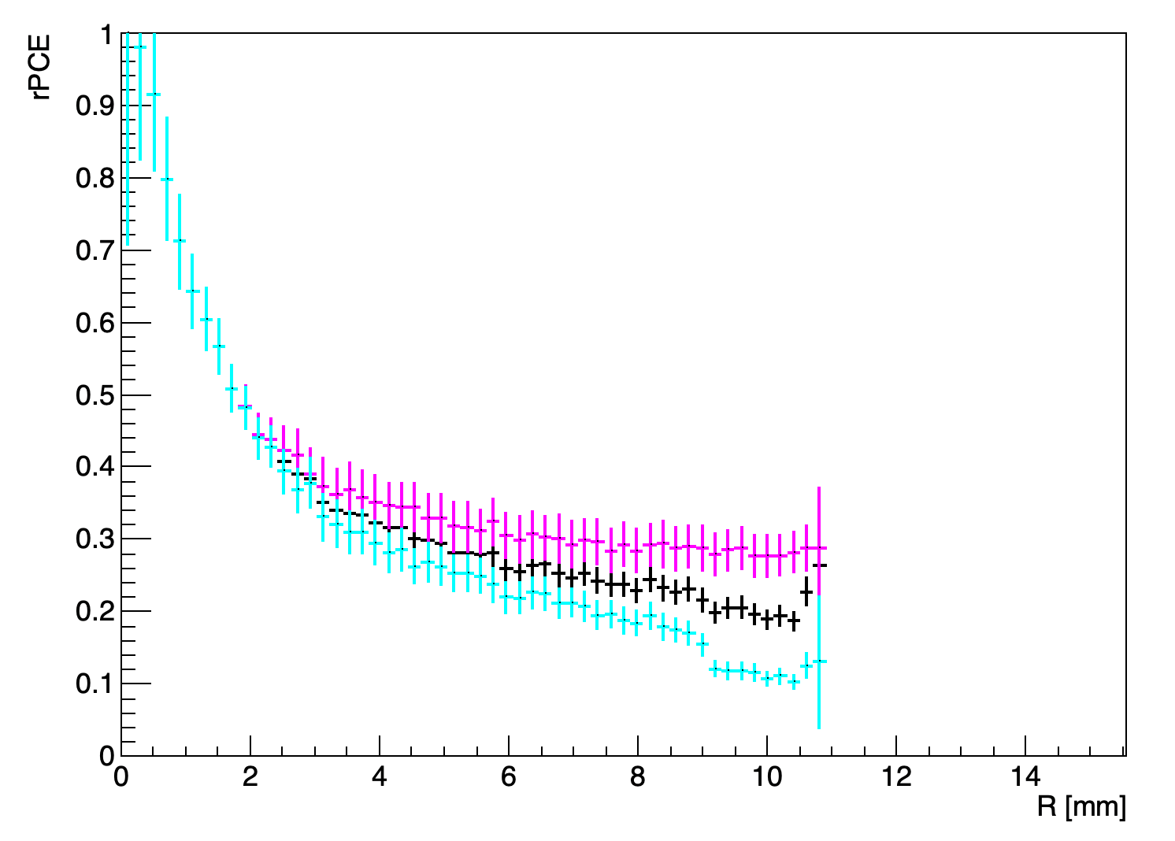
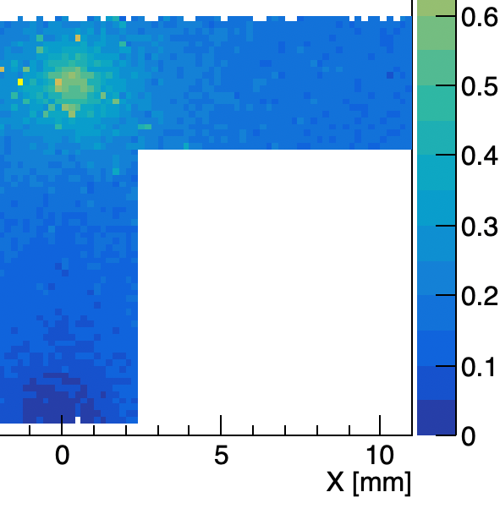
Toward Data + Simulation Comparison
Our data suggests that the predominant sources of phonon loss are not to thermal mounts or “dead metal”!
Data
Initial Sim

Slide 13
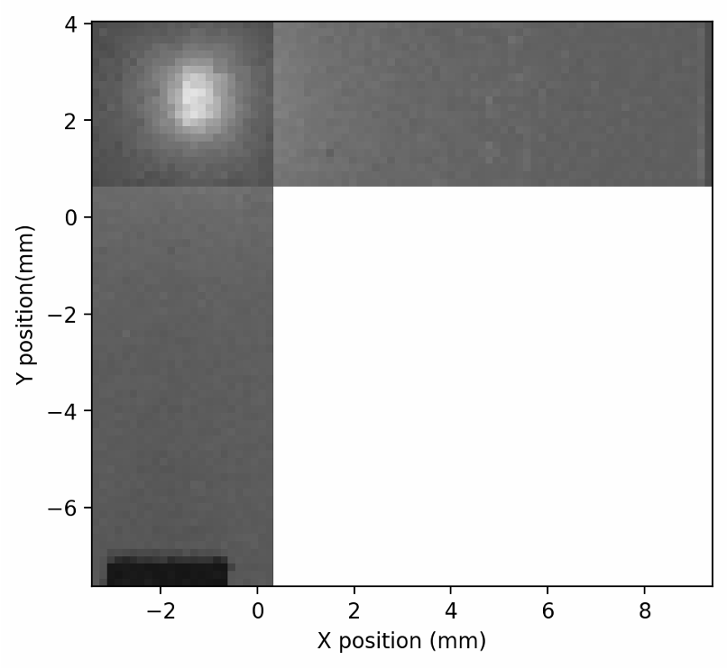
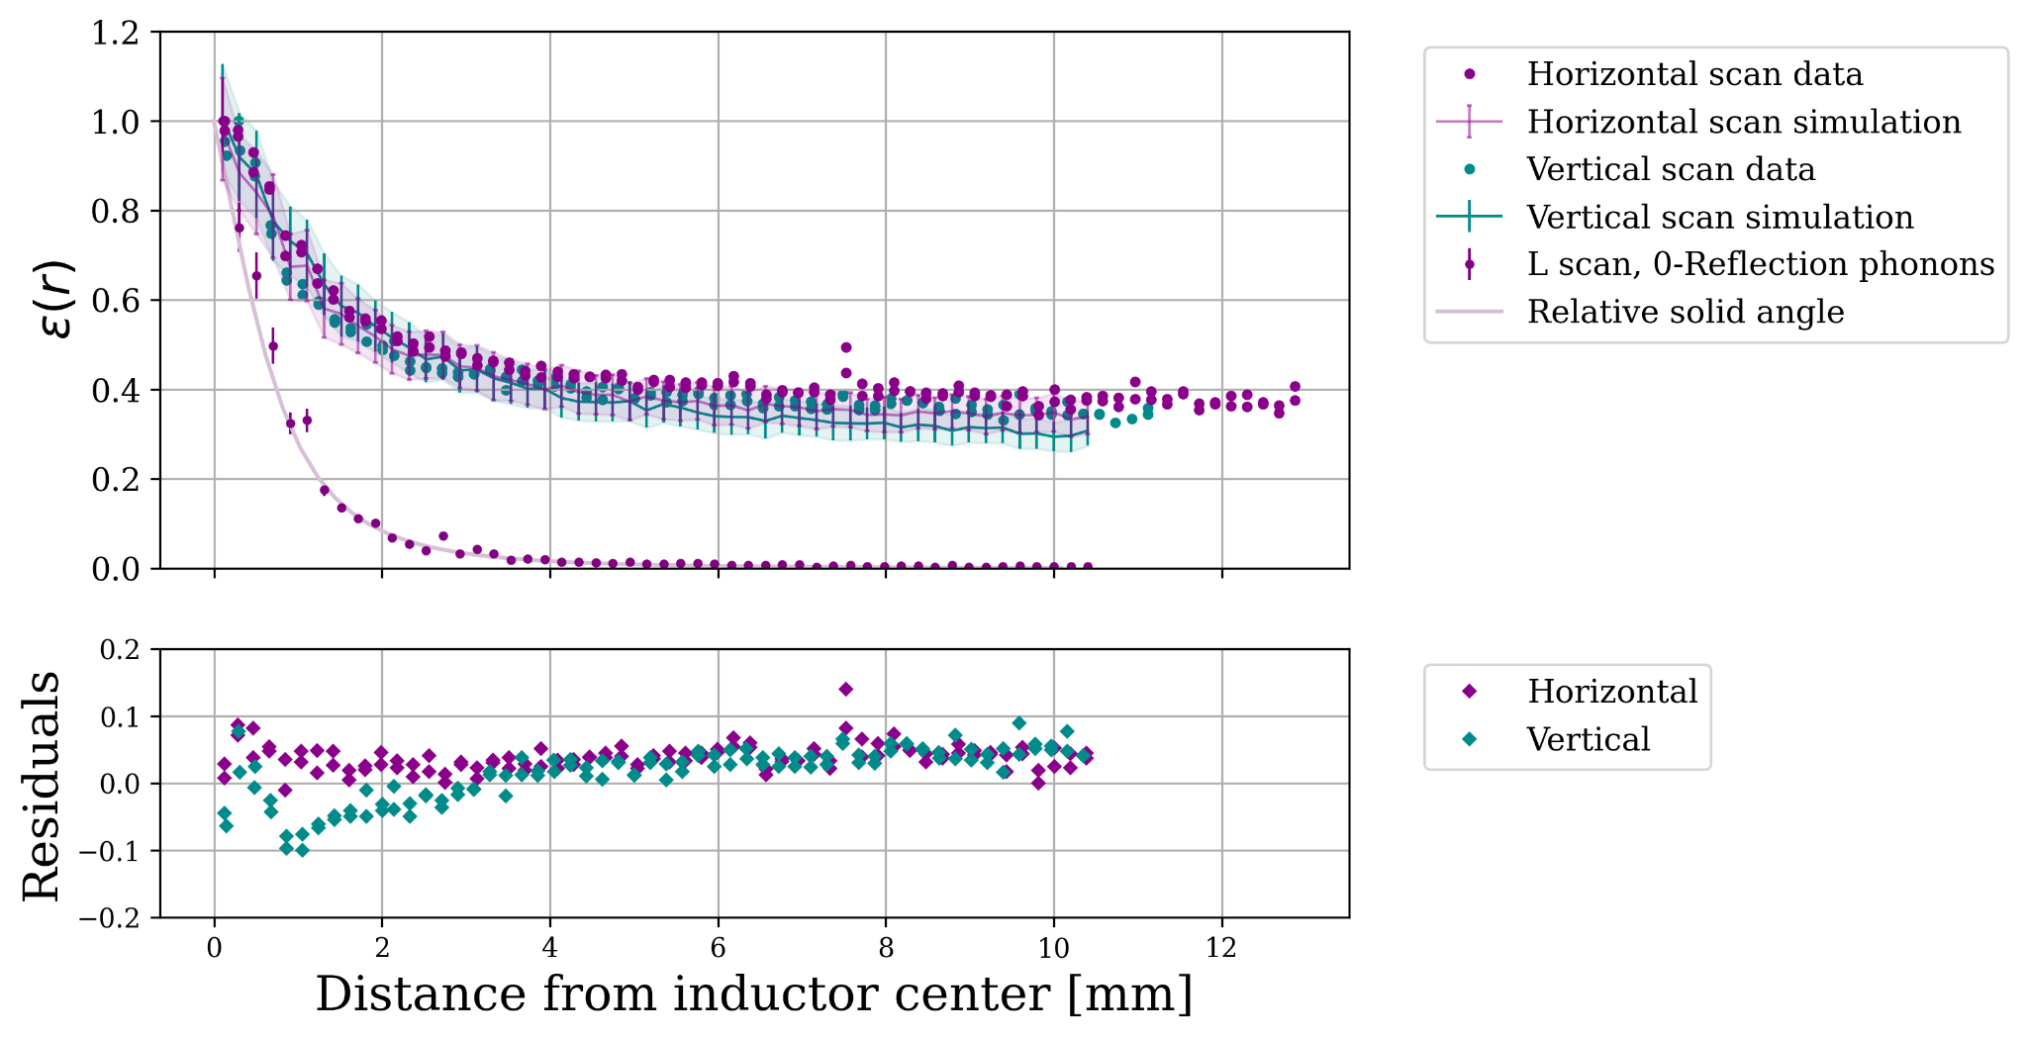
Data Reconstruction
We use a slice of 𝟄(r) data as a standard for qualitatively comparing models of phonon loss mechanisms.
PRELIMINARY

Slide 14
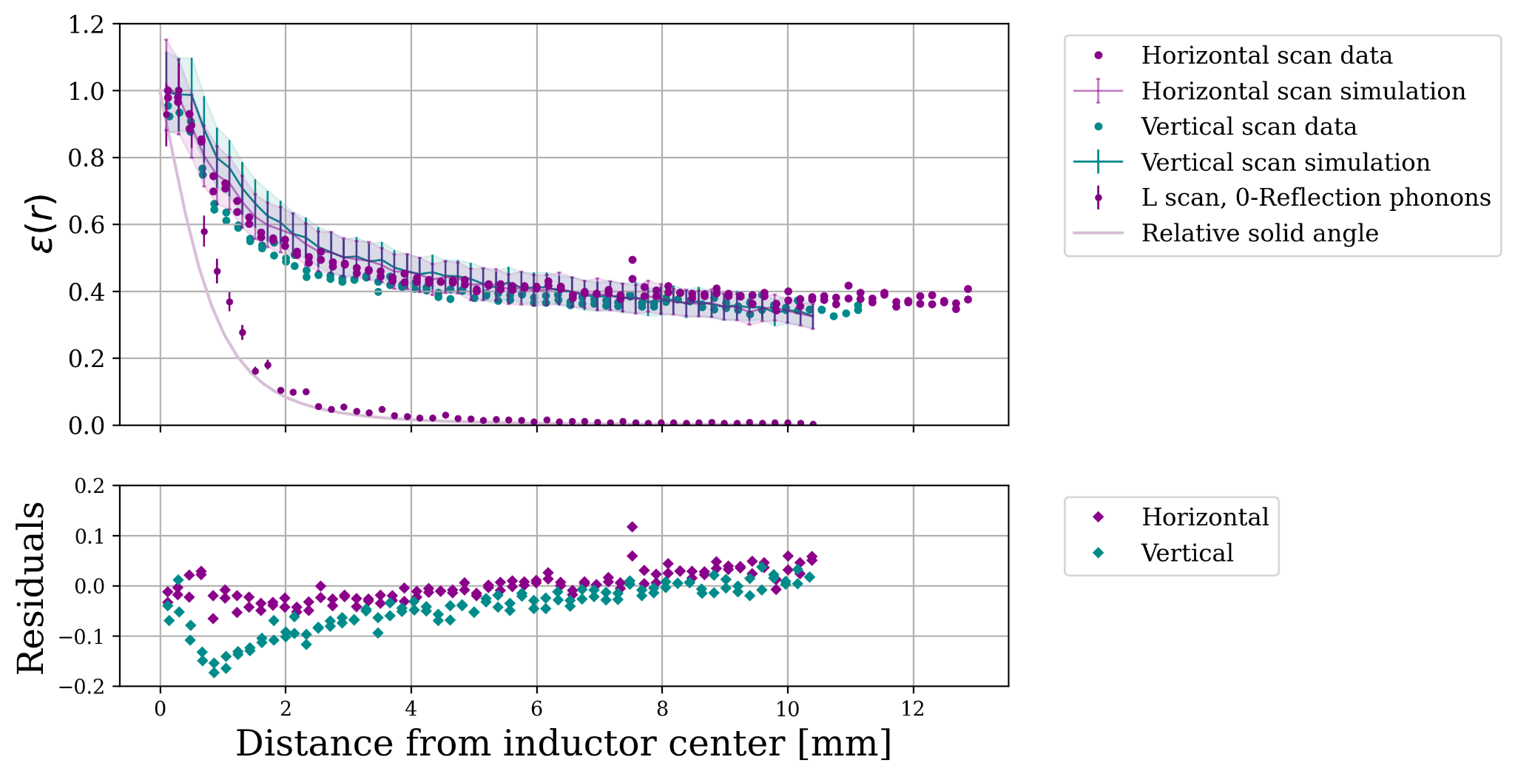
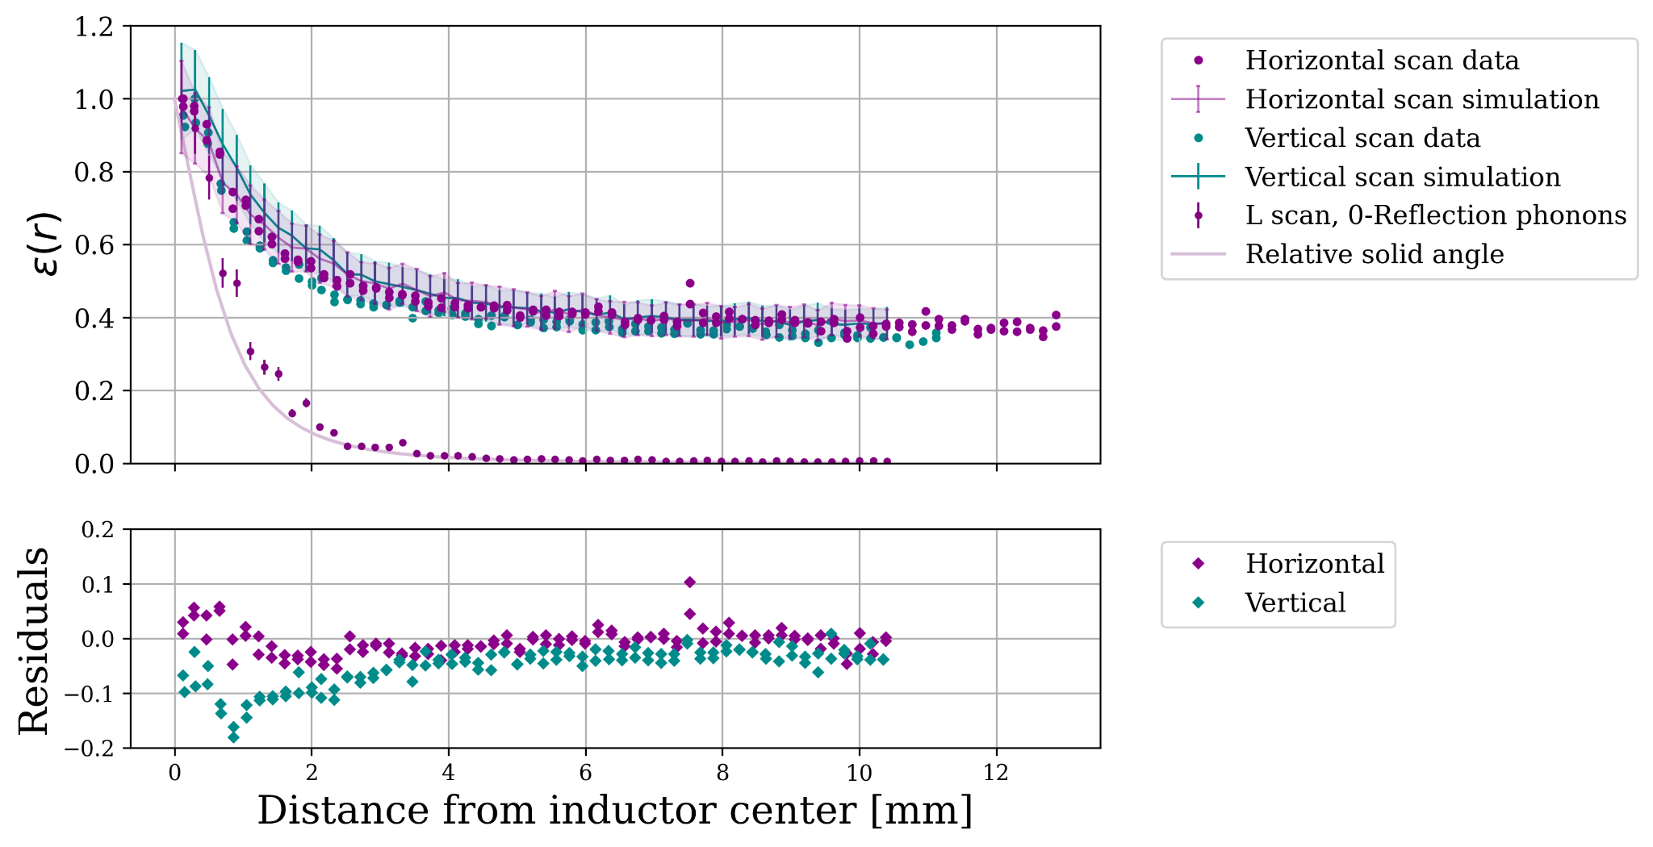
Comparing Loss Mechanisms
Currently, qualitative data comparisons yield degenerate “options for explanation” for phonon loss.
side walls
polished faces
polished faces + feedline
Notes:
phonon mfp

Slide 15
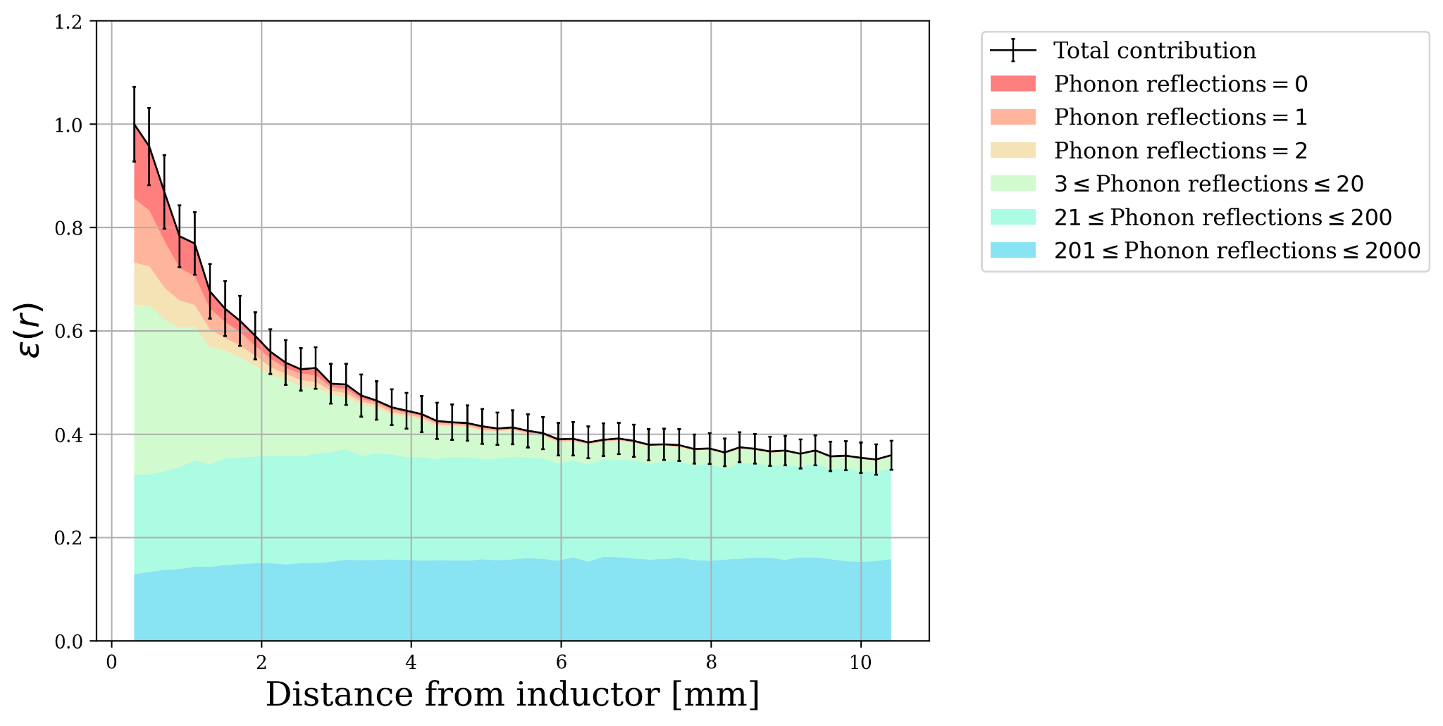
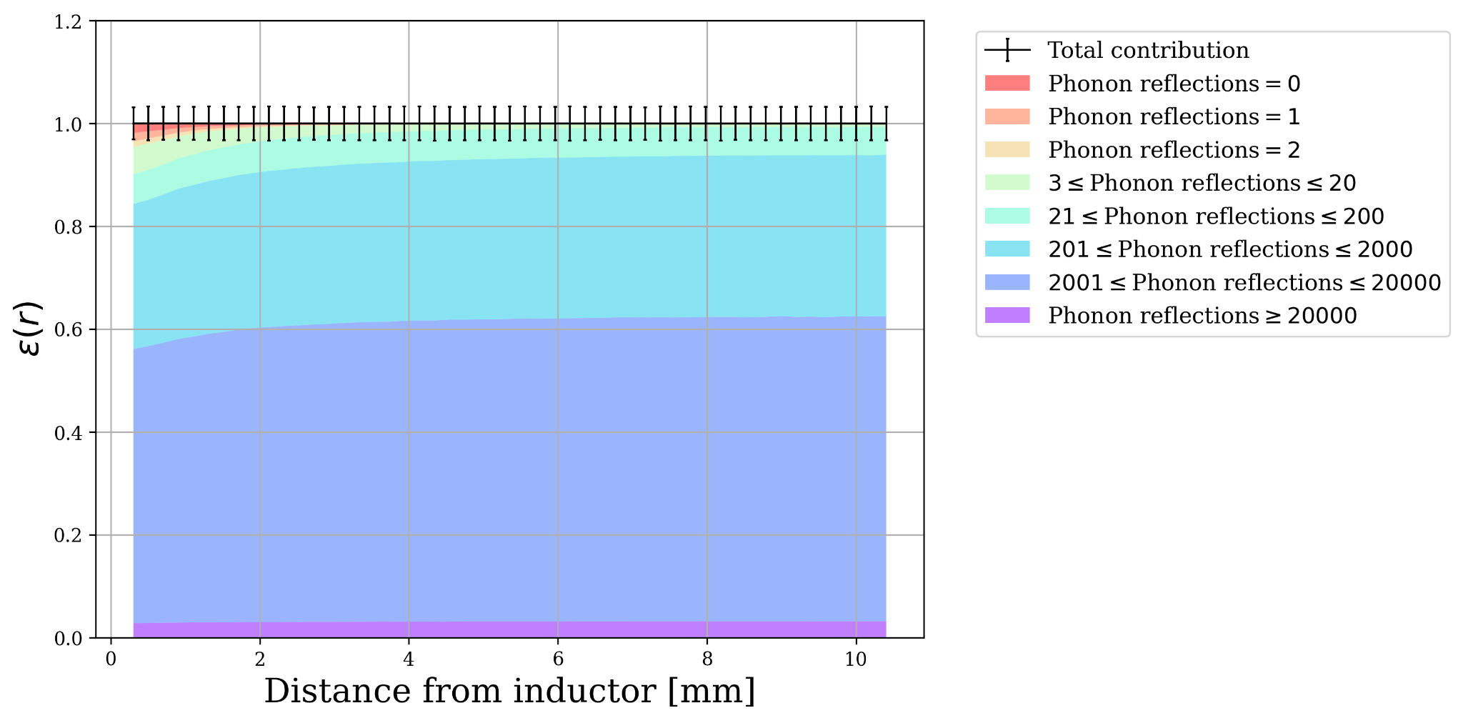
Phonon Loss vs. Position Dependence
Physical loss mechanisms give rise to the position dependence in 𝟄 by changing the total amount of “long-lived” phonons.
PRELIMINARY
PRELIMINARY
“lossy”
“lossless”
Notes:
Discuss: why does this have this shape?
We still don’t have a physical understanding of the 2-component model, but these two approaches both provide intuition
close to the KID → 2 component, far from the KID → 1 component
using number of bounces as a proxy

Slide 16
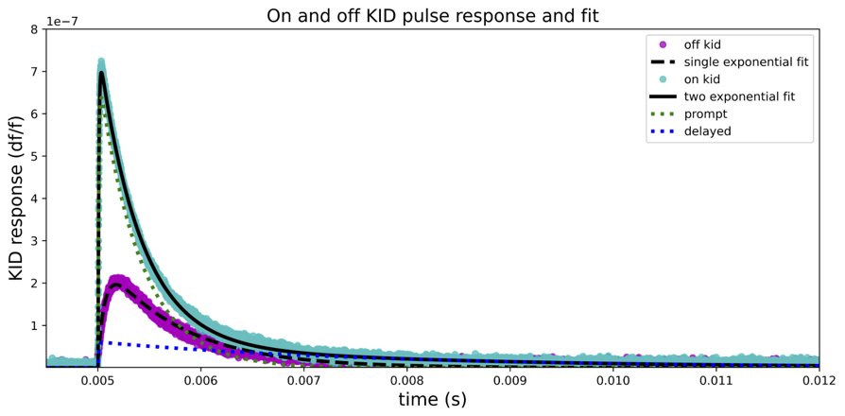
Phonon Loss vs. Detector Response
Tracking the number of phonon reflections provides an intuitional proxy for the two-component model of KIPM detector response.
PRELIMINARY
PRELIMINARY
PRELIMINARY
prompt
delayed
Notes:
Discuss: why does this have this shape?
We still don’t have a physical understanding of the 2-component model, but these two approaches both provide intuition
close to the KID → 2 component, far from the KID → 1 component
using number of bounces as a proxy

Slide 17
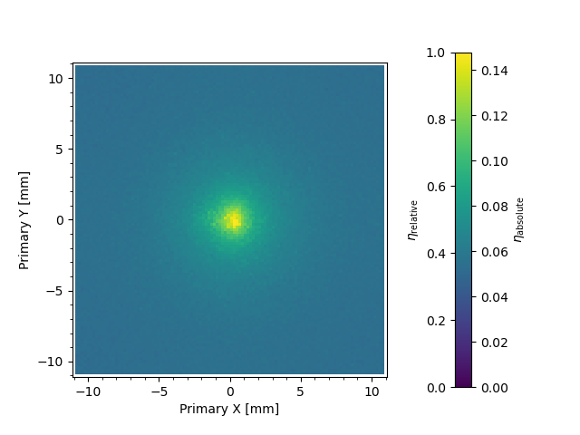
Conclusions
Our data suggests that thermal mounts and “dead metal” are not dominant sources of phonon loss
  The problems of low phonon collection efficiency and high position dependence persist!
We have demonstrated simulation models using several alternative loss mechanisms which can all qualitatively reconstruct the data
  Explanatory, but not prescriptive!
By tracking the energy, position, and number of reflections of phonons in simulation, we gain intuition into the relationship between loss mechanisms and position-dependent phonon collection
In preparation:
Spatial Phonon Responsitivity of a KIPM Detector
Z. J. Smith, S. Q. Dang et al.

Slide 18
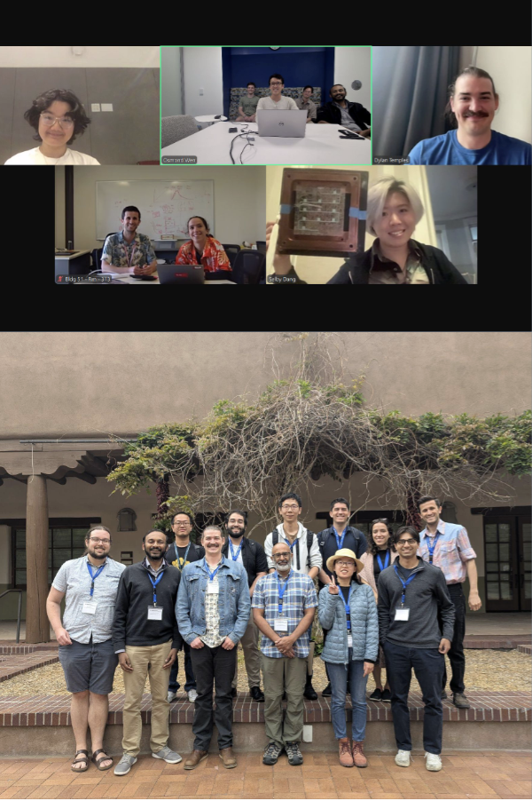
KIPM Detector Consortium
RDC 7 Low-Background Detectors
10/8, 2:40 - 3:00 pm
Dylan J. Temples, FNAL
The KIPM Detector Consortium
RDC 8 Quantum & Superconducting Sensors
10/7, 2:50-3:05 pm
Junwen Xiong, Caltech
Toward a meV Kinetic Inductance Phonon-Mediated (KIPM) detector for low mass dark matter searches
RDC 8 Quantum & Superconducting Sensors
10/7, 3:15-3:20 pm
Xinran Li, LBL
Phonon sensitive kinetic inductance device with low-Tc hafnium for light dark matter search
RDC 8 Quantum & Superconducting Sensors
10/7, 3:30-3:45 pm
Kungang Li, LBL
Enhanced Phonon Collection Efficiency in Aluminum MKIDs with Phonon Reflective Coating

Slide 19
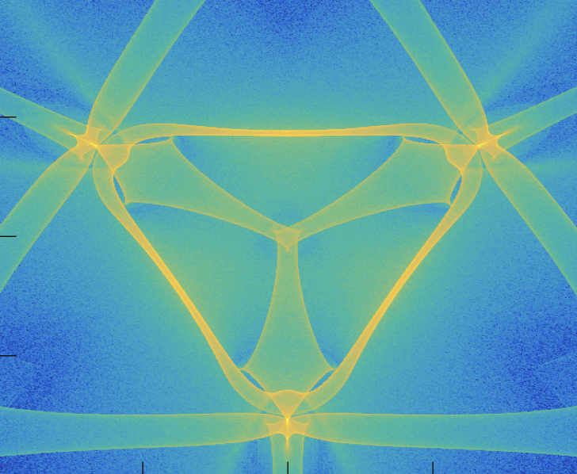
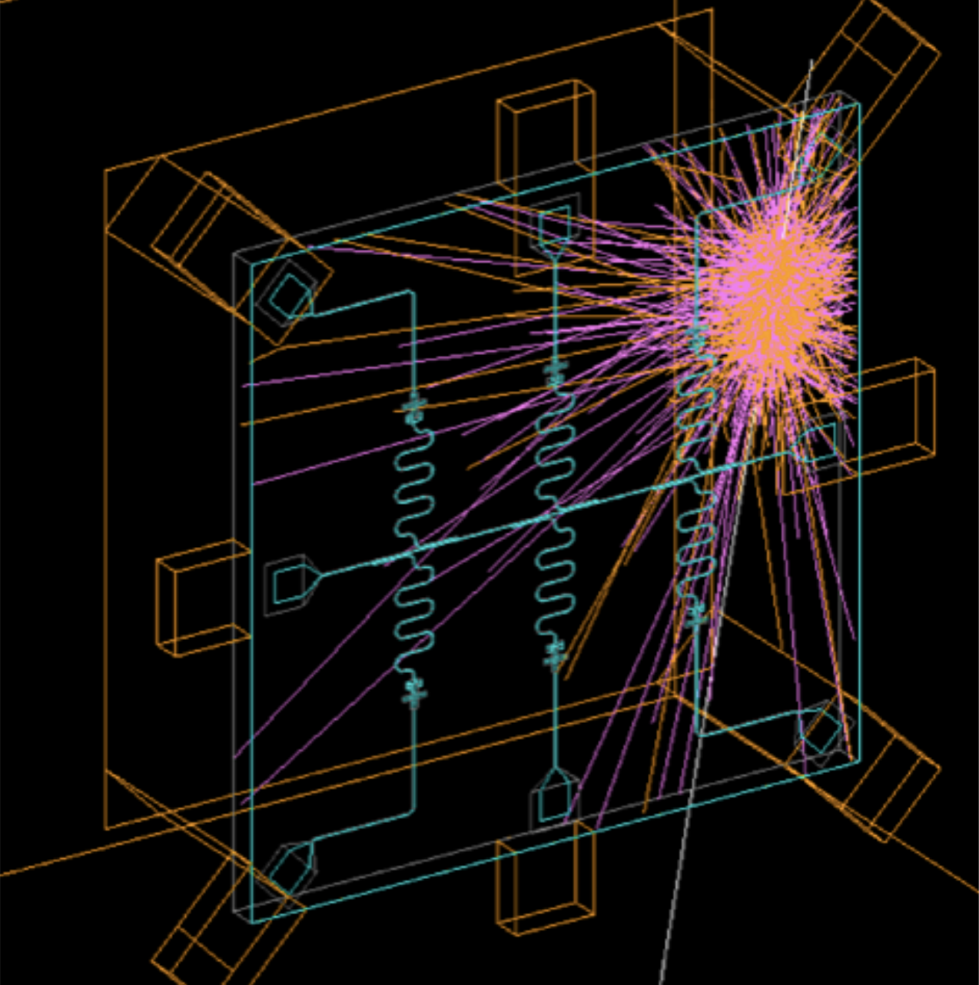
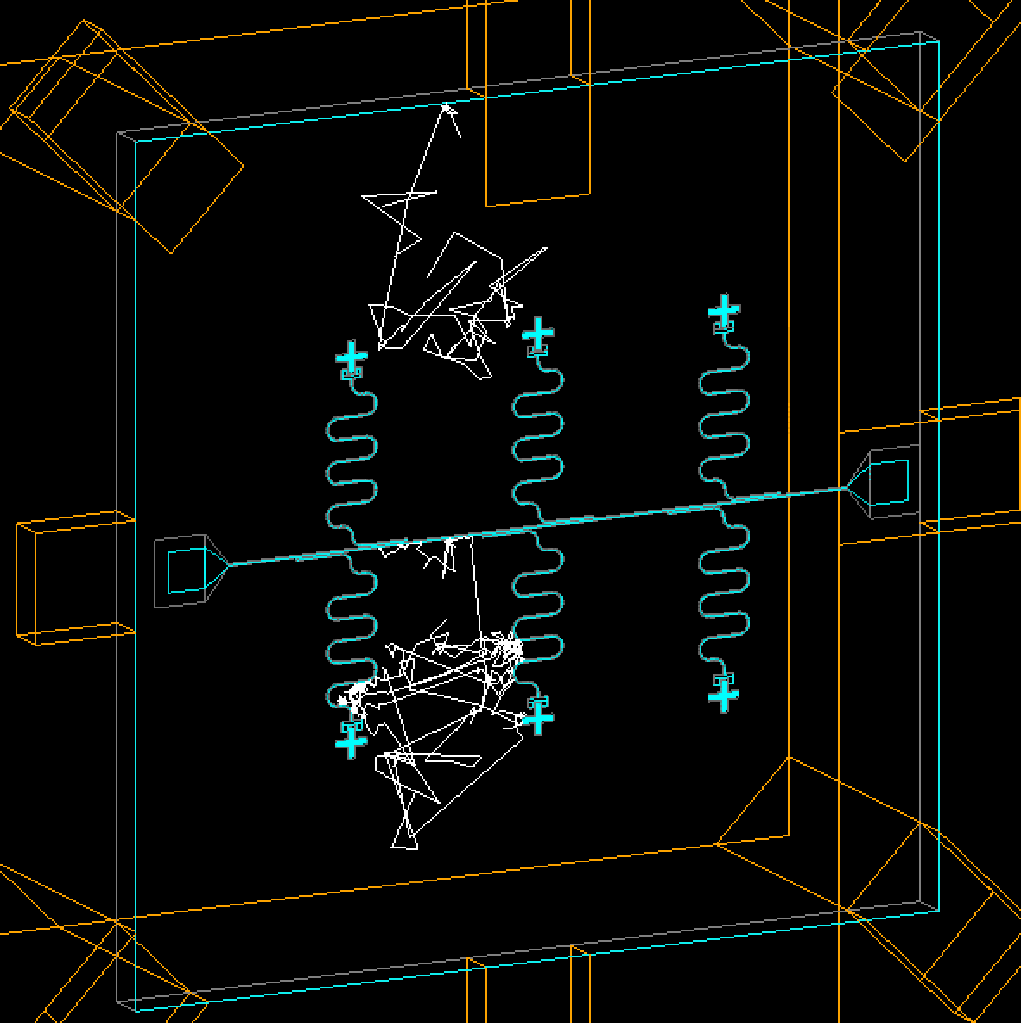

G4CMP Consortium
Charge/Phonon Transport
Radiation Impacts
Developer group for modeling low-energy physics processes in cryogenic devices
Started mid-2024
Members from >31 institutions participating
Contact info: linehan3@fnal.gov, kelsey@slac.stanford.edu
Biweekly coordination/technical meetings
Join us!
UW-Madison
UMD LPS
University of Waterloo
INFN
HRL Labs
PNNL
SNOLAB
Caltech
LLNL
Colorado School of Mines
University of Florida
IN2P3
Sandia National Labs
Fermilab
University of Montreal
Syracuse University
Google
Northeastern University
IIT
Northwestern University
Brookhaven National Lab
Texas A&M University
MIT
SLAC
WashU St. Louis
…and more!
Coming very soon: quasiparticle diffusion
Consortium Info + Listserv

Slide 20
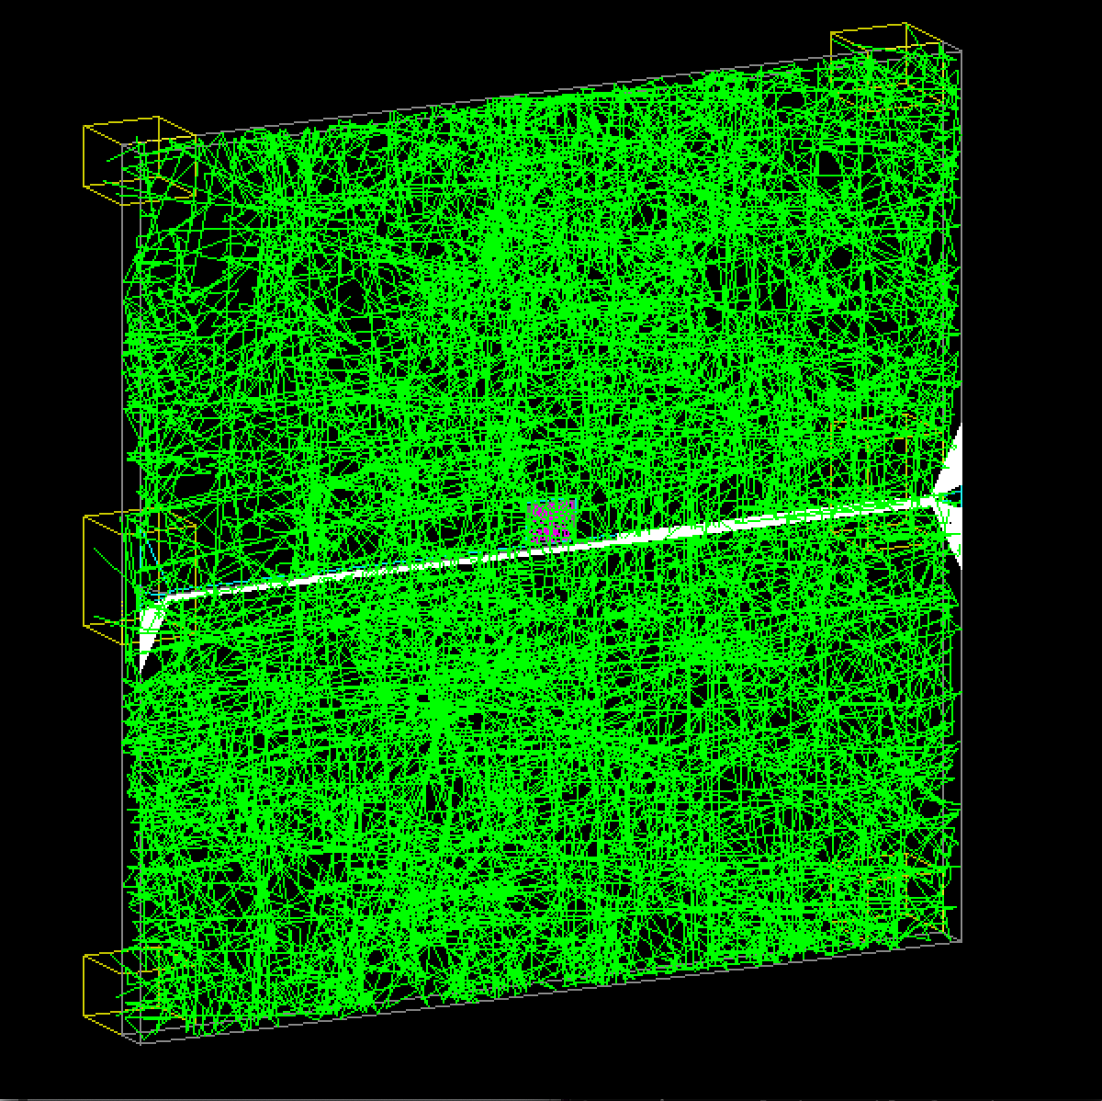
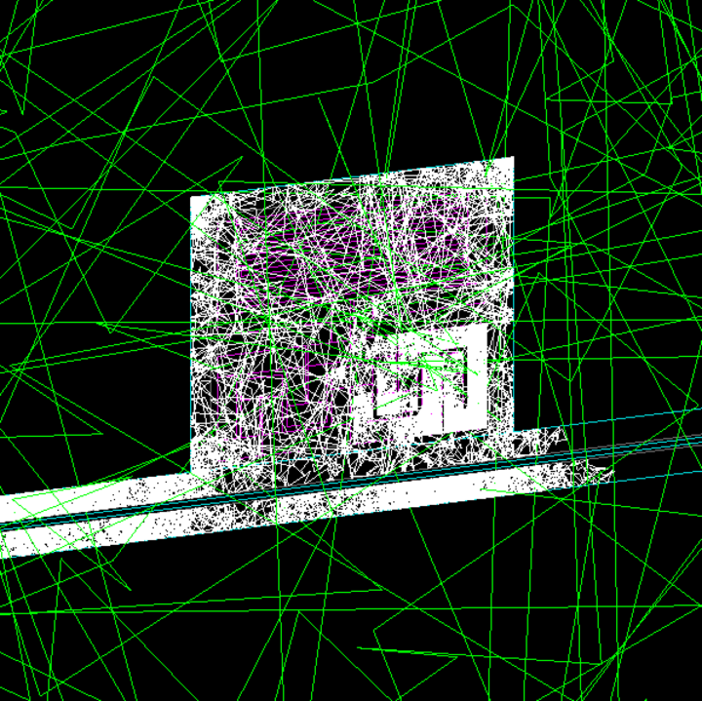
Phonon/QP Transport in Thin Films
Near-term G4CMP version update will enable 2D tracking and inelastic processes for phonons and QPs in superconducting thin films!
Quasi-elastic transport
Inelastic Processes
Phonon Boundary Processes (Transmission, Reflection, Absorption)
Phonon SC Pairbreaking
Phonons leaving through thermal mounts
Polycrystalline Quasielastic Scattering
QP Phonon Radiation
QP diffusion in inductor
green: phonons
white: quasiparticles
QP Diffusion and Boundary Processes
QP Recombination
https://github.com/kelseymh/G4CMP
feature/TrackedFilmResponse
In preparation: Linehan, Yelton et al.
QP Trapping

Slide 21
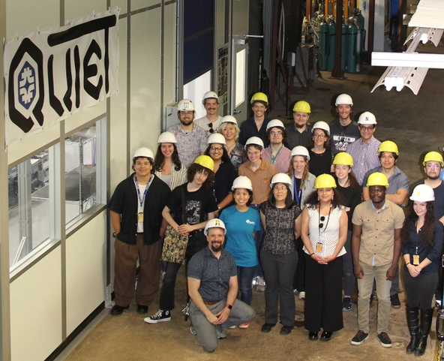
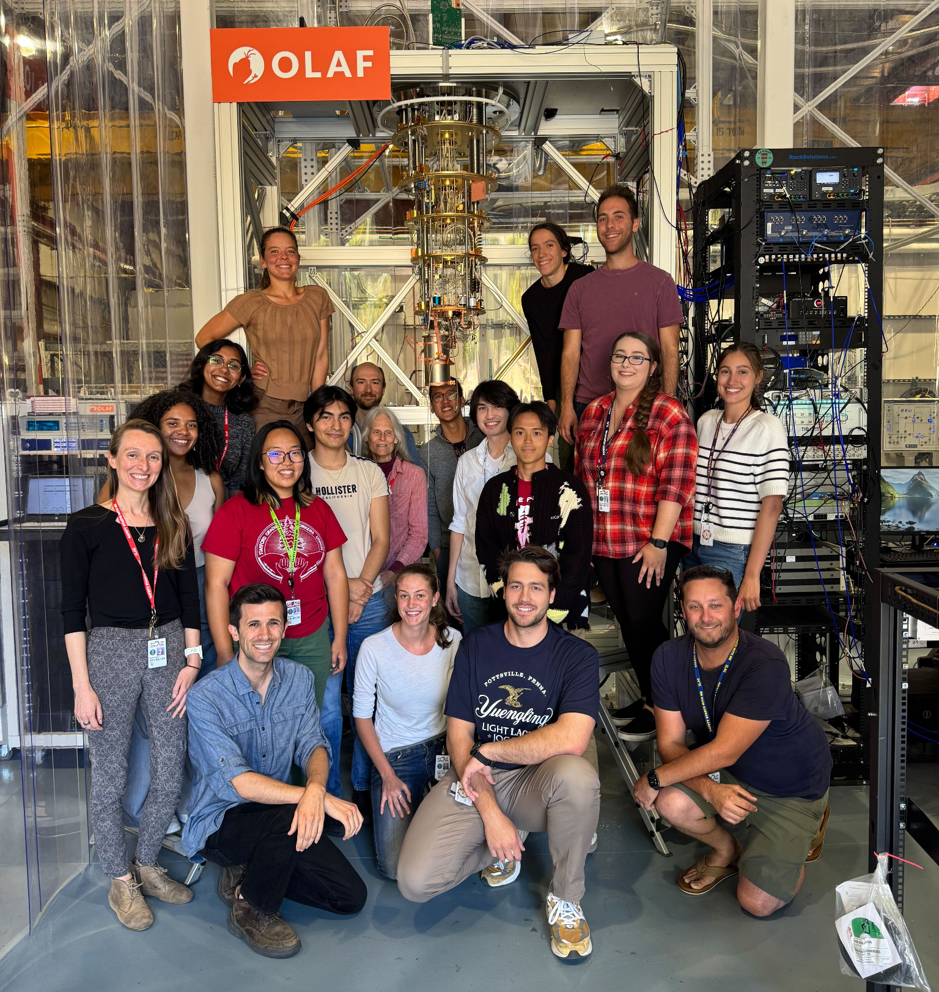


Thank you!
Development of G4CMP is supported primarily by the U.S. Army Research Office through the Laboratory for Physical Sciences. Additional support is provided by the U.S. Department of Energy through Q-NEXT and the Quantum Science Center.
This material is based upon work supported by the National Science Foundation Graduate Research Fellowship Program under Grant No. DGE-2146755. Any opinions, findings, and conclusions or recommendations expressed in this material are those of the author(s) and do not necessarily reflect the views of the National Science Foundation.

