Slide 1


FERMILAB-SLIDES-25-0275-ETD
Towards long-distance phase coherence for large-area quantum sensors.
Andrew Cameron, Claire Ellison, Prathwiraj Umesh, Raju Valivarthi, Michael Bregar, Si Xie, and Cristián Peña
CPAD - RDC 8 Quantum & Superconducting Sensors
9th October 2025

Slide 2
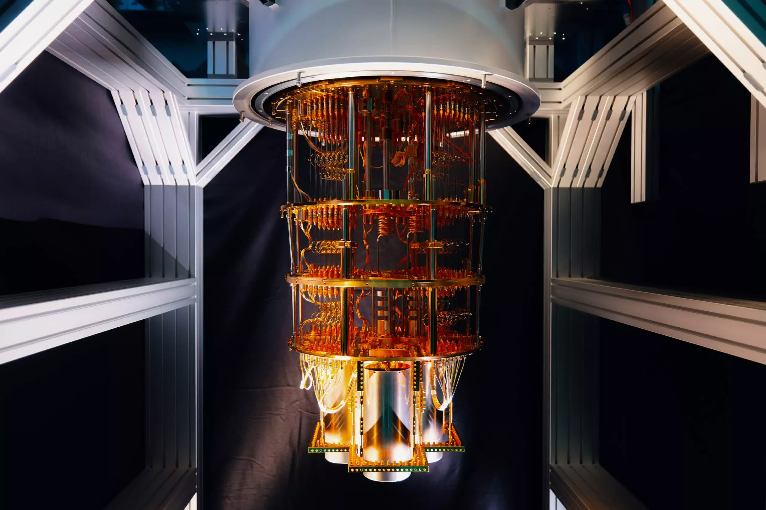

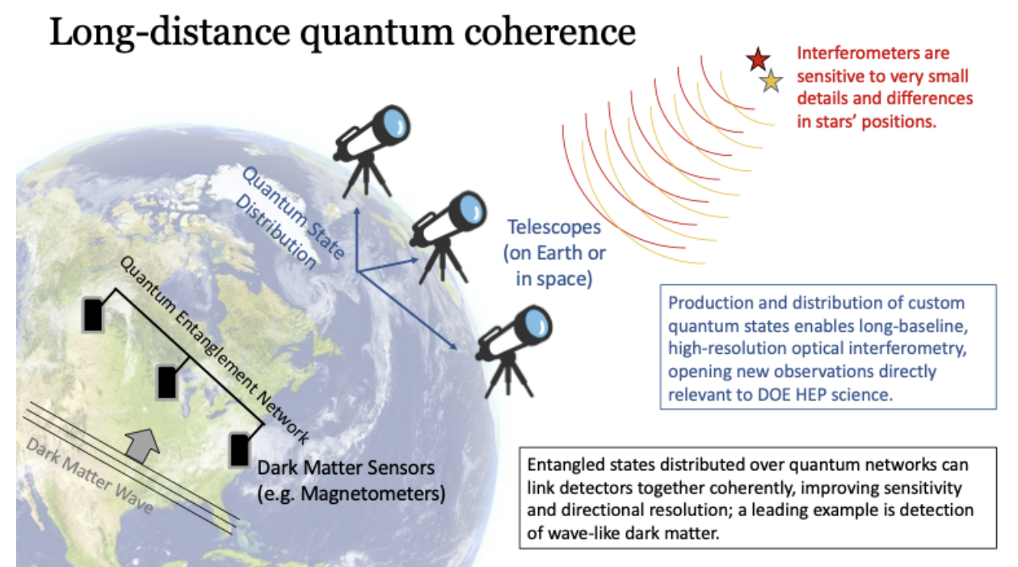
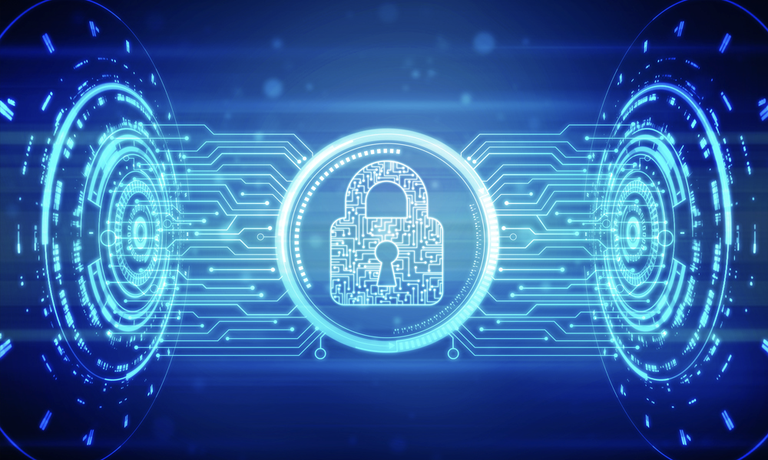
Why build a quantum network?
Connect Quantum Devices
Long-distance Quantum Coherence
Quantum-Enhanced Security

Slide 3
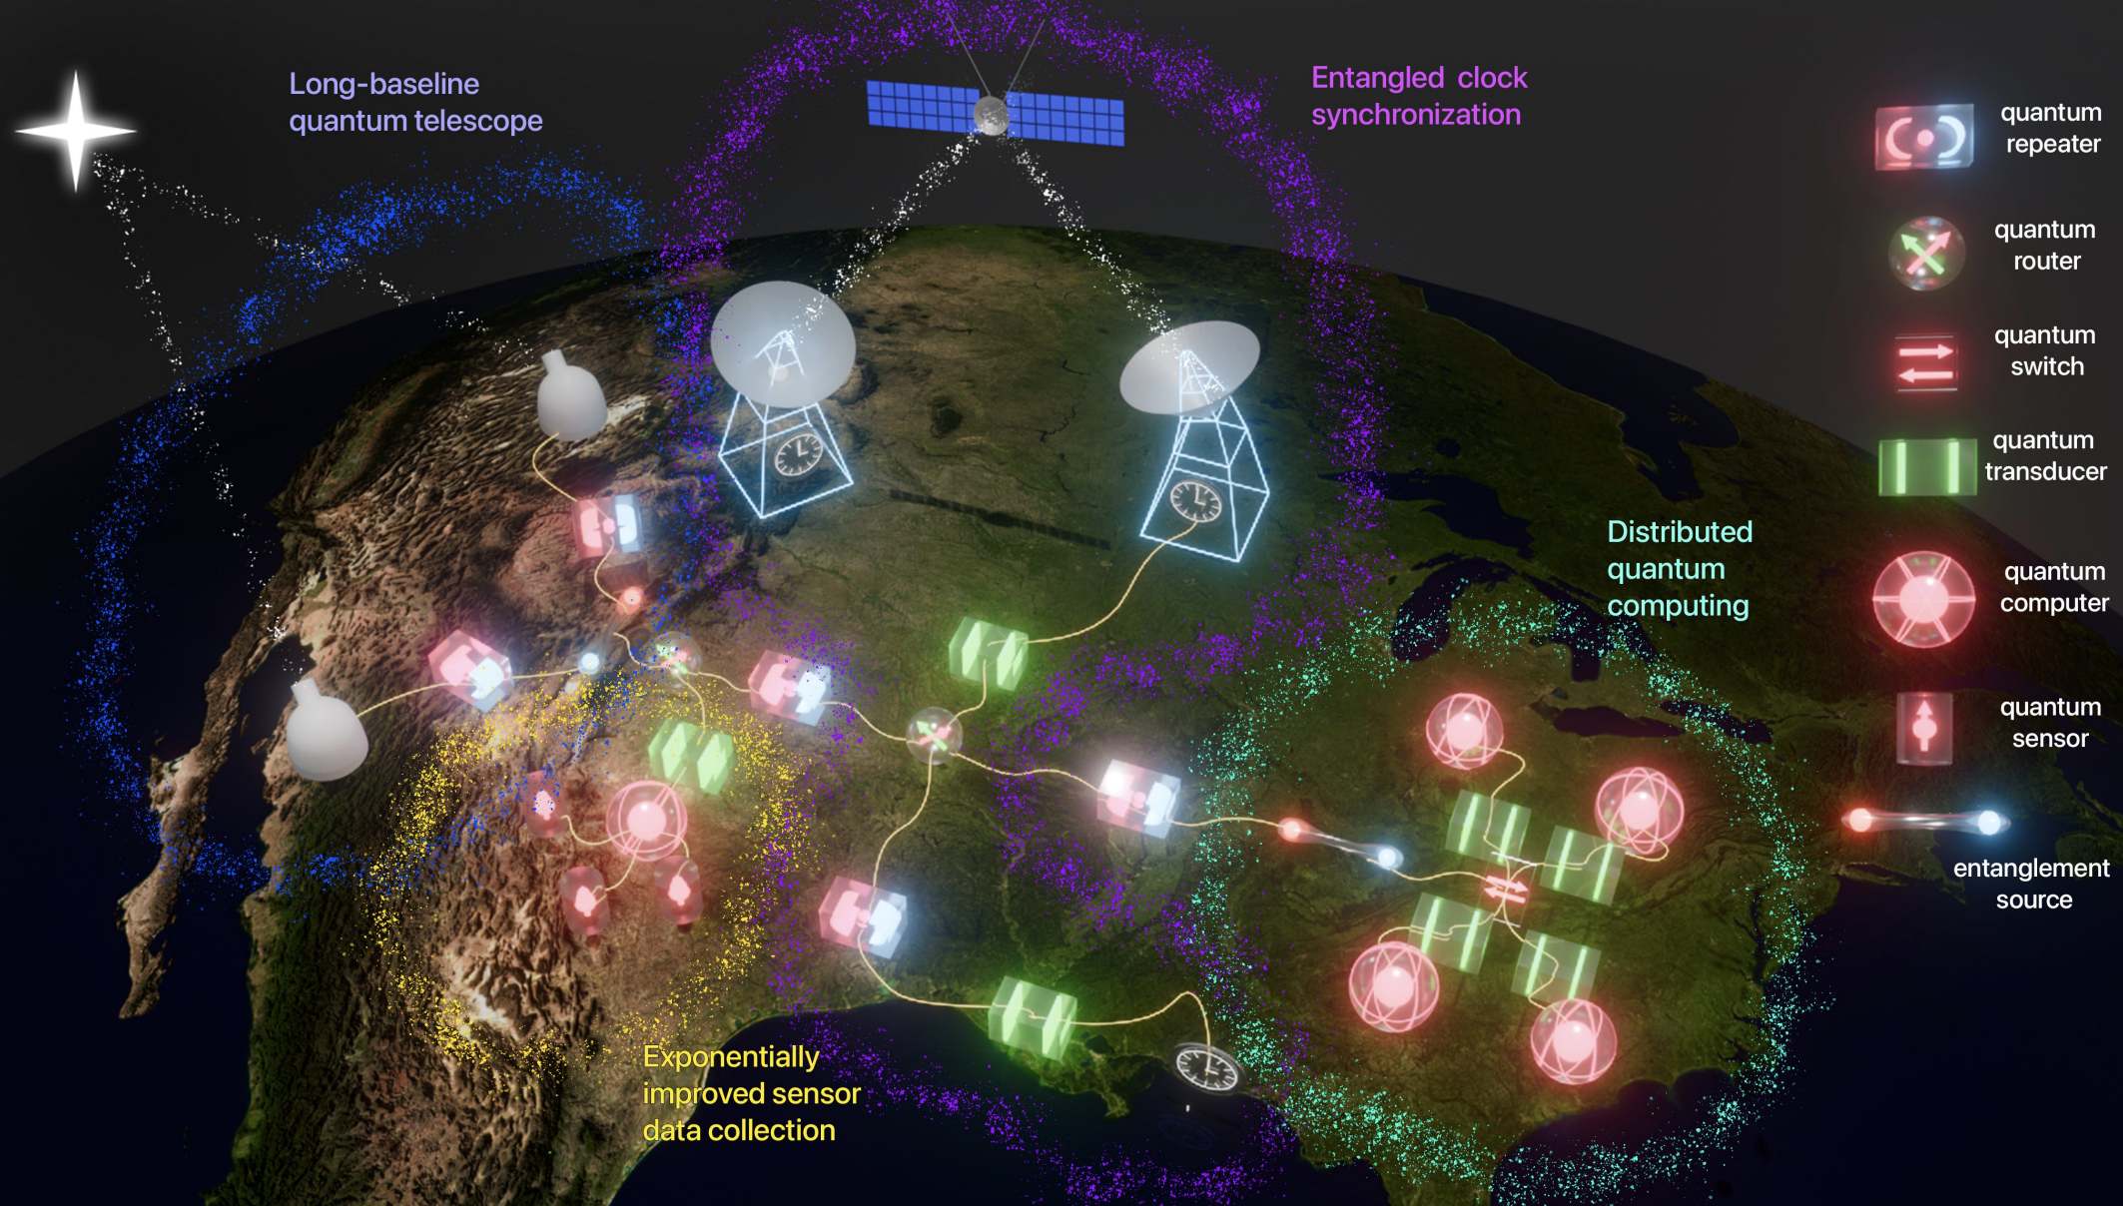
The quantum internet
2024 Quantum Information Science applications roadmap, DOE

Slide 4
Advanced Quantum Network (AQNET)

Slide 5
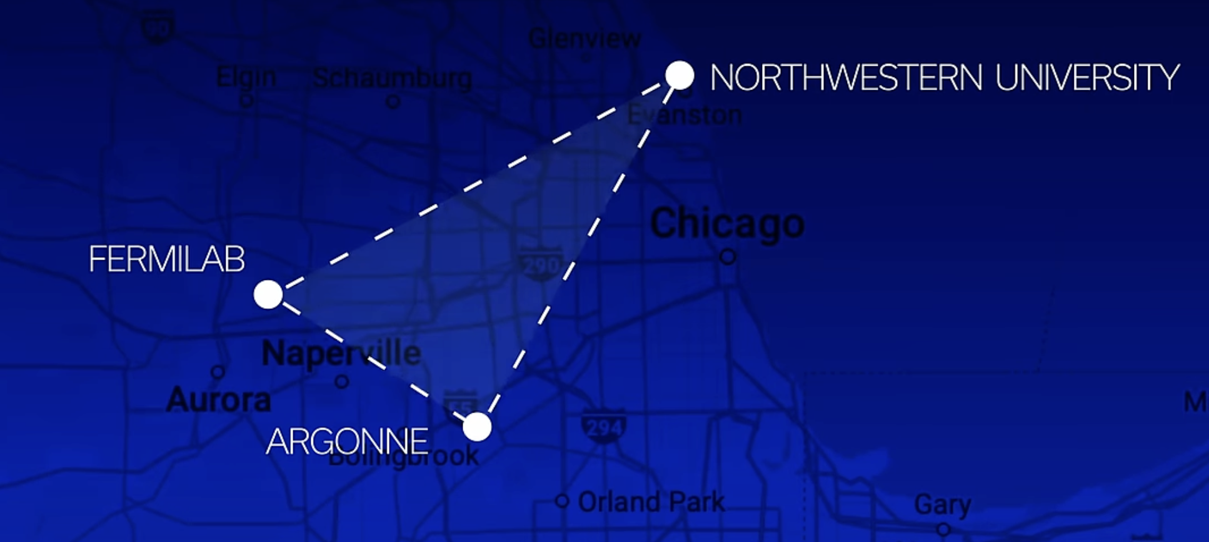
Advanced Quantum Network (AQNET)

Slide 6
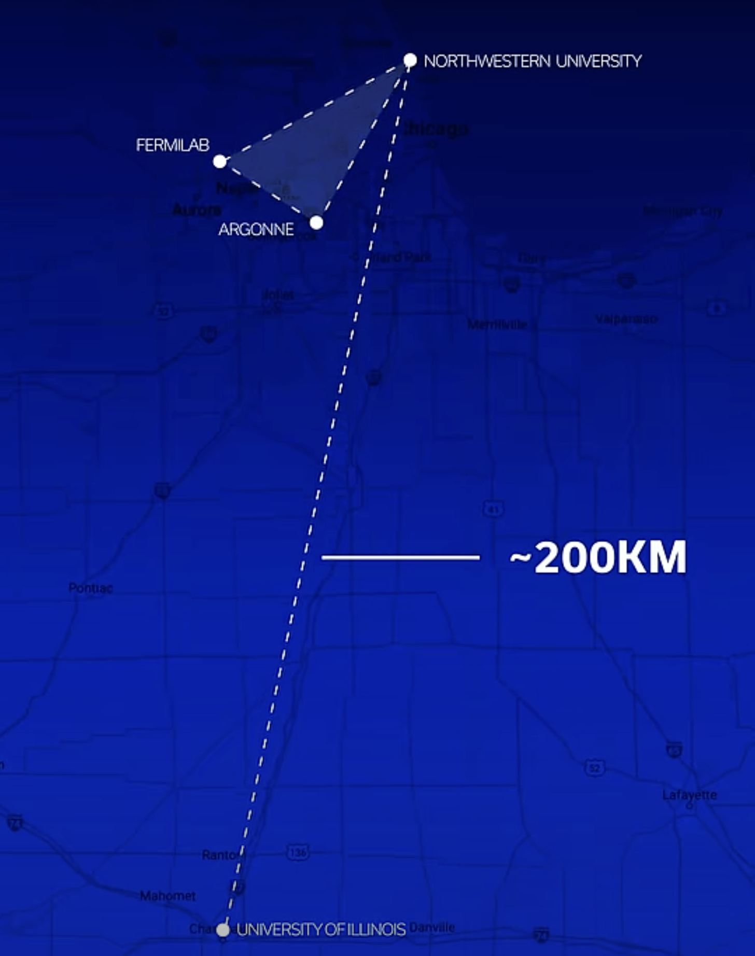
Advanced Quantum Network (AQNET)

Slide 7
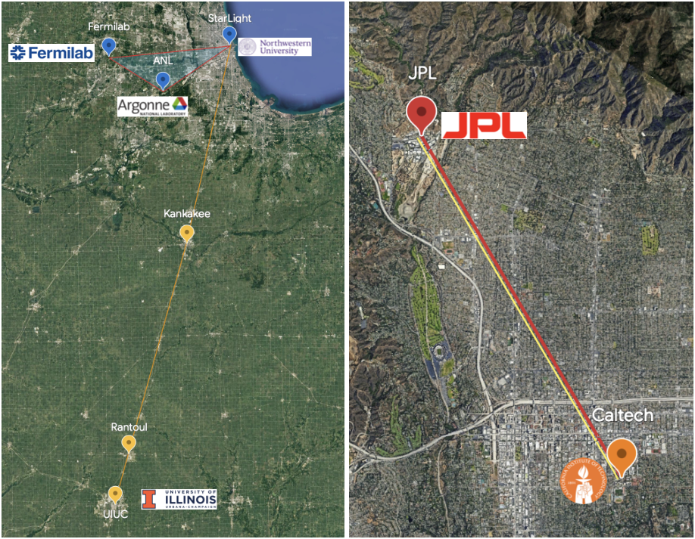
Chicago-based Networks developed in parallel with Pasadena-based Networks
AQNET

Slide 8
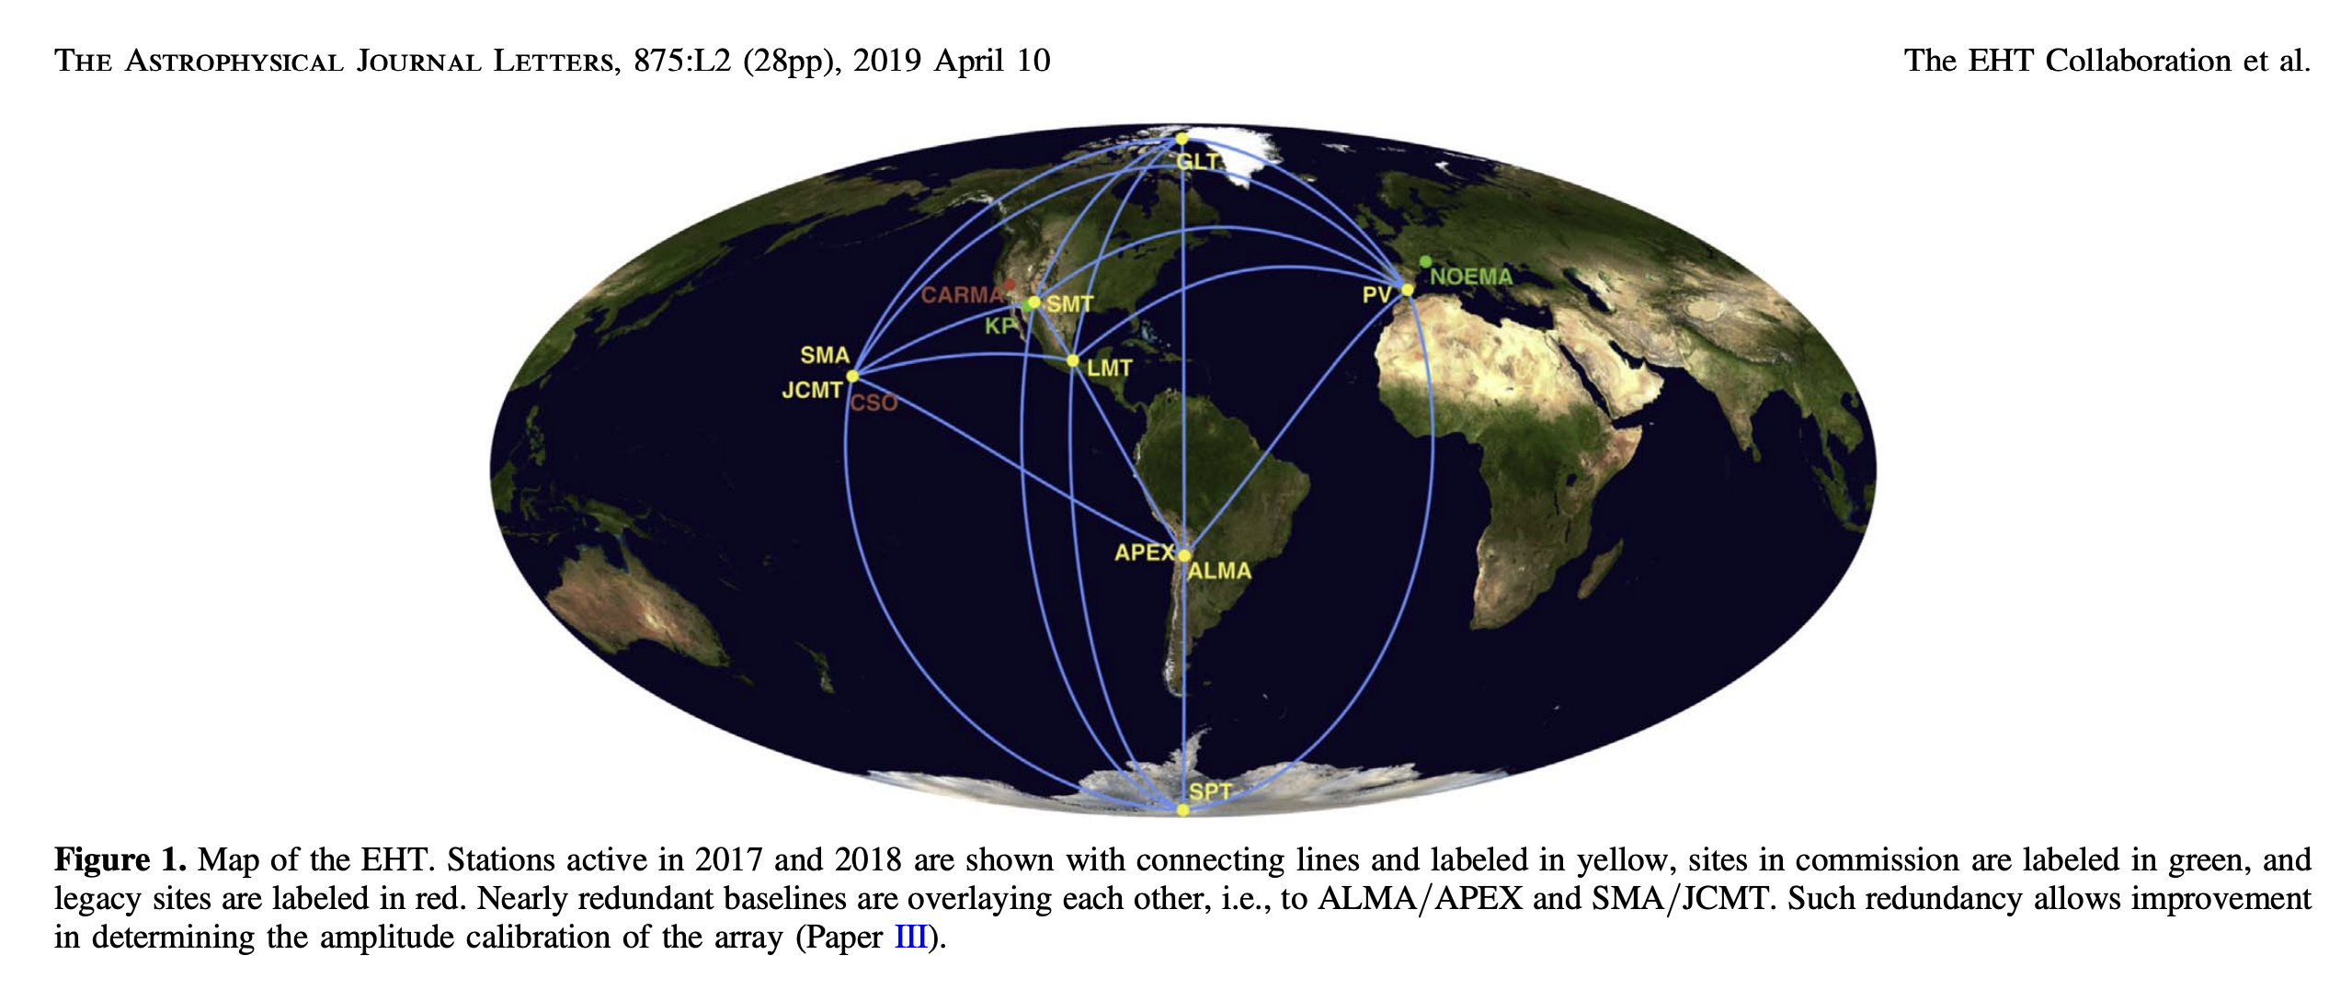
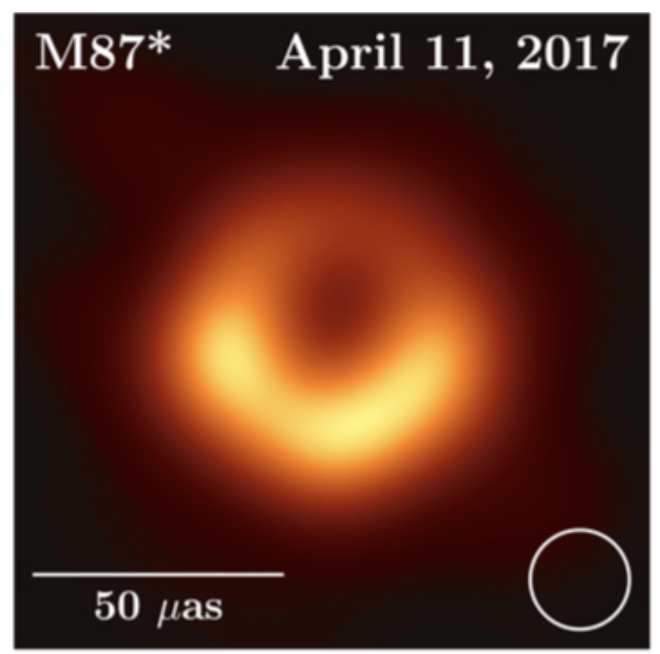
Turning a quantum network into a quantum sensor – telescope arrays
Radio Telescope array
1.3 mm wavelength (4.35ps)

Slide 9
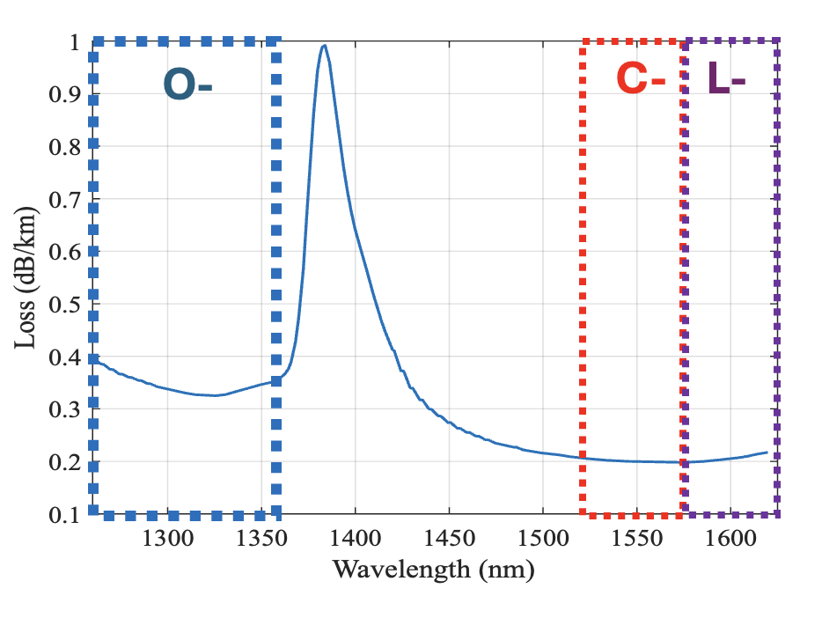
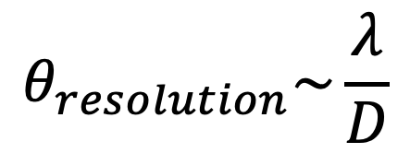
Optical or NIR Telescope arrays are much more challenging
Corning SMF-28 loss spectrum
Quantum networks typically operate in telecom fiber compatible frequency bands.
Take the C-band as an example. With a wavelength of 1550nm, that corresponds to a optical period of 5fs.
While that’s much more experimentally demanding, it also provides better angular resolution!)
$$θ_{resolution}\sim \frac{λ}{D}$$

Slide 10
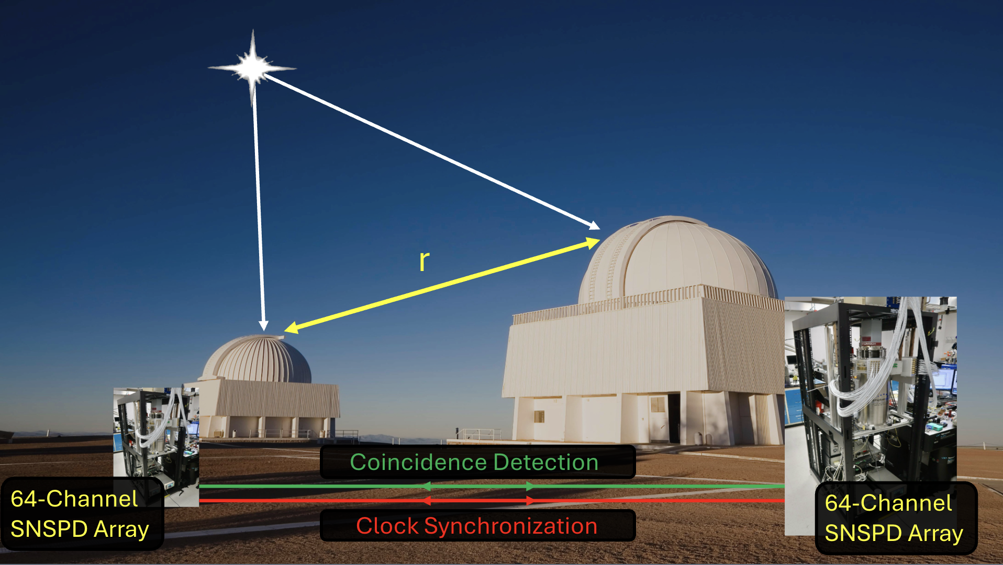
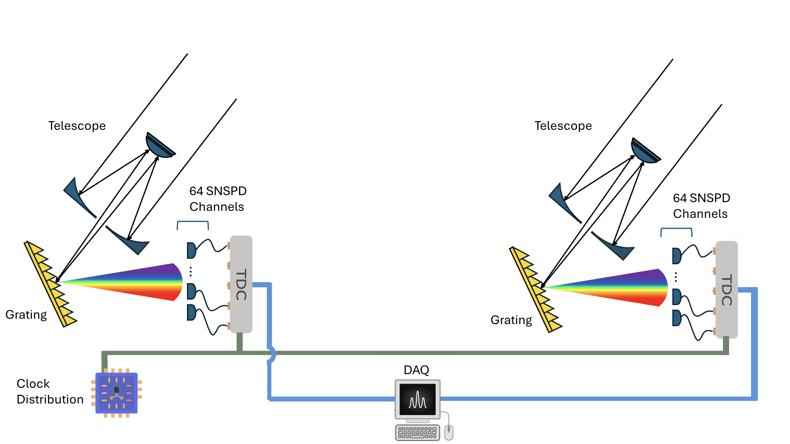
Optical telescope array step 1: Intensity interferometry
HBT intensity interferometry for optical telescope arrays
Cristián Peña’s 2024 CPAD talk first introduced this our group’s intensity measurement concept
https://indico.phy.ornl.gov/event/510/contributions/2156/attachments/1638/3846/CPAD_2024_Networks_CPENA.pdf

Slide 11
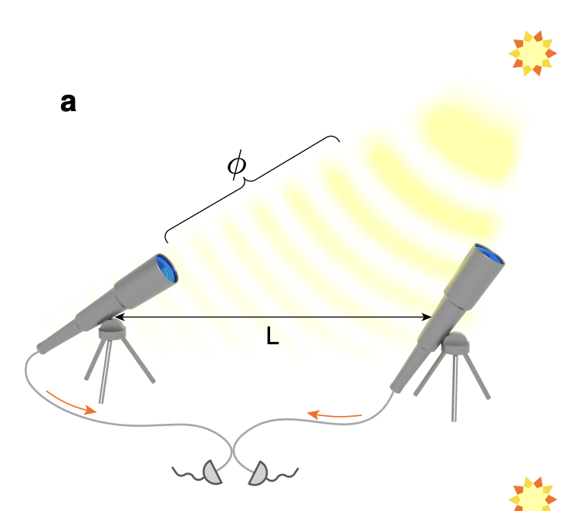
Towards phase coherence
Conventional amplitude interferometry
Intensity interferometry relied only on time synchronization and fast detectors
To fully explore the potential of a quantum network, consider protocols that require phase coherence.
In contrast to intensity interferometry, amplitude interferometry, or direct detection, interferes light from two telescopes.
Gottesman – Jennewein – Croke Protocol
Stas, P.-J. C., Wei, Y.-C., Sirotin, M. et al. (2025). Entanglement Assisted Non-local Optical Interferometry in a Quantum Network. arXiv. https://doi.org/10.48550/arXiv.2509.09464

Slide 12
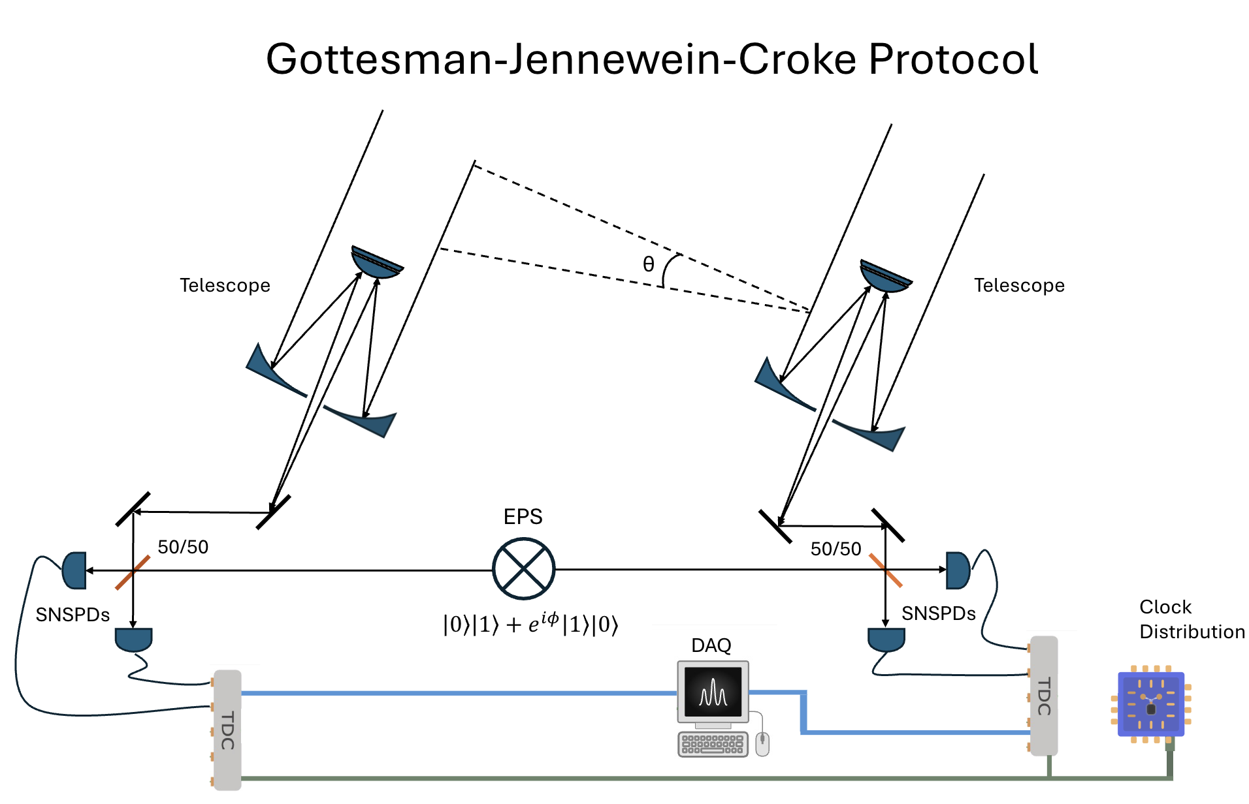
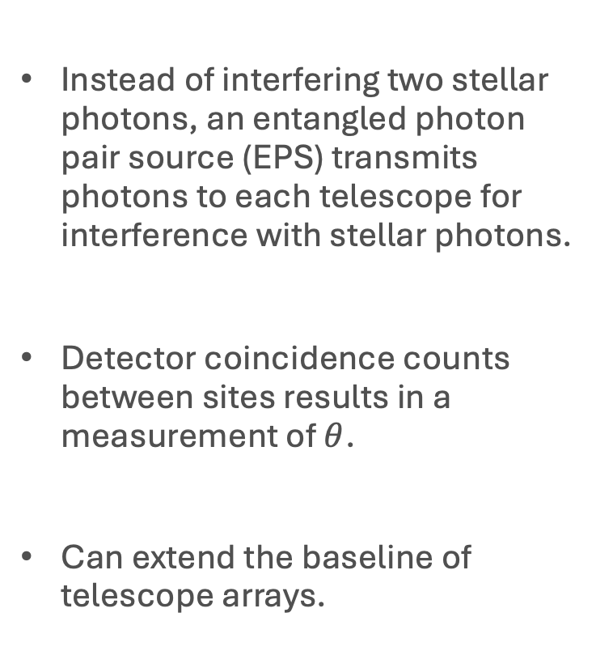
Entanglement assisted amplitude interferometry
[1]
Instead of interfering two stellar photons, an entangled photon pair source (EPS) transmits photons to each telescope for interference with stellar photons.
Detector coincidence counts between sites results in a measurement of $θ$.
Can extend the baseline of telescope arrays.
[1] D. Gottesman, T. Jennewein, and S. Croke, Longer baseline telescopes using quantum repeaters, Phys. Rev. Lett. 109, 070503 (2012).

Slide 13
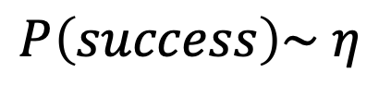




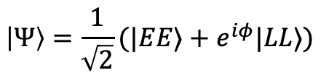
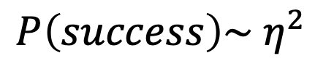
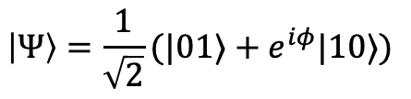
Time bin vs Fock state encoding
EPS
$$η$$
$$η$$
$$P\left(success\right)\sim { η}^{2}$$
$$\left|Ψ\right\rangle =\frac{1}{\sqrt{2}}(|EE⟩+e^{iφ}|LL⟩)$$
EPS
$$η$$
$$η$$
$$P\left(success\right)\sim η$$
$$\left|Ψ\right\rangle =\frac{1}{\sqrt{2}}(|01⟩+e^{iφ}|10⟩)$$
The experimental price you pay – phase stabilization .

Slide 14
HEP Applications – switch out telescopes for axion detectors
Long-distance Quantum Coherence
A very exciting emerging field as highlighted by Snowmass White Paper (arxiv:2203.16979) and Quantum Sensor for HEP DOE Workshop Report (arXiv:2311.01930)

Slide 15
Optical phase stabilization is challenging over long distances
That’s our vision, but we need to work on the technology required for these measurements
Our group works on each of the experimental challenges
Timing resolution of single photon detectors
Quantum networking protocol deployment
Generation and distribution of entanglement
Phase stability of fiber networks (this talk)

Slide 16
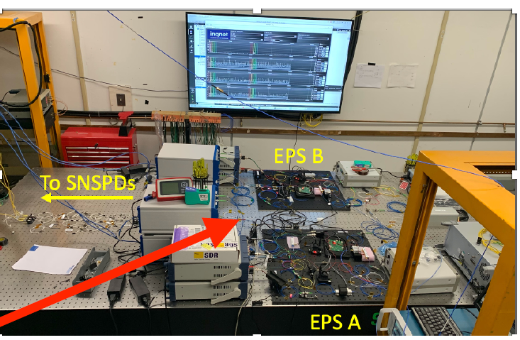
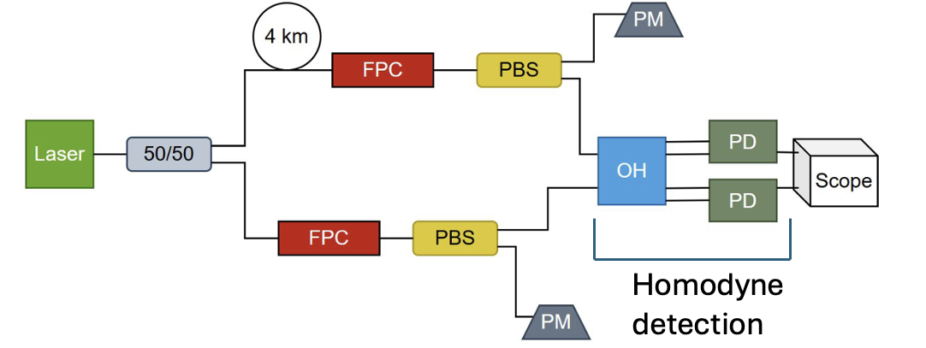
Phase Stability Testbed
0.58km
IERC
2km
2.08km

Slide 17
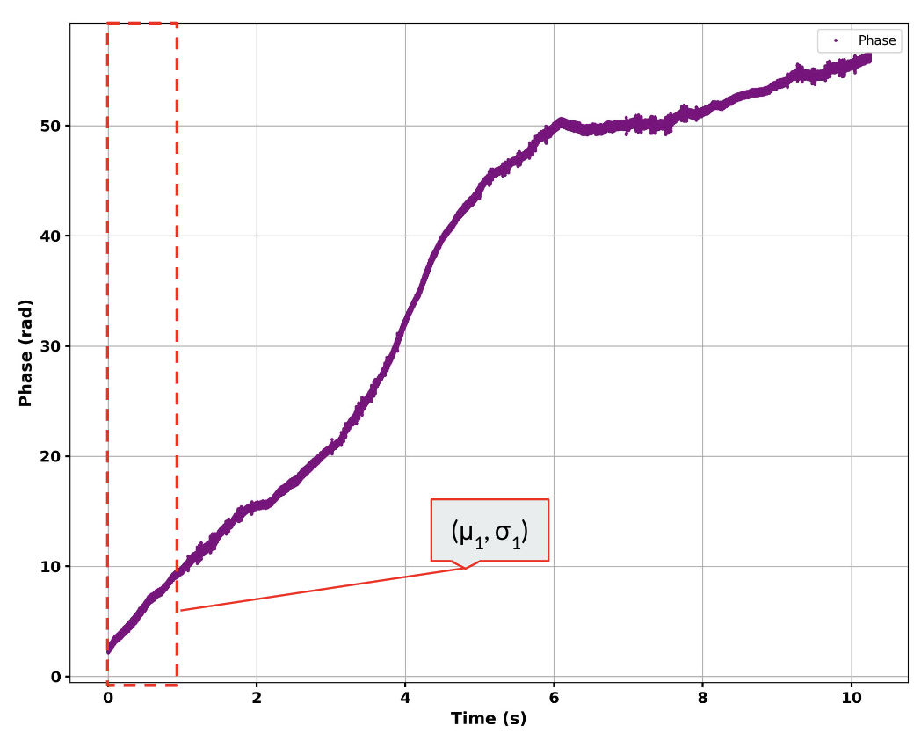
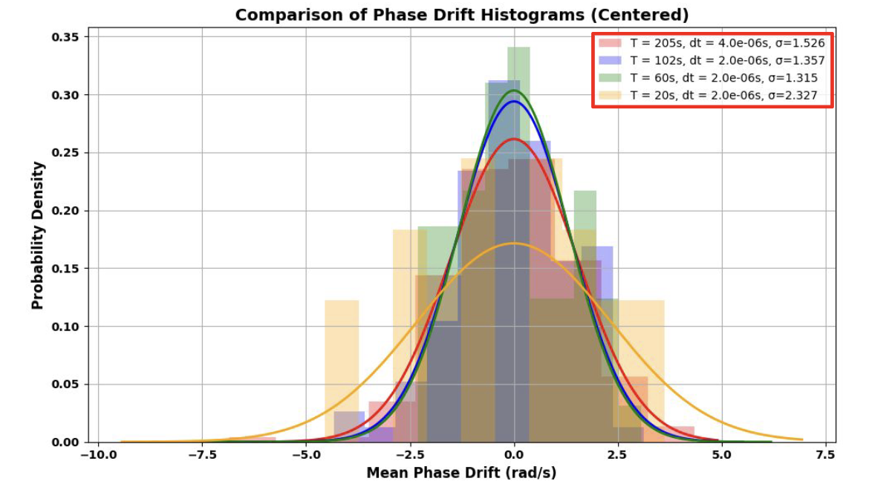
Stability of interferometer (without 4km link)
Interferometer on optical table has a phase drift of ~1.3 rad/s

Slide 18
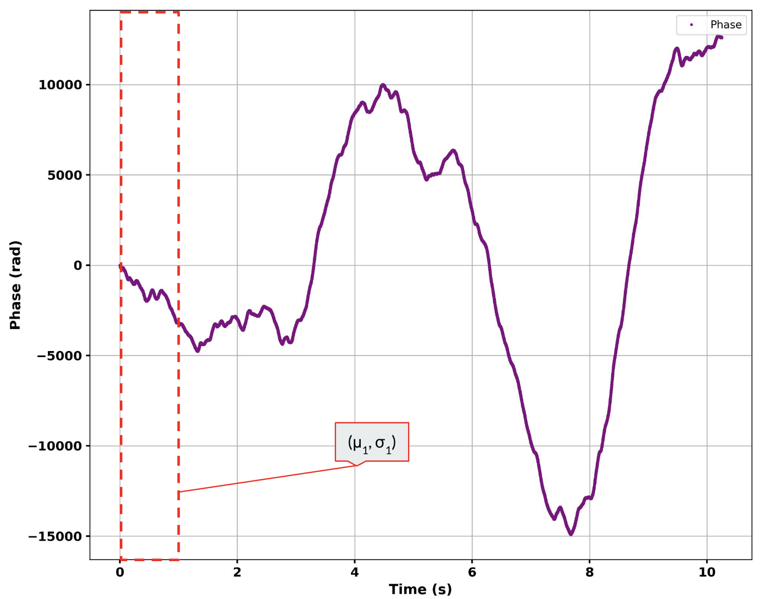
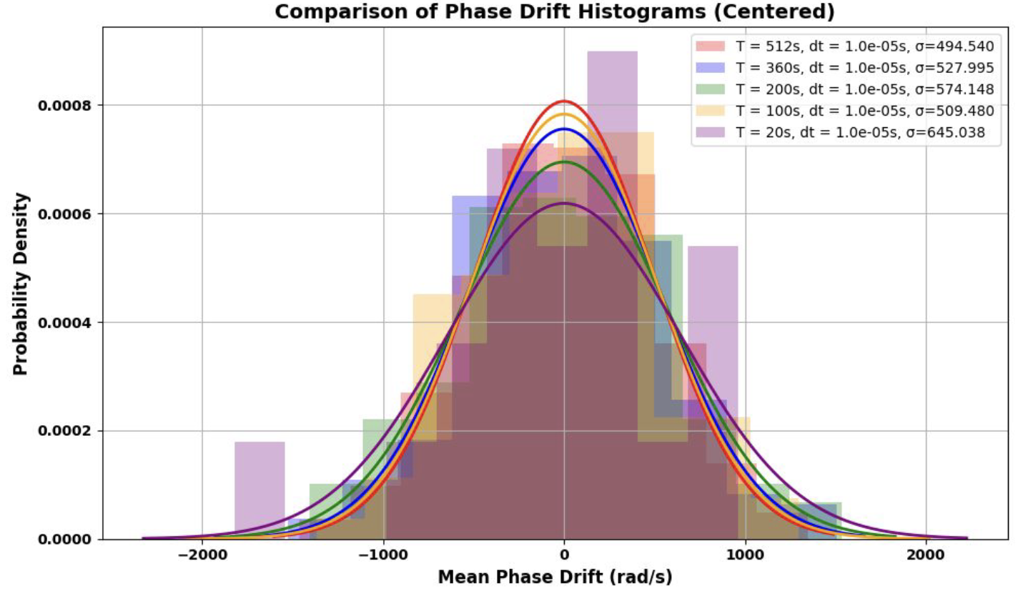
Stability of 4km link
4km fiber link has a phase drift of ~500 rad/s

Slide 19
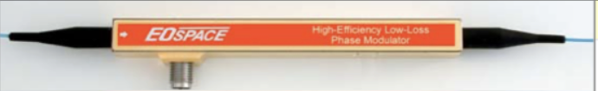
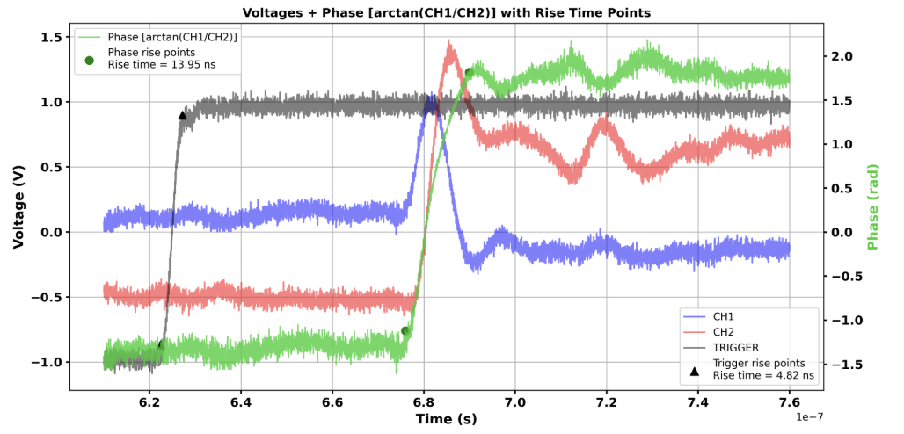
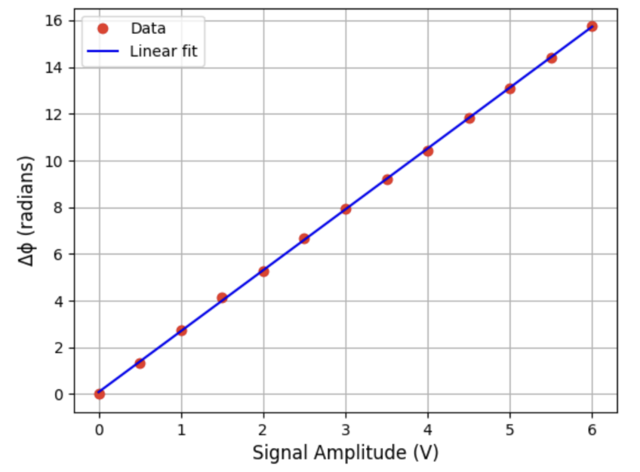
Characterization of modulator
40GHz, low loss
Lithium Niobate Phase modulator will be used to apply fast phase changes that counteract link disturbances

Slide 20
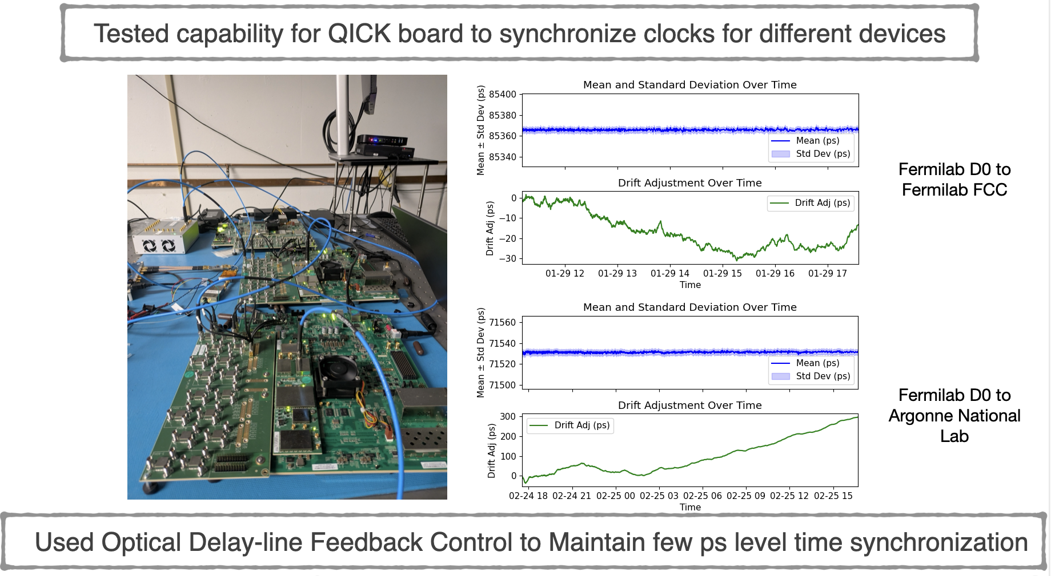
Looking forward – feedback loop with FPGA
The Quantum Instrumentation and Control Kit (QICK) team at Fermilab builds FPGAs for quantum information systems.
Between the board’s ADC and DAC, 100ns latency promises fast feedback for phase modulation

Slide 21
Conclusion
Quantum networks have the potential to connect distant quantum sensors to create a wide-area detector for astronomy and high energy physics measurements at optical and NIR wavelengths
We have demonstrated high precision timing detection and synchronization over long distances connected by telecom fibers
Our next step is long-distance phase stability:
We have measured phase changes in our fiber links (~500rad/s over 4km)
Characterized phase modulators for active phase compensation
In the process of building fast feedback loops.

Slide 22
