Slide 1





Axion Search with HAYSTAC Phase III Multi-Rod Cavity Upgrade
Claire Laffan (Yale University)
CPAD Workshop
October 8th, 2025
HAYSTAC is a collaboration between…
Located at…
(host)

Slide 2
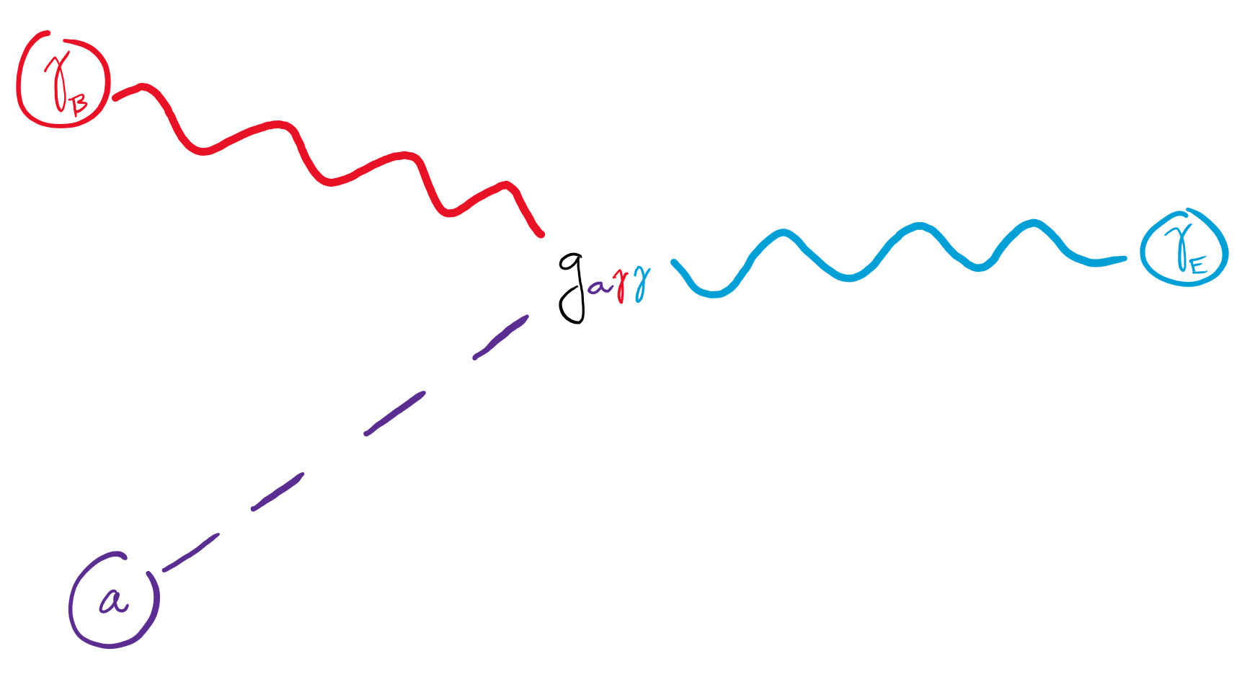
Axions as Dark Matter
Originally proposed axion field as solution to strong CP problem
Later found that axions are also dark matter candidates
One of the lightest DM candidates, making direct detection challenging
Inverse Primakoff Effect: Mixing between axion field & B-field induces E-field of frequency ν_{a}
ν_{a} ∝ m_{a}
Coupling strength = g_{aγγ}
m_{a} & g_{aγγ} both unknown
This interaction is a promising avenue for detection
Notes:
Consolidate to 3-4 bullets

Slide 3
HAYSTAC: Past, Present & Future

Slide 4
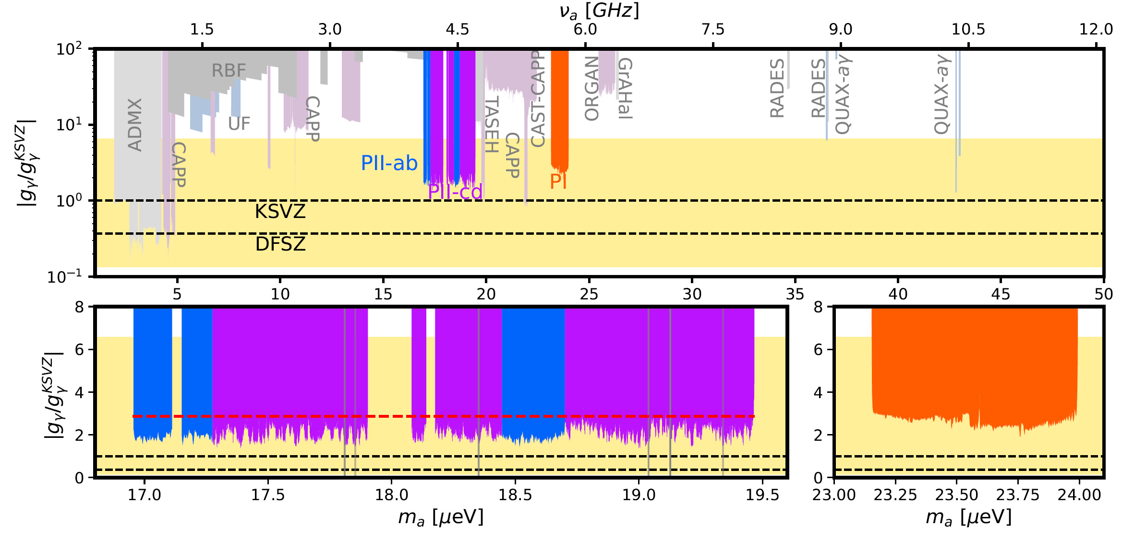
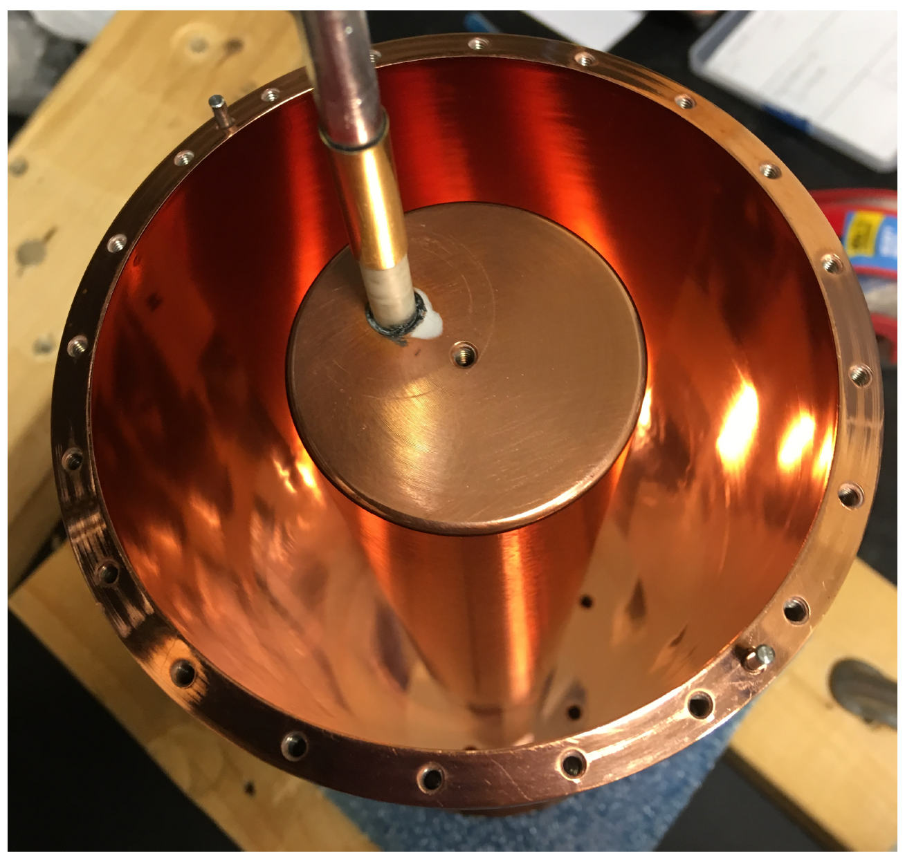
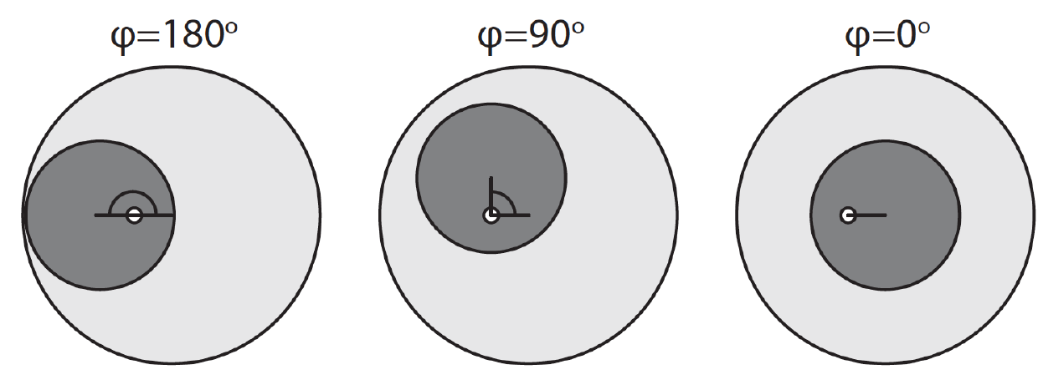
A Brief History of HAYSTAC
(Haloscope At Yale Sensitive To Axion CDM)
Phase I (PI):
Jan. 2016 – Jul. 2017
23.15-24.00 μeV (5.6-5.8 GHz)
1 JPA
Phase II-ab & Phase II-cd (PII):
Sep. 2019 – Aug. 2024
16.96 – 19.46 μeV (4.1 – 4.7 GHz)
Quantum squeezing with 2 JPAs
Cavity:
Cu-plated stainless steel
Unfilled V_{c} = 1.545 L
1 tuning rod
HAYSTAC
HAYSTAC
HAYSTAC
Top: Xiran Bai et al. PRL 134, 151006 (2025)
Bottom left: M. Simanovskaia. Ph.D. thesis, UC,Berkeley (2019)
Bottom right: K. M. Backes. PhD thesis, Yale University (2021)

Slide 5

Onto Higher Frequencies
Post-inflation axion models motivate high masses
Cavity frequency scales inversely with volume: V_{c} ∝ ν_{c}⁻³
Higher mass axion searches necessitate smaller cavities which have…
  Degraded signal power
  Higher intruder mode density
Electronic losses also increase with frequency
HAYSTAC plans to address these issues as we pursue higher frequencies
Here be dragons
Xiran Bai et al. PRL 134, 151006 (2025)

Slide 6
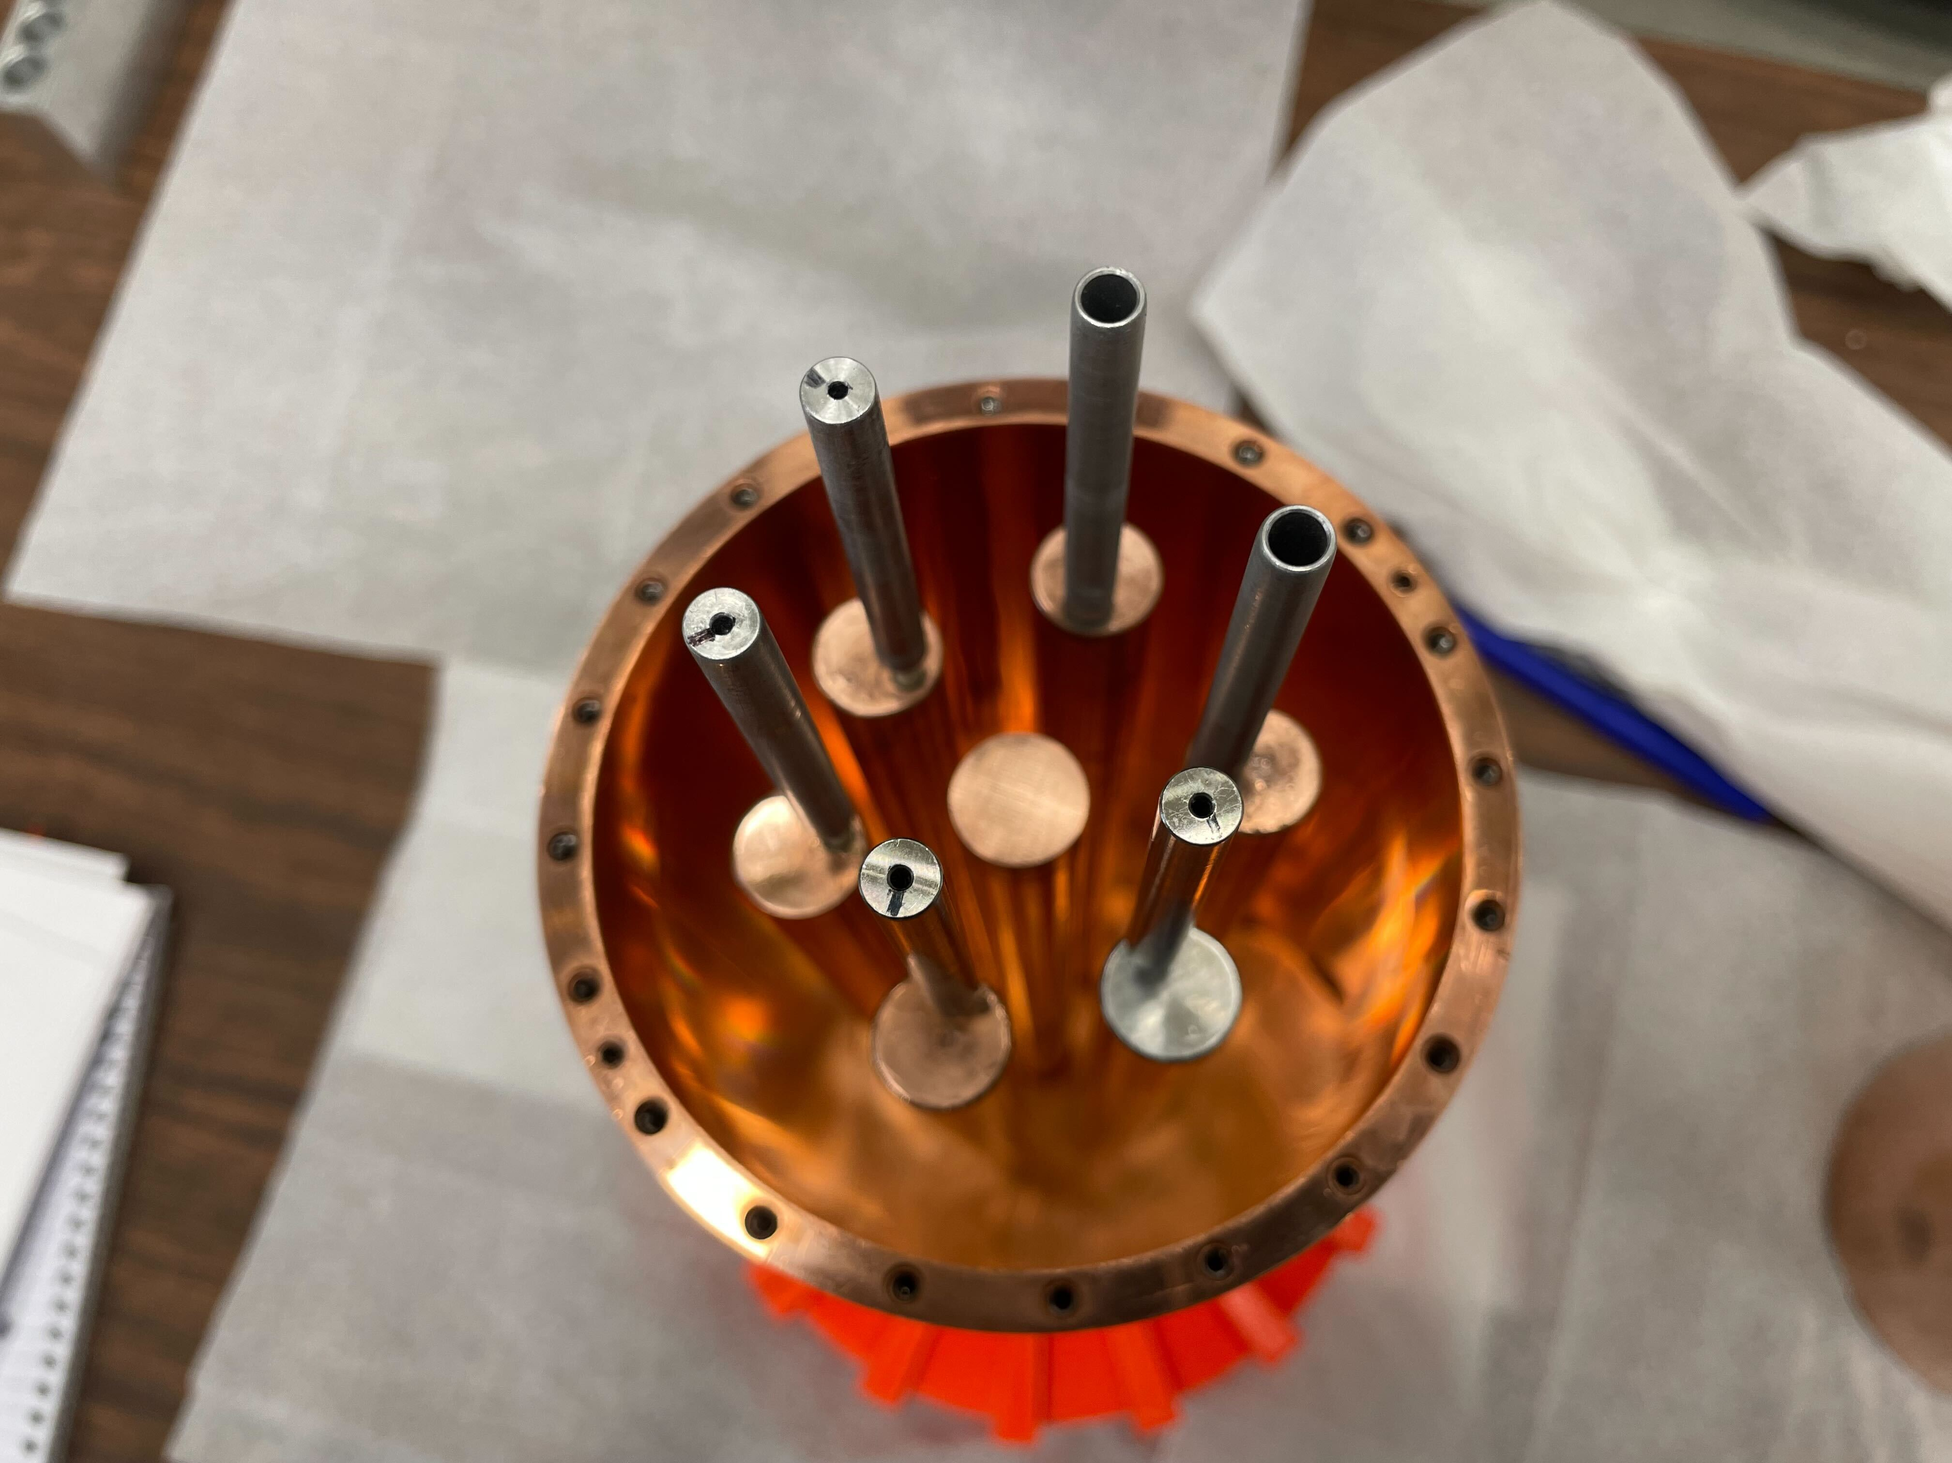
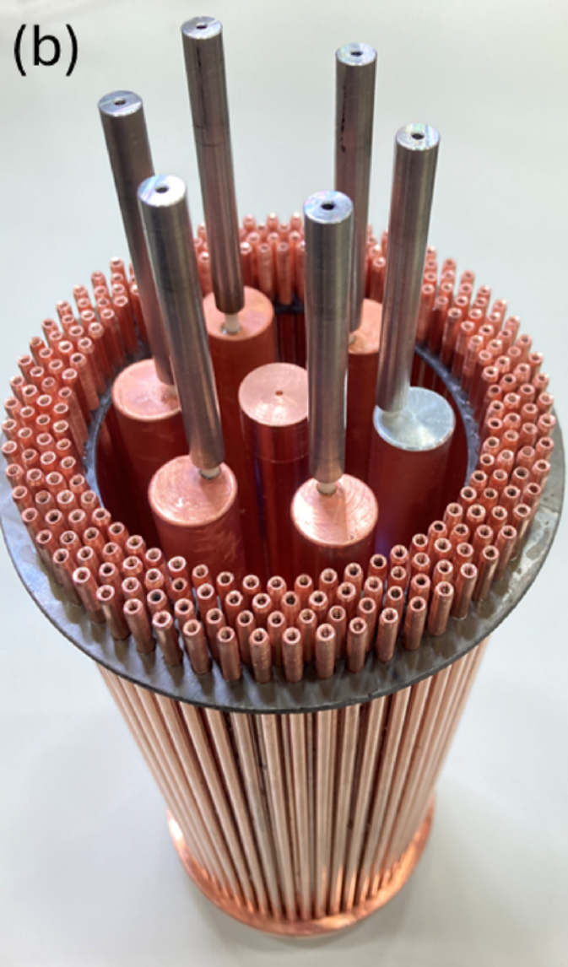

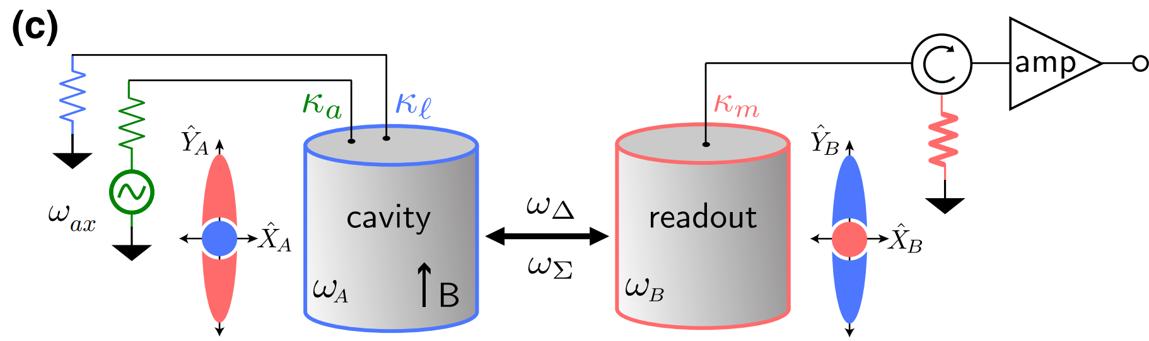
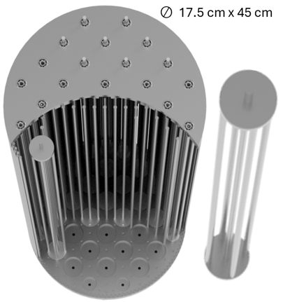
HAYSTAC: Onto Higher Frequencies
PIIIa: 7-Rod Cavity
PIIIb: 7-Rod + PBG
PIV: CEASEFIRE
PV: Plasma Haloscope (ALPHA)
Y. Jiang et al., PRX Quantum 4 (2024)
7 tuning rods
5.5 – 7.3 GHz (22.75 – 30.19 μeV)
Rev.Sci.Instrum. 96 094704 (2025)
Rev.Sci.Instrum. 96 094704 (2025)
Phase IIIa
Phase IIIb
Phase IV
Phase V
Xiran Bai et al. PRL 134, 151006 (2025)

Slide 7
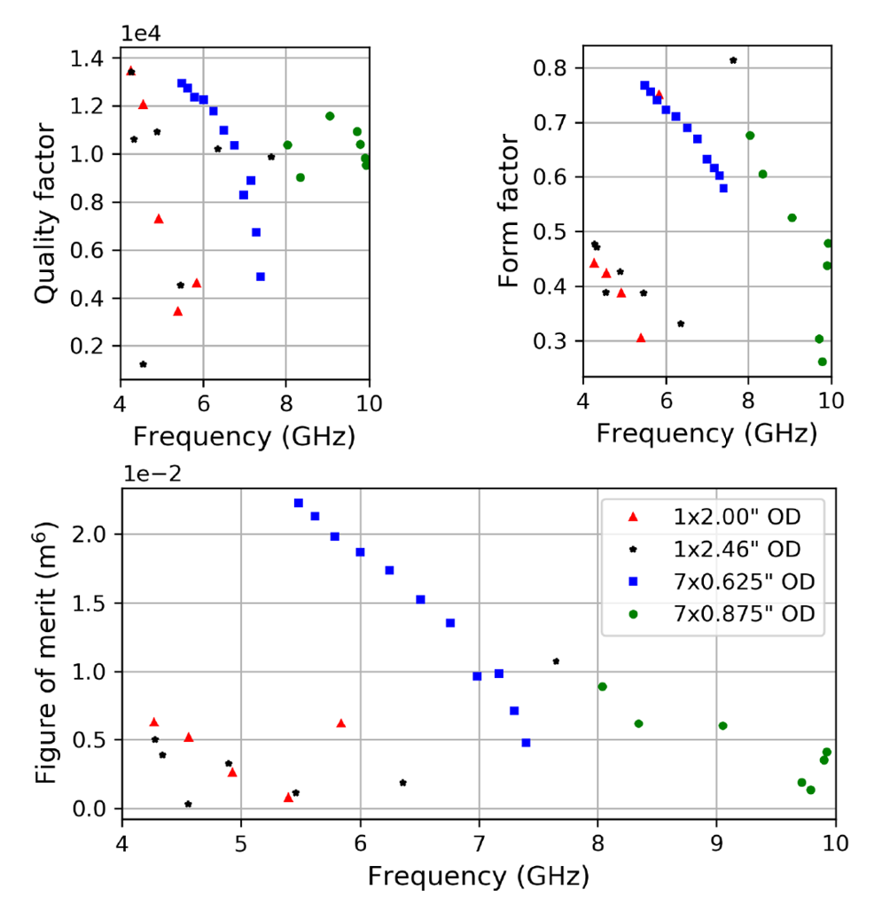
Motivation for 7-Rod Cavity
Comparing Performance of 4 Cavity Configurations
(constant volume)
Goal: Maximize cavity figure of merit (FOM) for given V_{c}
FOM = QC²V_{c}²
Many designs were simulated
Simulated Q & C, combined with V to calculate FOM
7-rod cavity configuration maximizes FOM for given volume
Quality factor
Form factor
Symbol
# Tuning Rods
1
1
7
7
Tuning Rod OD
2.00”
2.46”
0.625”
0.875”
PI/II
PIIIa
M. Simanovskaia et al, Rev. Sci. Instrum. 92, 033305 (2021)
Notes:
https://arxiv.org/pdf/2006.01248
Show predicted vs. realized FOM for PII maybe?

Slide 8
7-Rod Cavity Design

Slide 9
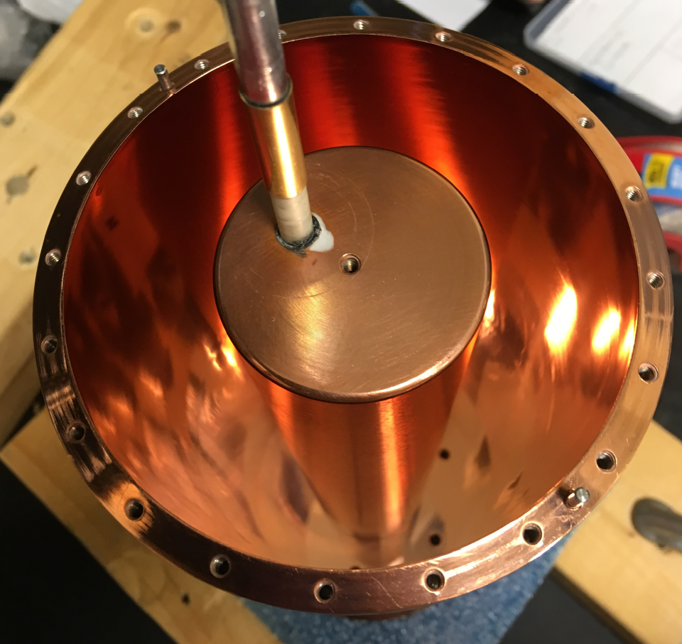
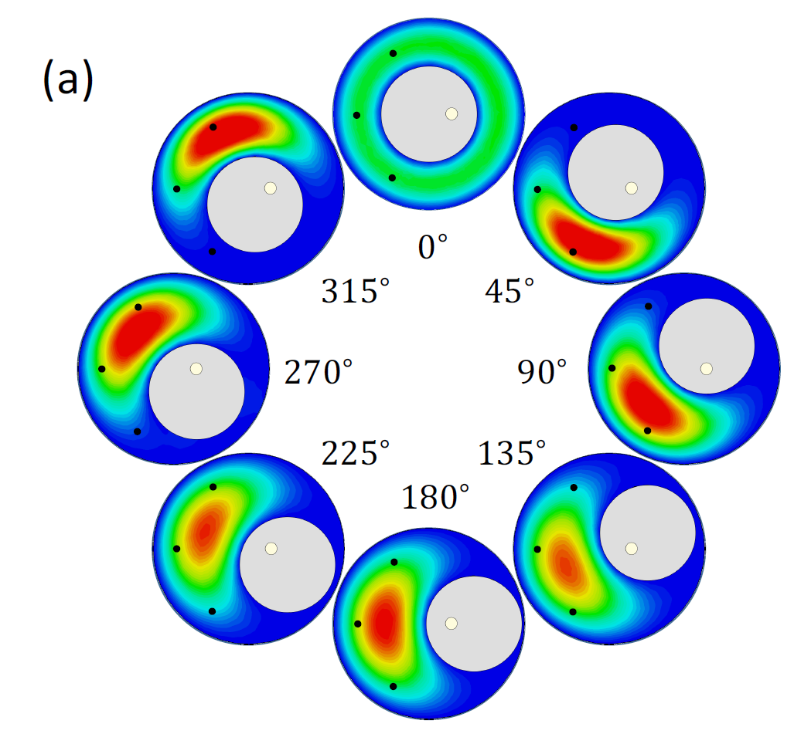
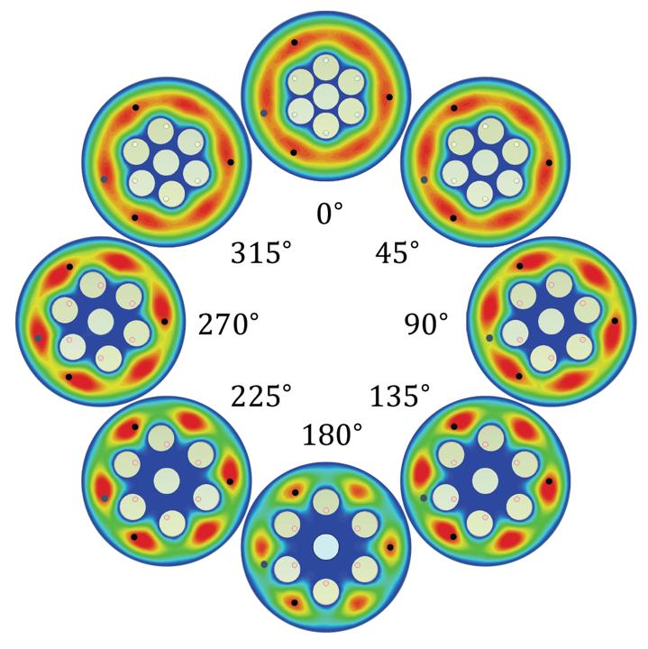
PI & II vs. PIII: Cavity Design
Phases I & II
Δν_{c}: 4.1 – 5.8 GHz
Single tuning rod
Asymmetrical mode structure
ID: 4”, height: 10”
Unfilled V_{c} ~1.545 L
Phase IIIa
Δν_{c}: 5.5 – 7.3 GHz
7 tuning rods
6-fold symmetrical mode structure
ID: 4”, height: 10”
Unfilled V_{c} ~1.707 L
Maria Simanovskaia, Ph.D. thesis, UC Berkeley, 2019.
Simulated E-field density maps of TM₀₁₀-like mode
Notes:
Preserving (increasing!) volume while going to higher frequencies is cool

Slide 10
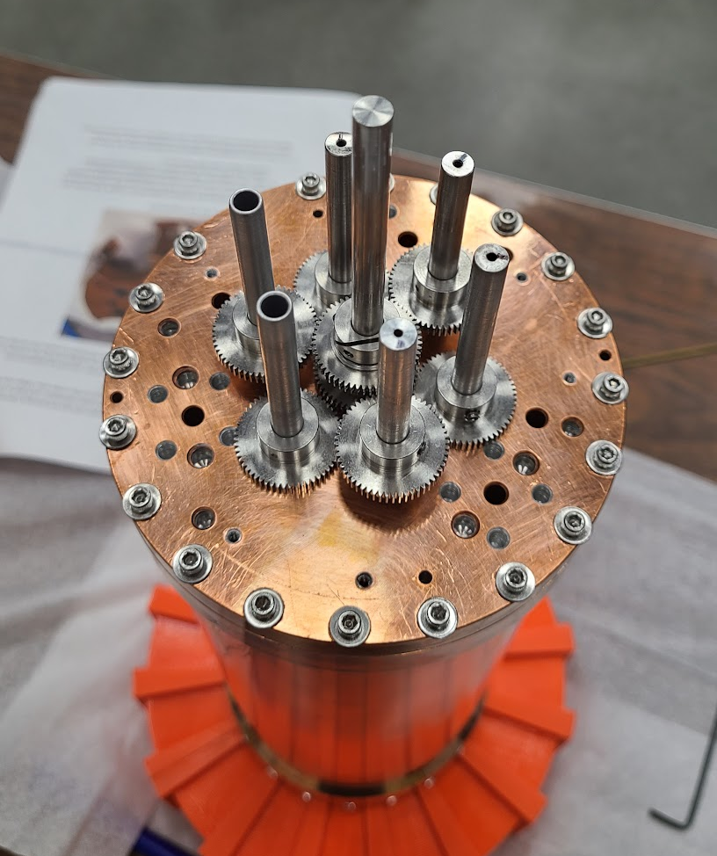
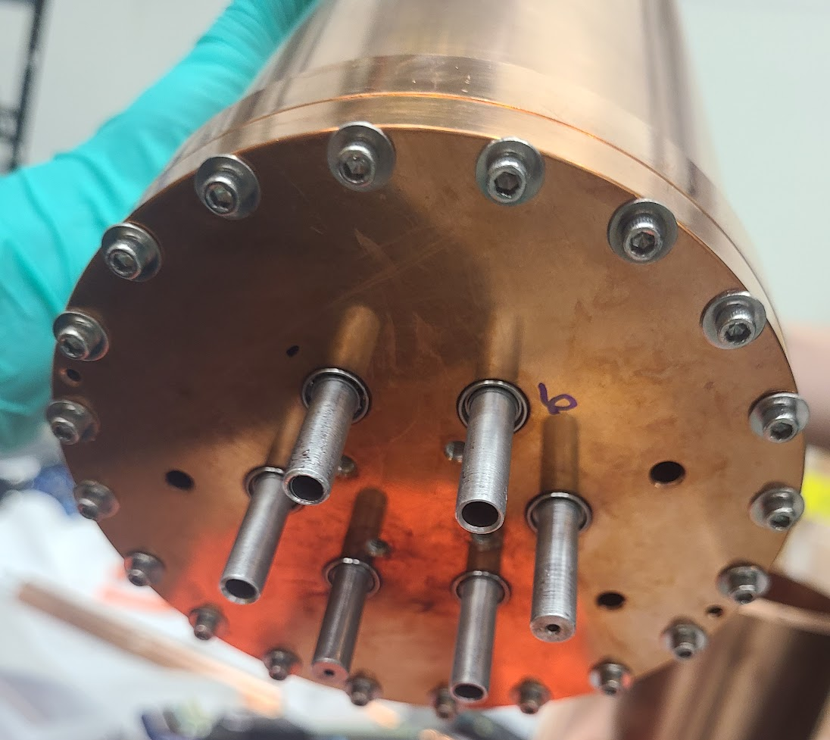
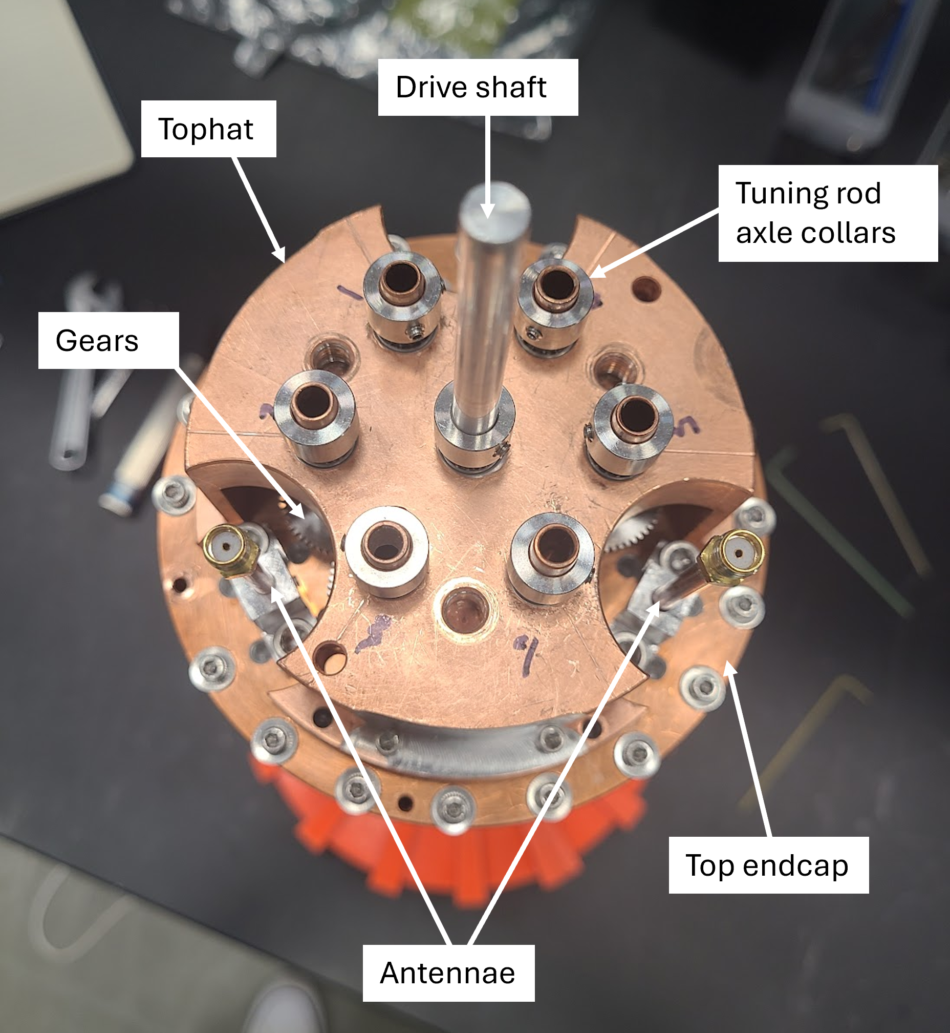
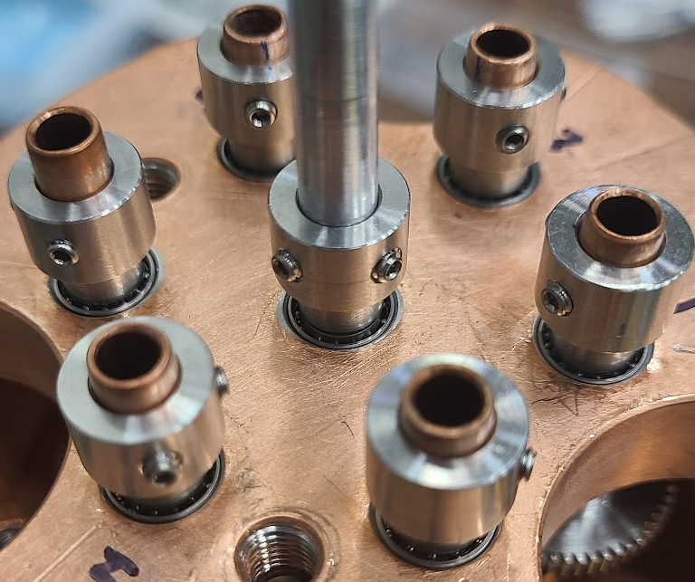
Let’s take a closer look…
Drive shaft
Bottom endcap
Ball bearings
Top axles
Top endcap
Gears
Bottom axles
Bottom of cavity
Collars
Antenna ports
(3 total)
Top of cavity (tophat removed)
Top of cavity (with tophat)
Ball bearings

Slide 11
7-Rod Cavity Testing & Optimization

Slide 12
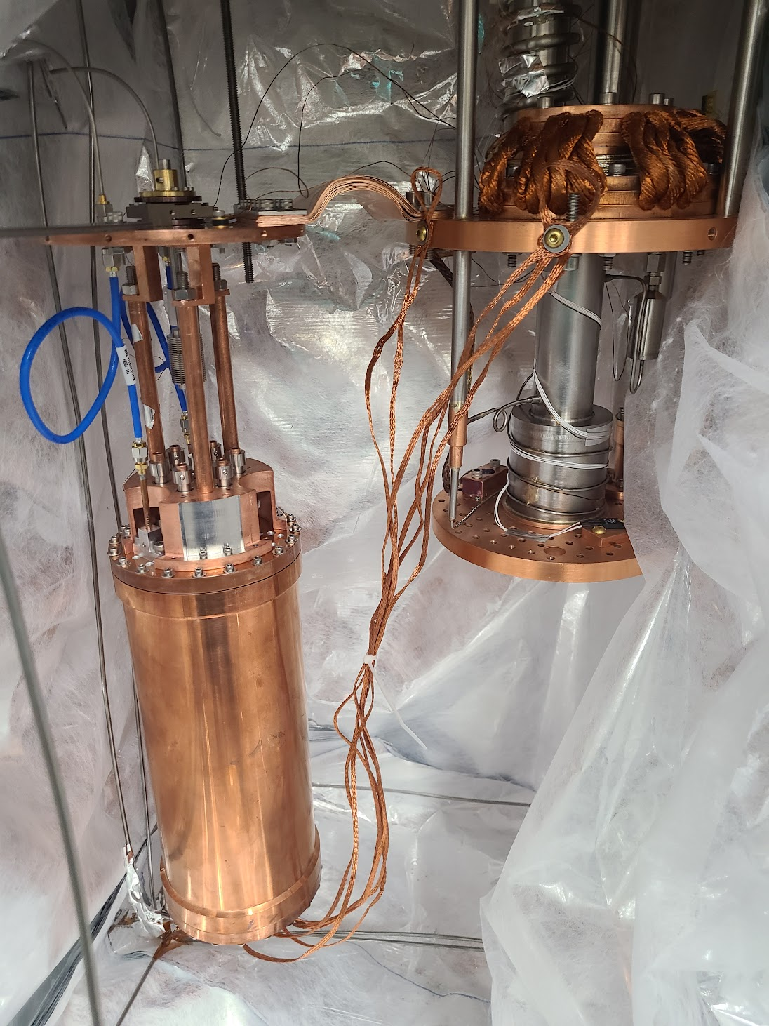
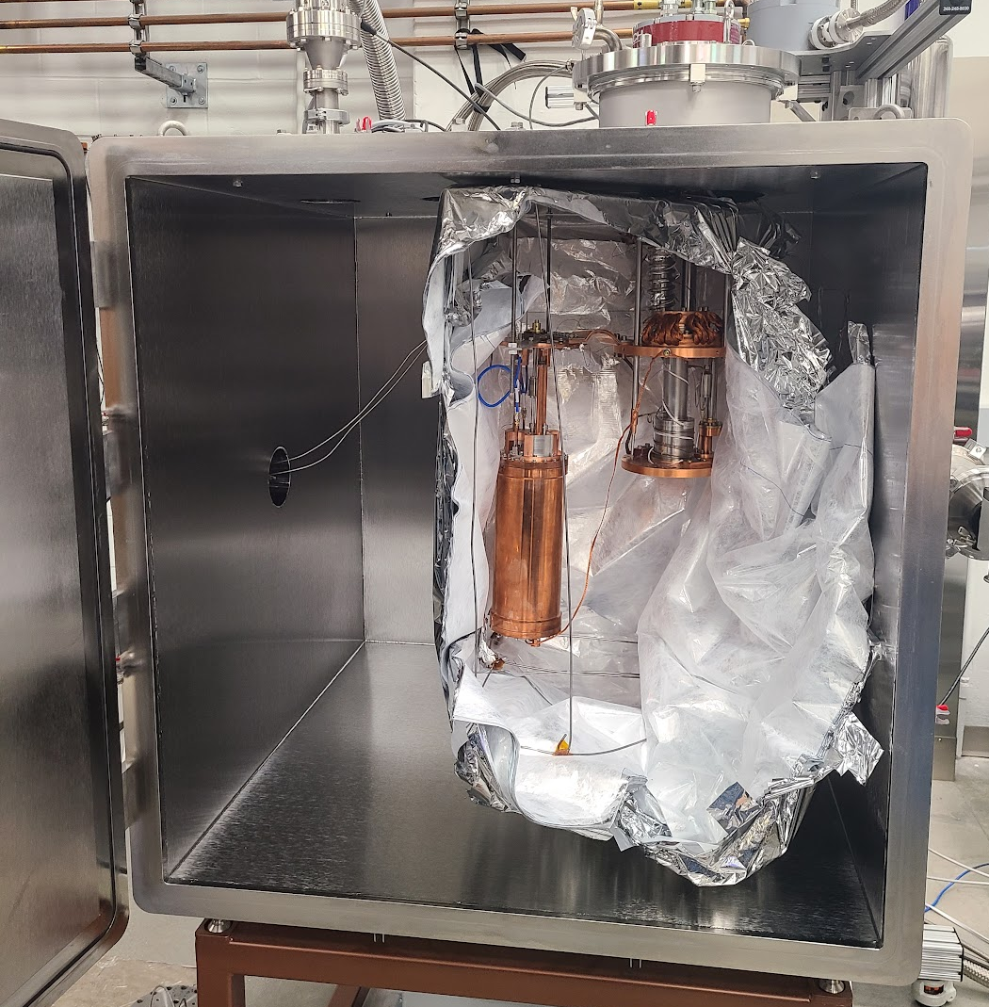
Dedicated Cryogenic Testing Setup
Tuning motor
First 7-rod cryo tests began at Yale in April
Testing at 15K in He fridge for fast turnarounds
Two critical functionalities need to work before data taking:
  Mechanical tuning
  Cryogenic Q
Heat strap
4K plate
1K plate
Tuning rod thermal braids
Fridge with cavity testing setup, insulated with MLI

Slide 13
Mechanical Tuning: Rod Design
Tuning rod cross-section
Hole for axle
Ø 0.125”
↧ 0.5
Cu-plated Al, OD 0.625”, ~9.98” long
1/8” holes on both ends to insert axle
Dielectric joints between axle shaft & rod prevent RF leakage
Axles attached to rod with Stycast
Cure for 24hrs in alignment jig
Challenges:
Axles must be perfectly coaxial
Thermalization through dielectric joint
RF leakage through axles
0.625”
Axle cross-section
0.25”
Axle shaft
Dielectric “rolling pin”
0.25”
0.125”
0.5”
0.125”
2.25”
1.00”
9.98”
Notes:
Stycast 1266

Slide 14
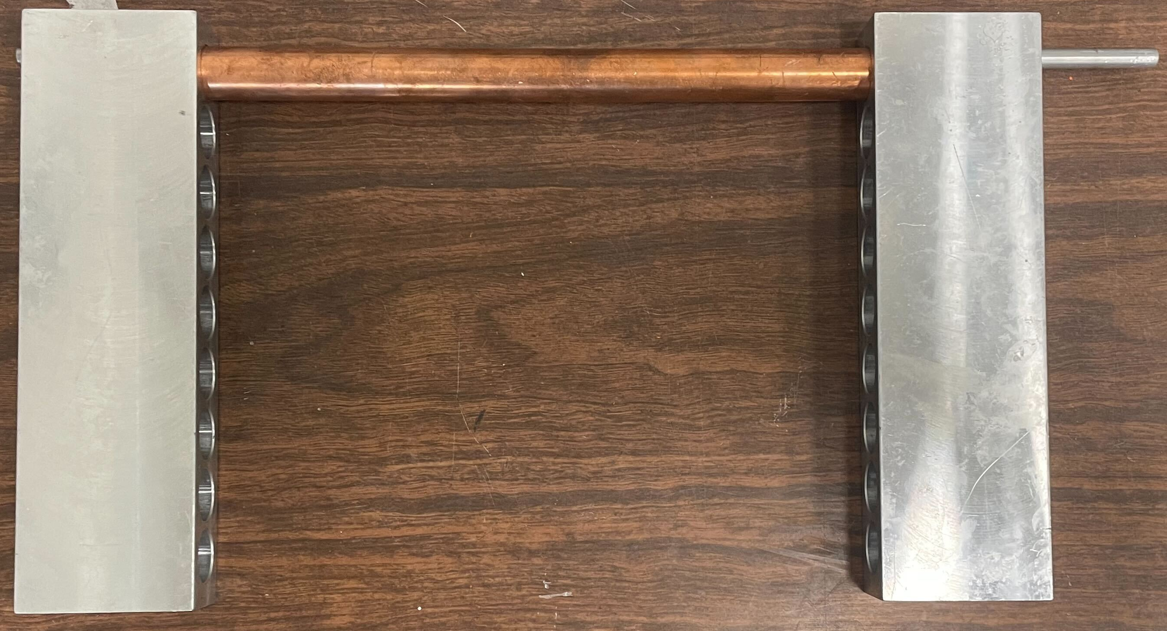
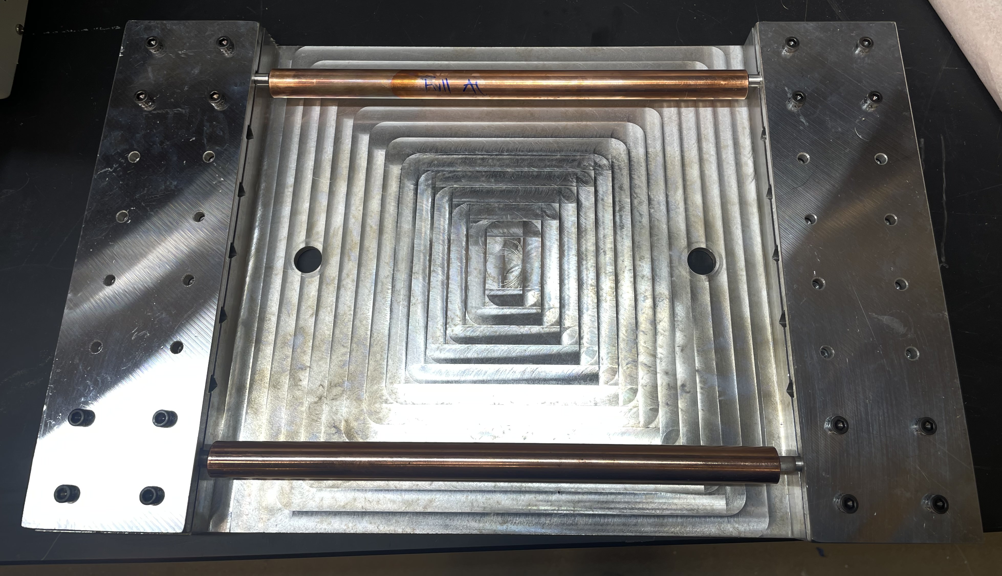
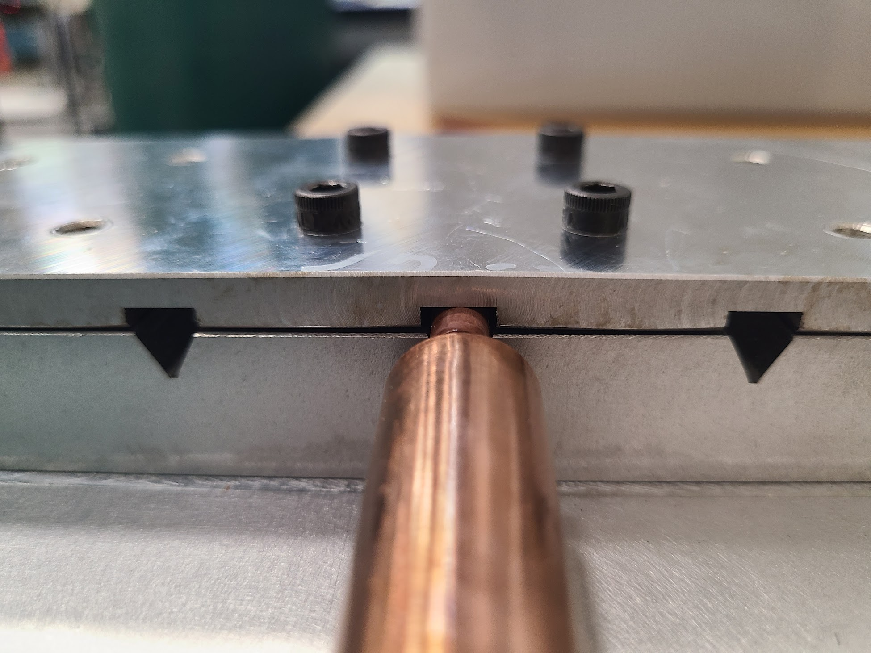
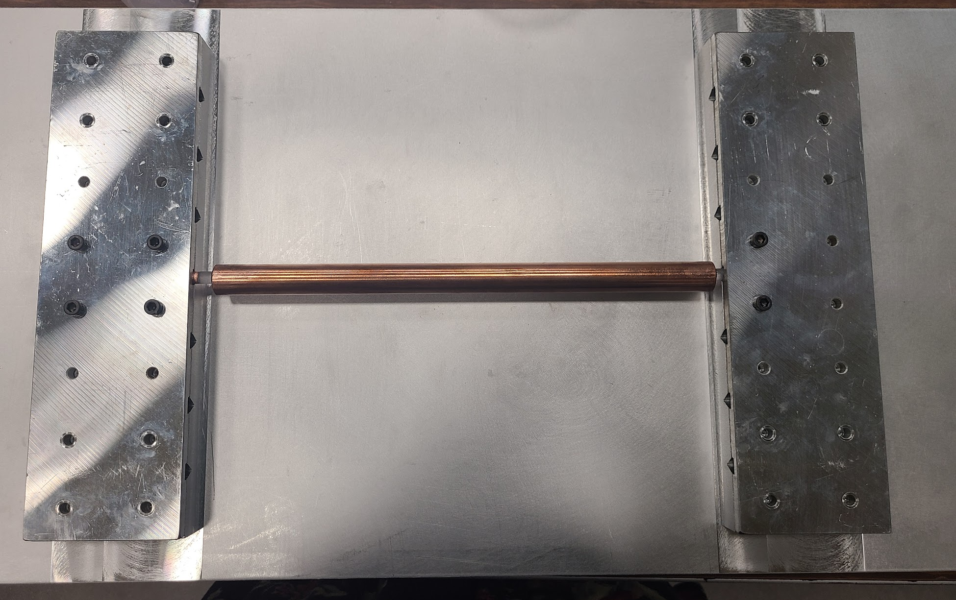
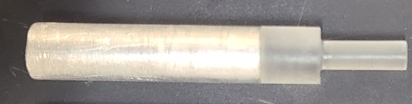
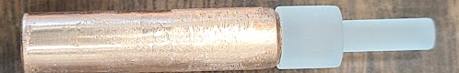
Mechanical Tuning: Optimization
Alignment Jig Iterations
Successful tuning requires perfect cooperation of all tuning rods & gears
Factors to optimize for tuning:
Smooth bearings
Radial tuning rod alignment
Gear engagement
Tuning rod axle-alignment
  Very challenging
  3 alignment jig iterations
Tuning rod thermalization
  Change axle shaft material
1
2
SS axle shaft
Copper axle shaft
3

Slide 15
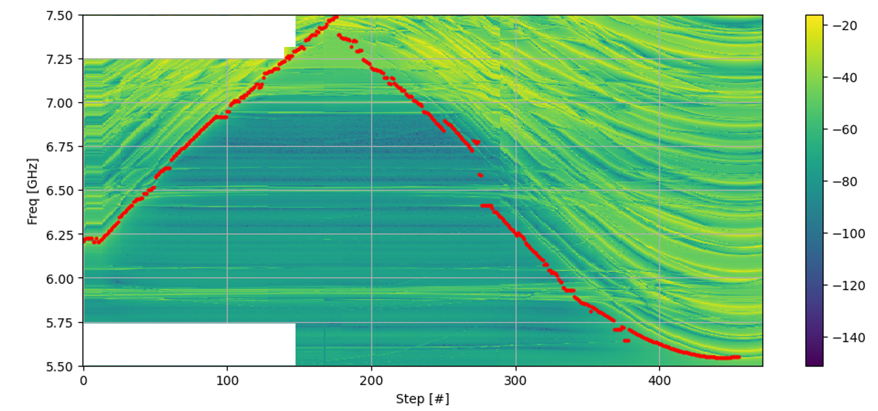
Mechanical Tuning: Success!
Achieved full cryogenic tuning range
5.5 - 7.5 GHz
Now to tackle cryogenic Q…
Mode map from first successful cryogenic tuning.
(Blank patches from interpolation)
S₂₁
TM₀₁₀ mode

Slide 16
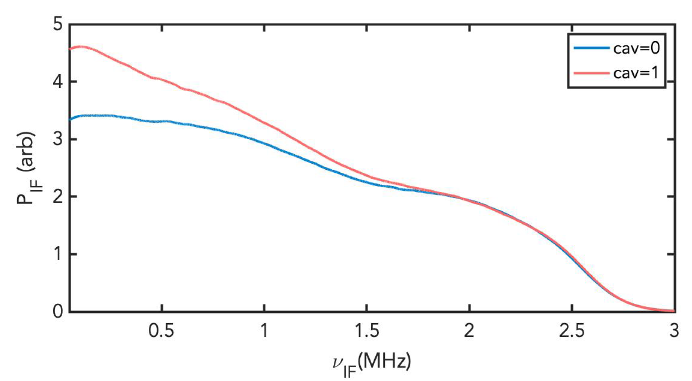
Cryogenic Q: The “Hot Rod” Problem
HAYSTAC has always observed excess cavity noise
Potential culprits:
  Vibrations (publication pending)
  RF leakage through tuning rod axles
  Tuning rod not thermalizing
Improved in PII:
  Copper stems inserted through alumina axles improved thermalization
  Did not fully fix problem
  Difficult to implement in 7-rod
Needs to be addressed for upgrade to multi-rod cavity
Cavity Spectra
Off-resonance
On-resonance
On-resonance power excess indicates cavity is not in thermal equilibrium
PSD
K. M. Backes. PhD thesis, Yale University (2021)

Slide 17
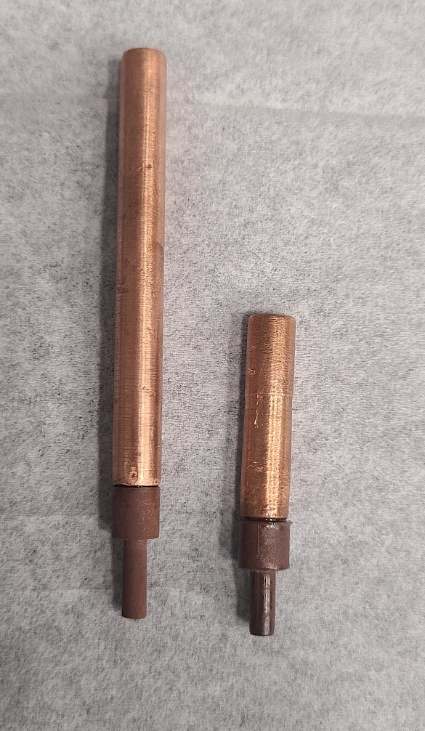
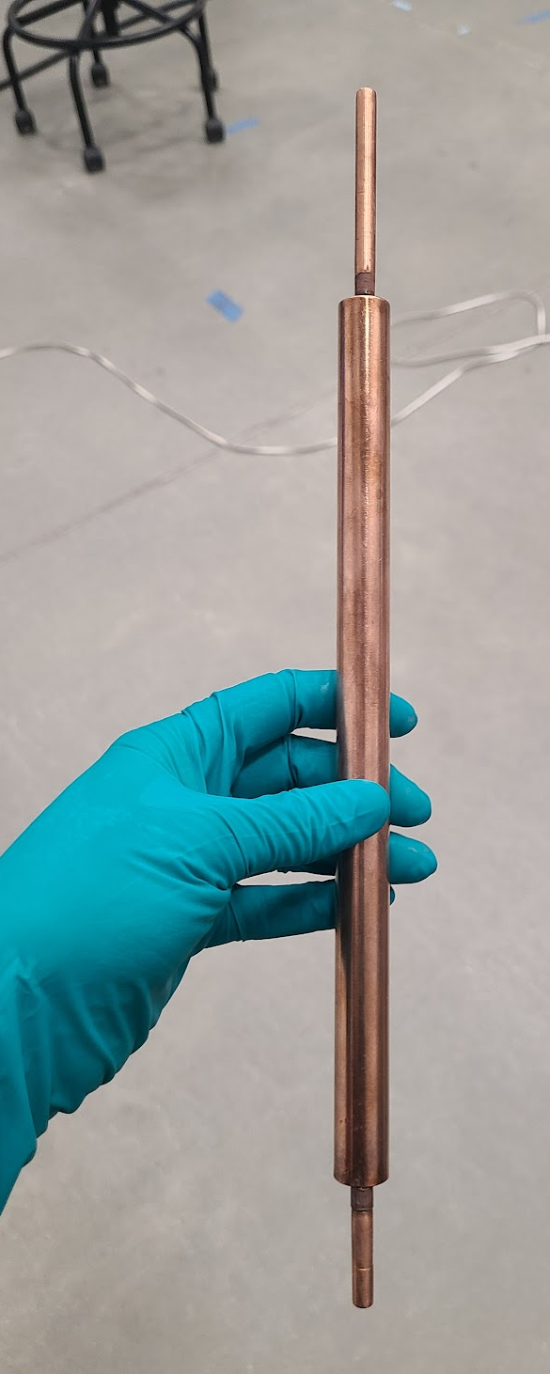
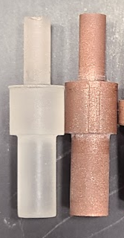
Cryogenic Q: Optimization
Features to optimize:
Rod thermalization
  Switching to Cu axle shafts helped
  Could be further improved by changing dielectric joint material
RF leakage through axles
  Need dielectric joint that conducts heat well
Search for new dielectric joint material:
Promising candidate: 50/50 Stycast & copper powder (by volume)
Hypothesis: Stycast serves as dielectric, Cu improves thermal conductivity & acts as filter against RF leakage
Promising, but still being characterized
Stycast
Cu + Stycast

Slide 18
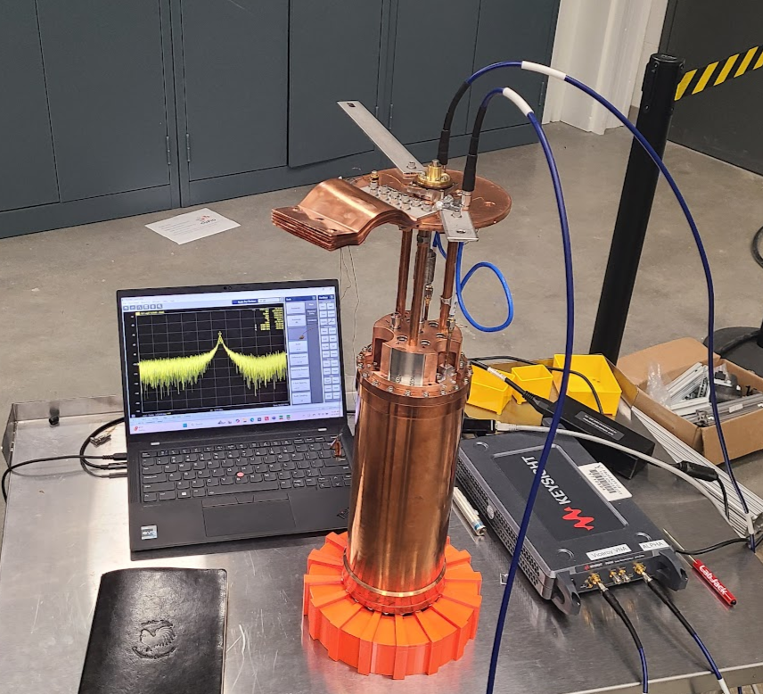
Current Status & Outlook
Quality factor optimization studies still underway
  Testing full 7-rod assembly with Cu-Stycast dielectric joints
  Will move ahead with install if cryogenic Q is good
  Will continue investigating this problem with PII cavity
Cryogenic tuning is well understood & optimized
Installation by end of year

Slide 19
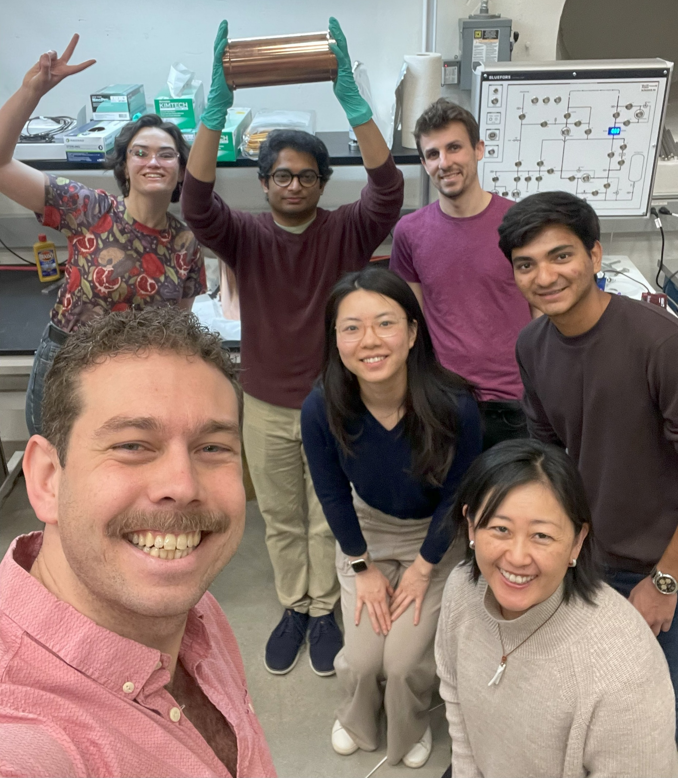
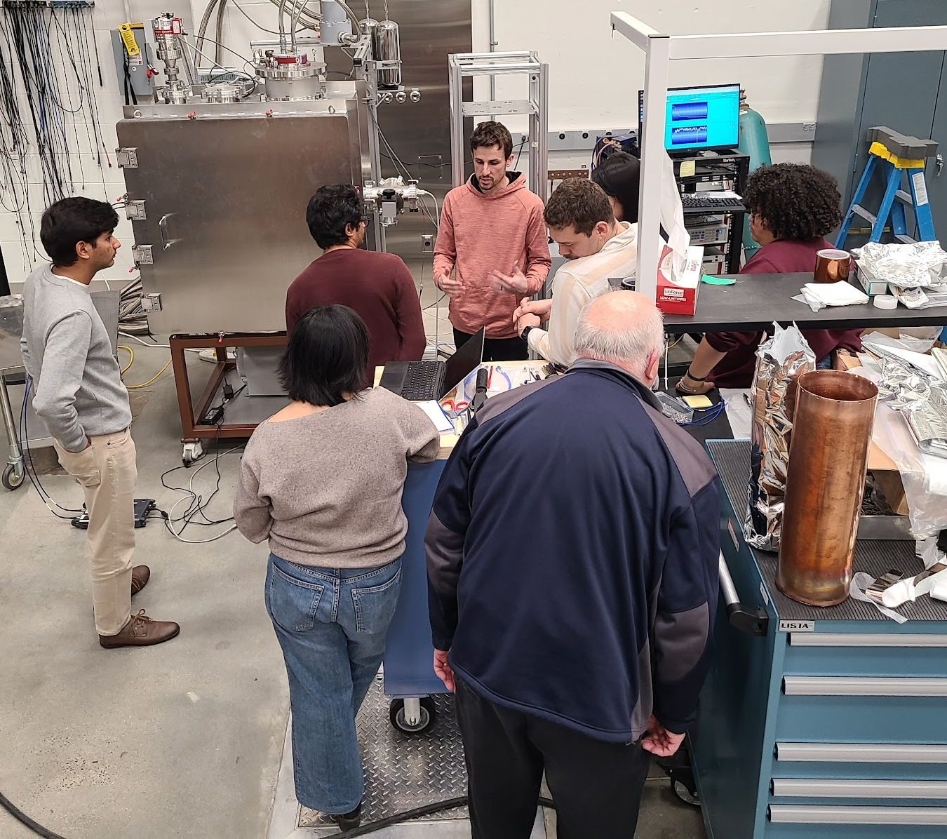

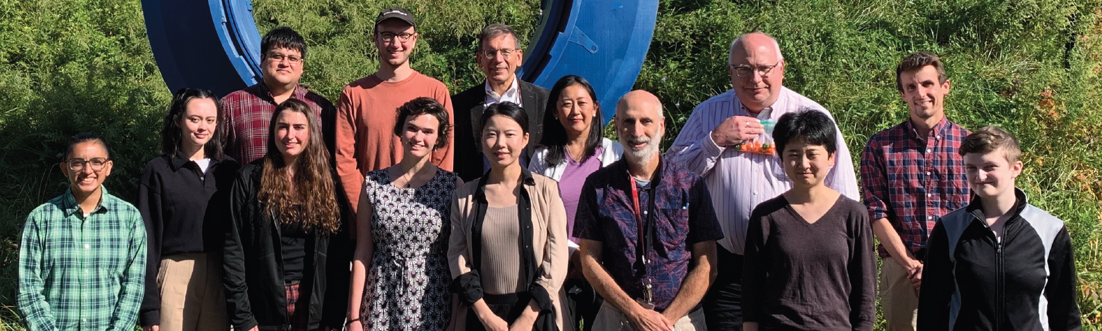
Thank You!

Slide 20
Backup Slides

Slide 21
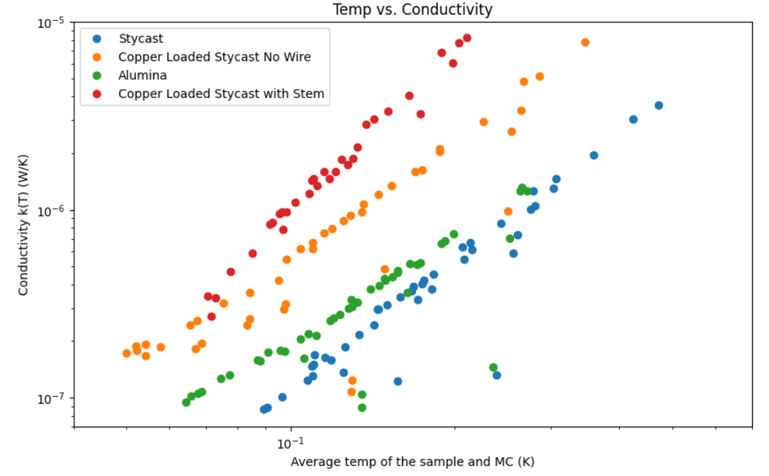
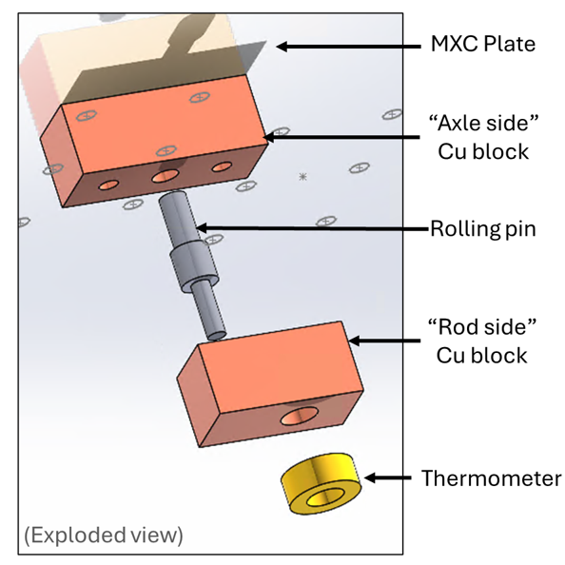
Thermal Conductivity Measurements
Thermal conductivity of samples measured in BlueFors dilution refrigerator
Cu-Stycast promising

Slide 22
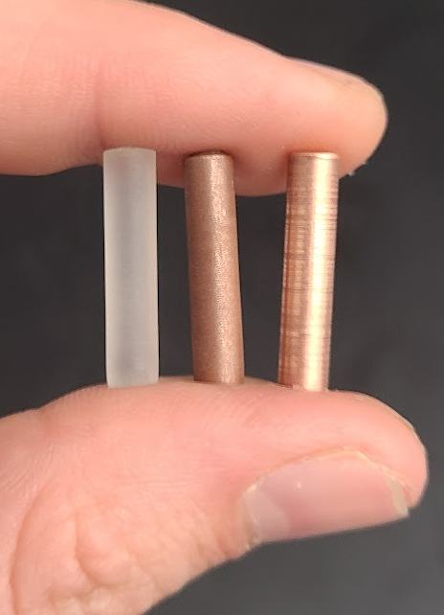
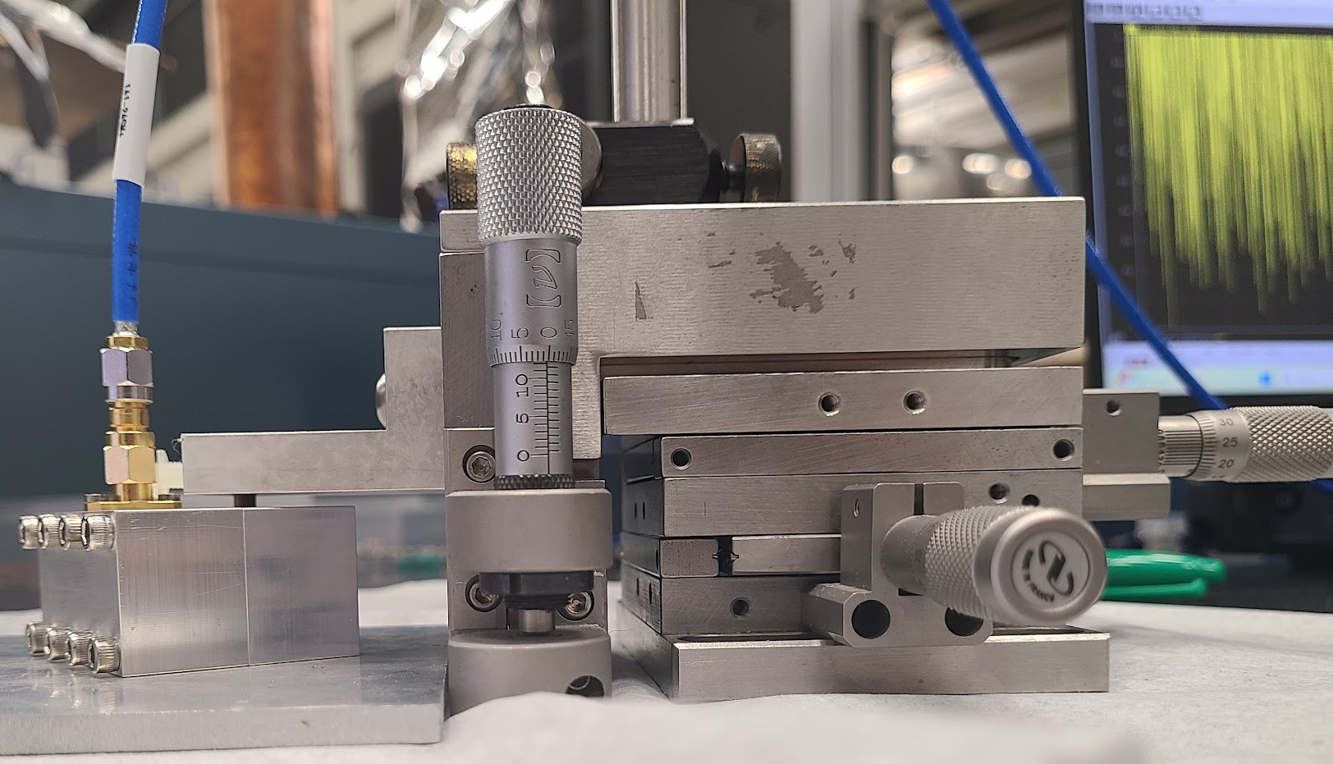
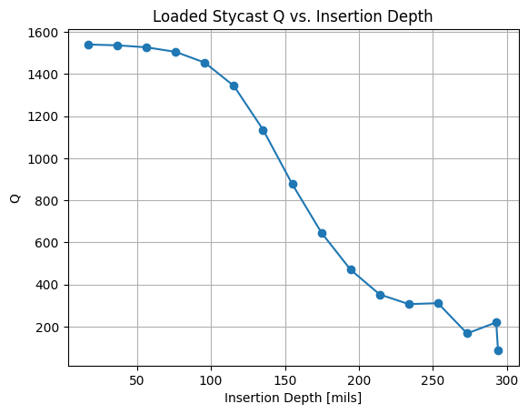
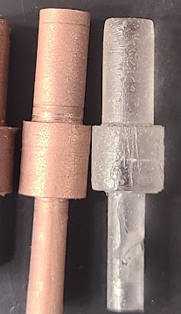
Cryogenic Q: Optimization
Features to optimize:
Rod thermalization
  Switching to Cu axle shafts helped
  Could be further improved by changing dielectric joint material
RF leakage through axles
  Need dielectric joint that conducts heat well
Search for new dielectric joint material:
Promising candidate: 50/50 Stycast & copper powder (by volume)
Stycast serves as dielectric, copper improves thermal conductivity
Suspended copper powder may also serve as filter against RF leakage
3-axis micrometer
Sample
Stycast
Copper
Cu-Stycast
7.1 GHz Al cavity
Cu-Stycast sample had promising results for Q retention

