Slide 1



MAIA: A Detector Concept for a 10 TeV Muon Collider
Rose Powers (Princeton University)
On behalf of the MAIA team
CPAD 2025 at University of Pennsylvania
8 October 2025

Slide 2
Outline
Introduction
The MAIA detector
Detector performance
  Standard candles
  More challenging objects
Reconstruction optimization progress
Conclusions and outlook

Slide 3
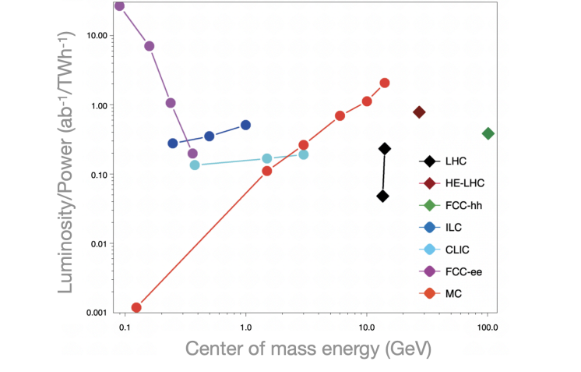
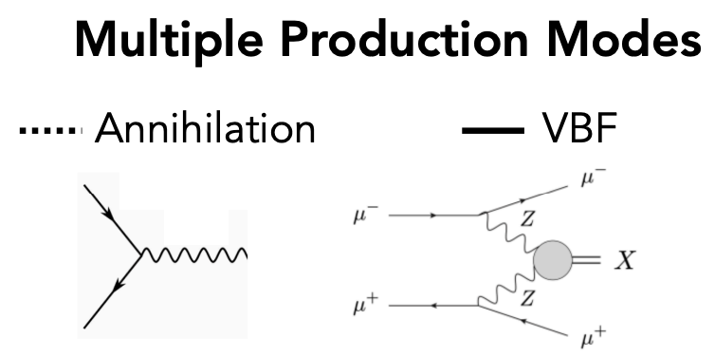
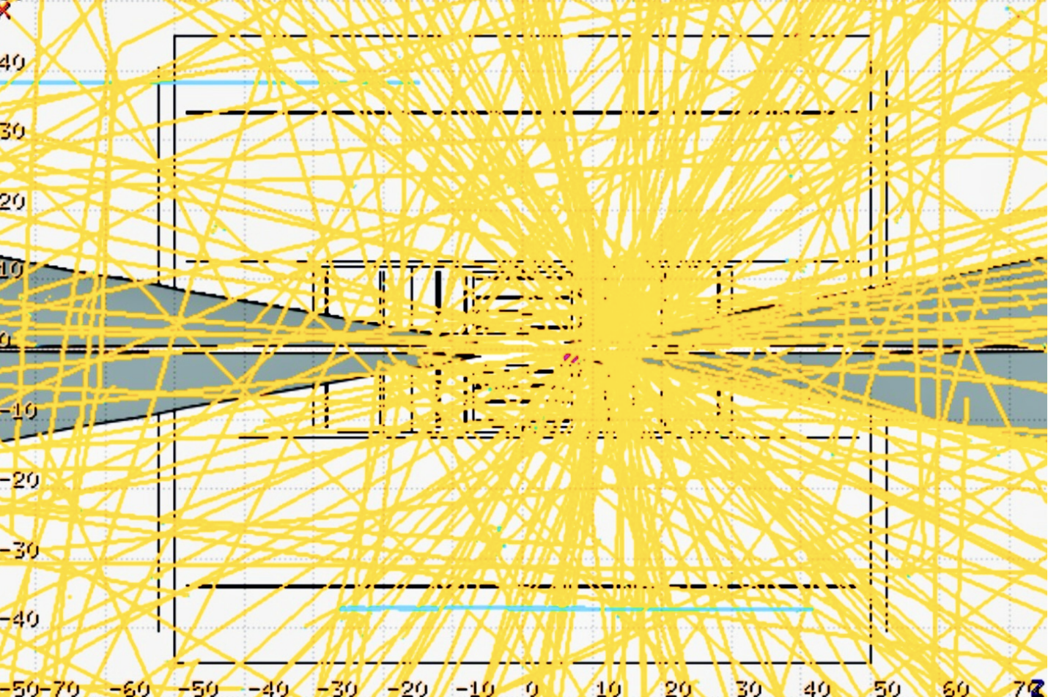
Introduction
See Ben Rosser’s talk for more!
10 TeV Muon Collider: Detector Priorities
Muons: the perfect collider particle?
  Fundamental, second-generation
  Probes energy and intensity frontiers
  Synchrotron radiation suppressed
  However…
Muons decay→ beam-induced background (BIB)
  Decay products flood detector with low-energy secondaries
  How to remain robust to interesting physics while mitigating BIB?
K. Kennedy

Slide 4
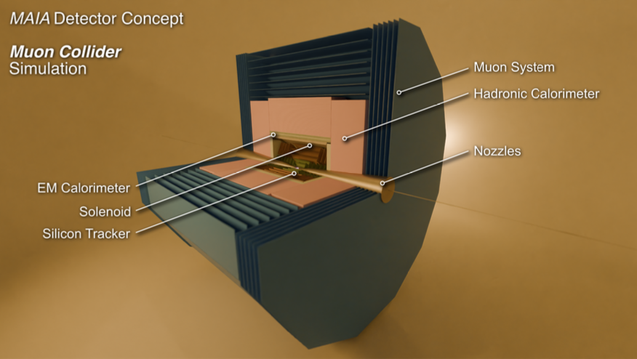
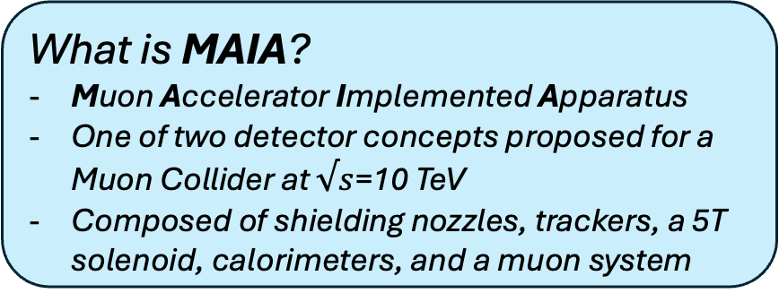
Introduction
See Ben Rosser’s talk for more!
10 TeV Muon Collider: Detector Priorities
Muons: the perfect collider particle?
  Fundamental, second-generation
  Probes energy and intensity frontiers
  Synchrotron radiation suppressed
  However…
Muons decay→ beam-induced background (BIB)
  Decay products flood detector with low-energy secondaries
  How to remain robust to interesting physics while mitigating BIB?
What is MAIA?
Muon Accelerator Implemented Apparatus
One of two detector concepts proposed for a Muon Collider at $√s$=10 TeV
Composed of shielding nozzles, trackers, a 5T solenoid, calorimeters, and a muon system
[1] arXiv:2502.00181

Slide 5
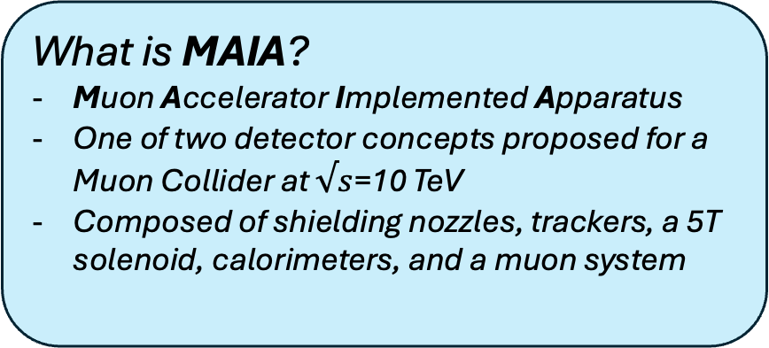
Introduction
See Ben Rosser’s talk for more!
10 TeV Muon Collider: Detector Priorities
Muons: the perfect collider particle?
  Fundamental, second-generation
  Probes energy and intensity frontiers
  Synchrotron radiation suppressed
  However…
Muons decay→ beam-induced background (BIB)
  Decay products flood detector with low-energy secondaries
  How to remain robust to interesting physics while mitigating BIB?
What is MAIA?
Muon Accelerator Implemented Apparatus
One of two detector concepts proposed for a Muon Collider at $√s$=10 TeV
Composed of shielding nozzles, trackers, a 5T solenoid, calorimeters, and a muon system
How does MAIA address this challenge?
5T solenoid shields calorimeters
High-granularity tracking and calorimetry
Excellent timing precision
Optimizing reconstruction software for our high-background environment

Slide 7
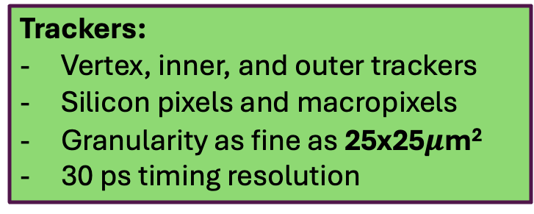
Nozzles:
Tungsten (INERMET) and borated polyethylene
Shields detector, softens punch-through BIB
Trackers:
Vertex, inner, and outer trackers
Silicon pixels and macropixels
Granularity as fine as 25x25$μ$m²
30 ps timing resolution

Slide 8
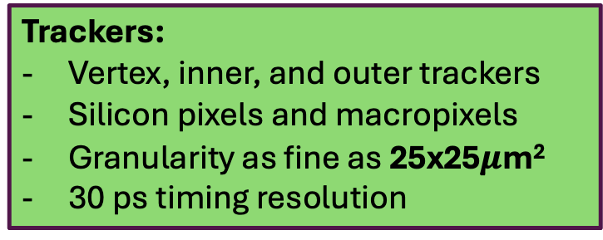
Nozzles:
Tungsten (INERMET) and borated polyethylene
Shields detector, softens punch-through BIB
Solenoid:
5T field
Aluminum
Before ECAL for maximal shielding
Trackers:
Vertex, inner, and outer trackers
Silicon pixels and macropixels
Granularity as fine as 25x25$μ$m²
30 ps timing resolution

Slide 9
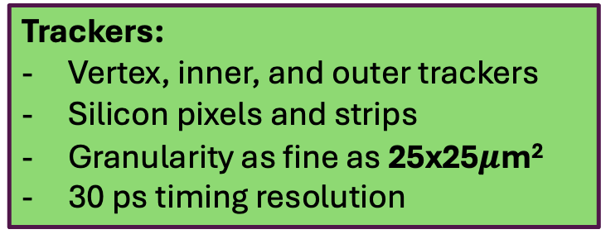
HCAL:
Iron and scintillator
30x30 mm² cells
75 layers
ECAL:
Silicon and Tungsten
5x5 mm² cells
50 layers
Nozzles:
Tungsten (INERMET) and borated polyethylene
Shields detector, softens punch-through BIB
Solenoid:
5T field
Aluminum
Before ECAL for maximal shielding
Trackers:
Vertex, inner, and outer trackers
Silicon pixels and strips
Granularity as fine as 25x25$μ$m²
30 ps timing resolution

Slide 10
Muon System:
RPC (resistive plate chambers)
HCAL:
Iron and scintillator
30x30 mm² cells
75 layers
ECAL:
Silicon and Tungsten
5x5 mm² cells
50 layers
Nozzles:
Tungsten (INERMET) and borated polyethylene
Shields detector, softens punch-through BIB
Solenoid:
5T field
Aluminum
Before ECAL for maximal shielding
Trackers:
Vertex, inner, and outer trackers
Silicon pixels and strips
Granularity as fine as 25x25$μ$m²
30 ps timing resolution

Slide 11
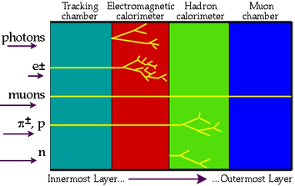
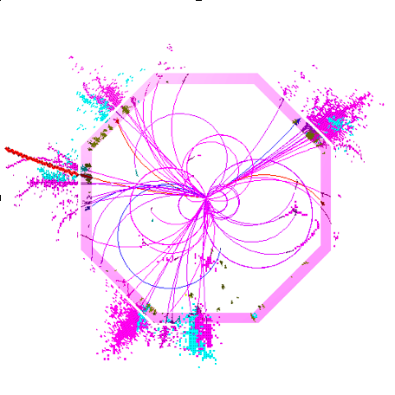


Detector Performance
How do we assess detector performance?
Basic objects as standard candles for each subdetector
Tracker performance → muons
ECAL performance → photons
HCAL performance → neutrons
What is the simulation and reconstruction process?
BIB is simulated in FLUKA, overlaid with signal Monte Carlo sample
Tracking performed with ACTS
Pandora particle flow used for full reconstruction
  Still subject to optimization; see later slides!
S. Demers
See Ben Rosser’s talk for more!

Slide 12
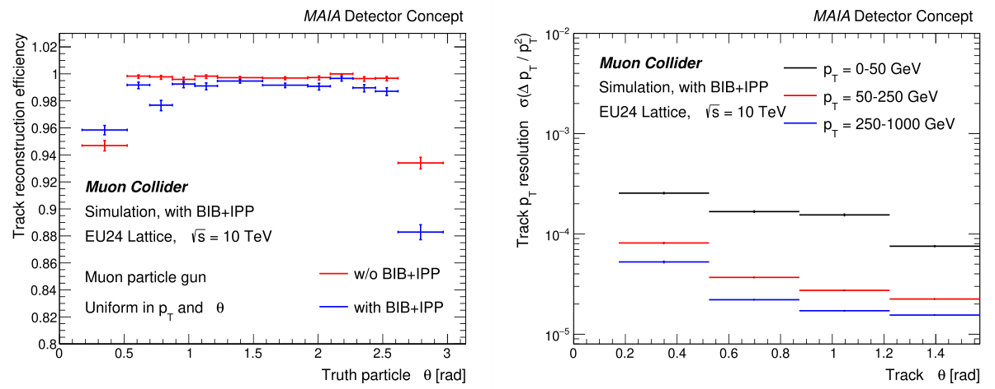
Tracker Performance
Plots courtesy of J. Offermann
The tracker performs best in the barrel region, furthest from the nozzles
Efficiency in this region above 98%, globally above 85%
Resolution improves with p_{T}
Excellent in the barrel; globally better than 0.02%/GeV
Note zoomed efficiency axis!

Slide 13
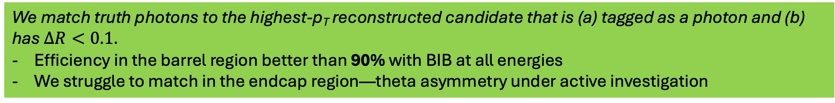
ECAL Performance: Photon Efficiency
We match truth photons to the highest-p_{T} reconstructed candidate that is (a) tagged as a photon and (b) has $∆R<0.1$.
Efficiency in the barrel region better than 90% with BIB at all energies
We struggle to match in the endcap region—theta asymmetry under active investigation

Slide 14
ECAL Performance: Photon Resolution
Energy resolution below 10% in the barrel at all energies, even in the presence of BIB!
Resolution for low-energy photons in the transition region improved over our benchmark by more than a factor of 2.
Endcap resolution shown only for no-BIB sample: reconstruction still needs optimization in this region.

Slide 15
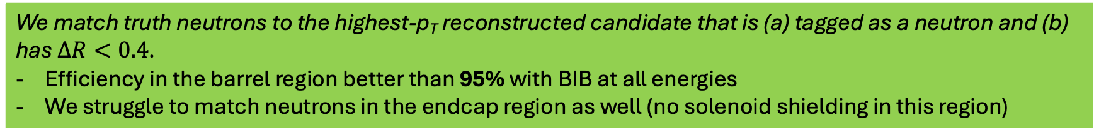
HCAL Performance: Neutron Efficiency
We match truth neutrons to the highest-p_{T} reconstructed candidate that is (a) tagged as a neutron and (b) has $∆R<0.4$.
Efficiency in the barrel region better than 95% with BIB at all energies
We struggle to match neutrons in the endcap region as well (no solenoid shielding in this region)

Slide 16
HCAL Performance: Neutron Resolution
In the barrel and transition regions, vast improvement in neutron energy resolution over benchmark
(more than a factor of 3 at low energies!)

Slide 17
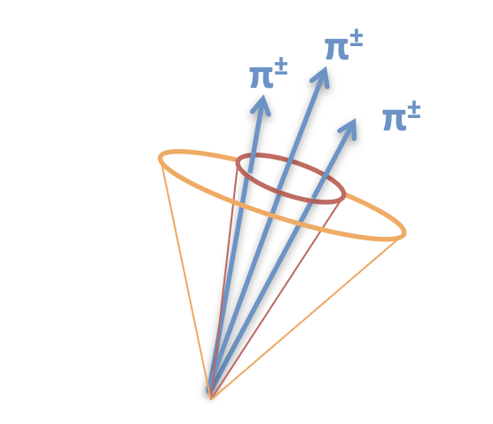
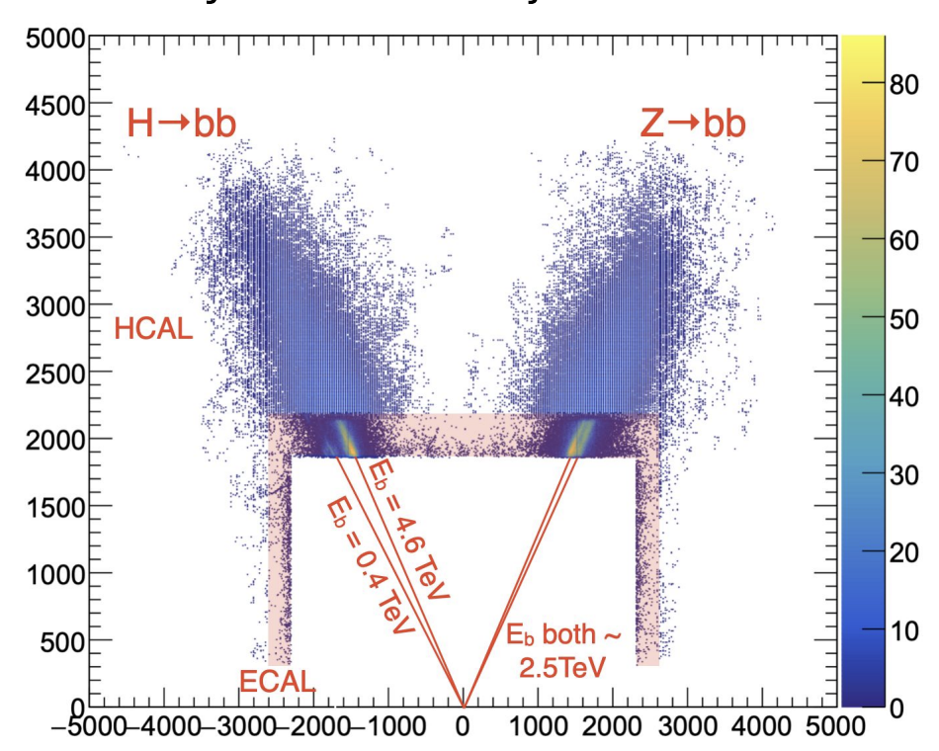
More Advanced Objects
Charged pions
Need good performance from tracker, ECAL, HCAL
Track-to-cluster matching (nontrivial process in Pandora!)
Taus
Heavy third-generation leptons decay promptly
Hadronic decay modes
Need good pion reconstruction
Group decay products to form a tau candidate
Di-jets, b-jet tagging, etc…
Several studies currently underway on jets!
S. Demers
P. Chang

Slide 18
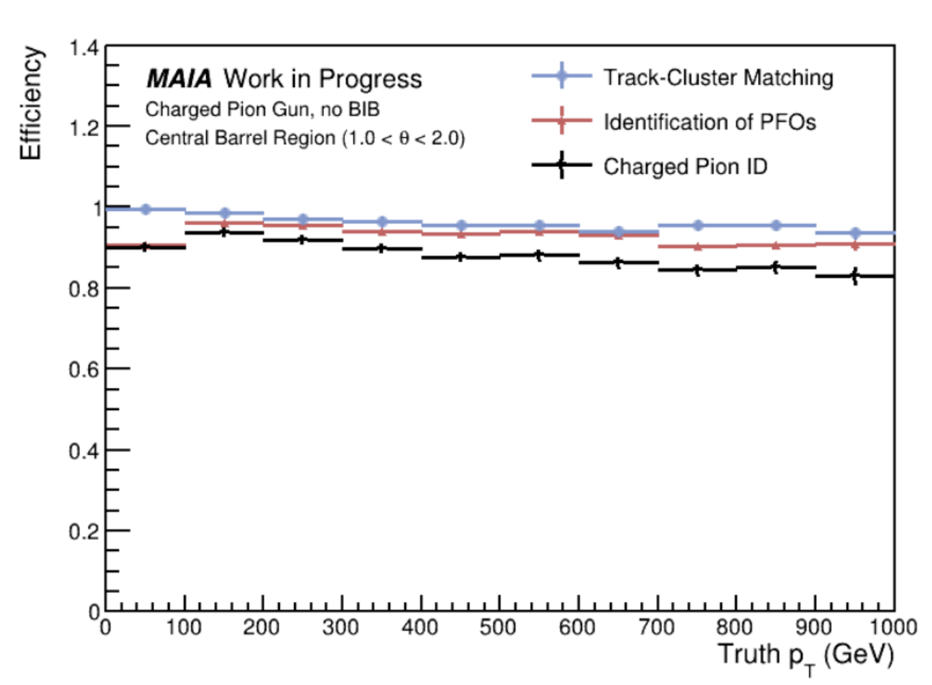
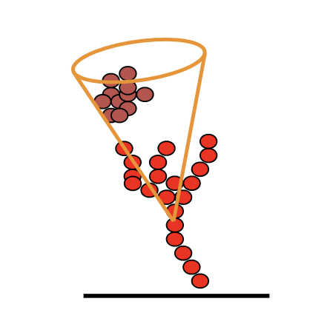
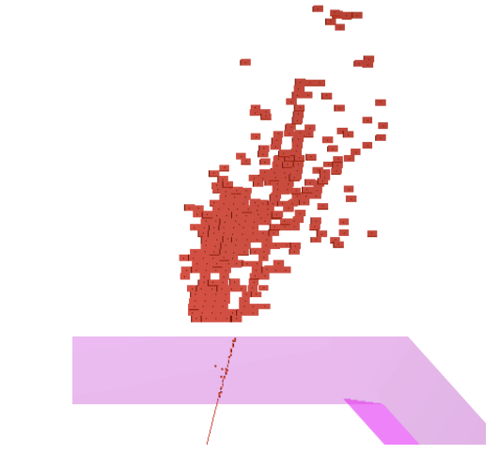
Charged Pion Reconstruction Performance
Plots courtesy of G. Penn
Illustrations from J. Marshall, S. Green
Charged pion reconstruction efficiency with three figures of merit: track-to-cluster matching, particle flow object ID, and charged pion ID. Results shown for a no-BIB environment.
Challenges with track-to-cluster matching in pion samples inspired our current optimization of Pandora—see slide 21.

Slide 19
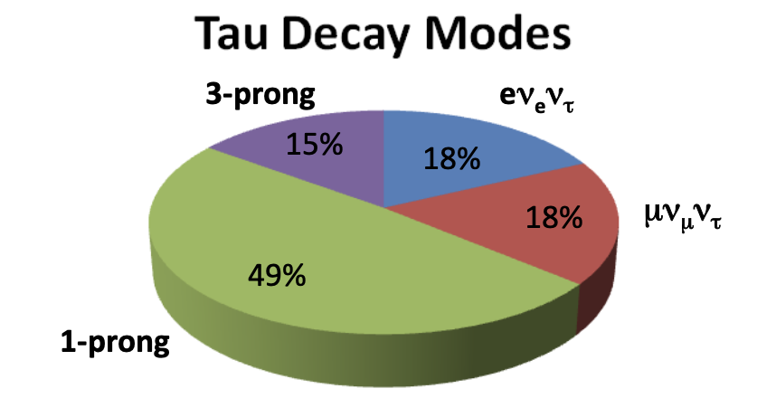
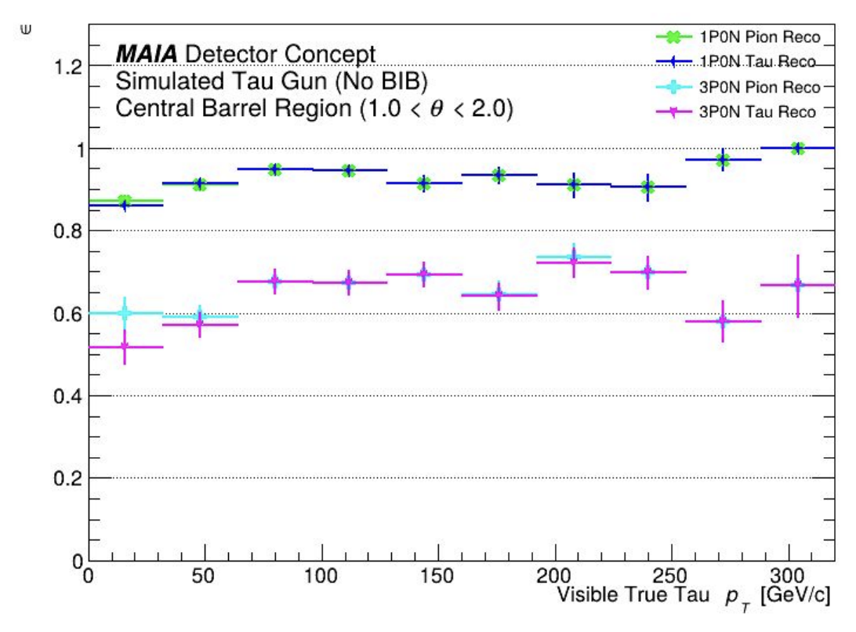


Tau Reconstruction Efficiency
Plot courtesy of K. Dewyspelaere, M. Glassman, C. Kianian, E. Martinez
The most common decay mode contains a single charged hadron (often a charged pion); alternatively, hadronic decays involve three charged hadrons about 15% of the time.
S. Demers
$$τ^{±}→π^{±}ν_{τ}$$
$$τ^{±}→π^{±}π^{∓}π^{±}ν_{τ}$$
We reconstruct 1-prong taus with no neutral decay products in a no-BIB environment with a global efficiency of ~90%!

Slide 20
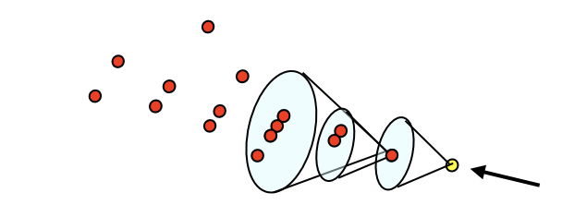
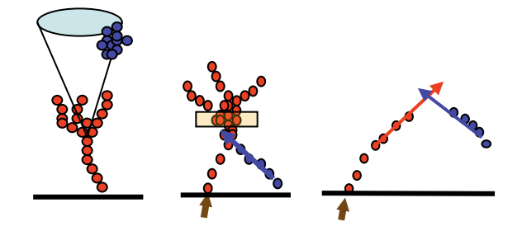
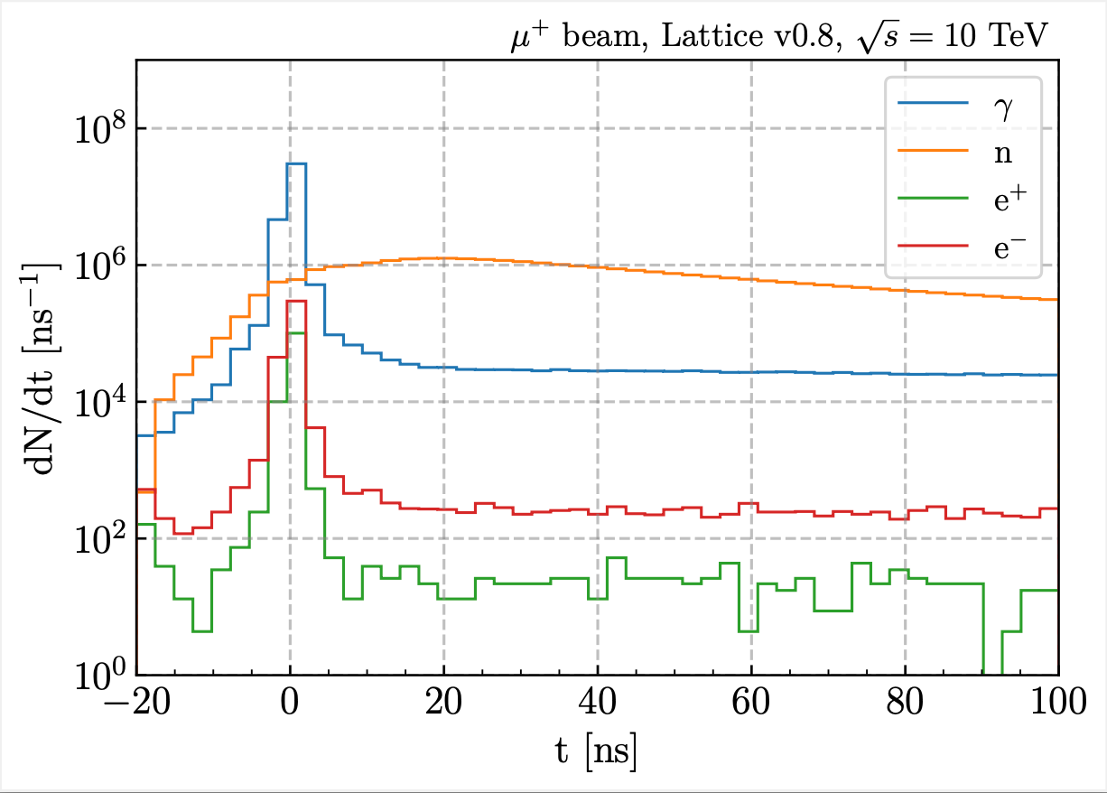
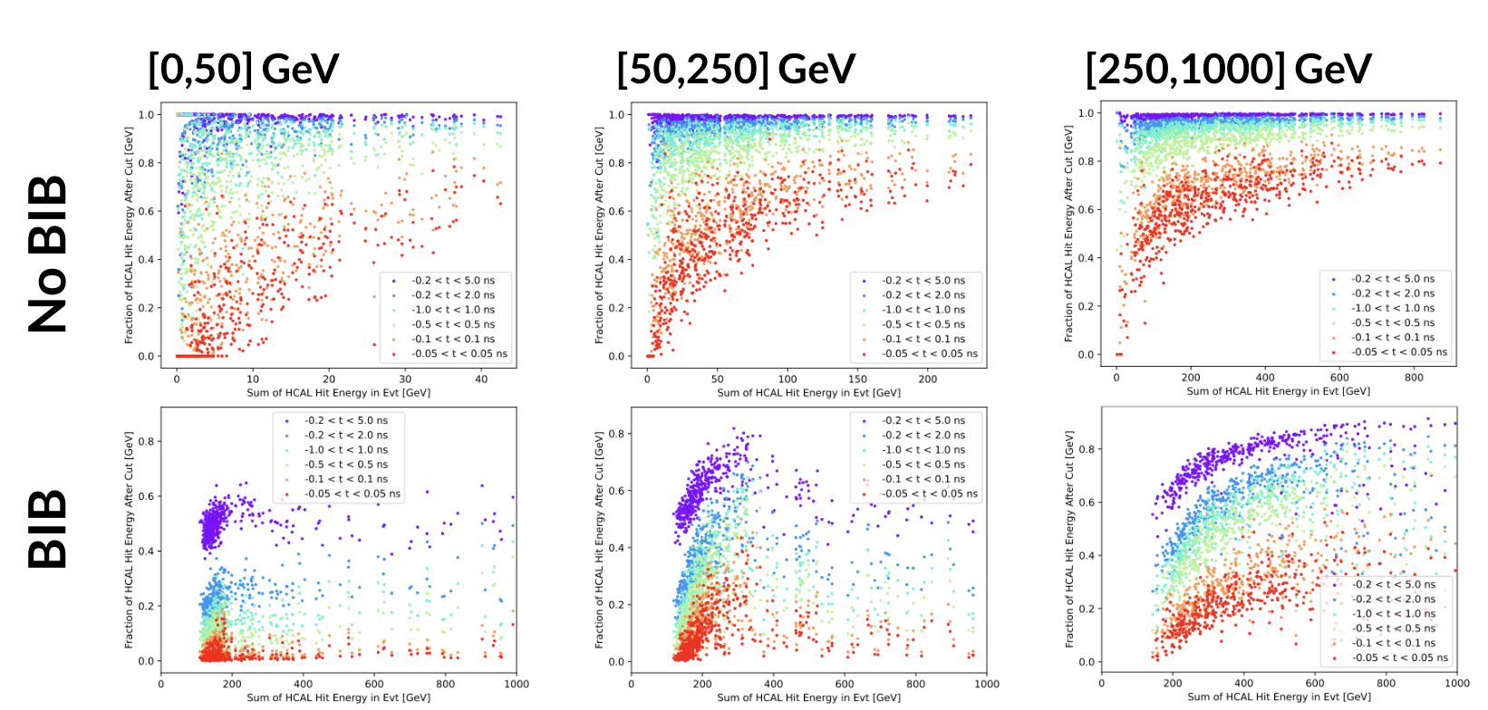
Reconstruction Optimization
The detector performance improvements displayed here are the result of a suite of recent optimization efforts. Among them…
Pandora Particle Flow Optimization (see Gregory Penn’s talk)
BIB timing cuts → 5D Precision Calorimetry
D. Calzolari

Slide 21
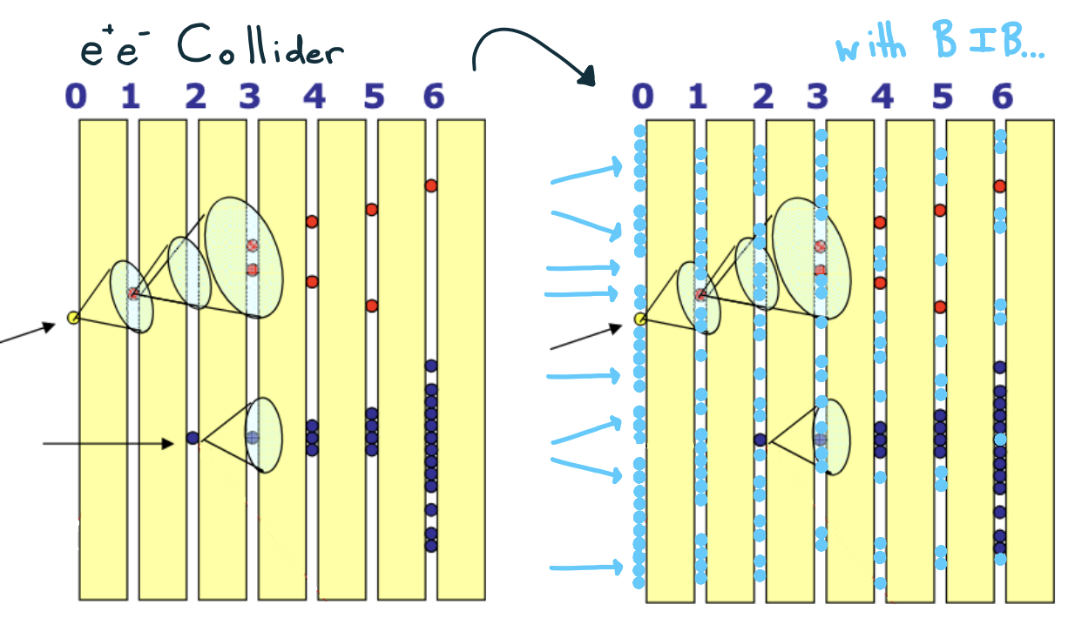
Optimizing Pandora
PandoraPFA was originally developed for a linear electron-positron collider.
Relies on a series of iteratively implemented algorithms to achieve…
  Clustering
  Track-to-cluster matching
  Cluster “cleaning” (removing and merging fragments)
  Particle ID
In a high-background environment, this iterative process creates ballooning combinatorics and is prohibitively computationally expensive.
Figs from Gregory Penn’s USMCC Talk

Slide 22
Optimizing Pandora
We have pared down the extensive list of algorithms called by Pandora and developed a “recipe” that reduces computational time by a factor of ~10 without significant degradation to reconstruction performance.
In a high-background environment, this iterative process creates ballooning combinatorics and is prohibitively computationally expensive.
Figs from Gregory Penn’s USMCC Talk

Slide 23
BIB Timing Cuts
Plots courtesy of A. Tang, K. Kennedy
Most BIB arrives out-of-time. Assuming cutting-edge timing precision from ECAL, we can use timing info to our advantage.
Study of BIB timing distribution determined range of feasible time cuts on calo hits → 300 ps chosen as optimal value

Slide 24
Conclusions and Outlook
After several recent optimizations, we have achieved new benchmarks for simple object reconstruction in the MAIA detector.
Still optimization to be done in the endcap regions for all subdetectors
  Looking into forward muon tagging at very edges of endcap acceptance
Simulating the BIB remains a computational bottleneck; studies underway into the possible use of generative AI to produce full-BIB samples
We can now study more complicated objects – such as the pions, taus, and jets mentioned here
It is an exciting time for the MAIA detector concept, with many ways to get involved in research!
Link to the MAIA Software Tutorial: https://mcd-wiki.web.cern.ch/software/howto/maia/
Please reach out if you are interested in joining the effort!

Slide 25
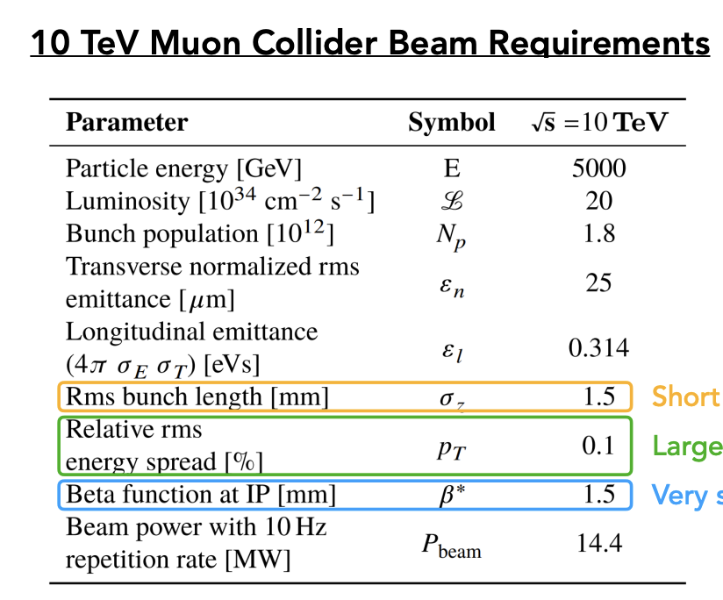
Backup – Muon Collider Requirements
K. Kennedy

Slide 26
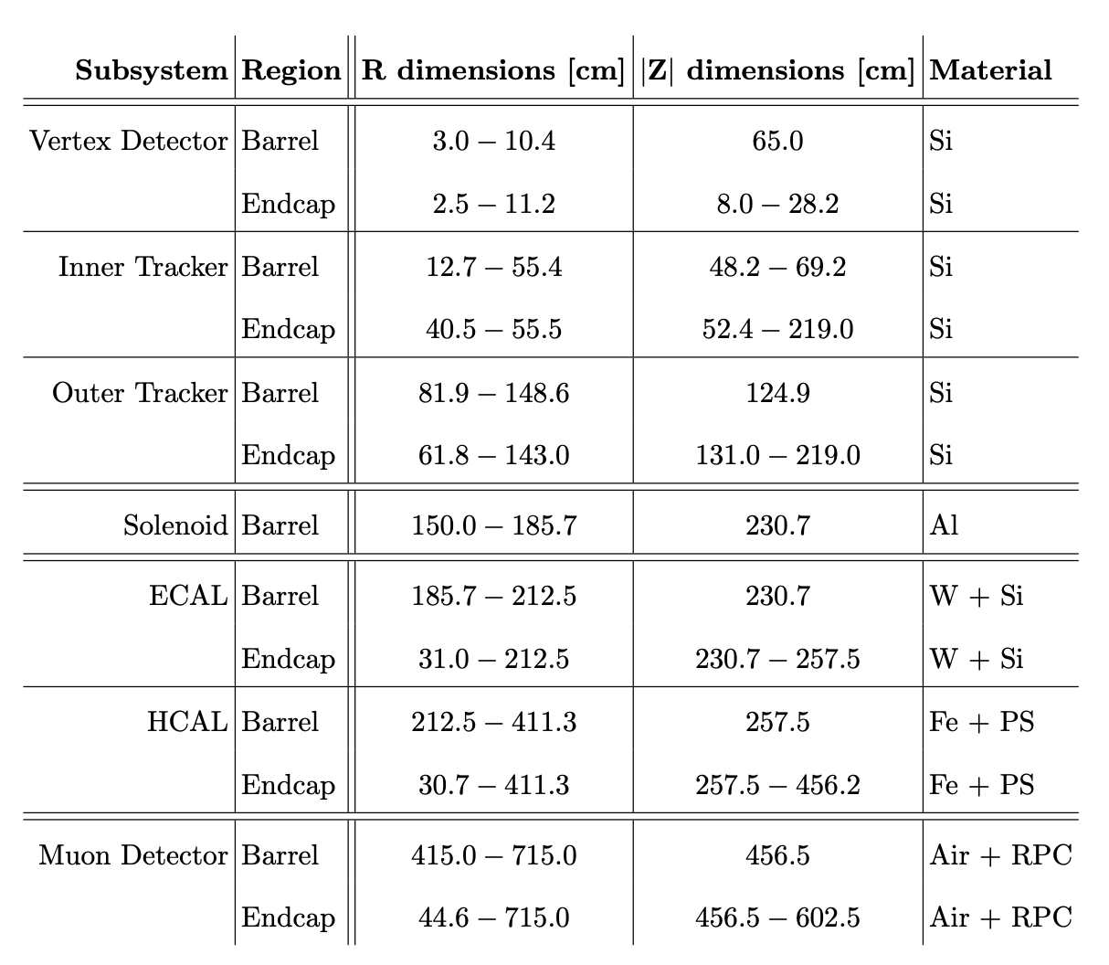
Backup – MAIA Dimensions

Slide 27
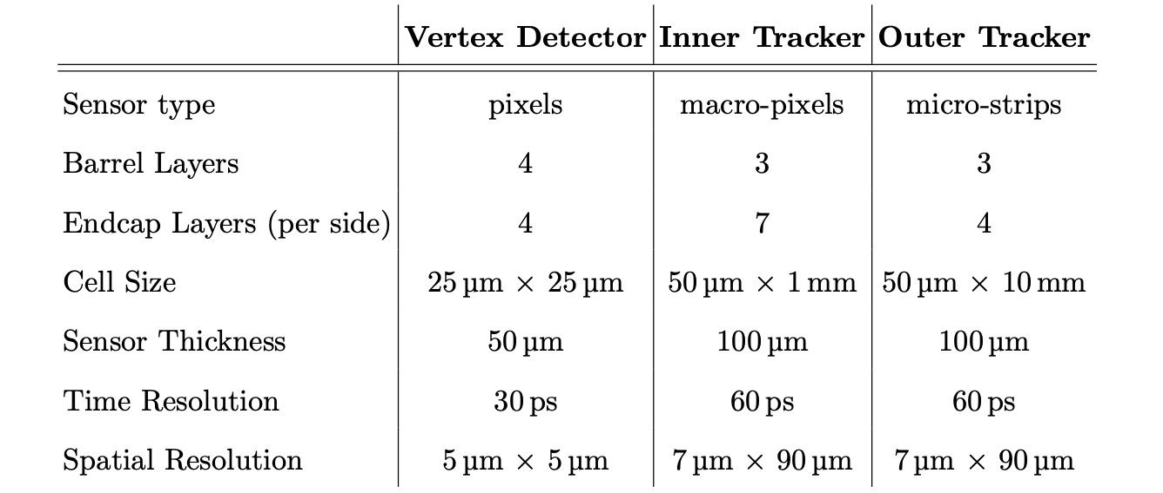
Backup – Tracker Specifics

Slide 28
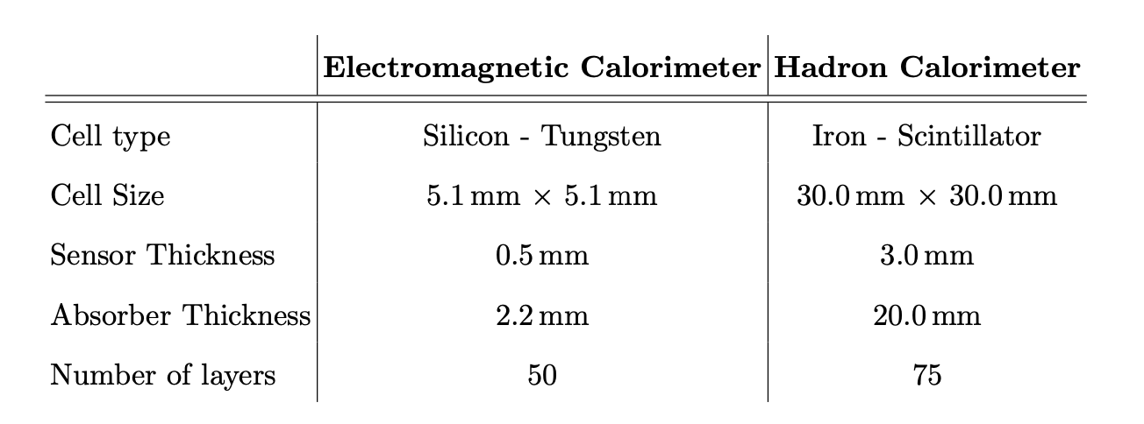
Backup – Calorimeter Specifics

