Slide 1

Aligning Data to Better Than one Picosecond
Erich Frahm, Roger Rusack, Rohith Saradhy, Yahya Tousi, Emily Vadnais.
The University of Minnesota
Rohith Saradhy

Slide 2
One of the big problems of getting to ultra-precise timing is the distribution of the reference clock across the whole detector.
Current strategy is to send a clock encoded in the data stream from the off-detector electronics and monitor what comes back.
In this talk I will describe a new solution to monitor the reference clock on detector.

Slide 3
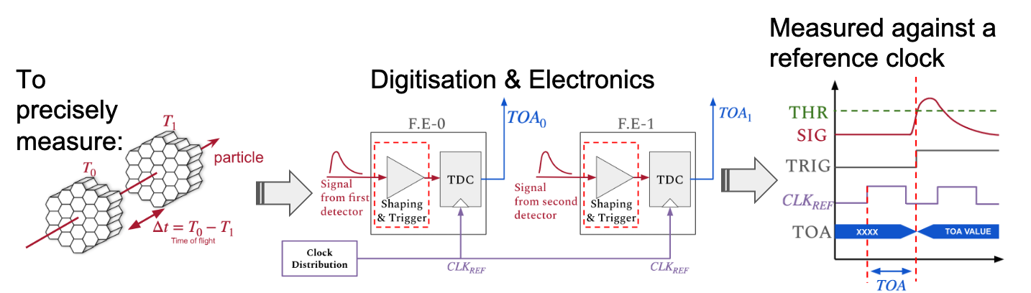
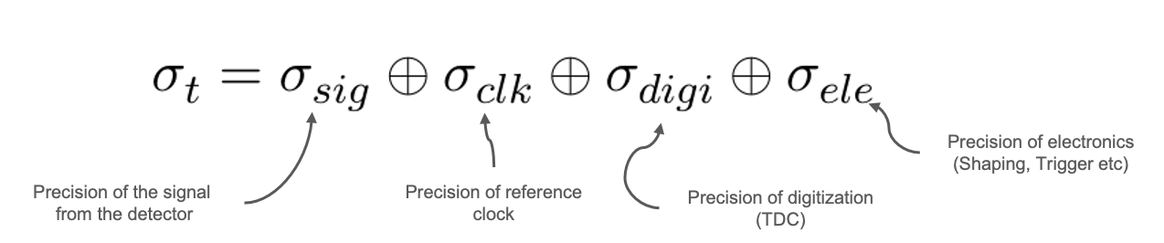
Concentrate on this here.

Slide 4
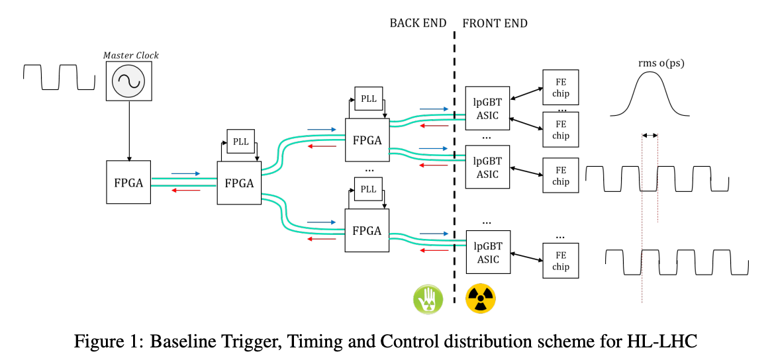
What are we doing now?

Slide 5
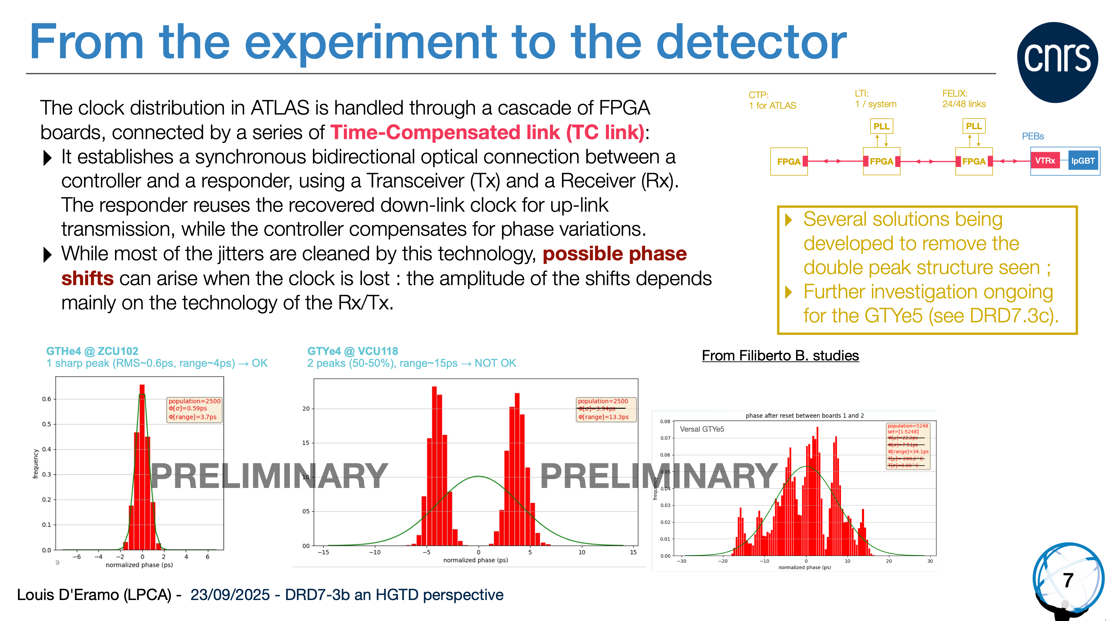
From DRD7.3c Presentation by Louis D’Eramo Sept 25th 2025. — Here

Slide 6
Primer on noise in clock signals:
A pure clock is a balanced sequence of zeroes and ones
An encoded clock is when a clock is encoded onto a date stream.
A clock data recovery (CDR) circuit is used to recover a pure clock from a data stream
Jitter, high-frequency phase variations.
Wander, Low frequency phase variations.

Slide 7
What do you need to stabilize the clock on detector?
Jitter can be stabilized on detector with a PLL.
Wander cannot be corrected this way.
Wander can be caused by changes in the clock transmission system.
Eg 100 m fiber —> temperature change of 1C —> 16 ps drift.
To address this we need:
Something to detect the phase on-detector
Something to shift the phase if it is moves.

Slide 8
Phase Shifter:
Two solutions:
Standard PLL with frequency adjustments.
Specialized ASIC with 300 fs steps — DCPS.

Slide 9
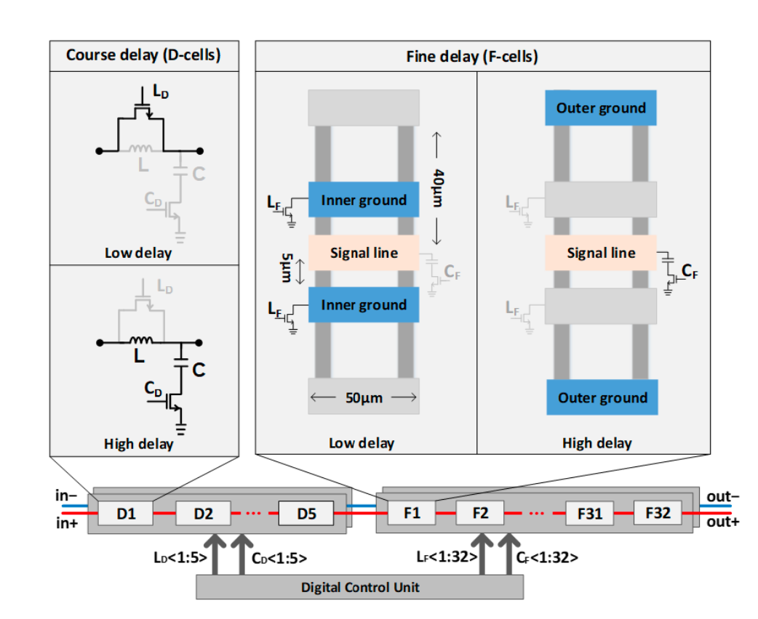
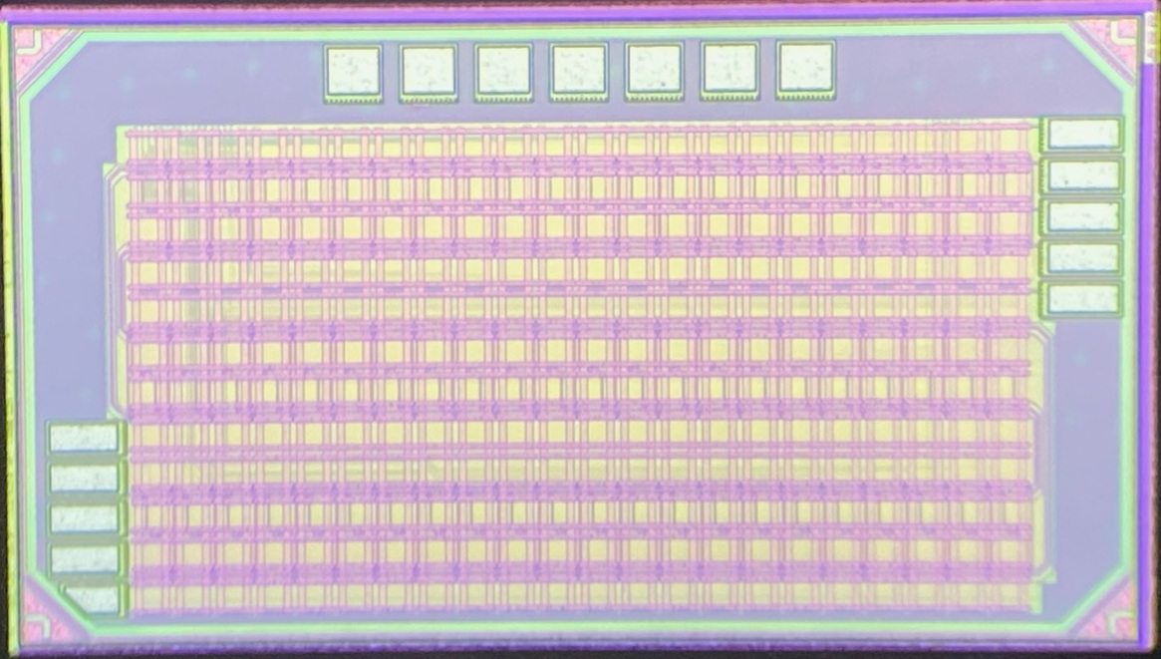
Digitally Controller Phase Shifter
Sequence of waveguide cells each with
$$L_{2}>L_{1}C_{2}>C_{1}$$
Low Delay
$$\sqrt{L_{1}C_{1}}$$
and
$$\sqrt{\frac{L_{1}}{C_{1}}}=\sqrt{\frac{L_{2}}{C_{2}}}=Z_{0}$$
High Delay
$$\sqrt{L_{2}C_{2}}$$
0.8mm
1.3mm
62 cells with 300 fs steps — Max delay 20ps
Temperature stable and rad tolerant.
Extended range with lumped delays to 250ps.

Slide 10
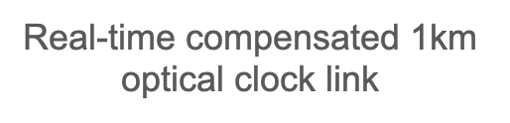
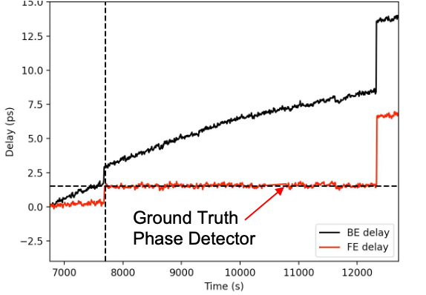
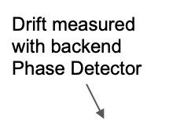
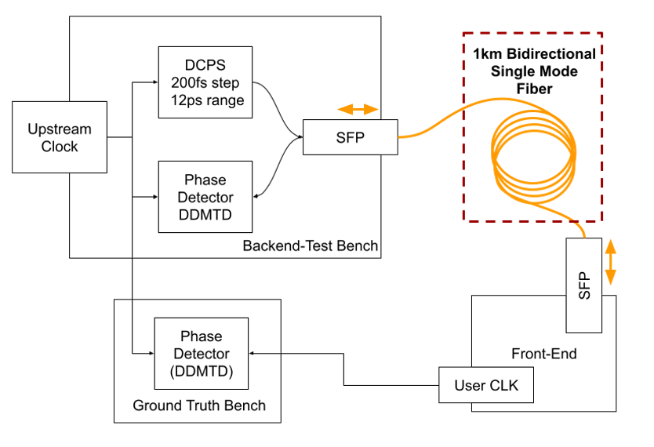
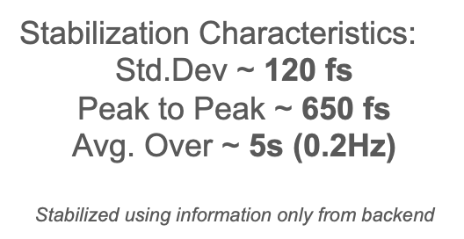

Demonstration: 1km stabilization

Slide 11
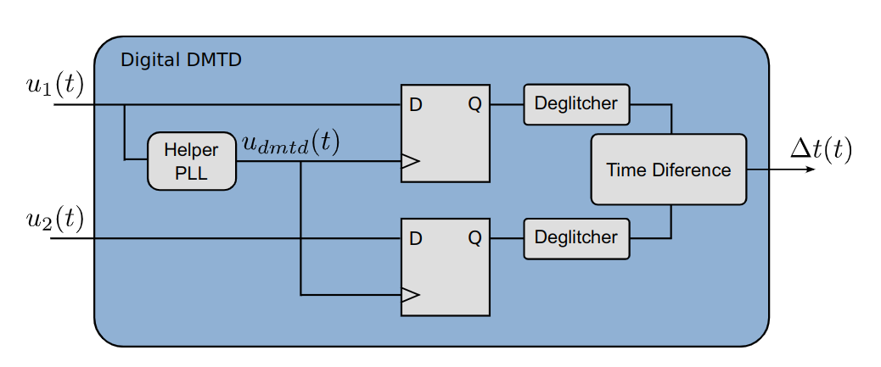
DDMTD
The digital dual mean time difference (DDMTD) circuit used to measure phase difference between two same frequency clocks by measuring their beat times with a clock with a small frequency difference.
$$f_{ref}$$
$$f_{offset}=f_{ref}\frac{N}{N+1}$$
$$N=100,000$$

Slide 12
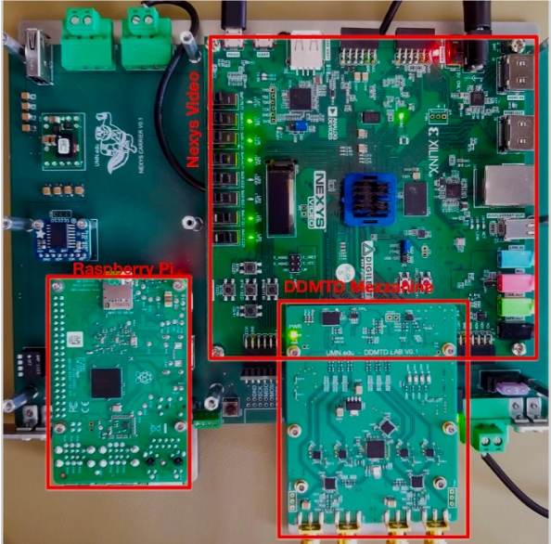
DDMTD — Phase Detector
Length of the metastability interval as the phases align and un-align matters a lot!
FPGA implementation is limited by the setup-and-hold times of ~800 ps. This limits the phase detection resolution of the order of 2-3 ps.
Implemented the circuit with RF components with setup-and-hold times of ~20 ps and got resolutions of the order of 100~fs.

Slide 13
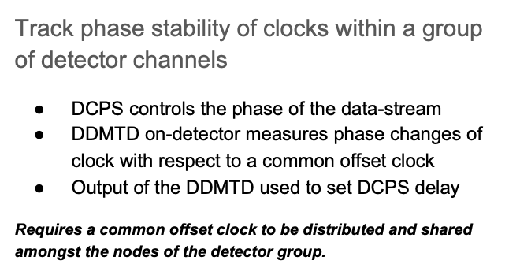
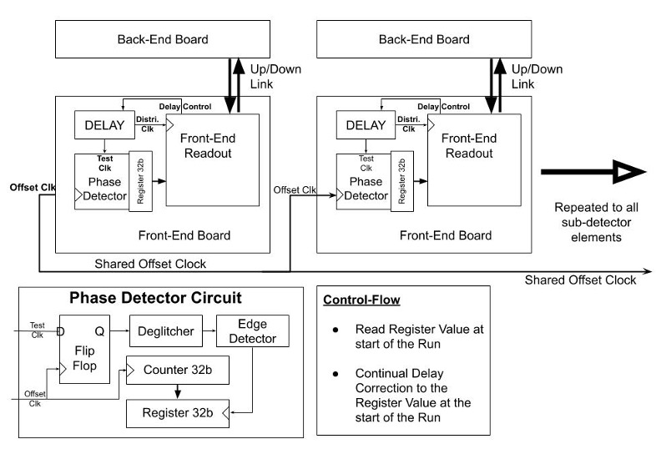
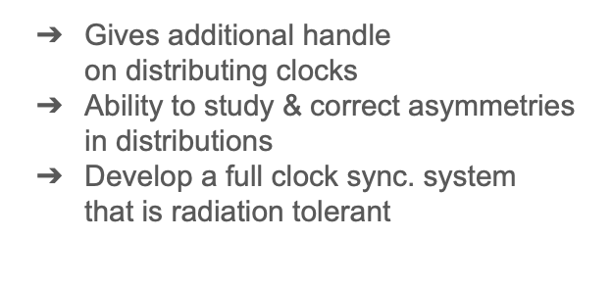

On Detector Phase Stabilization

Slide 14
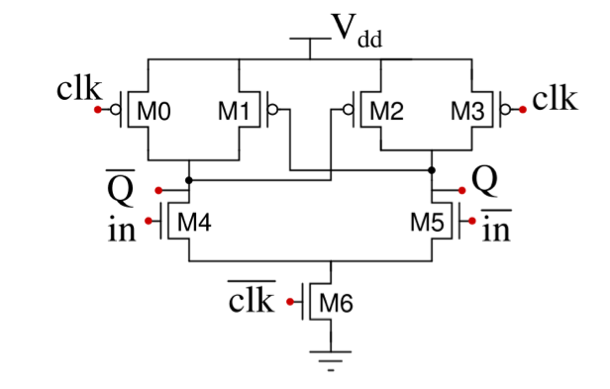
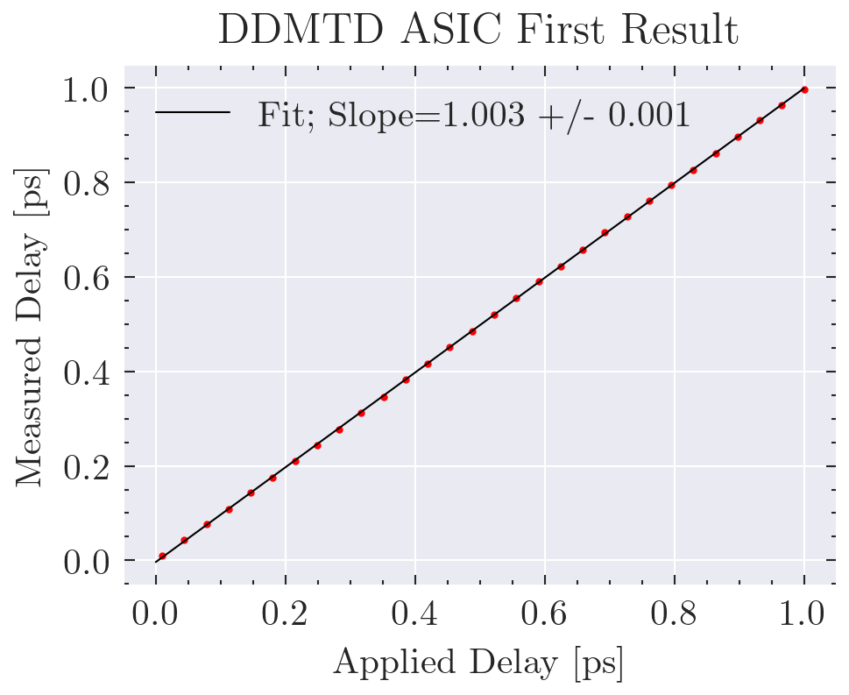
DDMTD — ASIC
Rohith Saradhy designed a DDMTD ASIC in the TSMC 65nm LP process.
Designed in CML for speed and optimized for the DDMTD application.
M. Maiti, A. Paul, S. K. Saw and A. Majumder, “A Dynamic Current Mode D-Flipflop for High Speed Application”
Preliminary Cadence simulation (no added noise)

Slide 15
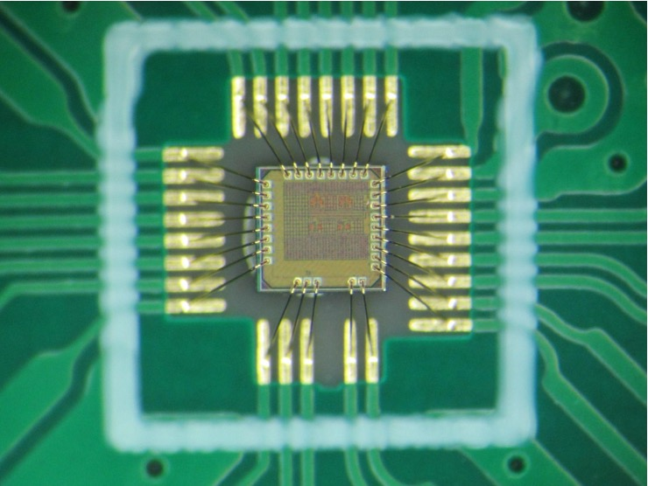
DDMTD — ASIC
How to test it?

Slide 16
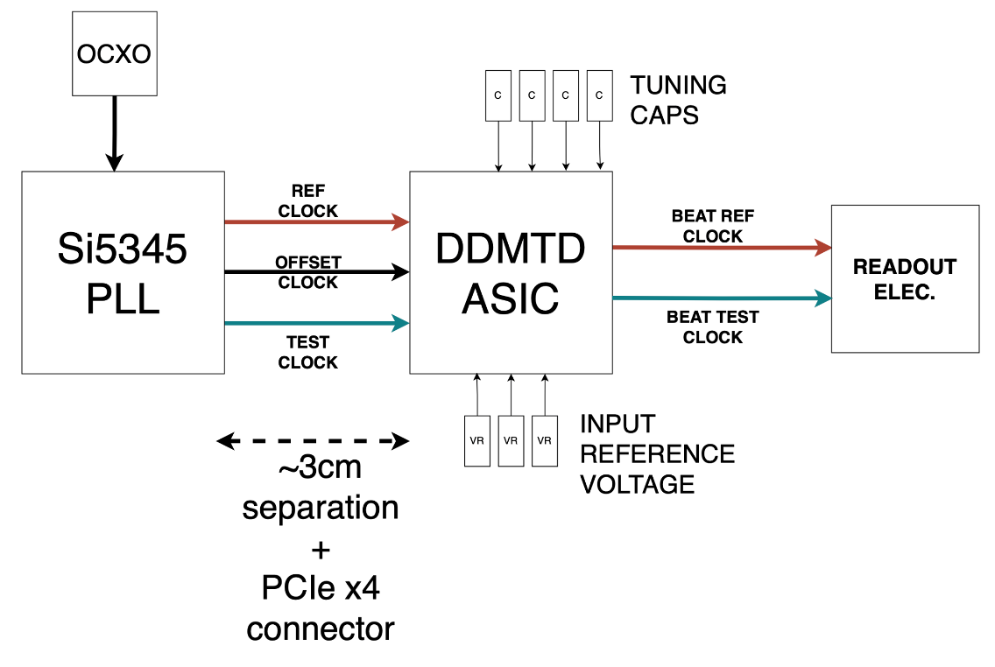

DDMTD ASIC Test Setup:
40 MHZ Oven Controlled Crystal Oscillator
717.000 MHz
7.17 kHz
716.993 MHz
Use PLL to adjust phase of test clock
N = 100,000

Slide 17
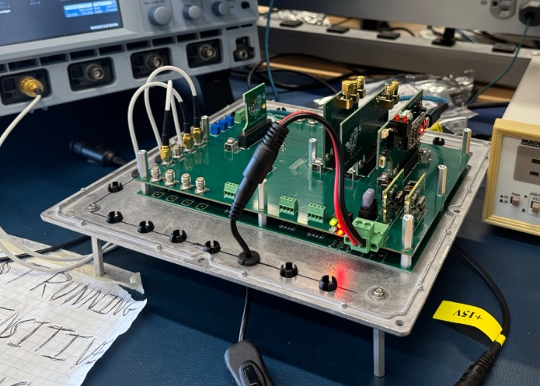
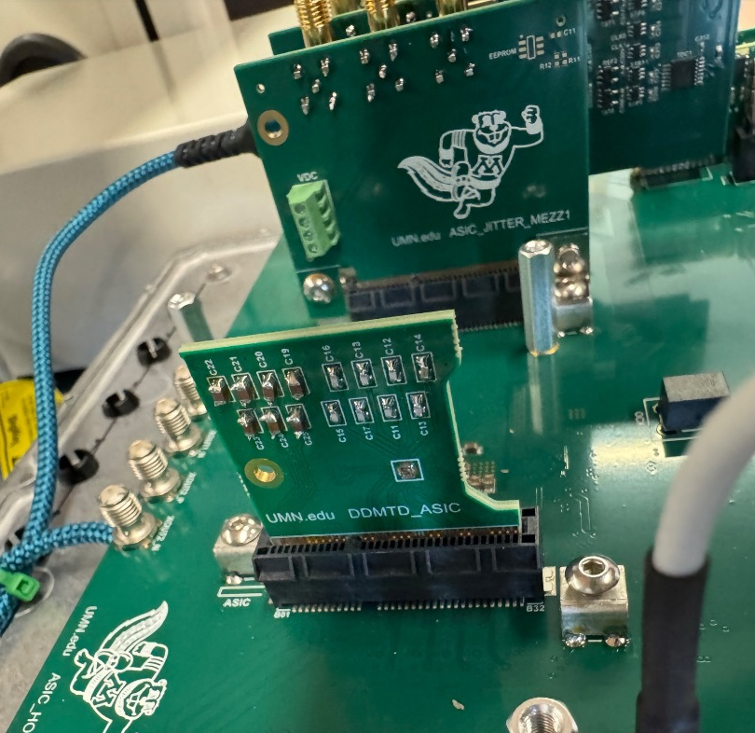

Slide 18
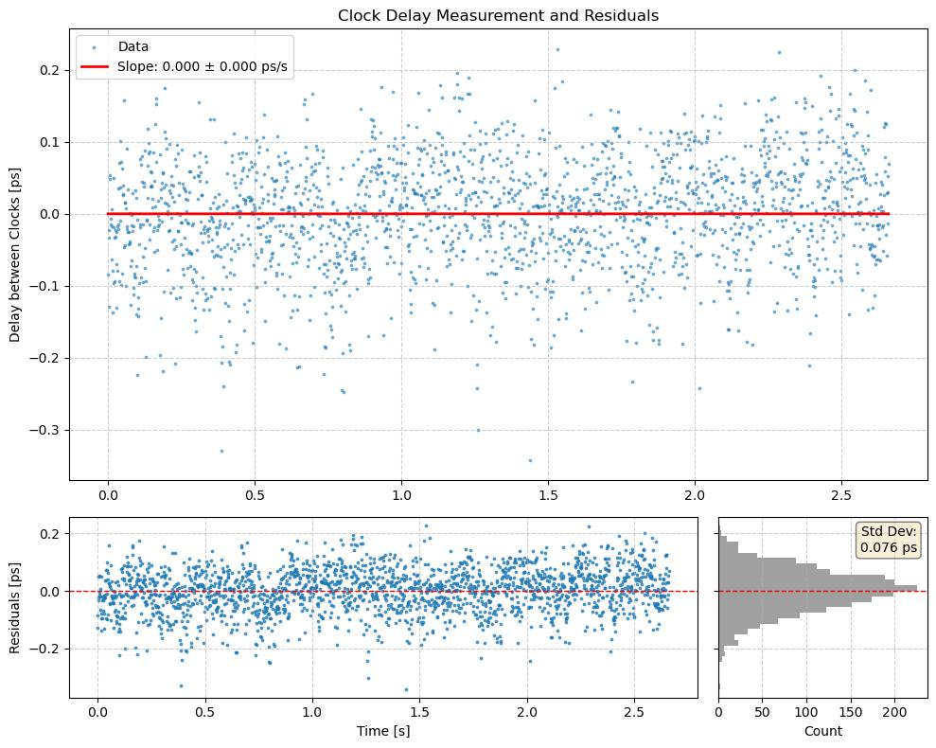
Clock 717 MHz
Frequency Offset
$f/{100,000}$
Standard Deviation of 76 femtoseconds

Slide 19
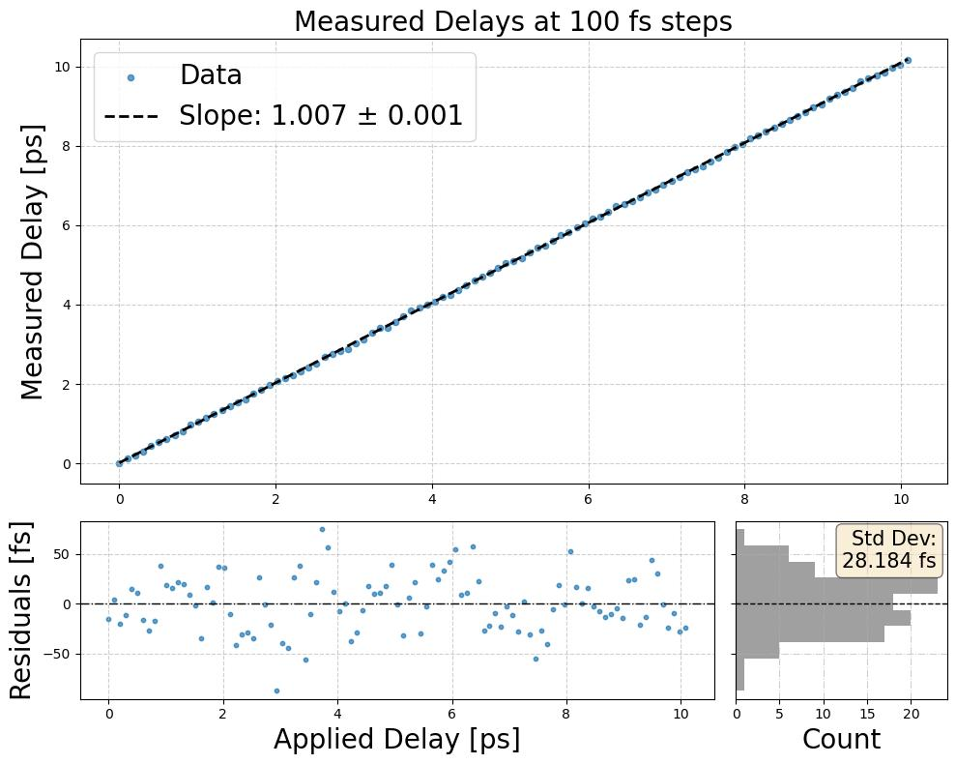
Clock 717 MHz
Frequency Offset
$f/{100,000}$
Each point is average of ~2,000 collected at 7 kHz.
Standard Deviation of 28 femtoseconds

Slide 20
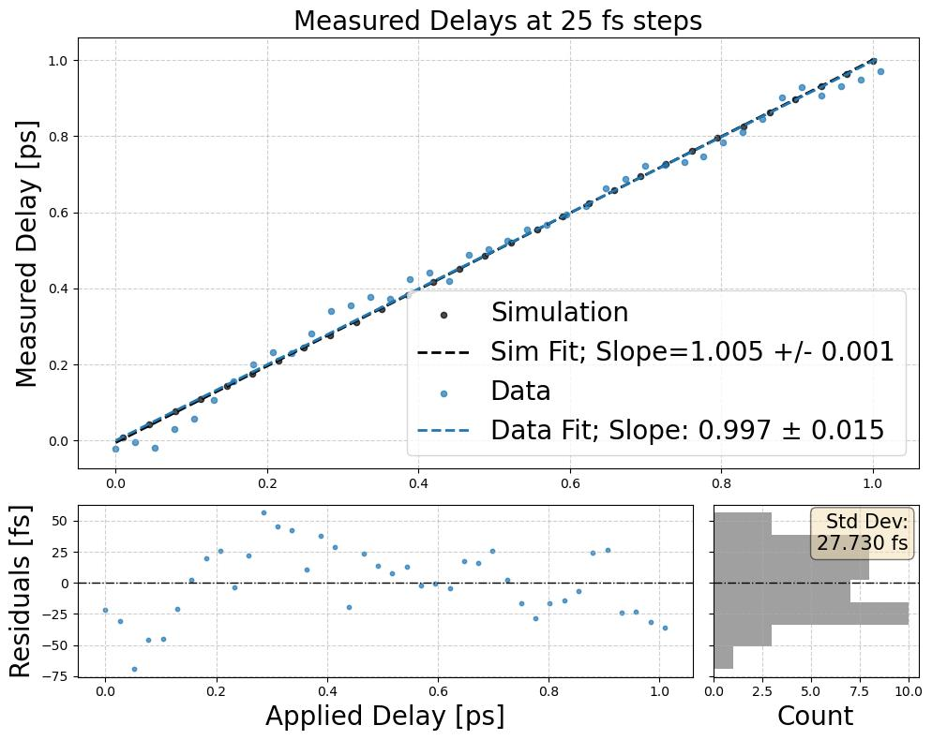
Standard Deviation of 28 femtoseconds
Clock 717 MHz
Frequency Offset
$f/{100,000}$
Each point is average of ~2,000 collected at 7 kHz.

Slide 21
On Detector Phase Stabilization

Slide 22
This can now be less than 1 picosecond

Slide 23

By detecting phase shifts at the front-end we can remove wander from our clock distribution systems and align the reference time across large subsets of a detector with sub-picosecond precision
With thanks to the DOE Office of Science, Division of HEP, who funded this research under award DE-SC0020185

