Slide 1













Q-Pix R&D Update
Kalindi Gosine
University of Texas at Arlington
on behalf of the Q-Pix Consortium

Slide 2


The consortium
A consortium of universities and labs formed to realize
and test the Q-Pix concept
Each university group has individual roles, expertise, and contributions, but with an excellent amount of collaboration
UTA: Leadership, Prototyping, Light Detection, Simulations
Penn: Analog and Digital Design, Testing
A&M: Simulations
Wellesley: Prototyping
Manchester: Leadership, Simulations, Light Detection, Prototyping
Syracuse: Testing and Simulations
Granada: Light Detection
Hawaii: Digital Design (historically)
Q-Pix consortium would like to thank the DOE and the Gordon & Betty Moore Foundation for their support
1

Slide 3
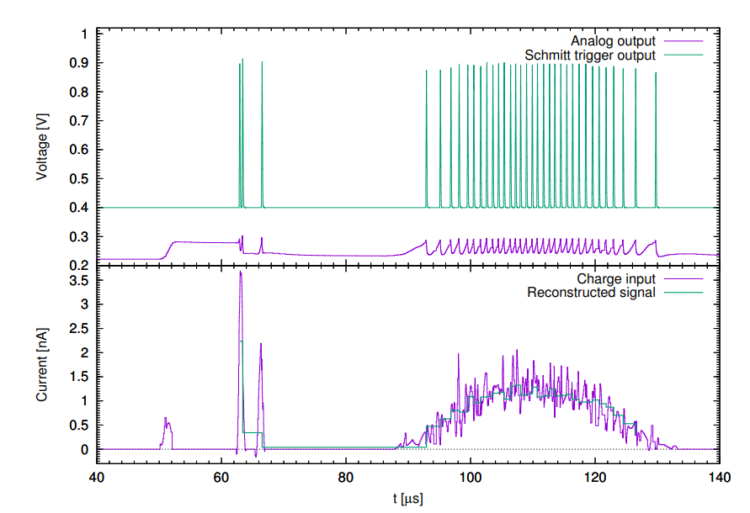
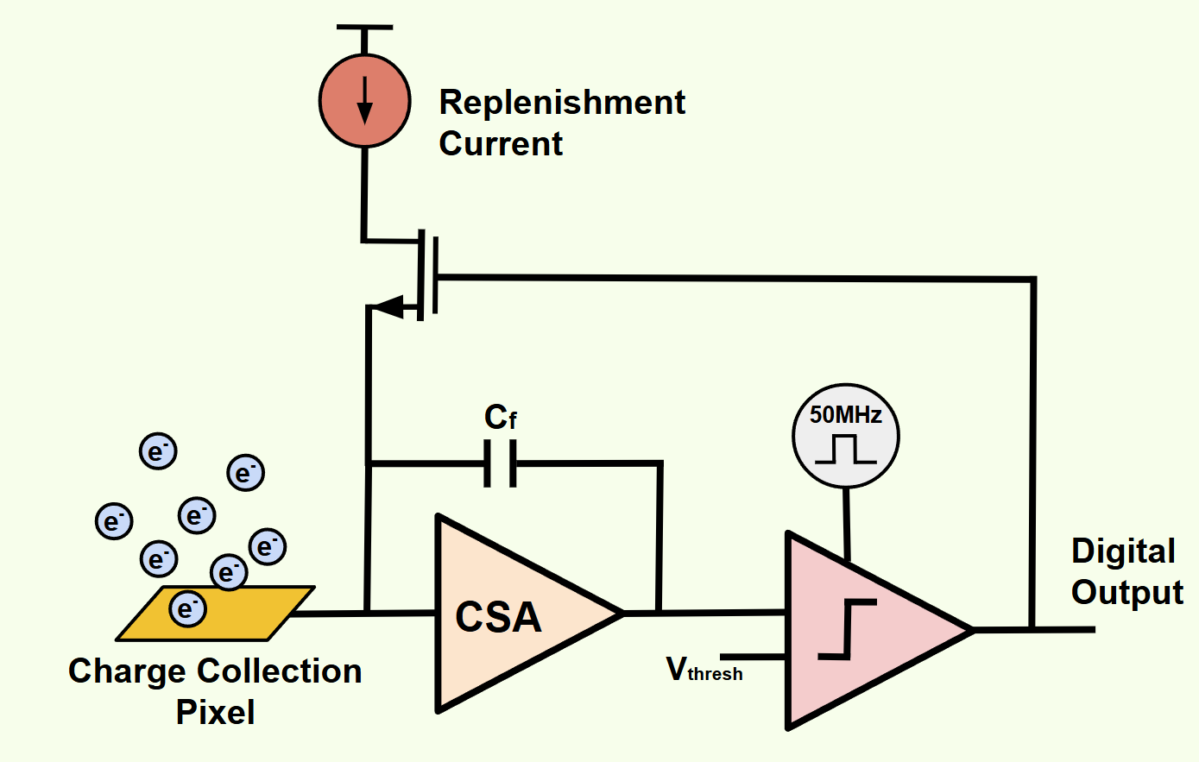
A novel pixelated readout
The QPix concept (https://arxiv.org/abs/1809.10213) developed by Yuan Mei (UTA/LBNL) and Dave Nygren (UTA) outlines a novel ionization signal capture and waveform digitization scheme for kiloton-scale liquid Argon Time Projection Chamber (TPC) detectors
2
Notes:
Plot from https://arxiv.org/pdf/1809.10213

Slide 4
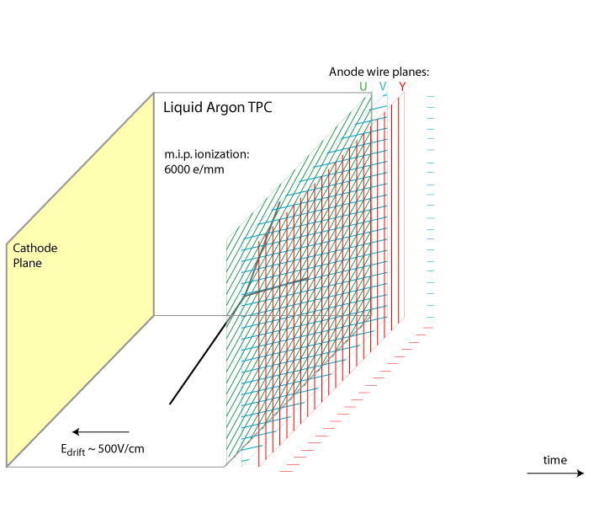
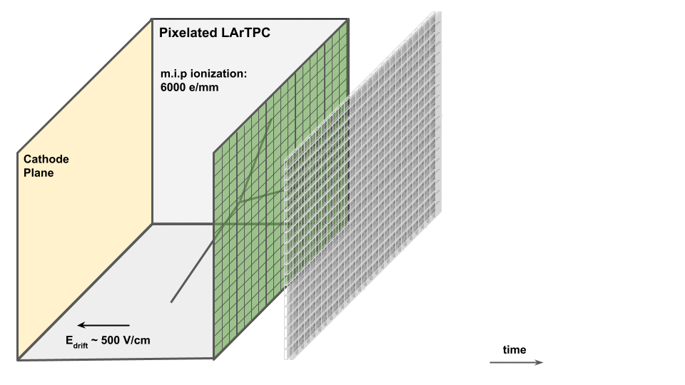

The challenge of a kiloton-scale TPC
Q-Pix is designed to face the challenges of a large scale, underground neutrino detector (like the DUNE far detector):
Low event rate
  The large size of the detector motivates an intrinsically 3D readout (pixelated sensors) over the conventional 2D wire projective readout (arXiv:1912.10133 / JINST 15 P04009)
Low threshold detection
  The low threshold pixel based readout also offers discovery potential for low energy events
    Long sensing wires increase electronic noise
    Supernova neutrinos (arXiv:2207.11127)
    *Solar neutrinos (arXiv:2507.15459)
Cryogenic (low power) operation
Large data rates
  For a low threshold experiment (looking for depositions of 3MeV or more), reading out a wire-based 10-kton module would generate PB/yr compared to ~1 TB/yr for a Q-Pix readout
3
Notes:
Data rates in QPix are calculated by counting the number of resets in the events and considering that each reset occupies 8 bytes of memory (timestamp)
higher spatial resolution, and improved reconstruction for events with dense, complex topologies
O(10^8) channels for a kilotonne scale detector
Further-
more, the long sensing wires introduce a capacitive load
that adds noise to the readout electronics, potentially
rising the effective energy threshold [37].

Slide 5
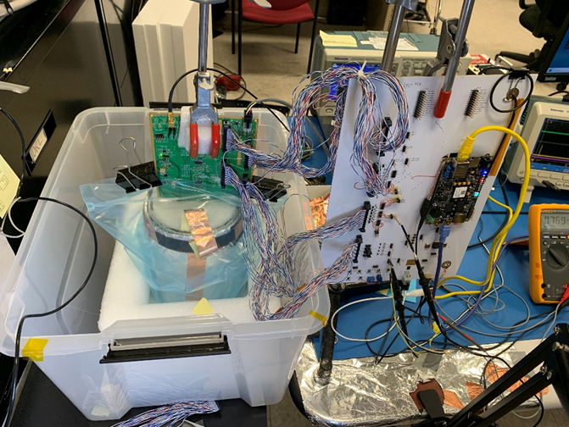
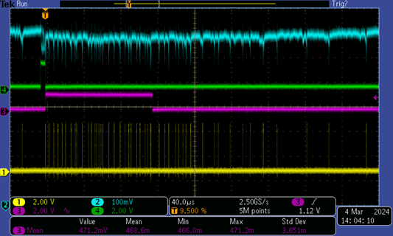
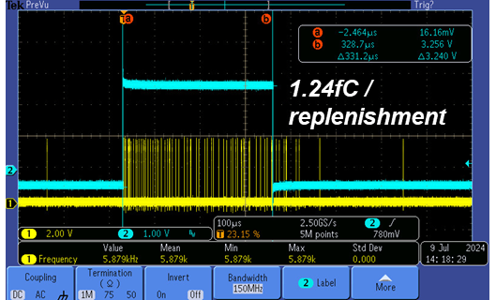
First Q-Pix Analog Chip
16-channel chip (TSMC 180nm):
25uW/45uW per channel power consumption
Leakage current at cryogenic temperature of a few fA
Controllable replenishment charge set between 0.4-3.0fC via 5 bit DAC
Integrator Out
Calibration Window (100fC)
Calibration Window (100fC)
Replenishments
Replenishments
27°C
LN2
4

Slide 6
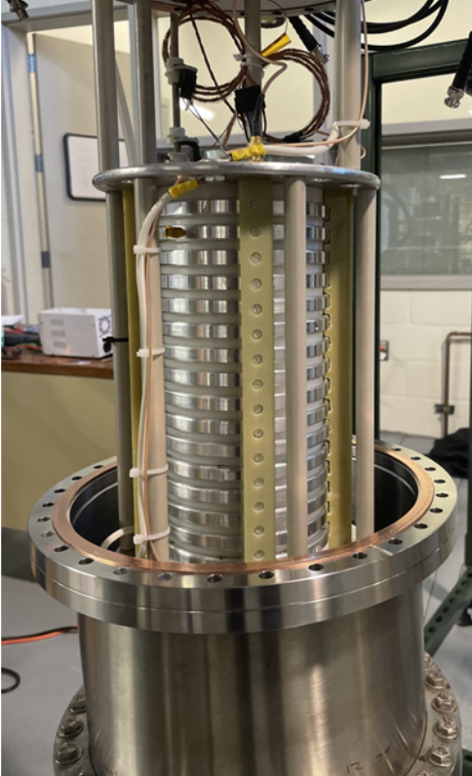
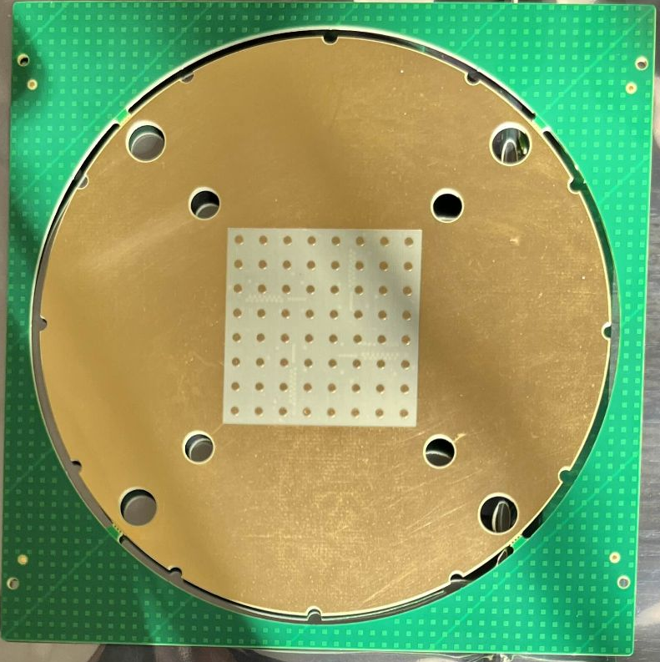
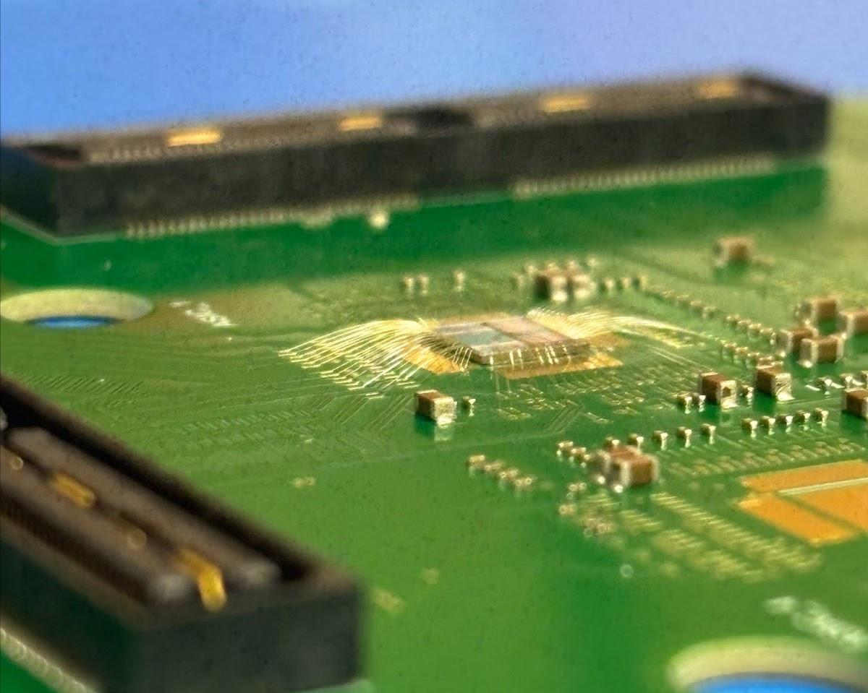
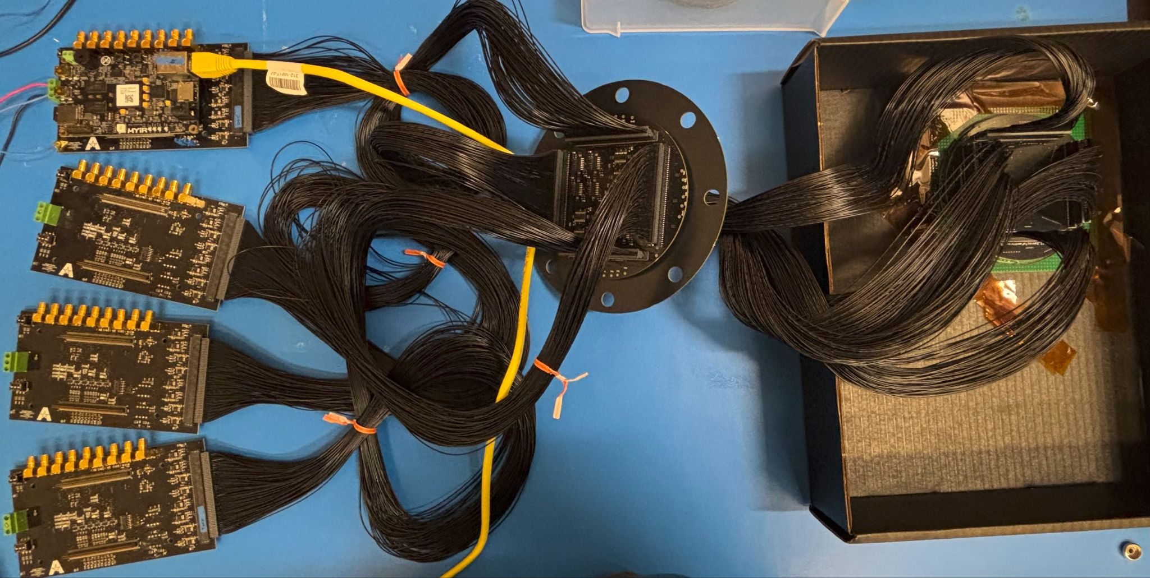
Deploying ASICS (64-Pixels) in a TPC
Preparing to place 4 analog front end chips designed by Penn in gaseous Argon TPCs at UTA and Wellesley. Aiming for tracks by the end of the year
5

Slide 7
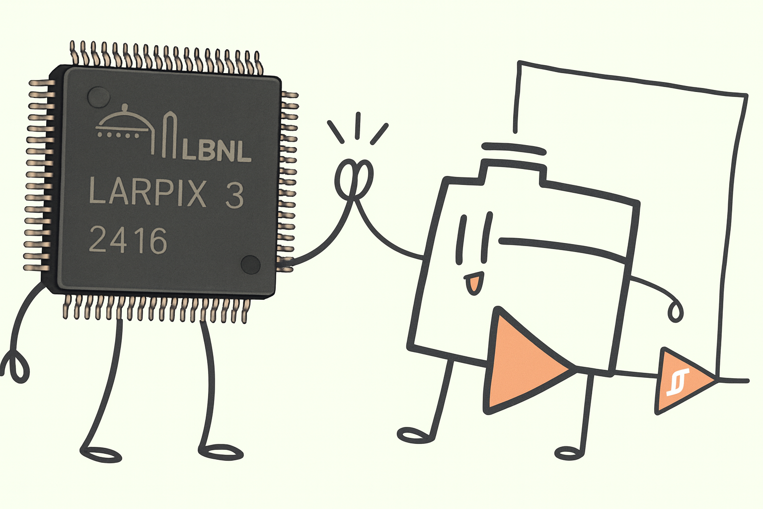
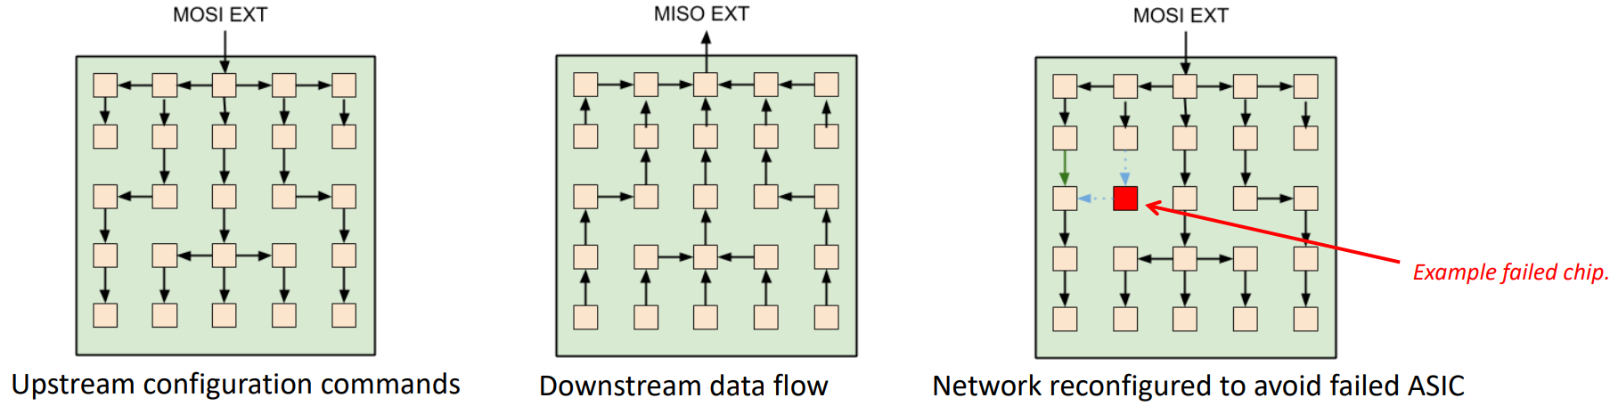
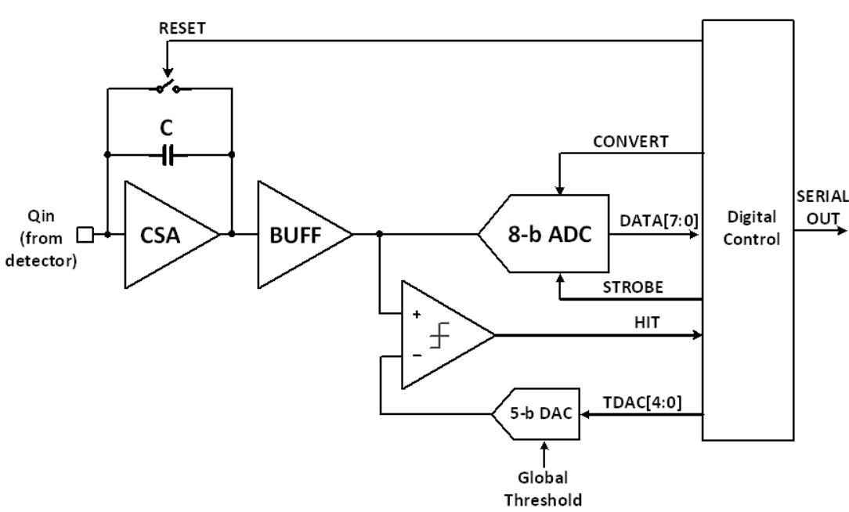
Integration with LArPix Digital Backend
Planning to accelerate the Q-Pix development by collaborating more closely with the LArPix team (LBNL) and integrating our analog front end with their developed digital back end to allow scaling of pixels into tiles with robustness against single-point failure of chips
QPix
Hydra I/O
6
LArPix
Notes:
https://indico.global/event/4503/contributions/38137/attachments/19292/31646/DDwyer_LArPixLightPixSoLAr_10Mar2022.pdf

Slide 8
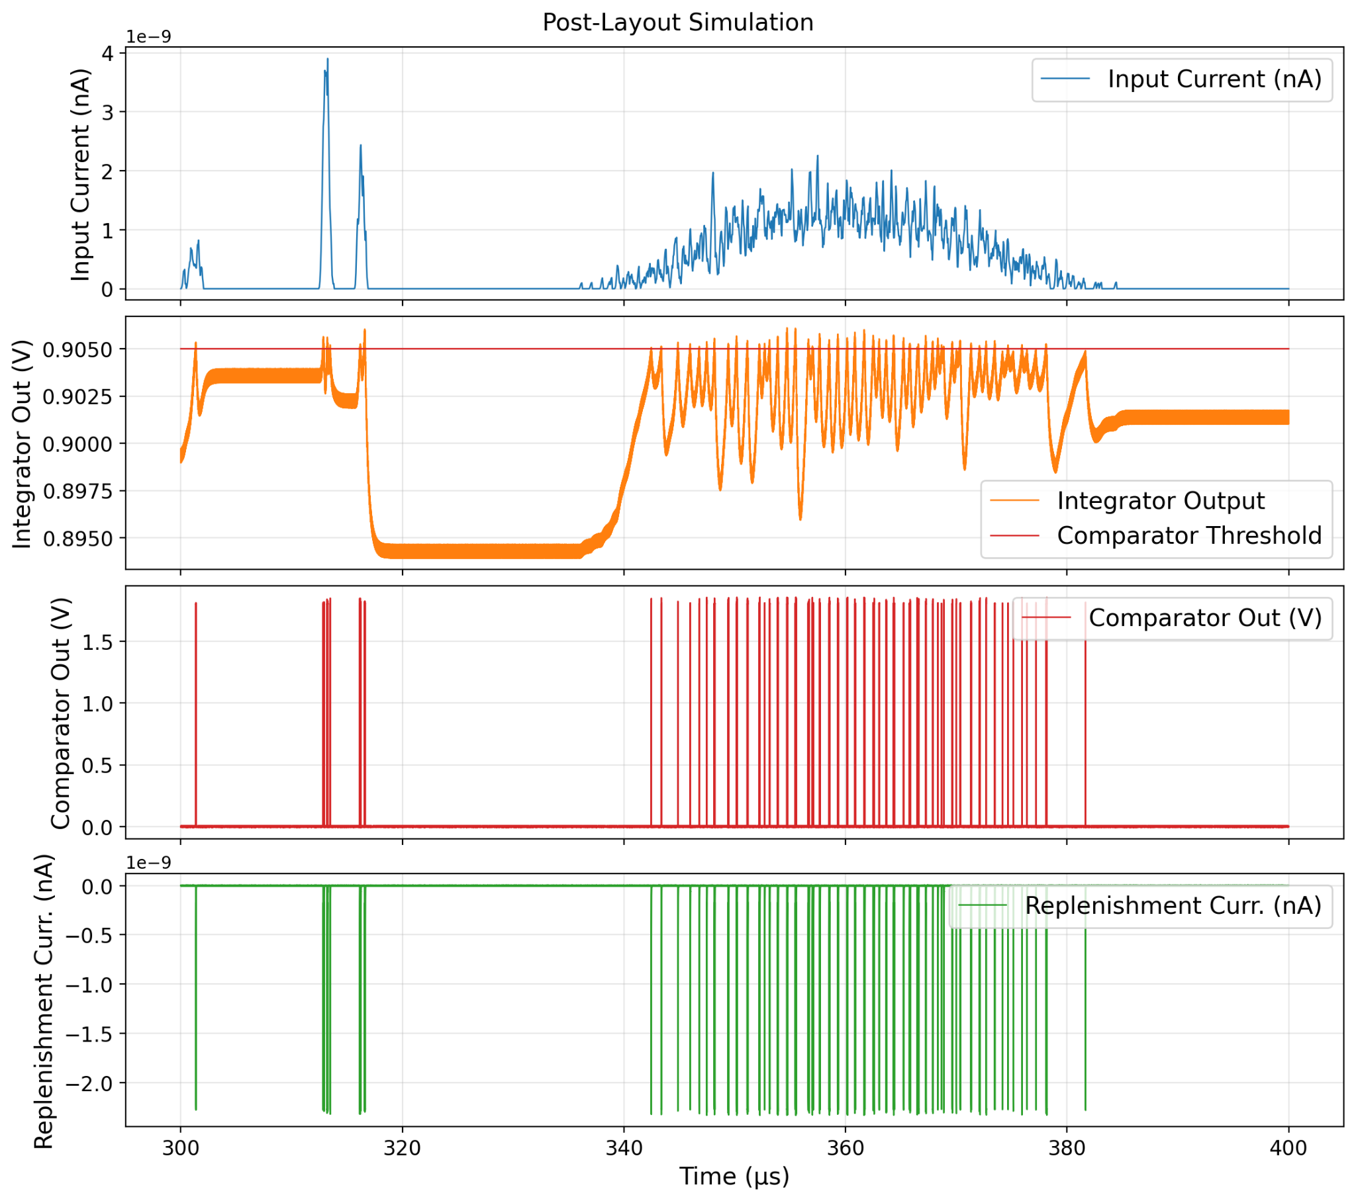
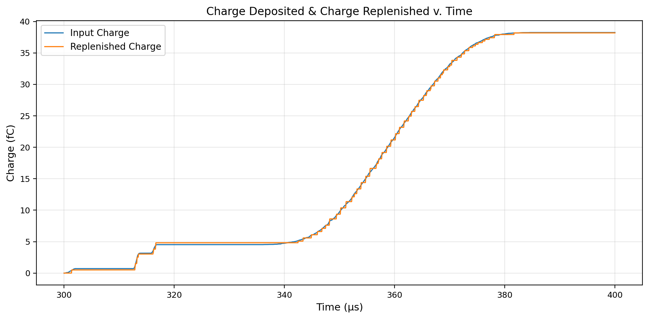
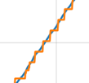
Integration with LArPix Digital Backend
I’ve been developing a Q-Pix analog front end design that will be taped out this month. I’ve been working closely with Yuan Mei (UTA) on getting trained in the ASIC tool kit in preparation for moving to LBNL and working closely with the designers there on this technology integration.
Aiming to have a Q-Pix/LArPix hybrid chip designed by the first half of 2026
7
Notes:
https://indico.global/event/4503/contributions/38137/attachments/19292/31646/DDwyer_LArPixLightPixSoLAr_10Mar2022.pdf

Slide 9
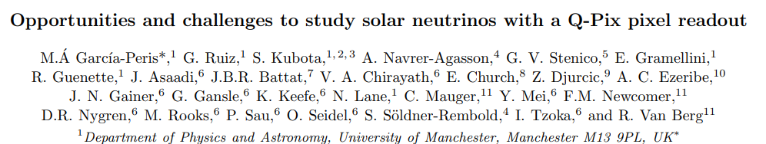
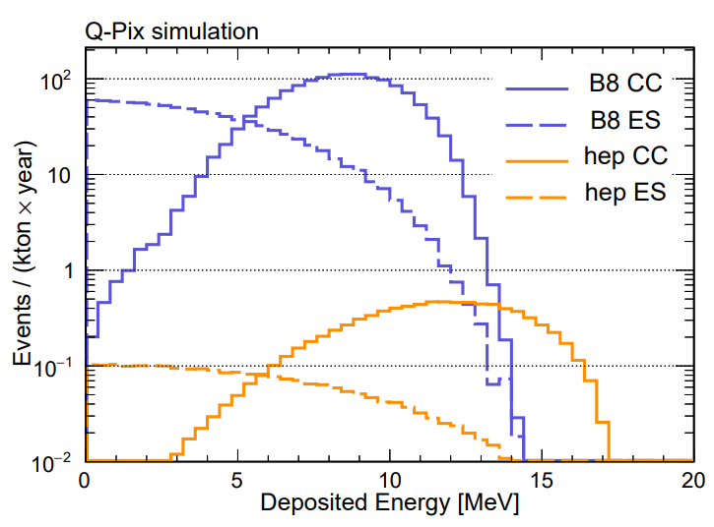


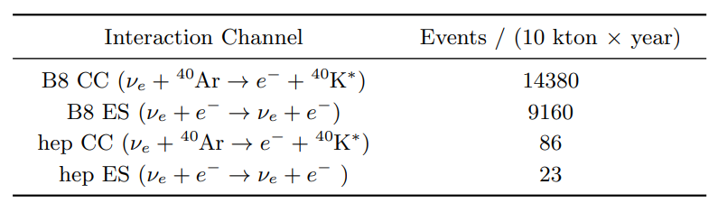
Solar neutrino detection
Studying the two highest energy spectrum solar neutrinos:
The B8 neutrinos which can serve to measure neutrino oscillation parameters
And the high energy process (hep) neutrinos which have not yet been observed but are predicted by the Solar Standard Model
arXiv:2507.15459
With an energy spectrum peaking ~10MeV, detection of solar neutrinos will require low energy-detection thresholds and mitigation of backgrounds.
8
Notes:
B8 neutrinos energies extend to 15MeV. Rare process but the B8 neutrinos are a tool to measure neutrino oscillation parameters including mass squared differences and mixing angles
The high energy process neutrinos have not been observed but have been predicted by the Solar Standard Model
12 reset threshold (3MeV)

Slide 10
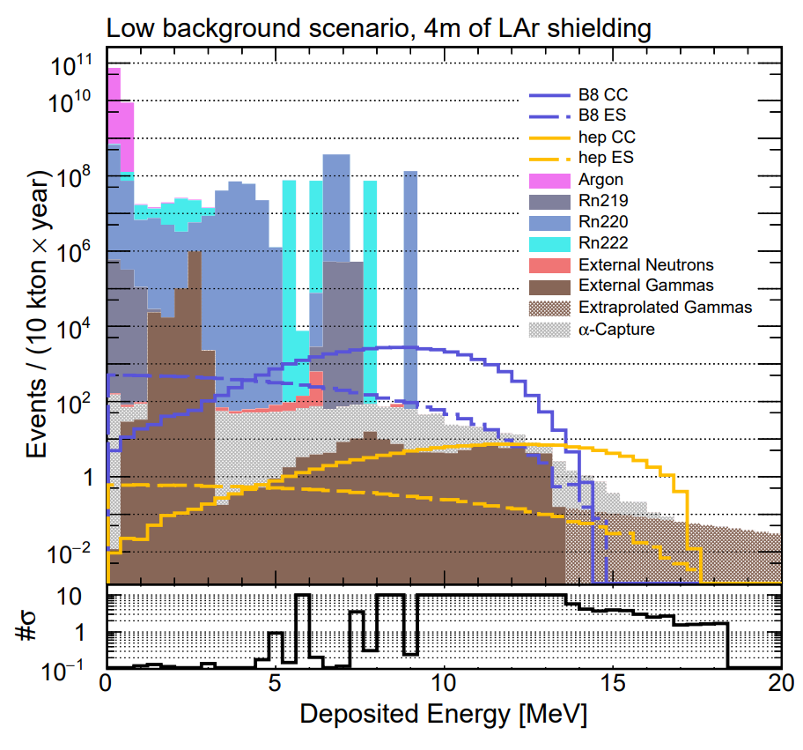
arXiv:2507.15459
Solar neutrino detection
Provides a comprehensive study of the realistic background levels and capabilities of the multi-kton LArTPC detector approach to detect solar neutrinos.
The improved reconstruction from a 3D readout allows background suppression via event direction correlated with respect to the Sun for ES interactions.
The high backgrounds makes triggering of a projective readout impractical, motivating a continuous readout system with reduced data rates.
Internal radioactive backgrounds make detection of solar neutrinos below 5MeV of deposited energy difficult to detect. With fiducialization, light coincidence, use of UAr, and a neutron absorber (water shield or borated cryostat) and a continuous pixelated readout, solar neutrino studies above 5MeV are possible
9
Notes:
The light detection has a photon coverage of 37% and a quantum efficiency of 15% at 128nm
Neutron absorber reduce the neutron contributions by 4 orders of magnitude and the radon background is suppressed by 3 orders of magnitude with dedicated argon re-circulation and purification systems.
Above 5 MeV, the dominant background sources are
photons originating externally to the detector—which
can only be mitigated through fiducial volume cuts—and
photons generated by α-capture processes in argon.
As
neutrinos propagate through the dense solar medium,
Mikheyev–Smirnov–Wolfenstein (MSW) matter effects
have a significant impact on the oscillation effect [6].
This makes solar neutrinos a powerful probe to accurately
measure oscillation parameters, including mass-squared
differences and mixing angles [7].
Charge current interactions from solar neutrinos on argon
(1) could be isolated from background via the detection
of a delayed light flash emitted by the de-excitation of
the 40K
∗
[108]. Fig. 11 shows the fraction of CC inter-
actions for which the final-state 40K
∗
atom can de-excite
by emitting a 1.64 MeV γ with half-life of 336 ns [86].
While 336 ns is too short a time to produce distinguish-
able charge signals, it is long enough to resolve via light
detection.
the two primary background processes above
5 MeV are poorly constrained due to the limited availabil-
ity of measurements of γ fluxes in the detector cavern and
α-capture cross sections on argon.

Slide 11


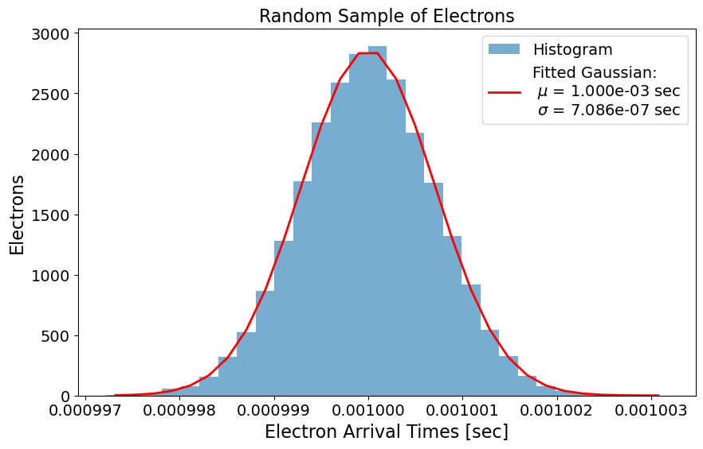


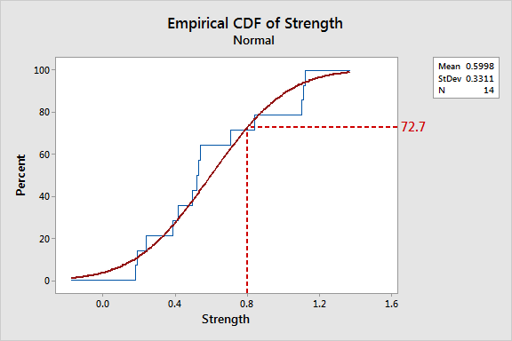
Event Reconstruction with QPix’s resets
Carter Eikenbary (A&M graduate student) has been developing a tool chain to allow evaluation of the reconstruction performance of Q-Pix and the potential for Q-Pix to function as a ‘lightless’ reconstruction approach
Q-Pix readout turns a swarm of electrons from ionization into a discrete distributions of “resets/replenishments” in time
Encoded in this information is the diffusion of the electron cloud and thus the distance the charge has drifted (without using an external t0)
Uses Cumulative Distribution Functions (CDFs) to extract information about the electron swarm (drift distance, dE/dX, and track reconstruction)
10

Slide 12
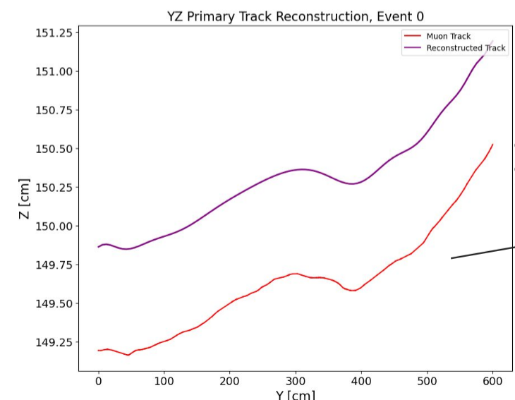
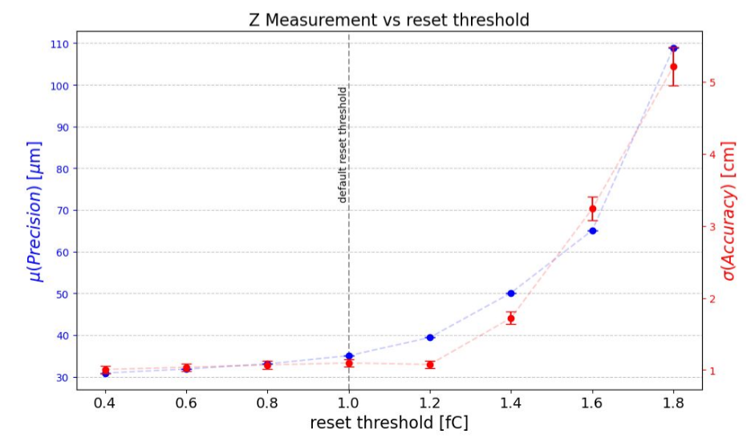
Event Reconstruction with QPix
Some encouraging findings (using fairly realistic assumptions of noise & leakage)
For muon tracks, the drift distances accuracy is O(1 cm) for parallel tracks and O(10 cm) for more inclined tracks
Accuracy is factors of 2-3 worse for other particle types considered (Kaon, pion, proton) but still quite good
Studies of reconstruction performance as a function of Q-Pix parameters (clock speed, reset threshold, etc…) suggest our current working numbers are a soft optimum
These results are currently being written into a paper to be submitted in 2025
11

Slide 13
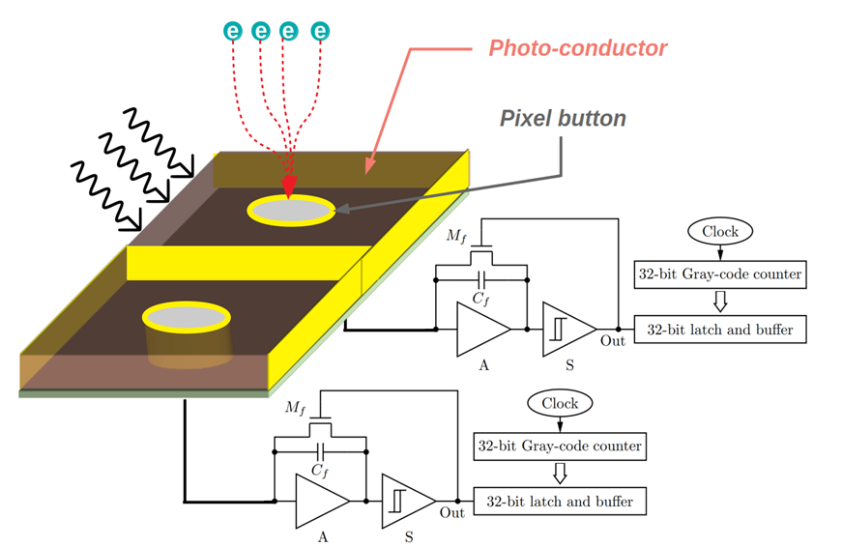
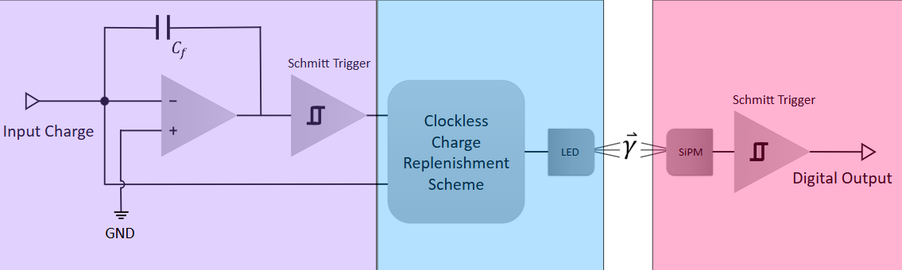
Q+L Sensing & Photonic Readout
There is continuing work in developing a complementary light sensor with amorphous Se that would use a Q-Pix readout for an integrated charge and light sensor.
As well as development of an optically transmitted data readout scheme
See Poster: A Novel Optical Communication Scheme for a New Clock-less Q-Pix Detector Design (Grace Gansle, UTA)
See Talk: Is lamination the key to large-area, uniform multi-well amorphous Selenium detectors?(V. A. Chirayath, UTA) Wednesday, 3pm
12

Slide 14
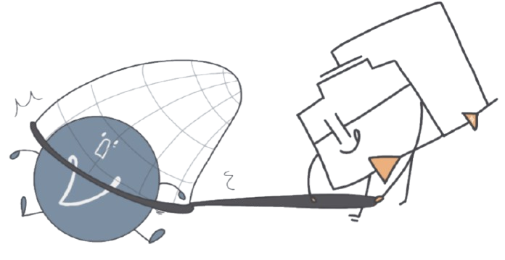
Conclusion
The Q-Pix consortium is continuing to make progress on its pixel readout design
Since 2019 the consortium has published 9 papers related to simulation and hardware demonstrations of both the charge and light ideas being pursued
Continued progress on the demonstration of the Q-Pix readout
New simulations results
Q-Pix Solar Analysis
Lightless reconstruction using Q-Pix rests
Continuing hardware work
Work on 64 channel TPC demonstrator continues (hopeful for results by end of 2025)
QPix analog front end integration with the LArPix digital backend to take place this Fall
Tapeout of a new analog front end expected next month
The consortium has funding through 2029 and hopes to bring this technology to its fruition by then for consideration in DUNE Phase-II
Thank you!
13

Slide 15
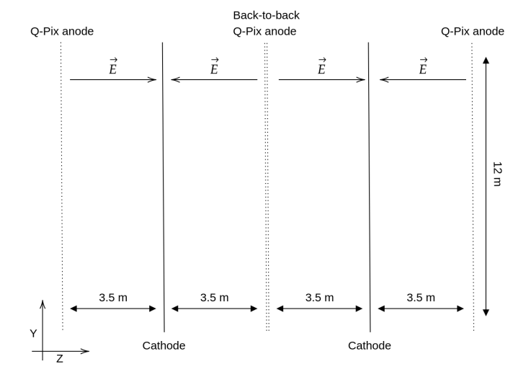
Kiloton-Scale Detector Geometry

Slide 16
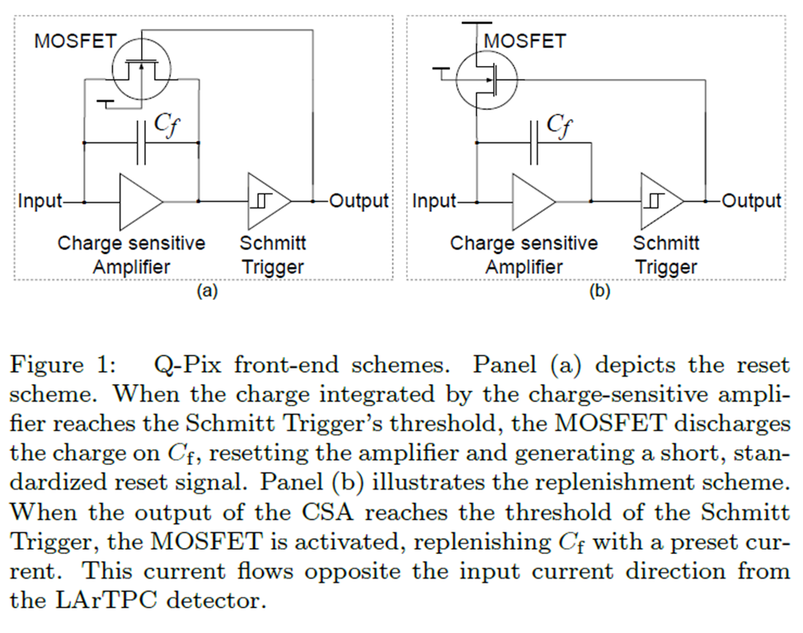
Different Feedback Schemes
P. Miao et. al (2023) arXiv: 2311.09568.

Slide 17
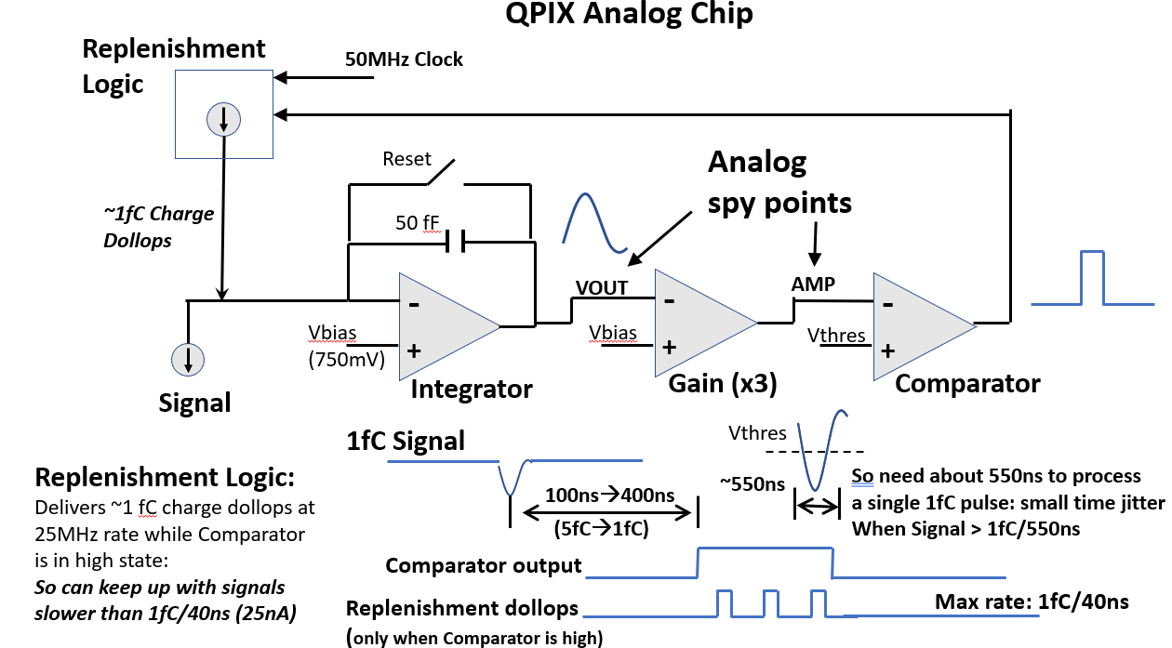
Penn ASIC Design

Slide 18

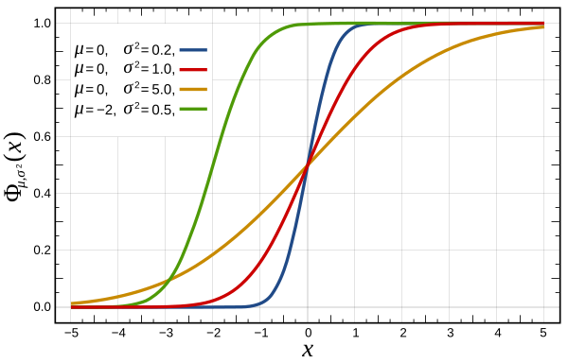
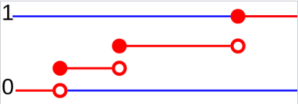
Cumulative Distribution Function
A CDF gives the probability that a random variable will be less than or equal to a given value. For discrete variables it’ll rise in steps
CDF for the normal distribution
https://en.wikipedia.org/wiki/Cumulative_distribution_function

